Slide 1
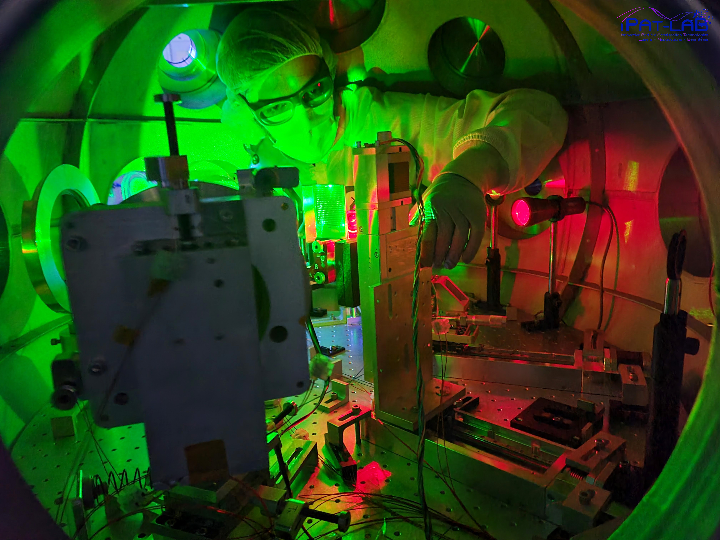
20-Dimensional surrogate-assisted Bayesian optimization of laser-driven proton beams
Elias Catrix, PhD student
Institut national de la recherche scientifique (INRS), Centre Énergie Matériaux Télécommunications
Laser-matter interaction and applications, Particle acceleration and applications laboratory of Patrizio Antici
Laser-Plasma Acceleration Workshop 2025
Notes:
Good morning everyone,
My name is Elias and I am a PhD student at the Institut national de la recherche scientifique and more precisely at the Advanced Laser Light Source ion beamline under the supervison of prof Antici.
In this talk, I will be talking about a specific way of improving not laser-driven ion beamlines but all types of laser-driven ion accele
Here, I will demonstrate a 70% increase in the maximum energy of laser-driven protons by optimizing the wavefront of ALLS laser using Machine Learning: This was accomplished through adaptive control of a deformable mirror using a 20-Dimensional surrogate-assisted Bayesian optimization approach

Slide 2
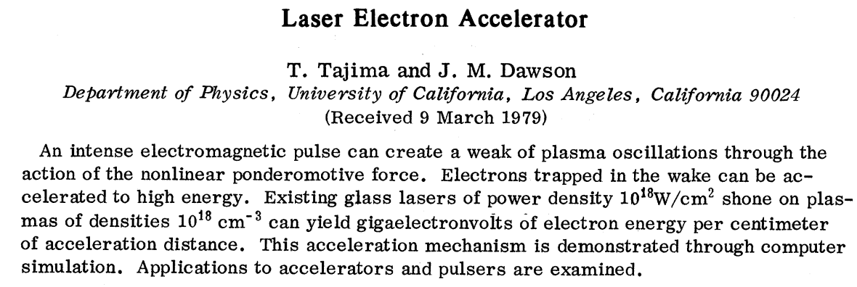
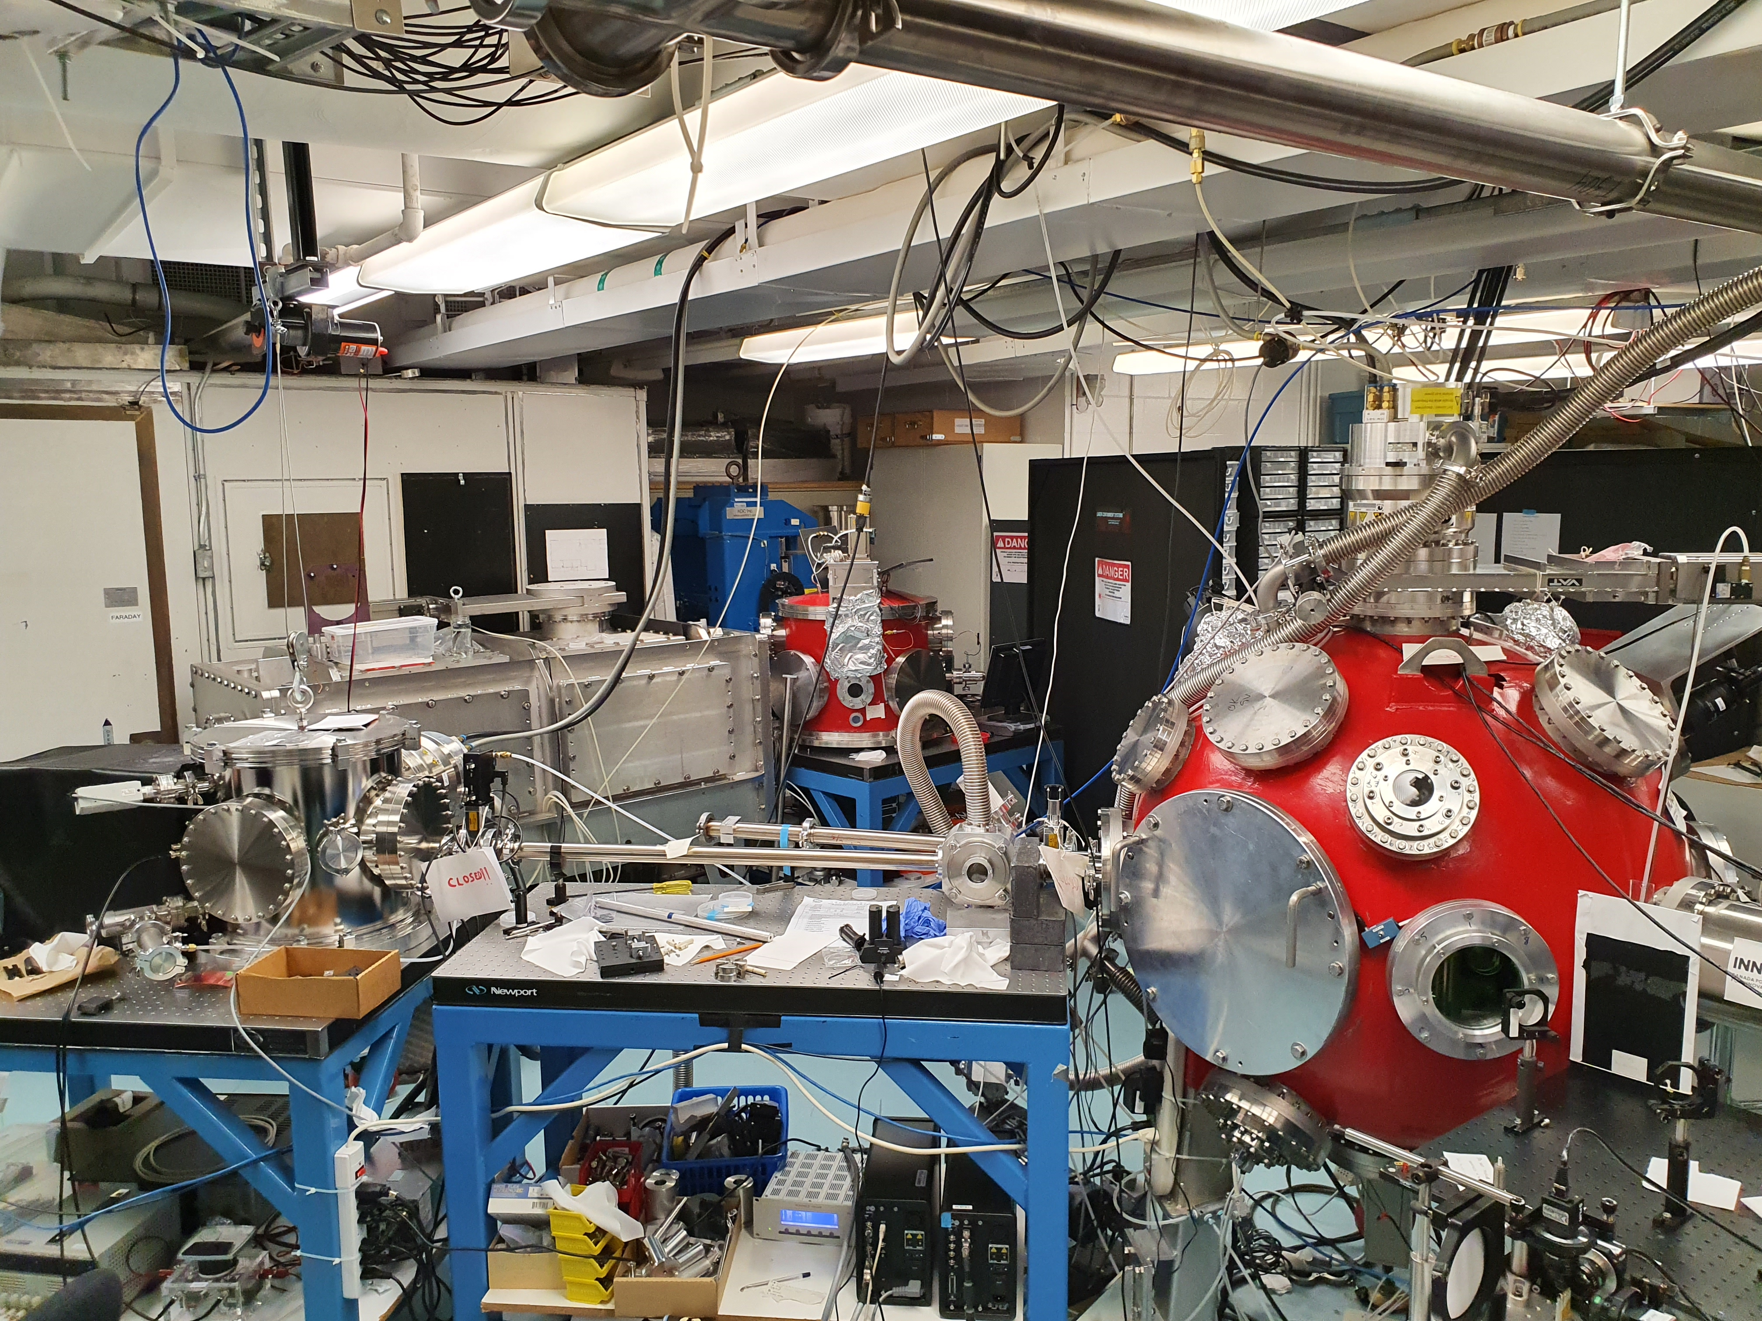
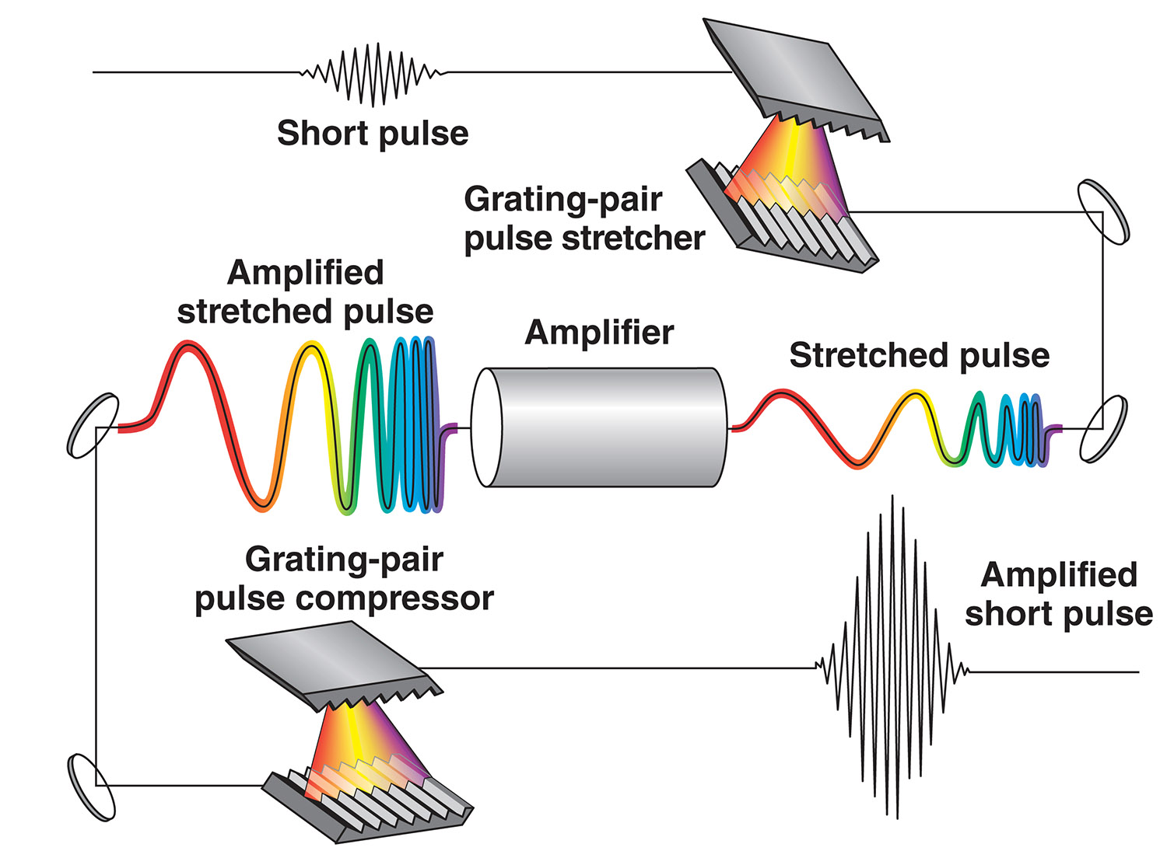
ALLS ion beamline
Chirped-Pulse Amplification
Elias Catrix et al., Stable high repetition-rate laser-driven proton beam production for multidisciplinary applications on the advanced laser light source ion beamline. Rev. Sci. Instrum.; https://doi.org/10.1063/5.0160783
D. Strickland and G. Mourou “Compression of Amplified Chirped Optical Pulses,” Opt. Commun. 56 3219-221 (1985).
Notes:
The advent of high-power lasers which can produce compact bunches of coherent photons has opened up possibilities of laser-based particle acceleration.
The original idea of laser-driven particle acceleration was initially brought up by Toshiki Tajima and John M. Dawson in 1979, at a timely moment with regards to the advent of the Chirped Pulse Amplification (CPA) technique which would occur six years after.
These two events further triggered the development of laser-based electron and ion acceleration.

Slide 3
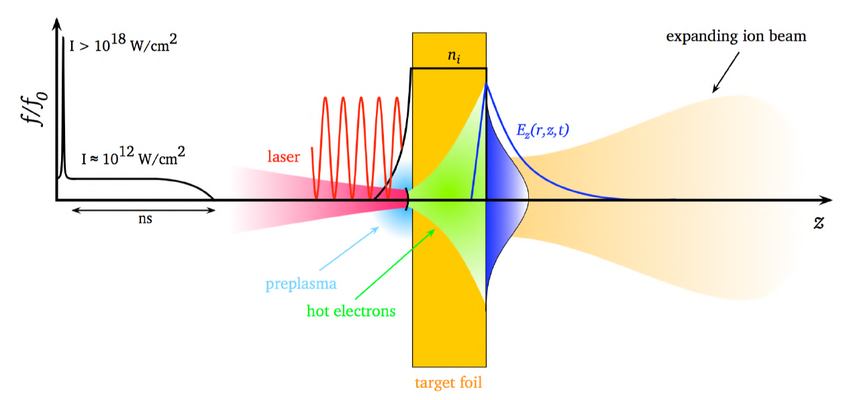
Target Normal Sheath Acceleration (TNSA)
M. Roth & M. Schollmeier, "Ion Acceleration - Target Normal Sheath Acceleration", Proceedings of the CAS-CERN Accelerator School: Plasma Wake Acceleration, Geneva, Switzerland, 23-29 November 2014, vol. 1, pp. 231-270 (2016).
High-intensity : $I_{0}>{10}^{18} W.cm^{−2}$
Short pulse : duration < 1ps
Electron relativistic intensity threshold $:$
$I_{0}>{10}^{18} W.cm^{−2}$for a wavelength of $1 μm$
Notes:
TNSA occurs when a high-intensity short-pulse laser hits a target, typically a solid target in the micrometric thickness range.
Above the electron relativistic intensity threshold ($I_{0}>{10}^{18} W.cm^{−2}$for a wavelength of $1 μm$), the intense EM wave pushes the electrons from the target, which are easily ionized mainly through high field tunnel ionization in the laser’s forward direction through the relativistic ponderomotive force.
The electrons undergo strong heating. Hot electrons then propagate through the target at relativistic velocities and exit the target rear side where some of them are retained due to strong charge separation and form an electron cloud (“the sheath”) that establishes an intense quasi-electrostatic field over a distance on the order of the Debye length.
The longitudinal electric field completely ionizes the water and hydrocarbon molecules instantaneously , which are naturally present on the surface and ions get accelerated along the target-normal direction by the electron sheath.
In this regime, plasmas can sustain fields in the TV/m range, i.e., at least four orders of magnitude higher than in a very compact scheme, making them more cost efficient.
Transition :
However, generating high-brightness laser-plasma proton beams require carefully balancing a multitude of physical effects that nonlinearly couple laser and plasma parameters.
This balance is quite difficult to reach

Slide 4
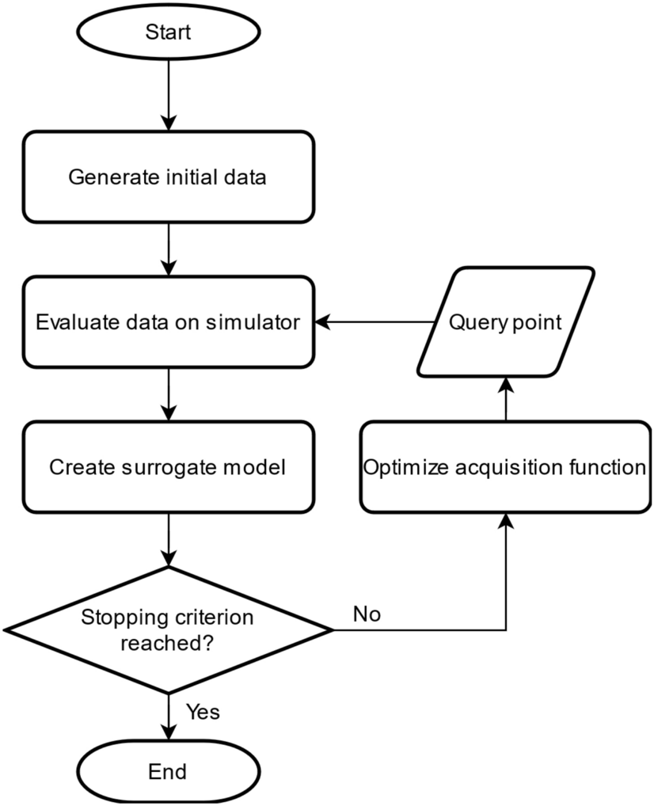
Bayesian Optimization
Frazier, P. I. (2018). A tutorial on Bayesian optimization. arXiv preprint arXiv:1807.02811.
Mockus, J. (2005, September). The Bayesian approach to global optimization. In System Modeling and Optimization: Proceedings of the 10th IFIP Conference New York City, USA, August 31–September 4, 1981 (pp. 473-481). Berlin, Heidelberg: Springer Berlin Heidelberg.
Brochu, E., Cora, V. M., & De Freitas, N. (2010). A tutorial on Bayesian optimization of expensive cost functions, with application to active user modeling and hierarchical reinforcement learning. arXiv preprint arXiv:1012.2599.
Shahriari, B., Swersky, K., Wang, Z., Adams, R. P., & De Freitas, N. (2015). Taking the human out of the loop: A review of Bayesian optimization. Proceedings of the IEEE, 104(1), 148-175.
Jones, D. R., Schonlau, M., & Welch, W. J. (1998). Efficient global optimization of expensive black-box functions. Journal of Global optimization, 13, 455-492.
Notes:
Optimizing the acceleration for applications is further complicated by the nonlinear and highly dynamic laser-plasma interactions and the limited repetition rates and stability of today’s drive lasers that typically constrain the available knowledge of the system to a few noisy measurements.
To overcome this hurdle, several groups have started adopting Machine Learning to optimize the laser-plasma acceleration process. In particular, Bayesian optimization (BO) happens to be a method designed to find optima of a costly-to-evaluate black-box function based on limited and noisy measurements and therefore seems well suited to optimize the complex parameter space of particle accelerators.

Slide 5
Bayesian Optimization
Notes:
In this talk we will show how a multi-step Bayesian method can optimize the maximum energy of laser-driven proton beams.

Slide 6
Motivation
Why Laser-Driven Proton Acceleration?
Laser-driven proton accelerators are relevant candidates for many applications.
Generation of on-target intensities of around 10¹⁹ to 10²¹ W/cm² produces multi-MeV protons using commercial table-top lasers.
Can routinely reach proton energies of ~15-20 MeV, a current in the kA regime and a laminarity at the source 1000 times better than conventional accelerators.
Core challenges to address
Nonlinear dynamics of laser-plasma interactions.
Experimental limitations (low repetition rates, shot-to-shot fluctuations).
High-dimensional parameter spaces (e.g. laser wavefront, pulse, target properties).
Need for robust, data-efficient optimization strategies.
Notes:
Laser-driven proton accelerators offer compact and versatile solutions for applications in material science, medical physics, and cultural heritage, capable of producing multi-MeV proton beams using table-top systems.
These accelerators can reach on-target intensities up to 10^23 W/cm² and generate proton beams with high laminarity.
However, the nonlinear and highly dynamic laser-plasma interactions, combined with experimental constraints such as low repetition rates, shot-to-shot noise, and limited diagnostics, hinder the stability and repeatability of high-energy ion generation.
The optimization of such systems is further complicated by the high-dimensional nature of control parameters (e.g., laser wavefront, pulse duration, target structure).

Slide 7
Core scientific question
How can we develop data-efficient, robust optimization strategies capable of navigating noisy, high-dimensional, nonlinear experimental landscapes to reliably enhance the performance of laser-driven proton accelerators?
Optimization Strategy :
Goal: Maximize proton maximum energy
→ by finding the best deformable mirror (DM) actuator voltages → which directly shape the laser focal spot and intensity profile
→ and optimize the TNSA mechanism
Notes:
So the core question is : How can we develop data-efficient, robust optimization strategies capable of navigating noisy, high-dimensional, nonlinear experimental landscapes to reliably enhance the performance of laser-driven proton accelerators?
Here is how we will proceed : to optimize the proton maximum energy
By finding the best deformable mirror (DM) actuator voltages → which directly shape the laser focal spot and intensity profile
→ and optimize the TNSA mechanism

Slide 8
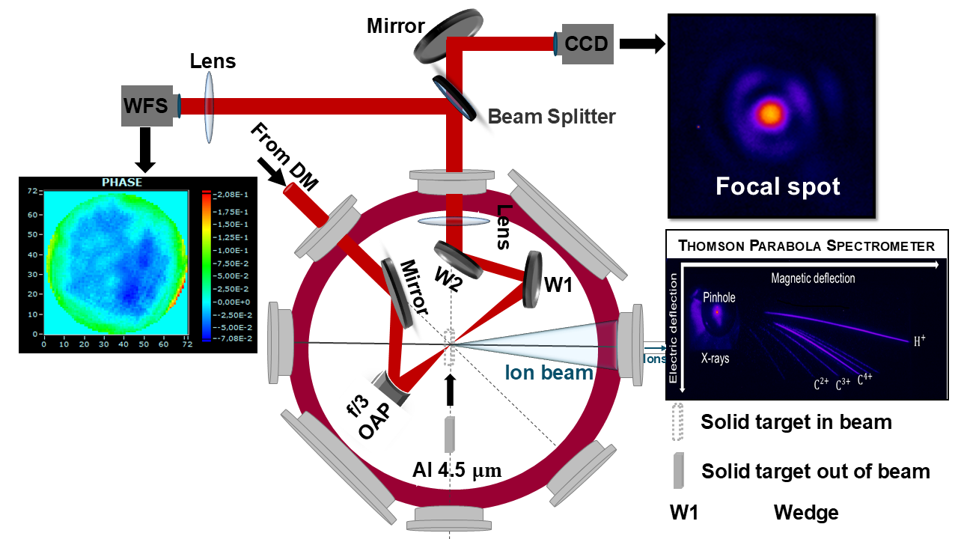
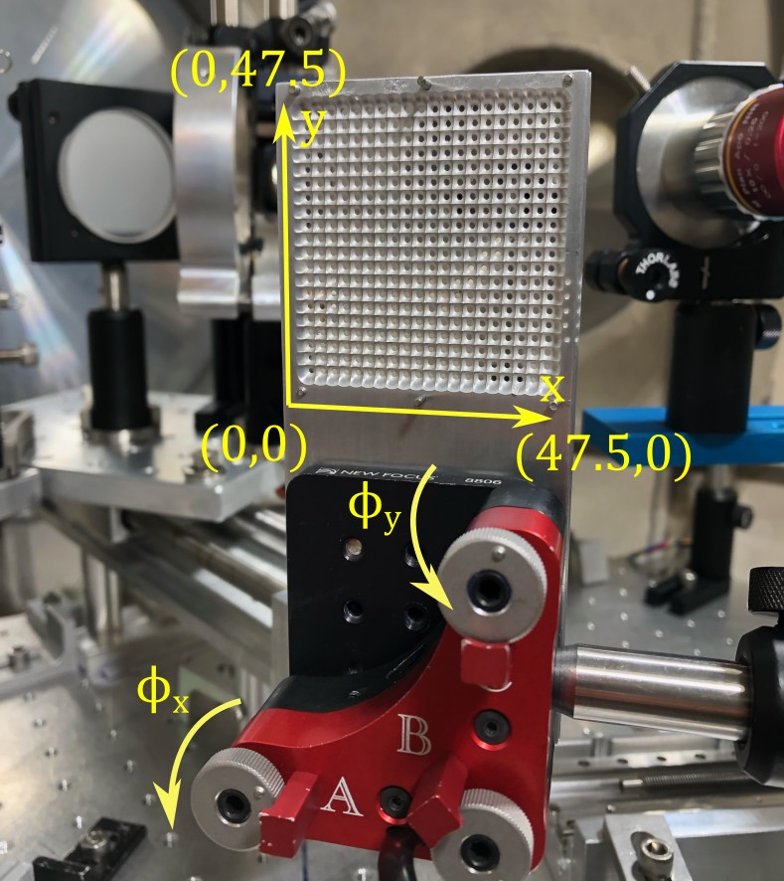
Experimental setup
Ti:sapphire ALLS 150 TW laser :
Minimum focal spot size : Ø5 µm.
Peak intensity ~$1.3×{10}^{20}$ W.$cm^{−2}$
Configuration 1 : Real time processing of laser beam wavefront and shape at 2.5 Hz.
Configuration 2: Real time processing of Thomson parabola images at 0.625 Hz.
Targets used : 4.5-µm-thick aluminum foil
Proton maximum energy shot-to shot fluctuation : ~5%
$λ_{0}$ [nm] | $τ_{L}$ [fs] (best compression) | $$E_{Laser}$$ [J] | $$Φ_{BeforeOAP}$$ [mm]
800 | 22 | 3.3 | 95
Elias Catrix et al., Stable high repetition-rate laser-driven proton beam production for multidisciplinary applications on the advanced laser light source ion beamline. Rev. Sci. Instrum.; https://doi.org/10.1063/5.0160783
Notes:
ALLS laser delivers 3.2 J on target with a pulse duration of 22 fs (Full-Width-Half-Maximum) and at a central wavelength 800 nm.
The experimental setup employs an f /3 OAP to focus the 95 mm diameter beam down to a focal spot size of wFWHM ∼ 5 μm, achieving a peak intensity of approximately 1.3 × 1020 W/cm2.
A piezoelectric bimorph DM with 48 actuators with a maximum voltage range [-200 V,+200V]), allows for precise wavefront shaping.
In configuration 1 : A wavefront sensor (WFS) provides real-time feedback to assess quantitatively the impact of DM actuator configurations on the laser beam wavefront. At the same time, a CCD camera is imaging the focal spot. This beam analysis is performed at the laser nominal energy of 3.2 J by attenuating the laser beam energy with wedges before the diagnostics.
In configuration 2 : TNSA is performed on 4.5 micrometer thick target foils mounted on a multi-target holder allowing for 400 shots per pumping cycle and a TPS allows for characterization of the ion source for a given DM actuator configuration.

Slide 9
Multi-step surrogate-assisted Bayesian optimization (MSBO)
Notes:
A multi-step approach combining Random Forest modeling and Bayesian Optimization was used to maximize proton energies.
Step 1: Dataset Generation
360 different DM actuator configurations were tested to fill an initial dataset.
Step 2: RF Model Training
RF captured the relationship between 20 actuators and proton energy with robustness against noise.
Step 3: Bayesian Optimization
BO used Python’s gp_minimize from scikit-optimize, with RF as the objective function.
Step 4: Experimental Validation
BO identified an optimal actuator configuration.
Predicted maximum proton energy was tested experimentally.

Slide 10
Step 1
2
Generate initial dataset of 360 DM configurations
Example of data points:
0 | 1 | 2 | 3 | 4 | 5 | 6 | 7 | 8 | 9 | 10 | 11 | 12 | 13 | 14 | 15 | 16 | 17 | 18 | 19 | $$E_{p,max}$$
3 | -43 | -4 | -44 | -43 | 68 | 6 | 37 | 47 | -29 | 39 | -13 | -55 | -49 | -27 | -77 | 10 | 34 | 14 | 7 | 3.64
50 | 60 | -58 | 54 | 8 | 44 | -55 | -79 | -57 | -24 | -68 | 2 | 23 | -77 | 16 | 71 | -69 | -75 | 12 | -44 | 5.17

Slide 11
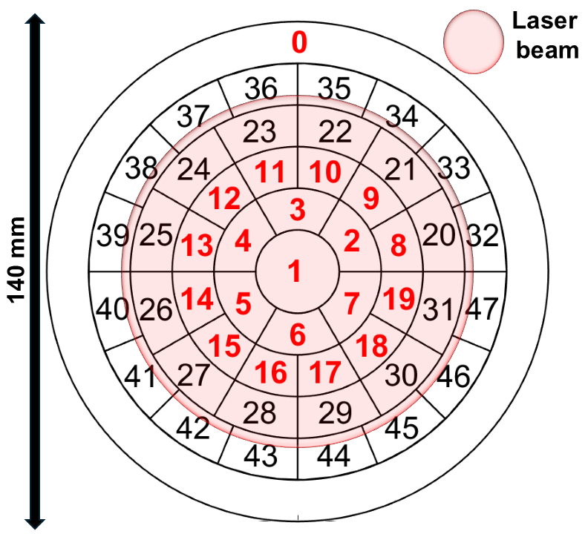
Deformable mirror to shape ALLS laser beam
2
How is it tuned ?
Actuators from 0 to 19 = 20-D parameter space
Range of voltages [-80 V ; +80 V]
Latin Hypercube sampling to best cover the parameter space
DM configurations are tested at 0.625 Hz via the OAsys Phasics SDK.

Slide 12
Step 2
Build Random Forest model to fit dataset
Generate an estimate of maximum proton energy function

Slide 13
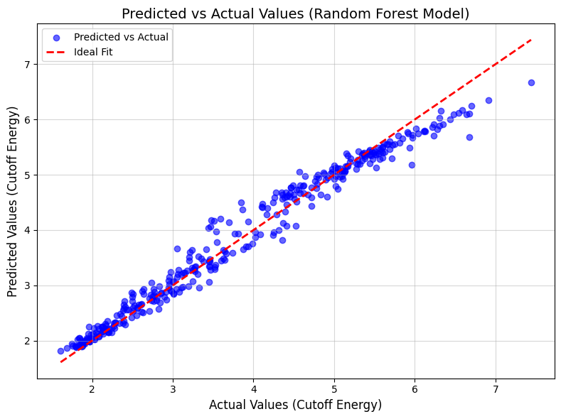
Random forest prediction and visualization
Key Insight | Details
Strongest Correlation | Actuator 0 ↔ maximum proton energy = 0.86
Average Correlation (Others) | 0.08 – Suggests weaker influence of most actuators
Inter-Actuator Correlations | Mostly < |0.1|, indicating independence among actuators
Conclusion | Actuator 0 is a dominant driver, others contribute marginally and independently = 20-D dynamic
Model prediction :
R² = 0.97
RMSE = 0.23
The points show a consistent spread along the diagonal, which suggests the model performs well across the entire range of target values.
360 DM configurations
Notes:
The correlation matrix reveals a strong positive correlation (0.86) between actuator 0 and the cutoff energy, which controls the laser pulse defocus, indicating its primary influence. Most actuators exhibit weaker correlations suggesting lower impact than actuator 0, with an average correlation of (0.08). Moreover, the correlation matrix indicates weak inter-actuator correlations (< |0.1|), showing that most actuators function independently with minimal mutual influence.
RF was selected for its ability to capture complex non-linear relationships and handle noisy, high-dimensional. In this study, RF is used to approximate and predict the maximum proton energy as a function of input actuator voltages while BO is used to find an optimal DM configuration.
The idea also is to propose a robust offline optimization that smooths out noise and can ignore failed shots, enabling a computationally efficient emulation of our experiment.

Slide 14
Step 3
Bayesian Optimization
Use the Random Forest model to evaluate proton maximum proton energy
UCB acquisition function chooses the next DM configuration to test
Build/update a probabilistic model (Gaussian Process)
No
Number of maximum evaluations reached ?
Yes
Outputs an optimal DM configuration and the corresponding proton maximum energy
14

Slide 15
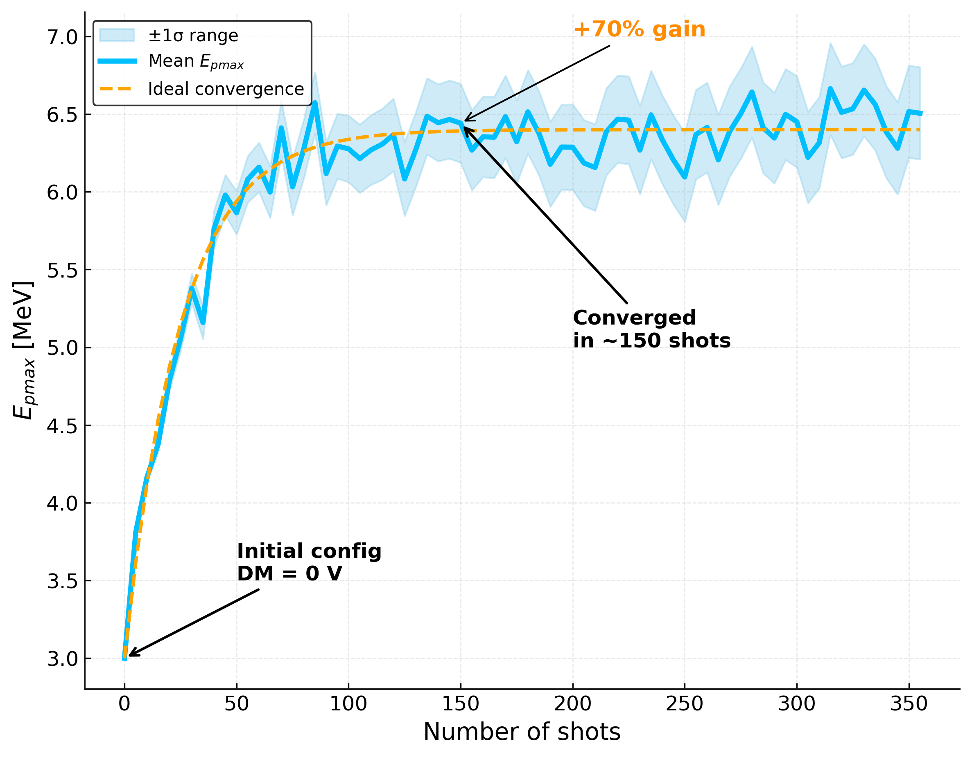
+70% Energy gain in under 150 Shots
Notes:
To evaluate the efficiency and reliability of our method, we conducted 89 consecutive optimization trials, each one using a different RF predictive model trained on a randomly selected and size-increased subset of 2 to 358 laser shots from the initial dataset (2, 6, 10, 14 ... up to 358). Each optimization trial was repeated 10 times for statistical robustness, tracking the global maximum proton energy predicted by the Bayesian optimization scheme at each iteration. All runs started with DM actuator voltages set to 0 V. This figure shows the mean (blue curve) and standard deviation (shaded sky blue curve) of the predicted optima across ten runs, illustrating the evolution of Epmax as a function of the number of laser shots. Initially, Epmax is ∼3 MeV for ∼5 shots, rising sharply to ∼90% of its final value within 30 shots and reaching 6 MeV around 50 shots. The growth then slows down, stabilizing around 6.2 MeV after about 100 shots, with minor fluctuations up to 358 shots. This suggests that 100-150 shots suffice to determine an optimal DM configuration and reliably estimate Epmax = (6.44 ± 0.33) MeV, closely matching the experimental value (Epmax = (6.64 ± 0.30) MeV). The shaded region represents uncertainty, which is initially higher due to limited data but which is narrowing as more shots improve the model confidence. This analysis highlights the trade-off be-tween data acquisition and predictive accuracy, crucial for optimizing experiments.
Testing the MSBO-determined DM configuration on anew target-holder resulted in a lower maximum proton energy(Epmax = (5.82 ± 0.38) MeV), a 13% reduction, with minimal misalignment effects. This decline is likely due to target sur-face quality, alignment variations, or long-term laser energydrift, which can reach ∼10% if unadjusted during an experiment

Slide 16
Step 4
2
Yes
Outputs an optimal DM configuration and the corresponding proton maximum energy

Slide 17
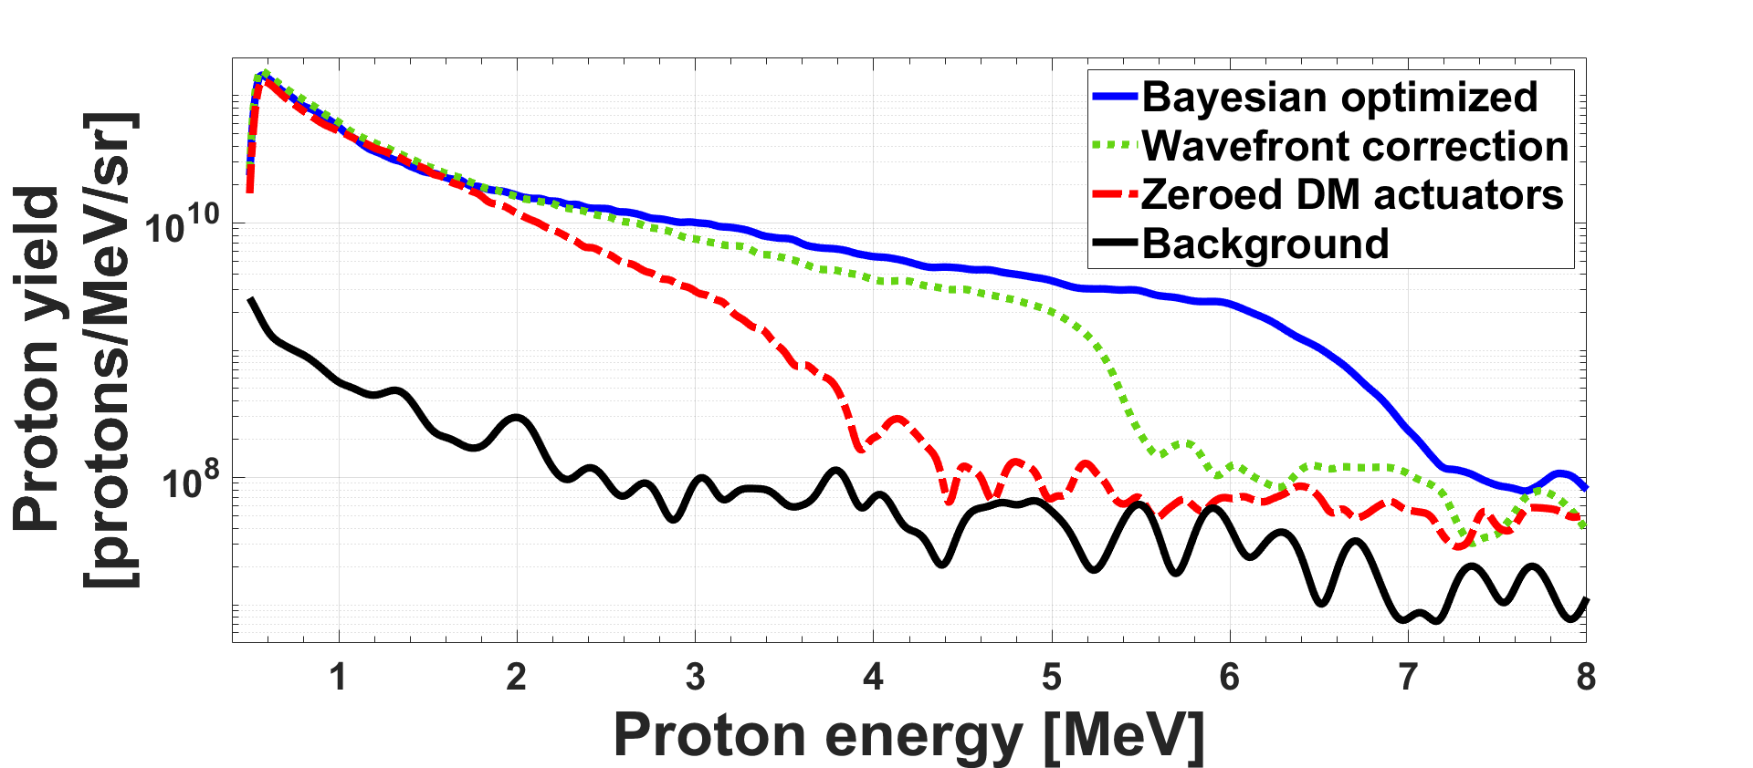
Optimization of proton maximum energy: $E_{p,max}$
2
Wavefront sensor optimization :
$E_{p,max}=$ (5.37$±0.24)$ MeV
Zeroed DM actuators :
$E_{p,max}=$ ($3.85±0.14)$ MeV
Bayesian optimization :
$E_{p,max}=$ ($6.32±0.23)$ MeV (predicted)
$E_{p,max}=$($6.64±0.30)$ MeV (measured)
+24%
70%
Notes:
A comparison of experimental proton spectra for three actuator configurations is shown here.
The maximum proton energy increased by ∼70%, reaching Epmax =(6.64 ± 0.30) MeV with the MSBO-determined optimal DM configuration. This represents a significant improvement over the zeroed DM configuration, which yielded Epmax =(3.85 ± 0.14) MeV.
MSBO also outperforms conventional wavefront correction methods, which optimizes the laser beam towards a flat wavefront, by ∼24% (Epmax = (5.37 ±0.24) MeV.

Slide 18
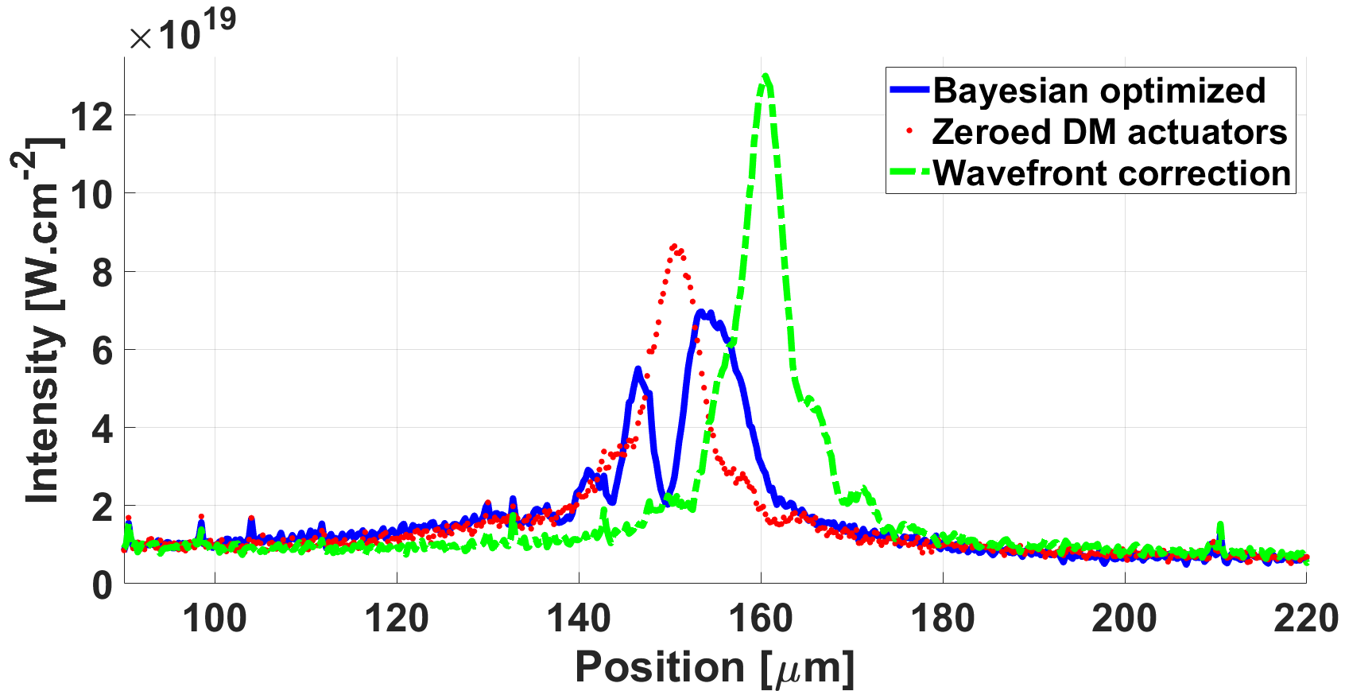
When deforming the wavefront beats flattening it
1
DM = 0 V
WFS
MSBO
20 $μm$
Brabetz, C. et al. Laser-driven ion acceleration with hollow laser beams. Physics of Plasmas, 22(1).
Willim, C et al. (2023). Proton acceleration with intense twisted laser light. Physical Review Research, 5(2), 023083.
Notes:
Unlike MSBO, traditional wavefront correction lacks proton beam feedback when relying solely on the WFS.
The results reveal that the highest maximum proton energy consistently corresponds to a deformed wavefront, as shown here.
Therefore, maximum proton energy is achieved without maximizing laser intensity on the target.
The Figure below highlights focal spot differences under identical conditions (same camera settings and gain). These findings suggest that BO optimizes proton acceleration by shaping the wavefront for a more favor-able laser-plasma interaction, even with lower peak intensity and broader width than WFS-based optimization.
This matches with prior findings where ion acceleration optimization was achieved through advanced control techniques without maximizing on-target laser intensity.

Slide 19
Conclusion and perspectives
Achieved +70% increase in maximum proton energy using <150 shots — outperforming traditional wavefront correction by 24%.
Direct actuator-level control of a deformable mirror — a possible WFS-free strategy.
Demonstrated that non-flat, machine-learned wavefronts outperform canonical "flat" corrections.
Robust ; enables offline or online optimization even in data-scarce regimes.
Framework is scalable and adaptable — applicable to low-repetition-rate facilities or limited target availability.
Broadly extendable to other regimes and platforms: Laser Wakefield Acceleration, High-Harmonic Generation, Laser-based X-ray or neutron sources.

Slide 20
Acknowledgements
Patrizio Antici (Supervisor)
Sylvain Fourmaux (Research associate at INRS)
Simon Vallières (Research associate at INRS)
Joël Maltais (Laser’s technician)

