Slide 1
New designs of helical coil targets for laser-driven proton, carbon and alpha acceleration
M. Bardon¹, C.L.C. Lacoste^{1,2}, A. Hirsch-Passicos^{1,3}, K. Aliane¹, T. Carrière¹, E. Catrix², S. Vallières²,
S. Fourmaux², P. Nicolaï¹, D. Raffestin¹, P. Antici², V.T. Tikhonchuk^{1,4} and E. d’Humières¹
1) CELIA, Université de Bordeaux-CNRS-CEA, UMR 5107, Talence F-33405, France
2) INRS EMT, Varennes J3X 1P7, Canada
3) Helmholtz-Zentrum Dresden-Rossendorf, Bautzner Landstraße 400, Dresden 01328, Germany (currently)
4) Extreme Light Infrastructure ERIC, ELI-Beamlines Facility, Dolní Brežany 25241, Czech Republic

Slide 2
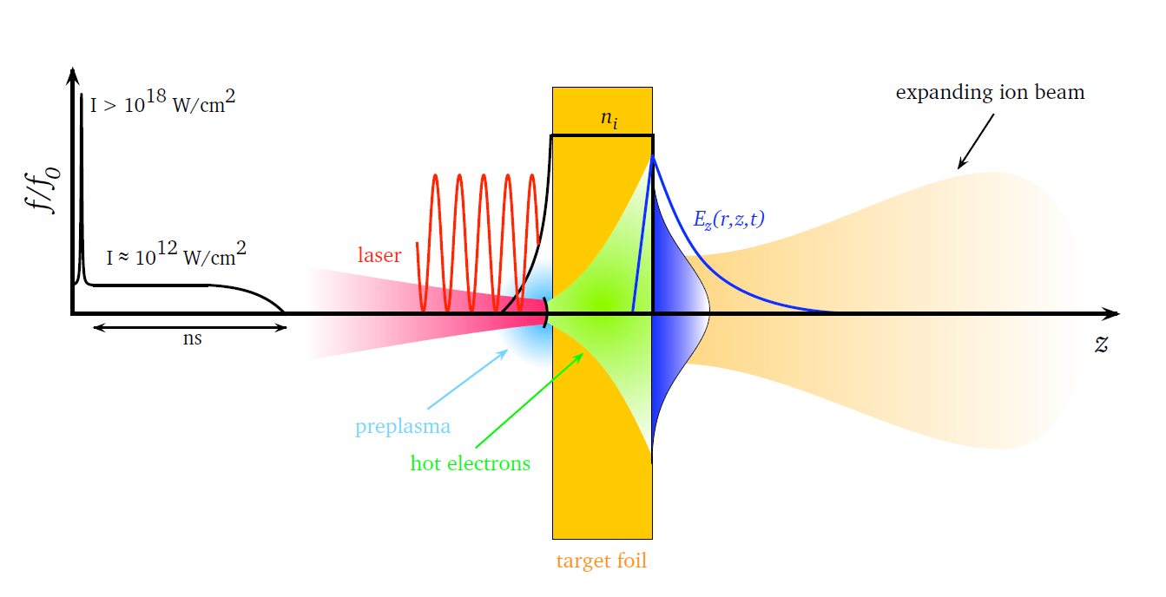
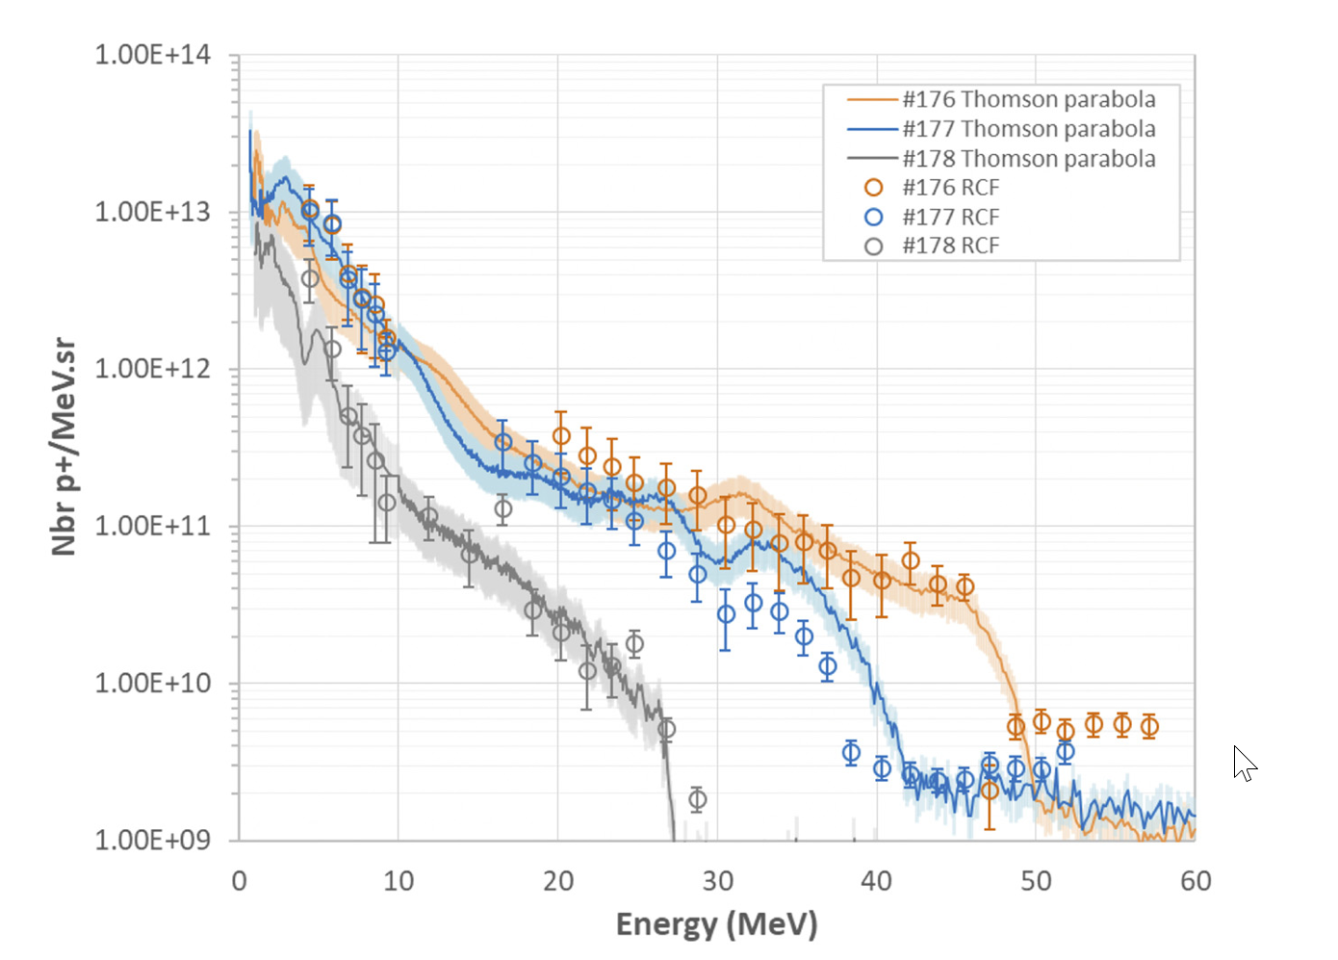
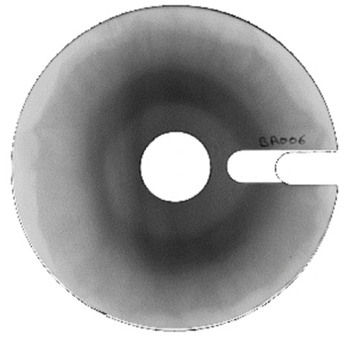
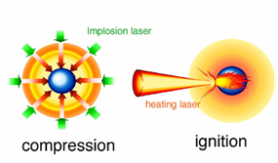
Motivations
Development of a new tunable proton source for different applications
TNSA beam features
Most robust laser-driven ion acceleration process: the TNSA
TNSA proton energy distribution
TNSA proton half-angular divergence
±20°
M. Roth et al, CERN Yellow Reports (2016)
D. Raffestin et al. Matter Radiat. Extremes 6, 056901 (2021)
TNSA beam features are not suitable for various applications ⇒ We need to shape this proton beam
Proton isochoric heating
Radioisotope production
ICF fast ignition scheme
p+
p+
PET scan
laser
WDM studies
laser
Sc isotopes
Proton target
Heated target
Proton target
Calcium
target

Slide 3
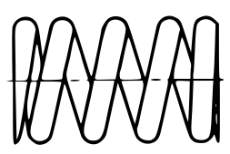
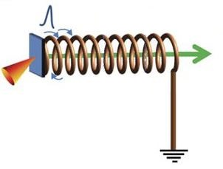
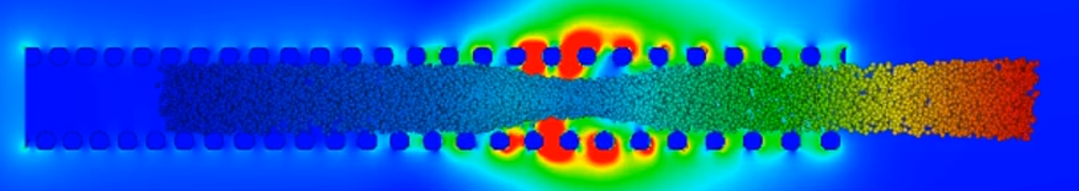
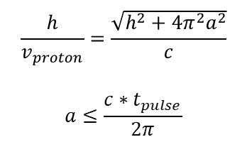
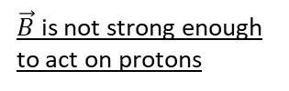


Helical coil target (HC)
Length L
(5-20mm)
Discharge current pulse
$$\vec{E_{r}}$$
Radius a
Target
(0.4-1mm)
Protons
Laser
Helix
$$\vec{E_{z}}$$
$\vec{B}$ is not strong enough to act on protons
Pitch h
(0.3-0.8mm)
S. Kar et al., Nature Com. 7 10792 (2016)
Proton beam is focused, collimated, post-accelerated & bunched by the helical-coil
Only one single laser beam is needed to generate the protons and the discharge current
Rules to design a helical-coil
Helix acts as a EM wave-guide & also as a delay line
$$\frac{h}{v_{proton}}=\frac{\sqrt{h^{2}+{4π}^{2}a^{2}}}{c}$$
$$a≤\frac{c∗t_{pulse}}{2π}$$
Proton and current pulse propagations must be synchronized
Current pulse must spread over, at least, one turn
PIC simulation (Sophie)
Protons
Current

Slide 4
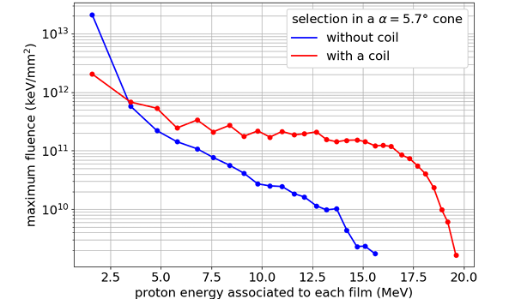
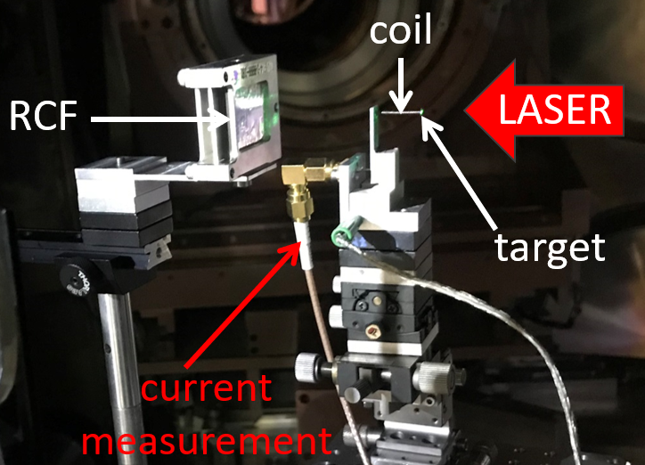
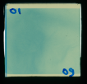
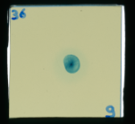
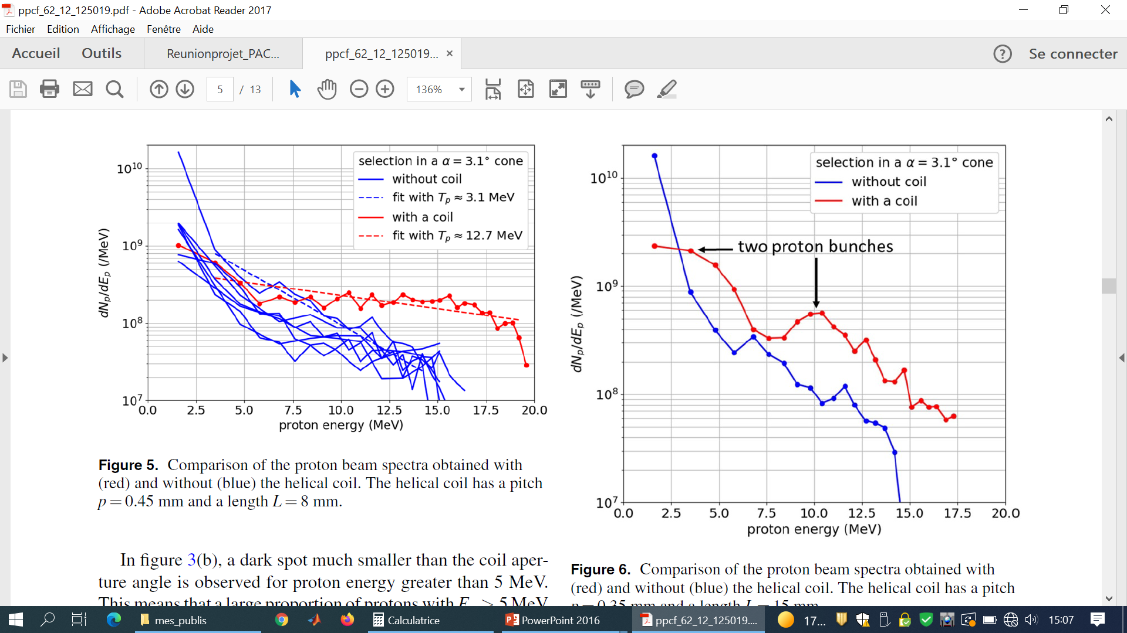
Results of the Pacman 1 experiment on LULI2000 (2019)
M. Bardon et al., PPCF 62, 125019 (2020)
RCF without HC
50J, 1ps
Focusing
RCF with HC
Acceleration
Bunching
Fluence multiplied by 10 (E>12MeV)
30% increase in the cut-off energy
Limited bunching
Limited yield (~10%)

Slide 5
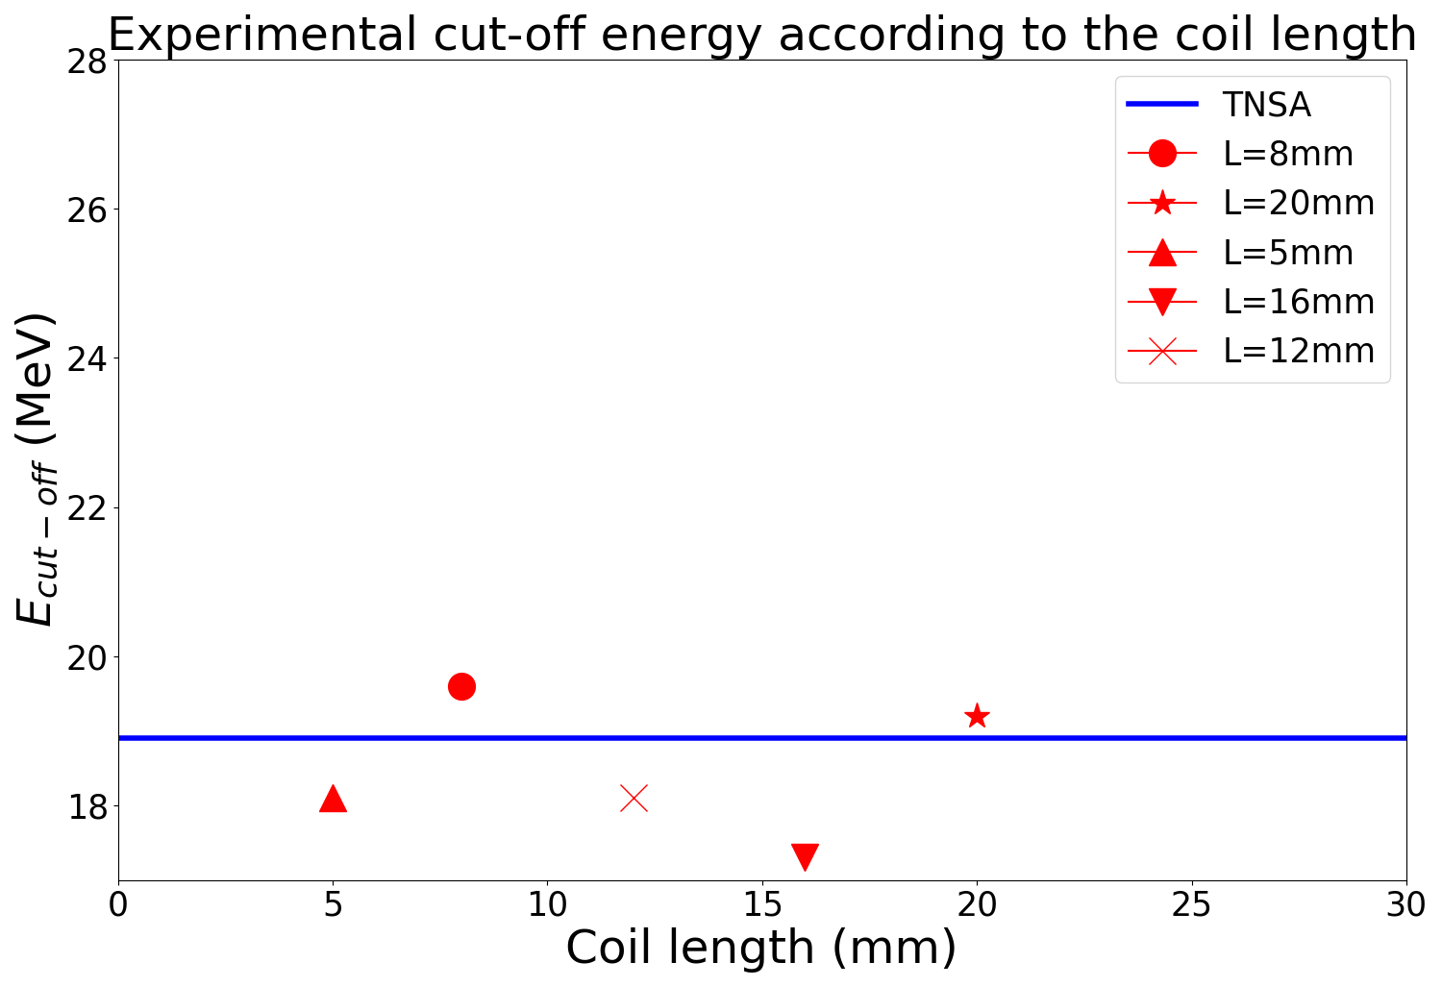
Results of the Pacman 2 experiment on LULI2000 (2020)
Variations on the helical coil length
Cut-off energy does not increase with the coil length
Post-acceleration is not efficient all along the coil length
Why?

Slide 6
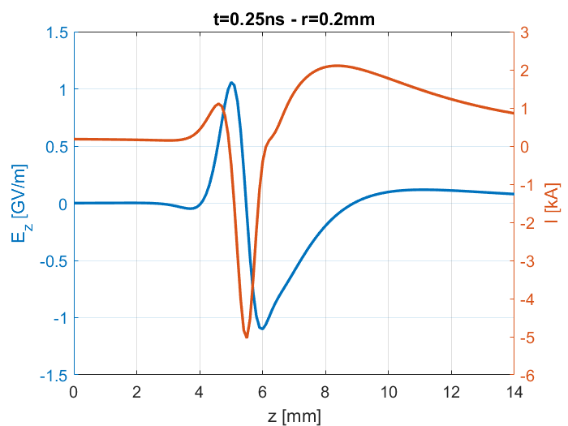
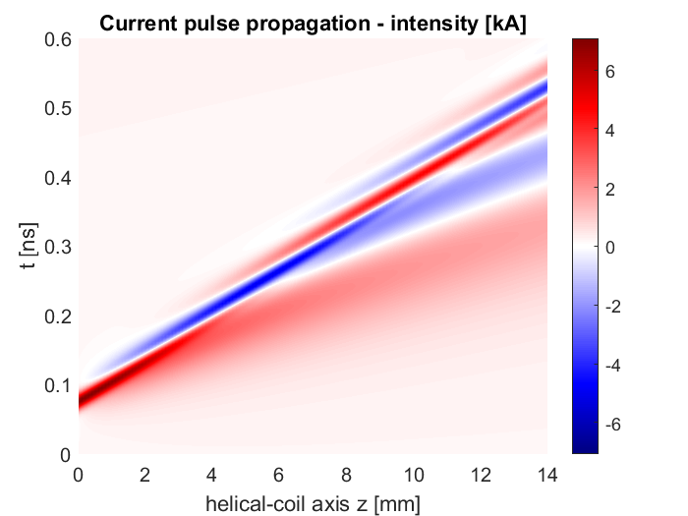
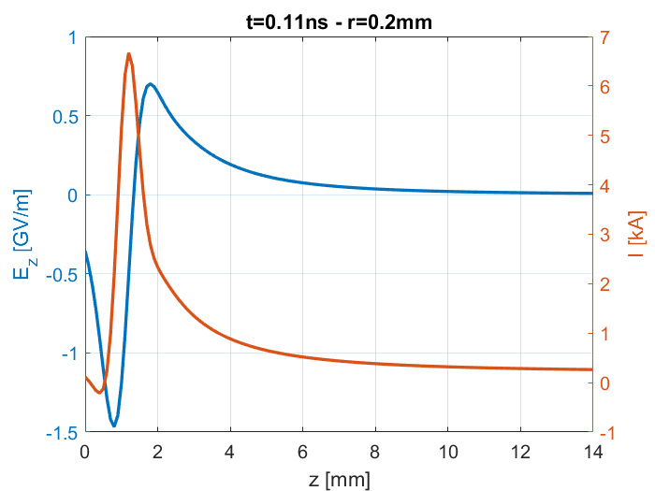


Current dispersion
HC parameters: a=0.5mm h=0.35mm
M. Bardon et al., PPCF 62 125019 (2020)
Current pulse propagation along the helical coil is dispersed
Acceleration
Current pulse (~10ps) has a broadband frequency spectrum
Frequencies do not propagate at the same speed
This will modulate the current pulse intensity
Deceleration
$$V_{HC}$$
Bunching
Acceleration
PIC simulation (Sophie)
$$V_{HC}=\frac{c}{\sqrt{1+{\left(2πa/h\right)}^{2}}}$$
Deceleration
Splitting
A series of small bunches is produced. Bunching & acceleration are not efficient all along the HC

Slide 7



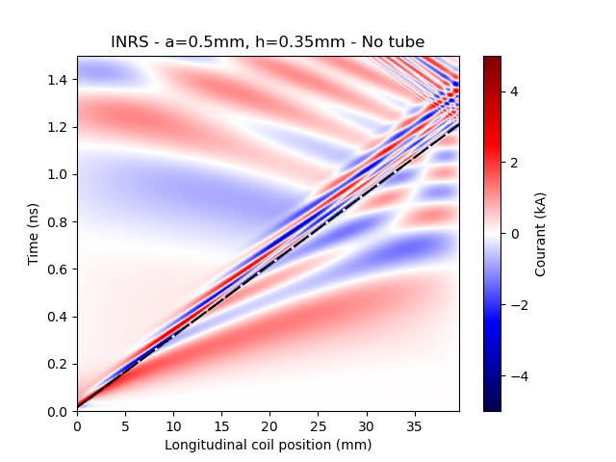
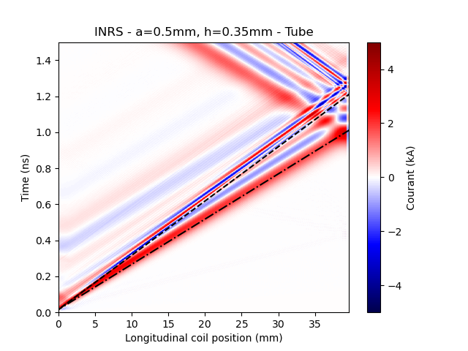
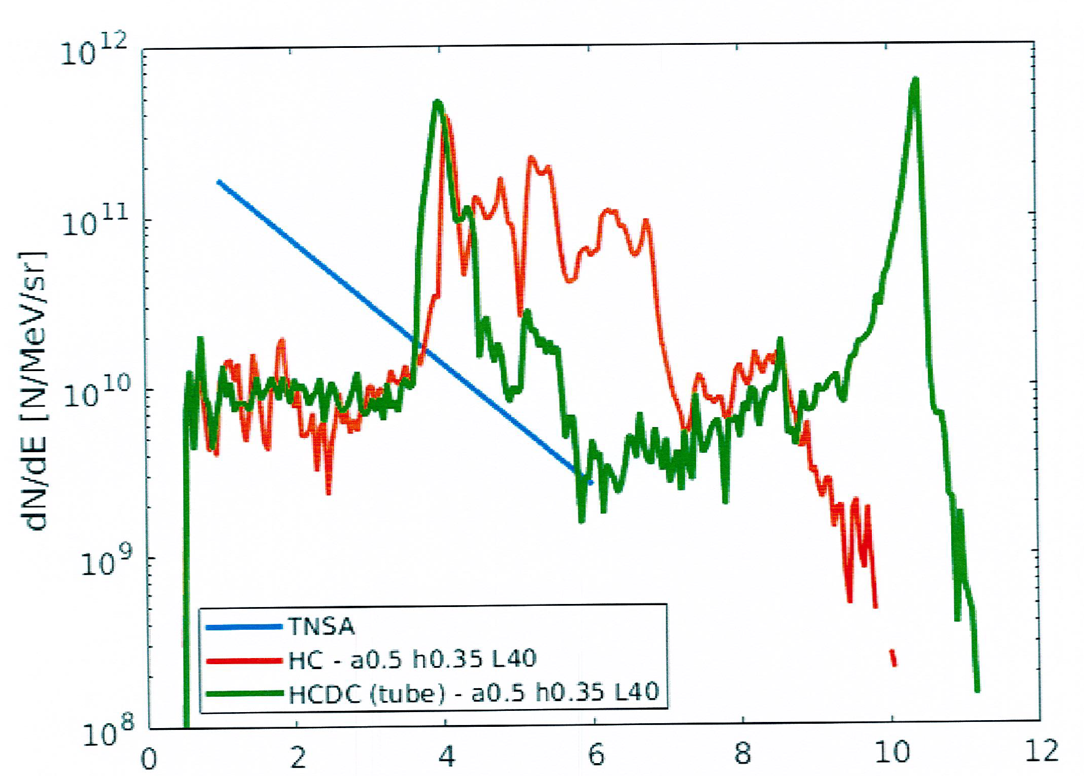
New helical coil design with a tube (HCT)
Tube limits the current dispersion along the helix
Target
Tube
Helix
Holder
LASER
Holder
Without tube
With tube
and increases the proton bunching
A. Hirsch-Passicos et al., Phys. Rev. E 109, 025211 (2024)
TNSA
HC without tube
HC with tube
We are able to predict the energy of the bunches depending on the HCT geometry
E [MeV]

Slide 8

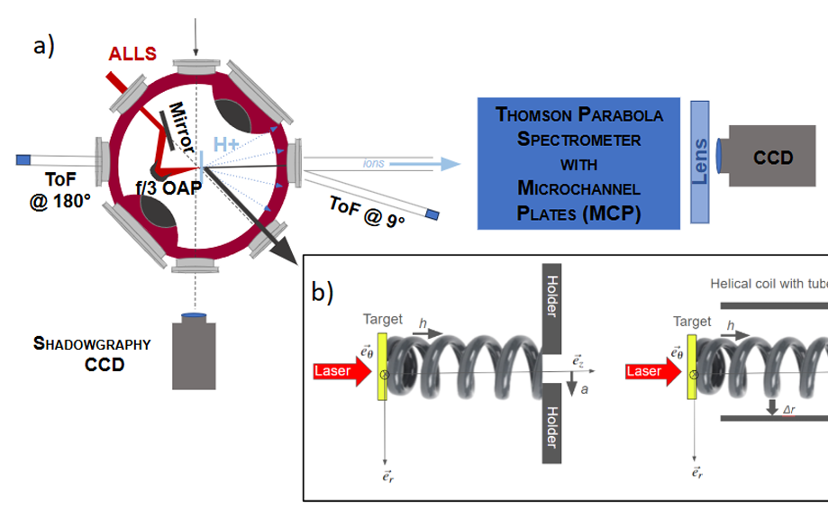
Experiment at the ALLS facility (INRS-EMT – Canada - June 2024)
First time that a Thomson Parabola was used as main diagnostic in a HC experiment
ALLS parameters
E_{laser}= 3J (on target)
Δt = 30fs
Spot size (FWHM) = 5µm
I = 10²⁰ W/cm²
Target : Ta (2µm)

Slide 9
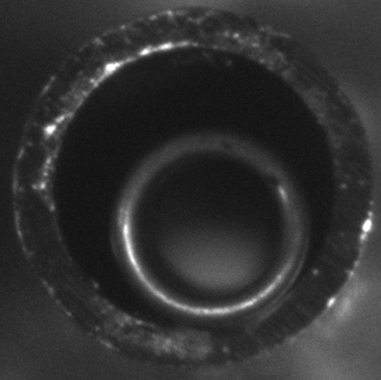
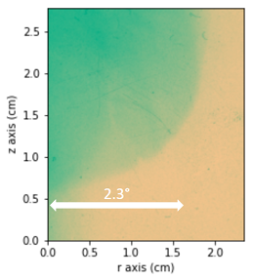
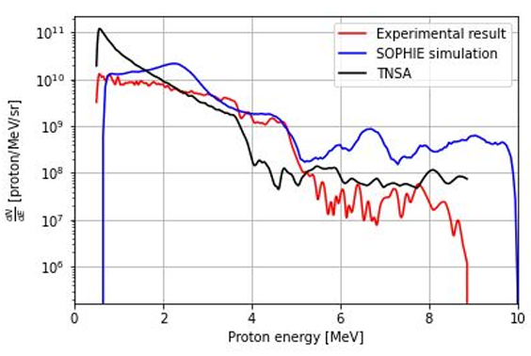
ALLS experiment: Results on the proton spectrum
RCF
We had some issues with:
The target assembly with tubes,
The current intensity in the coil was weaker than expected.
But, with the helical coil, we observed:
A good focusing & collimation of the proton beam (2° divergence),
An increase in the proton temperature,
An increase in the proton cut-off energy.
We successfully identified the appropriate input parameters for our simulations to achieve a good agreement with the measurement on the proton spectrum.
C.L.C. Lacoste et al., Matter Radiat. Extremes 10, 037602 (2025)

Slide 10
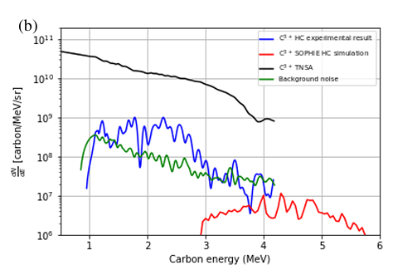
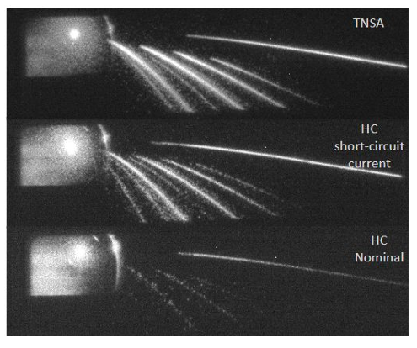
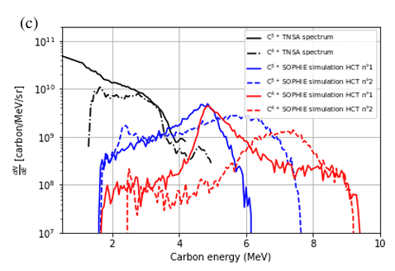
ALLS experiment: Results on the carbon spectrum
Results also confirmed by PIC simulations
3 MCP images of the TPS
Same inputs parameter as the ones we used to reproduce the proton spectrum
protons
carbons
Same inputs for both simulations
HC geometry can be optimized for carbons
Carbons are suppressed by the HC in this geometry
Proton beam at the HC exit is quite pure
⇒ First experimental evidence that the HC can act on carbons
C.L.C. Lacoste et al., Matter Radiat. Extremes 10, 037602 (2025)

Slide 11
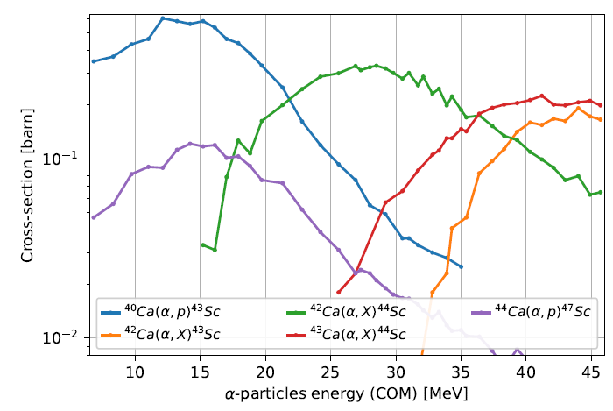
Bunching of alpha particles with HCT for radioisotopes production
PIC simulations (Sophie) – Alpha particles bunching with HCT
Nuclear cross-section reaction of a Ca target
Based on simulated alpha spectra for LFEX laser (ILE-Japan)
3 HCT geometries
C.L.C Lacoste et al., Submitted to Phys. Rev. & Part. Beams (2025)
We can strongly increase the Sc⁴⁴ production (confirmed by Fluka simulations) ⇒ need to be validated by an experiment

Slide 12
Conclusion
New designs of HC with tube (HCT) were developped to mitigate current dispersion & increase proton bunching
Need to improve the target assembly with tube
ALLS experiment is the first evidence that HC can act, not only on protons, but also on carbons
PIC simulations show that HCT can also bunch, focus & accelerate alpha particles for radioisotopes production
Next steps
  Experimental validation of HCT at high energy & high intensity with the LFEX laser (ILE-Japan)
  Towards high repetition rate: firts step is to dissociate the proton generation from the current pulse production ⇒ This will be performed with the use of 2 laser beams at DRACO facility (HZDR-Germany)

Slide 13
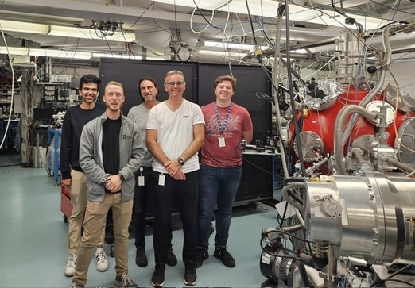
Acknowledgements
CELIA
C. Lacoste, K. Aliane, T. Carrière, H. Larreur, M. Ben Tayeb, M. Huault, T. Guilberteau, M. Lafargue, J. Lopez, L. Merzeau, F. Blais,
R. Bouillaud, N. Fedorov, I. Manek-Hönninger, J.L. Feugeas, D. Batani, P. Nicolaï, D. Raffestin, V.T. Tikhonchuk and E. d’Humières
INRS
E. Catrix, S. Vallières, J. Maltais, S. Fourmaux and P. Antici
CEA
J. Moreau, I. Lantuéjoul, R. Nuter and O. Cessenat
HZDR
A. Hirsch-Passicos
This study was granted access to the HPC resources of IRENE under allocation Grant
No. A0170512899 made by GENCI.

Slide 14
Backup

Slide 15
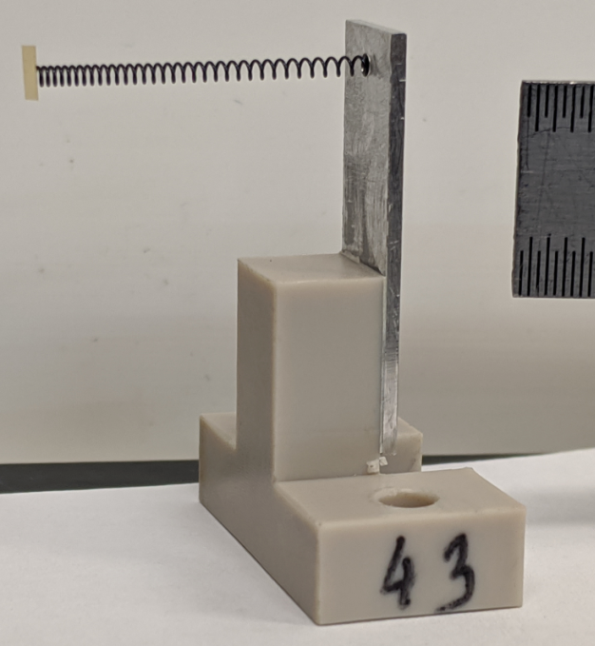
Optimization of the proton post-acceleration: principle
Protons are accelerated during their propagation inside the HC
Current pulse propagation must also be accelerated in order to be synchronized with the protons
Use of HC with variable pitch or diameter along their axis
1 radius a, 1 pitch h ⇒ Infinity of degrees of freedom
We need an efficient model to perform an optimization of the HC geometry

Slide 16





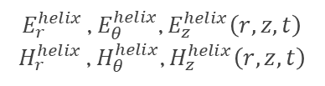
The DoPPLIGHT code
DoPPLIGHT (Dynamics of Particles Produced by Laser Interaction in Grounded Helical Targets)
Inputs
Coil geometry
Particles
Helix fields
Space charge fields
Boris pusher
$$a, h, L$$
For each particle species
$Q, q, m, R_{0}$, $z_{0}$
$$\frac{dN}{dt},\frac{dN}{dE},\frac{dN}{dθ},\frac{dN}{dφ}$$
Electric current
$I_{z=0}\left(t\right)$, $t_{0}$
$E_{r}^{helix }$, $E_{θ}^{helix}$, $E_{z}^{helix}\left(r, z,t\right)$
$H_{r}^{helix }$, $H_{θ}^{helix}$, $H_{z}^{helix}\left(r, z,t\right)$
$E_{r}^{SC}$, $E_{z}^{SC} \left(\frac{r}{σ_{r}},\frac{z}{σ_{z}},\frac{σ_{r}}{σ_{z}}\right)$
The helix
A hellically conducting cylindrical sheet
DoPPLIGHT
2D axi-symmetric
Time resolved
Not self-consistent
Runs in few minutes on a laptop
Valid for helixes with constant pitch & diameter along their axis
Length L
The Sheath helix model J. R. Pierce (1950)
Radius a
a
$$ψ$$
$$ψ=arctan\left(h/2πa\right)$$
Pitch h

Slide 17
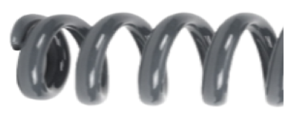
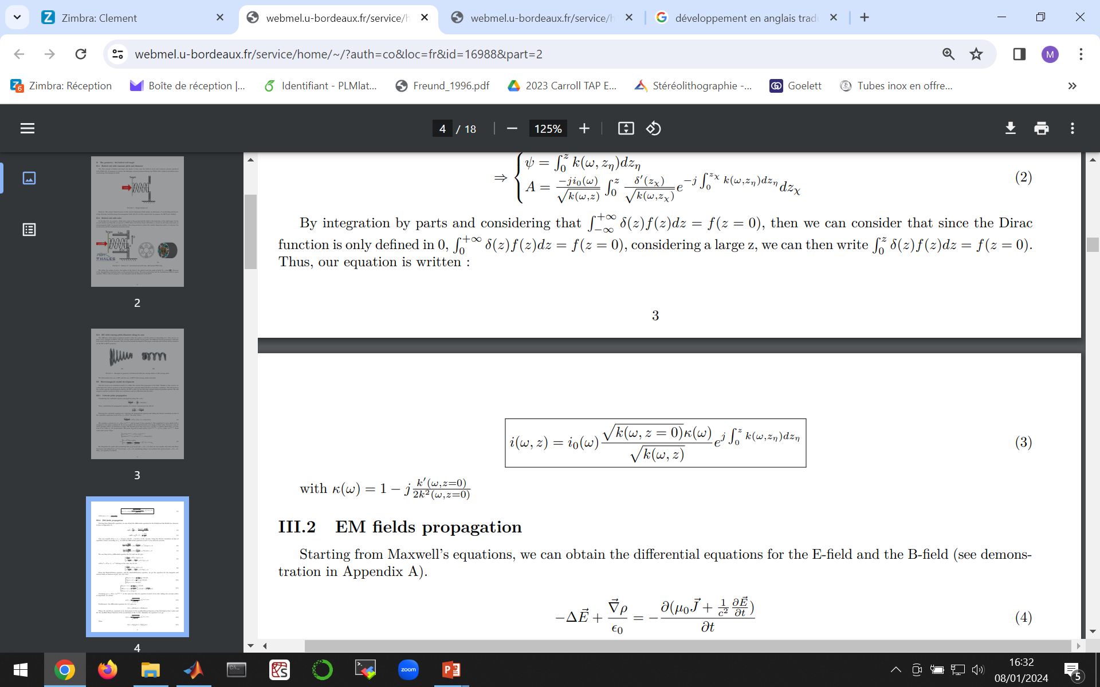
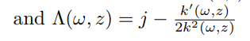
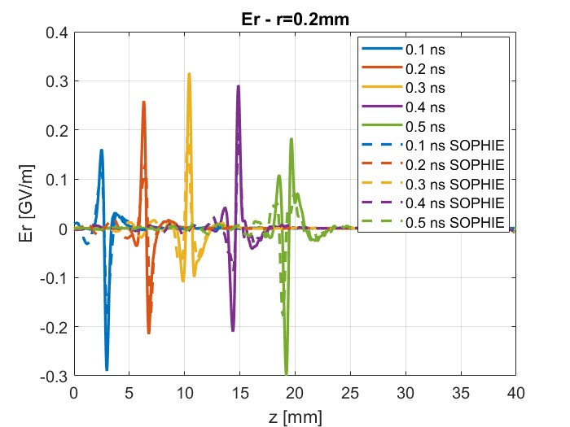
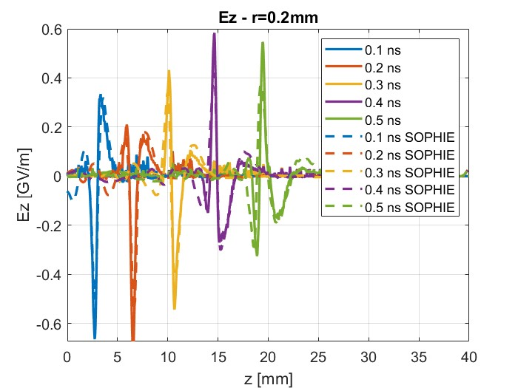
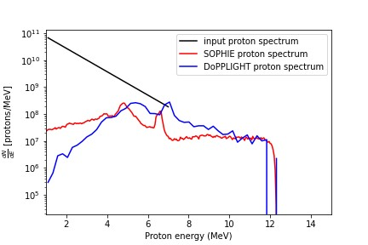
Development of an electromagnetic model for HCT with varying pitch & diameter
C.L.C. Lacoste et al., Matter Radiat. Extremes 9, 067201 (2024)
pitch=0.35mm
pitch=0.525mm
pitch=0.7mm
radius a =0.5mm
radius b =0.7mm
tube
Modelling of helixes with varying pitch & diameter is validated ⇒ We can begin optimization process using ANN (in progress)

Slide 18
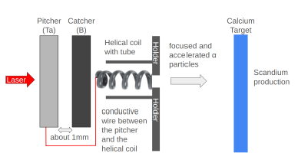
Bunching of alpha particles with HCT for radioisotopes production
Setup proposal
PIC simulations (Sophie) – Alpha particles bunching with HCT
Based on simulated alpha spectra for LFEX laser (ILE-Japan)
3 HCT geometries
Nuclear cross-section reaction
Submitted to Phys. Rev. & Part. Beams (2025)
We can strongly increase the Sc⁴⁴ production (confirmed by Fluka simulations)

Slide 19
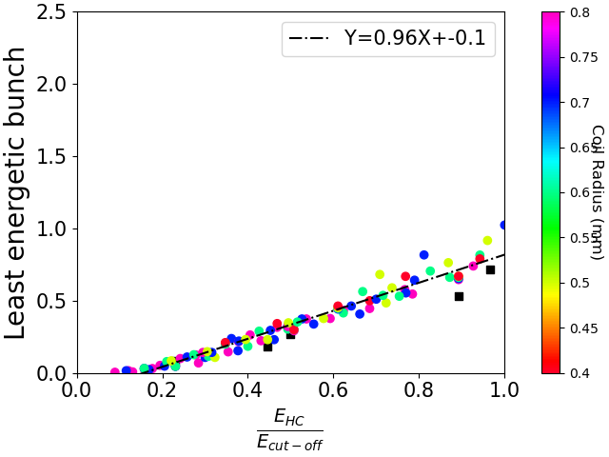
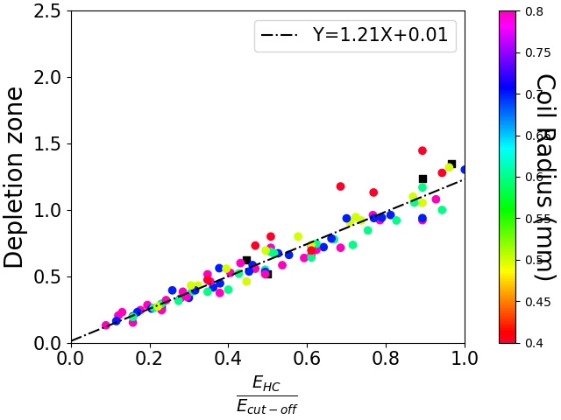
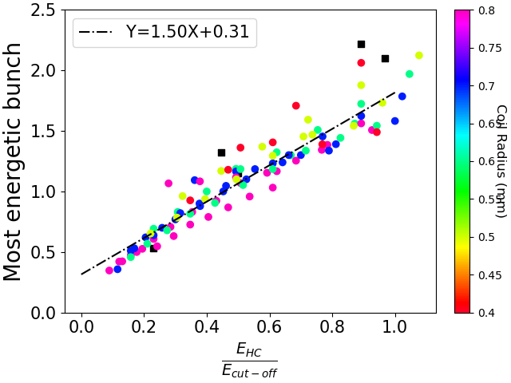

New helical coil design with a tube (HCT)
Tube limits the current dispersion along the helix & increases the proton bunching
Target
Tube
TNSA
HC without tube
Holder
HC with tube
Helix
$$V_{HC}$$
$$V_{HC}$$
LASER
$${1.2 V}_{HC}$$
Holder
Without tube
With tube
A. Hirsch-Passicos et al., Phys. Rev. E 109, 025211 (2024)
E [MeV]
Scaling laws:
We are able to predict the energy of the bunches depending on the HCT geometry

