Slide 1
Ultra-efficient proton acceleration from planar cryogenic hydrogen jets at 1 Hz repetition rate
Stefan Assenbaum^{1,2}, M. Rehwald¹, C. Bernert¹, M. Müller^{1,2}, T. Streil^{1,2}, J. Garreis^{1,2},
J. D. Schilz^{1,2}, T. Kluge¹, P. Ordyna^{1,2}, R. Gebhardt¹, S. Bock¹, S. Göde³, M. Gauthier⁴, C. Schoenwaelder⁴, S. Glenzer⁴, U. Schramm^{1,2} and K. Zeil¹
(1) Helmholtz-Zentrum Dresden-Rossendorf e.V. (HZDR), Institut für Strahlenphysik, Bautzner Landstraße 400, 01328 Dresden, Germany
(2) Technische Universität Dresden, 01069 Dresden, Germany
(3) European XFEL GmbH, Holzkoppel 4, 22869 Schenefeld, Germany
(4) Stanford Linear Accelerator Center (SLAC), 2575 Sand Hill Road, Menlo Park, CA, 94025, USA
Laser-Plasma Accelerators Workshop (LPAW)
14.04.2025, Ischia, Italy

Slide 2
Laser interactions with plasmas of different densities
Underdense, transparent target
Near-critical density target
Dense, opaque target
MVA
TNSA
HB-RPA
BOA
…
RTF-RPA
CSA
$$n_{e} ≪ {γn}_{c}^{}$$
$$n_{e}\sim {γn}_{c}^{}$$
$$n_{e}≫{γn}_{c}^{}$$
Laser pulse mostly absorbed → volumetric interaction
→ high conversion efficiency
Laser pulse mostly transmitted
Laser pulse mostly reflected
(mirror-like behavior)
Density
Under-critical density - Gases
Near-critical density
Over-critical density - Solids
Notes:
Let me first introduce to you what this regime is and why it is of itnerest for laser ion acceleraion. For this let‘s consider the target denstiy.
One of the most important characteristics is here the target density, which influence I would therfore like to discuss in detail in the following.

Slide 3
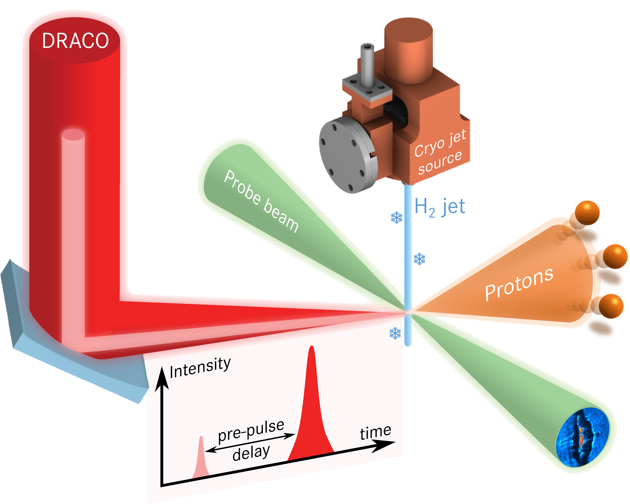
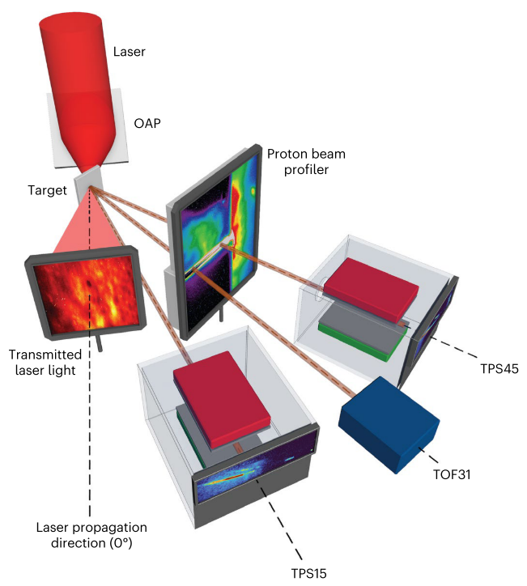
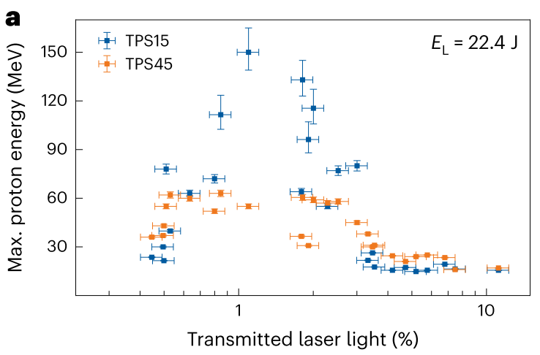
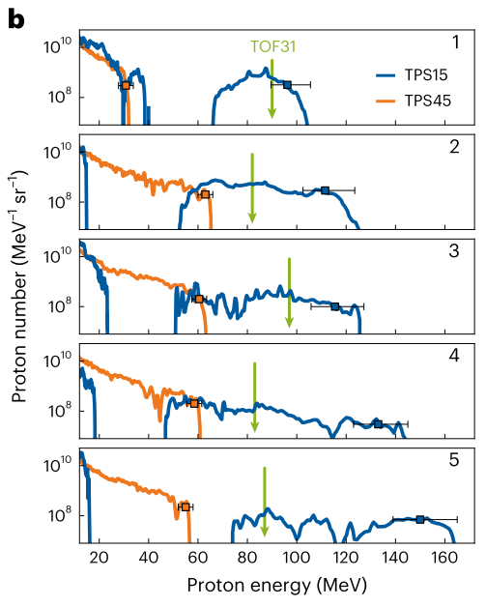
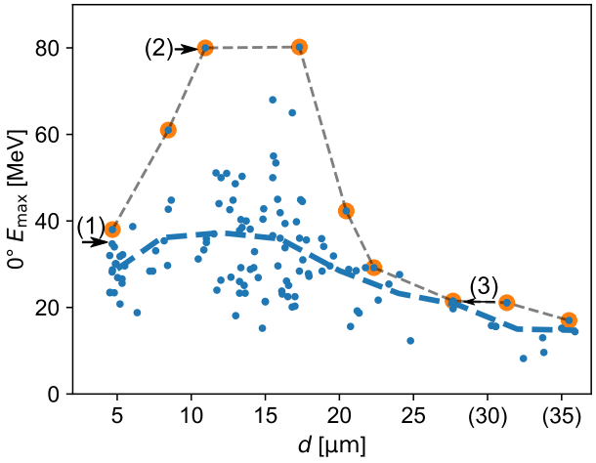
Reaching the near-critical density regime in laser-ion acceleration experiments
Tailored target density by controlled pre-expansion
Matching foil target thickness with laser contrast
Under ideal conditions: Increase of ion energy by factor of 2 (up to 80 MeV)
Under ideal conditions: up to 150 MeV proton energy observed
T. Ziegler et al. (2024) Nat. Phys. 20 1211–1216
M. Rehwald, et al. Nat Commun 14, 4009 (2023)

Slide 4
Learning more about near-critical LPA
Near-critical laser-proton acceleration critically depends on many parameters that can fluctuate during experiments:
Target: Local thickness, density profile (gradients), position, ionization state, …
Laser: Intensity profile, energy, pointing, contrast, …
Chaotic plasma dynamics during acceleration
We need more high quality data to study the effects of individual parameters
Things to improve
1. Increase repetition rate (more shots, better statistics)
2. Increase stablity and reproducibility
(reduce laser and target fluctuations)
3. better knowledge of exact conditions (measure laser and target parameters on shot)
T. Ziegler et al. (2024) Nat. Phys. 20 1211–1216
M. Rehwald, et al. Nat Commun 14, 4009 (2023)

Slide 5
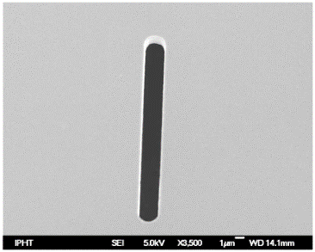
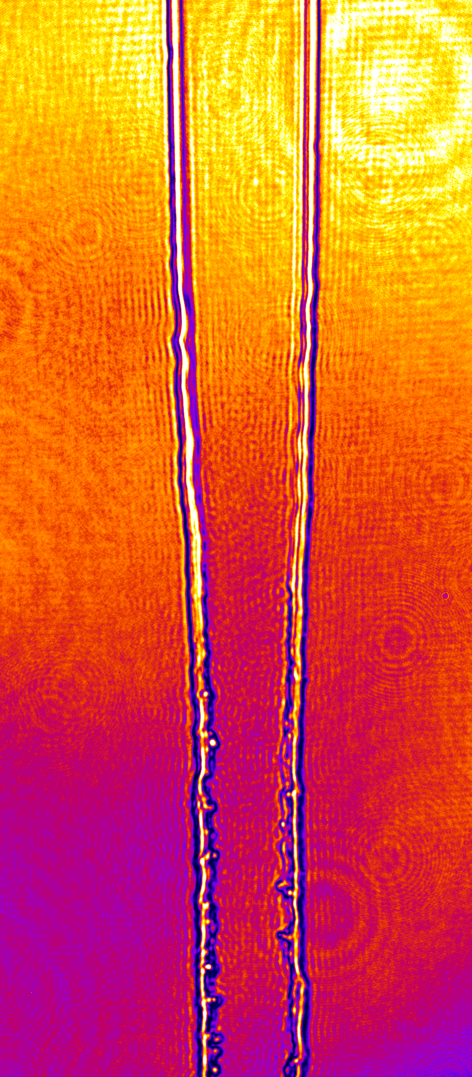
Challenges on the way to 1 Hz operation
Target: solid hydrogen sheet jet
Cryogenically liquified H2
Protecting the cryogenic source
Radiation shield
Cryogenic source
Slit nozzle creates alter- nating, orthogonal sheets
Evaporative cooling freezes the jet into solid H2 → preserves the shape
Width: ~ 25 µm
Thickness: ~500 nm
Very stable, HRR capable, debris-less planar target
Laser-driven relativistic plasma close to source can:
damage the Nozzle
de-stabilize the target after each shot
4µm
20 µm
Liquid Jet
5∙10²⁰ W/cm²
Rotating Chopper
8 mm below nozzle
Data handling
Efficient storage and access
Automated (online) analysis
Online Visualization
Rotation: 45°
freezing
Jitter: ~2 µm
Frozen solid
M. Rehwald, S. Göde, S. Assenbaum in preparation
M Rehwald, et al, 2023 J. Phys.: Conf. Ser. 2420 012034
L. Obst, Scientific Reports (2017), C. Curry, JoVE (2020)
15 µm

Slide 6
1 Hz experimental Setup
Target: Cryogenic hydrogen jet
Planar geometry
High laser-induced breakdown (LIB) threshold resistant to pre-expansion
-150°
Draco PW
30 fs
f/2.2 OAP → 2.5 µm FWHM
1.6J, 1 Hz – 4.6∙10²⁰ W/cm² 2.7J, 0.2 Hz – 7.8∙10²⁰ W/cm²
LIB in dielectric targets: Poster in next session!
0°
15°
Proton spatial profile monitor
Target & Plasma diagnostic
3 axes optical off-harmonic probing
Proton diagnostics
TPS (15° and 45°) equiped with Lanex scintillator + MCP
Time of flight (0°, 30° -150°)
Spatial profile monitor
30°
45°
Other diagnostics:
Reflected/transmitted light
Online Laser diagnostics
…
Talk K. Zeil
C. Bernert et al. Phys. Rev. Appl. 19, 014070 (2023)

Slide 7
First results: Stable acceleration at 1 Hz
Experiments two weeks ago!
Preliminary results
1.6 J laser energy, 1 Hz repetition rate.
>1000 consecutive shots without any input or corrections
45° to laser axis:
Median cutoff energy: 28.7 MeV
Very stable
Large particle numbers
15° to laser axis:
Median cutoff energy: 25.1 MeV
More cutoff energy spread
Large particle numbers
Redacted
Redacted
Notes:
Left:
32 shots > 40 MeV 1 shot > 50 MeV
Right:
112 shots > 40 MeV 7 shots > 50 MeV

Slide 8
First results: Increasing laser energy
Experiments two weeks ago!
Preliminary results
1.6 J laser energy, 1 Hz repetition rate.
>1000 consecutive shots without any input or corrections
45° to laser axis:
15° to laser axis:
Redacted
Redacted
2.7 J laser energy, 0.2 Hz repetition rate.
62 shots
Notes:
Left:
32 shots > 40 MeV 1 shot > 50 MeV
Right:
112 shots > 40 MeV 7 shots > 50 MeV

Slide 9
First results: Increasing laser energy
Experiments two weeks ago!
Preliminary results
2.7 J laser energy, 0.2 Hz repetition rate.
62 shots
45° to laser axis:
15° to laser axis:
Redacted
Redacted
Median cutoff energy: 41.8 MeV
Higher particle numbers than at 1.6 J
Median cutoff energy: 30.1 MeV
Higher particle numbers than at 1.6 J
Notes:
Left:
5 shot > 50 MeV
Right:
112 shots > 40 MeV 7 shots > 50 MeV

Slide 10
Comparison to Formvar foils
Experiments two weeks ago!
Preliminary results
Comparison to thin formvar foils under the same conditions
Best shots per data set
Areal electron density of 500nm solid hydrogen corresponds to 65 nm Formvar
1.6 J laser energy on target
2.7 J laser energy on target
Redacted
Redacted
Higher energies and Particle numbers than for Formvar foils → very high conversion efficiency
Further evaluations pending (transmitted light, angular particle distribution, …)

Slide 11
Thank you for your attention
And thanks to all my colleagues and collaborators
HZDR:
Martin Rehwald, Constantin Bernert, Maximilian Müller, Thomas Streil, Joshua Schilz, Milenko Vescovi, Tim Ziegler, Marvin E.P. Umlandt, Hans-Peter Schlenviogt, Josefine Metzkes-Ng, Florian Kroll, Radka Stefanikova, Thomas Kluge, Paweł Ordyna, Thomas Cowan, Ulrich Schramm and Karl Zeil
René Gebhardt, Uwe Helbig, Thomas Püschel, and Stefan Bock
Christoph Eisenmann, Simon Grams
EuXFEL HED group :
Sebastian Göde, Fan Yang, Daniel Loureiro,
HEDS group from SLAC:
Maxence Gauthier, Christopher Schönwälder, Chandra Curry, Franziska Treffert, Siegfried Glenzer

