Slide 1
Impact of the gas species and optical ionization effects in kHz laser-wakefield acceleration
Joséphine Monzac, S. Smartsev, L. Rovige, J. Huijts, A. Vernier,
I.A. Andriyash, J. Kaur, A. Cavagna, A. Kalouguine, V. Tomkus,
G. Raciukaitis, R. Lopez-Martens, and J. Faure
Laboratoire d’Optique Appliquée (LOA)

Slide 2
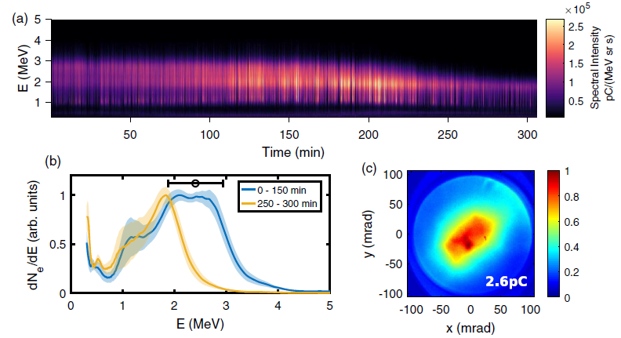
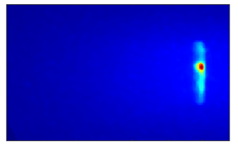
Motivations and context
APPLI team at LOA: Development of a kHz Laser-Wakefield Accelerator with kHz, few-mJ, few-fs laser pulses
Major recent kHz LWFA results:
LOA, 2020: stable continuous kHz beams @ few MeV using gradient injection and N₂ plasma
L. Rovige et al., PRAB 23, 093401 (2020)
University of Maryland, 2021: 15 MeV using H₂ plasma in burst regime
F. Salehi et al, PRX 11, 021055 (2021)
18 M shots
Energy (MeV)
2
3
5
15
-30
θ_{x} (mrad)
0
30
Today’s presentation:
Differential pumping for continuous LWFA at kHz in light gases
Impact of gas species on accelerator performance
Notes:
De quoi je vais vous parler et pourquoi

Slide 3
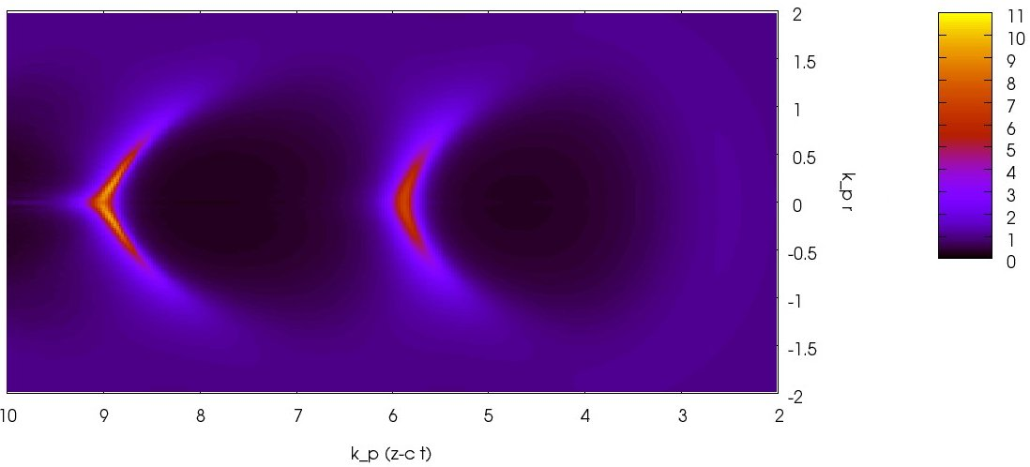

Scaling laws for a kHz laser wakefield acceleration
λ_{p}
R
Pulse
n_{e}
Laser pulse has to be resonant with plasma wave :
r
R ≈ λ_{p}/2, cτ ≈ λ_{p}/2
λ_{p} ∝ 1/√n_{e}
1 J
mJ
Laser energy scaling
= 30 fs,
n_{e} ≈ 10¹⁸ cm⁻³
= 3 fs,
n_{e} ≈ 10²⁰ cm⁻³
Electron energy gain
100 MeV - 1 GeV
1-10 MeV
Lu et al., PRSTAB 10, 0613001 (2007)
Beaurepaire et al., NJP 16, 023023 (2014)
Notes:
Accélération laser plasma au kHz, rappel rapide sur lois d’échelles -> qq mJ, qq fs, très haute densité électronique

Slide 4
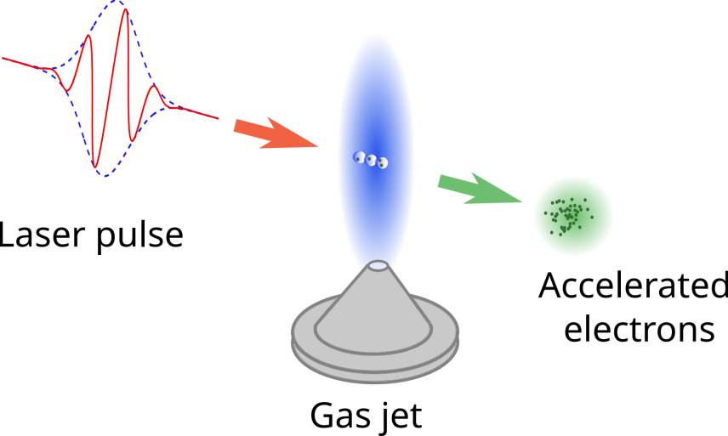
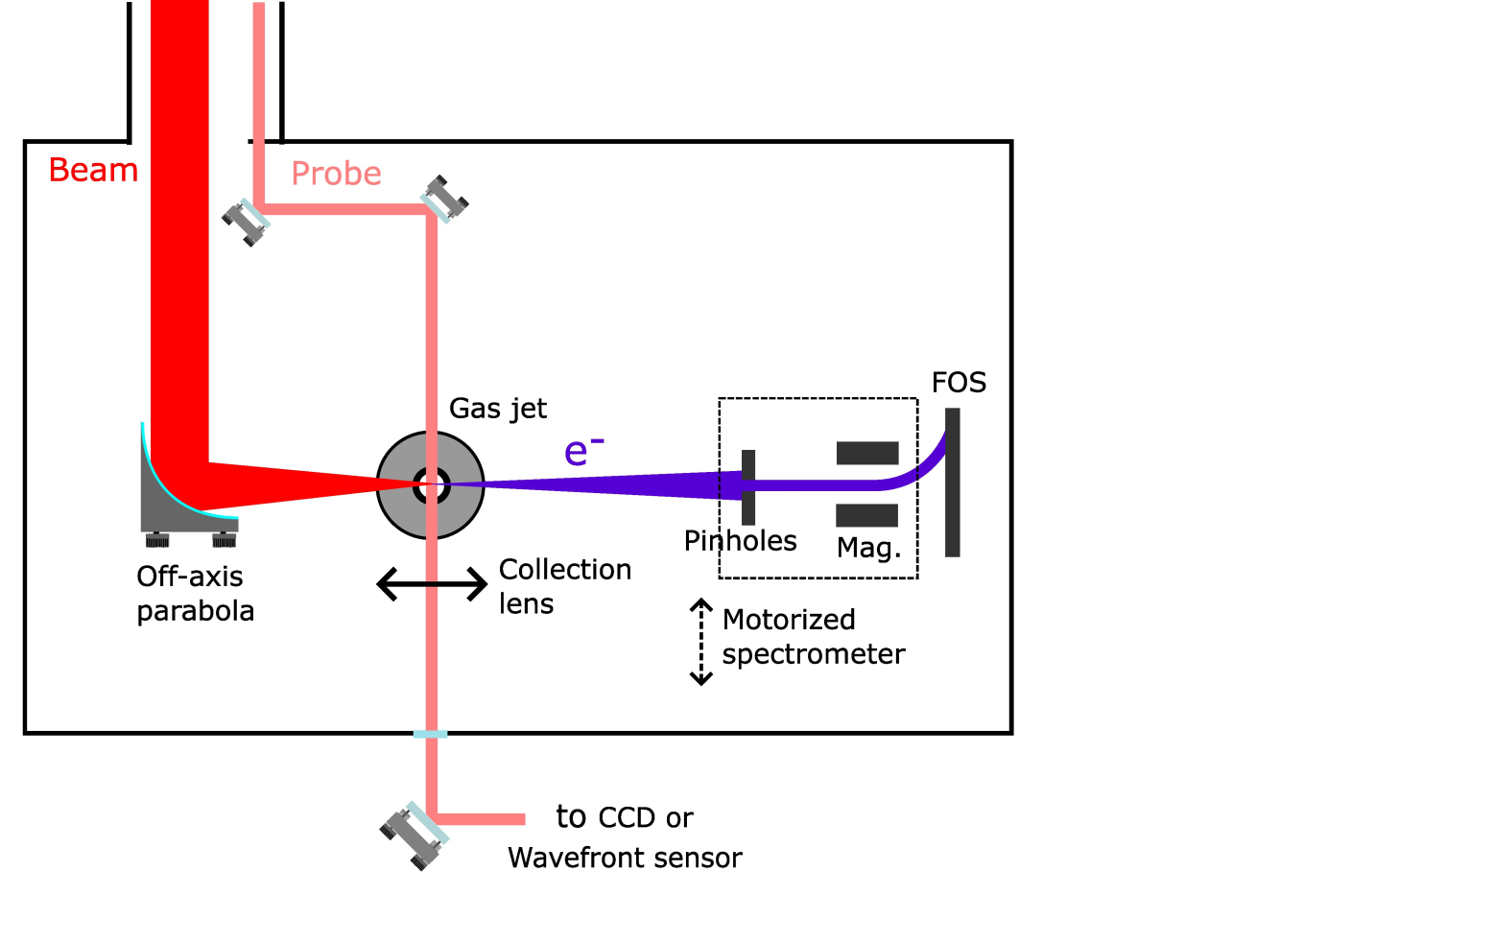
Experimental set-up
Laser :
  E = 2.5 mJ
  τ = 4.0 fs (=1.5 optical cycle at 800nm)
  Spot : 5 µm FWHM
  I = 2 ﮲10¹⁸ W.cm⁻²
  Continuously flowing gas jet
  Shocked density profile
Gas target :
Continuous kHz operation !
A lot of work already done :
Observable quantities:
Energy spectrum
Beam profile
Charge
Beaurepaire et al., NJP 16, 023023 (2014) D. Gustas et al., PRAB 21, 013401 (2018)
D. Guénot et al., Nat. Phot. 11, 293 (2017) L. Rovige et al., PRAB 23, 093401 (2020)
J. Faure et al., PPCF (2018) J. Huijts et al. Physical Review X (2022)
Notes:
Présentation set up + jets de gaz free flowing nécessaires pour les densités et kHz

Slide 5
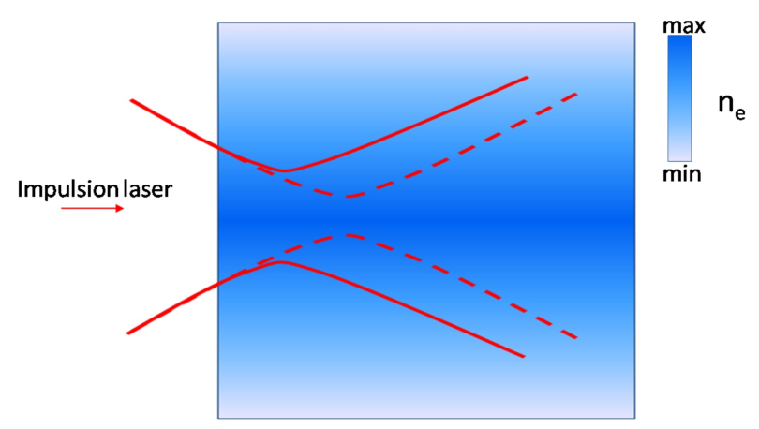
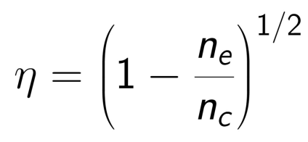
Differential pumping for using lighter gases
 | 1+ | 2+ | 3+ | 4+ | 5+ | 6+ | 7+
N (eV) | 14.5 | 29.6 | 47.4 | 77.5 | 97.9 | 552.1 | 667.0
He (eV) | 24.6 | 54.4
H (eV) | 13.6
N₂ provides 10 electrons : operation at 20 - 30 bars backing pressure
But : non-uniform ionization induces
defocusing of the laser pulse
He or H₂ only provides 2 electrons : requires 100 - 150 bars in the free-flowing gas jet
Notes:
Dans l’azote -> pas de pb, mais on veut tester d’autres gaz pour voir l’impact du gaz
Bcp + difficile de pomper les gaz légers -> besoin pompage diff

Slide 6
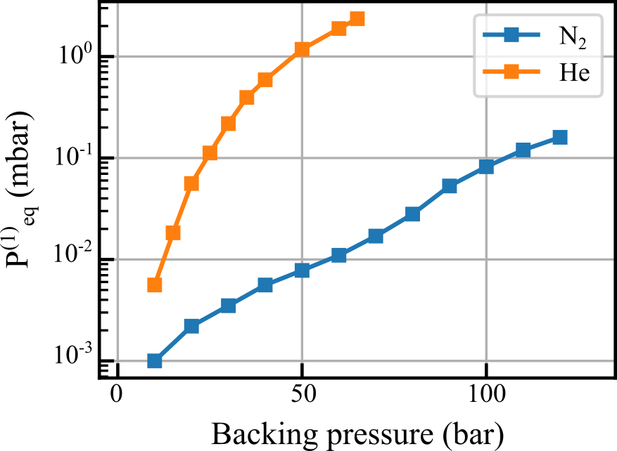
Differential pumping for using lighter gases
Free-flowing gas jet
Nozzle aperture: 180 µm
NO differential pumping
Classical pumping system fails to keep the experimental chamber under vacuum
Need for differential pumping
Monzac et al, Rev. Sci. Instrum. 96, 043302 (2025)
Notes:
Dans l’azote -> pas de pb, mais on veut tester d’autres gaz pour voir l’impact du gaz
Bcp + difficile de pomper les gaz légers -> besoin pompage diff

Slide 7
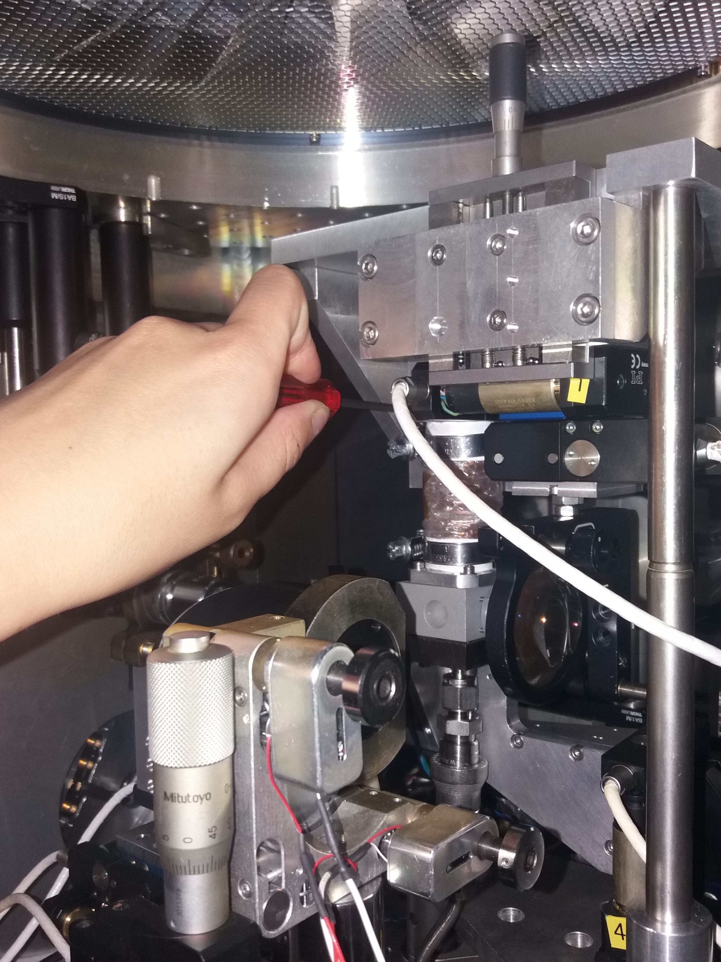
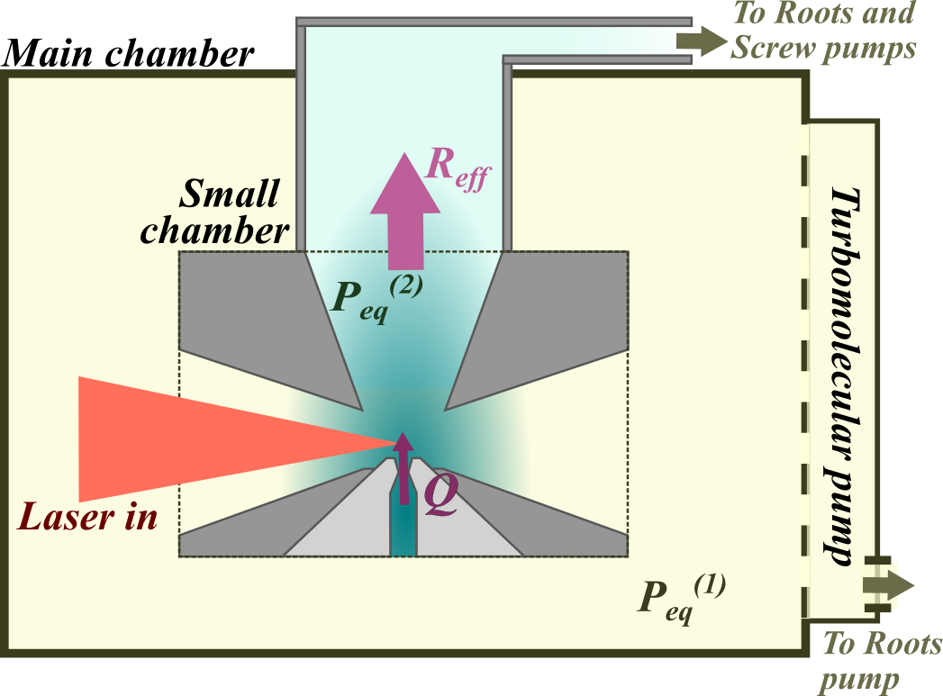
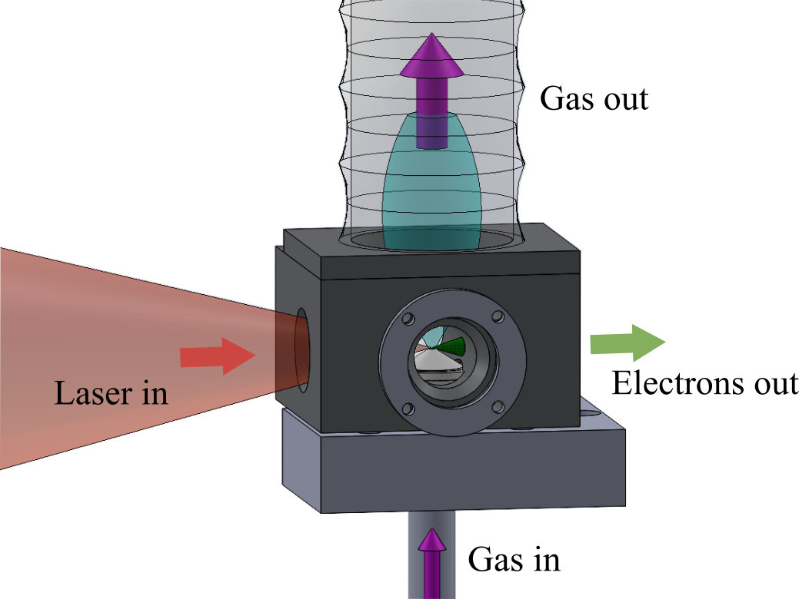
Differential pumping for using lighter gases
Miniature interaction chamber :
P_{He/H2} = 100-150 bar
Monzac et al, Rev. Sci. Instrum. 96, 043302 (2025)
Notes:
Ça ressemble à ça

Slide 8
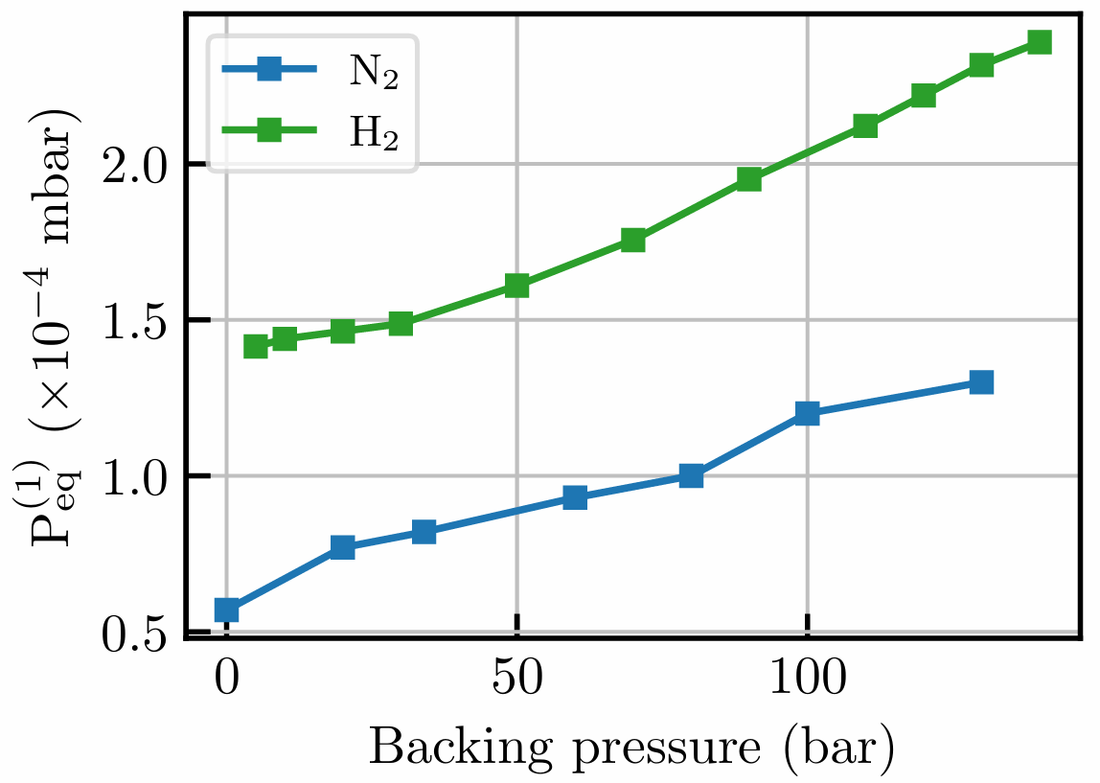
Gas loading in the experimental chamber
Without differential pumping:
With differential pumping:
The equilibrium pressure in the experimental chamber remains below 3 × 10⁻⁴ mbar with a backing pressure of 140 bar of H₂ in the gas jet.
Monzac et al, Rev. Sci. Instrum. 96, 043302 (2025)
Notes:
Marche bien pour contenir la pression dans l’enceinte

Slide 9
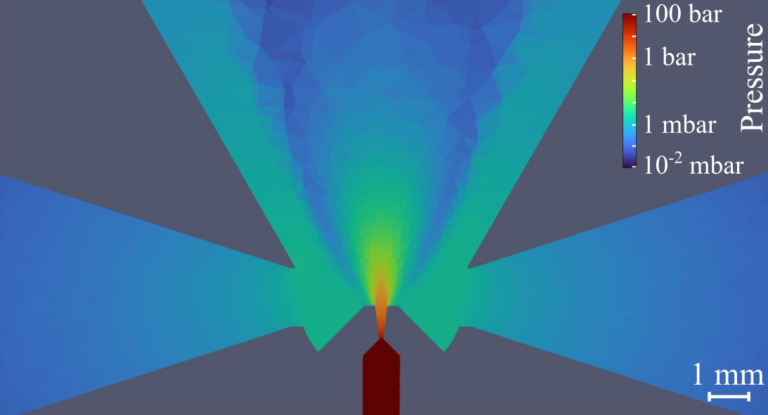
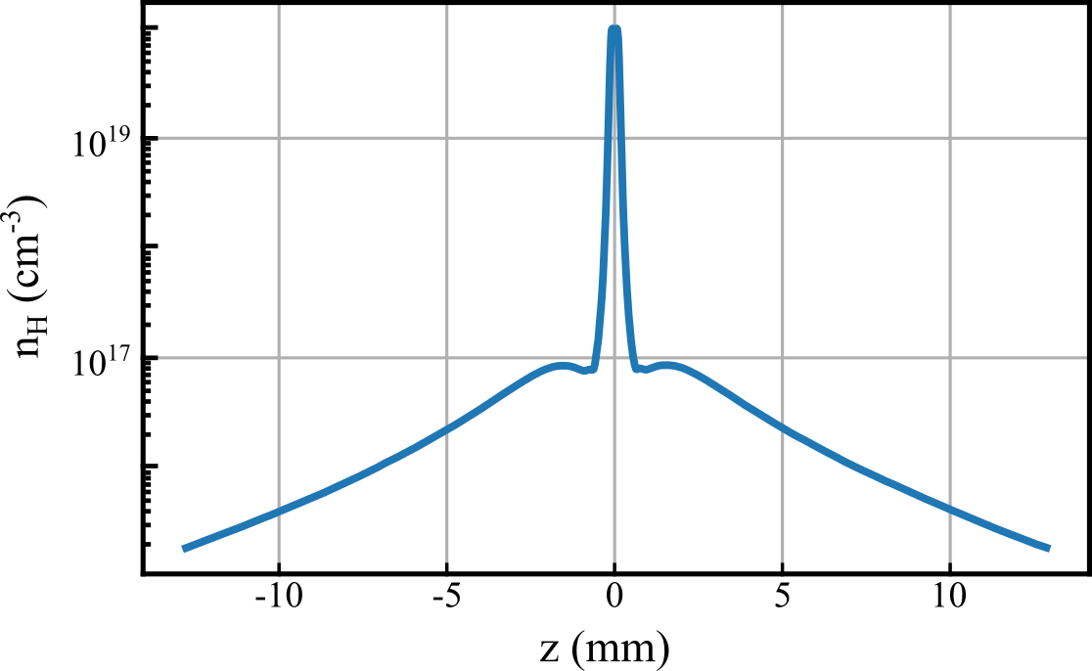
Impact of the stagnating gas on the laser propagation
Fluid simulations done using ANSYS Fluent with H₂ gas, P_{back} = 100 bar, nozzle opening diameter : 180 µm
The gas remains well-confined within the differential chamber, but there is still some stagnation observed ~3 mm before the gas jet
Monzac et al, Rev. Sci. Instrum. 96, 043302 (2025)
Notes:
La question maintenant c’est -> est-ce qu’il y a une accumulation de gaz dans la petite enceinte ? Et si oui est-ce que ça impact le laser ?
-> simu fluent pour la stagnation du gaz : on a un peu de stagnation au centre de l’enceinte mais ç adescend bien quand même

Slide 10
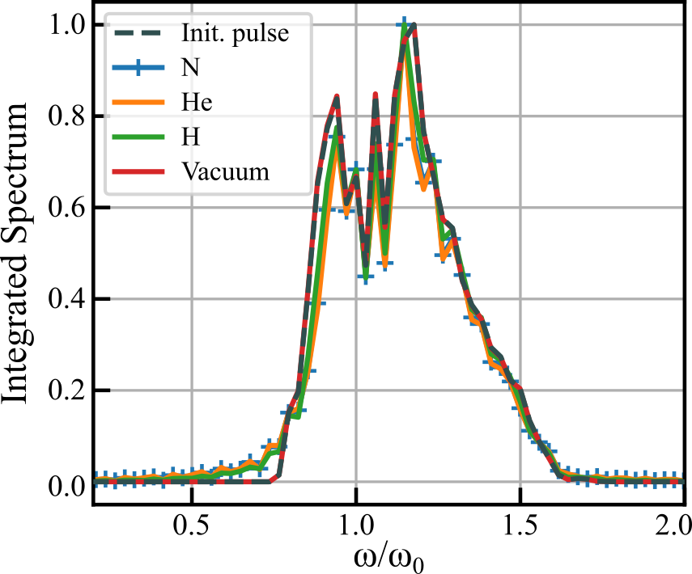
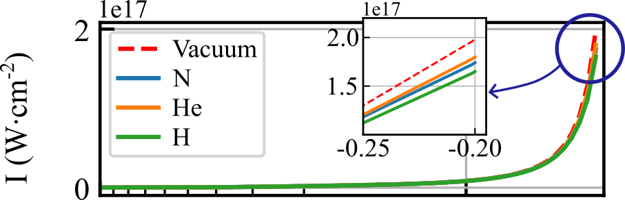
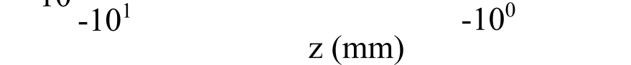
Propagation of the laser in the gas
Simulations done using the library “Axiprop”: τ = 4.2fs, E_{L} = 2.7mJ, Focal spot size: 4.5µm (FWHM)
The stagnating gas has a limited impact on laser propagation :
  Minor reduction in intensity
  Minor blueshift in the spectrum
These changes do not prevent a priori electron acceleration
Monzac et al, Rev. Sci. Instrum. 96, 043302 (2025)
Notes:
Simulation de la propagation du laser dans ces différents gaz
-> l’intensité décroit peut par rapport au cas du vide, et le spectre et vraiment pas changé de ouf.
Maintentant qu’on sait que pompage diff permet de maintenir une bonne pression dans l’enceinte et le laser est ok pour LWFA au niveau du pic de densité, on peut tenter une manip avec != gaz.

Slide 11
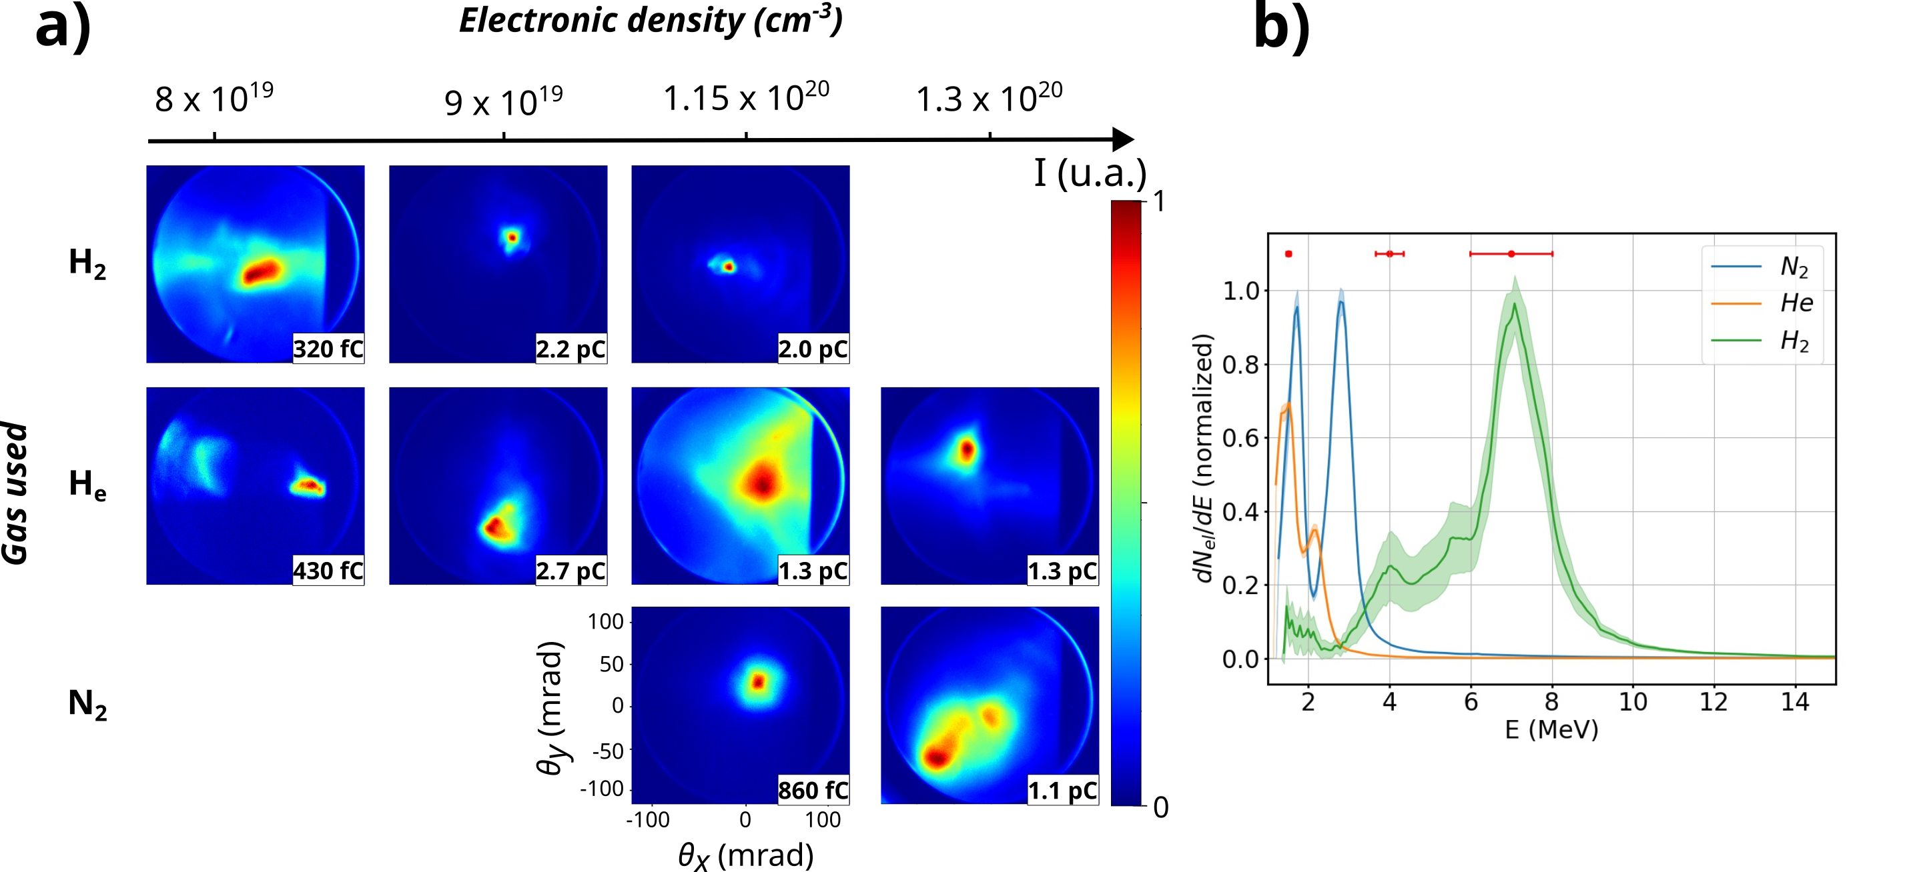
Dramatic improvement of beam quality in H₂ plasma
E_{laser} = 2.7 mJ
τ = 4 fs
Shock injection
Hydrogen stands out : Higher energy : from 2.5 MeV in N₂ to 7 MeV in H₂
Higher charge : > 2 pC / shot
Smaller beam profile : 15 mrad in H₂ vs 49 mrad in N₂
Monzac et al, Phys. Rev. Research 6, 043099 (2024)
For H₂ results, see also F. Salehi et al, PRX 11, 021055 (2021)

Slide 12
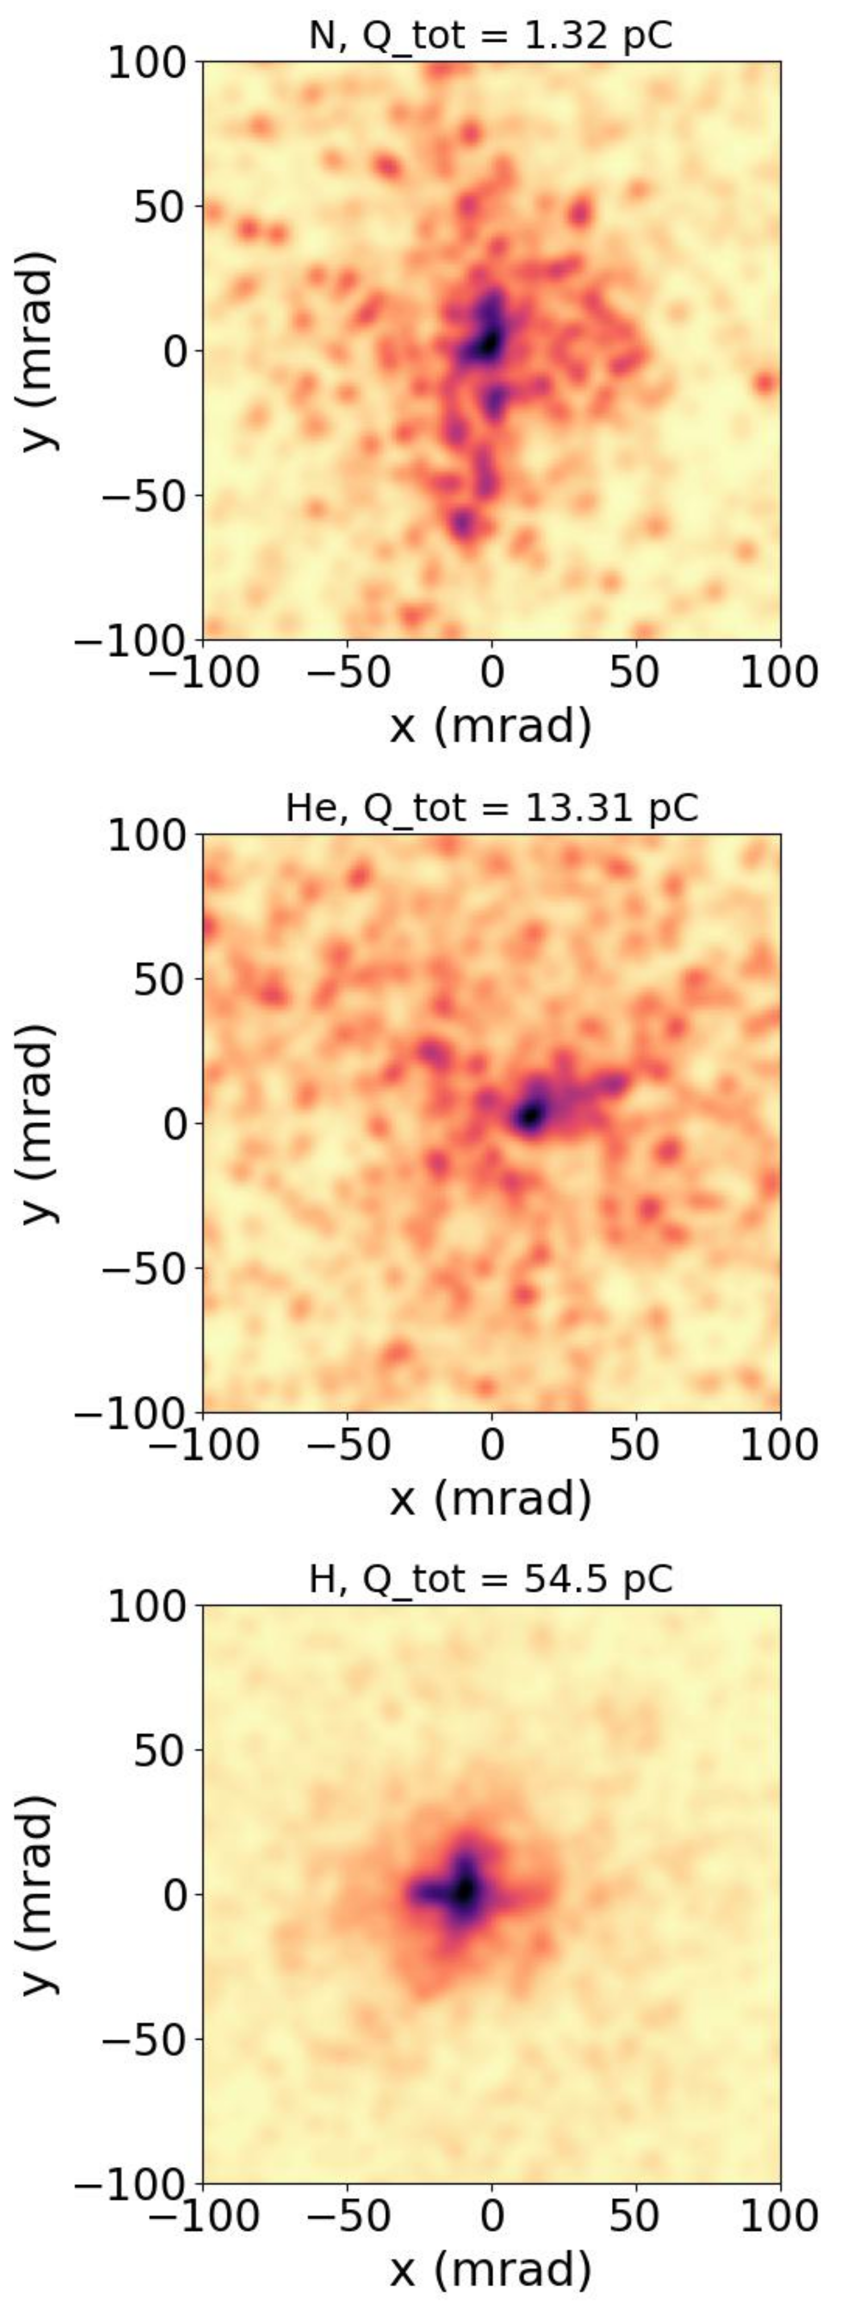
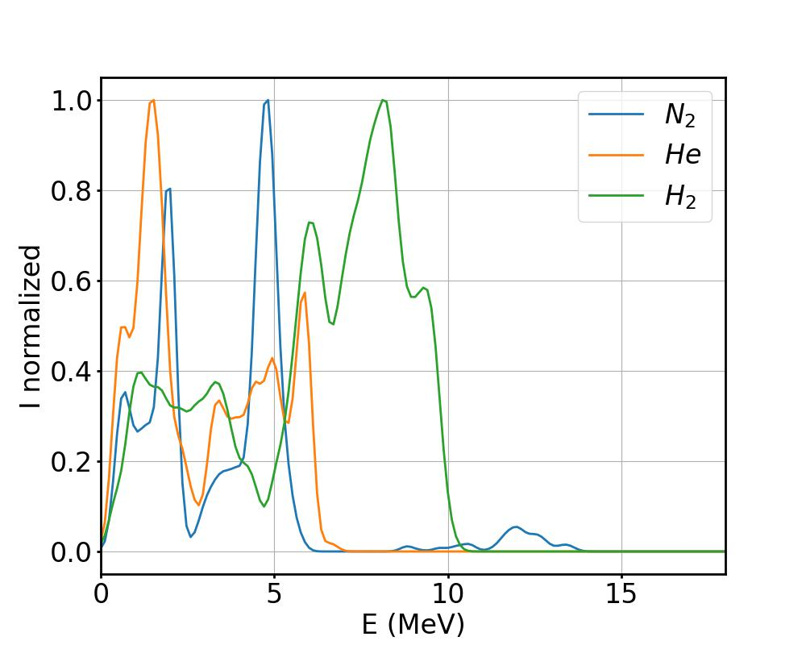
FBPIC simulations in the three gases
H₂, Q = 10.1 pC
Parameters for the simulation :
  E_{L} = 2.5 mJ
  τ = 4 fs
  R_{fwhm} = 4.5 µm
He, Q = 2.7 pC
  max(n_{e}) = 1 x 10²⁰ cm⁻³
  Density profile from a
  shocked jet
N₂, Q = 540 fC
The simulations reproduce the experimental trends :
Hydrogen stands out with higher charge, higher energy, better shaped beam
Monzac et al, Phys. Rev. Research 6, 043099 (2024)

Slide 13
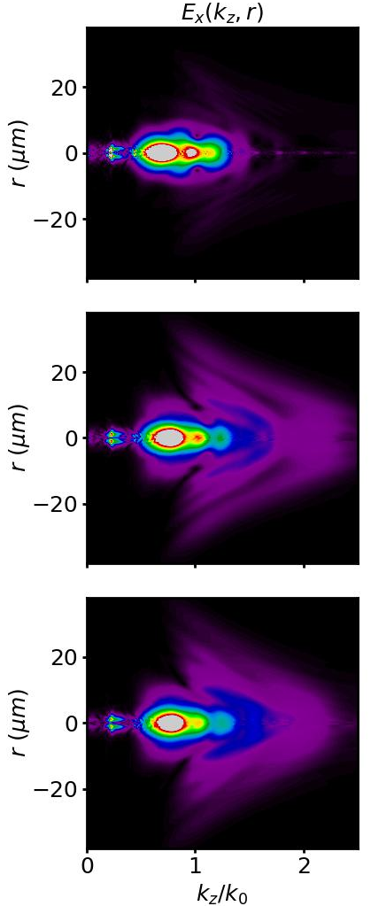
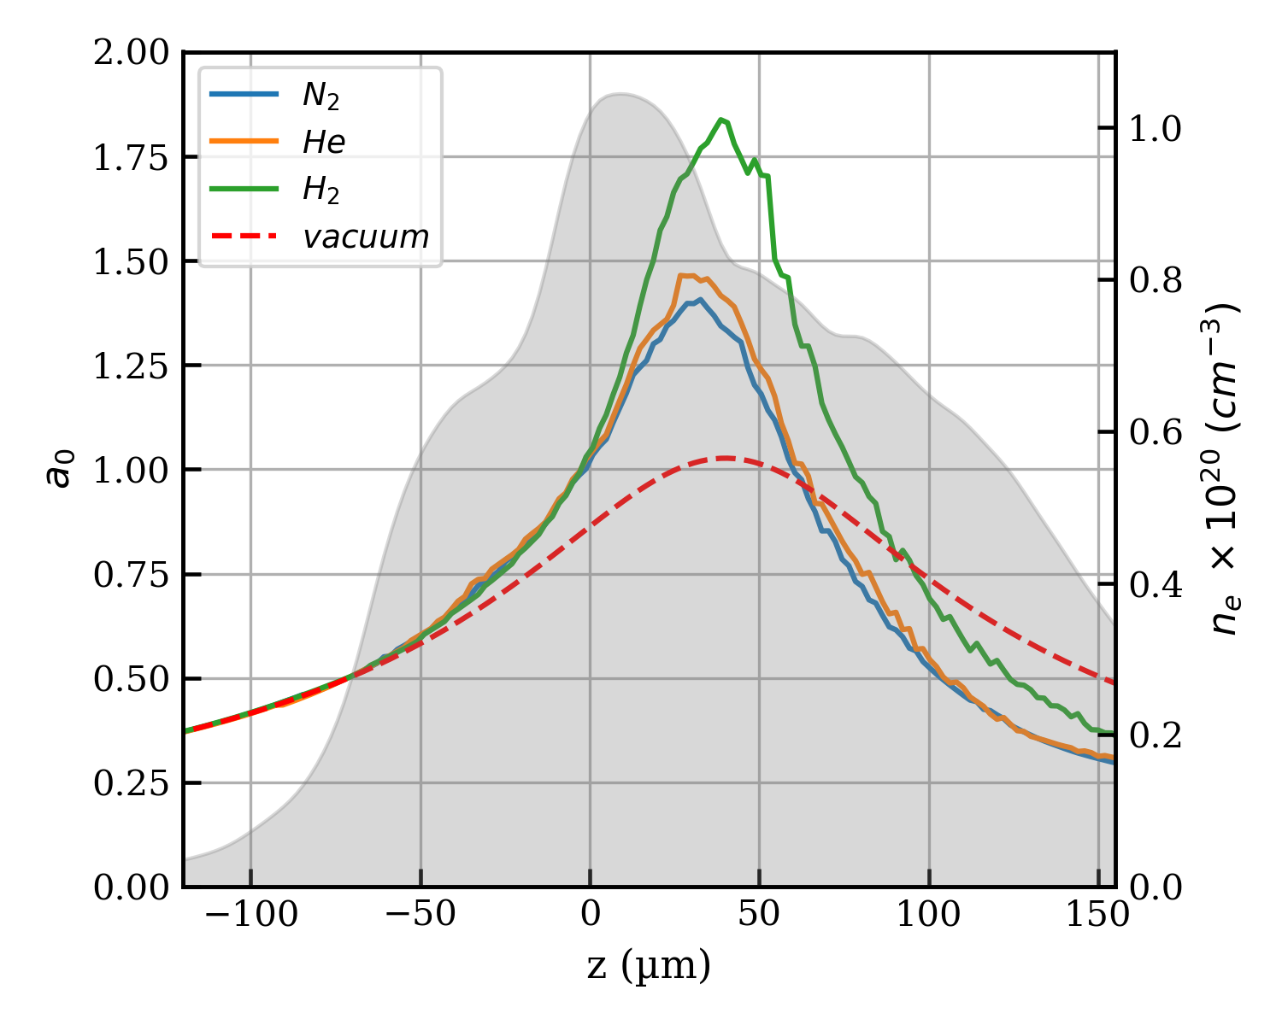
Ionization-induced defocusing and spatio-spectral distortion
H₂
Transverse spread of the laser pulse due to defocusing
He
N₂
Blue shift of the laser pulse due to ionization
Monzac et al, Phys. Rev. Research 6, 043099 (2024)

Slide 14
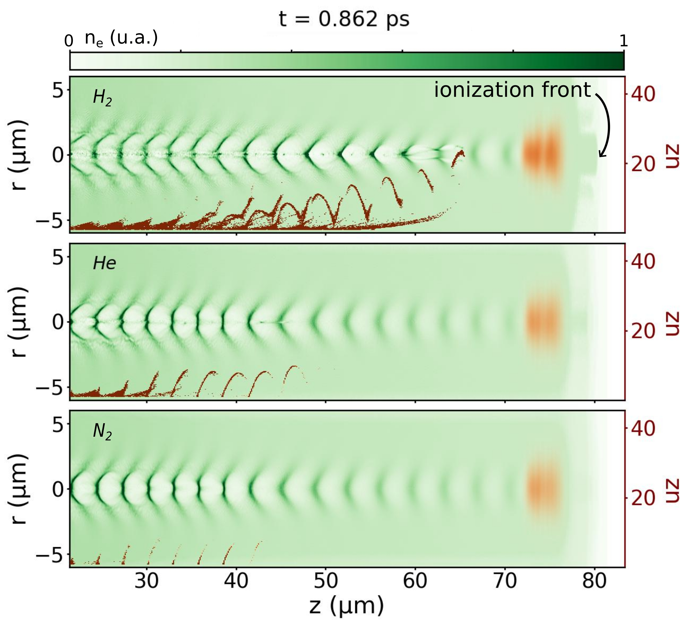
Degradation of the laser and injection in the different gases
The laser pulse is less damaged in H₂.
He and N₂ comparably damage the pulse.
Injection occurs closer to the laser pulse in the H₂ plasma
The accelerating field are stronger
The final accelerated beam gain more energy
Monzac et al, Phys. Rev. Research 6, 043099 (2024)

Slide 15
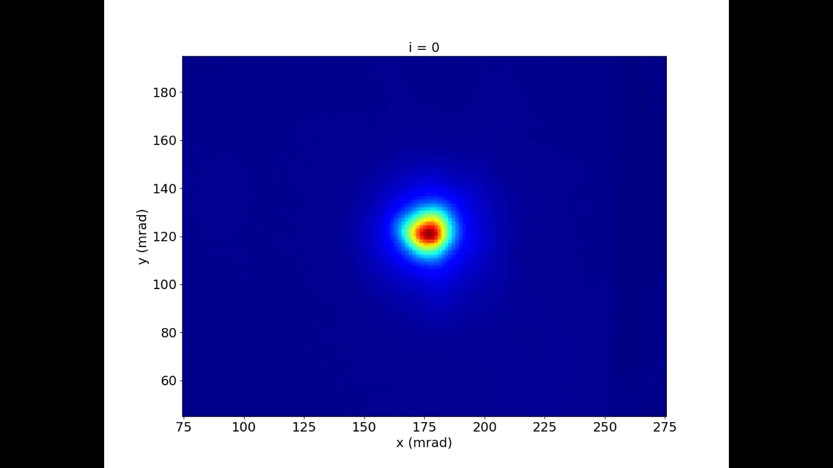
Tests using H₂ plasma doped with N₂
Beam profile of the electrons (single shots)
Shot to shot statistics of the electron beam
 | Mean | rms
Energy | 2.9 MeV | 5 %
Energy spread | 1.8 MeV | 3 %
charge | 2 pC | 3%
divergence | 17 mrad | 4 %
Beam pointing |  | 1.5 mrad
Monzac et al, Rev. Sci. Instrum. 96, 043302 (2025)

Slide 16
Conclusions
  Differential pumping helps maintaining good vacuum despite extreme gas jet conditions (140 bar H₂).
  Continuous kHz LWFA achieved in light gases.
  Significant improvement of the beam quality and energy in the specific frame of kHz LWFA using H₂.
  Very stable and high-quality beams achieved with H₂N₂.

Slide 17





Collaborators
kHz laser-plasma source
S. Smartsev, L. Rovige, J. Huijts
A. Vernier, J. Faure
I. Andriyash (PIC simulations)
Laser system:
J. Kaur, A. Cavana, A. Kalouguine, M. Ouillé, Z. Cheng
R. Lopez-Martens
Gas jet fabrication:
V. Tomkus, V. Girdauskas, G. Raciukaitis, J. Dudutis , V. Stankevic , P. Gecys
FemtoElec
HighRep

Slide 18
Thanks for your attention !

Slide 19
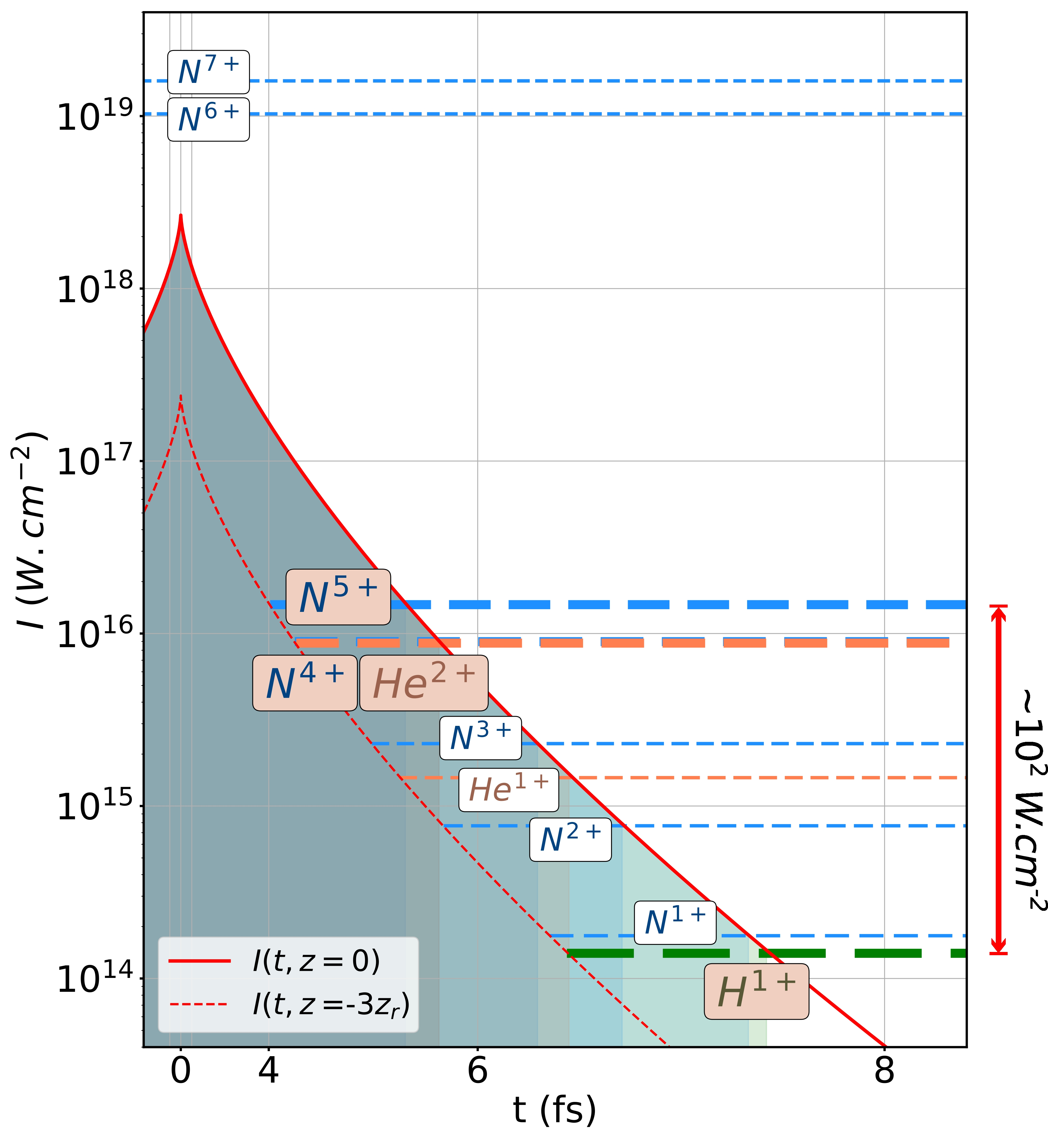

Slide 20
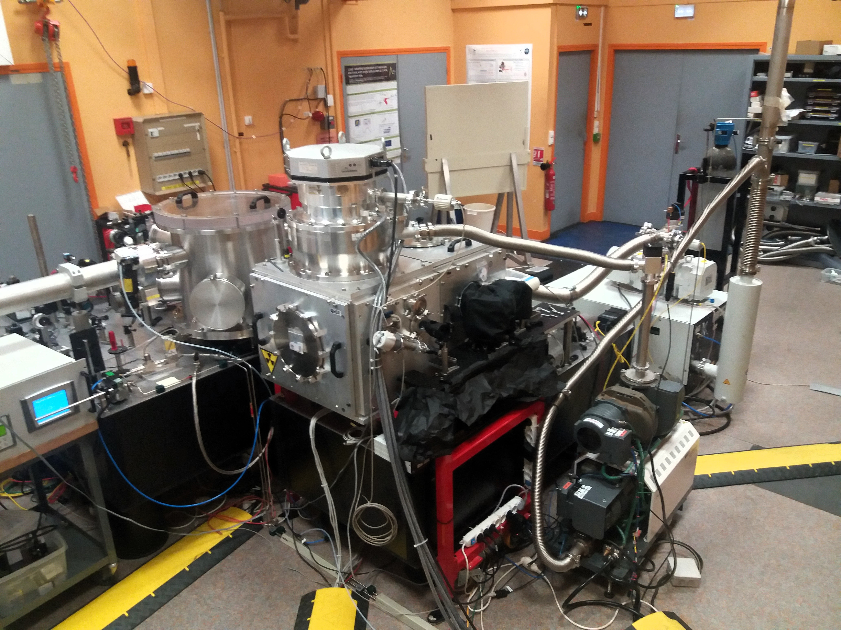
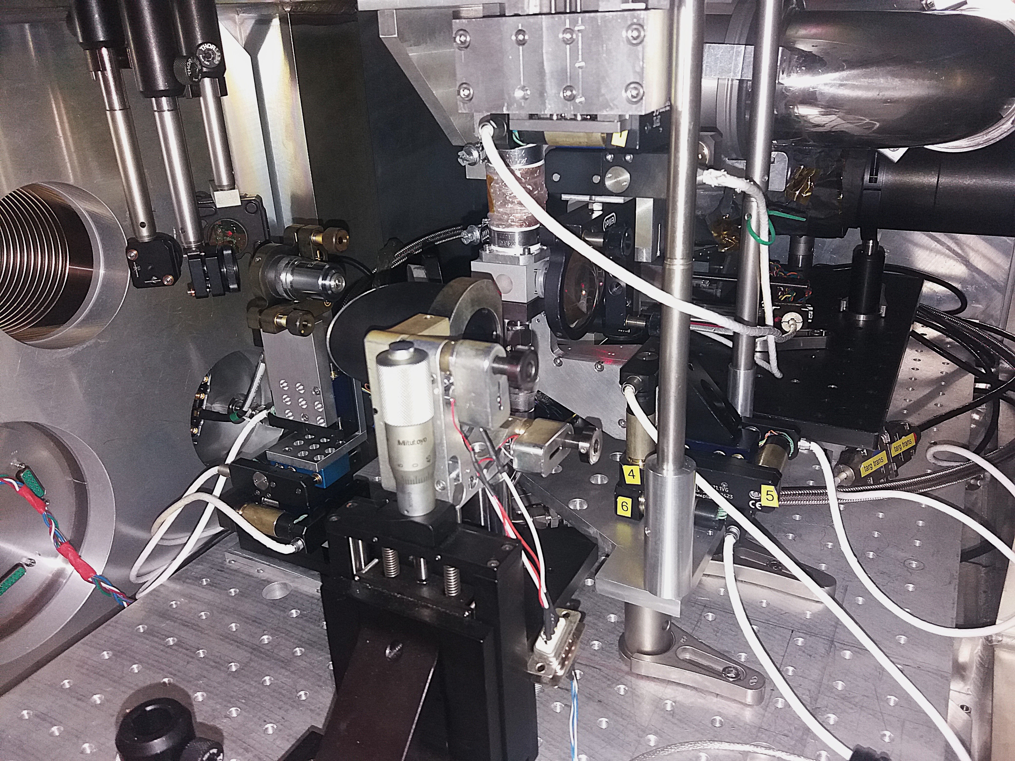
Experimental set-up: laser and accelerator

