Slide 1
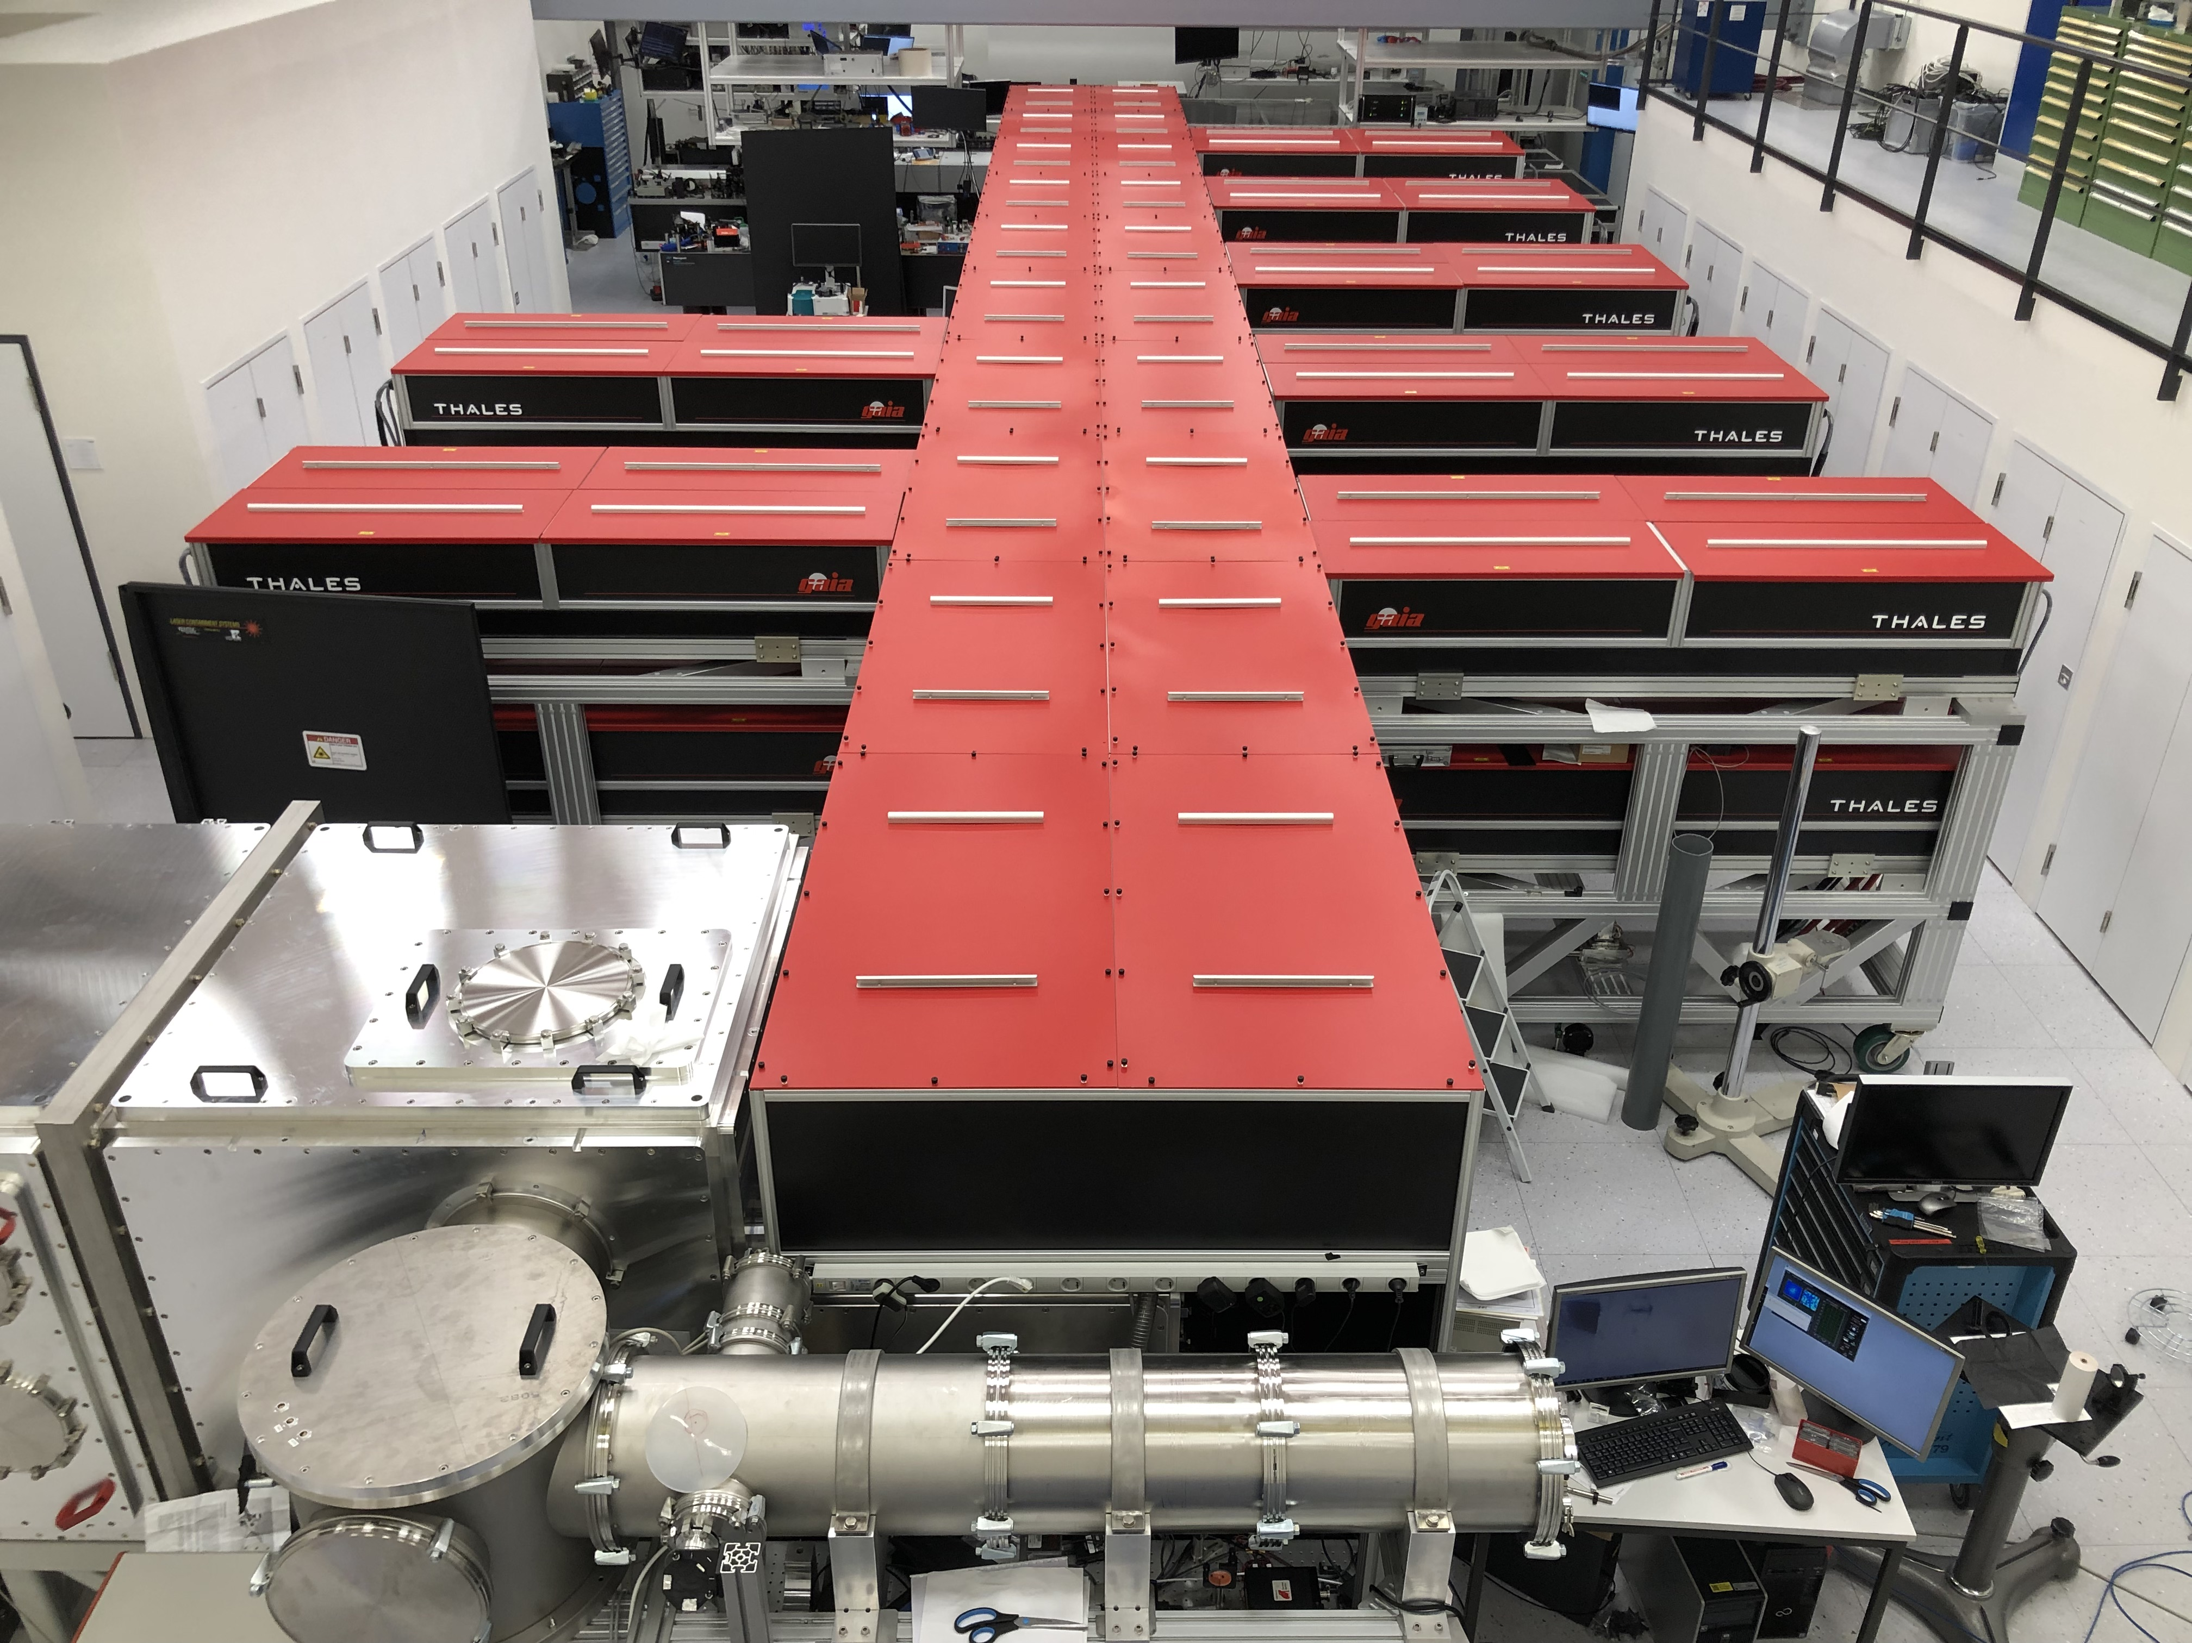

Laser Wavefront-based Classification of successful Injection in LWFA
Johannes Zirkelbach
LMU/CALA (Karsch group)

Slide 2
ATLAS-3000 (Garching/LMU/Centre for Advanced Laser Applications)
~100 m
Wavelength: 800 nm (Ti:Sa)
Pulse duration: 27 fs
Pulse energy: ~70 J (curr.: ~20 J)
Repetition rate: 1 Hz
Applications:
Electron acceleration
X-ray generation
Ion acceleration
Fundamental research
Remember:
- Don’t use “Gaias”, instead “Pump Lasers”

Slide 3
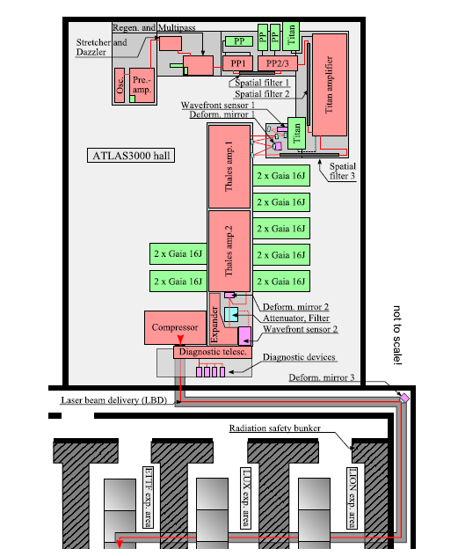
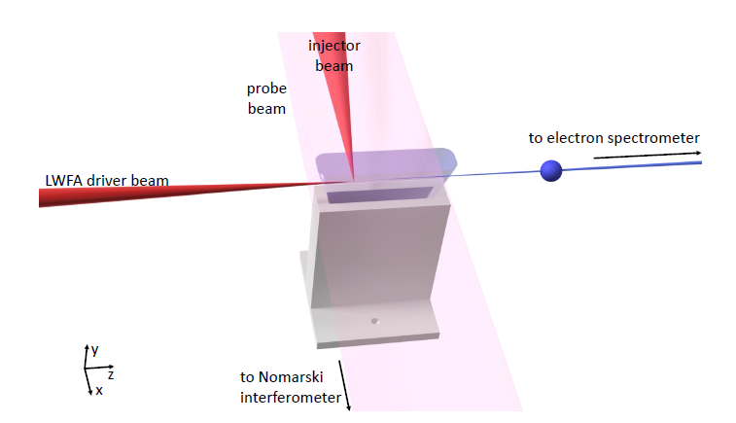
ATLAS-3000 (Garching/LMU/CALA)
Frontend (-> 2 J)
Data discussed today:
LWFA with slit nozzle and optical injection
Hydrogen
Main Amplifier
(-> 20-30 J)
From: PhD thesis of M. Förster
~8 J on target
26 fs pulse duration
f/56
20 mm
Laser parameters:
18 cm beam (bypassing AMP2)
Beamline & Labs
From: PhD thesis of K. von Grafenstein

Slide 4
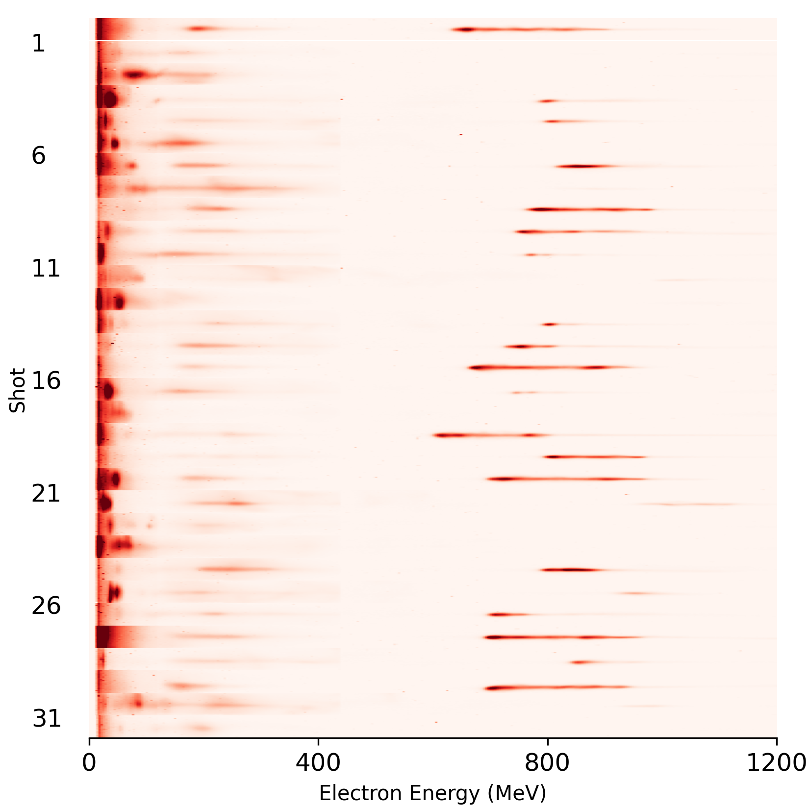
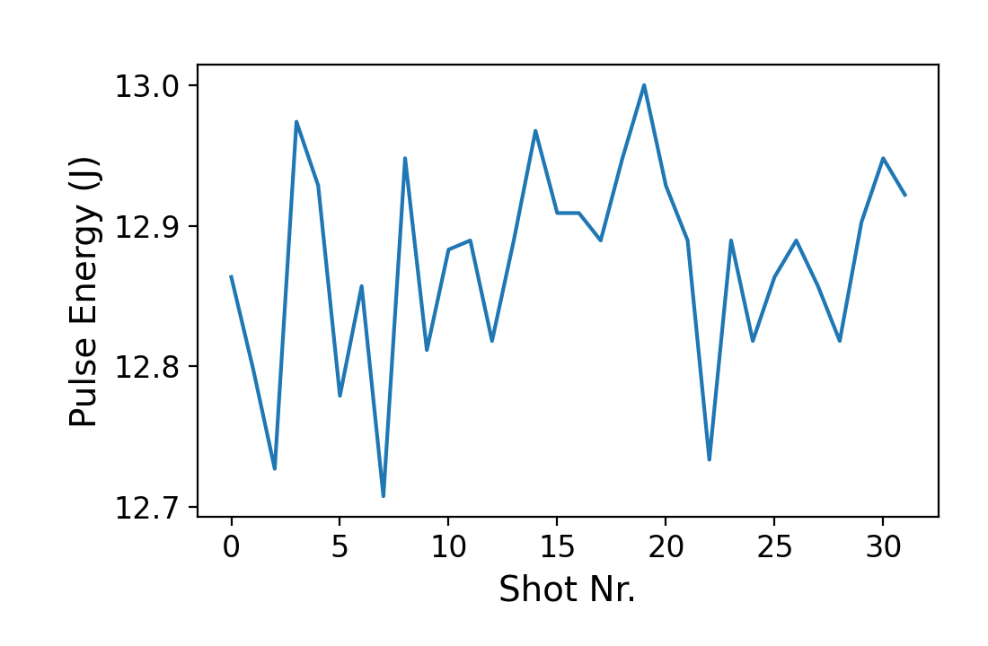
Electrons from LWFA driven by ATLAS-3000
Shots without injection into the first bubble
Shot-to-shot fluctuations
Drift
Why?
Laser output appears more stable than LWFA electrons:
Shot
Electron Energy (MeV)

Slide 5
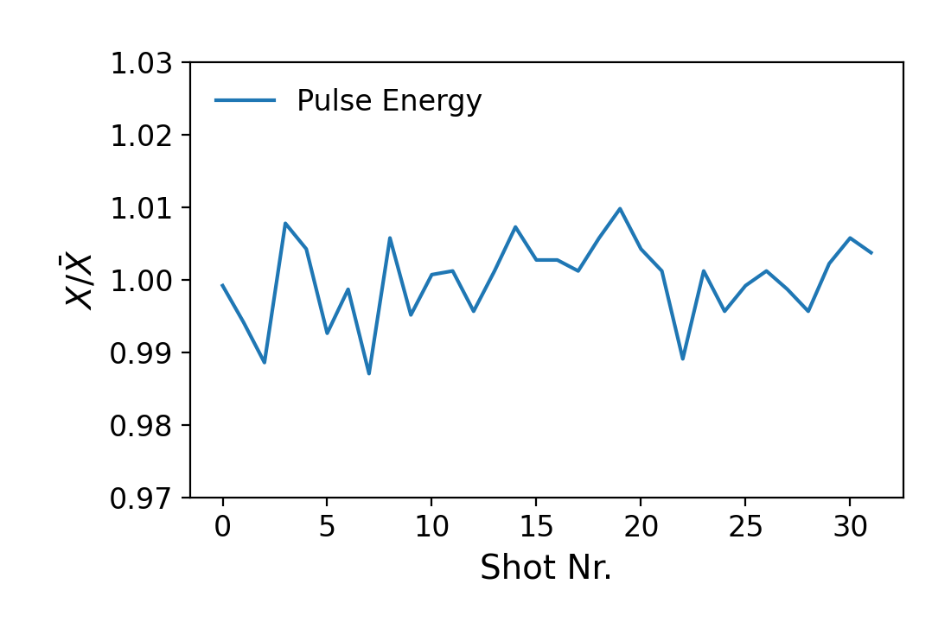
Laser Parameters are more stable than Electron Energy
Shots without injection into the first bubble
Shot-to-shot fluctuations
Drift
Why?
Laser output appears more stable than LWFA electrons:
Shot
Electron Energy (MeV)

Slide 6
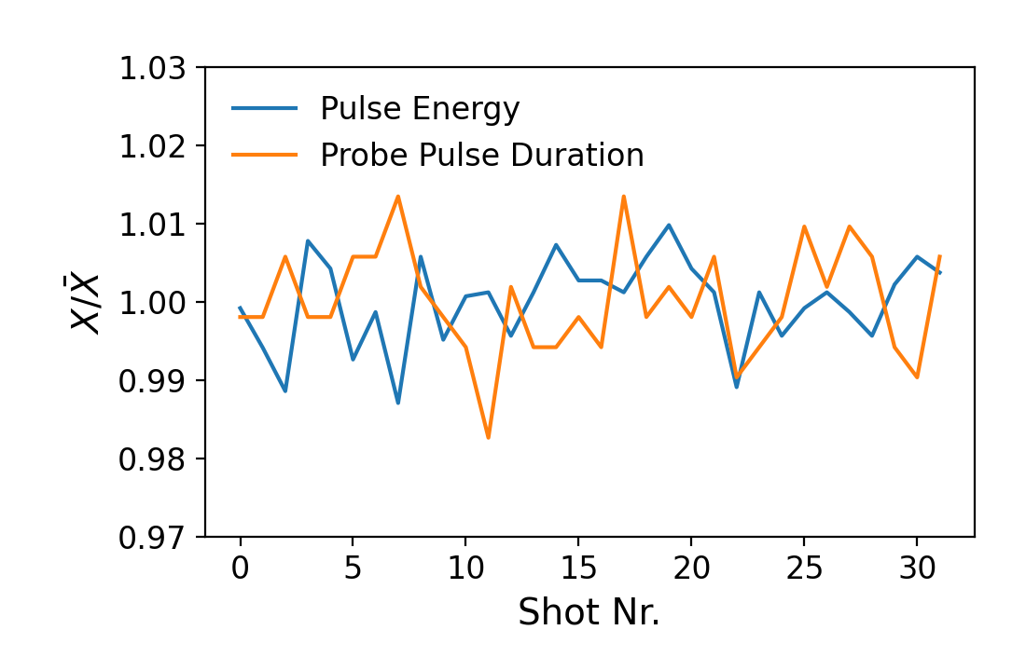
Laser Parameters are more stable than Electron Energy
Shots without injection into the first bubble
Shot-to-shot fluctuations
Drift
Why?
Laser output appears more stable than LWFA electrons:
Shot
Electron Energy (MeV)

Slide 7
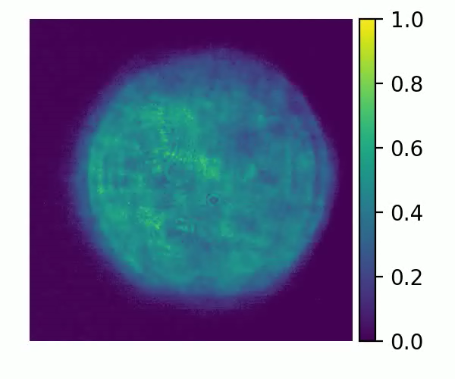
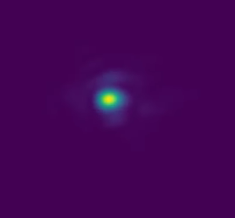
Laser Parameters are more stable than Electron Energy
Shots without injection into the first bubble
Shot-to-shot fluctuations
Drift
Why?
Laser output appears more stable than LWFA electrons:
Shot
6 cm
Norm. Intensity
Indicate scale
Electron Energy (MeV)

Slide 8
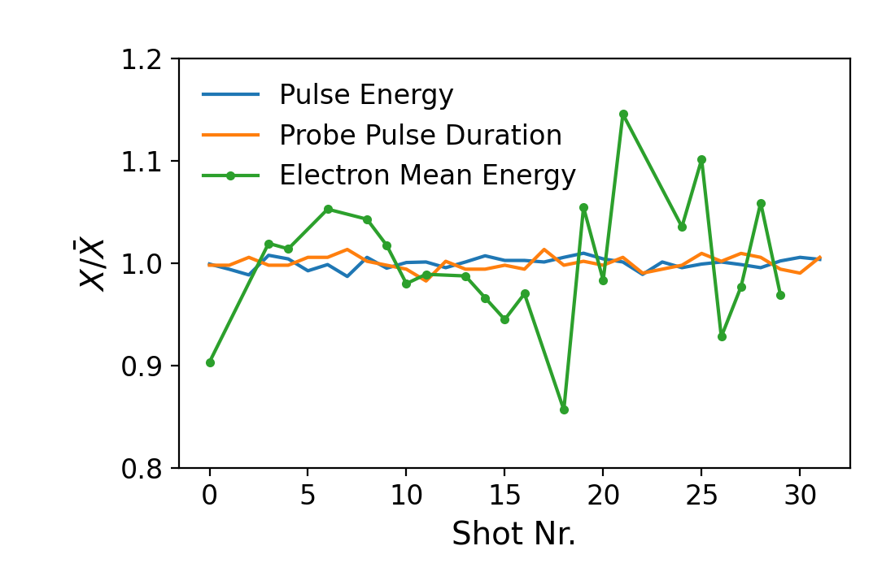
Laser Parameters are more stable than Electron Energy
Shots without injection into the first bubble
Shot-to-shot fluctuations
Drift
Why?
Laser output appears more stable than LWFA electrons:
~6%
Shot
Change to
Pulse Duration (Probe)
~0.5%
Electron Energy (MeV)

Slide 9
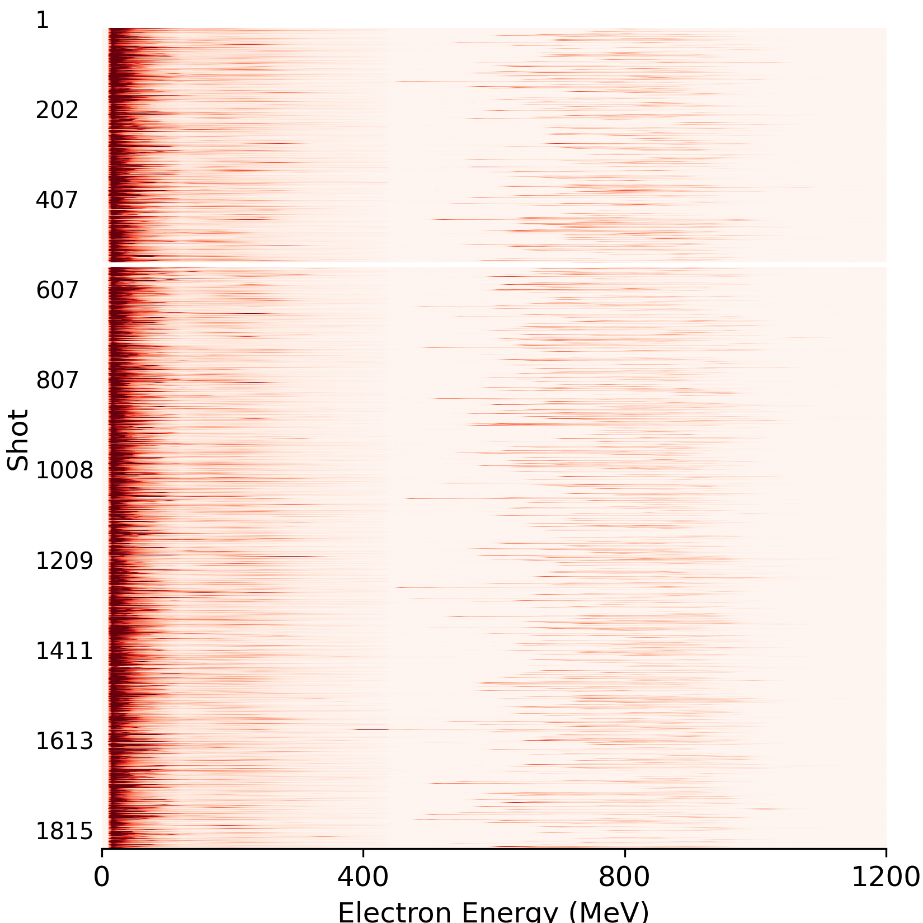
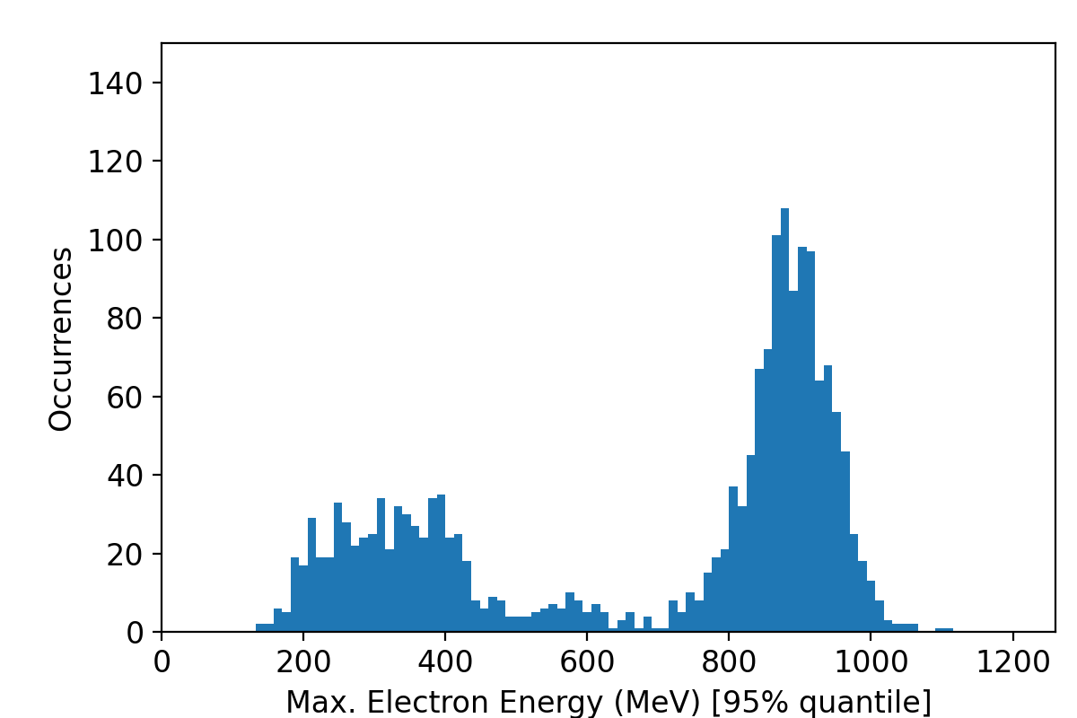
~2000 Shot Data Set for Statistical Analysis
~2000 shot series at 0.25 Hz repetition rate
Recorded without actively changing any parameters
‘Successful’ injection only in 2/3 of the cases:
No/little injection into the first bubble
Injection into the first bubble
Shot
Why does this vary?
37%
63%
Electron Energy (MeV)

Slide 10
Diagnostics at ATLAS-3000 and in LWFA Lab
Record in sync with the electron spectra:
Laser pulse energy
Laser pulse spectrum
Laser beam nearfield

Slide 11
Diagnostics at ATLAS-3000 and in LWFA Lab
Record in sync with the electron spectra:
Laser pulse energy
Laser pulse spectrum
Laser beam nearfield
Laser beam pointing

Slide 12
Diagnostics at ATLAS-3000 and in LWFA Lab
Record in sync with the electron spectra:
Laser pulse energy
Laser pulse spectrum
Laser beam nearfield
Laser beam pointing
Laser output wavefront

Slide 13
Diagnostics at ATLAS-3000 and in LWFA Lab
Record in sync with the electron spectra:
Laser pulse energy
Laser pulse spectrum
Laser beam nearfield
Laser beam pointing
Laser output wavefront
Laser pulse spectrum (probe)
Laser pulse duration (probe)
Laser beam pointing (probe)
Laser probe pulse energy

Slide 14
Diagnostics at ATLAS-3000 and in LWFA Lab
Record in sync with the electron spectra:
Laser pulse energy
Laser pulse spectrum
Laser beam nearfield
Laser beam pointing
Laser output wavefront
Laser pulse spectrum (probe)
Laser pulse duration (probe)
Laser beam pointing (probe)
Laser probe pulse energy
Plasma density (interferometer)
Shock position
Gas pressure

Slide 15
Diagnostics at ATLAS-3000 and in LWFA Lab
Record in sync with the electron spectra:
Laser pulse energy
Laser pulse spectrum
Laser beam nearfield
Laser beam pointing
Laser output wavefront
Laser pulse spectrum (probe)
Laser pulse duration (probe)
Laser beam pointing (probe)
Laser probe pulse energy
Plasma density (interferometer)
Shock position
Gas pressure
Electron beam pointing
Electron energy spectrum
Accelerated charge
Correlation matrix

Slide 16
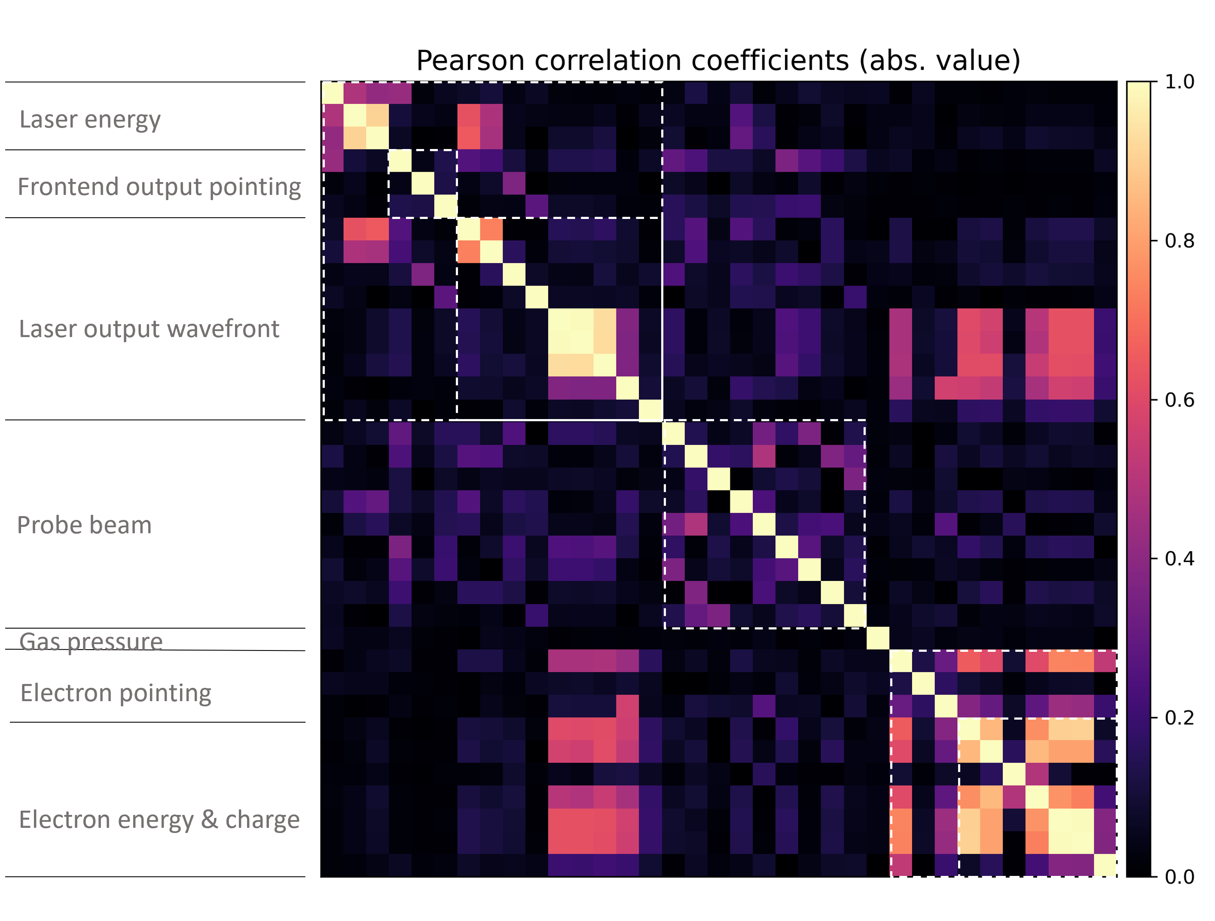
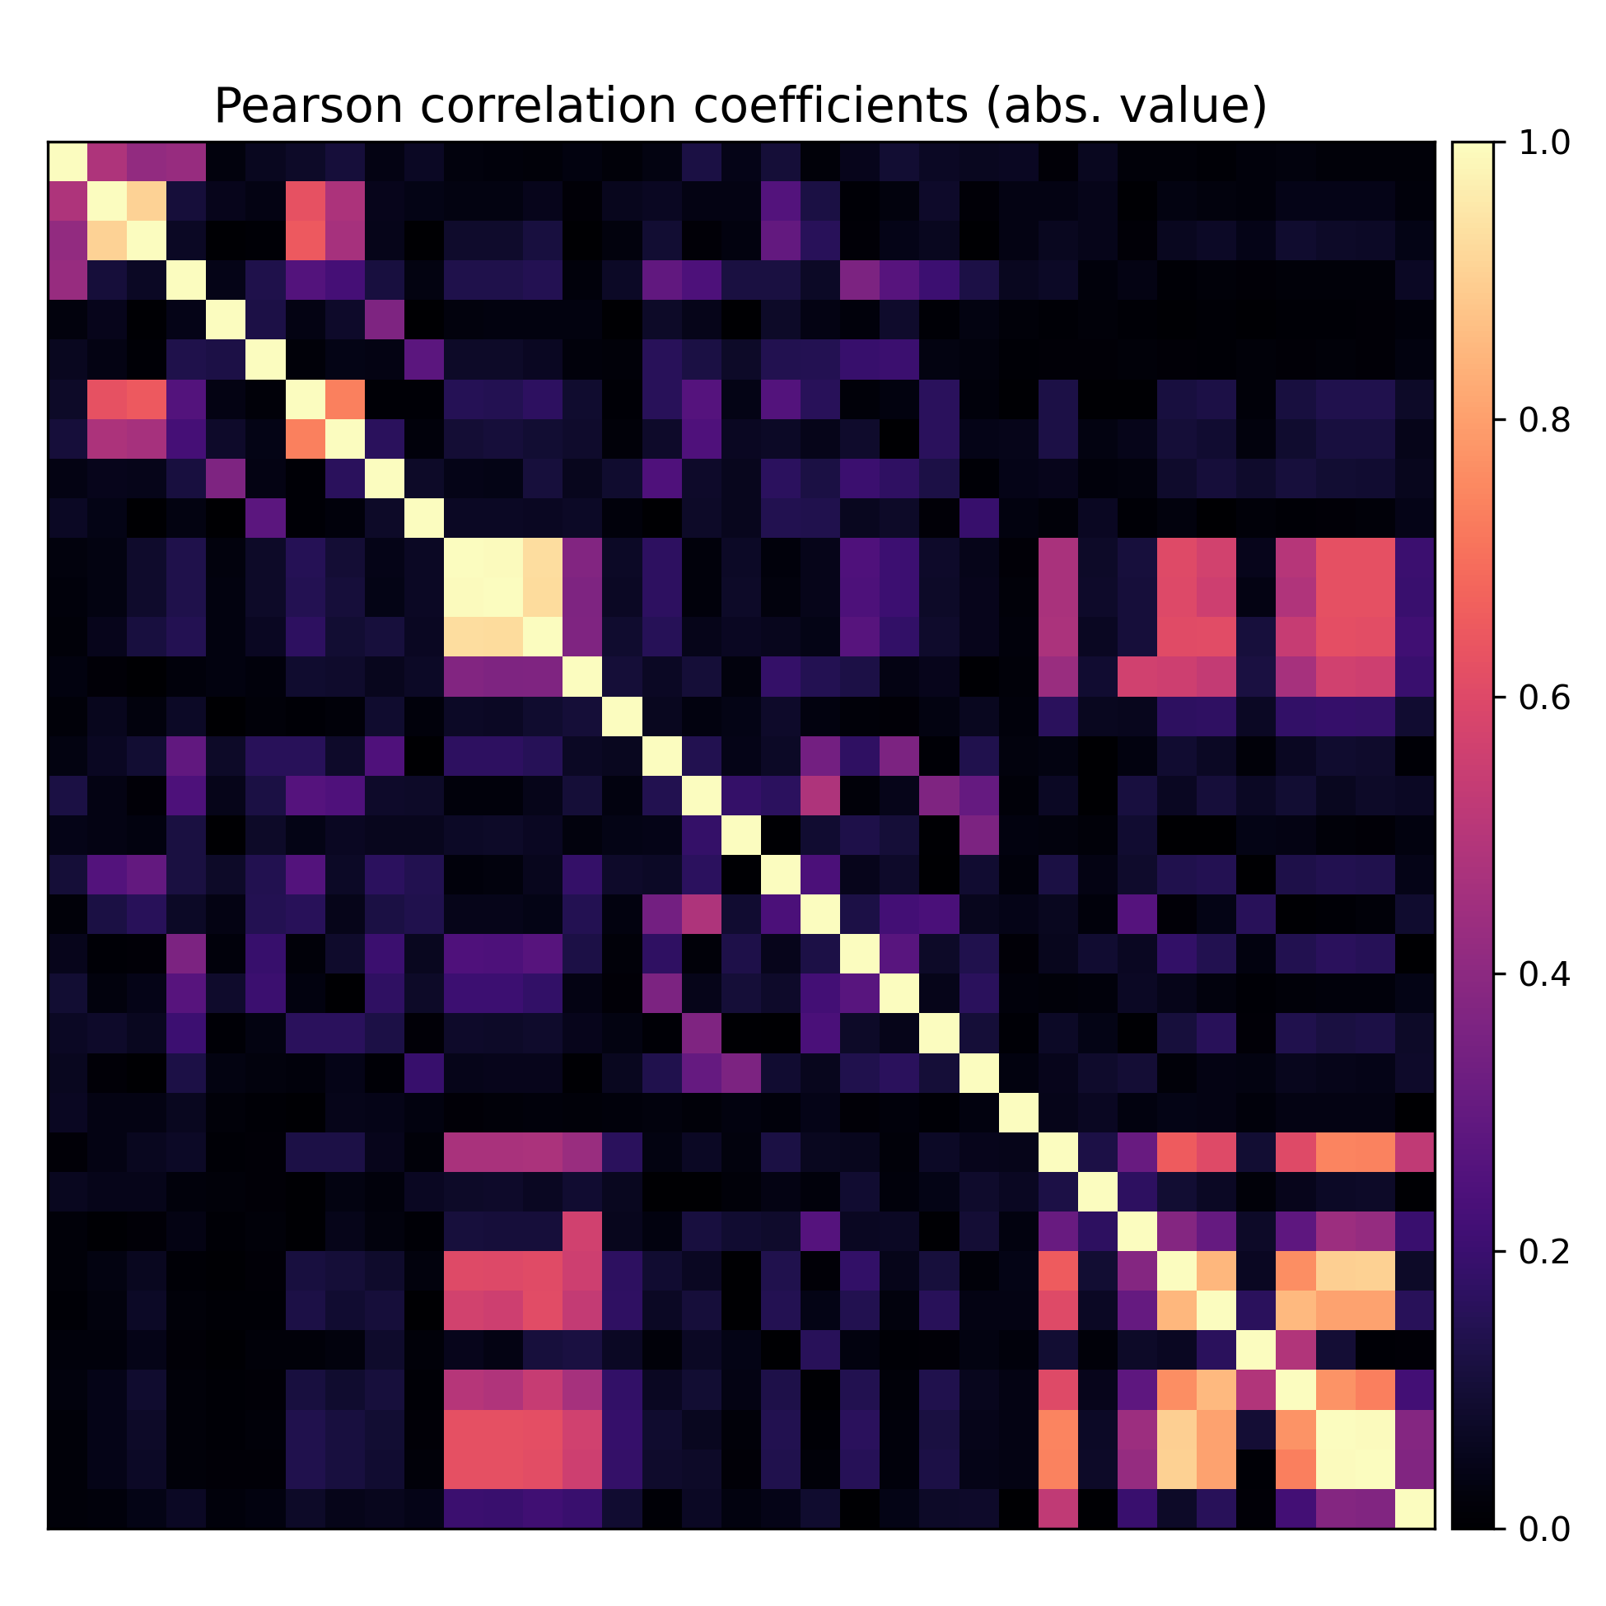
Correlation between LWFA Electrons and Laser Parameters
Laser energy
Frontend output pointing
Laser output wavefront
Probe beam
High correlation between electron energy and wavefront coefficients
Gas pressure
Electron pointing
Frontend output
pointing
Laser output
wavefront
Electron energy
& charge
Electron pointing
Electron energy & charge
Laser energy
Gas pressure
Probe beam
Mention:
In squares: non-independent measurements
Tend to be correlated

Slide 17
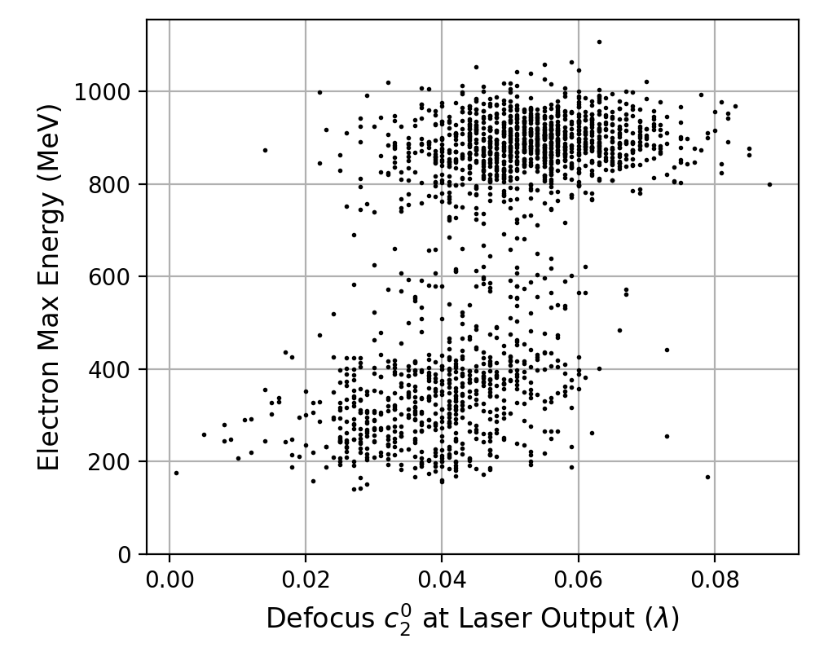

Correlation between LWFA Electrons and Laser Parameters
$$ρ=0.56$$
Injection into the first bubble
No/little injection into the first bubble
Defocus Zernike coefficient at the laser output
vs. maximum electron energy
Frontend output
pointing
Laser output
wavefront
Electron energy
& charge
Electron pointing
Laser energy
Gas pressure
Probe beam

Slide 18
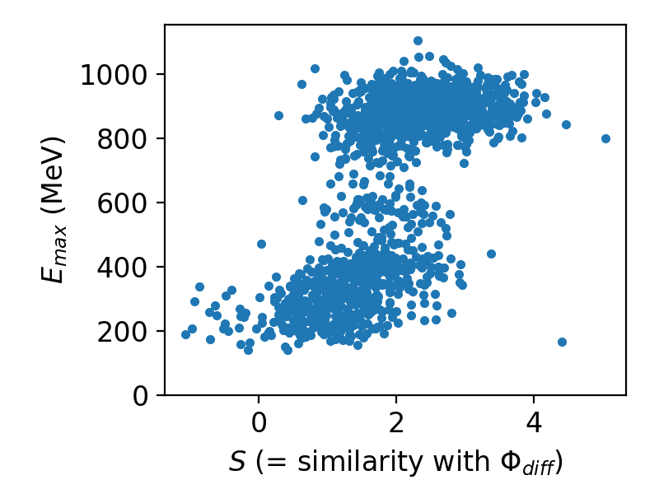
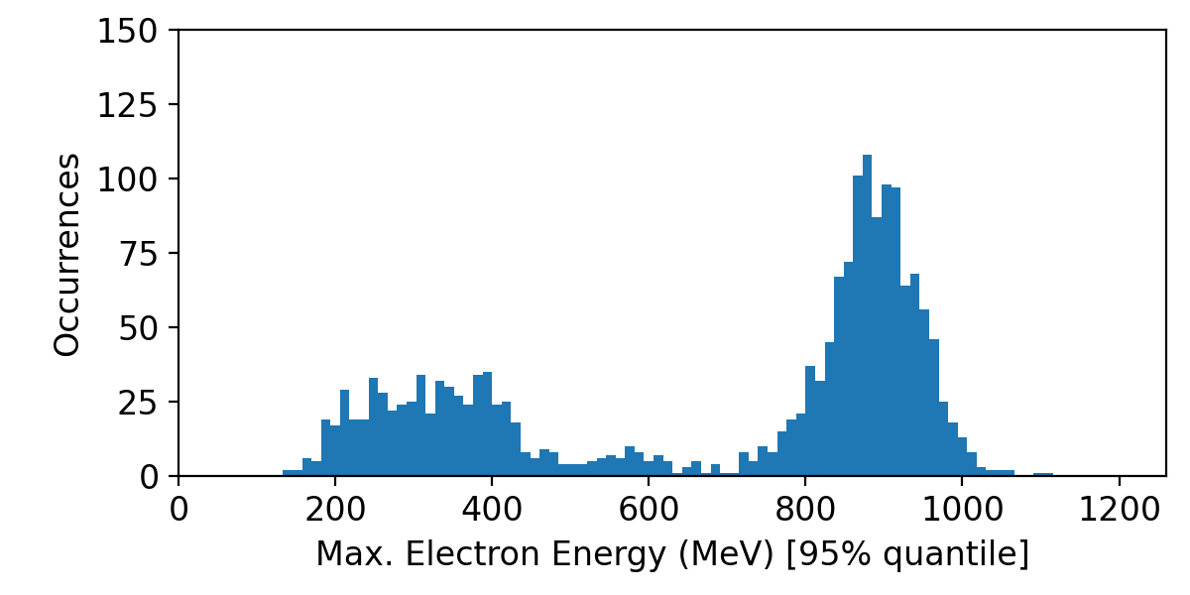
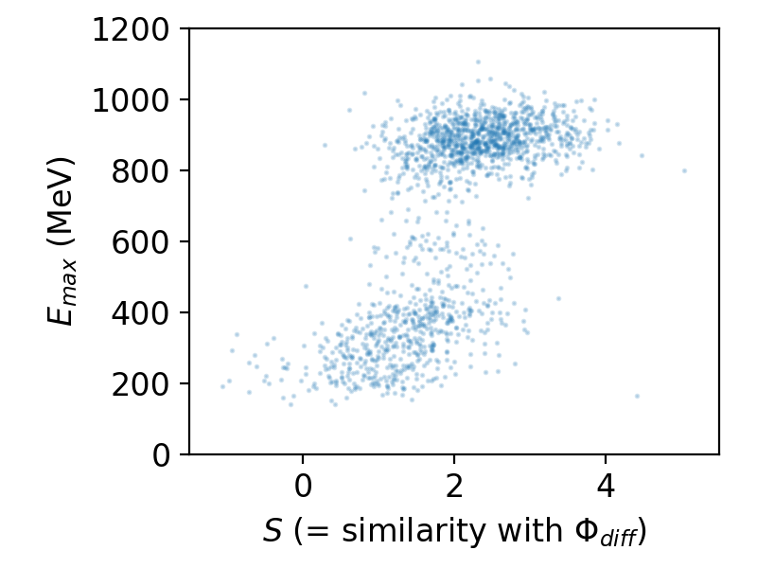
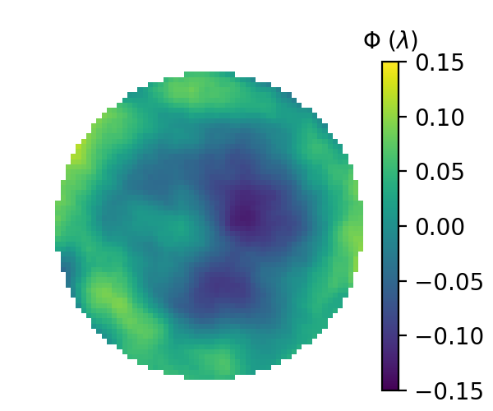
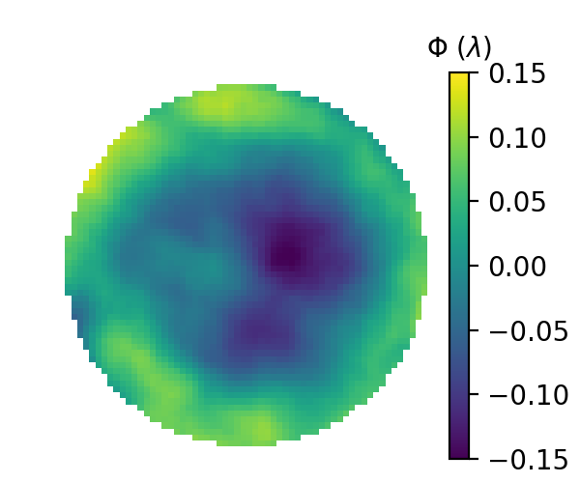
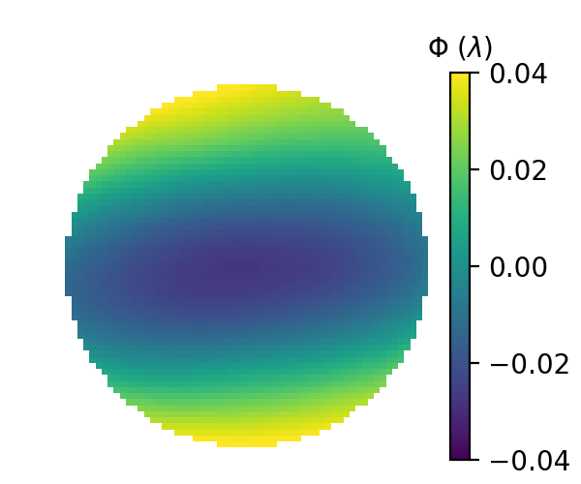




Classification of Injection based on Wavefront
Can predict based on the laser wavefront whether $E_{max}> 700 MeV$?
37%
63%
Average wavefront at the laser output:
$$S=∫Φ_{i}⋅Φ_{diff}dA$$
$$E_{max}< 700 MeV$$
$$E_{max}> 700 MeV$$
$$Φ_{diff}$$
difference
Add reference to classification based on full wavefront.
Mention:
Fluctuations as subtle as a small fraction of the wavelength can have profound effects
Add Zernike decomp
And quantify defocus and astig contributions

Slide 19
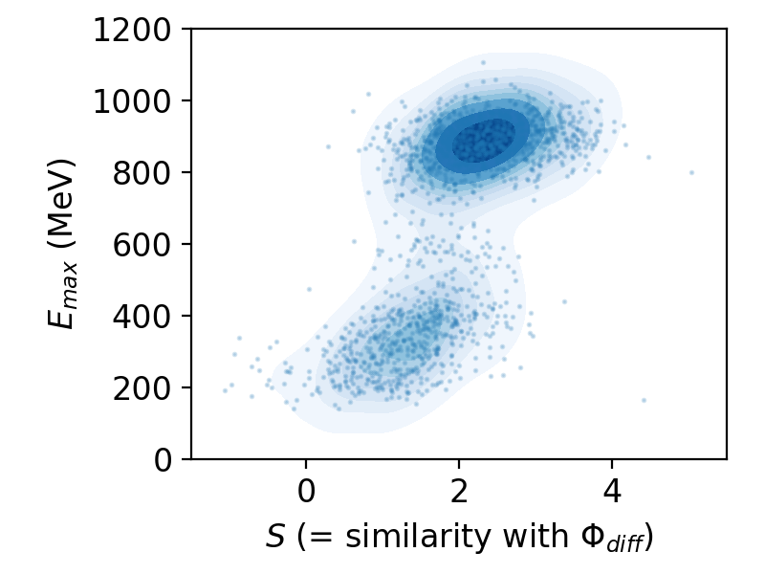
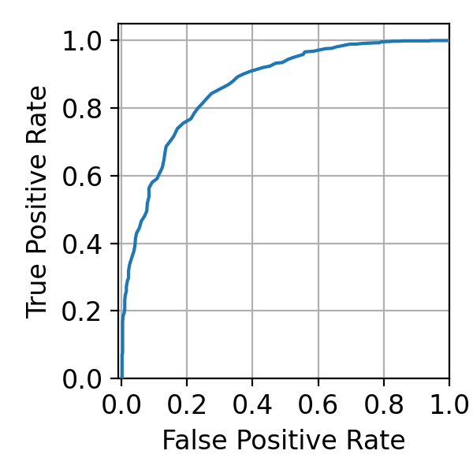
Classification of Injection based on Wavefront
Can predict based on the laser wavefront whether $E_{max}> 700 MeV$?
AUC = 0.87
Mention:
Diagonal -> completely random
‘Square’ -> perfect classification
37%
63%
Average wavefront at the laser output:
$$S=∫Φ_{i}⋅Φ_{diff}dA$$
$$E_{max}< 700 MeV$$
$$E_{max}> 700 MeV$$
$$Φ_{diff}$$
difference
Add reference to classification based on full wavefront.
Mention:
Fluctuations as subtle as a small fraction of the wavelength can have profound effects
Add Zernike decomp
And quantify defocus and astig contributions

Slide 20
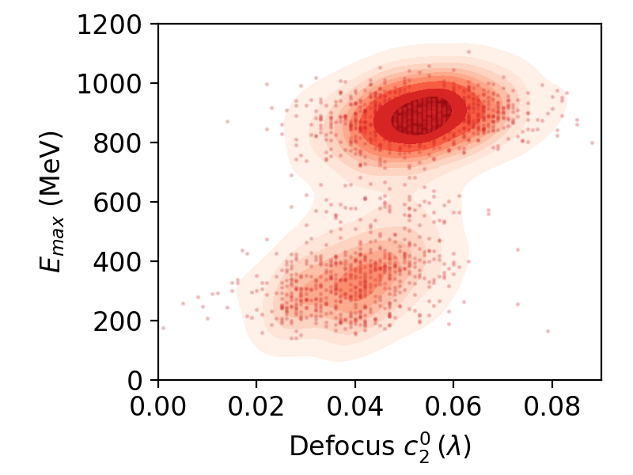
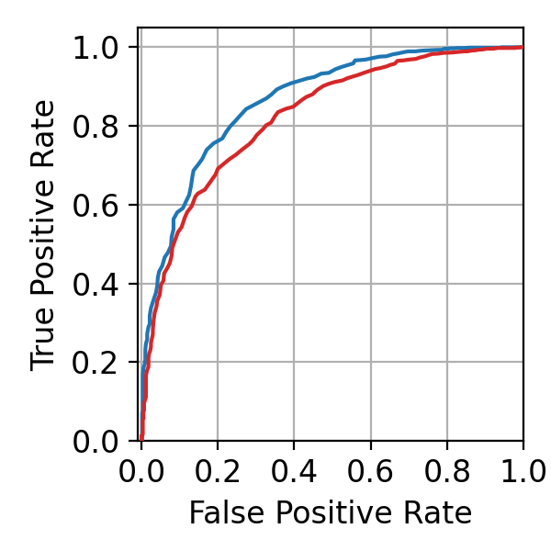
Classification of Injection based on Defocus
Can predict based on the defocus parameter whether $E_{max}> 700 MeV$?
AUC = 0.87
AUC = 0.81
37%
63%
How to improve classification?
More information on target parameters (?)
Pulse front tilt/curvature (?)
… (?)
How to move on from here?
Understand physics/run simulations.
Reduce defocus fluctuations.

Slide 21
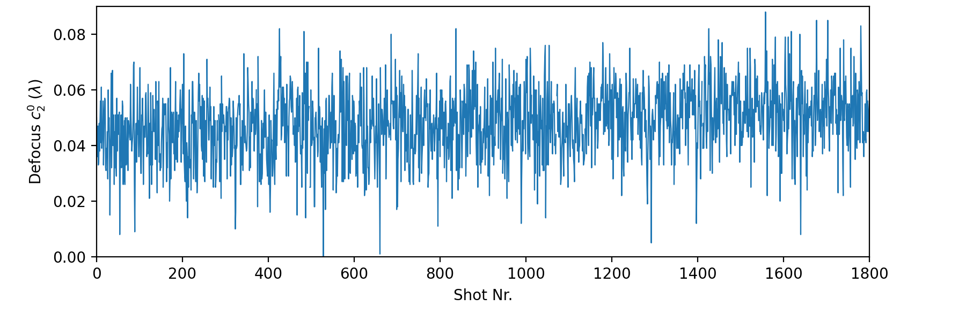
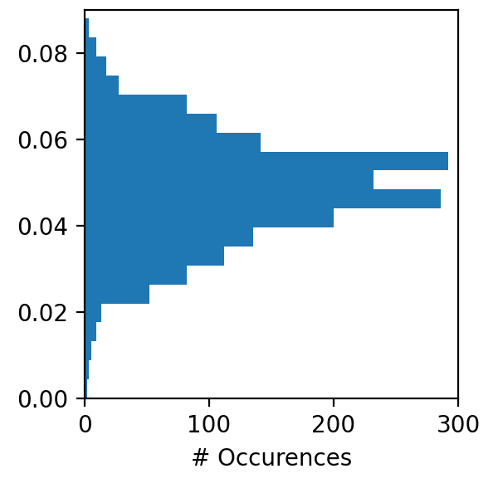





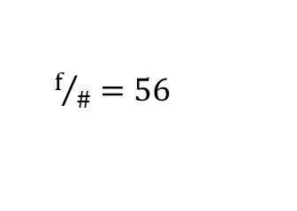


Fluctuations in Focus Position
Defocus fluctuations during the experiment:
RMS = $±$ 1.2%$⋅λ$
$$\sim 1.6 mm$$
30 min
Sensor repeatability: $<2 nm= 0.25\%⋅λ$
Focal shift $ε_{z}$:
$$ε_{z}=−16⋅\sqrt{3}⋅{\left(f/\#\right)}^{2}⋅c_{2}^{0}$$
$f/\#=56$
$${RMS[ε}_{z}]=±0.8 mm$$
Wavefront video?
To demonstrate that not statistical noise?
$$z_{R}=3.2 mm$$
Check: could the laser focus have fluctuated from slightly upstream of the shock to on the shock?
Look up exact Phasics model and check repeatability
Reference to DESY

Slide 22
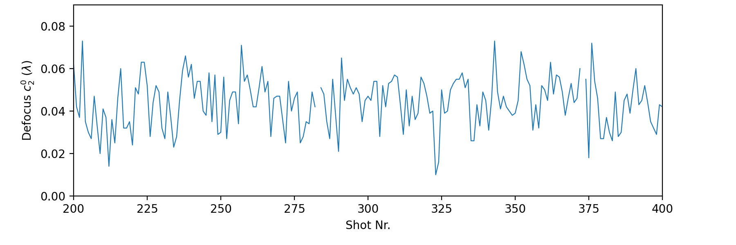
Fluctuations in Focus Position
Defocus fluctuations during the experiment:
RMS = $±$ 1.2%$⋅λ$
$$\sim 1.6 mm$$
4 min
Sensor repeatability: $<2 nm= 0.25\%⋅λ$
Focal shift $ε_{z}$:
$$ε_{z}=−16⋅\sqrt{3}⋅{\left(f/\#\right)}^{2}⋅c_{2}^{0}$$
$f/\#=56$
$${RMS[ε}_{z}]=±0.8 mm$$

Slide 23
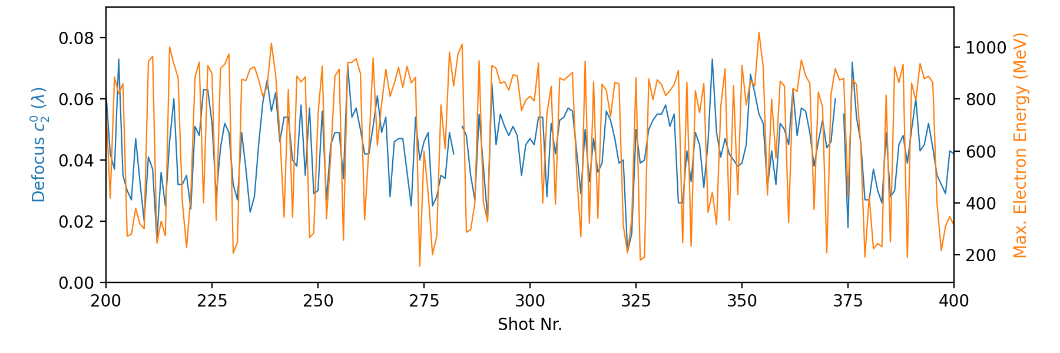
Fluctuations in Focus Position
Defocus fluctuations during the experiment:
RMS = $±$ 1.2%$⋅λ$
Upstream of target/shock
$$\sim 1.6 mm$$
Downstream of target/shock
Sensor repeatability: $<2 nm= 0.25\%⋅λ$
Focal shift $ε_{z}$:
$$ε_{z}=−16⋅\sqrt{3}⋅{\left(f/\#\right)}^{2}⋅c_{2}^{0}$$
What causes these defocus fluctuations?
Candidates:
Fluctuations in the amplifier crystal temperature
Air humidity fluctuations
Air turbulence
$f/\#=56$
$${RMS[ε}_{z}]=±0.8 mm$$
Work in progress

Slide 24
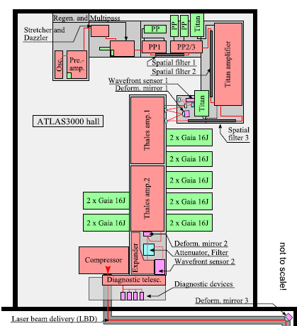
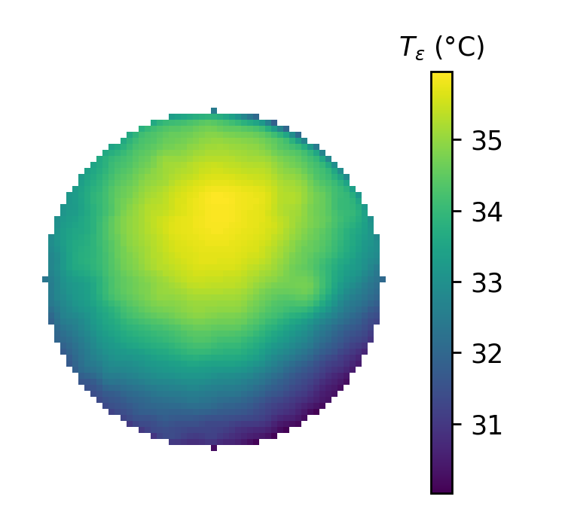

Where do the Defocus Fluctuations come from?
Temperature distribution in laser crystals, in particular at the main AMP:
Cooling from the side via index-matched liquid
$$ΔT$$
9 cm
IR-image of AMP1 laser crystal while pumped with 4 Gaias
IR camera
Pump lasers
Pump lasers
Seed
Seed
Ti:Sa
Mention that temperature profile is shifted and moves up after turning on the pump lasers.

Slide 25
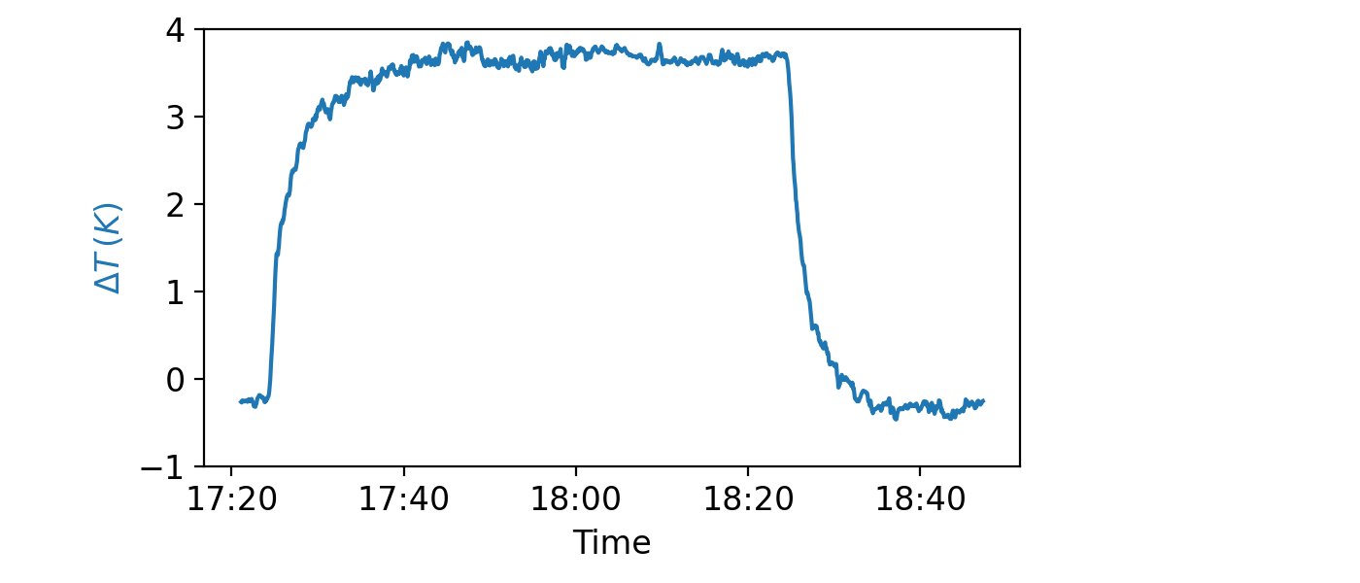

Does the Thermal Lens induce Defocus Fluctuations?
Temperature distribution in laser crystals, in particular at the main AMP:
Pump lasers on
Pump lasers off
$$ΔT$$
9 cm
IR-image of AMP1 laser crystal while pumped with 4 Gaias

Slide 26
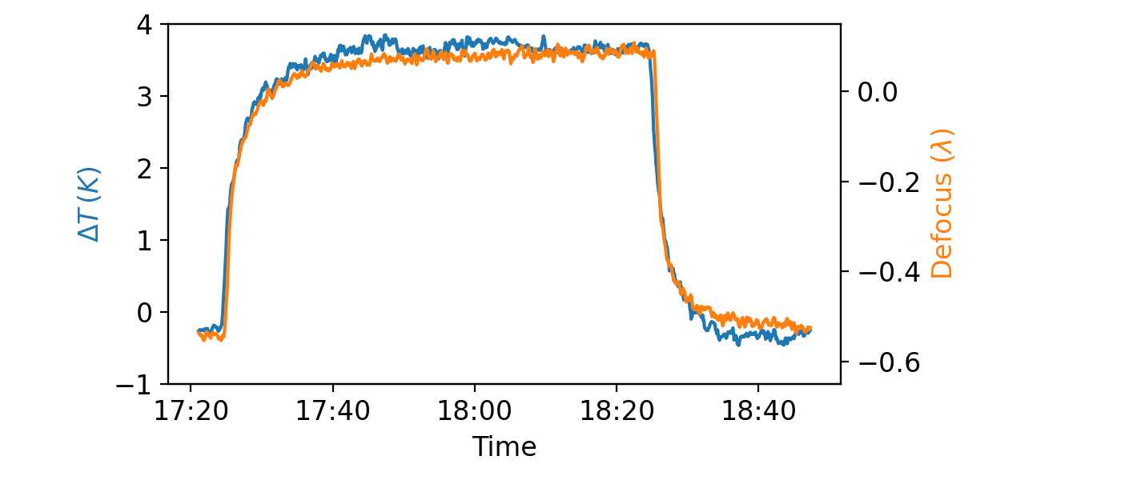
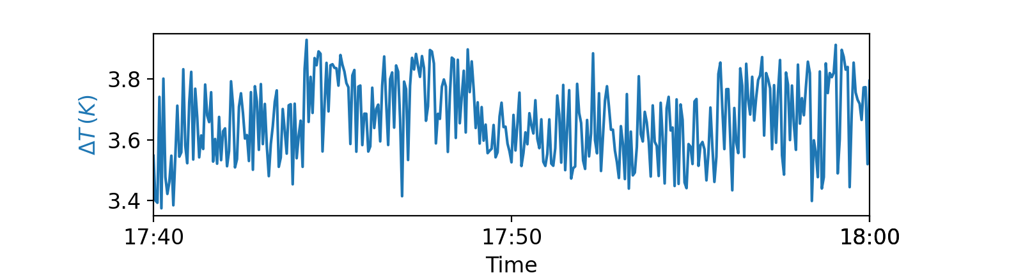


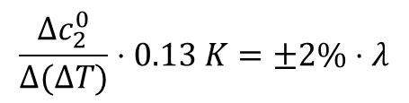
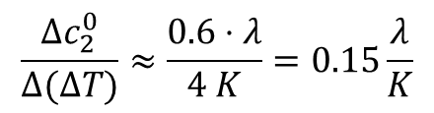
Does the Thermal Lens induce Defocus Fluctuations?
Thermal lenses in laser crystals, in particular at the main amplifier:
Pump lasers on
Pump lasers off
$$ρ≈1$$
$$ΔT$$
9 cm
$$\frac{Δc_{2}^{0}}{Δ(ΔT)}≈\frac{0.6⋅λ}{4 K}=0.15\frac{λ}{K}$$
Thermal lensing
IR-image of AMP1 laser crystal while pumped with 4 Gaias
Correlation between $ΔT$ and defocus coefficient fluctuations?
Expected defocus RMS:
$$\frac{Δc_{2}^{0}}{Δ(ΔT)}⋅0.13 K=±2\%⋅λ$$
Measured defocus RMS: $±$ 1.2%$⋅λ$
Might be measuring additional thermal dynamics that is not relevant for the defocus at the laser shots.

Slide 27
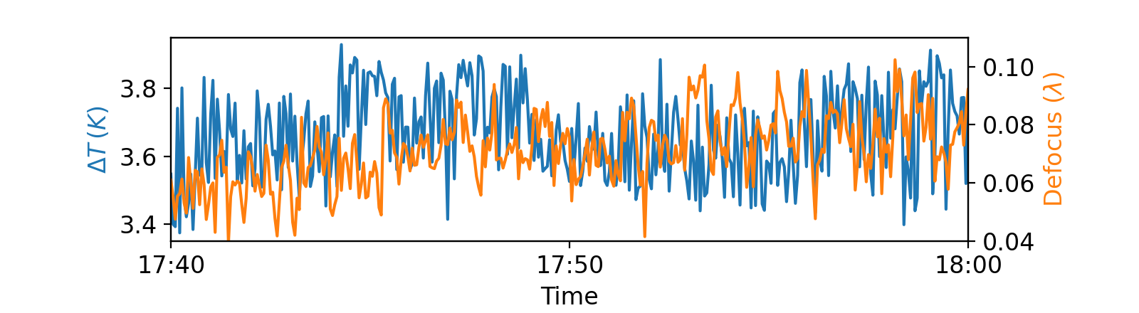

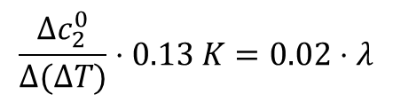
Does the Thermal Lens induce Defocus Fluctuations?
Thermal lenses in laser crystals, in particular at the main amplifier:
Pump lasers on
Pump lasers off
$$ρ≈1$$
$$ΔT$$
9 cm
$$\frac{Δc_{2}^{0}}{Δ(ΔT)}≈\frac{0.6⋅λ}{4 K}=0.15\frac{λ}{K}$$
Thermal lensing
IR-image of AMP1 laser crystal while pumped with 4 Gaias
Correlation between $ΔT$ and defocus coefficient fluctuations?
Expected defocus RMS:
$$ρ=0.06$$
$$\frac{Δc_{2}^{0}}{Δ(ΔT)}⋅0.13 K=0.02⋅λ$$
Based on our current measurement, we can not directly explain the defocus fluctuations based on thermal lens fluctuations in the main AMP crystal.

Slide 28
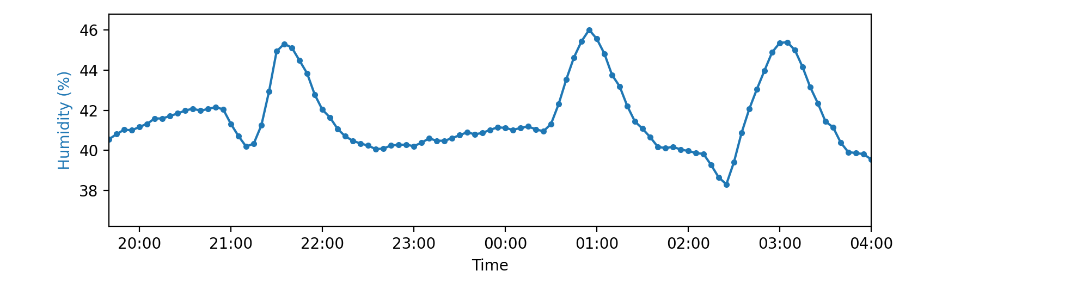
Do Air Humidity Fluctuations induce Defocus Fluctuations?
The air humidity control in the ATLAS-3000 lab sometimes creates spikes (during the winter time…):

Slide 29
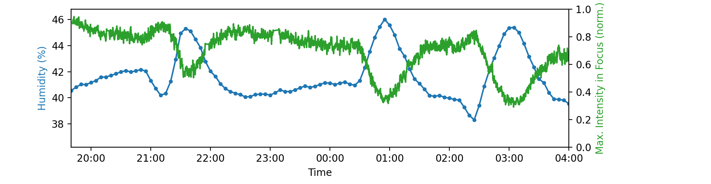
Do Air Humidity Fluctuations induce Defocus Fluctuations?
The air humidity control in the ATLAS-3000 lab sometimes creates spikes (during the winter time…):
Measurement with cw-diode; only using part of the full laser chain.

Slide 30
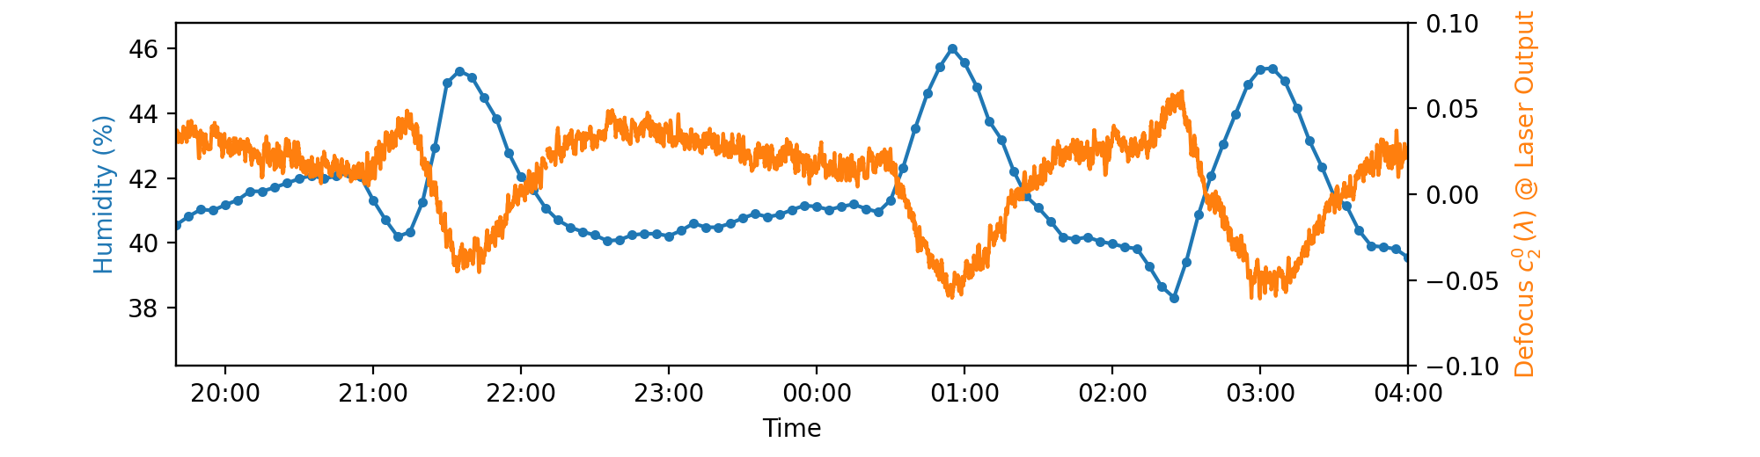
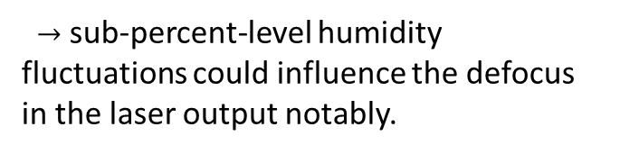


Do Air Humidity Fluctuations induce Defocus Fluctuations?
The air humidity control in the ATLAS-3000 lab sometimes creates spikes (during the winter time…):
For operation of the full laser chain:
$$\frac{\begin{aligned}Δ{Defocus c}_{2}^{0}\end{aligned}}{Δhumidity}≈−\frac{2.5\%⋅λ}{humidity \%}$$
Typical defocus RMS: $±1.2\%⋅λ$
Measurement with cw-diode; only using part of the full laser chain.
$→$ sub-percent-level humidity fluctuations could influence the defocus in the laser output notably.
How does air humidity affect the laser wavefront?

Slide 31
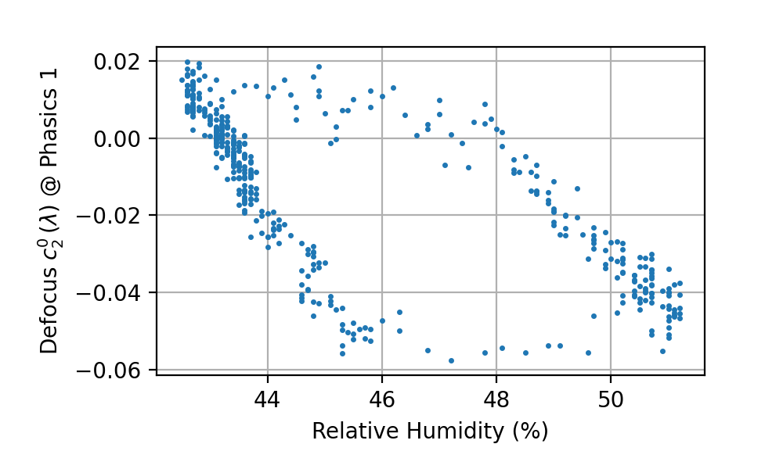
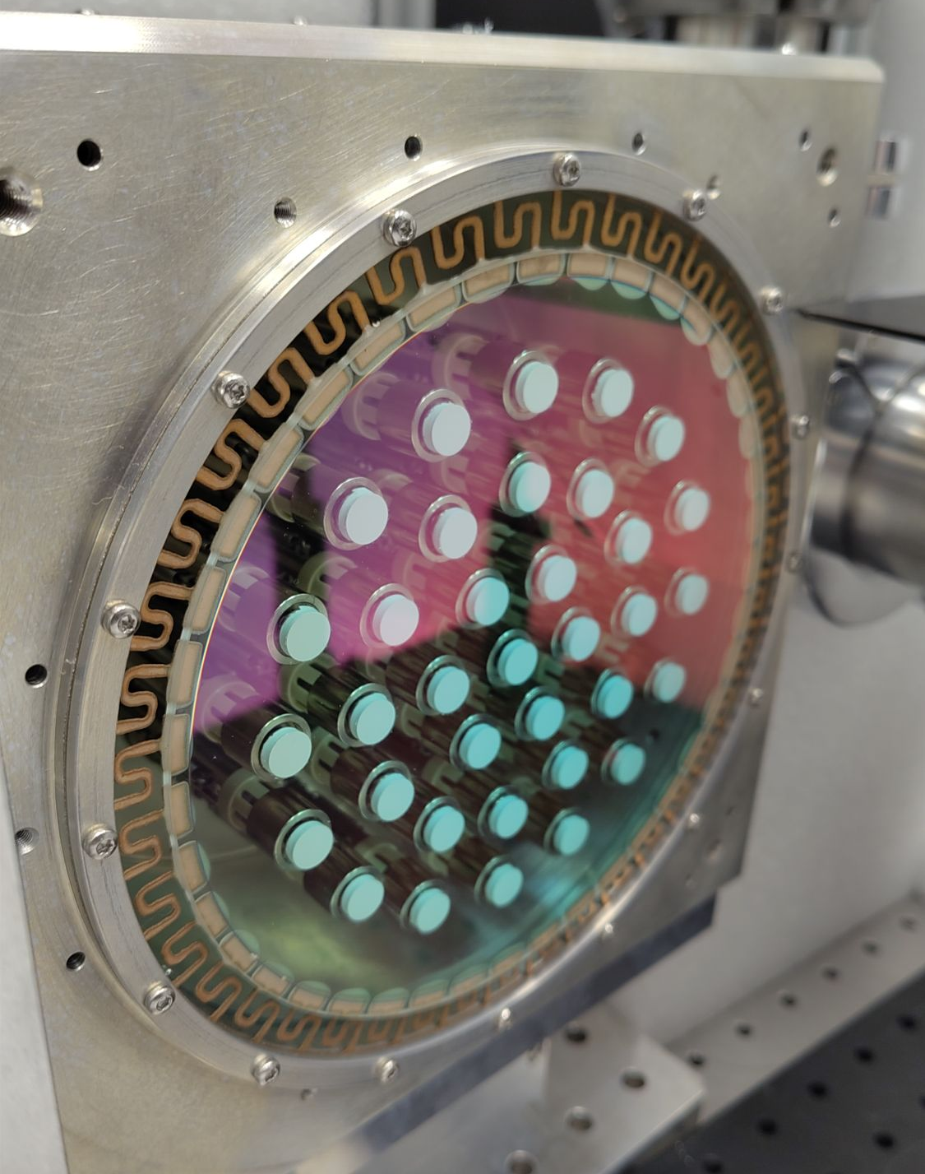
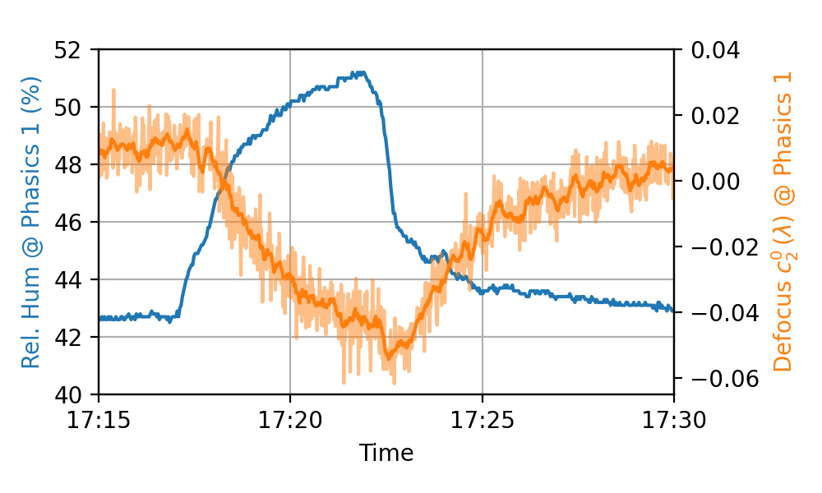
Do Air Humidity Fluctuations induce Defocus Fluctuations?
The air humidity control in the ATLAS-3000 lab sometimes creates spikes (during the winter time…):
For operation of the full laser chain:
$$\frac{\begin{aligned}Δ{Defocus c}_{2}^{0}\end{aligned}}{Δhumidity}≈−\frac{2.5\%⋅λ}{humidity \%}$$
Typical defocus RMS: $±1.2\%⋅λ$
$→$ sub-percent-level humidity fluctuations could influence the defocus in the laser output notably.
Test with humidifier close to adaptive mirror (“DM1”):
Hypothesis:
Water accumulates in (porous E-beam) coatings and creates stress.
The flexible substrates of the adaptive mirrors deform more readily than thicker, regular substrates.
Main deformation:
curvature -> introduces defocus.

Slide 32
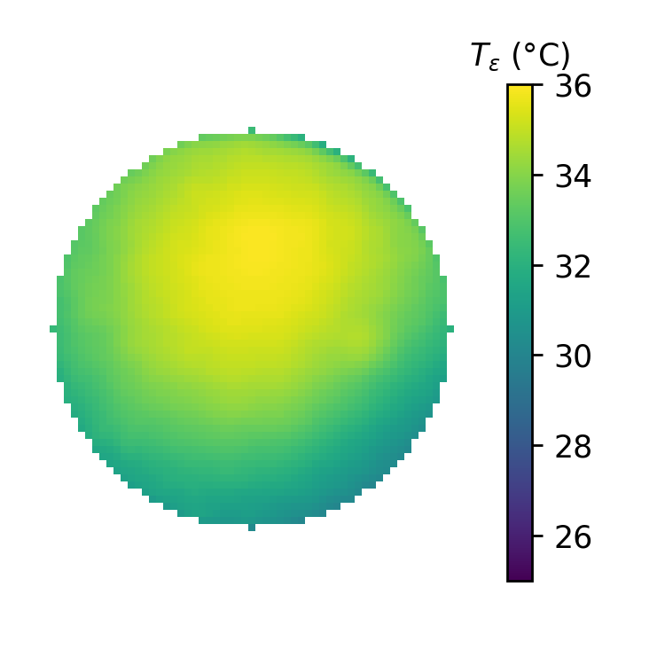
Reducing Crystal Temperature in the Main Amplifier
Temperature profile of the AMP1 crystal:
Crystal mount
Cooling liquid
Pump lasers
Pump lasers
9 cm
Seed
Seed
Ti:Sa

Slide 33
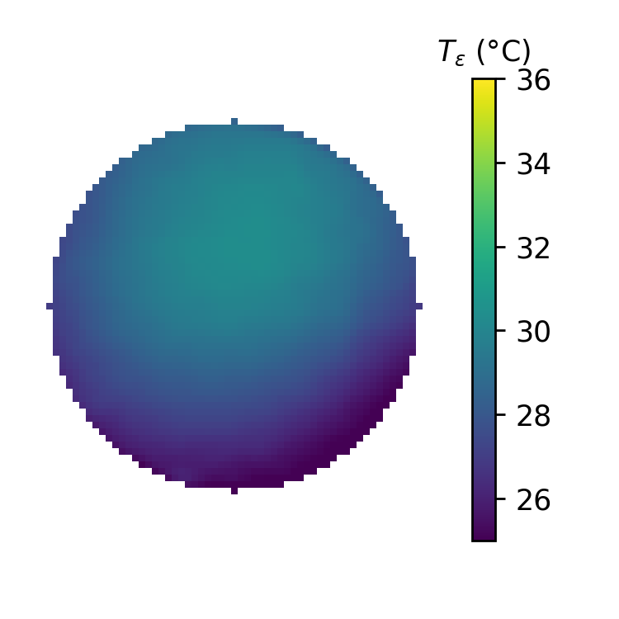
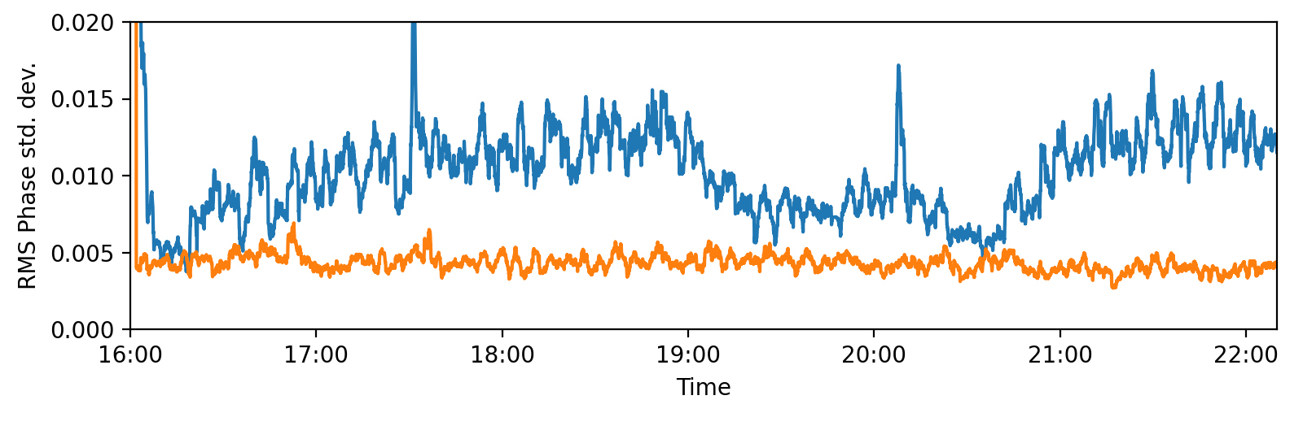
Reducing Crystal Temperature in the Main Amplifier
Temperature profile of the AMP1 crystal:
Crystal mount
Cooling liquid
Air flow/
turbulence
Pump lasers
9 cm
Seed
20°C
Ti:Sa
40°C
Upgrade heat exchanger
Flow speed -> 2x
Chiller temperature 18°C-> 15°C
30°C
36°C
Main AMP output
Seeing indications that wavefront overall becomes more stable by cooling the crystal.
Frontend output
Needs confirmation!

Slide 34
Conclusions
Subtle fluctuations in the laser wavefront can induce substantial fluctuations in the energy of LWFA electrons and determine to a good extent whether injection takes place or not.
Among all Zernike coefficients, defocus (and astigmatism) have the strongest impact on electron energy and injection probability.
The defocus fluctuations might be caused by a combination of temperature fluctuations in the main amplifier crystal, humidity fluctuations, and air turbulence.
Will look into this in more detail.
Reducing the temperature of the main amplifier crystal appears to reduce (higher-order) wavefront fluctuations.

Slide 36
Conclusions
Subtle fluctuations in the laser wavefront can induce substantial fluctuations in the energy of LWFA electrons and determine to a good extent whether injection takes place or not.
Among all Zernike coefficients, defocus (and astigmatism) have the strongest impact on electron energy and injection probability.
The defocus fluctuations might be caused by a combination of temperature fluctuations in the main amplifier crystal, humidity fluctuations, and air turbulence.
Will look into this in more detail.
Reducing the temperature of the main amplifier crystal appears to reduce (higher-order) wavefront fluctuations.

Slide 37
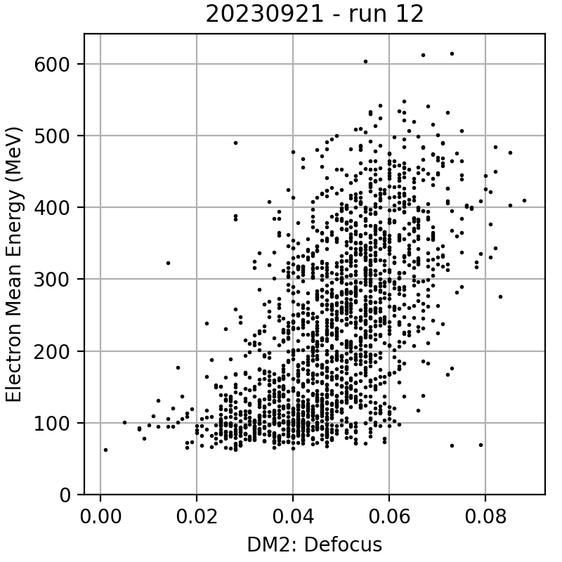


Correlation between LWFA Electrons and Laser Parameters
$$ρ=0.6$$
Mean Electron Energy (MeV)
Defocus at Laser Output ($λ)$
Defocus Zernike coefficient vs. average electron energy
Frontend output
pointing
Laser output
wavefront
Electron energy
& charge
Electron pointing
Laser energy
Gas pressure
Probe beam

Slide 38

Correlation between LWFA Electrons and Laser Parameters
Defocus @ Laser Output
Electron Max. Energy
Origin of defocus drifts?
Some: originates in front-end
Most of it: Thermal lensing in the main amplifier (?)
Currently exploring in more detail…
Defocus and the maximum electron energy fluctuate in sync on a timescale of minutes.
Standardized time series
Smoothed Time Series
30 min
Shot Number (Rep. rate: 0.25 Hz)

Slide 39

Correlation between LWFA Electrons and Laser Parameters
Defocus @ Laser Output
Electron Mean Energy
Origin of defocus drifts?
Some: originates in front-end
Most of it: Thermal lensing in the main amplifier (?)
Currently exploring in more detail…
Defocus and mean electron energy fluctuate in sync on a timescale of minutes.
Standardized time series
Smoothed Time Series
30 min
Shot Number (Rep. rate: 0.25 Hz)

Slide 40


Slide 41


