Slide 1
How are CEP effects affected by the injection mechanism in a Laser Wakefield Accelerator driven by near single-cycle laser pulses?
Slava Smartsev, Joséphine Monzac, Aline Vernier, Igor Andriyash, Jérôme Faure
Laboratoire d’Optique Appliquée (LOA)
ENSTA-CNRS-Ecole Polytechnique, FRANCE

Slide 2






Collaborators
High repetition rate laser-plasma source
J. Monzac, L. Rovige, D. Gustas, P. Larmonier, S. Tchetovsky,
A. Bourhis, D. Guenot, J. Huijts, S. Smartsev
A. Vernier, J. Wheeler, J. Faure
I. Andriyash, A. Lifschitz (PIC simulations)
Laser system:
M. Ouillé, J. Kaur, A. Cavana , A. Kalouguine, Z. Cheng,
R. Lopez-Martens
Gas jet fabrication:
V. Tomkus, V. Girdauskas, G. Raciukaitis, J. Dudutis ,
V. Stankevic, P. Gecys

Slide 3
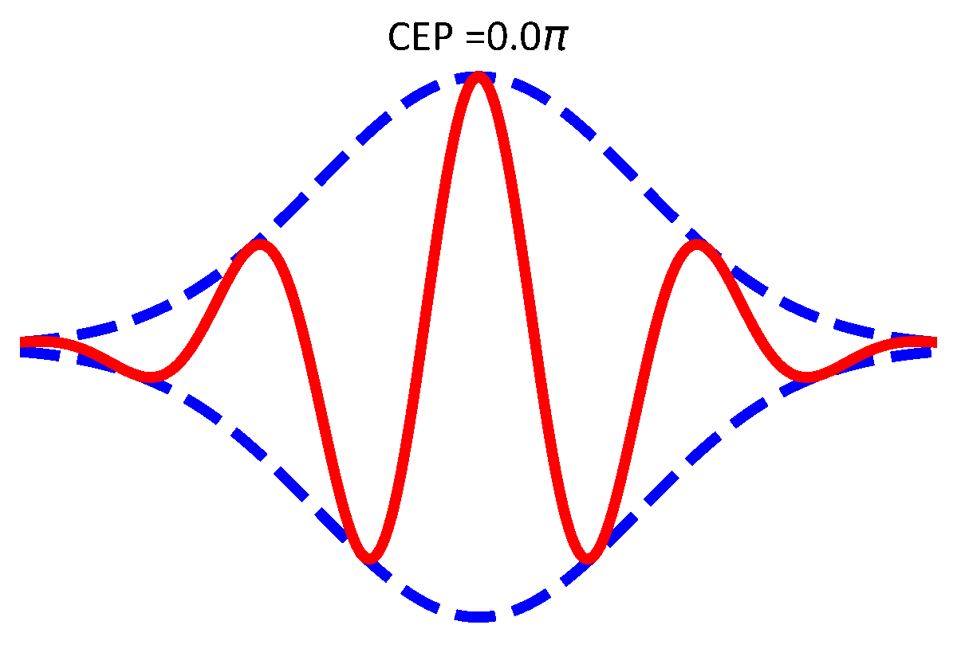
What is the Carrier Envelope Phase (CEP) ?
At LOA:
Controlled & stable CEP
stab 200-300 mrad rms
20 mrad when averaging
plasma
propagation
In a plasma, the CEP slips because
Slippage length
Notes:
CEP plot: Shot to shot fluctuations significant
→ requires averaging. Black line: 200 shot average

Slide 4
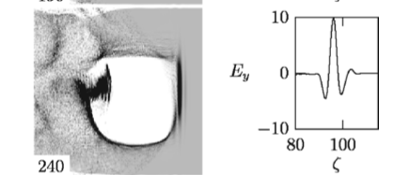
Motivation for studying CEP effects
Curiosity driven: fundamentals of laser-plasma interaction
Technology driven : current kHz LWFA use few cycle pulses
  Post-compressed Ti:saph pulses → 3-4 fs, 3 mJ, kHz
  Guénot et al., Nat. Phot. 11, 293 (2017); Salehi et al., PRX 11, 021055 (2021)
  OPCPA laser systems → 8-10 fs
    SYLOS laser at ELI-ALPS: 8 fs, 100 mJ, 1 kHz Budriunas et al., Opt. Exp. 25, 5797 (2017)
    L1 laser at ELI-Beamlines: 15 fs, 30 mJ, 1 kHz Lazzarini et al., PoP 31 030703 (2024)
For few-cycle pulses
Asymmetric plasma response in polarization plane
Depends on CEP
→ Oscillating bubble
Nerush & Kostyukov, PRL 103, 0035001 (2009)
Notes:
Duration argument is getting weaker: few fs bunch in FELs, steady decrease of jitter to tens of fs. Still an interest to go to few femtosecond resolution of below
Paradigm change is happening with accelerator labs now fully invested in this field (DESY, IJCLab)
Standard of modern light sources: European XFEL has operated at 5000 X-ray pulses/second up to 27 000 possible

Slide 5
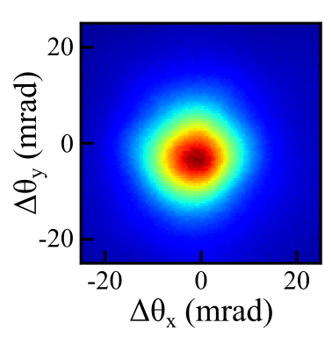
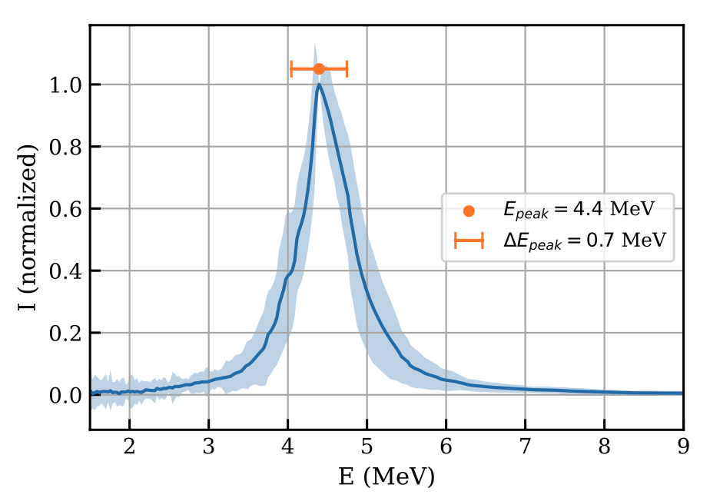
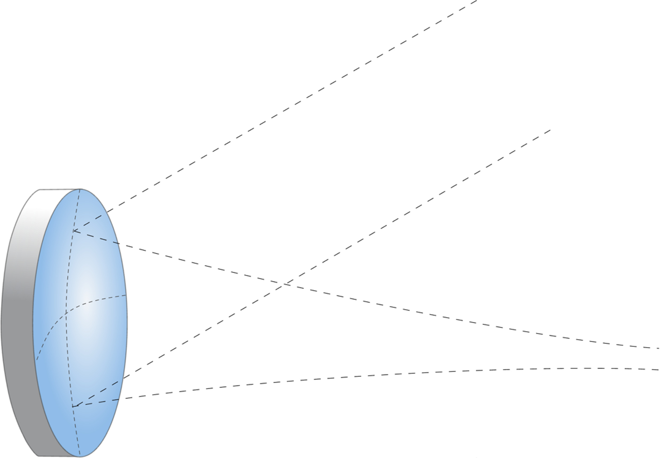
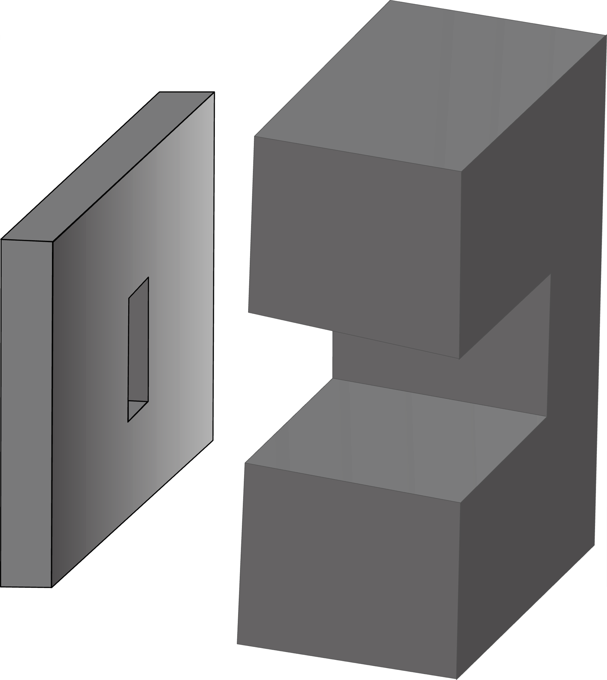
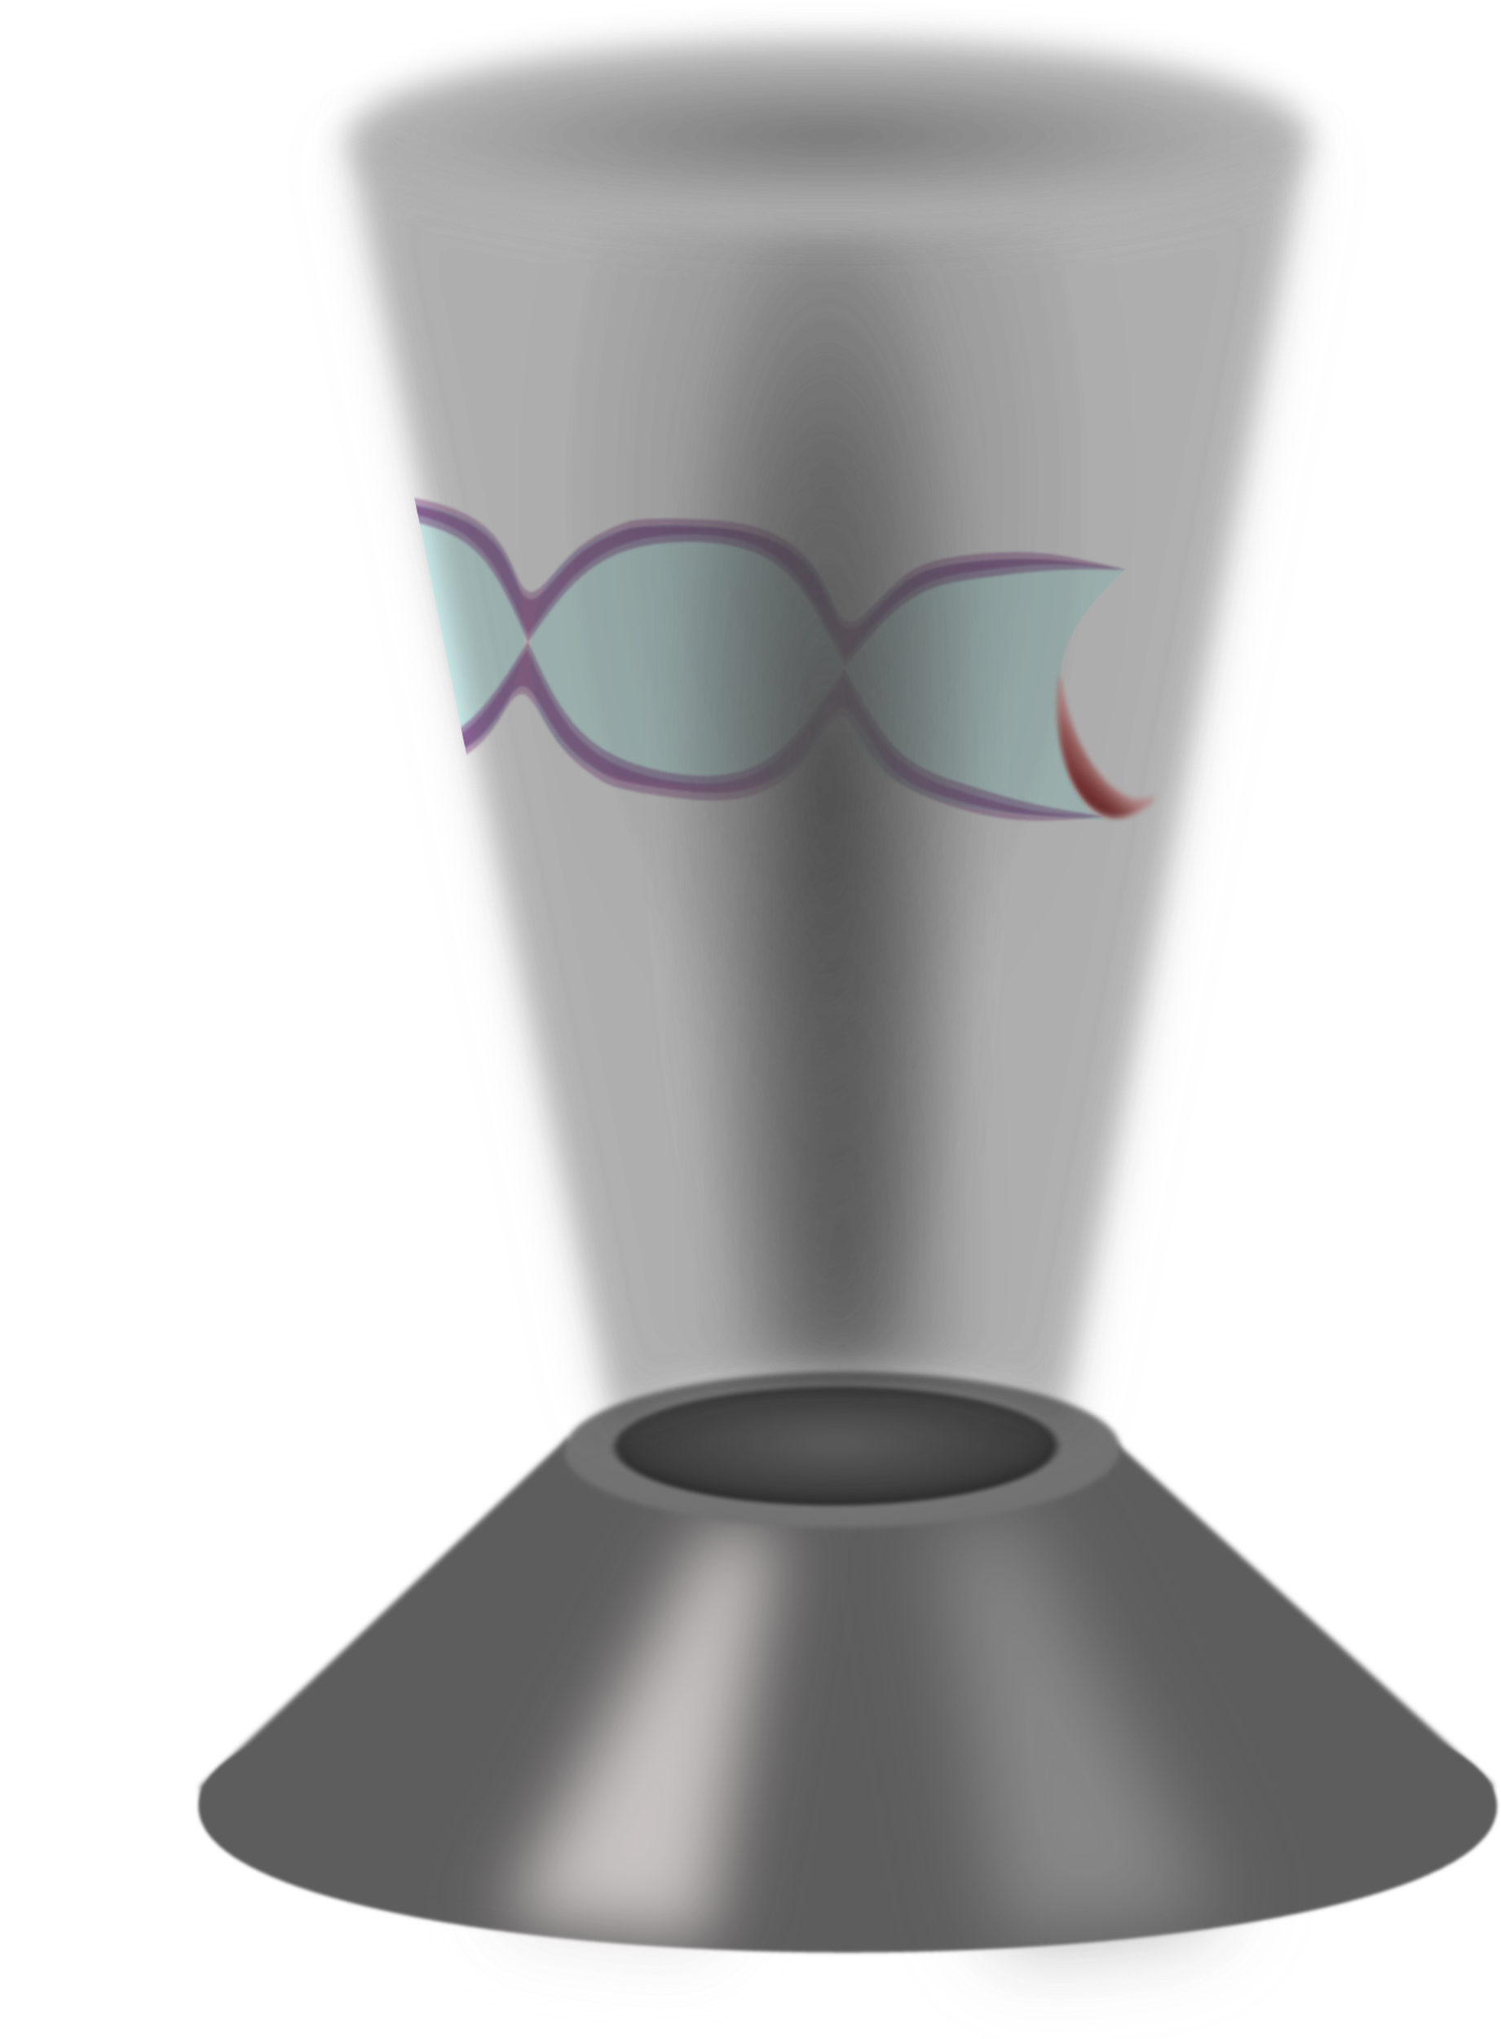
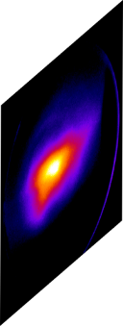
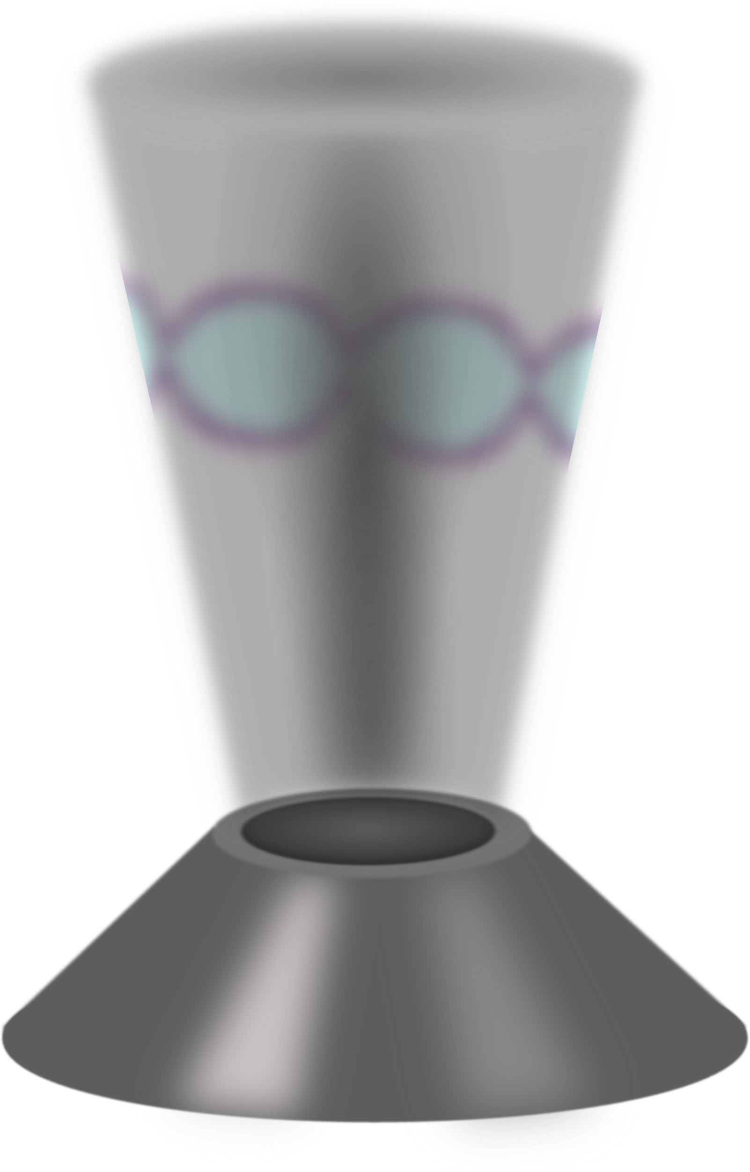
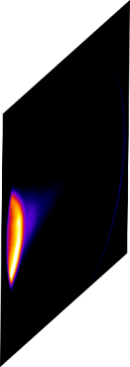


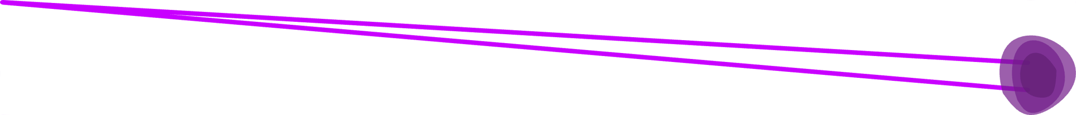
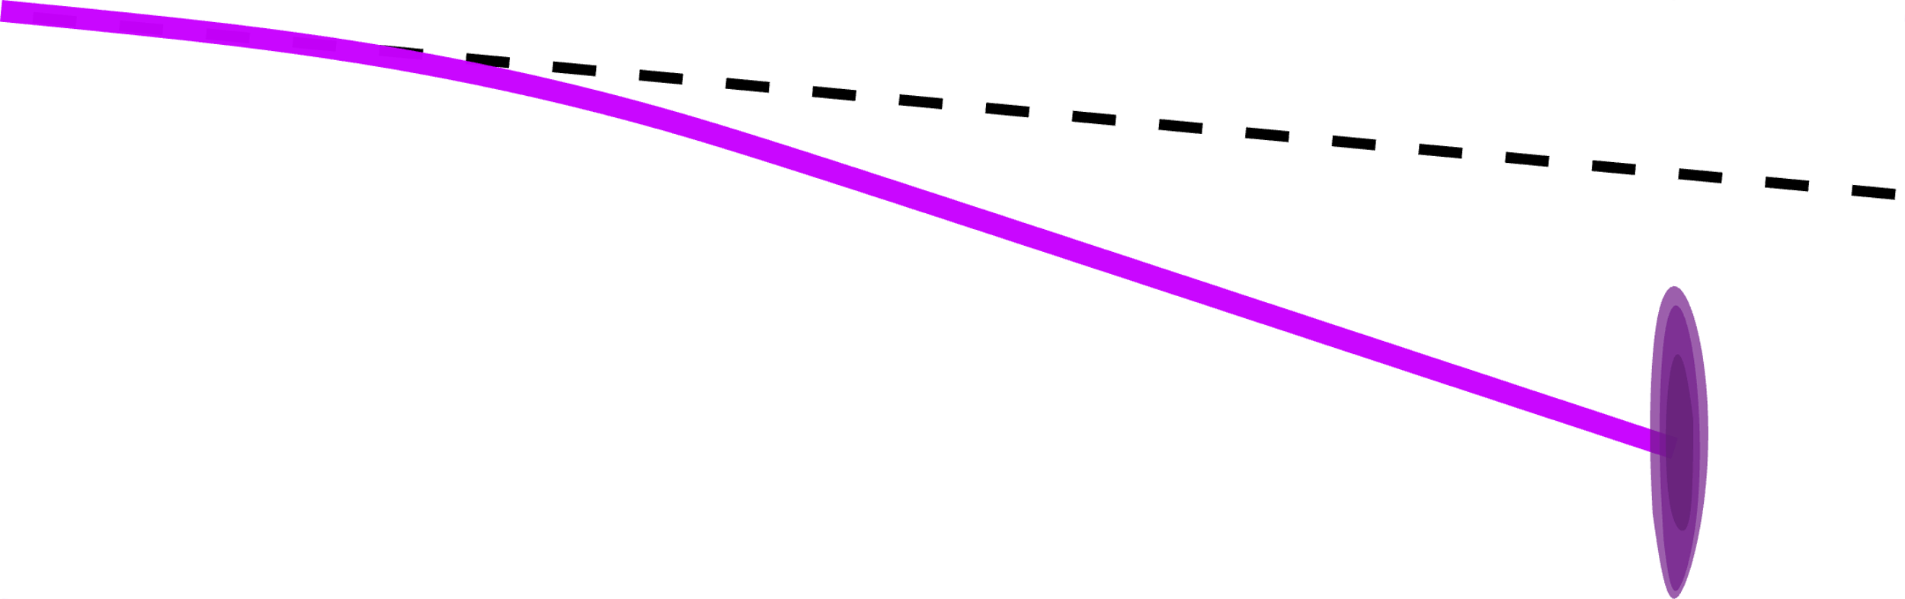
Experimental set-up
  Laser
  τ = 3.5-4.0 fs, E = 2.5 mJ, Spot : 5 µm FWHM
  I = 2x10¹⁸ W.cm⁻²
Stable kHz beams in H₂
Retractable
Slit and Magnet
We vary the CEP and monitor:
Beam profile
Charge
Energy spectrum
Plasma target
Micrometer gas jet (150 µm)
Differential pumping for continuous operation
H₂ experiments
Notes:
Duration argument is getting weaker: few fs bunch in FELs, steady decrease of jitter to tens of fs. Still an interest to go to few femtosecond resolution of below
Paradigm change is happening with accelerator labs now fully invested in this field (DESY, IJCLab)
Standard of modern light sources: European XFEL has operated at 5000 X-ray pulses/second up to 27 000 possible

Slide 6
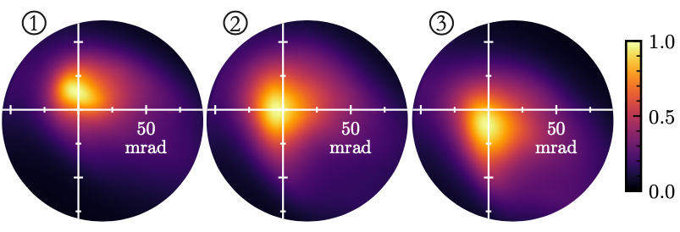
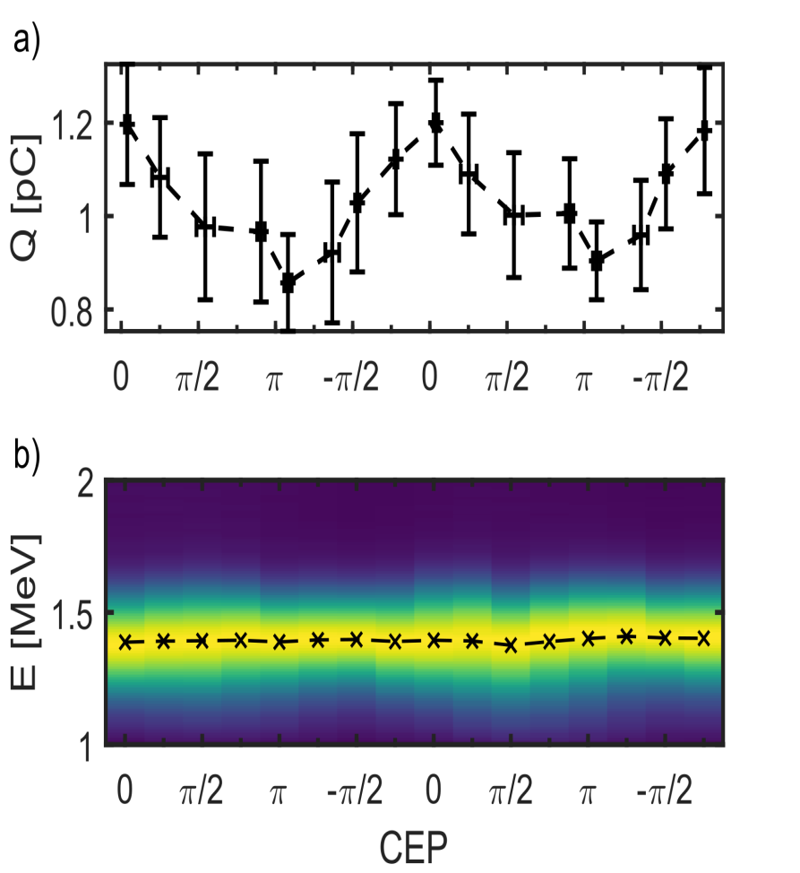
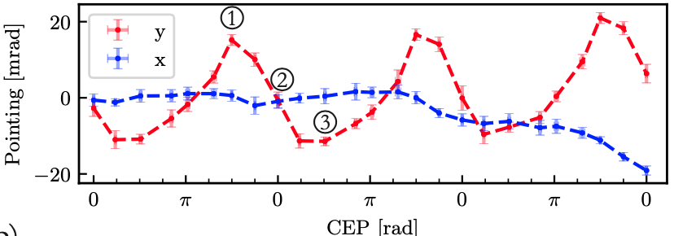
Previous results: CEP dependent beam pointing (in N₂ and He)
Self-injection
CEP dependent beam pointing
+/- 15 mrad
CEP –π/2
CEP 0
CEP π/2
No significant energy variation
Similar behavior in N₂ and He
excluding ionization injection
Huijts & Rovige et al., Phys. Rev. X 12 011036 (2022) → In N₂
Rovige et al. Eur. Phys. J. Spec. Top. (2023) → In He

Slide 7
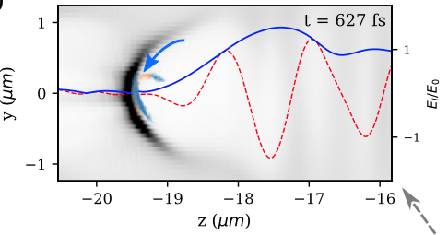
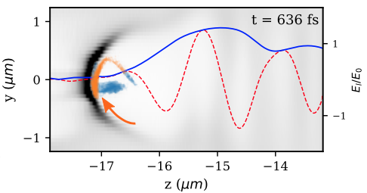
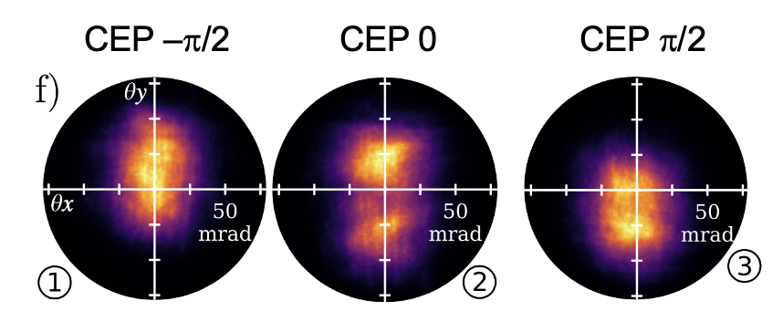
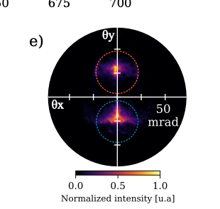
Interpretation (FBPIC): off-axis self-injection
Wake asymmetries driven by CEP
Off-axis self-injection
Initial transverse momentum
→ CEP dependent beam pointing
Including space charge and pointing fluct.
2 sub-beams from 2 injection events
Huijts & Rovige et al., Phys. Rev. X 12 011036 (2022); Rovige et al. Eur. Phys. J. Spec. Top. (2022)
Notes:
Say that we could never see these 2 sub-beams

Slide 8
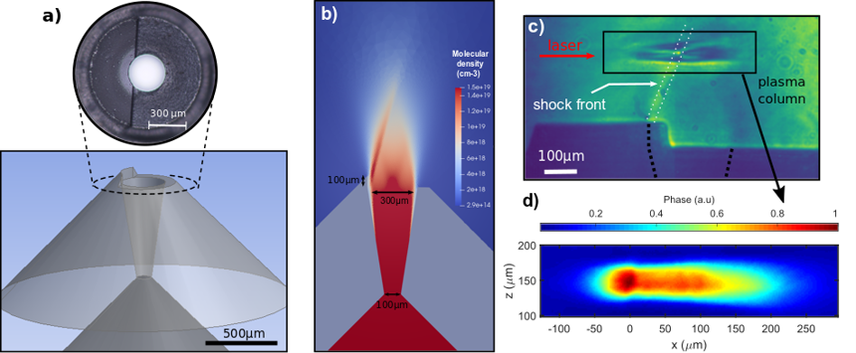
What about other injection mechanisms ? Gradient injection
Gradient injection in shocked micro-nozzles
Rovige et al., RSI 92, 083302 (2021); L. Rovige et al., PRAB 23, 093401 (2020)
1
1
2
Laser pulse
2
Slow down at the back of the plasma wave
Here injection is triggered by longitudinal dynamics of plasma wake
Mitigation of CEP effect is expected: factor of 2-3 decrease of beam oscillation was observed in PIC simulations in Huijts et al., Phys. Plasmas 28, 043101 (2021)

Slide 9
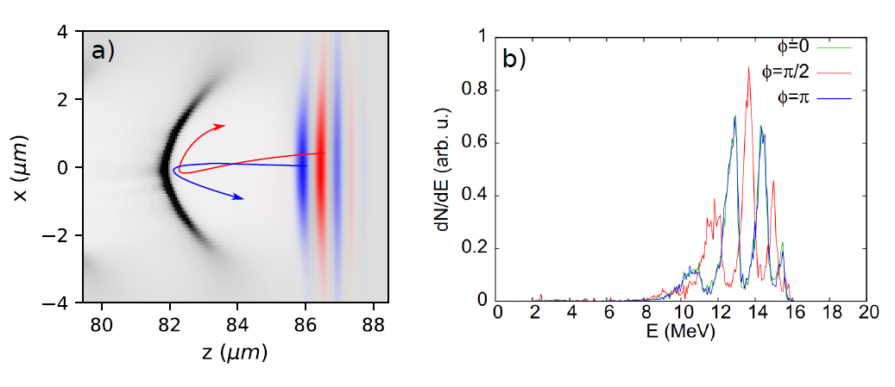
What about other ionization injection ?
Ionization injection
Minor modifications of electron energy
Transverse momentum depends on sign of E-field
CEP dependent beam pointing?
N⁶⁻⁷⁺
In our experiment, we tried:
H₂/N₂ (2%) →
H₂/CH₄ (2%) →
Lifschitz & Malka, NJP 14 053045 (2012)

Slide 10
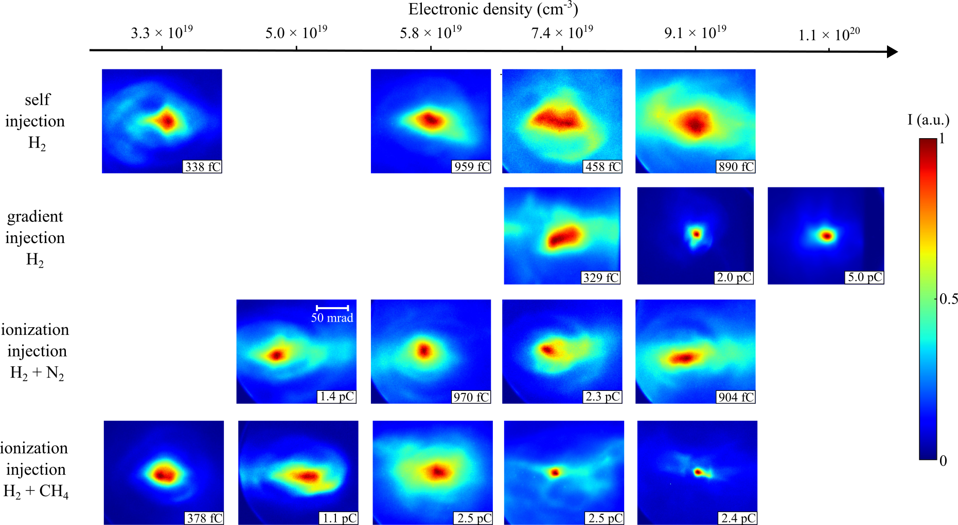
Overall behavior of e-beams in different injection schemes
Self-injection
pure H₂
15 mrad
5 MeV
ebeams
Gradient injection
pure H₂
Mixture H₂/N₂ (2%)
Mixture H₂/CH₄ (2%)

Slide 11
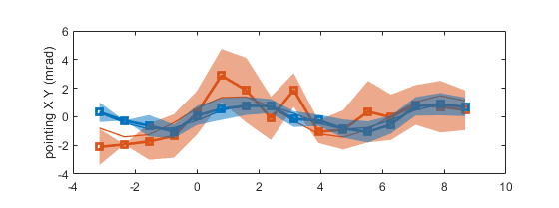
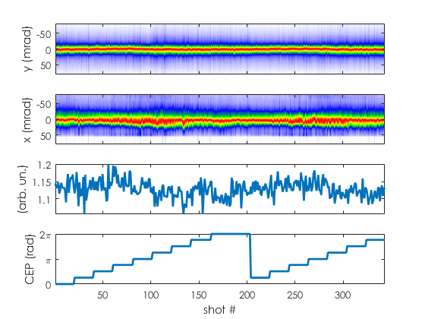
Mitigated CEP effects with gradient injected beams
Gradient injection: 140 bars (1.1x10²⁰ cm⁻³)
Beam centroid
polarization along x
CEP (rad)
Bad correlation in polarization direction (x) Amplitude (<2 mrad): 10 x less than previous
No significant energy changes
Q (a.u.
CEP
→ Similar to off-axis self-injection results but with reduced amplitude

Slide 12
Overall behavior of e-beams in different injection schemes
Self-injection
pure H₂
Gradient injection
pure H₂
50 mrad
1-2 MeV
ebeams
Mixture H₂/N₂ (2%)
Mixture H₂/CH₄ (2%)
Notes:
Explain difficult experiment: scans of scans. Needs stable beams, etc…

Slide 13
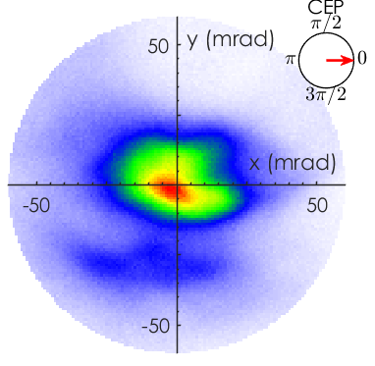
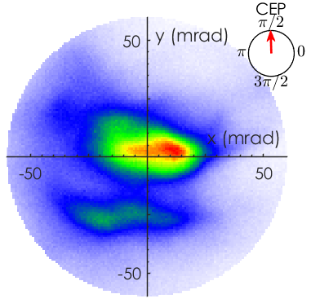
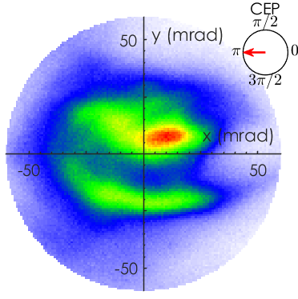
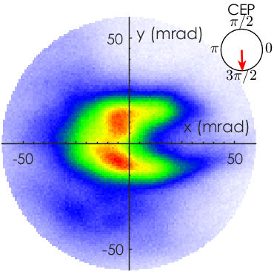
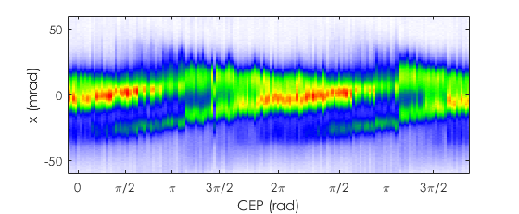
CEP effect in H₂/N₂ (2%) mixture
30 bars (2x10¹⁹ cm⁻³), polarization along y
CEP 0
CEP π/2
CEP π
CEP 3π/2
We observe an angular splitting of the beam (30 mrad) in the polarization direction.
Excellent correlation with the CEP
y (mrad)

Slide 14
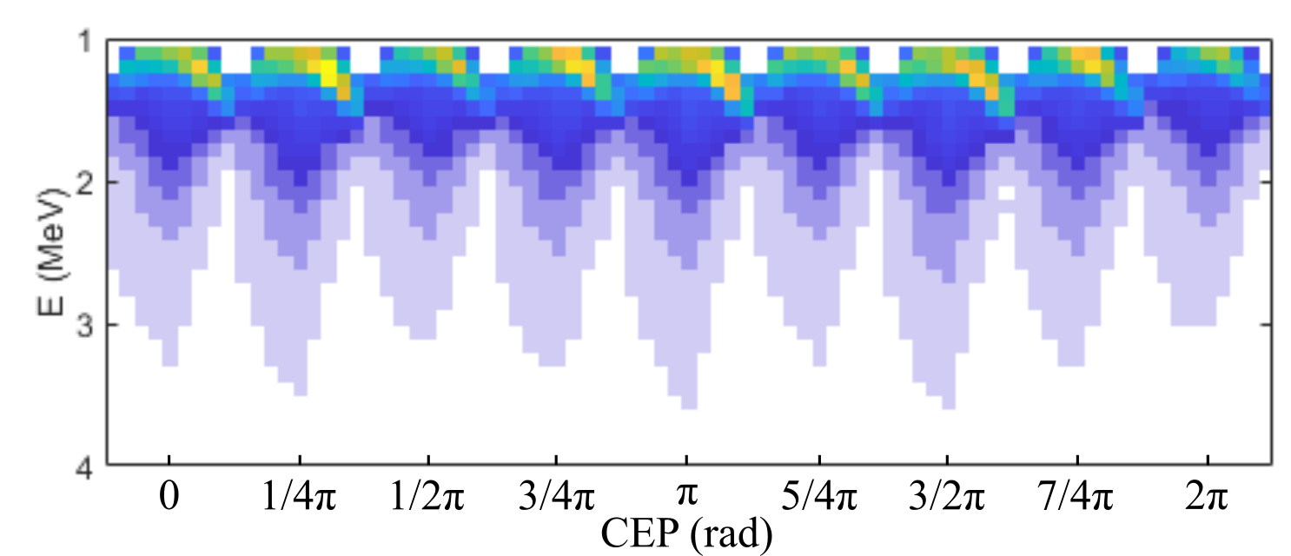
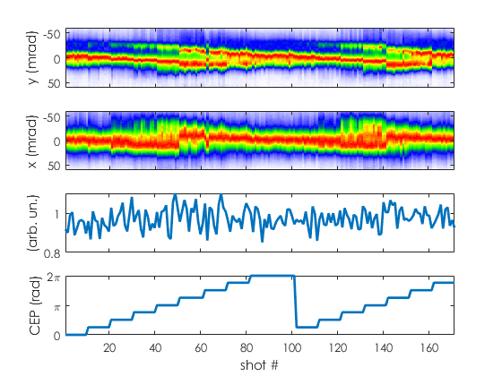
CEP effect in H₂/N₂ (2%) mixture
Polarization along y
Energy spectra
Q (a.u.
No significant charge variation
No significant energy variation
CEP
→ Is this a signature of ionization injection ?

Slide 15
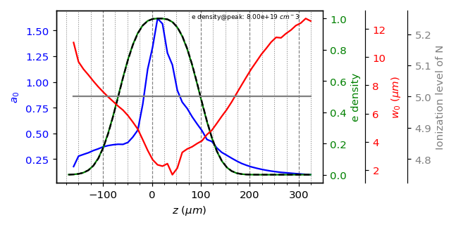
FBPIC indicates very small amount of ionization injection
Exp. focal spot, and pulse shape, n_{e} = 8x10¹⁹ cm⁻³
H₂/N₂ (2%)
Self-injection = 0.8 pC
Negligible ionization injection = 80 fC
Max intensity too small for significant ionization of N⁵⁺ :
→ Probably no significant ionization injection in experiment…

Slide 16
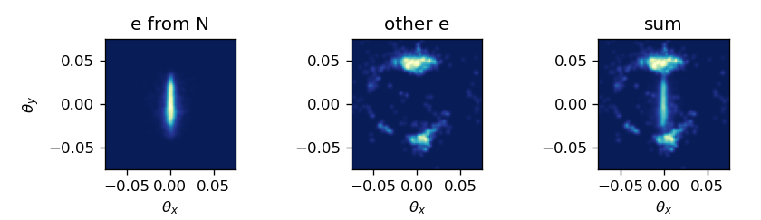
Ionization injection should lead to a different beam topology
We boost the doping to H₂/N₂ (20%)
Self-injection = 1.5 pC
Significant ionization injection = 0.5 pC
FBPIC
From N⁵⁺
Self-injection
Sum
Experiment
Beam topology is:
Consistent with off-axis self-injection
Inconsistent with ionization injection
→ Evidence that we are now seeing the 2 beamlets from 2 injection events

Slide 17
Let us speculate !
2 beamlets from 2 injection events
Is this 1 beamlet from a single sub-cycle injection event ?

Slide 18
Conclusions / perspectives
CEP π
In the few cycle regime, CEP effects can play a role
The wakefield becomes an asymmetric oscillating structure
Off-axis self-injection leads to CEP dependent beam pointing oscillations
Gradient injection mitigates the amplitude of the oscillation
The observation of 2 beamlets might be another signature of off-axis self-injection
Future explorations few cycle / CEP effects with ionization injection:
Self-injection in H₂/N₂ requires higher intensity
Alternatively, H₂/Ar mixture could also be tried
Upcoming beamtime on Sylos 3 at ELI-ALPS

Slide 19


We are hiring at LOA
1 postdoc position open on high rep. Rate LWFA
2 PhD position: Marie Sklodowka-Curie fellowship
https://www.epace.eu
Contacts:
jerome.faure@ensta.fr
cedric.thaury@ensta.fr

Slide 20
EXTRAS

Slide 21
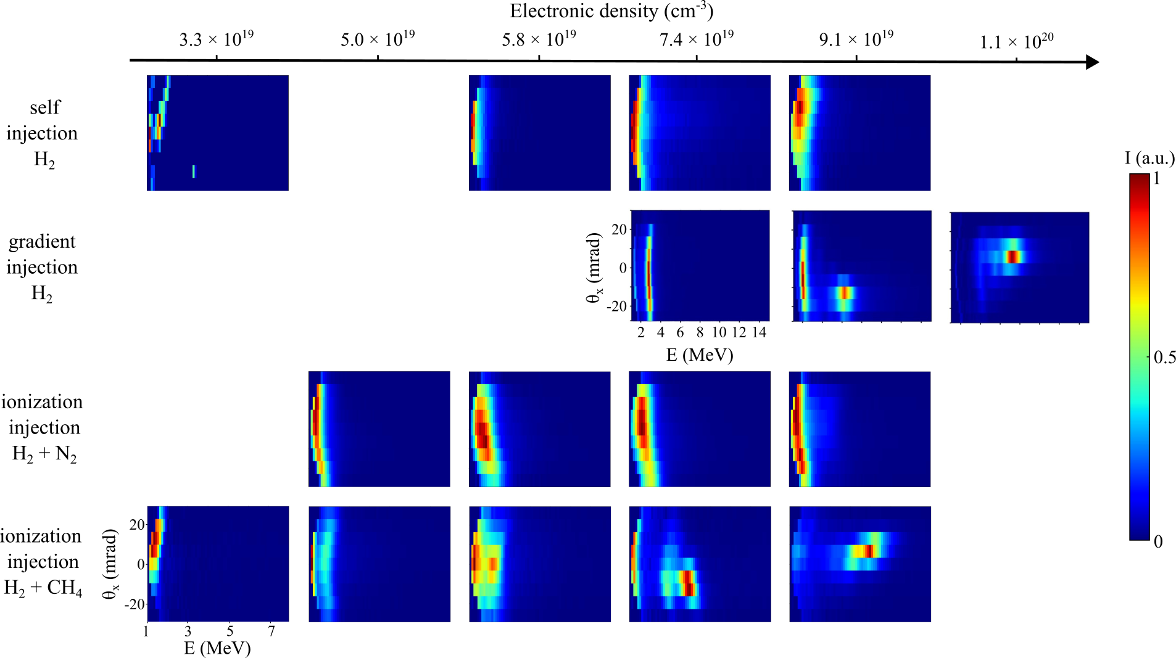

Spectra for different regimes

Slide 22
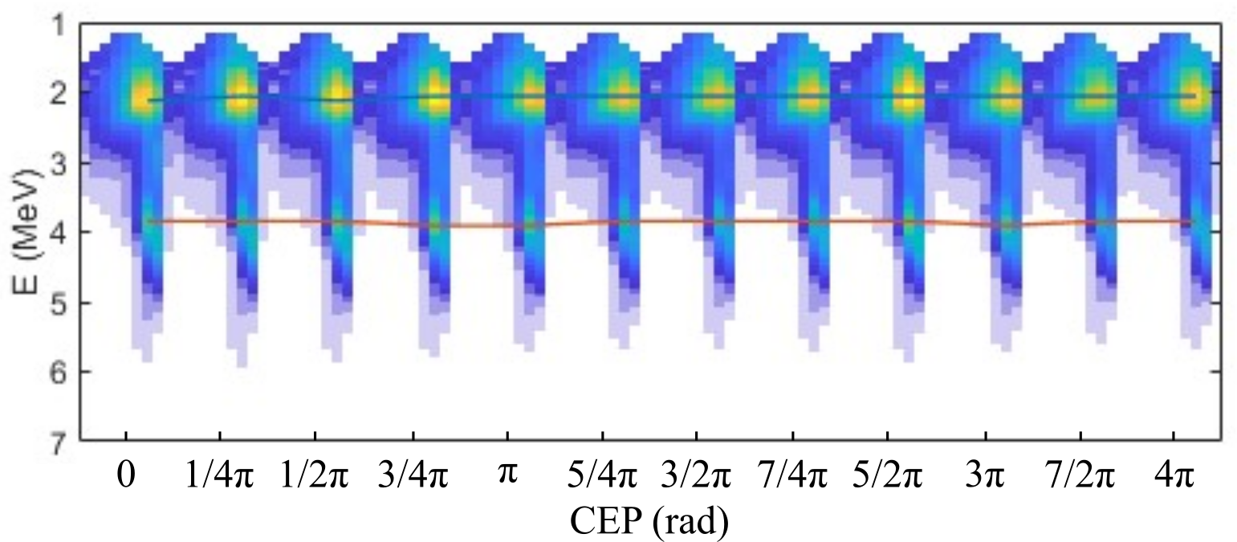
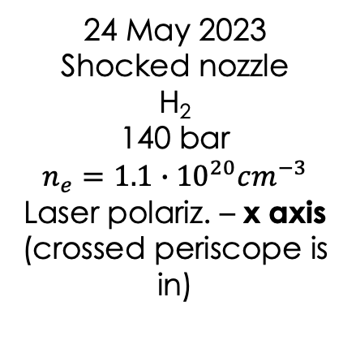
Gradient injection: no CEP effect visible on spectrum
Spectra vs CEP
24 May 2023
Shocked nozzle
H₂
140 bar
$$n_{e}=1.1∙{10}^{20}cm^{−3}$$
Laser polariz. – x axis
(crossed periscope is in)

Slide 23
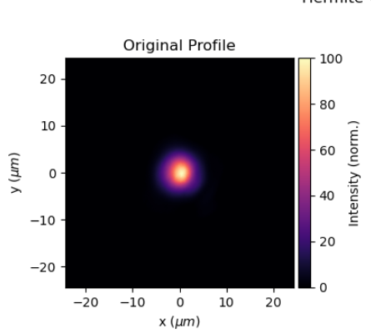
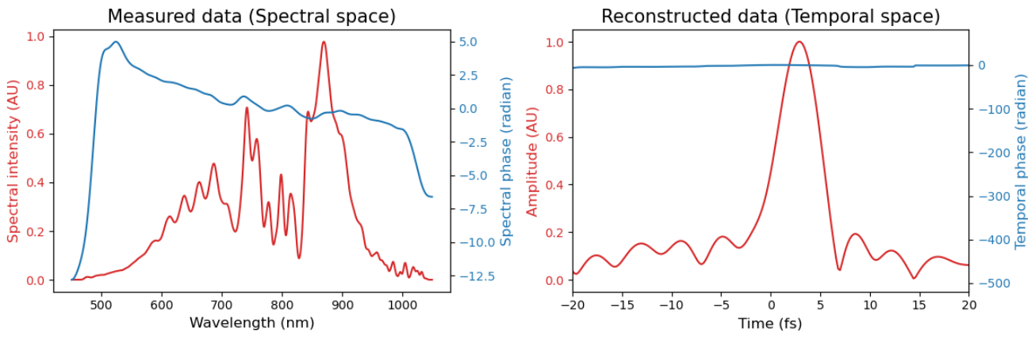
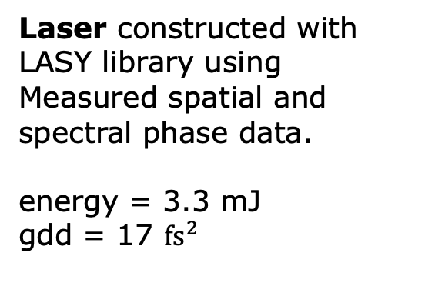
FBPIC important parameters of the simulation
PIC parameters:
4 azimuthal modes
p_nz = 4 # Number of particles per cell along z
p_nr = 4 # Number of particles per cell along r
p_nt = 16 # Number of particles per cell along theta
Preionized plasma:
Hydrogen: Z0_H = 1
Nitrogen: Z0_N = 5
Ne = 6x10¹⁸ cm⁻³
Laser constructed with LASY library using
Measured spatial and spectral phase data.
energy = 3.3 mJ
gdd = 17 $fs^{2}$

Slide 24
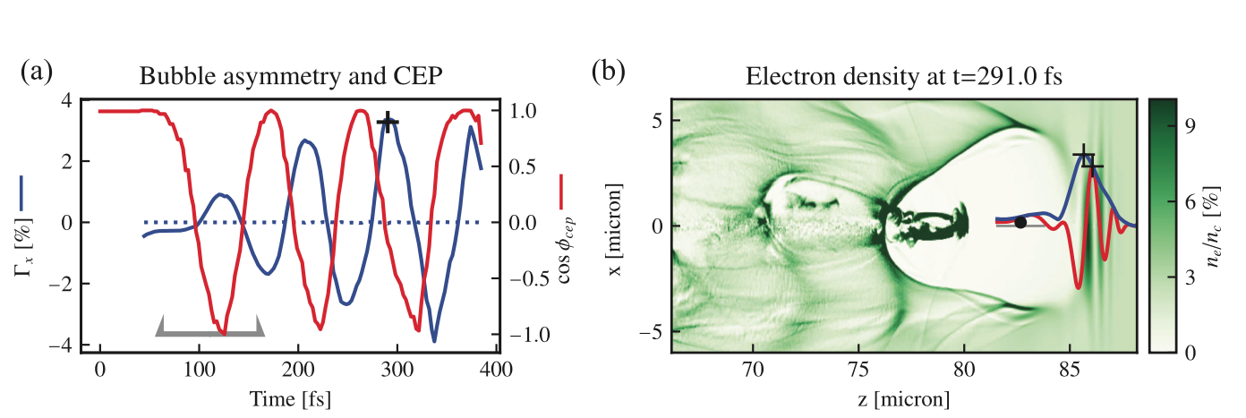

Predicted CEP-effects from asymmetric wakes
$a_{0}=4$ (vacuum), $τ=3$ fs
From PIC simulations:
Bubble oscillations in polarization plane
Causes off-axis injection with non zero transverse momentum
Experimental observables:
Minor modifications of electron energy distribution
CEP dependent beam pointing
Huijts et al., Phys. Plasmas 28, 043101 (2021)

Slide 25
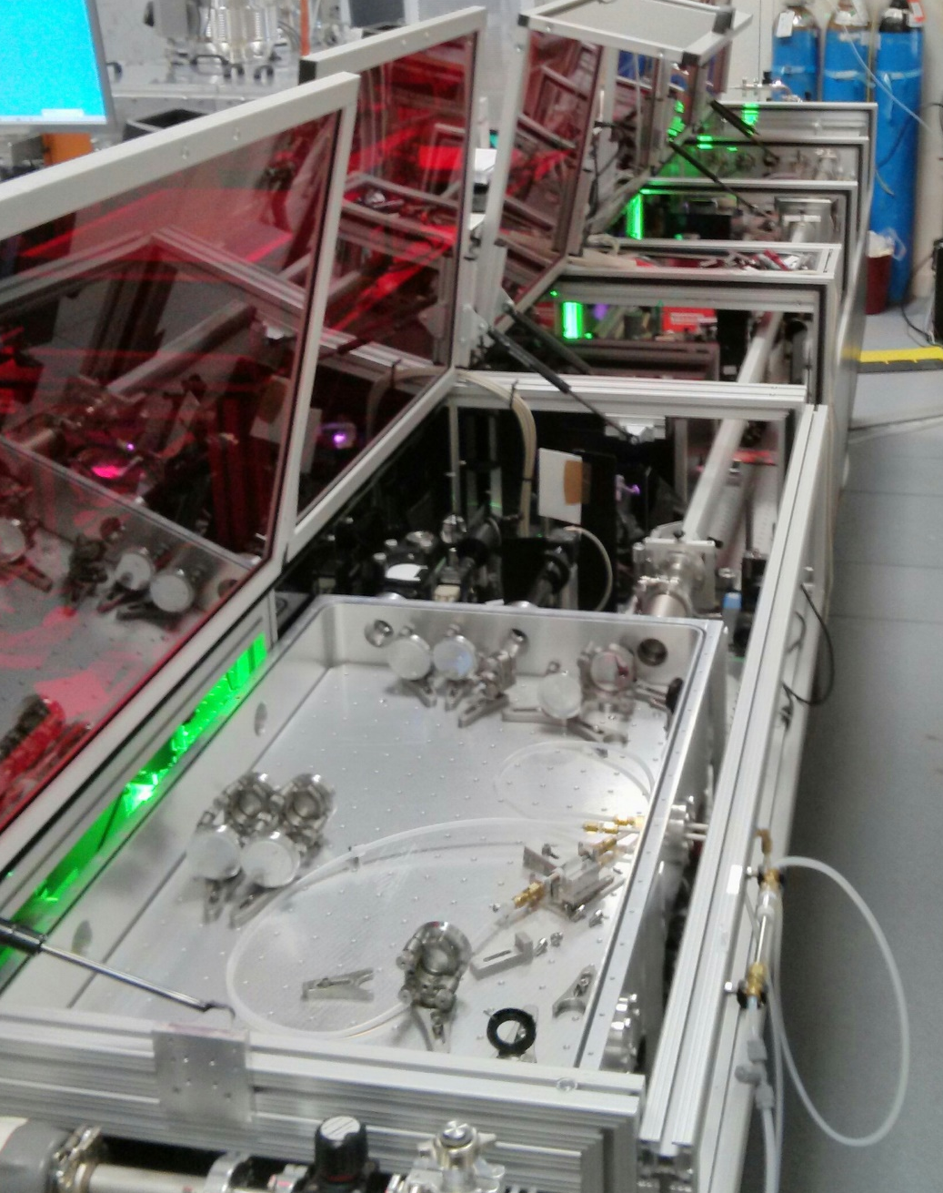
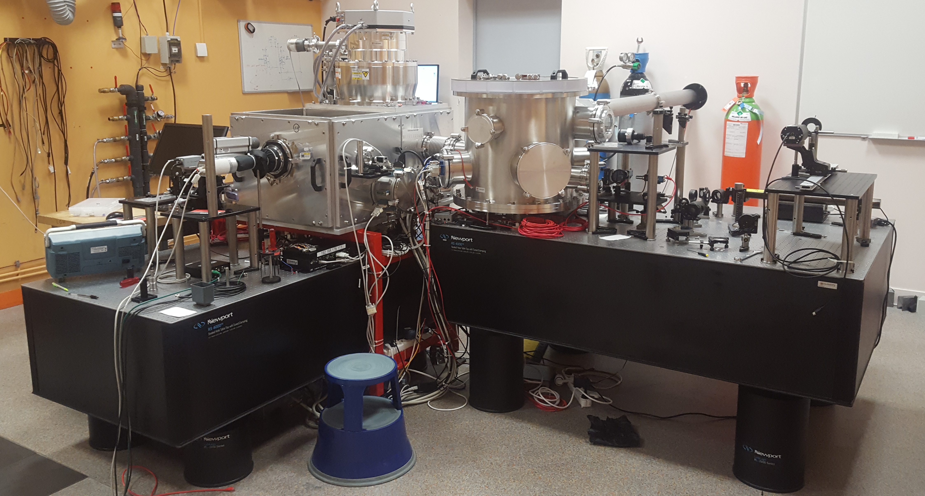
Experimental set-up: laser and accelerator

Slide 26
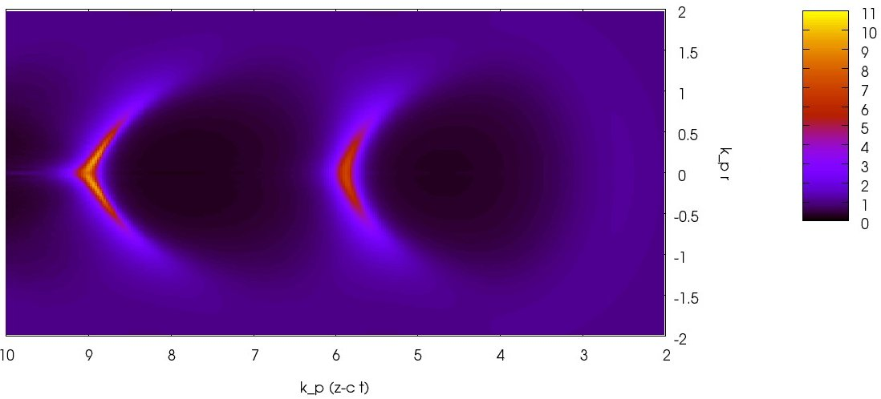
Scaling laws for a kHz laser wakefield acceleration
λ_{p}
R
Pulse
Laser pulse has to be resonant with plasma wave:
R≈λ_{p}/2, cτ≈λ_{p}/2
Laser energy scaling Electron energy gain
65 fs → 30 J → 5-10 GeV PW like
30 fs → 1 J → 100 MeV - 1 GeV 100 TW like
3 fs → mJ → 1-10 MeV
1 TW @ 1 kHz possible !
+ single cycle pulses !
Lu et al., PRSTAB 10, 0613001 (2007)
Beaurepaire et al., NJP 16, 023023 (2014)

Slide 27
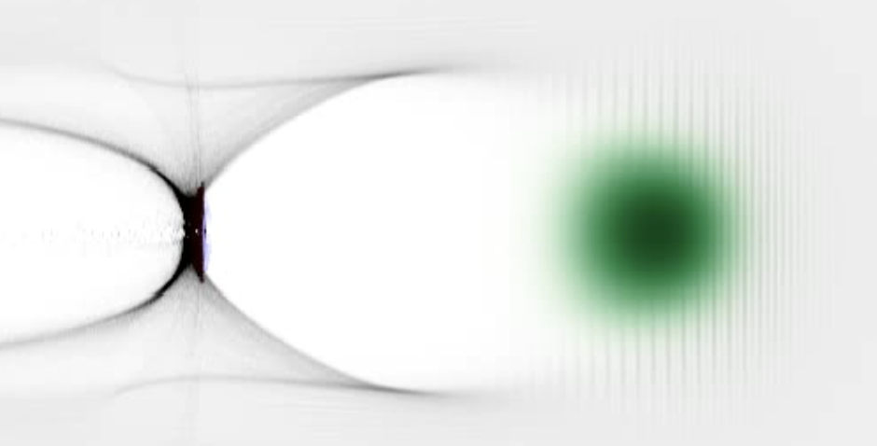
Asymmetric plasma response to single-cycle pulses
For “long” pulses (30 fs):
ponderomotive force is symmetric
→ Symmetric plasma wake
Single cycle pulses (3 fs):
Symmetry is broken in polarization plane
→ Asymmetric plasma response
Nerush & Kostyukov, PRL 103, 0035001 (2009)
Huijts et al., Phys. Plasmas 28, 043101 (2021)

Slide 28
Overall behavior of e-beams in different injection schemes
Self-injection
pure H₂
Gradient injection
pure H₂
Mixture H₂/N₂ (2%)
Mixture H₂/CH₄ (2%)
15 mrad
5 MeV
ebeams
Notes:
Explain about the difficulties of the experiment: beam has to stable, possibly looking for the highest energies, CEP needs to be stable. Difficulty with experimental variability: difficult to reproduce exactly the same beam parameters from day to day. So tried to carry out scans at least in the same day. Many parameters to scan for each injection schemes and then for a given optimized solution, we perform a CEP scan…

Slide 29
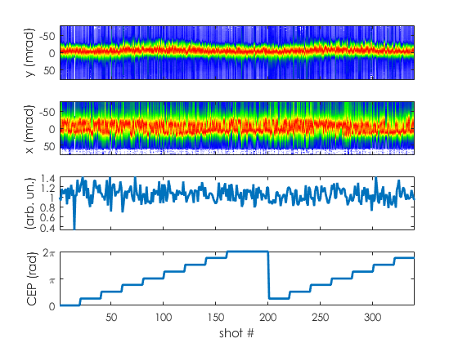
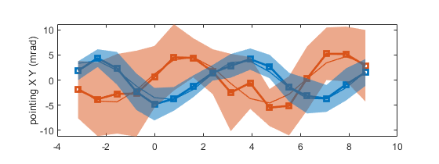
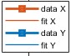
Beam pointing oscillations similar to previous study
CH₄ mixture: 100 bars (7.8x10¹⁹ cm⁻³)
Beam centroid
polarization along y
Q (a.u.
CEP (rad)
Good correlation in polarization direction (y) Amplitude +/- 5mrad
No significant energy changes
CEP
→ Comparable to previous off-axis self-injection results
Notes:
Note that for this scan, the energy was actually in the 1-2 MeV range

Slide 30
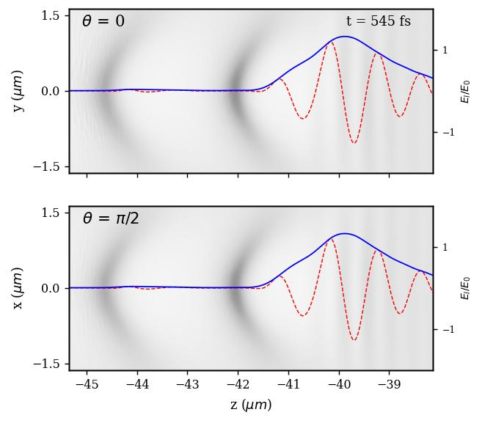
What is the physics ? PIC simulations
Polarization plane:
asymmetric
Perpendicular to
polarization plane:
symmetric
Huijts & Rovige et al., Phys. Rev. X 12 011036 (2022)

Slide 31
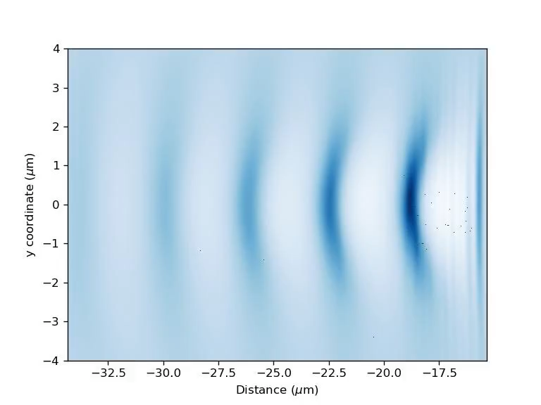
Ionization / off-axis injection

