Slide 1




Laser-Plasma Acceleration Workshop,
Ischia, 15 April 2025
Plasma electron acceleration
driven by a long-wave infrared (LWIR)* laser
Mike Downer, University of Texas at Austin
University of Texas at Austin:
Faculty: M. C. Downer
Research Scientist: R. Zgadzaj
PhD students: Y. Cao, J. Welch
Stony Brook University:
Faculty: Navid Vafaei-Najafabadi
Roman Samulyak
V. N. Litvinenko
Postdocs: L. D. Amorin, I. Petrushina
PhD Students: A. Cheng, A. Gaikwad,
P. Iapozzutto, P. Kumar
Brookhaven ATF*:
ATF Director: M. A. Palmer
Research Scientists: M. Babzien,
M. Fedurin, R. Kupfer, K. Kusche,
W. Li, I. V. Pogorelsky,
M. N. Polyanskiy, C. Swinson
UCLA:
Faculty: C. Joshi
Research Scientist: C. Zhang
*ATF = Accelerator Test Facility
LWIR lasers (and ATF) are poised to drive a new generation of laser-plasma accelerators
that deliver spin-polarized e-bunches with the ultra-low emittance and energy spread
required to drive free-electron lasers.
LWFA driven my MWIR laser (3.9 µm):
* 8 < 𝜆 < 15 µm
Woodbury et al., Opt. Lett. 43, 1131 (2018)
1

Slide 2
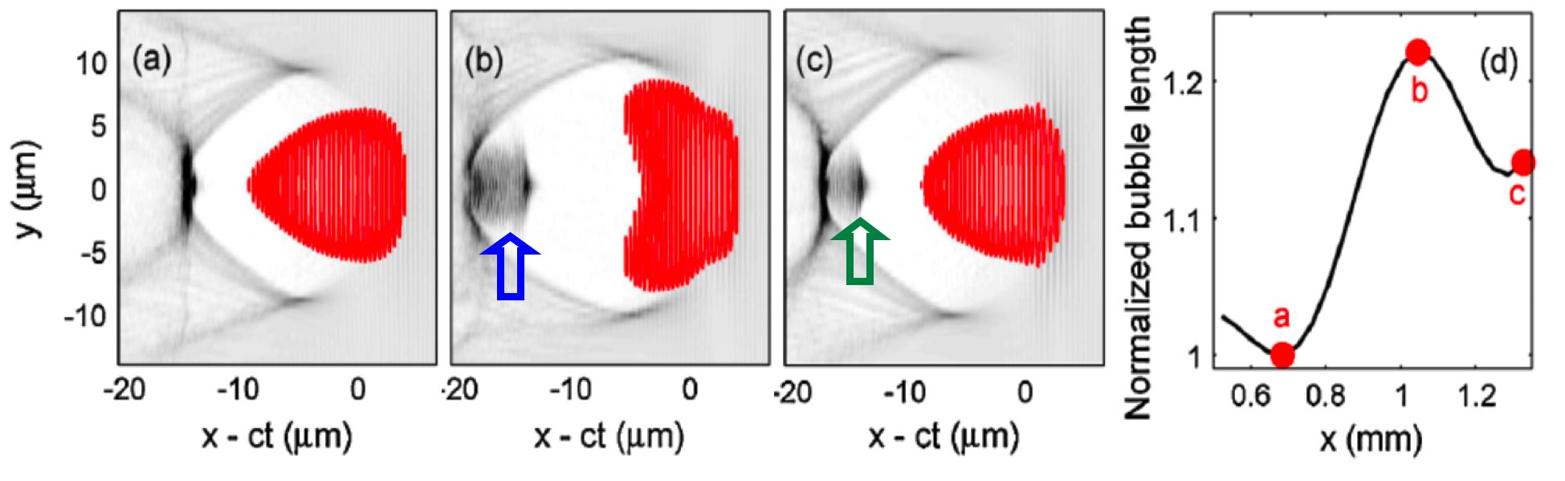
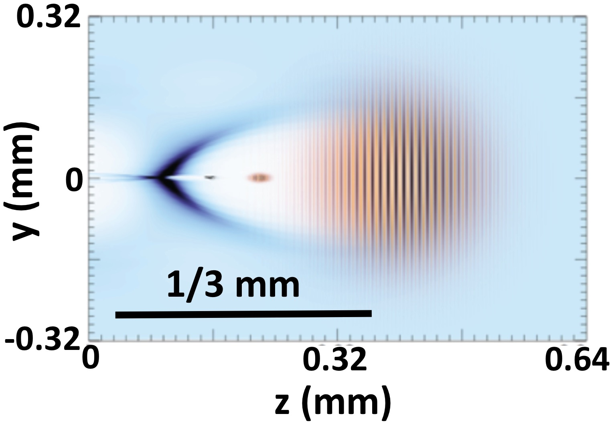
LWIR
Drive pulses with a₀ ≈ 4, τ ≈ ω_{p}⁻¹ , w₀ ≈ λ_{p}
generate
super-sized
plasma “bubbles”...
efficiently
plasma “bubbles”.
Pogorelsky et al., PPCF 58, 034003 (2016).
n_{e} ≈ 5 × 10¹⁸ cm⁻³
n_{e} ≈ 2 × 10¹⁶ cm⁻³
10
Externally-
injected
e-bunches
Externally-
injected
e-bunches
5
electron density (10¹⁸ cm⁻³)
x = 0 mm
x = 0.3 mm
x = 0.6 mm
0
λ [µm]:
1
10
λ [µm]:
1
10
within reach
at ATF
τ [fs]:
30
30
(τ ≈ 1 cycle)
τ [fs]:
500
500
w₀ [µm]:
8
8
(w₀ < λ)
(inefficient, impractical)
w₀ [µm]:
120
120
Polyanskiy et al.,
Photonics 8,
101 (2021)
Laser Energy [J]:
0.7
0.007
Energy [J]:
1250
12.5
Max e⁻ energy gain [GeV]:
0.6
Max e⁻ energy gain [GeV]:
1.6
Plasma electrons self-inject into a
region of strong EM field gradients.
Plasma electrons do not self-inject.
External injection is necessary.
...that preserve the low ℇ_{n}, low ∆E_{e}/E_{e}, spin polarization of linac-injected e-bunches.

Slide 3
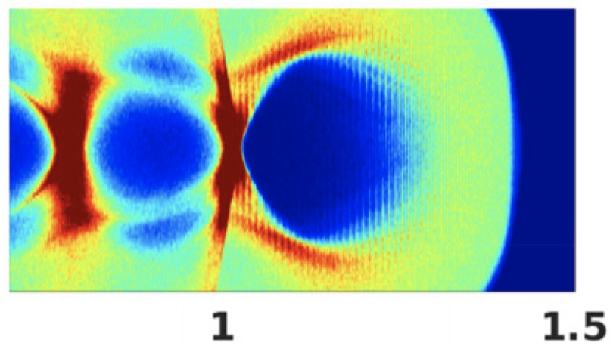

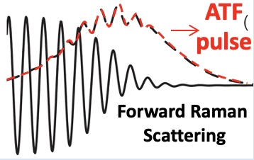
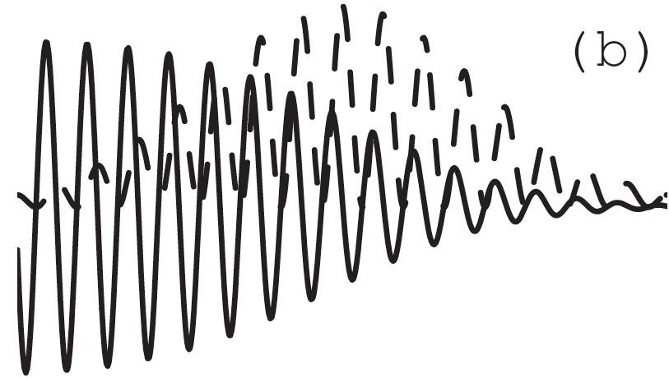
TW CO₂ laser technology & LWFA science advance hand-in-hand
CO₂ laser technology
LWFA regime
wake structure
plasma parameters
& diagnostics
electrons
10-15J, 0.5 ps, 20-30 TW
CO₂: isotopically enriched,
9R + 9P branches
CPA: augmented by nonlinear
post-compression
Polyanskiy, Opt. Expr. 29, 31714 (2021)
Kumar, Phys. Plasmas 28, 013102 (2021)
bubble
regime
AE-?? (2024-26)
100
x [µm]
𝛿n/n_{e0}
1 < n_{e} ≲ 4 × 10¹⁶ cm⁻³
external injection
• linac (synched, compressed)
• 2-color ionization
0
electron radiography,
Faraday rotation
-100
z [mm]
P = 20 TW, n_{e0} = 2x10¹⁶ cm⁻³, a₀ = 3.8
3-10J, 2 ps, 1.5-5 TW
CO₂: isotopically enriched,
9R branch, 𝜆 = 9.2 µm
CPA: 140 ps stretch; 100 l/mm,
75% T compressor
Polyanskiy, OSA Cont. 3, 459 (2020)
ATF
pulse
nonlinear
SM-LWFA,
forced LWFA
AE-95 (2022-24)
1 < n_{e} < 4 x 10¹⁷ cm⁻³
1.7 > P_{cr} > 0.5 TW
electron spectrometer
Q ≈ 1-500 pC
E_{e} ≈ 5-25 MeV
exponential & peaked
electron spectra
nonlinear wake
2J, 4 ps, 0.5 TW
CO₂: natural, 10R branch,
𝜆 = 10.3 µm
CPA: 25 ps stretch; 75 l/mm,
50% T compressor
Polyanskiy, Optica 2, 675 (2015)
linear
SM*-LWFA
(*Self-Modulated)
AE-71 (2018-20)
0.5 < n_{e} < 2 x 10¹⁸ cm⁻³
0.4 > P_{cr} > 0.1 TW
collective Thomson scatter
CPA (ATF) →
NONE
linear wake
60J, 300 ps, 0.2 TW
λ₁ = 10.59 µm;
λ₂ = 10.29 µm
PBWA
Plasma Beat-
Wave Accelerator
Clayton, PRL 70, 37 (1993)
laser
2-color
(MARS)
Q ≈ 5 fC
E_{e} ≈ 9 MeV
n_{e} = 8.6 x 10¹⁵ cm⁻³
linear wake
3

Slide 4
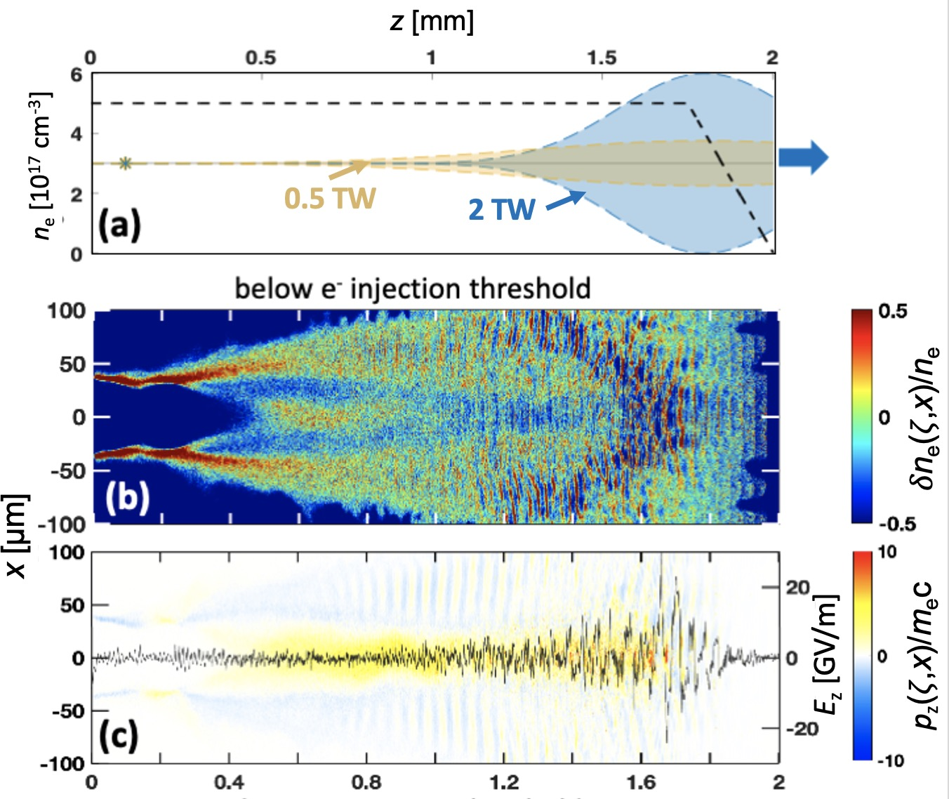
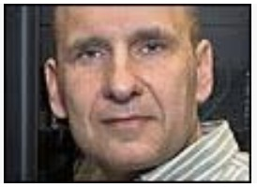
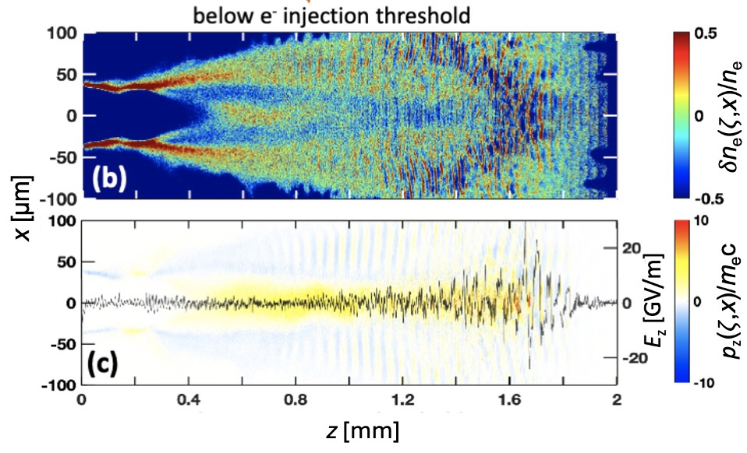

SPACE* simulations predicted detectable SM wakes,
but no accelerated electrons for P_{L} = 0.5 TW (2 J, 4 ps) CO₂ pulses
*
Yu et al., Comp. Phys. Commun. 277, 108396 (2022).
*
ion motion and atomic physics included
*
3D, parallel, relativistic PIC
simulations by...
z [mm]
Prof. Roman Samulyak
Only p_{z} attributable to
wake itself are observed.
Aiqi Cheng
4

Slide 5
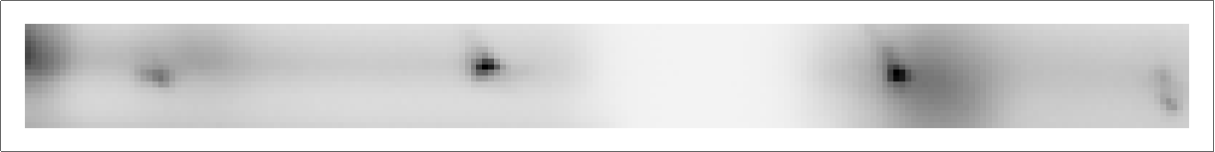
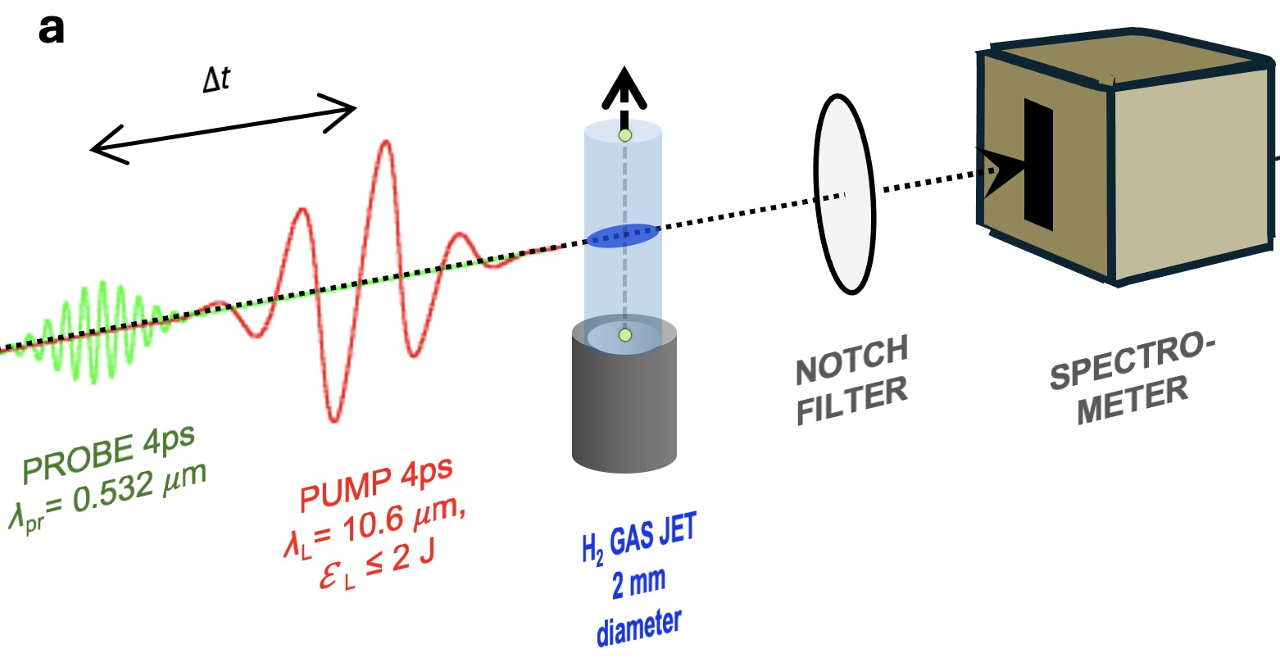

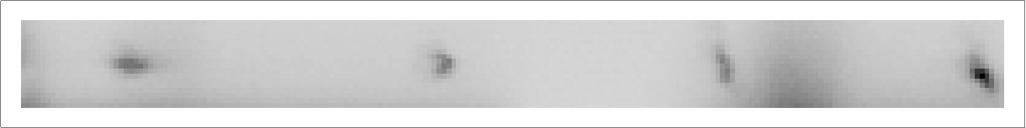
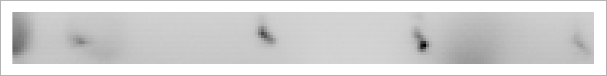
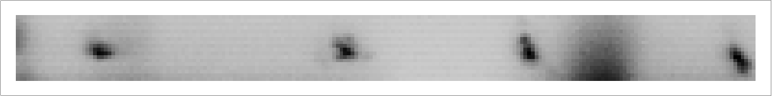
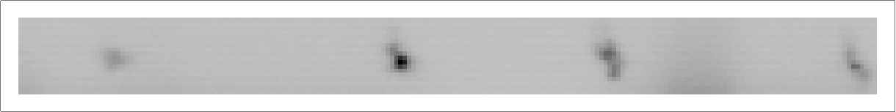
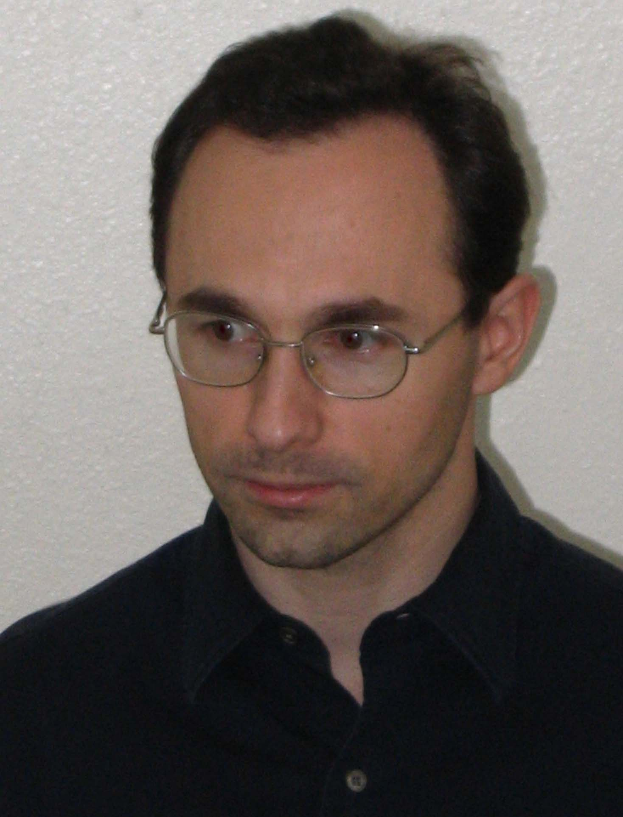
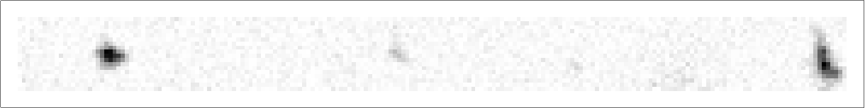
Collective Thomson Scatter (CTS)*
experiments to observe wakes
anti-
Stokes
Stokes
*
Slusher, Phys. Fluids 23, 472 (1980)
Villenueve, JOSA B 8, 895 (1991)
sum-
frequency
difference-
frequency
1.69
∆t
1.45
1.11
Notch filtered
n_{e} [10¹⁸ cm⁻³]
0.98
0.75
experiments led by...
0.63
rms jitter:
1 ps
120 cycles,
~30 𝜈_{p}⁻¹
0.57
-30
-20
-10
0
10
20
30
collective Thomson shift [nm]
Dr. Rafal
Zgadzaj
(UT-Austin)
(data for ∆t = 0, P = 0.5 TW, n_{e} variable)
5

Slide 6
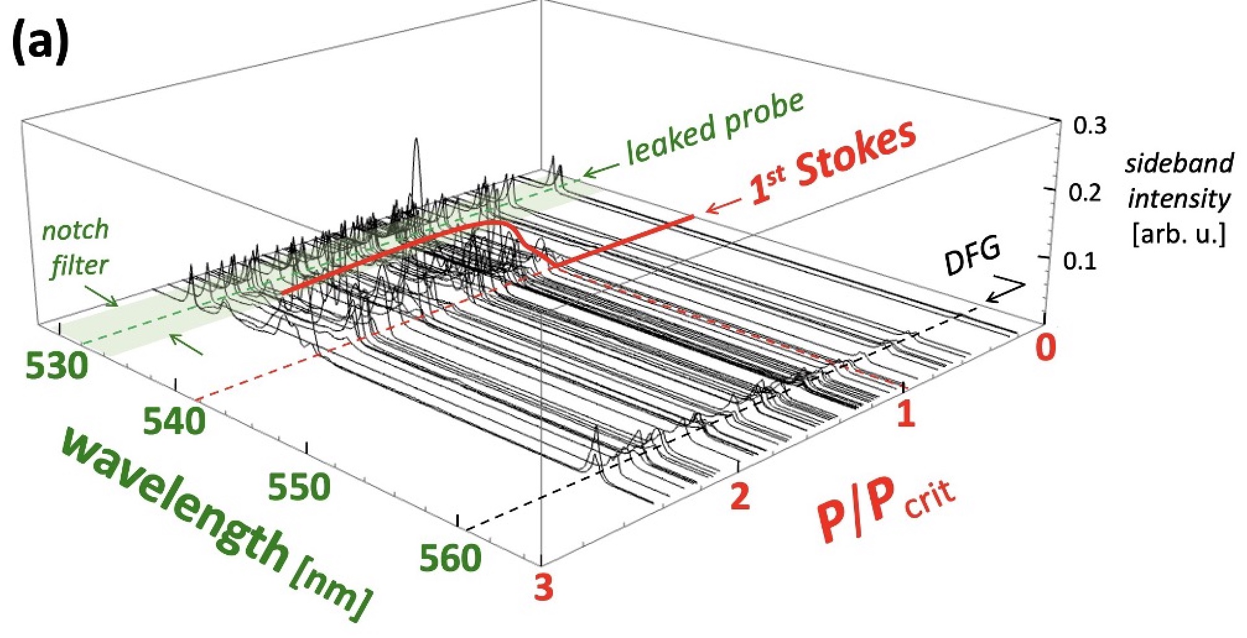
CTS data: variable CO₂ laser power P
(data for ∆t = 0, n_{e} = 1.3 × 10¹⁸ cm⁻³)
Stokes/anti-Stokes sidebands appear for P > P_{cr}
6

Slide 7
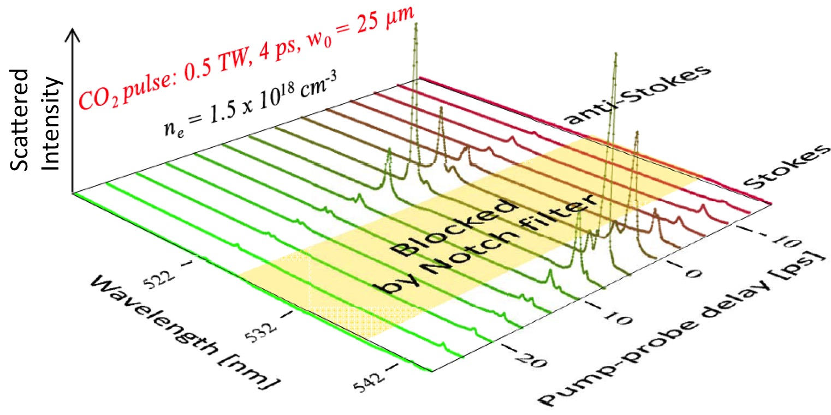
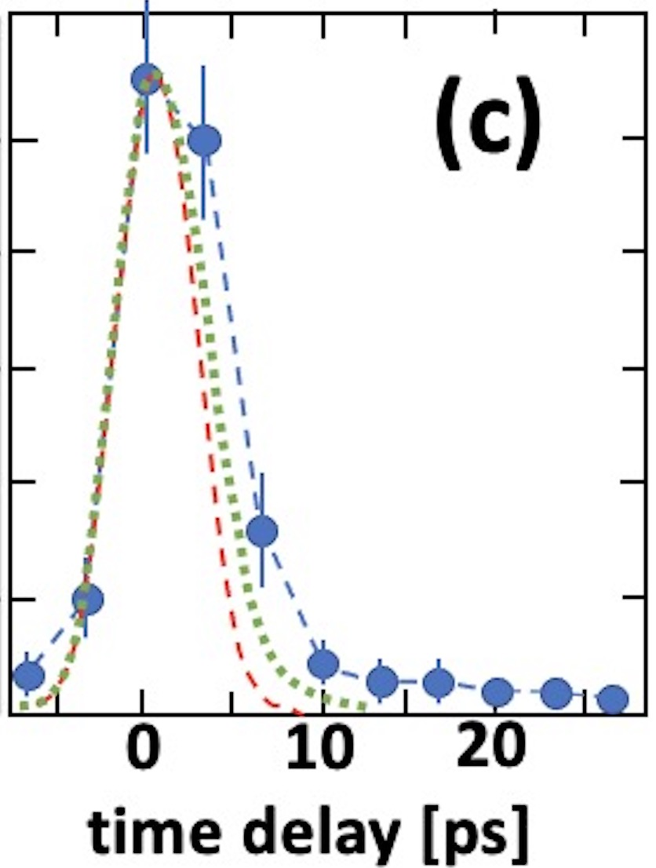
CTS data: variable time delay ∆t
(n_{e} = 1.5 × 10¹⁸ cm⁻³ , P_{L} = 0.5 TW = 3.75 P_{cr})
1
pu-pr
x-corr^{n}
PIC
Averaged & normalized
sideband amplitude
0.5
EXP
0
For further details, see:
• transverse wakes
• plasma channel
• ion acoustic waves
epw decays by converting into
Zgadzaj et al., Nat. Commun. 15, 4037 (2024)
7

Slide 8
TW CO₂ laser technology & LWFA science advance hand-in-hand
CO₂ laser technology
LWFA regime
wake structure
plasma parameters
& diagnostics
electrons
10-15J, 0.5 ps, 20-30 TW
CO₂: isotopically enriched,
9R + 9P branches
CPA: augmented by nonlinear
post-compression
Polyanskiy, Opt. Expr. 29, 31714 (2021)
Kumar, Phys. Plasmas 28, 013102 (2021)
bubble
regime
AE-?? (2024-26)
100
x [µm]
𝛿n/n_{e0}
1 < n_{e} ≲ 4 × 10¹⁶ cm⁻³
external injection
• linac (synched, compressed)
• 2-color ionization
0
electron radiography,
Faraday rotation
-100
z [mm]
P = 20 TW, n_{e0} = 2x10¹⁶ cm⁻³, a₀ = 3.8
3-6J, 2 ps, 1.5-3 TW
CO₂: isotopically enriched,
9R branch, 𝜆 = 9.2 µm
CPA: 140 ps stretch; 100 l/mm,
75% T compressor
Polyanskiy, OSA Cont. 3, 459 (2020)
ATF
pulse
nonlinear
SM-LWFA,
forced LWFA
AE-95 (2022-24)
0.3 < n_{e} < 4 x 10¹⁷ cm⁻³
1.7 > P_{cr} > 0.5 TW
electron spectrometer
Q ≈ 1-500 pC
E_{e} ≈ 5-25 MeV
exponential & peaked
electron spectra
nonlinear wake
2J, 4 ps, 0.5 TW
CO₂: natural, 10R branch,
𝜆 = 10.3 µm
CPA: 25 ps stretch; 75 l/mm,
50% T compressor
Polyanskiy, Optica 2, 675 (2015)
linear
SM*-LWFA
(*Self-Modulated)
AE-71 (2018-20)
0.5 < n_{e} < 2 x 10¹⁸ cm⁻³
0.4 > P_{cr} > 0.1 TW
collective Thomson scatter
CPA (ATF) →
NONE
linear wake
60J, 300 ps, 0.2 TW
λ₁ = 10.59 µm;
λ₂ = 10.29 µm
PBWA
Plasma Beat-
Wave Accelerator
Clayton, PRL 70, 37 (1993)
laser
2-color
(MARS)
Q ≈ 5 fC
E_{e} ≈ 9 MeV
n_{e} = 8.6 x 10¹⁵ cm⁻³
linear wake
8

Slide 9
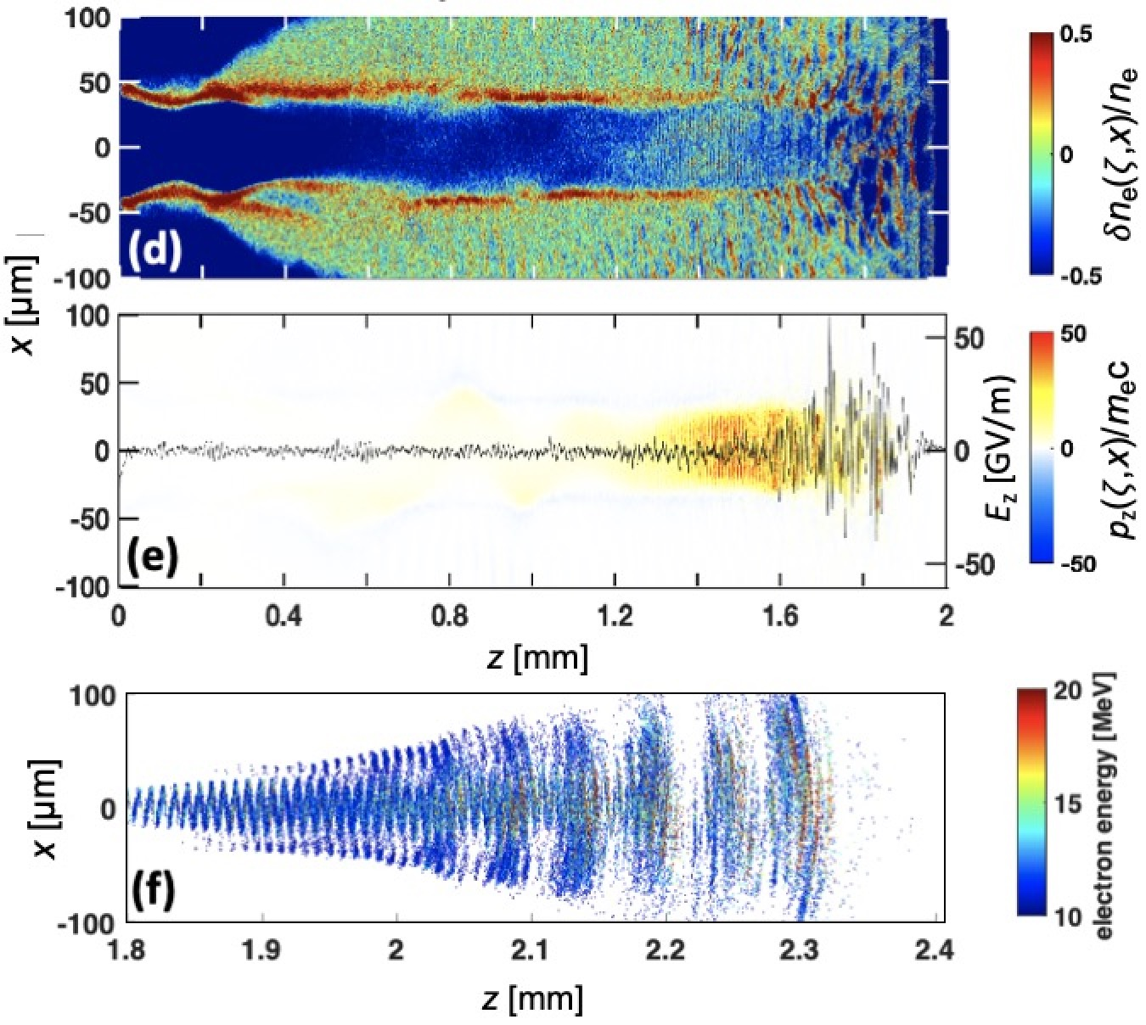


SPACE simulations predicted electron injection
and acceleration for P_{L} = 2 TW (4 J, 2 ps) CO₂ pulses
simulations by A. Cheng & R. Samulyak
Zgadzaj et al., Nat. Commun. 15, 4037 (2024)
P_{L} = 2 TW (4 J, 2 ps)
n_{e} = 5 × 10¹⁷ cm⁻³
above e⁻ injection threshold
0
1
2
z (mm)
p_{z} from trapped,
accelerated e- observed
simulations by...
e⁻ output
Q ≈ 50 pC
$\left\langle E_{e}\right\rangle ≈8$ MeV
Prof. Roman Samulyak
$∆θ_{HWHM}$~ 75 mrad
Aiqi Cheng
9

Slide 10
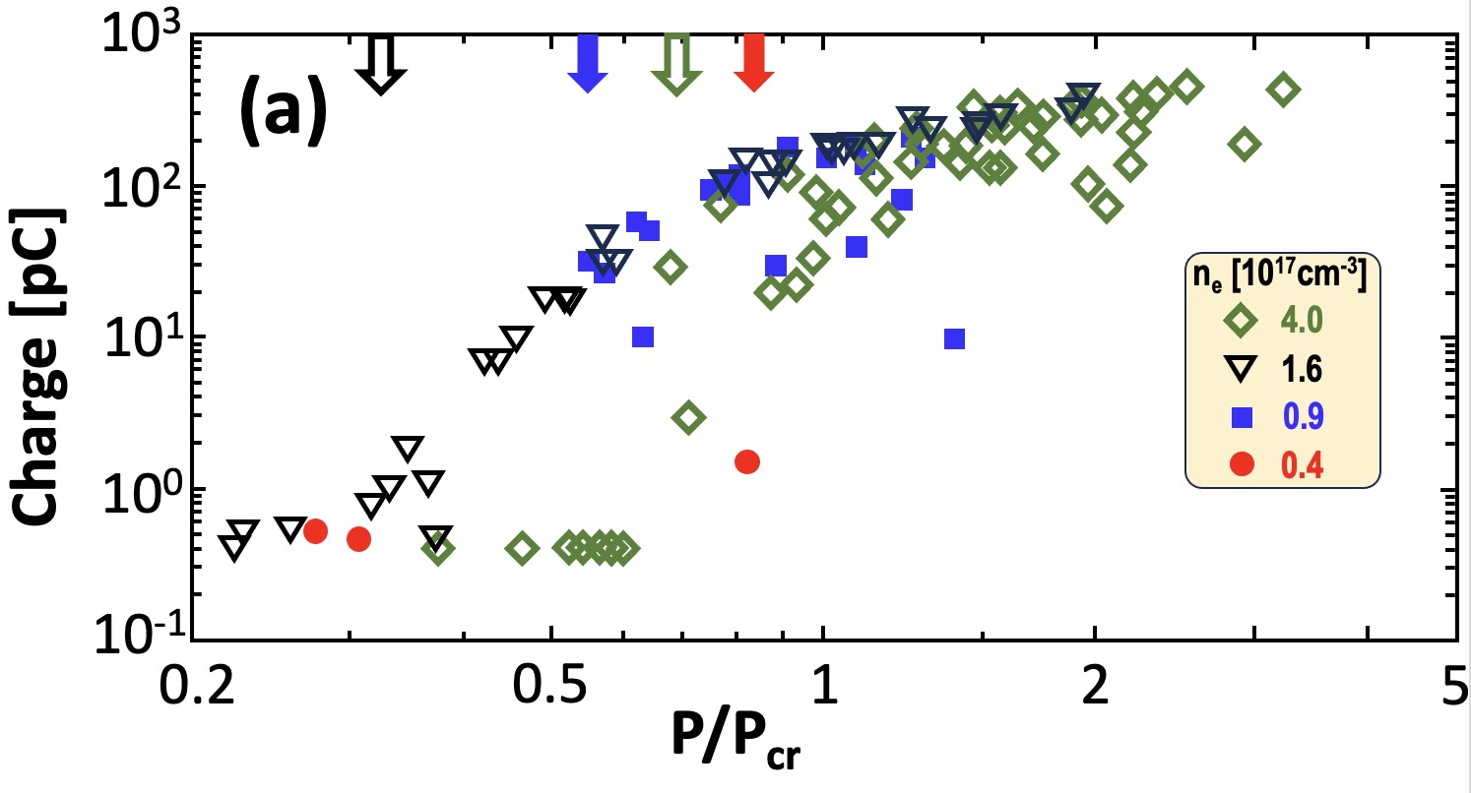
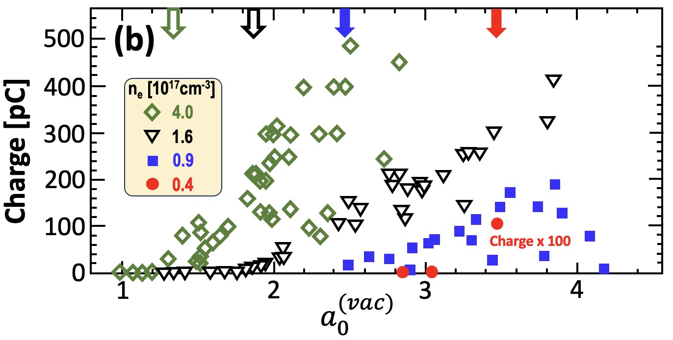

Detection and Characterization of
relativistic electron beams
P appearance thresholds
⇒ all are sub-P_{cr}
Q_{max} ≈ 500 pC
For 2 TW pulses,
self-focusing no
longer essential
to trigger LWFA.
H₂
jet
e⁻
$a_{0}^{(vac)}$appearance thresholds
⇒ all are relativistic
Lanex
CO₂ pulse
2-5 J, 2ps
CCD
integrated luminescence
⇒ total charge Q
10

Slide 11
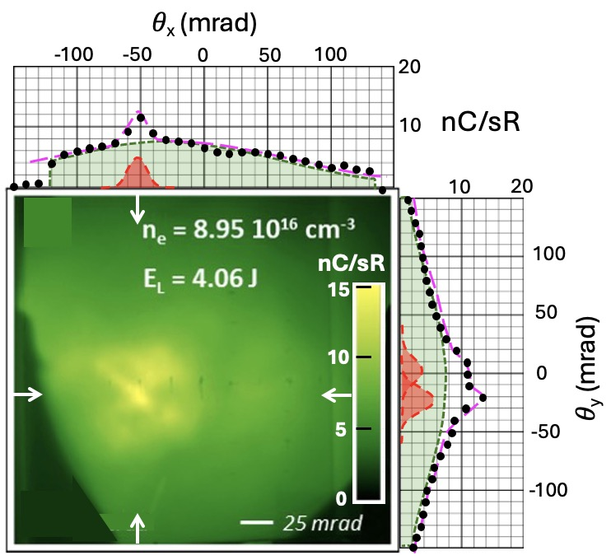
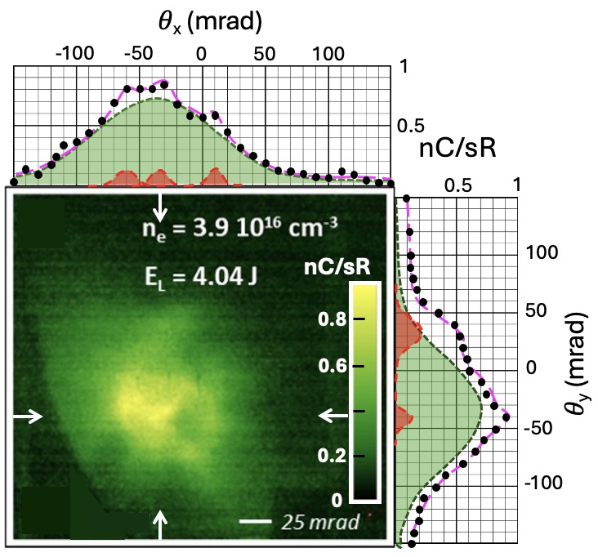
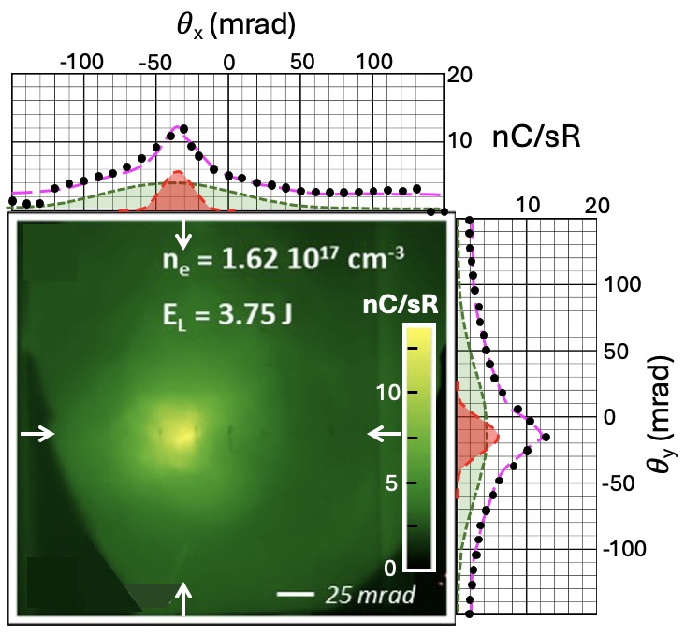
Transverse profiles of 90% of
e-beams have 2-components
H₂
jet
e⁻
Key to lineouts
data
Lanex
wide
Gaussian
CO₂ pulse
2-5 J, 2ps
narrow
Gaussian
CCD
wide (w) Gaussians: 60 < 𝜎_{w} < 120 mrad
narrow (n) Gaussians: 12 < 𝜎_{n} < 18 mrad
11

Slide 12
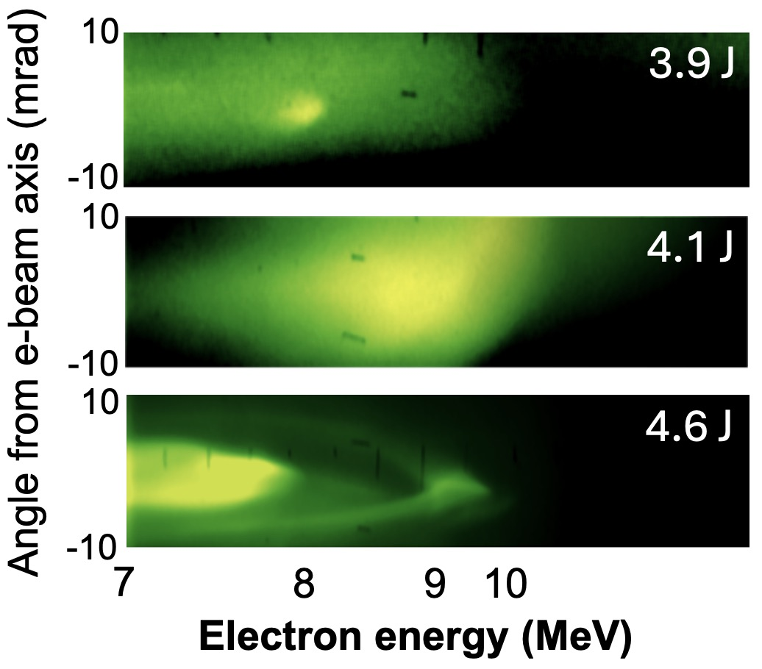
Electron energy spectra have
2 corresponding components
n_{e} = 4 × 10¹⁷ cm⁻³
*
H₂
jet
*
magnet
CCD
Lanex
*
CO₂ pulse
2-5 J, 2ps
*
Collimated quasi-monoenergetic
e-spectral features
⇒ transition from
SM-LWFA → bubble regime
12

Slide 13
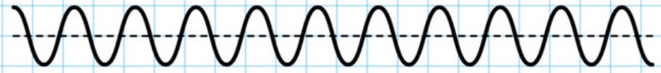
“Bubble”
Regime
*
”Forced” LWFA
4 × 10¹⁷ cm⁻³
3 × 10¹⁶ cm⁻³
~10¹⁶ cm⁻³
2 ps
4-6 J
2 ps
4-6 J
~ 0.5 ps
~ 10 J
10 wake periods
3 wake periods
~1/2 wake period
*
Malka et al., “Electron acceleration by a wake field forced by an intense ultrashort laser pulse” Science 298, 1596 (2002)
13

Slide 14
TW CO₂ laser technology & LWFA science advance hand-in-hand
CO₂ laser technology
LWFA regime
wake structure
plasma parameters
& diagnostics
electrons
10-15J, 0.5 ps, 20-30 TW
CO₂: isotopically enriched,
9R + 9P branches
CPA: augmented by nonlinear
post-compression
Polyanskiy, Opt. Expr. 29, 31714 (2021)
Kumar, Phys. Plasmas 28, 013102 (2021)
bubble
regime
AE-?? (2024-26)
100
x [µm]
𝛿n/n_{e0}
1 < n_{e} ≲ 4 × 10¹⁶ cm⁻³
external injection
• linac (synched, compressed)
• 2-color ionization
0
electron radiography,
Faraday rotation
-100
z [mm]
P = 20 TW, n_{e0} = 2x10¹⁶ cm⁻³, a₀ = 3.8
3-10J, 2 ps, 1.5-5 TW
CO₂: isotopically enriched,
9R branch, 𝜆 = 9.2 µm
CPA: 140 ps stretch; 100 l/mm,
75% T compressor
Polyanskiy, OSA Cont. 3, 459 (2020)
ATF
pulse
nonlinear
SM-LWFA,
forced LWFA
AE-95 (2020-24)
1 < n_{e} < 4 x 10¹⁷ cm⁻³
1.7 > P_{cr} > 0.5 TW
electron spectrometer
Q ≈ 1-500 pC
E_{e} ≈ 5-25 MeV
exponential & peaked
electron spectra
nonlinear wake
2J, 4 ps, 0.5 TW
CO₂: natural, 10R branch,
𝜆 = 10.3 µm
CPA: 25 ps stretch; 75 l/mm,
50% T compressor
Polyanskiy, Optica 2, 675 (2015)
linear
SM*-LWFA
(*Self-Modulated)
AE-71 (2018-20)
0.5 < n_{e} < 2 x 10¹⁸ cm⁻³
0.4 > P_{cr} > 0.1 TW
collective Thomson scatter
CPA (ATF) →
NONE
linear wake
60J, 300 ps, 0.2 TW
λ₁ = 10.59 µm;
λ₂ = 10.29 µm
PBWA
Plasma Beat-
Wave Accelerator
Clayton, PRL 70, 37 (1993)
laser
2-color
(MARS)
Q ≈ 5 fC
E_{e} ≈ 9 MeV
n_{e} = 8.6 x 10¹⁵ cm⁻³
linear wake
14

Slide 15
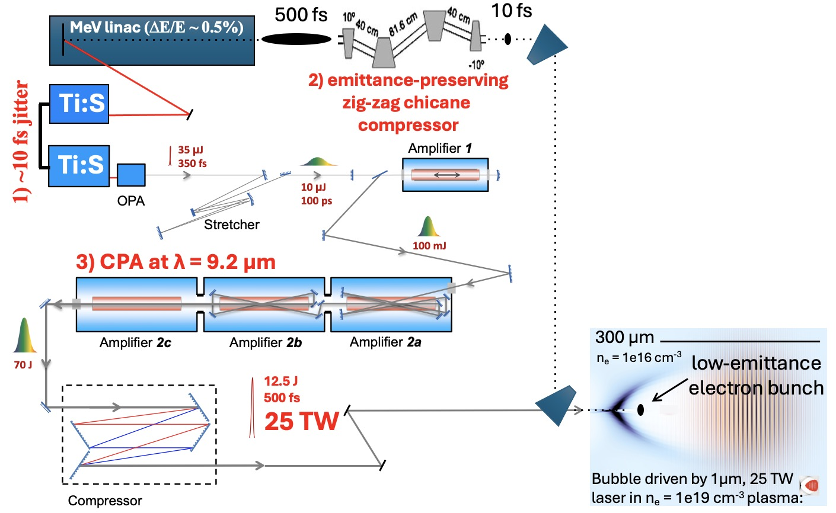
Next-generation ATF experiments will inject
~ 70 MeV electrons from linac into large LWFA
Dream parameters:
1) 10 fs laser-e-beam rms jitter
2) e-bunch compression to 10 fs
3) 20-25 TW CO₂ pulse
Actual parameters will depend
on status of laser and linac
development.
Simulations are in progress to define experimental parameters
15

Slide 16
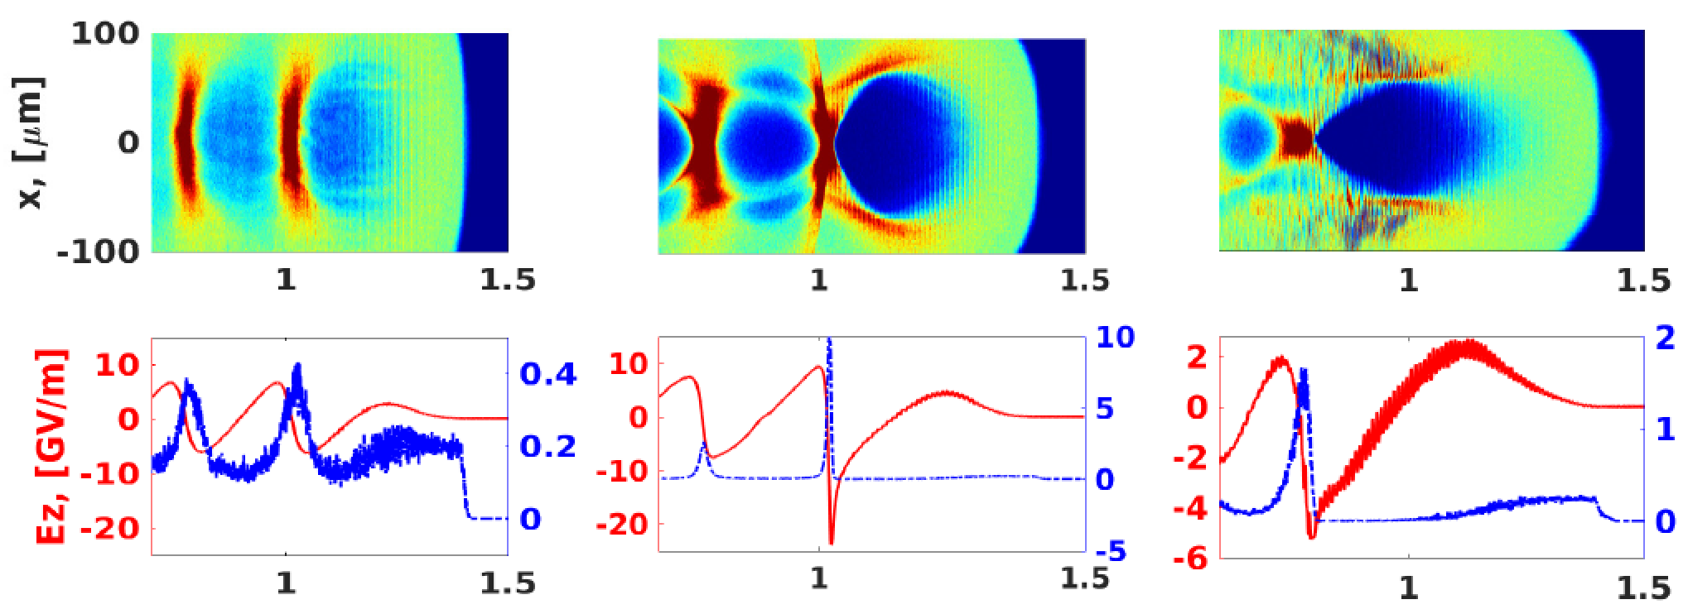
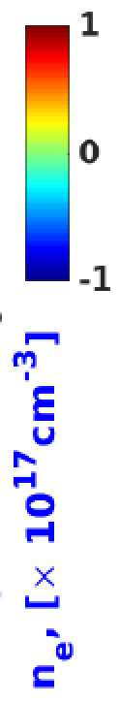
Simulations validated by experiments in SM regime
can be trusted to predict bubble regime accurately
Kumar, Phys. Plasmas 28, 013102 (2021)
matched
unmatched
unmatched
δn/n
laser
incomplete blowout
complete blowout
complete blowout
longitudinal distance z [mm]
P = 20 TW, τ = 0.5 ps
w₀ = 117 µm, a₀ = 2.4
P = 20 TW, τ = 0.5 ps
w₀ = 74 µm, a₀ = 3.8
P = 20 TW, τ = 1 ps
w₀ = 74 µm, a₀ = 3.8
n_{e} = 2 x 10¹⁶ cm⁻³
n_{e} = 2 x 10¹⁶ cm⁻³
n_{e} = 2.3 x 10¹⁶ cm⁻³
• Multiple ways to reach bubble regime
• no self-injection for z < 2.5 mm
• no e-laser overlap for τ ≲ 0.5 ps
16

Slide 17
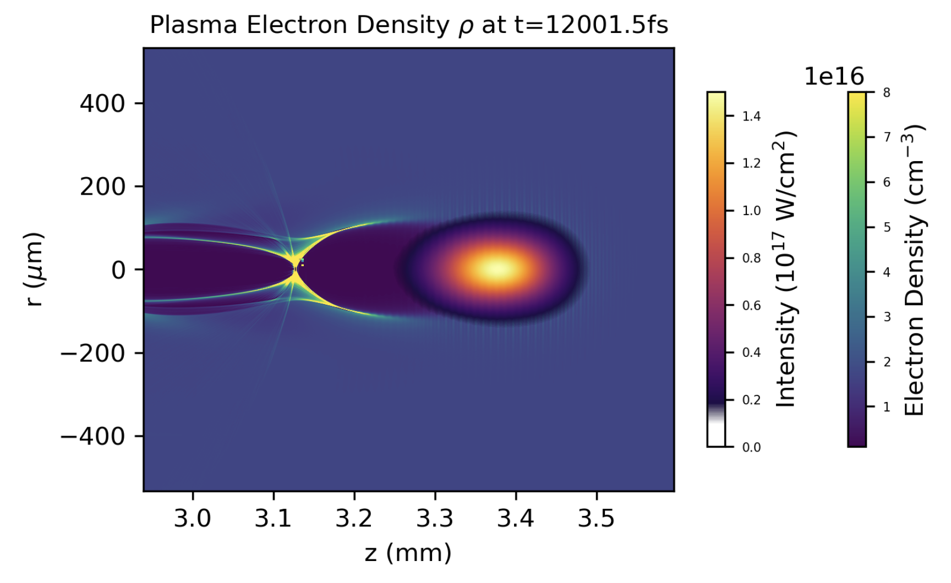
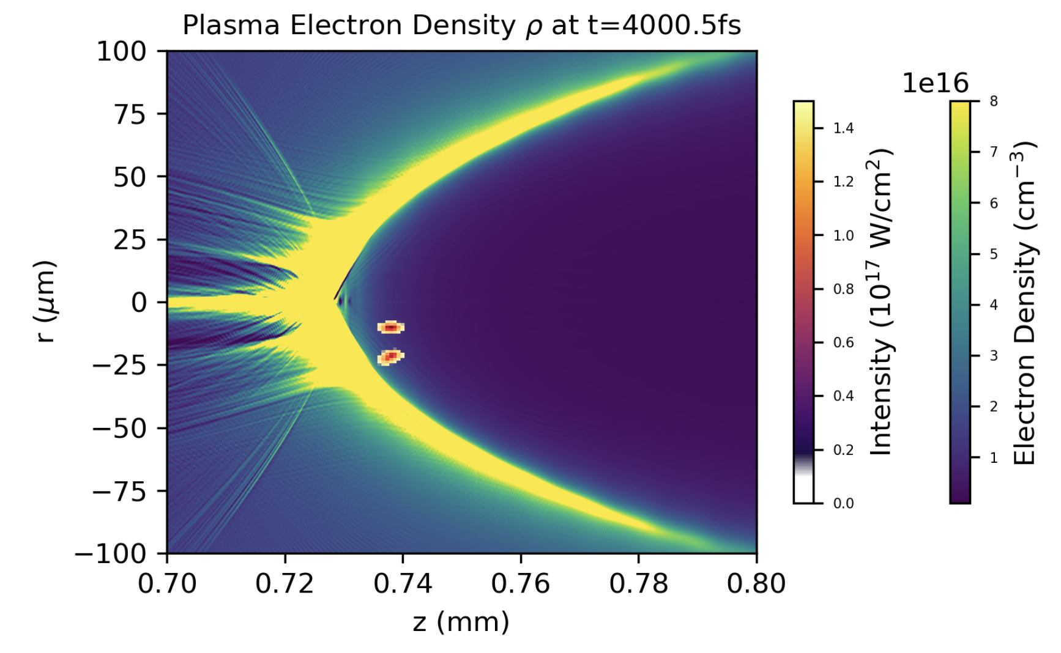
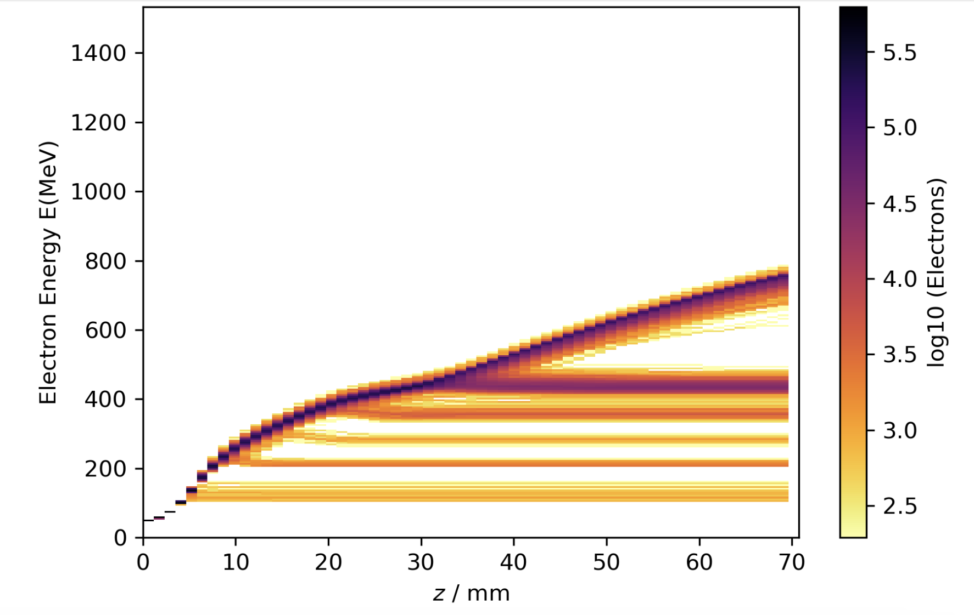
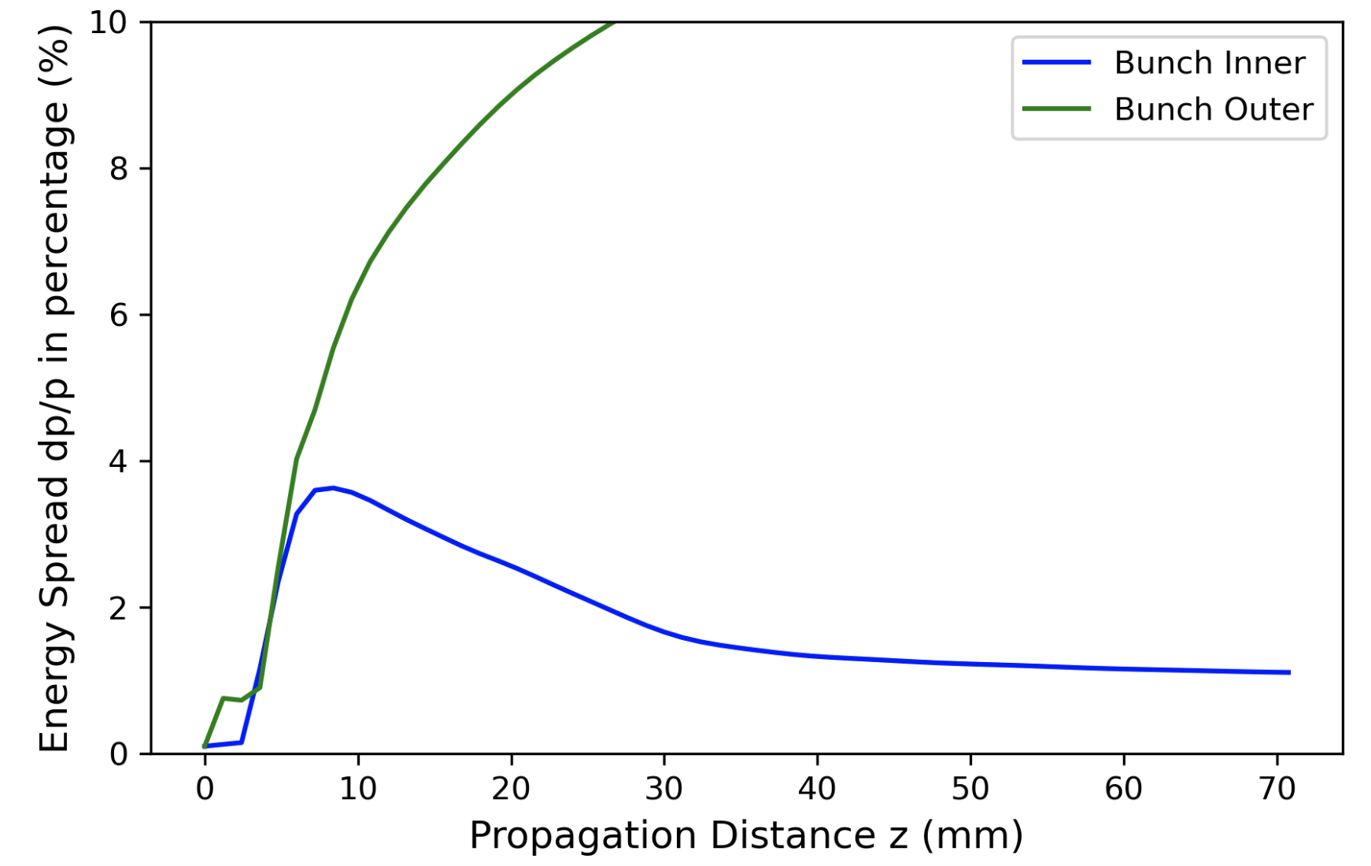
Simulations of growth of ∆E_{e}/E_{e} and emittance
of externally injected e-bunches in large bubbles.
See Tu WG1 poster Y. Cao, “Simulations of externally-injected CO₂-driven LWFA”
(a) n_{e} = 10¹⁶ cm⁻³
(b)
2 externally
injected
e-bunches
0.5 ps CO₂ pulse
(c) Electron Energy
(d)
Evolution of
Energy Spread (%)
17
7

Slide 18
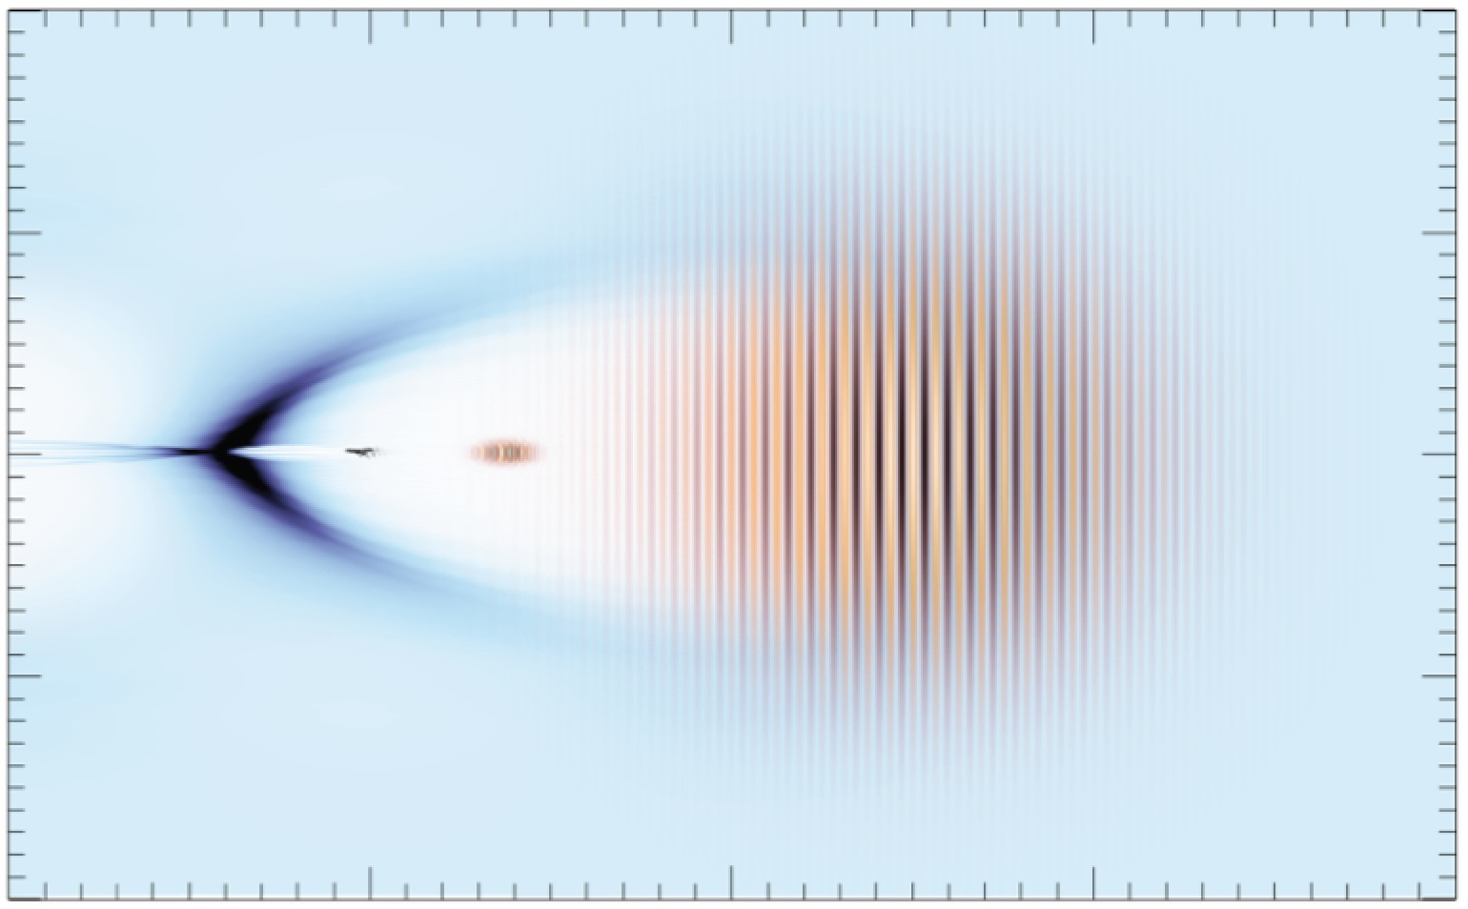
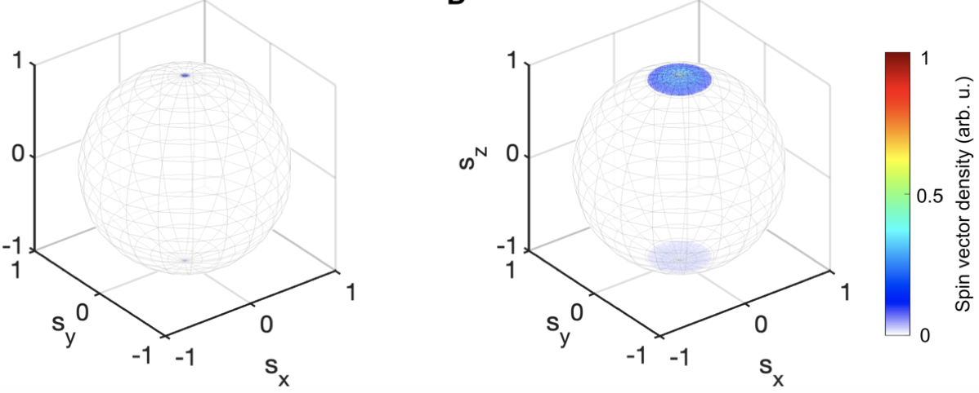
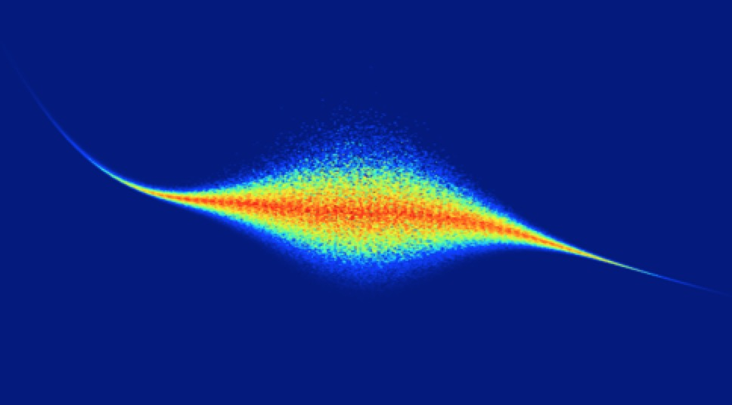
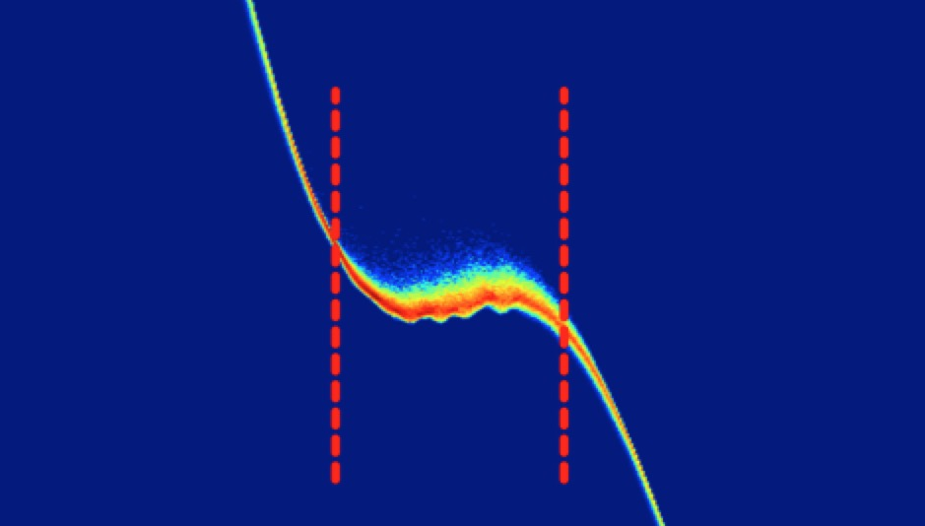
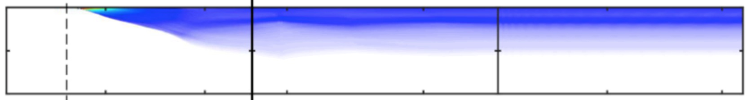
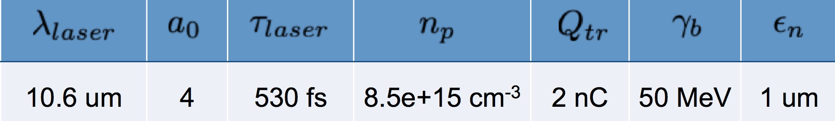
OSIRIS* quasi-3D simulations show that large bubbles preserve energy spread
& spin polarization of strategically injected e-bunches during acceleration
Simulations by Z. Nie, F. Li and W. B. Mori (UCLA)
after acceleration
spin-polarized
injected e-bunch
slightly depolarized
accelerated e-bunch
injection point
∆E/E ≈ 0.25%
s_{z}
s_{z}
E = 65 MeV,
∆E = 0.5 MeV
injected e-bunch
E = 330 MeV,
∆E = 0.8 MeV
accelerated e-bunch
s_{y}
s_{y}
0.07
s_{x}
s_{x}
electron energy
[GeV]
0.34
1.0
1.0
electron energy
[GeV]
s_{z}
0.33
∆E
0.06
0.32
0.8
0.3
0.6
1
0.8
0
2
z [mm]
50
100
-7.0
-6.5
-6.0
-7.0
-6.5
-6.0
longitudinal distance
z – ct [c/ω_{p}]
longitudinal distance
z – ct [c/ω_{p}]
• Depolarization due to spin precession is ~ few %
Simulation
parameters:
• Depends on coordinates of injection point
• Occurs predominantly from γ = 1 →10, constant thereafter
*
Fonseca et al., PPCF 55, 124011 (2013)

Slide 19

New compact TW-scale MIR/LWIR
CPA laser technologies are emerging ...
A bird in the hand...
Gain medium | 𝜆 [µm] | anticipated fs/mJ/TW | references
Cr: ZnSe | 2.5 | 100/100/1 | Y. Wu et al., Sci. Rpts. 10, 7775 (2020)
Fe: ZnSe | 4 - 5 | 100/100/1 | Y. Wu et al., in Emerging Laser Technol. for High-Power Ultrafast Science, ed. F. Légaré (IOP, 2021)
optically-pumped CO₂ | ~10 | 500/500/1 | D. Tovey et al., Opt. Express 29, 31455 (2021)
discharge-pumped CO₂ | 9.2 | 500/10000/20 | Polyanskiy et al., Photonics 8, 101 (2021)
...to drive future LWFAs in the super-bubble regime.
But for now, this is the only game in town!
18

Slide 20
SUMMARY
• Plasma e⁻ acceleration driven by LWIR laser demonstrated at ATF
• Peak laser power: 2-3 TW
• Plasma density: 3e16 ≲ n_{e} ≲ 4e17 cm⁻³
• Accelerated electrons: 5-10 MeV, plasma-injected,
quasi-monoenergetic features ⇒ “forced” LWFA
Zgadzaj et al., Nat Comms 15, 4037 (2024)
record
• An upgraded ATF laser is poised to demonstrate low-∆E_{e}/E_{e}, low-
emittance acceleration of electrons injected from the ATF linac.
• Injected e⁻: synchronized, compressed to fs scale
• Plasma: n_{e} ≲ 10¹⁶ cm⁻³
• CO₂ laser: 0.5 ≲ 𝜏_{L} ≲ 2 ps; ℇ_{L} ~ 10 J
• Plasma physicists need not re-invent the cathode. Use plasma
for what God intended: compact particle acceleration.
19

Slide 21
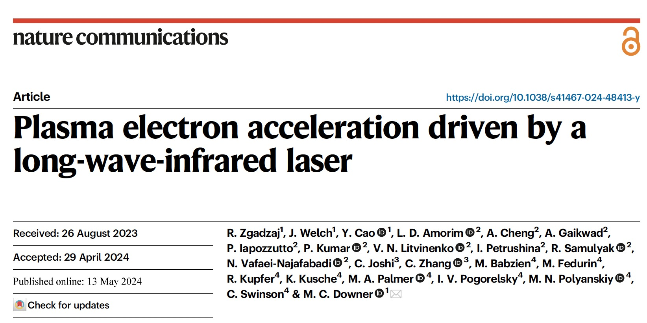
Nat Comms 15, 4037 (2024)
Thanks to all
of these co-
workers!
Financial Support
• DoE grant DE-SC0014043 (Stony Brook U., N. Vafaei-Najafabadi, PI)
• DoE grant DE-SC0011617 (U. Texas-Austin, M. C. Downer, PI)
• DoE grant DE-SC0012704 (Brookhaven NL, M. A. Palmer, PI)

Slide 22

Centimeter-long LWFAs have progressed
steadily toward multi-GeV electron energy...
drive FELs,
probe reso-
nant particle
interactions
probe nuclear
spin states,
parity
violation
high
luminosity
at collider
IP
electron
energy
“bubble”
regime
discovery
E-beam quality*, not energy,
is the concern of the HEP
research community.
E_{e} (GeV)
∆E_{e}/E_{e}
Π_{spin}
Q (nC)
10
10⁰
1.0
10⁰
quasi-monoenergetic
all
research
acceler-
ators
most RF
accelerators
HEPAP
2015
10⁻¹
10⁻¹
ATF
oppor-
tunity
5
0.5
10⁻²
10⁻²
10⁻³
0
10⁻³
Report of Accelerator R&D Subpanel
0
*energy spread, spin pol^{n}, emittance
preservation, beam stability & control,
high rep-rate, peak current, staging,...
2000
2010
2020
Year
conventional RF
accelerator capability
...but are stuck at 10% energy spread,
unpolarized spins
, tens pC charge

Slide 23
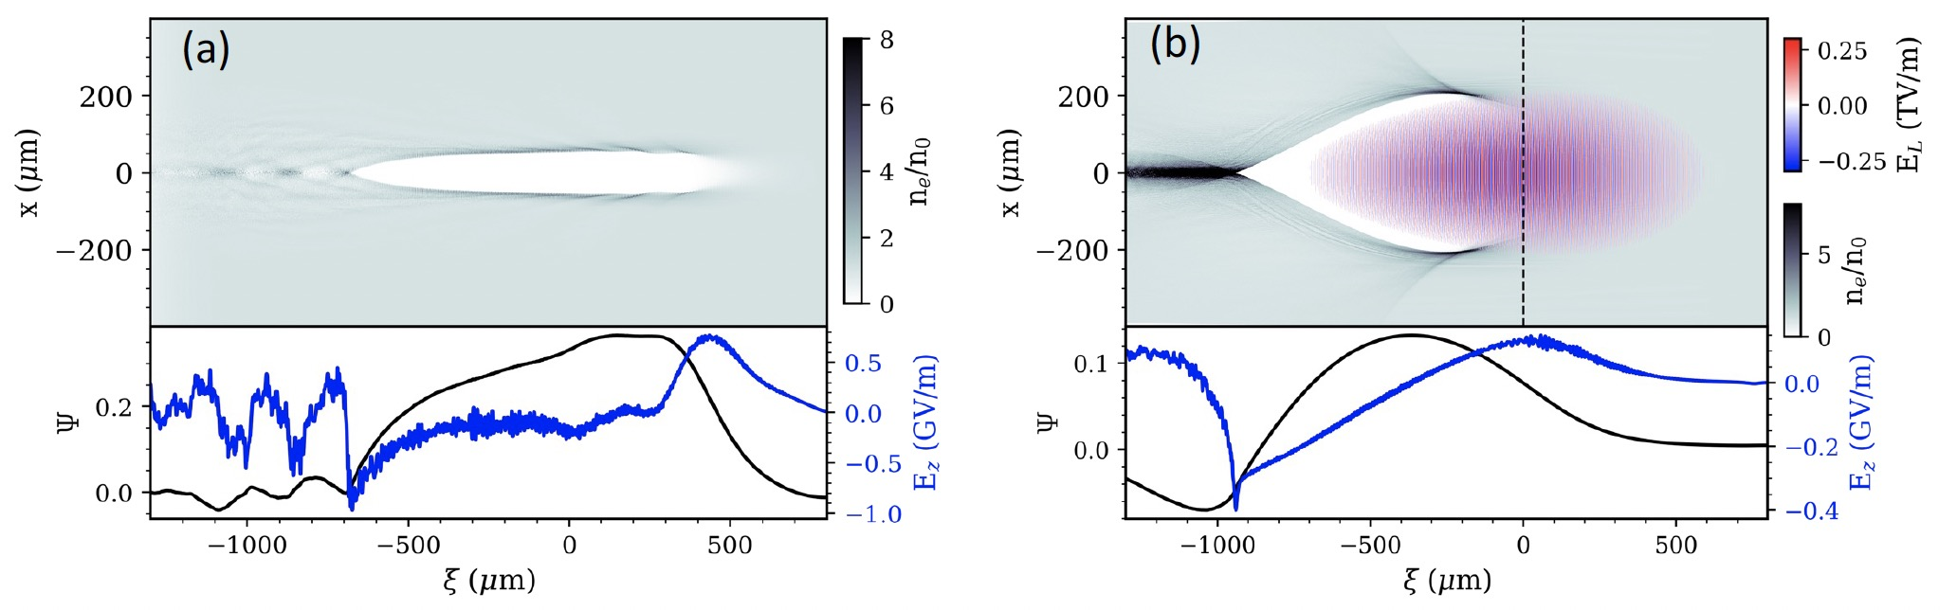
There are near-term scientific opportunities
even for currently available 2 ps pulses
OSIRIS* simulations courtesy N. Vafaei-Najafabadi
CO₂ laser parameters: 10 J, 2 ps, 5 TW, w₀ = 40 µm, a₀^{(vac)} = 3.56
n_{e} = 10¹⁶ cm⁻³
n_{e} = 10¹⁴ cm⁻³
* Fonseca et al., PPCF 55, 124011 (2013)

