Slide 1
Experimental and Simulation Study on Direct Acceleration of Electron Beams Driven by Vortex Lasers
Wenpeng Wang
State Key Laboratory of Ultra-intense Laser Science and Technology, Shanghai Institute of Optics and Fine Mechanics, Chinese Academy of Sciences
LPAW (Naples, Italy)
2025.4.14

Slide 2



SULF introduction and opens for users
Particle acceleration driven by LG lasers (spatial vortex)
Acceleration and radiation driven by STOV lasers (spatiotemporal vortex)
Experimental development driven by vortex lasers
Conclusion and outlook
2

Slide 3
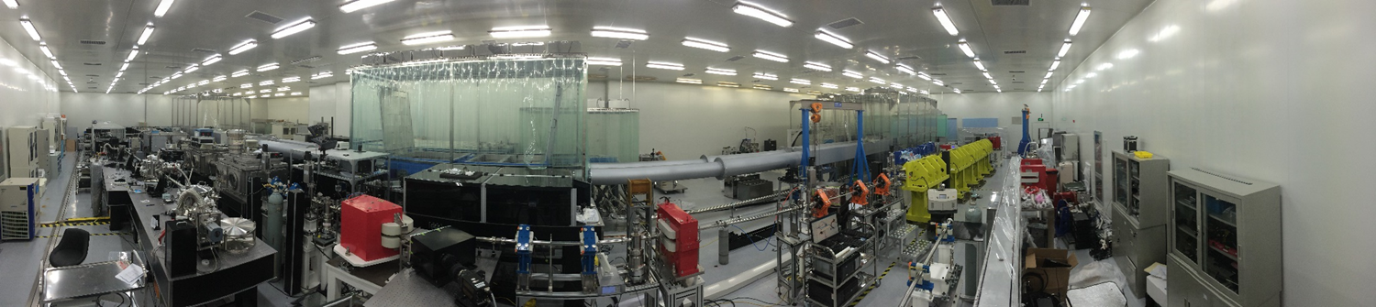
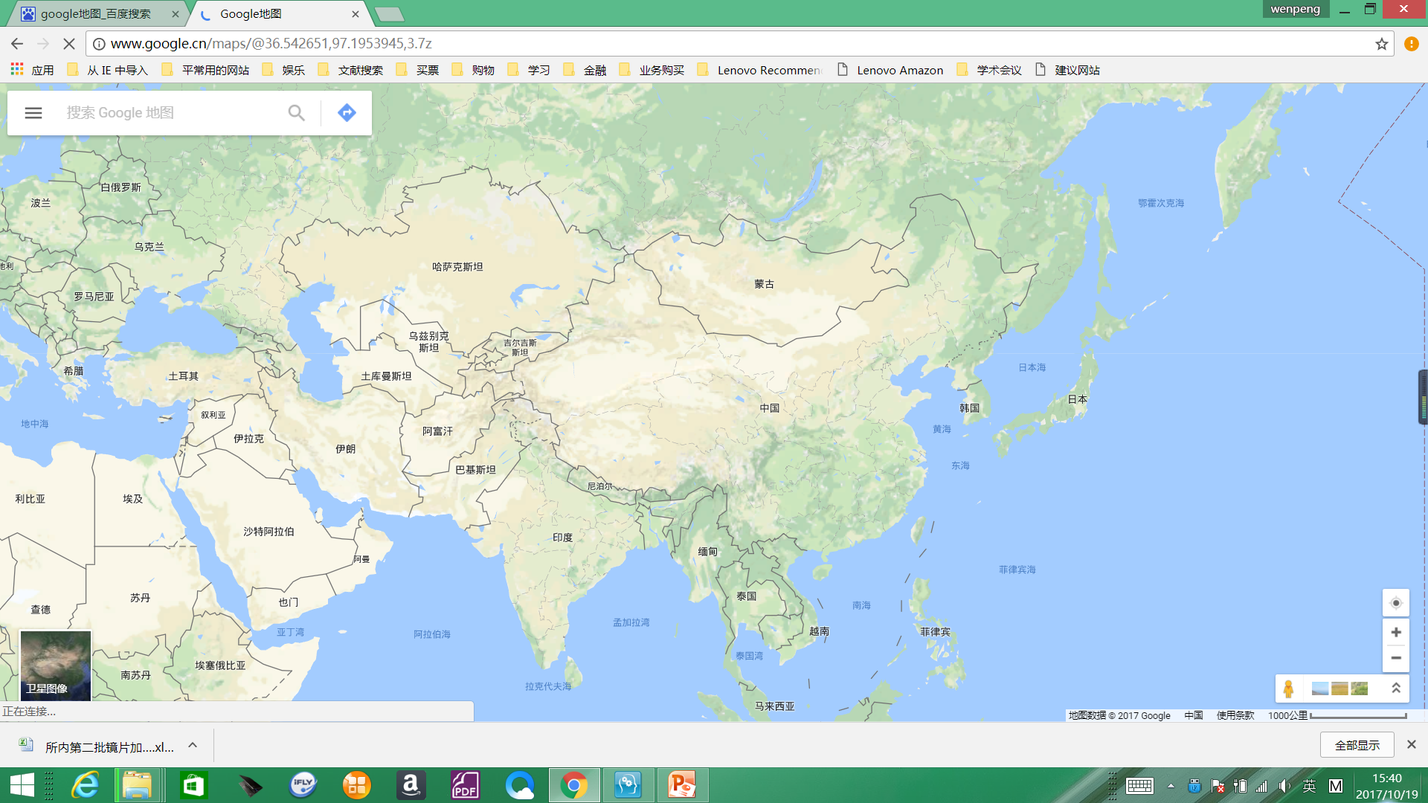
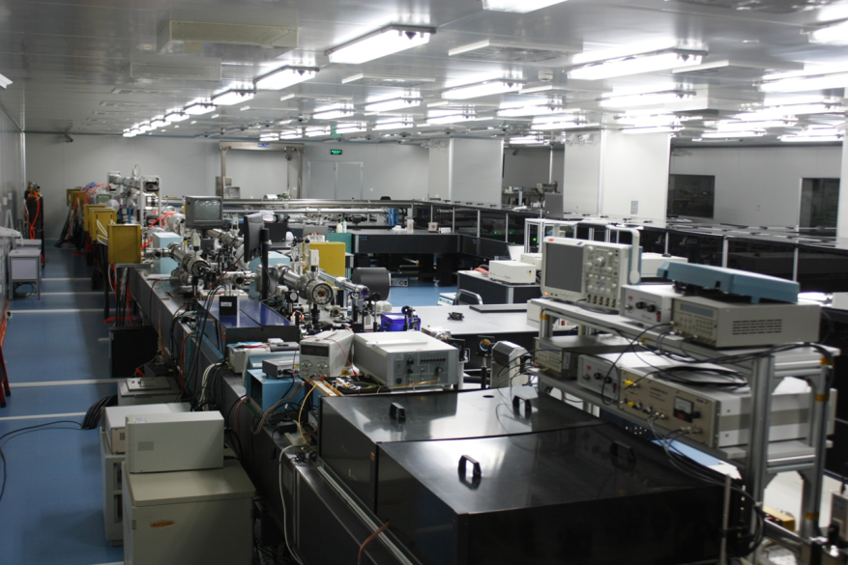
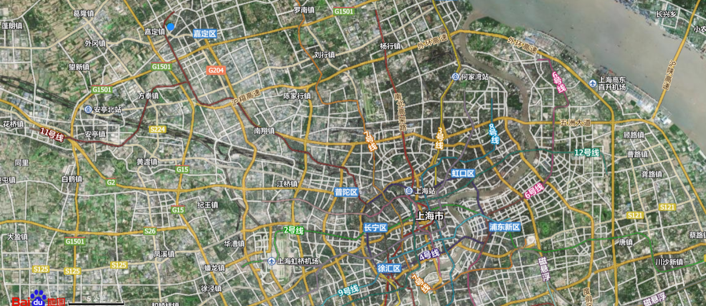

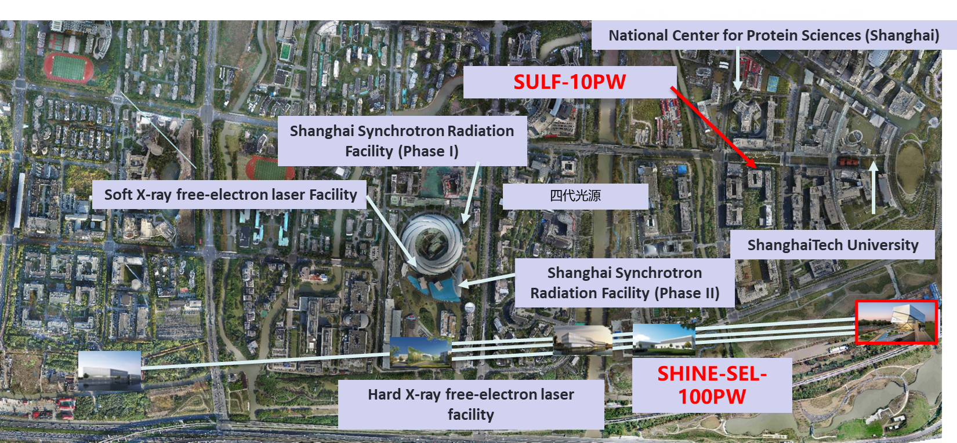
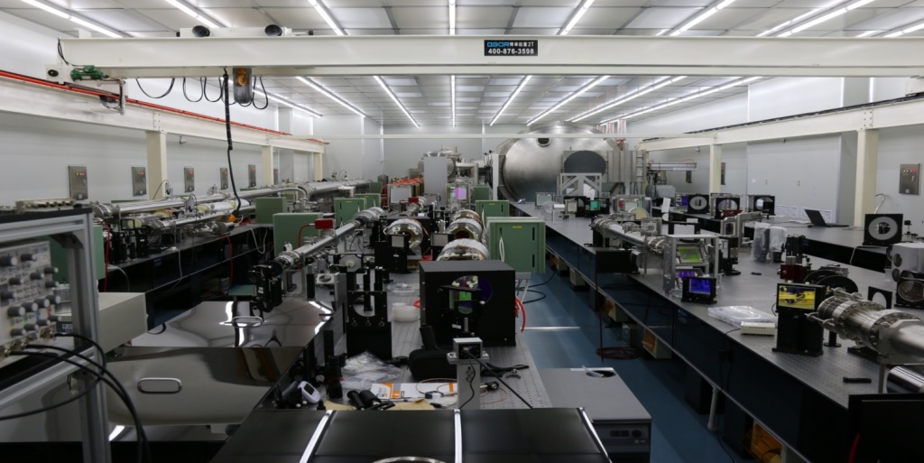
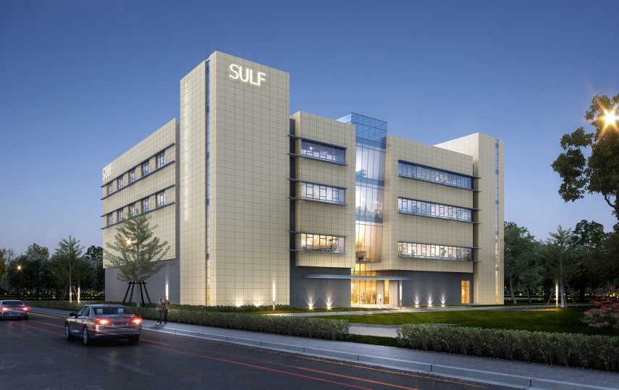
上海超强超短激光实验装置
Shanghai Superintense Ultrafast
Laser Facility
3

Slide 4
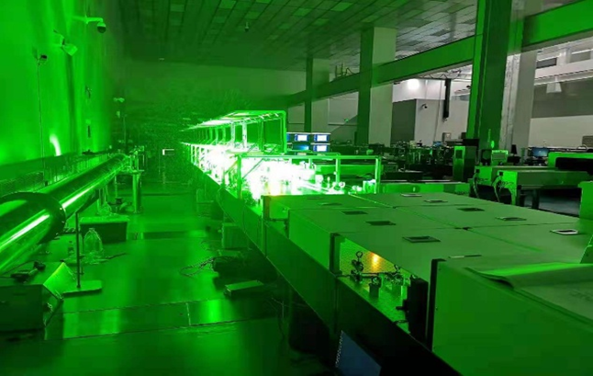
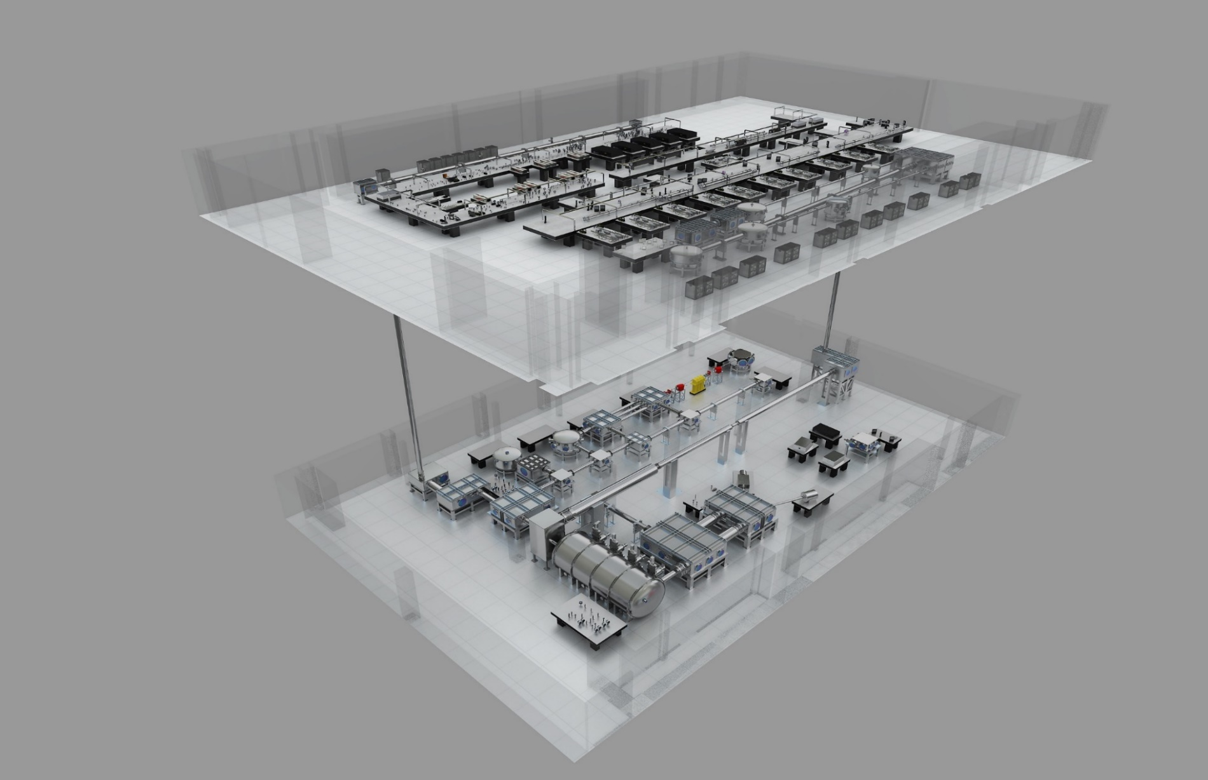
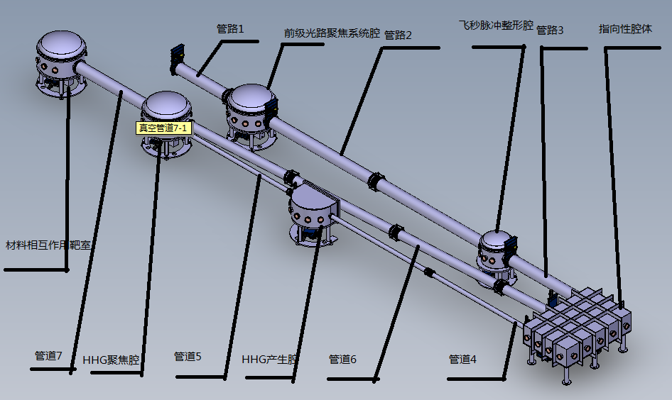
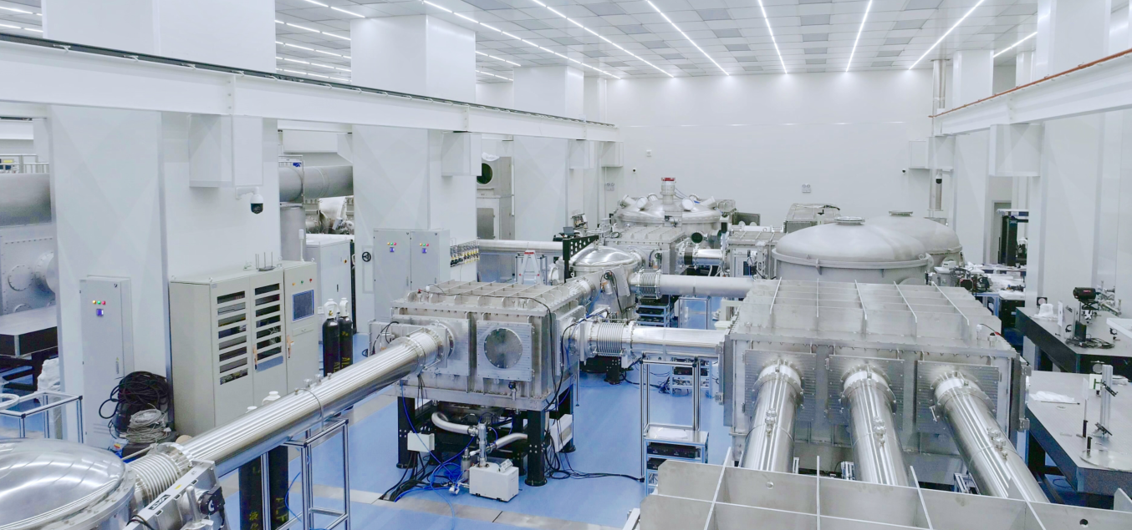
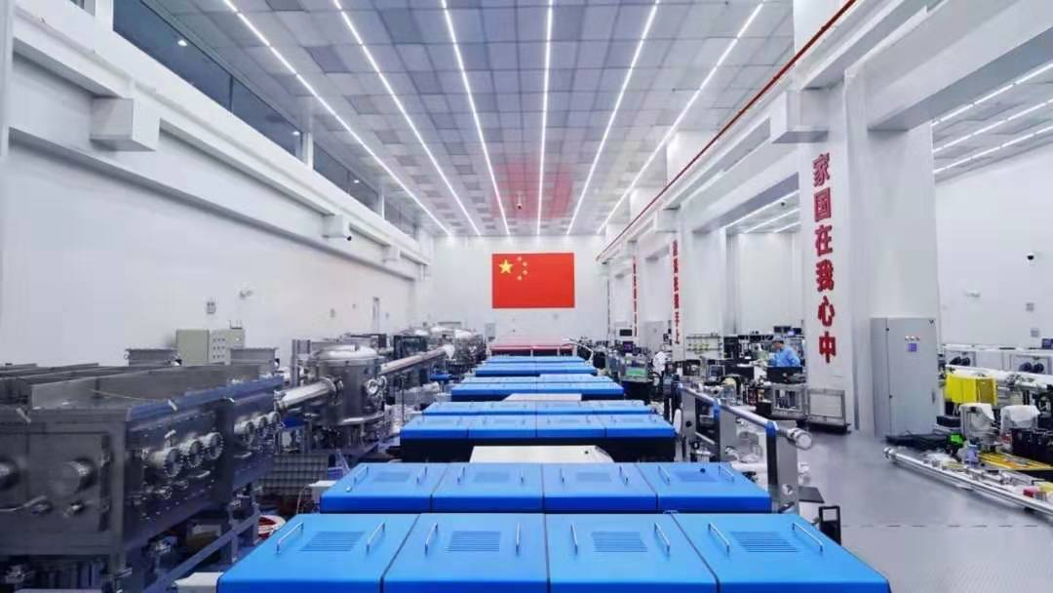
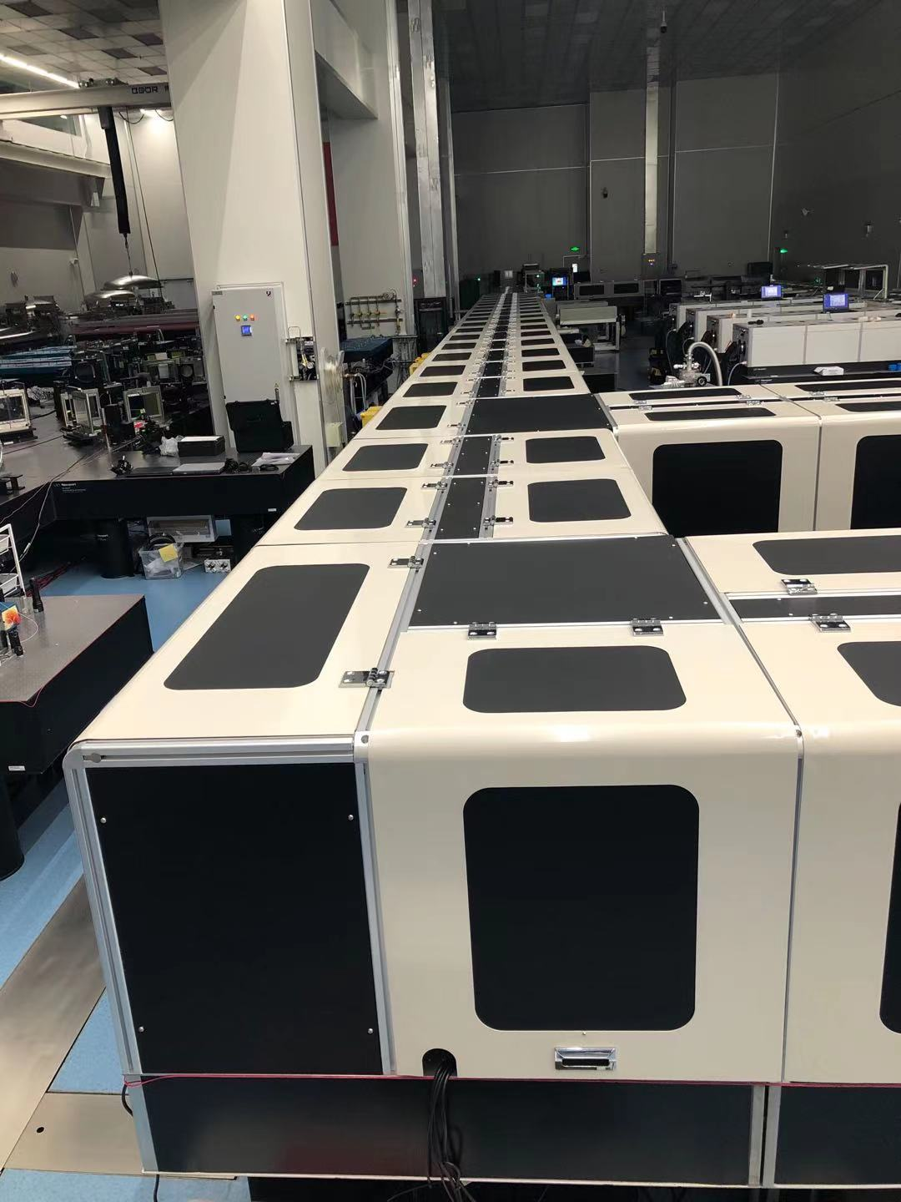
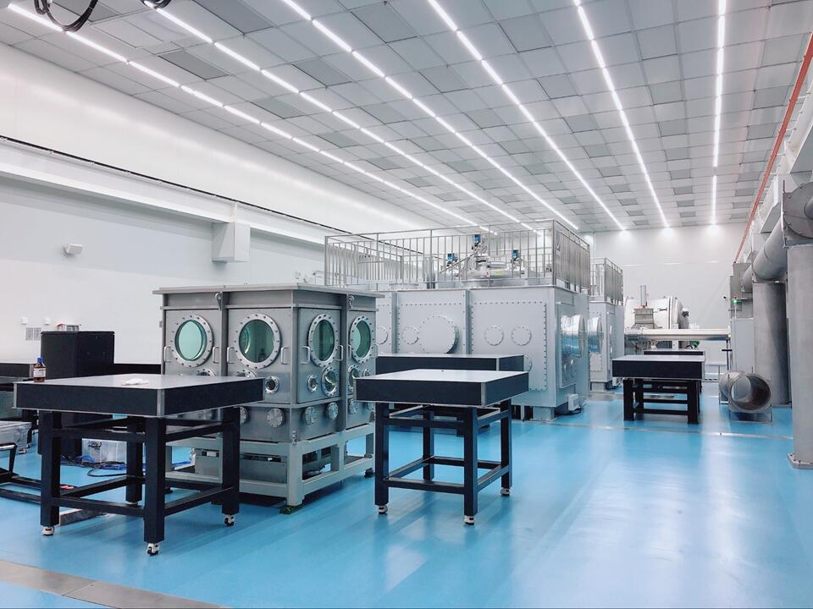
SULF laser facility
300J, ns laser
Repetitive 1PW
10PW laser front
Extreme Condition Materials Science Research Platform
1 PW laser (0.1Hz)
Platform 1
10PW laser system
Ultrafast Chemistry and Macromolecular Dynamics Research Platform
Hundreds of Joules pump source
10 PW (1min./shot)
Platform 2
10 PW laser end
Ultra fast subatomic physics research platform
300J, ns laser
Platform 3
4
Notes:
这是我们羲和大楼激光装置和物理实验平台的布局，一楼为10PW、1PW激光装置和物理实验平台一，负二楼为激光器终端已经两大物理实验平台。

Slide 5
SULF
Operational plan for 2024
Laser systems/platforms | Running time(hour) |  |  |  |  | Annual operating failure rate（%）
 | First quarter | Second quarter | Third quarter | Fourth quarter | Annual switchboard time
10 PW laser system | 420 | 500 | 180 | 520 | 1620 | <15%
Platform 2 | 510 | 530 | 560 | 400 | 2000 | <10%
1 PW laser system | 448 | 368 | 488 | 464 | 1768 | <8%
Platform 3 | 450 | 350 | 450 | 350 | 1600 | <5%
300 J laser system | 200 | 200 | 200 | 200 | 800 | ≤20%
Platform 1 | 400 | 320 | 360 | 416 | 1496 | <10%
5

Slide 6
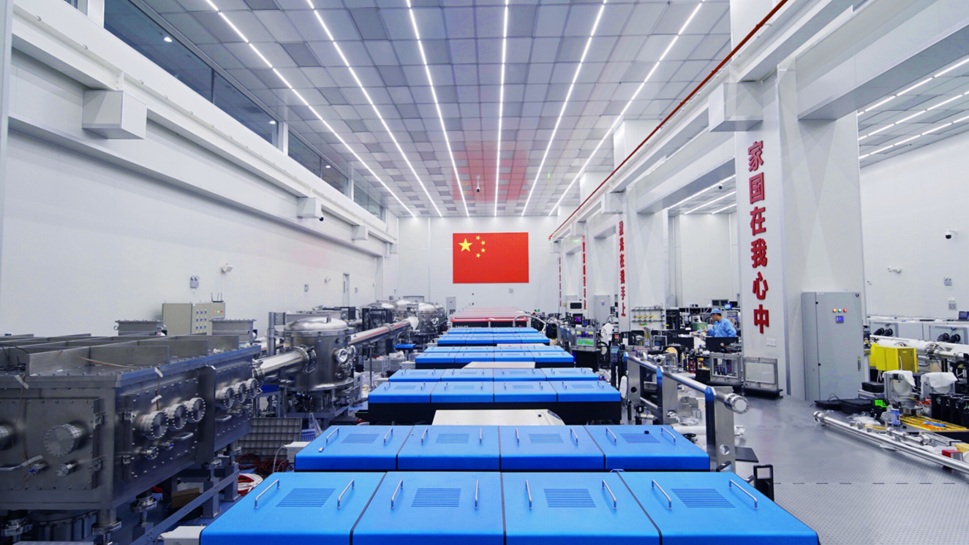
SULF is open to users (http://sulf.siom.ac.cn).
6

Slide 7
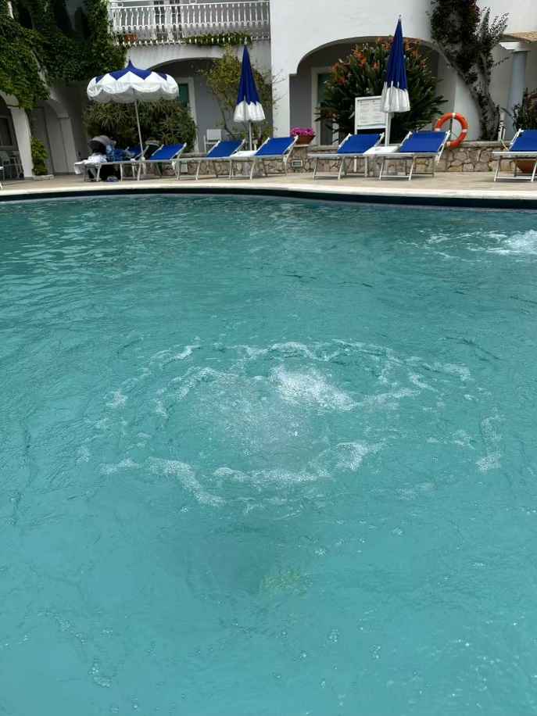

Laser opens new doors for scientific researches and optical technologies
突泉
(in the hotel)
Gaussian
水涡
Vortex
7
Notes:
The laser contrast was further improved with a single plasma mirror installed after off-axis parabola (OAP), which allows SULF-10 PW laser interacting with nanometer-thick CH (Hydrocarbon) foils. The laser power on target is 1.7 PW and the intensity is 1.4*1021 W/cm2.
Using the lower-energy laser interacting with nanometer-thick CH (Formvar) foils, the 70.2 MeV proton beam was obtained via the relativistic-induced transparency regime.
This work is in preparation.

Slide 8


Meaning of vortex
知其雄，守其雌，为天下谿。
——老子《道德经》
Singularity
Potential well
谿(xī)
(571 BC ~ 470 BC)
Allen et al. PRA 45, 8185 (1992)
Orbital angular
momentum
OAM
8
Notes:
The laser contrast was further improved with a single plasma mirror installed after off-axis parabola (OAP), which allows SULF-10 PW laser interacting with nanometer-thick CH (Hydrocarbon) foils. The laser power on target is 1.7 PW and the intensity is 1.4*1021 W/cm2.
Using the lower-energy laser interacting with nanometer-thick CH (Formvar) foils, the 70.2 MeV proton beam was obtained via the relativistic-induced transparency regime.
This work is in preparation.

Slide 9
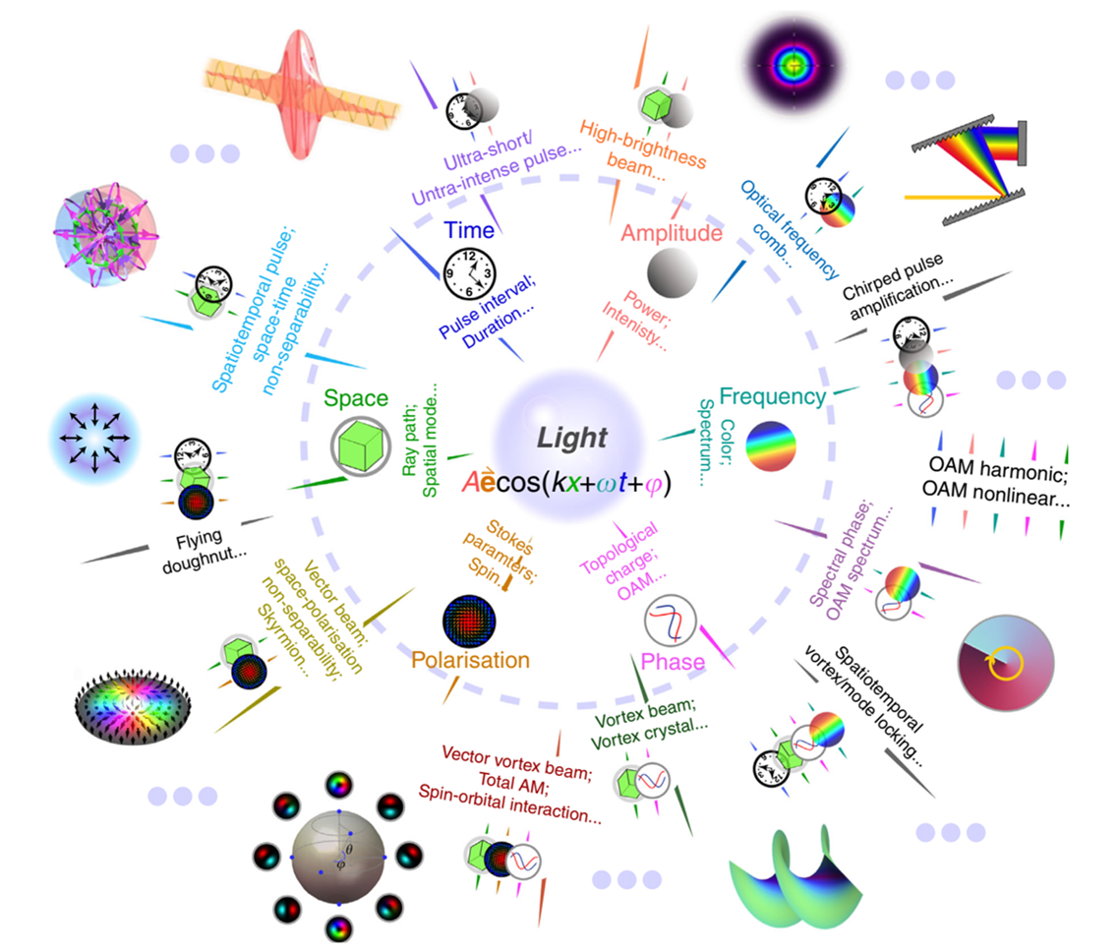
Orbital angular momentum 30th anniversary
Light Sci Appl 11, 205 (2022)
9
Notes:
The laser contrast was further improved with a single plasma mirror installed after off-axis parabola (OAP), which allows SULF-10 PW laser interacting with nanometer-thick CH (Hydrocarbon) foils. The laser power on target is 1.7 PW and the intensity is 1.4*1021 W/cm2.
Using the lower-energy laser interacting with nanometer-thick CH (Formvar) foils, the 70.2 MeV proton beam was obtained via the relativistic-induced transparency regime.
This work is in preparation.

Slide 10
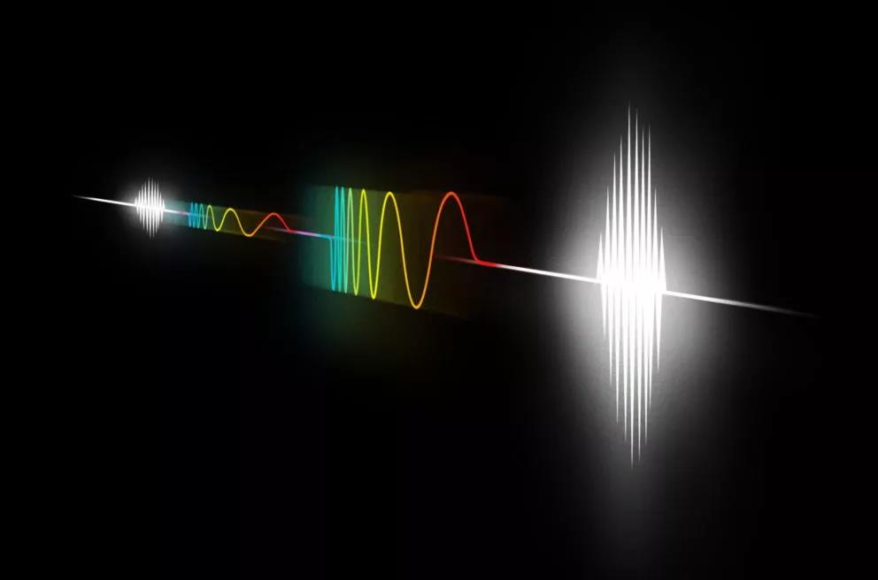
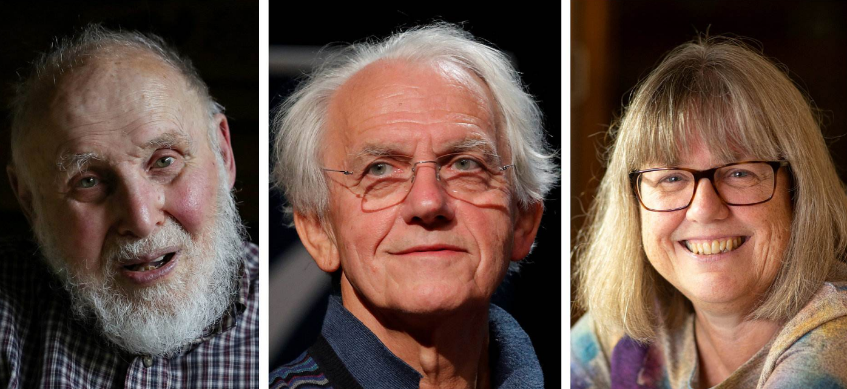
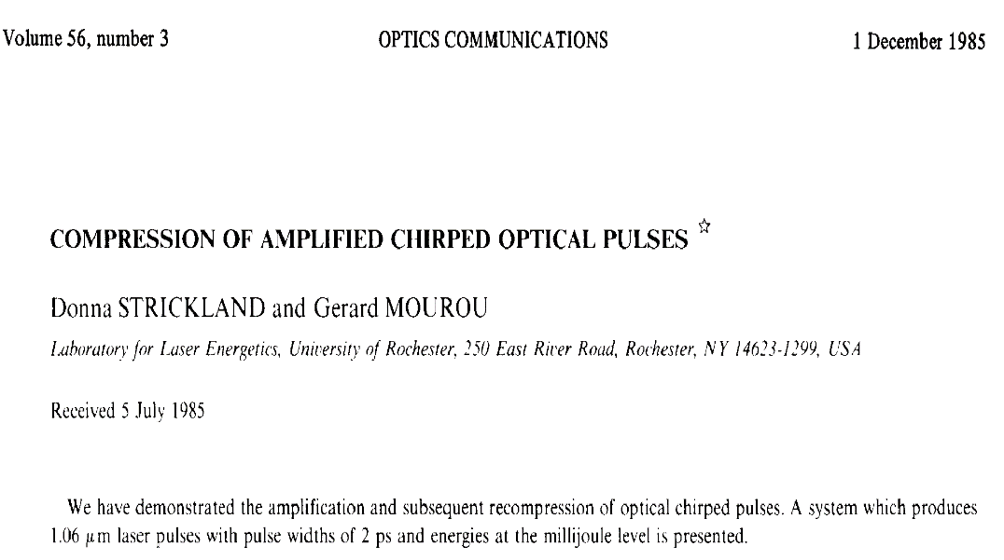


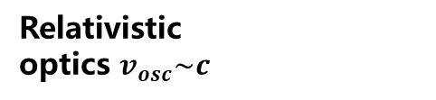


Relativistic vortices
e – e⁺ generation
Nonlinear QED
10¹⁵
Relativistic?
10³⁰
$E∙e∙λ_{c}=$2$m_{0}c^{2}$
Ultrarelativistic optics
10²⁵
$$EQ=m_{p}c^{2}$$
10¹²
Relativistic
optics $v_{osc}\sim c$
电场强度 [V/m]
Laser intensity I [W/cm²]
10²⁰
$$EQ=m_{e}c^{2}$$
Electric field intensity [V/m]
Free electron
10¹⁵
CPA
10⁹
$$EQ=hv$$
Bound electron
10¹⁰
10⁶
1960
1970
1980
1990
2000
2010
2020
2030
10
year
Notes:
The laser contrast was further improved with a single plasma mirror installed after off-axis parabola (OAP), which allows SULF-10 PW laser interacting with nanometer-thick CH (Hydrocarbon) foils. The laser power on target is 1.7 PW and the intensity is 1.4*1021 W/cm2.
Using the lower-energy laser interacting with nanometer-thick CH (Formvar) foils, the 70.2 MeV proton beam was obtained via the relativistic-induced transparency regime.
This work is in preparation.

Slide 11
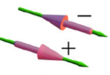
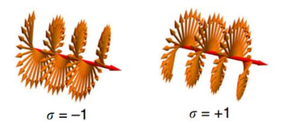

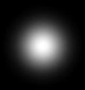
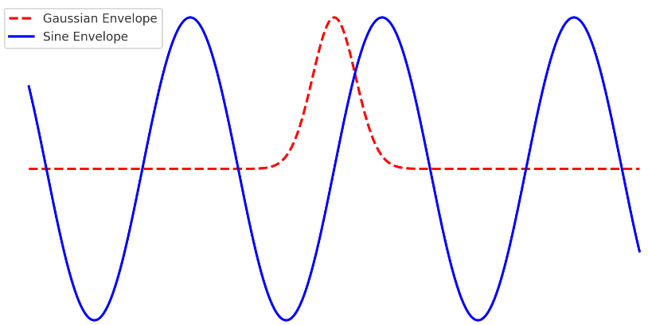

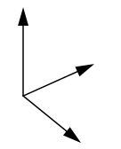
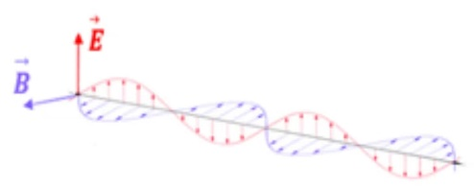
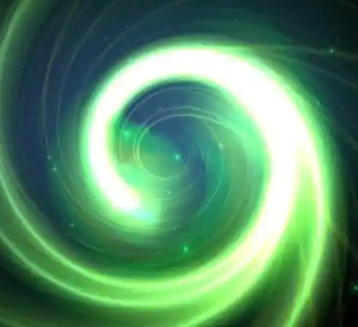
RPA driven by LG laser
Amplitude
Spatial mode
Temporal envelope
Propagate Phase
Polarization (SAM)
Wave vector
x
y
Wavelength
z
Vortex
Let the laser rotate in the phase.
11

Slide 12
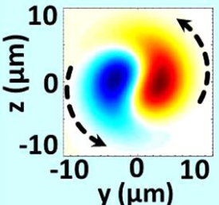

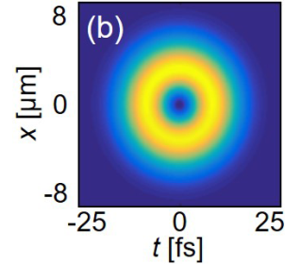
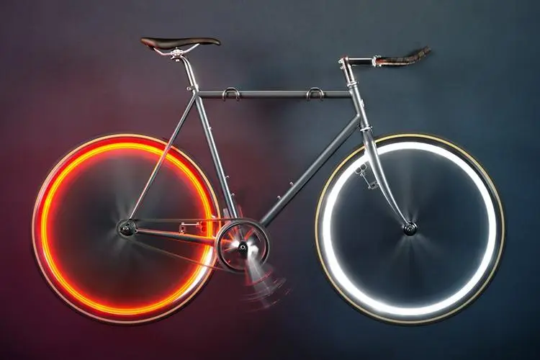
Vortex laser
Relativistic Vortices
Spatial vortices
e^{-ilφ(x, y)}
spatiotemporal vortices
e^{-ilφ(x, y, z, t)}
y
Scientific Reports 5, 8274 (2015)
PRL 122, 024801 (2019)
PRL 125, 034801 (2020)
PRR 6, 013075 (2024)
12

Slide 13
SULF introduction and opens for users
Particle acceleration driven by LG lasers (spatial vortex)
Acceleration and radiation driven by STOV lasers (spatiotemporal vortex)
Experimental development driven by vortex lasers
Conclusion and outlook
13

Slide 14
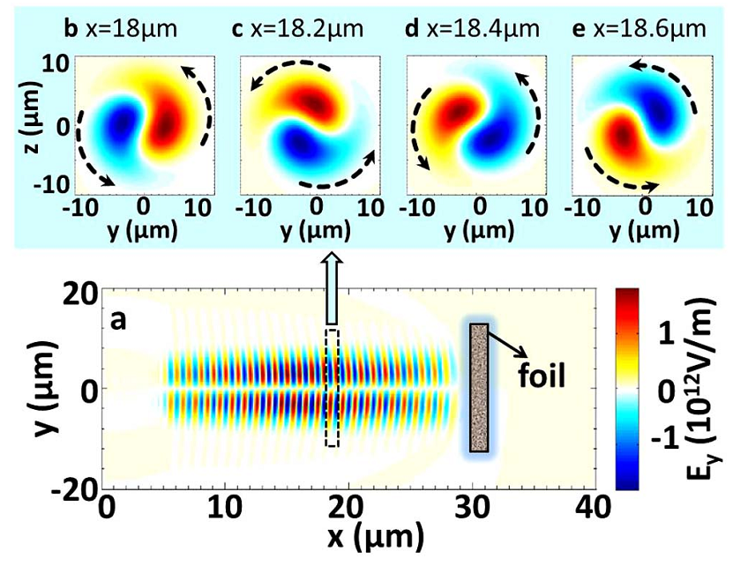
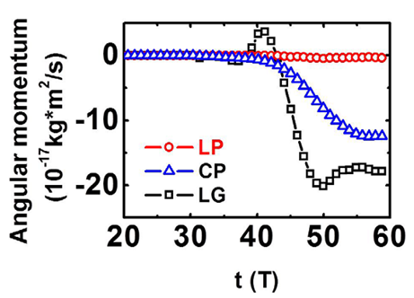
Relativistic LG laser plasma interaction
Hollow screw-like drill by LG lasers
Optical wrench
W. P. Wang, et al.
Scientific Reports 5,8274 (2015)
14

Slide 15
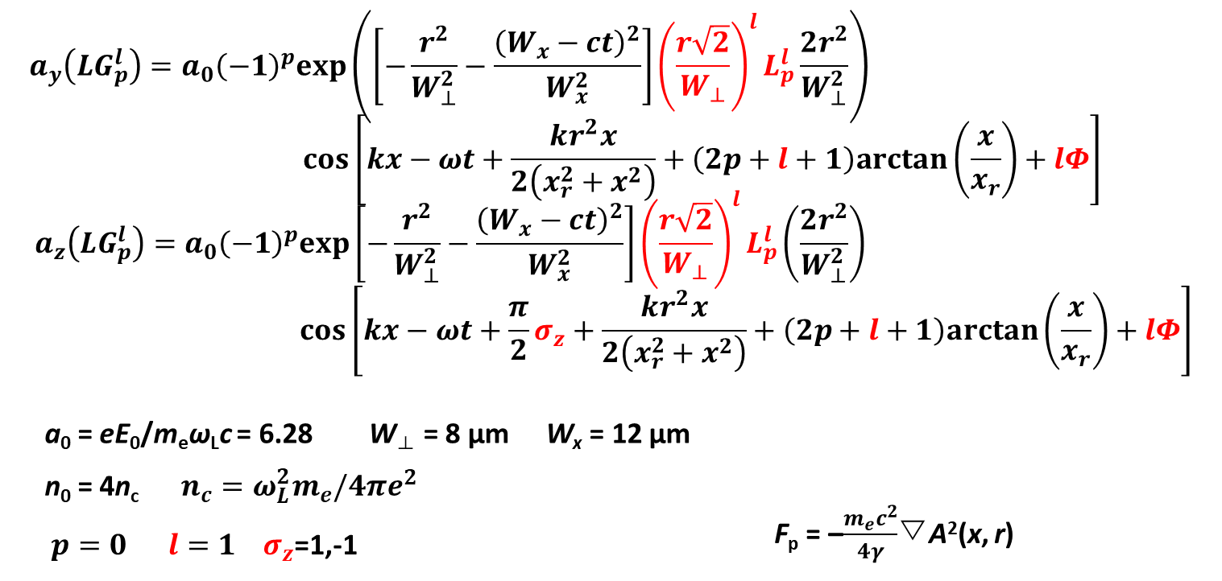
LG mode
15

Slide 16
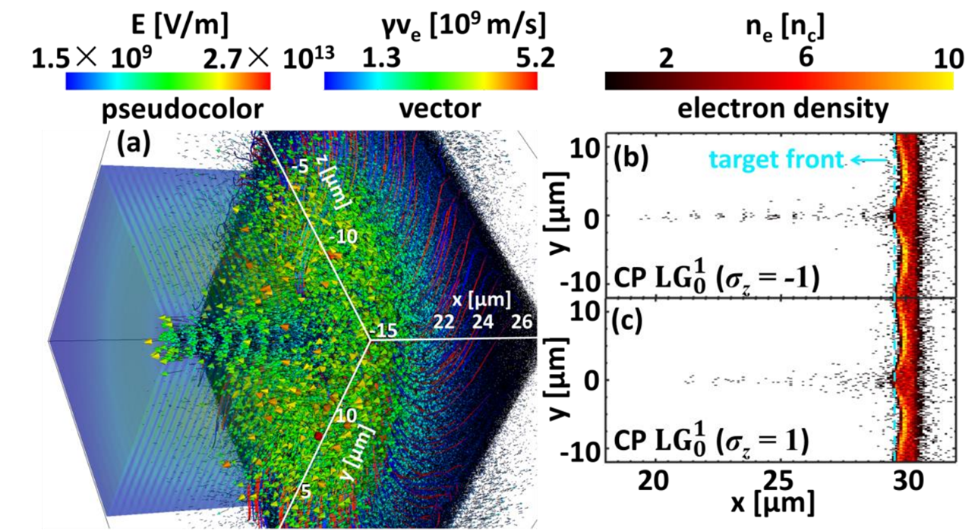
Electron modulation driven by LG laser
Different electron acceleration for σ_{z} =1, -1 mode.
16
Wang et al. PPL 125, 034801 (2020)

Slide 17
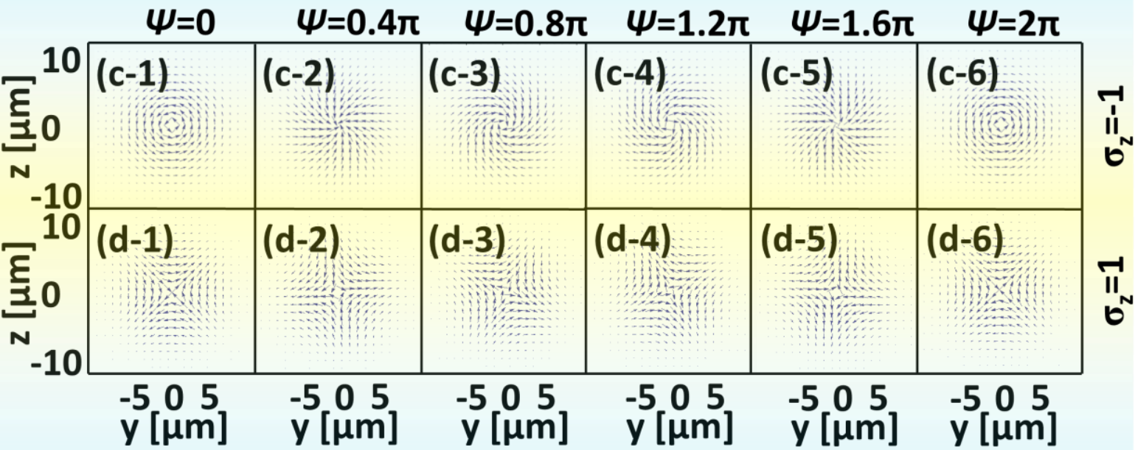
Electric field of different LG laser mode
Electric field for different modes of vortex lasers (l=1 σ_{z} = -1).
17

Slide 18
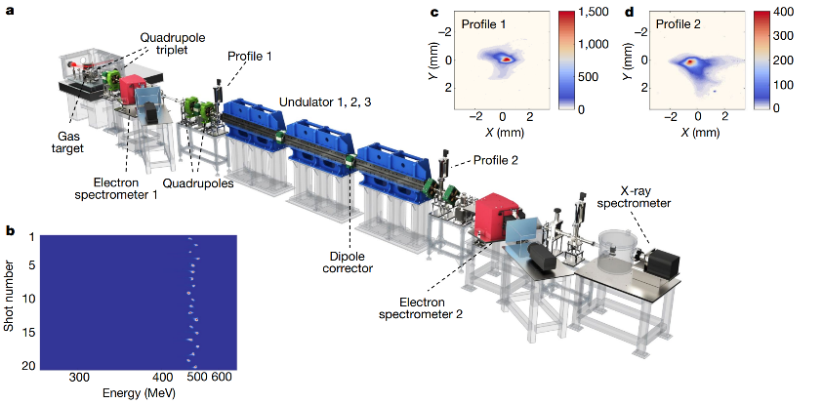
Possible application for XFEL
Miniaturization of free electron laser is possible be done by vortex lasers?
1. Further improve the acceleration gradient; 2 new micro beam generation schemes by LG lasers.
W. T. Wang, Nature (2021)
18

Slide 19
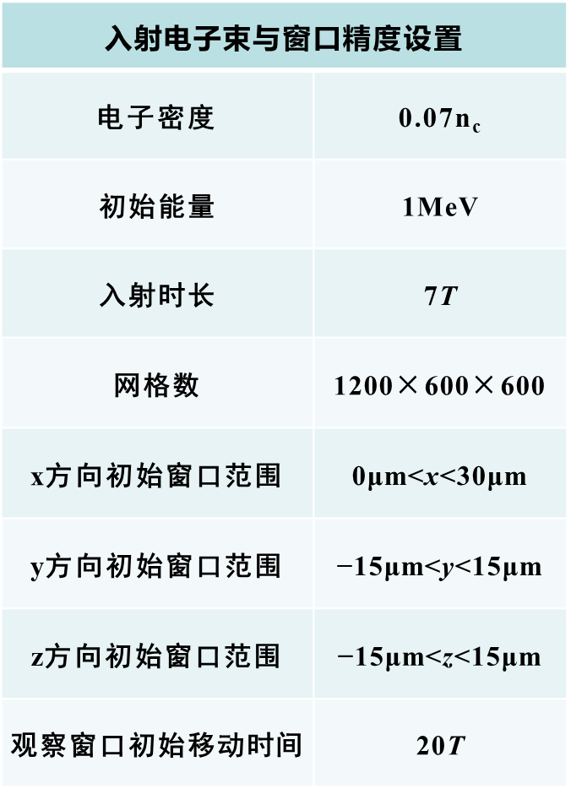
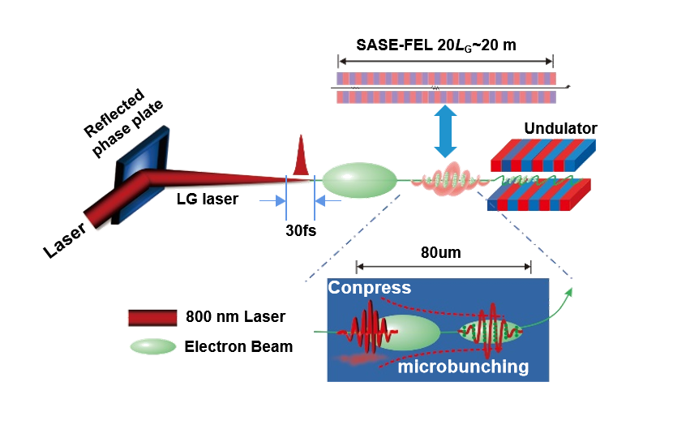
Possible application for XFEL
Compressed electron beam is hoped to be realized within 100 micrometers.
19

Slide 20
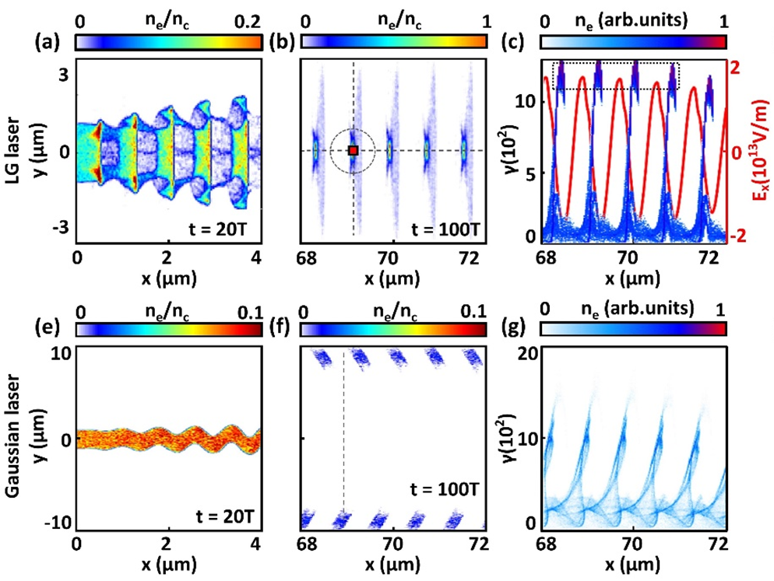
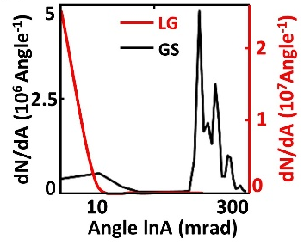
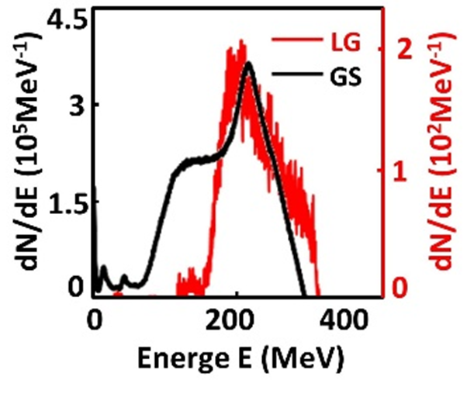
Possible application for XFEL
20
Hao et al. COL 125, 034801 (2020)

Slide 21
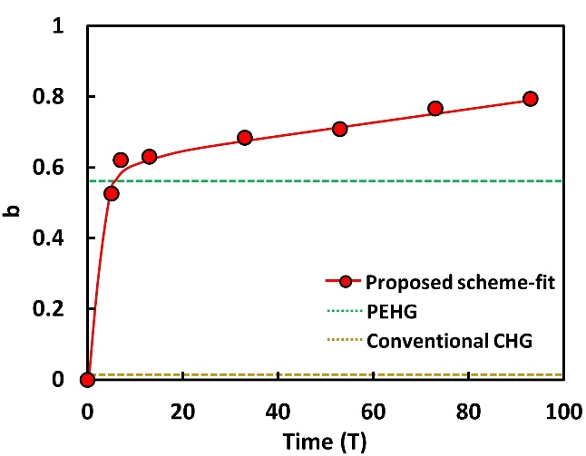
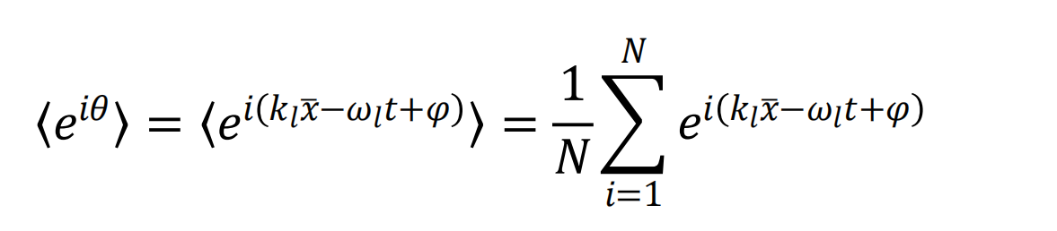
Compared with traditional techonologies of CHG、PEHG
CHG（Coherent harmonic amplification）
PEHG（High order harmonics enhanced by phase micro clustering）
Expression of spatial clustering factor (b)
b parameter tuned by LG lasers：
★higher than CHG
★higher than PEHG whin 20T
★about b = 0.8 is obtained at t = 90T
21
Hao et al. COL 125, 034801 (2020)

Slide 22
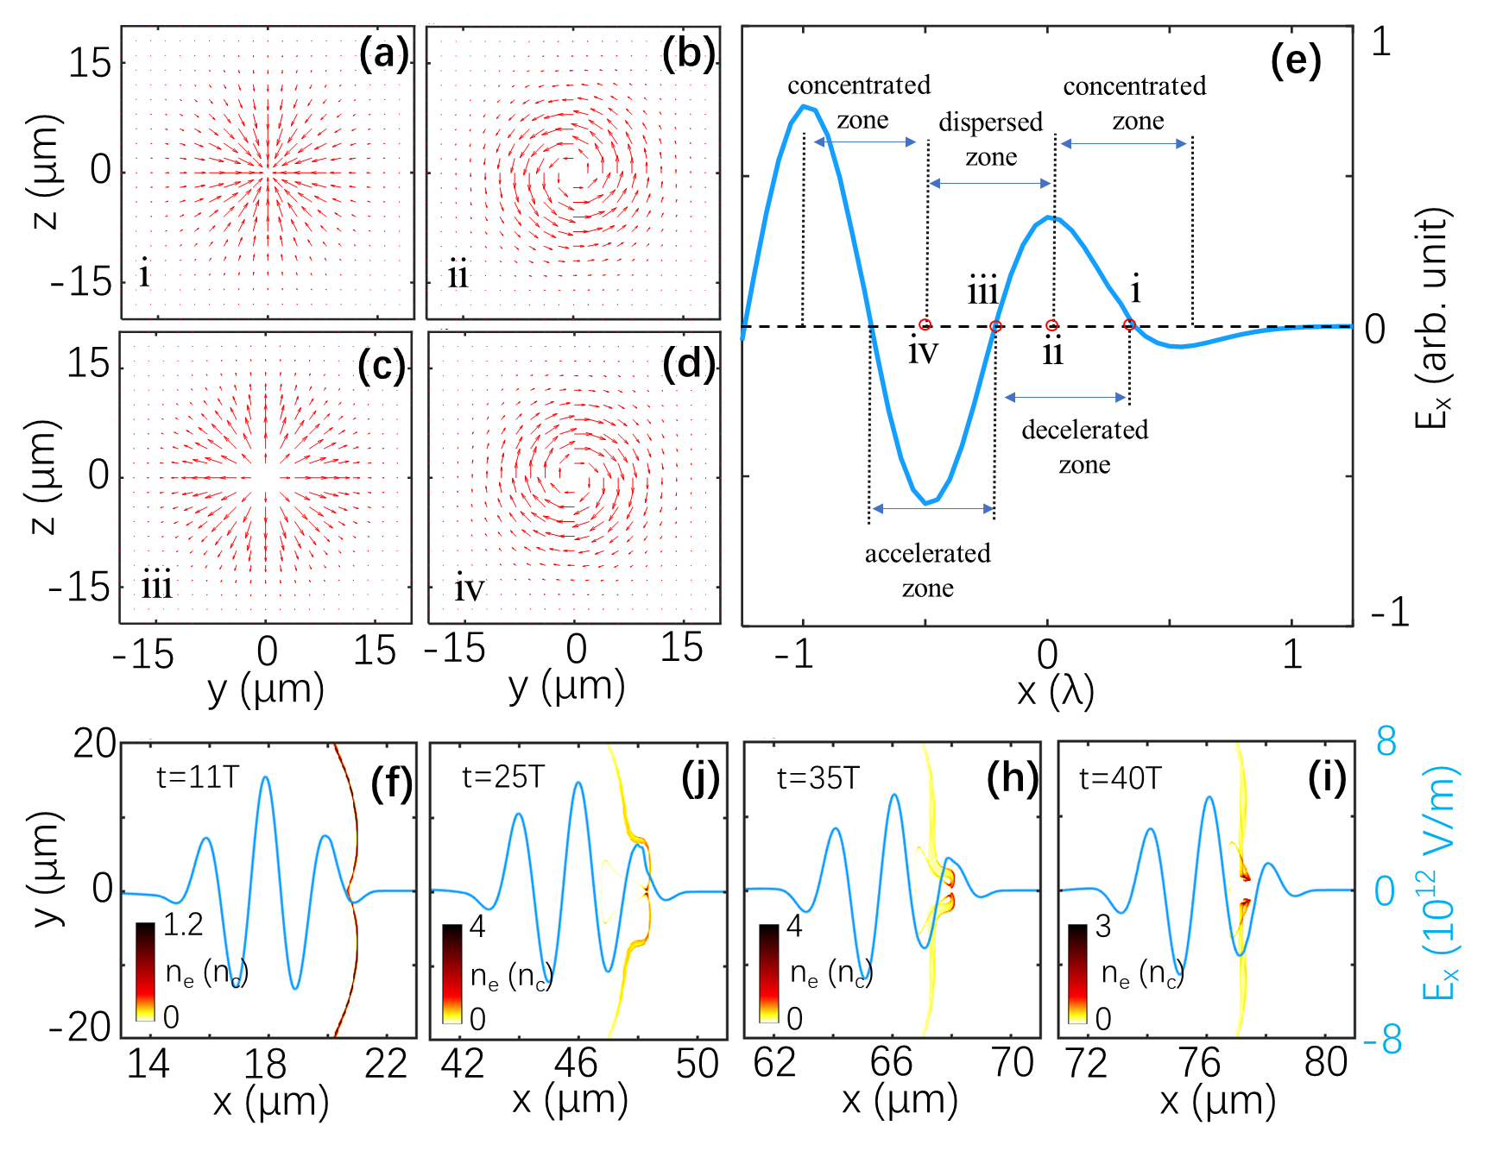
Hollow attosecond election slice acceleration
Electron slice can be modulated
by transverse and longitudinal
electric fields (Carrier-Envelope
Phase) at the same time.
A hollow attosecond electron slice
can be generated by inserting
electrons in the proper accelerating
phase in LG laser.
Transverse electric field
Electron density
22
C. Jiang, W. P. Wang*,…High Power Laser Science and Engineering 9，e44(2021)

Slide 23
SULF introduction and opens for users
Particle acceleration driven by LG lasers (spatial vortex)
Acceleration and radiation driven by STOV lasers (spatiotemporal vortex)
Experimental development driven by vortex lasers
Conclusion and outlook
23

Slide 24
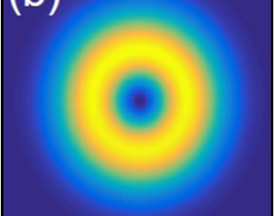
Relativistic spatiotemporal vortices
STOV laser

Slide 25
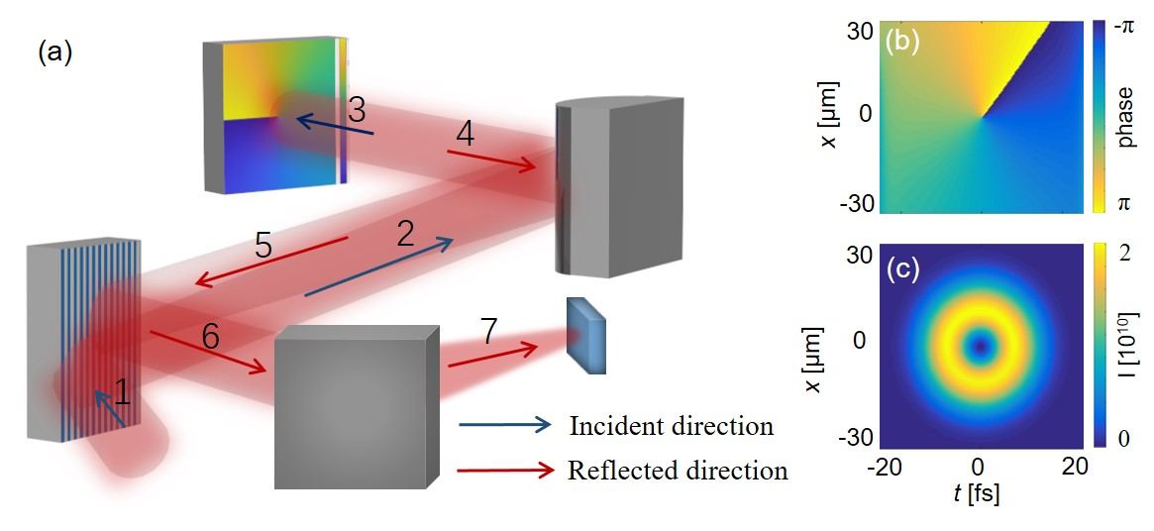
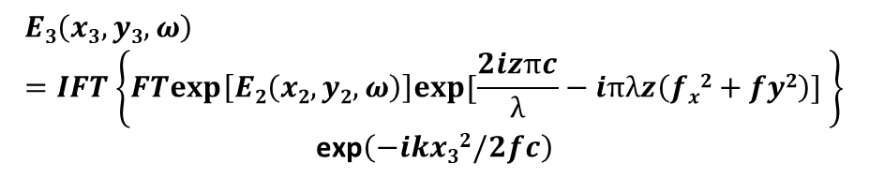

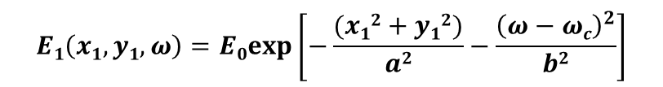
Generation of relativistic STOV laser
Expression of gaussian laser:
$$E1\left(x1,y1,ω\right)=E0exp\left[−\frac{(x12+y12)}{a2}−\frac{{\left(ω−ωc\right)}^{2}}{b2}\right]$$
1 to 2:
The blazed grating reﬂects and diffracts the Gaussian pulse in the spectrum to the ﬁrst-order ﬁeld.
$$E2\left(x2,y2,ω\right)=E1\left(βx1,y1,ω\right)exp\left[iη\left(ω−ωc\right)x2\right]$$
2 to 3:
A cylindrical mirror is used to focus the laser in the x dimension.
$$E3\left(x3,y3,ω\right)=IFT\left\{FTexp\left[E2\left(x2,y2,ω\right)\right]exp[\frac{2izπc}{λ}−iπλz\left(fx2+fy2\right)] \right\}$$
$$\text{exp}\left(−ikx32/2fc\right)$$
3 to 4:
The reﬂected phase plate adds the vortex to the light in the frequency domain.
$$E4\left(x4,y4,ω\right)=E3\left(x3,y3,ω\right)exp\left[−il\tan^{−1}(\frac{y}{x})\right]$$
25
发明专利，CN_116224606_A
Notes:
The laser contrast was further improved with a single plasma mirror installed after off-axis parabola (OAP), which allows SULF-10 PW laser interacting with nanometer-thick CH (Hydrocarbon) foils. The laser power on target is 1.7 PW and the intensity is 1.4*1021 W/cm2.
Using the lower-energy laser interacting with nanometer-thick CH (Formvar) foils, the 70.2 MeV proton beam was obtained via the relativistic-induced transparency regime.
This work is in preparation.

Slide 26
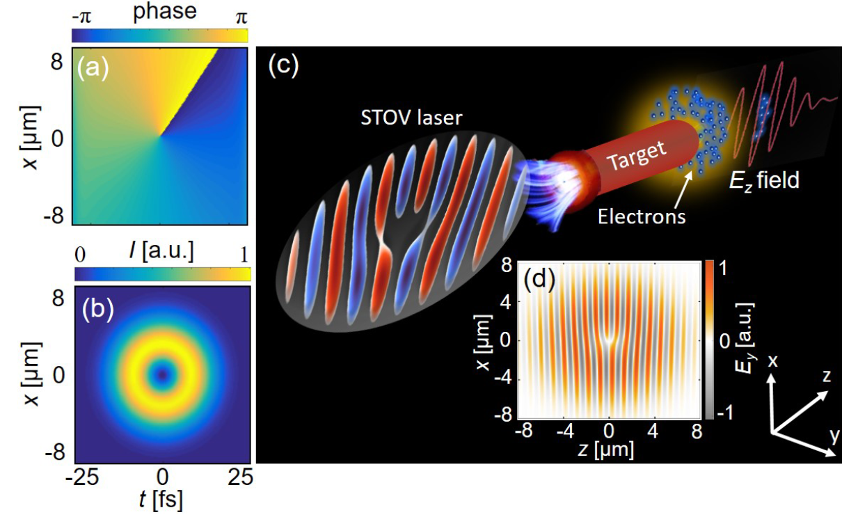


STOV lasers
PRR 6, 013075 (2024)
$φ_{st}=\tan^{−1} (z/ξ)$is the spatiotemporal plane azimuthal angle.
26

Slide 27



Electron acceleration driven by STOV lasers
PRR 6, 013075 (2024)
PRR 6, 013075 (2024)
27

Slide 28


STOV laser produce the isolated gamma ray
Attosecond γ ray can be selected by intense STOV lasers
QED radiation parameter: $χ_{e}∝γ_{e}\left|E_{⊥}\right|E_{s}$
Photon radiation power: $P_{γ}≈2eE_{s}cα_{f}χ_{e}^{2}g\left(χ_{e}\right)/3$
Peak brightness$↑$ = $photons/s↓/{mm}^{2}↓/{mrad}^{2}↓/0.1\%BW$
Field：
Regular momentum density is used to describe the momentum of STOV lasers：
The lateral orbital angular momentum of STOV laser in
the center of mass coordinate system is calculated as：
Under review
28
Notes:
首先，激光与丝状固体靶相互作用，电子被横向有质动力拉出，并束缚在激光相位奇点处，在相位奇点中存在的纵向电场将会进一步加速电子，从而产生高能的电子片。这一点已经在刚才研究进展中详细介绍；
进一步，被平面靶反射的时空涡旋激光的类高斯前沿部分与孤立的电子片对撞，触发非线性康普顿散射机制，产生孤立阿秒的伽马射线脉冲。其中在电子辐射产生光子过程中，非线性QED参数$χ_{e}$可以达到0.3，导致光子辐射功率增大，这意味这将有大量的光子辐射产生。并且在时空涡旋激光调制下，电子片和伽马射线脉冲的脉宽被大大压缩，并且源的尺寸会减小，最后产生了峰值亮度很高的伽马射线脉冲。
最重要的是，在之前研究工作中，我们未对激光和粒子横向轨道角动量进行解析，这里我们首先介绍模拟中STOV激光单光子角动量计算。利用模拟中场的信息作为输入，可以计算出模拟中STOV激光单光子角动量为1hbar，这与理论结果是一致的。

Slide 29
SULF introduction and opens for users
Particle acceleration driven by LG lasers (spatial vortex)
Acceleration and radiation driven by STOV lasers (spatiotemporal vortex)
Experimental development driven by vortex lasers
Conclusion and outlook
29

Slide 30





Generation of LG lasers
Simulation
Phys. Rev. Lett. 112, 235001 (2017)
Nat. Comm. 7, 1 (2016)
Opt. Express 30(16), 29388 (2022)
10²¹
10²⁰
POP 30, 033108 (2023)
Intensity (w/cm²)
Phys. Rev. Lett.
125, 34801 (2020)
Experiment
10¹⁹
Nat. Phys
13, 440 (2017)
10¹⁸
J. Opt
24, 085501 (2022)
10¹⁷
2017
2018
2019
2020
2021
2022
30
Year
Notes:
The laser contrast was further improved with a single plasma mirror installed after off-axis parabola (OAP), which allows SULF-10 PW laser interacting with nanometer-thick CH (Hydrocarbon) foils. The laser power on target is 1.7 PW and the intensity is 1.4*1021 W/cm2.
Using the lower-energy laser interacting with nanometer-thick CH (Formvar) foils, the 70.2 MeV proton beam was obtained via the relativistic-induced transparency regime.
This work is in preparation.

Slide 31

Experiments
laser intensity: 6.3×10¹⁹W/cm²
31
Wang et al. PPL 125, 034801 (2020)

Slide 32


Calculation verification
Huygens-Fresnel principle:
Intense LG laser by a reflected phase plate and a parabola in the relativistic region.
32
Wang et al. PPL 125, 034801 (2020)

Slide 33
Simulations
Collimation of the proton beam can be generated by 500 TW LG laser.
It is assumed to be related to the self-collimation of the electrons during TNSA.
33
Notes:
The laser contrast was further improved with a single plasma mirror installed after off-axis parabola (OAP), which allows SULF-10 PW laser interacting with nanometer-thick CH (Hydrocarbon) foils. The laser power on target is 1.7 PW and the intensity is 1.4*1021 W/cm2.
Using the lower-energy laser interacting with nanometer-thick CH (Formvar) foils, the 70.2 MeV proton beam was obtained via the relativistic-induced transparency regime.
This work is in preparation.

Slide 34

Conclusion for physics driven by vortex laser
Physics driven by intense vortex lasers
Gaussian
Gaussian
LG
STOV
34

Slide 35
Conclusion and outlook
Relativistic LG laser provides longitudinal OAM and Relativistic STOV laser provides transverse OAM, both of which introduce new dimensional manipulating or detecting for laser-plasma interactions, such as triggering unusual nuclear channels.
Luckly, we have generated the highest intensity LG laser in laboratory and applied it to particle accelerations in experiments.
Attosecond electron beam is firstly realized by intense STOV lasers, which is hoping to be realized in laboratory.
SULF 10PW laser facility is open to users now.
wangwenpeng@siom.ac.cn

Slide 36


Thanks for you attention！
谢 谢 ！
上海超强超短激光实验装置
Shanghai Superintense Ultrafast
Laser Facility

