Slide 1
Photon bemalines
F. Villa
On behalf of EuPRAXIA@SPARC_LAB team

Slide 2
Contributions from
Marco Angelucci
Zeinab Ebrahimpour (FERMI)
Federico Galdenzi (Tor Vergata)
Andrea Liedl
Emiliano Principi (FERMI)
Fabio Villa

Slide 3
General remarks
Big impulse to keep the beamlines as compact as possible while fulfilling all the requests from user group
Conventional solutions are preferred (if ready) for most of the elements for beamline reliability
TRL of every device is shown in this presentation
Status of TDR readiness is highlight for every device/measurement type

Slide 4
Beamline priorities
We defined a Relevance for the TDR and a technical Complexity to be realized to give each section a Priority

Slide 5
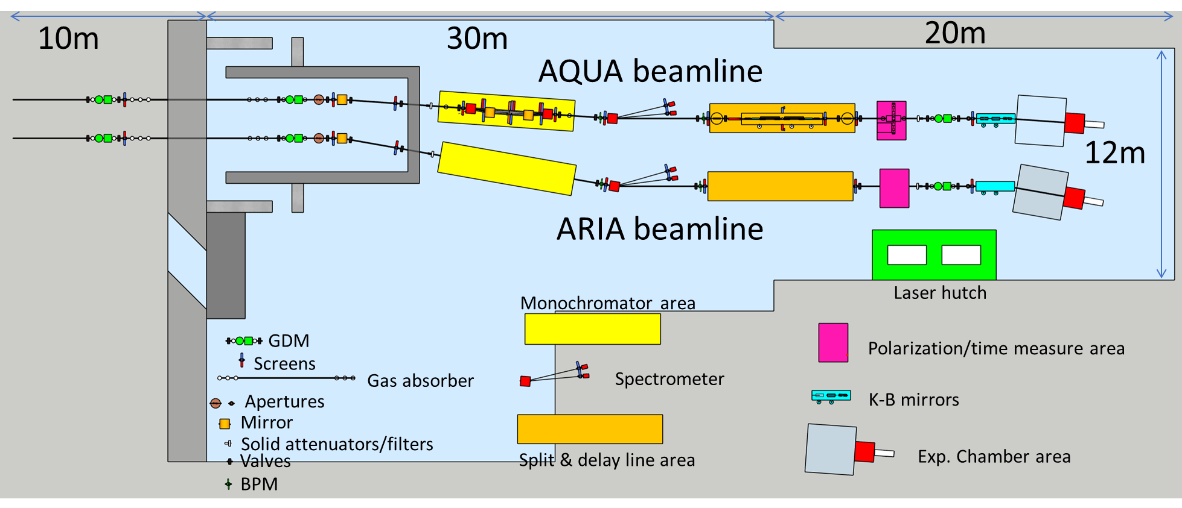
Beamline layout
We updated the layout after discussions with safety group and Fermi scientists
Drawn a first sketch of the safety hutch for gas bremsstrahlung radiation, validation is ongoing

Slide 6
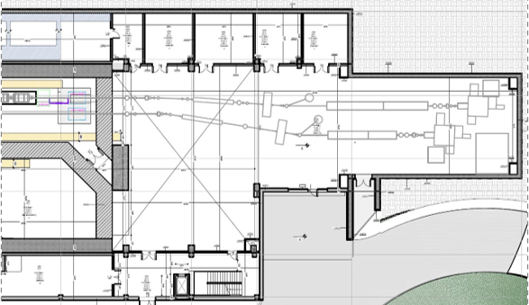
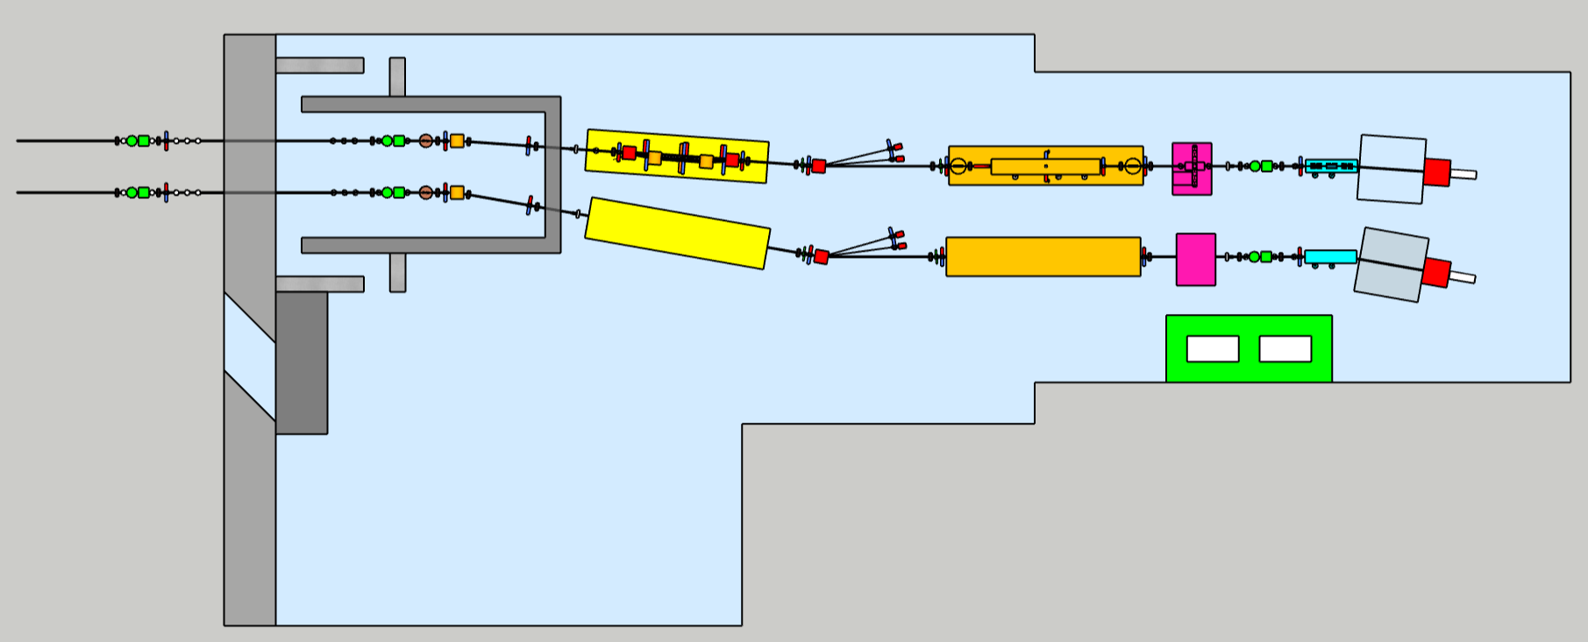
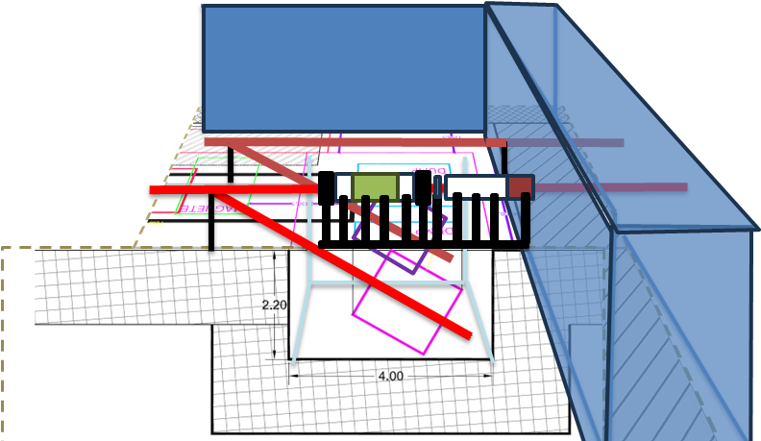
AQUA Beamline layout
Undulators’ end
screens
valves
pumps
BDA
Filter wheels
GMD
Gas attenuator
GMD
Mirror
17m
Gas attenuator in between the main shielding wall to save space
Added an additional GMD before for attenuation feedback
Check of the first part of the beamline for interference with other part of the machine have to be done

Slide 7
AQUA Beamline layout
Filter wheels
14m
S&D area
(and layout)
BPM
BPM
Mirror
Monochromator
area (and possible layout)
Spectrometer
Filter wheels moved outside the hutch for ease of access
Drawn preliminary design of monochromator, spectrometer and split and delay (for long delays). Designs still need validations, see in dedicated slides.

Slide 8
AQUA beamline layout
S&D area
(and layout)
Spectrometer
Filter wheels
Exp. chamber area
BPM
BPM
High res xray cam
KB mirrors
Hartmann sensor
Aperture
20m
GMD
Time measurement area (and layout)
2m
3m
4m
Added a diaphragm aperture in front of the KB mirrors
Increased the KB chamber for the possibility for an additional mirror
Added a tentative layout for the cookie box

Slide 9
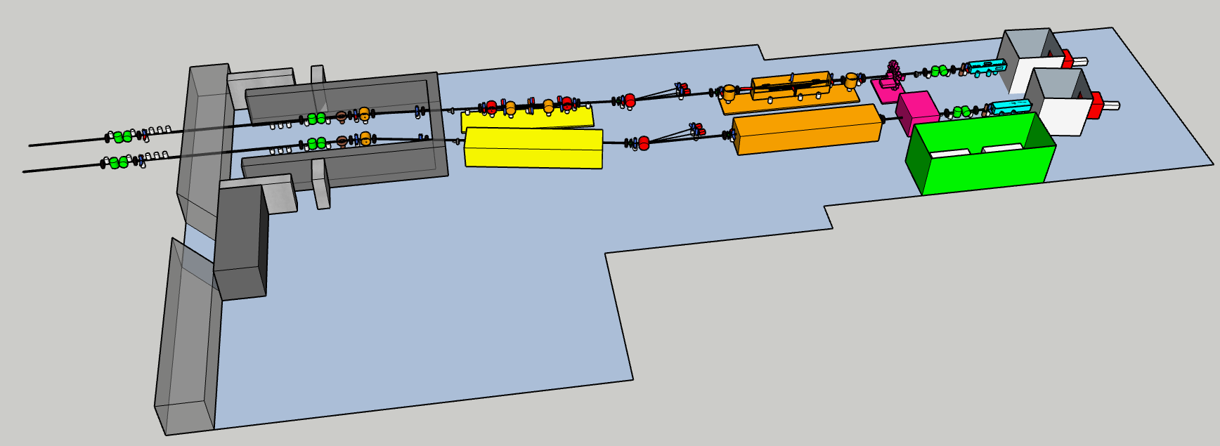
3D layout of the beamlines (as now)

Slide 10
Preliminary estimations on losses
System | Transmission | #
Mirror chamber | 0.80 (0.85) | 1
BDA | 0.99 | 2
BPM | 0.98 | 2
Spectrometer | 0.75 (0.80) | 1
Monochromator | 0.08 to 0.02 | 1
Intensity monitor | 0.99 | 2
Time measurement | 0.99 | 1
Split & delay | 0.41 (0.52) | 1
attenuators | 1 to 0 | 3
YAG screens | 1 or 0 | 13
Valves (1st estimation) | 1 or 0 | 11
K-B focusing | 0.64 (0.72) | 1
 | FEL parameters (Linear Polarization) | FEL parameters (Circular Polarization)
Central wavelength range (nm, eV) | 4.0 nm, 310eV | 4.0 nm
Spectral bandwidth (rms, % to the central wavelength) | 0.088% | 0.117%
Beam length (rms, fs) | 3.50 fs | 3.76 fs
Beam transverse size (rms, um) | 133 um | 132 um
Beam divergence (half angle, mrad) | 0.023 mrad | 0.022 mrad
Photons per pulse (number) | 2.33*10^11 | 2.77*10^11
Polarization (direction) | H | C
Repetition rate (Hz) | 100 | 100
Total transmission
without monochromator and S&D: 34% (with R=85% mirrors: 44%)
with Split & Delay: 14% (23%)
with monochr. 1-g: 2.6% (3.3%) x $δλ/Δλ$
with monochr. 2-g: 0.8% (1.0%) x $δλ/Δλ$
with monochr. 2-g + S&D: 0.32% (0.52%) x $δλ/Δλ$

Slide 11
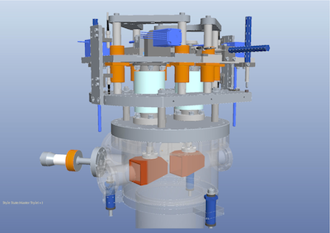
Beam defining apertures
Double rectangular aperture to select the beam from background at the beginning of the beamline
Second aperture as tunable diaphragm before KB mirror for better elimination of spurious radiation
TRL 8
Writing readiness: main description ready, details still missing
Technical readiness: calculations for damage done, design of chamber and motor still missing => Fermi has similar device, contacted for sharing the design, final diaphragm still to be designed.

Slide 12
Gas attenuator
Attenuation of the beam with continuous variability
In between shielding wall (as in FERMI, FLASH, PSI…) to reduce impact on the beamline length
TRL: 7
Writing readiness: draft (only general description of the system)
Technical readiness: differential pumping and gas cross section vs wavelengths needed to be studied, design still in draft

Slide 13
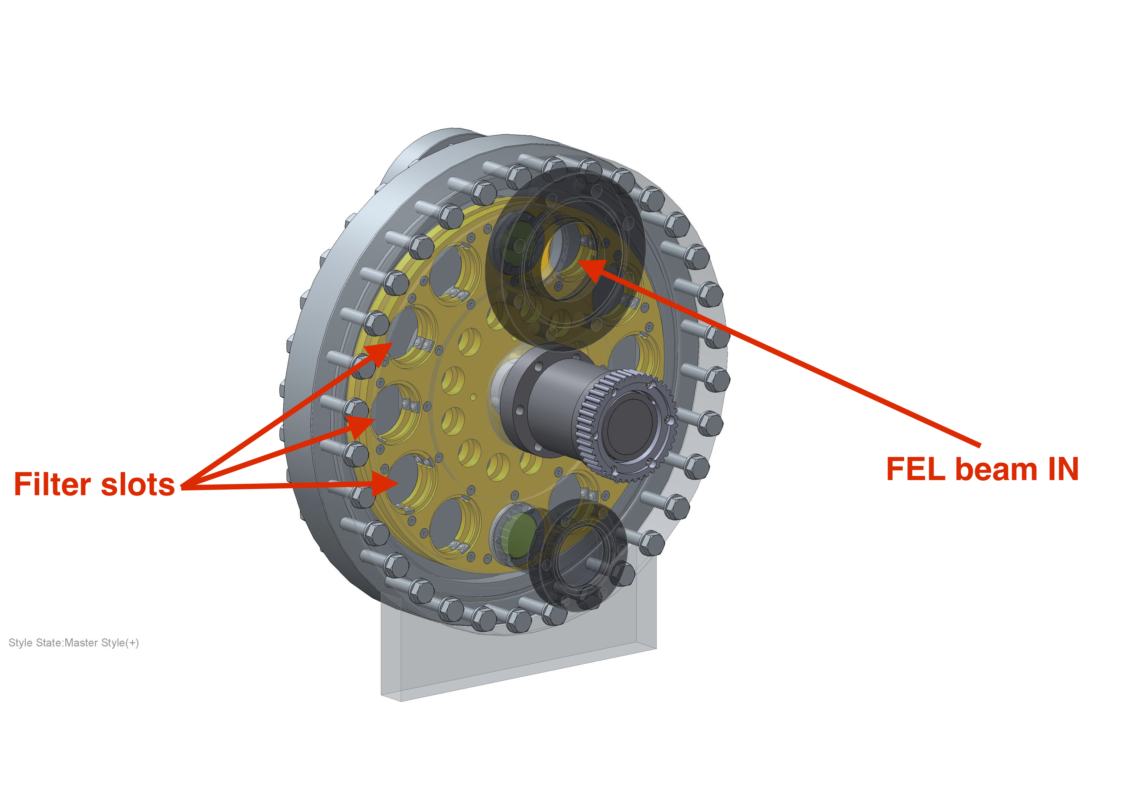
Solid Filters
2 filter wheels with different filter configuration (thickness and materials)
TRL 7
Writing readiness: draft (only general description of the system)
Technical readiness: draft, filter materials and thickness still needed to be evaluated, chamber and motors need to be designed => asked Fermi for its design

Slide 14
Mirror
2° grazing incidence for best transmission vs beamline compactness
Horizontal size 8$σ$ of the beam (projected due to incidence angle), much relative larger in vertical direction ($∼$cm) for changing impact position to recover reflectivity from damage before change it
Progressing on coating material study
TRL: 7
Writing readiness: draft, general layout of the text readied, need to be filled with values
Technical readiness: mirror coating under study; mirror, motor and chamber design is in draft state
Beam $σ≈0.6$mm
@2° $4σ≈74.5$ mm
Mirror: 40x150 mm^2
17m

Slide 15
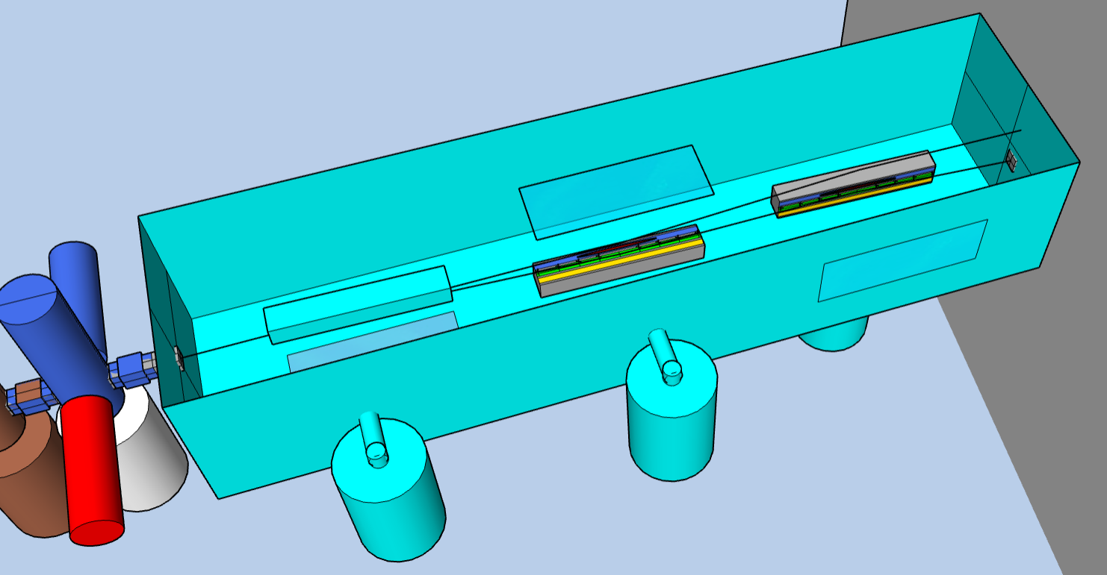
KB focusing
Bendable mirrors in front of the experimental chamber (about 2 m from focal spot)
Desing most sensible to machine parameters variations (mostly divergence)
Added the possibility for a steering mirror before the KB in case of specific experiments needing horizontal aligned beams
TRL: 7
Writing readiness: draft
Technical readiness: draft, calculation for mirrors shape should be optimized after fixing the beam parameter acceptance; same for beam focal spot evaluation. Drawings not started. => Collaboration with FERMI (Ebrahimpour, Principi) where bendable mirror were first employed
Beam $σ≈1.6$mm
@2° $4σ≈195$ mm
Mirror: 40x400 mm^2

Slide 16
Split and delay System
We are evaluating two different systems: a large ($∼$8m) for large delays capability (26 ps) and a smaller one ($∼$1m) inside the experimental chamber (similar to MiniTIMER at FERMI) with 100s fs of delay capability
May be installed in a second phase of the machine realization (only for pup-probe experiments)
TRL: 5
Writing readiness: draft
Technical readiness: draft, some preliminary calculation for mirror position for the longer system for encumbrance evaluation

Slide 17
Monochromator
Installed in a second phase (only for high resolution spectroscopy experiments)
Many constrains:
Need to not shift the beam (outside acceptance) when inserted (=>using the first steering mirror may help at the cost of some reflectivity)
Need to not change (much) the pulse front tilt for short pulse experiments (=> configuration with 2 grating dispersion free configuration)
Need to preserve a reasonable photon number (=> configuration with 1 grating)
TRL: 4
Writing readiness: draft
Technical readiness: draft, layout and parameters still to be decided

Slide 18
Open problems
Manpower (technical is severe and scientific is moderate)
stronger collaboration with Fermi (Principi, Ebrahimpour) for scientific collaboration and sharing of technical drawings of similar elements
Parameter definition: changes in the machine has repercussions on final photon parameters
start with reference beam, keep the machine able to accept large parameters

Slide 19
Beamline readiness
 | Technical readiness | Writing readiness | TRL
Layout integration | 40% | 10% | N/A
Gas attenuators | 20% | 10% | 7
Solid filters | 10% | 10% | 7
Steering mirrors | 20% | 20% | 7
KB mirrors and focusing | 20% | 10% | 7
Beam defining apertures | 40% | 30% | 8
Split and delay system | 20% | 10% | 5
Monochromator | 10% | 10% | 4

Slide 20
Conclusions
The beamlines are progressing slowly due to low manpower issue.
Major problems:
Related to parameter definition
Related to manpower
Related to complete the design of some elements
Risk mitigation:
Contact and collaboration with other groups (Fermi, CNR, Flash, SwissFEL)
Increase the time to deliver the TDR

