Slide 1
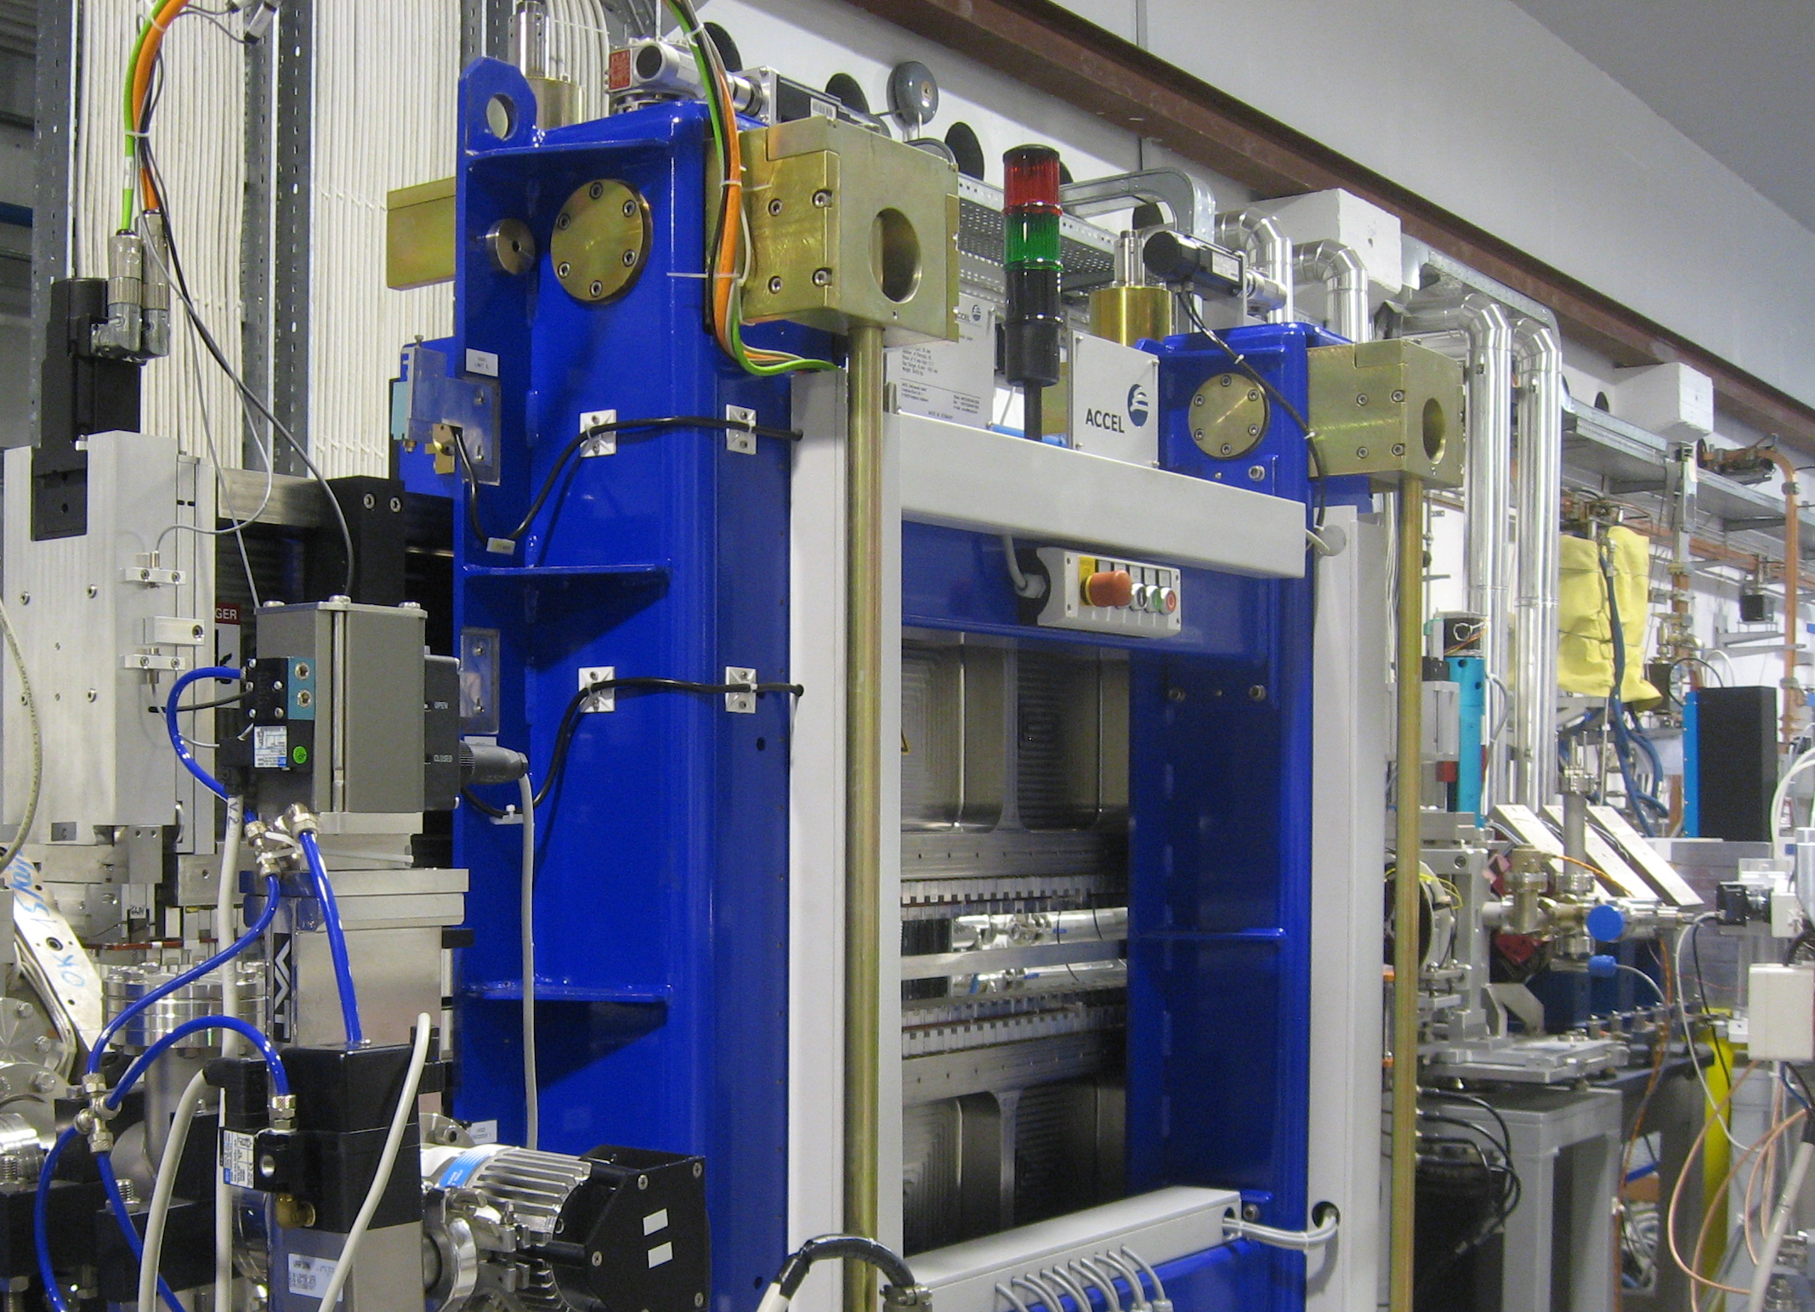



WA6 Report
FEL & Undulators
L. Giannessi (LNF),
on behalf of the WA6 collaboration team
A. Doria, M. Carpanese, F. Nguyen, A. Petralia (ENEA),
I. Balossino, M. Del Franco, M. Galletti, A. Giribono, A. Ghigo, A. Iovine, M. Opromolla, L. Sabbatini, A. Selce, C. Vaccarezza, A. Vannozzi, F. Villa, M. Castellano (Laboratori Nazionali di Frascati),
Vittoria Petrillo (Un. Milano),
Cristian Boffo (FNAL),
Najmeh Mirian (DESY)
Support from ENEA - Holographyc Interferometry & Fibre Optic Sensors (HIFOS) Laboratory (M. Caponero, A. Polimadei)

Slide 2
Outline
Introduction
Freezing the AQUA undulator geometry: minimum gap – vacuum chamber
AQUA Magnetic design / max field
AQUA Beam acceptance / FEL performances / tuning range
Alignment tolerances
Lessons from the SABINA Undulator: mechanical tolerances/feasibility
Magnetic tolerances
Missing parts

Slide 3
EUPRAXIA FELs
  VUV seeded HGHG FEL
ARIA
AQUA
Seed
Modulator
Radiators
Dispersive section
Focus on the AQUA line
  Soft-X ray SASE FEL – optimized for 4 nm

Slide 4

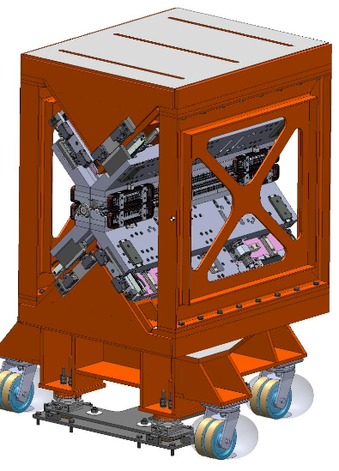
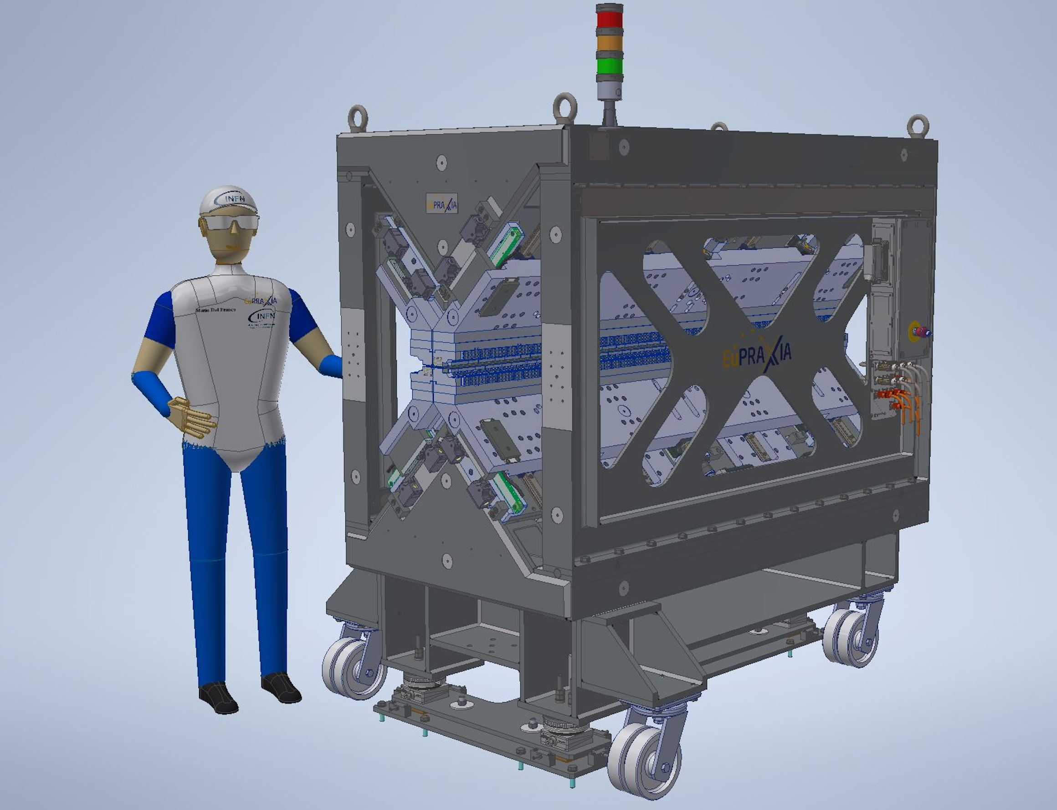
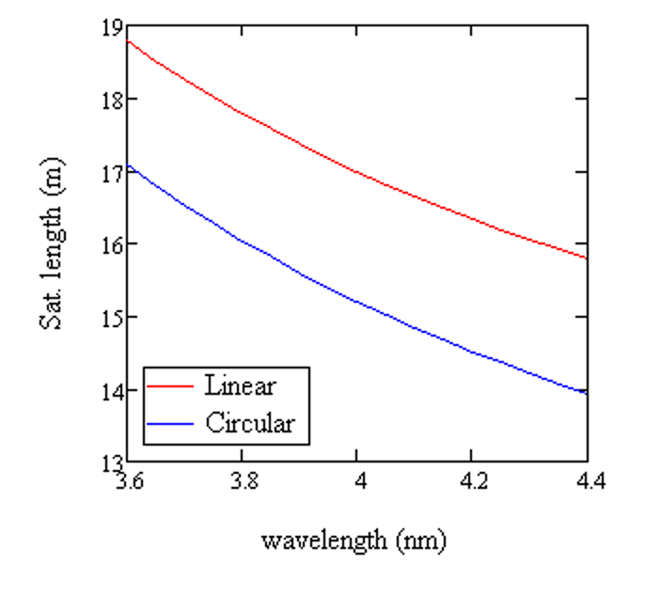
EUPRAXIA AQUA Undulator Model (derived from SABINA)
The total undulator magnetic length considered is 20 m, i.e. 10 modules 2 m each.
Period length: provide sufficient tuning range at fixed energy which allows the FEL to reach carbon and eventually nitrogen K-edge (at higher peak current/beam energy) is 18 mm.
Polarization: variable polarization is an asset as it fits with the requests from the scientific case. Circular polarization ensures higher gain (about 2 m = 1 module)
Apple X type: Substantially higher field at comparable undulator aperture = extended tuning range. Tuning range independent of polarization.
Experience from the SABINA Undulator at LNF (KYMA).
The target photon energy range is extended toward lower photon energies by
  Small gap aperture (thin UV chamber walls – Apple X design)
  High undulator remanent field (high remanent field magnets are assumed – Br=1.35 T)
  Tuning the electron beam energy
AQUA - APPLE-X 1990 mm long modules, period 18 mm, polarization circular left (CL), circular right (CR), linear horizontal (LH), possibly linear vertical (LV).
Fully symmetric (K_{max} independent of polarization)
No mechanical or magnetic prototyping will be carried out specifically for the TDR, but feasibility studies for magnetic and
From SABINA Undulator:
Magnetic design
Mechanical deformation analysis

Slide 5
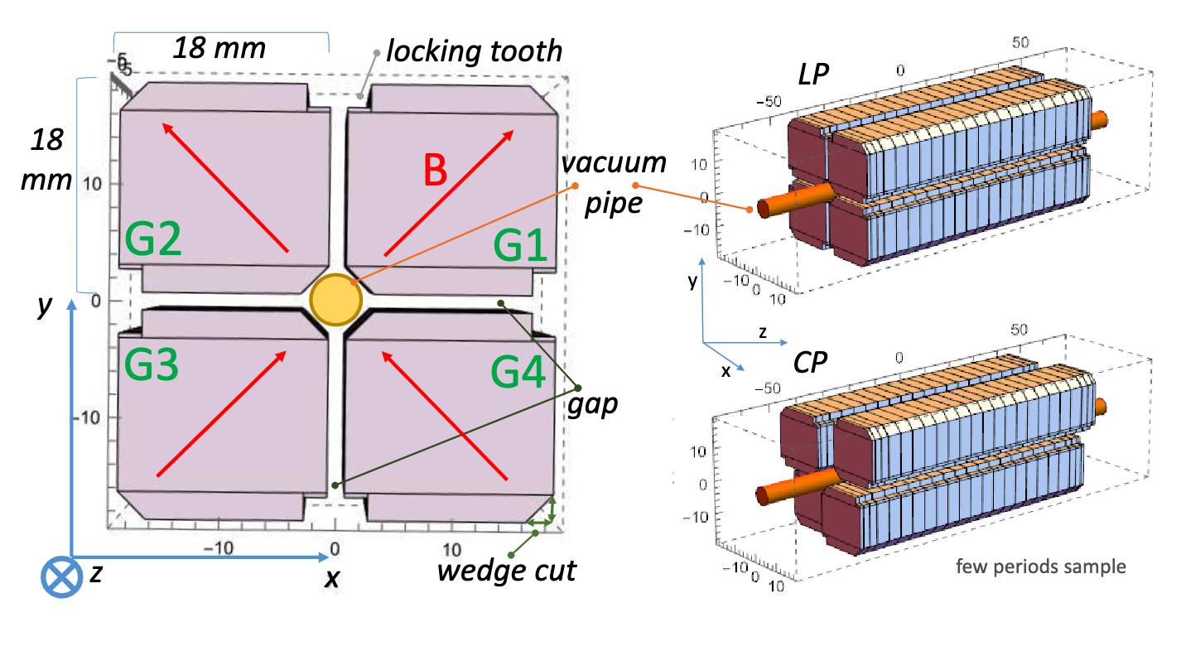
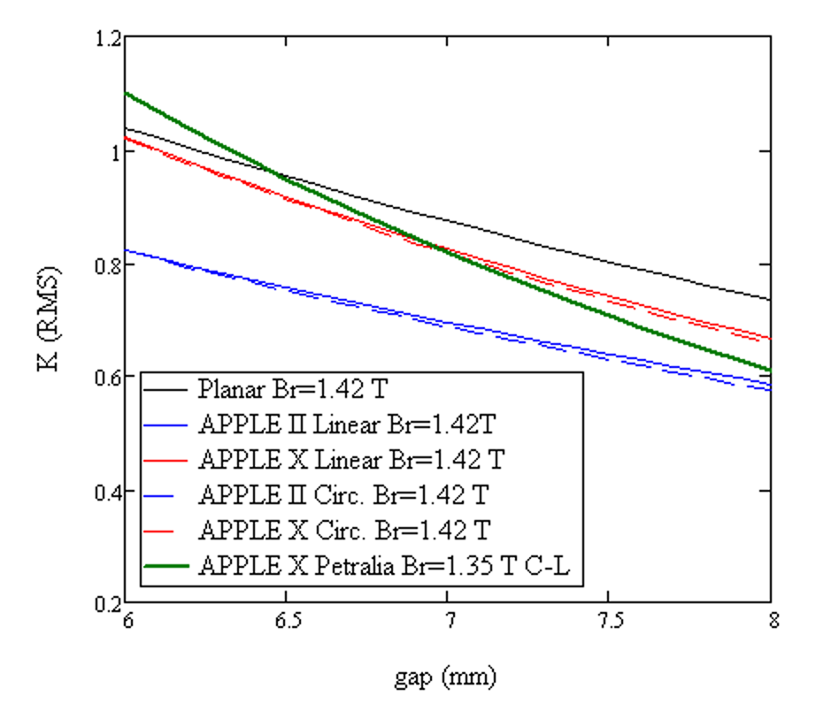
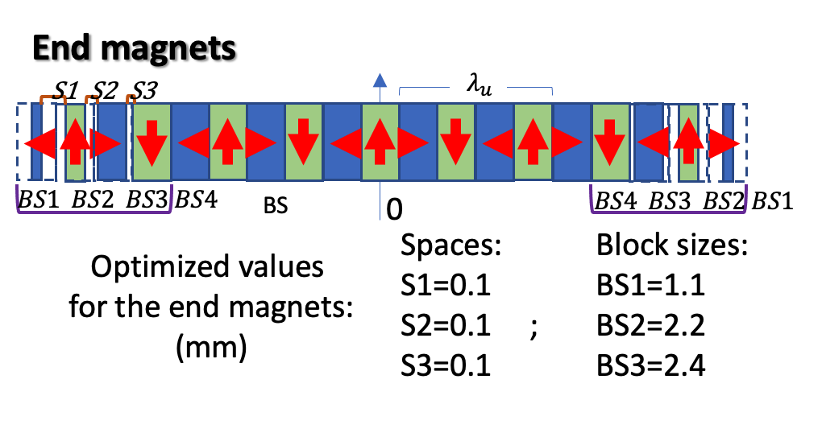

AQUA UNDULATOR Magnetic design
Modeling parameters:
Remanent field Br = 1.35 T
Undulator period λ_{u} = 18 mm
4 blocks / period, NdFeB
# of periods (eff.) N = 110 (Lu=2m)
EUPRAXIA AQUA UM (linear) –
Min gap 6 mm (RADIA)
Number of periods N = 111.5
Total length of the magnetic array L_{und}= 1990.4 mm
Field Integrals
 | LP (h) | CP | LP (v) | units
Ix | 0 | 0 | 0 | G m
Iy | 0.0119 | -0.0095 | 0.4118 | G m
IIx | 0 | -0.0179 | -0.1322 | G m²
IIy | 0 | -0.0001 | 0 | G m²
D5.1: Technologies for the CompactLight Undulator,
F.Nguyen et al., XLS Deliverable

Slide 6
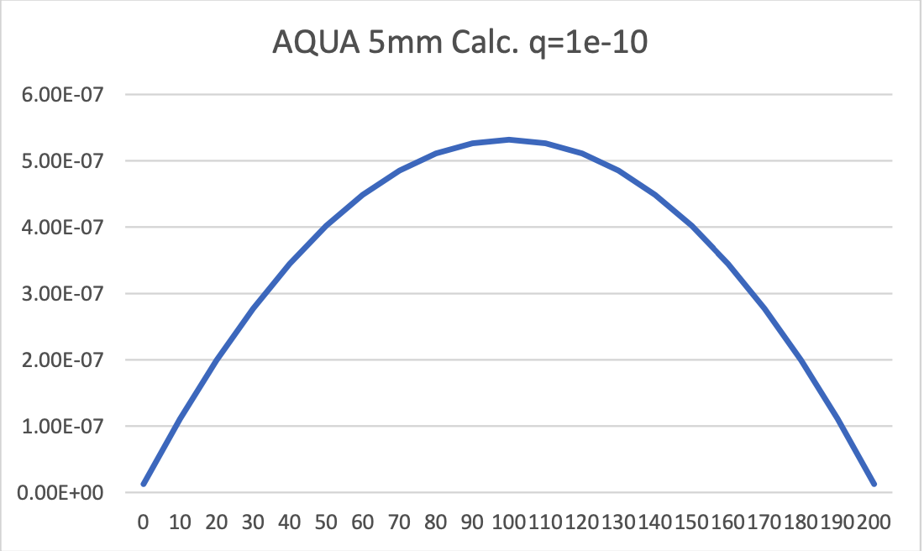
Vacuum pipe geometry
Apple X undulator is symmetric, minimal access from sides. Vacuum chamber is a cylinder of diameter d = 5 mm with sustaining blades
Wake fields mimimization requires smooth and regular surface – minimise apertures and other discontinuities. Wake field effects tolerated at d = 5 mm
Vacuum: access ports for pumping available only at the
undulator transitions
d
d
5 10-7
Vacuum pipe by extrusion, circular, uniform thickness < 300 um. No coating. Cleaning and long-term heating procedure (V. Lollo).
L_{u} = 1990 mm
Pipe ext. diam. (mm) | 5.6
Piper inner diam. d (mm) | 5.0
Wedge cut (mm) | 2.8
φ aperture (mm) | 6.0
B max (T) (in LP) | 0.935
K_{max} (in LP) | 1.572
K_{rms} (a_{w} = max in CP) | 1.111
max 𝜆₀ (nm) (@ 1 GeV) | 5.25
Tuning range
pumping stations
courtesy of A. Liedl

Slide 7
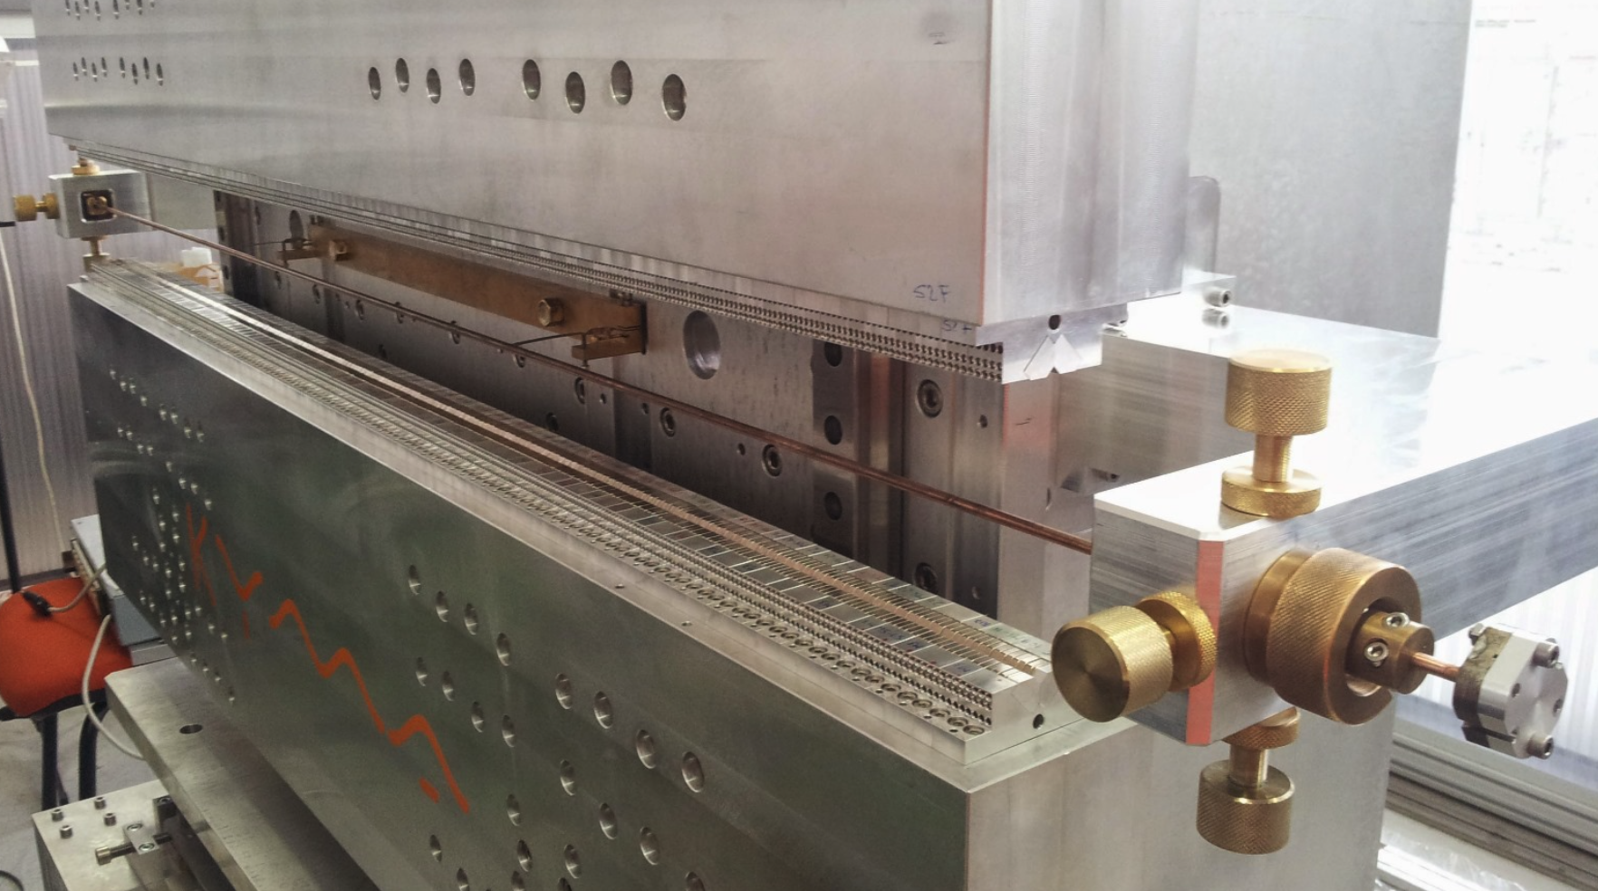
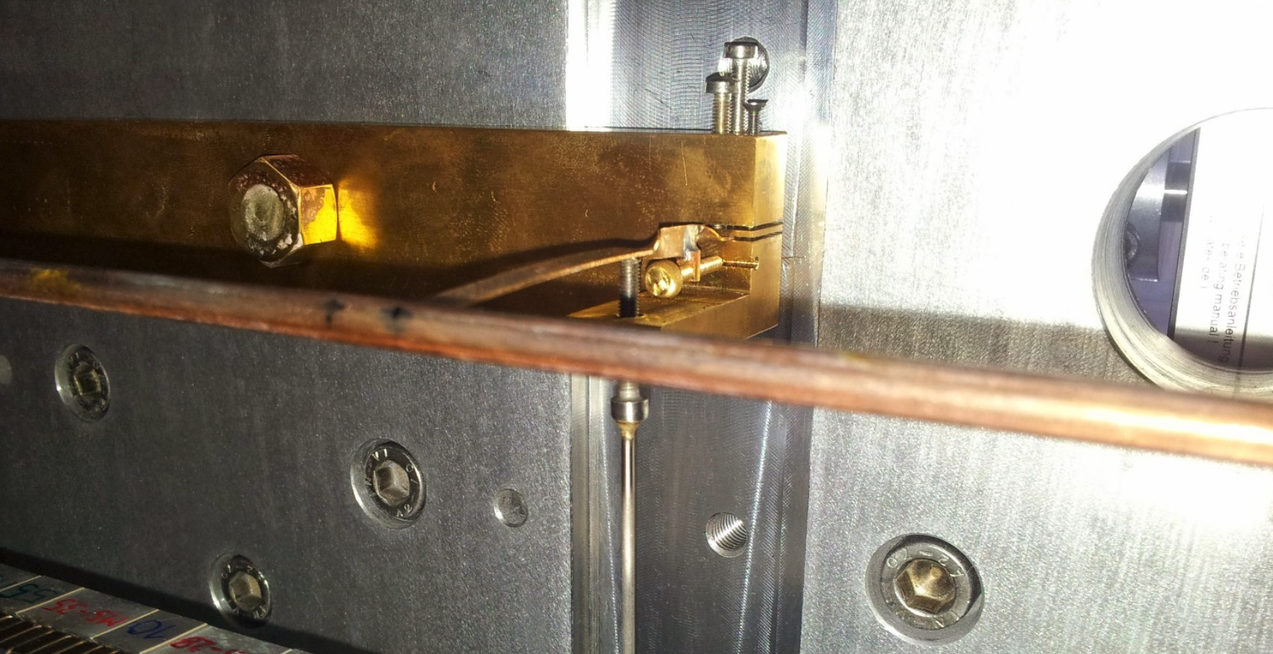
Vacuum chamber positioning and tensioning
Vacuum chamber tensioned at the two UM extrema + holders along the UM
horizontal
vertical
Position
Tension
Mechanical design required for defining size and tolerances

Slide 8
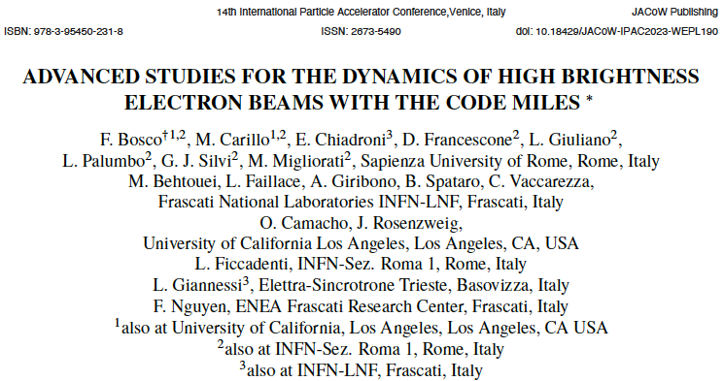
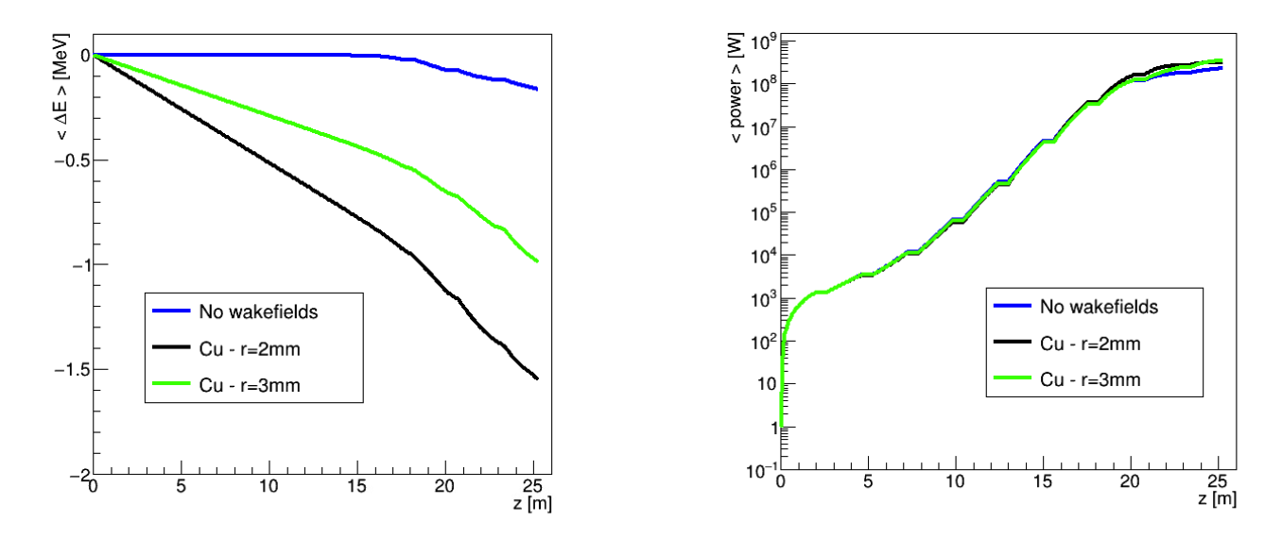
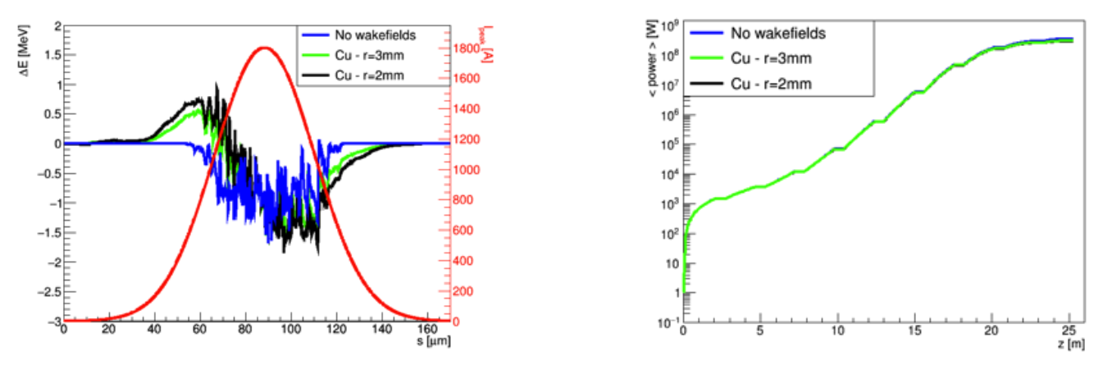
Wake field analysis (courtesy of F. Nguyen)
Recall from previous TDR Committee meeting
Assuming cylindrical symmetry for the wall geometry, the longitudinal (monopole) wakefield generates an energy loss and an increase in energy spread independent of the beam orbit, while the transverse (dipole) wakefield generates an emittance growth that actually depends on the orbit.
Longitudinal:
The energy loss due to the longitudinal resistive wall wakefields was calculated by M. Migliorati, F. Bosco et al. (Uni La Sapienza – Rome) and plugged into time dependent Genesis 1.3 simulations for EuPRAXIA@SPARC_LAB electron both short and long bunches
30 pC
The resulting longitudinal RW wakefield introduces energy spread, affecting the FEL gain length and overall performance. Energy loss and FEL power are evaluated with the RW wakefield mode], assuming a copper VC with different inner radii.
The energy loss – and so the average
FEL power – for both inner radii is comparable to the case of no wakefields at all.
30 pC
300 pC
300 pC

Slide 9
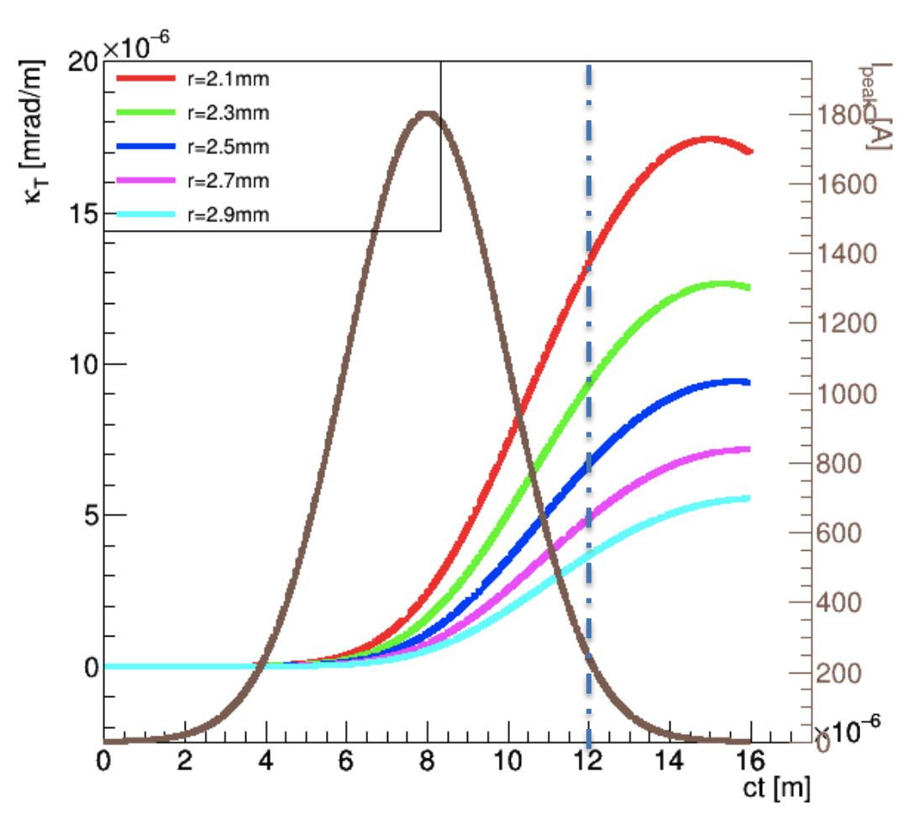
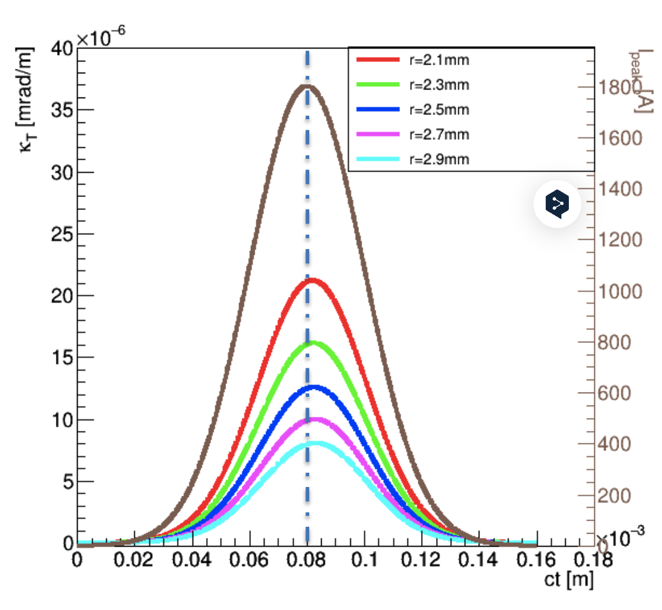
Transverse wake field analysis (courtesy of F. Nguyen)
Recall from previous TDR Committee meeting
The transverse (dipole) wakefield generates an emittance growth that actually depends on the orbit. Analytical treatment based on K. Bane & G. Stupakov formulae and the relationship between transverse and longitudinal RW impedances are used to estimate the kick angle κ_{T} parameter. We assume an orbit offset of 50 μm. The kick scales linearly with the offset (and it is zero on axis).
Charge
30 pC
r = 2.5 mm
Transverse:
For a vacuum chamber inner radius of 2.5 mm, the peak current region of the bunch is affected by a potential kick angle per unit length of 5 nrad/m (10 nrad/m in the high charge case), assuming 50 μm of trajectory transverse offset. Larger offsets would suppress FEL lasing for the shift in resonance (see next).
This lets us estimate the required accuracy in the vacuum chamber alignment. A transverse offset of the vacuum chamber with respect to a perfectly aligned trajectory induces a transverse kick.
Assuming an offset of ±150 μm of the vacuum chamber the kick corresponds to inducing an angle of ∽60 nrad
kick angle per unit length (mrad/m x 10⁻⁶)
beam current profile
Charge
300 pC
r = 2.5 mm

Slide 10
FEL Parameter acceptance analysis
The undulator is engineered to amplify radiation at 4 nm from a suitable beam. We analyze its performance at 4 nm as well as its tuning range.
We used a (modified) Ming Xie model to analyse the FEL performance vs. the e-beam parameters.
We assume a photon energy of 4 nm = 310 eV at 1 GeV (the highest photon energy)
We assume a gaussian beam (in current energy, energy spread, transverse momenta and spatial distributions)
With a peak current 1.5 kA, duration 5 fs, average beta functions β_{x}= β_{y} =10 m, we also assume ε_{x}= ε_{y.}

Slide 11
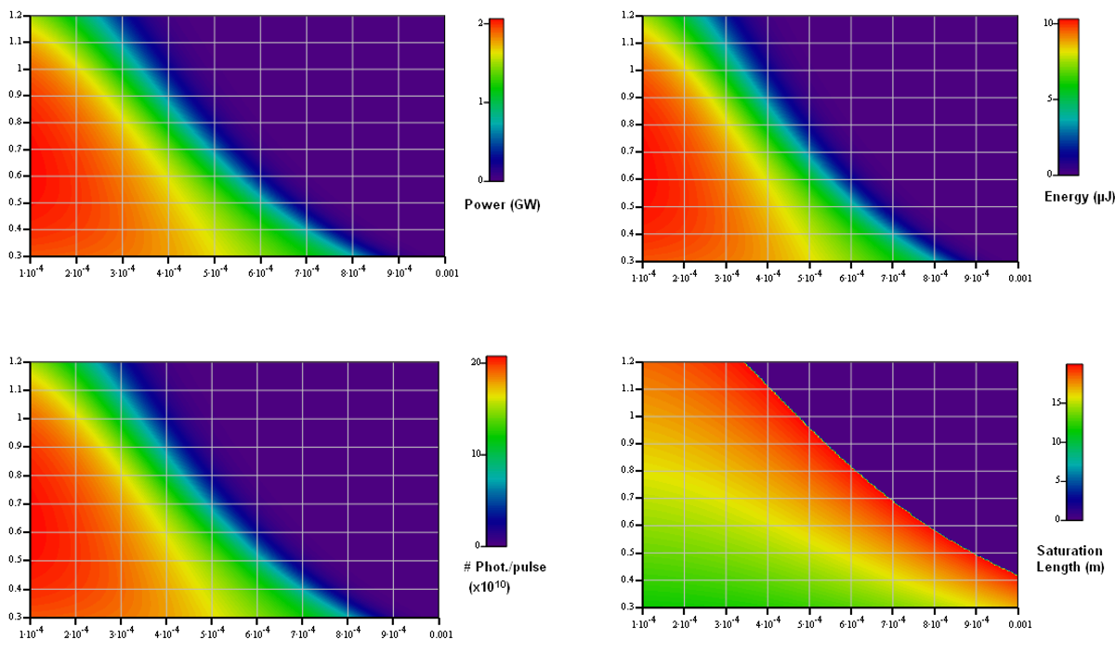
Performance at 4 nm – circular polarization
Circular polarization
1.5 kA
4 nm
beta 10 m
parameters from nominal case (14/6/2024)
emittances (mm-mrad, e_{x}=e_{y})
emittances (mm-mrad, e_{x}=e_{y})
CHICANE
DOGLEG*
energy spread (rel.)
energy spread (rel.)
emittances (mm-mrad, e_{x}=e_{y})
emittances (mm-mrad, e_{x}=e_{y})
energy spread (rel.)
energy spread (rel.)
* The "DOGLEG" case is characterised by 3.2 kA peak current (fluctuating between 1 kA to 9 kA)

Slide 12
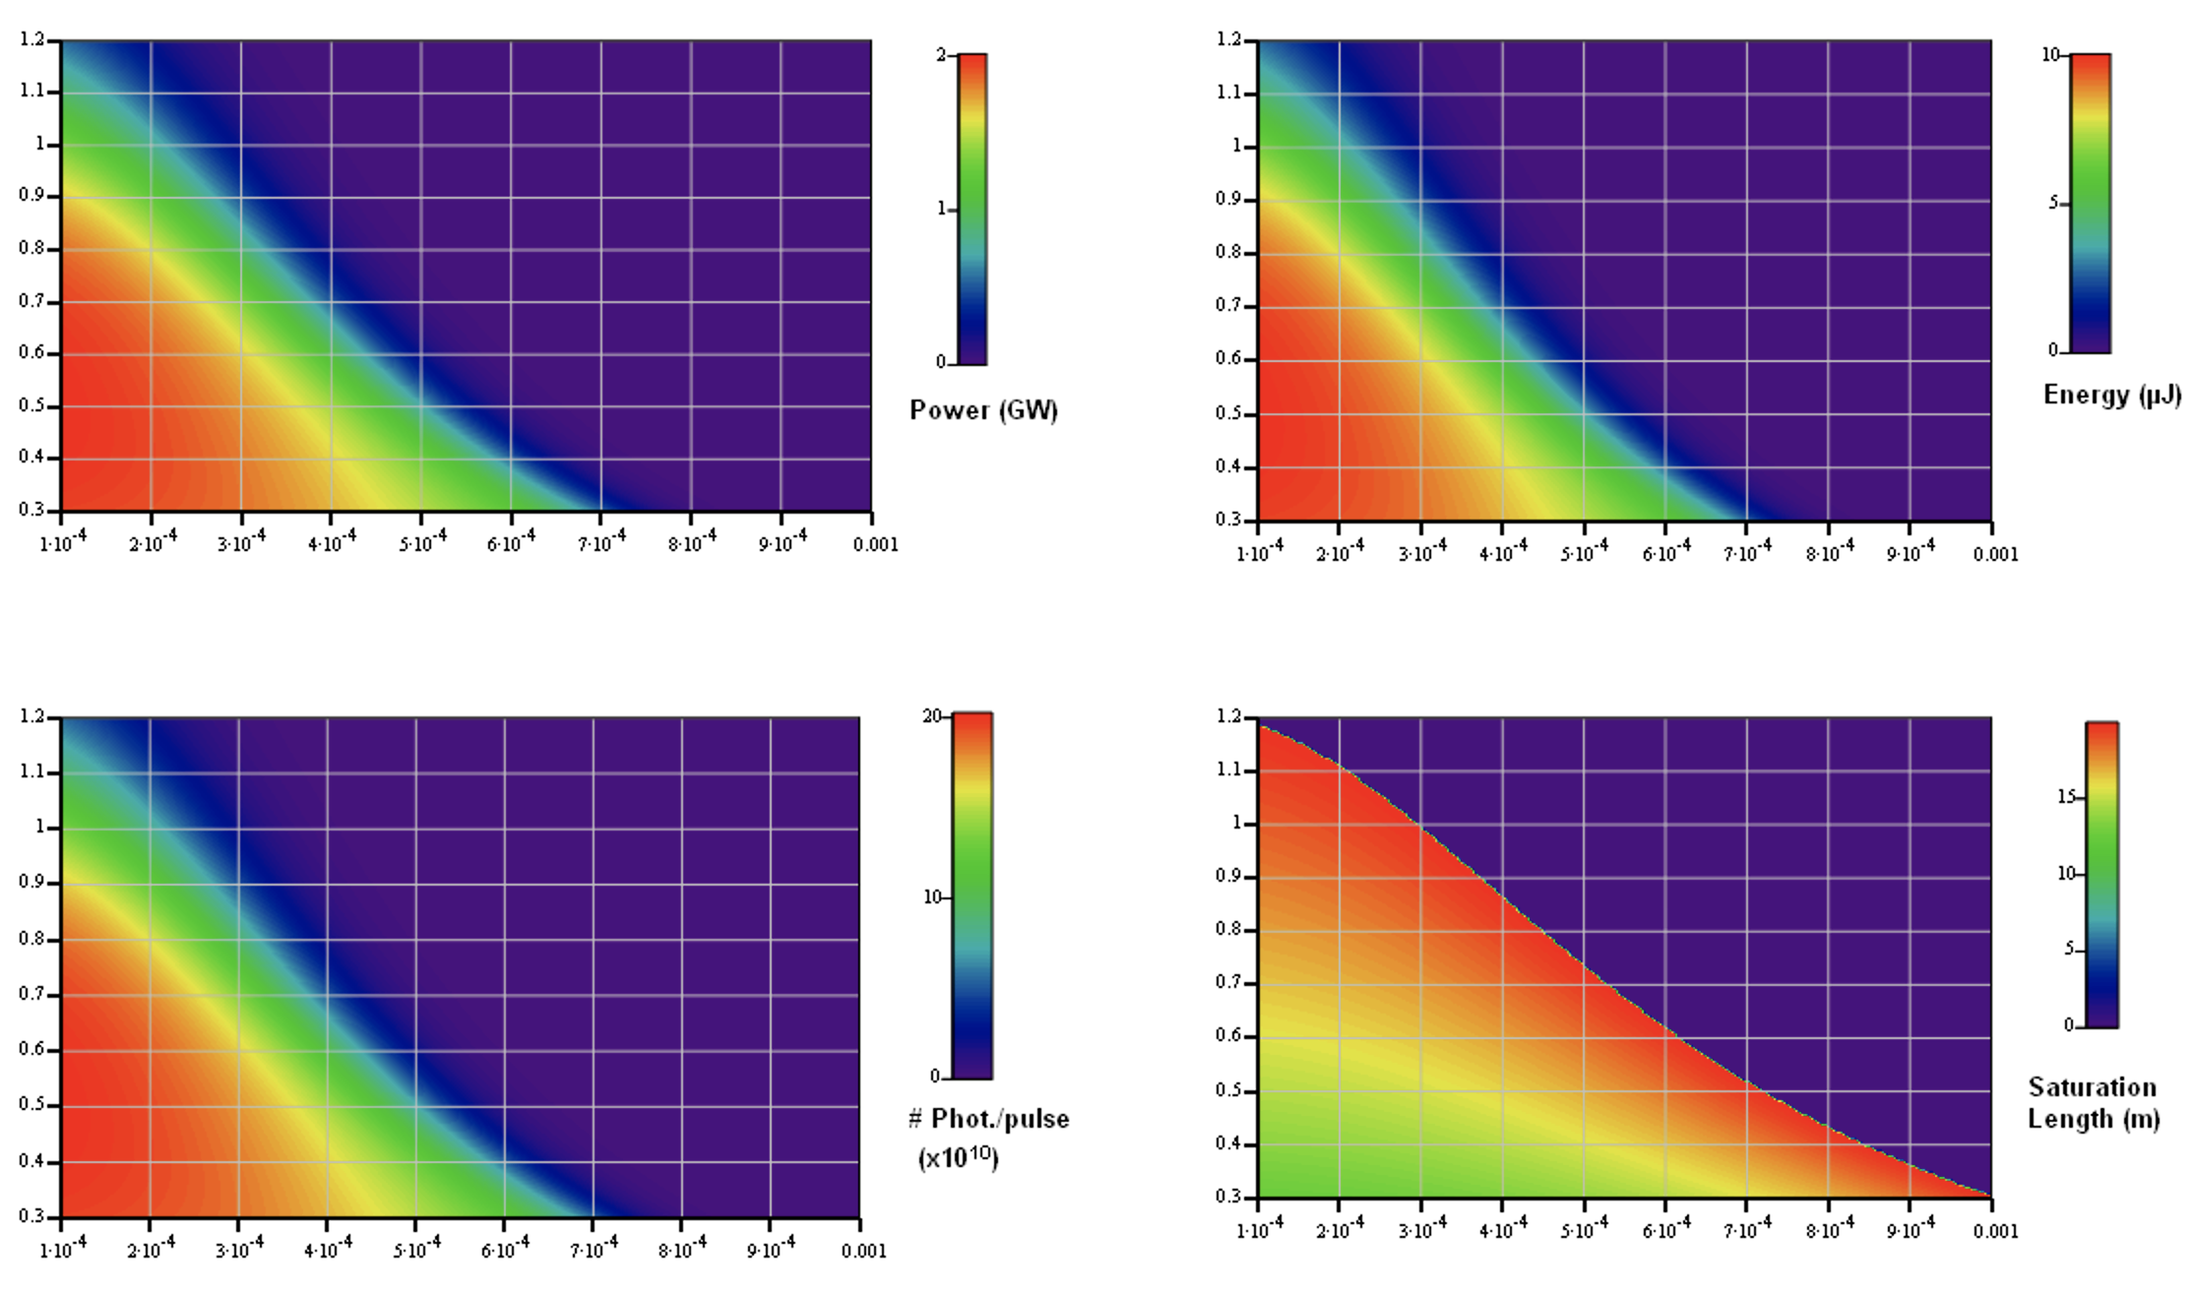
Performance at 4 nm – linear polarization
Linear polarization
1.5 kA
4 nm
beta 10 m
emittances (mm-mrad, e_{x}=e_{y})
emittances (mm-mrad, e_{x}=e_{y})
energy spread (rel.)
energy spread (rel.)
emittances (mm-mrad, e_{x}=e_{y})
emittances (mm-mrad, e_{x}=e_{y})
energy spread (rel.)
energy spread (rel.)

Slide 13
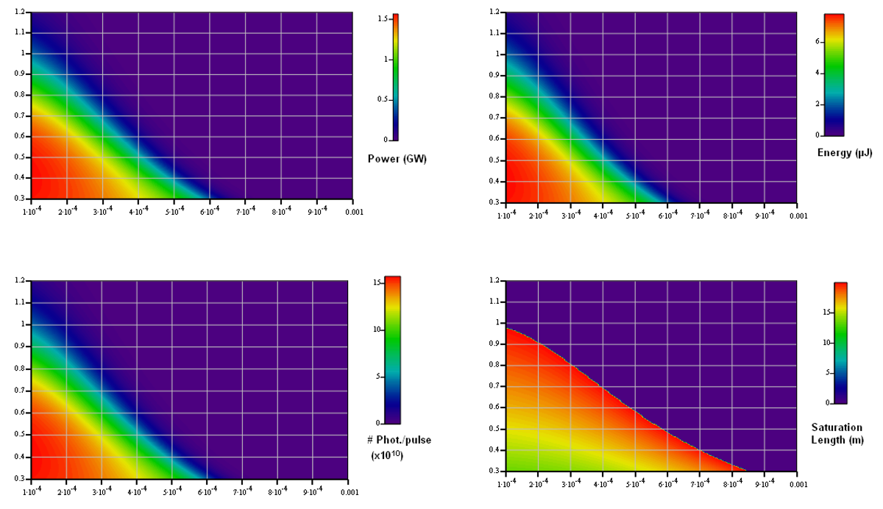
Performance at 4 nm – linear polarization 1.2 kA
Linear polarization
1.2 kA
4 nm
beta 10 m
emittances (mm-mrad, e_{x}=e_{y})
emittances (mm-mrad, e_{x}=e_{y})
energy spread (rel.)
energy spread (rel.)
emittances (mm-mrad, e_{x}=e_{y})
emittances (mm-mrad, e_{x}=e_{y})
energy spread (rel.)
energy spread (rel.)

Slide 14
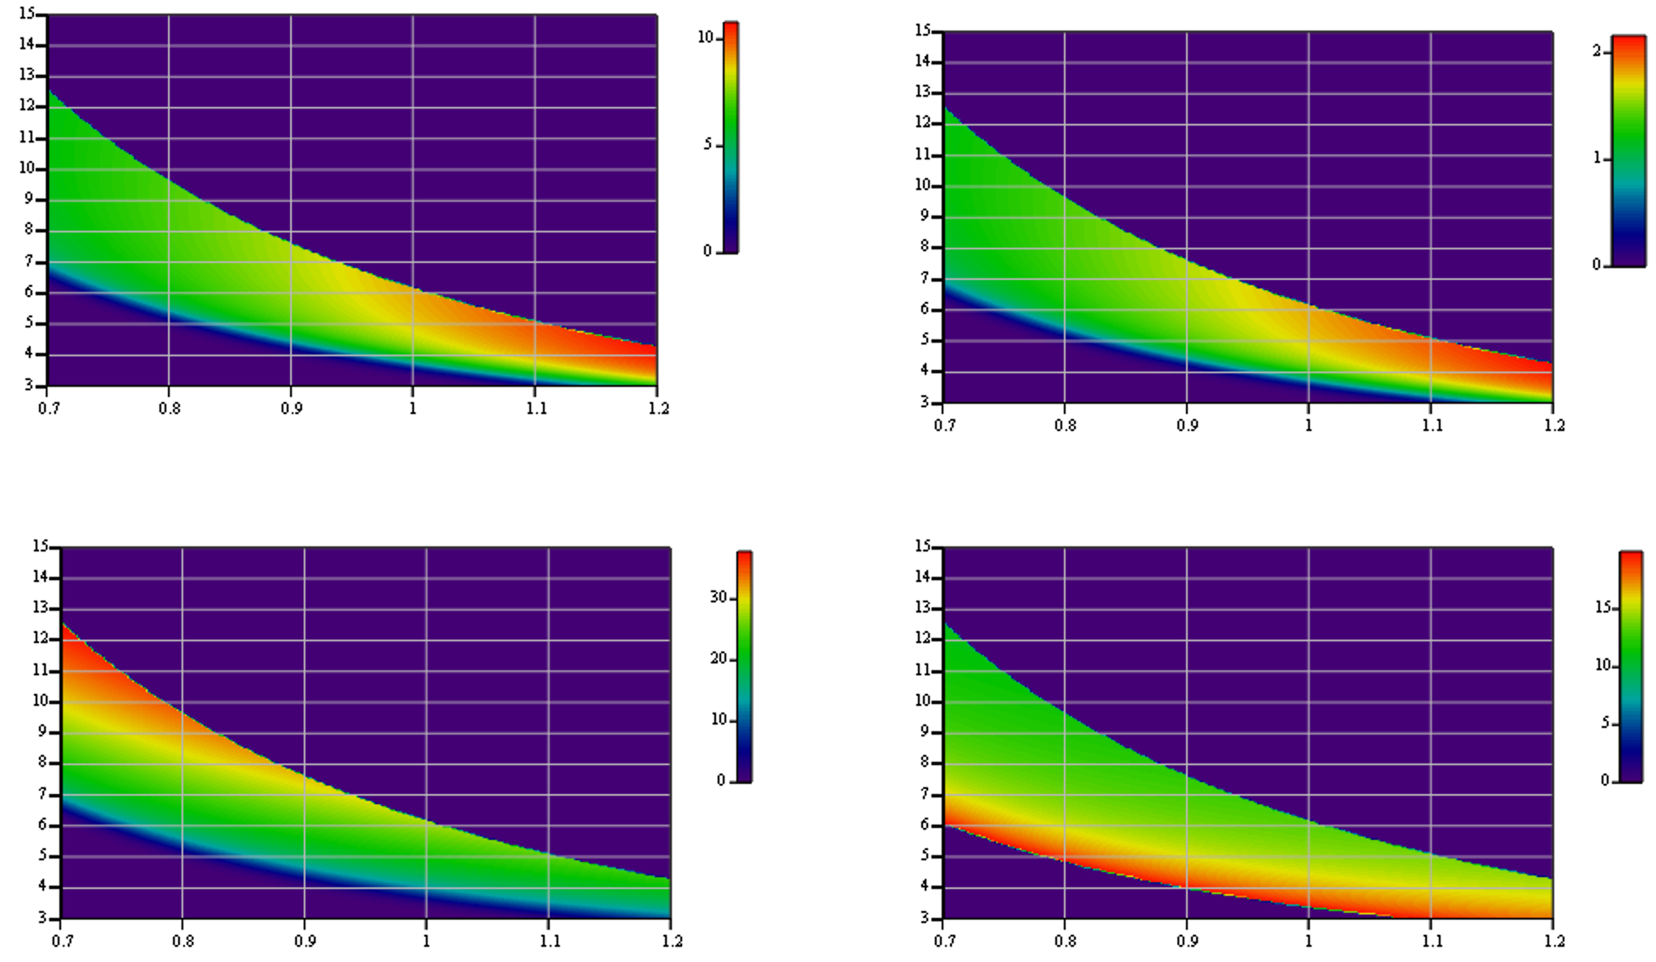
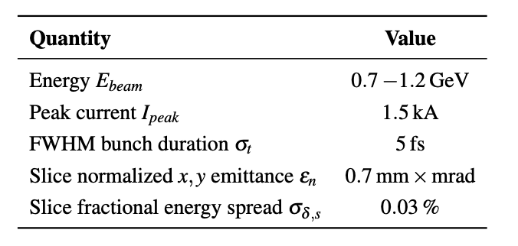
AQUA tuning range – Linear polarization
Tuning range is calculated assuming the following reference beam parameters
Wavelength (nm)
Pulse energy (μJ)
Peak power (GW)
extended range
Wavelength (nm)
Energy (GeV)
Energy (GeV)
(x10¹⁰)
Nphot/pulse
Wavelength (nm)
Wavelength (nm)
Sat Length (m) (magnetic)
Energy (GeV)
Energy (GeV)

Slide 15
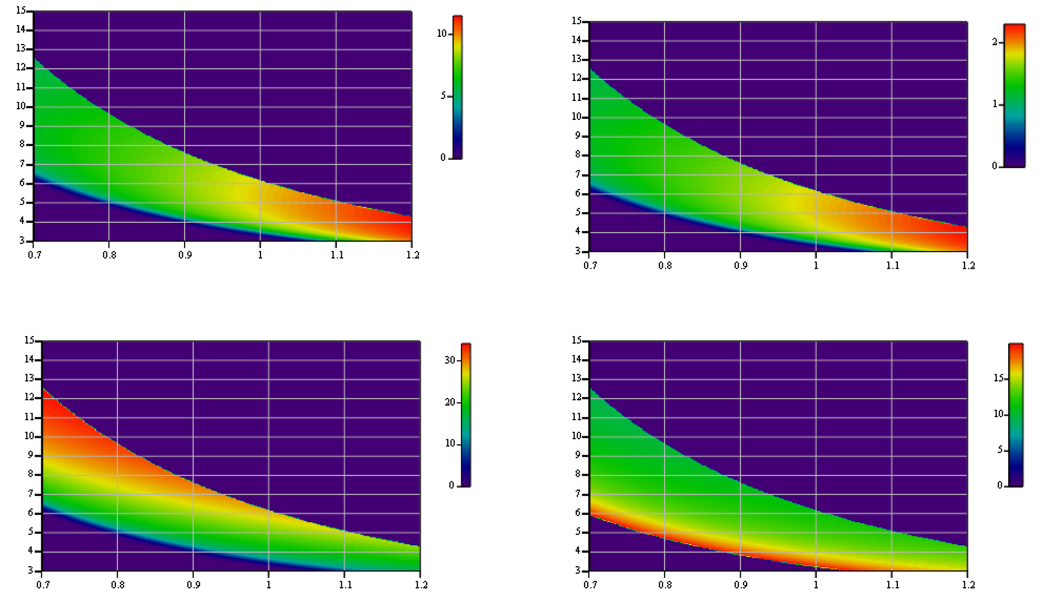
AQUA tuning range – circular polarization
The Apple X undulator provides the same K_{RMS} value in both linear and circular polarizations
Tuning range is calculated assuming the following reference beam parameters
Wavelength (nm)
Pulse energy (μJ)
Peak power (GW)
extended range
Wavelength (nm)
Energy (GeV)
Energy (GeV)
(x10¹⁰)
Nphot/pulse
Wavelength (nm)
Wavelength (nm)
Sat Length (m) (magnetic)
Energy (GeV)
Energy (GeV)

Slide 16
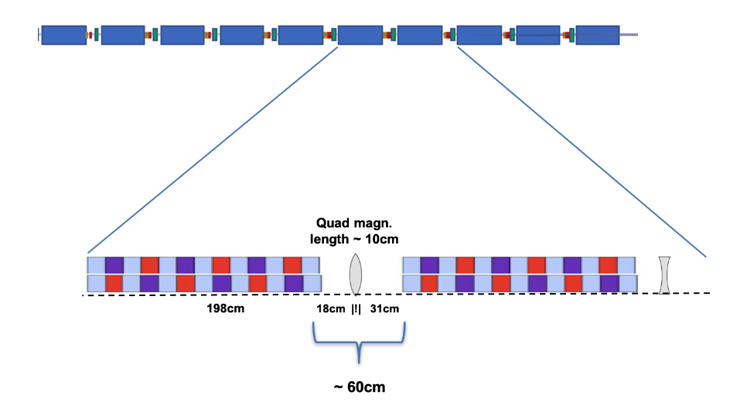
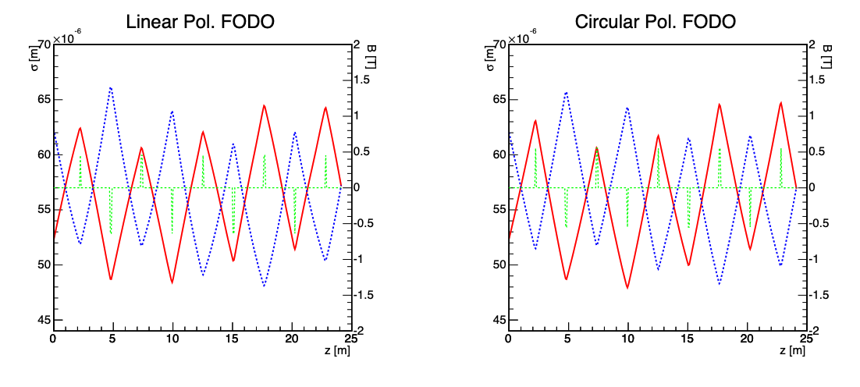
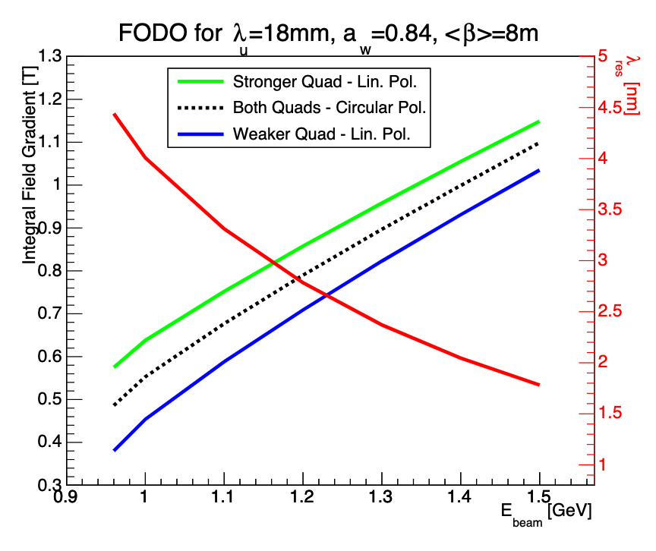
Trajectory, matching
Integrated quadrupole field vs. beam energy.
Examples of FODO matching
Quadrupole offset errors up to q_{x,y} = 400 μm lead to an off-axis beam wander which can be pre-corrected with a corrector magnet (less than 10 mT if 3.6 cm-long), to ensure FEL amplification.
Ideal correction is when correctors are embedded into the quadrupole (share same iron).
This would pose an upper limit to the orbit correction loop response time. To be investigated.

Slide 17
Sensitivity to transverse offsets (2 μm bunch), no wakes (presented 11/2023)
Tolerances: trajectory, injection offset 1
While quadrupole offsets can be compensated by steering the trajectory to force it to stay close to the undulator axis, injection jitters in angle and position cannot be compensated.
FEL power reduction in
Circular polarization APPLE-X
FEL power reduction in
Linear polarization APPLE-X
Conclusion
Circular Polarization: 50μm offset gives rise to ~ 67% power decrease
Linear Polarization: the reduction is steeper and 50 μm is probably too much
Courtesy of F. Nguyen

Slide 18
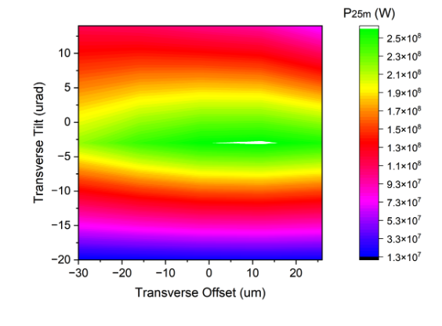
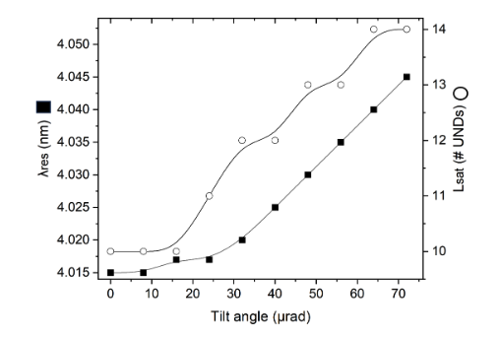
Tolerances: trajectory, injection offset 1
effect of transverse tilts/offsets

Slide 19

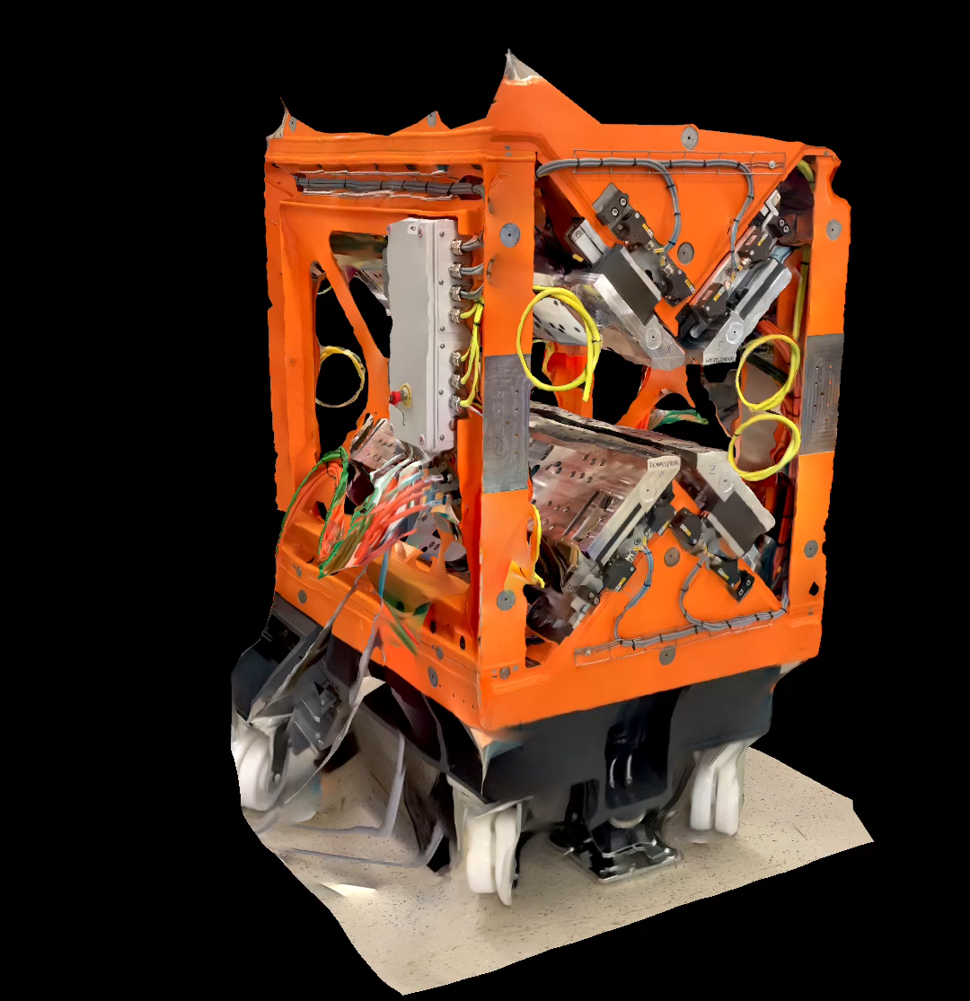
Lessons learned from the SABINA Undulator
Mechanical stability and reproducibility
In collaboraton with the Holographyc Interferometry & Fibre Optic Sensors (HIFOS) Laboratory at ENEA (ref. M. Caponero) we measured the deformations of the undulator guilders
Magnetic error analysis
Indication on the undulator feasibility comparing the SABINA undulator and the ideal RADIA model to reconstruct magnetic dipolar errors along the undulator

Slide 20
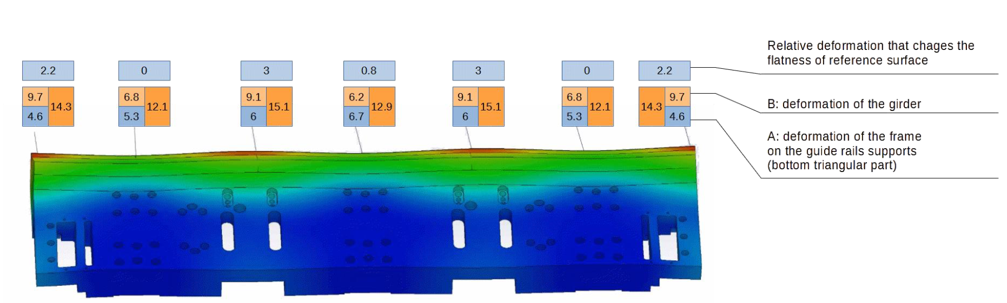
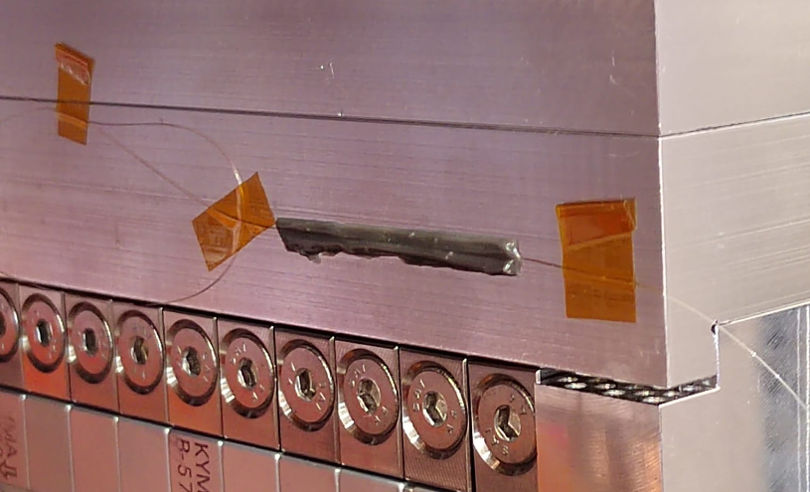
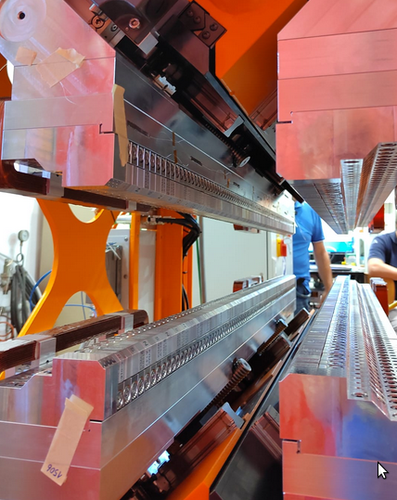
Undulator Mechanical tests on the SABINA undulator
FBG measurements
Courtesy of I. Balossino, A. Selce, A. Polimadei, A. Vannozzi, M. Del Franco, L. Sabbatini, M. Caponero
deformations in μm
CAD model by KYMA
1
2
A diffraction grating is produced by modifying the refraction index of the core of a fiber (FBG Sensors). Rough approximation: the refractive index has a sinusoidal modulation along the axis of the fibre.
The sensor length is 10 mm, temperature and strain sensing at the level 0.1K - 1/10⁶ relative elongation sensitivity
3
Sensors

Slide 21
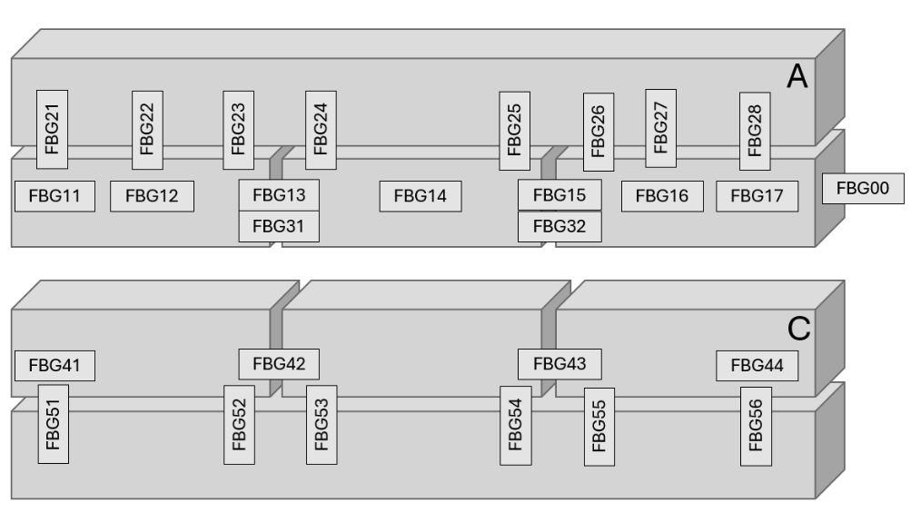
Undulator Mechanical tests on the SABINA undulator
FBG measurements
Distribution of sensors
Undulator tested for
Temperature dependence over a rance of 3 °C
Magnetic forces: gap – phase variations opening
sensors were used in two different ways:
  as strain measurement, by gluing the fiber fully adhered to the surface of the magnet holder-plates;
  as gap measurement devices, by placing the sensors between adjacent plates.

Slide 22
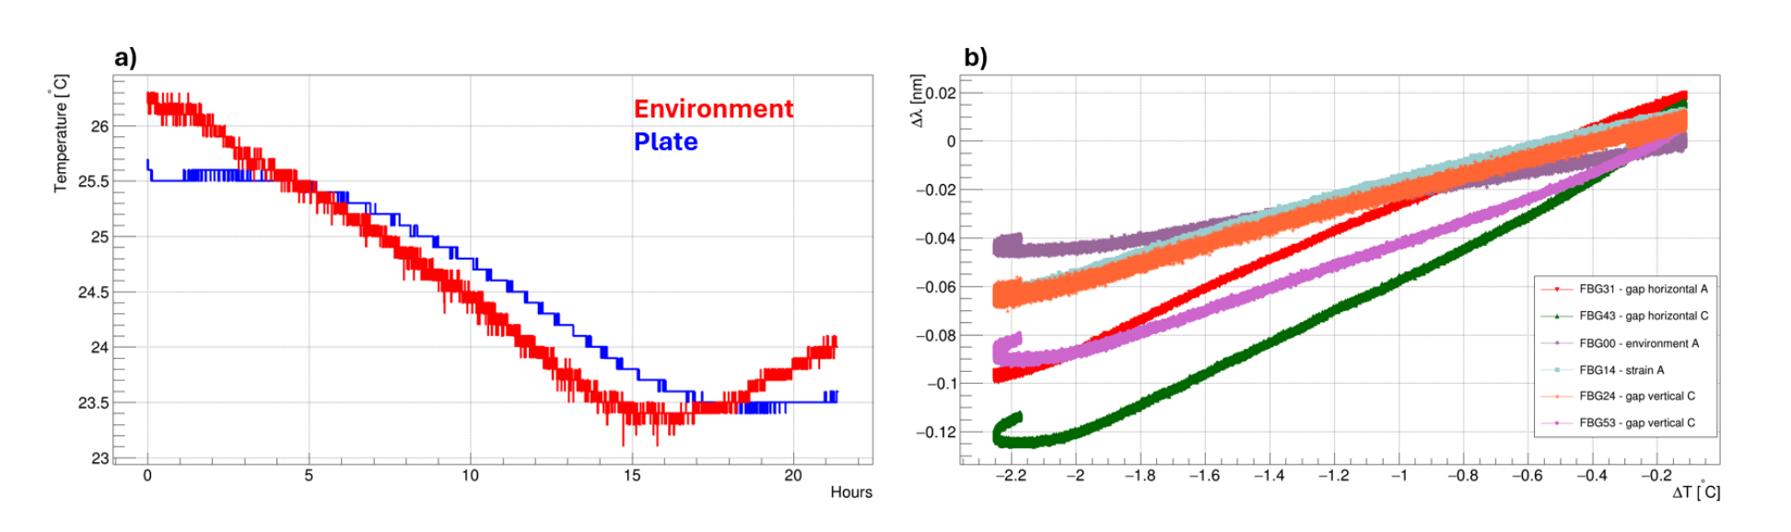
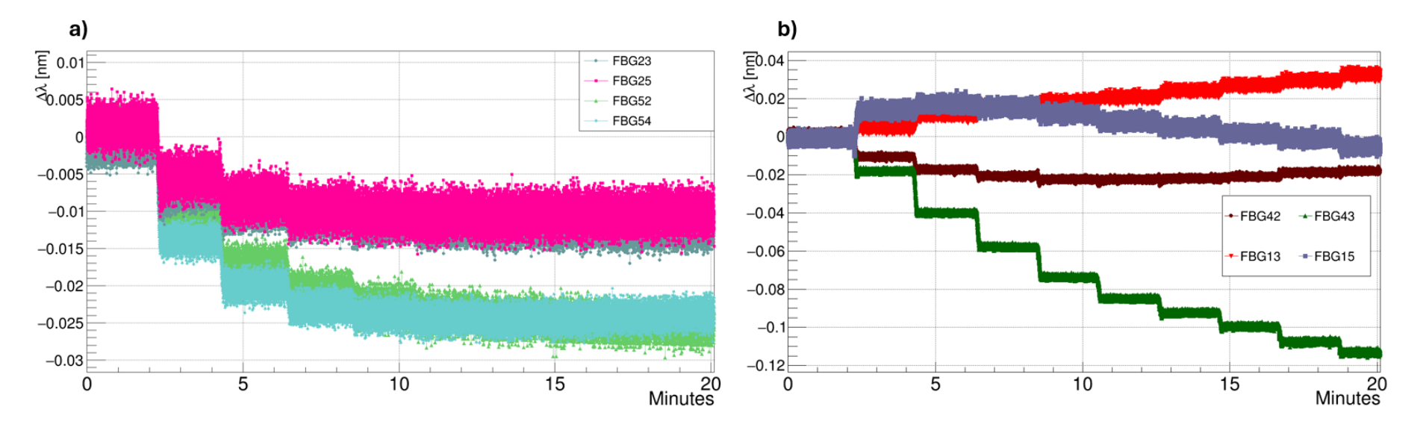
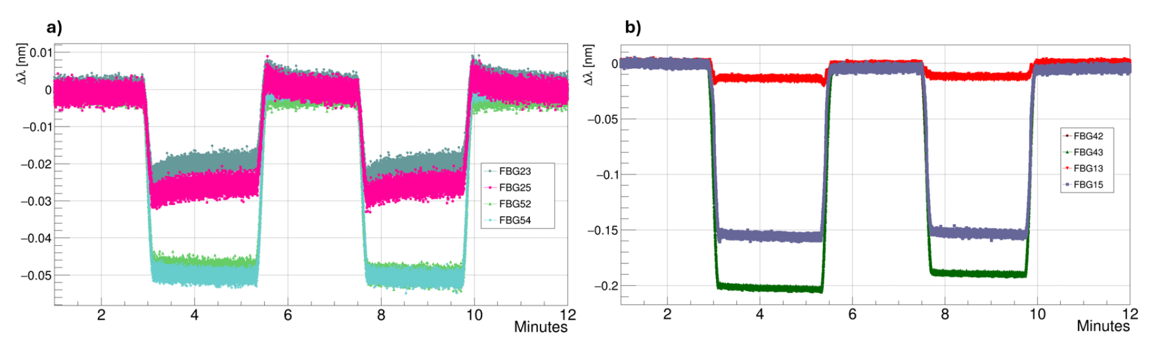
Brief summary of FBG strain measurements
Temperature dependence:
  max deformation of 0.12 nm over 2.7 °C/15 hours
Mechanical
  by moving the four arrays all together from the minimum gap to the maximum gap, and in small steps from minimum gap to 50 mm of gap opening.
  by shifting the phase at different undulator gaps. In Fig. (right) the effect of a phase shift with the undulator tuned at minimum gap is shown.

Slide 23
FBG strain measurement conclusions
The wavelength shifts are perfectly reproducible. No hysteresis or values not correlated to a gap macroscopic movement were observed, except for the temperature dependence.
The largest observed wavelength shift is ∼0.2 nm for the gap sensors and a factor 2-5 lower for the strain sensor devices.
Gap sensors, the reference length is the plates separation. The plate sepatation cannot be measured an is virtually zero. In order to estimate an upper limit, we may consider that over an hypothetical 1 mm gap, the variation would be ∽ 150 nm. This has a negligible effect on the undulator field.
Strain sensors, the reference length is the sensor length: the local deformation is ∽300 nm/cm.
These deformation values are compatible or lower than those calculated by finite elements methods and confirm the reliability of the undulator mechanical structure
A finite element model of the long AQUA undulator module should provide a suitable estimate of the expected structure deformation under the effect of magnetic forces.

Slide 24
Study of tolerances for magnetic field errors
We analyzed the sensitivity of the FEL radiation growth with respect to the magnetic errors by means of a procedure, miming the protocols used by the undulator manufacturers.
We group the hypothetical magnets in 3-5 magnets ensembles, each group is characterised by the magnetic moment corresponding to a single magnet N or S
We assume a truncated gaussian distribution for these magnetic moments, we follow a sorting procedure to generate the magnetic errors corresponding to an entire array of 110x4 magnets, corresponding to the 2.2m undulator.
We use this distribution of magnetic errors to simulate SASE FEL amplification in Genesis1.3
S
N

Slide 25
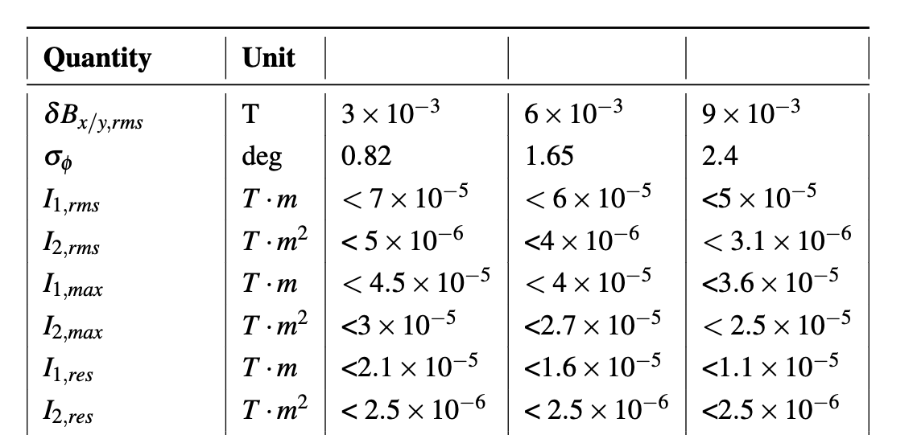
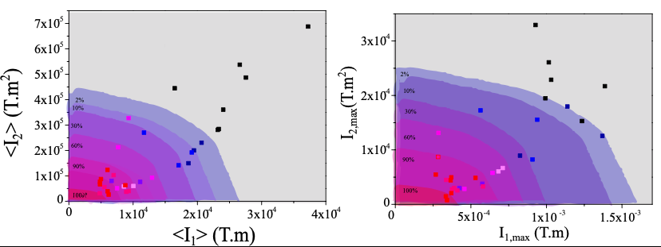
Study of tolerances for magnetic field errors
The table (right) summarises the required conditions on field and field integral required (ref. V. Petrillo).
different δB/B of
the dipoles ensamble
resulting condition
on the field
We now link these field /field integrals with those resulting from the field distributions measured from the SABINA undulator. This provides a link between a similar realized device and the specs of the magnets used for the realization
ΔBx (T)
ΔBy (T)
B_{measured}-B_{radia,rescaled}
Difference between the measured field and the model for SABINA UM
z (m)

Slide 26

Summary – status of the TDR
WP6 Undulators Design and Physical requirements:
The physical parameters and specification of the AQUA undulator system are established
Most of the sensitivity studies are concluded.
Coherence between the set of parameters presented still need to be improved
The constructive design of the components requires engineering and design support that is not currently available. However, the components that require the most significant effort (the undulators) are those that need to be assigned to industry for development outside the laboratories.
We indicated a technical readiness status at 41%
WP6 Undulators: TDR Writing
The TDR structure (chapters) is ready - the order of the various arguments need to be adjusted
Consistency between different sections has to be improved
The link between the magnetic specs required and the SABINA measurements to be included
We indicated a writing readiness status at 30%

Slide 27
Supplementary slides

Slide 28
ARIA
Undulators, seed and tuning range

Slide 29
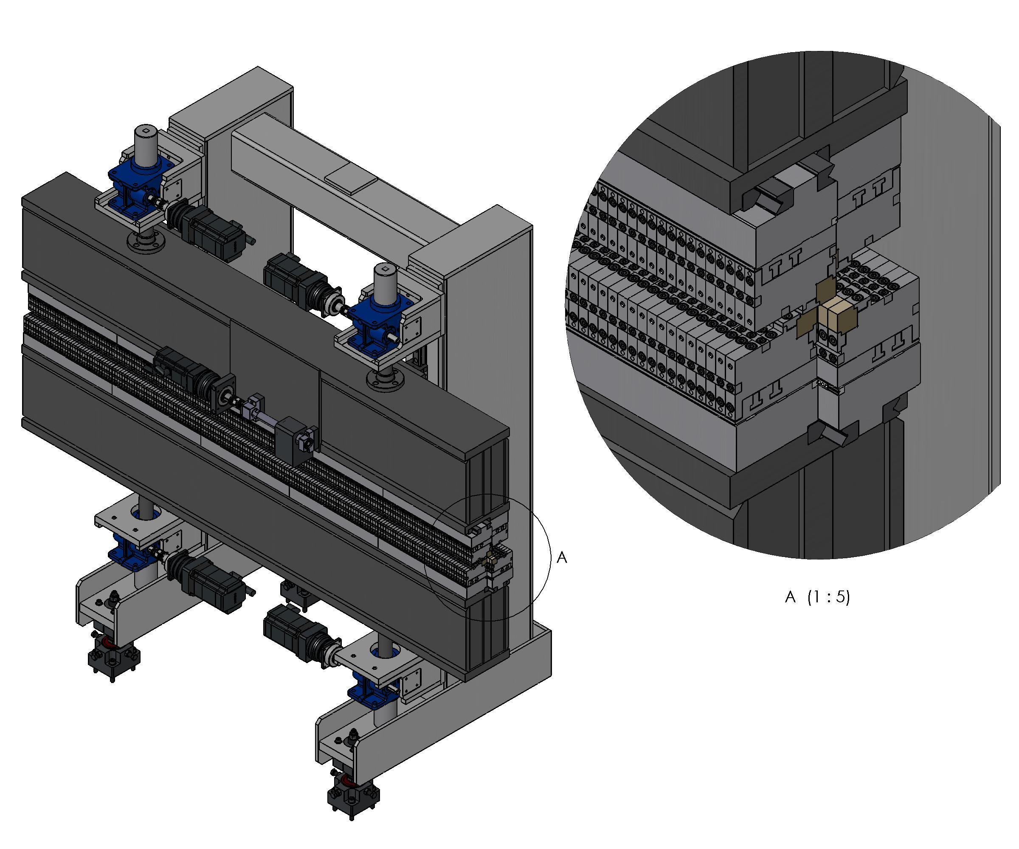
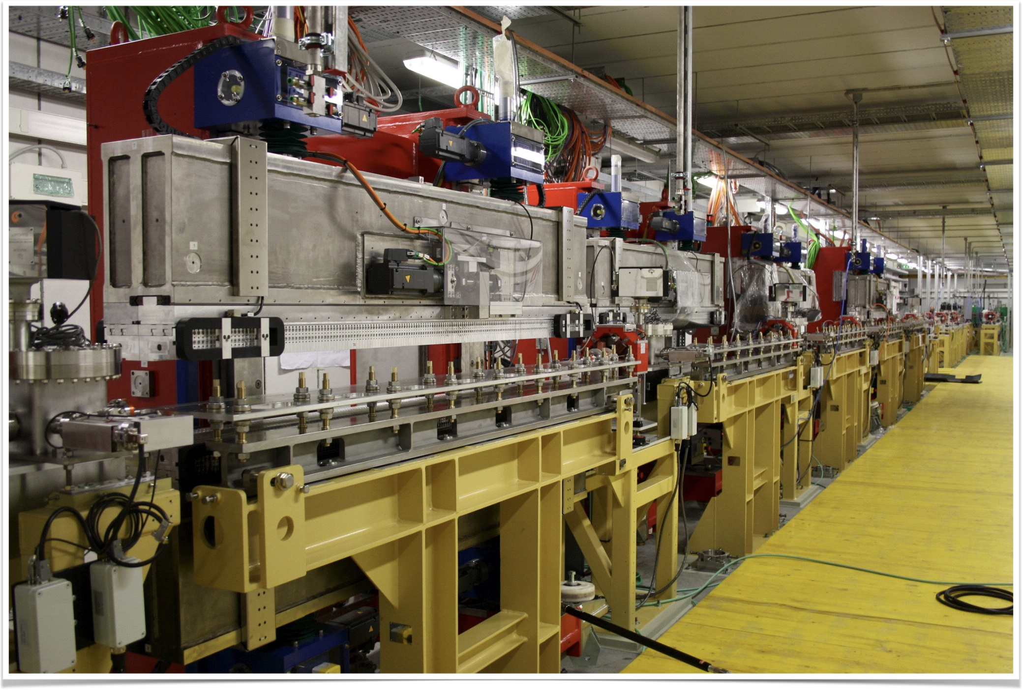
ARIA
Radiator Undulators
FERMI FEL-1 Radiator
Modulator
Radiators
Seed
Dispersive section
Main features:
variable gap, variable phase for adjustable polarization (EPU) (six motors)
𝛌_{u} = 55.2 mm, Np=42, L_{u}=2.4 m
working gap: 10 ÷ 32 mm
Main Physical Specifications:
Phase error σ_{Φ} < 5 º rms
Trajectory offset error < 20 μm rms
Trajectory tilt error < 25 μrad rms
Peak-to-peak field error ΔB/B < 0.5% rms
Integrated Quadrupole (N/S) < 100 G
Integrated Sextupole (N/S) < 100 G/cm
Similar to FERMI FEL-1 radiators
built by KYMA in 2009-2010 for FERMI
FEL-1
Courtesy of Bruno Diviacco

Slide 30
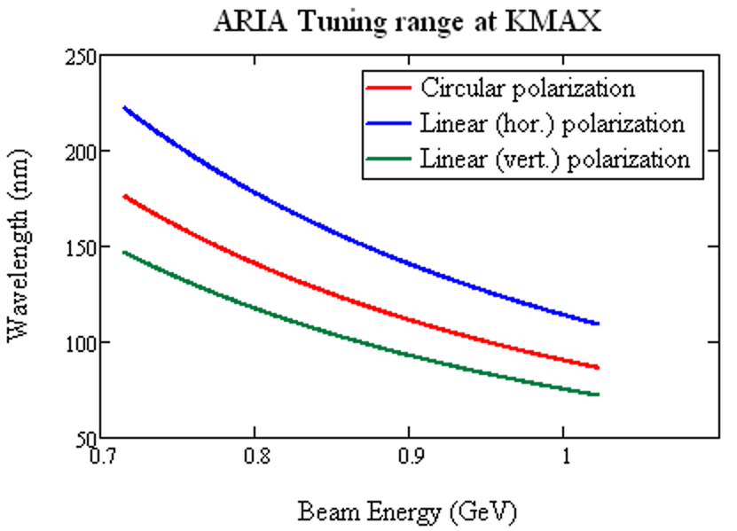
ARIA Tuning range parameters
FEL
  Max harmonic = 10
  Undulator K-range from FERMI FEL-1:
  K_{max} = 3.4 (CR), 4.35 (LV), 5.45 (LH)
Electron beam parameters:
  Energy 1.0 -> 0.7 GeV
  Energy spread 200 keV @ 0.8 kA -> 400 keV@1.5 kA
  e-beam duration:
    > 100 fs (long bunch mode, 200 pC)
    -> 8 fs (short bunch mode, 30 pC)
  beam emittance 2 mm mrad in long bunch mode/ 0.8 mm mrad in short bunch mode - beta function 10 m
Seed laser:
  We assume a minimum seed energy available in the range, of 20 uJ
  The seed spot size (average) is independent on the wavelength and is 0.5 mm^2
  Seed duration 400 fs (long seed) -> 200 fs (short seed), possibly no frequency chirp – i.e. seed spectral width close to FTL (not essential in short bunch mode)

Slide 31
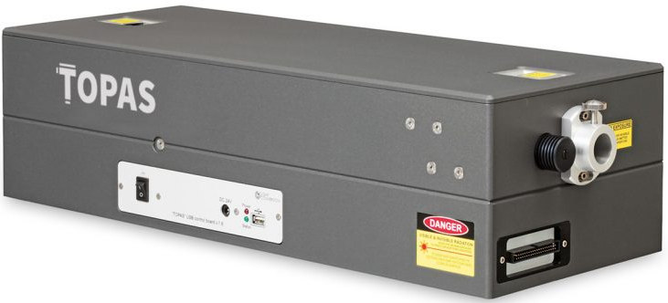
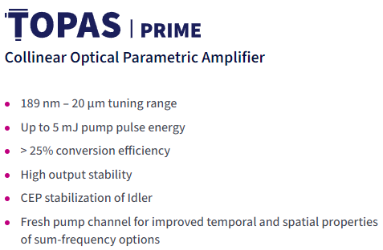
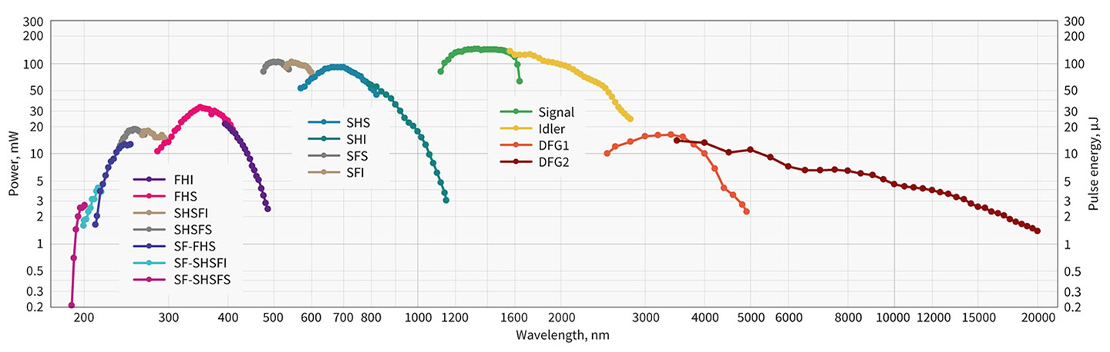
ARIA Seed laser option
https://lightcon.com/product/topas-prime-opa/#performance
Courtesy of M. Galletti
A
B
TOPAS-PRIME tuning curves. Pump: 1 mJ, 100 fs, 800 nm. HE version is commercial and E>10 uJ for the entire BW.

Slide 32
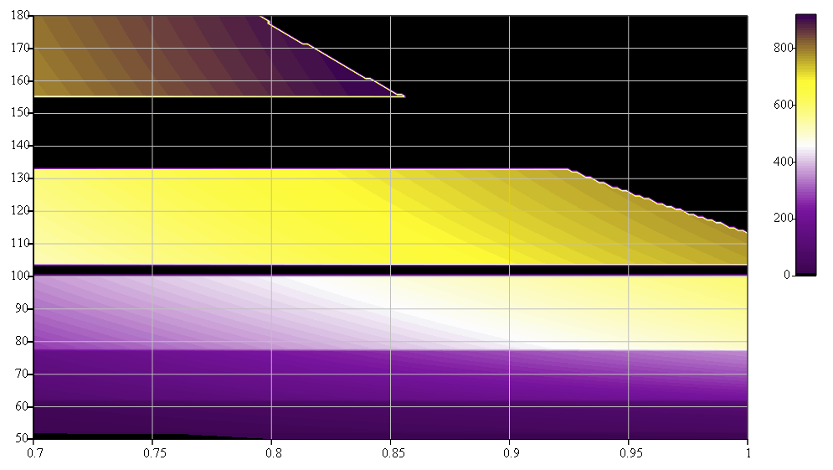
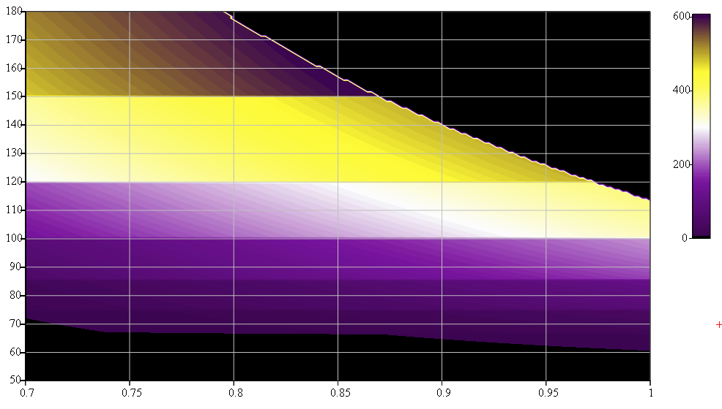
Long-bunch long-seed mode Linear Polarization
A: Seed range 320-400 nm
High energy range 100-50 nm – higher power
B: Seed range 600-800 nm
Continuous tuning in the range 60-180 nm
Pol. LH
Pulse energy (μJ)
Pol. LH
Pulse energy (μJ)
Minimum gap/max K
h=2
h=4
h=3
h=5
FEL Wavelength (nm)
FEL Wavelength (nm)
h=6
h=4
h=7
h=8
h=5
h=6
h=7
Beam energy (GeV)
Beam energy (GeV)
An OPA such as the TOPAS can seed the ARIA FEL line covering the spectral range 200-50 nm with a single OPA process 2HG (B). Improved performances below 100 nm can be achieved with the 4th HG process (A)

Slide 33
ARIA short summary
ARIA operates in High Gain Harmonic Generation and may cover the VUV spectral range down to 50 nm with an undulator similar to the one of FERMI FEL-1. Contrary to FERMI it uses a seed longer than the electron bunch and uses the electron bunch shaping and control capabilities of Eupraxia@SPARCLAB for controlling thethe lught pulse properties.
A commercial laser based on an Optical Parametric Amplifier such as the TOPAS should have the correct pulse energy and overall features to seed ARIA
Two OPA regimes can be used to cover the full spectral range with harmonic order below seven. In case a single OPA regime is used with second harmonic conversion, the full range is covered with harmonic order below 12

Slide 34
AQUA
  Magnetic design & tuning range -> vacuum chamber geometry
  Longitudinal and transverse wake-fields
  Analysis of SABINA Undulator and first lessons for the AQUA undulator
    Magnetic: field quality, field integrals, trajectory and FEL amplification
    Mechanical: stability and reproducibility tests

Slide 35
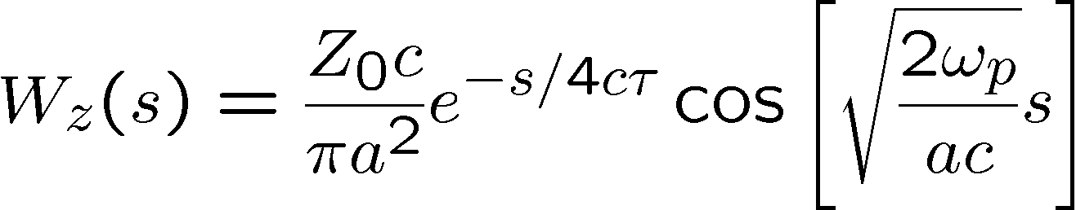
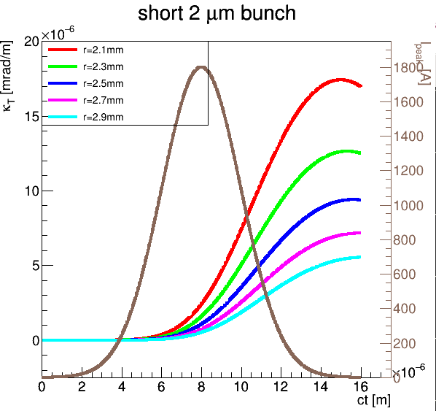
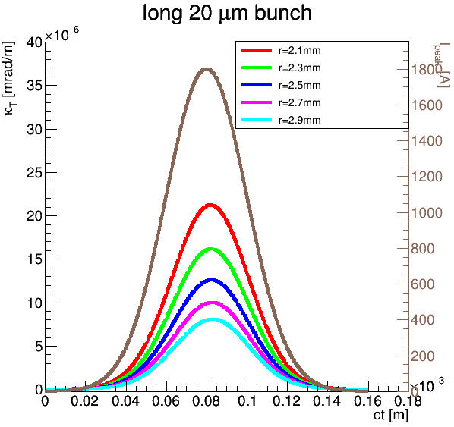
Transverse resistive wall wakefields
Courtesy of F. Nguyen
Transverse RW wakefields induced inside the cylindrical Cu vacuum chamber of radius a=2… 3 mm affect the electron bunch orbit along the undulator line, depending on the initial transverse offset at entrance.
Analytical treatment based on K. Bane & G. Stupakov formulae and the relationship between transverse and longitudinal RW impedances are used to estimate the kick angle κ_{T} parameter
Preliminary conclusions
Short bunch: Max kick: 2×10⁻⁵ mrad/m but outside the current peak
Long bunch: same order of magnitude, but superimposed to the current profile

Slide 36
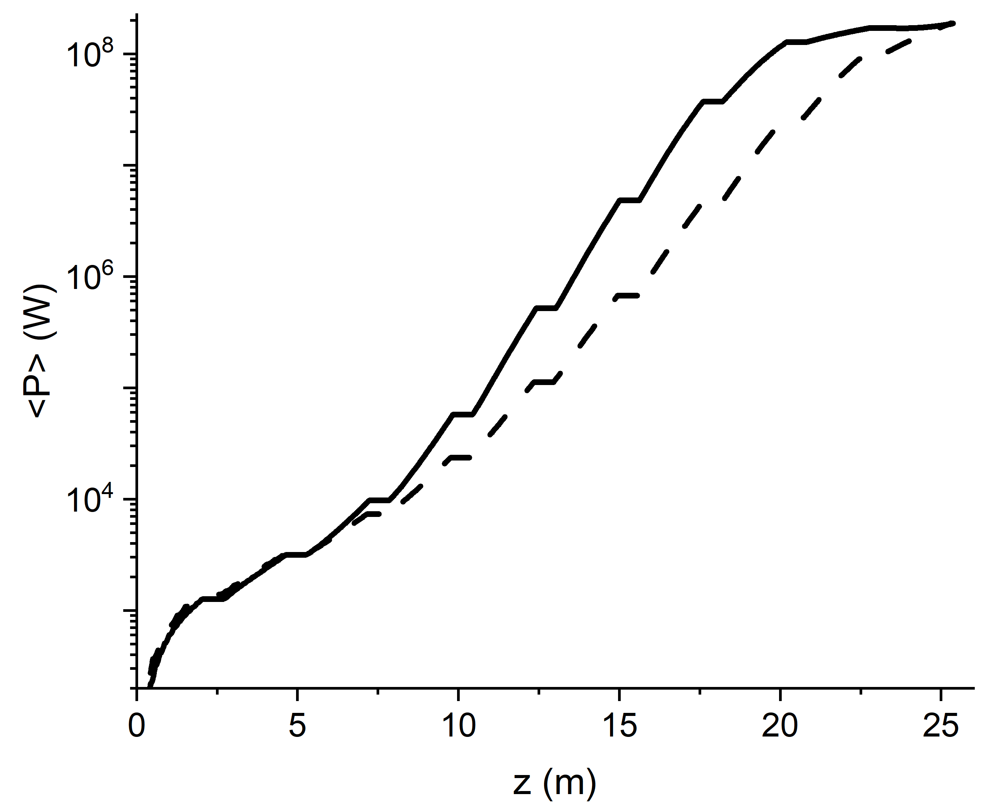
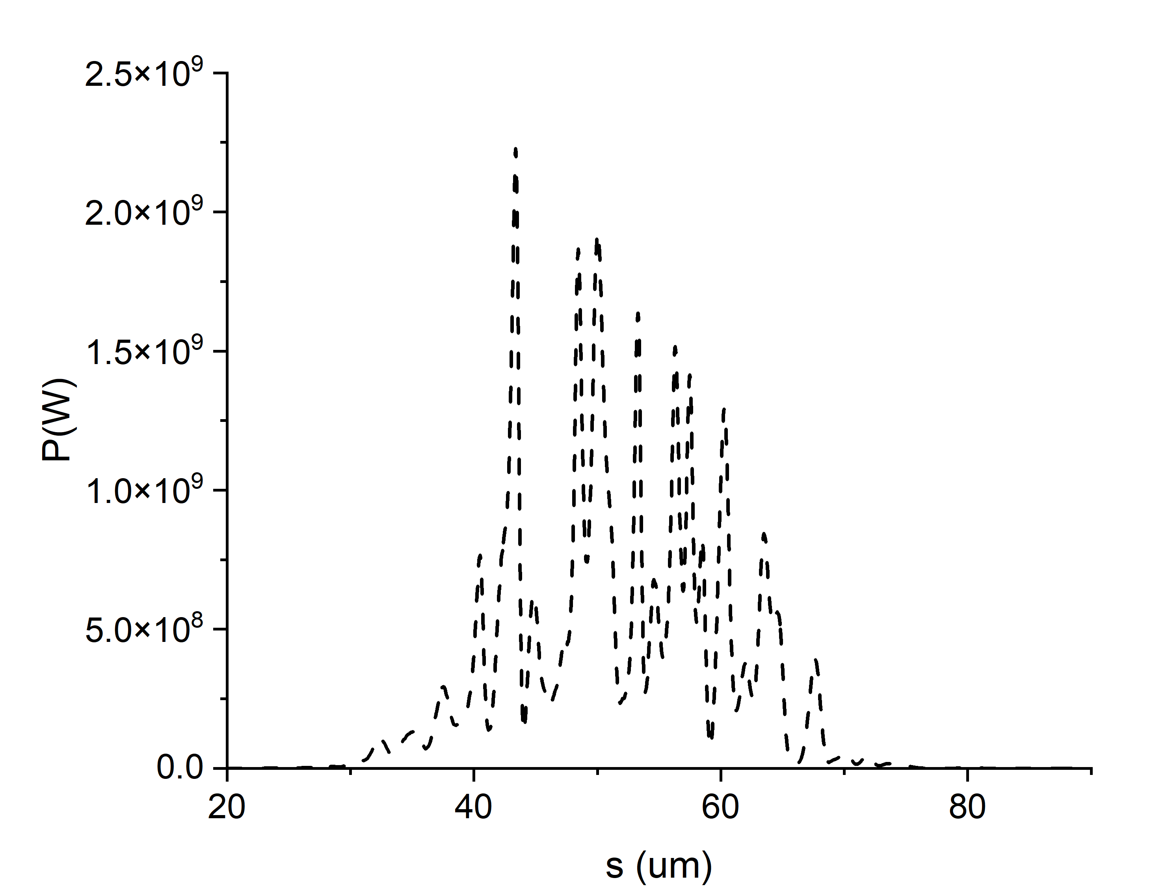
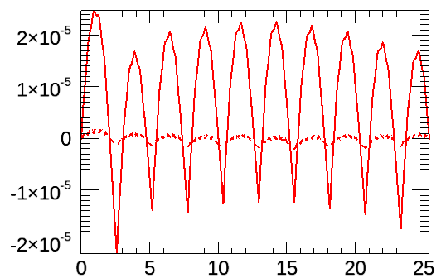




First tolerance study of undulator magnetic field errors for the AQUA beamline using the data from the SABINA undulator measurements. Courtesy of M.Opromolla
Considered a simulation in a long bunch case to reduce SASE shot to shot statistical fluctuations
Magnetic field errors reconstructed from the SABINA undulators measurements (3 modules used in random sequence to provide similar field integrals)
Without orbit correction the beam walks out of axis and particles are lost.
Added correctors at the end of each undulator section to zero the second field integral betweenthe undulators (similar to the correction of a trajectory feedback system)
Long beam (60 fs), $ρ_{3d}$ = 0.94e-3
- - - long beam
PWA short beam
E (GeV) | 1 | $σ_{E}$slice (MeV) | 0.489
Q (pC) | 200 | $ε_{x,y}$ slice (um) | 0.8
$I_{peak}$ (kA) | 1.26 | $σ_{x,y}$(µm) | 60.9, 56
corrected trajectory
Ideal
<x> (m)
<Y> (m) - - -
W. Magnetic
errors
z (m)
First and second field integrals specs. achieved for the SABINA undulator seems sufficient for the AQUA undulator line
$$E_{sat}=69 µJ vs. 74µJ$$

Slide 37

Timeline for SCU development at FERMILAB
(Courtesy of C. Boffo)
Some delay with respect to previous schedule.
New schedule:
Prototype completed (testing after Christmas 23' )
Vacuum vessel in final stages of manufacturing
Thermal shield and MLI in procurement
Assembly will be completed in September 2024
DELAYED 1 YEAR
21.11.2023 C. Boffo | EuPRAXIA

Slide 38
AQUA summary after last meeting (Nov. 2023)
Magnetic design is completed for different magnet apertures. The effective aperture depends on the next item
Vacuum chamber design is in progress. Diameter between 5 and 6 mm. The diameter in this range still allows 20% photon energy tuning via gap aperture change
Longitudinal wake fields do not constitute a problem for the pipe radius/beam conditions selected
Transverse wake field calculations were carried out. The figures will be used to define the straightness and alignment tolerances required by the vacuum chamber.
The tolerance on the beam injection indicates that the transverse beam position jitter at the undulator entrance has to be less than 50 um pp. Similar simulations will be carried out for the injection angle jitter.
Similar calculation are in progress for the determination of the maximum field integral from the undulator and from the quadrupoles alignment.
Mechanical stiffness of the SABINA undulator is indicating some unexpected behavior under investigation. The results will be discussed with the producer to explore mitigation strategy for the AQUA undulator.

