Slide 1

X-band linac and TEX facility
David Alesini
(INFN-LNF)
SUMMARY
TDR X BAND LINAC: STATUS
TEX FACILITY UPDATE
NEXT STEPS
7th EuPRAXIA@SPARC_LAB TDR Review Committee, 26–28 June 2024

Slide 2
TDR X BAND LINAC: STATUS

Slide 3
D. Alesini, X BAND LINAC, TDR MAC Review 26-28 June 2024

Slide 4
D. Alesini, X BAND LINAC, TDR MAC Review 26-28 June 2024

Slide 5
TDR: X BAND LINAC
David Alesini
D. Alesini, X BAND LINAC, TDR MAC Review 26-28 June 2024

Slide 6
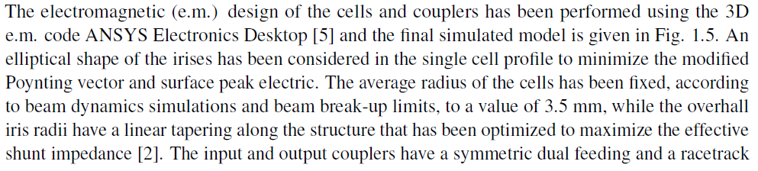
D. Alesini, X BAND LINAC, TDR MAC Review 26-28 June 2024

Slide 7
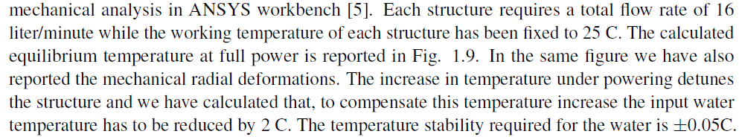

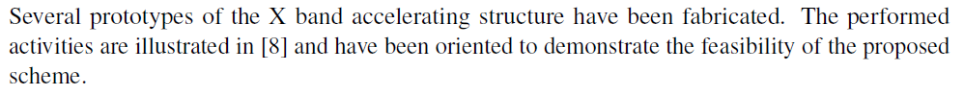
D. Alesini, X BAND LINAC, TDR MAC Review 26-28 June 2024

Slide 8
TDR: X BAND LINAC
David Alesini
D. Alesini, X BAND LINAC, TDR MAC Review 26-28 June 2024

Slide 9
D. Alesini, X BAND LINAC, TDR MAC Review 26-28 June 2024

Slide 10
TDR: X BAND LINAC
David Alesini
D. Alesini, X BAND LINAC, TDR MAC Review 26-28 June 2024

Slide 11

D. Alesini, X BAND LINAC, TDR MAC Review 26-28 June 2024

Slide 12
TDR: X BAND LINAC
David Alesini
D. Alesini, X BAND LINAC, TDR MAC Review 26-28 June 2024

Slide 13

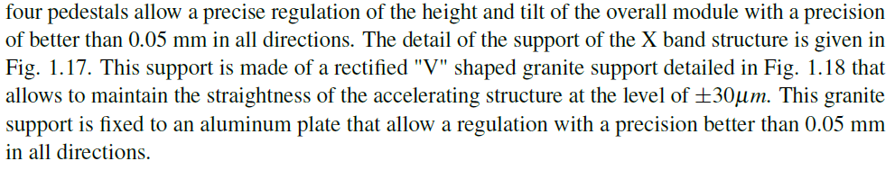
D. Alesini, X BAND LINAC, TDR MAC Review 26-28 June 2024

Slide 14
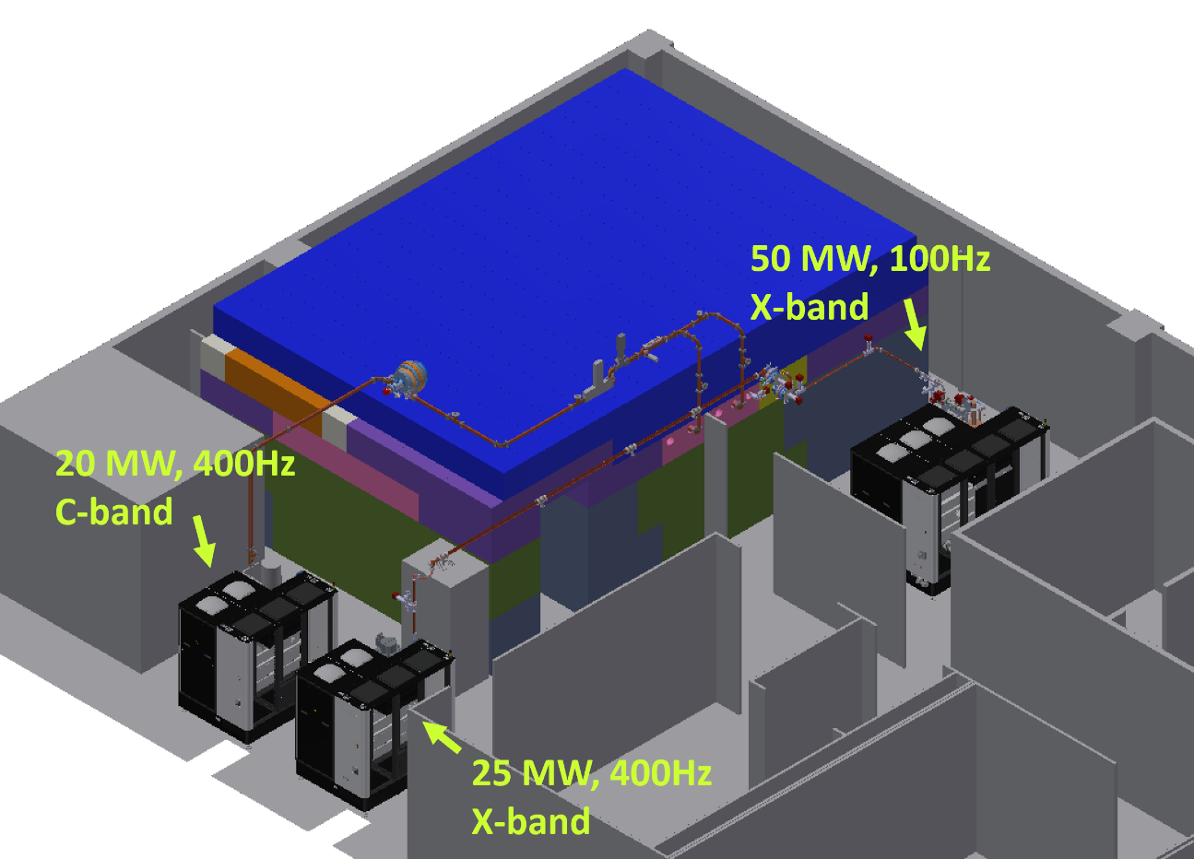
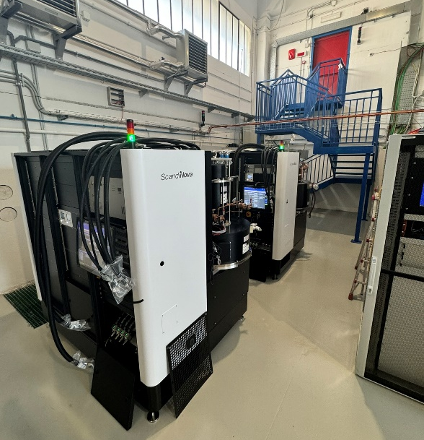
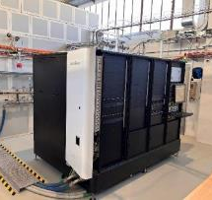
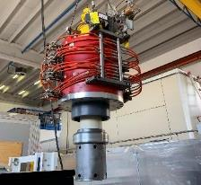
TEX FACILITY NOW AND UPGRADE
UP TO MAY 24
Currently undergoing an upgrade with the installation of two new high repetition rate RF sources: a new X-band RF power source and a new C-band RF power source for the test of RF components and a C-band photoinjector.
These two sources (modulator + klystron) have been tested at factory at end of May 2024 (at Scandinova) in diode mode at full power.
Have been shipped at the beginning of June, positioned, and the klystrons installed. The entire waveguide system is also currently being delivered.
The commissioning of these sources and the waveguide networks is scheduled for January 2025, after the installation of the cooling and power systems that will serve these sources.
Parameter | Unit | Canon E37217 | Canon E37119
Frequency | MHz | 5712 | 11994
Peak RF output Power | MW | 20 | 25
Average RF output power | kW | 21 | 15
Modulator Average power | kW | 75,2 | 75,2
RF pulse length | us | 2.5 | 1.5
Repetition Rate | Hz | 400 | 400
Gain | dB | 50 | 47
Efficiency | % | 40 | 40
The TEst-stand for X-band (TEX) is conceived for R&D and test on high gradient X-band accelerating structures, RF components, LLRF systems, Beam Diagnostics, Vacuum system and Control System
It has been co-funded by Lazio region in the framework of the LATINO project (Laboratory in Advanced Technologies for INnOvation). The setup has been done in collaboration with CERN and it will be also used to test CLIC structures
Nominal EUPRAXIA power source X band
CPI VKX8311A Klystron (50 MW, 50Hz)
K400 Scandinova
D. Alesini, X BAND LINAC, TDR MAC Review 26-28 June 2024

Slide 15
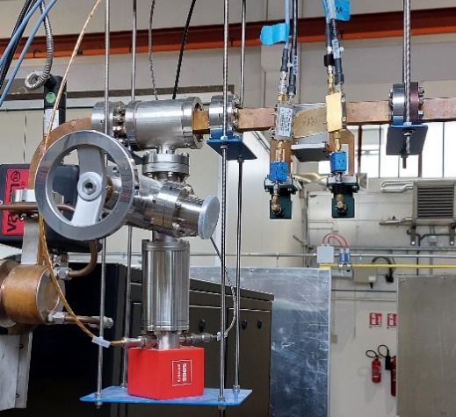
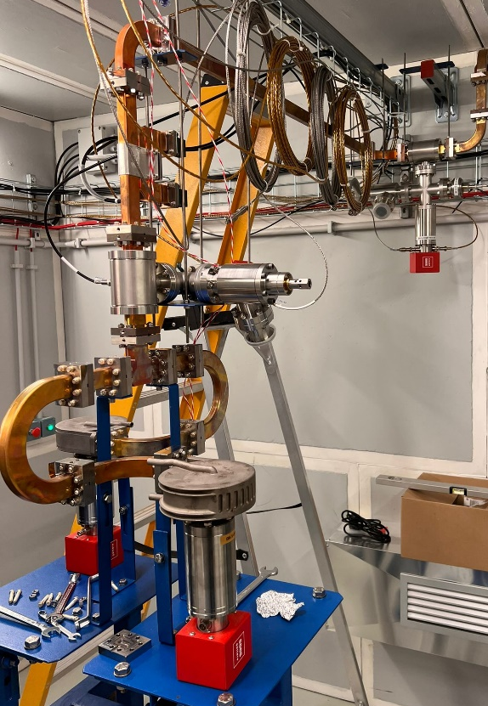
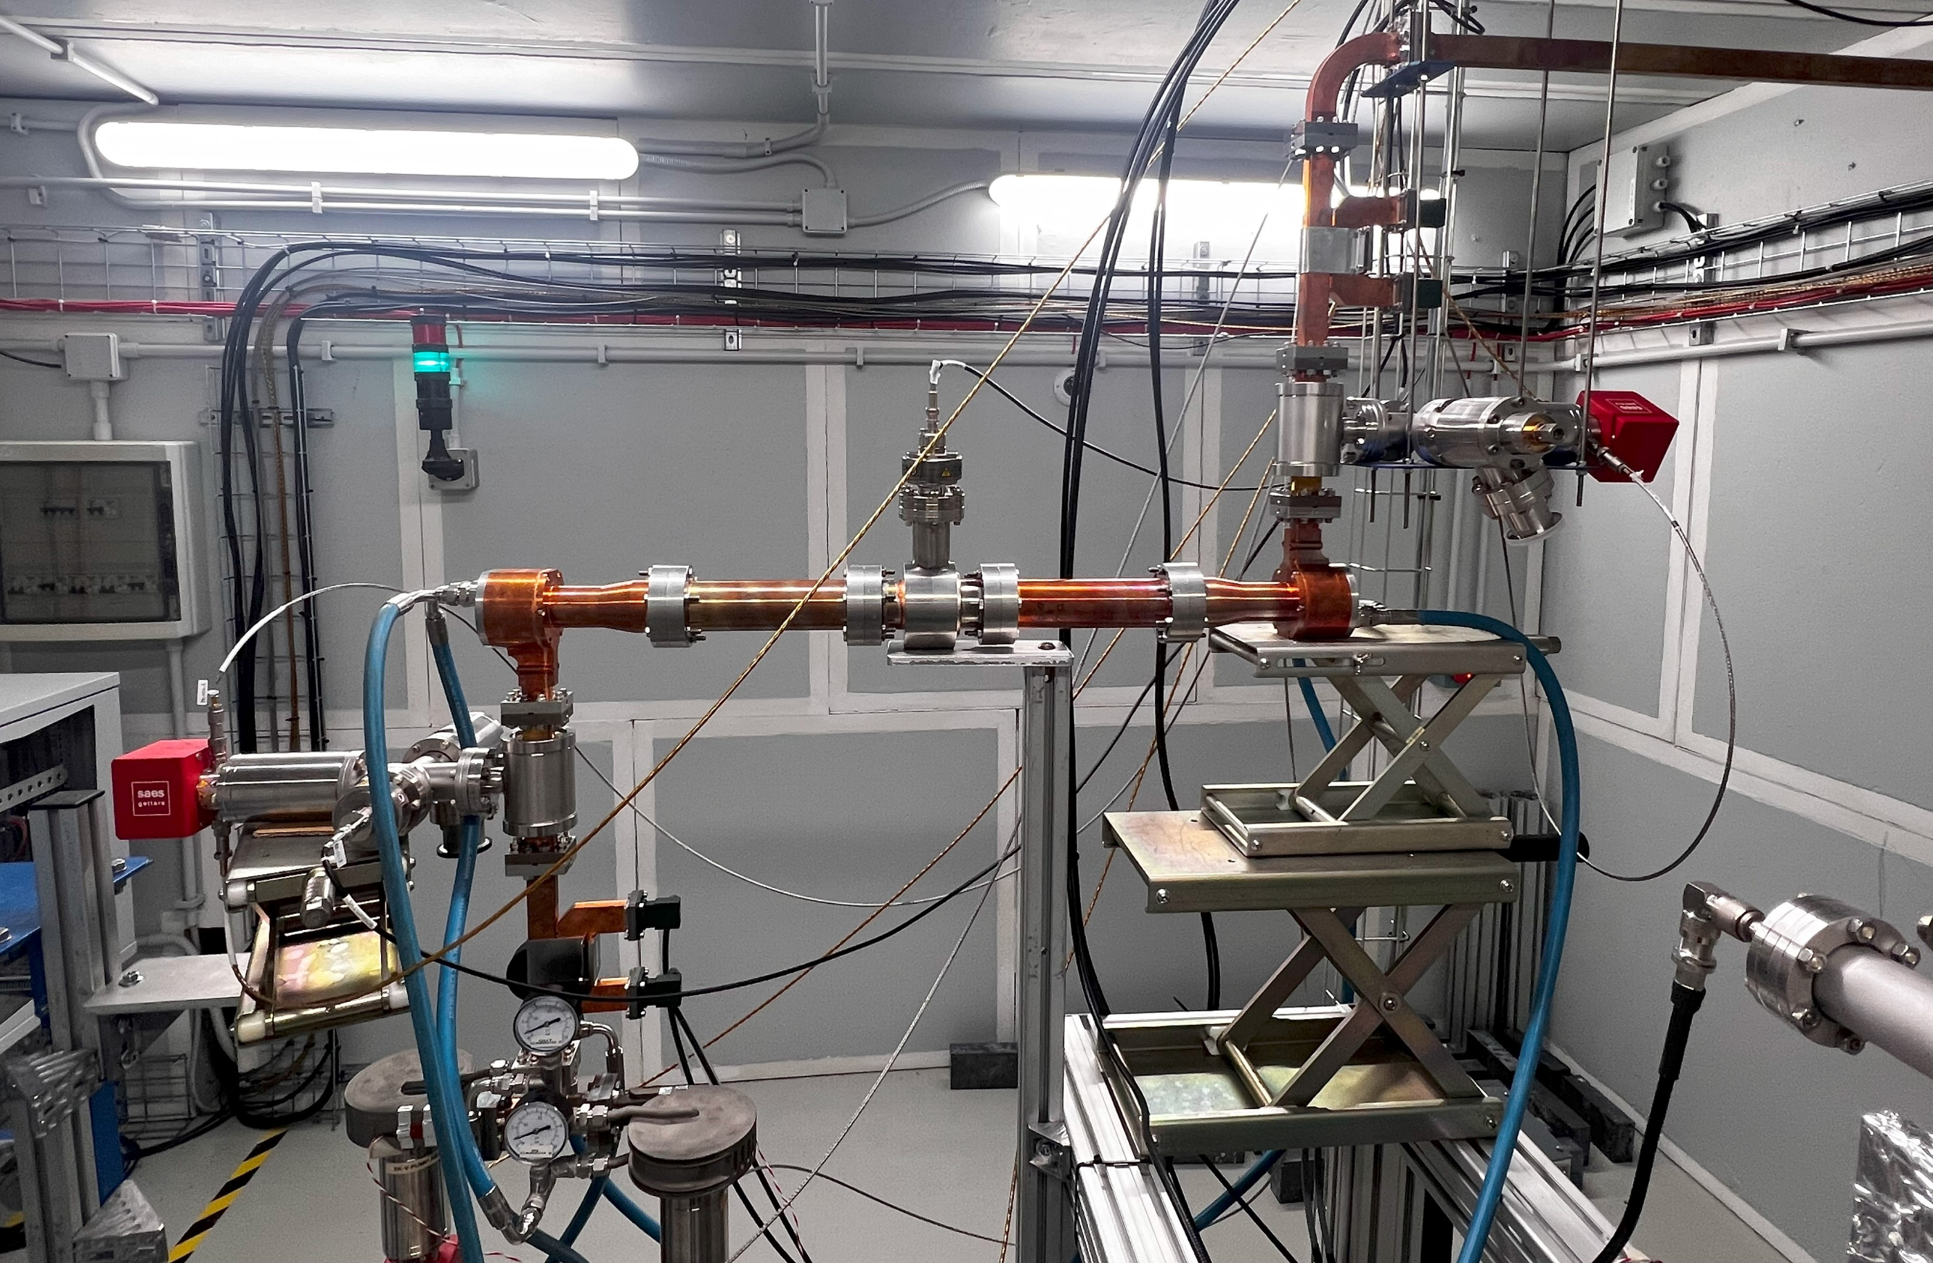
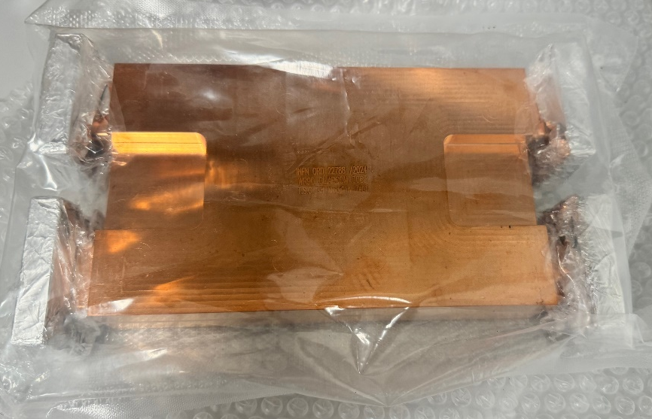
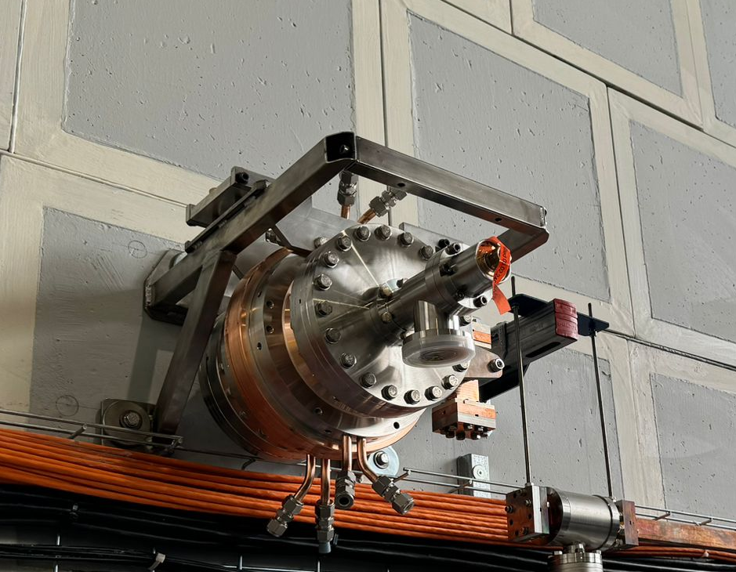
X-band WAVEGUIDE COMPONENTS
COMPONENT | DESIGN BY | STATUS | LEVEL OF POWER TO BE TESTED FOR EUPRAXIA MODULE | COMMENTS
Pump units (rect. Wav.) | CERN | Fabricated and installed @ TEX | 25 MW 1.5 μs and 70-35 MW 0.13 μs Compressed pulse 100 Hz | Tested up to now to 1 μs, 50 Hz, 33 MW
Directional coupler | CERN | Fabricated and installed @ TEX | 25 MW 1.5 μs and 70-35 MW 0.13 μs compressed pulse 100 Hz | Tested up to now to 1 μs, 50 Hz, 33 MW
Splitter | CERN | Fabricated and installed @ TEX | 70-35 MW, 0.13 μs Compressed pulse 100 Hz | Tested up to now to 0.6 μs, 50 Hz, 33 MW
RF load | CERN | Fabricated and installed @ TEX | 18-9 MW 0.13 μs compressed pulse 100 Hz | Tested up to 0.6 μs, 50 Hz, 16 MW.
Mode converter circular/rectangular | INFN | Fabricated and Installed @ TEX | 25 MW 1.5 μs 100 Hz | Tested up 1 μs, 50 Hz, 25 MW
Pump unit (circ. Waveg.) | INFN | Fabricated and Installed @ TEX | 25 MW 1.5 μs 100 Hz | Tested up to now to 1 μs, 50 Hz, 25 MW
3dB hybrid | CERN | Delivered | 140-70 MW 0.13 μs Compressed pulse 100 Hz
BOC pulse compressor | PSI | Delivered | 140-70 MW 0.13 μs Compressed pulse 100 Hz

Slide 16
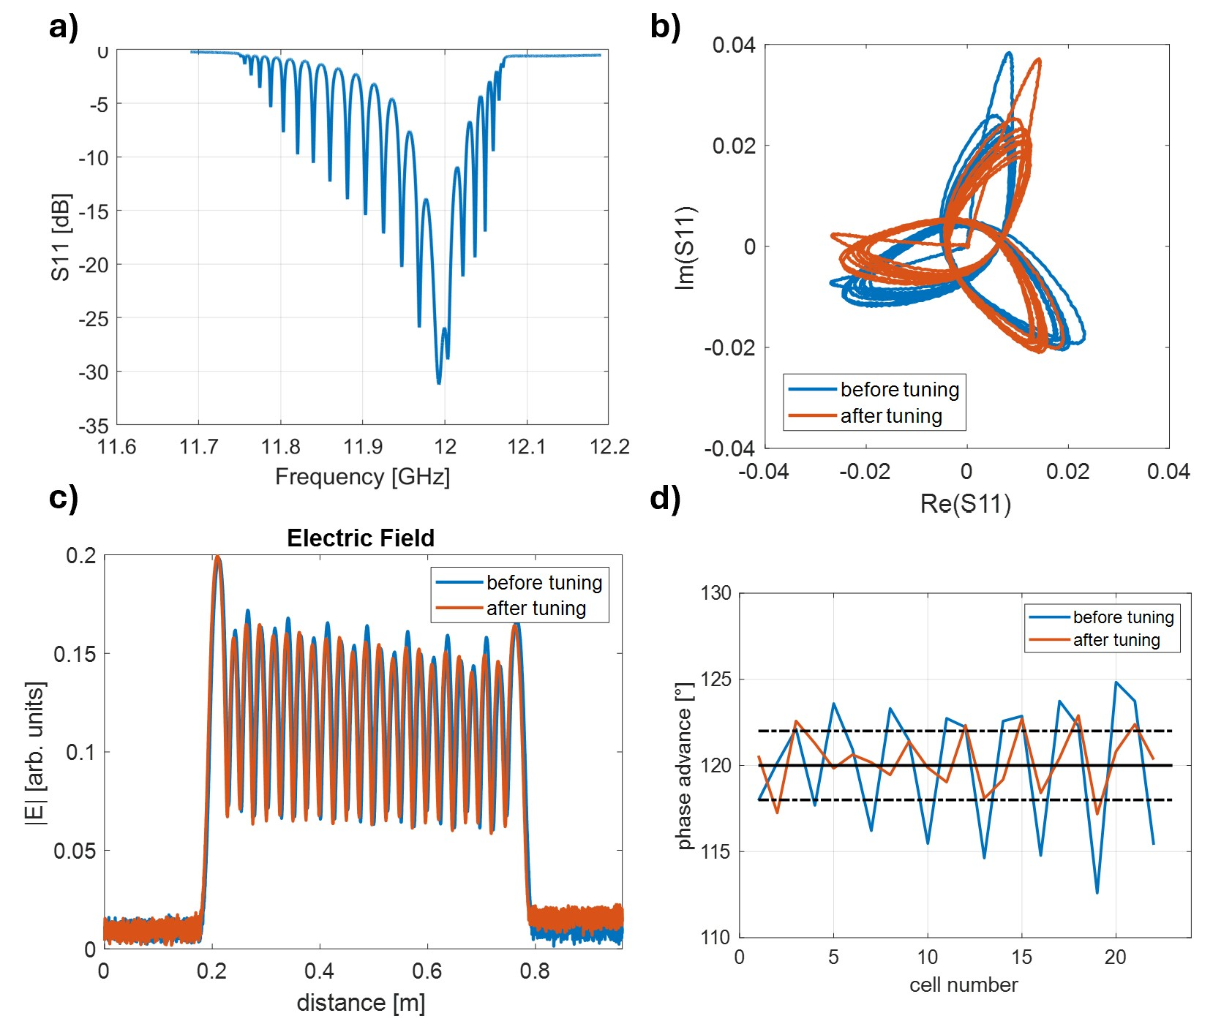
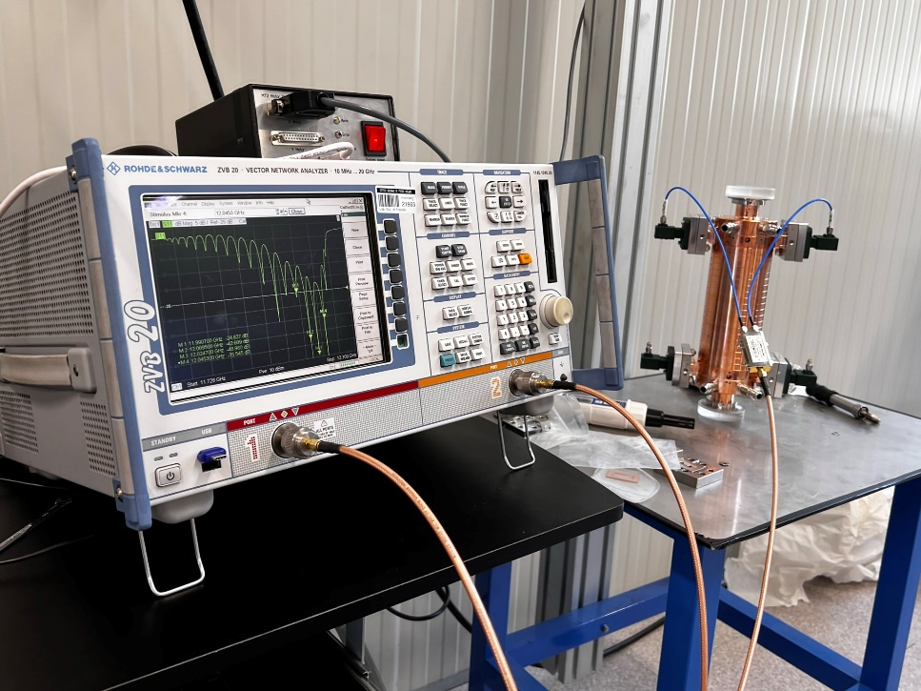
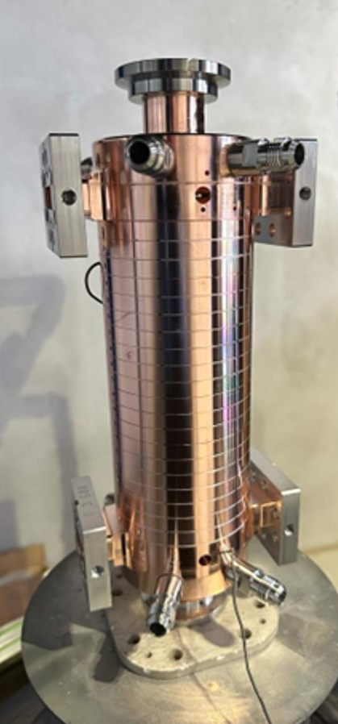
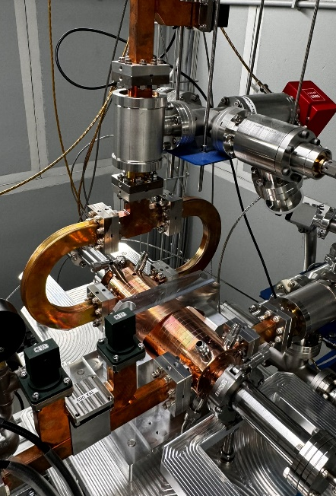
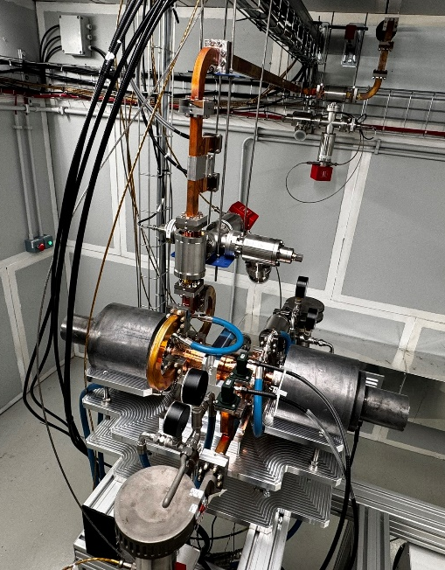
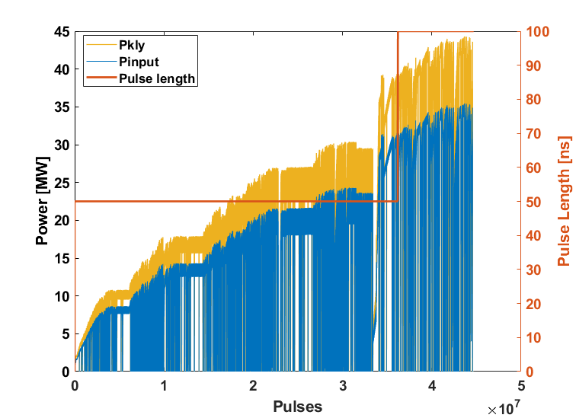
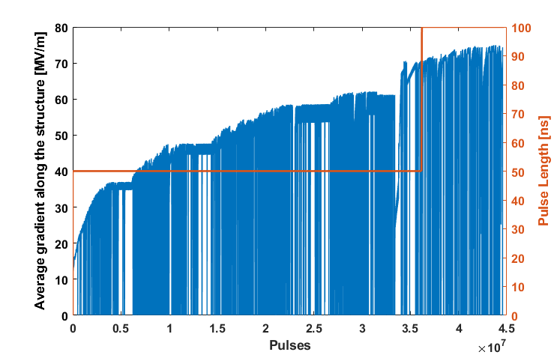
EUPRAXIA X-band structure RF prototype
A 20 cells RF prototype has been realized for the high power test.
It has been realized without tuners on the cells, we just have two tuners on the two couplers
In 10 days we reach an input pulse of 35 MW, 100 ns length at 50 Hz repetition rate, that correspond to an average gradient along the structure equal to 74 MV/m and a peak gradient at the structure input of 80 MV/m.
The test will continue, after an initial phase of installations for the TEX upgrade, with the BOC pulse compressor also installed on the line.
D. Alesini, X BAND LINAC, TDR MAC Review 26-28 June 2024

Slide 17

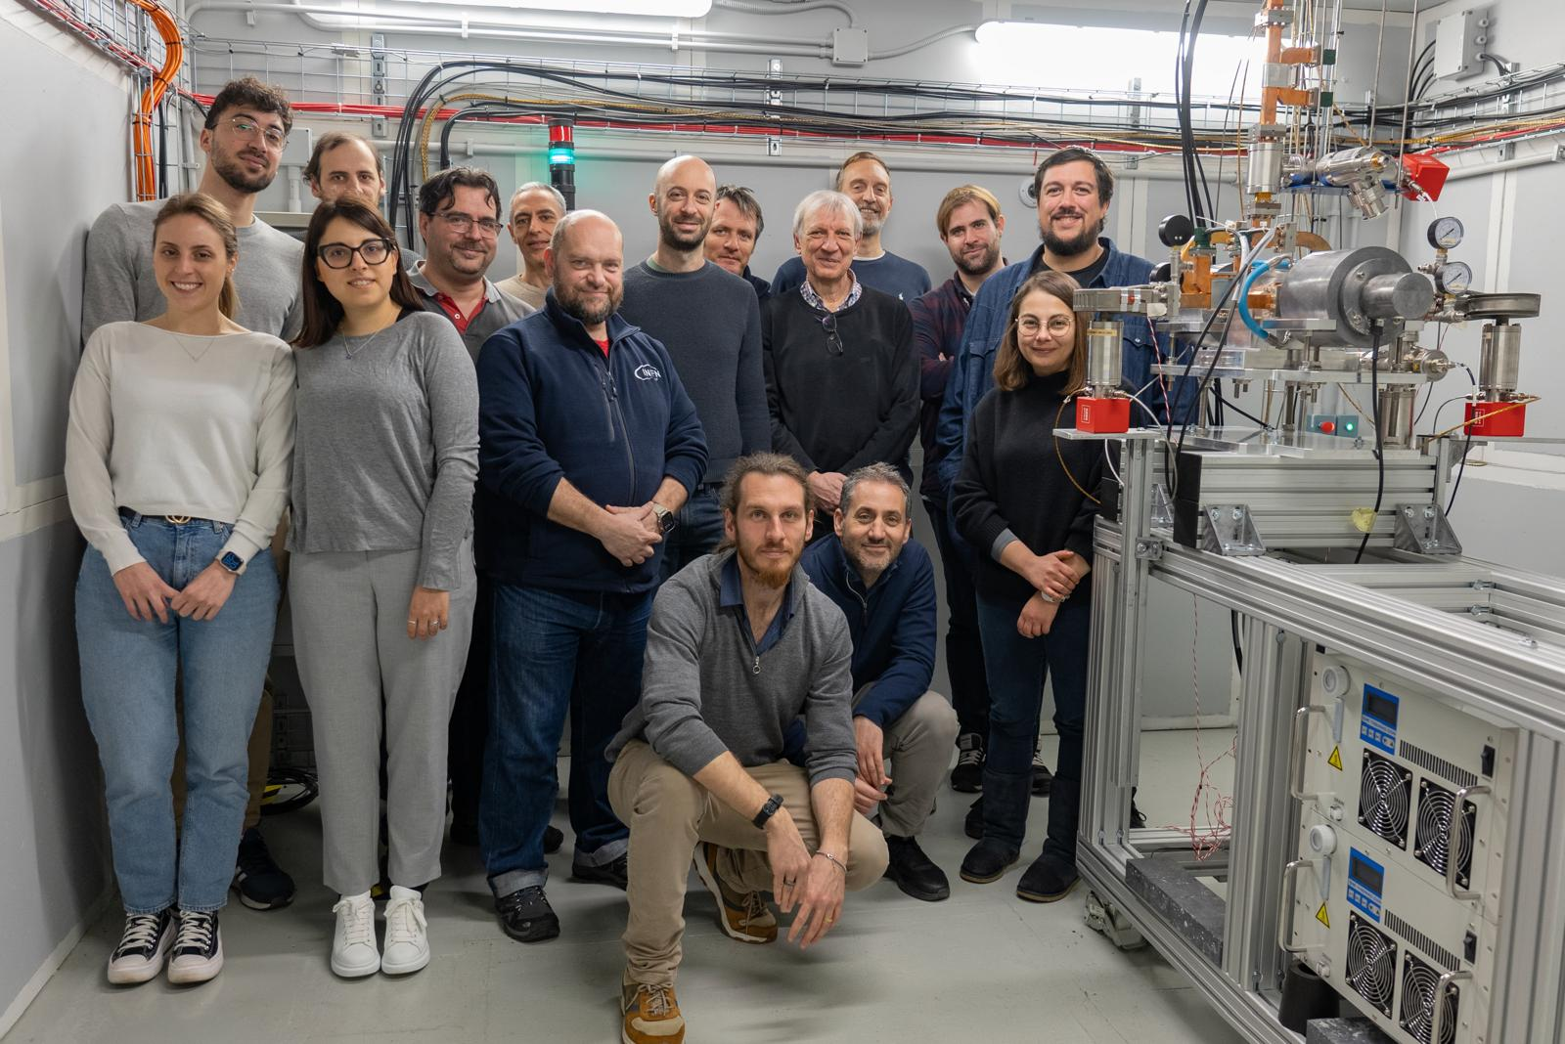
EUPRAXIA X-band structure RF prototype

Slide 18
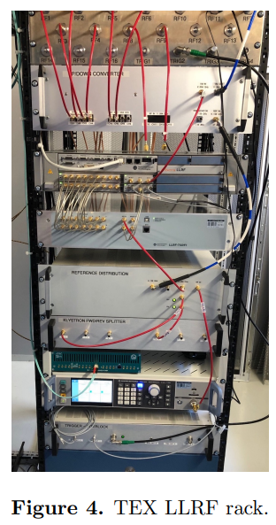
X-band LLRF activities
Courtesy RF group
[1] L. Piersanti et al. “RF power station stabilization techniques and measurements at LNF” In Proc. IPAC24 - TUPR01.
[2] L. Piersanti et al. “Design and test of a klystron intra-pulse phase feedback system for electron linear accelerators” Photonics 2024, 11(5), 413.
Requirements phase jitter (compliant with BD requirements):
0.02 deg S band (S-band RF stability state of the art (PSI))
0.06 deg X band
Scientific collaboration request with PSI for LLRF system development, update and production declined due to lack of manpower;
We cannot develop the system in house because of the complexity, dimension, maintenance for a user facility.
2 industrial partners willing to participate to X-band LLRF R&D (Instrumentation Technologies - solid LLRF experience, Safran - new to high frequency applications);
The internal procedures for the tender for the production of the whole LLRF system should start by the end of 2024;
Detailed jitter studies on X-band power station carried out at TEX facility in February 2024 [1] (no klystron loop):
  Driver added jitter: <0.04 deg rms
  Klystron added jitter: <0.04 deg rms
  LLRF added jitter (tender spec.): <0.015 deg rms
  Estimated RF station jitter: <0.06 deg rms
Dedicated stability measurements will be carried out at SPARC in S band after the SABINA upgrade.
We believe also that with solid state modulator and klystron loops we can have an additional jitter reduction from new fast intra-pulse phase feedback system [2] to be evaluated for S-band and X-band stations at SPARC and TEX respectively.
Jitter compression down to 0.019 deg rms already demonstrated for C-band station at SPARC in Dec 2023.

Slide 19
X BAND LINAC: NEXT STEPS AND CONCLUSIONS
R&D ACTIVITY AND TEST
Test of the 20 cell X RF prototype with BOC (depending on Safety/radioprotection authorizations)
Realization of the full scale RF prototype (CI)
Cooling/power works@ TEX
X-band power sources (25 MW CANON) and new WG networks commissioning
Test of the full scale RF prototype
Test of the 3dB Hybrid in combination with RF structure and BOC
TDR WRITING
LLRF paragraph: short recap of the RF system Chapter: October 2024
X band structure support final definition: October 2024
Quadrupole/stripline within RF modules
1/2/25
1/4/25
1/6/25
1/7/24
1/10/24
1/12/24
Aknowledgements:
INFN-LNF: F. Cardelli, S. Pioli, S. Bini, B. Buonomo, S. Cantarella, R. Clementi, M. Diomede, L. Faillace, A. Gallo, L. Giuliano, C. Di Giulio, E. Di Pasquale, G. Di Raddo, R. Di Raddo, G. Latini, A. Liedl, L. Spallino, V. Lollo, L. Piersanti, M. Bellaveglia, R. Ricci, B. Serenellini, M. Zottola, P. Chimenti, B. Spataro, M. Cianfrini, G. Luminati, G. Catuscelli, A. Iungo, A. Esposito, F. Chiarelli, R. Donghia, D. Chiti, M. Ferrario
CERN: W. Wuensh, N. Catalan-Lasheras, A. Grudiev, G. McMonagle on behalf of the CLIC and XBOX group
SLAC: V. A. Dolgashev
D. Alesini, X BAND LINAC, TDR MAC Review 26-28 June 2024

