Slide 1
EuPRAXIA@SPARC_LAB
Machine Layout
at SPARC_LAB
Andrea Ghigo & Mario Del Franco, INFN
7th EuPRAXIA@SPARC_LAB Review Committee Meeting, LNF June 26-28, 2024

Slide 2
Outlook
Functional description of the building
Accelerator design criteria
Layout of the accelerator
Undulators and electron beam dump
FEL photons beam lines
High power laser clean rooms
Particle experimental Labs
User area

Slide 3
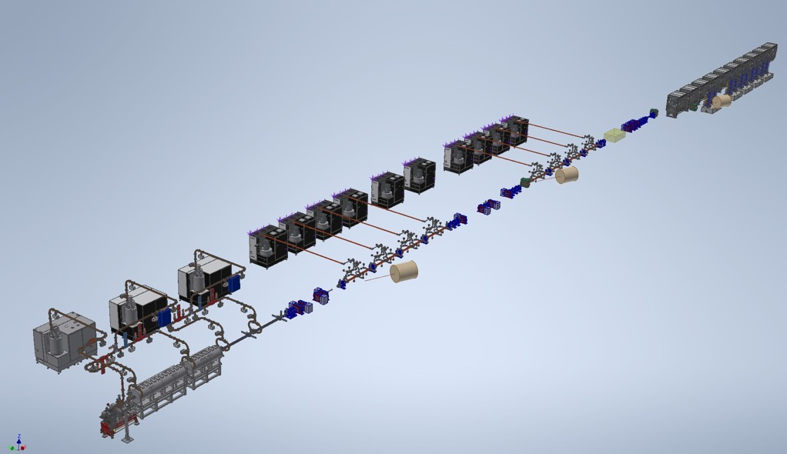
Machine & undulator 3D Layout

Slide 4
Building areas
Ground floor
Accelerator Tunnel
Modulator & power supply area
Undulator tunnel
FEL user area
Experimental Areas
Laser Rooms
First floor
Control room
Laser Rack room
UTA corridors
Users offices & meeting room
Break area
Terrace

Slide 5
Building Functional Layout – Ground floor
Particle experimental area
Laser clean rooms
Cooling Plants area
FEL user area
Undulators tunnel
Klystron Gallery
Accelerator tunnel
cfr Simona Incremona talk

Slide 6
Building Functional Layout – First floor
Laser racks area
Control Room
Users & meeting rooms
UTA -corridors
UTA -corridors
Elecric cabins

Slide 7
Building Functional Layout – Undulator area
AQUA & ARIA undulators
Removable wall
Electron beam dump

Slide 8
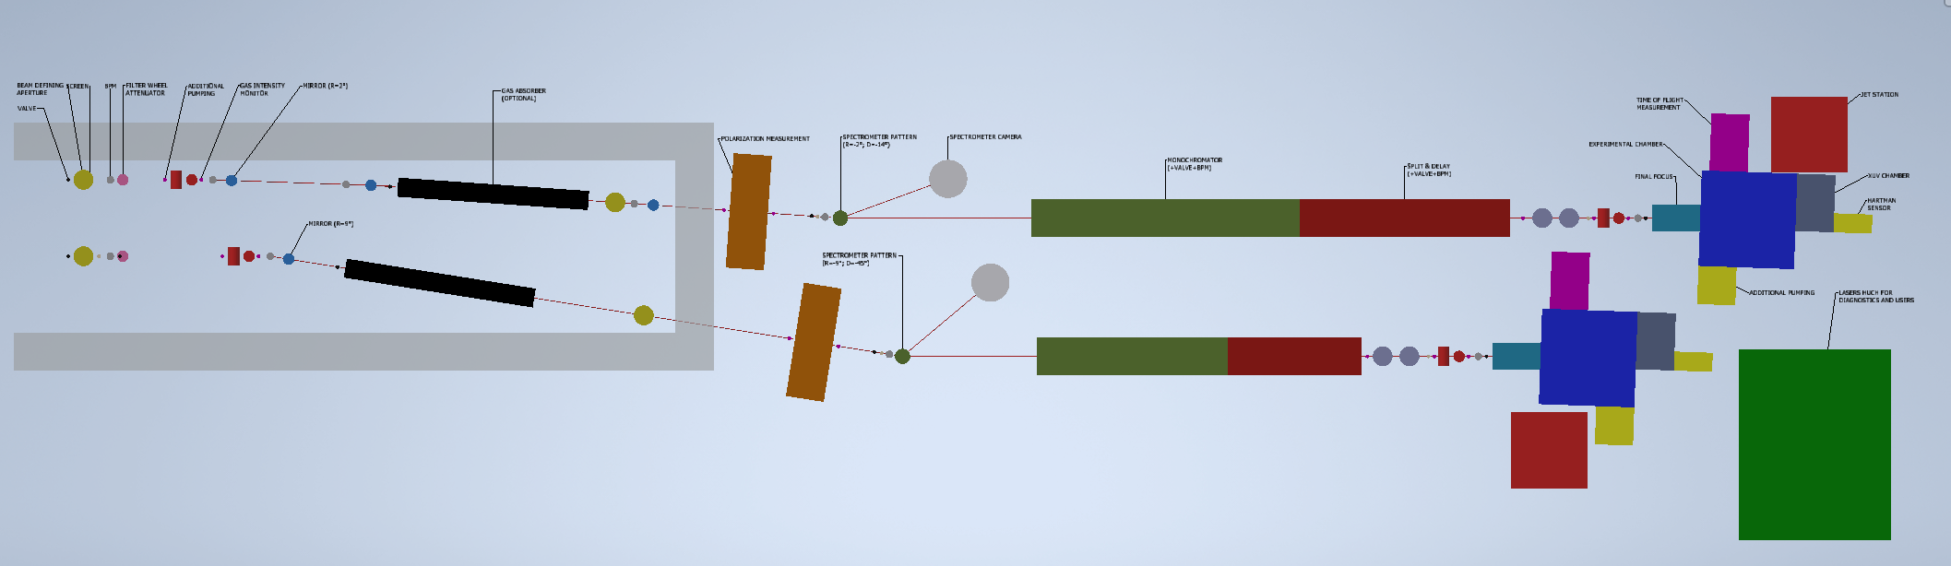
Beam lines & user area schematic
the components of the photon beamline are being defined (F. Villa talk):
the real vacuum chamber still need to be designed

Slide 9
Machine design criteria -1
After the first machine layout, prepared for the building definition taking into consideration only the dimensions of the main components, we restart the design of the machine replacing them with the real objects prepared for other projects or developed specifically.
Following the indications of the beam dynamics, we placed first the accelerating sections and the magnets.
Compact diagnostics tools have been designed and inserted in the strategic places in order to have good beam measurements saving important longitudinal space. (A. Cianchi)
In this layout version we used magnets that had the required field, and field quality, for which we already had the design.

Slide 10
Machine design criteria -2
The design of the accelerating sections are in progress and the RF power distribution has been finalized
The modulator & klystron drawings are those of the ordered prototypes.
The dump have been studied by radio-protection group and the schematic design has been inserted.
The vacuum components have been chosen and inserted in the layout but:
all specially shaped vacuum chambers, such as those in the laser heater, in the chicane, in the the spectrometers, still need to be specified and drawn.

Slide 11
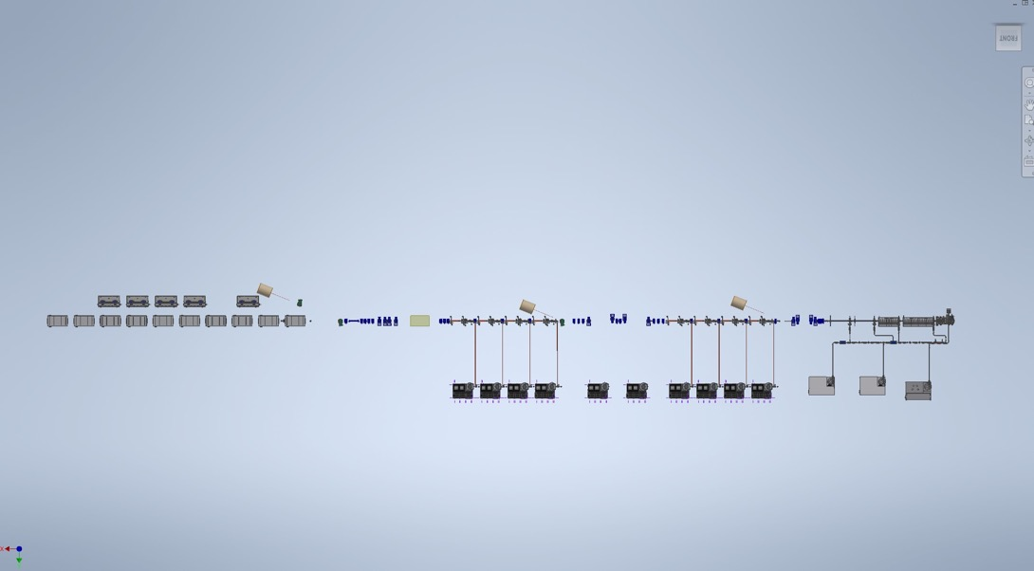
Accelerator & undulators layout

Slide 12
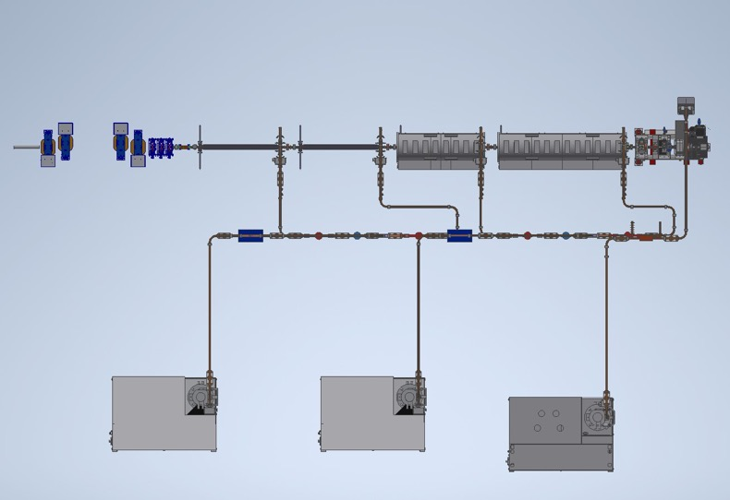
Injector
S-band photogun
S-Band accelerating section
First accelerating section Solenoids
Laser heater – magnetic compressor
X-band linearizer
Injector diagnostics
RF modulator & Klystron
RF waveguide network

Slide 13
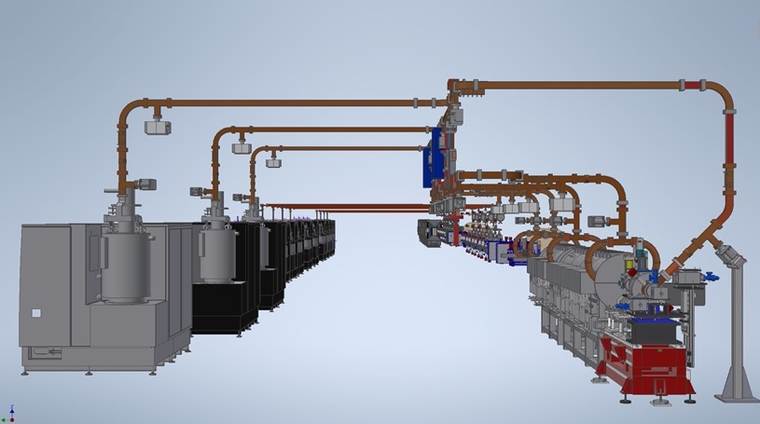
RF distribution overview
cfr: David Alesini

Slide 14
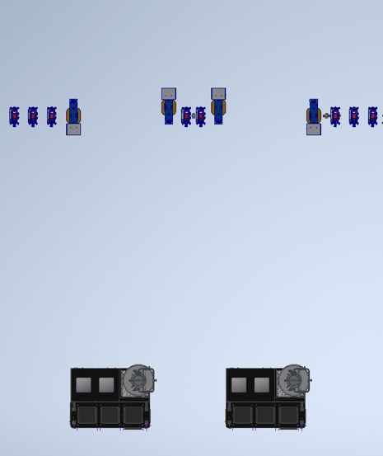
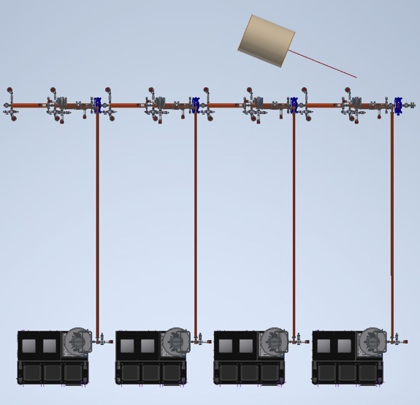
Low energy X-band linac & bunch compressor

Slide 15
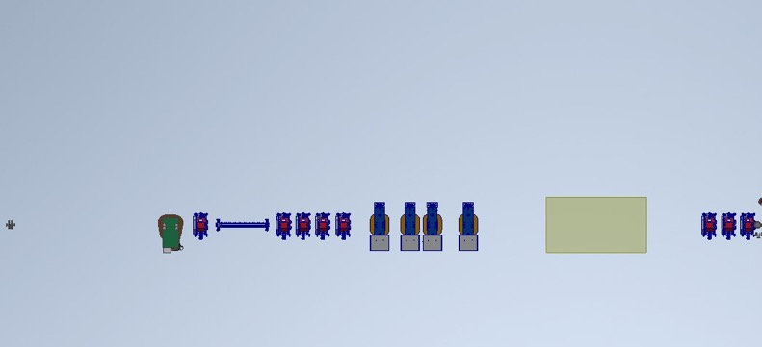
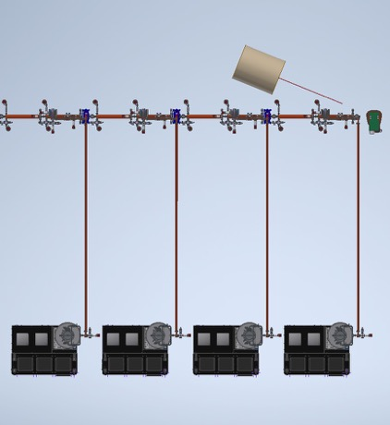
High energy X-band linac & Plasma acceleration module
cfr: Angelo Biagioni

Slide 16
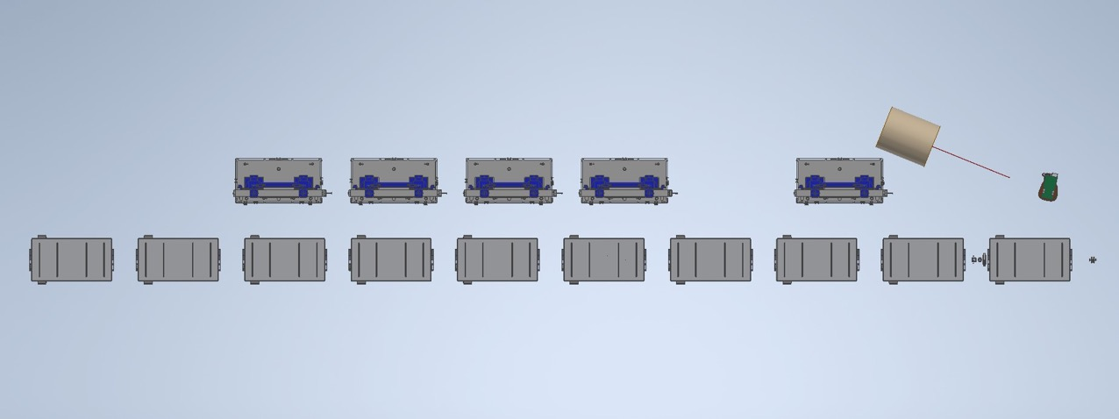
Undulators area
cfr: Luca Giannessi

Slide 17
Machine layout - TDR status
Accelerator & undulator definition 70%
Photon beam lines & end stations 30%
Building functional area definition 90%
Description of components 70%
Mechanical drawing for tender request 20%
Writing 10%

Slide 18
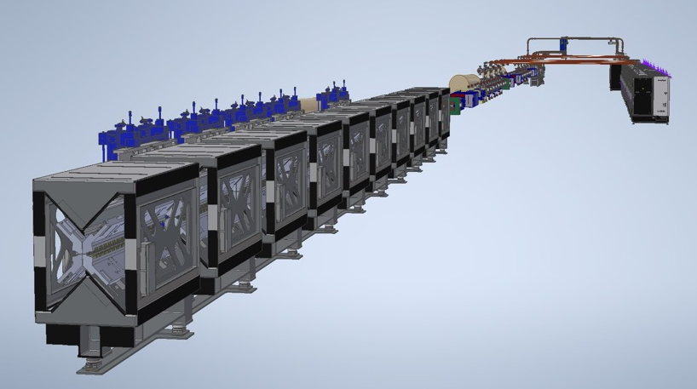
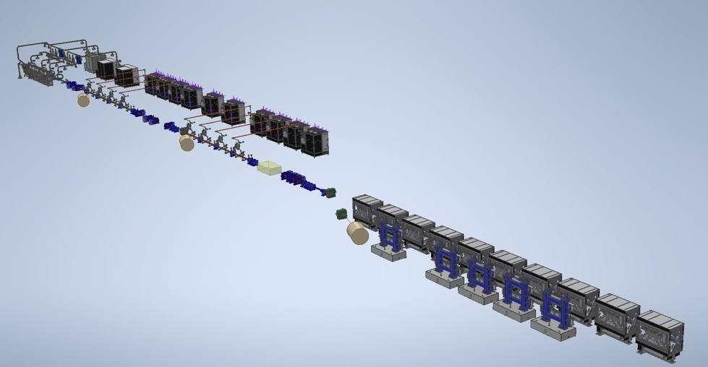
3D accelerator & undulators view
Thanks for
the attention

