Slide 1
EuPRAXIA@SPARC_LAB: schedule and cost review
Giorgio Delzeri (INFN - LNF)
TDR Review Committee 26/06/2024

Slide 2


EuPRAXIA Program
EuPRAXIA is consolidating its position in the RI landscape as a European Program.
INFN-LNF is the leading institute.
At the moment several correlated projects are ongoing —> EuPRAXIA@SPARC_LAB is the main pillar of the program and the Beam Driven pillar of the future Distributed Research Infrastructure.
TDR Review committee 26/06/2024

Slide 3
EuPRAXIA Program
 | EuPRAXIA@SPARC_LAB. & EuPRAXIA Building |  | EuAPS | EuPRAXIA-Preparatory Phase | EuPRAXIA - Doctoral network
Scope | Redaction of the TDR of the Beam Driven Pillar | Design and construction of the building that will house the facility | Betatrone Source High Power Laser High Repetition Rate Laser | Definition and design of EuPRAXIA as distributed RI (legal, governance, financial model) | 10 PhD programs across Europe on plasma accelerator science
Duration | TDR is expected at the end of 2025 | Mid-2029 (approx) | 30months (+6) Not later than 31/12/2025 | 48 months 30/10/2026 | 48 months 31/12/2026
Budget | 9 M€ | To be assessed. O(40M€) | 22,3 M€ | 2,7 M€ (+ In kind contribution) | 2,5 M€ (+ In kind contribution)
Funding source | Internal funding through GE | Internal funding through GE | PNRR | Horizon Europe | Horizon Europe
R&D required | Yes | NO | Some | NO | NO
Partner | Mainly internal LNF with some partnership with Elettra, ENEA UniTOV, Uniroma1, INFN-MI | Internal LNF | LNF, LNS, INFN-MI (INFN) CNR UniTOV | 25 Partner + 9 Associated | 23 Partner + 15 Associated
TDR Review committee 26/06/2024

Slide 4
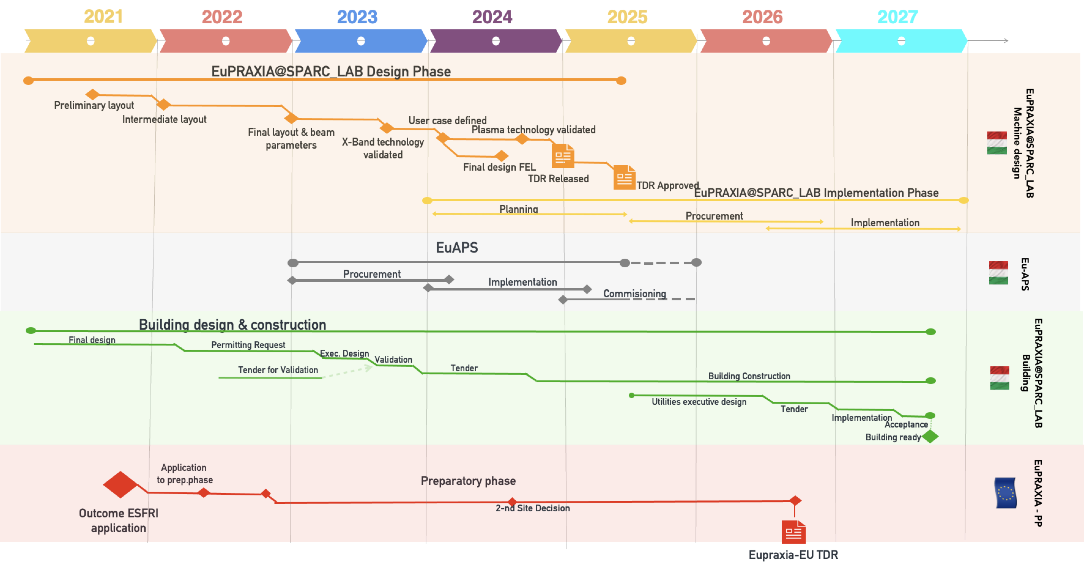
EuPRAXIA baseline updating
Needs revision
Needs revision
TDR Review committee 26/06/2024

Slide 5
EuPRAXIA baseline updating
Several delays accumulated —> time for a realistic update of the baseline
Building availability is a super-critical milestone:
                More knowledge and expertise on the upcoming steps to be done
                Realistic scenario based on the advancement of the executive design
                Authorization process is now concluded and therefore the upcoming baseline can be considered much
                more realistic.
Based on these considerations a new baseline is being discussed. At the moment we have updated the building construction schedule and we are working on the machine implementation baseline update.
TDR Review committee 26/06/2024

Slide 6
EuPRAXIA baseline updating - building
Contingecy
Sectional Completion
As it happened
TDR Review committee 26/06/2024

Slide 7
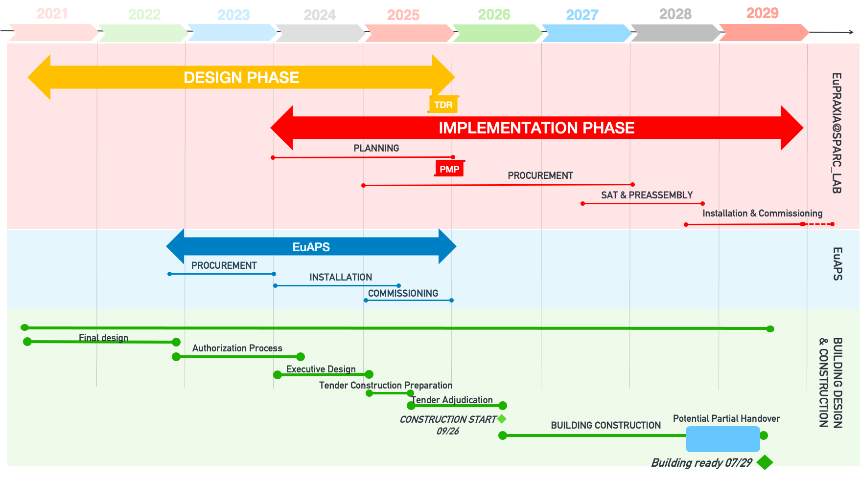
EuPRAXIA baseline updating
Sectional Completion
TDR Review committee 26/06/2024

Slide 8
EuPRAXIA baseline updating
This high level strategic approach is being implemented through a detailed schedule.
Basically big tenders should be launched in 2025 (RF, Injector and maybe Undulators).
Storage and pre-assembly space is being organized to allow a fast integration at least for the first stage of the implementation.
TDR Review committee 26/06/2024

Slide 9
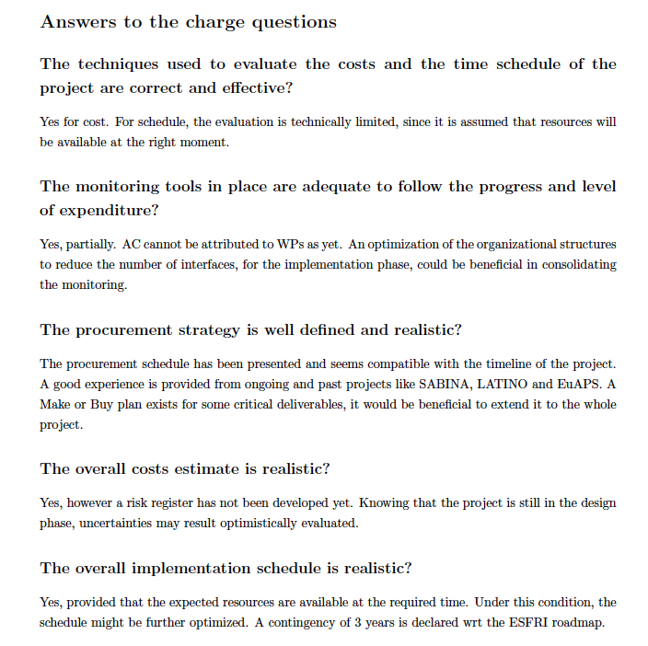
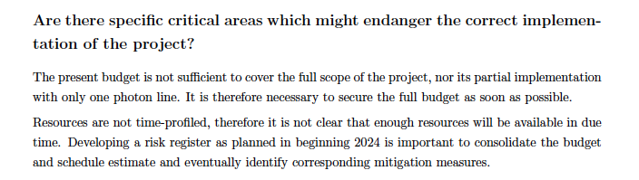
EuPRAXIA@SPARC_LAB Cost Review
1st Cost&Schedule Review 11 and 12 December 2023.
Overall we have presented a sound cost estimation that needs to be refined though.
Overbudget that needs to be managed (definition of a bottom line minimum requirements)
TDR Review committee 26/06/2024

Slide 10
EuPRAXIA@SPARC_LAB Cost Review
Since December we have monitoring the cost-estimation and make a comprehensive review (which is still in progress).
ITEM | Expected Cost | Best Case | Worst Case
LINAC | 19.751.540 | 18.798.976 | 21.105.428
RF Power | 15.760.000 | 14.972.000 | 17.336.000
FEL Line Aqua | 15.425.000 | 13.882.500 | 18.510.000
FEL Line ARIA | 4.476.000 | 4.028.400 | 5.371.200
Beam Line & User end station AQUA | 6.670.000 | 6.003.000 | 8.004.000
Beam Line & User end station ARIA | 5.590.000 | 5.031.000 | 6.987.500
Building & Hi Tech utilities | 53.945.500 | 51.248.225 | 56.642.775
TOT | 121.618.040 | 113.964.101 (-6%) | 133.956.903 (+10%)
Some errors detected & some cost updated (e.g. LLRF based on formal and final quotation).
Additional updates are expected in the next weeks.
AACE standard for cost estimation to assess expected range based on maturity level.
TDR Review committee 26/06/2024

Slide 11
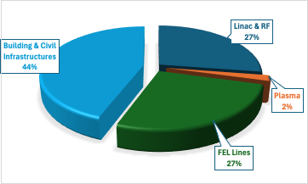
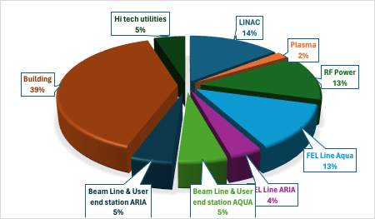
EuPRAXIA@SPARC_LAB Cost Review
TDR Review committee 26/06/2024

Slide 12
EuPRAXIA@SPARC_LAB Cost Review
TDR Review committee 26/06/2024

Slide 13
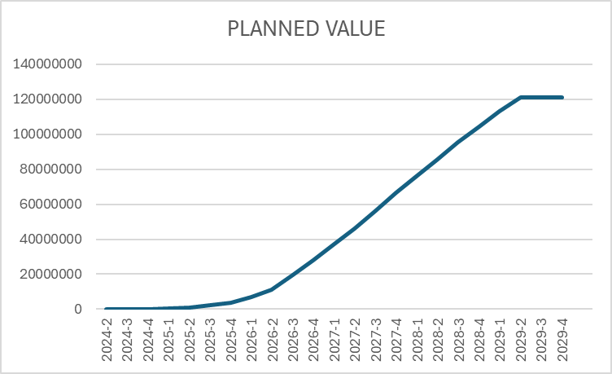
EuPRAXIA@SPARC_LAB Cost Review
TDR Review committee 26/06/2024

Slide 14
EuPRAXIA@SPARC_LAB Cost Review
We are currently updating the costs and schedule in detail.
We are also working in light of the suggestions received during the Cost & Schedule review held in Frascati last December.
The new Cost & Schedule review will be set by the end of the year, hopefully in November 2024.
TDR Review committee 26/06/2024

Slide 15
CONCLUSIONS
TDR. We are approaching the first draft. Final release during 2025.
Schedule: The Schedule is being updated. The building construction is expected to begin mid-2026.
Costs: We are now updating the costs, taking into account the new estimates also in light of the latest changes to the layout. Bottom-up WBS based approach.
Funding: We are looking for additional funding lines.
TDR Review committee 26/06/2024

Slide 16
THANKS
Thank you all for your attention
TDR Review committee 26/06/2024

