Slide 1
Introduction to: VII EuPRAXIA@SPARC_LAB TDR Review Committee
Massimo Ferrario (INFN - LNF)
TDR Review Committee 26/06/2024

Slide 2
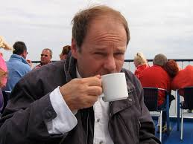
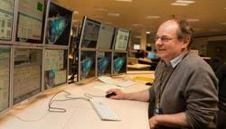
Ciao Siggi e Grazie di Tutto!
As INFN team from Frascati and Milan LASA, we had the privilege of working alongside Siggi for many years at the TTF/FLASH accelerator, where he served as the esteemed leader of the project. Siggi's exceptional competence and dedication were evident to all who had the privilege of collaborating with him. He was not only a skilled professional but also a true gentleman, known for his kindness, warmth, and witty personality. Siggi was a shining example for younger generations, inspiring us all with his leadership and unwavering commitment to excellence.
His guidance and mentorship have left an indelible mark on us, shaping our professional growth and personal development. We are profoundly moved and saddened by his loss, and we wanted to express our deepest sympathies during this difficult time.
We are also grateful for Siggi's invaluable contribution as a referee during his time with the EuPRAXIA@SPARC_LAB project, where he brought his unmatched expertise, further enriching our endeavors.
Siggi's legacy of professionalism and humanity will forever be remembered by all who had the privilege of knowing and working alongside him.

Slide 3
Defining the Agenda
The RC would like to have its role in the release process of the document defined soon. In particular, the depth of the review by the RC for that process needs to be established. The RC recommends that smaller reviews by more specialized review committees be organized for the major technical work packages of the TDR.
The lifetime of the capillary used for plasma production has clearly emerged as a major challenge to be met in the context of future operation of a facility (e.g., 400 Hz, 24/7). The RC strongly recommends that investigation in damage processes and more damage resistant materials be started very soon.
The RC notes that a different method to produce the drive-witness bunch train, the use of a masking technique is considered. Preliminary results on parameters and their sensitivity to variations from beam dynamics simulations are encouraging. The RC recommends this option to be thoroughly investigated through start to end simulations. The RC notes that the parameters of a number of components of the beam line are not yet determined.
Work on the X-ban linac is progressing well with tests of components and klystron at TEX, success with brazing of the X-band structure, and the procurement process for test klystrons and modulators.
The RC notes that the ARIA FEL line is not funded. The team may consider it as outside of the scope of the TDR and as an upgrade to the facility.

Slide 4
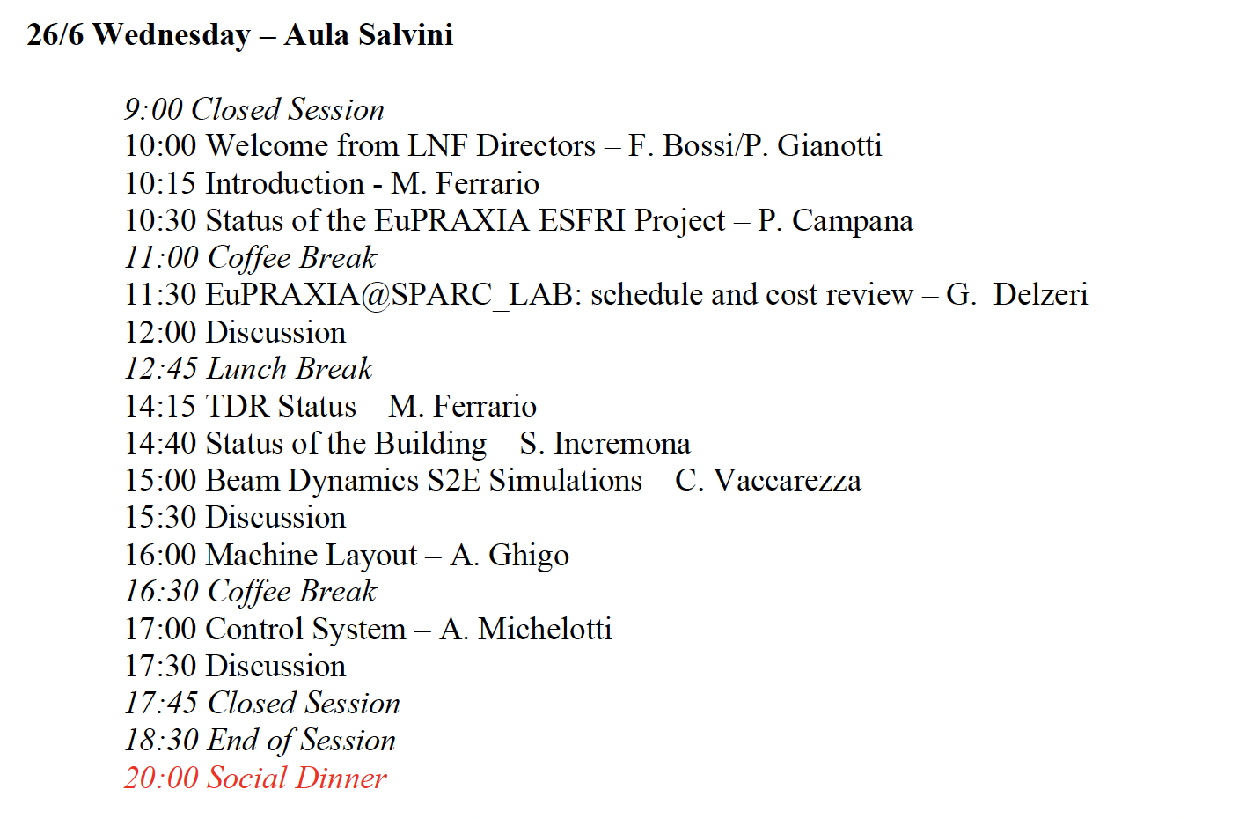
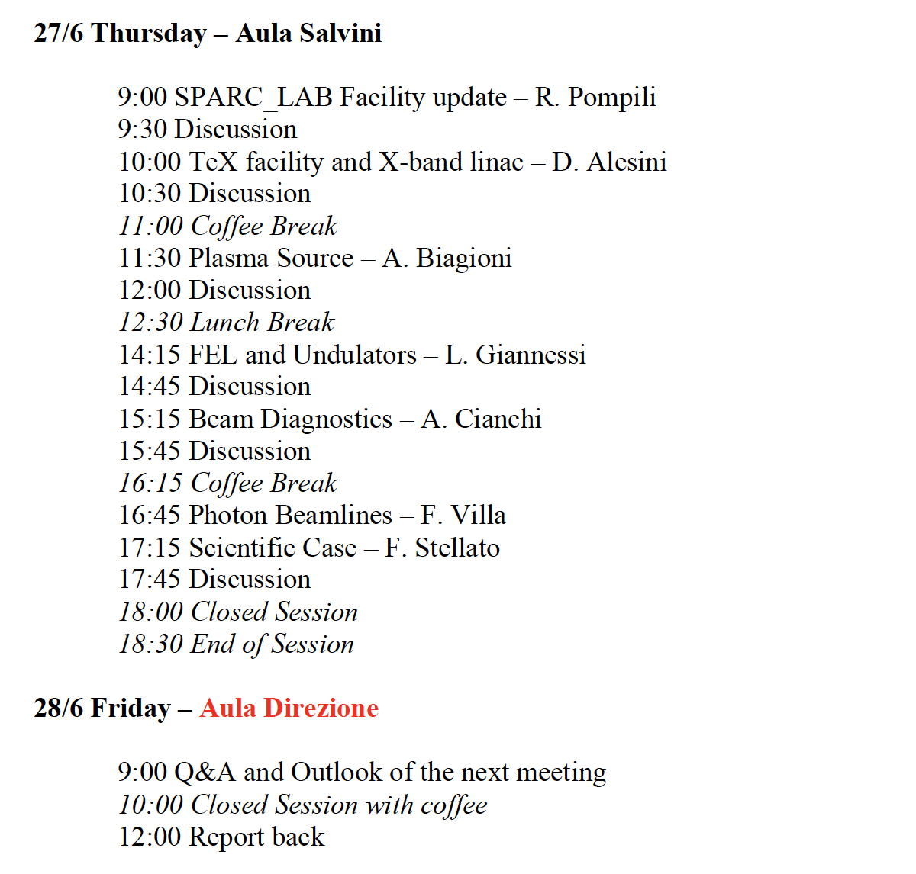
Agenda
About Synchronization: next time
https://agenda.infn.it/event/42282/timetable/#20240626

Slide 5
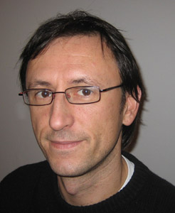
Welcome to Holger Schlarb (DESY)
The accelerator physicist Dr. Holger Schlarb was awarded the Bjørn H. Wiik-Preis 2007. He was honoured for his outstanding developments in diagnostics and synchronization of the free-electron lasers FLASH and XFEL.
Already in his doctoral thesis, Holger Schlarb made decisive contributions for the commissioning and optimisation of DESY’s first free-electron laser at the TESLA Test Facility TTF, and he implemented a collimator system which protects the highly sensitive undulators from radiation damages. This was a significant basis for FEL operation with high beam currents.
Afterwards – including one year at SLAC - he dedicated himself to high-resolution beam diagnosis and the synchronisation of FEL pulses at shortest time scales. He was one of the first to discover that average high-frequency synchronisation systems in long linear accelerators do not have sufficient time accuracy and have to be replaced by laser optical systems.

Slide 6
New Proposal Submitted: PACRI
HORIZON-INFRA-2024-TECH-01-01: R&D for the next generation of scientific instrumentation, tools, methods, solutions for RI upgrade
Dead line 12 March 2024
Target Budget ~10 MEuro
Plasma Accelerators for Compact Research Infrastructures
# | Partner | Acronym
1 | Elettra - Sincrotrone Trieste SCpA (Coordinator) | ST
2 | European Organization for Nuclear Research | CERN
3 | Istituto Nazionale Fisica Nucleare | INFN
4 | University of Liverpool | ULIV
5 | Thales-MIS | Th-MIS
6 | Scandinova Systems AB | SCND
7 | VDL ETG Technology & Development BV | VDL
8 | COMEB | COMEB
9 | United Kingdom Research and Innovation | UKRI
10 | Consiglio Nazionale delle Ricerche | CNR
11 | Extreme Light Infrastructure ERIC | ELI-ERIC
12 | Centre National de la Recherche Scientifique CNRS | CNRS
13 | Thales LAS France SAS | Th-LAS
14 | Amplitude | Amplitude
15 | Centro de LÁSERES Pulsados | CLPU
16 | Ferdinand-Braun-Institut gGmbH, Leibniz-Institut für Hoechstfrequenztechnik | FBH
17 | Associacao do instituto superior Tecnico para a Investigacao e Desenvolvimento | IST
18 | Università degli Studi di Roma La Sapienza | USAP
19 | Heinrich-Heine-Universitaet Duesseldorf | UDUS
20 | Deutsches Elektronen-Synchrotron DESY | DESY
21 | The Chancellor, Masters and Scholars of the Univ. of Oxford | UOX
22 | Ludwig-Maximilians-Universitaet Muenchen | LMU
23 | GSI Helmholtz Centre for Heavy Ion Research | GSI
24 | Università degli Studi di Roma Tor Vergata | UTOR
25 | SourceLAB | SourceLAB
26 | Paul Scherrer Institut (Associated partner) | PSI
WP No. | Work Package Title | Lead Partic. Short Name
1 | Coordination and project management | ELETTRA
2 | Scientific and industrial exploitation | ULIV
3 | Plasma accelerator theory and simulations | IST
4 | High repetition rate plasma structures | INFN
5 | Plasma acceleration diagnostics and instrumentation | CNRS
6 | High efficiency RF generator | Thales-MIS
7 | High repetition rate modulator | Scandinova
8 | X-band RF Pulse Compressor (BOC) | INFN
9 | RF tests and validation | CERN
10 | High repetition rate high power Ti:Sa amplifier module | UKRI
11 | Efficient kHz laser driver modules for plasma acceleration | CNR
12 | High-rep rate pump sources for laser drivers | ELI-ERIC
13 | Prototype of high average power optical compressor | Thales-LAS
14 | Laser Driver System Architecture,transport and engineering | CNRS
25 Members
+
1 Associated partner
19 Universities and Scientific Labs.
+
7 Industries

Slide 7
Plasma Accelerators for Compact Research Infrastructures (PACRI)
The objective of the PACRI project is to develop innovative breakthrough technologies, increasing their Technology Readiness Level (TRL) for electron accelerators while taking energy consumption, resource efficiency, costs, and environmental impact into due account. This includes the following draft non-exclusive goals:
developing high rep-rate plasma modules, as required for the EuPRAXIA project, extending its scientific domain from high average brightness radiation sources up to high energy physics;
developing key laser components required to upscale high-power high repetition rate Laser technology as required by the EuPRAXIA and ELI Research Infrastructure.
improving the performance of normal conducting technology for X-band linac drivers, extending them to the kHz regime, with focus on efficiency and energy consumption;
supporting development towards compact linear colliders and nuclear physics facilities;
developing compact advanced undulator modules, in order to reduce the overall size of the future FEL facilities.
supporting the availability of compact X-ray facilities (FELs, ICSs, Betatron) to serve a larger number of users in many scientific fields, industry and society;

Slide 8
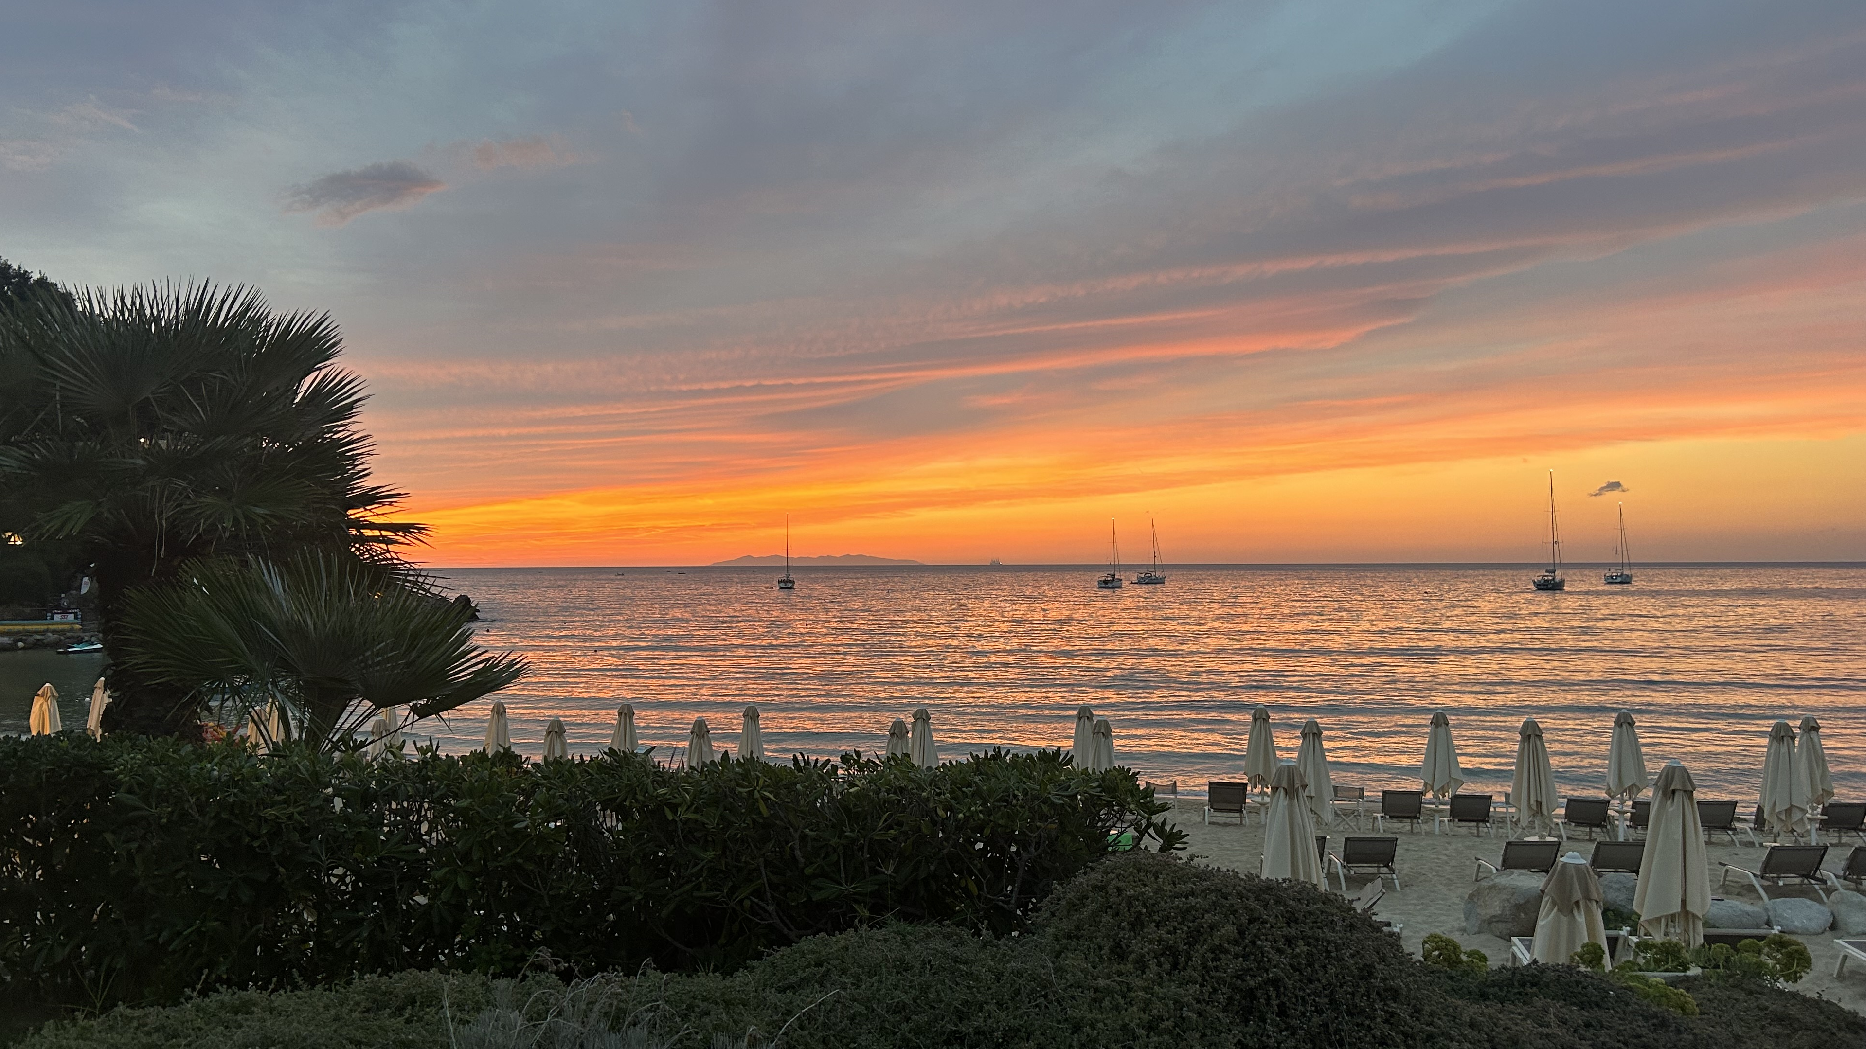
EuPRAXIA Workshop
22-27 September 2024
Elba
EuPRAXIA_PP Annual Meeting
M15.2 Workshop on “EuPRAXIA@SPARC_LAB machine upgrade and additional beam lines“ (M20) giugno 2024 [Pompili, Vaccarezza]
M6.1 Outreach Workshop (M24) ottobre 2024 [Cros, Mostacci]

Slide 9
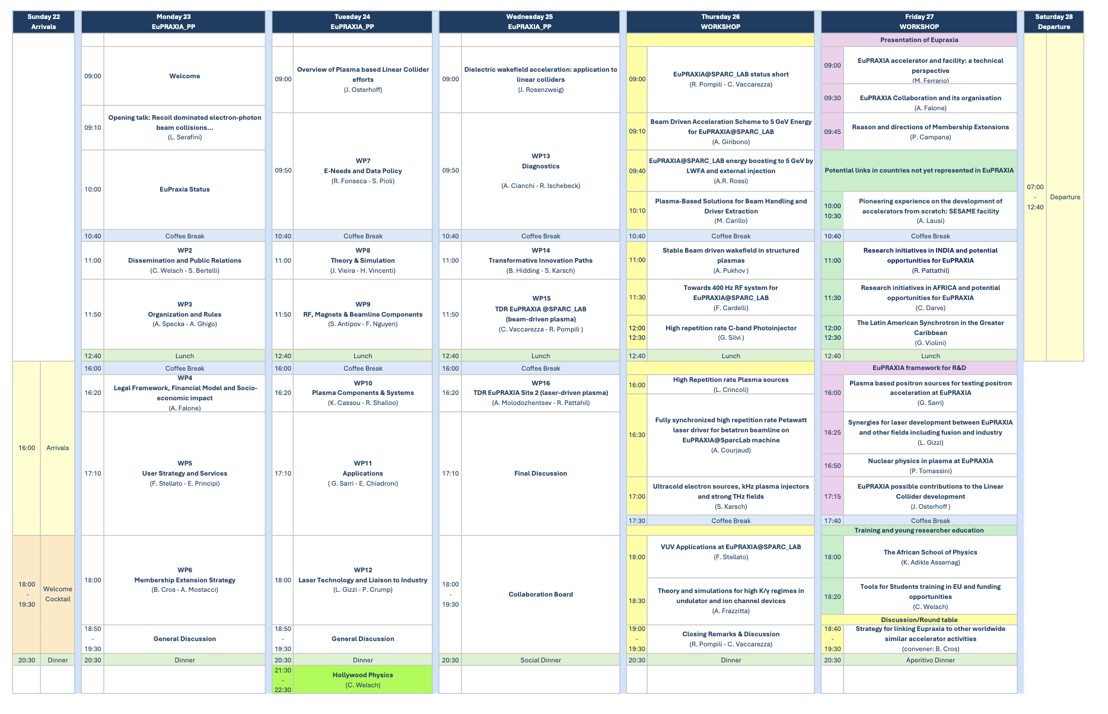

Slide 10
Thanks

Slide 11
EuPRAXIA@SPARC_LAB TDR Status
Massimo Ferrario (INFN - LNF)
TDR Review Committee 26/06/2024

Slide 12
The RC strongly recommends the following:
Allocate sufficient time to create a preliminary, but complete version of the Technical Design Report (TDR), focusing on establishing key parameters for consistency checks, and identifying areas that need attention before reaching the “TDR released” milestone. By complete, we mean that all chapters shall contain the list of target parameters and the expected performances that will be included in the final TDR version, as well as their current status and next steps.
Initial Drafting of TDR: This objective emphasizes the importance of creating an initial draft of the TDR. This step is crucial, as it sets the foundation for reaching the TDR milestones. By drafting the TDR, one can identify the main parameters and ensure coherence across different aspects of the project. This initial draft acts as a baseline for future developments.
Identifying Gaps and Milestones: The process of drafting the TDR helps in identifying gaps that need to be addressed before reaching the TDR released milestone. This is a proactive approach to project management, allowing for the early detection of potential issues or areas that require more attention.
Defining Priorities for the Next 12 Months: With the initial draft in place, it becomes easier to define priorities for the upcoming year. This involves determining which aspects of the TDR need more focus and resources, ensuring that the project stays on track and aligns with the overall objectives.
Planning Reviews on Specific Topics: This objective suggests planning targeted reviews on specific topics. This is an effective way to deep-dive into particular areas of the TDR that might be complex or require additional expertise. These reviews can provide valuable insights and contribute to the refinement of the TDR. Status Report by June 2024 on Preliminary TDR.
Finally, the recommendation proposes having a Status Report by June 2024 directly based on the preliminary TDR document. This deadline serves as a checkpoint to assess the progress made on the TDR. It ensures that the project is moving forward as planned and allows for adjustments if necessary.

Slide 13
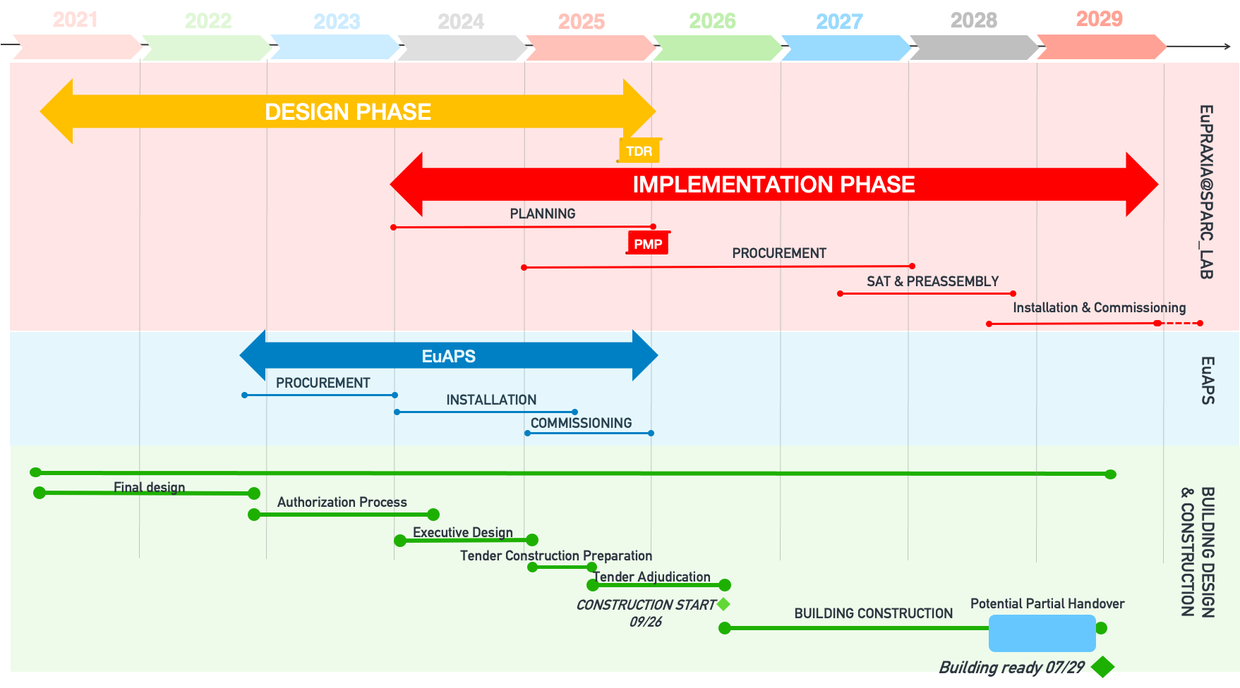
EuPRAXIA baseline updating
Sci-Com 27/05/2024

Slide 14
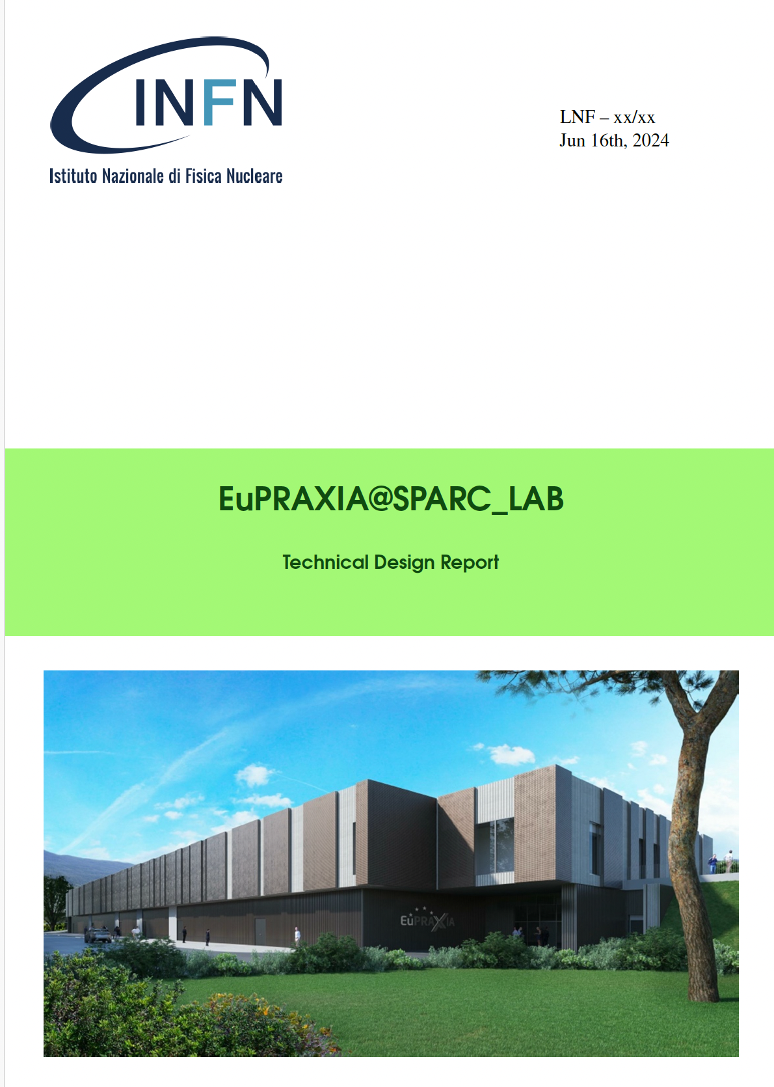
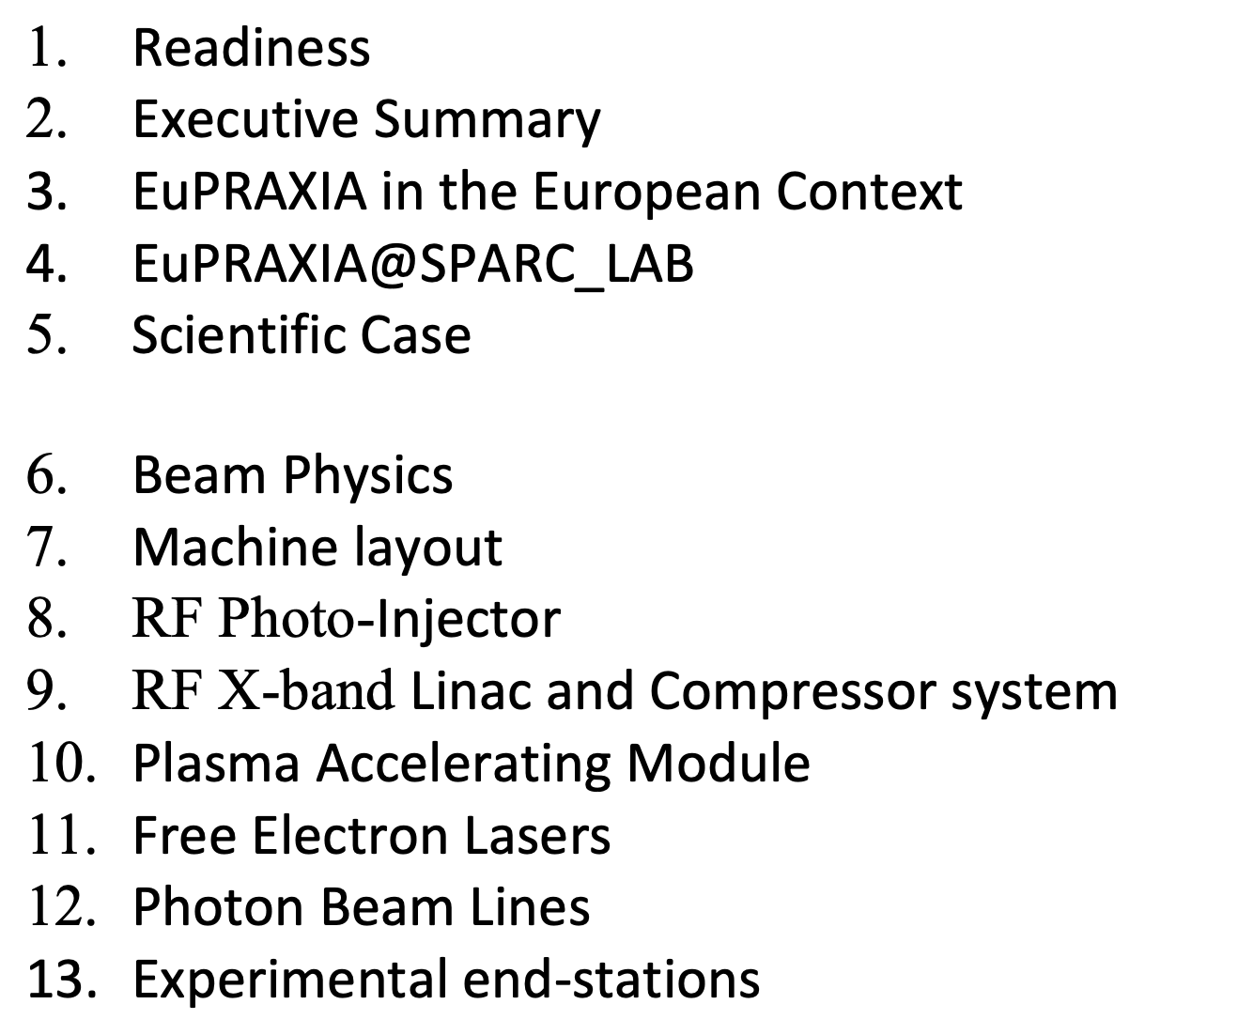
TDR Status
https://www.overleaf.com/6441975428vfsgmvpctmph#ebe5ff

Slide 15
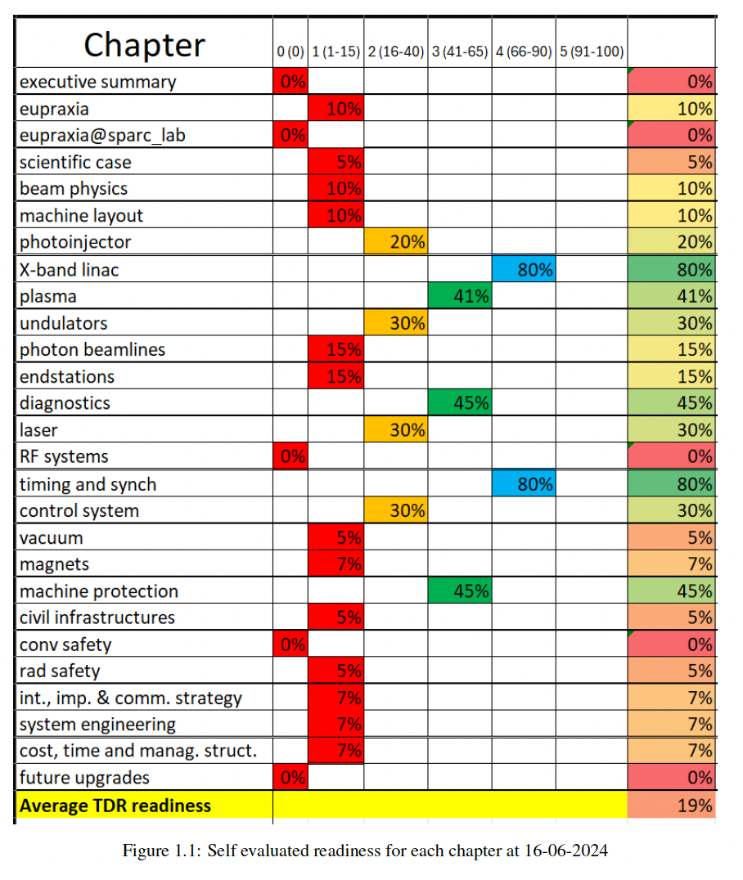
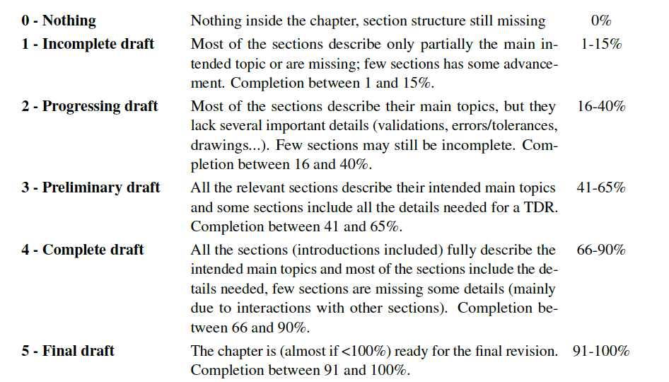
TDR Status
Many thanks to Fabio Villa for his editorial effort
https://www.overleaf.com/6441975428vfsgmvpctmph#ebe5ff

Slide 16
Next Steps
TDR Draft delivered by April 2025
Final TDR ready by October 2025
TDR Approval by the end of 2025
Procurement should start anyway beginning 2025 based on the design and tests completion of well established components (ex: Injector, RF Linac,..)

Slide 17
Thanks

