Slide 1



Testing flavour/modular symmetry theories in neutrino experiments
Monojit Ghosh
Ruđer Bosković Institute, Zagreb, Croatia
FLASY 2025
Rome, 30 June-4 July 2025

Slide 2
Outline
Neutrino Experiments: with a focus on ESSnuSB
Alekou, et al. [ESSnuSB] Eur. Phys. J. ST 231 (2022), 3779-3955
Testing a set of flavour symmetry models
Blennow, MG, Ohlsson and Titov, JHEP 07 (2020), 014
Blennow, MG, Ohlsson and Titov, Phys. Rev. D 102 (2020), 115004
Testing a set of modular symmetry models
Mishra, Behera, Panda, MG and Mohanta, JHEP 09 (2023), 144

Slide 3
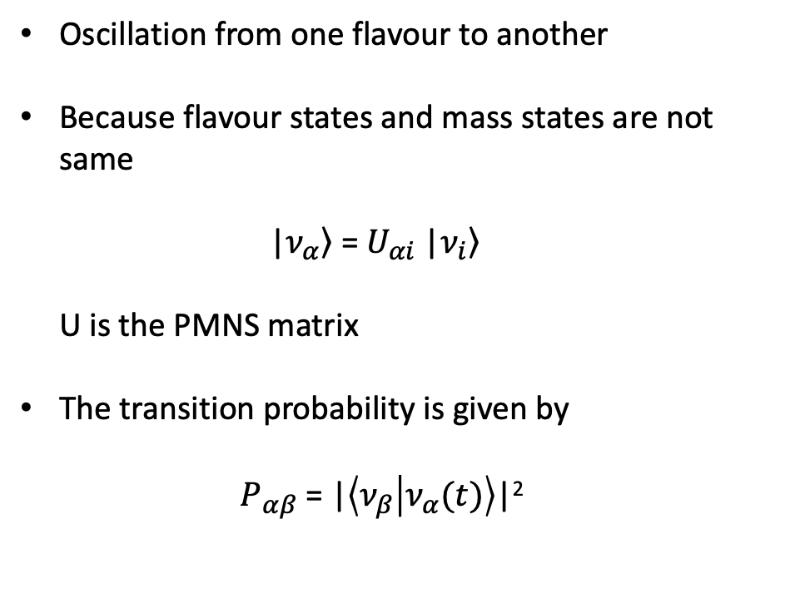
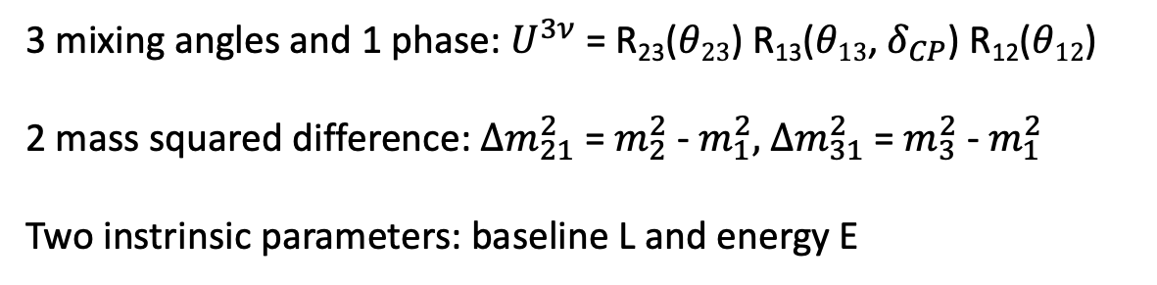
Neutrino Oscillation
Oscillation from one flavour to another
Because flavour states and mass states are not same
|$\left.ν_{α}\right\rangle$ = $U_{αi}$ |$\left.ν_{i}\right\rangle$
U is the PMNS matrix
The transition probability is given by
$P_{αβ}$ = |$\left\langle ν_{β} | ν_{α}(t)\right\rangle$|²
3 mixing angles and 1 phase: $U^{3ν}$ = R₂₃($θ23$) R₁₃($θ13$, $δ_{CP}$) R₁₂($θ12$)
2 mass squared difference: ${Δm}_{21}^{2}$ = $m_{2}^{2}$ - $m_{1}^{2}, { Δm}_{31}^{2}$ = $m_{3}^{2}$ - $m_{1}^{2}$
Two instrinsic parameters: baseline L and energy E

Slide 4
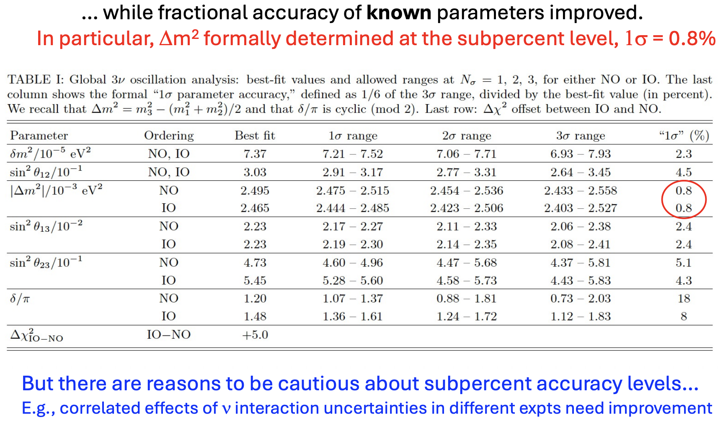
Global fit status
The prediction of the flavour/symmetry models must be in agreement with experimental data
Talk by Eligio

Slide 5
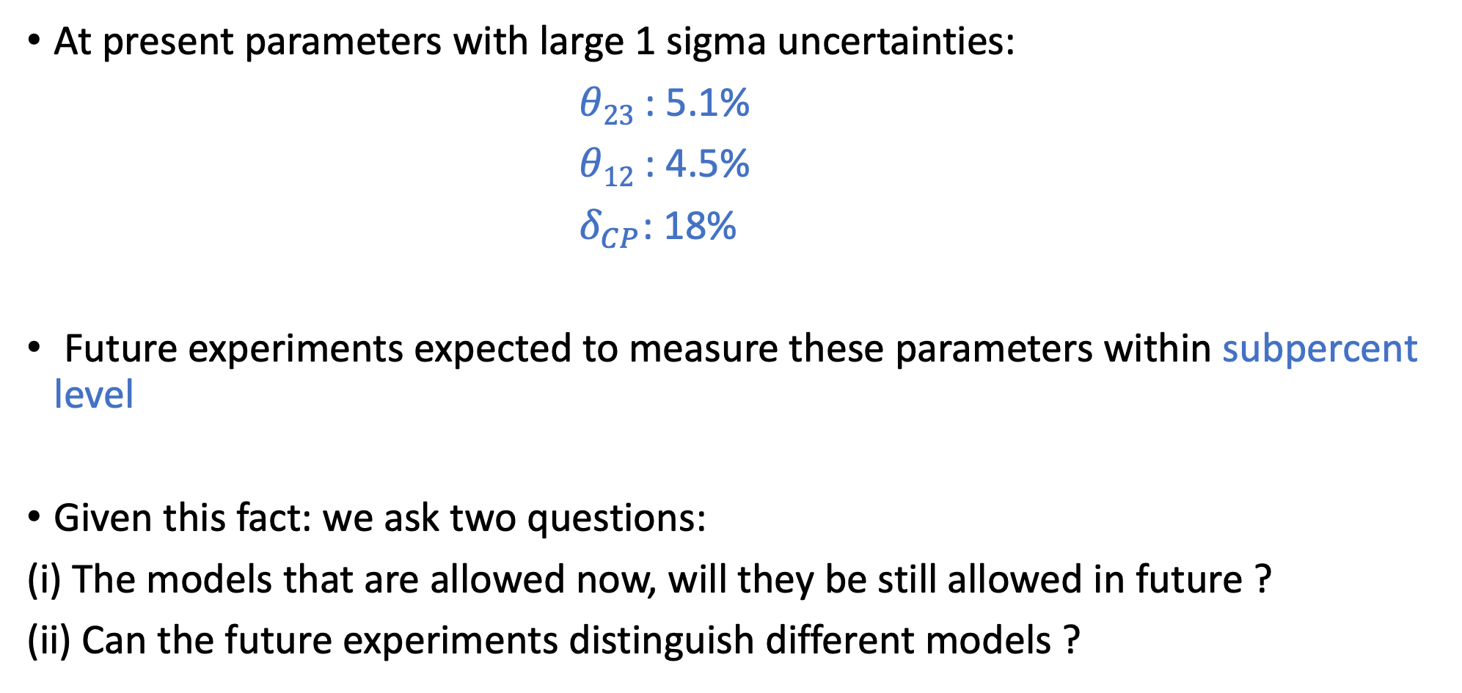
Motivation
At present parameters with large 1 sigma uncertainties:
$θ23$ : 5.1%
$θ12$ : 4.5%
${ δ}_{CP}$: 18%
Future experiments expected to measure these parameters within subpercent level
Given this fact: we ask two questions:
(i) The models that are allowed now, will they be still allowed in future ?
(ii) Can the future experiments distinguish different models ?

Slide 6
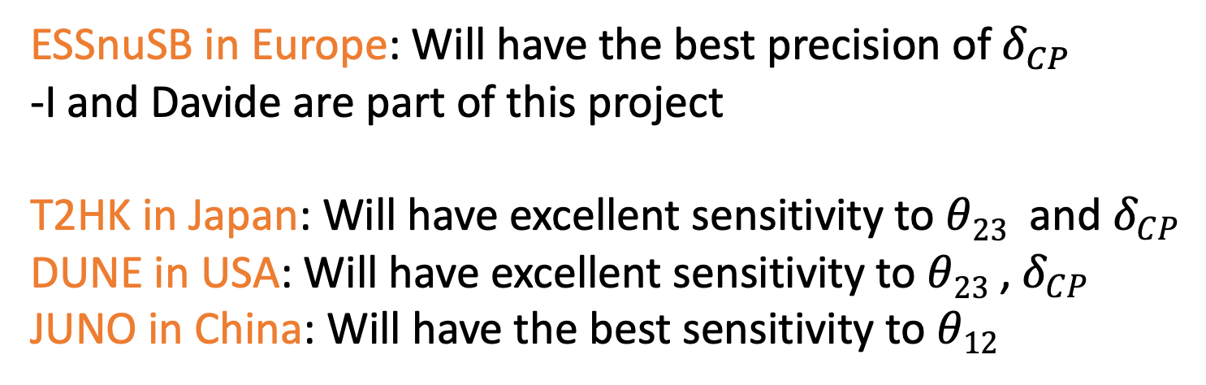
Experiments
The experimts we consider to test the models are
ESSnuSB in Europe: Will have the best precision of${ δ}_{CP}$
-I and Davide are part of this project
T2HK in Japan: Will have excellent sensitivity to $θ23$ and $δ_{CP}$
DUNE in USA: Will have excellent sensitivity to $θ23$ ,$δ_{CP}$
JUNO in China: Will have the best sensitivity to $θ12$

Slide 7
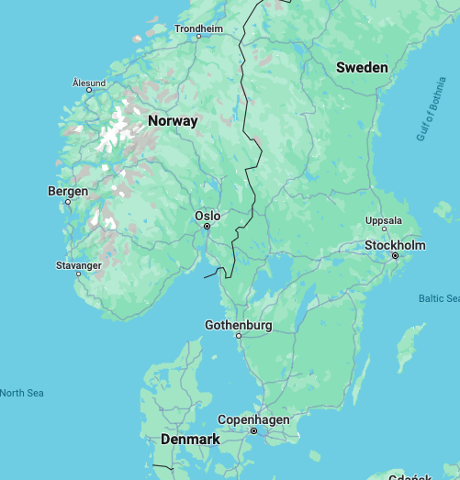

The ESSnuSB Experiment
13 countries
23 Instititutes
ESSnuSB - Horizon (2018 - 2022) – 3 M€
ESSnuSB+ -Horizon EU (2023 - 2026) - 3 M€
Water Cherenkov Far Detector- 540 kt
5 MW Proton beam, 2 Gev proton energy
Zinkgruvan
Main Goal: Precision measurement of the CP Violation phase
with a long baseline setup
Other goals: Neutrino Cross-section measurements with
the near detectors, Sterile neutrino searches
with a short baseline setup, etc.
360 km
ESS

Slide 8
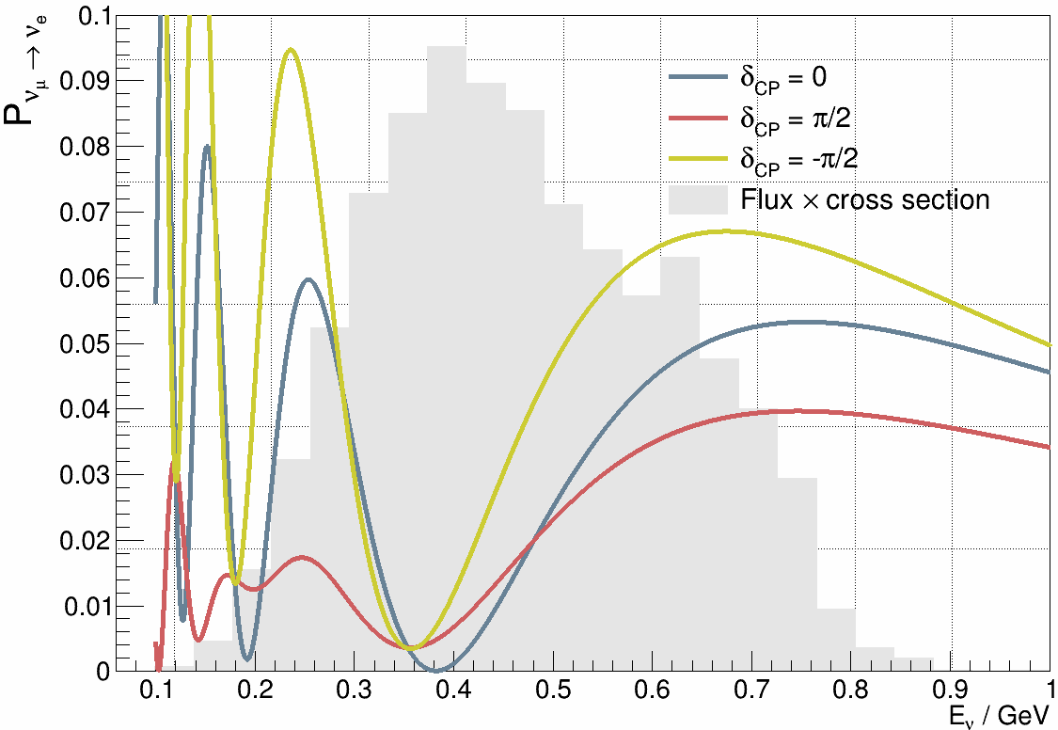
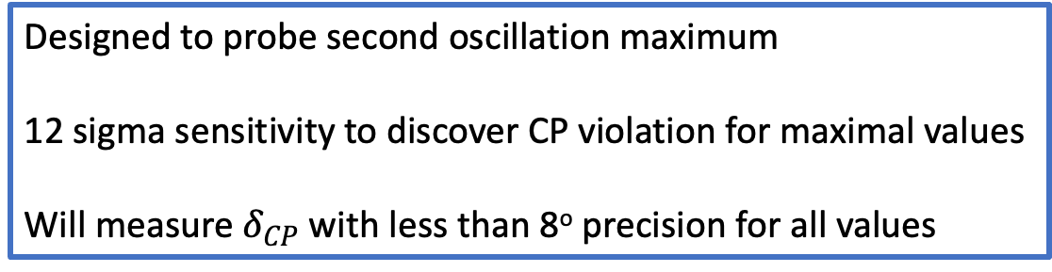
Sensitivity of ESSnuSB
Designed to probe second oscillation maximum
12 sigma sensitivity to discover CP violation for maximal values
Will measure $δ_{CP}$ with less than 8º precision for all values
Alekou, et al. [ESSnuSB] Eur. Phys. J. ST 231 (2022), 3779-3955

Slide 9
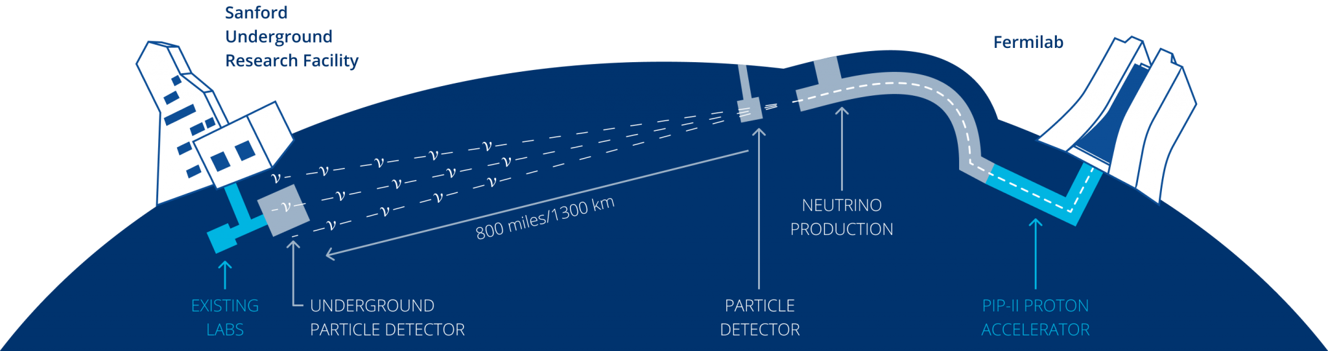
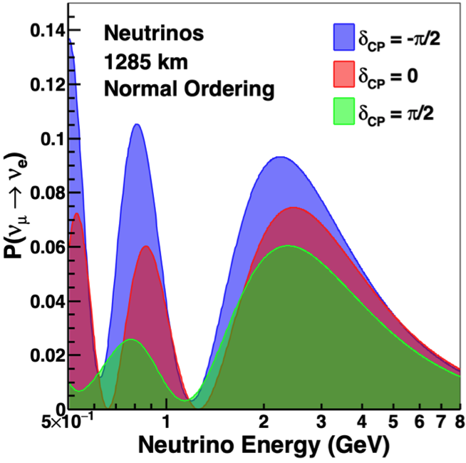
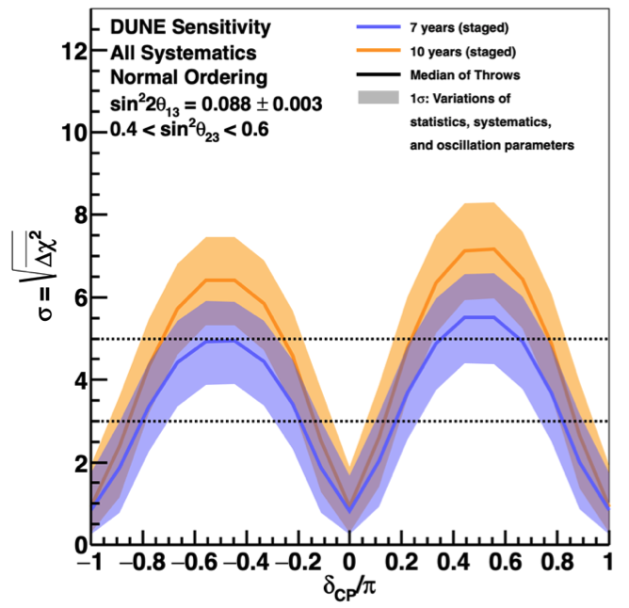
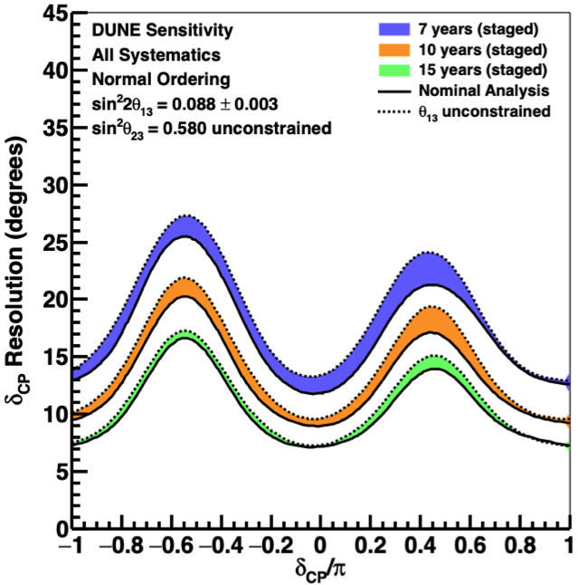
DUNE
Liquid Argon TPC of 40 kt
L = 1300 km
Abi et al. [DUNE], Eur. Phys. J. C 80 (2020), 978

Slide 10
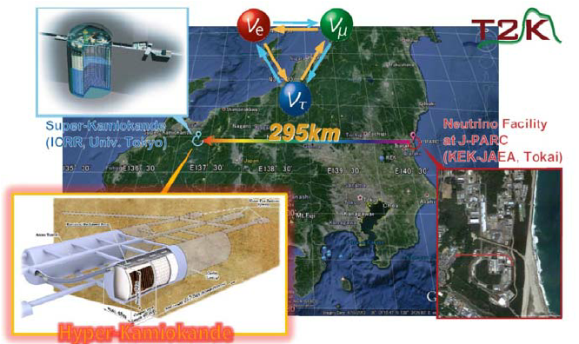
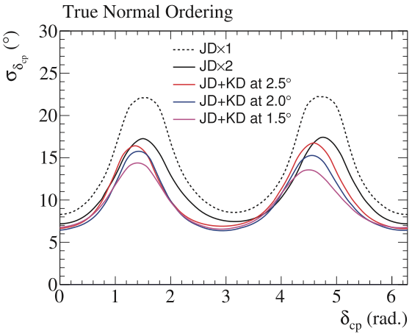
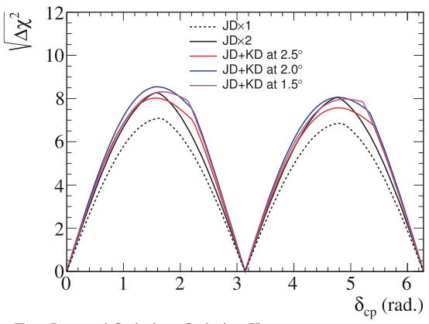
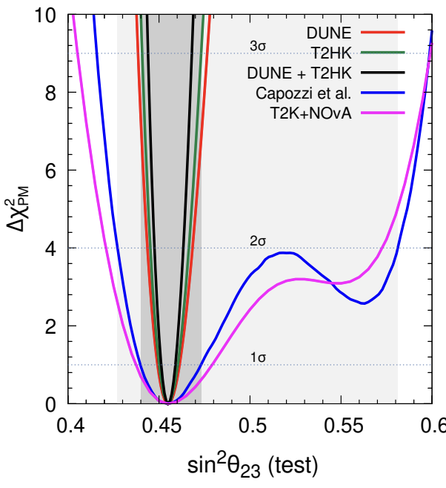
T2HK
WC 374 kt
295 km
Abe et al. [Hyper-Kamiokande](2018), Ghosh and Ohlsson (2020), Agarwalla, Kundu and Singh (2024)

Slide 11
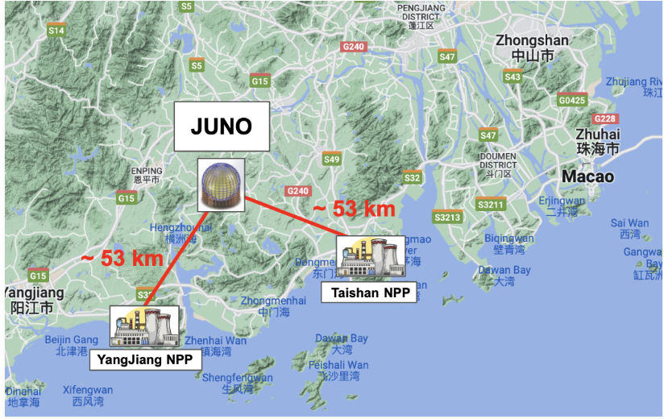
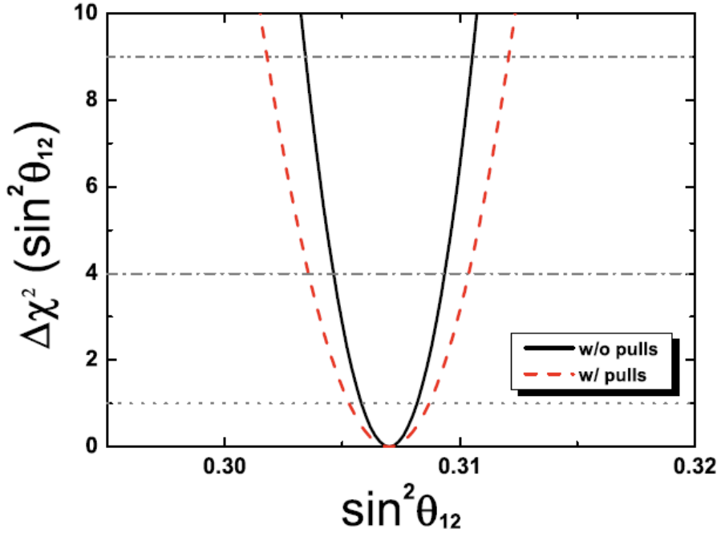
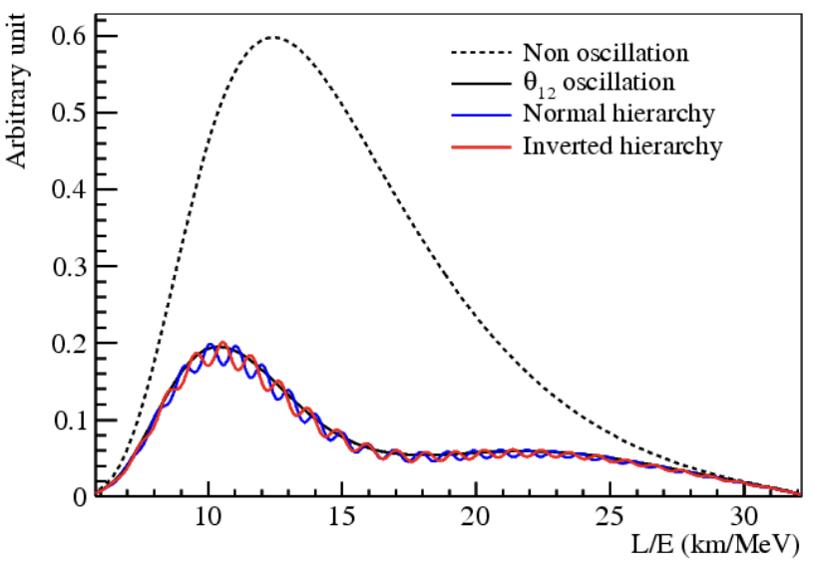
JUNO
Liquid Scintillator, 20 kt
53 km
An et al. [JUNO], J. Phys. G 43 (2016) no.3, 030401

Slide 12
Testing a flavour symmetry model

Slide 13
Testing a flavour symmetry model
Let’s consider a model which predicts the values of mixing parameters in the form of a sum rule
And the sum rule depends only upon one variable: One parameter model

Slide 14
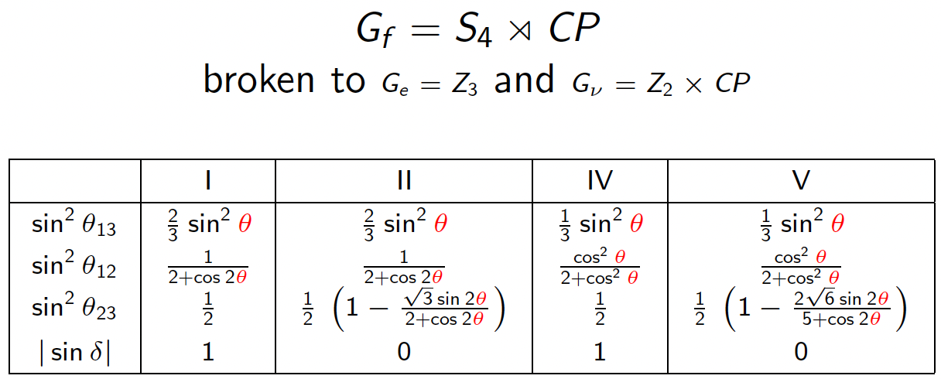
Testing a flavour symmetry model
Let’s consider a model which predicts the values of mixing parameters in the form of a sum rule
And the sum rule depends only upon one variable: One parameter model
For example: Feruglio, Hagedorn and Ziegler JHEP 07 (2013) 027

Slide 15
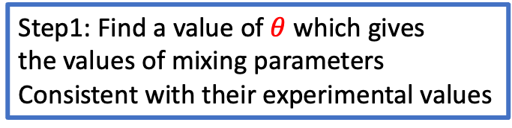
Testing a flavour symmetry model
Let’s consider a model which predicts the values of mixing parameters in the form of a sum rule
And the sum rule depends only upon one variable: One parameter model
For example: Feruglio, Hagedorn and Ziegler JHEP 07 (2013) 027
Step1: Find a value of $θ$ which gives
the values of mixing parameters
Consistent with their experimental values

Slide 16

Testing a flavour symmetry model
Let’s consider a model which predicts the values of mixing parameters in the form of a sum rule
And the sum rule depends only upon one variable: One parameter model
For example: Feruglio, Hagedorn and Ziegler JHEP 07 (2013) 027
Step1: Find a value of $θ$ which gives
the values of mixing parameters
Consistent with their experimental values
To do that define a $χ$² = (data – model)²/$σ$

Slide 17
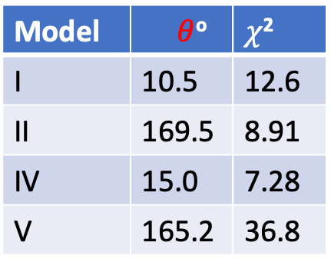
Testing a flavour symmetry model
Let’s consider a model which predicts the values of mixing parameters in the form of a sum rule
And the sum rule depends only upon one variable: One parameter model
For example: Feruglio, Hagedorn and Ziegler JHEP 07 (2013) 027
Step1: Find a value of $θ$ which gives
the values of mixing parameters
Consistent with their experimental values
To do that define a $χ$² = (data – model)²/$σ$
Model | $θ$º | $χ$²
I | 10.5 | 12.6
II | 169.5 | 8.91
IV | 15.0 | 7.28
V | 165.2 | 36.8

Slide 18
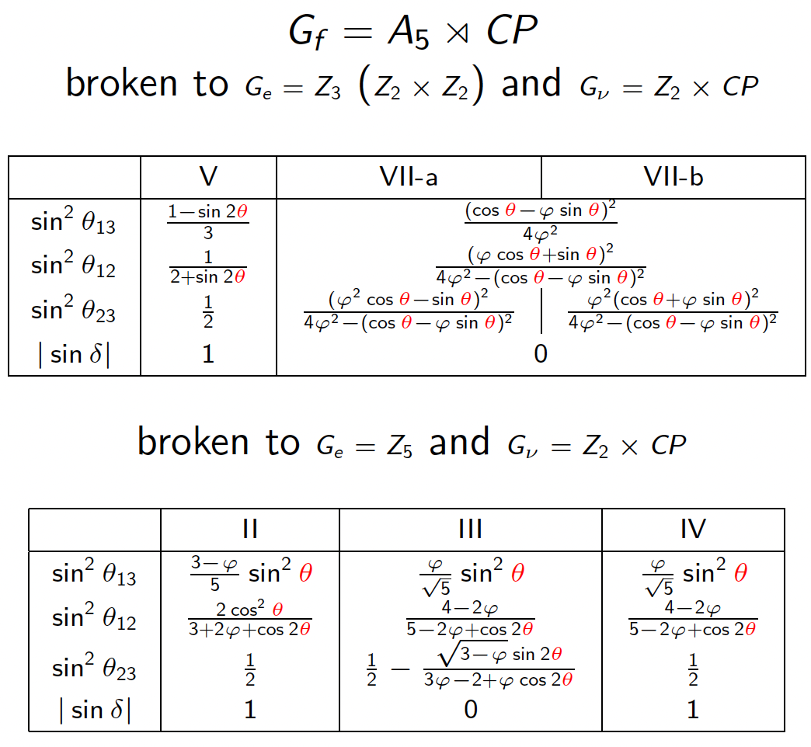

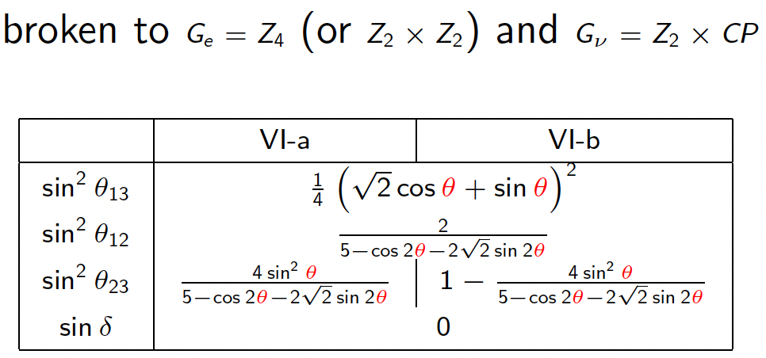
Full set of one parameter models
Feruglio, Hagedorn and Ziegler JHEP 07 (2013) 027, Li and Ding, JHEP 05 (2015)

Slide 19
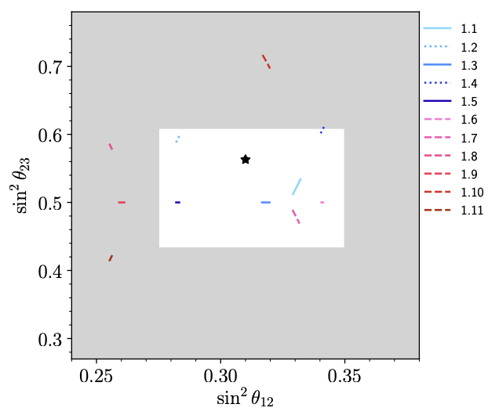
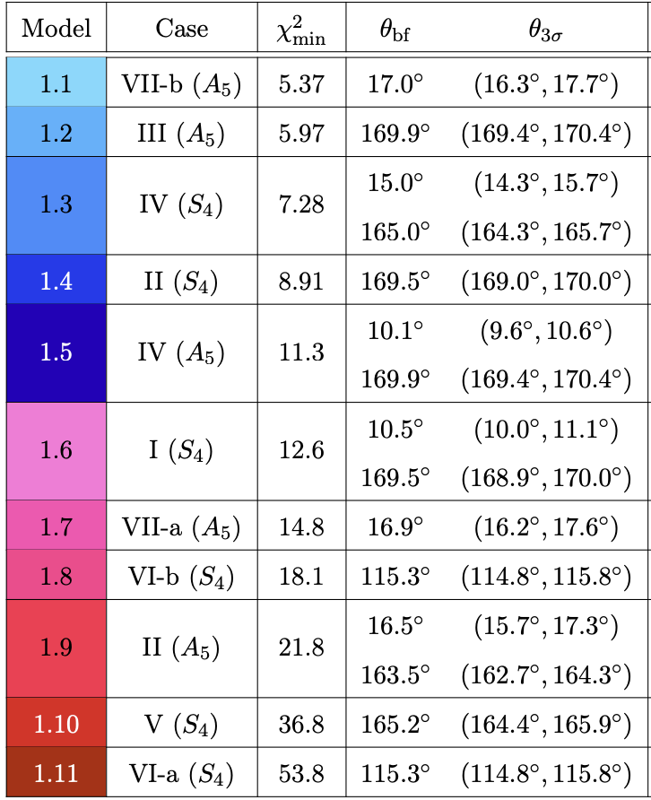
Step 2
Step2: List all the models according to the value of the $χ$² and reject the ones which have very
high values of $χ$² : This excludes the models with respect to the current data
The Models 1.6 – 1.11 are excluded for further analysis
Blennow, MG, Ohlsson and Titov, JHEP 07 (2020), 014

Slide 20
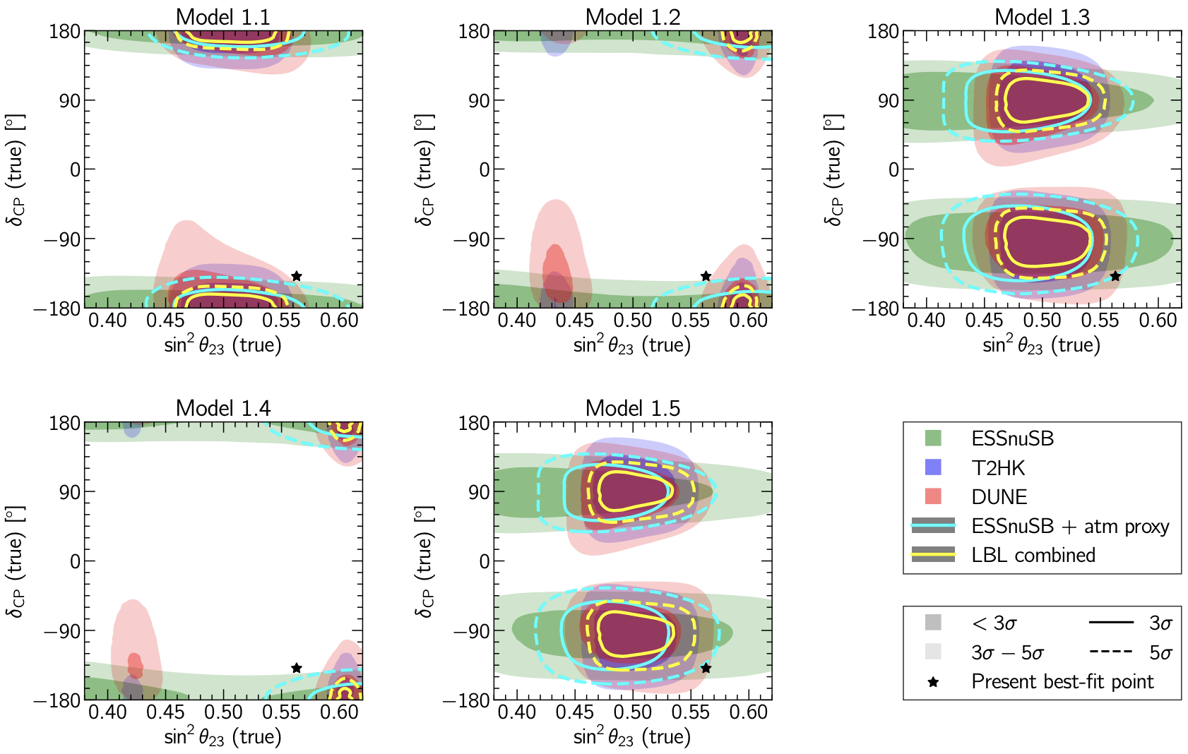
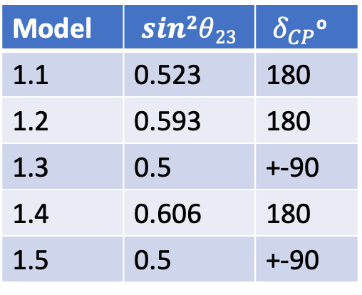
Final step
Final step: Test the survived models in future experiments
Model | $$sin2θ23$$ | ${ δ}_{CP}$º
1.1 | 0.523 | 180
1.2 | 0.593 | 180
1.3 | 0.5 | +-90
1.4 | 0.606 | 180
1.5 | 0.5 | +-90
Depending on the precision, LBL can verify their viability
Blennow, MG, Ohlsson and Titov, Phys. Rev. D 102 (2020), 115004

Slide 21
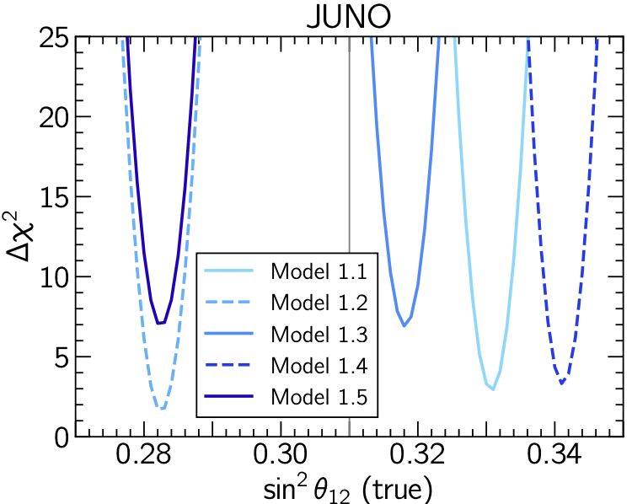
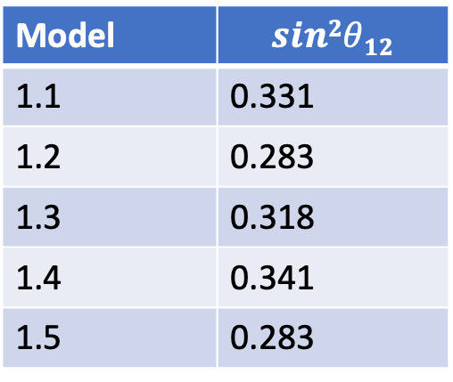
Test in JUNO
Model | $$sin2θ12$$
1.1 | 0.331
1.2 | 0.283
1.3 | 0.318
1.4 | 0.341
1.5 | 0.283
Depending on the precision,
JUNO can exclude all the models
Blennow, MG, Ohlsson and Titov, Phys. Rev. D 102 (2020), 115004

Slide 22
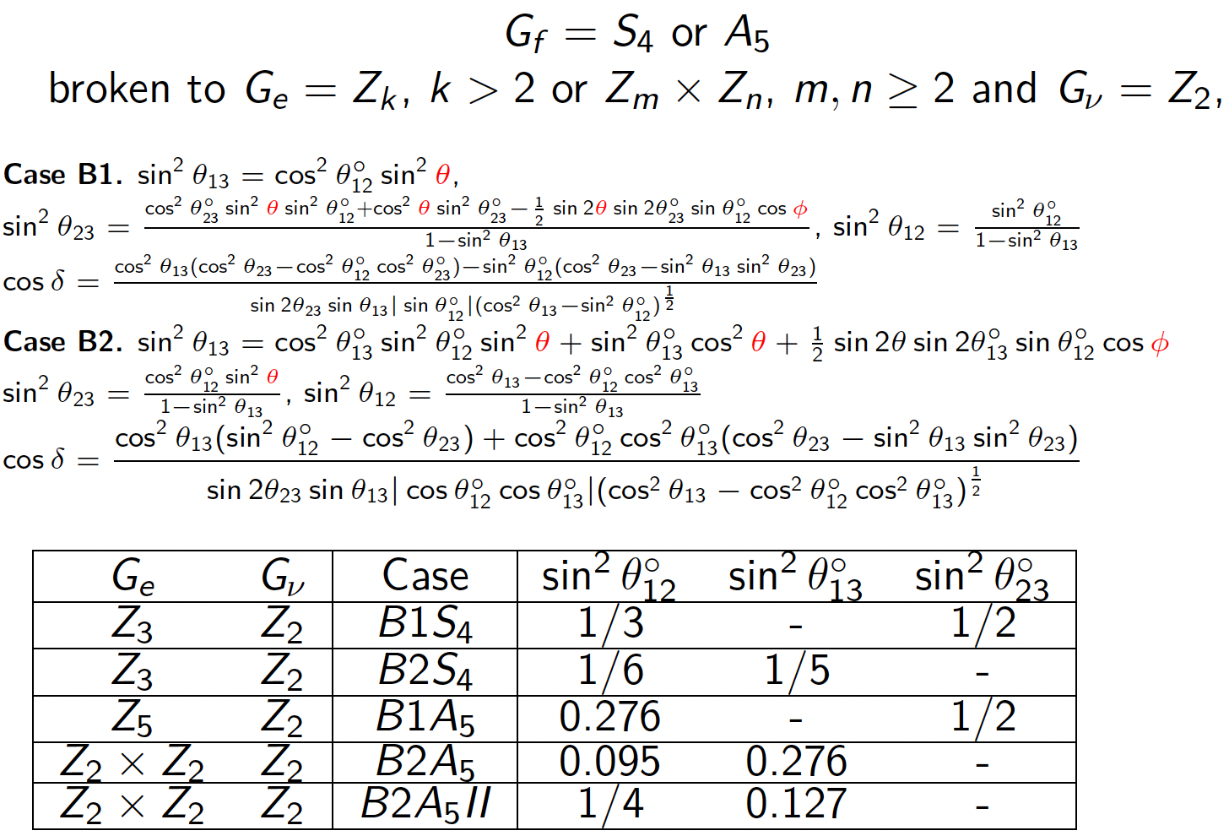
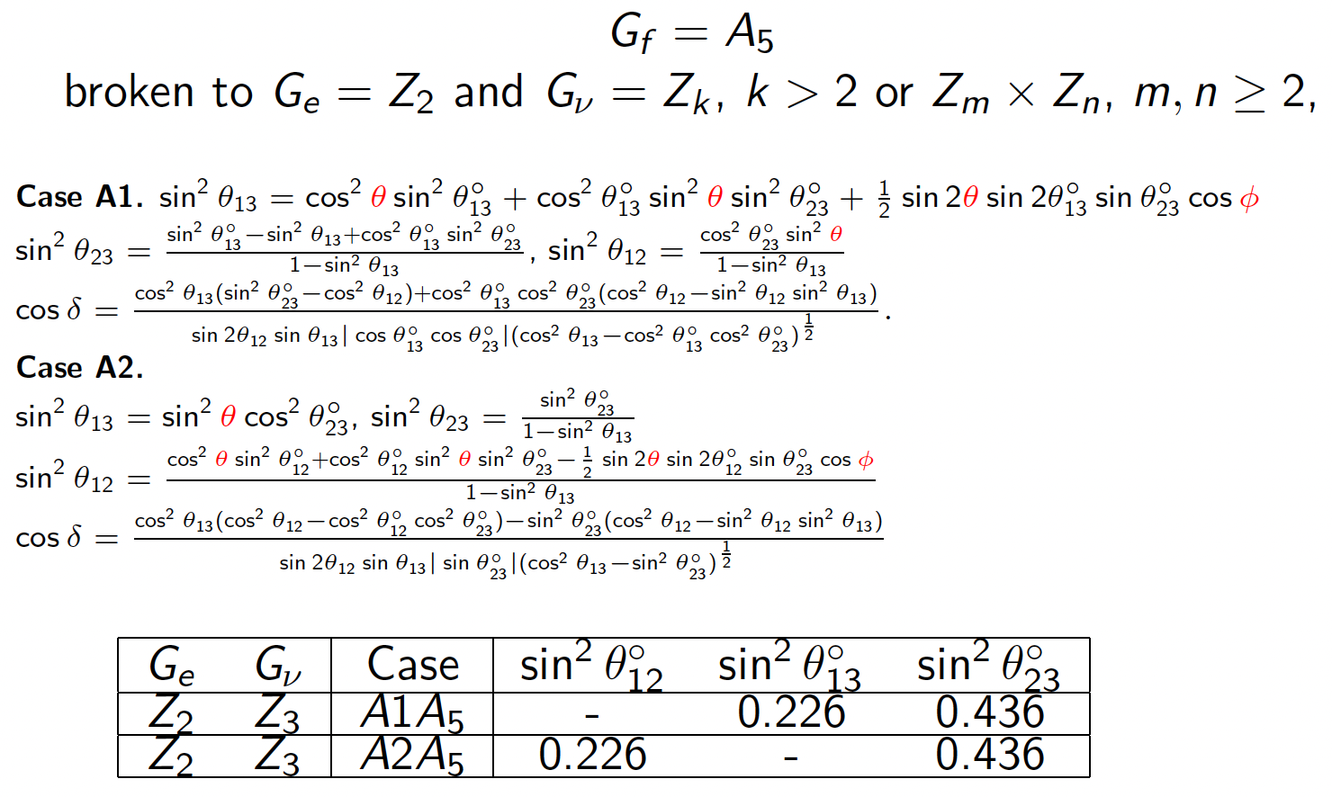
Two parameter models
Sum rule depends only upon two variables
Girardi, Petcov, Stuart and Titov , Nucl. Phys. B902 (2016) 1

Slide 23
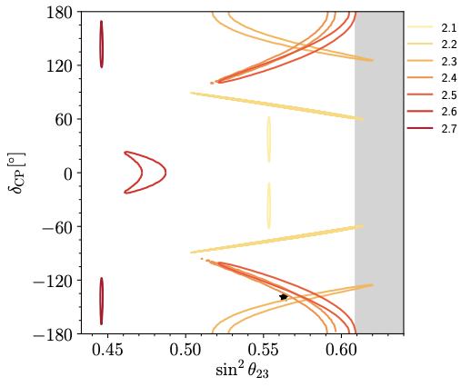
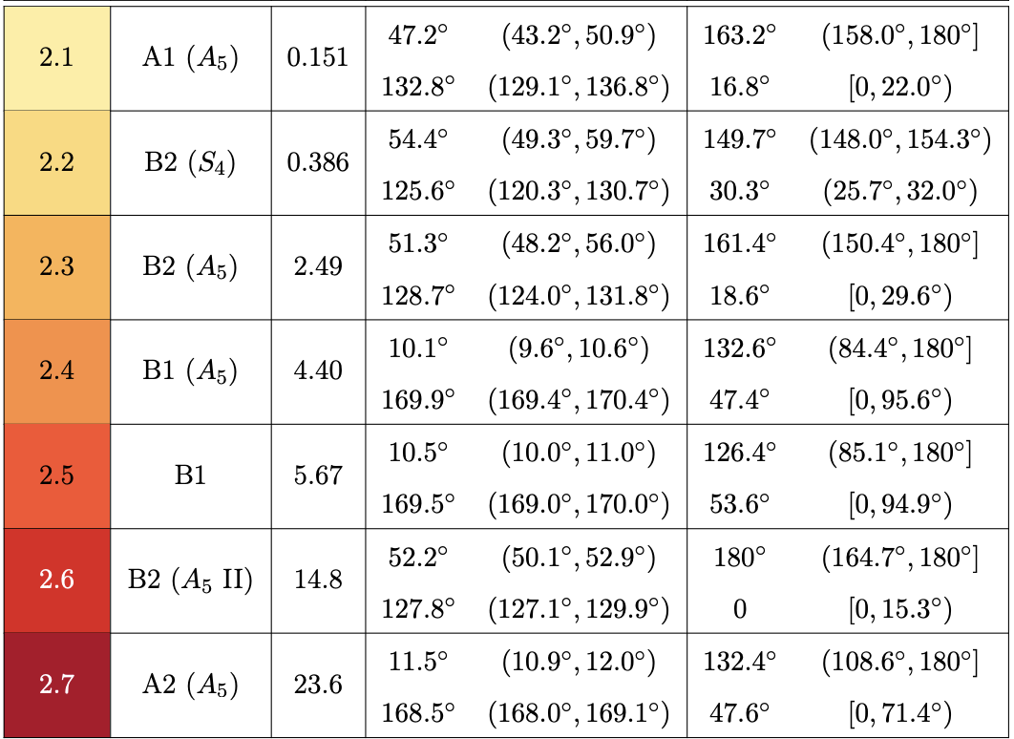
Model predictions
The Models 2.6 – 2.7 are excluded for further analysis
Blennow, MG, Ohlsson and Titov, JHEP 07 (2020), 014

Slide 24
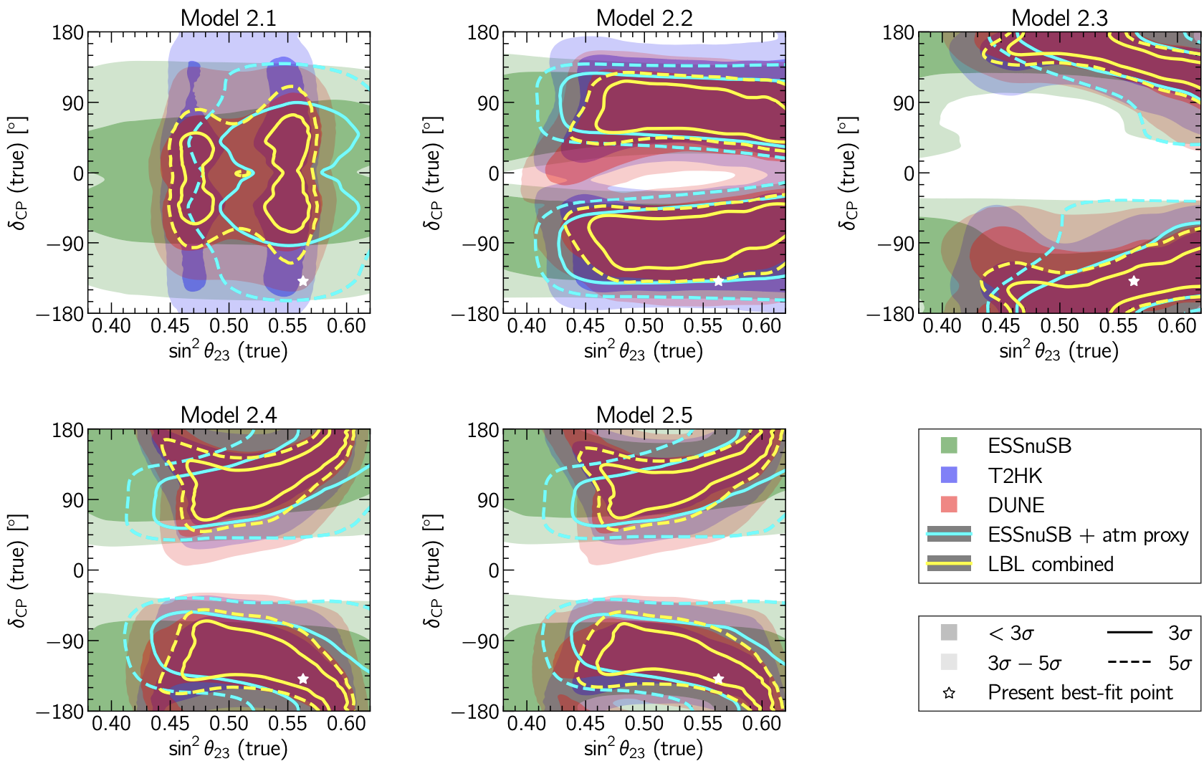
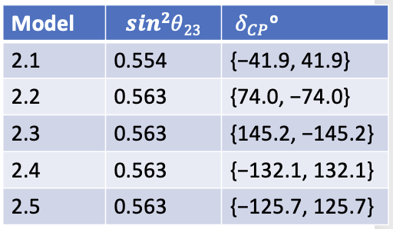
Test in LBL
Difficult to exclude by LBL
Blennow, MG, Ohlsson and Titov, Phys. Rev. D 102 (2020), 115004

Slide 25
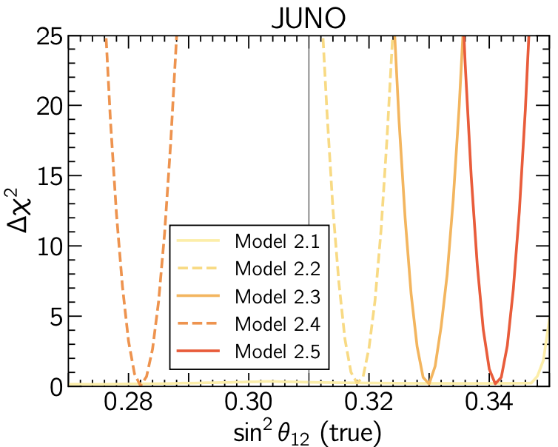
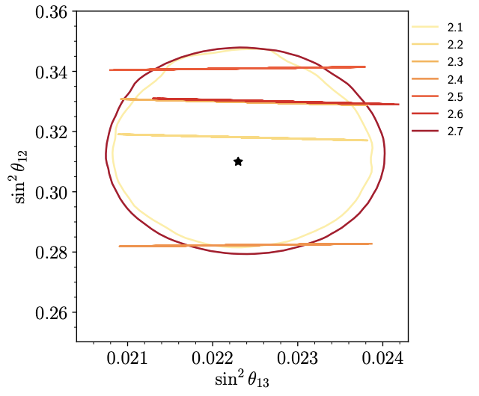
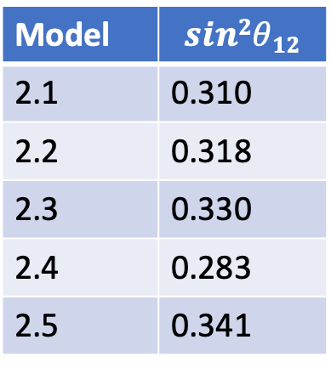
Test in JUNO
Depending on the precision,
JUNO can exclude all the models
Except 2.1 and 2.2 (may be)
Model | $$sin2θ12$$
2.1 | 0.310
2.2 | 0.318
2.3 | 0.330
2.4 | 0.283
2.5 | 0.341
Blennow, MG, Ohlsson and Titov, JHEP 07 (2020), 014, Blennow, MG, Ohlsson and Titov, Phys. Rev. D 102 (2020), 115004

Slide 26
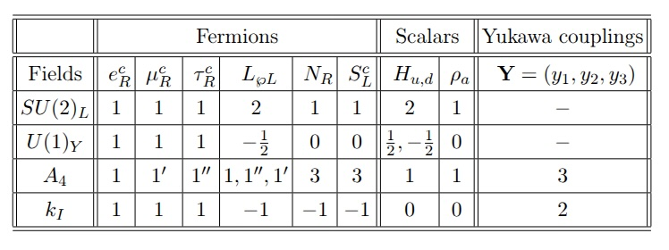
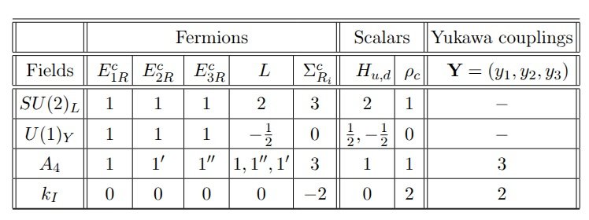
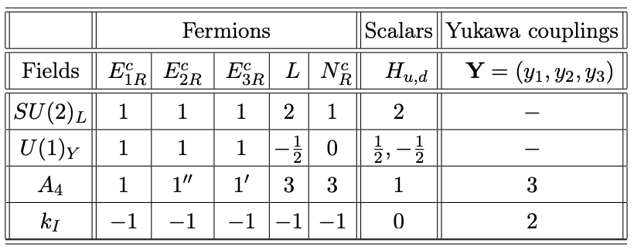
Testing a modular symmetry theory
They need different treatment as generally they don’t give a sum rule
Model A: With linear seesaw
Behera, S. Mishra, Singirala and Mohanta, Phys. Dark Univ. 36 (2022) 101027
3 theories based on A₄ modular symmetry
Model C: With type III seesaw
P. Mishra, Behera, Panda and Mohanta, Eur. Phys. J. C 82 (2022) 1115
Model B: With type I seesaw
F. Feruglio, 1706.08749

Slide 27
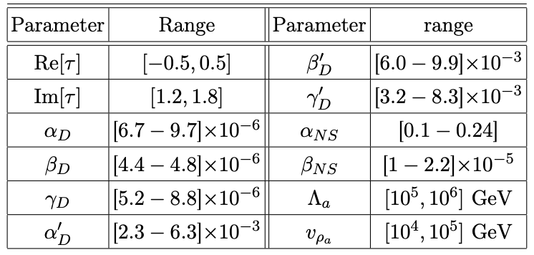
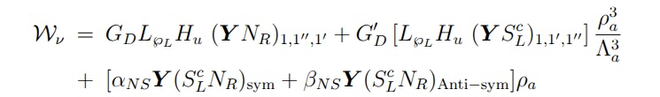

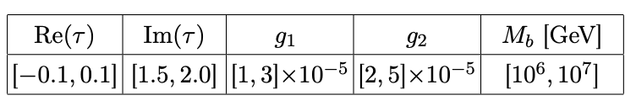
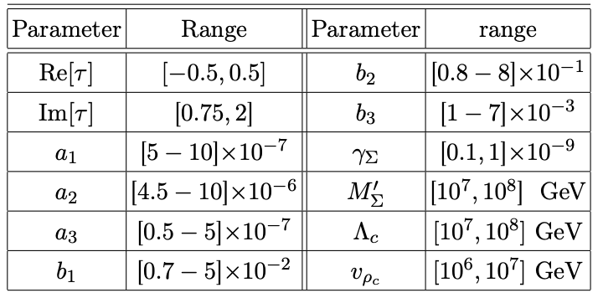
Model predictions
Parameter ranges for Model A
Parameter ranges for Model B
g term gives two invariant singlets g₁and g₂
Parameter ranges for Model C
Model A and C: predict normal mass ordering
Model B: Predicts inverted mass ordering
Mishra, Behera, Panda, MG and Mohanta, JHEP 09 (2023), 144

Slide 28
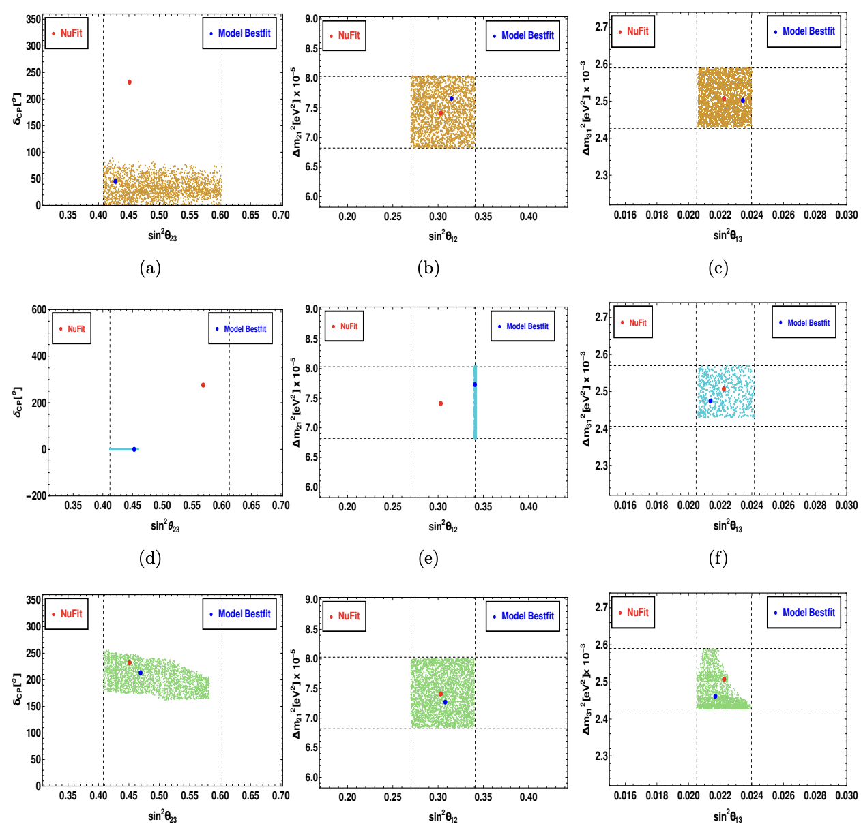
Allowed parameter space
Model A
Model B
Model C

Slide 29
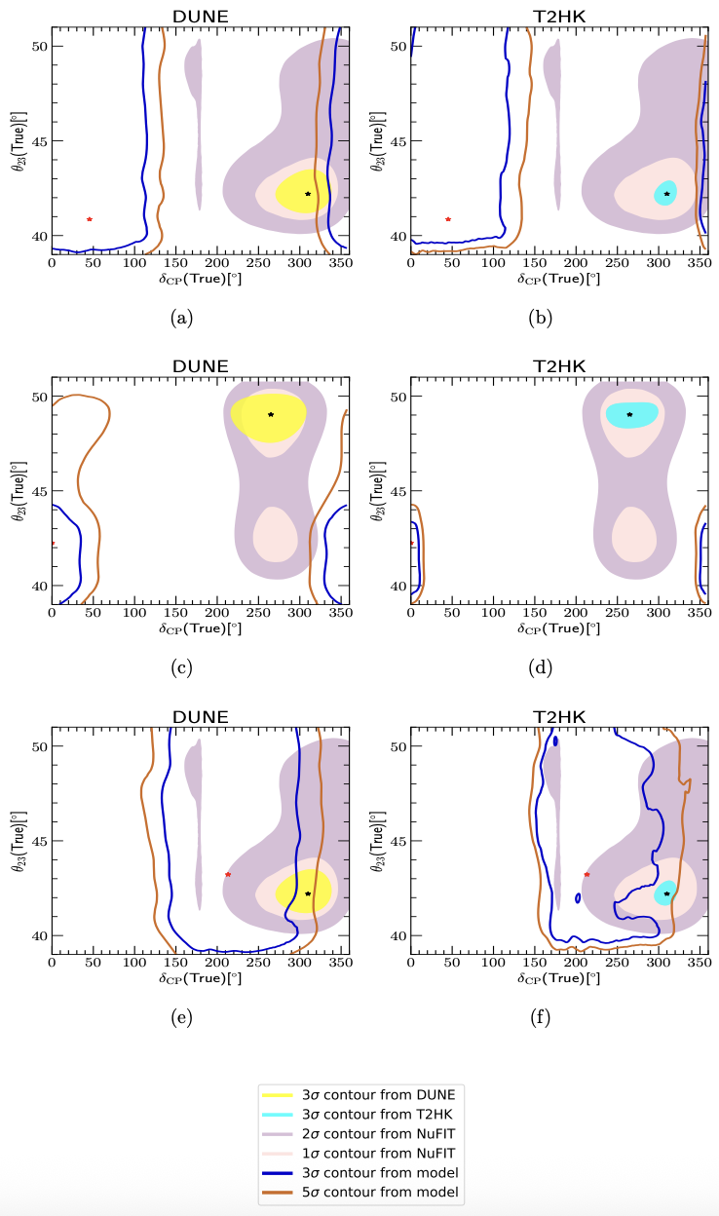
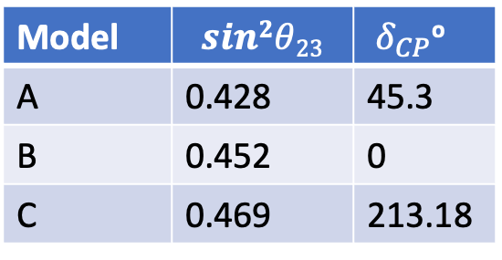
Tests in LBL
Model | $$sin2θ23$$ | ${ δ}_{CP}$º
A | 0.428 | 45.3
B | 0.452 | 0
C | 0.469 | 213.18
Models can be severely constrained
Mishra, Behera, Panda, MG and Mohanta, JHEP 09 (2023), 144

Slide 30
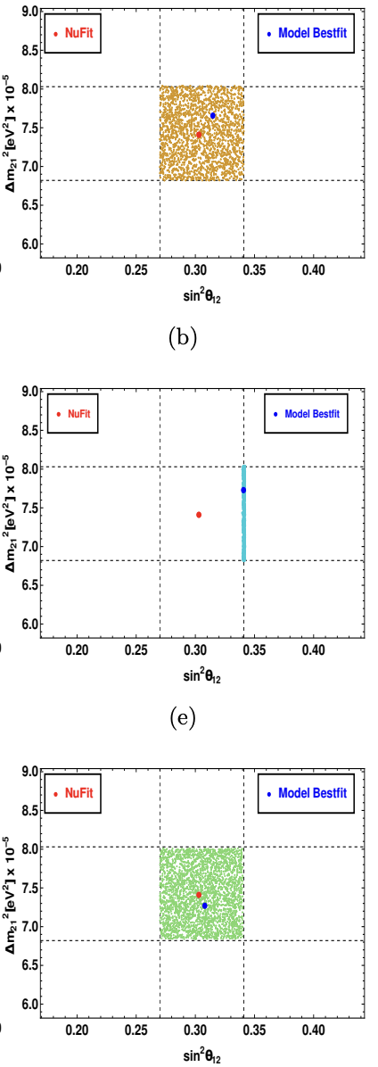


Test in JUNO
JUNO can exclude Model B
Model | $$sin2θ12$$
A | 0.315
B | 0.340
C | 0.308
Mishra, Behera, Panda, MG and Mohanta, JHEP 09 (2023), 144

Slide 31

Further test: Seprating Model-A from Model-B
Model A has assumed to be true model
and Model B is under test
Blue and brown regions are the allowed
region for Model-A at 3σ C.L and 5 σ C.L.
Green region corresponds to the parameter
space for which Model-B cannot be separated
from Model-A at 3σ C.L
Mishra, Behera, Panda, MG and Mohanta, JHEP 09 (2023), 144

Slide 32
Summary
Flavour/modular symmetry theories predict values of the mixing parameters which are allowed by the data
Future experiments will measure the mixing parameters with sub percent precision
Therefore, these models can be tested in these experiments
ESSnuSB, T2HK, DUNE and JUNO will play a major role in validating these models.

Slide 33
Summary
Flavour/modular symmetry theories predict values of the mixing parameters which are allowed by the data
Future experiments will measure the mixing parameters with sub percent precision
Therefore, these models can be tested in these experiments
ESSnuSB, T2HK, DUNE and JUNO will play a major role in validating these models.
Thank You

