Slide 1
Field Cages Validation with the GIN Detector
Biondi, G. Dho, G. Mazzitelli
27/06/2024

Slide 2
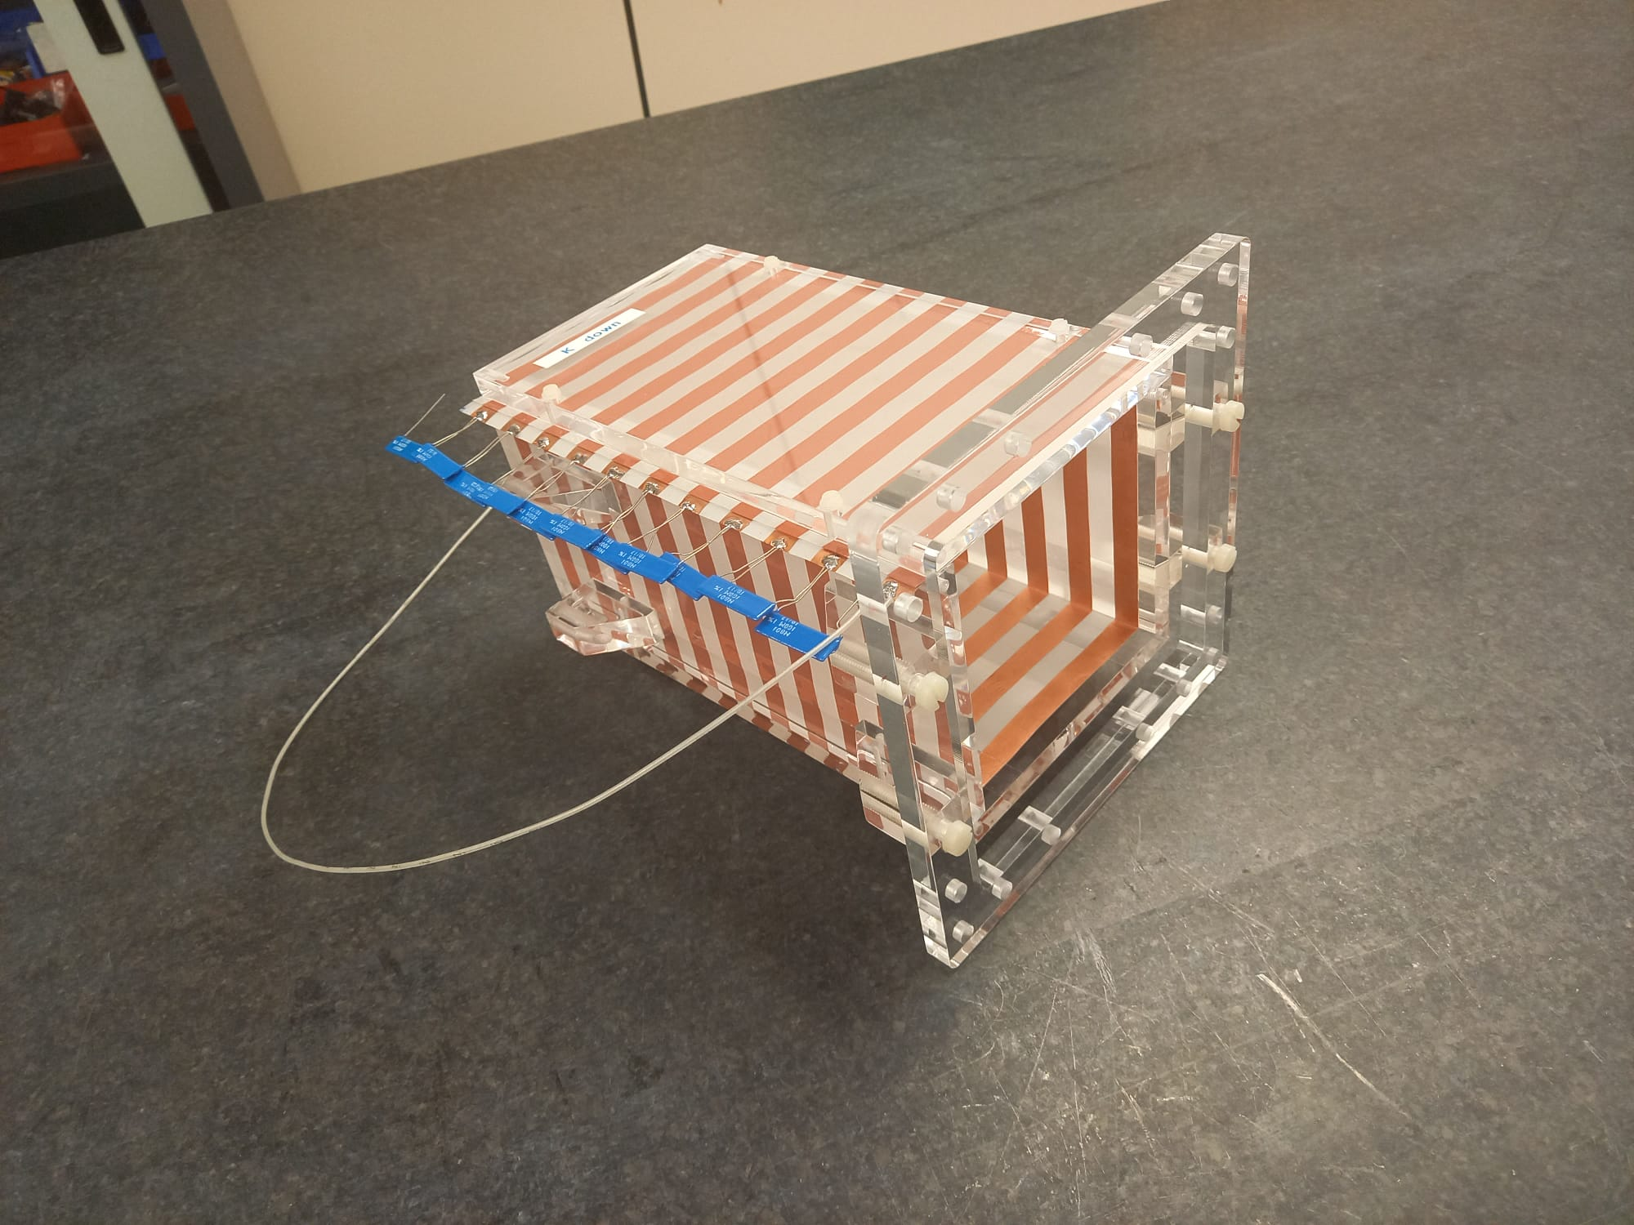
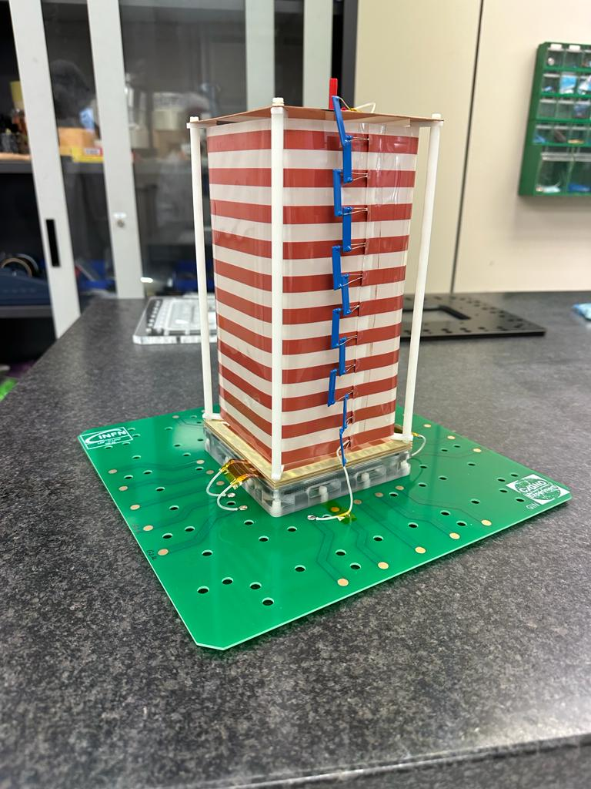
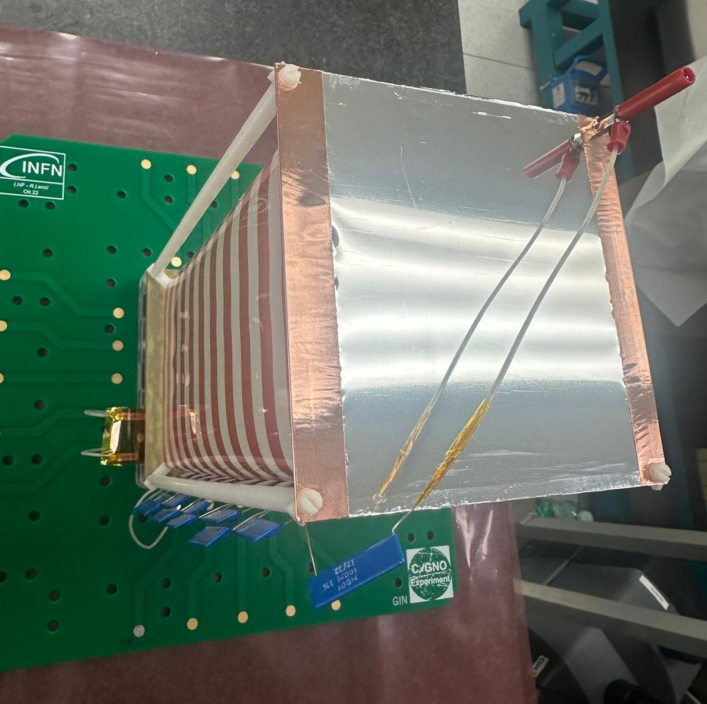
EXPERIMENTAL SETUP
"Glued" Field Cage with Cu Cathode
"Ethereal" Field Cage with Cu Cathode
"Ethereal" Field Cage with Aluminized Mylar Cathode

Slide 3
GLUED FC WITH CU CATHODE
FC Characteristics:
Glued on PVC
Four indepent panels glued (one per side)
Electric contact when glued together
Cathode Characteristics:
Made of well-levigated Copper
Simple construction
Named C0
Measure Plan:
Unstable, impossible to take measures in controlled conditions

Slide 4
ETHEREAL FC WITH CU CATHODE
FC Characteristics:
Rolled up on DELRIN Pillars
Glued to itself
Not connected to PVC
Measure Plan:
Studied Light Yield with ⁵⁵Fe Source scanning VGEM, Drift Field and Source Position
Field Cage map with muons and natural radioactivity

Slide 5
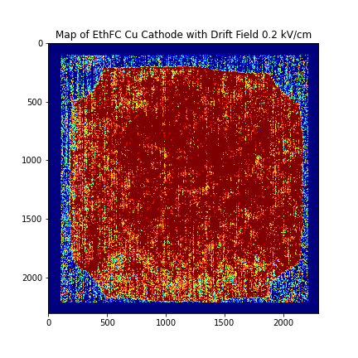
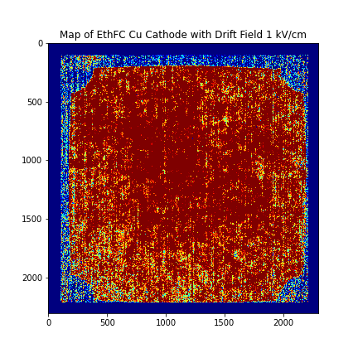
ETHEREAL w/C0 – FC MAP I

Slide 6
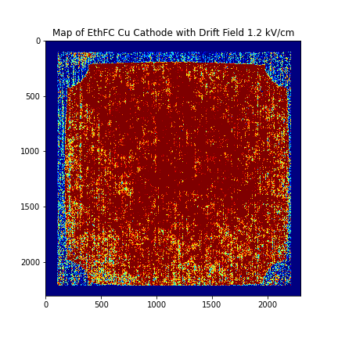
ETHEREAL w/C0 – FC MAP II
Borders more defined with higher fields
Corners disuniformity due to FC shape
Up-Down disuniformity <10%, known from LIME
Right-Left disuniformity < 5%
Compliant with uniformity requirements

Slide 7
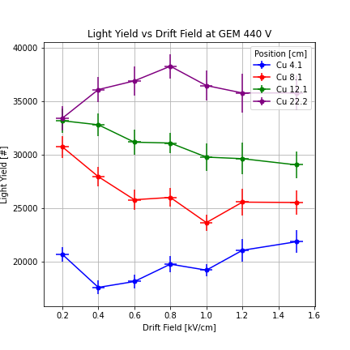
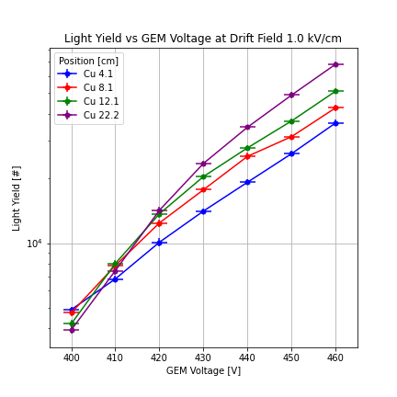
ETHEREAL w/C0 – LIGHT YIELD I

Slide 8
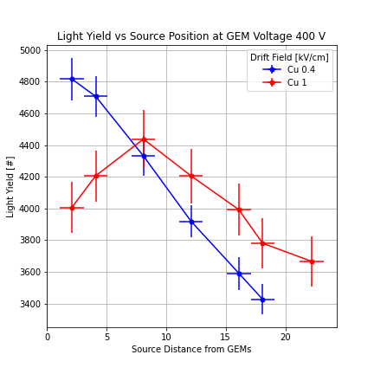
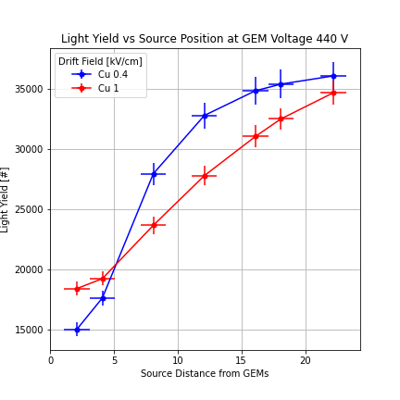
ETHEREAL w/C0 – LIGHT YIELD II

Slide 9
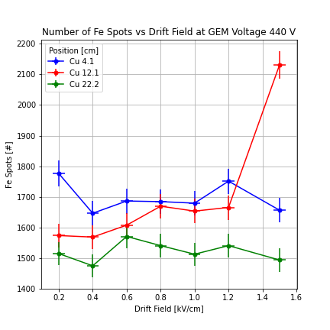
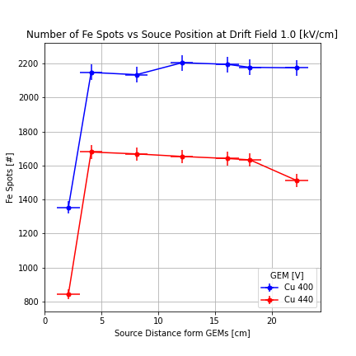
ETHEREAL w/C0 – Fe SPOTS

Slide 10
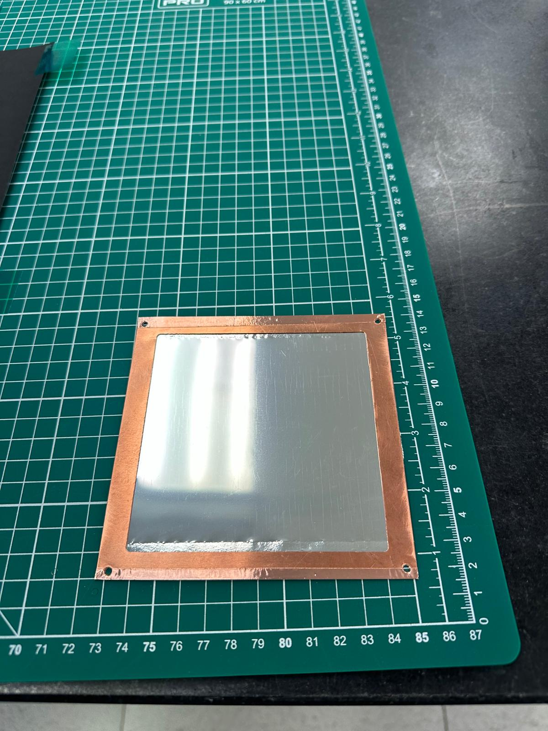
ETHEREAL FC W/ Al MYLAR CATHODE
Cathode Characteristics:
0.9 µm Aluminized Mylar film
Inspired by DRIFT collaboration
Shape which can reduce Radon attaching
Copper tabs for electric contacts
Named C1
Measure Plan:
Studied Light Yield with ⁵⁵Fe Source scanning VGEM, Drift Field and Source Position
Field Cage map with muons and natural radioactivity

Slide 11
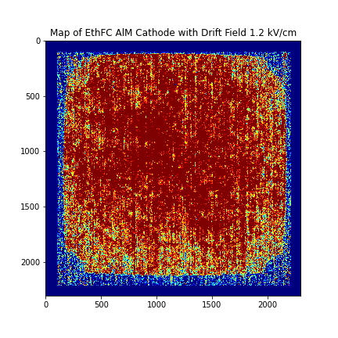
CATHODES COMPARISON - MAP

Slide 12
CATHODES COMPARISON - MAP II
C1 Cathode Disuniformities:
Up-Down < 10%
Right-Left < 5%
C0 Map has 12% more light than C1 Map
More precise estimation of disuniformities in ongoing

Slide 13
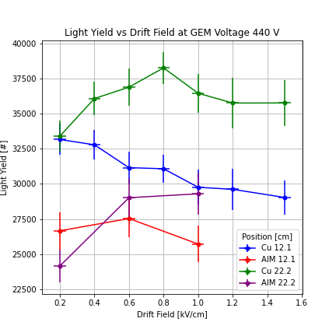
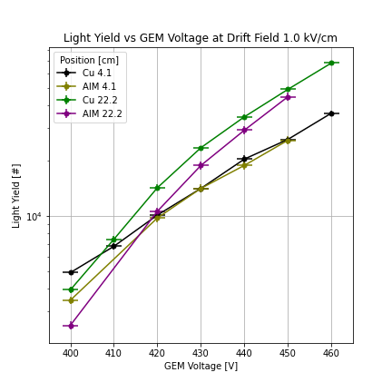
CATHODES COMPARISON – LY I

Slide 14
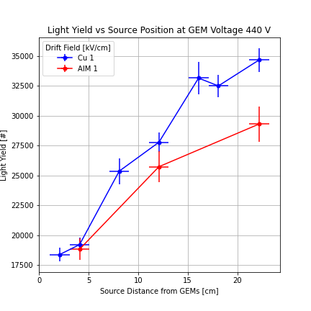
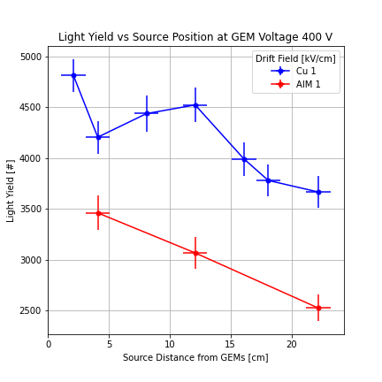
CATHODES COMPARISON – LY II

Slide 15
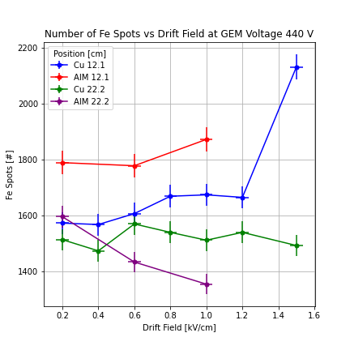
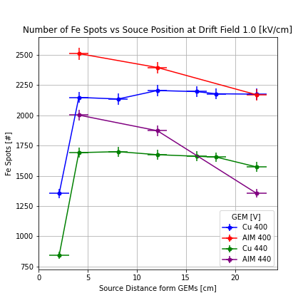
CATHODES COMPARISON – Fe SPOTS

Slide 16
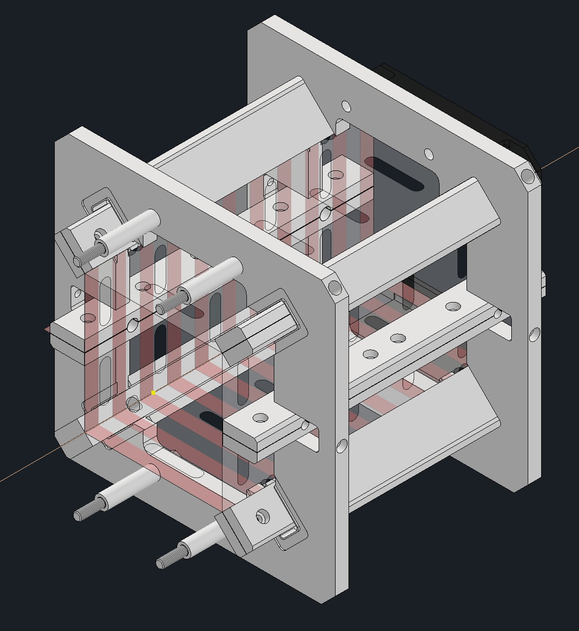
FIELD CAGE P3
Enhanced version of Ethereal Field Cage
Currently in Production at LNF
Will be tested soon

Slide 17
CONCLUSIONS AND OUTLOOKS
Conclusions:
The Glued Field Cage is unstable and should be rejected for CYGNO04
The Ethereal Field Cage can be considered as validated as is compliant with uniformity requiments
Both C0 and C1 cathodes are stable and provide reliable field
Outlooks:
Aging test is ongoing for the components, can help to understand the instability of Glued FC
C1 Cathode seem to provide little less uniform field: test are ongoing for further understanding
Up to now C0 Cathode is preferred

Slide 18
BACKUP / ETH CU MEASURE PLAN
Measure Plan:
Fixing Drift Field at 1 kV and scanning GEM Voltage from 400V to 460V
Fixing GEM at 440V and scanning Drift Field from 0.2 to 1.5 kV/cm
Same scan at GEM 400V
Scan of 7 Positions for Fe Source (2.1 to 22.2 cm from GEMs)
Camera Exposure: 0.15 s for Short Exposures and 0.18s for Long Exposures

Slide 19
BACKUP / ETH AlM MEASURE PLAN
Measure Plan:
Positions: 2.1 cm, 12.1 cm, 22.2 cm from GEMs
Field Values: 0.2, 0.6, 1 kV/cm taken at 400V and 440V
GEM Voltages: 400 to 450
Cathode capable of working up to 1.3 kV/cm, but no measures taken due to conditioning
Camera Exposure: 0.15 s for Short Exposures and 0.18s for Long Exposures

Slide 20
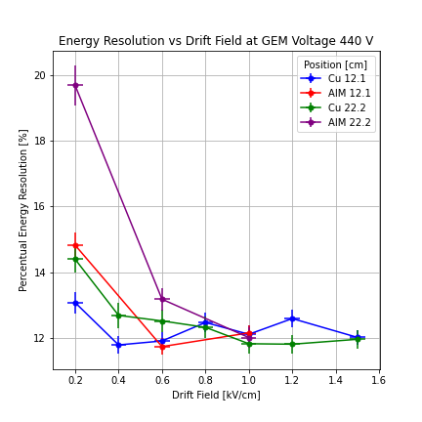
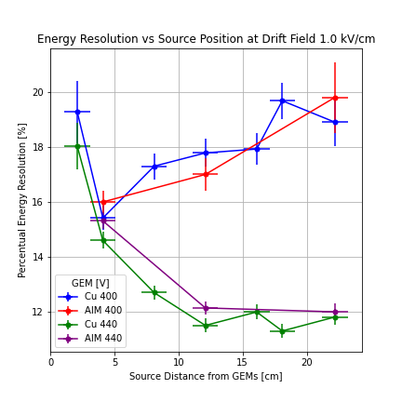
BACKUP /CATHODES COMPARISON - ER

Slide 21
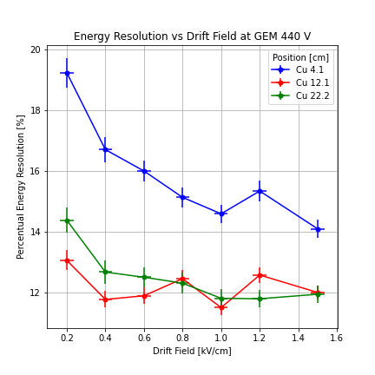
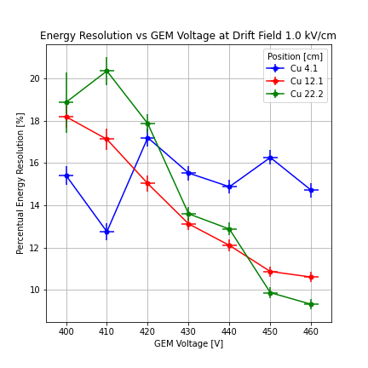
BACKUP / ETHEREAL w/CU – ENERGY RESOLUTION

Slide 22
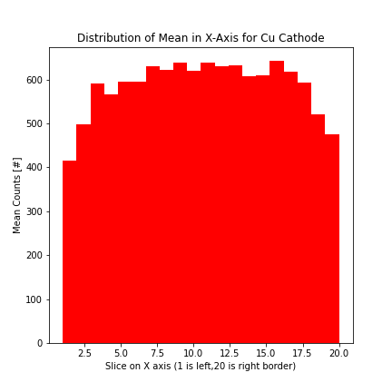
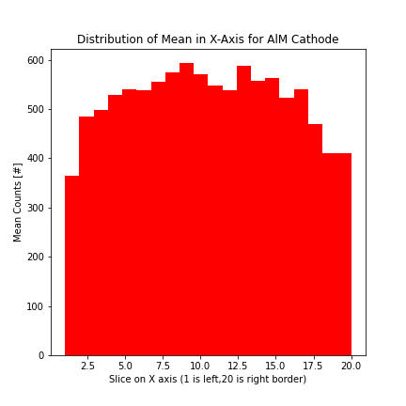
BACKUP / PROJECTIONS OF MAPS (X-AXIS MEAN)

Slide 23
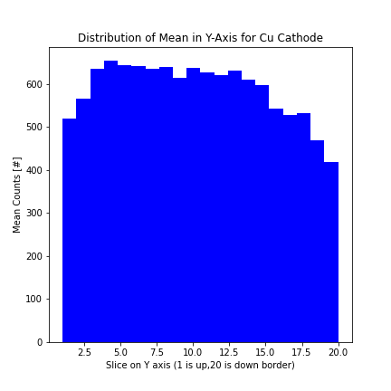
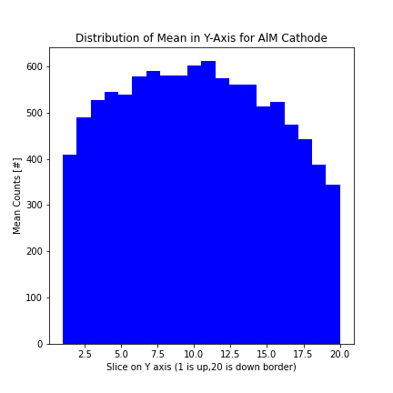
BACKUP / PROJECTIONS OF MAPS (Y-AXIS MEAN)

Slide 24
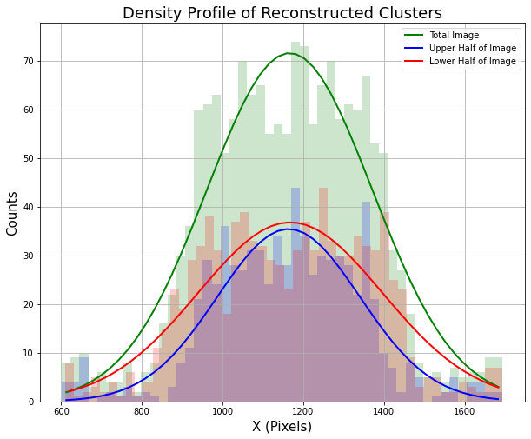
BACKUP / UNCERTAINTY ON SOURCE POS

