Slide 1
CTA
Giovanni Marsella
On behalf of CTA group
Dipartimento di Fisica e Chimica
Università degli studi di Palermo e INFN sez. Catania

Slide 2
CTA Consortium

Slide 3
CTA Design

Slide 5
Attività Multimessenger

Slide 7
CTA+
Progetto presentato per € 89.243.506,60
Approvato per € 71.477.540,83
Costruzione di 2 LST, 5 SST per il sito Sud (Cile) e un WP di R&D

Slide 8
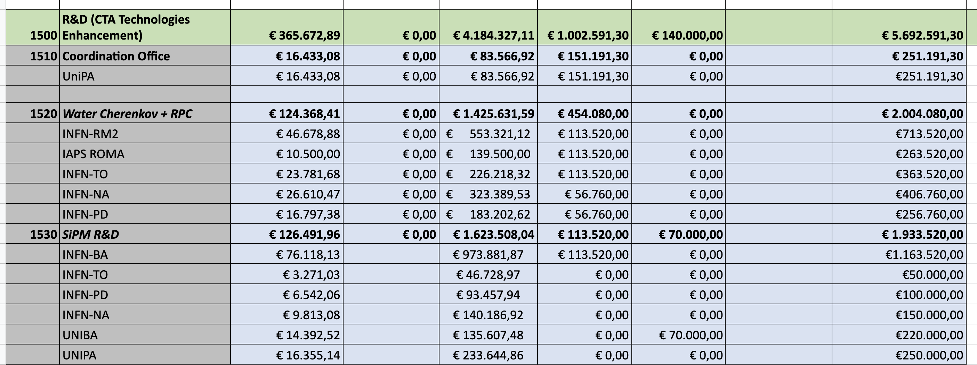
CTA+ WP R&D

Slide 9
CTA+ WP Science

Slide 10
Anagrafica 2025
PNRR
PNRR
+n. rtd_b Unipa
PNRR
PNRR

Slide 11
Richieste 2025
Descrizione | Richieste (Keuro) | SJ | Assegnate | Totale (Keuro)
Missioni | 20 |  |  | 20
Consumi | 10 |  |  | 10
Inventariabile | 15 |  |  | 15
Totale | 45 |  |  | 45
- Missioni: Turni presa dati (La Palma e Arizona), meeting di collaborazione
- Consumi: materiale per laboratorio
- Inventariabile: Sistema per fare in automatico le curve IV dei SiPM (picommaetro)
Da Definire!

Slide 12
Bakup

Slide 13
Articoli e presentazioni a conferenze
Poster at Pisa Meeting 2022: «Quality control tests on the new front-end electronics for the Schwarzschild-Couder Telescope»
Technical article: «High Density Near Ultraviolet Silicon Photomultipliers: characterization of photosensors for Cherenkov light detection» Submitted to NIMA
SCT Coll.: «Assembly and performance of SiPM arrays for the prototype SCT proposed for CTA» Submitted to NIMA
SCT Coll.: «Technical and scientific performance of the prototype Schwarzschild-Couder Telescope for CTA», Proceedings of SPIE - The International Society for Optical EngineeringVolume 118202021 Article number 118200°
SCT Coll.: «Design and performance of the prototype Schwarzschild-Couder telescope camera», Journal of Astronomical Telescopes, Instruments, and SystemsOpen AccessVolume 8, Issue 11 January 2022 Article number 014007

Slide 16
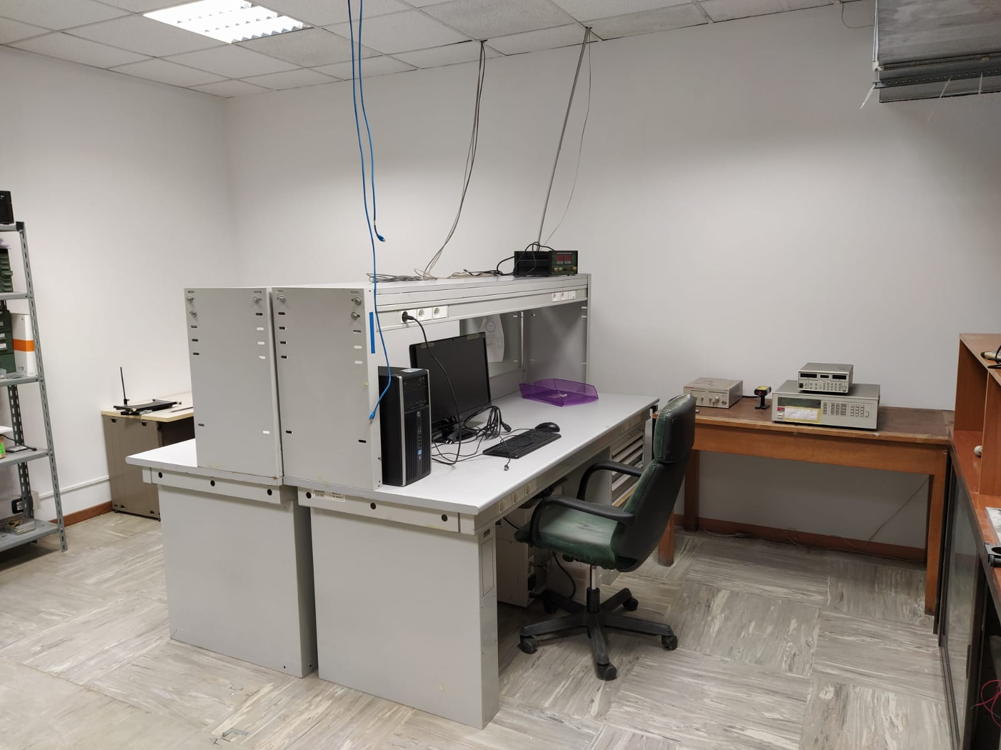
Ongoing activities in Catania
Experimental setup
Optical bench
Front-end electronics
Data Acquisition
Measurements
Break-down voltage
Dark Count Rate
Gain
Data Analysis
New CTA-Lab in CT

Slide 17
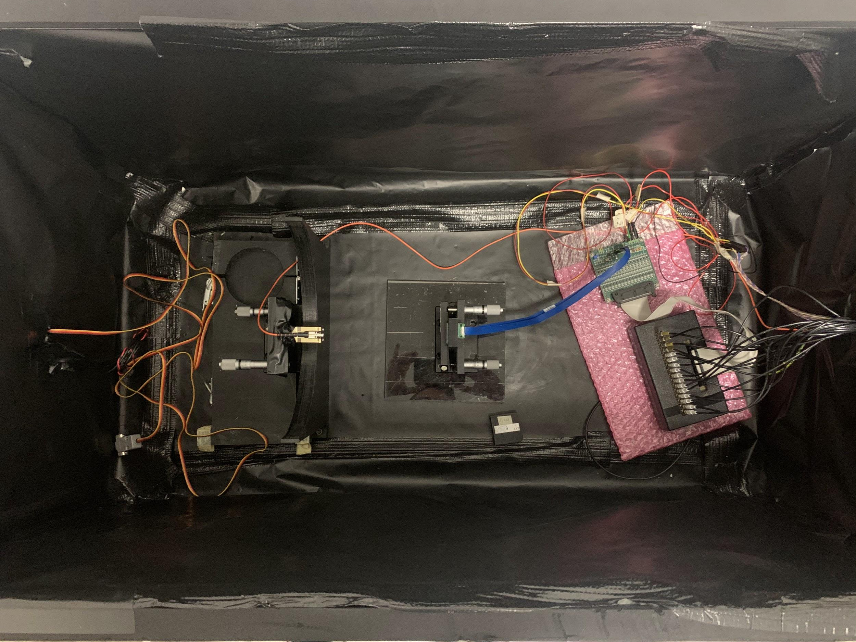
Setup
Dark box 45 x 90 cm
Samba - Leukos laser: wavelength 350 nm - 2400 nm, pulsed, fixed amplitude
Bebop - Leukos monochromator: 350-850 nm, Δλ = 5 nm - 100 nm
Programmable Power supply Agilent 6626A , 4 channels
SiPM NUV-HD3 FBK 4x4 (40 μm, 6x6 mm²)
Custom amplifier board 16 channels
Digitizer CAEN DT5742B - 16 channels, 5 GSa/s
Labview-based DAQ
Dark Box
SiPM Matrix
Amplifier board
Digitizer
Laser
Monochromator
Diffuser
trigger

Slide 18
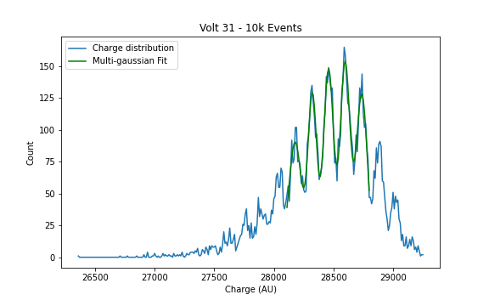
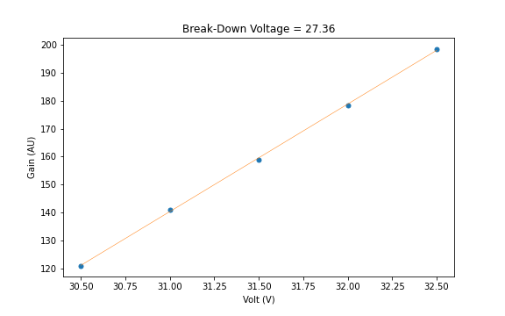
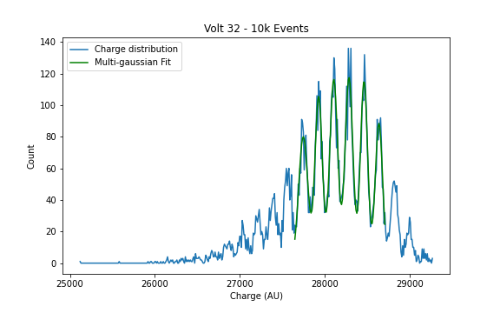
Gain vs HV (with HV 30.5 - 32.5 V step 0.5 V)

Slide 19
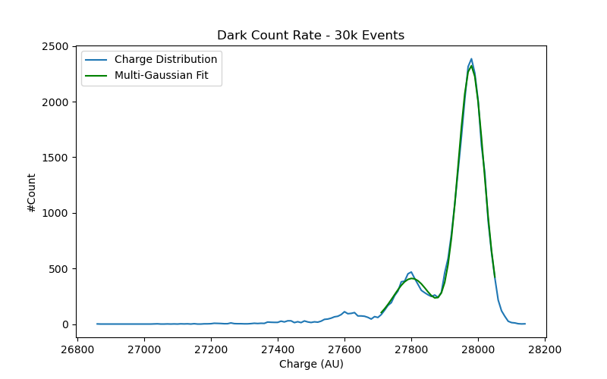
Dark

Slide 20
Contribution on MC task
G. Manicò
Using importance sampling in Monte Carlo simulations we can reduce the variance.
Some random values in a simulation have more impact than others on the parameter being estimated.
Emphasizing these values by sampling more frequently we can obtain variance reduction.
Hence, the basic methodology in importance sampling is to choose a distribution which "encourages" the important values.

Slide 21
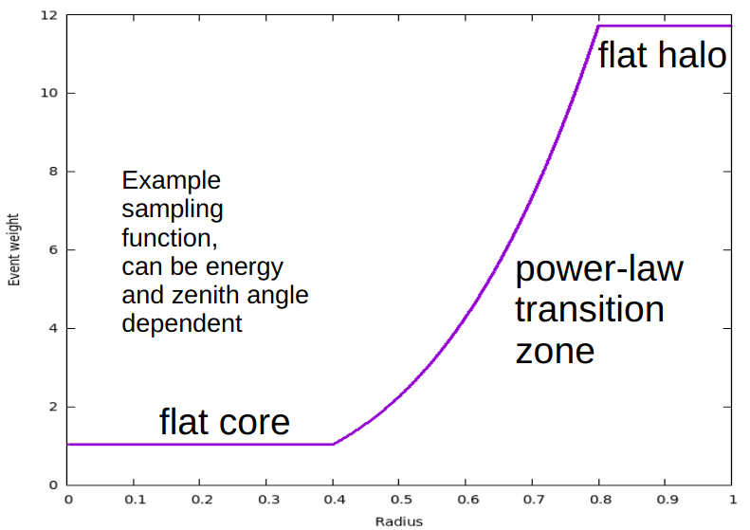
IS in Corsika/IACT
(From K. Bernlohr’s talk: «Importance sampling etc. in Corsika/IACT
simulations», CTA ASWG telecon, 2021-02-03)

