Slide 1

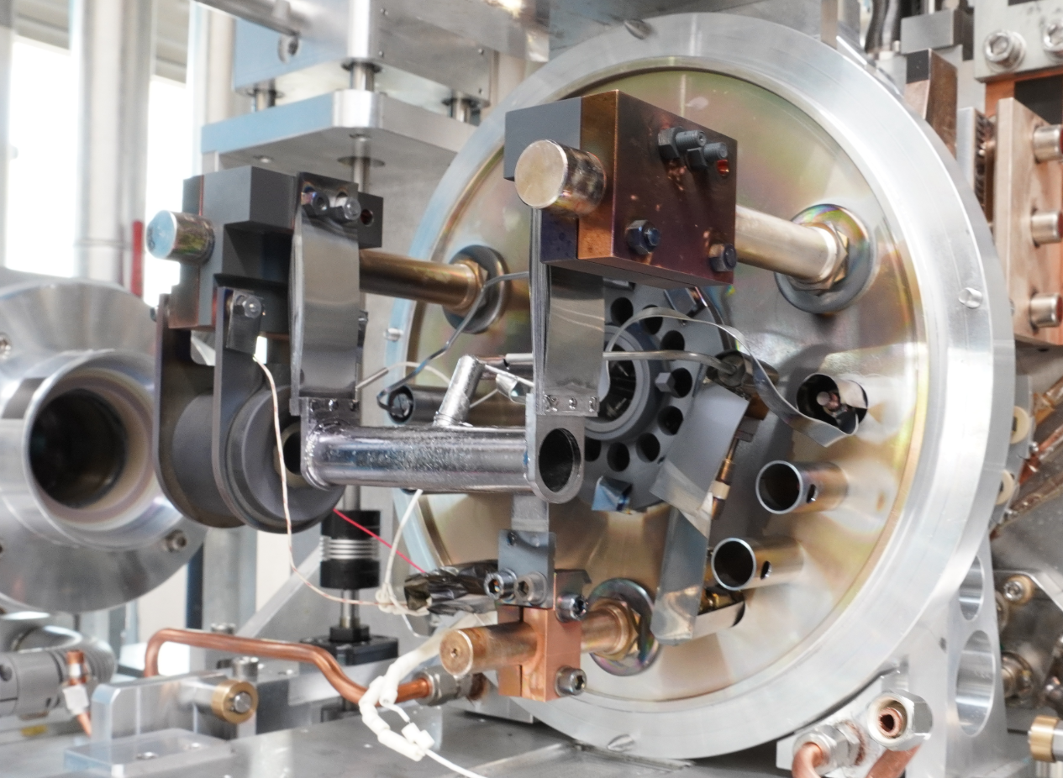
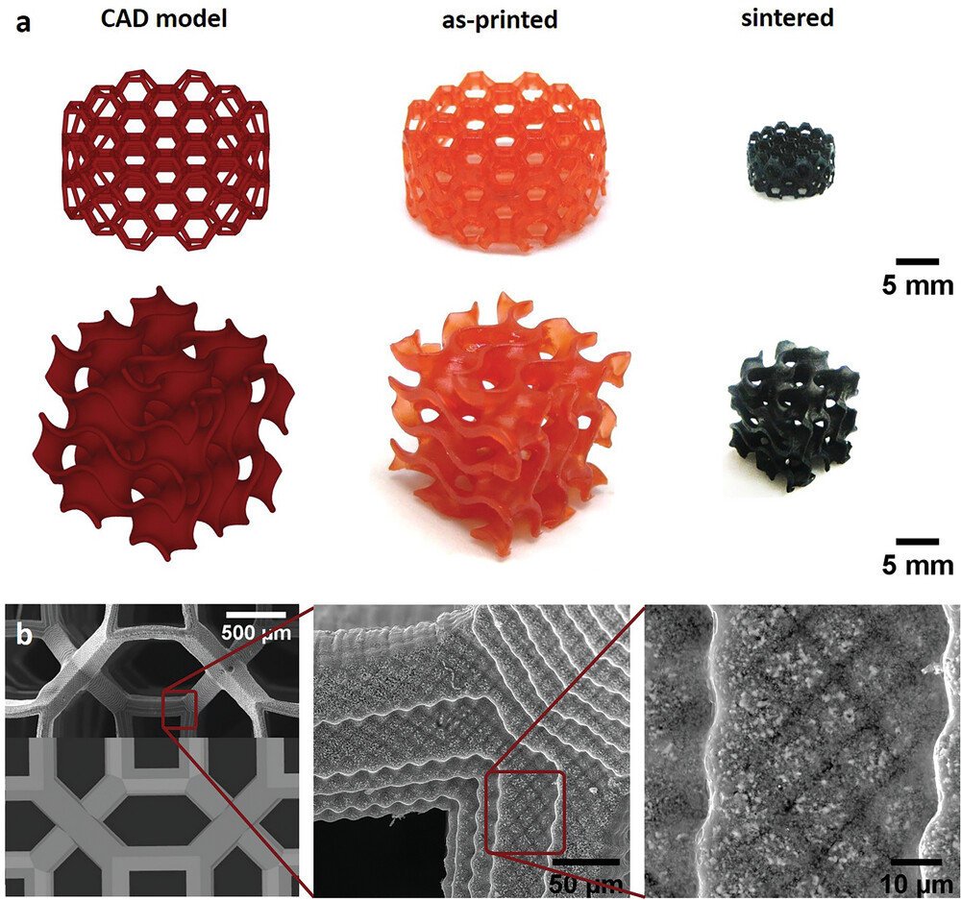
HISOL_NEXT
Development of High performance ISOL target – ion source systems for the NEXT on-line operation at SPES
HISOL meeting, Legnaro National Laboratories
01/07/2024

Slide 2
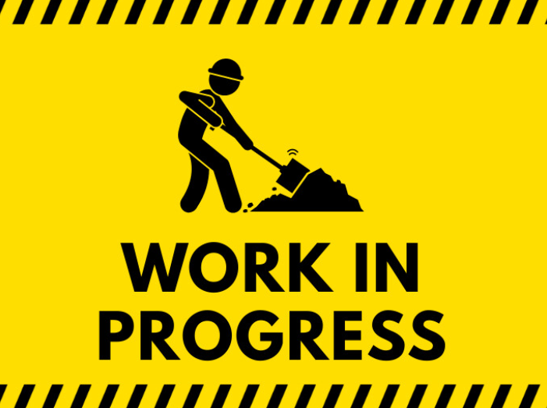
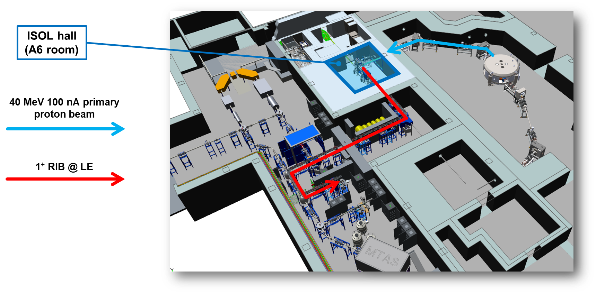
General notes
DECEMBER 2024 - SPES commissioning, phase 2: irradiation of the SPES ISOL target @ bunker 1
Regular irradiations at SPES for the years 2025, 2026, 2027 > 2025-2027 is the HISOL_NEXT timewindow!

Slide 3
General notes
titolo: HISOL_NEXT (development of High performance ISOL target – ion source systems for the NEXT on-line operation at SPES)
tema: The HISOL_NEXT experiment is designed to continue and finalize the development of ISOL target – ion source systems that began with the HISOL experiment. The goal is to make these systems available for the online commissioning campaign of the ISOL SPES facility.
sezioni partecipanti: INFN-LNL, INFN-PD, INFN-PV
budget: continuità con HISOL
durata: 3 anni

Slide 4
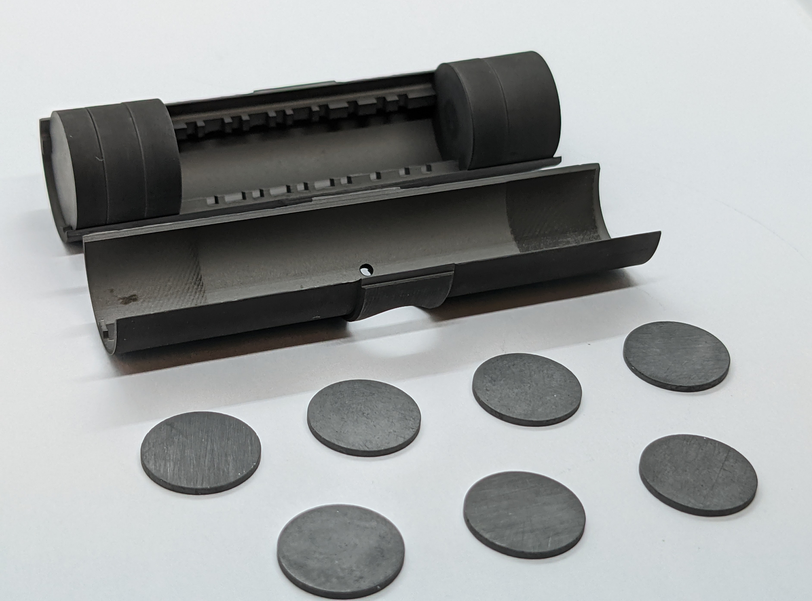
WP1: targets
Manufacturing, preparation and characterization of a standard ISOL target and on-line testing
Manufacturing, preparation and characterization of a High Performance ISOL target and on-line testing
COMPARISON

Slide 5
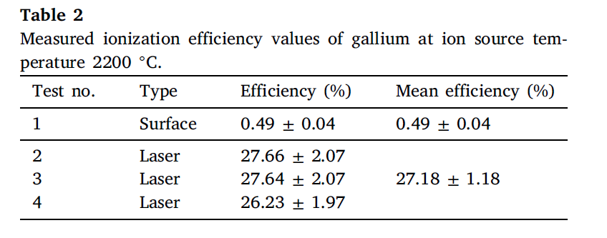
WP2: ion sources
Finalization of the SPES FEBIAD ion source design and on-line testing
Improvement of the SPES hot-cavity ion source for surface and laser ionization and on-line testing

Slide 6
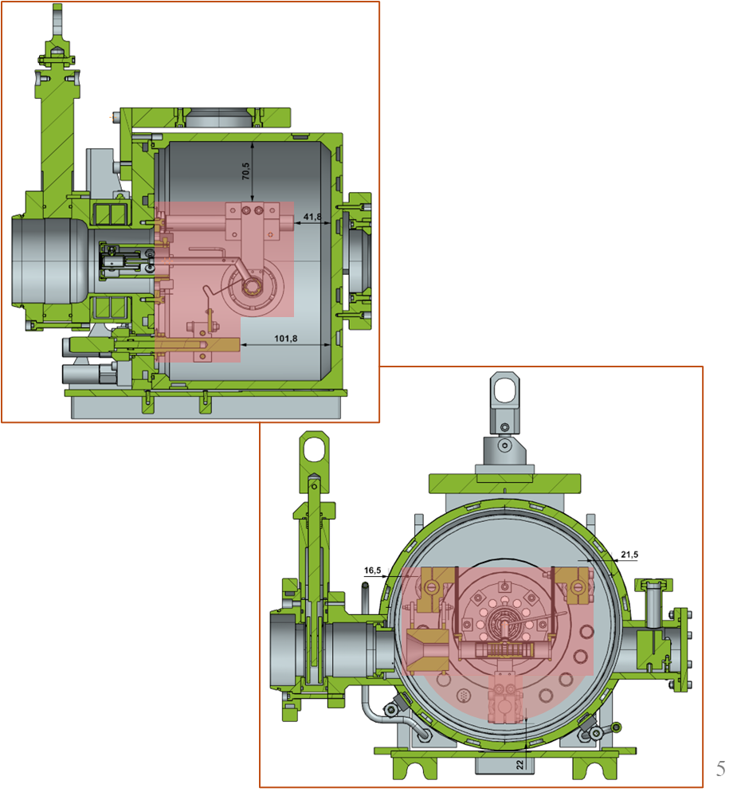
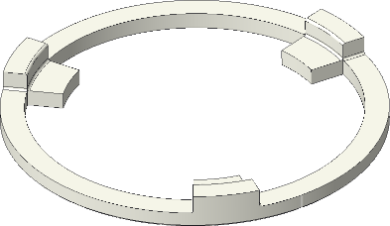
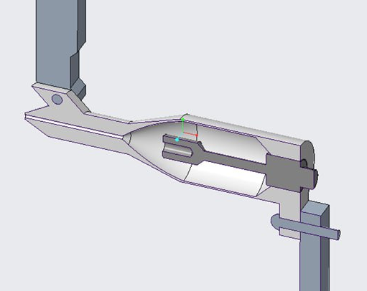
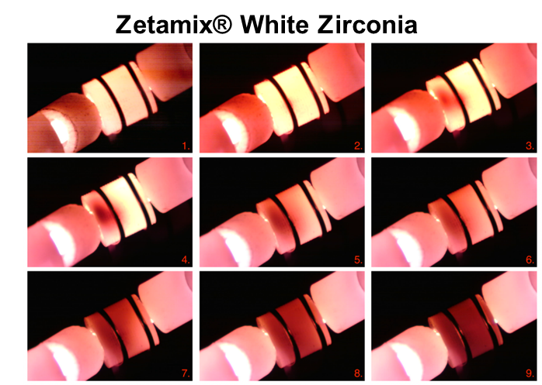
WP3: auxiliary components
Improvement of the vacuum chamber for the target - ion source system
Insulators with complex shapes for high temperature targets and ion sources
An atomizer for neutral injection in ion sources is a device used to produce a stream of neutral atoms or molecules that can be injected into an ion source.

Slide 7
MANY THANKS FOR YOUR ATTENTION
Detailed information on tasks, manpower and budget will follow soon!

