Slide 1
HISOL
CSNV Experiment
High performance ISOL systems for the production of radioactive ion beams
Work package 3
Thermal and electrical characterization of LPBF metals
Giacomo Voltan – INFN-LNL

Slide 2
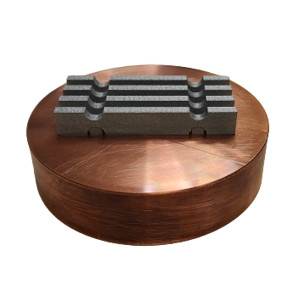
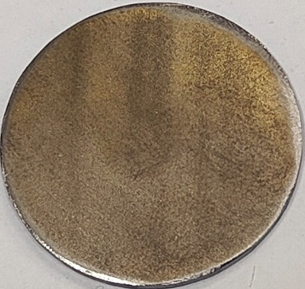
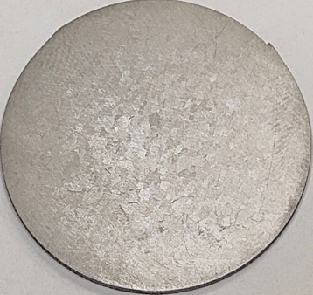
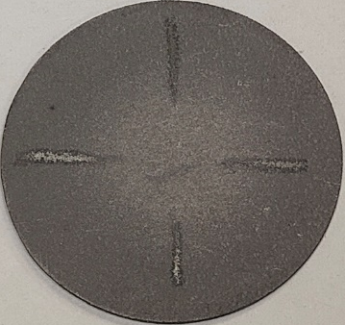


Characterization of LPBF Ta and W
Completion of the characterization regarding Additively Manufactured refractory metals
Electrical characterization of new AM Ta samples
Thermal characterization of standard and AM Ta samples
Mechanical characterization of AM W samples
Ta STD
Ta AM90
Ta AM45

Slide 3
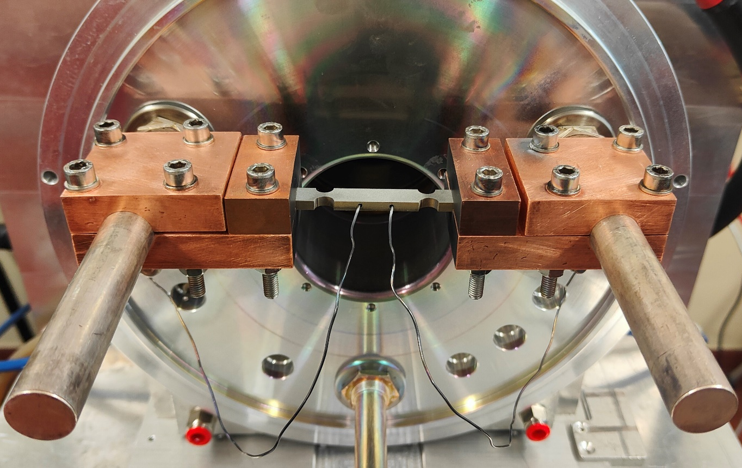
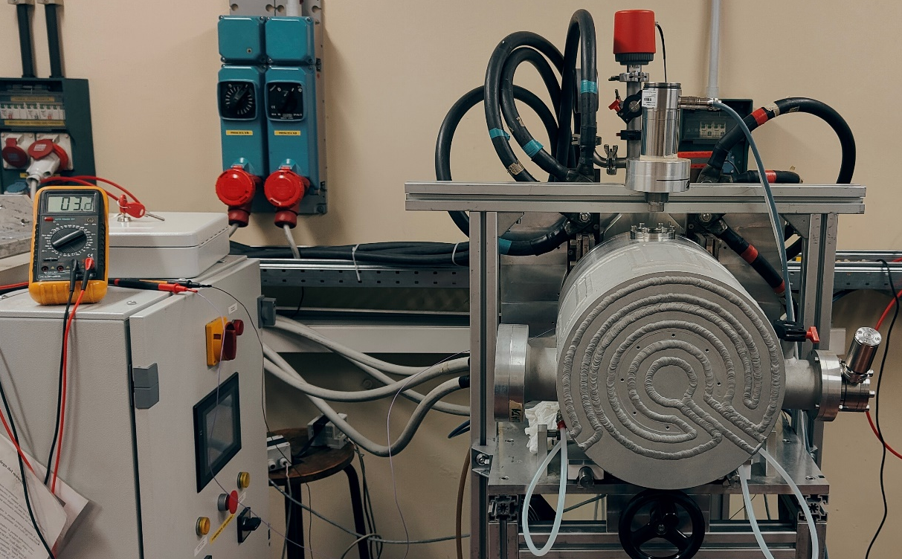
Electrical characterization of AM Ta
Setup for electrical resistivity measurements
Voltmeter
Vacuum chamber
Pyrometer
Sample
Tantalum wires
Electrodes

Slide 4
Electrical characterization of AM Ta
Potential drop measured
Ohm’s laws
Electrical resistivity

Slide 5
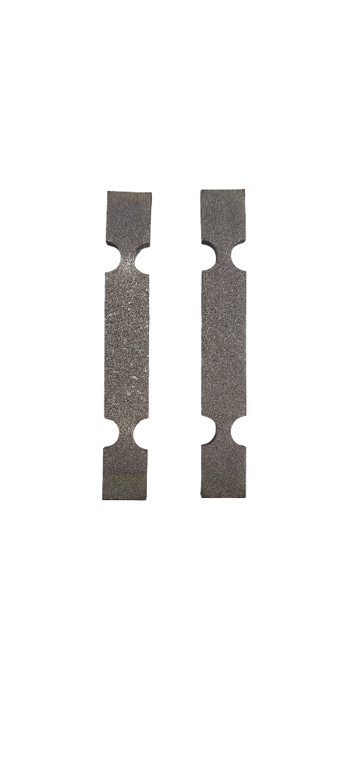
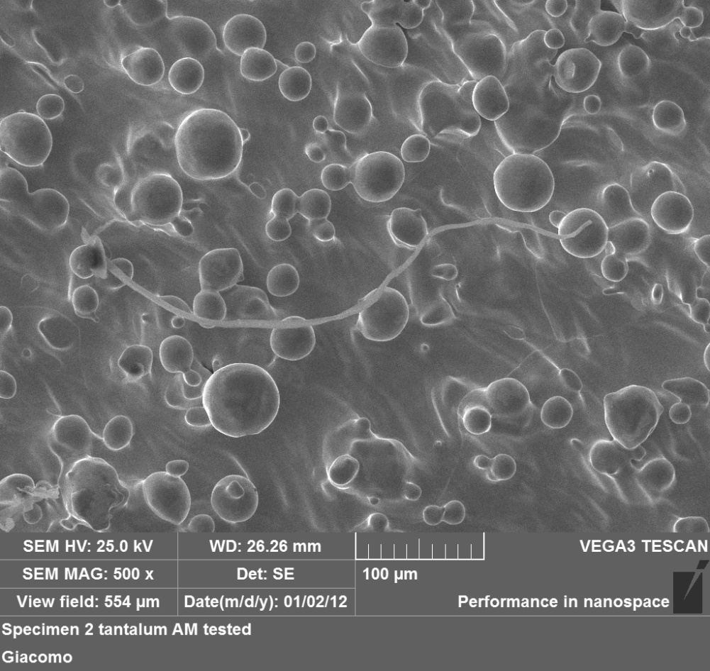
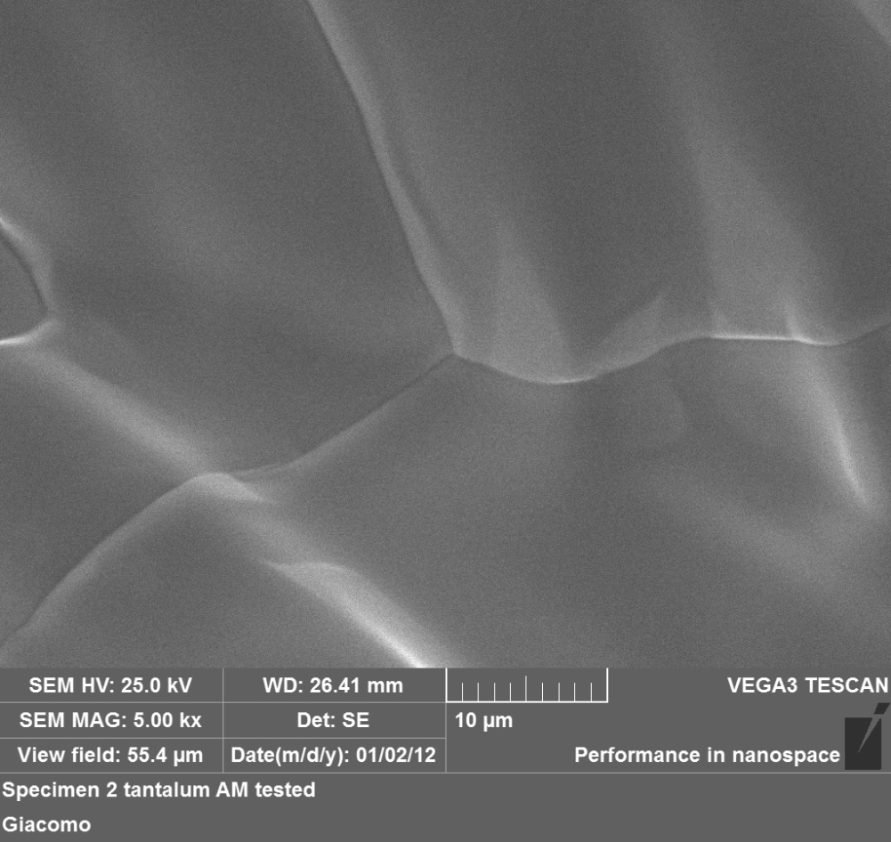
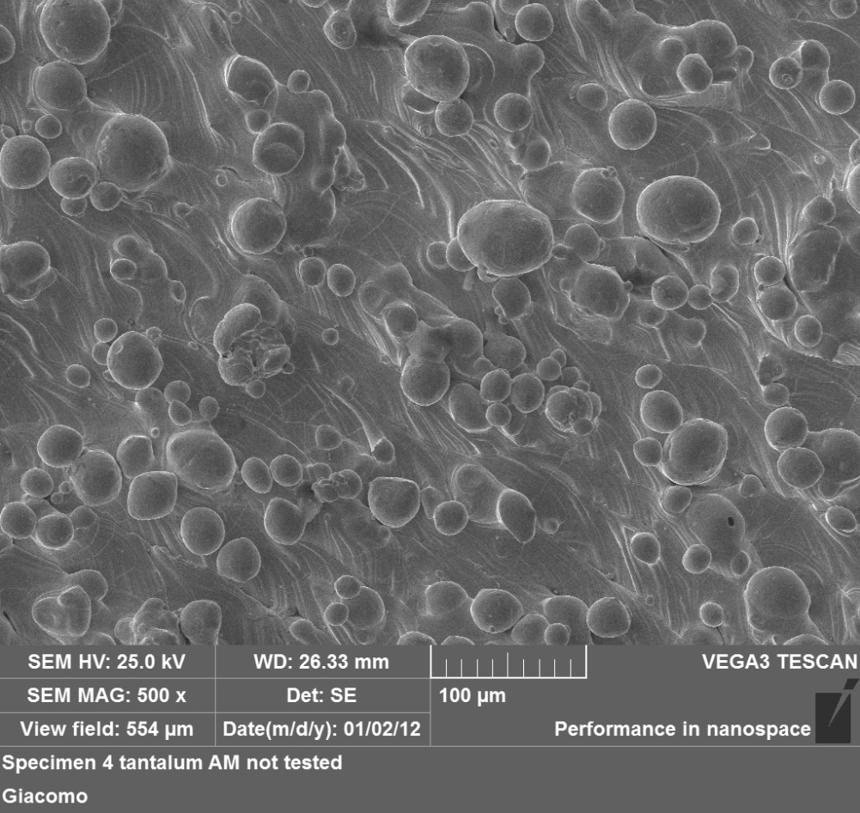
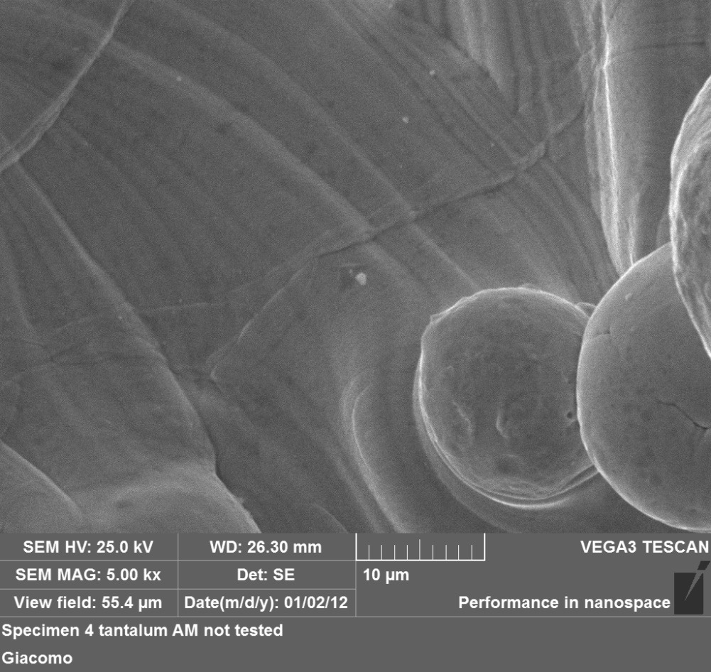
Electrical characterization of AM Ta
Recrystallization phenomena
Influence on the material behaviour
Sample 2
Sample 4

Slide 6
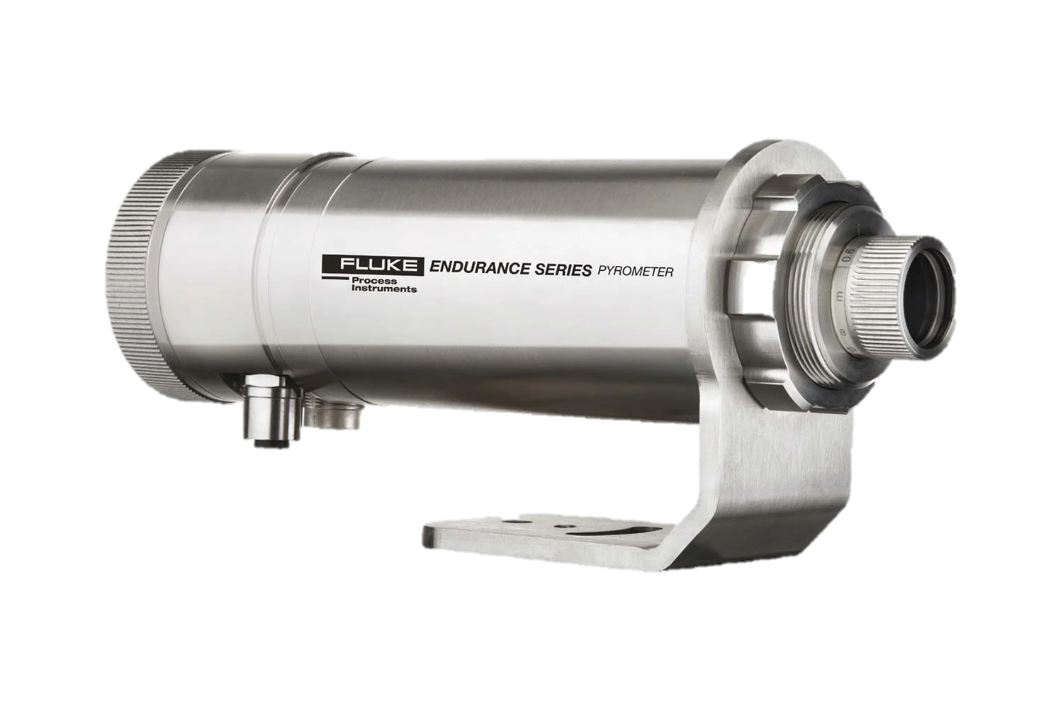
Thermal characterization of AM Ta
HT emissivity measurements during electrical resistivity tests
Matching of 2-color mode and 1-color mode temperatures

Slide 7

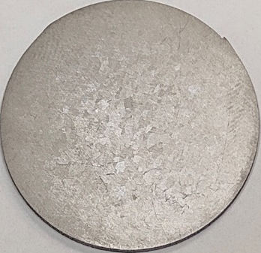
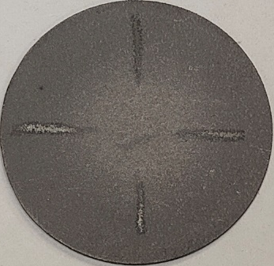
Thermal characterization of AM Ta
LT emissivity measurements
Ta STD
Ta AM90
Ta AM45
Experimental apparatus

Slide 8
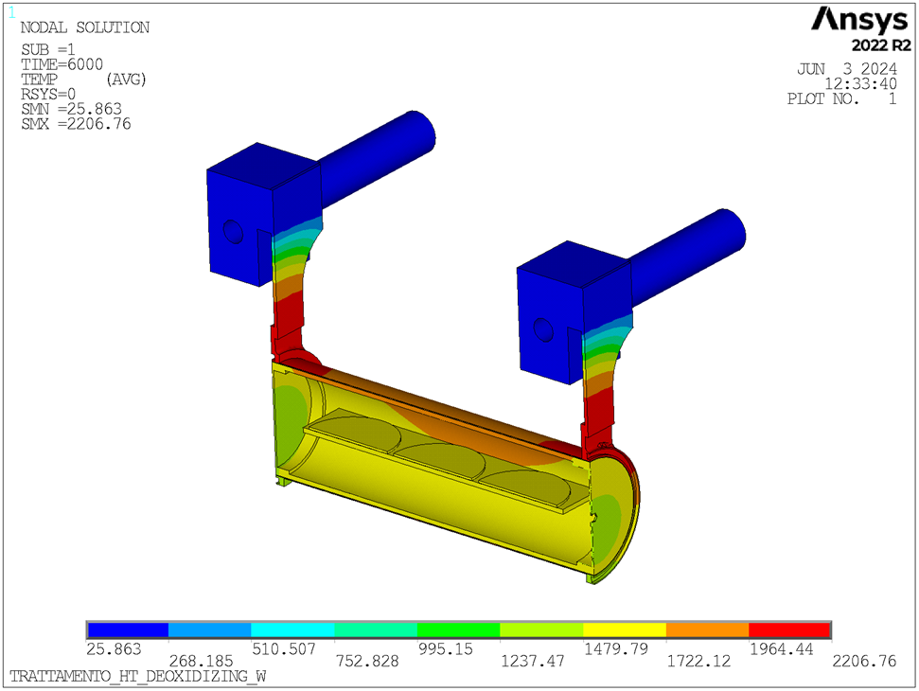
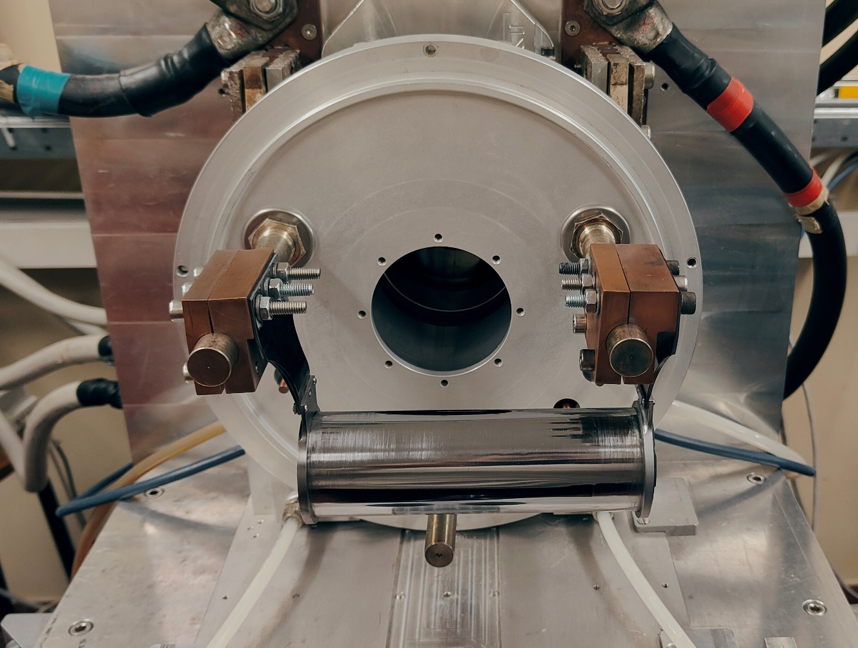
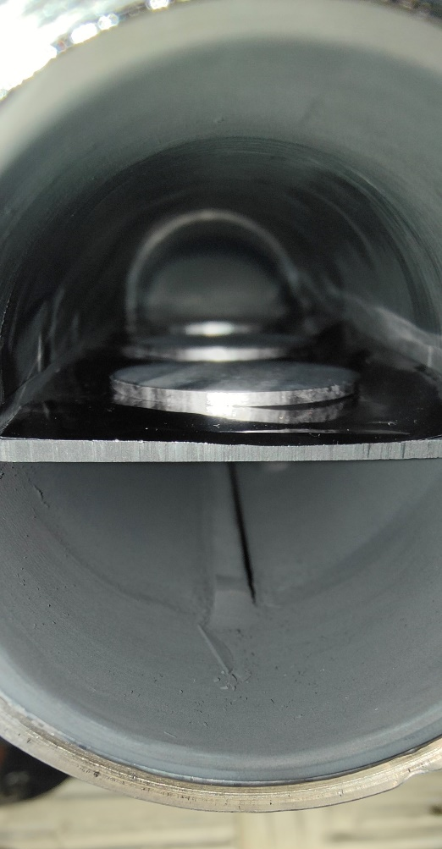
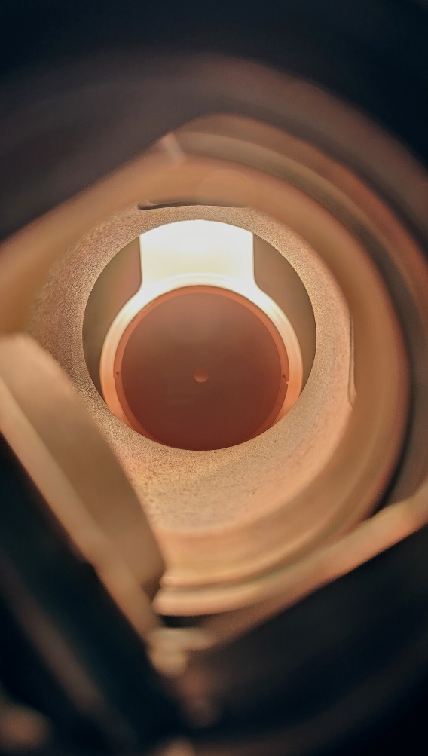
Thermal characterization of AM Ta
LT emissivity measurements
Tantalum oxide is stable up to 1500°C
Thermal treatment at 1100A for 2 hours
Graphite support covered with a tantalum foil
Tantalum tube containing a graphite box
Heat treatment for removing the superficial oxide layer

Slide 9
Thermal characterization of AM Ta
LT emissivity measurements
Increase the roughness of the samples with mechanical operations
Perform the test manually making use of FLUKE® pyrometers

Slide 10

W AM mechanical characterization
6 samples of AM tungsten ready for performing compression tests
Mechanical operation required for the removal of the growth substrate

Slide 11
Conclusions - planned activities
Tantalum STD
Thermal characterization of 4 specimens
Tantalum AM
Thermal characterization of 4 specimens
Comparison between STD and AM results
Electrical characterization of further specimens
Tungsten AM
Mechanical characterization of 6 specimens

Slide 12
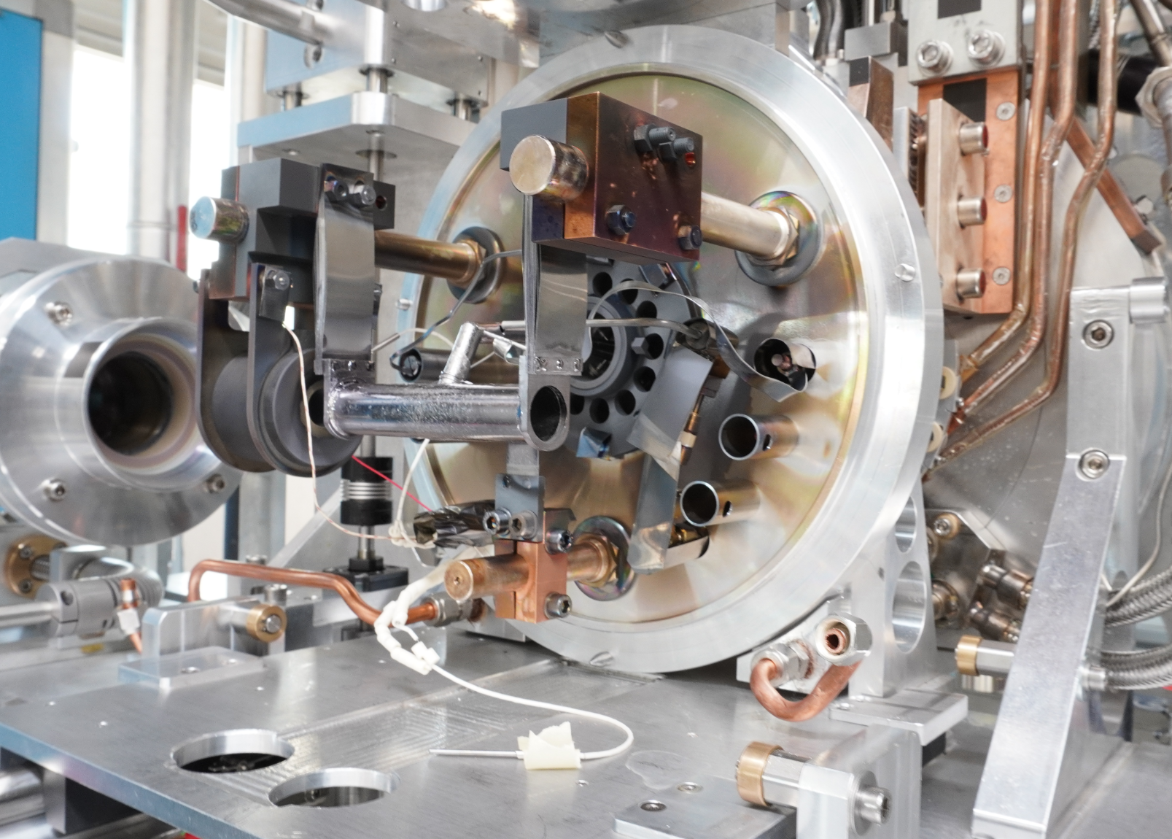
Thank you
Notes:
This is the question that your experiment answers

