Slide 1
HISOL
CSNV Experiment
High performance ISOL systems for the production of radioactive ion beams
Work package 3
Material Characterization and Multiphysics Simulation – Status update
Michele Ballan – INFN-LNL

Slide 2
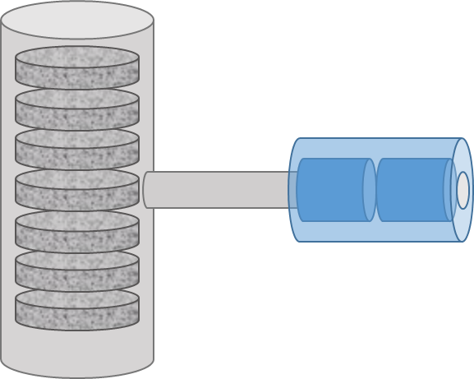

HISOL Objectives
Main goal:
Development of a new generation of High Performance ISOL Targets and Ion Sources with cutting edge technologies available within INFN and its collaboration network.
Such aim foresees three fundamental objectives:
Study and development of innovative recipes and methods to produce ISOL targets
Study and development of innovative methods to produce and operate ion sources
Characterization and multiphysics simulation of the obtained components by means of advanced techniques

Slide 3



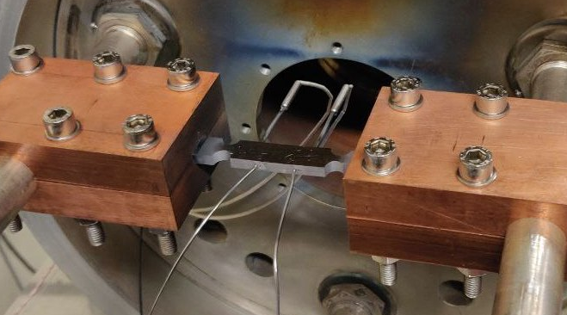
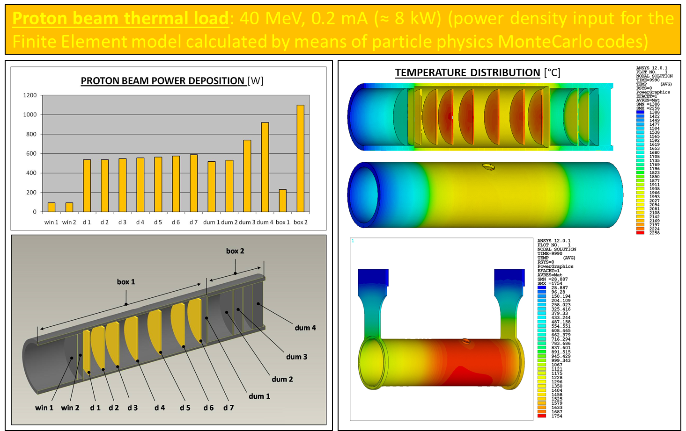
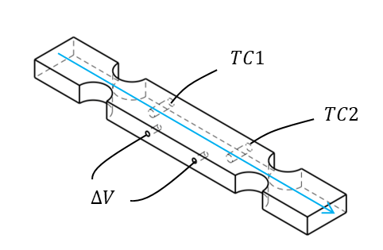
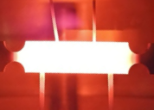
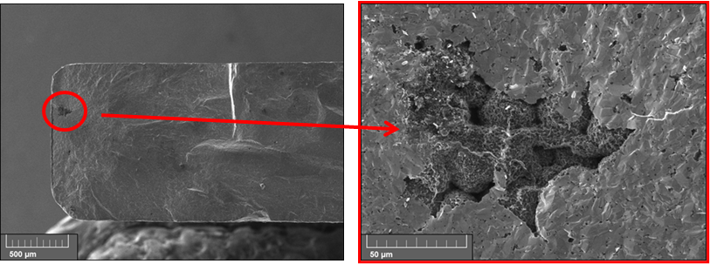
Work package 3 organization
Work package 3: Materials Characterization and Multiphysics Simulation
emissivity and thermal conductivity measurements
electrical resistivity measurements
thermionic emission measurements
multiphysics simulations
microstructural characterization
Reliable Material Property Data at High Temperature are required for Robust Multiphysics Simulation of ISOL Targets and Ion Sources

Slide 4
Work package 3 timetable and milestones
 |  | Year 1 |  |  |  | Year 2
 |  | M3 | M6 | M9 | M12 | M15 | M18 | M21 | M24
WP3 | Materials Characterization and Multiphysics Simulation
T3.1 | Microstructural Characterization |  |  |  | MS3.1
T3.2 | Thermal and Electrical Characterization
T3.3 | Mechanical Characterization |  |  |  |  |  | MS3.2
T3.4 | Multiphysics Simulation of High Performance ISOL Targets |  |  |  |  |  |  |  | MS3.3
T3.5 | Multiphysics Simulation of High Performance ISOL Ion Sources |  |  |  | MS3.4 |  |  |  | MS3.5
WP3 milestones |  | Date
MS3.1 | Microstructural Characterization | M12
MS3.2 | Thermal, Electrical and Mechanical Characterization | M18
MS3.3 | Multiphysics Simulation of High Performance ISOL Targets | M24
MS3.4 | Definition of the Multiphysics Simulation strategy for High Performance ISOL Ion Sources | M12
MS3.5 | Multiphysics Simulation of High Performance ISOL Ion Sources | M24

Slide 5
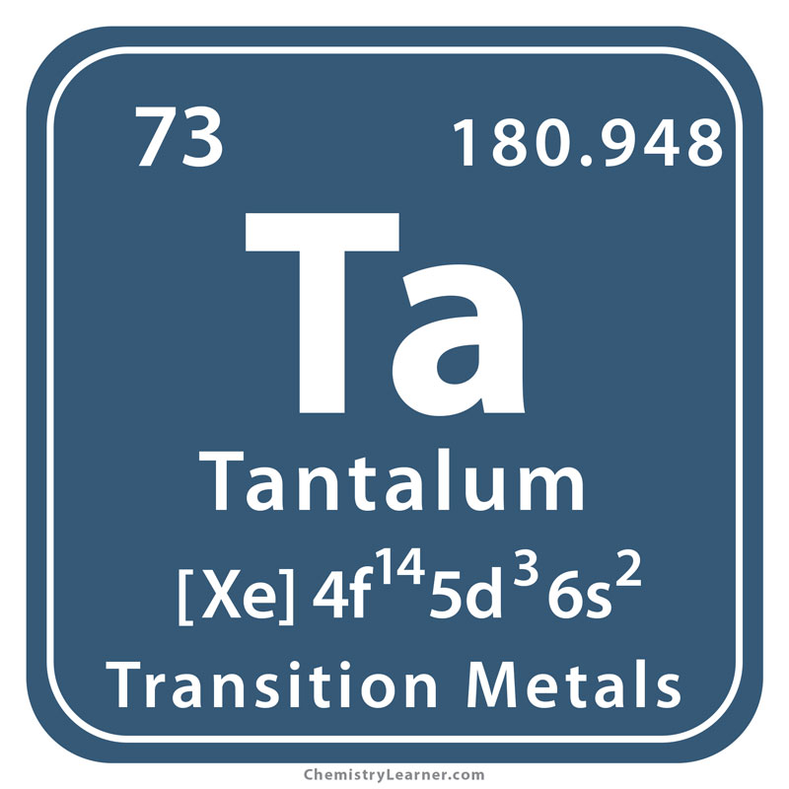
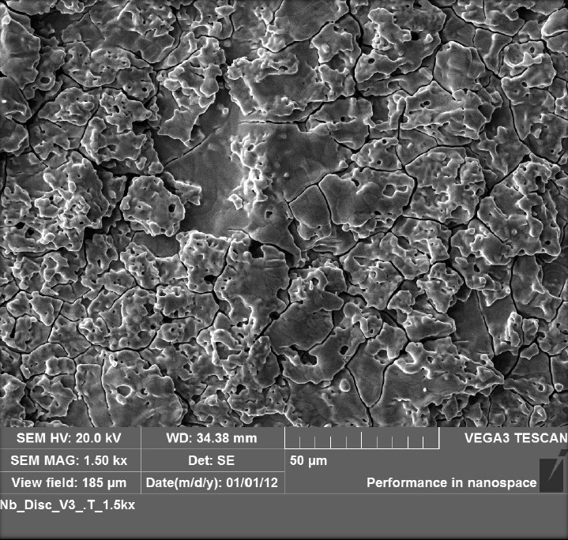
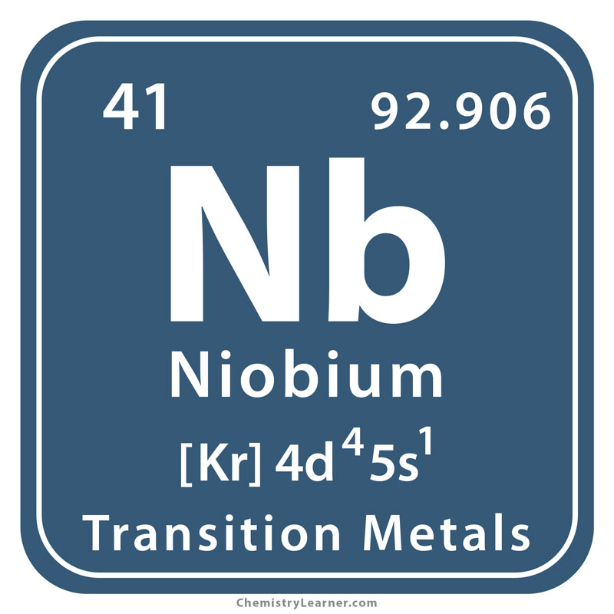
T3.1: Material development and microstructural characterization
Giacomo Voltan, Master thesis in Materials Engineering, UNIPD, Supervisor M. Manzolaro - to be defended end of 2024
Emmanuel Tochukwu Ezeaba, Master thesis in Materials Engineering, UNIPD, Supervisor M. Manzolaro - to be defended end of 2024

Slide 6
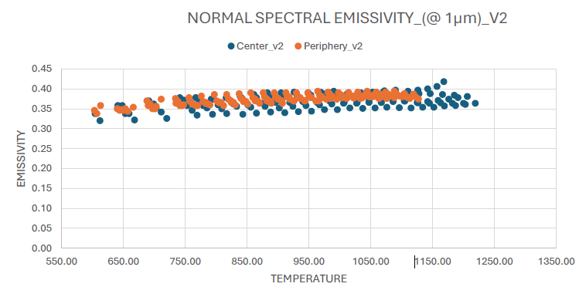
T3.2: Thermal and Electrical Characterization
Giacomo Voltan, Master thesis in Materials Engineering, UNIPD, Supervisor M. Manzolaro - to be defended end of 2024
Emmanuel Tochukwu Ezeaba, Master thesis in Materials Engineering, UNIPD, Supervisor M. Manzolaro - to be defended end of 2024

Slide 7



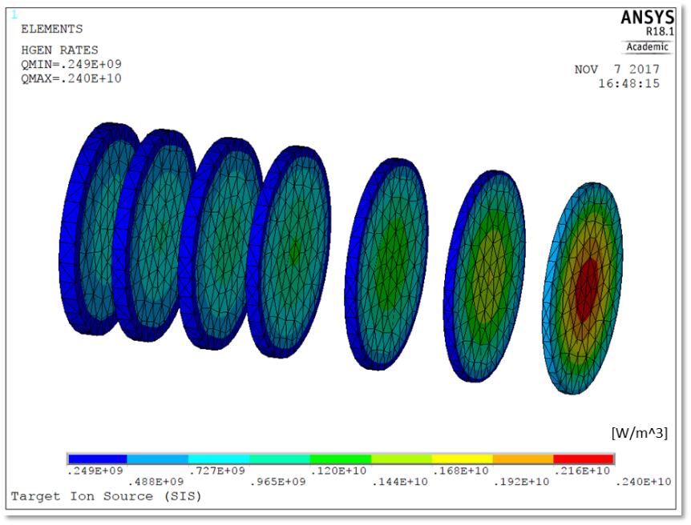
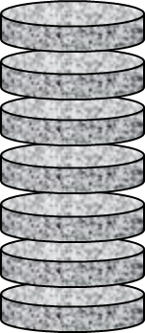
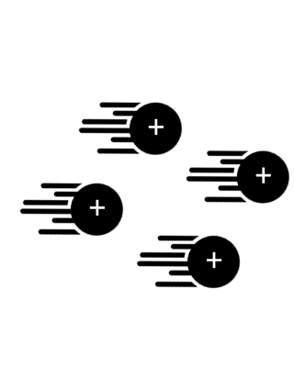
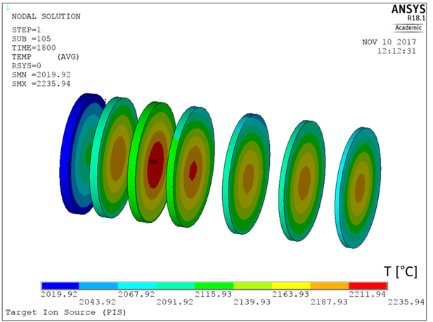
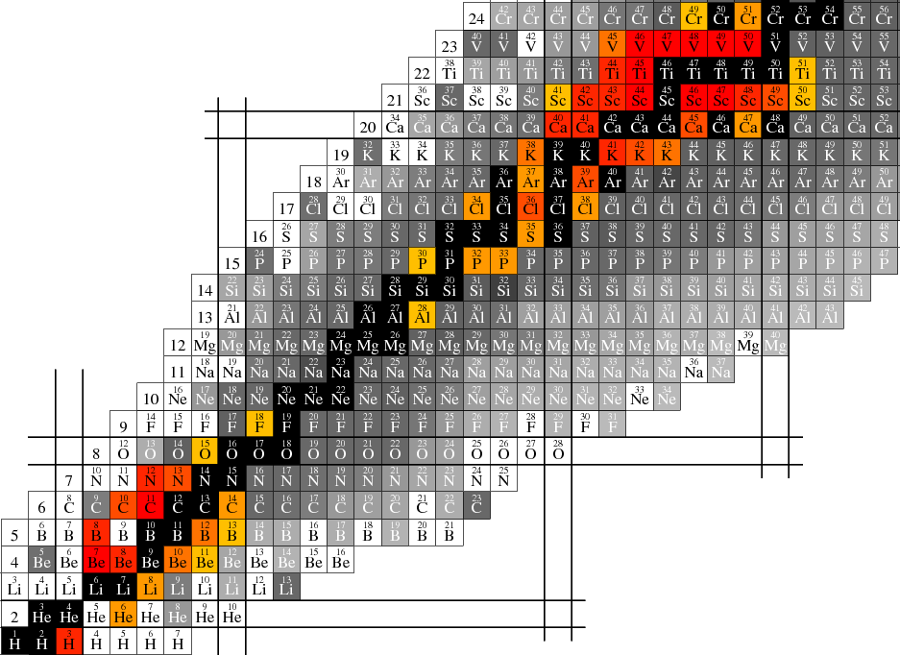
T3.4: Multiphysics Simulation of High Performance ISOL Targets
A complex multistep simulation process
Monte Carlo simulations:
Particle transport and interaction with matter
Multiphysics FEM simulations:
Thermal and structural analyses
Strucutral analysis
required material properties:
E (Young’s modulus)
ν (Poisson’s ratio)
α (coeff. of th. expansion)
Power deposition
Thermal analysis
required material properties:
k (thermal conductivity)
ε (emissivity)
Proton Beam Properties
(energy, intensity, profile)
Target temperature field
Isotope production
Target stress field
Target characteristics
(composition, geometry, density)

Slide 8
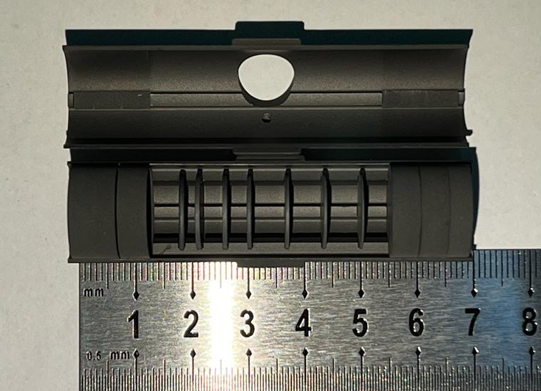
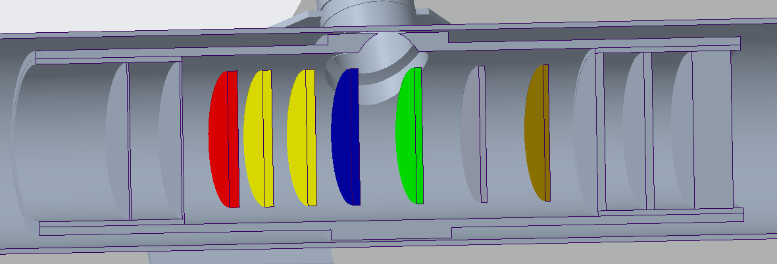
SiC target geometry
SiC disk thickess and spacing were carefully checked and implemented in the MC model geometry
1
2
3
4
5
6
7
Disk | Thickness | Diameter | Material
\ | [mm] | [mm] | \
1 | 1 | 13 | SiC
2 | 0,9 | 13 | SiC
3 | 0,9 | 13 | SiC
4 | 0,8 | 13 | SiC
5 | 0,7 | 13 | SiC
6 | 0,6 | 13 | SiC
7 | 0,5 | 13 | SiC

Slide 9

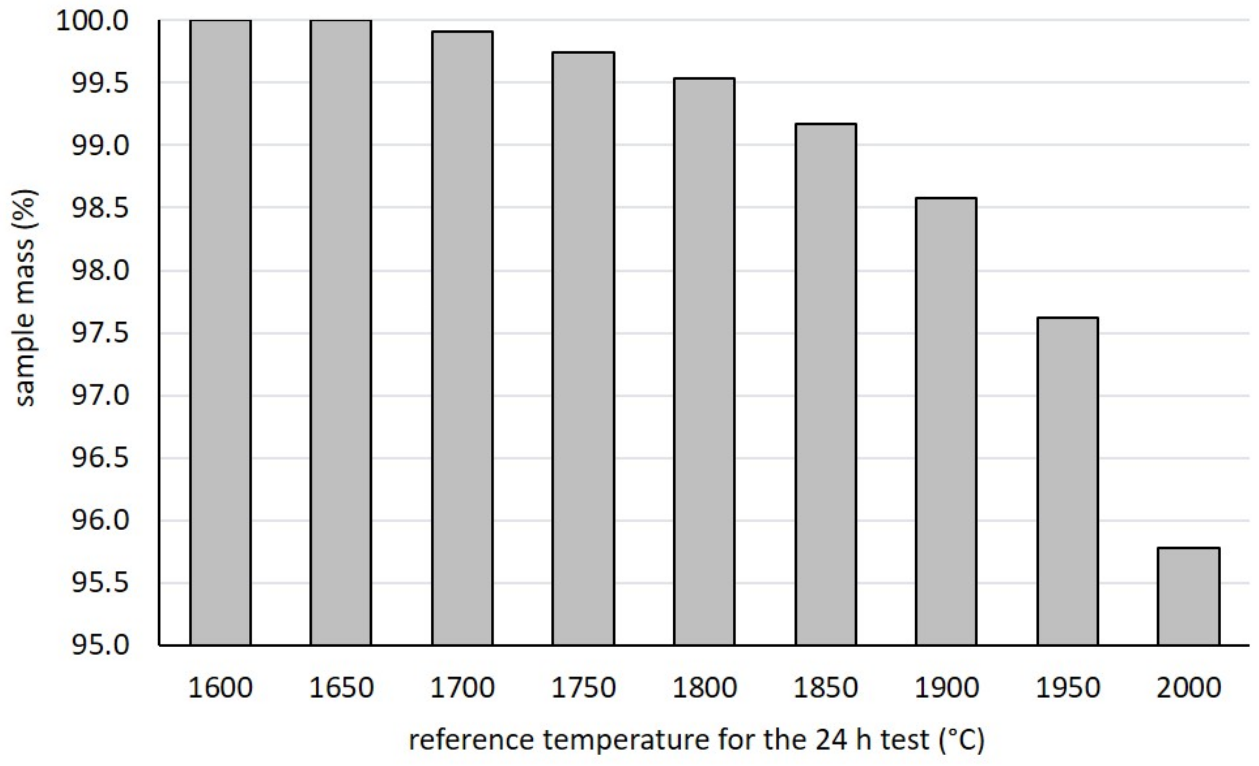
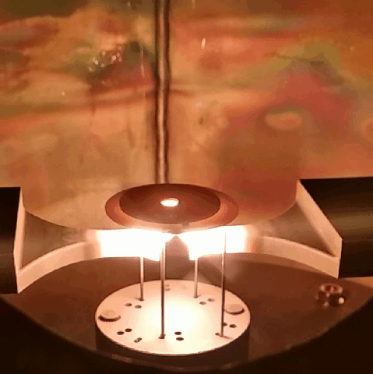
SiC target material – operation limits: T_{lim} and σ_{lim}
Effect of target overheating: target degradation
Effect of excessive thermal stresses: target failure
Safe temperature range
Target degradation
T<T_{lim}
T>T_{lim}
Typical target temperature distribution {T} during irradiation:
Radial temperature gradients
{T} causes the occurrence of thermal stresses {σ}
If σ_{max} > σ_{lim}
High risk of target instantaneous failure
σ_{lim} for SiC SA: 190 MPa
Manzolaro, M. et al.; Materials 2021, https://doi.org/10.3390/ma14102689

Slide 10
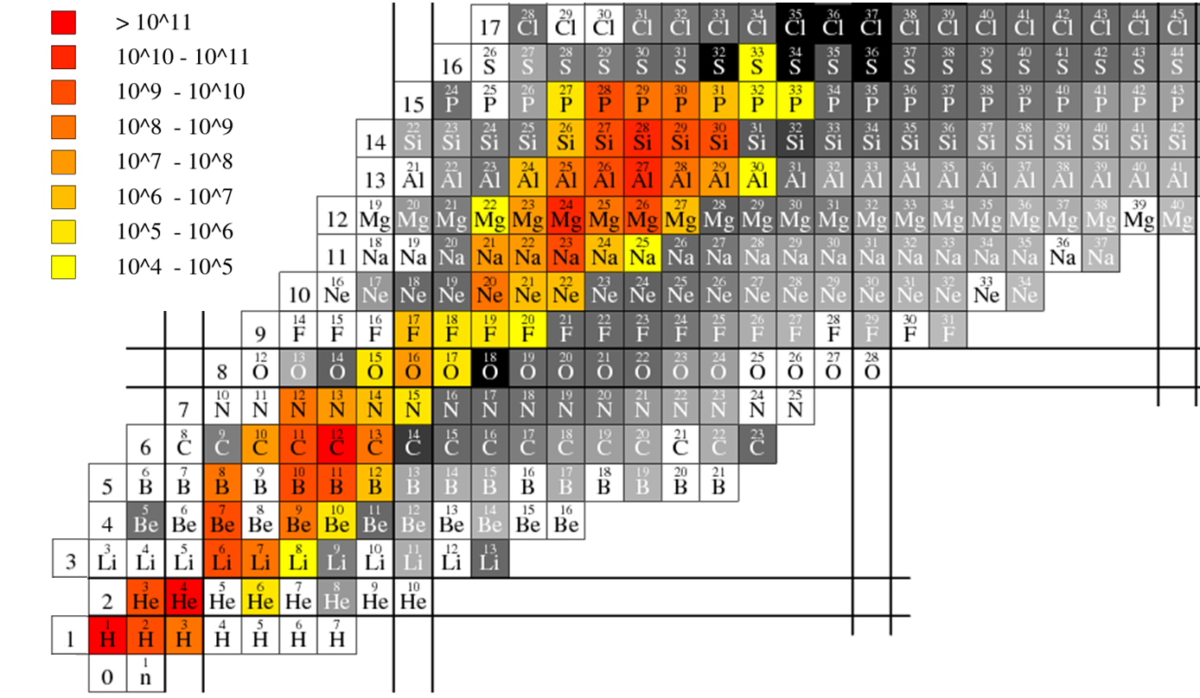
Isotope production: SiC target
In-target yields – 40 MeV 2 μA p⁺ on SiC
[particles/s]
Al beams: reference M. Barbui (2008)
https://doi.org/10.1016/j.nimb.2008.05.04
Na beams: reference J. Jeong (2023)
https://doi.org/10.1016/j.nimb.2023.05.060

Slide 11
Target possible operation conditions
0% mass loss every 24 hours
slower release rate
0.2% mass loss every 24 hours
acceptable release rate
0.5% mass loss every 24 hours
faster release rate
Acceptable operation conditions
T<T_{lim}

Slide 12
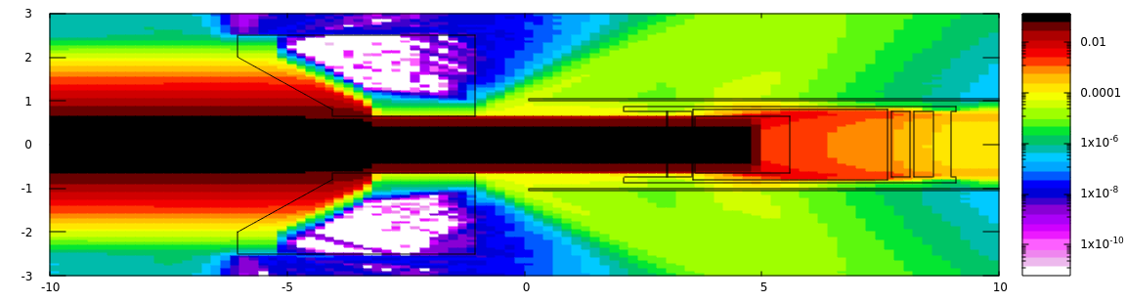
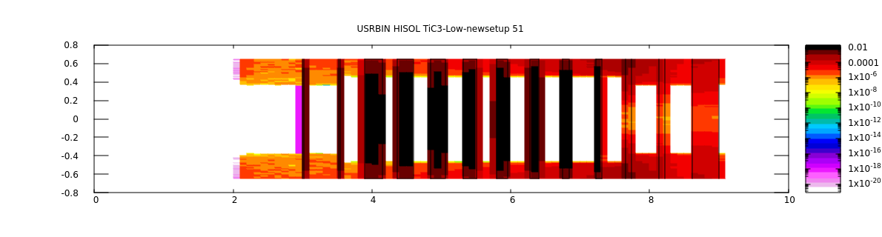
Optimisation of TiC target performance: Monte Carlo simulation
A. Donzella & D. Pagano - UNIBS
One-disk target equivalent simulated to define thicknesses of TiC target disks so as to distribute energy loss equally
40 MeV proton beam
Target disk
Thickness (mm) | Energy loss (MeV/prot) | Discrepancy %
2,6 | 2,69 | 2,5
2,3 | 2,59 | 6,2
2,1 | 2,59 | 6,2
1,9 | 2,64 | 4,3
1,6 | 2,60 | 5,8
1,3 | 2,63 | 4,7
0,9 | 2,76 | 0
0,9 | 1,92 | 30,43
13,6 | 20,4
Energy loss (MeV)
Best solution: 7 disks, dicrepancy in energy loss by about 6%!
disk thickness (mm)
The 8th disk absorbs less than 2 MeV: shall we remove it?
The FEM thermal and structural analyses has to be completed

Slide 13
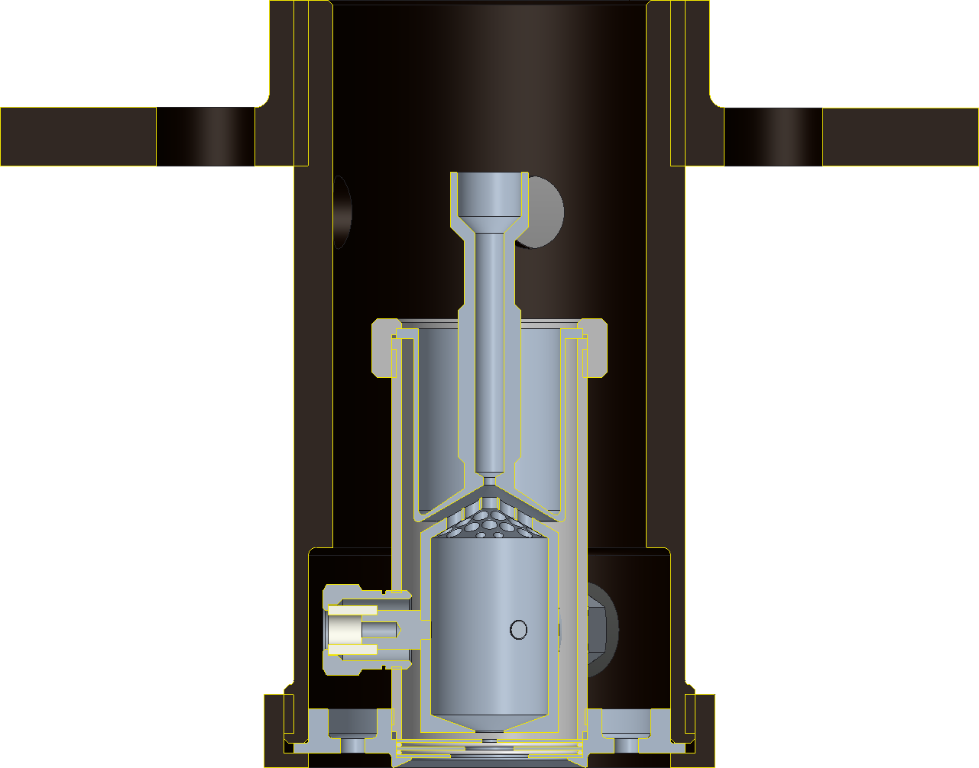
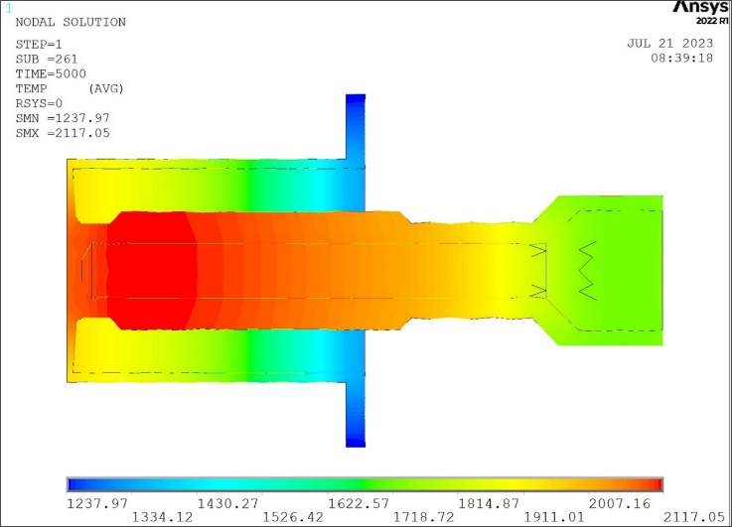
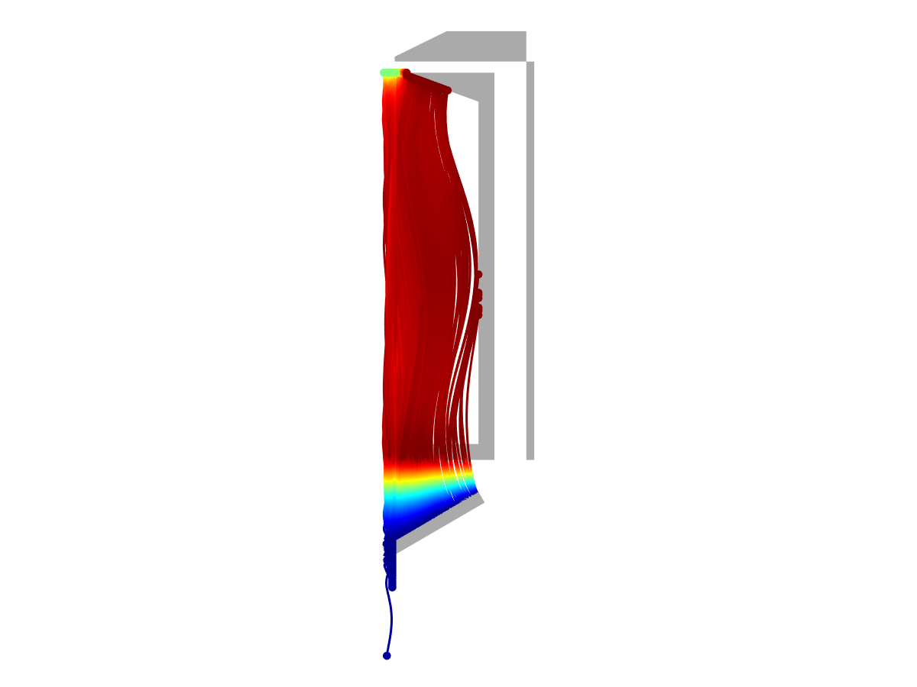

T3.5: Multiphysics Simulation of High Performance ISOL Ion Sources
A path towards a FEBIAD ion source with enhanced performances benefitting of the flexibility of the LPBF technology
Step 1:
First AM FEBIAD source component
(cathode)
Step 3:
Innovative anode-cathode interfaces
Step 0:
Standard FEBIAD source
(cathode)
Step 2:
Enhanced AM FEBIAD source

Slide 14
Conclusions - planned activities
T3.1: Material development and microstructural characterization
Development of Innovative LPBF W and Ta based alloys
T3.2 & T3.3: Thermal, electric and mechanical Characterization
Completion of the characterization of LPBF Ta
Characterization of LPBF Nb Characterization of LPBF W and Ta based alloys
T3.4: Multiphysics Simulation of High Performance ISOL Targets
New set of simulations on the optimised TiC standard targets
T3.5: Multiphysics Simulation of High Performance ISOL Ion Sources
Completion of thermal-electric simulations on conical anode-cathode interfaces

Slide 15
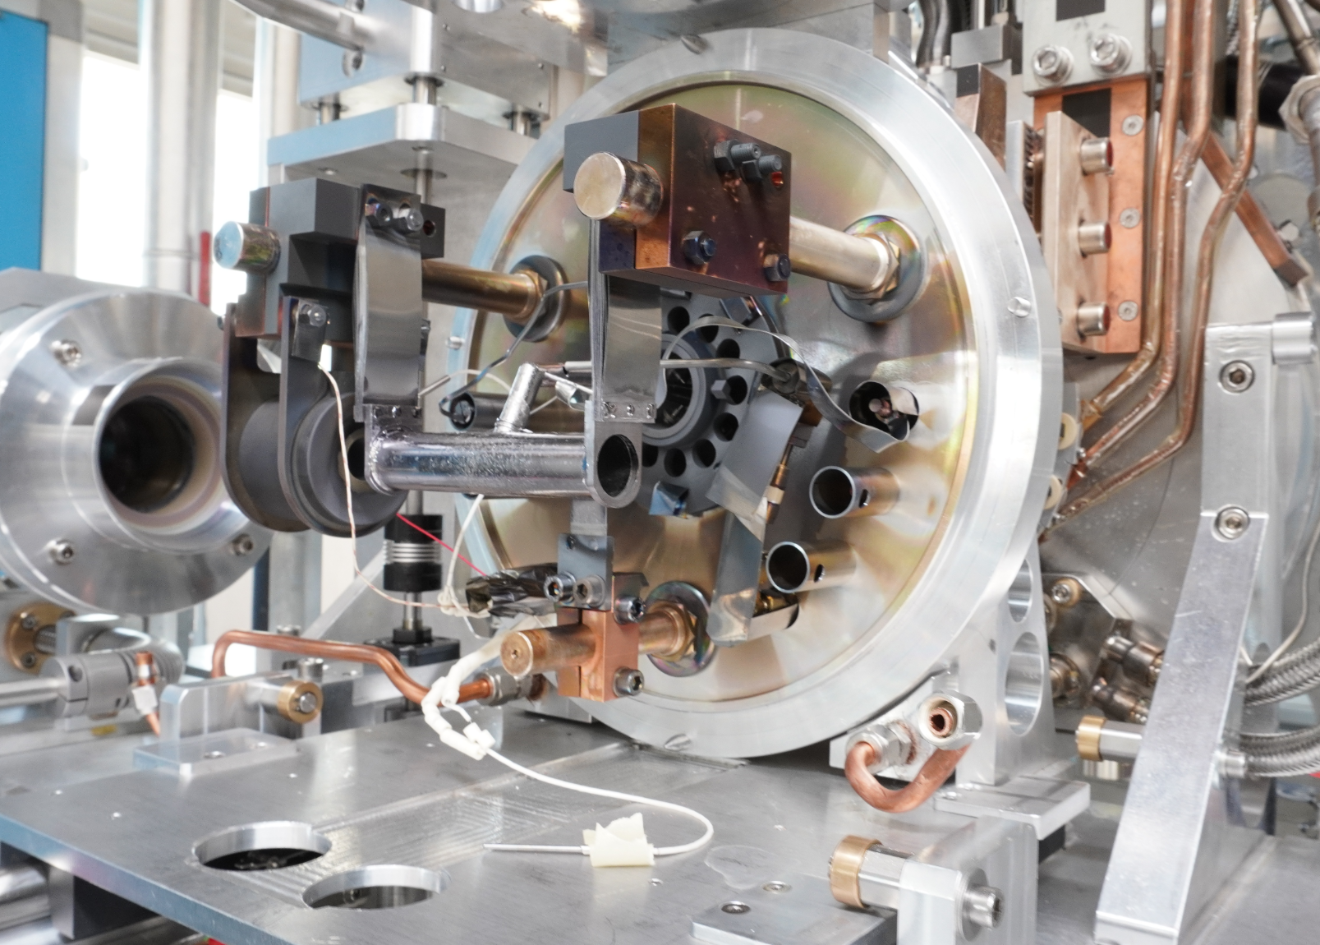
Thank you
Notes:
This is the question that your experiment answers

