Slide 1
HISOL
CSNV Experiment
High performance ISOL systems for the production of radioactive ion beams
Work package 2
Thermionic emission tests on LPBF FEBIAD ion source components
HISOL periodic meeting – 1st July 2024

Slide 2
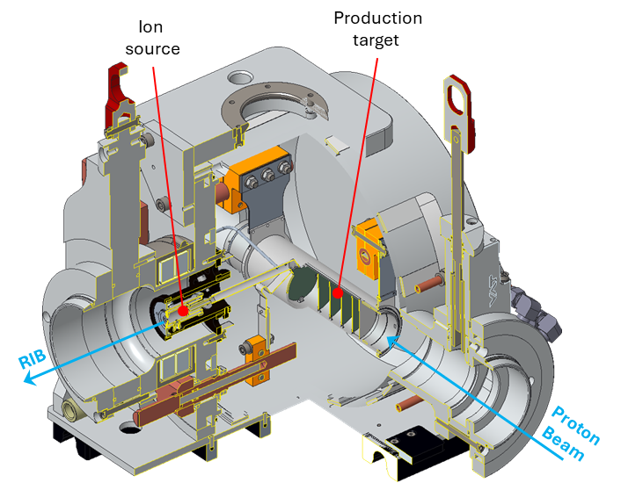
Introduction
The ion source performs the isotope ionization process, which is essential for the transport of the radionuclides as a particle beam up to the desired experiment.
Among the several type of ISOL ion sources, the Forced Electron Beam Induced Arc Discharge (FEBIAD ) ion source is one of the most used, for its flexibility, being able to ionize a wide range of elements.

Slide 3
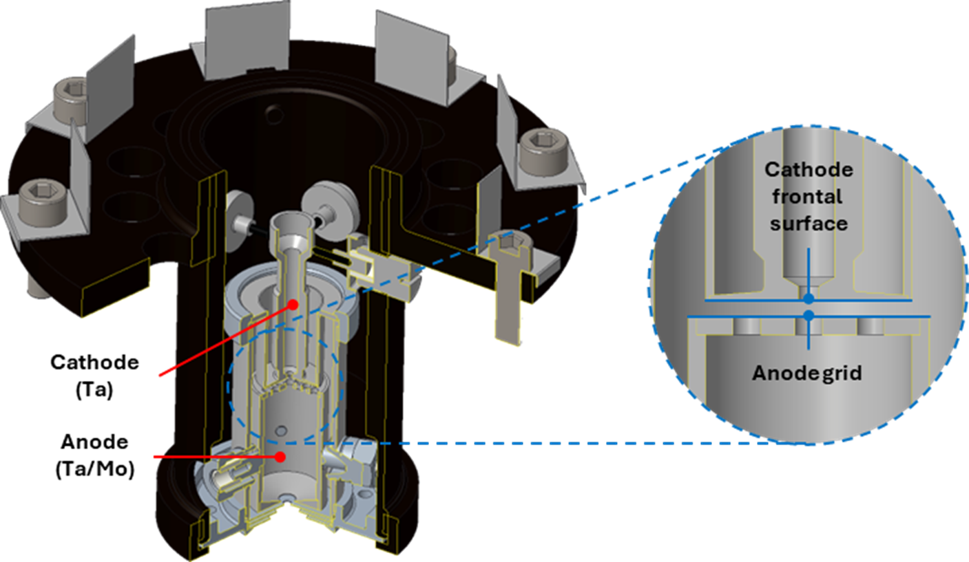
Introduction
The FEBIAD type ion source performance is driven by the thermionic emission
The thermionic emission consists on the electrons release from the cathode occurring at T>2000°C
The electrons released are accelerated and attracted toward the anode by an electric field
The electons inside the anode plasma chamber bombard the neutral species coming from the primary target to perform the ionization process

Slide 4
Introduction
The drain current can be assumed as the electron current generated by the thermionic emission process during operation. It depends on three main factors:
Temperature
Anode voltage Anode-cathode distance
Richardson law:
Child-Langmuir law:
$$J_{CL}=4\frac{ε0}{9}\sqrt{\frac{2e}{me}}∙\frac{V^{\frac{3}{2}}}{a^{2}}$$
$$J_{R}=A0 T^{2} exp\left(−\frac{W}{kBT}\right)$$
J_{CL}= electron current emission
ε₀ = vacuum permittivity e = elemental charge m_{e} = electron mass V = anode voltage a = anode-cathode distance
J_{R} = electron current emission
A₀ = material dependent coefficient
T = temperature W = material dependent work function K_{B} = Boltzmann constant

Slide 5
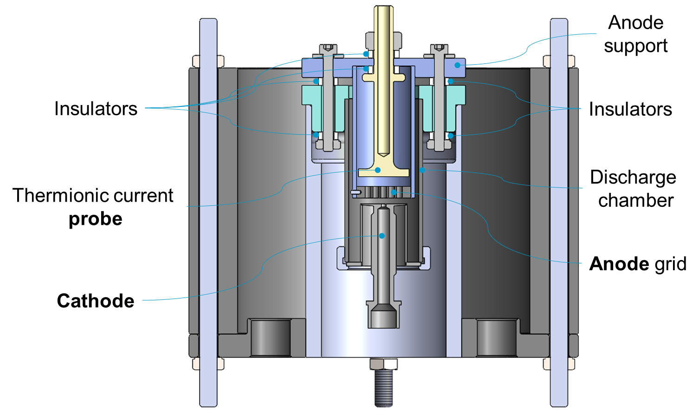
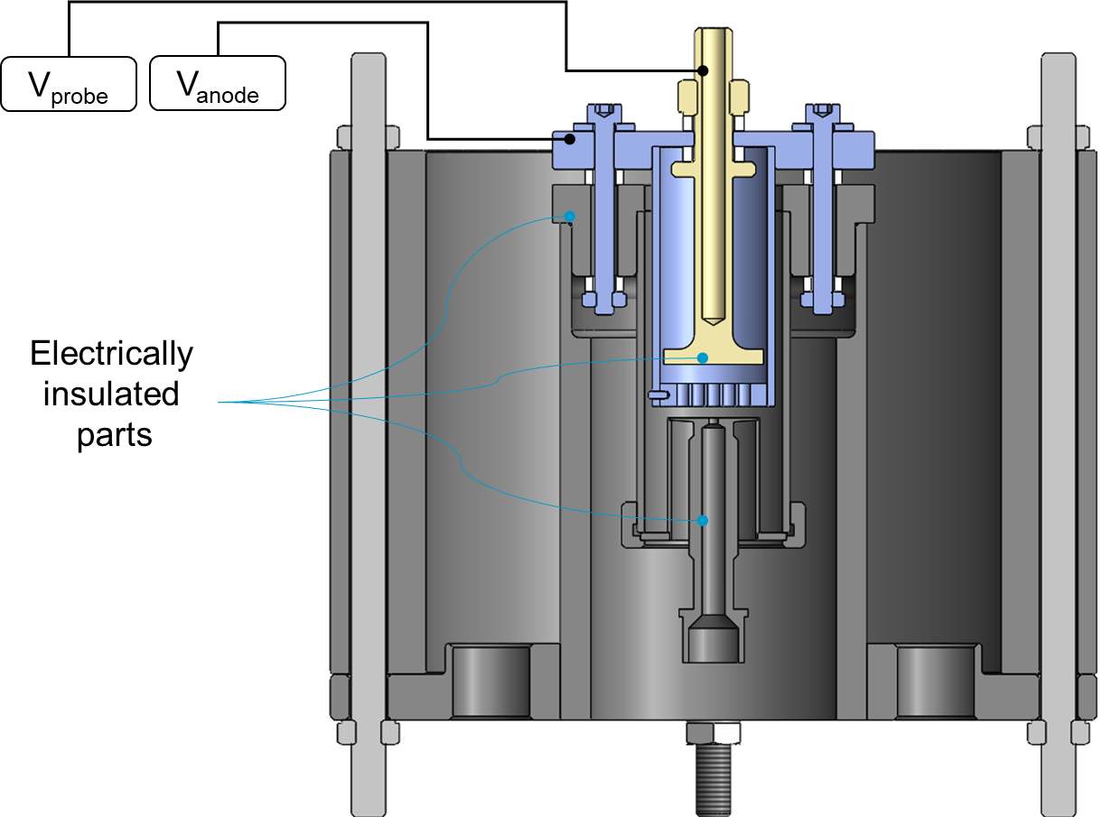
Thermionic emission analysis goal
The aim of the analysis is to investigate the impact of different key feature affecting the thermionic emission on the free electrons released by the cathode frontal surface. Such a setup must be capable to separately measure the electron current absorbed by the anode grid (anode drain current) and the electron current absorbed by the probe (probe drain current).

Slide 6
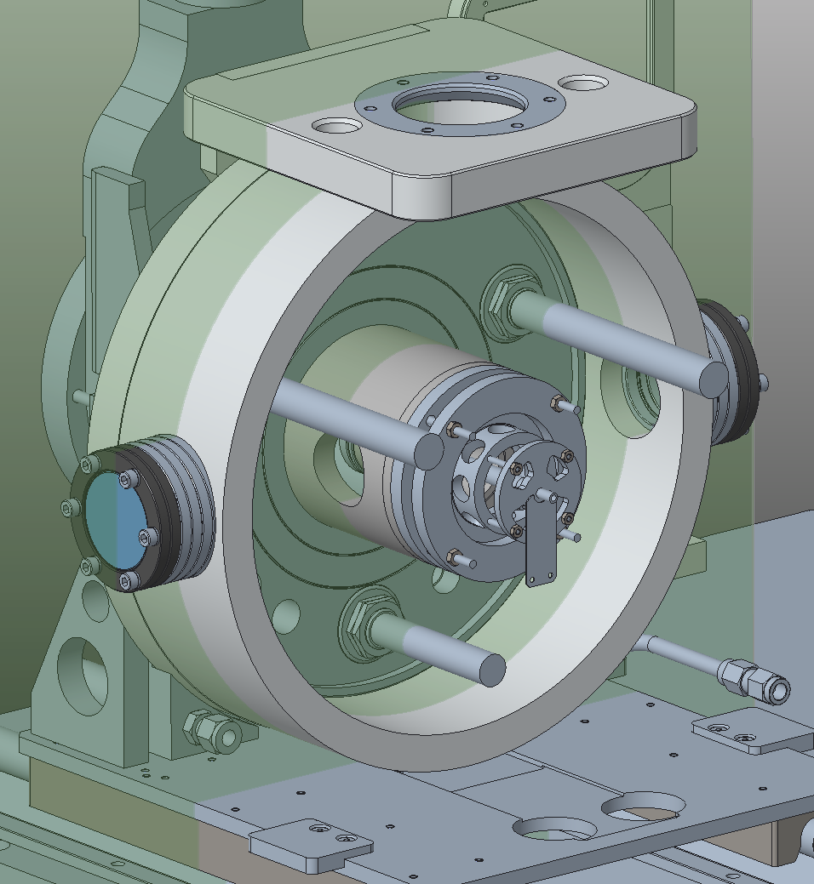
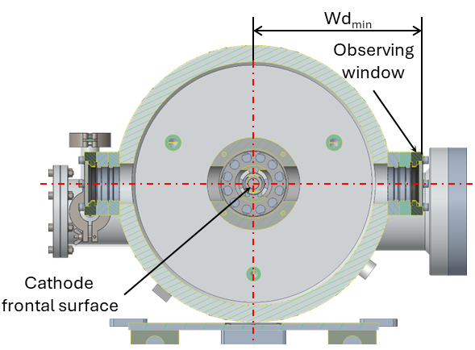
Thermionic emission setup assembly
Section
plane

Slide 7
Thermionic emission analysis measurements
I_{probe}
V_{probe}
I_{anode}
The thermionic emission setup is capable to investigate through comparative analysis the impact on the thermionic effect of the following key features:
Anode grid geometry (transparency)
Innovative cathode-anode interfaces
Cathode HT deformation
Different surface finishing
(Marco Passaretti’thesis)
V_{anode}
-
-
-
-
-
-
-
-

Slide 8
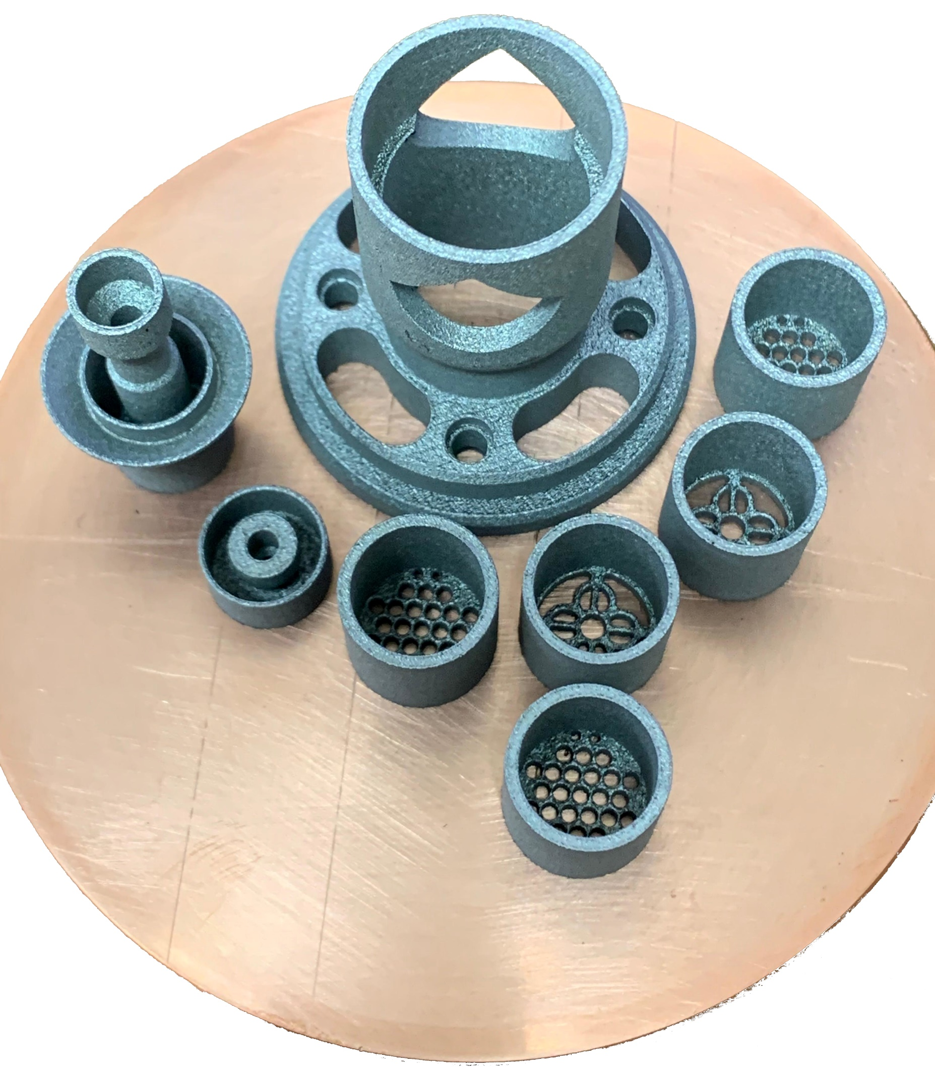
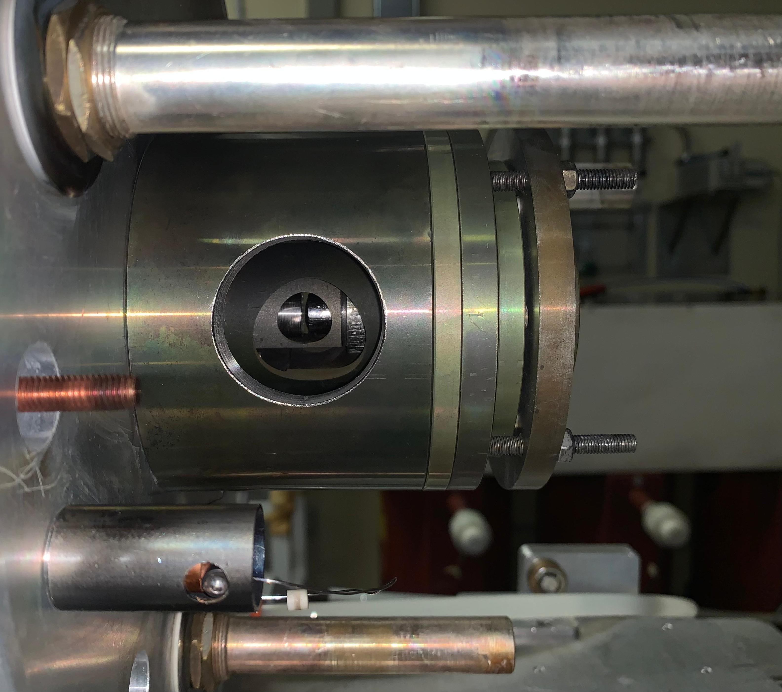
Thermionic emission setup LPBF production, machining and assembly

Slide 9
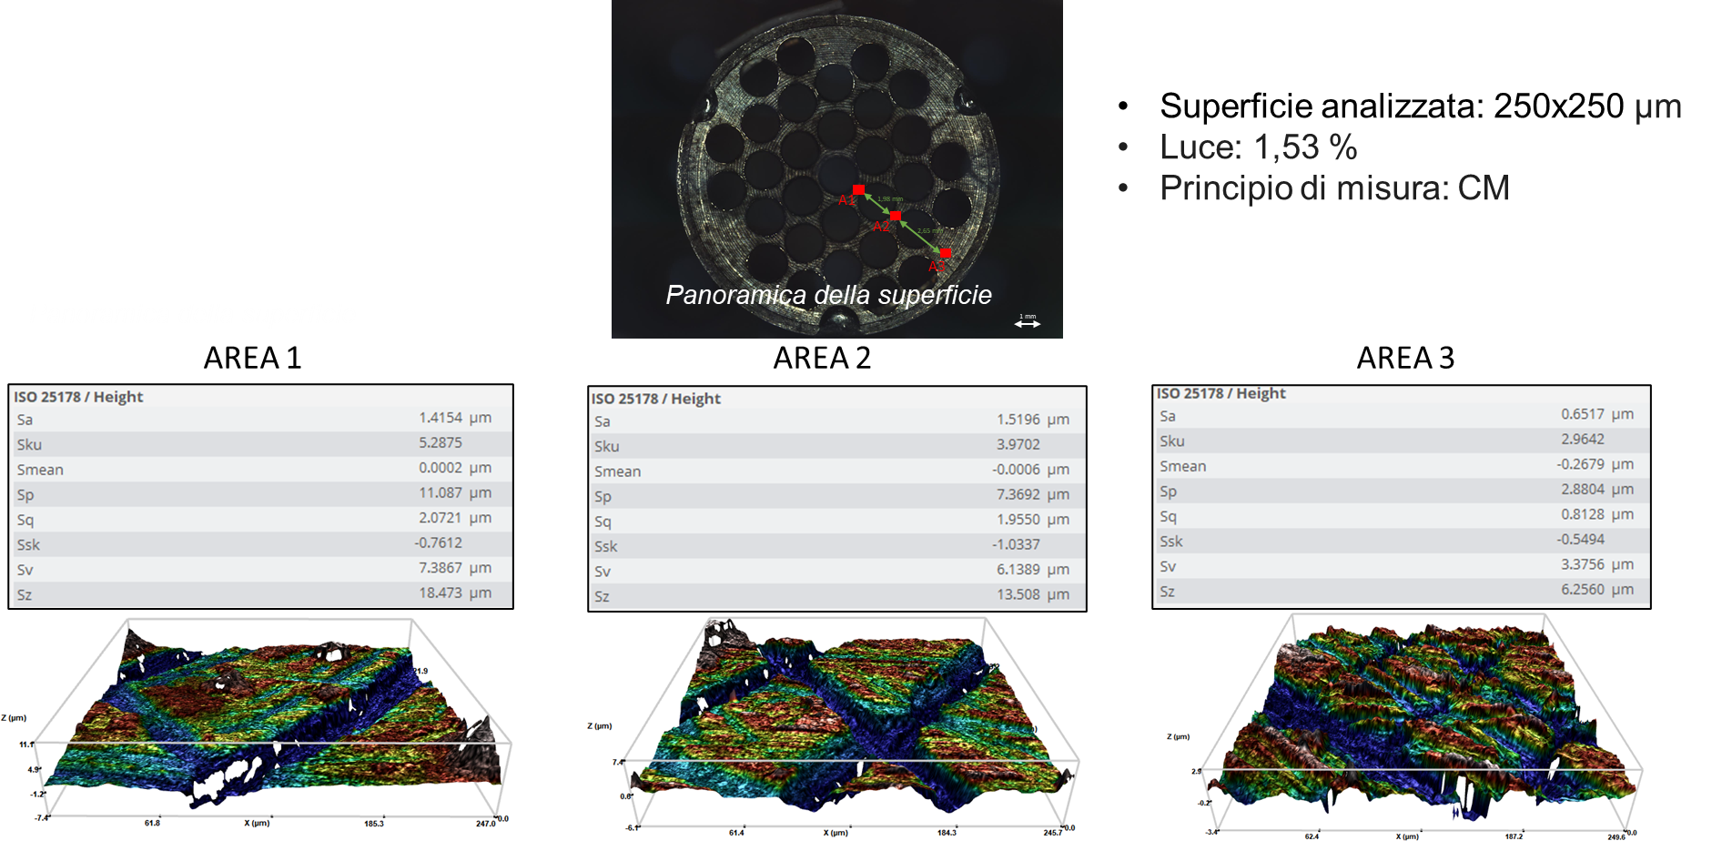
Optical profilometer surface finishing analysis
Standard (STD)
anode grid

Slide 10
Optical profilometer surface finishing analysis
AM conventional
anode grid

Slide 11
Assembly 1: AM anode conventional – STD cathode
The key dimensions were measured through a depth caliper:
Anode – cathode distance = 1.16 mm
Anode – Probe distance = 1.34 mm
The thermionic emission measurements were performed according to the following procedure:
Nr. 3 line currents (I_{line}): 390 A, 400 A, 410 A;
The anode voltage (V_{anode}) was fixed at 150 V;
Nr. 3 probe voltages (V_{probe}): 150 V, 170 V, 200 V → ΔV₁= 0V ΔV₂= 20V ΔV₃= 50V

Slide 12
Thermionic emission measurement

Slide 13
Thermionic emission measurement
Total drain current I_{tot} = I_{anode} + I_{probe}

Slide 14
Termionic emission measurement
Rateo between the probe drain current (I_{probe}) and the total drain current (I_{tot}):
$$R\%=\frac{I_{probe}}{I_{tot}}$$
It provides information concerning the anode grid transparency (i.e. the free electrons emitted by thermionic effect passing the anode grid and flowing through the probe).

Slide 15
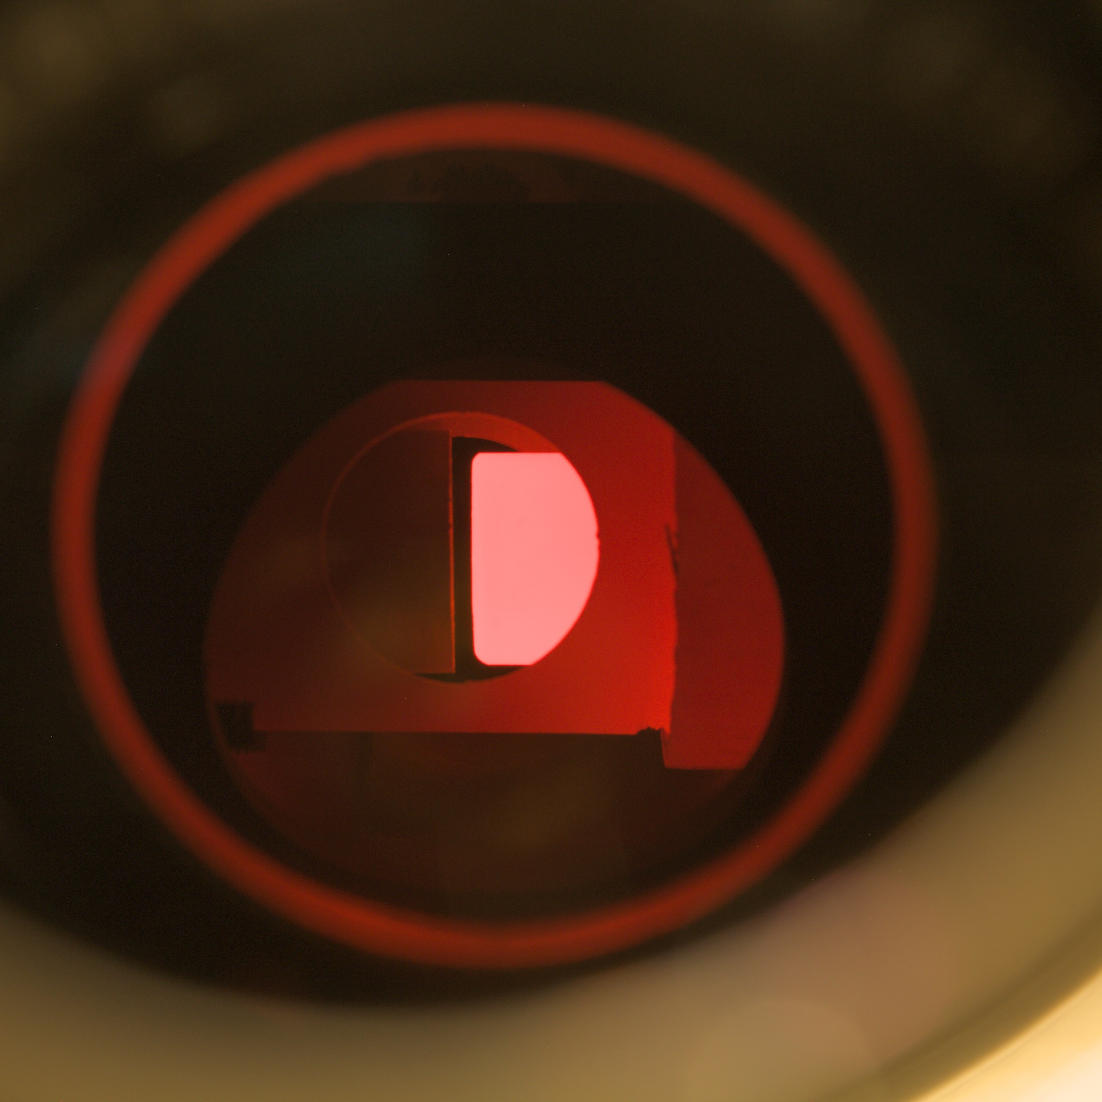
Image processing to estimate the cathode deformation at high temperature
Image processing

Slide 16
Image processing to estimate the cathode deformation at high temperature

Slide 17
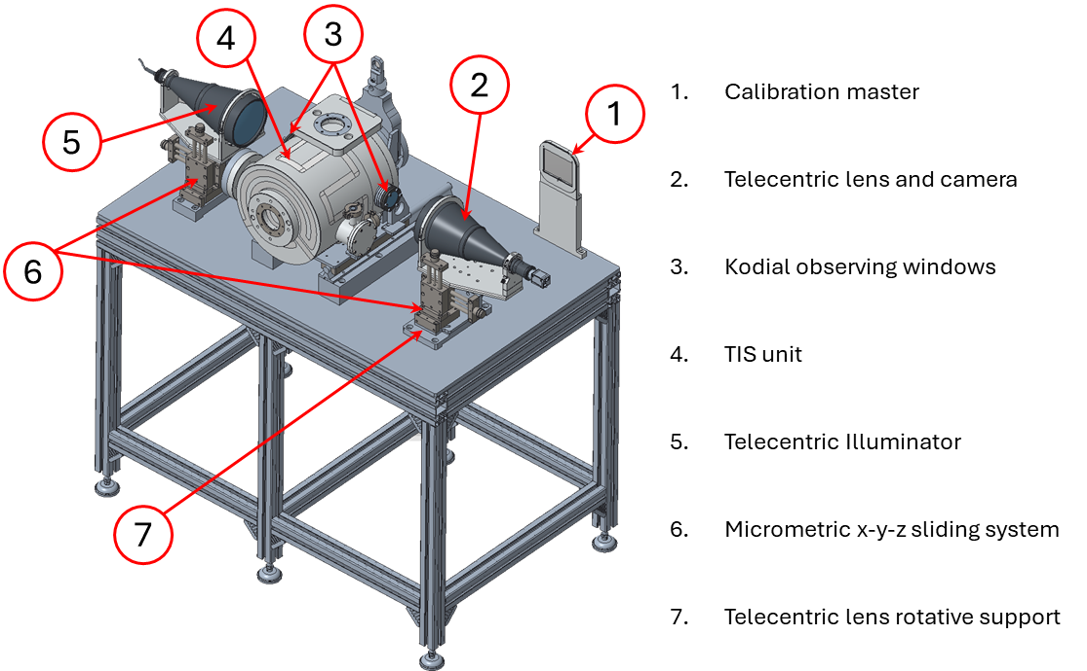
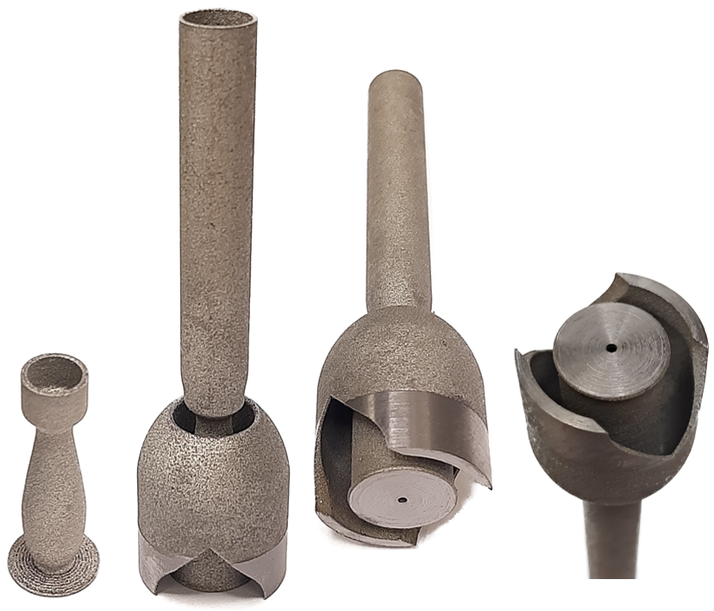
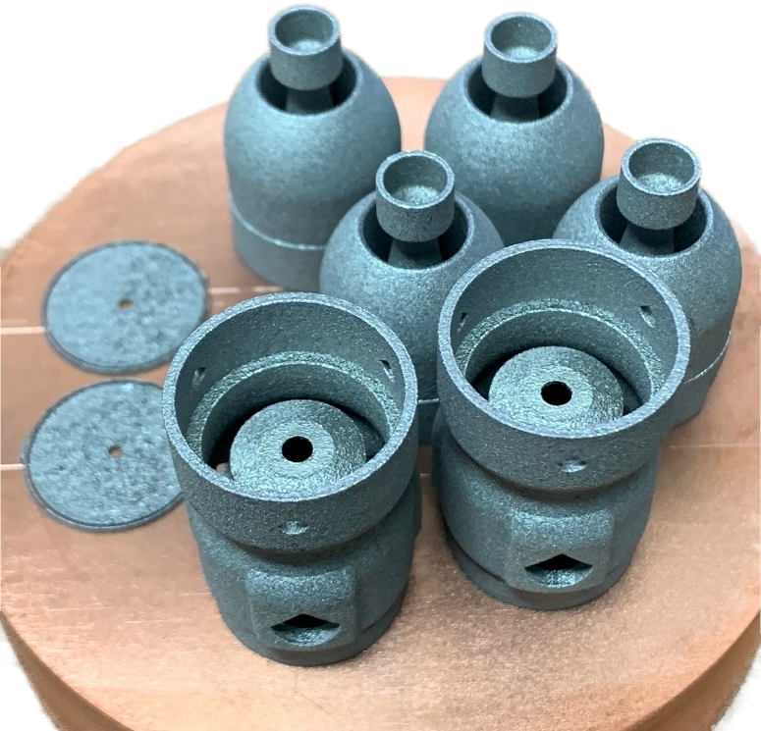
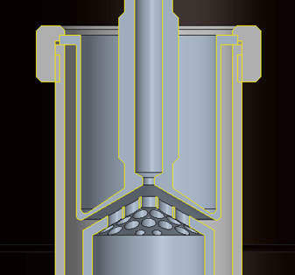
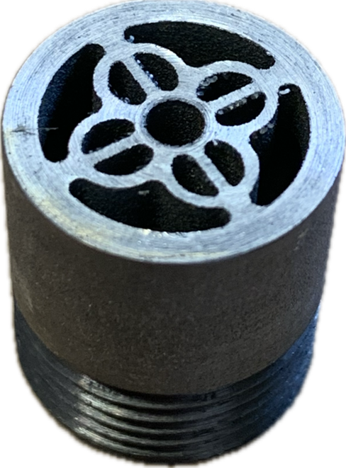
Future developments

Slide 18
Conclusions
The thermionic emission setup was successfully produced and assembled
At the moment, no failures occurred during the test. The anode, the cathode and the probe were maintained electrically insulated
The probe drain current and the anode drain current were separately measured
Considering a total drain current around 90 mA at 410, the probe drain current is about the 27% of I_{tot}

