Slide 1
HISOL
CSNV Experiment
High performance ISOL systems for the production of radioactive ion beams
Work package 1
Production and characterization of Carbide targets with Additive Manufacturing
Luca Avanzi and Alice Zanini – UNIPD-DII & INFN-LNL
HISOL periodic meeting – 1st July 2024

Slide 2
Targets for Isotope Separation On-Line (ISOL)
Targets Requirements
high thermomechanical properties to work at very high temperatures
high ion emissivity from nuclear reactions with the primary ion beam
formation and release of radioactive species
porous structure with tailored architecture to enhance the diffusion of radioisotopes
metal carbide/carbon nanocomposite as target material via additive manufacturing
Titanium carbide/carbon nanocomposite
Silicon carbide/carbon nanocomposite
Notes:
The following research activity focused on the developing of photocurable material feedstocks that can be later used for the Digital Light Processing. In the material feedstock need to be present so a certain amount of solvent, since a sol-gel route is adopted, a photopolymer for the photopolymerization step and the chemical reagents that enable the production upon the thermal treatment of silicon carbide. Until now three types of material feedstocks have been studied the first which contains only the inorganic precursor TEOS (T4), while the remaining two contains organic precursor MTES+TEOS(T8) and TMSPM+TEOS (T7). As can be seen from the table with the first two material feedstocks we were able to abotain 3D printed structures and also to carry out the thermal treatment obtain some Silicon Carbide while with the last one we are still stuck to the Printing stage with no samples available for now.

Slide 3
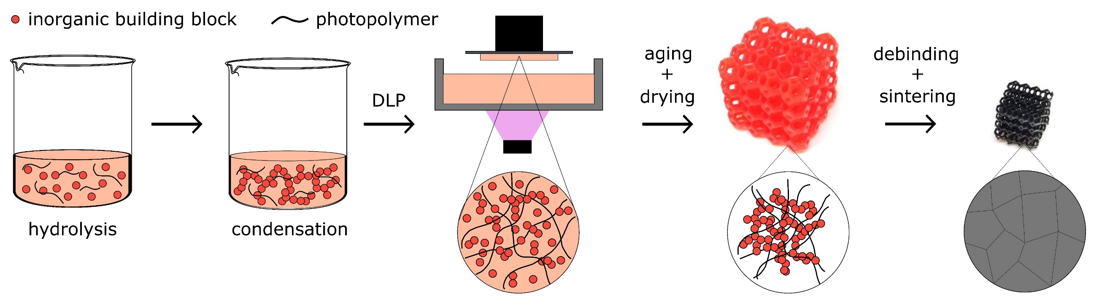
Targets for Isotope Separation On-Line (ISOL)
Sol-gel formulations:
chemical versatility
material design by assembling
molecular building blocks
fine tuning of the material properties
high homogeneity of the final product
mild synthesis conditions à introduction of organic moieities (i.e. photocurable functionalities for printing via digital light processing)
Notes:
The following research activity focused on the developing of photocurable material feedstocks that can be later used for the Digital Light Processing. In the material feedstock need to be present so a certain amount of solvent, since a sol-gel route is adopted, a photopolymer for the photopolymerization step and the chemical reagents that enable the production upon the thermal treatment of silicon carbide. Until now three types of material feedstocks have been studied the first which contains only the inorganic precursor TEOS (T4), while the remaining two contains organic precursor MTES+TEOS(T8) and TMSPM+TEOS (T7). As can be seen from the table with the first two material feedstocks we were able to abotain 3D printed structures and also to carry out the thermal treatment obtain some Silicon Carbide while with the last one we are still stuck to the Printing stage with no samples available for now.

Slide 4
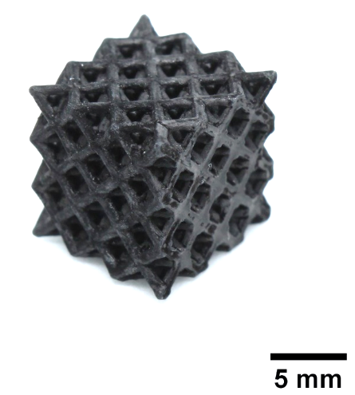
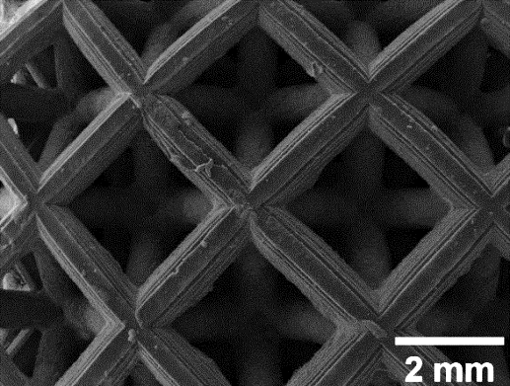
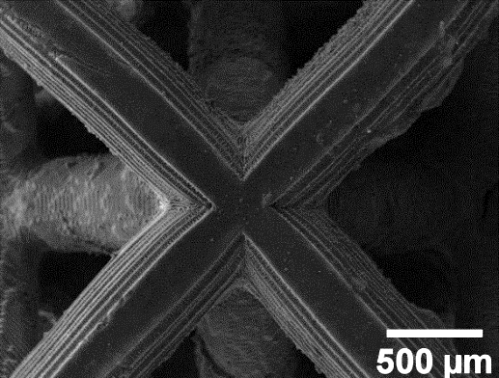
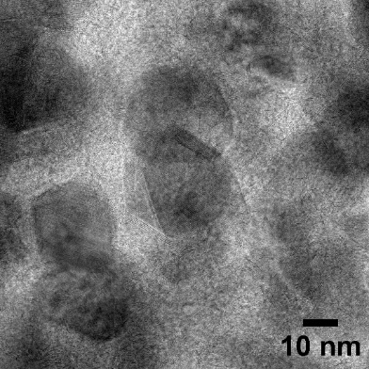
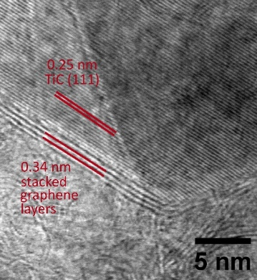
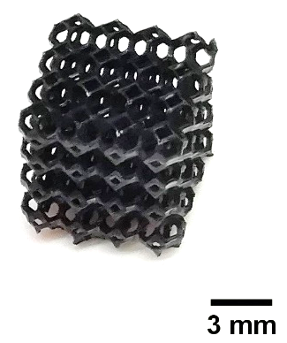
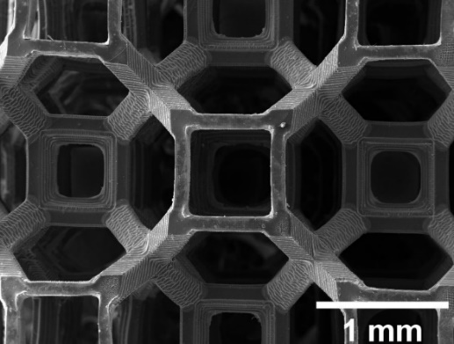
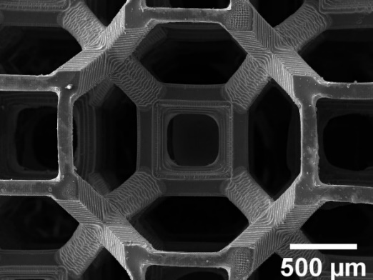
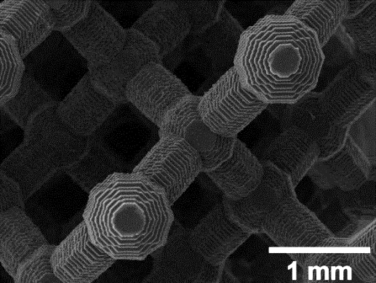
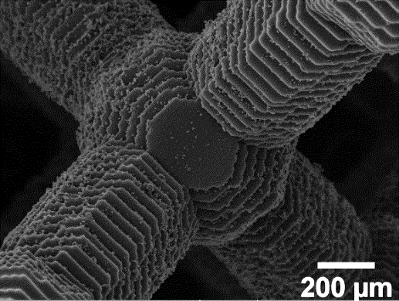
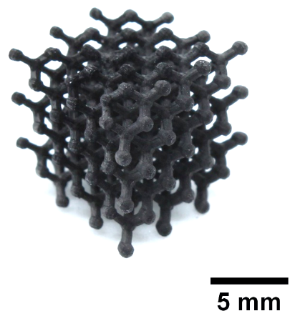
Additive manufacturing of TiC/C nanocomposites
Sol-gel synthesis using titanium isopropoxide as the Ti precursor, sucrose as C source and PEGDA as the photopolymer
3D printing via digital light processing (DLP) and sintering at 1750°C in vacuum
à TiC nanocrystallites randomly oriented in a carbon matrix and graphene layers from turbostratic graphite distributed along the (111) planes of TiC lattice
Notes:
The following research activity focused on the developing of photocurable material feedstocks that can be later used for the Digital Light Processing. In the material feedstock need to be present so a certain amount of solvent, since a sol-gel route is adopted, a photopolymer for the photopolymerization step and the chemical reagents that enable the production upon the thermal treatment of silicon carbide. Until now three types of material feedstocks have been studied the first which contains only the inorganic precursor TEOS (T4), while the remaining two contains organic precursor MTES+TEOS(T8) and TMSPM+TEOS (T7). As can be seen from the table with the first two material feedstocks we were able to abotain 3D printed structures and also to carry out the thermal treatment obtain some Silicon Carbide while with the last one we are still stuck to the Printing stage with no samples available for now.

Slide 5
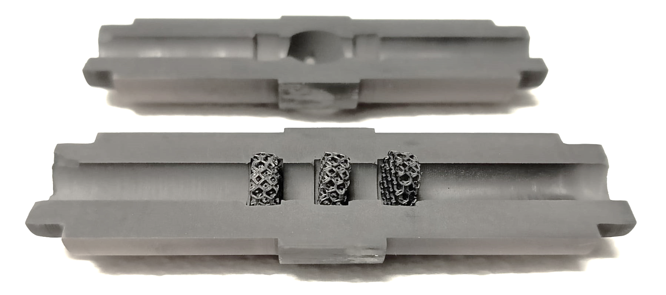
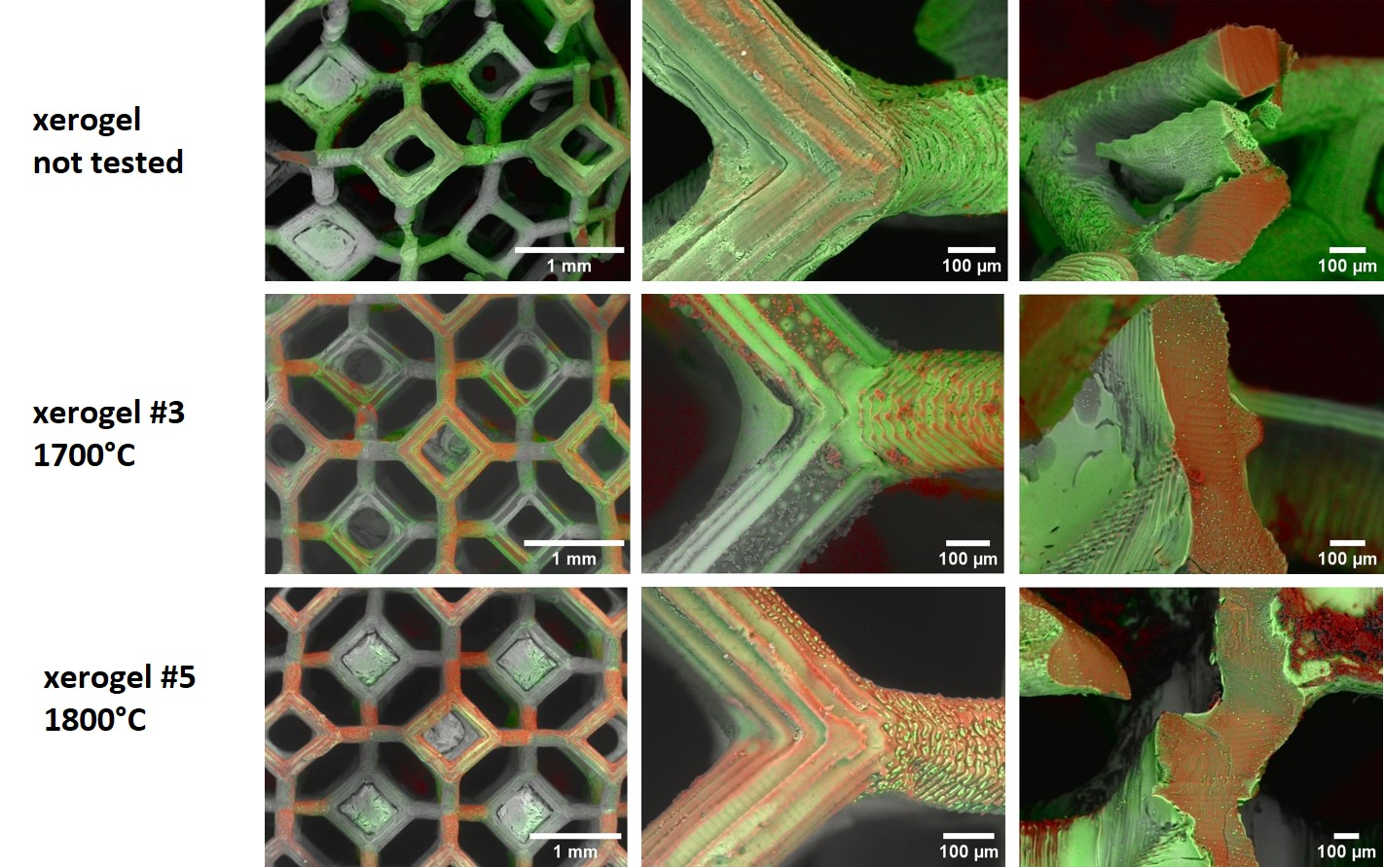
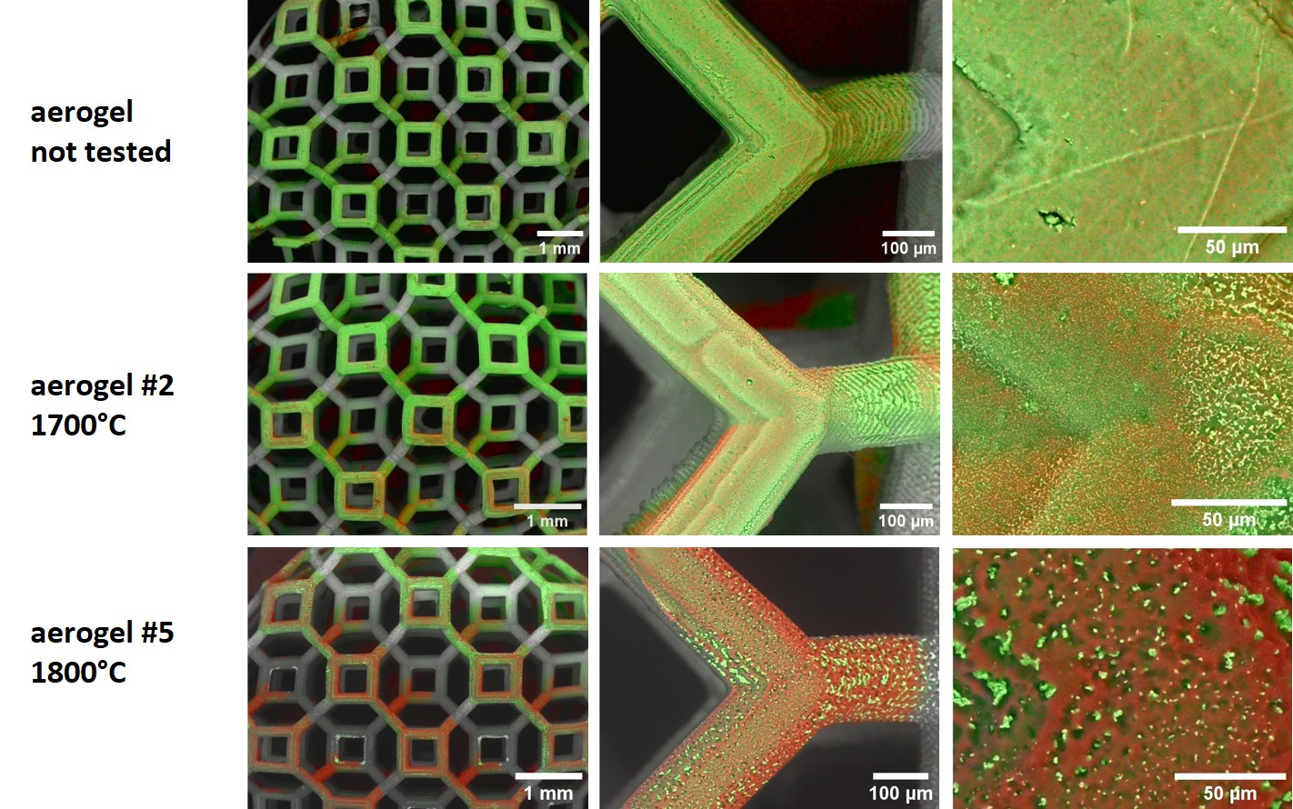
Additive manufacturing of TiC/C nanocomposites
Evaluation of the applicability of the printed components:
à endurance test under extreme operating conditions
1700°C, 24 h, 10⁻⁶ mbar
1800°C, 24 h, 10⁻⁶ mbar
à progressive loss of Ti with increasing temperature
Ti
C

Slide 6
Additive manufacturing of TiC/C nanocomposites
Evaluation of the applicability of the printed components:
à endurance test under extreme operating conditions
1700°C, 24 h, 10⁻⁶ mbar
1800°C, 24 h, 10⁻⁶ mbar
à progressive loss of Ti with increasing temperature
sample | SSA_{BET} [m²/g] | V_{micro} [%]
xerogel reference | 328 | 55
xerogel 1700°C | 135 | 29
xerogel 1800°C | 81 | 18
sample | SSA_{BET} [m²/g] | V_{micro} [%]
aerogel reference | 284 | 34
aerogel 1700°C | 175 | 24
aerogel 1800°C | 122 | 17

Slide 7
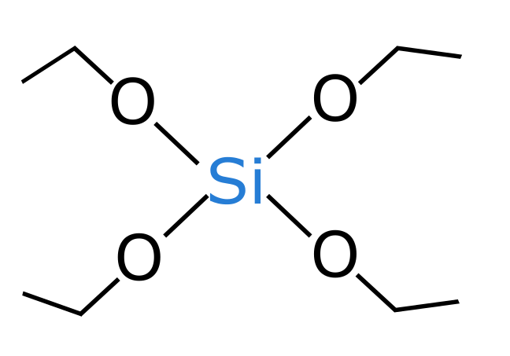
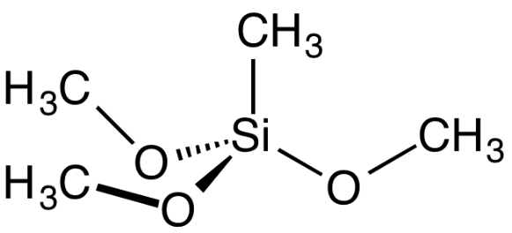
Additive manufacturing of SiC/C nanocomposites
Sol-gel Synthesis
Printing
Thermal treatment
Work in progress
TEOS
SiC is partially obtained, various parameters are being analized
MTES+
TEOS
Work in progress
TMSPM
+
TEOS
Work in progress
Notes:
The following research activity focused on the developing of photocurable material feedstocks that can be later used for the Digital Light Processing. In the material feedstock need to be present so a certain amount of solvent, since a sol-gel route is adopted, a photopolymer for the photopolymerization step and the chemical reagents that enable the production upon the thermal treatment of silicon carbide. Until now three types of material feedstocks have been studied the first which contains only the inorganic precursor TEOS (T4), while the remaining two contains organic precursor MTES+TEOS(T8) and TMSPM+TEOS (T7). As can be seen from the table with the first two material feedstocks we were able to abotain 3D printed structures and also to carry out the thermal treatment obtain some Silicon Carbide while with the last one we are still stuck to the Printing stage with no samples available for now.

Slide 8
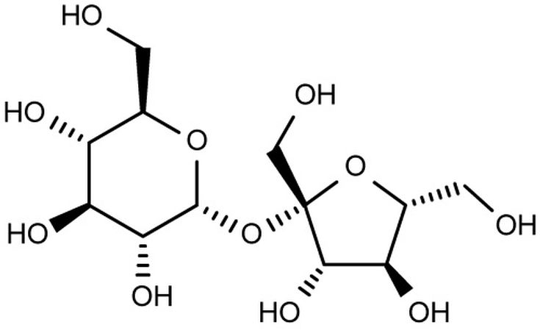
AM of SiC/C: TEOS approach
First synthetic approach for SiC:
silicon tetraethoxide (TEOS) – silicon source
sucrose – carbon source
pegda $M_{n}$ 575 - photopolymer
$${SiO}_{2}+3C⇋SiC+2CO$$
Composition
EtOH : Si = 6.5
H₂O : Si = 5
sucrose : Si = 0.67
Acid catalysis – HNO₃ 1M
C : Si = 3.07
The stoichiometric ratio between carbon and silica for the complete carbothermal reaction must be at least three
Notes:
Here we can understand the composition of the solution T4. As a very rule of thymb the amounts of solvents and photopolymer should remain respectively between 20-30% w/w and 15-20%w/w. The solvent should not be too high, otherwise we risk of having a very low concentration of the chemical precursor responsible for the production of the carbides, which is the TEOS, also the amount of photopolymer should not be too high otherwise we risk of lowering the yield of carbide since we are also introducing also oxygen and also an higher concentration of acrylates tend to reduce the porosity of the microstructures. Which is not beneficial for the release of the radioisotopes. The chemical synthesis in practice is performed adding the regents starting from TEOS and going down up to the addition of the nitric acid, then we wait an hour for the hydrolysis reaction to happen, after an hour the sucrose is added and after half an hour the photopolymer will be added. The solution will be then tested the next day to understand if phase separation have occurred while in the solution, or during the phtopolymerisation step.

Slide 9
AM of SiC/C: TEOS approach
Printing parameters
▪ $3.75 s$ for the base below the printed structures, to facilitate the removal
▪ $3 s$ was adopted for the structures to avoid over-exposure
▪ $100 \text{μ}m$ as layer thickness
▪ $1.2\frac{mm}{s}$ approach velocity
▪ $3 mm$ separation distance
▪ $1.6\frac{mm}{s}$ separation velocity
After 3D printing, the samples are left to the aging step for one week at room temperature
Then the samples are dried:
▪ from 30°C up to 50°C with a heating rate of 0,2°C/min, dwell for 15 hours
▪ from 50°C up to 120°C with a heating rate of 0,13°C/min, dwell for 15 hours
Notes:
The next step is the DLP, since one of the future step will also understand which is the best structure to use for the targets a test that must be done is the capability of the material feedstock to be printed in much more different way as possible, we could think of it as the easiness of printability of the material feedstock. The solution T4 as can be seen from the figures have already been tested with various type fo geometries, like truss structures but also with geometries that have also a lot of areas like the gyroid, The only difficulty is the printing of really bulky components in which there are multiple layers one on top of the other composed by a unique area. The printer adopeted is the ASIGA Pico 2 which is a DLP printer so the structure is printed layer by layer, so is a pretty fast technique respect to a SL machine that photpolymerize point by point, and is also in a bottom up configuration, so the stresses that can develop during the printing stage are less.

Slide 10
AM of SiC/C: TEOS approach
The furnace set up has been designed so that it can withstand a current up to 1300 A and a maximum temperature of 2250°C, while the vacuum level that can be reached during the operation is around 10⁻⁶ mbar
After performing the experimental calibration and comparing the data with the FEM model, 1050 A was set as the optimal current to ensure a final temperature of 1500°C

Slide 11
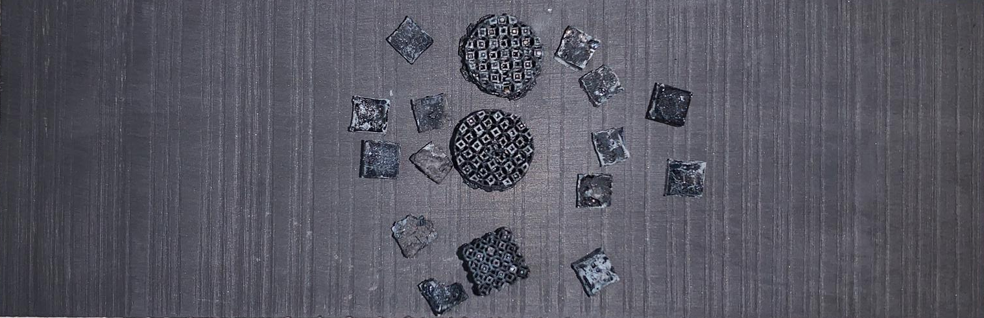
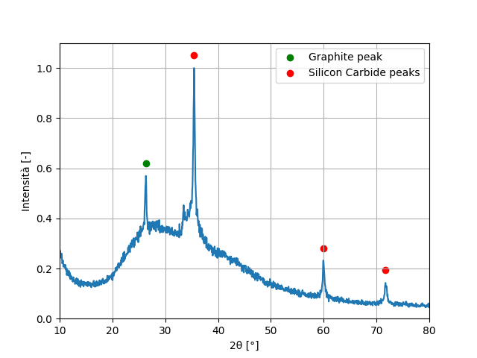
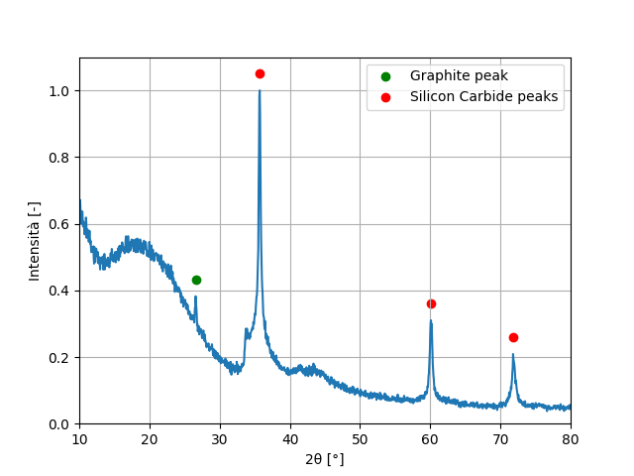
AM of SiC/C: TEOS approach
Pre-treatment at 1350°C for 3 hours to remove the organic compounds that could damage the vacuum system
Final sintering step at 1500°C in vacuum for 5 hours
à The phases are SiC, graphite and amorphous silica. Despite the use of a stoichiometric C:Si ratio, unreacted silica is still formed in the samples.

Slide 12
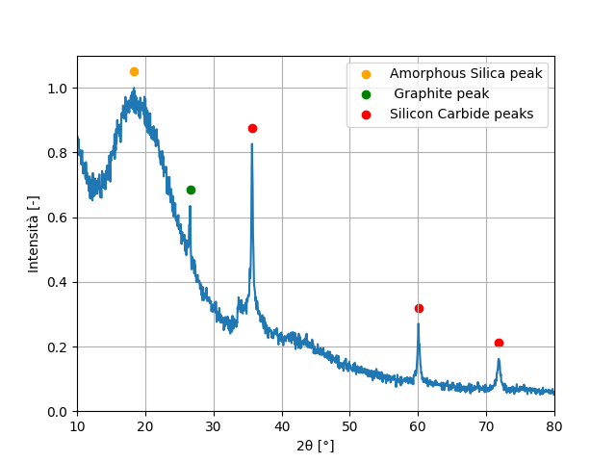
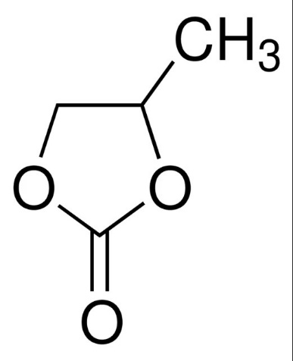
AM of SiC/C: TEOS approach
+ high boiling point solvent
The presence of high boiling point solvents seems to decrease the final SiC content upon carbothermal reduction at 1500°C, despite the use of the same C:Si ratio.

Slide 13
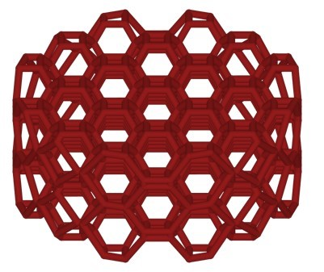
AM of SiC/C: TEOS approach
To make a valid comparison, the 3D samples have been printed using the same geometry as bulk components might lead to lower carbothermal reduction conversion due to the larger diffusion paths within the sample
Different synthesis and fabrication parameters tested:
Water used for hydrolysis
$H_{2}O:Si$= 1, 2, 5 tested
1 and 2: phase separation before printing
5: stable solution
Effect of C:Si ratio
Carbothermal reduction not completed with C:Si = 3
à to be investigated the use of a sub/over –stoichiometric ratio C:Si =1.5, 3, 5
Time for the thermal treatment
Carbothermal reduction not completed after 5 hours at 1500°C
à to be tested different sintering times (10 and 15 hours)

Slide 14
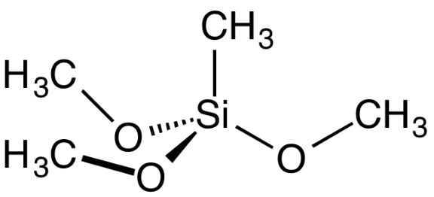
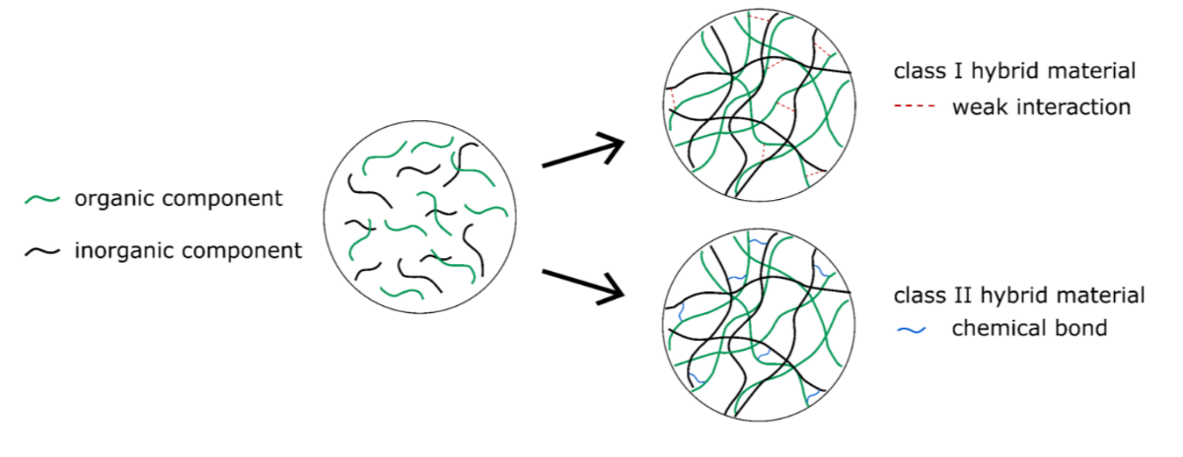
Other material feedstocks- Sol-gel synthesis
Other silicon precursors can be used besides TEOS, such as hybrid organic-inorganic precursors:
Methyltrimethoxysilane (MTES)
3-(Trimethoxysilyl)propyl methacrylate (TMSPM)
Differences respect to TEOS:
presence of an already existing covalent Si-C bond
TMSPM contains an acrylic functionality that can participate to photopolymerization reactions, forming class II hybrid material
MTES
TMSPM

Slide 15
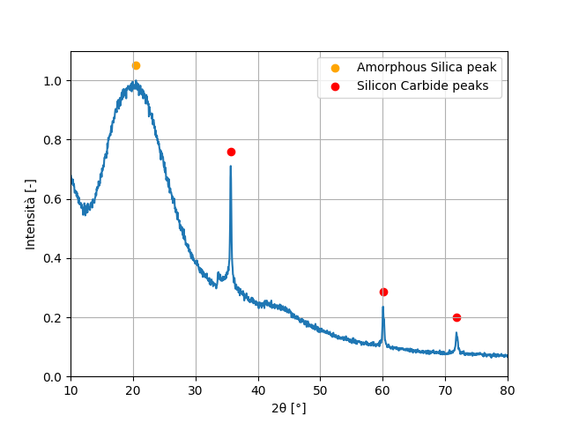
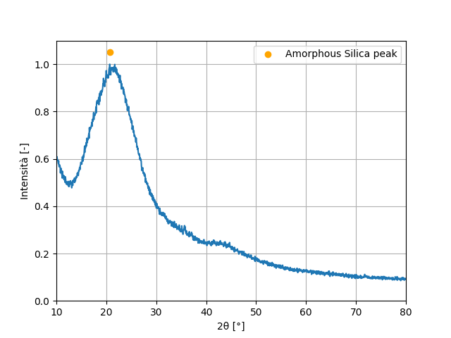
MTES + TEOS approach
test 1
TEOS : MTES = 0.5
PEGDA : TEOS = 5.3 (mass ratio)
sucrose : Si = 0.33
C : Si = 1.69
test 2
TEOS : MTES = 0.5
PEGDA : TEOS = 5.3 (mass ratio)
sucrose : Si = 0
C : Si = 0.19
1500°C 5 h
1500°C 5 h
This further confirms the need of sucrose as the carbon source, despite the use of precursors already containing a direct Si-C bond
Ongoing test using an increased sucrose:Si ratio of 3.07

Slide 16
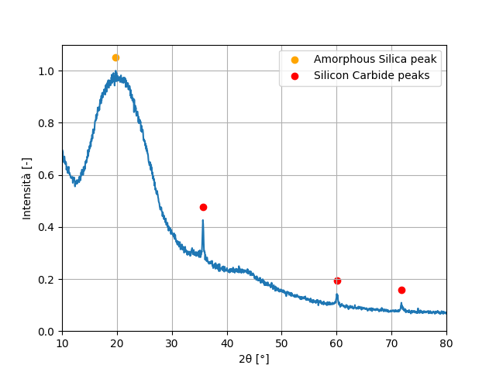
MTES + TEOS approach
test 1
TEOS : MTES = 0.5
PEGDA : TEOS = 5.3 (mass ratio)
sucrose : Si = 0.33
C : Si = 1.69
3D printed components with different geometries and surface-to-volume ratio
1500°C 5 h
1500°C 5 h
thin features
thick features
à Further confirmation that carbothermal reduction is greatly affected by the type of geometry, in particular the presence of thicker pillars results in lower conversion into SiC

Slide 17
TMSPM + TEOS approach
test 3
TEOS : TMSPM = 0.5
PEGDA : TEOS = 12.3 (mass ratio)
sucrose : Si = 0.66
C : Si = 3.47
sucrose and TMSPM poor compatibility à phase separation and scattering during UV-photopolymerization
problem during the printing step, the printed parts tend to detach from the base, using lower speeds and lower times might help, but require a lot of photopolymer to ensure high homogeneity of the printed part
TPM is a better compatibilizer than ethanol for sucrose and TMSPM
limitations on the dimensions of the samples that can be fabricated without printing failures
à Ongoing optimization

Slide 18
Conclusions
development of UV-photocurable formulation coupled with sol-gel chemistry suitable for DLP → fabrication of complex-shaped structures
explore the effect of different precursors TEOS, MTES and TMSPM on the final yield of Silicon Carbide
explore the effects of the other reagents for the sol gel synthesis, and determination of the right thermal treatment
calibration of experimental set-up to carry out the thermal treatment of the samples

Slide 19
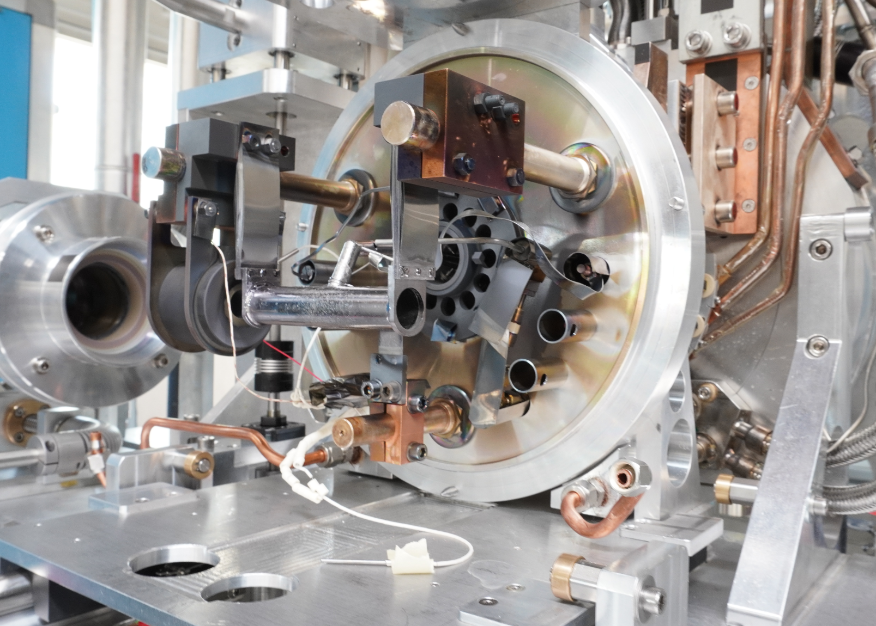
Thank you
Notes:
This is the question that your experiment answers

