Slide 1
HISOL
CSNV Experiment
High performance ISOL systems for the production of radioactive ion beams
Work package 1
Development of High Performance ISOL Targets – Status update
Stefano Corradetti – INFN-LNL

Slide 2
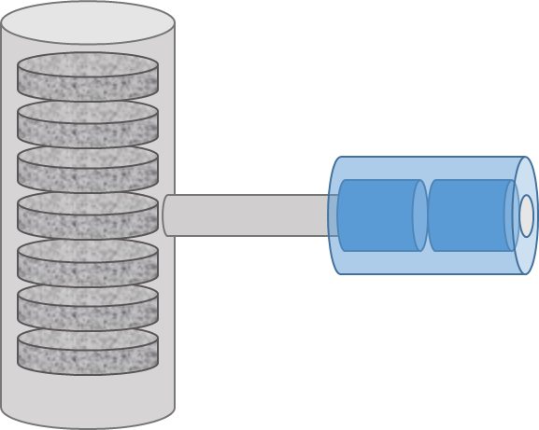
HISOL Objectives
Main goal:
Development of a new generation of High Performance ISOL Targets and Ion Sources with cutting edge technologies available within INFN and its collaboration network.
Such aim foresees three fundamental objectives:
Study and development of innovative recipes and methods to produce ISOL targets
Study and development of innovative methods to produce and operate ion sources
Characterization and multiphysics simulation of the obtained components by means of advanced techniques

Slide 3
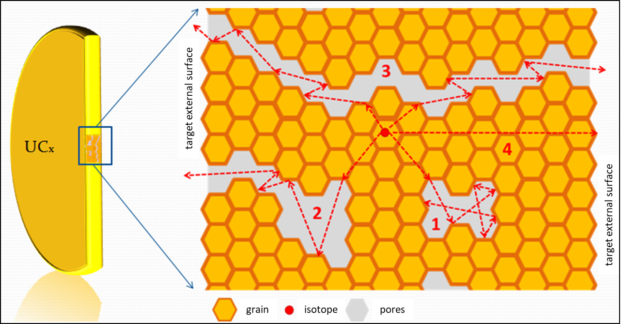
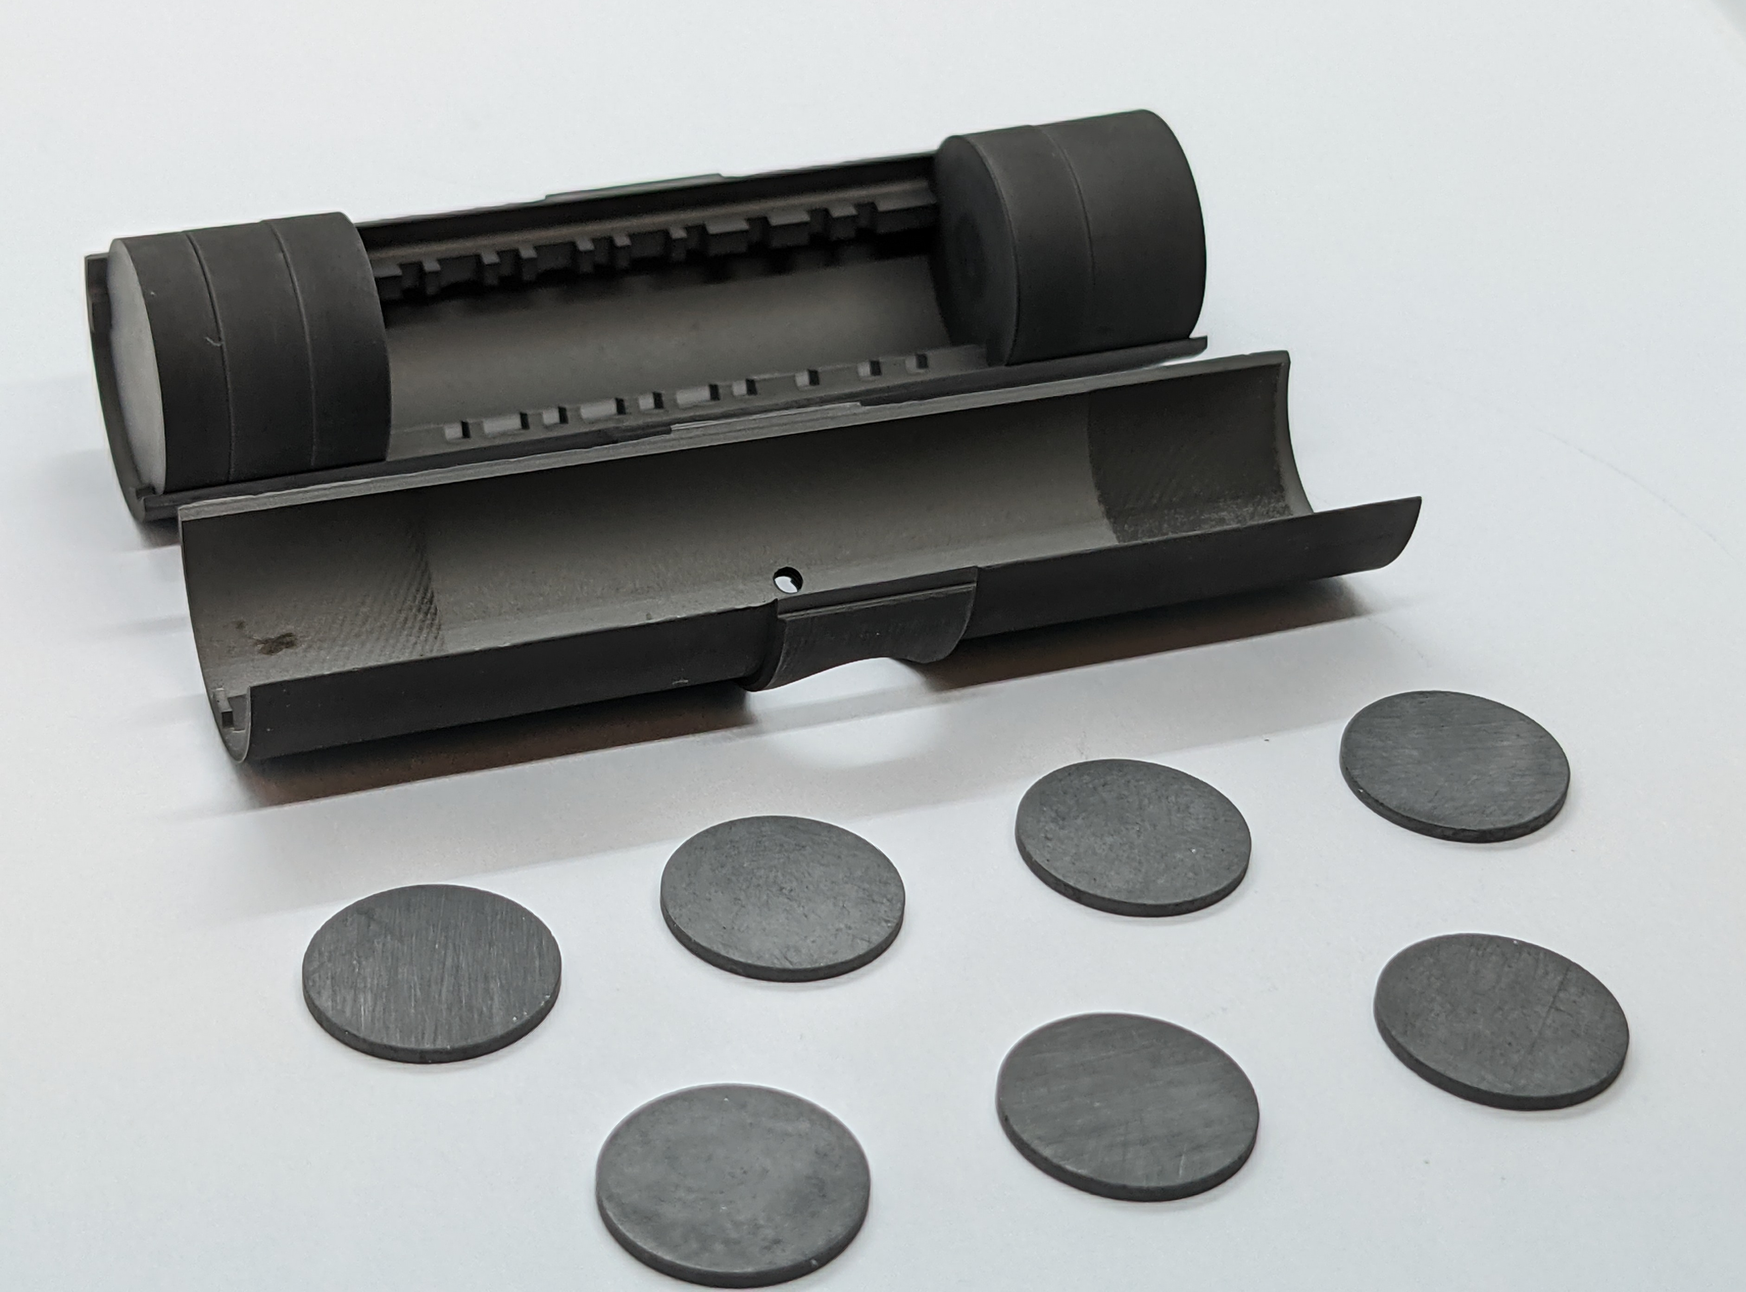
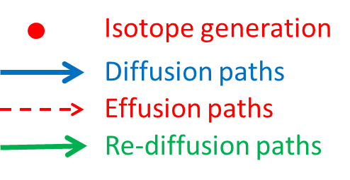
ISOL target requirements
Target requirements:
open porosity and reduced grain size
high thermal conductivity
high mechanical properties
stability at high temperature
production of radioisotopes
Total isotope yield deeply affected by open porosity (diffusion/effusion processes)
BULK TARGET = BAD RELEASE!!
Need of targets with regular improved microstructure
Notes:
Summarise your research in three to five points.

Slide 4
Timetable, Milestones and Budget
 |  | Year 1 |  |  |  | Year 2
 |  | M3 | M6 | M9 | M12 | M15 | M18 | M21 | M24
WP1 | Development of High Performance ISOL Targets
T1.1 | Production of TiC samples with regular structures for characterization activities |  | MS1.1
T1.2 | Development of TiC disks with regular structures for ISOL Targets |  |  |  | MS1.2
T1.3 | Production of SiC samples with regular structures for characterization activities
T1.4 | Development of SiC disks with regular structures for ISOL Targets |  |  |  |  |  |  | MS1.3
T1.5 | Long term high temperature test of a TiC/SiC ISOL Target coupled with a Plasma Ion Source |  |  |  |  |  |  |  | MS1.4
WP1 milestones |  | Date
MS1.1 | Production of TiC/SiC samples with regular structures for characterization activities | M06
MS1.2 | Printing Test of TiC disks with regular structures for ISOL Targets | M12
MS1.3 | Development of TiC/SiC disks with regular structures for ISOL Targets | M21
MS1.4 | Long term high temperature test of a TiC/SiC ISOL Target coupled with a Plasma Ion Source | M24
Notes:
Summarise your research in three to five points.

Slide 5
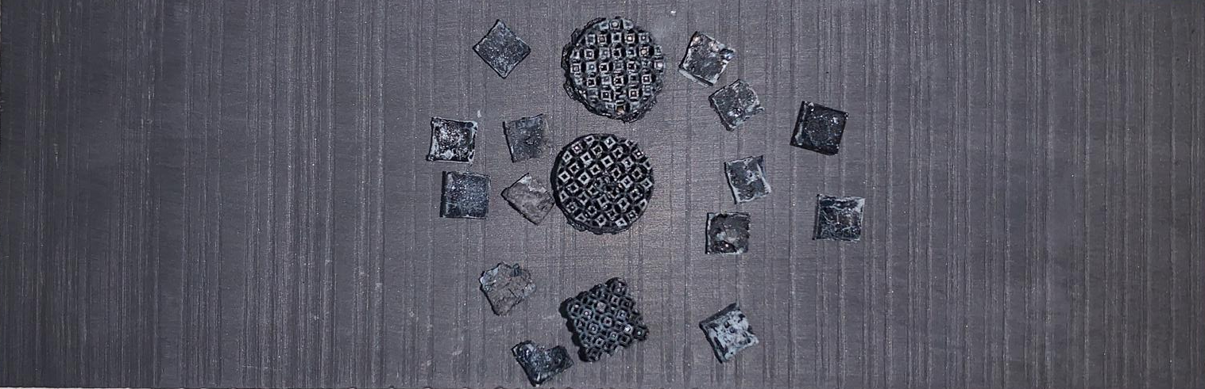
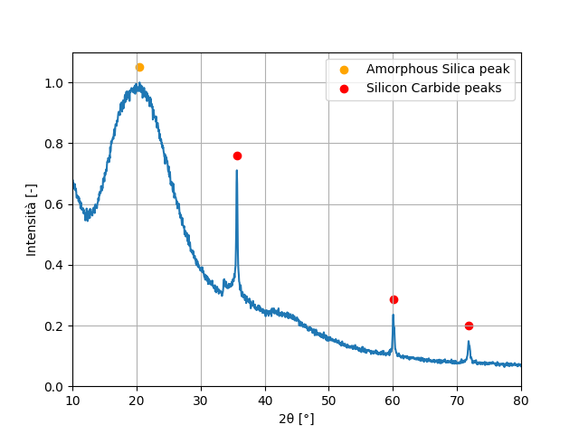
Developments in HISOL
T1.3: Production of SiC samples with regular structures for characterization activities
Optimisation of the production of SiC samples via Digital Light Processing
Luca Avanzi, Master thesis in Materials Engineering, UNIPD, Supervisor G. Franchin- to be defended end of 2024
Notes:
Summarise your research in three to five points.

Slide 6
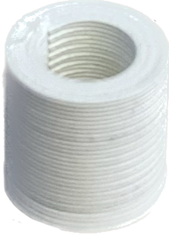
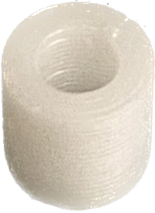
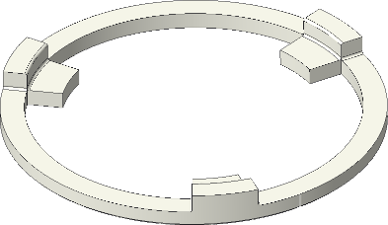
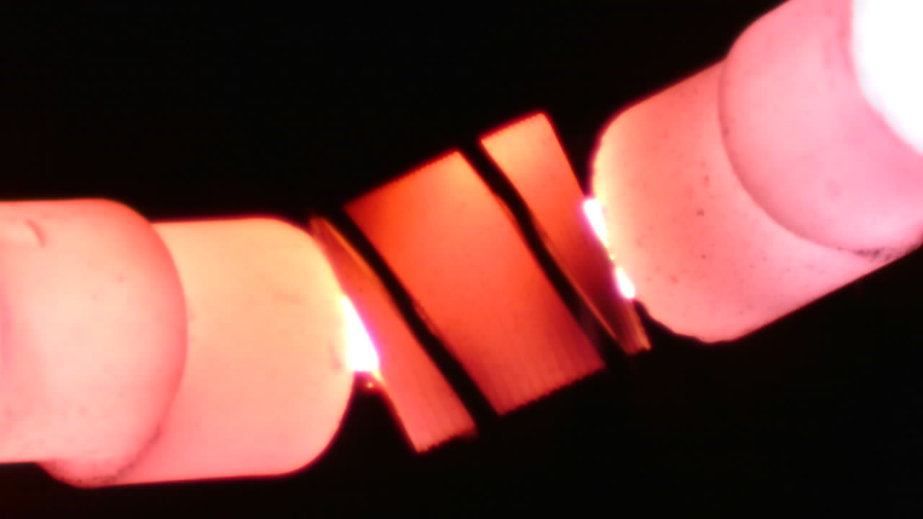
Developments in HISOL
EXTRA: Production and characterization of Oxide insulators with Additive Manufacturing via Fused Filament Fabrication (WP1-WP2 transversal activity)
Possible future geometry
(Additive Manufacturing)
Dev Jyoti Roy, Master thesis in Materials Engineering, UNIPD, Supervisor G. Franchin- to be defended end of 2024
Notes:
Summarise your research in three to five points.

Slide 7
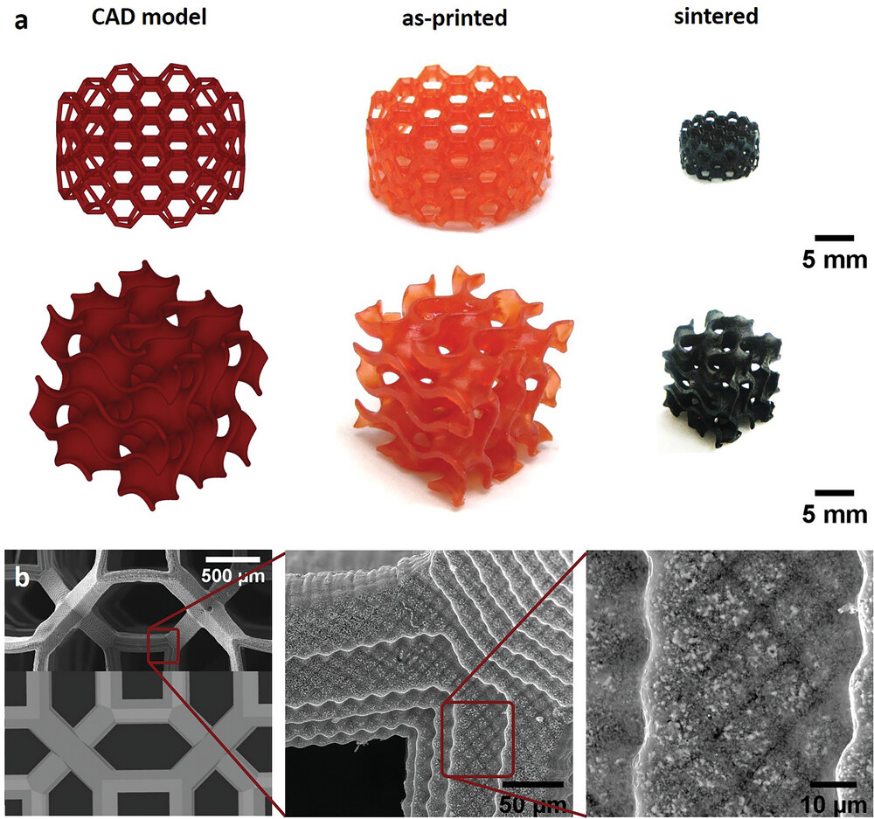
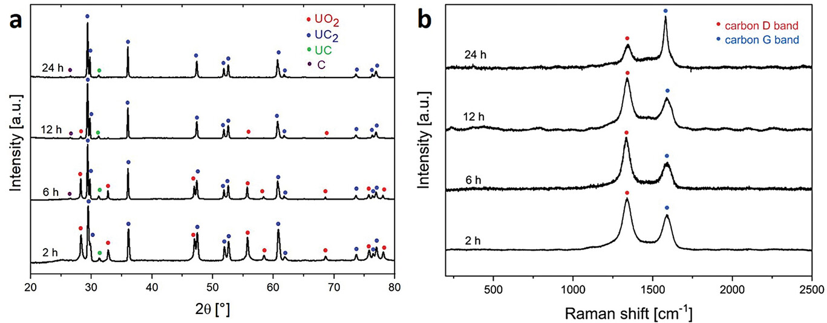
Developments in HISOL
EXTRA: LaCx and UCx sample production with Digital Light Processing (activity performed at JRC-Karlsruhe)
Data published in:
A. Zanini, P. A. Celdran, O. Walter, S. M. Carturan, J. Boshoven, A. Bulgheroni, L. Biasetto, M. Manzolaro, R. Eloirdi, S. Corradetti, G. Franchin, First Structured Uranium-Based Monoliths Produced via Vat Photopolymerization for Nuclear Applications. Adv. Funct. Mater. 2024, 2406916. https://doi.org/10.1002/adfm.202406916
Notes:
Summarise your research in three to five points.

Slide 8
Conclusions - planned activities
T1.3 & T1.4: Development of SiC disks with regular structures for ISOL Targets
Consolidation of the formulation to produce SiC targets via DLP
Characterization of DLP SiC samples
T1.5: Long term high temperature test of a TiC/SiC ISOL Target coupled with a Plasma Ion Source
Evaluation of the long-term stability of the AM targets and possible release studies
EXTRA: Ongoing production and characterization of oxides insulators with Additive Manufacturing techniques
Development of other geometries

Slide 9
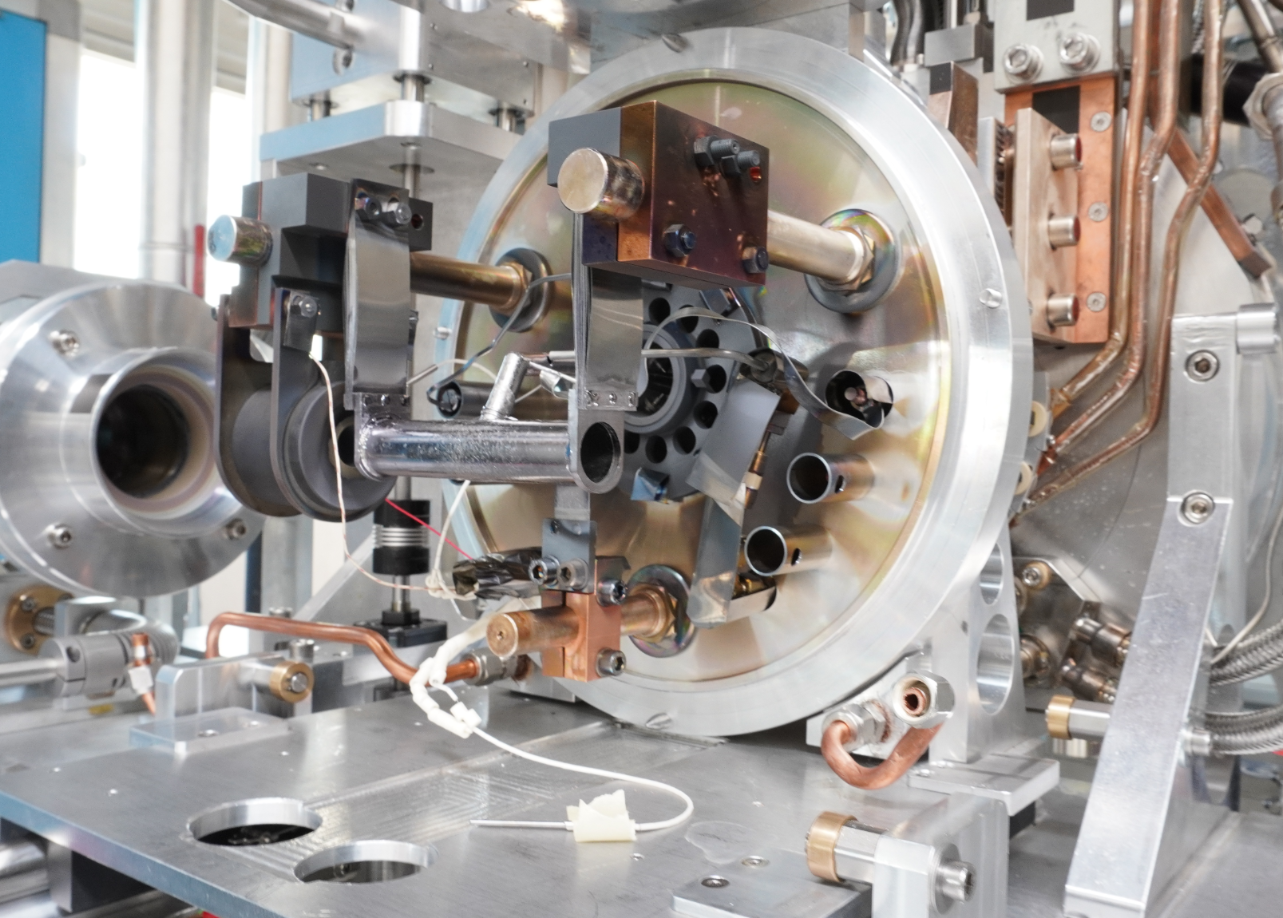
Thank you
Notes:
This is the question that your experiment answers

