Slide 1
High-precision clocks and triggers for longitudinal beam measurements in high energy synchrotrons
LLRF Topical Workshop on Timing, Synchronization, Measurements and Calibrations
Frascati, 29 October 2024
G. Papotti,
H. Damerau, G. Hagmann, T. Levens, A. Spierer
CERN, Geneva, Switzerland

Slide 2
outline
introduction on SPS, SPS RF
SPS longitudinal beam observation systems
in particular Mountain Range and Beam Quality Monitor
standard triggering scheme
including limitations, especially for ion operation
triggering scheme with WR2RF

Slide 3
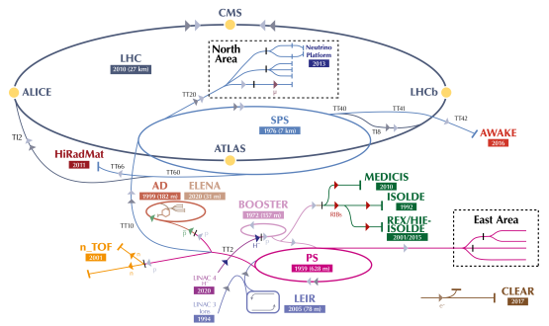
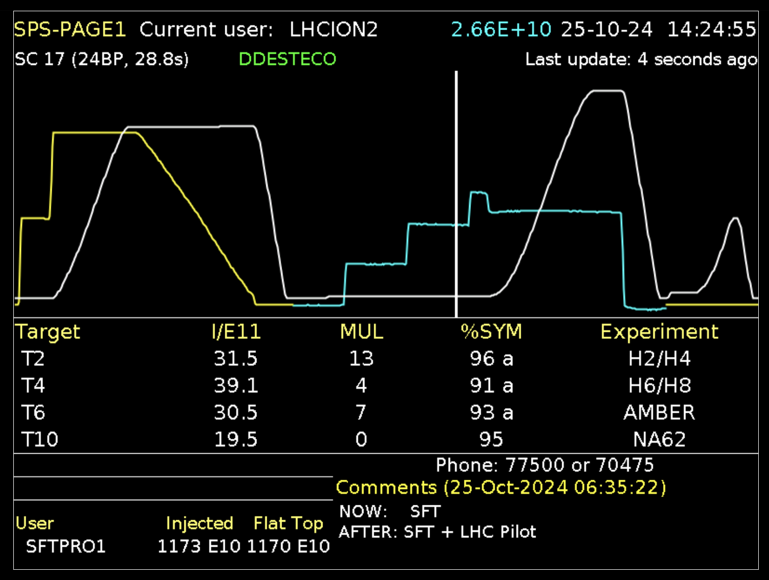
introduction: the SPS
Super Proton Synchrotron (SPS): second largest CERN accelerator
LHC injector, fixed target program in North Area, AWAKE, HiRadMat
different “users” served in the same minute
SPS status display (Page 1)

Slide 4
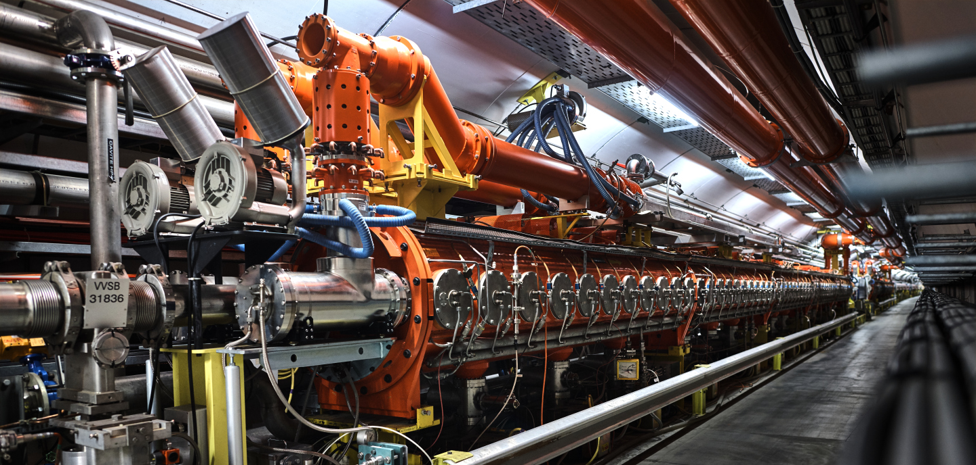
introduction: SPS RF
6x 200 MHz Travelling Wave structures
designed for 10 - 450 GeV/c protons
bandwidth: 199.5 - 200.4 MHz
for p+, f_{RF} = h f_{rev}, with h = 4620
Δf = 0.06-0.2%
note: operation for heavy ions is more complex
p [GeV/c] | f_{rev} [kHz] | f_{RF} [MHz] | bucket [ns]
10 | 43.186 | 199.5185 | 5.012
14 | 43.279 | 199.9468 | 5.001
26 | 43.347 | 200.2645 | 4.993
450 | 43.375 | 200.3944 | 4.990

Slide 5
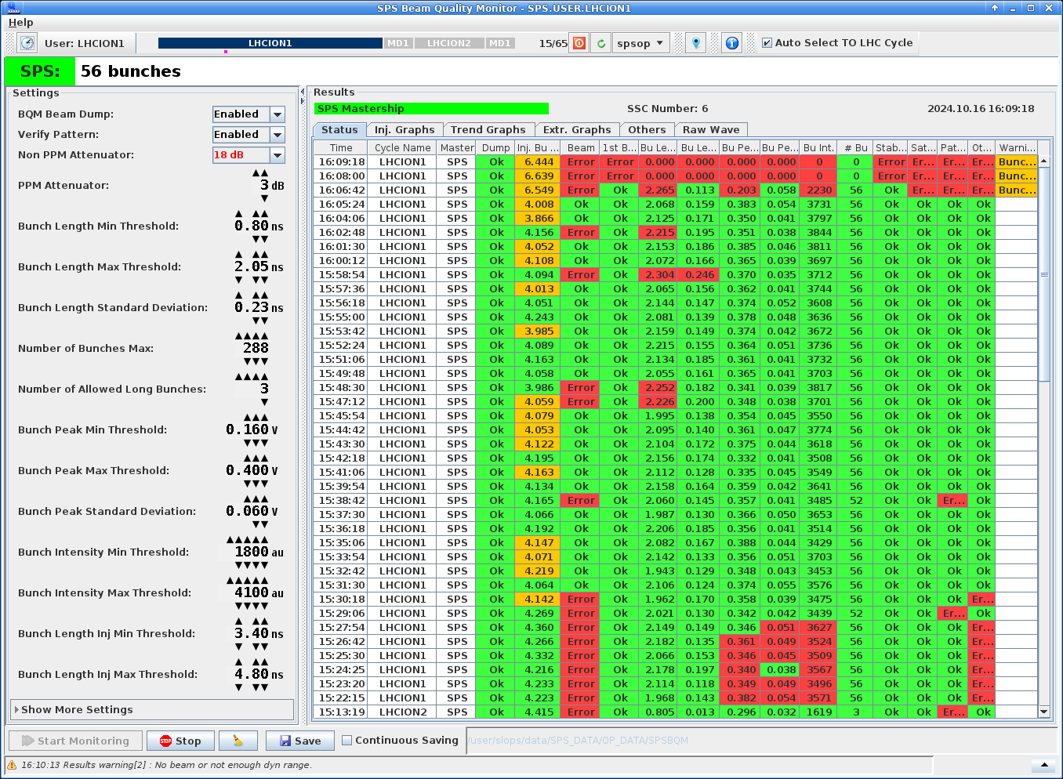
SPS longitudinal beam observation systems
accelerator
tunnel
surface building
(Faraday Cage)
several different systems
remotely controlled programmable attenuators
~100 m on cable or fibre to ADC
ADC on the surface
(triggering scheme on next slide)
beam
shielding
wall current monitor
pickup
attn
ADC
(~15m)
cable / fibre
(~100m)
MR
two main systems used in operation
“Mountain Range” for visual checks
beam structure, injection phase, …
older pickup, transmission on cable
“Beam Quality Monitor” for automated evaluation of longitudinal beam quality and pattern
inhibits injection into the LHC if parameters out of spec
newer pickup, transmission on optical fibre for improved profile quality
BQM

Slide 6
longitudinal observation triggering scheme
General Machine Timing
General Machine Timing
telegram broadcast on cable to synchronize equipment to events like injection, start of ramp, start of flat top, start of fast or slow extraction…
Local Timing receiver
outputs pulse triggered by timing event, with option of additional delay (generally ms precision)
VME Trigger Unit
RF-synchronous counter, thanks to f_{rev} and f_{RF} inputs (despite the changing frequencies)
precise to the bucket + fine alignment down to 20 ps precision
started by local timing pulse and f_{rev}
alternatively to local timing, could also be started by e.g. injection or extraction pulse, for turn accuracy
can do single pulse, or pulse burst at chosen spacing
VME Trigger Unit finally triggers the ADC
for desired user/cycle, at desired time in the cycle, at desired bucket, with fine alignment
i.e. beam synchronous triggers at any azimuth with resolution of 20 ps
example: for standard MR, acquire bucket 1 for 42 consecutive turns (i.e. 1 ms) at every injection
Local Timing
receiver
f_{rev}
VME
Trigger Unit
f_{RF}
ADC

Slide 7
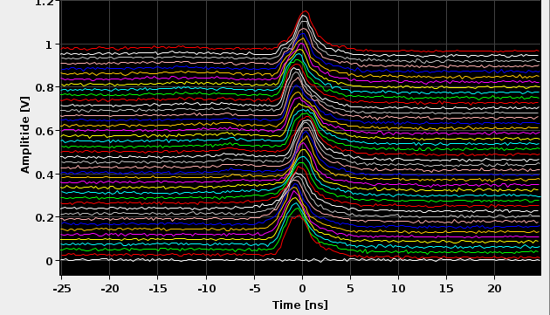
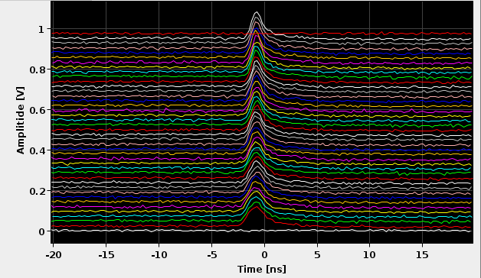
examples of acquisitions with protons
MR along the cycle
1 ms (42 turns)
10 s
MR at injection

Slide 8
observation jitter
BQM includes beam longitudinal stability analysis
comparison of 8 acquisitions at turn spacing of fraction of synchrotron period
must make sure it is not the trigger that moves!
instability measurement includes component proportional to ADC trigger offset
trigger offset is due to free running clock of ADC, different for each acquisition, and <125 ps (ADC is 8 GS/s)
top plot: stable beam is measured as marginally unstable, proportionally to trigger offset excursion among acquisitions
bottom plot: if profiles are interpolated according to trigger offset, instability measurement is reduced
for the purposes of longitudinal beam observation, the trigger jitter of the observation systems is negligible
30
20
instability [%]
10
0
30
20
instability [%]
10
0
hand-written notes
from my 2009 logbook!

Slide 9
added complexity for ion operation
p [GeV] (Pb) | f_{rev} [kHz] | f_{RF} [MHz]
17.07 | 42.967 | 198.5094
451.15 | 43.375 | 200.3921
f_{RF} = 4620 f_{rev} too low at injection for ions
e.g. for lead (Pb)
(cavity bandwidth: 199.5 – 200.4 MHz)
Δf = 0.9%
use Frequency Shift Keying (FSK) and “Amplitude” Modulation (AM)
FSK: f_{RF,on} and f_{RF,off} in the same turn
AM: RF off for half of the time
choose f_{RF,on} as needed for beam, within cavity bandwidth
at injection: bunch to bucket transfer from injector (CERN Proton Synchrotron), and capture at SPS (h = 4653, f_{RF,on} = 199.9255 MHz)
f_{RF,off} in the other half of the ring, such that beam is in bucket 1 and with correct phase after a turn
f_{RF,avg} = 4620 f_{rev} = (f_{RF,on} + f_{RF,off})/2
in addition, Fixed Frequency Acceleration: accelerate with varying h (f_{RF,cen} = 200.222 MHz)
1 turn
f_{RF,on}
f_{RF,off}

Slide 10
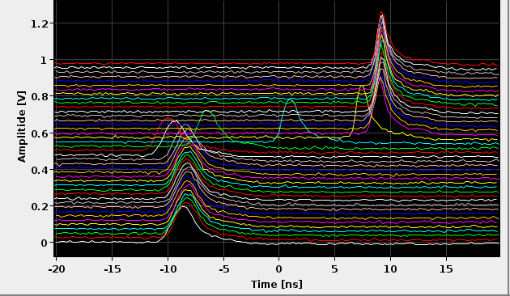
examples of acquisitions with Pb ions
complex RF operation complicates longitudinal observations
frequency swing from injection to high energy combined with cable delays results in moving acquisition
e.g. bucket 1 in MR acquisition moves by ~4 buckets
BQM needs to verify beam pattern: pattern matching depends on time in acquisition, and on phase of FSK modulation
10 s

Slide 11
triggering scheme with White Rabbit
in 2024, f_{rev} and f_{RF} synthesized locally by WR2RF (receives digitally the FTW for the f_{RF})
on WR2RF see A. Spierer and G. Hagmann at this workshop
delay compensation knob: calculate cable delay compensation, at every turn
FSK offset knob: adjust for counting f_{RF,on} and f_{RF,off}
trigger unit offset: used for compatibility with previous setup
advantages
observation does not slip with acceleration
same bucket 1 reference for different beams
results also in easier settings management for different users
General Machine Timing
Local Timing
Receiver
WR
network
WR2RF
f_{rev}
VME
Trigger Unit
f_{RF}
ADC

Slide 12
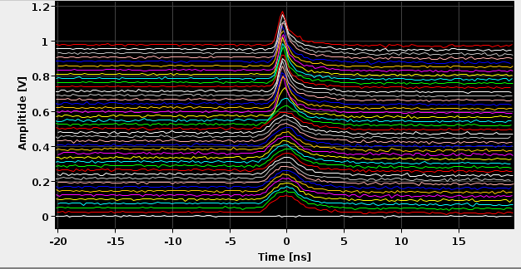
examples of acquisitions with WR2RF - ions
10 s
10 s
with standard distribution
with WR2RF

Slide 13
present installation
Local
Timing
Receiver
VME
Trigger
Unit
WR2RF
General
Machine
Timing

Slide 14
conclusions
several systems used at CERN SPS for longitudinal beam observations
e.g. Mountain Range for visual checks
e.g. Beam Quality Monitor for automated analysis of beam pattern, stability, … and inhibition of injection into LHC if parameters are out of spec
improvement in longitudinal beam observations thanks to WR2RF
no observation slippage throughout acceleration ramp
single bucket 1 reference for different beam types
easier setting management
WR2RF settings management to be improved
ideally, user to input delay and azimuth
results in cumbersome commissioning at present

Slide 15
references
I. Béjar Alonso, O. Bruning, P. Fessia, M. Lamont, L. Rossi, L. Tavian, M. Zerlauth, "High-Luminosity Large Hadron Collider (HL-LHC): Technical design report", CERN, Geneva, Switzerland, 2020.
J. Coupard et al., "LIU Technical Design Report- Volume I: Protons", CERN, Geneva, Switzerland, Rep. CERN- ACC2014-0337, Dec. 2014.
E. Shaposhnikova, E. Ciapala, E. Montesinos, "Upgrade of the 200 MHz RF system in the CERN SPS", in Proc. 2nd Int. Particle Accelerator Conf. (IPAC’11) IPAC11, San Sebastian, Spain, Sept. 2011, MOPC058.
D. Boussard, T. Bohl, T. Linnecar, U. Wehrle, “Non integer harmonic number acceleration of lead ions in the CERN SPS”, 16th Biennial Particle Accelerator Conference and International Conference on High-Energy Accelerators, Dallas, TX, USA, 1 - 5 May 1995, pp.1506-1508.
information on WR2RF: https://www.white-rabbit.tech/rf-over-wr-cern/
Tomasz Włostowski et al.,“TRIGGER AND RF DISTRIBUTION USING WHITE RABBIT”, ICALEPCS201.

Slide 16
spares

Slide 17
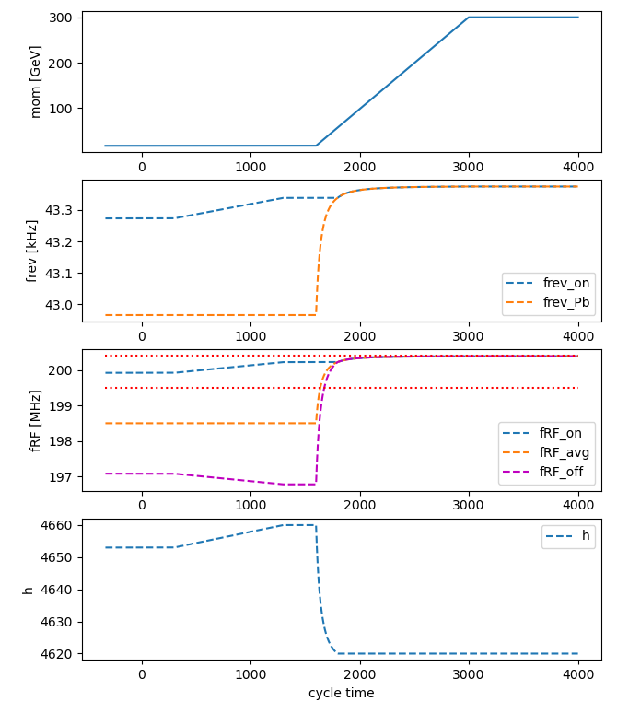
more on ion operation
1.
2.
3.
4.
injection: h = 4653 (AM and FSK)
after inj, before ramp: f_{RF} to f_{RF,cen}
f_{rev} constant, h varies, f_{RF} varies
during energy ramp: f_{RF} = f_{RF,cen}
f_{rev} varies, h varies, f_{RF} constant
stop FFA when f_{rev,Pb} 4620 = f_{RF,cen}
continue with standard: f_{RF} = 4620 f_{rev}
stop FSK
Notes:
FFA_LSA.py

Slide 18
abstract
High energy synchrotrons, like the Super-Proton Synchrotron (SPS) and the Large Hadron Collider (LHC) at CERN, require high-precision beam synchronous triggers for longitudinal measurements, e.g. to acquire bunch profiles from a wall current monitor pickup.
The observation triggering scheme is based on the General Machine Timing (GMT) followed by dedicated trigger units counting the revolution and RF frequency clocks to allow synchronisation to the exact RF bucket.
Combined with a programmable fine delay, accurate triggers can be placed at any azimuthal position with a resolution of about 20 ps.
The SPS installation is described in detail, including its additional flexibility for measurements at injection, extraction and bunch rotation.
The performance and limitations of such an implementation are analysed in terms of jitter with respect to the beam, delay variation due to cable lengths between the clock generation and acquisition with a sweeping revolution frequency.
Such varying delays can be compensated with the White Rabbit (WR) technology, and highlights from the recent upgrade in the SPS are presented.

