Slide 1
Beam-based Stability Evaluation in the LINAC of European XFEL.
Feedback & Monitoring Systems.
Marie Kristin Czwalinna, Björn Lautenschlager, Holger Schlarb
On behalf of :
group for accelerator beam controls (DESY, MSK)

Slide 2
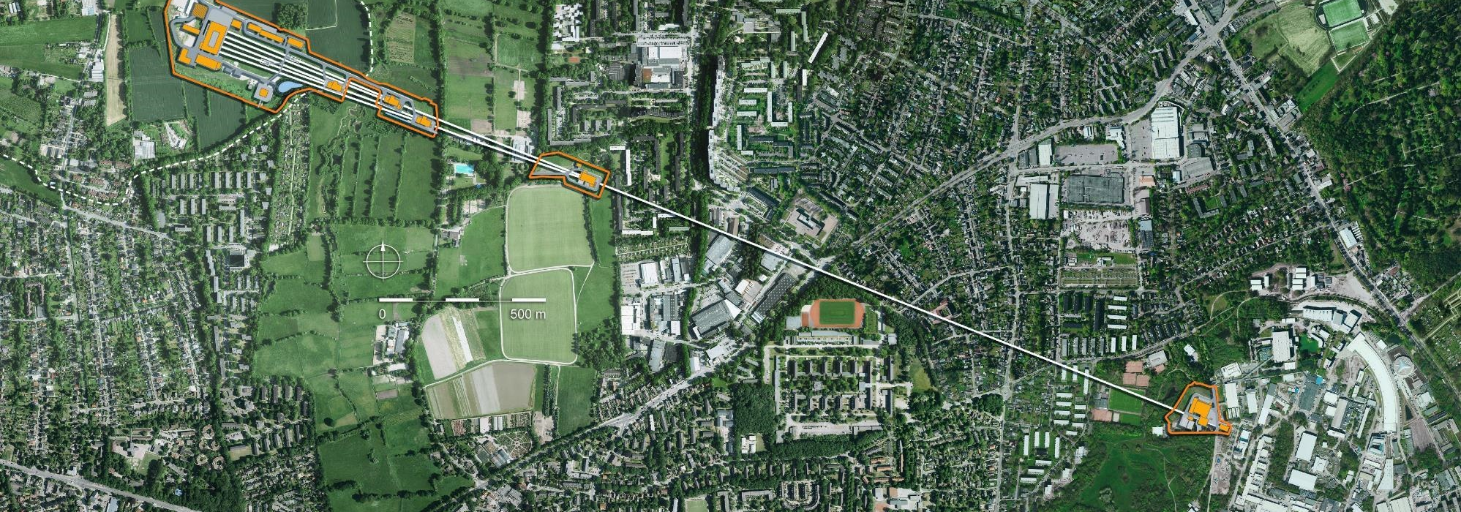
Agenda
Introduction
Typical Stability
Enhanced Stability
Beam-based Monitoring & Failure Detection
Summary & Outlook
3.5km long X-Ray FEL Facility

Slide 3
Introduction

Slide 4
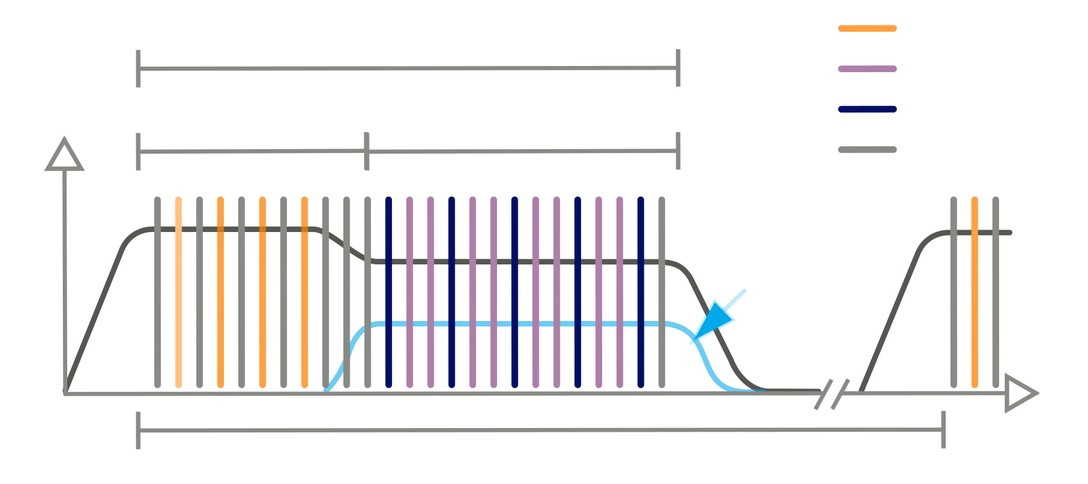
European XFEL
Operated in burst-mode, 10Hz, 600us.
10Hz burst mode,
4.5MHz bunch rep. rate,
User bunch selection at final beam energy
≤600 µs
SASE 2
SASE 3
SASE 1
dump
Beam Region 1
Beam Region 2
Flat-top
kicker
FEL pulse width at saturation:
100ms (10Hz bursts)
T_{ph}(FWHM) = σ_{e}(rms)
3.5km
Beam Energy
FEL pulse energy → center wavelength
Bandwidth of the spectrum
Timing Relation Bunch to FEL
<t_{e}> → <t_{ph}>
Peak current, Bunch Current profile
Intensity of FEL pulses
Number of modes / FEL pulse width
…
Longitudinal
Bunch Properties
Relative fluctuations in arrival time of the center of mass
$$σArr=std\left(Tph−Te\right)$$
Arrival times

Slide 5
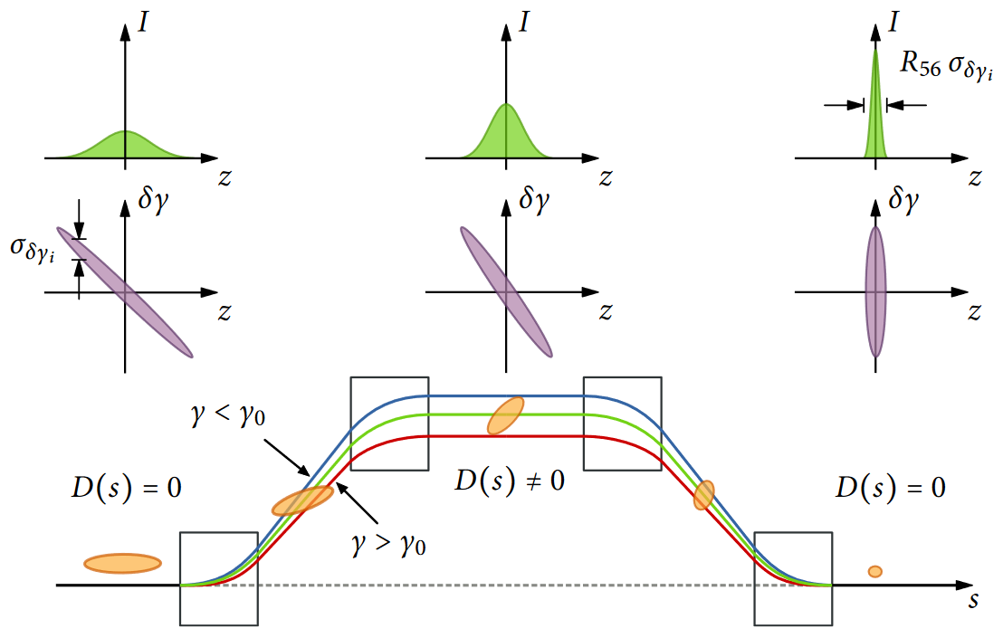
Sections with Longitudinal Dispersion
→ Beam Monitoring & Evaluation of RF Stability.
Off-crest acceleration
Magnetic Bunch Compressor Chicane, R56>0
δE/E(s)
longitudinal phase space
Q(s)
s
s
s
current profiles
s
s
s
C, $σ$
bunch compression
bunch arrival-time
Δt, ΔE

Slide 6
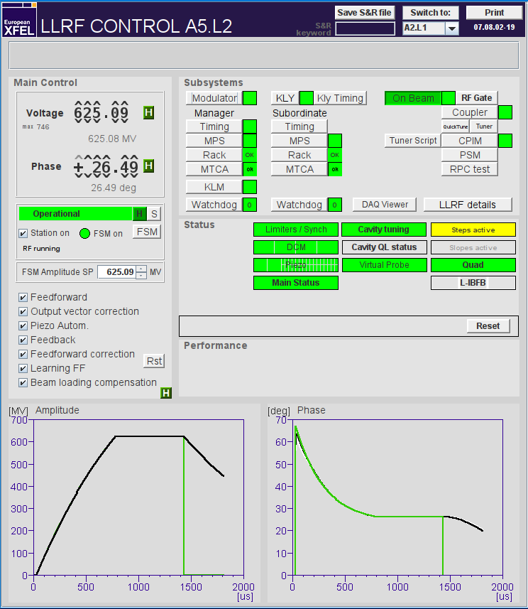
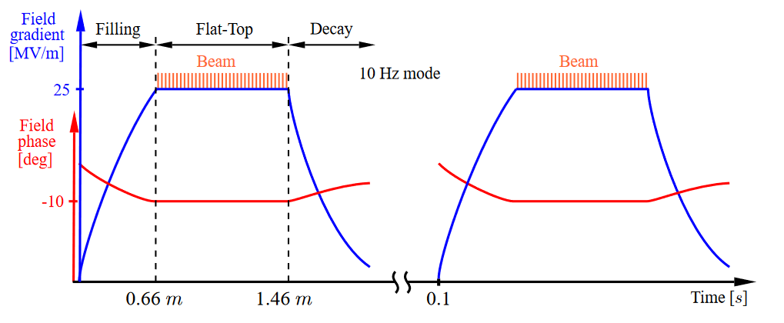
Burst-Mode Operation with 600us RF Pulses
LLRF Vectorsum Regulation & Multi-Cavity Controller.
LLRF: Control → Amplitude A and Phase φ
Calculates drive signal for high power provided by the klystron
Three different parts
Filling
Flat-tops, bunches are accelerated
Decay
Complex System: Different controller types combined : MIMO, PI, or learning feedforward
In-loop signal are shown here

Slide 7
Typical Performance Energy ←→ Arrival-time Stability

Slide 8
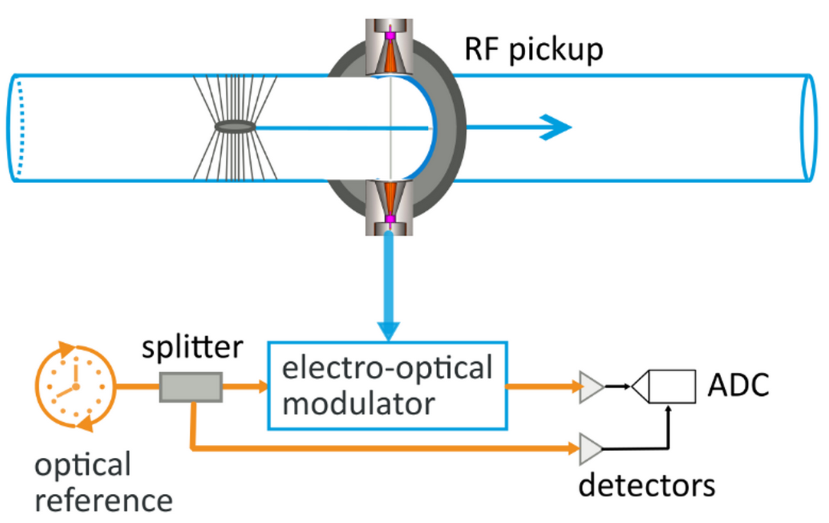
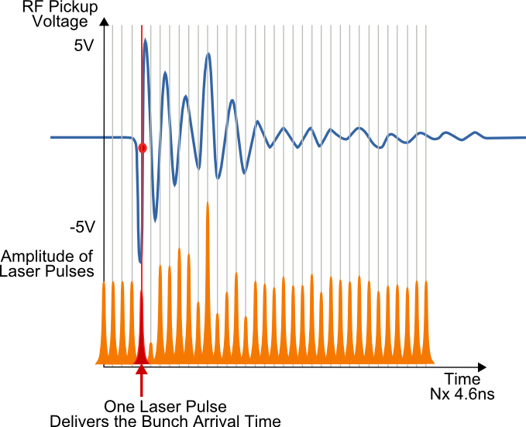
Electro-optical Bunch-Arrival-time Monitors
Measures Deviation from Expected Arrival-Time with Femtoseconds Resolution.
BC0
BC1
BC2
In-loop FB monitors
Out-of-loop monitors
40GHz
t_{arrival} → A_{laser}
Arrival-time Deviation
→ Measure for Energy Deviations
ΔT ~ ΔE/E
Typical resolution 3 fs (100…250pc)

Slide 9
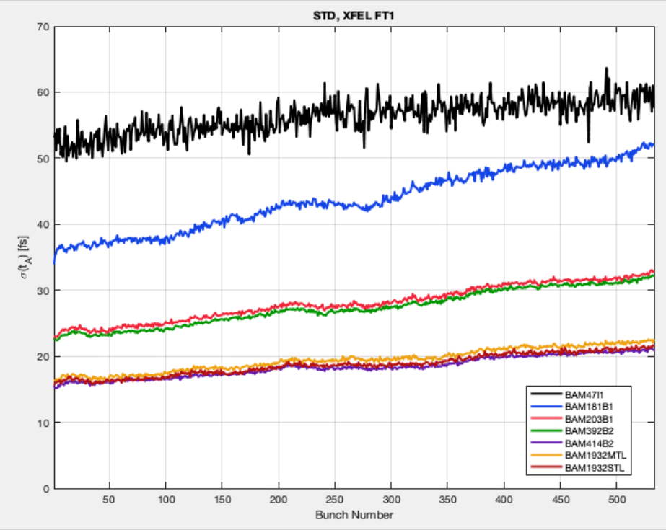
Requirements on RF Stability
Arrival-time Jitter? → Ultimately Limits Performance in Timing-Sensitive User Experiments.
BAM
BAM
BAM
BAM
BAM
BAM
BAM
BC0
BC1
BC2
BAM
BAM
Inj.
BAM
Derived from a linear compression, the timing jitter after BC dependents on
Goal = 10 fs rms
Arrival time jitter (fs rms) over 10 sec.
BAM 0
Inj. : 55 fs
Relative amplitude noise $\frac{σ_{v}}{v}$
Initial jitter $Σ_{t_{,}i}$
BAM 1
RF phase jitter $σ_{φ}$
BC0 : 45 fs
BAM 2.1 and 2.2
BC1 : 2 8fs
BAM 3, 4.1 and 4.2
Typically <0.01% rel.Amp. & <0.01deg Phase
BC2 : 20 fs
Bunch numbers 1 to 550 per train

Slide 10
Enhanced Stability → Using Beam-based Feedbacks

Slide 11
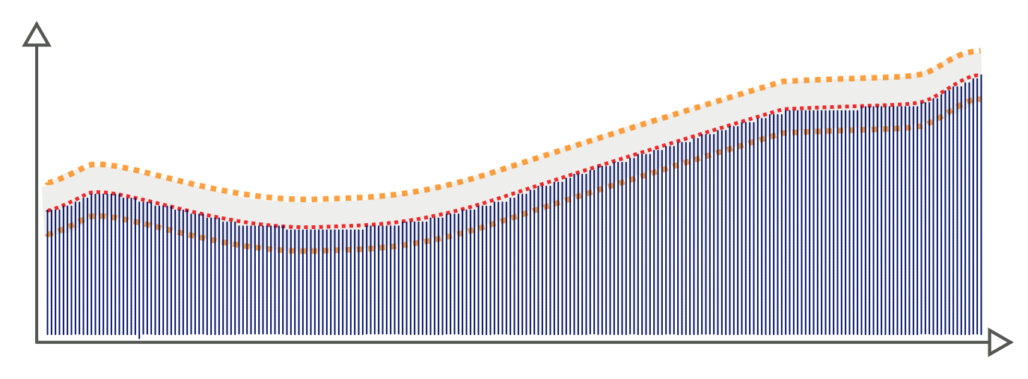
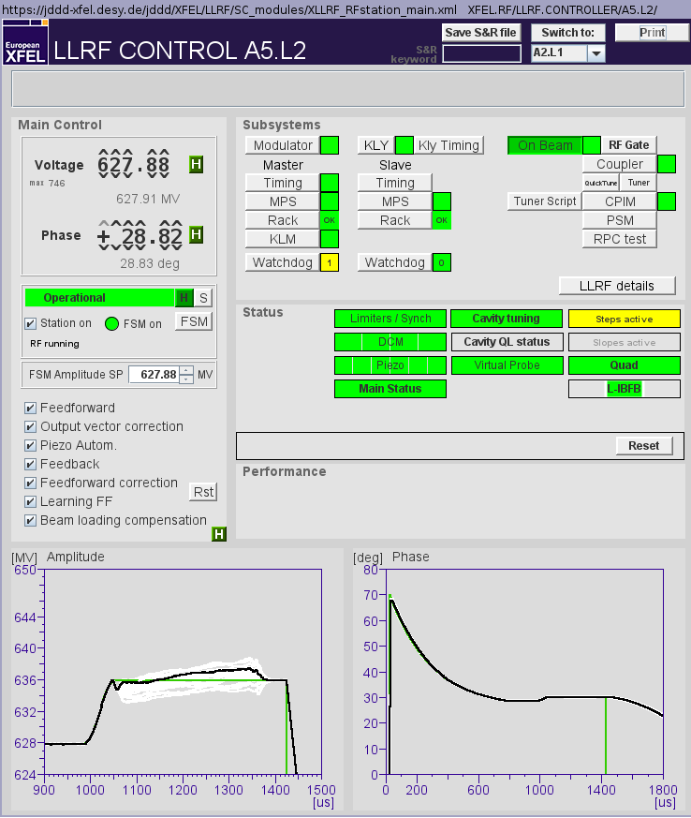
Beam-based Feedback Loop as Integral Part of the LLRF Controller
Intra-burst Stabilization & Removal of Repetitive Errors.
Slope removal, adaptive feedforward
Jitter reduction, feedback within bunch-train
Non-uniformity
But repetitive
Burst-to-burst jitter
Arrival time
Target
Bunches
Accelerator
Module
BC
BAM
Drive signal
A, φ
Field
detection
LLRF
Controller
Arrival time,
per bunch data
Basic feedback loop:
Error signal combination in the LLRF controller.

Slide 12
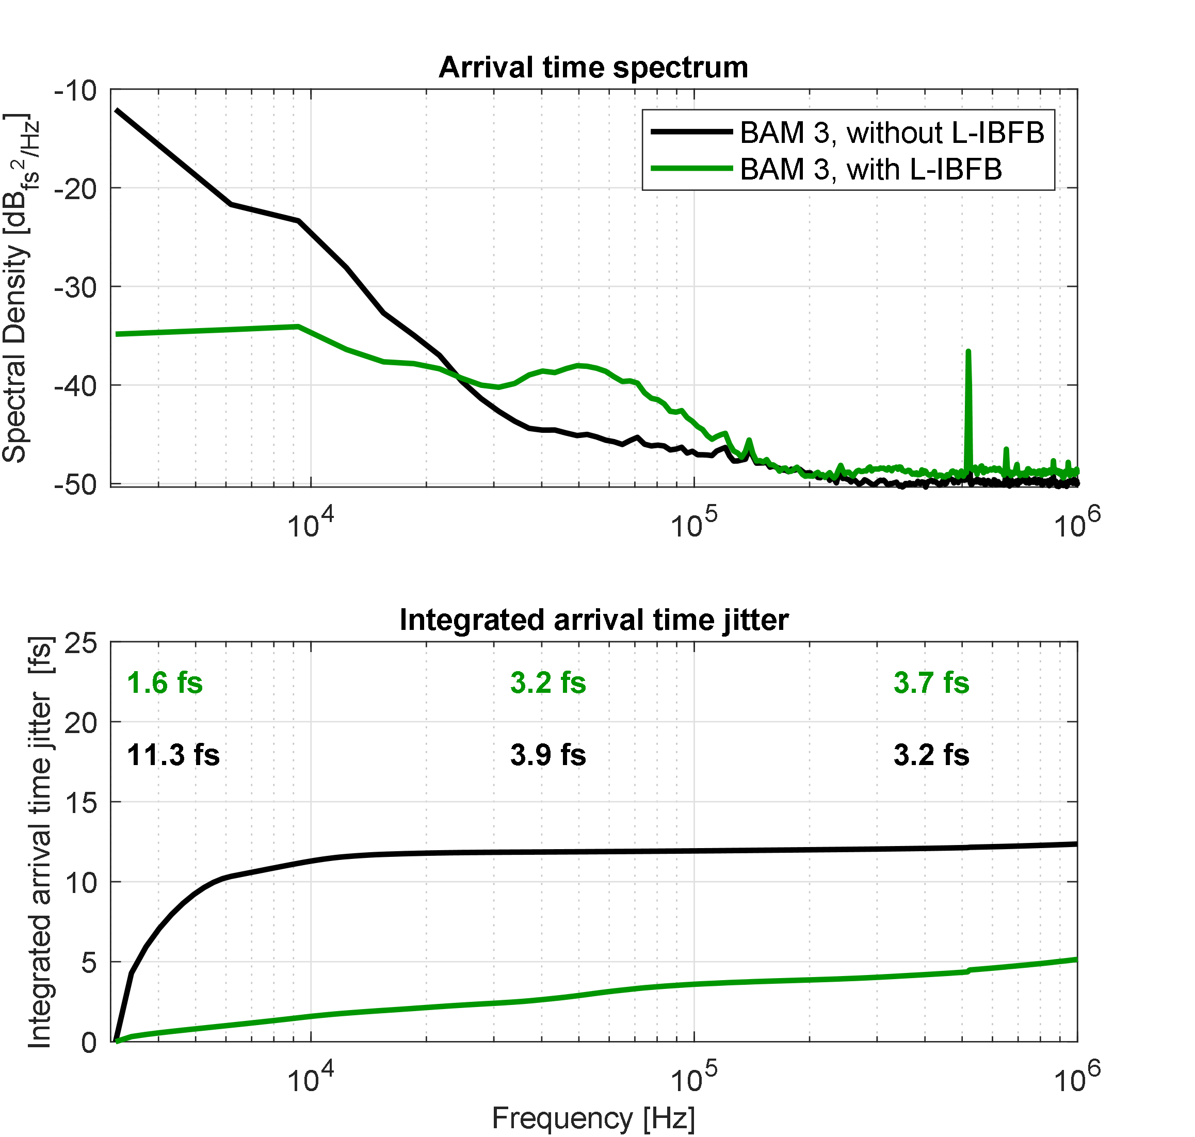
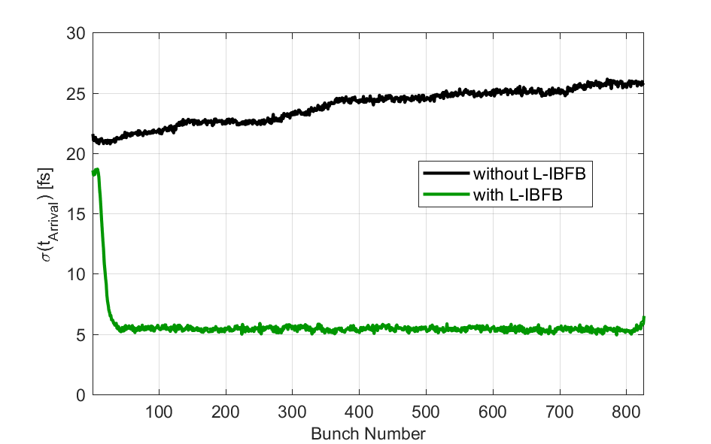
Intra-Train Stabilization
Facility | Best | Daily
EuXFEL | 3.3 fs | ~ 4…5 fs
FLASH | 4.7 fs | ~ 6 fs
Suppression of RF field fluctuations within 25kHz BW.
Energy corrections ~ 10⁻⁶ (e.g. ±5MeV @2.4GeV),
Adaptation time ~ 10-15 µs,
Operation stable over days,
Limited regulation range → offset correction by slow feedbacks.
L-IBFB Off
In-loop arrival time jitter of 600 bunch-trains
~ 25kHz BW
Mean = 24 fs
L-IBFB On
L-IBFB Off
BAM noise floor
BAM resolution
3 – 4.5fs
Mean = 5.5 fs
L-IBFB On

Slide 13
Beam-based Monitoring & Failure Detection

Slide 14
Example 1, Dynamic Cavity Tuning
Automation with Piezo Actuators (DC + AC Voltage)
Dynamic cavity tuning (piezos)
detuning of individual RF cavities
Compensates microphonics
high degree of automation
→ Essential component in multi-cavity control
when absent,
increased energy, thus timing jitter
deterioration of field stability within the burst
Arrival time jitter [fs] ,100 shots
30-45fs, piezo automation OFF
~15fs, piezo automation ON
Bunch No.

Slide 15
Example 2, Observe Unusual Behavior of Beam
Beam-based Monitors as Possibility for Detecting LLRF Control Errors
Inj.
BC0
BC1
BC2
High complexity of HPRF + LLRF controllers
Lack of out-of-loop monitoring in RF controls
→ valuable information from beam
continuous monitoring
Uses single-shot beam monitors (timing, energy, compression, …)
Implemented as middle-layer server
Online statistics (mean, std, slopes,…)
When thresholds exceeded → alarm
transition
timing jitter [fs] over 100 shots
BR1
BR2
Inj. ← GUN + Inj. Laser,
BC0 ←additive jitter in booster (A1/AH1)
BC1
BC2
L-IBFB active on BR2
time-series plot,
1st bunch of each BR

Slide 16
Example 2, Observe Unusual Behavior
Requires expert knowledge to investigate → Capability to add Data-driven Fault Diagnosis
Identified Cause: Oscillation in detuning automation
Solved: reduction of gain in regulation loop (piezo AC voltage)
Injector → sees GUN + Inj. Laser,
BC0 → sees Booster (A1/AH1)
BC1
BC2
L-IBFB active on BR2

Slide 17
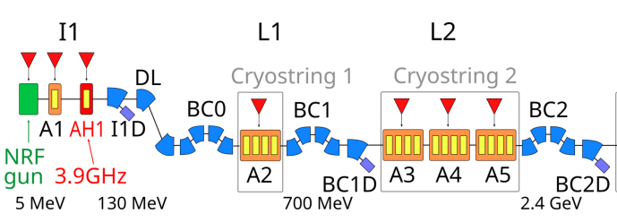
Example 3, Short-circuited Cavity Probe
Disturbance introduced on beam → Thorough Investigation to Find a Solution
Identified Cause:
Cavity with faulty probe connector but still requires to be included in vector sum regulation
Large effect on beam ~ 300fs unwanted arrival-time slope (over 600us)
… Details see Poster today,
Possible way for mitigation.

Slide 18
Summary & Outlook

Slide 19
Conclusion & Outlook
Importance of Monitoring Systems.
Achieved :
RF Field Stability → ΔE/E
Active beam stabilization [10Hz…100Hz]
~ 10⁻⁶
< 5 fs
Beam-based Information for Fault Detection & Fault Diagnosis of LLRF Systems
Requires sufficiently precise beam monitoring
Resolve energy deviation ~ 1E-6
Resolve phase deviation ~ 10mdeg

Slide 20
Thank you .
Czwalinna, Marie Kristin
marie.kristin.czwalinna@desy.de
+49 (0)40 8998 9 2912

