Slide 1


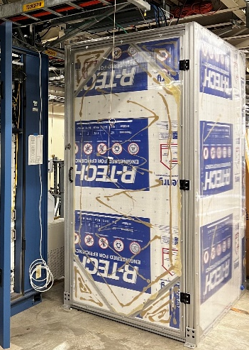
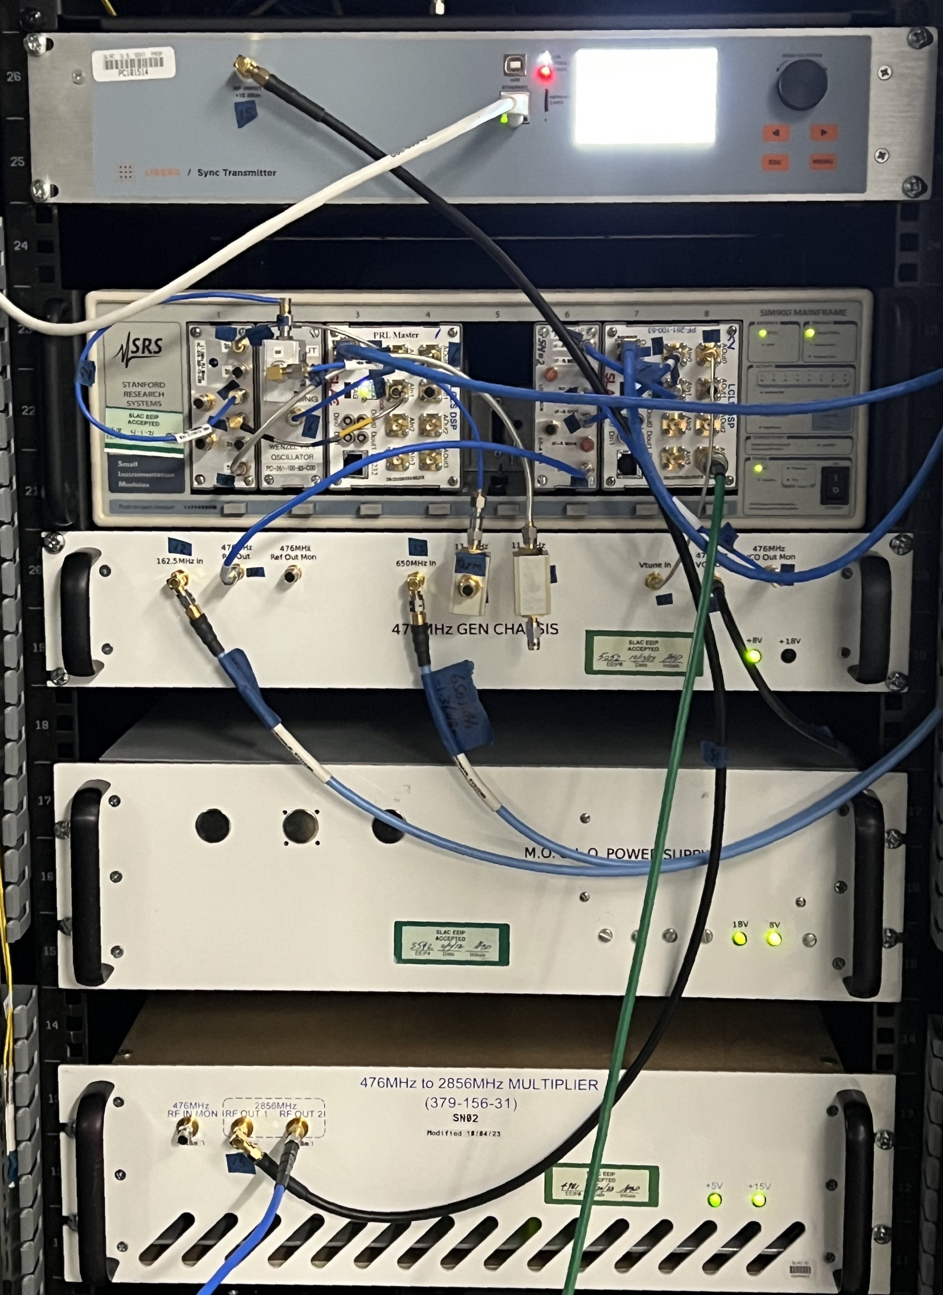
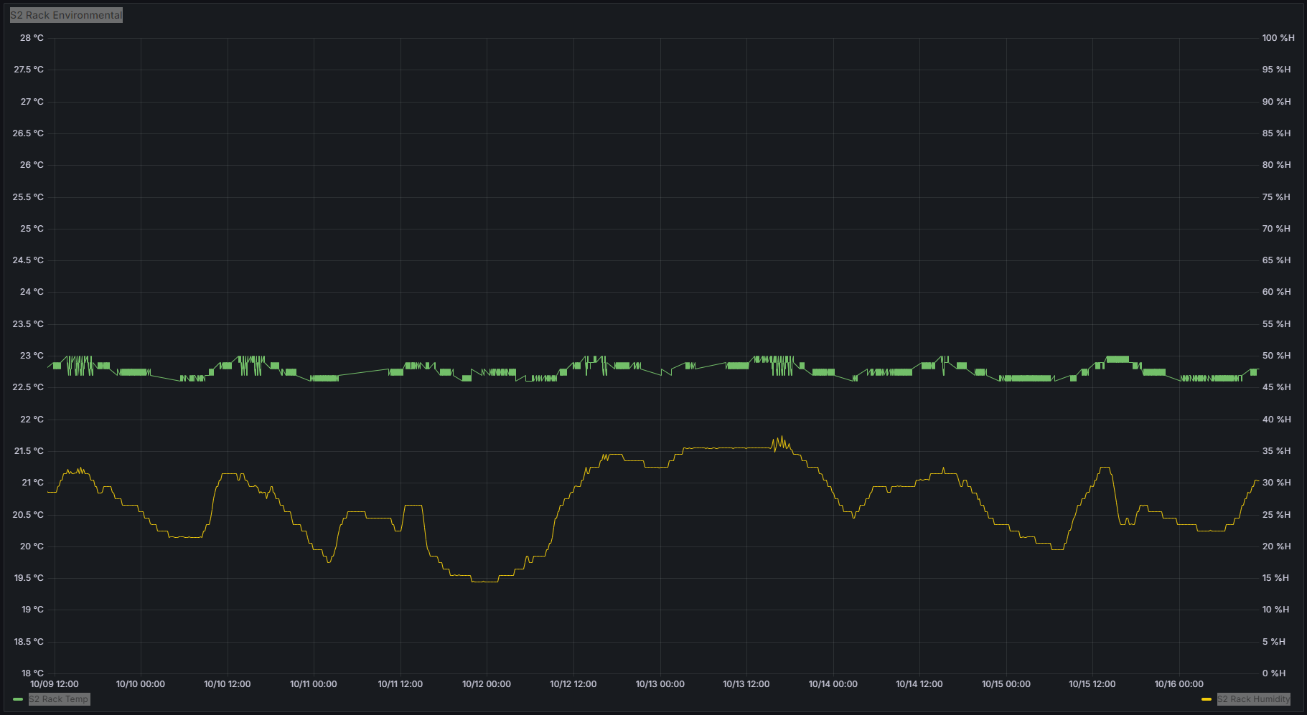
OPERATION OF THE PHASE REFERENCE LINE
SYNCHRONIZATION FOR LCLS-I AND LCLS-II
B. Hong†, M. Weaver, C. Xu, J. Xiang, S. Fung, K. Kim, L. Ruckman, R. Herbst, SLAC National Accelerator Laboratory, Menlo Park, CA 94025, USA
INTRODUCTIOIN
With LCLS-II becoming operational [1] [2], there are critical demands of operating the LCLS-I and LCLS-II mode simultaneously in the same facilities for different beam lines. This requires to synchronize the LCLS-I 476MHz Main Drive Line (MDL) to the LCLS-II 1.3GHz Phase Reference Line (PRL). LINAC Locking ensures the signal synchronization and event timing alignment of the frequencies between the two machines. Fig. 1 is the overview of the major phase reference and timing systems along with the accelerator and experimental beam structures at SLAC.
Switching the LCLS-I from stand-alone mode to synchronized mode during tightly scheduled user time requires rigorous checkups and preparation. Five instrument hutches utilize the 476 MHz reference line to synchronize various ultrafast optical lasers to the LCLS-I FEL X-ray such as performing pump-probe experiments [3].
FREQUENCY SYNCHRONIZATION
EVENT TIMING ALIGNMENT
COMMISSIONING AND OPERATION
Synchronization of the non-integer frequencies with homemade synthesizer.
Frequency division programming without external control required.
Resync feature to prevent non-deterministic initial phase state
Timing attribute and the frequency derivation for synchronization
Timing Attribute | Value
Master Oscillator (MO) | 162.5MHz
LCLS-II Phase Reference (LINAC RF) | 1300MHz
Clock (Timing Ref and GUN RF) = LINAC RF/7 | 185.7MHz
Nominal Beam Rate = Clock/200 | 0.92857MHz
LCLS-II Fiducial Resync Frequency = LINAC RF/18200 | 0.07143MHz
Fiducial (Power Line Phase) | 360Hz
LCLS-I Phase Reference (MDL RF) | 476MHz
LCLS-I Fiducial Resync Frequency = MDL RF/6664 | 0.07143MHz
Establishing the environment to meet the critical requirement of the RFOF Tx/Rx under the hash ambient condition.
An economical air-conditioning enclosure has achieved 0.4°C stability over a 20°C temperature swing.
Phase stabilized cable is chosen with <0.5ps over diurnal temperature swing for inter-rack connection.
A special fiber with negative thermal expansion material is chosen to compensate the phase drift with 1 km length in 20°C diurnal change. Linden phase-stabilized STFOC with a coefficient of <10 fs/°C/m, helps alleviate this issue.
During commission and operation, periodic phase jump incidents were reported by the LCLS-I instrument hutches and the Phase Cavity along the electron beam line. The root cause has been found from the TPG system. The issue with Xilinx GTX7 transceiver DFE (Decision Feed-back Equalization) mode in the PCIe card was encountered when used with 8b/10b encoding protocol. An alternative TPR hardware with Xilinx GTH Ultra scale transceiver has been installed and operating with no more triggering issue. Meanwhile, the PCIe card has been running in the lab without problem for more than two weeks using a different equalizer mode.
Frequency derivation from LCLS-II 162.5MHz MO to LCLS-I MDL 476MHz
LINAC Locking Derivation | Value
Frequency Division-1 = (MOx4)/26 | 25MHz
Frequency Division-2 = 25/2 | 12.5MHz
Frequency Division-2 = 25/25 | 1MHz
Mixer-1 Frequency = 12.5-1 | 11.5MHz
MOx3 = 162.5x3 | 487.5MHz
Mixer-2 Frequency = 487.5-11.5 | 476MHz
1/14 MHz frequency, which is the highest common de-nominator between the RF frequency harmonics of the two machines, is utilized for communication over their fiber optic systems.
Phase ambiguity or called “bucket jumps” between the RF drive signals and the beam bunches can be corrected by comparing the TTL signals from the LCLS-I Timing Event Receiver (EVR) and the LCLS-II Timing Pattern Receiver (TPR) to align the 1/14 MHz strobes via 476MHz VCO phase offset.
The LCLS-II Timing Pattern Generator (TPG) receives an AC Line trigger from the LCLS-I Timing Fiducial for AC Line Sync and broadcasts the triggers that synchronize all the systems.
Temperature and humidity of the Rack for RFOF Tx
REFERENCES
The phase noise performance has improved by approximately 20 fs [10 Hz-10 MHz] compared to the previous MDL oscillator, and better results (17.5 fs [10 Hz-10 MHz]) obtained in the lab.
The major noise contributor, AC line spurs, are neglectable so far because all systems have been synchronized by the AC line Fiducial.
[1] C. Xu, J. Frisch, B. Hong, S. Smith, L. Ruckman, “LCLS II Phase Reference System”, LLRF Workshop 2017, Barcelona, Spain, Oct. 2017
[2] S.D. Murthy, L. Doolittle, C. Xu, B. Hong, A. Benwell, J. Chen, “Installation, Commissioning and Performance of Phase Reference Line for LCLS-II”, LLRF Workshop 2022, Brugg-Windisch, Switzerland, Oct. 2022
[3] J. M. Glownia et al., “Time-resolved pump-probe experiments at the LCLS,” Opt. Express, vol. 18, no. 17, p. 17620, Aug. 2010, doi: 10.1364/OE.18.017620.
* Work supported by DOE, Office of Science contract DE-AC02-76SF00515. †Email: hongbo@slac.stanford.edu
LLRF Topical workshop, INFN, Frascati, Italy, October 2024

