Slide 1
ISOLPHARM_Admiral:
ISOL beams for medical applications
Meeting WP2- WP4 : 20/06/2024
Alberto Andrighetto (INFN) – Project Leader

Slide 2
The ISOLPHARM Project – 4 pillars
Also…Scientific and training hub
1. National Collaboration
Broad, focused on radio-
pharmaceutical development:
synthesis,characterization
and preclinical tests (vitro/vivo)
2. Innovative Method
Innovative production @SPES of several (medical)
Carrier Free + High Purity
radionuclides
(¹¹¹Ag,⁸⁹Sr,¹³⁶Cs..)
4. Activities, INFN Experiments
Financed by CSN5 (physics application): ISOLPHARM_Ag +
ISOLPHARM_EIRA + ADMIRAL
3. Facility at SPES
An irradiation station,
using the SPES
Low Energy Beams, is
planned in the SPES building
.

Slide 3
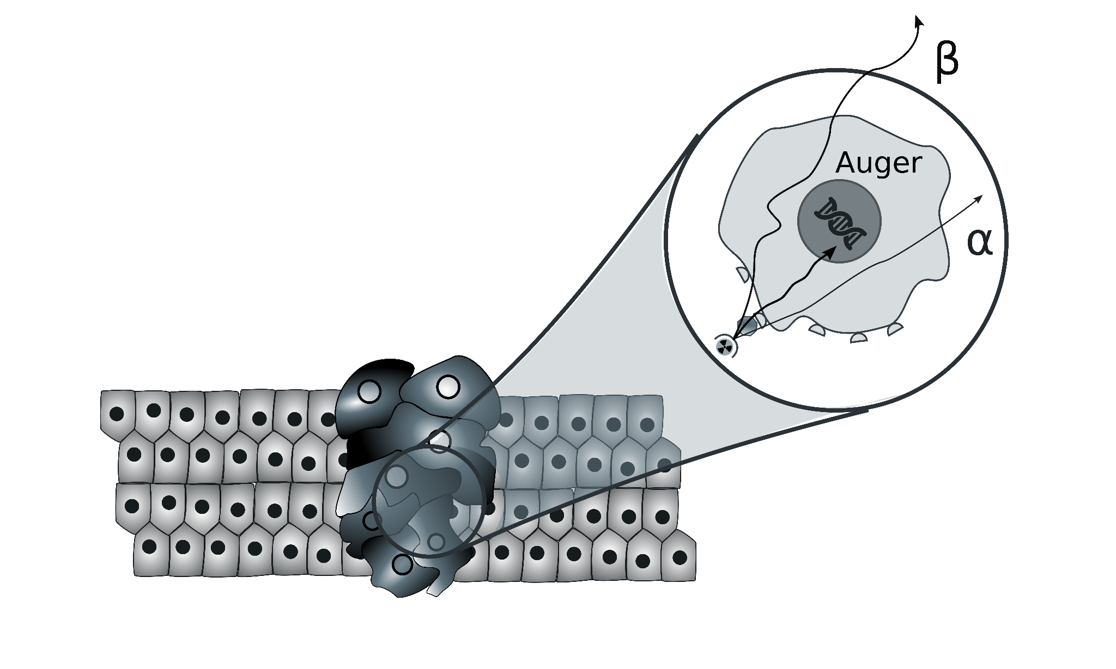
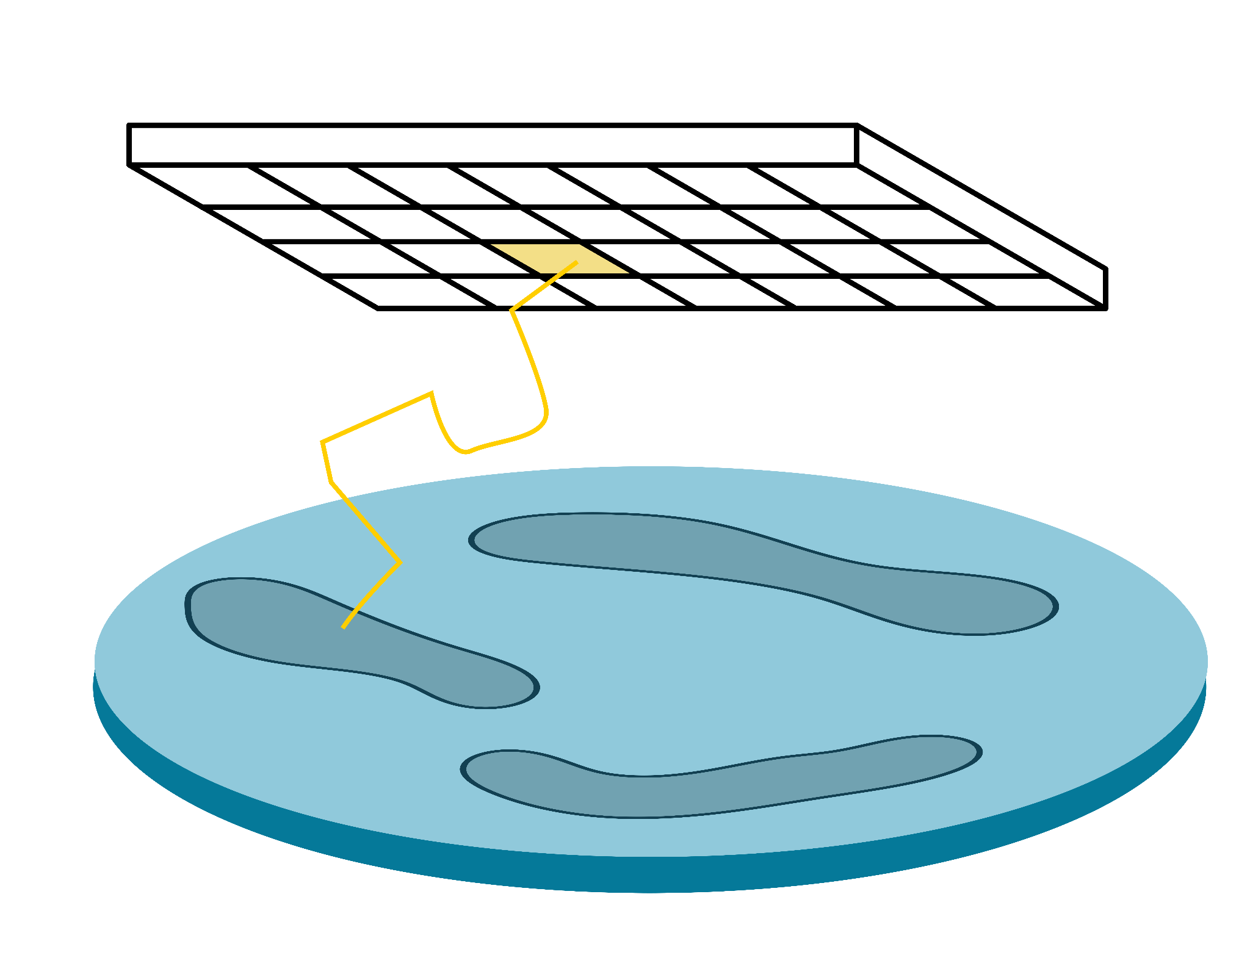
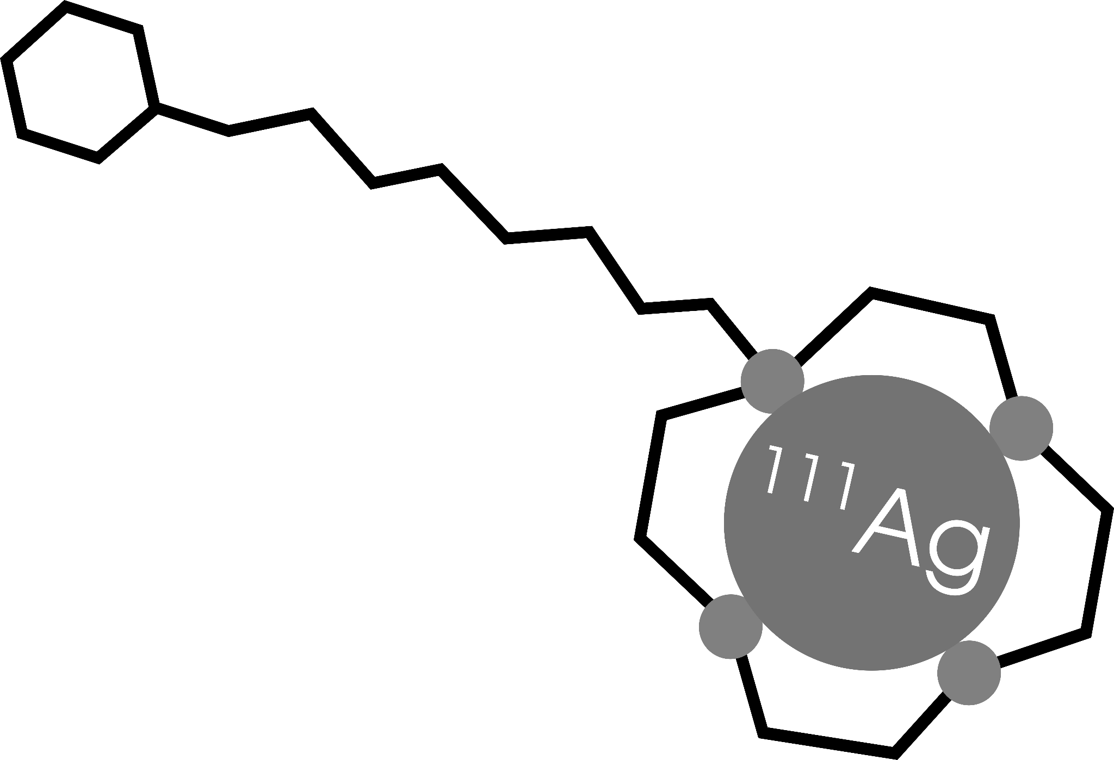
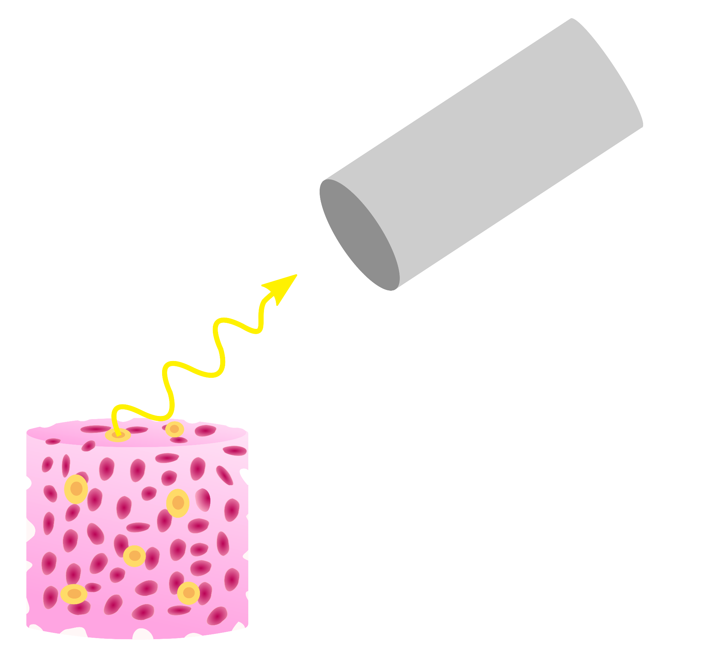
The ISOLPHARM collaboration
Development of a β-imaging
system based on solid-state detector
Radiopharmaceutical
production
Radiobiological characterization
Development of a γ-imaging scintigraphic system

Slide 4
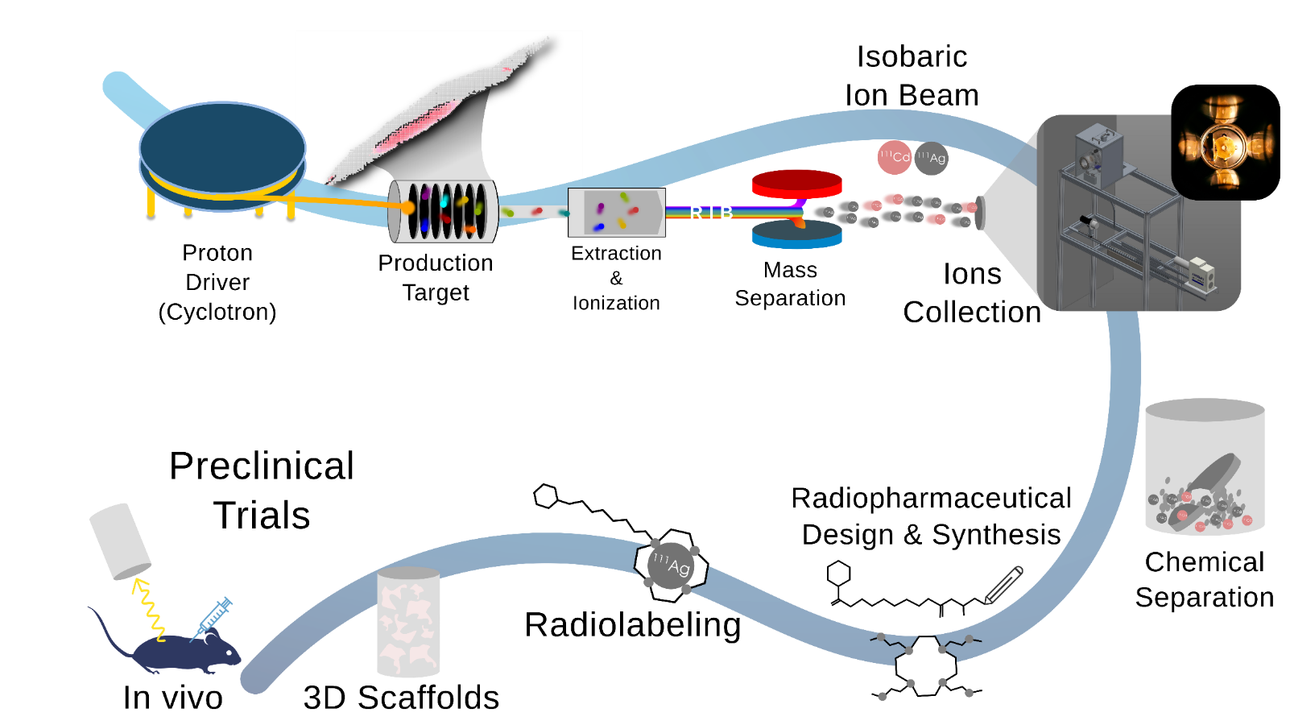
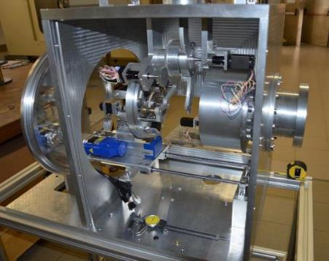
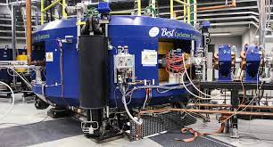
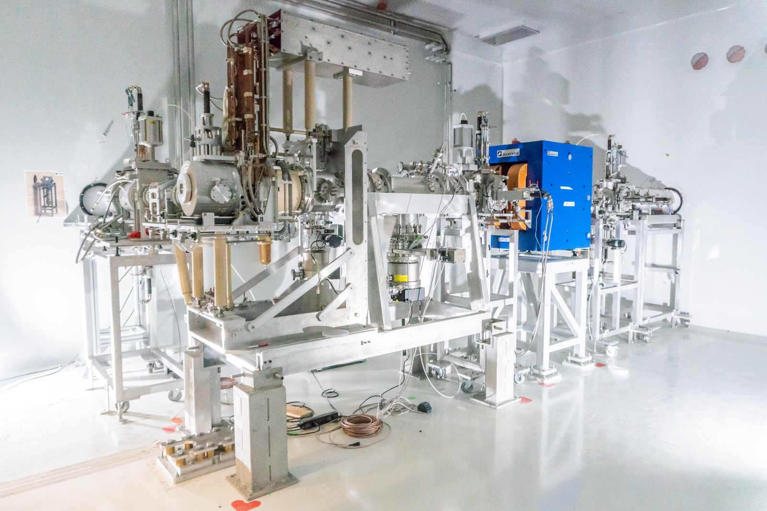
ISOLPHARM: Innovative Method
The ISOLPHARM method is capable of selecting and isolating a
SINGLE RADIO-ISOTOPE
+ high specific activity
+ radionuclide purity
The ISOLPHARM Method is an INFN Patent

Slide 5
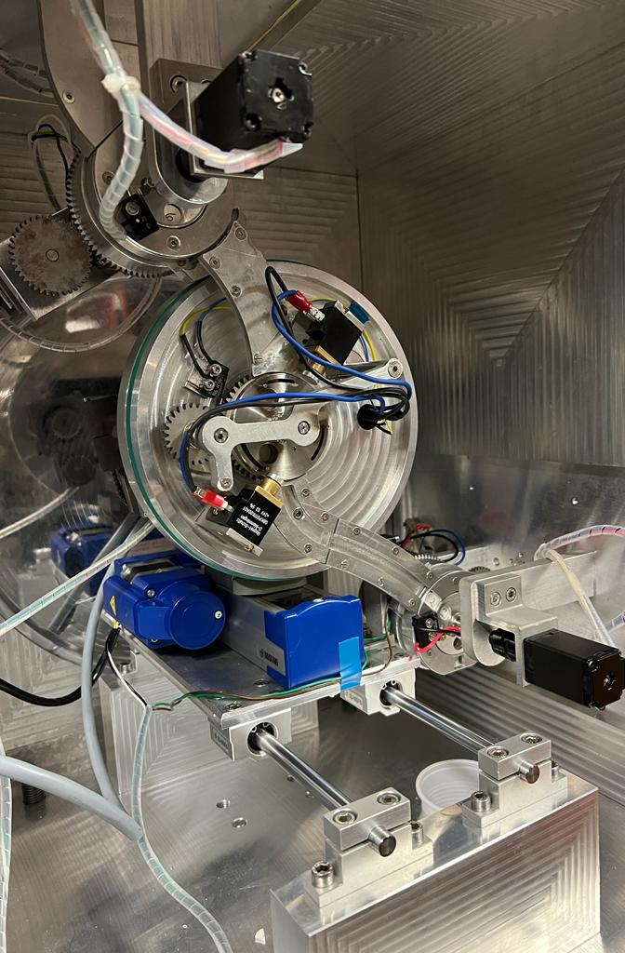
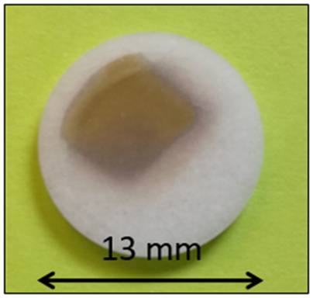
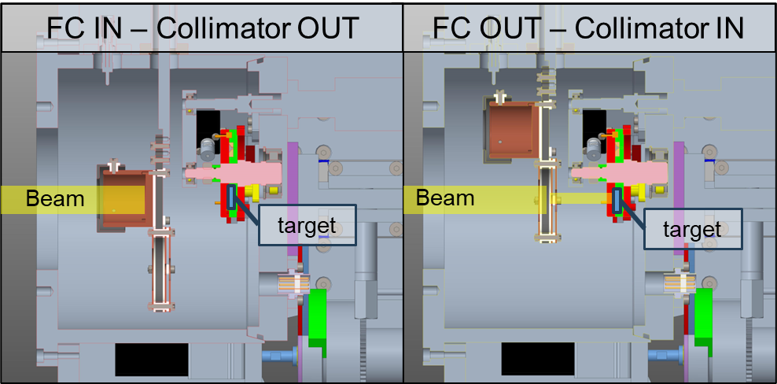
The ISOLPHARM beamline
Detection and quality control station station
SPES low energy experimental area

Slide 6
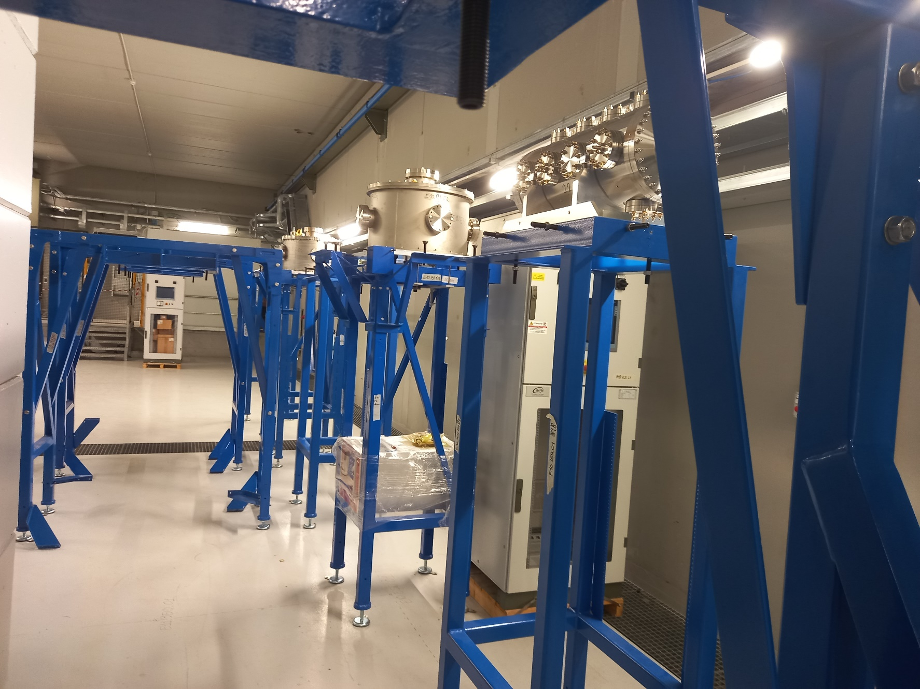
The ISOLPHARM beamline (June 2024)
Isolpharm Beam Line

Slide 7
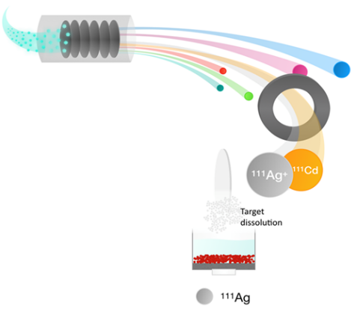
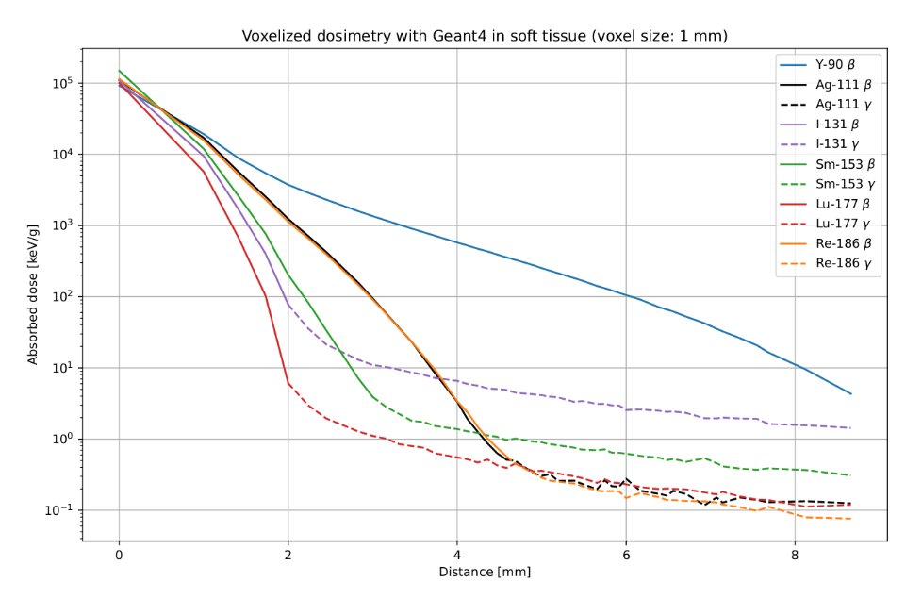
Radiopharmaceutical radiolabeled with ¹¹¹Ag
¹¹¹Ag properties
β⁻ emitter (average energy 360 keV)
Good half-life (7.45 days)
Average tissue penetration (1.8 mm)
Medium energy γ rays -> SPECT candidate
→ No radiopharmaceuticals radiolabeled with 111Silver in the market.
→ Silver-111 can be produced @ SPES with high purity & with high production rate
→ No Isobaric 111 contamination in the secondary target (also with LASER off)!
→ ¹¹¹Ag exhibits possible ‘theranostic’ properties
similar to ¹⁷⁷Lu which was recently approved by FDA.
→ ¹¹¹Ag has dosimetric behavior equal to ¹⁸⁶Re, which was recently studied in Phase I / II trials
111 Isobaric chain | Half-Life T_{½} | Decay | Target Yield
Cadmium-111 | Stable |  | Low yield production
Silver-111 | 7.45 days | β─ | Good yield production
Palladium-111 | 23.4 min | β─ | Bad release, short T_{1/2}
Rhodium-111 | 11 sec. | β─ | No release, very short T_{1/2}

Slide 8
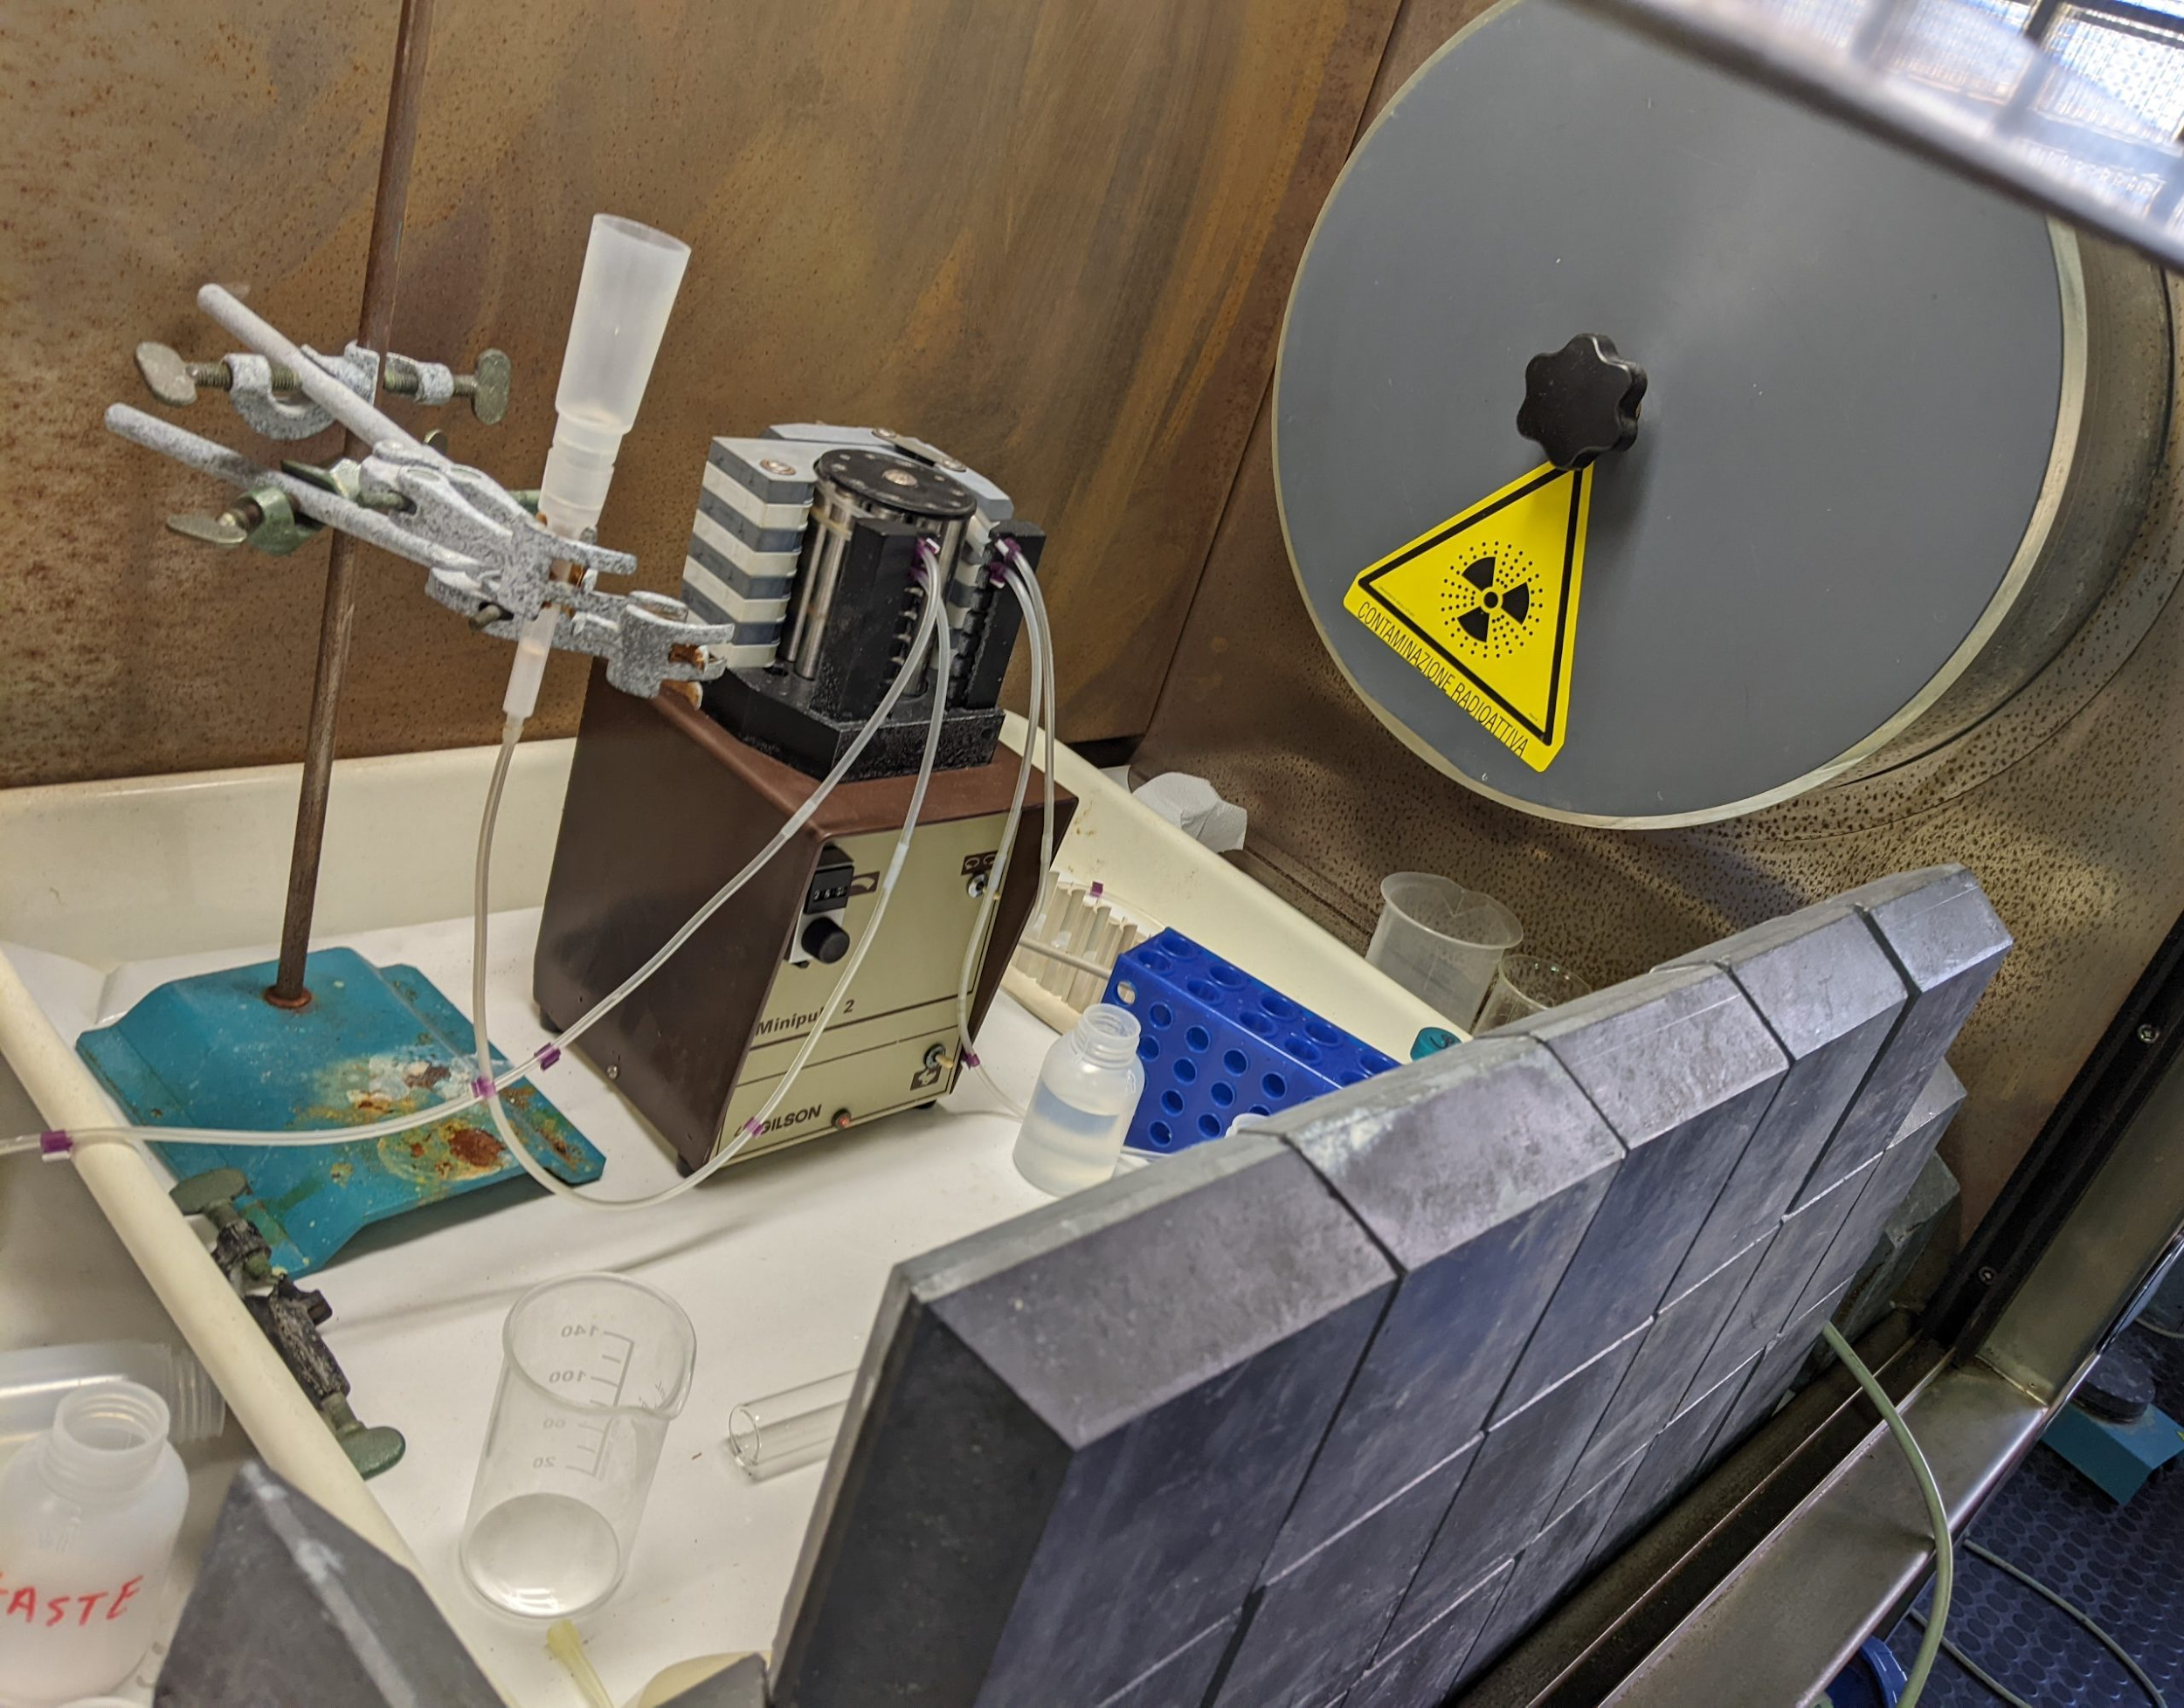
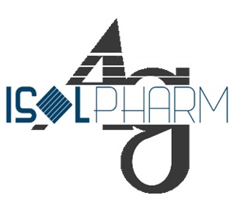
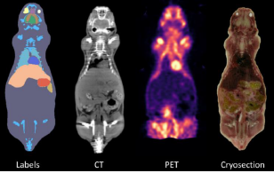
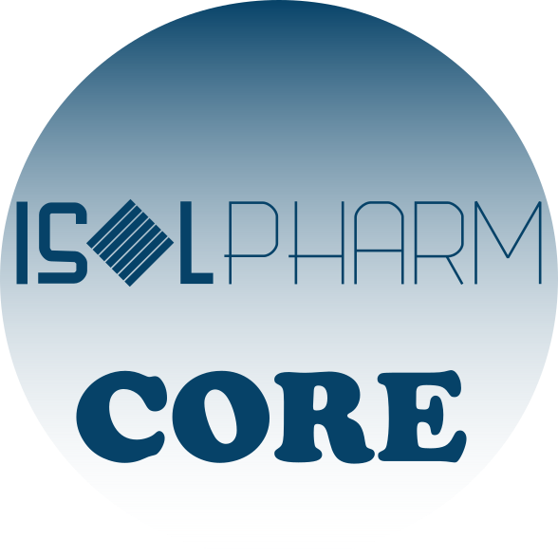
ISOLPHARM: a 10 years adventure
2014 - 2017
Interdisciplinary Study Group on production of medical radioisotopes at SPES
Simulations and feasibility evaluation
of Ag as radiopharmaceutical precursor
2018 - 2019
INFN experiments
First production of ¹¹¹Ag in reactor and beginning of in-vitro and in-vivo testing
2020 - 2022
Providing new tools for preclinical trials on 3D scaffolds
2023 - 2025
PRIN
Follows the technological aspect for the radionuclide production
2024 - 2025

Slide 9
ISOLPHARM-ADMIRAL strategy
CHEMISTRY
PHYSICS
PHARMACOLOGY
INSTRUMENTATION
RADIOBIOLOGY
WP2 :
β-imaging
WP3 :
γ-imaging
WP4:
Targeted Radiobiology
Production of Ag-111 at the LENA facilities, purification and quality control
Radiochemistry of Ag-111
Pharmacology
Bioengineering of 3D scaffolds
Mechanics & electronics design
Monte Carlo simulations for mechanics and detector design
Detector characterization and tests with fluorescence
Monte Carlo simulations for detector design
Planar imaging detector construction for Ag-111 γ detection
Characterization and test of the planar system
Cell survival tests in 2D flasks
Cell survival tests in 3D scaffolds
Dose computation in cell cultures

Slide 10
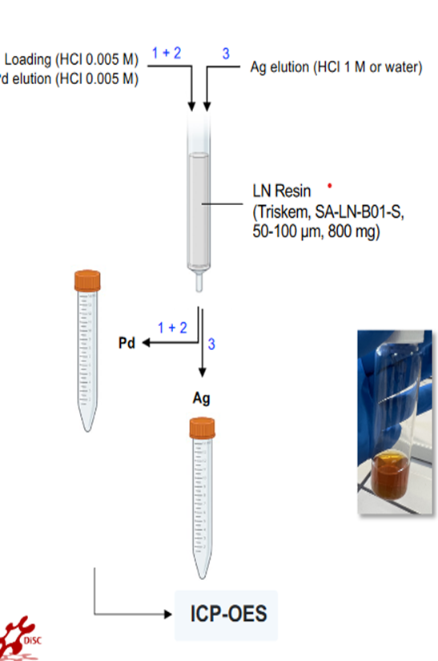
WP1: ¹¹¹Ag production & separation

Slide 11
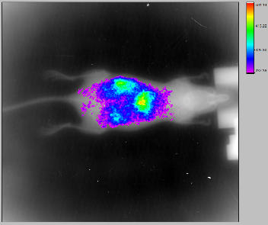
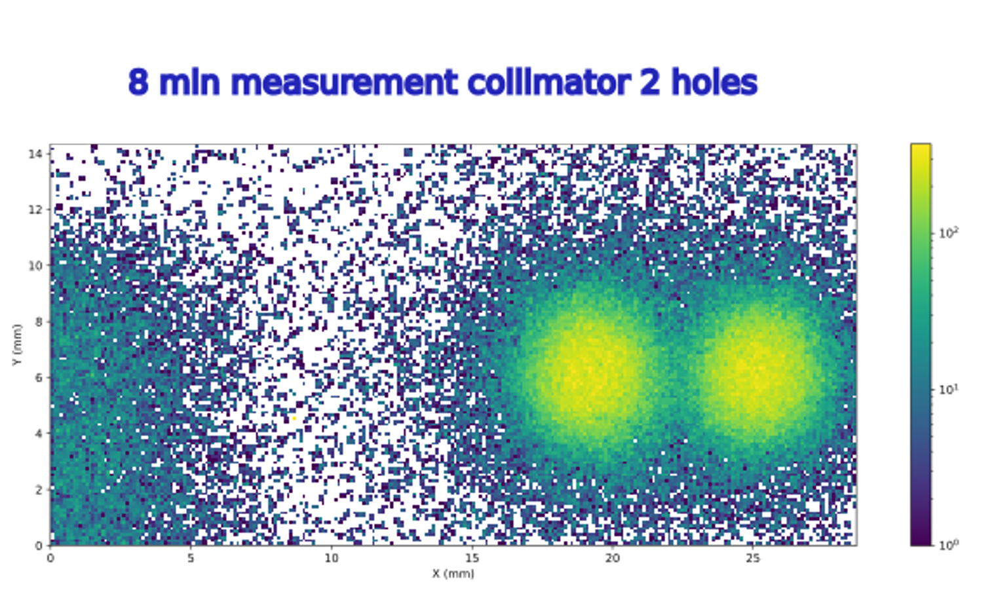
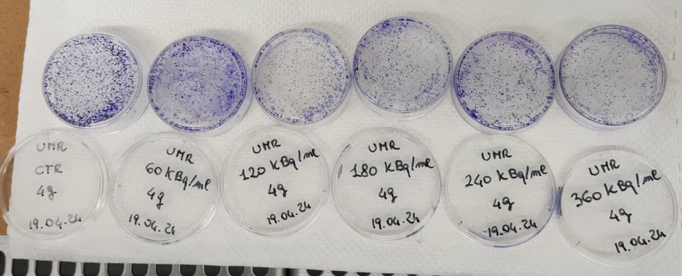
WP1 – experiments with ¹¹¹Ag
MS1.1 – Routine production of Ag-111 at the LENA facilities, purification and quality control
In March, 2024, Ag-111 was produced and used for 3 experimental applications, conducted simultaneously:
In vivo test @ Capir (WP1)
Beta detector resolution test @ L.E.N.A. (WP2)
In vitro test @ UniPv (WP4)
50 MBq
3 MBq
The same activities will be performed again in July, 2024
and October, 2024.
20 MBq

Slide 12
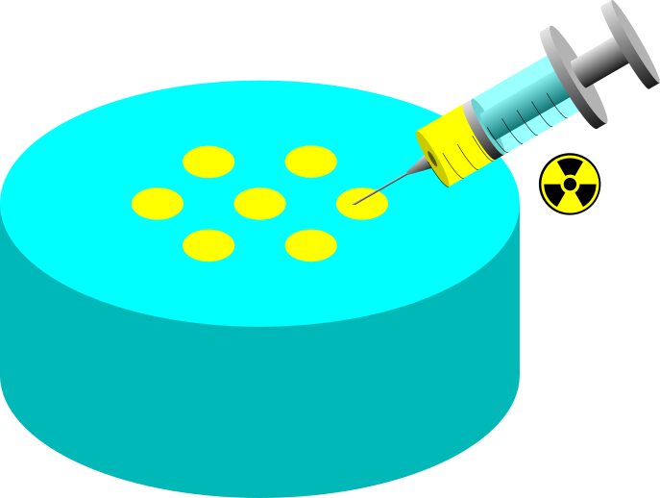
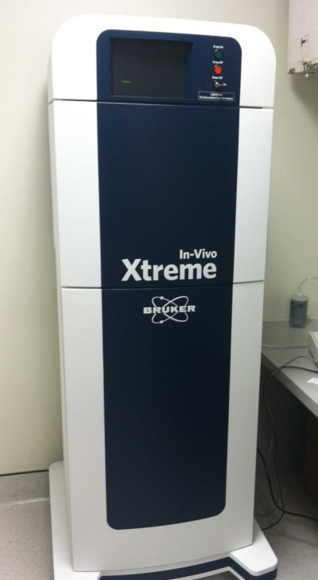
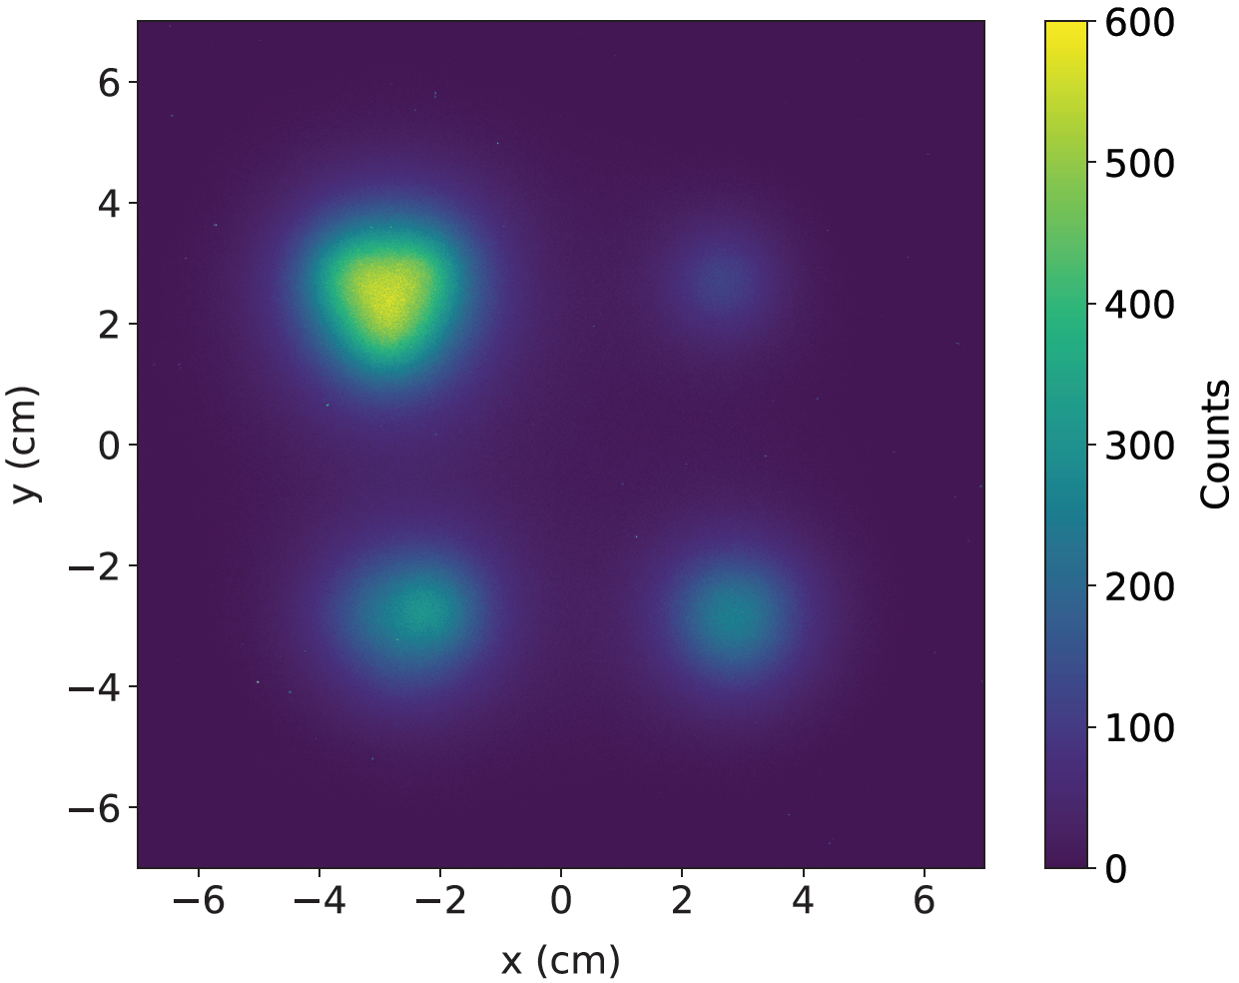
WP1: Test with ¹¹¹Ag in phantoms (2023)
Can Ag-111 be imaged?
Bruker In-Vivo Xtreme can perform pre-clinical imaging via ¹¹¹Ag radiopharmaceuticals:
Used the Direct Radioisotopic Imaging (DRI)
PMMA Phantoms filled with ¹¹¹Ag solution
Xtreme will be used to evaluate the targeting efficiency-> Only planar distribution
5 mm
2 mm
DRI
3 mm
Nicola Zancopè, M.Sc. thesis - Uni. Padova, 2022

Slide 13
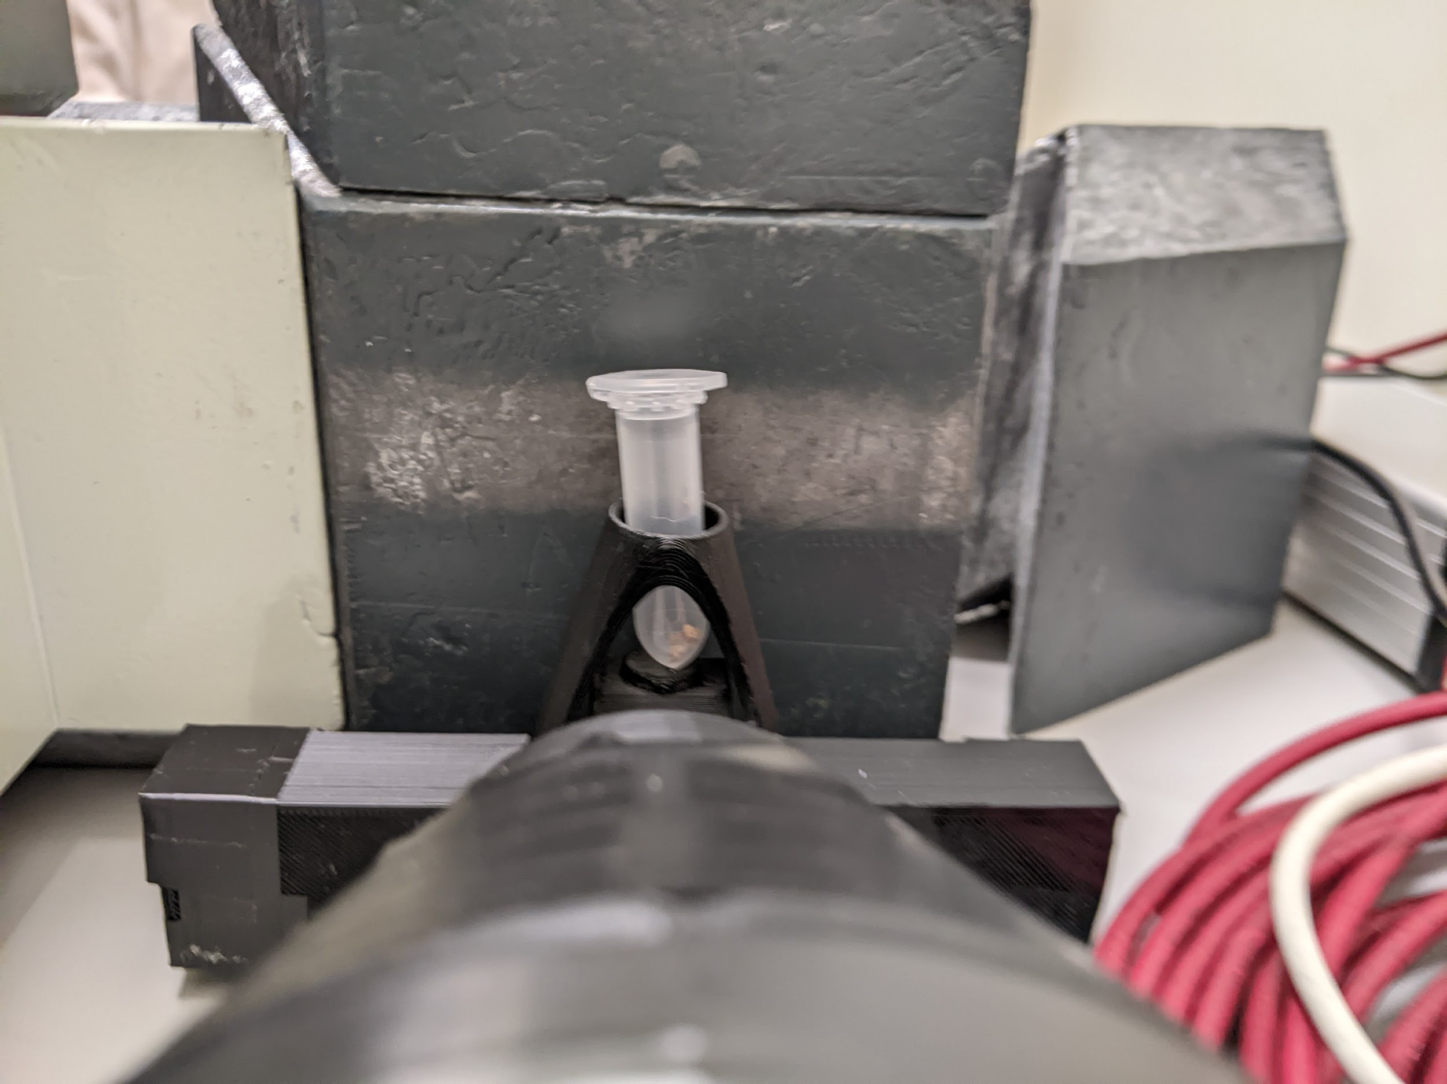
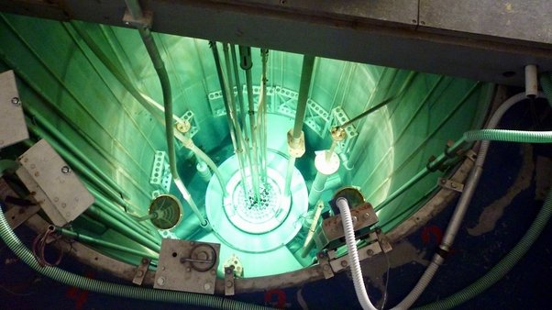
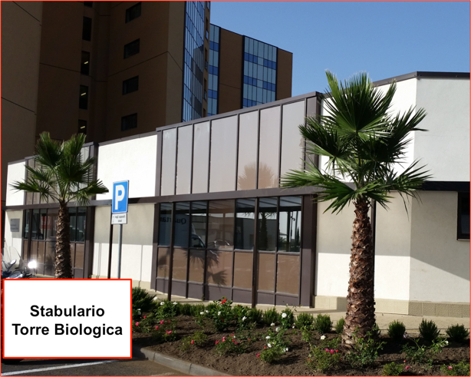
WP1: Imaging with free ¹¹¹Ag (March 2024)
¹¹¹Ag
150 mg of ¹¹⁰Pd
irradiated in the LENA
central thimble
biodistribution
in vivo imaging
Obtained 88 MBq of ¹¹¹Ag
5 days after injection
13

Slide 14
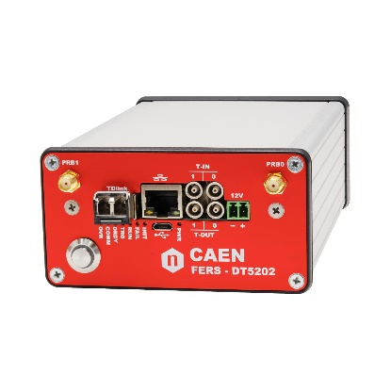
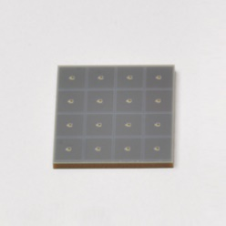
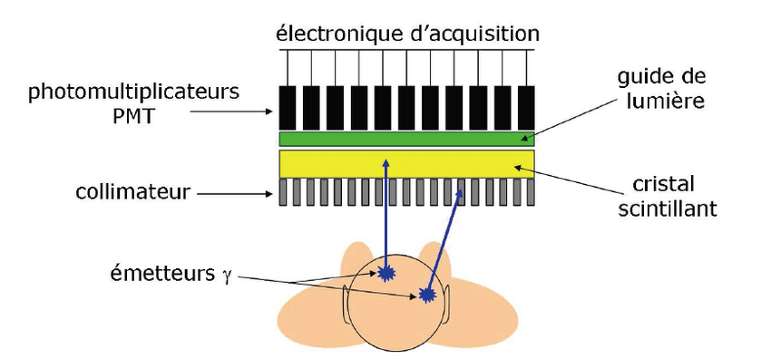
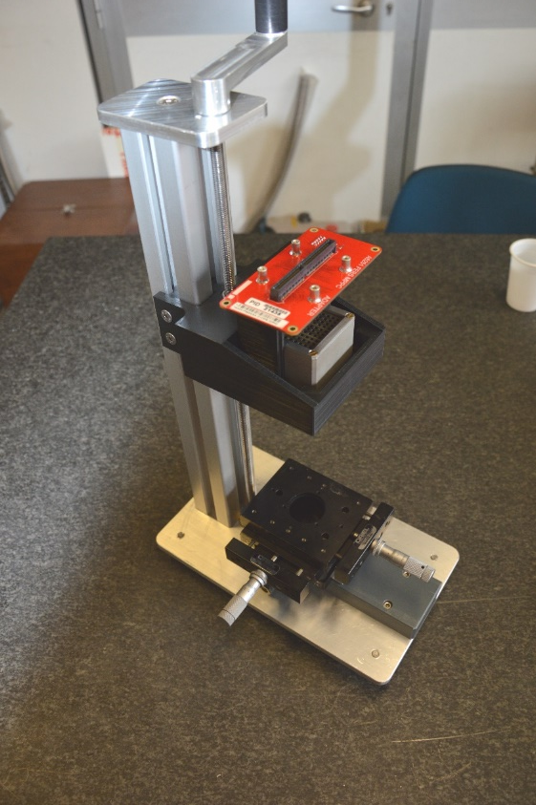
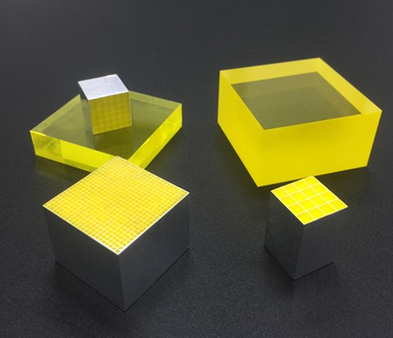
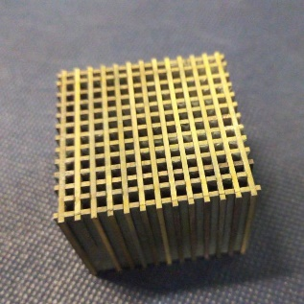
WP3 – Detector construction
MS3.2 Planar imaging detector construction for Ag-111 γ detection
System built up to now:
Device used to image γ radiation emitting radioisotopes;
Selected elements:
Electronics
CAEN FERS DT5202
Optical photon detectors (SiPM)
Hamamatsu S14161 8x8 ch 3x3 mm²
Collimator (tungsten)
2 mm holes, 1 mm septa, 30 mm length
Scintillating crystal (GAGG)
1x1x26 mm³ matrix

Slide 15
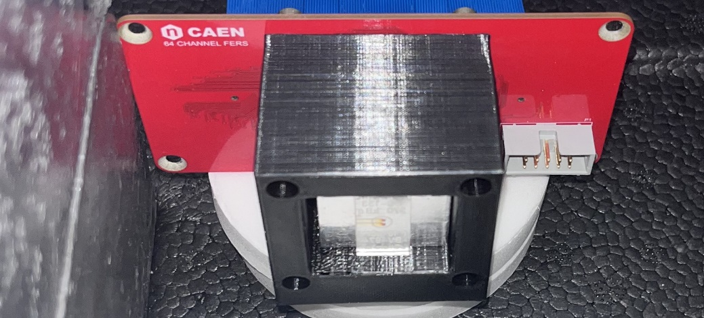
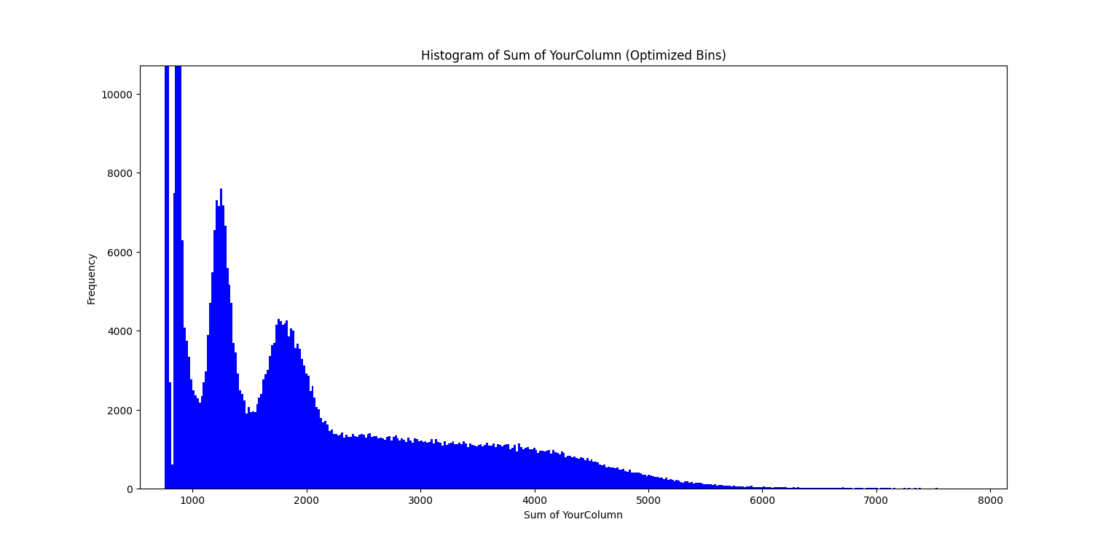
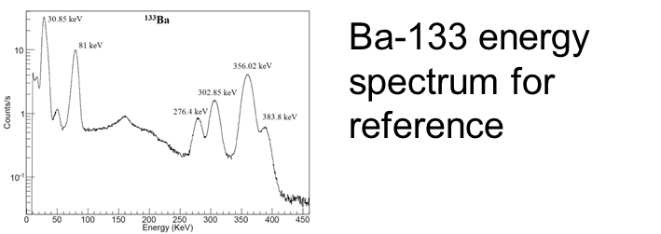
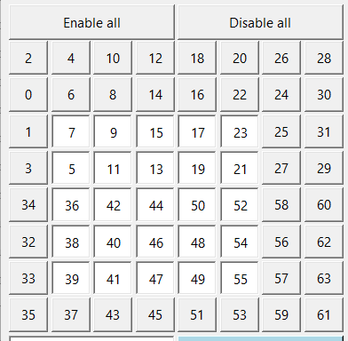
WP3 – System characterization
MS3.3 Characterization and test of the planar system
Experiments were conducted at Bologna (S. Spadano E. Borciani);
Simulations can give a reference.
The signal from 25 channels is integrated
First tests with Ag-111 are planned by the end of the year.

Slide 16
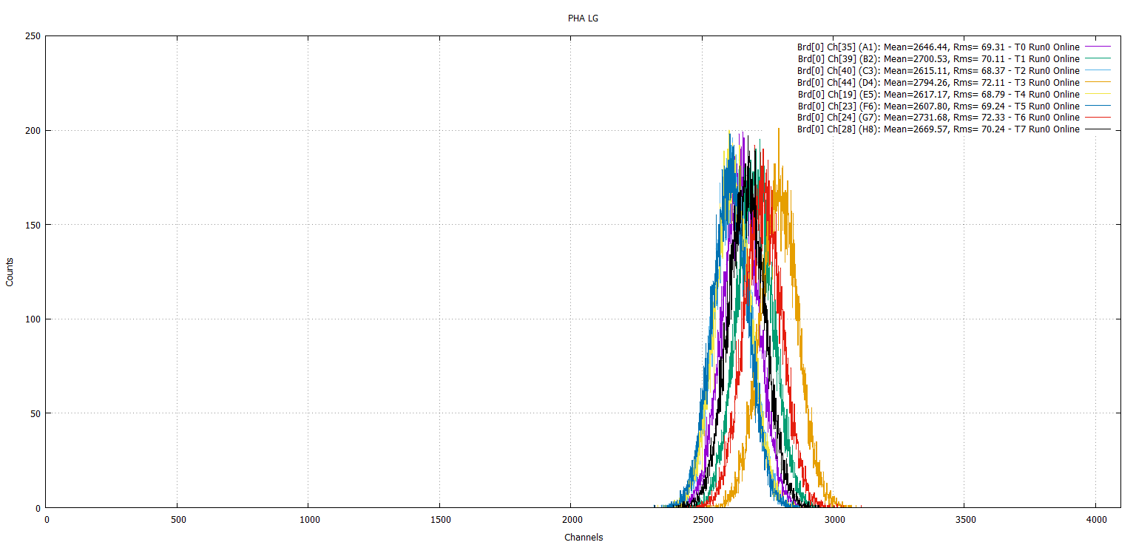
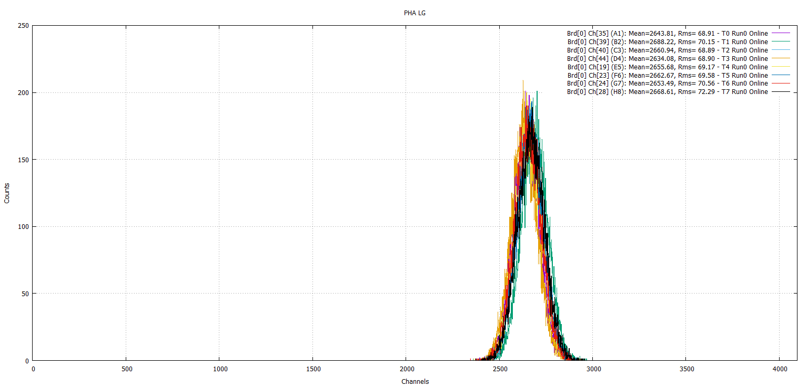
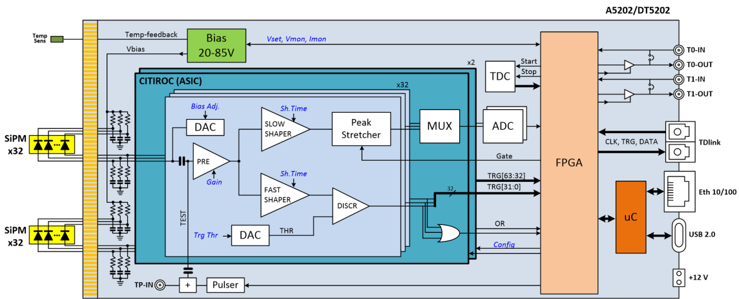
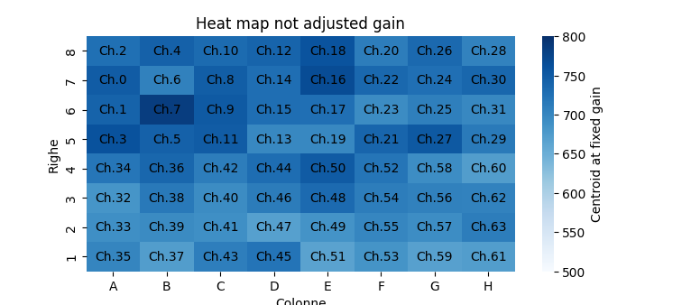
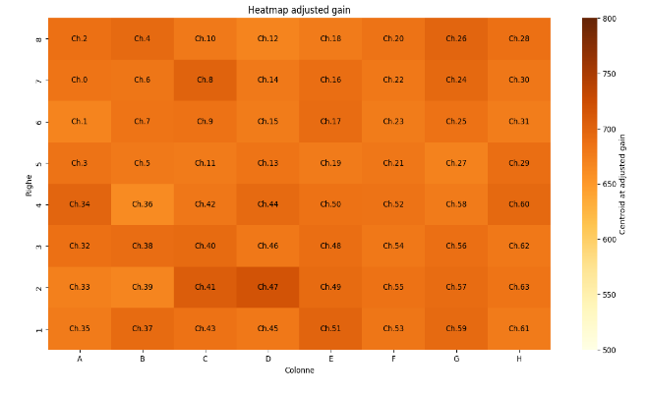
Laser flat field correction
64 channels

Slide 17
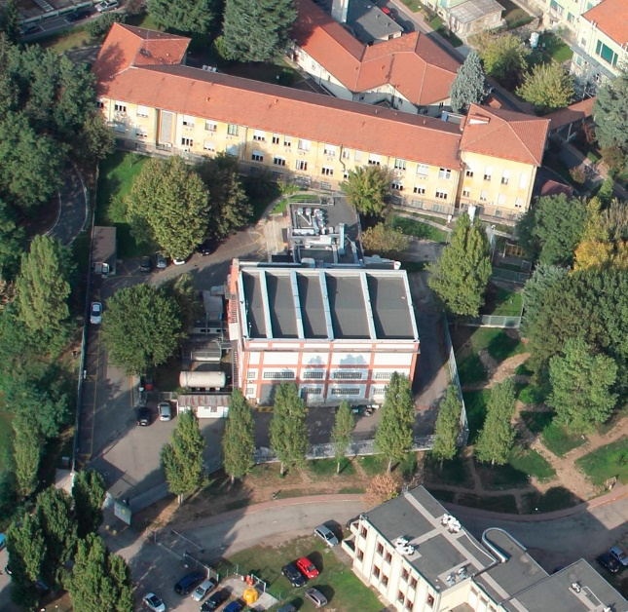
Main goals for 2024
¹¹¹Ag compound into a scaffold (WP1)
¹¹¹Ag compound in front a β detector (WP2)
¹¹¹Ag production & separation
@ LENA
¹¹¹Ag compound in front a γ camera (WP3)
¹¹¹Ag compound into a cell cultures (WP4)
¹¹¹Ag compound into a mice -> 3 run

Slide 18
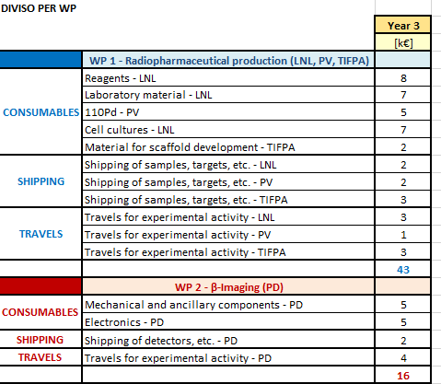
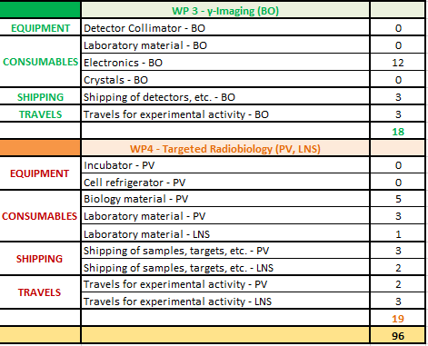
ISOLPHARM budget for 2025

Slide 19
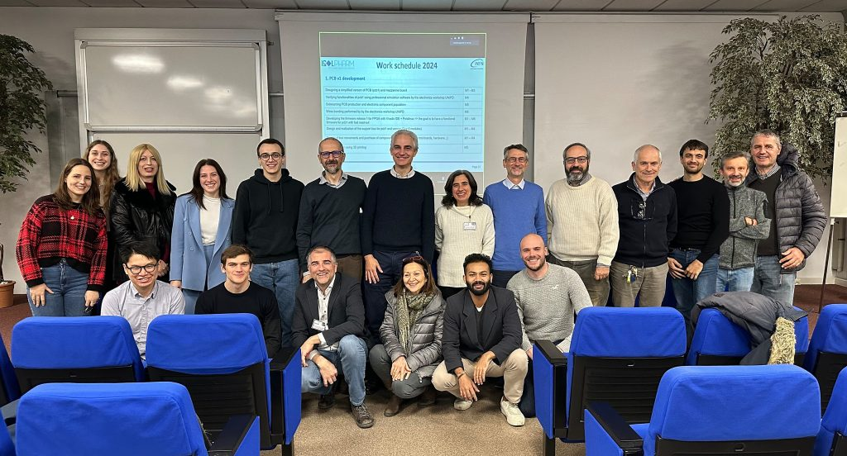
The ISOLPHARM Team
Post-graduate students:
Alberto Arzenton, Daiyuan Chen, Jessica Delgado, Giorgio Grosso, Omorjit Singh Khwairakpam, Aurora Leso, Davide Serafini, Nicola Zancopè
Thank you for your kind attention!
Visit our webpage: https://isolpharm.pd.infn.it/web/

