Slide 1


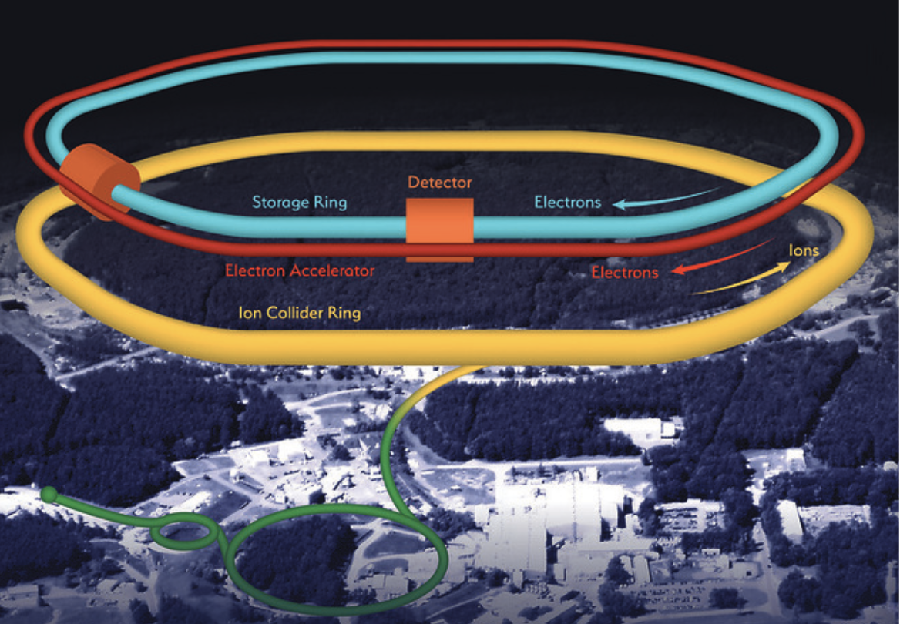
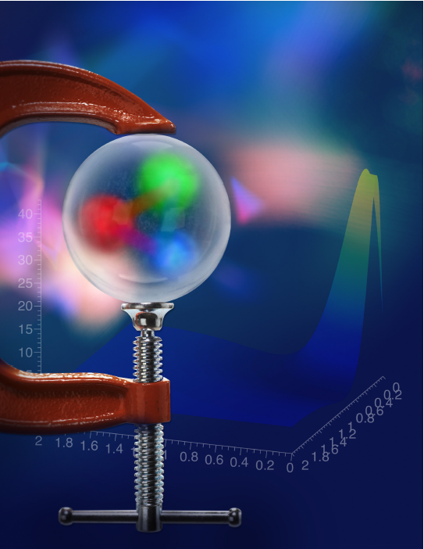
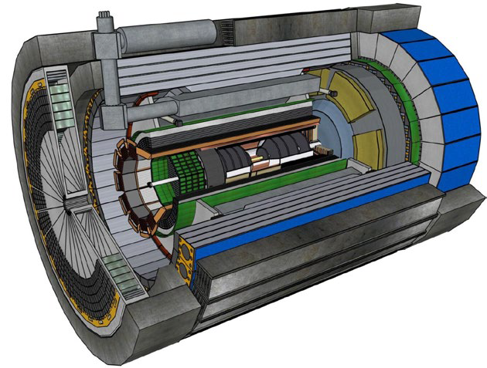

July 3rd 2024
The EIC project
Annalisa D’Angelo
University of Rome Tor Vergata & INFN Rome Tor Vergata Rome – Italy
Outline:
Physics case: color confinement and strong QCD
TMD and DVCS – N spin structure and 3D image and the role of the glue
The ePIC detector
The ePIC collaboration

Slide 2
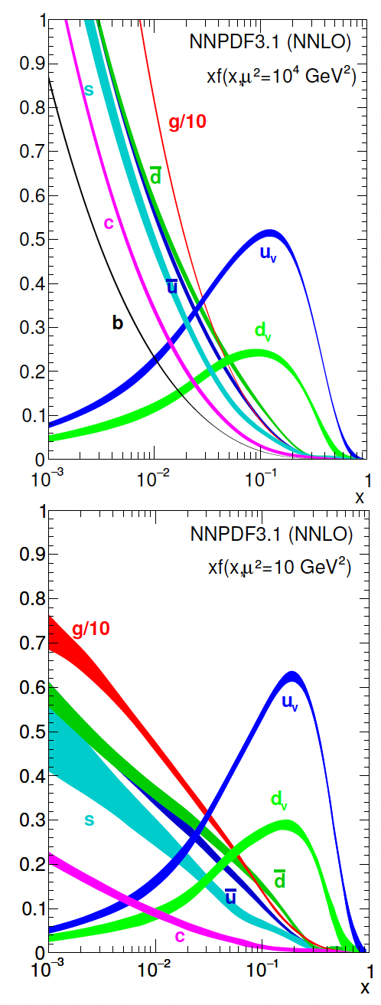
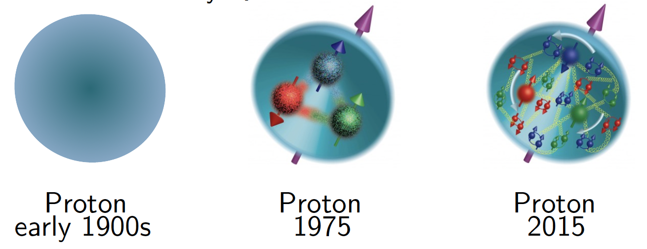
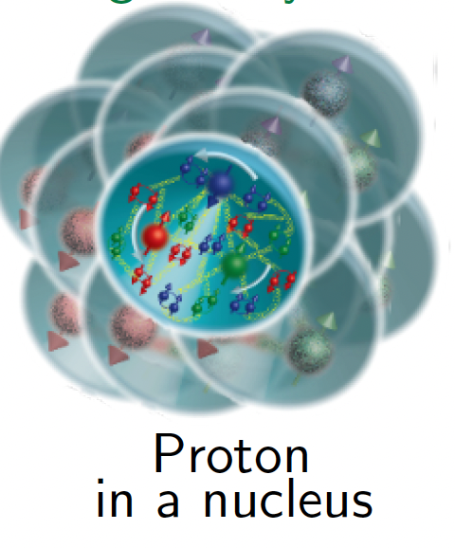
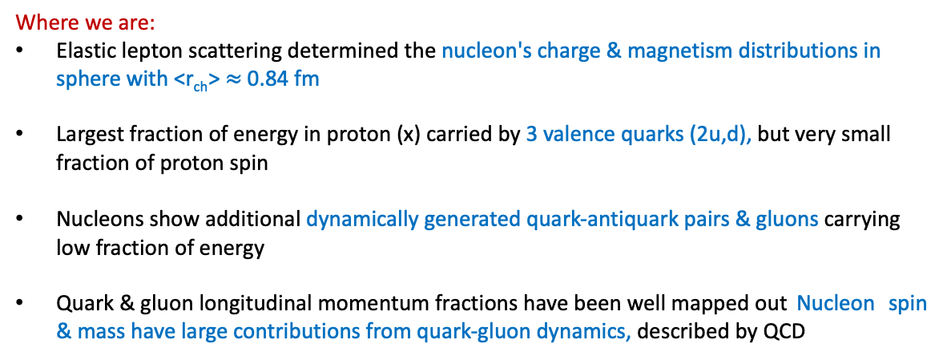
Back to the basics of Hadron Physics
Where we are:
Elastic lepton scattering determined the nucleon's charge & magnetism distributions in sphere with <r_{ch}> $≈$ 0.84 fm
Largest fraction of energy in proton (x) carried by 3 valence quarks (2u,d), but very small fraction of proton spin
Nucleons show additional dynamically generated quark-antiquark pairs & gluons carrying low fraction of energy
Quark & gluon longitudinal momentum fractions have been well mapped out Nucleon spin & mass have large contributions from quark-gluon dynamics, described by QCD

Slide 3
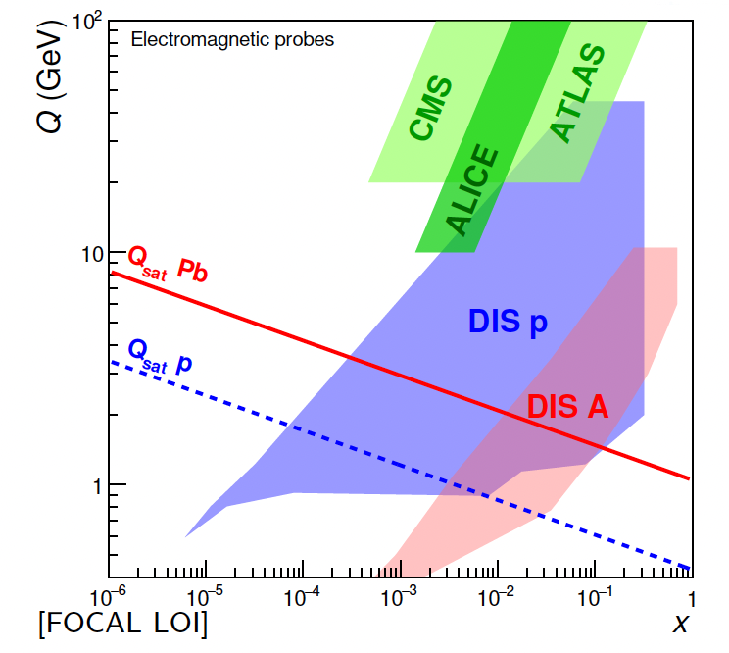
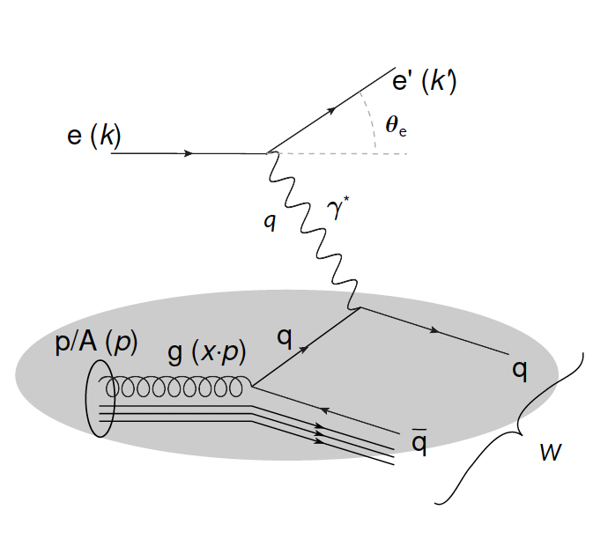
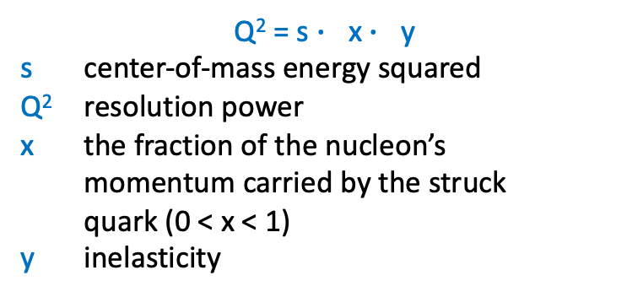
How did we learn this?
Deep Inelastic Scattering (DIS)
Q² = s $∙$ x $∙$ y
s center-of-mass energy squared
Q² resolution power
x the fraction of the nucleon’s
momentum carried by the struck
quark (0 < x < 1)
y inelasticity
As a probe, electron beams provide unmatched precision of the electromagnetic interaction
Direct, model independent determination of parton kinematics and spin of physics processes at the leading order
Additional information obtained indirectly from hadron-collider measurements

Slide 4
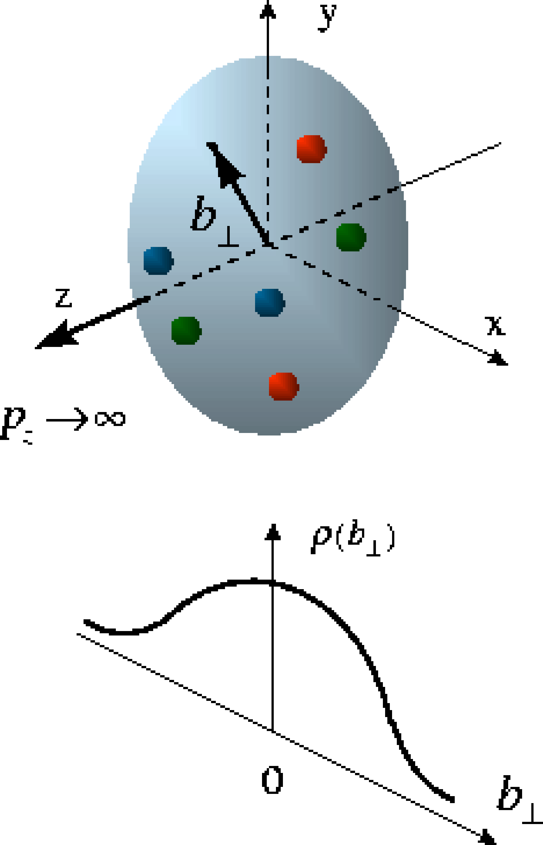
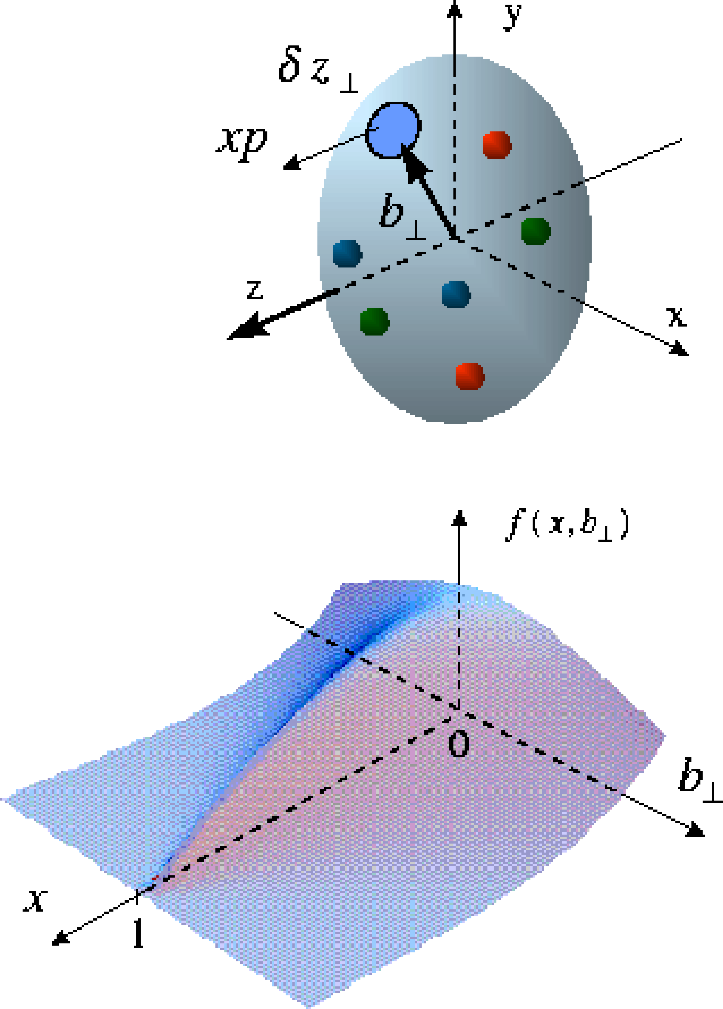
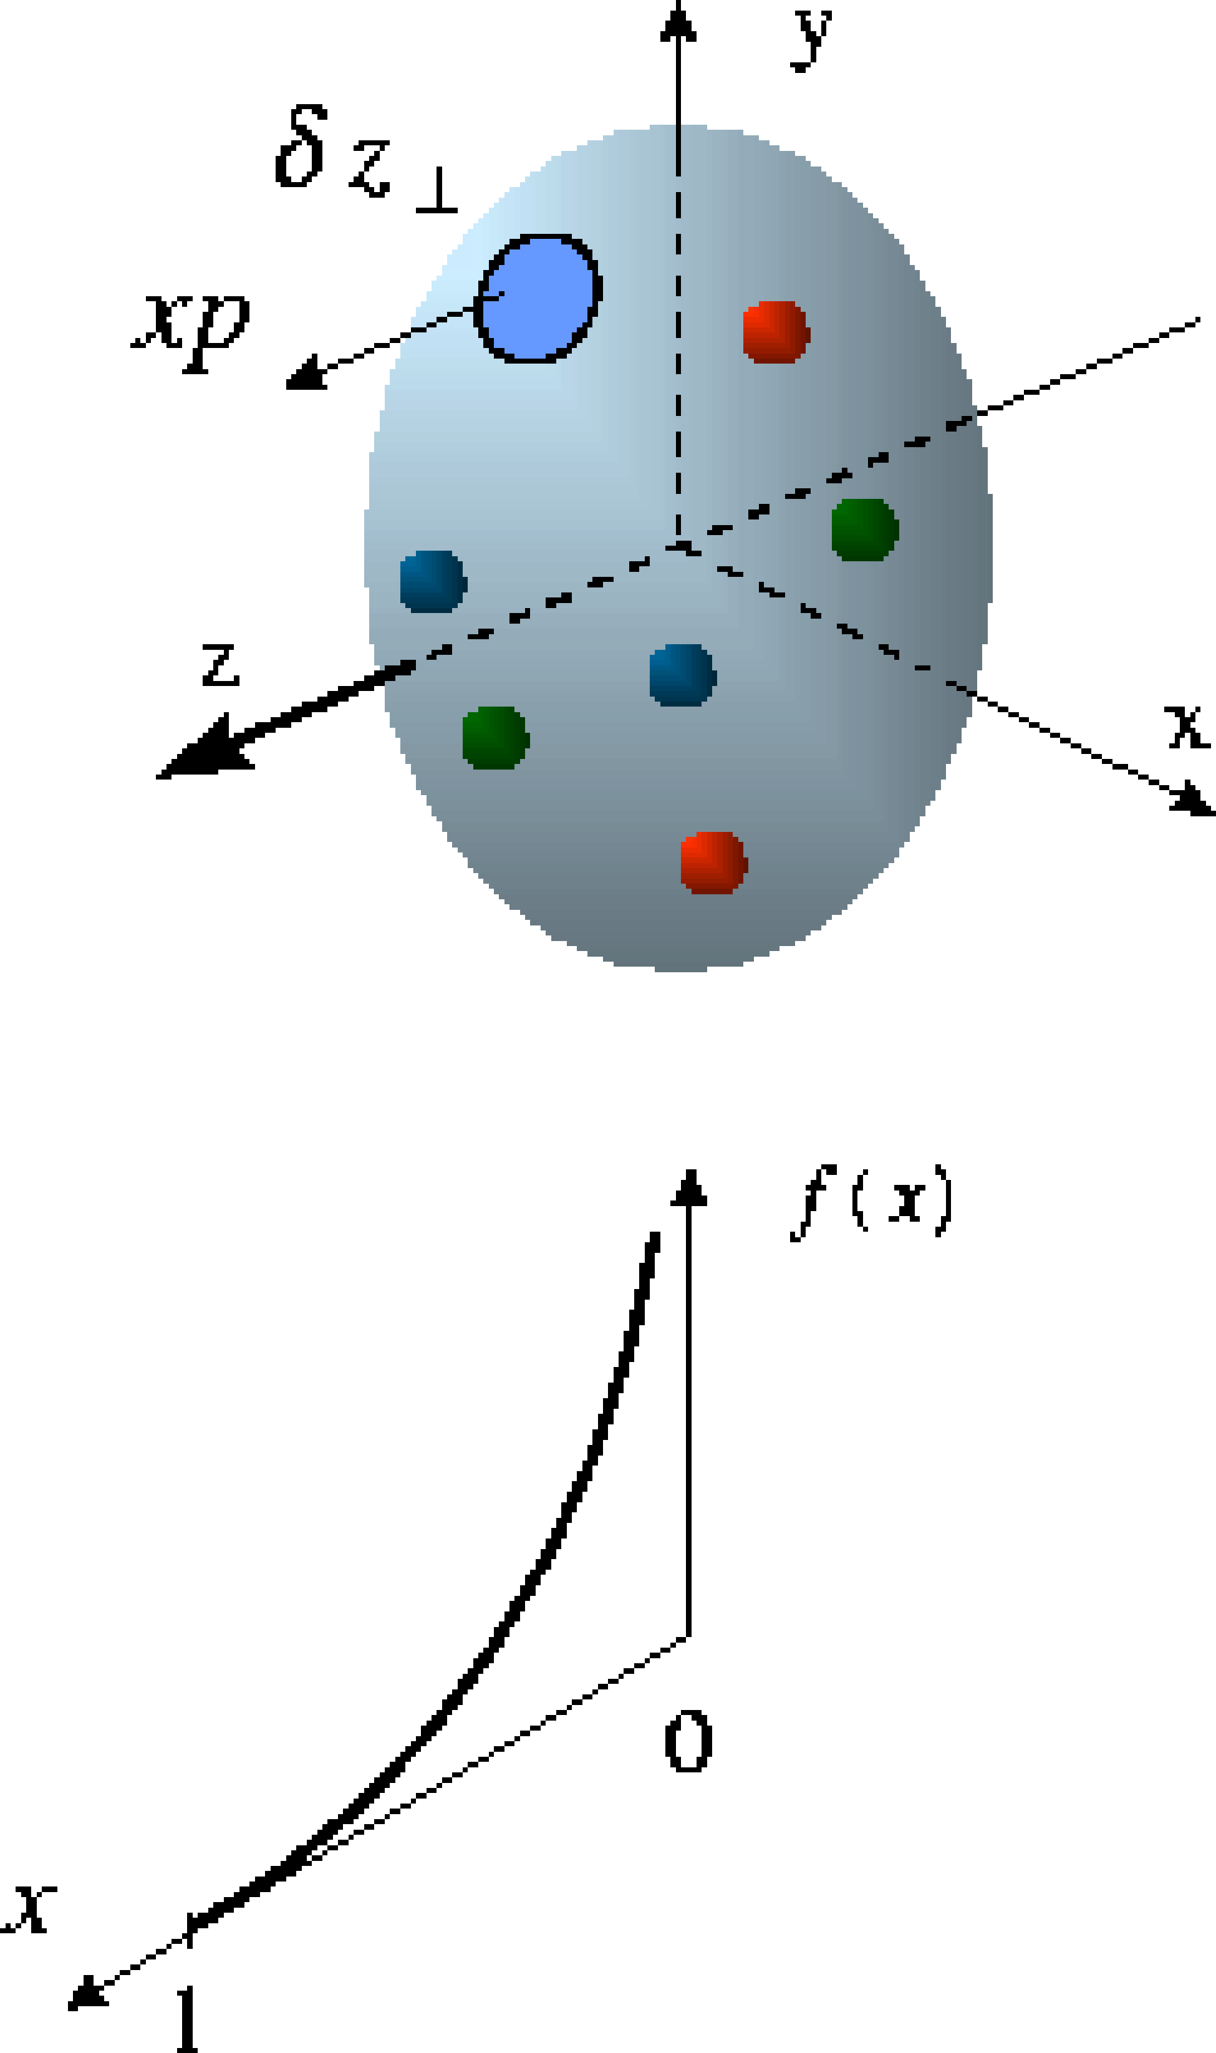
Nucleon Structure Evolution
elastic scattering
deep-exclusive scattering
deep-inelastic scattering
Transverse quark distribution in coordinate space
Correlated quark space and
momentum distributions – GPD
Longitudinal quark distribution in momentum space

Slide 5
History of Nucleon Structure Studies
1950-1960: Does the proton have finite size and structure?
  Elastic electron-proton scattering
    the proton is not a point-like particle but has finite size – seen through charge and current distribution in the proton G_{E}/G_{M}
Nobel prize 1961- R. Hofstadter
1960-1990: What are the internal constituents of the nucleon?
  Deeply inelastic scattering
    discover quarks in ‘scaling’ of structure function - measure their momentum and spin distributions
Nobel prize 1990 - J. Friedman, H. Kendall, R. Taylor
Today: Unraveling a 3-D image of the quark and gluon distributions, including mass, spin, and pressure distributions

Slide 6
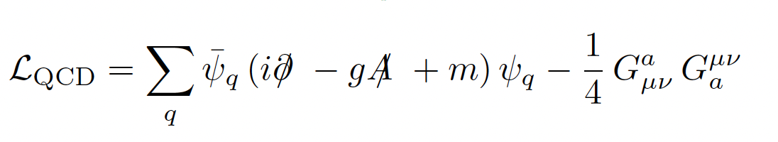

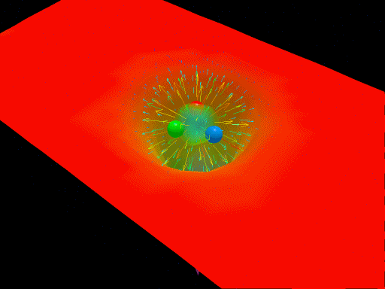
Critical QCD Questions Addressed
How do properties of colorless hadrons emerge from the confined dynamics of colored quarks and gluons?
QCD is the most complex part of the Standard Model
At Nucleon mass scale (1 GeV), dynamics is highly nonlinear and leads to confinement of partons. How do N mass / size / spin emerge from these dynamics?
“Nucleons are the stuff of which our world is made.
As such they must be at the center of any discussion of why the world we actually experience has the character it does.”
Nathan Isgur, 2000
Derek B. Leinweber – University of Adelaide

Slide 7
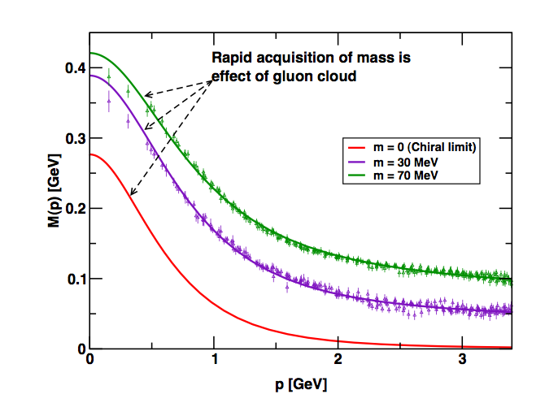
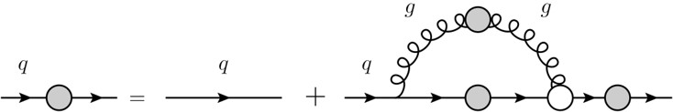
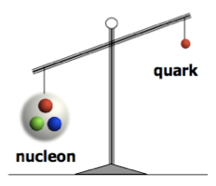
Critical QCD Questions Addressed
How do massless quarks acquire mass?
Effective quark mass depends on its momentum
numerical simulations
of unquenched lattice QCD
(Bowman et al.)
M=M(p)
m₀=m_{HM}
Dyson-Swinger equation
(Bhagwat et al.)
dressed quark
bare quark
dressing kernel
mass composition
<2% Higgs mechanism
>98% non-perturbative strong interaction
Almost all the nucleon mass comes from the energy spent to bind the quarks inside it!

Slide 8
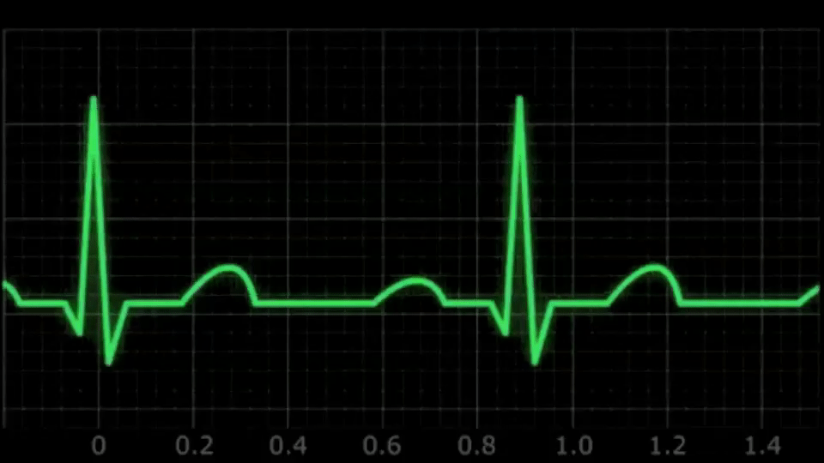
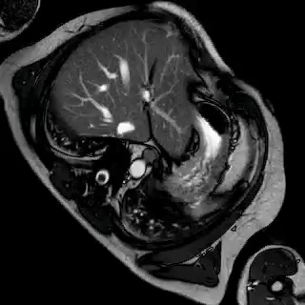
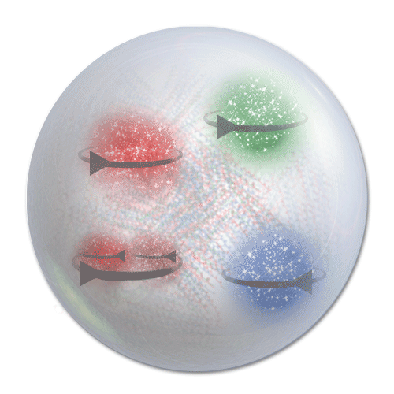
Critical QCD Questions Addressed
How are the quarks and gluons, and their intrinsic spins distributed in space & momentum inside the nucleon? What is the role of the angular momentum ?
SIDIS and TMDs measurements toward a 3D imaging of the proton

Slide 9
Critical QCD Questions Addressed
How is color confinement realized in the force and pressure distributions and stabilize nucleons?
Electro-magnetism
Vector
Tensor
Gravity
Q_{p} μ_{p}
M_{p} J_{p} D_{p}
PCAC
g_{A} g_{P}
Weak interaction
Study GPDs and their moments from DVCS

Slide 10
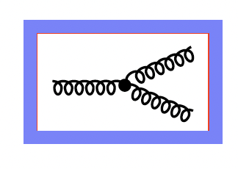
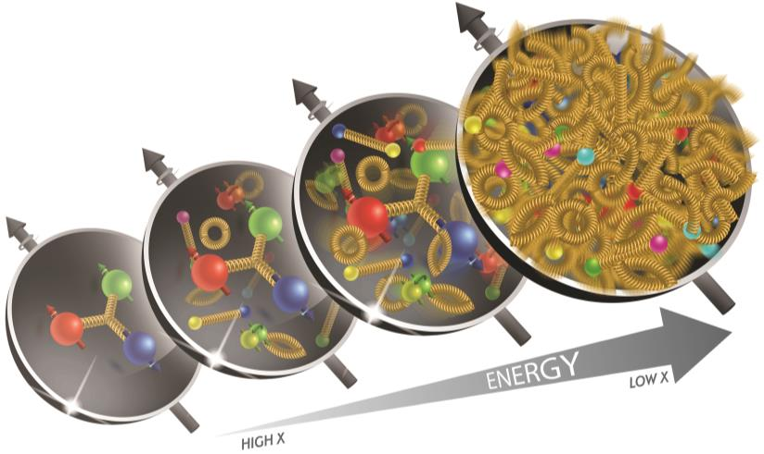
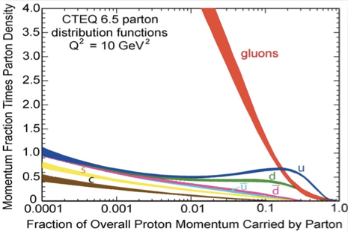
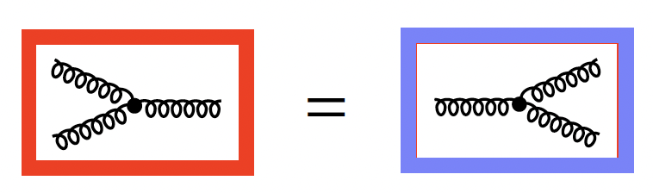
Critical QCD Questions Addressed
Where does gluon saturation set in ? Universal gluonic matter at high density ? quark-gluon interactions in nuclear matter ?
Gluon self-interaction leads to the proliferation of the number of gluons
Unitarity → gluons must recombine to balance splitting (saturation)

Slide 11
Critical QCD Questions Addressed
How do properties of colorless hadrons emerge from the confined dynamics of colored quarks and gluons?
      Measure the Q² dependence of hadrons electrocouplings and form factors
How do massless quarks acquire mass?
Access the Energy - Momentum Tensor and the Gravitational Form Factors
How are the quarks and gluons, and their intrinsic spins distributed in space & momentum inside the nucleon? What is the role of the angular momentum ?
SIDIS and TMDs measurements toward a 3D imaging of the proton
How is color confinement realized in the force and pressure distributions and stabilize nucleons?
Study GPDs and their moments from DVCS
Where does gluon saturation set in?
Study deep processes o Nuclei
The EIC scientific program addresses all these questions

Slide 12
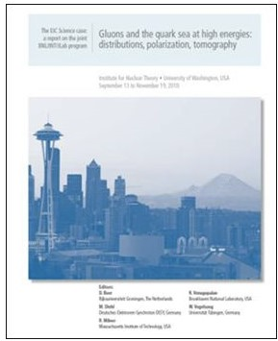
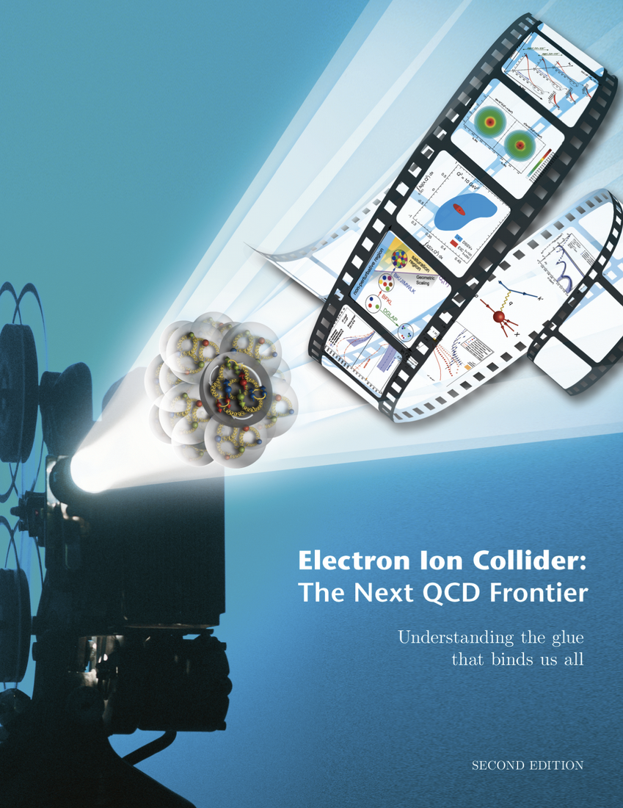

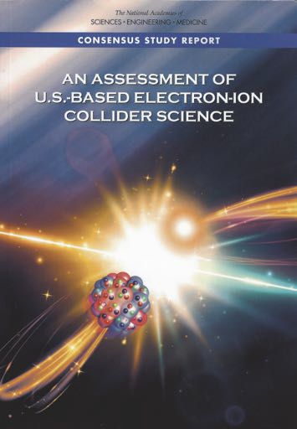


The Path to the EIC project
2010
“Gluons and the quark sea at high energies: distributions, polarization, tomography”, INT - Seattle, Sept 13 - Nov 19 2010, arXiv:1108.1713
Electron Ion Collider: the Next QCD Frontier”, E.P.J. A52 (16) 268, arXiv:1212.1701 - 1200 citations on Inspire
2012 - White Paper
2015
Long Range Plan recommendations
2018
Assessment by the US National Academy of Science “The Committee finds that the science that can be addressed by an EIC is compelling, fundamental and timely”
2022
Yellow Report Nucl. Phys. A 1026 (2022) 122447
2023
NSAC - Long Range Plan
We recommend the expeditious completion of the EIC as the highest priority for facility construction

Slide 13
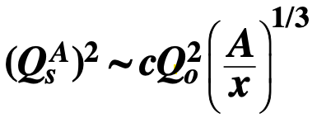
QCD exploration at EIC
REQUIREMENTS
Access to gluon dominated region and wide kinematic range in x and Q2
Access to spin structure and 3D spatial and momentum structure
Accessing the highest gluon densities
Studying observables as a function of x, Q2, A, hadronic flavour, …
THE EIC COLLIDER PROVIDES
Large center-of-mass energy range:
√s = 21 -140 GeV
Polarized electron, proton and light nuclear beams
≥ 70%
Nuclear beams, the heavier the better (from H to U)
High luminosity (100 x HERA): 10³³⁻³⁴ cm⁻² ^{s-1}

Slide 14
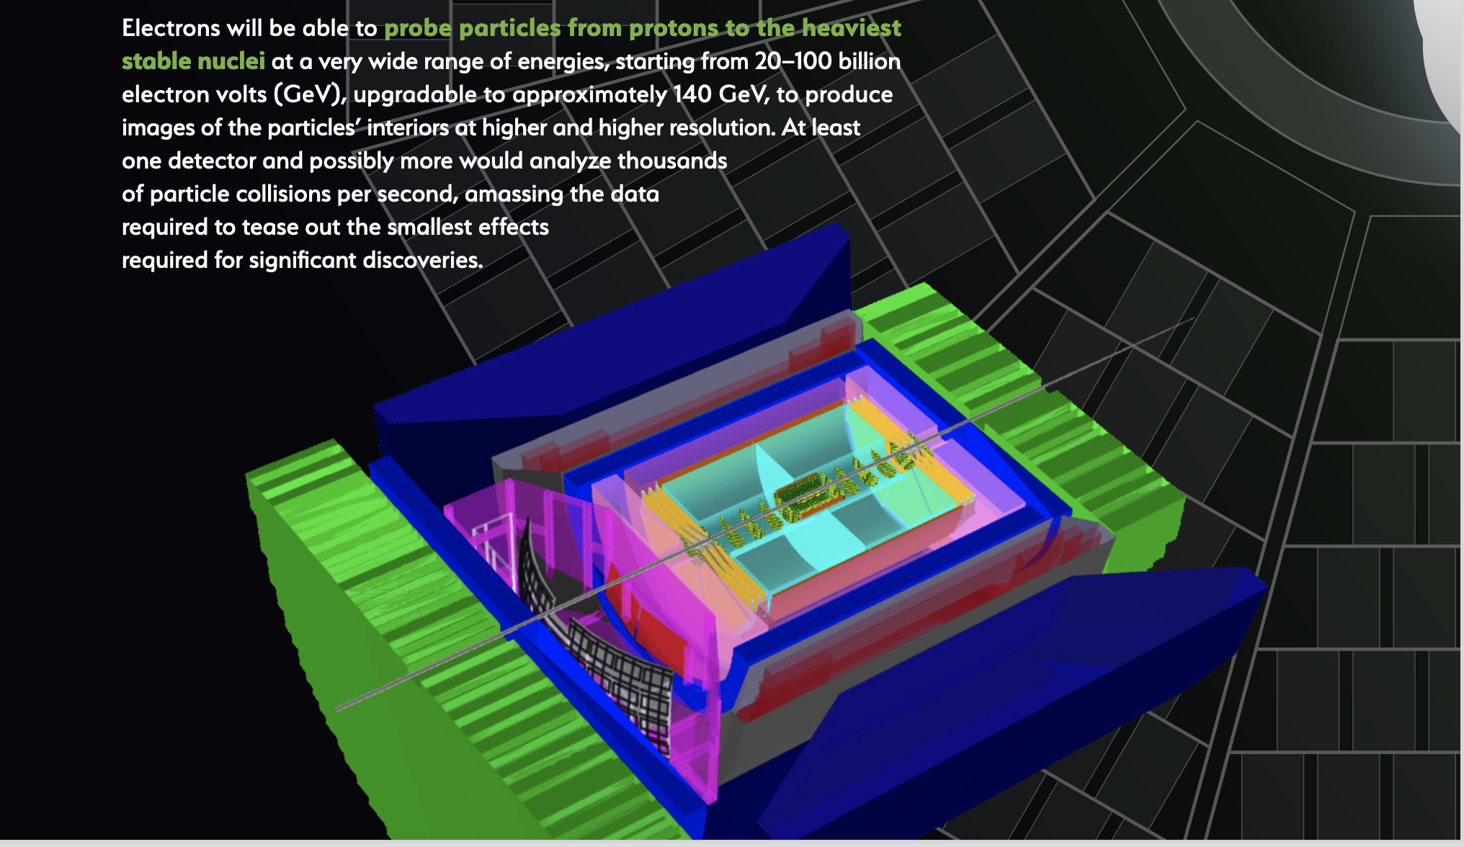
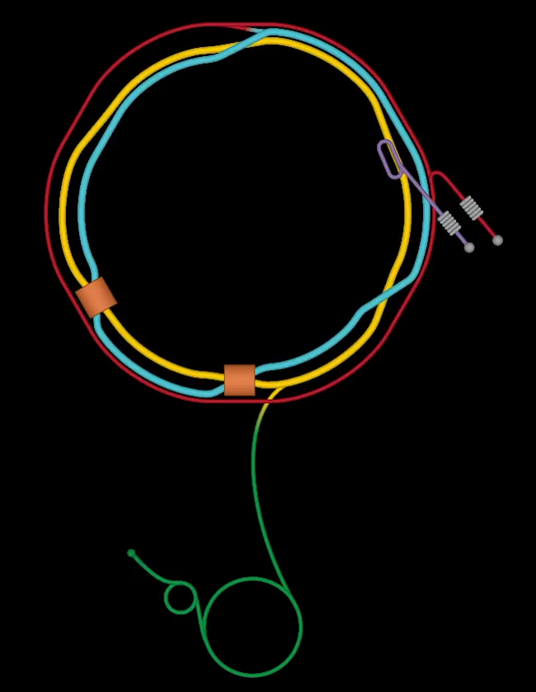
EIC @ BNL
E_{e} =100-140 GeV
Electron-Ion Collider
101 INFN Physicists
16 INFN Institutes
ePIC
Si Vertex detector
Dual RICH
Streaming Read-out
MPGD Endcap trackers

Slide 15
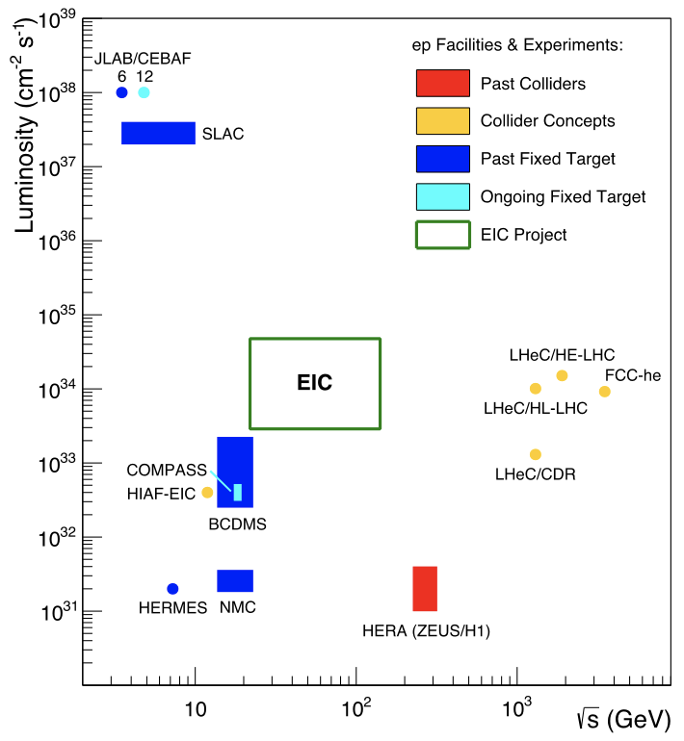
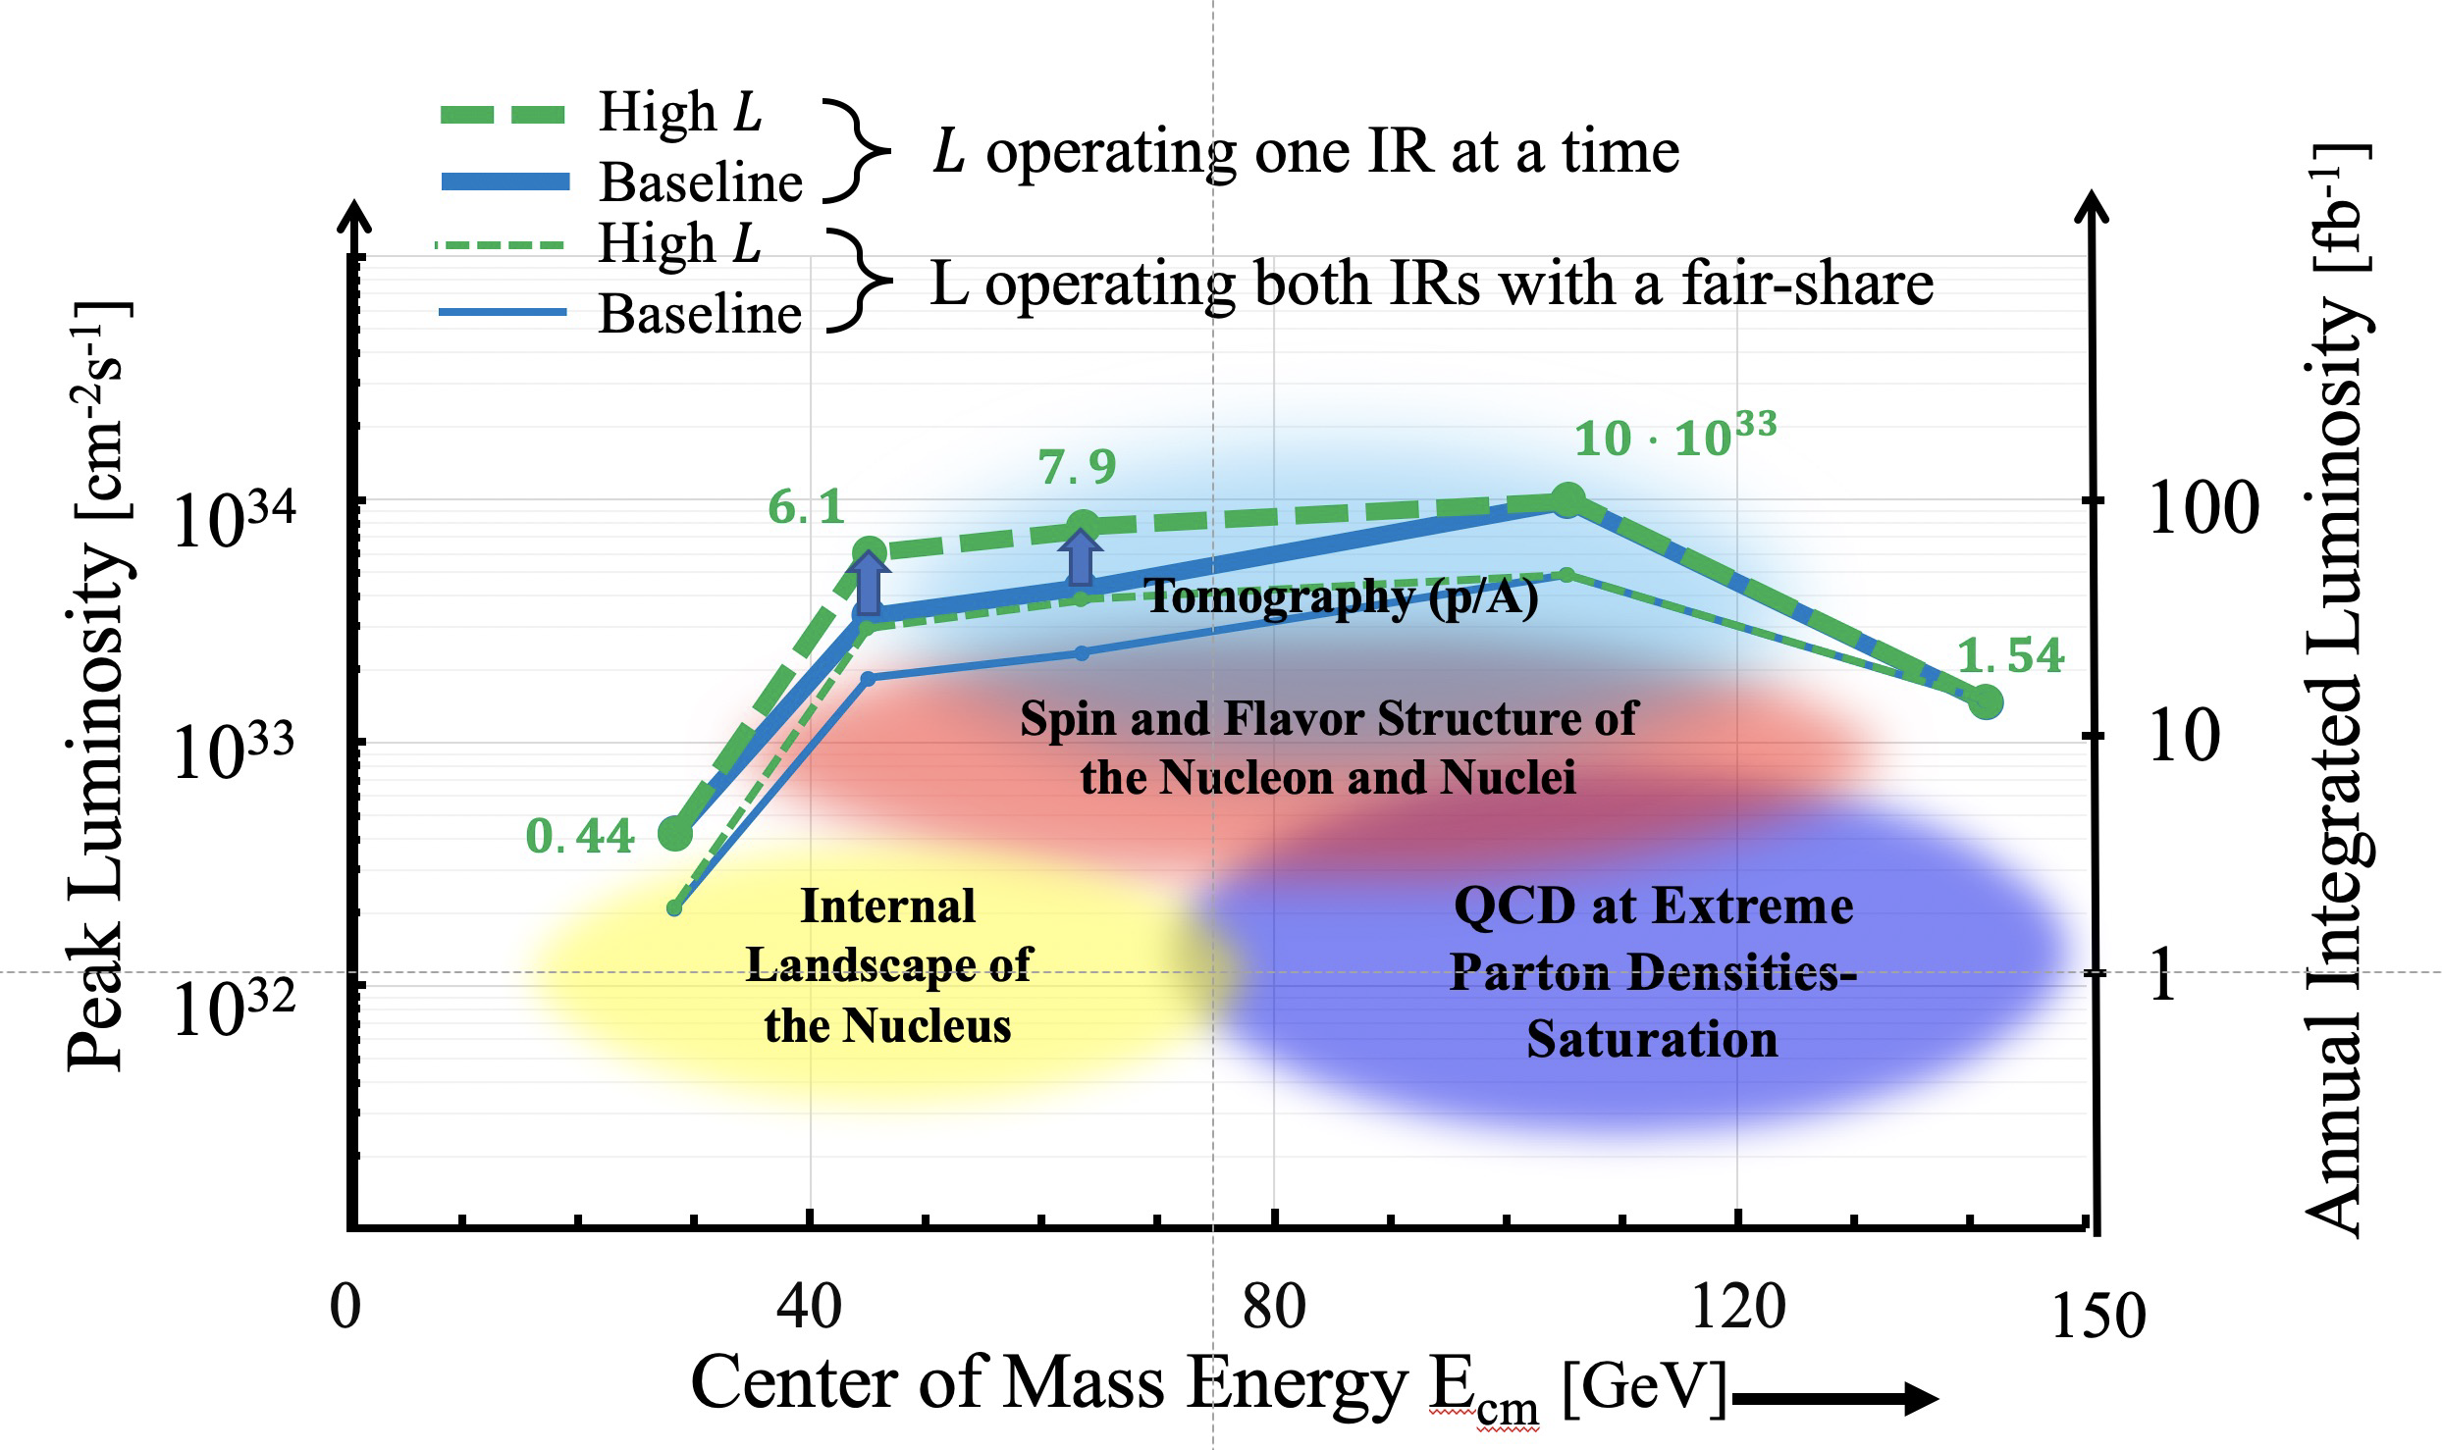
EIC @ BNL
E_{e} =100-140 GeV
Electron-Ion Collider
X1000
If we ask for: - high luminosity and wide range in s
- polarized electron & light-ion beams
- large variety of ion beams
EIC stands out as unique facility

Slide 16
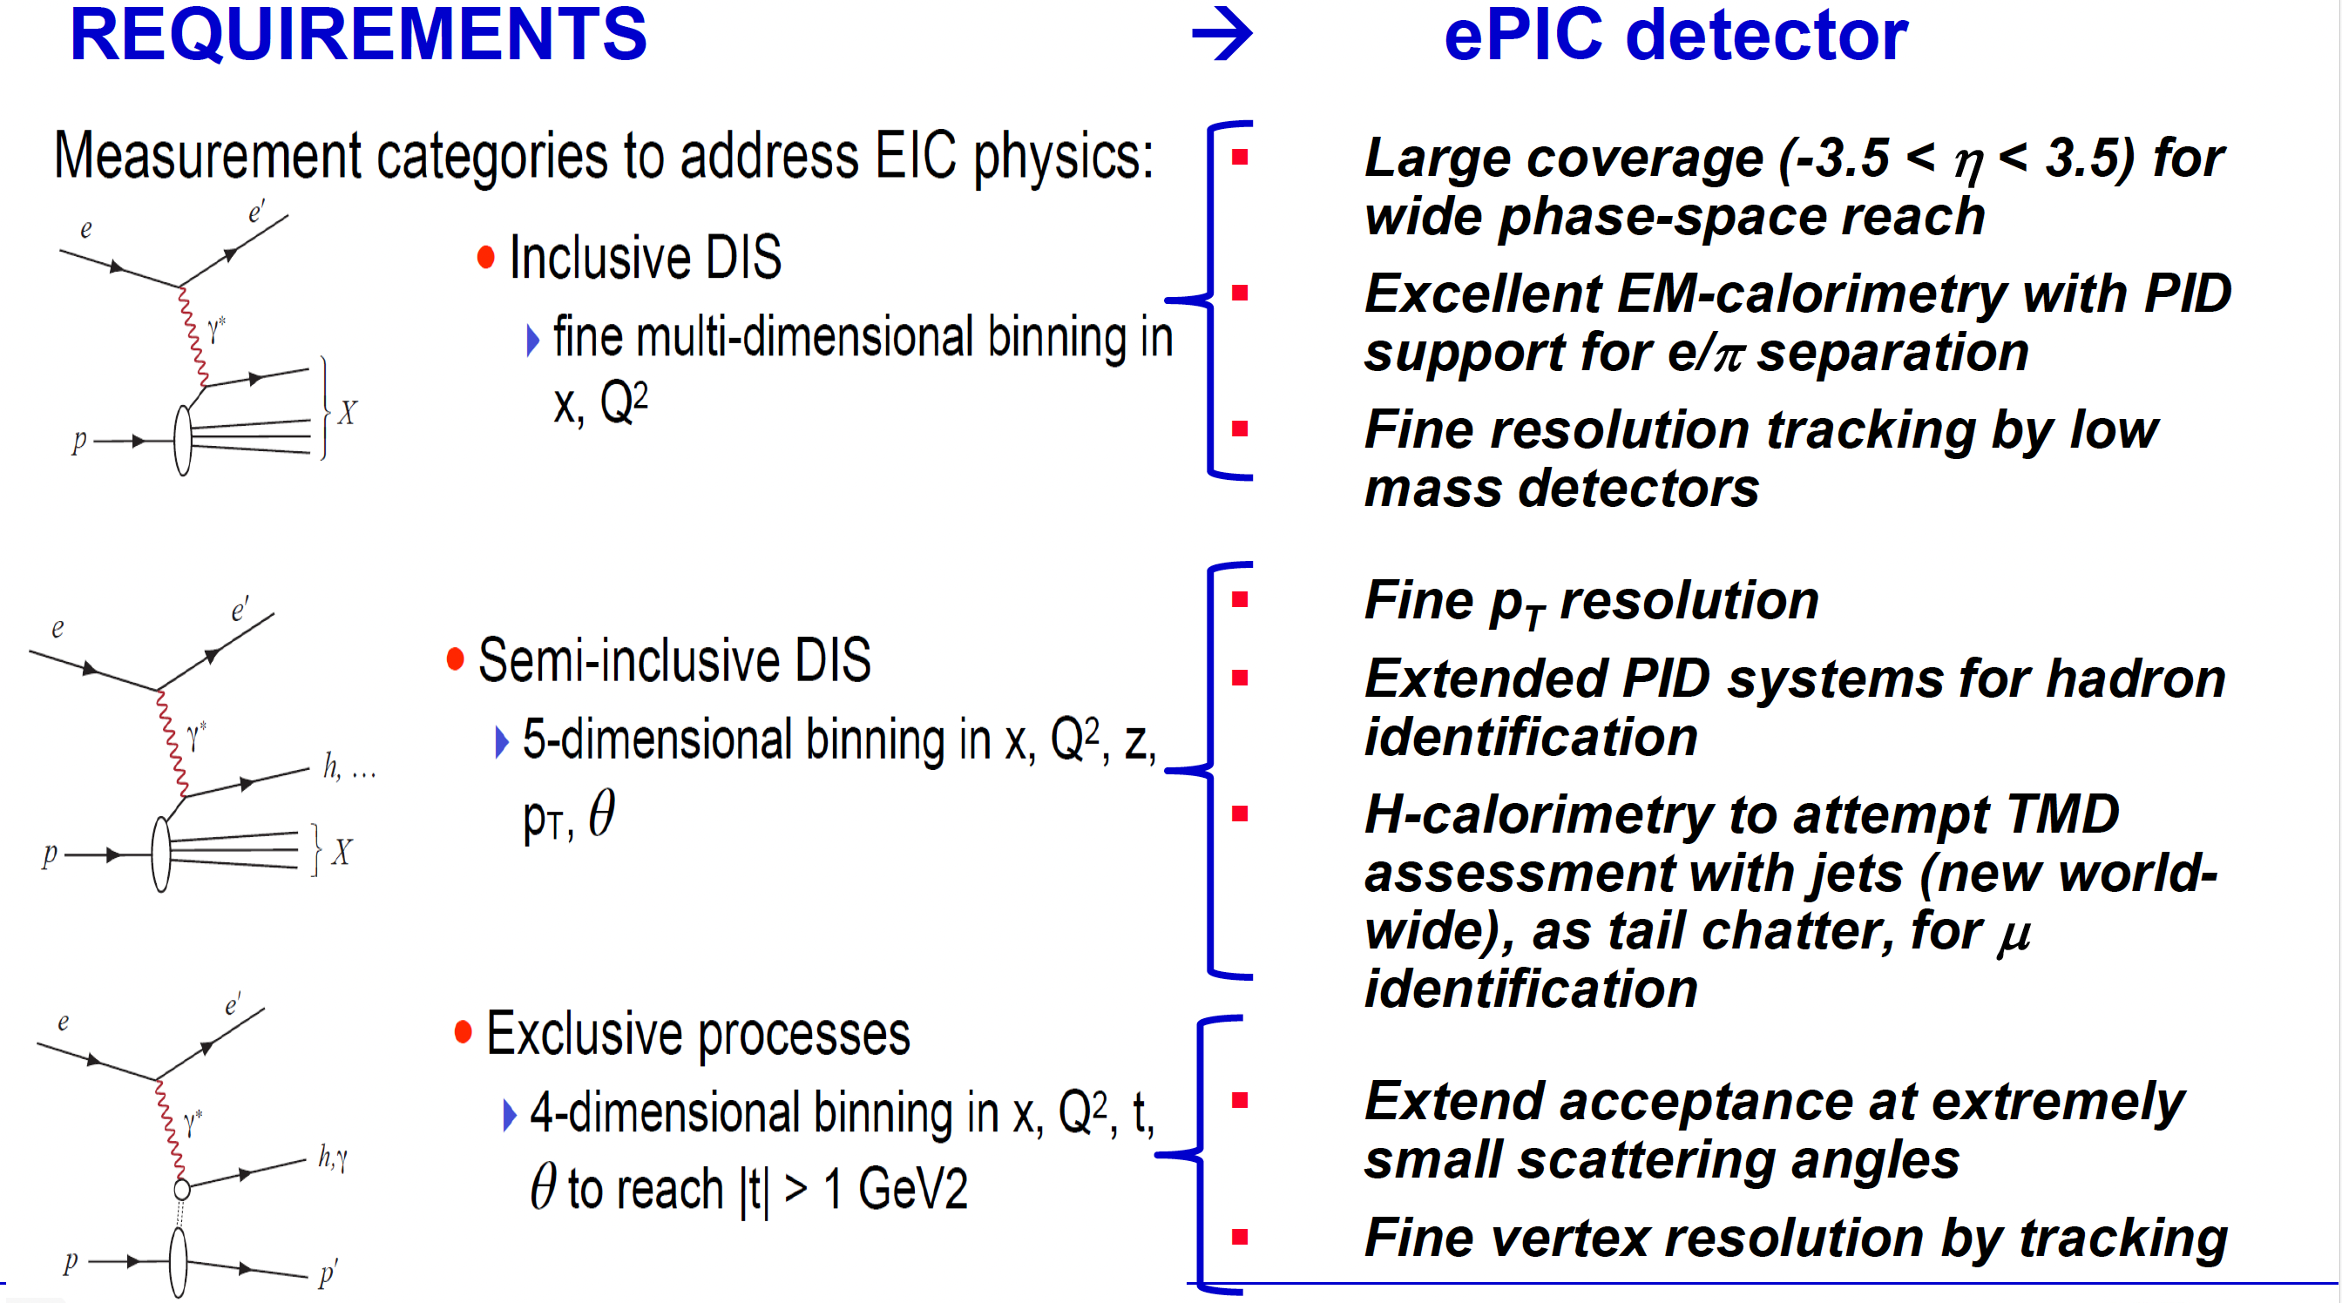
The ePIC detector
~
~

Slide 17
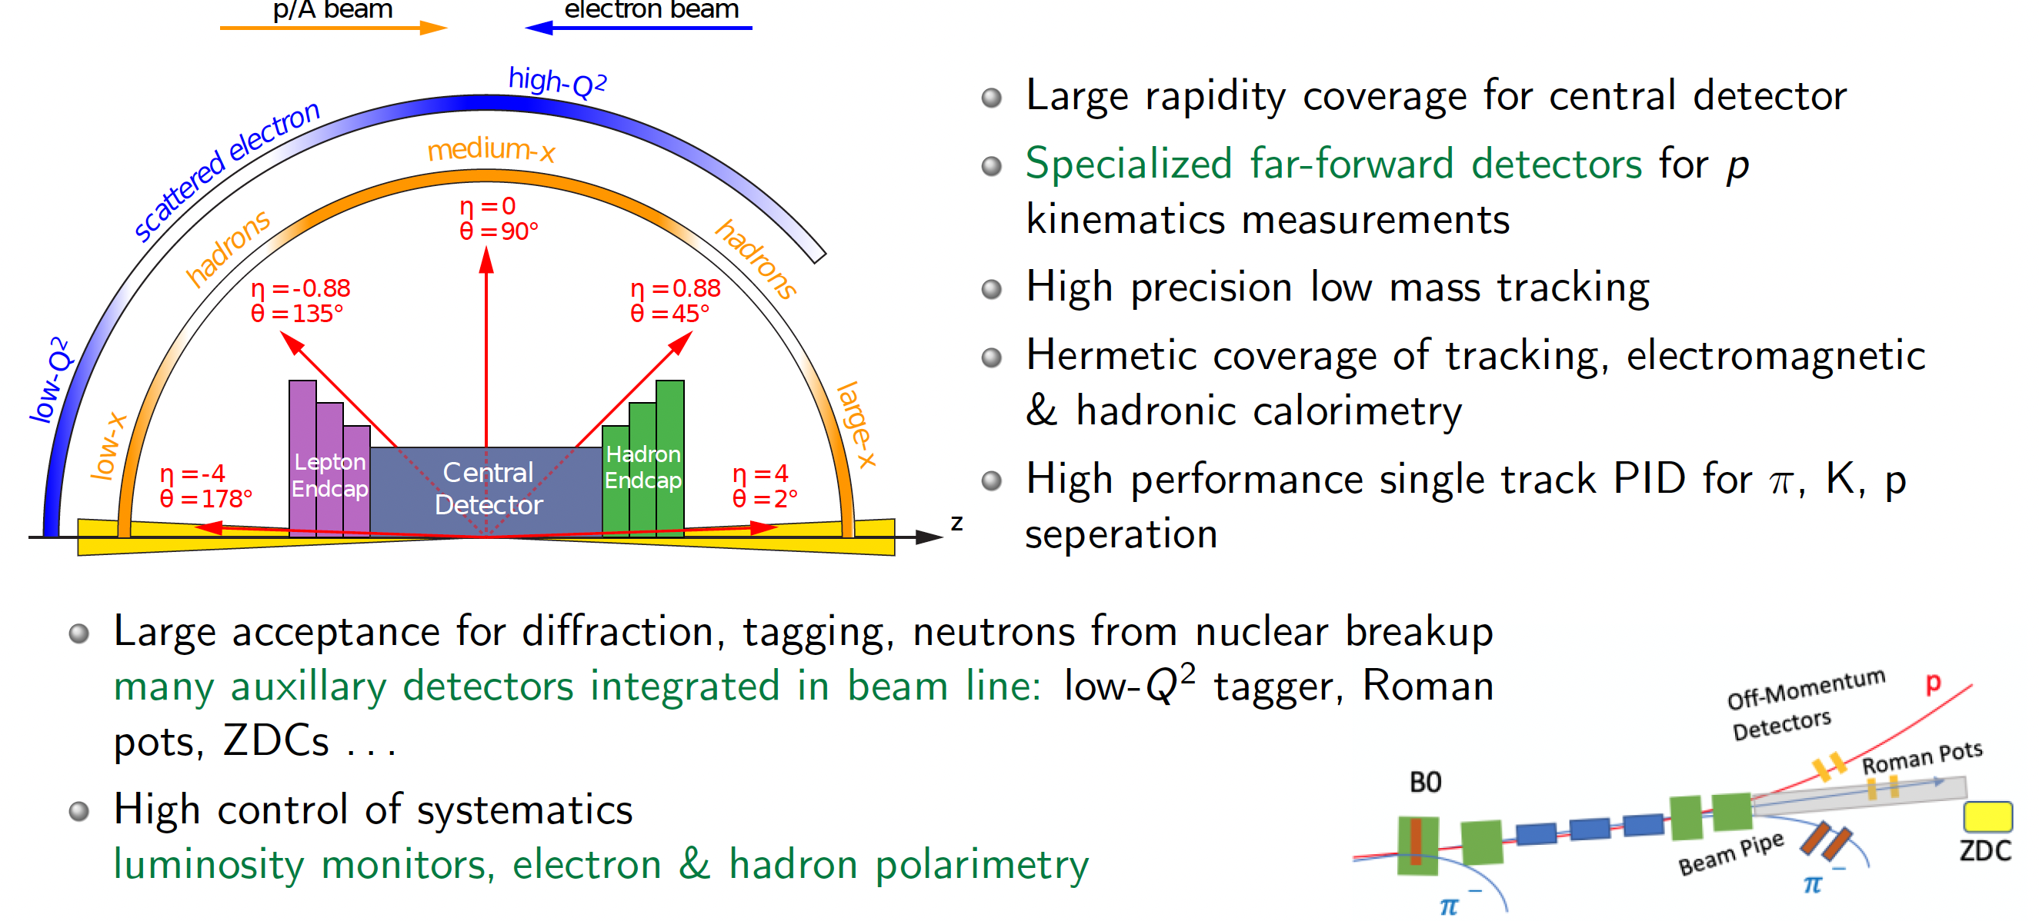
Generalized detector design considerations
Highly integrated design between detector and accelerator
~
~

Slide 18
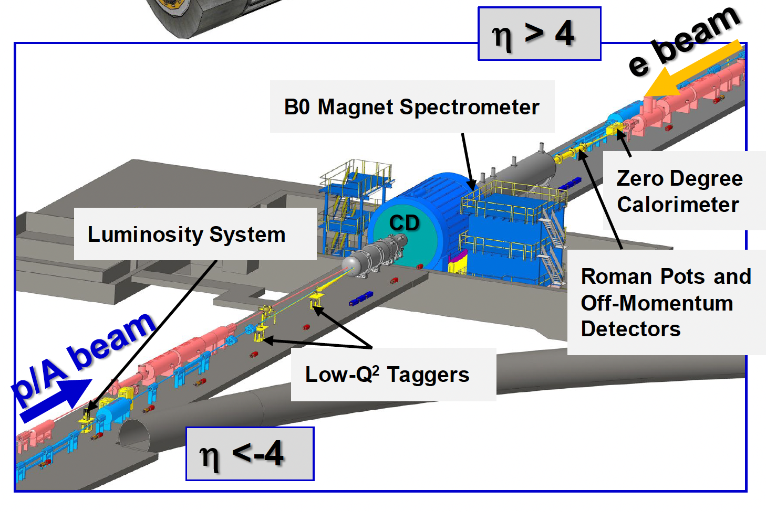


The ePIC detector
$$−4<η<4$$
The Central Detector
The Far Forward and Far Backward Detector
~
~

Slide 19
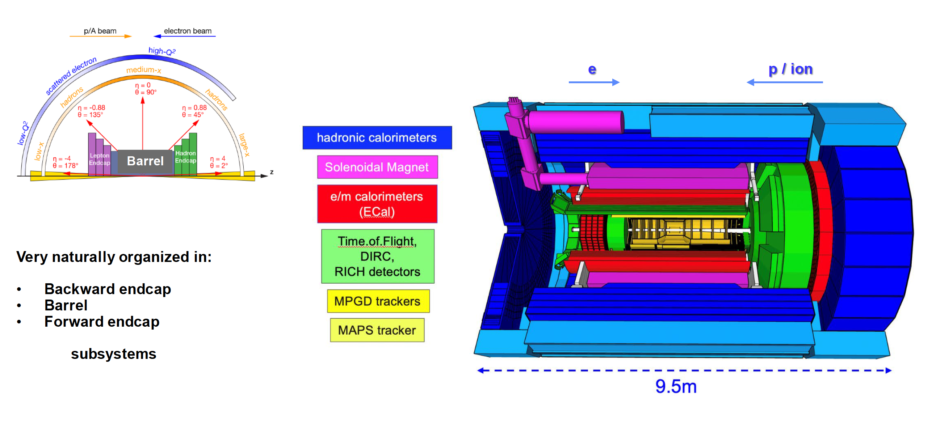
The ePIC Central Detector
~
~

Slide 20
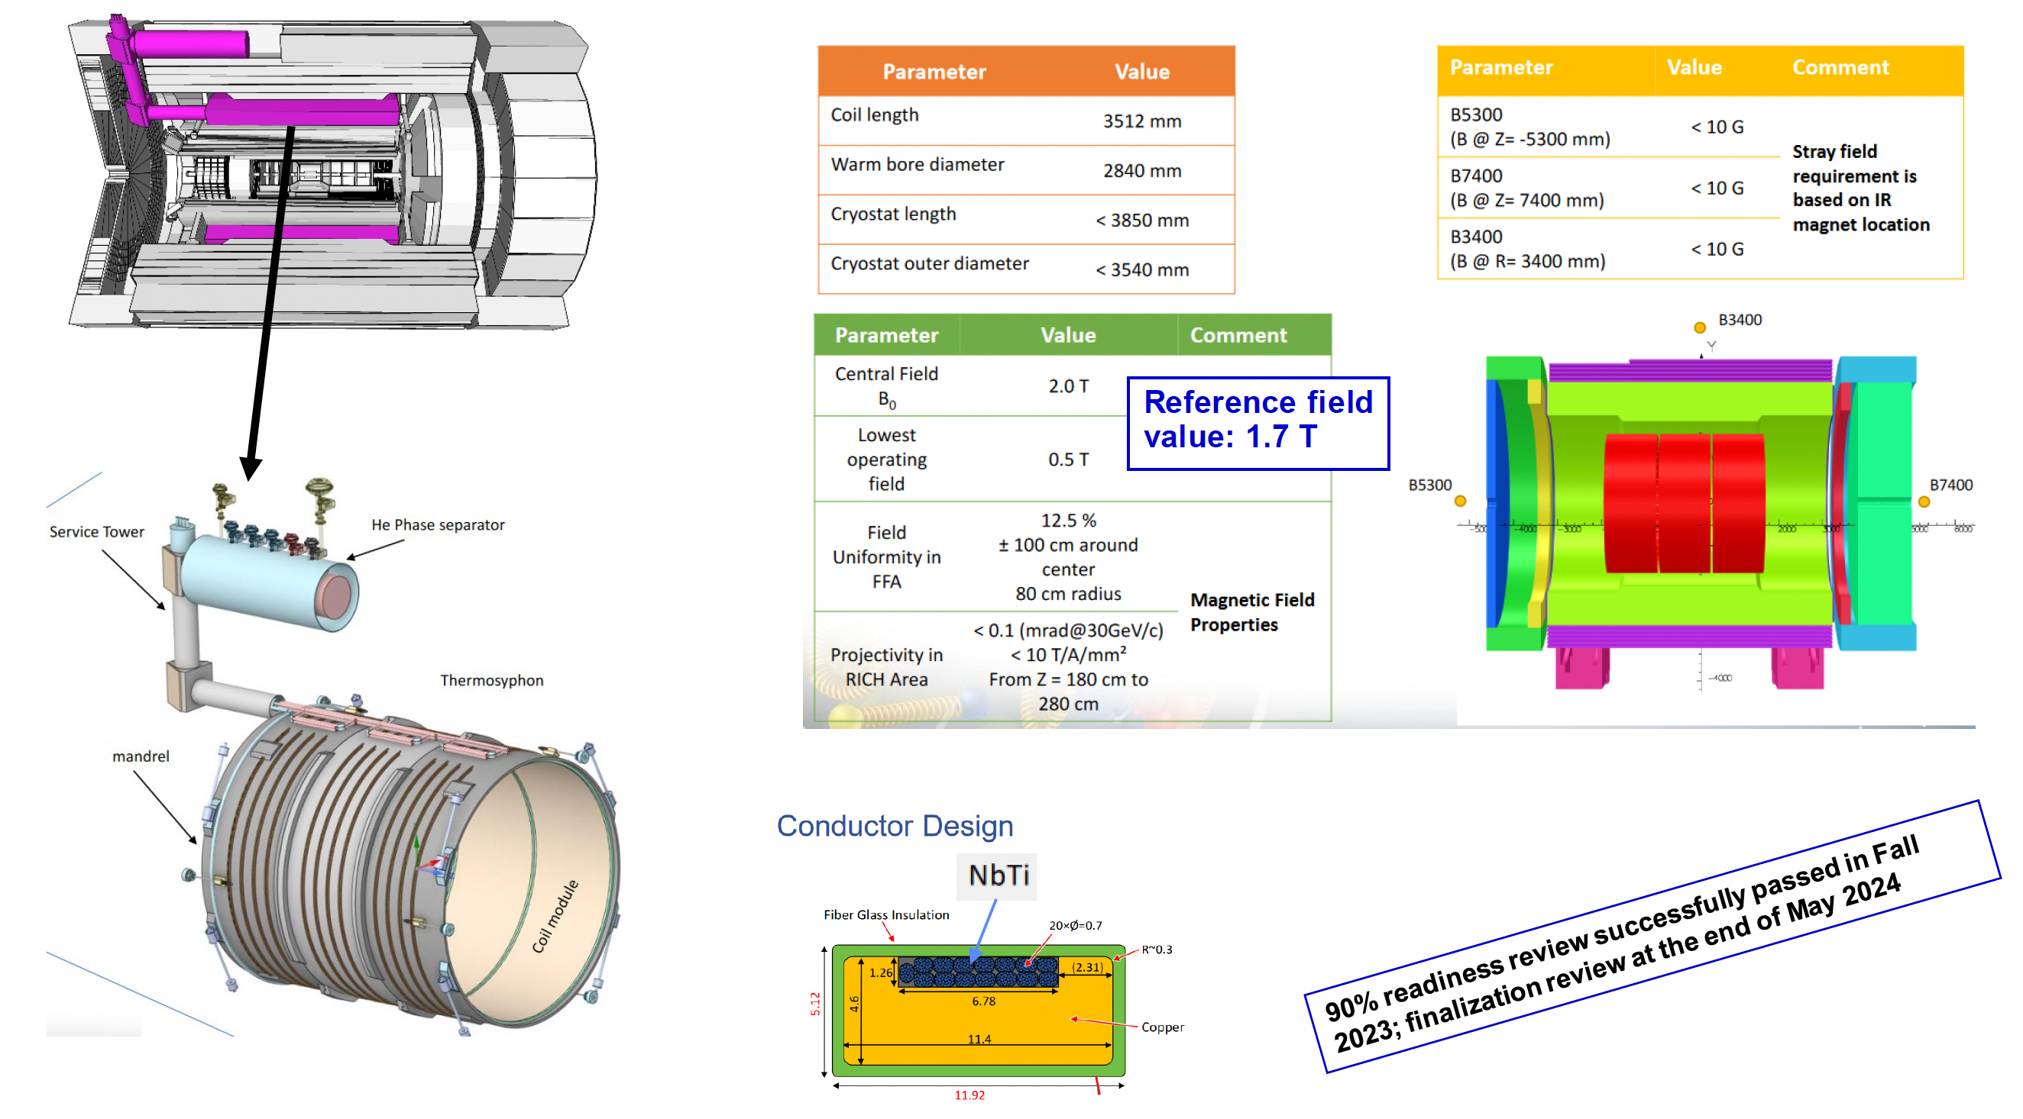
The ePIC Solenoid
~
~

Slide 21
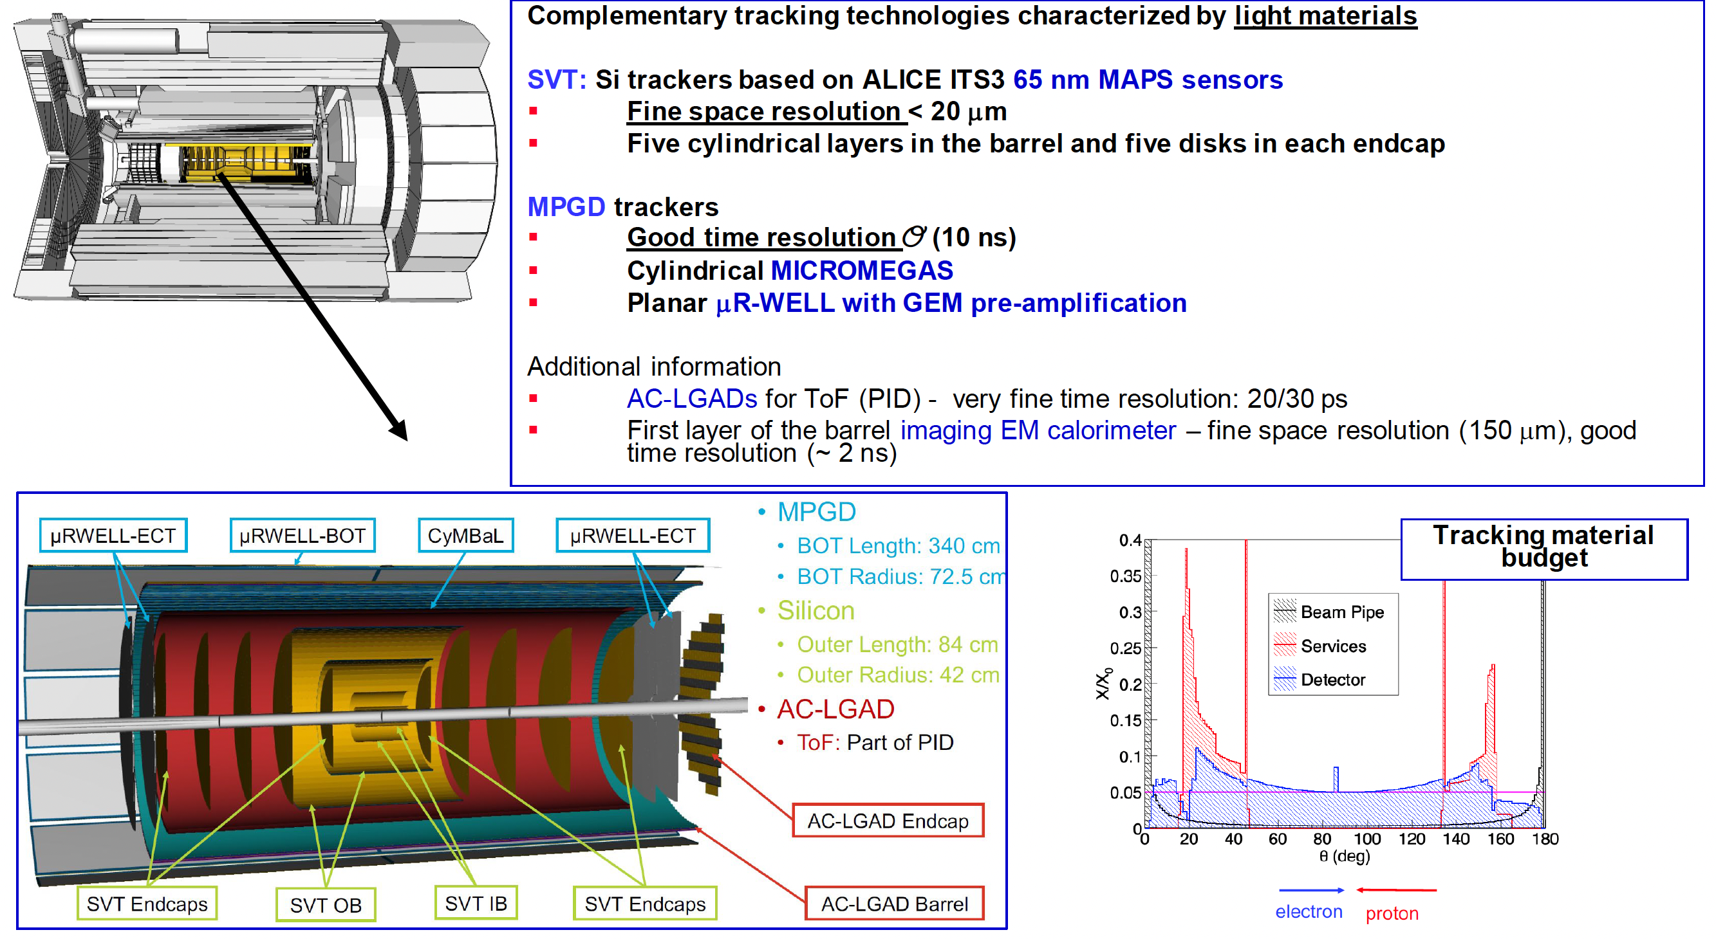
The ePIC Tracking
~
~

Slide 22
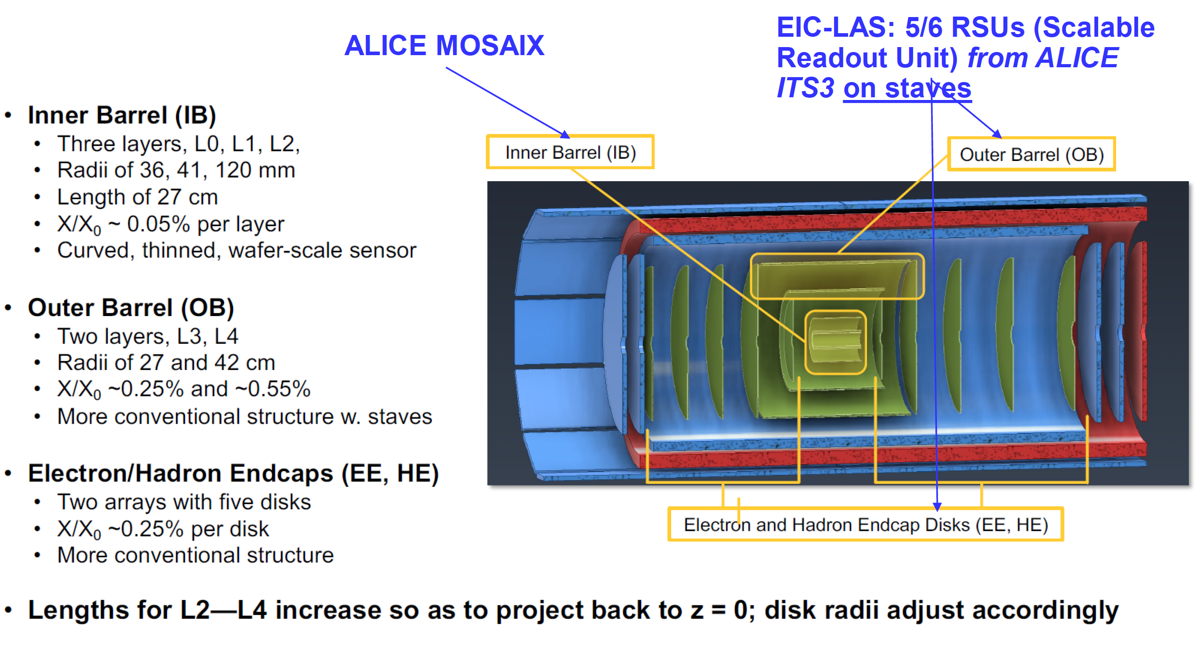
The ePIC Silicon Tracking
~
~

Slide 23
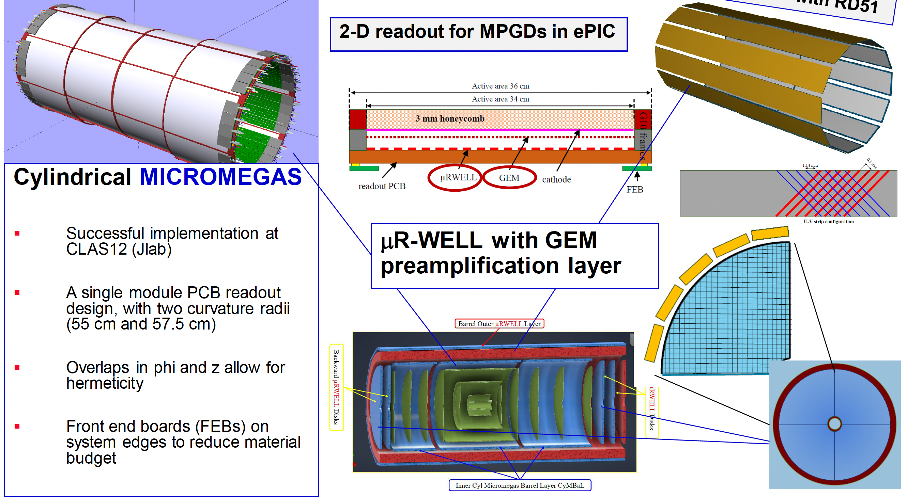
The ePIC MPGD Tracking
~
~

Slide 24
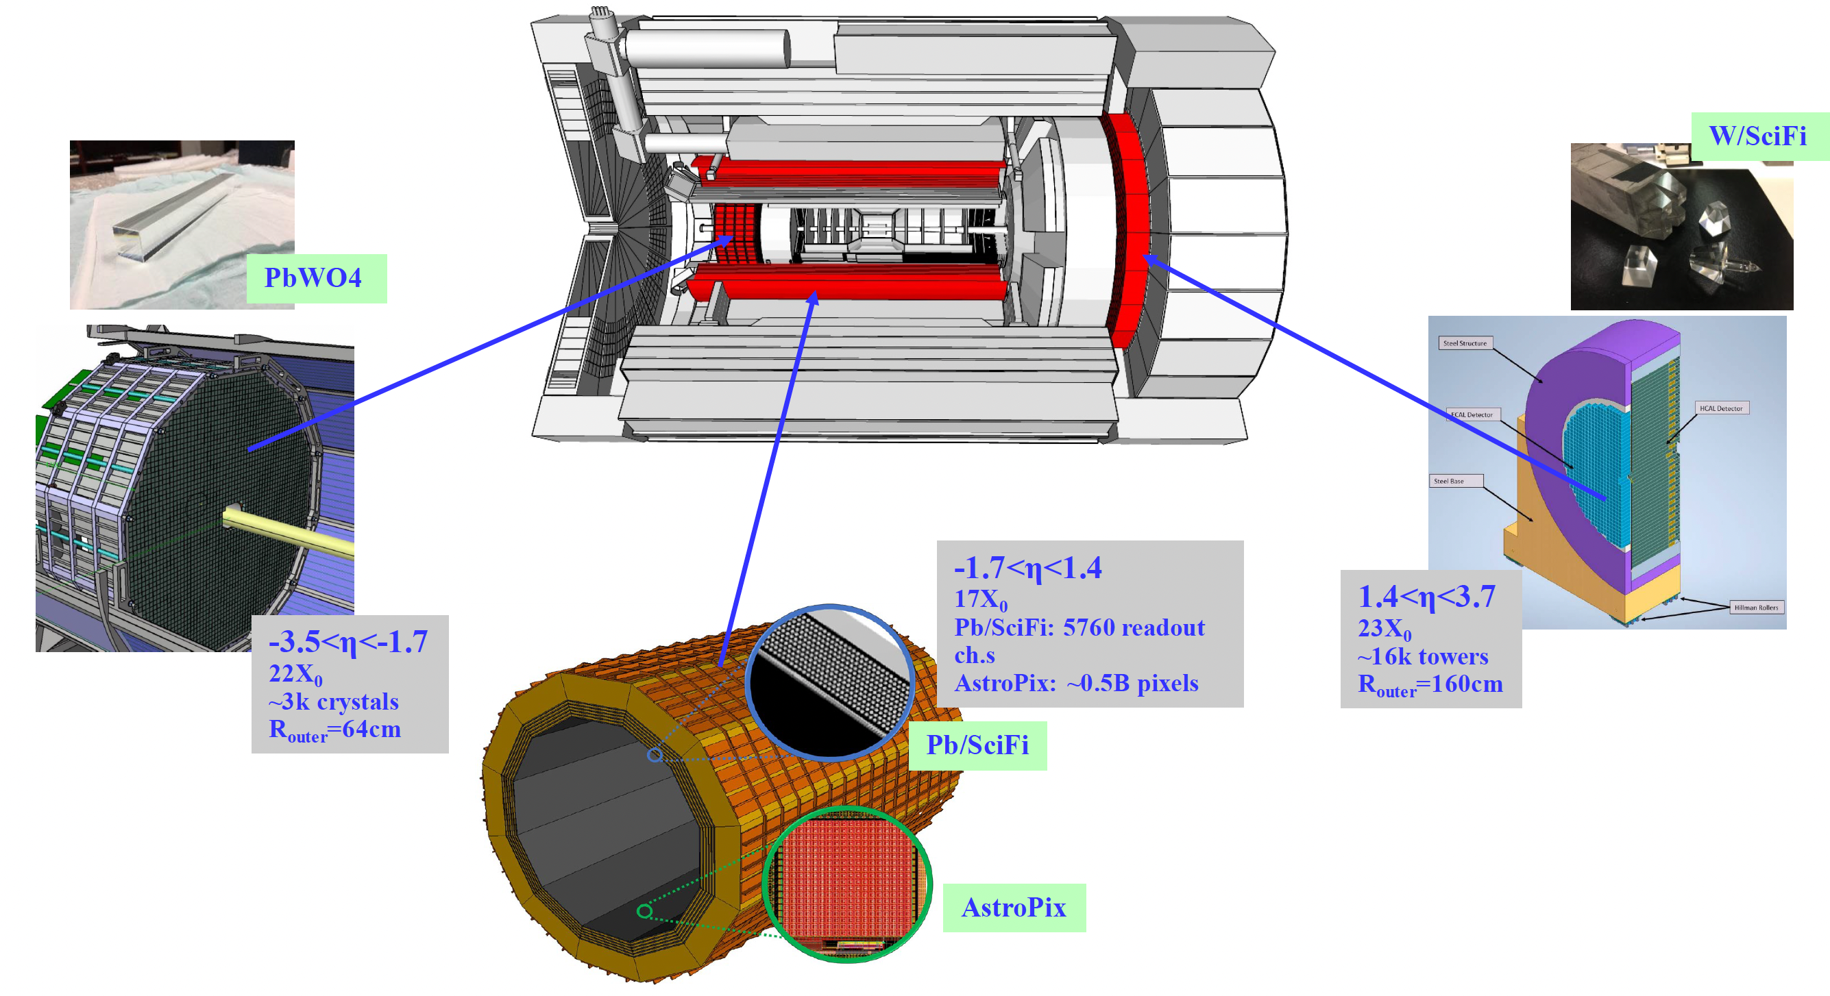
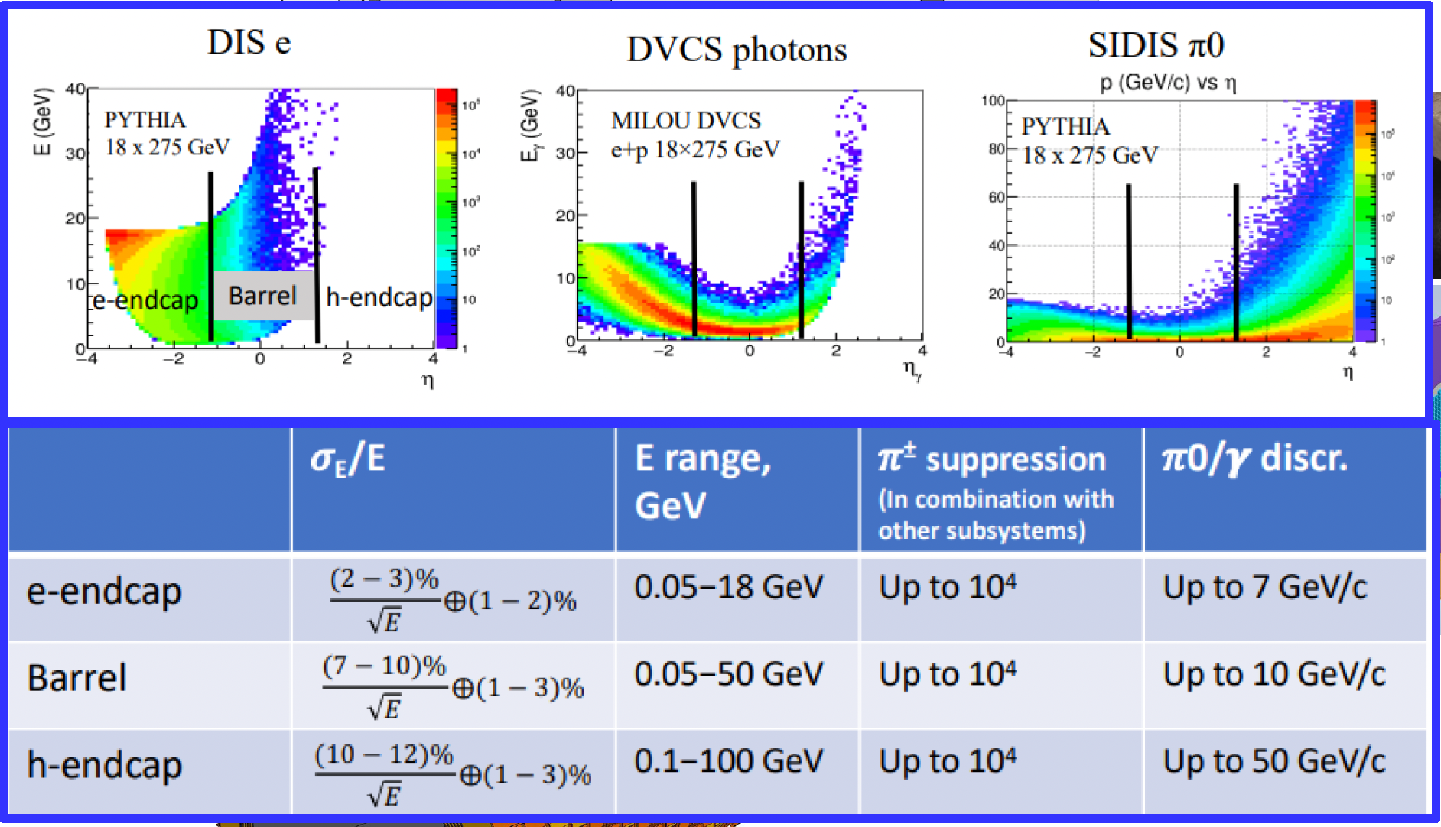
The ePIC Calorimeters
~
~

Slide 25
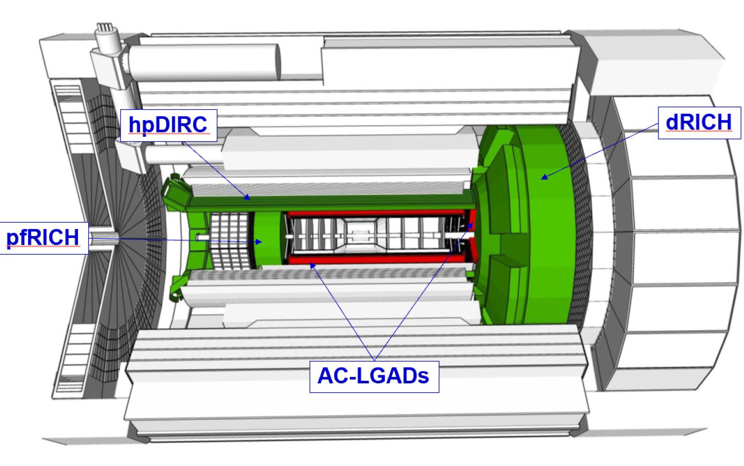
The ePIC PID
high performance DIRC (hpDIRC)
Dual radiator RICH
(dRICH)
Aerogel and C₂F₆
proximity focusing RICH
Low Gain Avalanche Detector
~
~

Slide 26
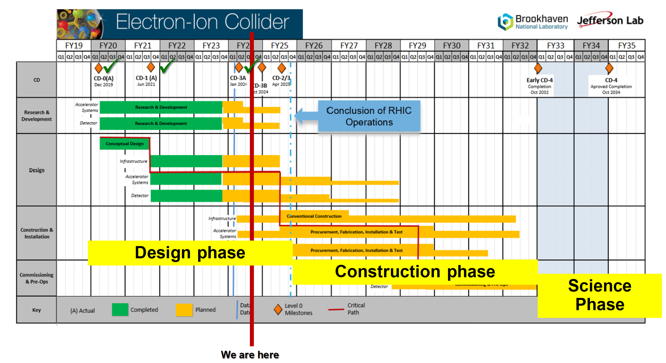
The ePIC Schedule
~
~

Slide 27
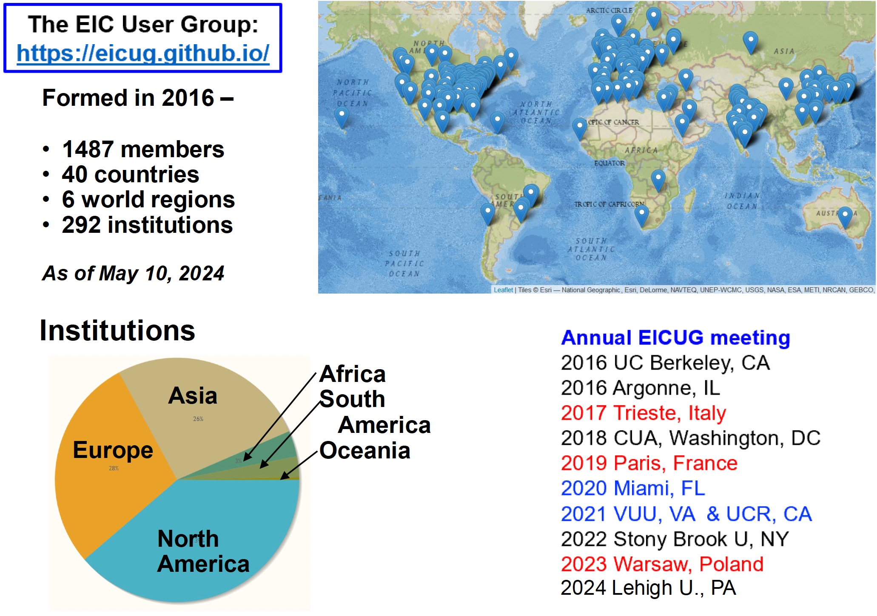
The EIC- ePIC International Collaboration
101 INFN Physicists
16 INFN Institutes
INFN In-Kind Responsibilities
Si Vertex detector
Dual RICH
Streaming Read-out
MPGD Endcap trackers
January 2025
Villa Mondragone
~
~

Slide 28
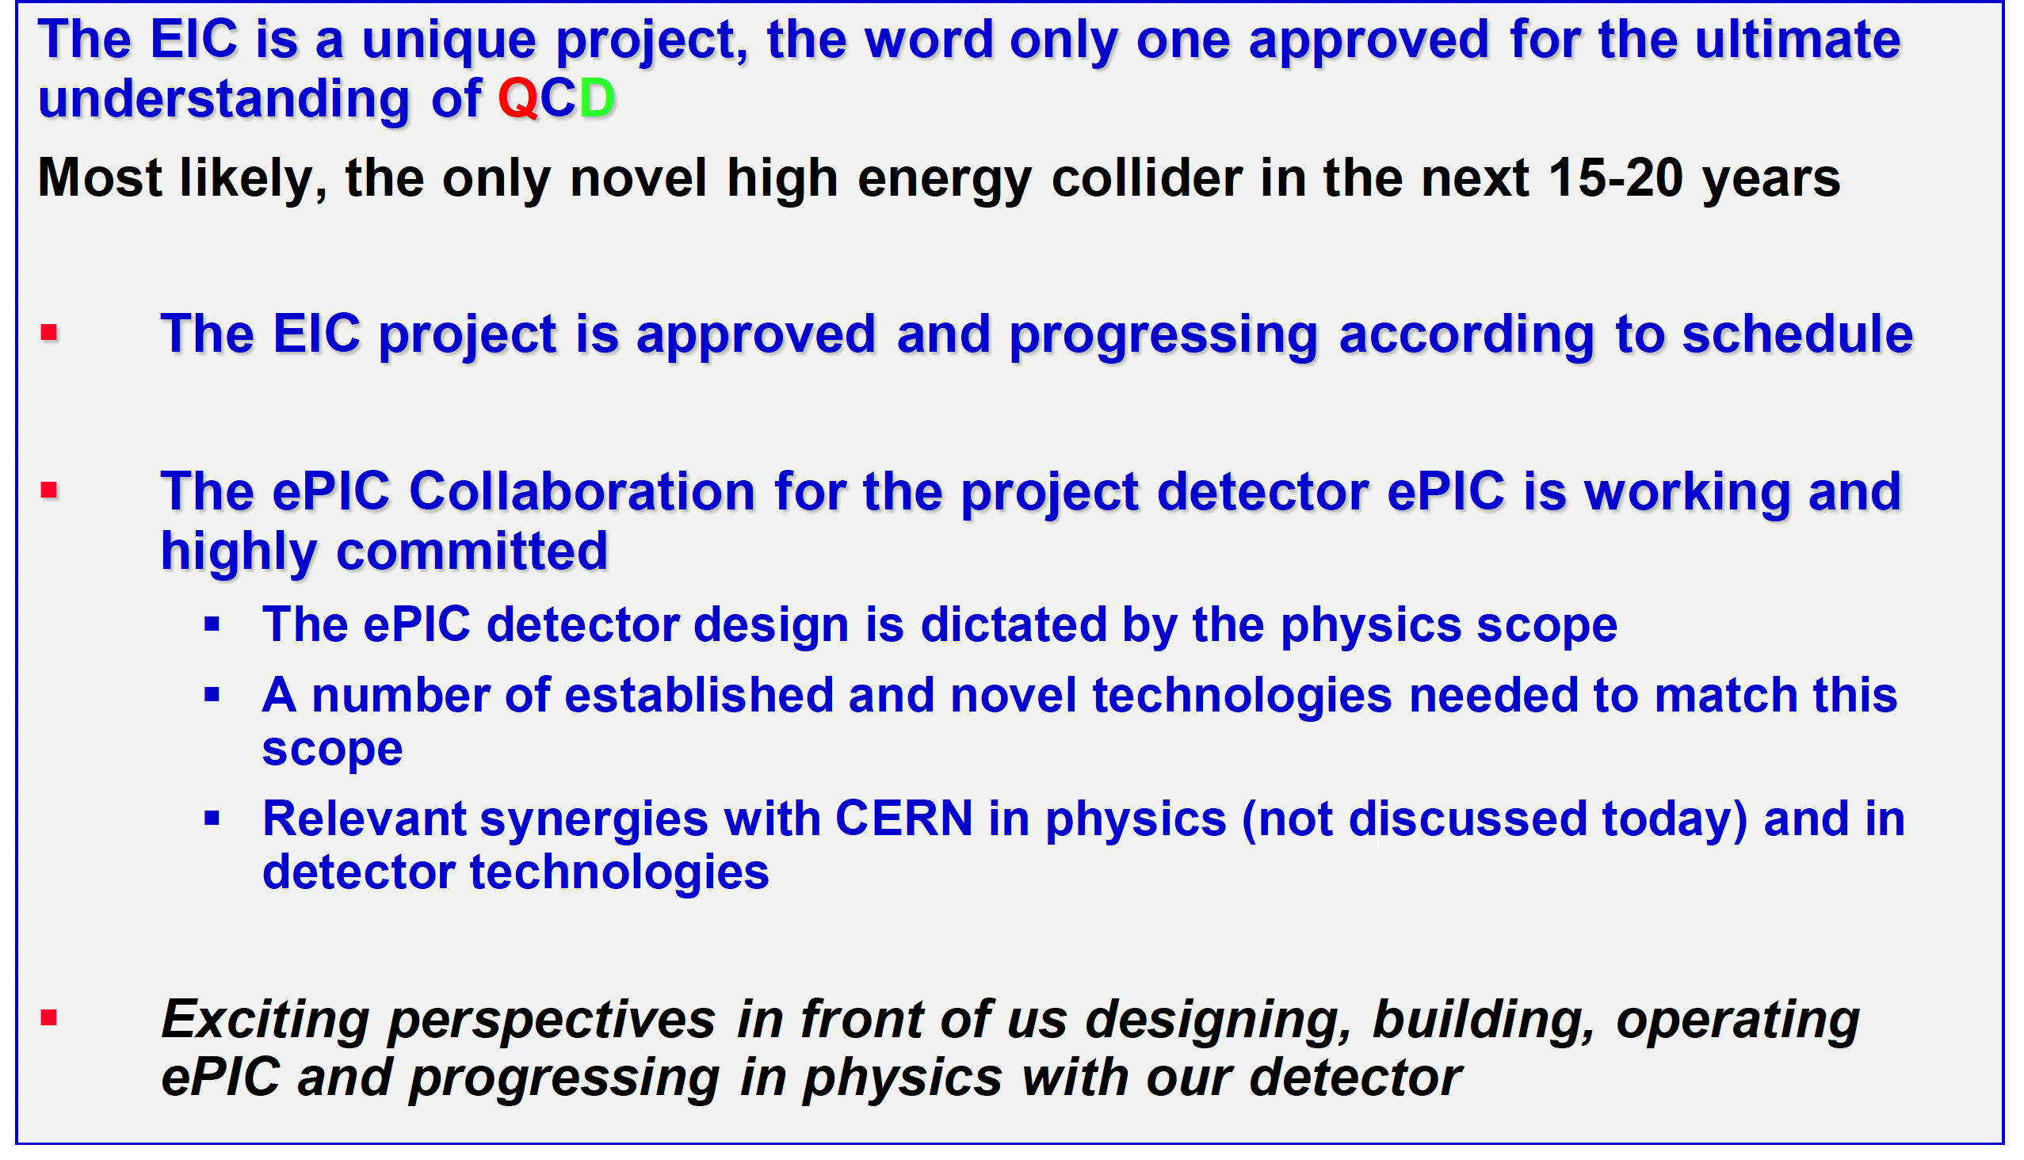
Final Considerations

Slide 29
Back-up slides

Slide 30
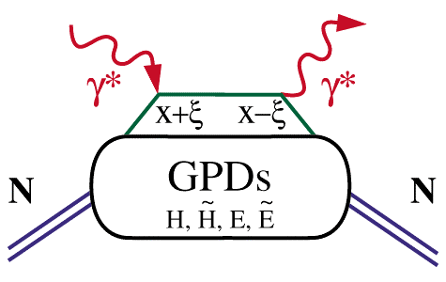
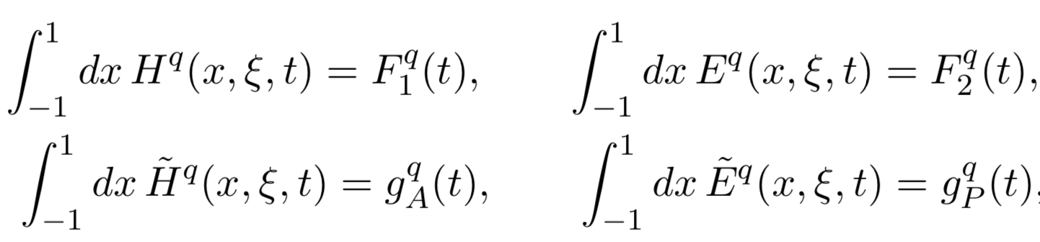
DVCS – The Quintessential Process
GPDs are universal and can be determined in any suitable reaction
Deeply Virtual Compton Scattering
x – longitudinal quark momentum fraction
hard vertices
2ξ – longitudinal momentum transfer
γ
N’
t – four momentum transfer to final N
N
GPD(x,ξ,t)
“handbag” mechanism
t
H, E : spin-independent GPDs
H, E : spin-dependent GPDs
~
~
~
~

Slide 31
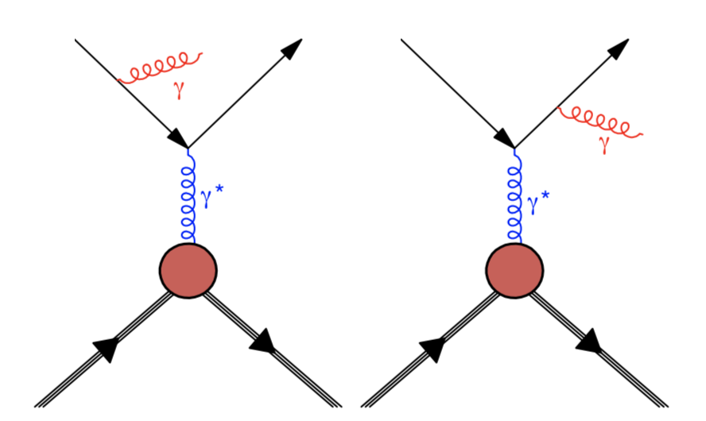

Accessing GPDs
ep → e'p'γ
e'
e
e'
e
e'
e
DVCS
+
Bethe-Heitler (BH)
p
p'
p
p'
p
p'
d⁴σ
~ |τ_{DVCS} + τ_{BH}|²
Measure one of various spin asymmetries:
dQ²dxdtdΦ
e.g. polarized beam + unpolarized target:
τ_{DVCS} : derived from GPDs
σ⁺ − σ⁻
σ⁺ + σ⁻
Δσ
2σ
τ_{BH} : derived from Form Factors
A =
=
~ Im(τ_{DVCS})τ_{BH}
~
X. Ji, Phys. Rev. D 55, 7114 (1997)
Δσ_{LU} ~ sinφ Im{F₁H + ξ(F₁+F₂)H +kF₂E} dφ
H(ξ,t)
(other terms kinematically suppressed)
~
~

Slide 32
Accessing GPDs
Different spin asymmetries are sensitive to different GPDs
σ⁺ − σ⁻
σ⁺ + σ⁻
Δσ
2σ
Polarized beam, unpolarized target:
A =
=
~
Δσ_{LU} ~ sinφ Im{F₁H + ξ(F₁+F₂)H +kF₂E} dφ
H(ξ,t)
kinematically suppressed
Unpolarized beam, longitudinal target:
~
~
H(ξ,t), H(ξ,t)
Δσ_{UL} ~ sinφ Im{F₁H+ξ(F₁+F₂)(H +ξ/(1+ξ)E) -...} dφ
kinematically suppressed
Unpolarized beam, transverse target:
Δσ_{UT} ~ sinφ Im{k(F₂H – F₁E) + …} dφ
H(ξ,t), E(ξ,t)
~
kinematically suppressed

Slide 33


Accessing the Forces & Pressure on Quarks
Nucleon matrix element of EMT contains:
Shear forces inside the nucleon
M₂(t) : Mass distribution inside the nucleon
J (t) : Angular momentum distribution
d₁(t) : Shear forces and pressure distribution
∫dx x [H(x,ξ,t) + E(x,ξ,t)] = 2 J(t)
∫dx x H(x,ξ,t) = M₂(t) + 4/5 ξ² d₁(t)
Separate M₂(t) and d₁(t) through measurements at small/large ξ.
Measuring these form factors, we learn about confinement forces.
V. D. Burkert, L. Elouadrhiri & F. X. Girod
Nature, 557 396-399 (2018)
Notes:
The nucleon matrix element of the energy-momentum tensor is known to contain 3 form factors. They describe ….. and can only be measured directly in elastic graviton-nucleon scattering. However, these form factors appear as moments of the unpolarized GPDs as shown here. The quark angular momentum in the nucleon is given by the 2nd moment of the sum of GPD H and E. The mass and pressure distribution of the quarks are given by the 2nd moment of H where the pressure is probed by parameter xi.

Slide 34


Exotic hadrons via photoproduction at EIC
COMPASS proved
that photo-production of exotic states is possible
COMPASS, PLB 783 (2018) 334
O (10⁵) XYZ events in six months at 10³³ cm-² s⁻¹ luminosity @EIC
Z $→$J/$ψ$ $π$ ⁺ (and J J/$ψ$ $→$e⁺e⁻)
It has been studied by the JPAC group

Slide 35




$Z$ photoproduction
The $Zs$ are charged charmonium-like $1^{+−}$ states close to open flavor thresholds
Focus on $Z_{c}{\left(3900\right)}^{+}→J/ψ π^{+}$, $Z_{b}{\left(10610\right)}^{+},Z_{b}^{′}{\left(10650\right)}^{+}→Υ(nS) π^{+}$
The pion is exchanged in the $t$-channel
Sizeable cross sections especially at Low Energies
A. Pilloni – Exotic hadron spectroscopy

Slide 36





$X$ photoproduction
Focus on the famous $1^{++} X\left(3872\right)→J/ψ ρ,ω$
Studying also $X\left(6900\right)→J/ψ J/ψ$ (assumed $0^{++}$)
𝛚 and 𝛒 exchanges give main contributions:
need to assume the existence of a OZI-suppressed $X\left(6900\right)→J/ψ ω$
Extremely suppressed cross sections at HE: LE most promising
A. Pilloni – Exotic hadron spectroscopy
36

Slide 37

Studying exotic hadrons nature via eA
3 10⁴ – 1.5 10⁵ events assuming
300 fb-1intergrated luminosity
Pan-Pan Shi et al., arXiv:2208.02639
37

Slide 38
Thank you !

Slide 39
BACKUP SLIDES

Slide 40





Semi-Inclusive-Deep-Inelastic-Scattering (SIDIS)
π⁺
p(e,e’π⁺)X
S. Diehl et al Phys Rev Lett 128, 062005 (2022)
Input to TMD program to extract 3D images in quark momentum space.
0.13 < x_{B} < 0.52
z=$\frac{E_{π}}{ν}$
0.3 < z < 0.7
High statistics enabled binning in several kinematical quantities for a total of 344 bins

Slide 41


The unresolved nature
Elementary particles
Nature
States could also be mimic by
Rescattering effects
Quarks & gluons
Color-singlet mesons and baryons
PRD 92 (2015) 071502
PLB 757 (2016) 231
PLB 757 (2016) 61
and others
strong interaction
(long-distance effects)
Compact tetra/pentaquark
Hadronic molecules
PRL 105 (2010) 232001,
PRL 115 (2015) 122001
PRD 100 (2019) 011502 (R)
and others
Diquark-antidiquark
PRD 71, 014028 (2005)
PLB 662 424 (2008)
qqg hybrid, glueball or mixture
Color Forces
Hadrocharmonium/adjoint charmonium
PLB 666 344 (2008)
PLB 671 82 (2009)
Nuclear Forces
41

Slide 42



Exclusive (quasi-real) photoproduction
XYZ have so far not been seen in photoproduction: independent confirmation
Not affected by 3-body dynamics: determination of resonant nature
Experiments with high luminosity in the appropriate energy range are promising
We study near-threshold (LE) and high energies (HE)
Couplings extracted from data as much as possible, not relying on the nature of XYZ
M. Albaladejo et al. [JPAC], PRD
$$<λ_{𝒬}λ_{N}^{′}|T|λ_{γ}λ_{N}>=\underset{V,ℰ}{∑}\frac{ef_{V}}{m_{V}}𝒯_{λ_{V}=λ_{γ},λ_{𝒬}}^{α_{1}⋯α_{j}}𝒫_{α_{1}⋯α_{j};β_{1}⋯β_{j}}ℬ_{λ_{N}λ_{N}^{′}}^{β_{1}⋯β_{j}}$$
Bottom vertex from standard photoproduction pheno,
exponential form factors to further suppress large t
Top vertex from measured $𝒬→Vℰ$ decay width
VMD is used to couple the incoming photon
to a vector quarkonium V
A. Pilloni – Exotic hadron spectroscopy

Slide 43

Missing Baryons in QCD Phase Transition

Slide 44




Why N* ? From the Hydrogen Spectrum to QCD
Niels Bohr (1922)
Spectral series of hydrogen
Understanding the hydrogen atom’s ground state requires understanding its excitation spectrum.
Understanding the proton’s ground state requires understanding its excitation spectrum.
From Bohr model of the atom to QED.
From the Constituent Quark model to QCD.

Slide 45

LQCD N* & Δ Spectra
Exhibit the SU(6)×O(3)-symmetry features
Counting of levels consistent with non-rel. quark model
Striking similarity with quark model
No parity doubling
4
5
3
1
2
3
2
1
1
1
2
2
1
Δ(1232)
N(938)
Problems are not solved!
Robert G. Edwards, Jozef J. Dudek, David G. Richards, Stephen J. Wallace
Phys.Rev. D84 (2011) 074508

Slide 46

Electroexcitation of N*/Δ resonances
Central question in hadron physics:
what are the relevant degrees of freedom at varying distance scale?
[56,2⁺]
2
N(1680)5/2⁺
N(1720)3/2⁺
Probe resonance strength vs photon virtuality Q
L_{3q}
[70,1⁻]
N(1675)5/2⁻
N(1520)3/2⁻
N(1535)1/2⁻
1
[56,0⁺]
0
Δ(1232)3/2⁺
N(940)
N(1710)1/2⁺
N(1440)1/2⁺
[70,0⁺]
0
1
N [ħω]
2

Slide 47



Electroexcitation kinematics
Measured σ are decomposed using UIM or fixed-t DR to extract N* & Δ helicity amplitudes.

Slide 48

Electrocouplings of the ‘Roper’ in 2016
LF RQM: I. Aznauryan, V.B. arXiv:1603.06692
Quark-core contributions from DSE/QCD
J. Segovia et al. PRL 115 (2015) 171801.
Meson Baryon cloud inferred from CLAS data as the difference between data and the quark-core evaluation in DSE/QCD.
V. Mokeev et al., PR C 93 (2016) 025206.
N(1440)1/2⁺
Non-quark contributions are significant at Q²< 2.0 GeV².
The 1st radial excitation of the q3 core emerges as the probe penetrates the MB cloud.

Slide 49

MB Contribution to electro-excitation of N(1535)1/2⁻
N(1535)1/2⁻
is consistent
with the 1st
orbital excitation
of the nucleon.
Meson-baryon cloud may account for discrepancies at low Q².

Slide 50

MB Contribution to electro-excitation of N(1675)5/2⁻
Measures the meson-baryon contribution to the γ* p N(1675)5/2⁻ directly.
Can be verified on γ* n N(1675)5/2⁻ which is not suppressed

