Slide 1
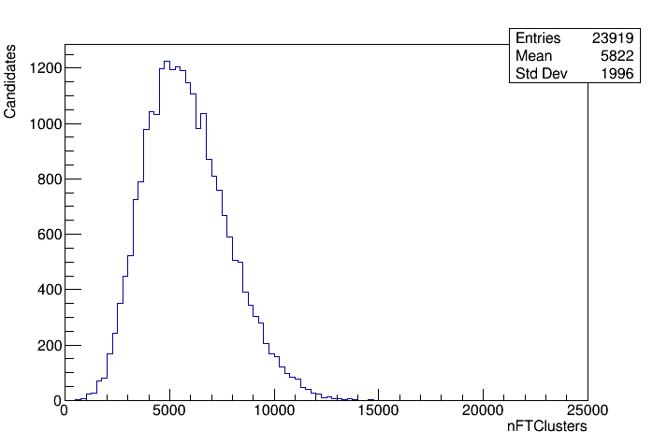
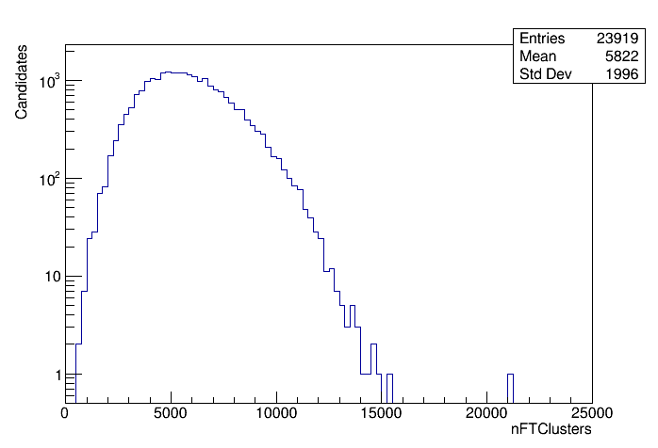
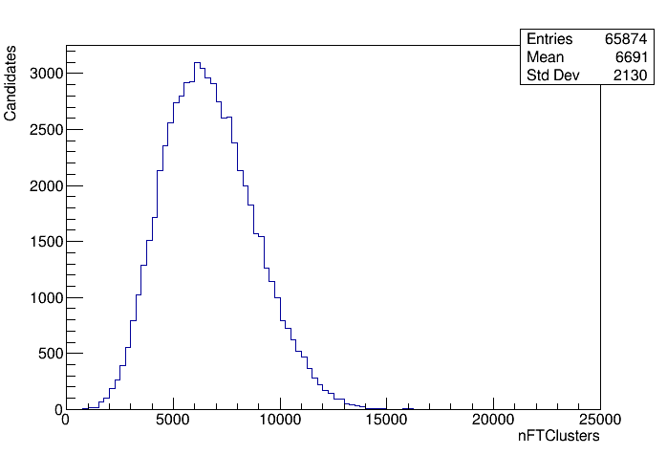
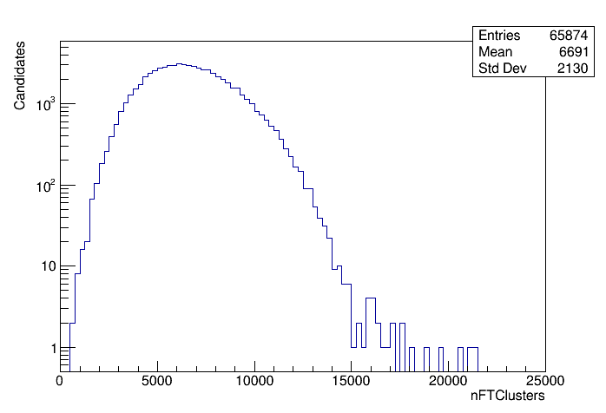
Run 3 Global Event Cut
"nFTClusters" : F.VALUE_OR(-1) @ F.RECSUMMARY_INFO( rec_summary, "nFTClusters"),
aka number of SciFi clusters
fill 9684, mu=4.4
clean Bd2DPi Run 3 data sample
proposed cut values: 15k 17.5k and 20k
fill 9687, mu=5.5

