Slide 1
DOCET : Doped Crystals for Electron EDM Tests
OUTLINE:
1) Probing Physics Beyond Standard Model & Fundamental Symmetries
2) Electron EDM Measurements Efforts: Brief Overview on Various Approaches
3) PHYDES Results: 1)Para-Hydrogen Crystal vs Electron Mobility, 2) BaF Beam, 3)Doped Cryo-Crystal
3) EDM Measurement Proposal: Sensing Paramagnetic Electrons with Doped Cryo-Crystal
4) Experimental Set-up for Electron EDM measurement through an EPR approach
5) Overview & Conclusions

Slide 2
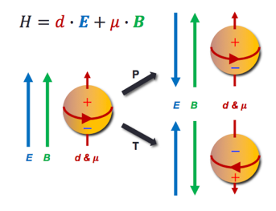
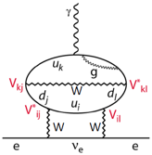
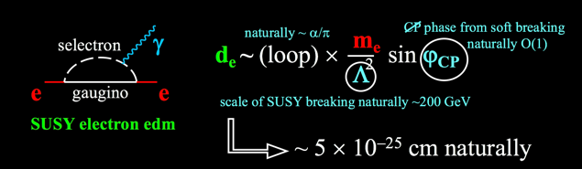
EDM Searches
The EDM is an asymmetric charge distribution along the particle spin
The EDM violates time reversal symmetry through CPT conservation – CP violation
CP violation is required to generate a cosmological matter-antimatter asymmetry.
It is present in the SM, through the complex phase in CKM matrix, however many order of magnitude below what is necessary
EDM’s in SM are tiny ( d_{e} < 10⁻³⁸ ecm ), but most SM extensions include new CP violating phases that contribute to EDM’s.
THIS MAKES EDM’s an ideal probe for detecting NEW PHYSICS associated with CP violation
and a powerful window on energy scales much larger than those that can be probed directly at LHC
four-loop level in perturbation theory

Slide 3
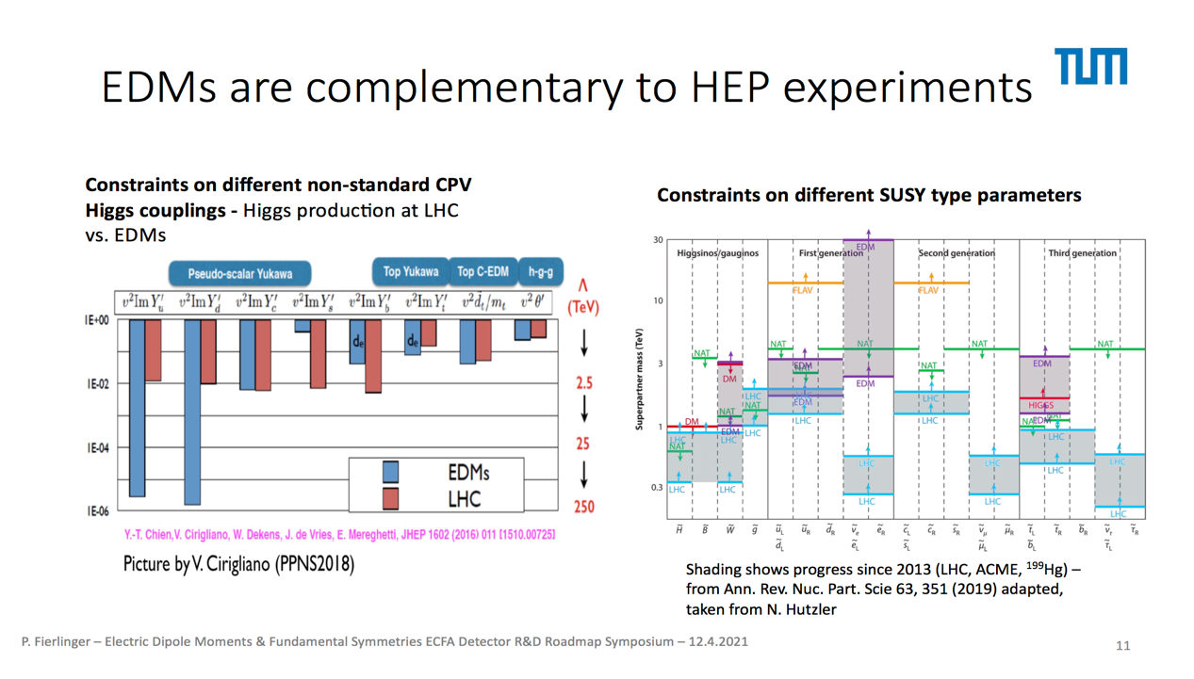

Slide 4
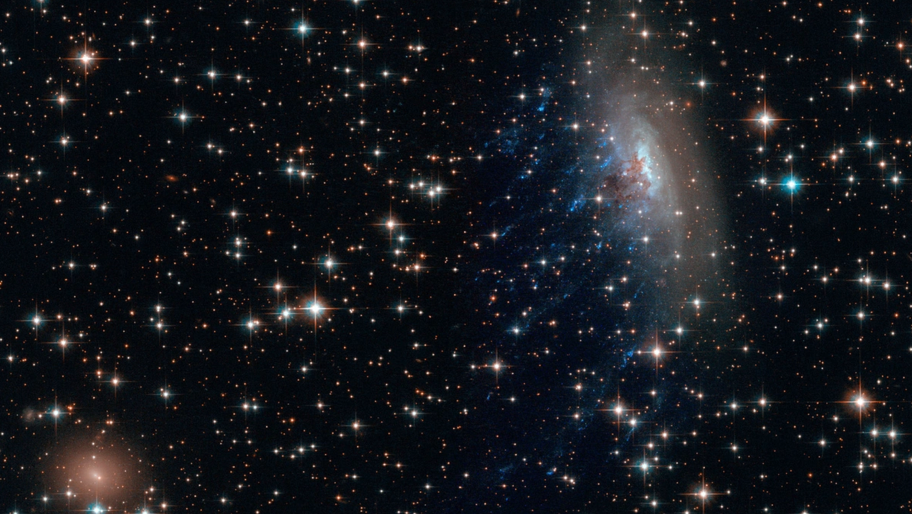

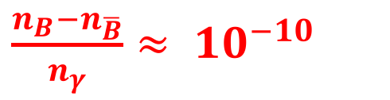
BARYON ASYMMETRY IN OUR UNIVERSE
ELECTROWEAK SM EXPECTATION
OBSERVED
$\frac{n_{B}−n_{\overline{B}}}{n_{γ}}≈ {10}^{−18}$
vs
$\frac{n_{B}−n_{\overline{B}}}{n_{γ}}≈ {10}^{−10}$
Connection Between Cosmology and SM of Particle Physics
Sahkarov Criteria for Baryogenesis in the early Universe JTEP Lett. 5, 24 (1967)
1) Baryon number violation
2) CP Violation
3) Thermal non-equilibrium

Slide 5
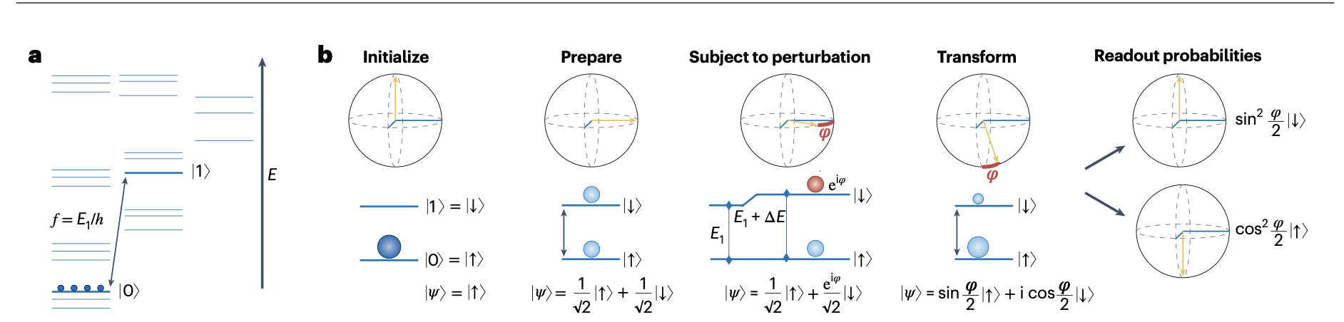
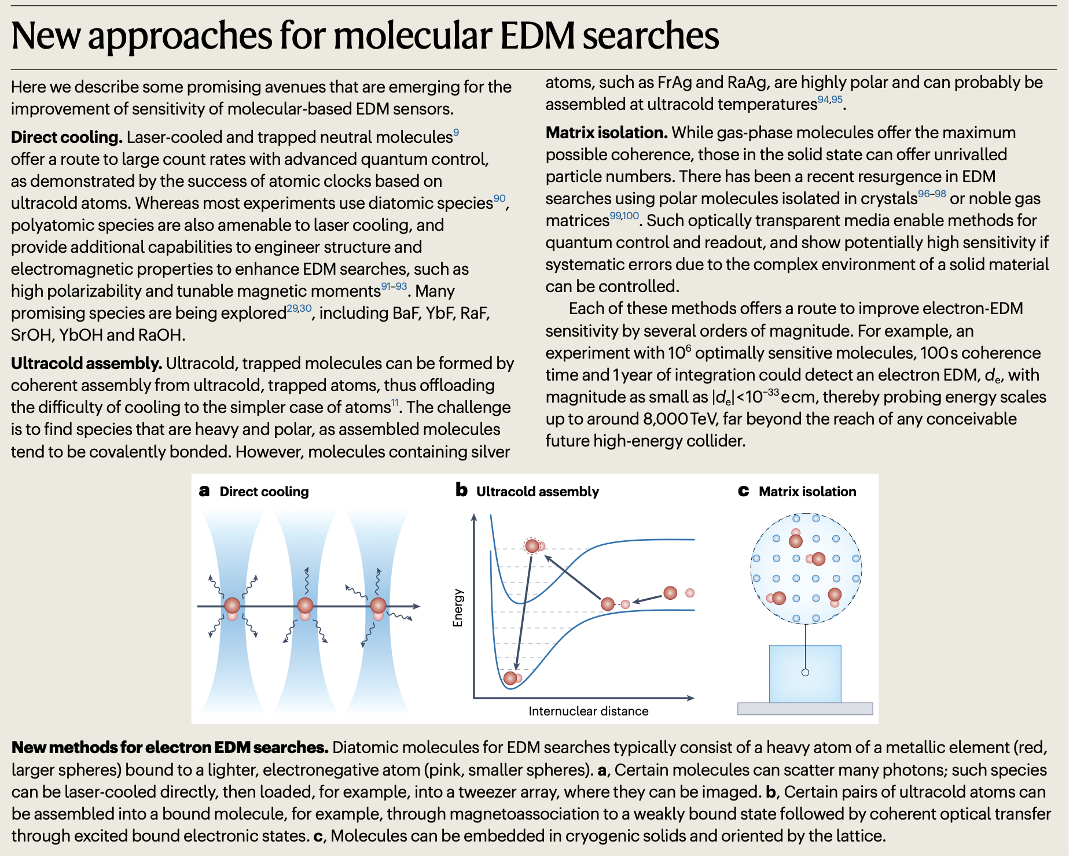
Quantum sensing and metrology for fundamental physics with molecules
Nature Physics
https://doi.org/10.1038/s41567-024-02499-9
May 2024

Slide 6
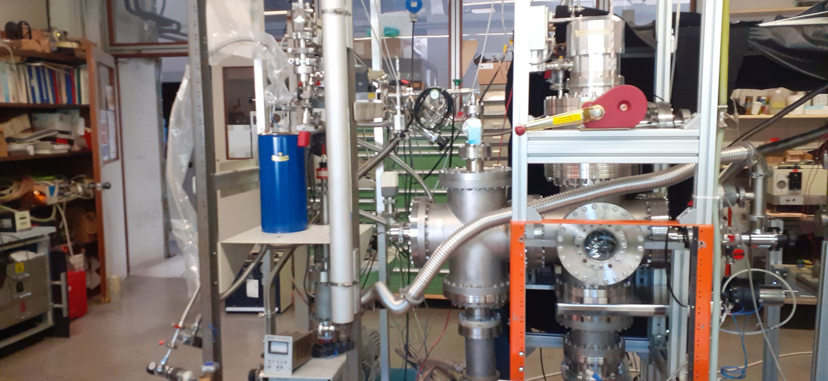
Para-Hydrogen: Production & Testing and Electron Mobility

Slide 7
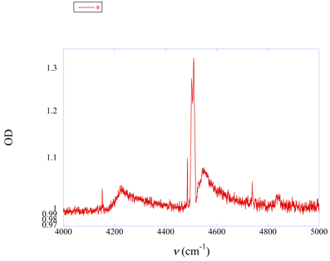
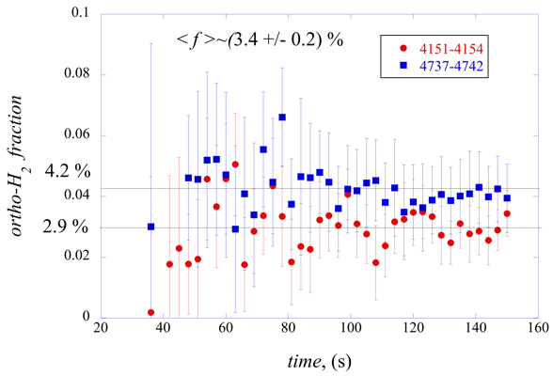
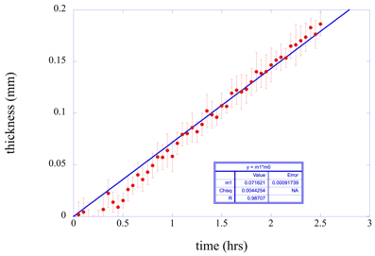
Spectroscopic Determination of pH2 film thickness: o-H2 fraction
Para-Hydrogen Absorption IR Line + Thickness
Ortho-Hydrogen concentration
O-H2 @ 3% level to be reduced
Temperature of the Cold Head Converter has to be reduced to 16 Kelvin to reduce O-H2 concentration

Slide 8
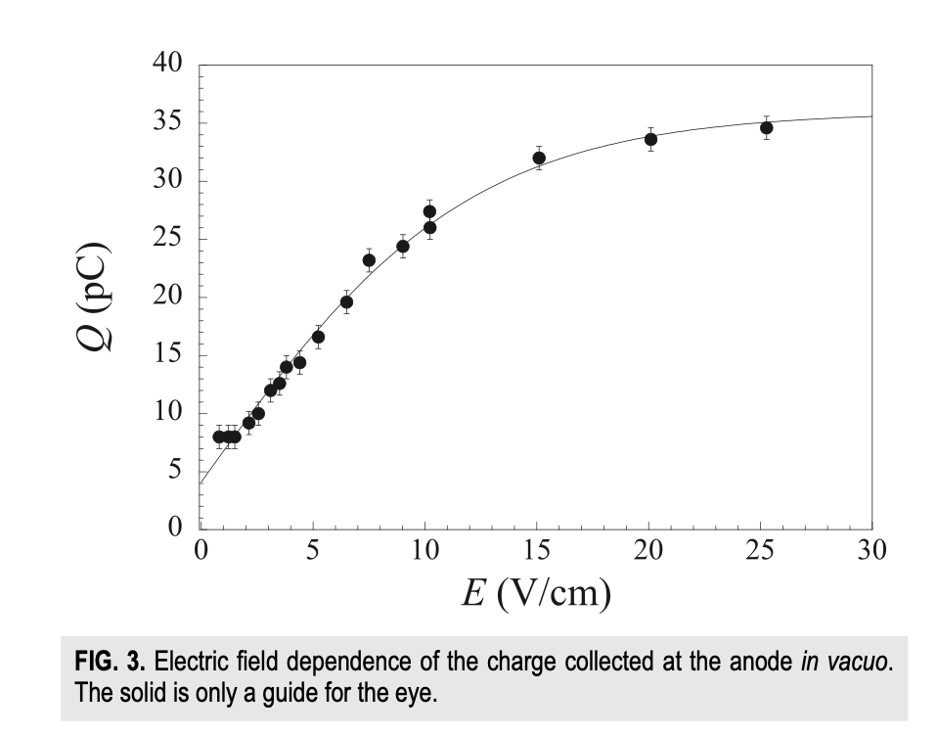
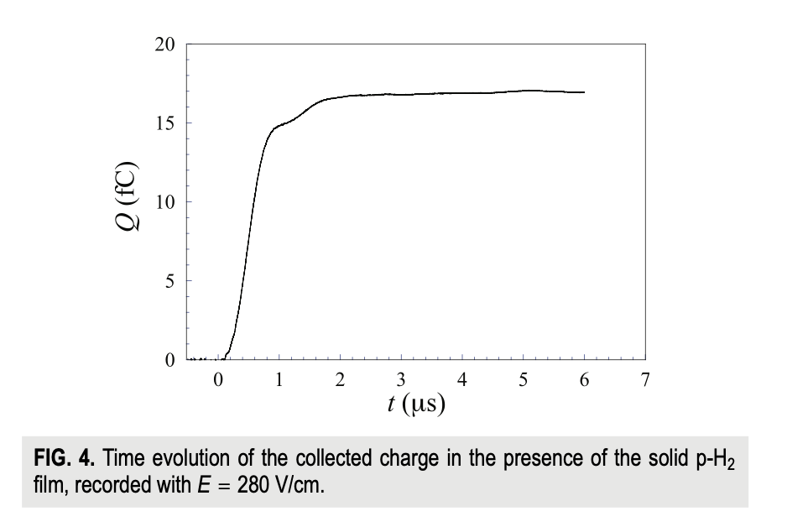
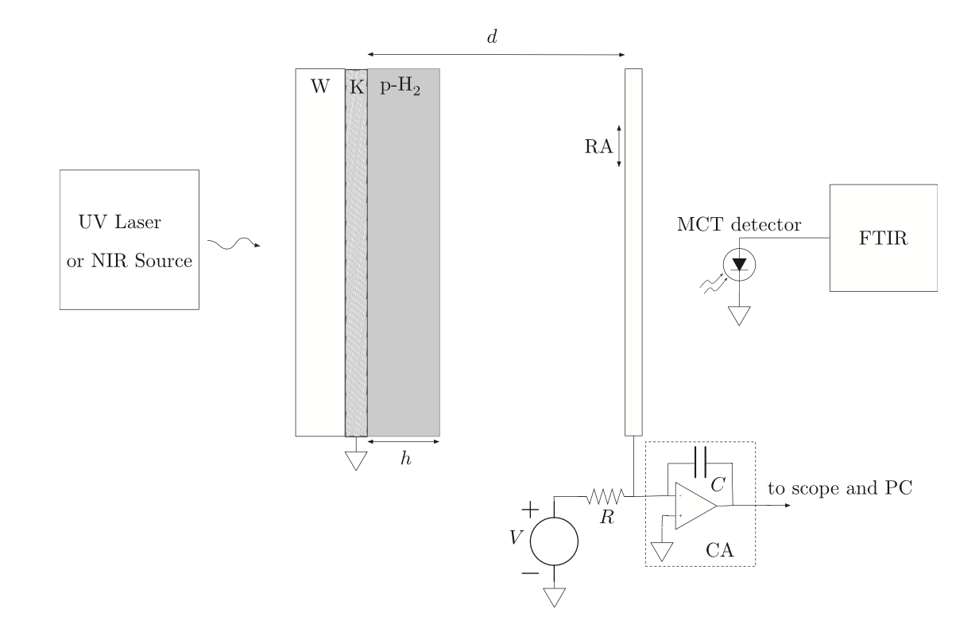
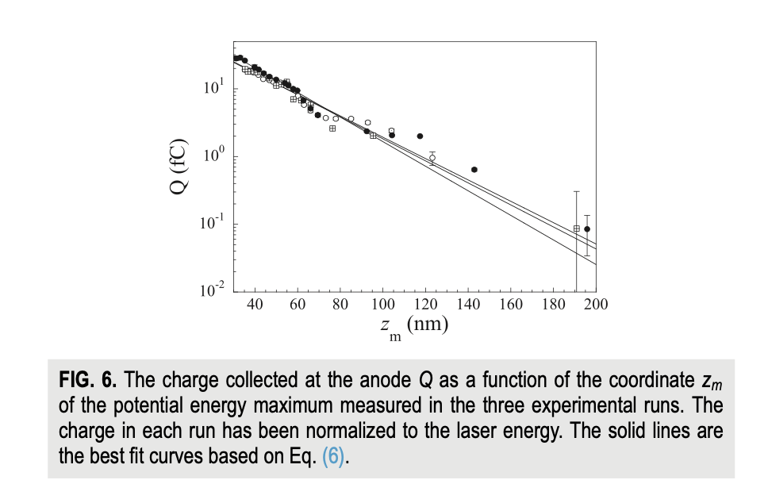
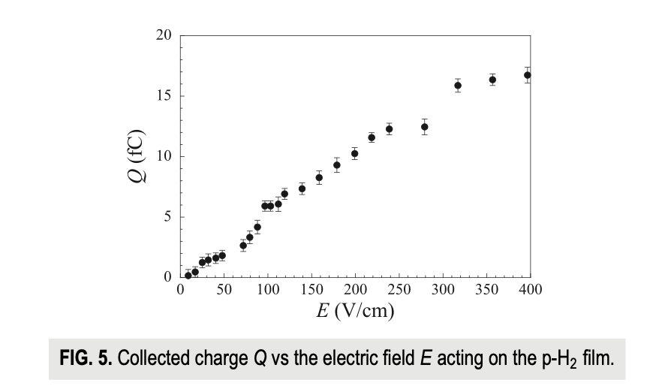

Electron thermalization length in solid para-hydrogen at low-temperature
Electron Thermalization Lenght @ 3 Kelvin

Slide 9
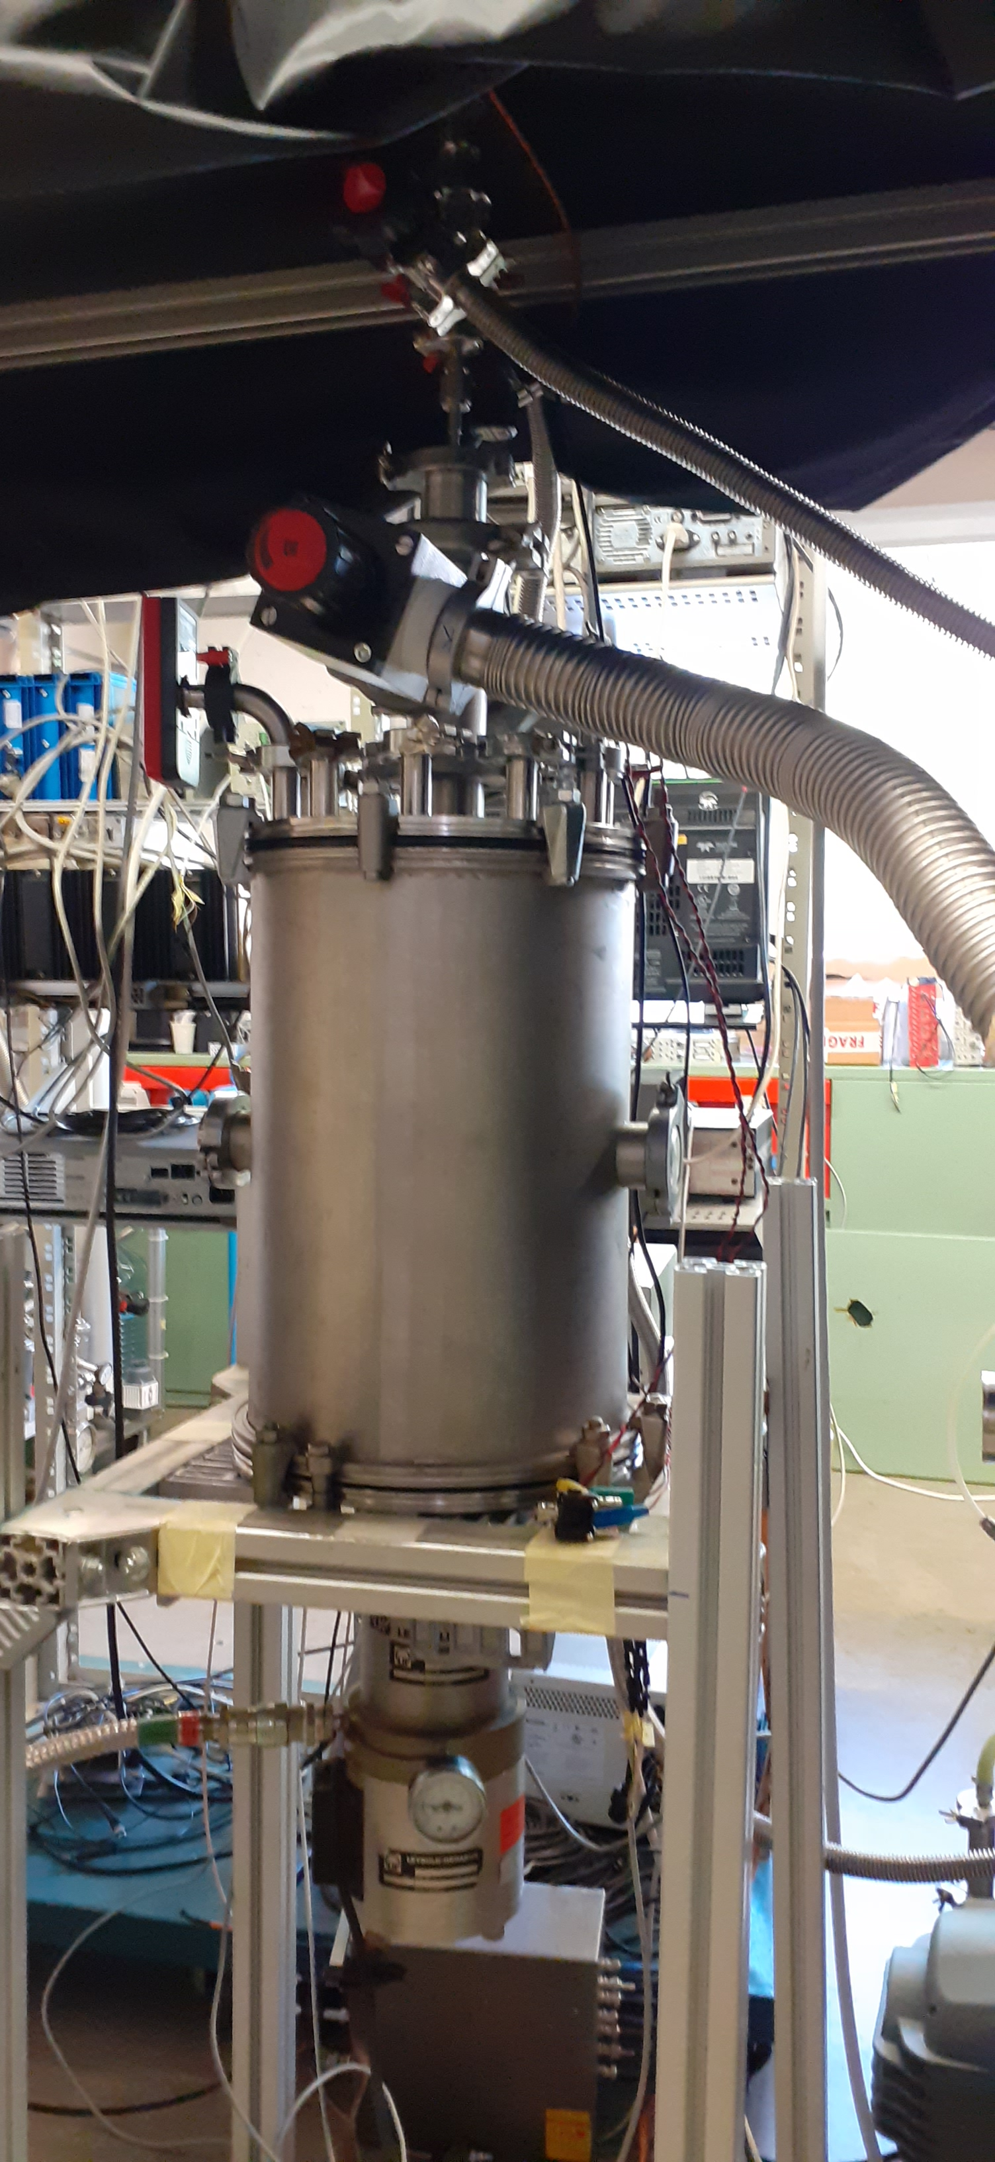
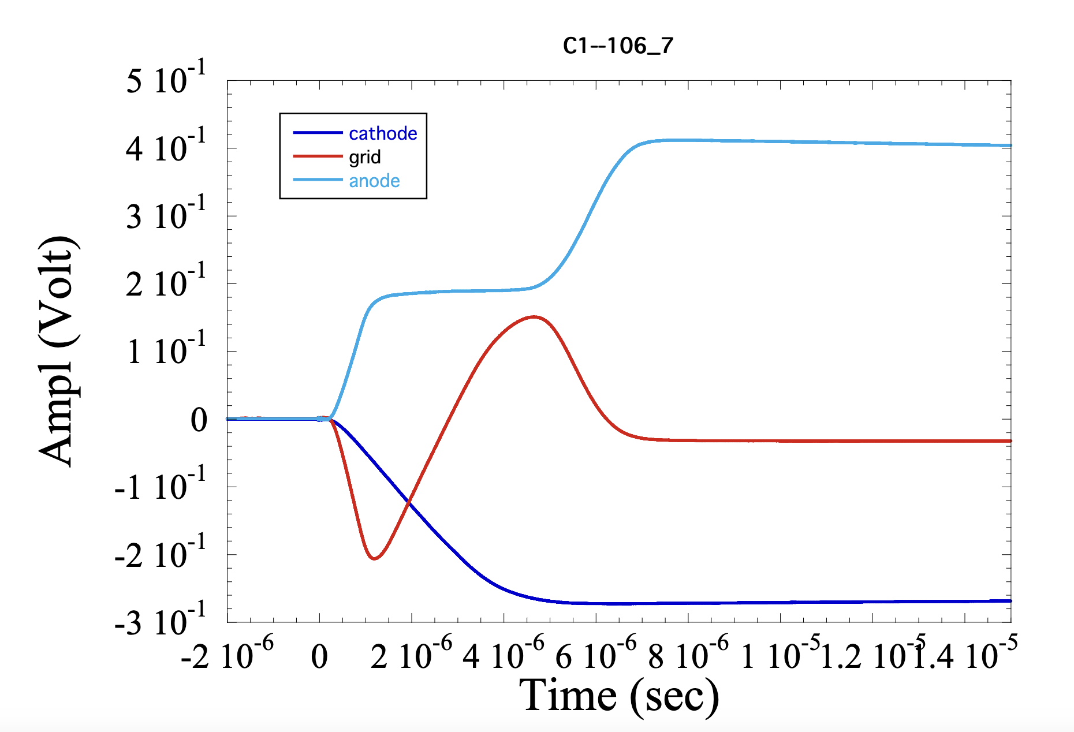
DRIFTING ELECTRONS APPARATUS IN PARA-HYDROGEN
From Room Temperature to Solid Hydrogen measurements set-up
Photoelectrons injection via Photoelectric Effect on Gold Cathode
Drifting Electron Charge into a multi grids chamber

Slide 10
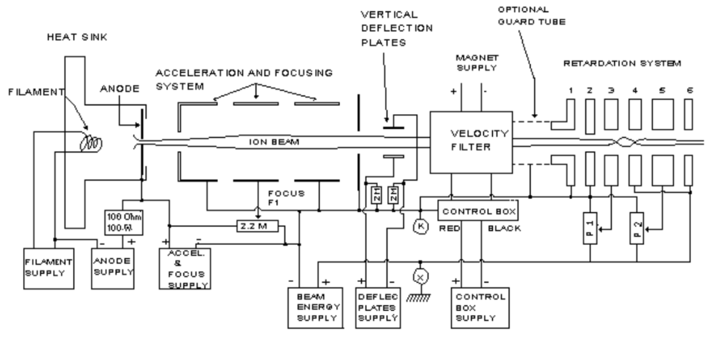
BaF Molecular Beams Handling System
He+
BaF+
BaF beam stable over 2 hours @ 20 nA current
Output Current vs AMU @ Decelerator Output

Slide 11
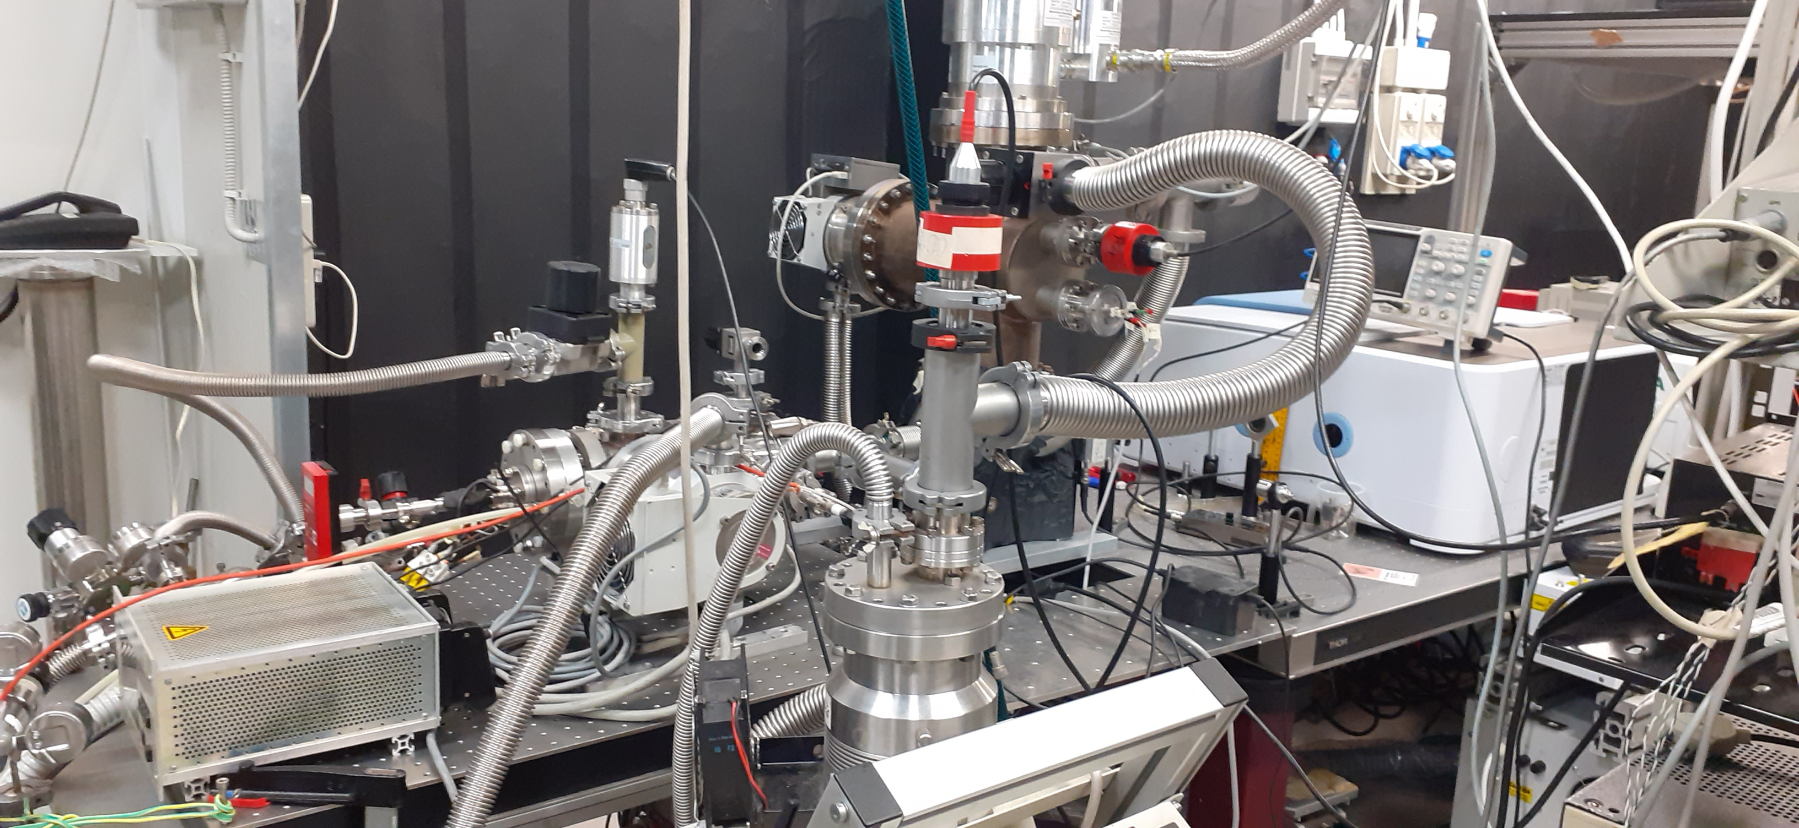
BaF Molecular Beam System + Para-Hydrogen Production = Doped Cold Cryogenic Crystal

Slide 12
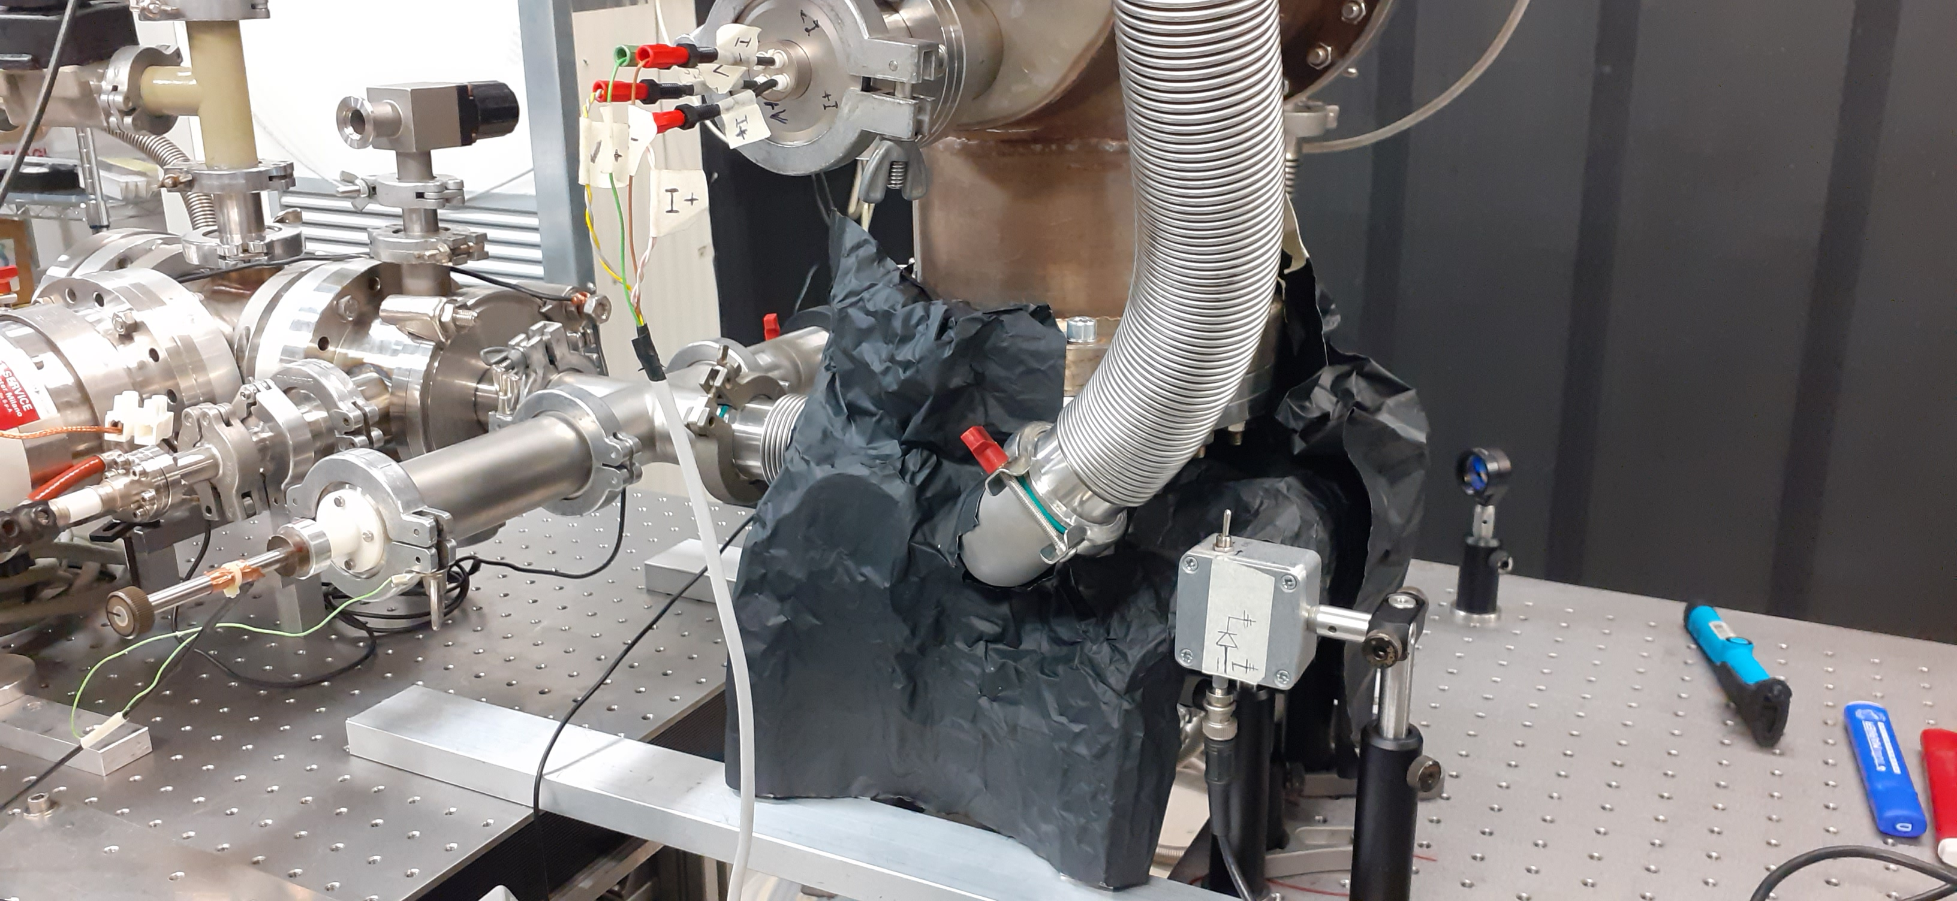
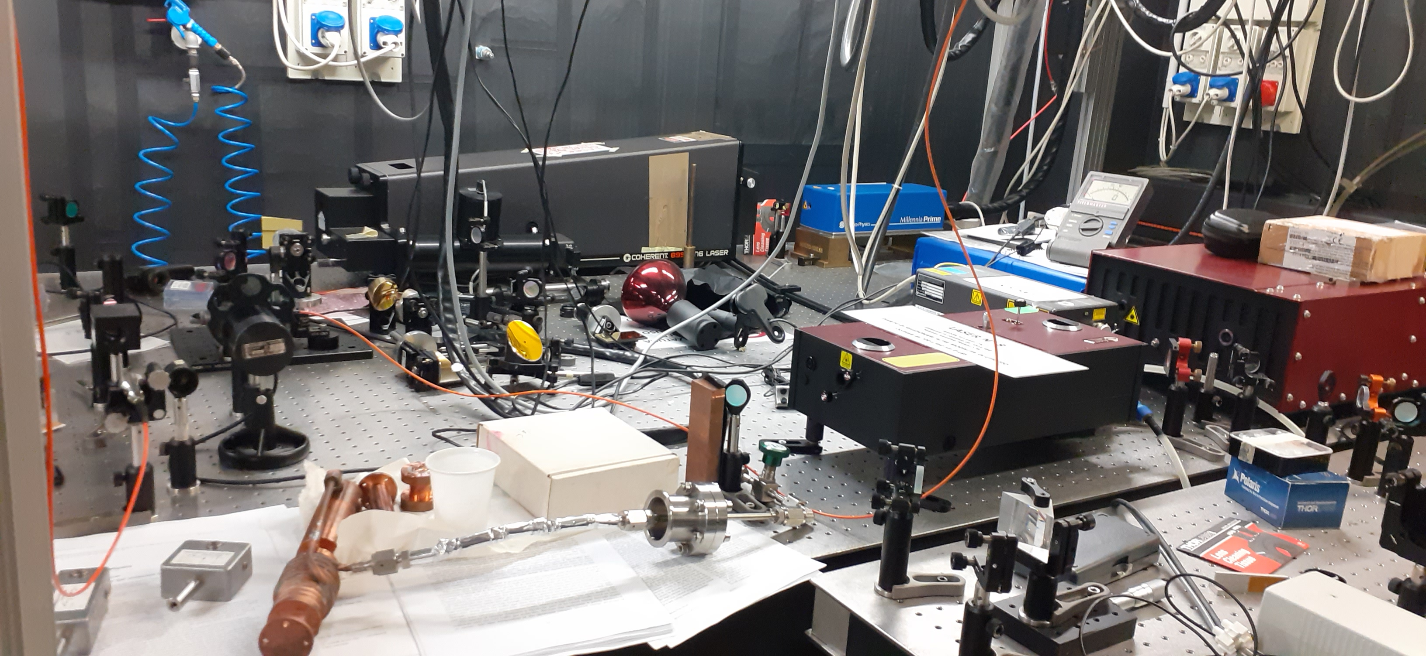
Laser System Excitation Set-up for Fluorescence Study
Fluorescence Light Collection Set-up
Tunable Laser Set-up

Slide 13


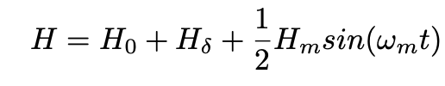
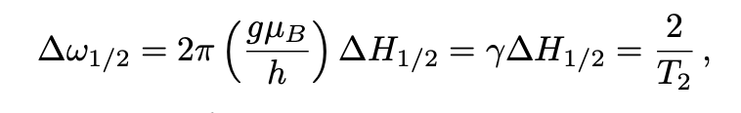
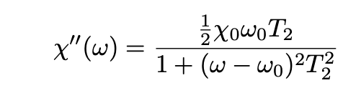
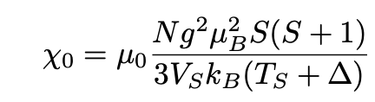
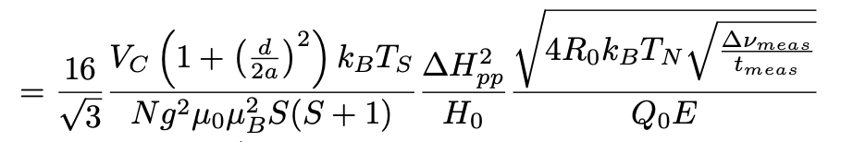
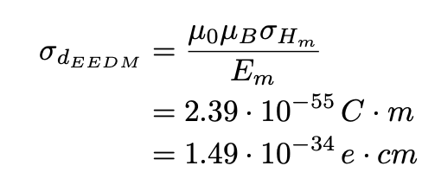

EDM Measurement Proposal: DOCET Experiment
$$σ_{Hm}$$
Vedere Documento allegato Proposta

Slide 14
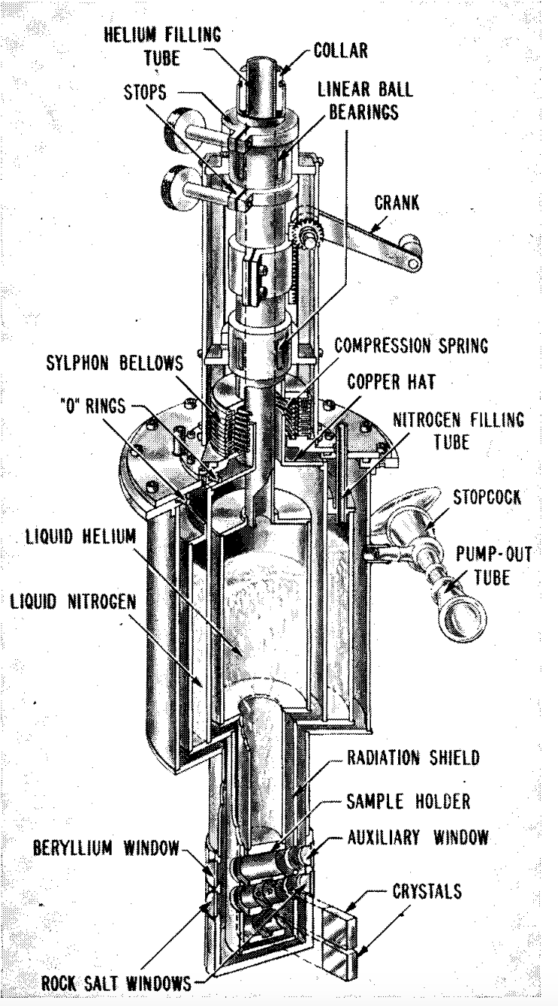
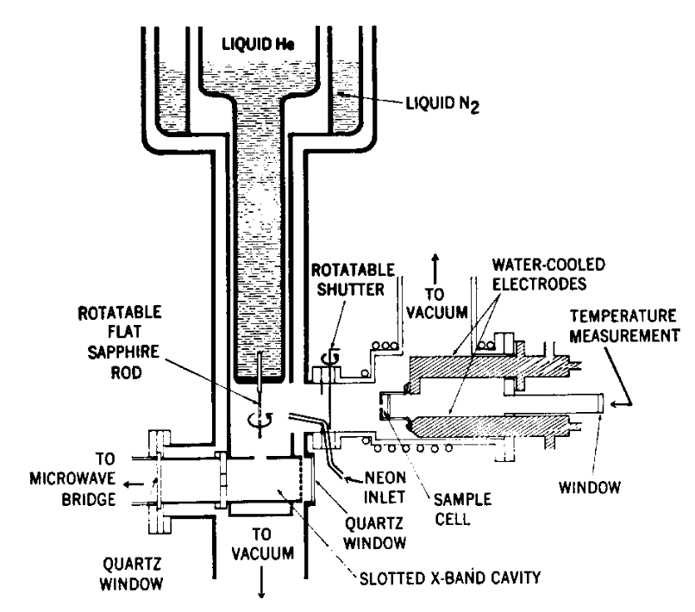
Possible Experimental Set-up for Electron EDM Measurements

Slide 15
TIME LINE + BUDGET:
    1⁰ Anno (140Ke):
    a) Sviluppo Sistema Criogenico @ 4 Kelvin per inserzione Cristallo Criogenico in Cavita’ Microonde
    b) Sviluppo e Test Sensibilita’ su Cavita TM102 con materiale paramagnetico Temperatura Ambiente
    2⁰ Anno (90 Ke):
a) Misura Tempo Rilassamento T2* campione pH2+BaF @ 4 Kelvin in cavita TM102
  b) Costruzione e Test cavita microonde con Campo Elettrico DC all’interno della stessa
  3⁰ Anno (60Ke):
a) Primo Limite EDM elettrone

Slide 16
DOCET
Sezioni INFN partecipanti all’esperimento: Padova, LNL, Ferrara
- Resp. Naz.: Giovanni Carugno
- COSTRUZIONE E PRESA DATI ESPERIMENTO @ LNL
- FTE-PD-2025 = 6,4 FTE
(Carugno 40%, Borghesani 100%, Messineo 100%, Gasparini 20%, Zanetti 15% , Pazzini 15%, Gonella 40%, Benettoni 10%, T.Tariq 100%,M.Mashod 100%, A.Lippi 100% )
- Richiesta Denari PD INFN : ## Keuro ( ##Keuro missioni , ## Keuro consumo , ## keuro manutenzioni , ## Keuro )
- Richiesta Servizi : 10 M.U. OM , 8 M.U. STGE , 2 M.U. OE, 1 M.U. Uff.Tec.

Slide 17
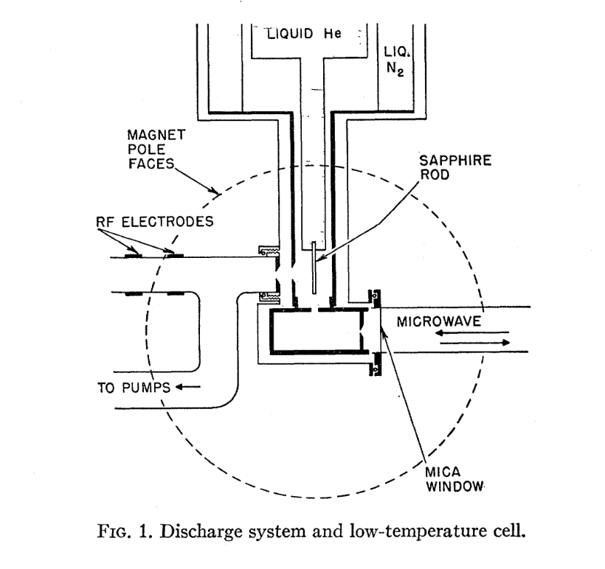

Slide 18
PHYDES
Sezioni INFN partecipanti all’esperimento: Padova: INFN + UNIPD , LNL, LNS (Palermo), Ferrara: INFN + UNIFE
Resp. Naz.: Giovanni Carugno
Research AREA : Detectors: Crystal Doped Cryogenic Detector
Totali FTE = 5,6
Richieste Finanziarie 2022 (110 Ke). , 2023 ( 60 Ke) , 2024 (40 Ke)

