Slide 1
Introduction to Quadrupole Mass Spectrometry
2024-06-12
Valerie Derpmann, Norbert Müller

Slide 2
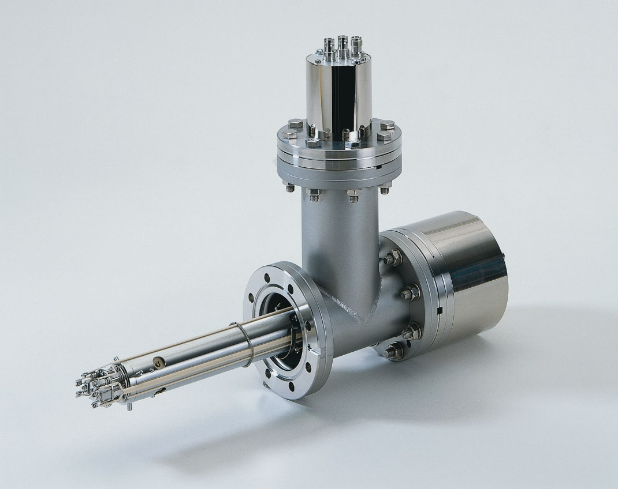
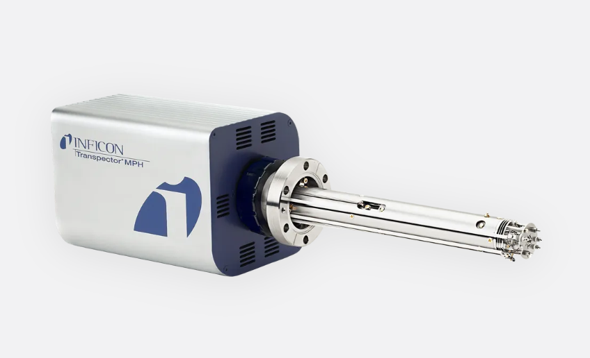
Quadrupole Mass Spectrometry
Basics of Quadrupole Mass
Spectrometry
  Ionization
  Mass separation
  Detection
Data acquisition modes
Applications
Exercises

Slide 3
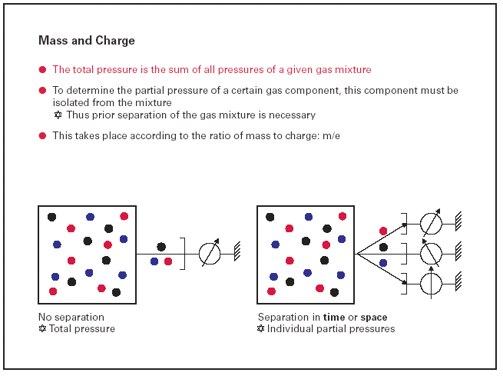
Total and Partial Pressure in vacuum chambers

Slide 4
Total and Partial Pressure
Partial Pressure Analysis informs on
residual gases at base pressure incl. outgassing rates
air leaks
Helium leaks (leaktest )
composition of process gases
impurities in process gases

Slide 5
MS basics
What does a quadrupole mass spectrometer do?
A mass spectrometer produces charged particles (ions) from the chemical substances that are to be analyzed.
The quadrupole mass spectrometer then uses electric fields to measure the mass (“weight” or more precisely the Mass/charge ratio, m/z or m/e) of the charged particles.
The charged particles that pass the mass spectrometer are collected, their charge is converted to a current and measured.

Slide 6
MS basics
What does the mass tell us?
Let us use water (H2O) as an example. A water molecule consists of two hydrogen's (H) and one oxygen (O). The total mass of a water molecule is the sum of the mass of two hydrogen's (approximately 1 atomic mass unit per hydrogen) and one oxygen (approximately 16 atomic mass units per oxygen):
2 H: 2 amu (atomic mass units)
+ O: 16 amu
___________
= H₂O: 18 amu
1 amu = 1.66E-27kg
¹⁶O ~ 16 amu
= Electron ~ 0 AMU
= Neutron ~ 1 AMU
= Proton ~ 1AMU

Slide 7
MS instrument set up

Slide 8
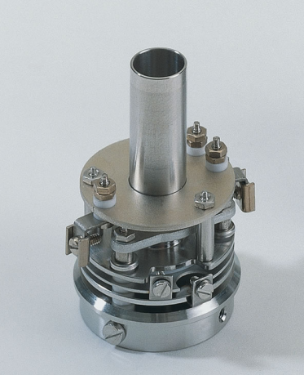
Ion Source
Ion-Source
Mass-Filter
Ion Counting
Faraday-Cup
and in general:
Electron Multiplier

Slide 9
MS basics
Ion source
A filament or cathode emits electrons which – on their path to the more positively charged
formation chamber / Anode– collide with gas particles and knock out electrons. In this process the gas particles become positively charged, they are ionized.
An Extraction lens extracts the ions from the formation chamber, and focusing lenses ensure ideal conditions at the entrance to the mass filter.

Slide 10
Introduction into Quadrupole Mass Spectrometry
- Ion Source for Electron Impact Ionization
I
Filament
Electron-Enenergy =
U
[eV]
Emission
e
-
Anode
Cathode
M + e
---> M
+ 2e
-
+
-
+ -
+
U
The emission is a function of the filament temperature, the material (work-function), the applied voltage and the geometry (local field strength).
The filament is heating up the ion source by radiation, and can so increase the outgassing rate

Slide 11
MS basics – H2O ionization and fragmentation
Let's suppose that we put some water vapor into the ion source of the mass spectrometer. If we shoot a beam of electrons through the water vapor, some of the electrons will hit water molecules and knock off an electron. If we loose a (negatively charged) electron from the (neutral) water molecule, the water will be left with a net positive charge. In other words, we have produced charged particles, or "ions" from the water:
H₂O + 1 (fast) electron --> [H₂O]⁺ + 2 electrons
Some of the collisions between the water molecules and the electrons will be so hard that the water molecules will be broken into smaller pieces, or "fragments". For water, the only possible fragments are [OH]⁺, O⁺ and H⁺.

Slide 12
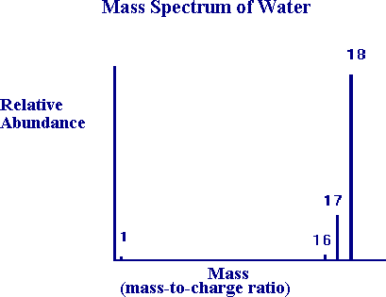
MS basics - H2O
The mass spectrum of water will show peaks that can be assigned to masses of
1 (H+), 16 (O+), 17 (OH+), und 18 (H2O+) m/e.
The relative abundance and the fragmentation pattern are like a finger print of a substance.

Slide 13
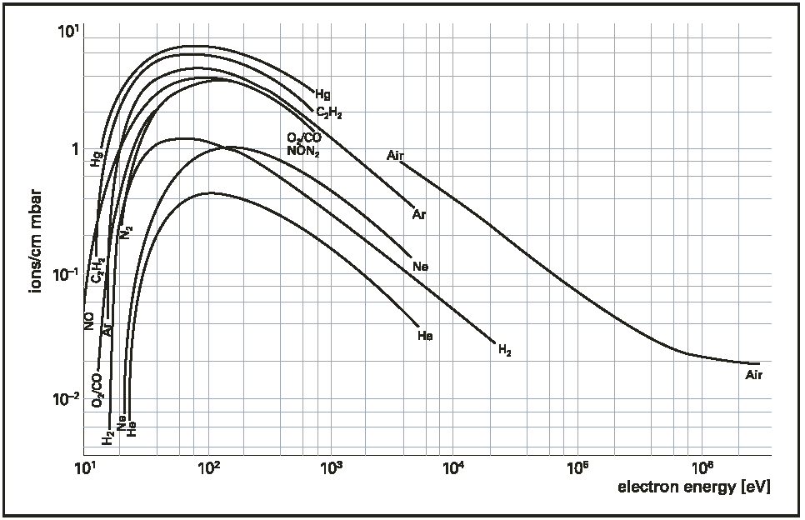
Introduction into Quadrupole Mass Spectrometry
Ionization produced by electron impact, as a function of the electron energy

Slide 14
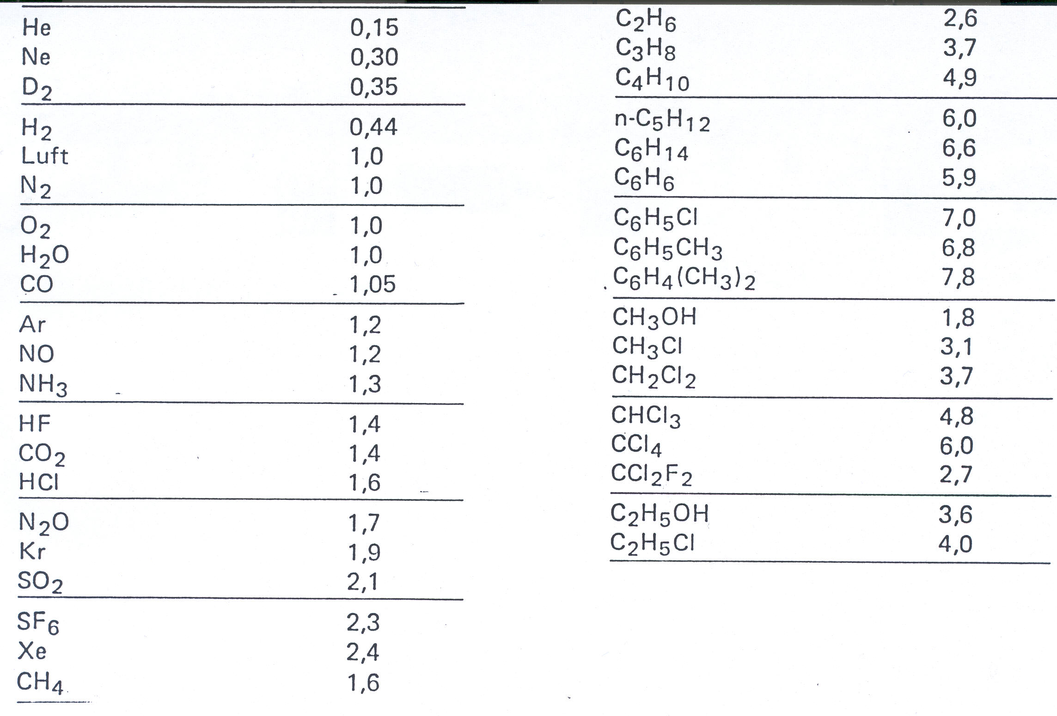
Introduction into Quadrupole Mass Spectrometry
Ionisation Probability compared to N₂
The sensitivity of any mass-spectrometer
and ionization gauge is gas-specific!

Slide 15
Introduction into Quadrupole Mass Spectrometry
Molecule + electron ➔ Ionization of molecule
➔ Fragmentation of molecule ➔ Multiple charged ions
➔ Isotopic effects are shown
Example:
CO₂ + e⁻ (70eV) ➔ CO₂⁺ 44 m/e
➔ C⁺ 12 m/e
➔ O⁺ 16 m/e
➔ CO⁺ 28 m/e
➔ CO2⁺⁺ 22 m/e
➔ ¹²C ¹⁶O ¹⁸O 46 m/e

Slide 16
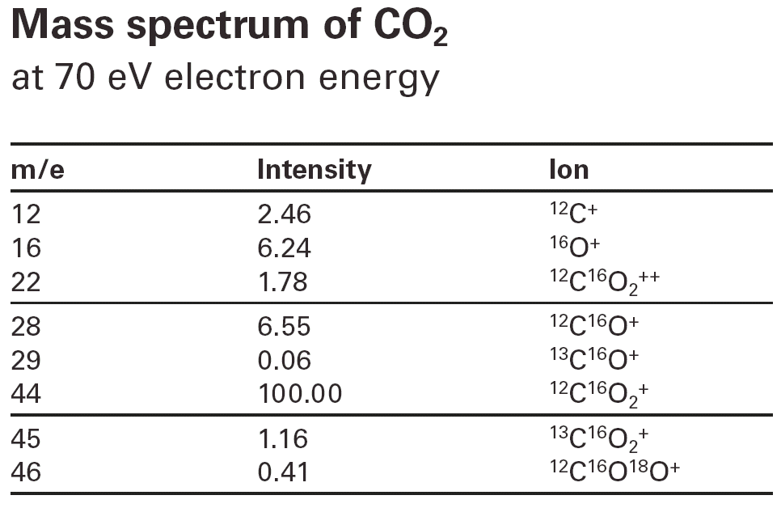
Introduction into Quadrupole Mass Spectrometry

Slide 17
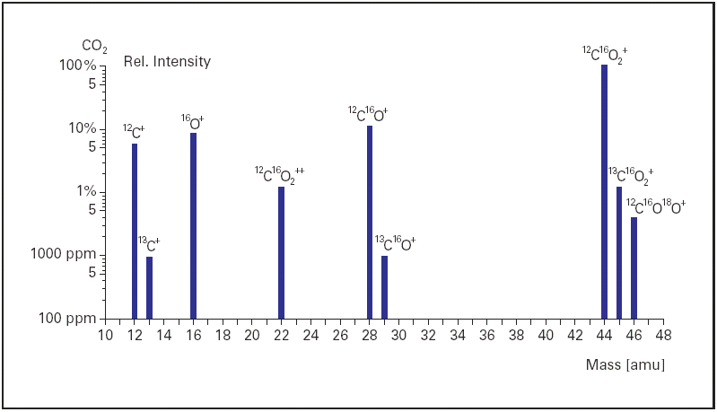
Introduction into Quadrupole Mass Spectrometry

Slide 18
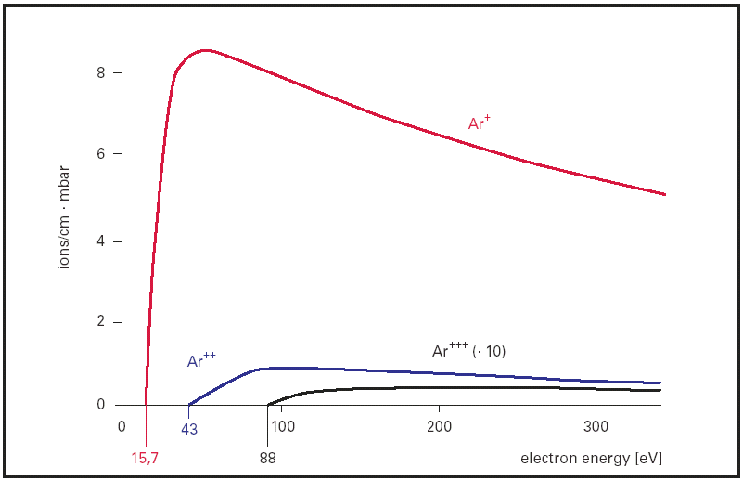
Introduction into Quadrupole Mass Spectrometry

Slide 19
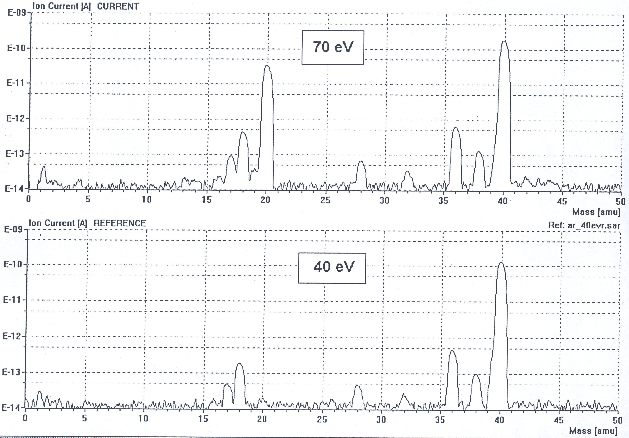
Introduction into Quadrupole Mass Spectrometry

Slide 20
Introduction into Quadrupole Mass Spectrometry

Slide 21
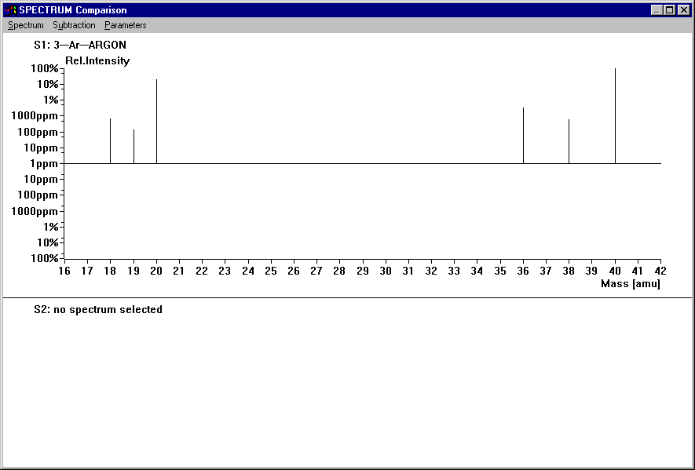
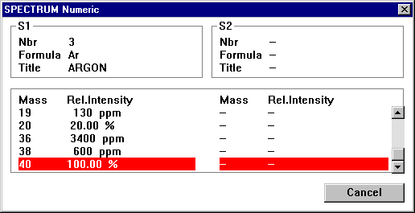
Measurement of pure Argon
Information from spectra
library

Slide 22
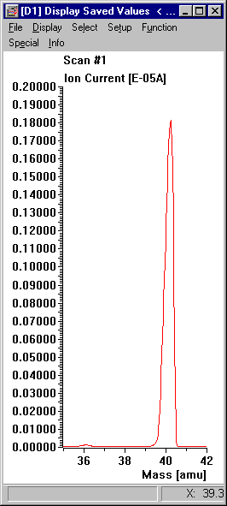
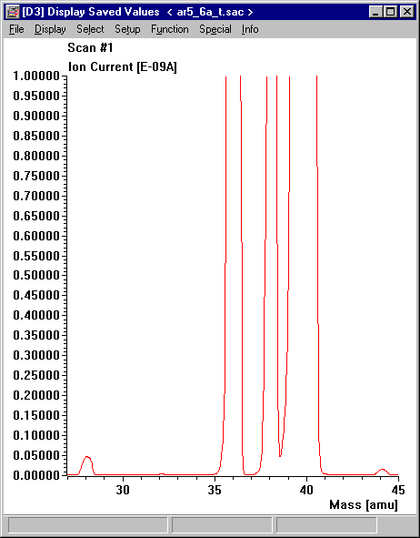
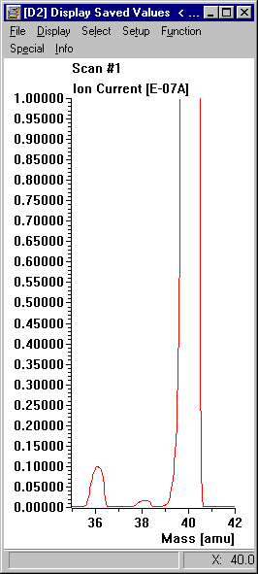
Pure Argon - or not???
Analog spectra from MS, linear display

Slide 23
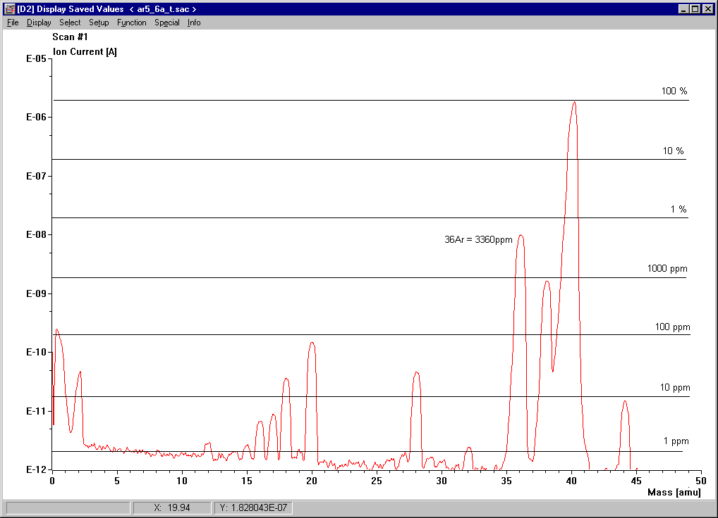
Pure Argon - or not???
Analog spectrum from MS, logarithmic display

Slide 24
Pure Argon - Quality 5.6
In the MS we see more then just a peak at mass 40.
Why???
36, 38: Argon has stable Isotopes with Mass 36 and 38
20: Argon is partially double ionized in the ion source and appears as Ar⁺⁺
The following peaks are system related (background):
18: Water vapor from the vacuum chamber, seals, etc.
14, 28: Nitrogen from the vacuum chamber, seals, etc.
16, 32: Oxygen from the vacuum chamber, seals, etc.
44: Carbon dioxide from the vacuum chamber, seals, etc.
1,2: Hydrogen from the vacuum chamber and from water vapor
All these are just traces in the level of <100ppm!

Slide 25
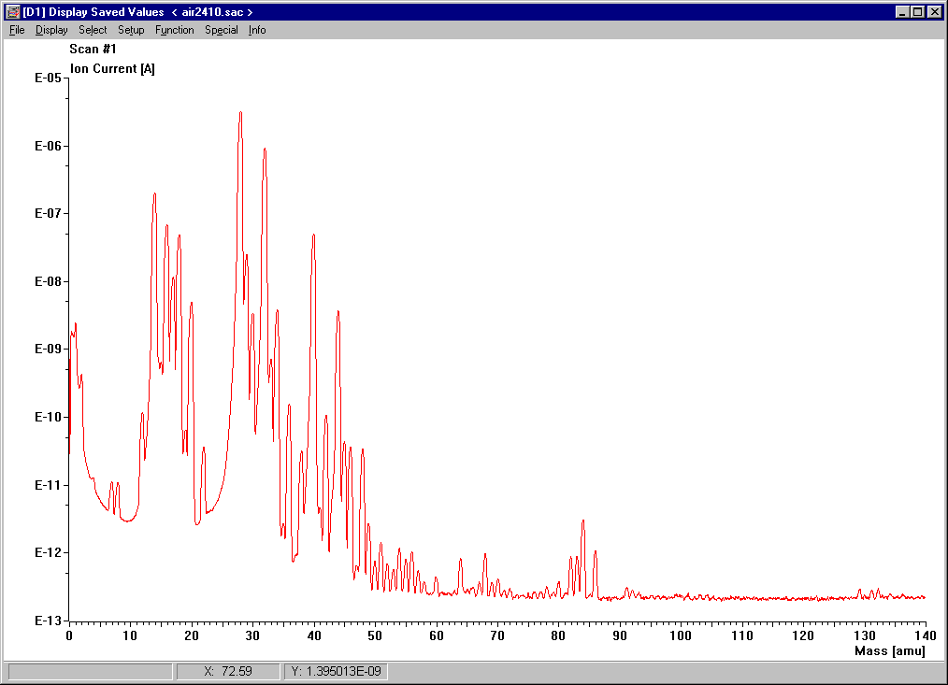
What do we find in air???
1, 2: H₂ from water vapor
4: He
7, 8: N⁺⁺, O⁺⁺
12: C von CO₂, C_{X}H_{Y}...
14, 15: ¹⁴N, ¹⁵N
16: O
17: HO
18: H₂O
20: Ar
28: N₂, CO
29: ¹⁴N¹⁵N
30: NO
32: O₂
34: ¹⁶O¹⁸O
36, 38: ³⁶Ar, ³⁸Ar
40: Ar
44: CO₂
82, 83, 84, 86: Kr
129, 131, 132: Xe

Slide 26
Possible errors
The last slide showed the most simple interpretation.
In detail it can be much more difficult.
16: Could be CH₄ instead of O
17: Could be NH₃ instead of HO
20: Could be Ne instead of Ar⁺⁺
29: Could be C₂H₅ (Ethanol) instead of ¹⁴N¹⁵N
36: Could be HCl instead of ³⁶Ar
44: Could be N₂O instead of CO₂
Knowledge about the sample and possible reactions are necessary for an exact interpretation of the measurements.
Mass spectra are reproducible, spectra libraries (e.g. Wiley, NIST) can help with the identification of unknown substances.
Nevertheless it should be noted that spectra vary from one mass spec to another and also by specific MS settings.

Slide 27
List of fragments part 1
Add. masses
Possible origin
Fragment
Masse (m/e)
15 CH₃+ CxHy 12, 13, 14, 26, 27 etc.
NH+ NH₃ 14, 16, 17
16 O+ O₂ 32, 34
O+ H₂O 17, 18
CH₄+ CH₄ 12, 13, 14, 15
NH₂+ NH₃ 14, 15, 17
17 OH+ H₂O 16, 18
NH₃+ NH₃ 14, 15, 16
18 H₂O+ H₂O 16, 17
19 F+ F₂ 38
F+ HF 20
20 HF+ HF 19
²⁰Ne+ ²⁰Ne 22
Ar++ Ar 40
22 CO₂++ CO₂ 6, 12, 28, 29, 44
²²Ne+ ²²Ne 20
24 C₂+ CxHy 12, 13, 14, 26, 27
26 C₂H₂+ CxHy 12, 13, 14, 24, 27
27 C₂H₃+ CxHy 12, 13, 14, 24, 26
28 N₂+ N₂ 7, 14, 29
C₂H₄+ CxHy 12, 13, 14, 24, 26
CO+ CO 6, 12, 29
CO+ CO₂ 6, 12, 29, 44
29 C₂H₅+ CxHy 12, 13, 14, 24, 26, 27, 28
¹⁴N¹⁵N+ N₂ 7, 14, 28
1 H+ H₂ 2
H+ H₂O 18, 17, 16
H+ CxHy 12, 13, 14, 26, 27 etc.
2 H₂+ H₂ 1
He++ He 4
4 He+ He 2
6 C++ CO 12, 28, 29
C++ CO₂ 12, 28, 44
C++ CxHy 12, 13, 14, 26, 27 etc.
7 N++ N₂ 14, 28, 29
8 O++ O₂ 16, 32, 34
O++ H₂O 16, 17, 18
12 C+ CO 28, 29
C+ CO₂ 28, 29, 44
C+ CxHy 13, 14, 26, 27 etc.
13 CH+ CxHy 12, 14, 26, 27 etc.
14 N+ N₂ 28, 29
N+ NH₃ 15, 16, 17
CH₂+ CxHy 12, 13, 26, 27 etc.
CO++ CO 28, 29

Slide 28
List of fragments part 2
30 C₂H₆+ C₂H₆ 12, 13, 14, 24, 26, 27, 28, 29
NO+ NO 14, 16
31 C₂H₂OH+C₂H₃OH 26, 28, 29
32 O₂+ O₂ 8, 16, 34
S+ H₂S 33, 34
S+ SO₂ 34, 64
34 H₂³²S+ H₂S 32, 33
³⁴S + H₂S 32, 33, 34
¹⁶O¹⁸O+ O₂ 8, 16, 32
35 ³⁵Cl+ Cl₂ 37, 70, 72,74
³⁵Cl+ HCL 36, 37, 38
36 H³⁵Cl+ HCl 35, 37, 38
³⁶Ar+ Ar 20, 38, 40
37 ³⁷Cl+ Cl₂ 35, 70, 72, 74
³⁷Cl+ HCl 35, 36, 38
38 H³⁷Cl+ HCl 35,36,37
C₃H₂+ CxHy 12, 13, 14, 24, 26, 27, 28
³⁸Ar+ Ar 20, 36, 40
39 C₃H₃+ CxHy 12, 13, 14, 24, 26, 27, 28, 38
³⁹K+ K 41
40 Ar+ Ar 36, 38
C₃H₄+ CxHy 12, 13, 14, 24, 26, 27, 28, 38, 39
41 C₃H₅+ CxHy 12, 13, 14, 24, 26, 27, 28, 38, 39
⁴¹K+ K 39
42 C₃H₆+ CxHy 12, 13, 14, 24, 26, 27, 28, 38, 39
43 C₃H₇+ CxHy 12, 13, 14, 24, 26, 27, 28, 38, 39
C₂H₃O+ C₂H₅OH 31, 44, 45, 46
44 C₃H₈+ C₃H₈ 41, 42, 43
CO₂+ CO₂ 6, 12, 28, 29
C₂H₄OH+ C₂H₅OH (alcohol) 31, 43, 45, 46
N₂O+ N₂O 14, 16, 28
45 C₂H₅O+ C₂H₅OH (alcohol) 31, 43, 44, 46
¹³CO₂+ CO₂ 6, 12, 28, 29, 44
46 NO₂+ NO₂ 14, 16
C₂H₅OH+ C₂H₅OH (alcohol) 31, 43, 44, 45
48 SO+ SO₂ 32, 64
55 C₄H₇+ CxHy 12, 13, 14, 24, 26, 27, 28, 38, 39
57 C₄H₉+ CxHy 12, 13, 14, 24, 26, 27, 28, 38, 39
58 (CH₃)₂CO+,C₃H₆O (acetone) 43
64 SO₂+ SO₂ 32, 48
77 C₆H₅+ Phenyl 50, 51, 52
78 C₆H₆+ C₆H₆ (benzene) 50, 51, 52
92.5 ¹⁸⁵Re++ Rhenium (filament) 93.5, 185, 187
93.5 ¹⁸⁷Re++ Rhenium (filament) 92.5, 185, 187
149 Phthalic ester (softening agent)
182 ¹⁸²W+ Tungsten (filament) 183, 184, 186
183 ¹⁸³W+ Tungsten (filament) 182, 184, 186
184 ¹⁸⁴W+ Tungsten (filament) 182, 183, 186
185 ¹⁸⁵Re+ Rhenium (filament) 187
187 ¹⁸⁷Re+ Rhenium (filament) 185

Slide 29
Spectra library
Most RGA software packages contain a spectra library
Additional spectra are available from the NIST library
https://webbook.nist.gov/chemistry/

Slide 30
Introduction into Quadrupole Mass Spectrometry
Mass-Filter
e
Axial Ion-Source
-
Ion
+
Filament
-
+
-
Extraction Lense
Residual Gas Analysis
Cross Beam Ion-Source
Filament
Mass-Filter
e
-
e
Ion
+
Molecular Beam
-
Ion
+
Extraction Lense
beam analysis

Slide 31
Introduction into Quadrupole Mass Spectrometry
Filament
Mass-Filter
Grid-
Ion-Source:
Ion
+
Ultra-High-Vacuum
Extractionlens
Mass-Filter,differentially pumped
Filament
Closed
Ion-Source:
Elektrons
Ions
10
-2
mbar
(SPM)
Filament
Process Gas Analysis, p>1E-4mbar

Slide 32
Residual Gas Analyzer
Transpector MPH

Slide 33
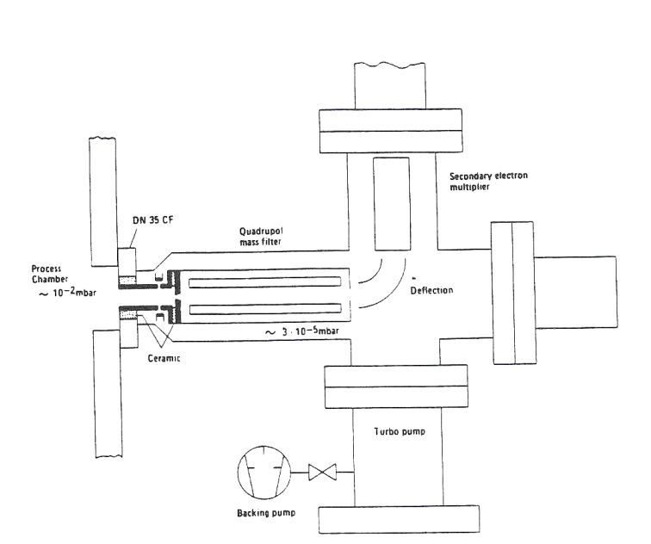
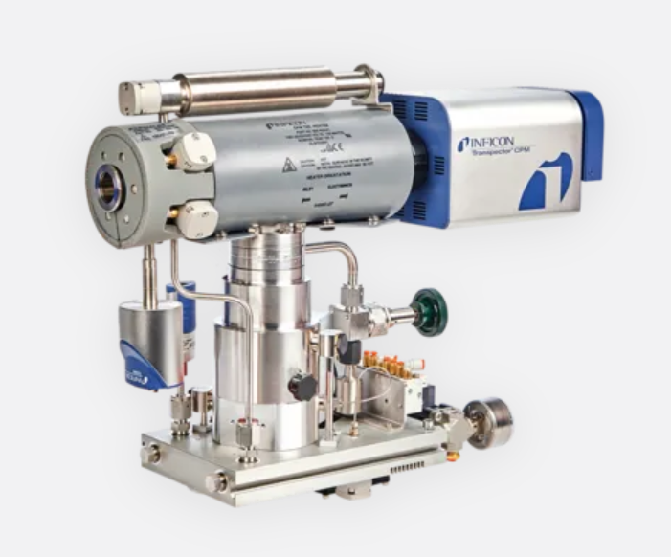
Differentially pumped analyzer
DN40CF
Approx. 3E-6mbar
SPM 800
Transpector CPM3

Slide 34
SPM 700 Ion Source
Ion Formation Chamber
(interal volume open to process)
Filaments (hidden)
Extraction Lens
Focus Lens
Base plate, connection to Quadrupole

Slide 35


SPM 700 Ion Source
Housing =
Filament baseplate =
Wehnelt =
Extraction
Quadrupole rod
Grid =
Formation Chamber
Faraday =
Focus
Filament
Pressure = 5E-6mbar
Pressure = 1E-2mbar

Slide 36
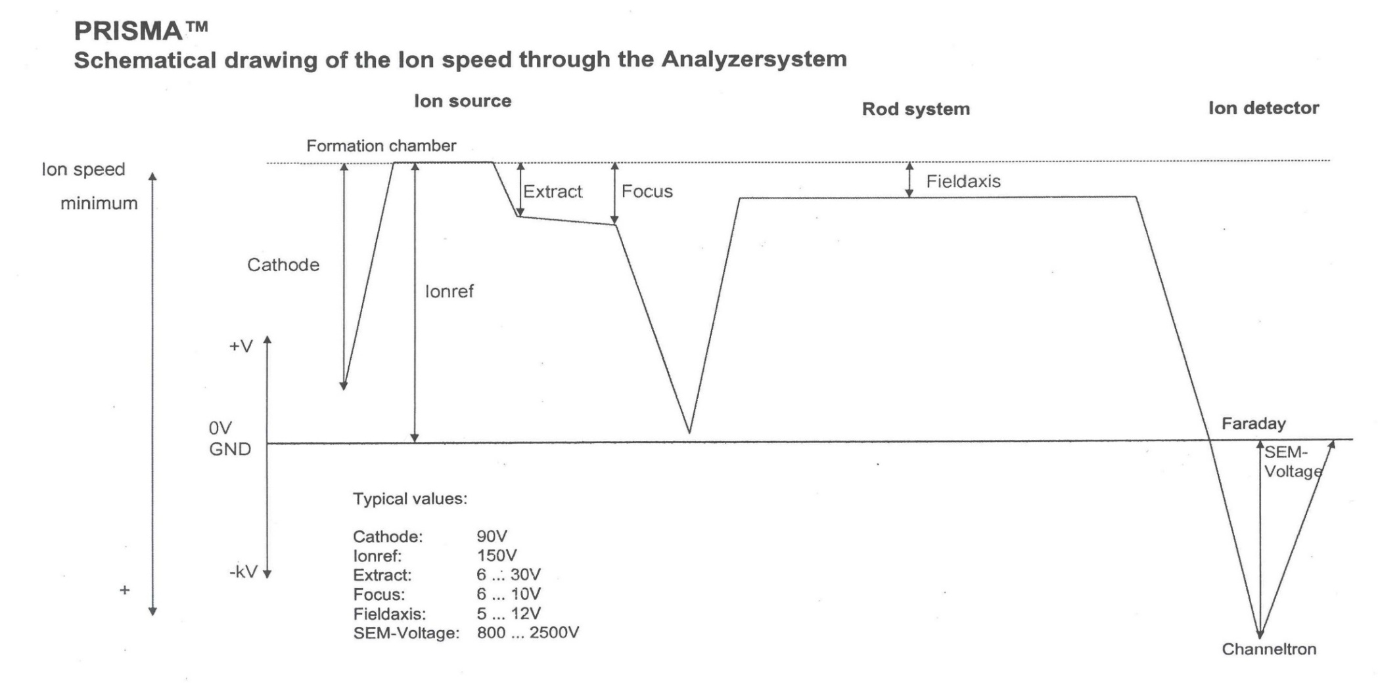
SPM 700 Ion Source Potentials
SEM

Slide 37
SPM 700 Ion Source Potentials
All voltages are measured with «Ion Reference» as reference
«Cathode» defines the energy of the electrons
«Field axis» is the potential on the axis of the Quadrupole
«Field Axis» defines energy / speed of ions in the Quadrupole
e.g. IonRef= 150V and Field Axis = -6V means
Field Axis =144V from ground

Slide 38
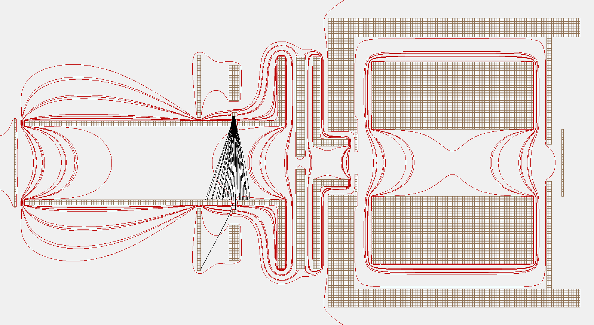
SPM 700 Ion Source
Flight paths of electrons
Formation chamber
Quadrupole rod system
Filament
Extraction
Focus
Entrance aperture
Faraday

Slide 39
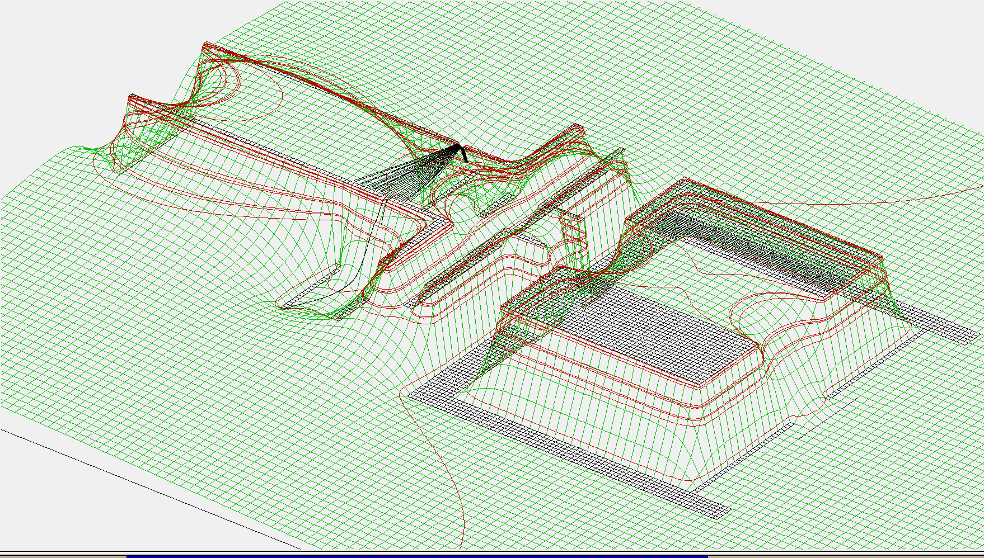
SPM 700 Ion Source
Flight paths of electrons

Slide 40
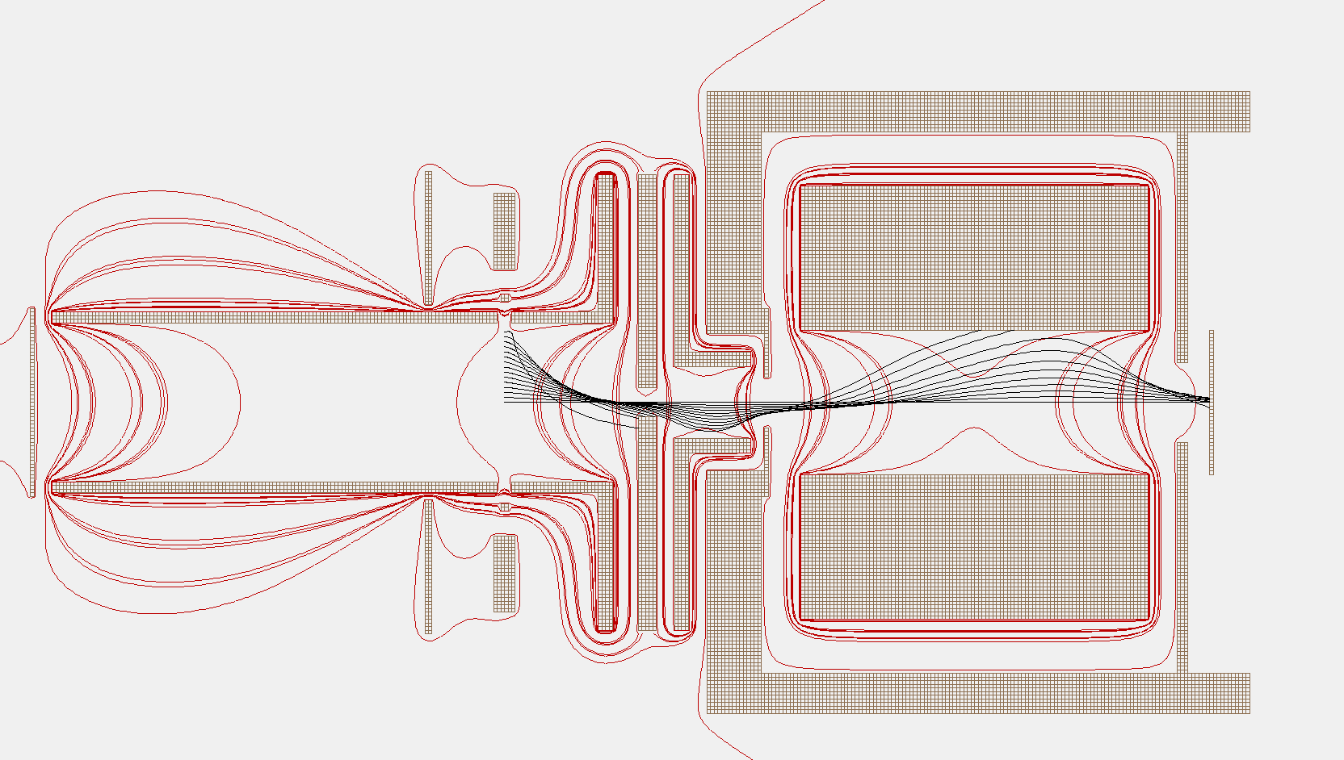
SPM 700 Ion Source
Flight paths of Ions
Formation chamber
Quadrupole rod system
Filament
Extraction
Focus
Entrance aperture
Faraday

Slide 41
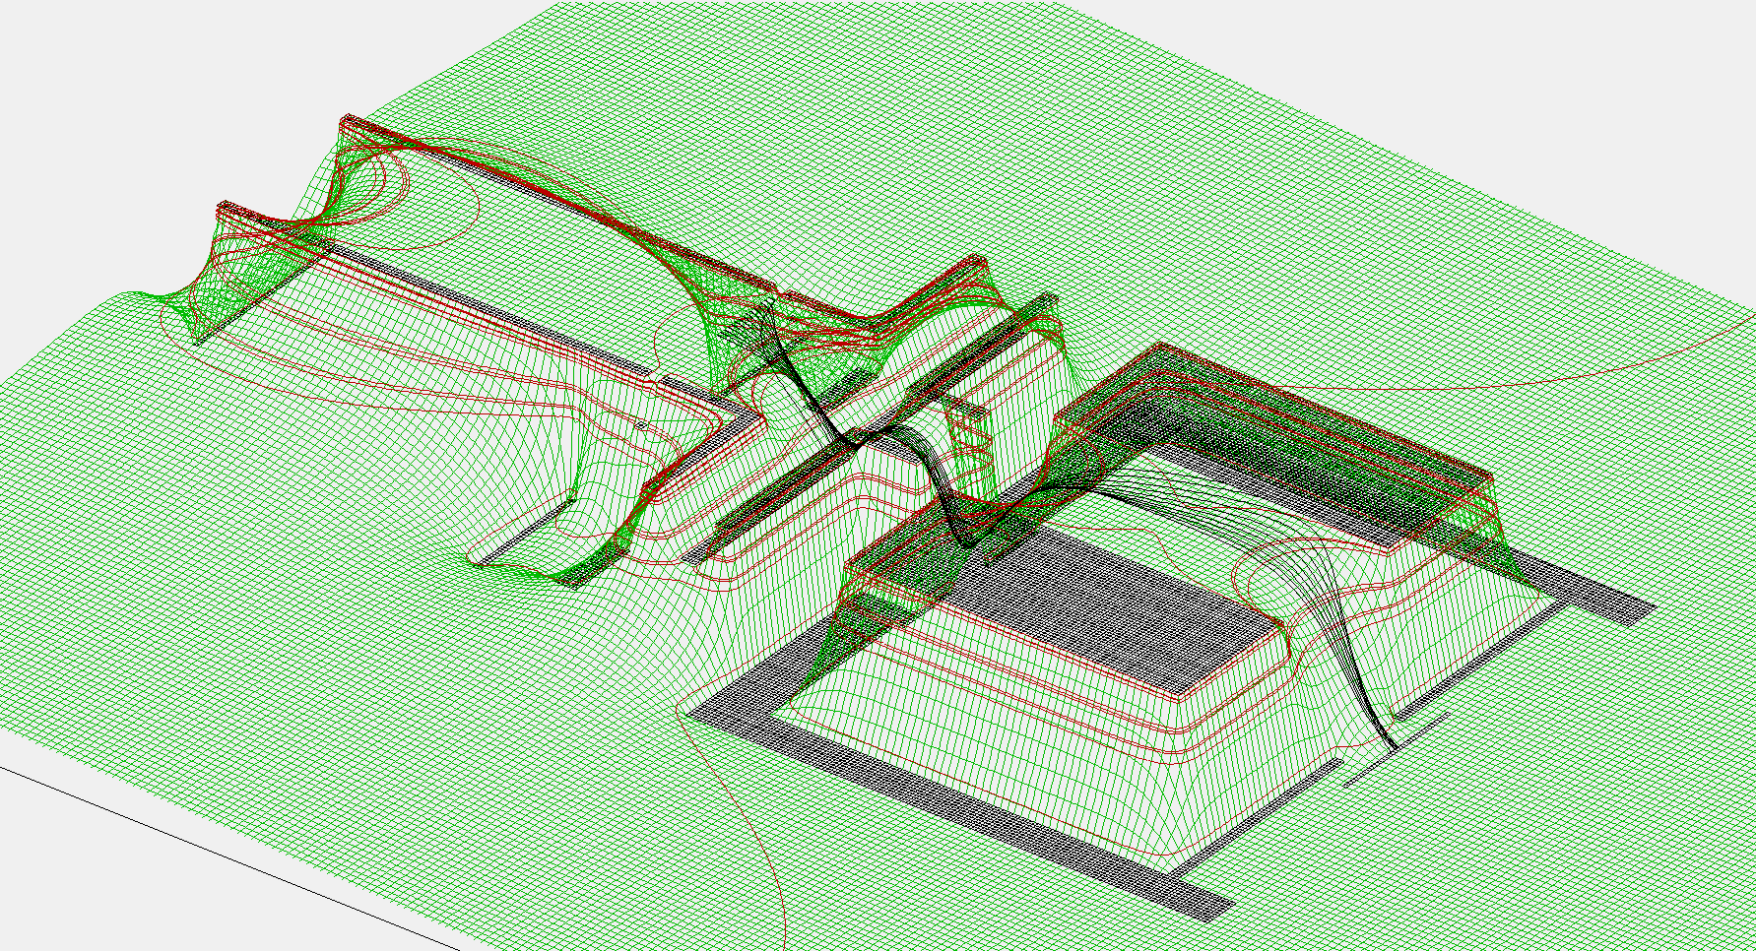
SPM 700 Ion Source
Flight paths of Ions

Slide 42
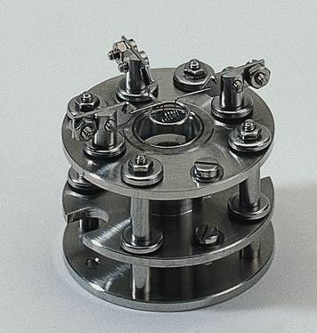
Axial ion source, open
Characteristics
  High sensitivity
  Robust, simple design
  Easy to clean
  Good ion injection into the QMA
  Single filament Re, W, Y2O3-Ir
Typical applications
  General gas analysis
  Residual gas and outgassing analysis at system with base pressure >1E-10mbar

Slide 43
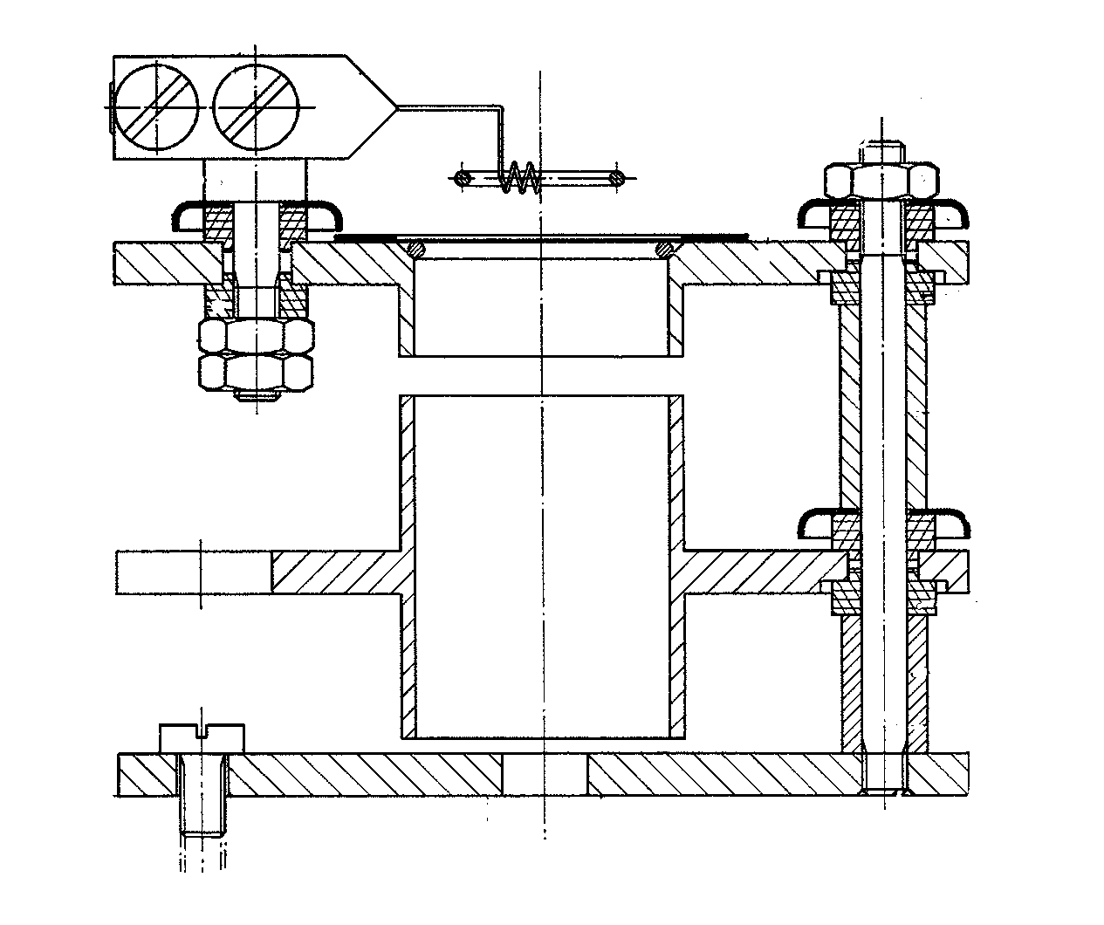
Axial ion source, open
Filament
Wehnelt
Anode / Ionref
Focus
Entrance to quadrupole

Slide 44
Axial ion source, electrodes and potentials

Slide 45
Axial ion source
Flight paths of electrons
Entrance aperture
Formation chamber
Quadrupole rod system
Focus
Wehnelt
Filament

Slide 46
Axial ion source
Flight paths of electrons

Slide 47
Axial ion source
Flight paths of positive ions
Entrance aperture
Formation chamber
Quadrupole rod system
Focus
Wehnelt
Filament

Slide 48
Axial ion source
Flight paths of positive ions

Slide 49
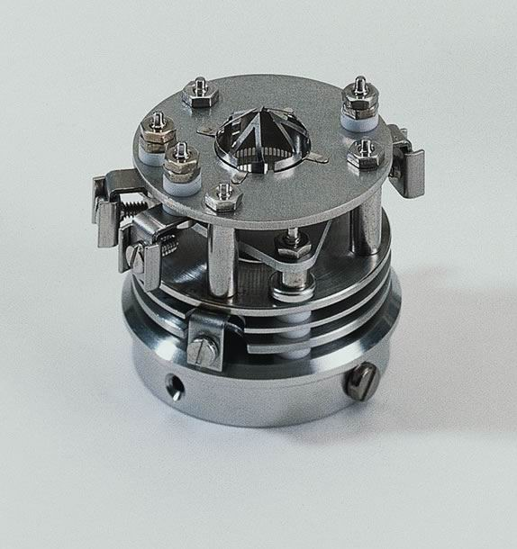
High Sensitivity (HS) ion source, open
Characteristics
  open design
  Fast reaction on gas composition
  changes
  High sensitivity
  Long lifetime
  Good ion injection into the QMA
  Double filament W, Y2O3-Ir
  Closed version available
Typical applications
  Residual gas analysis
  Quantitative and qualitative gas analysis
Presentation Title Goes Here
0000-00-00
49

Slide 50
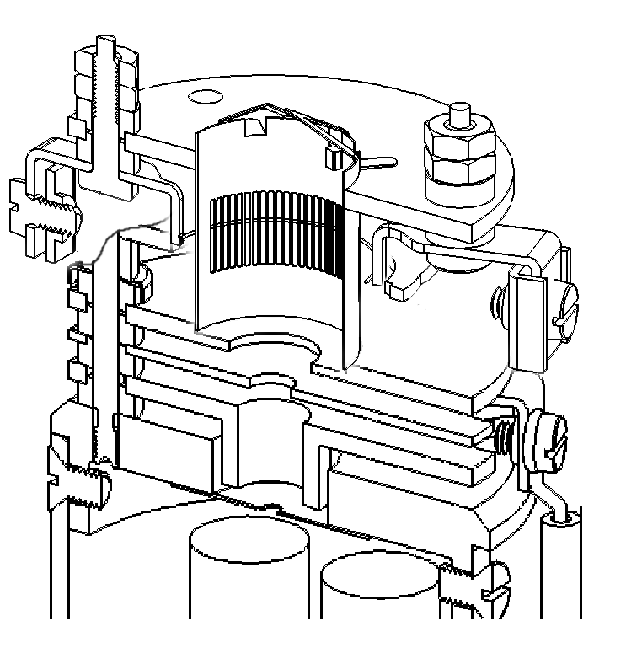
High Sensitivity (HS) ion source, open
Presentation Title Goes Here
0000-00-00
50

Slide 51

Ion Source Potentials

Slide 52
High Sensitivity ion source
Flight paths of electrons
Formation chamber
Grounded electrode
Entrance aperture
Quadrupole rod system
Filament
Extraction
Focus
Presentation Title Goes Here
0000-00-00
52

Slide 53
High Sensitivity ion source
Flight paths of electrons
Presentation Title Goes Here
0000-00-00
53

Slide 54
High Sensitivity ion source
Flight paths of positive ions
Grounded electrode
Quadrupole rod system
Formation chamber
Entrance aperture
Filament
Extraction
Focus
Presentation Title Goes Here
0000-00-00
54

Slide 55
High Sensitivity ion source
Flight paths of positive ions
Presentation Title Goes Here
0000-00-00
55

Slide 56
HS ion source, variable electron energy
Characteristcis
  variable electron energy
  from 10 eV to 150eV
Typical applications
  „low price“ appearance
  potential determination
  analysis of radicals
Presentation Title Goes Here
0000-00-00
56

Slide 57
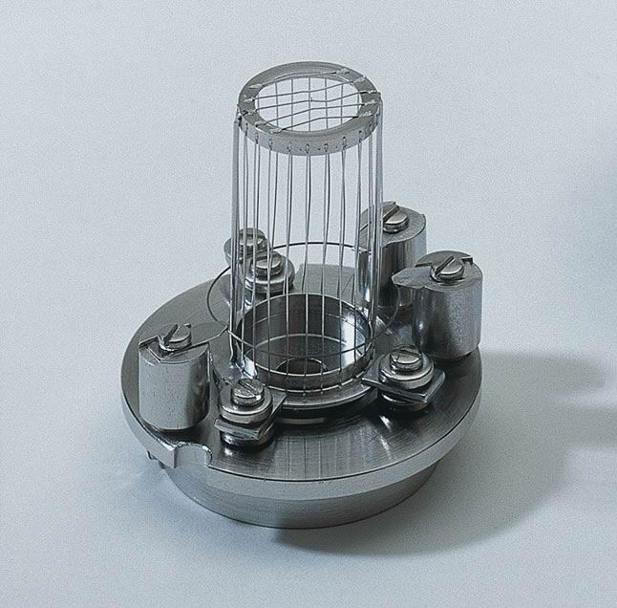
Grid ion source
Characteristics
  open design
  high sensitivity
  low degassing rate
  easy to degas
  double W- filament
Typical applications
  residual gas analysis in UHV / XHV
  desorption analysis (TDMS)

Slide 58
Grid ion source, electrodes and potentials

Slide 59
Grid ion source
Flight paths of electrons
Formation chamber
Entrance aperture
Quadrupole rod system
Filament

Slide 60
Grid ion source
Flight paths of electrons

Slide 61
Grid ion source
Flight paths of positive ions
Formation chamber
Entrance aperture
Quadrupole rod system
Filament

Slide 62
Grid ion source
Flight paths of positive ions

Slide 63
Introduction into Quadrupole Mass Spectrometry
Filament materials
Rhenium: rather high vapor pressure used mainly in High Vacuum
Tungsten used in the UHV, has a longer lifetime than Rhenium
Tungsten gets brittle at high Hydrocarbon concentrations
Yt-Oxide coating on Iridium wire rather resistant against air, temperature is much lower compared to pure metals

Slide 64
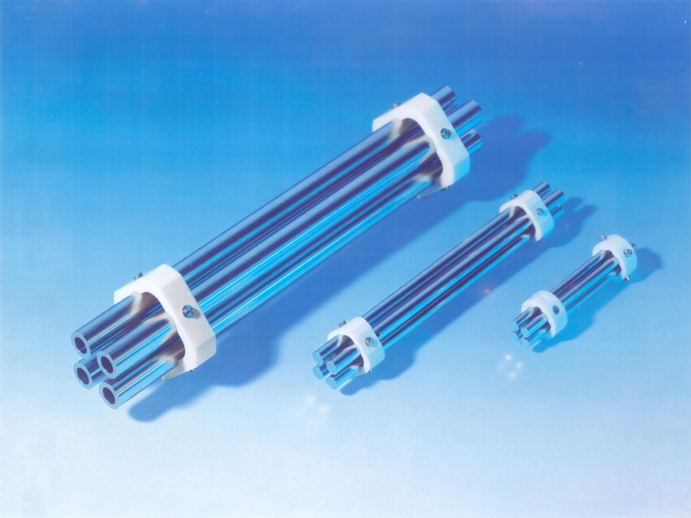
Quadrupole Mass Filter
Ion-Source
Mass-Filter
Ion Counting
Faraday-Cup
and in general:
Electron Multiplier

Slide 65
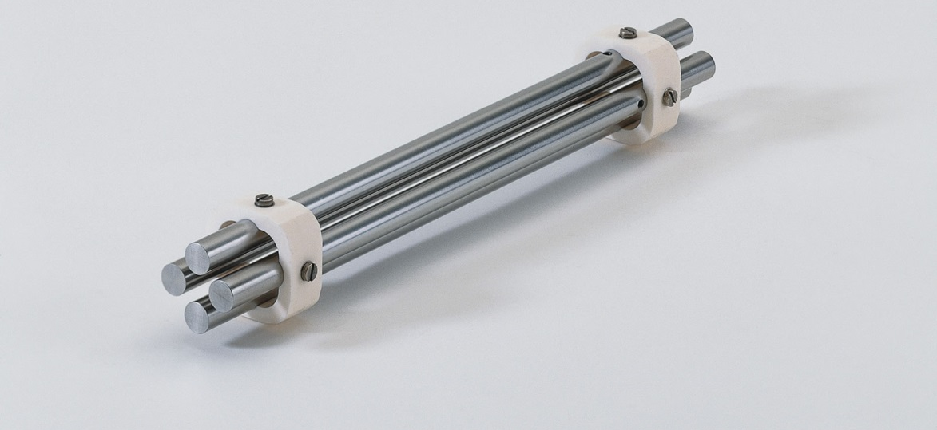
Introduction into Quadrupole Mass Spectrometry
The quadrupole
Mass filter
Four precisely aligned rods form an electric quadrupole field.
RF and DC voltages applied on the two rod pairs allow for separation of the charged particles according to their mass over charge ratio.

Slide 66
Introduction into Quadrupole Mass Spectrometry
Mass Filter - The Quadrupole-Field
1.2
E 1
E 2
2 r
o
-1.2
0
0
1.2
E 4
E 3
-1.2
+(U + V cos ω t) -(U + V cos ω t)
A superposition of an AC and a DC electrical field is applied onto the quadrupole rods.
Ions with an appropriate ratio of mass to charge achieve stable trajectories in the
high frequency field and pass the filter.

Slide 67
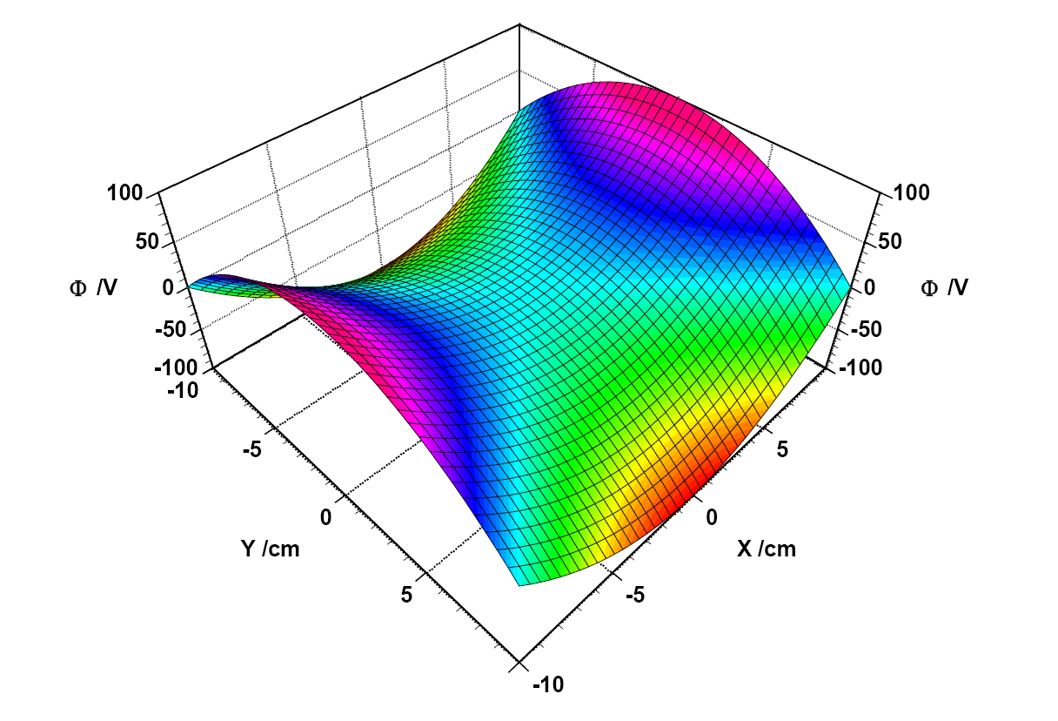
Introduction into Quadrupole Mass Spectrometry
Electrical potentials at one point in time

Slide 68
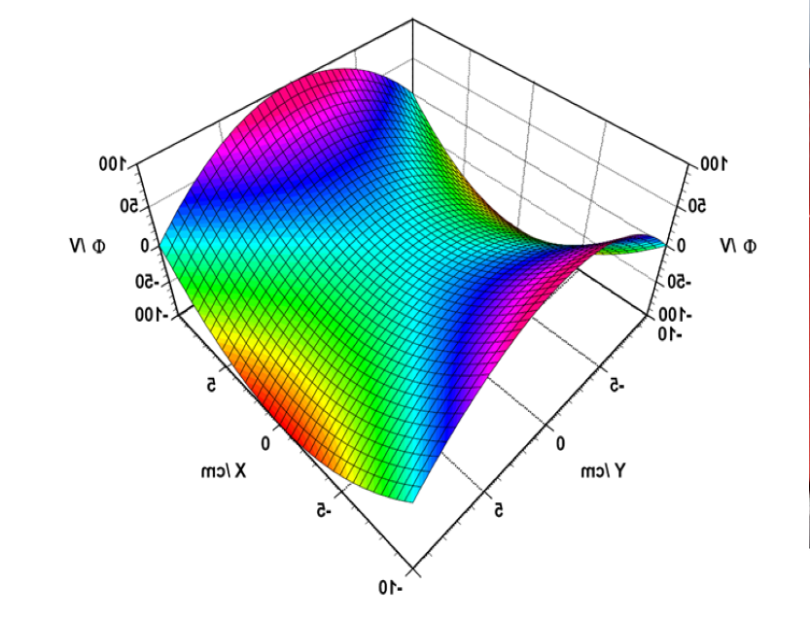
Introduction into Quadrupole Mass Spectrometry
Mass Filter - The Quadrupole-Field, variations over time
Electrical field at t=0
Electrical field at t=0+1/2ω

Slide 69
Introduction into Quadrupole Mass Spectrometry
Equations of motion
Use of the transformations
gives the following differential equations (Mathieu‘s equations)

Slide 70
Introduction into Quadrupole Mass Spectrometry
Mass Filter – Stability-Diagram
a
0.23699
8 * e * U
0.2
a =
m * r
2
* ω
2
instable region
instable region
0
0.1
stable region
4 * e * V
q
q =
m * r
2
* ω
0.2 0.4 0.6 0.8 1.0
2
0
0.706

Slide 71
Introduction into Quadrupole Mass Spectrometry
Mass Filter – Mass-Tuning
The ratio a/q (which is proportional to U/V) is kept
constant and the absolute values of U and V are
increased.
For a/q< 0.1678 (which is the top of the stability-diagram) the stability region is entered periodically for the different masses.
The slope a/q determines the mass resolution.

Slide 72
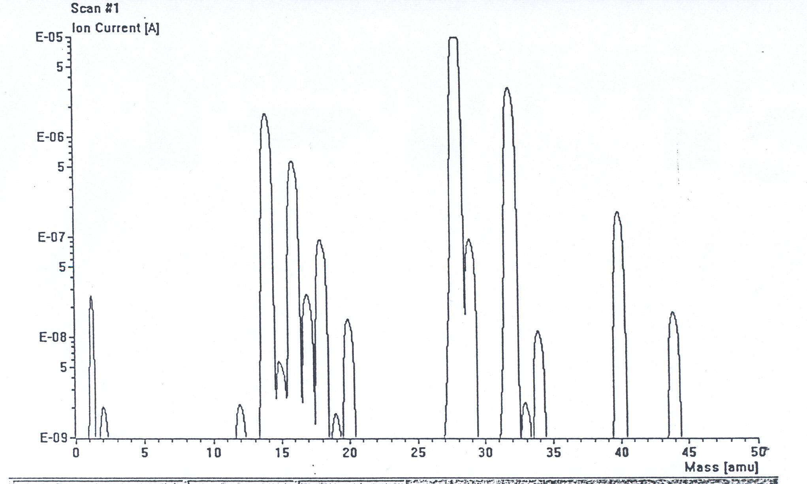
Introduction into Quadrupole Mass Spectrometry
The ratio a/q (which is proportional to U/V) is kept
constant and the absolute values of U and V are
increased --> A mass spectrum will result

Slide 73
Introduction into Quadrupole Mass Spectrometry
Mass Filter - The Quadrupole-Field, force on an ion
Electrical field at t=0
Electrical field at t=0+1/2ω

Slide 74
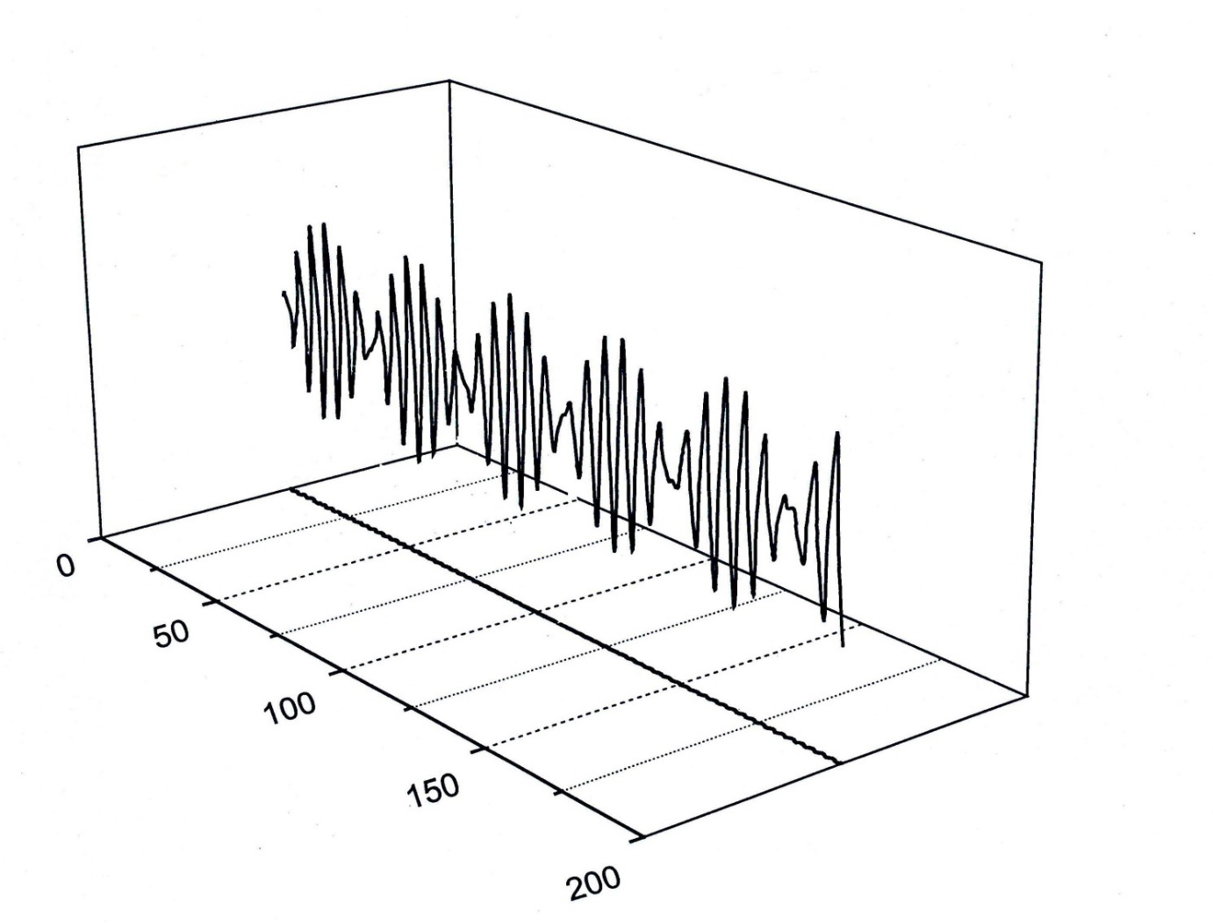
Quadrupole Mass Spectrometer
Flight path of ions through the mass analyzer
→ Ion mass identical to set mass

Slide 75
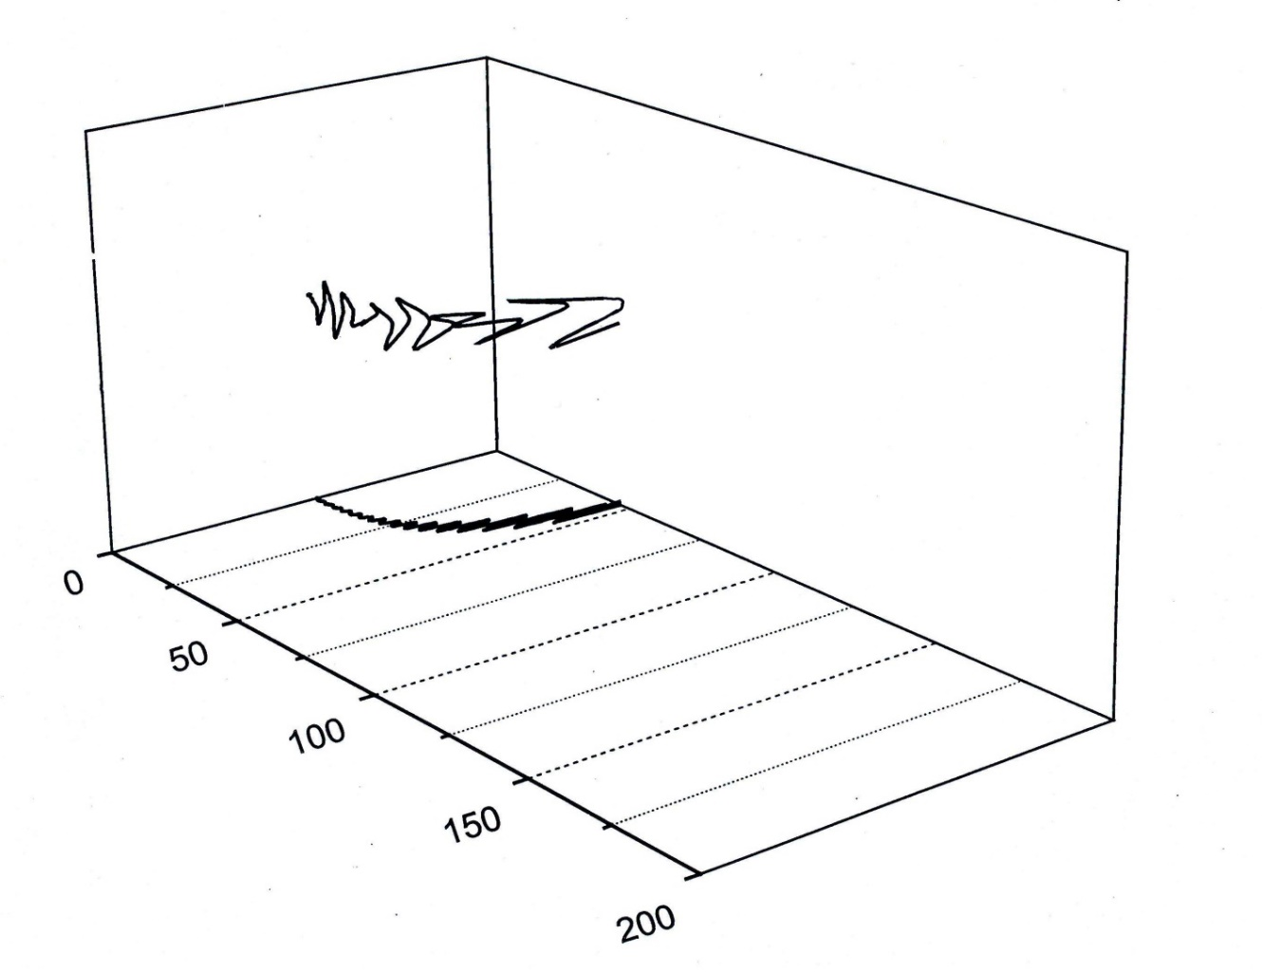
Quadrupole Mass Spectrometer
Flight path of ions through the mass analyzer
→ Ion mass higher than set mass

Slide 76
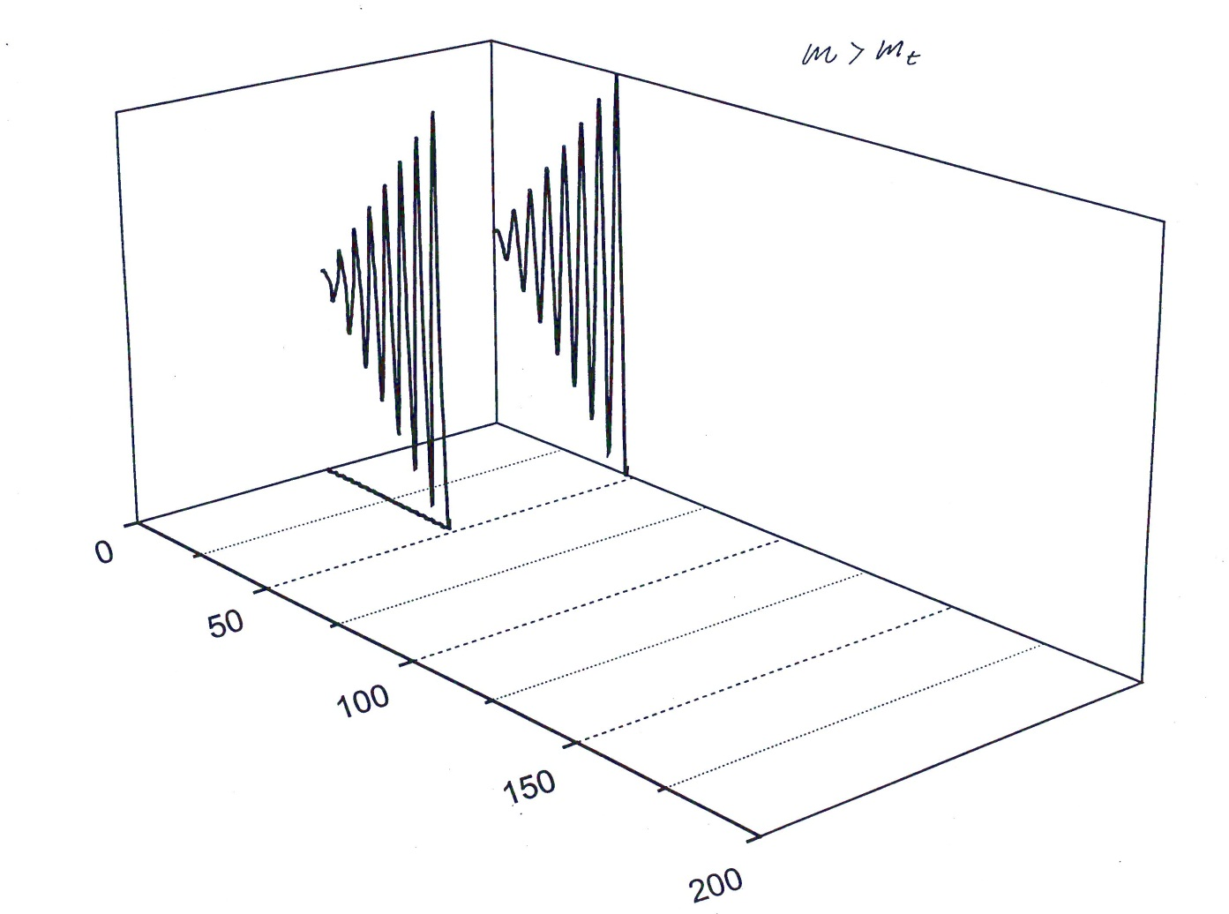
Quadrupole Mass Spectrometer
Flight path of ions through the mass analyzer
→ Ion mass lower than set mass

Slide 77
Introduction into Quadrupole Mass Spectrometry
Mass Filters
16 mm rod system for highest resolution, stability and transmission (e.g. He/D₂ separation)
8 mm rod system for High-End Applications
6 mm rod system for common analytical purpose (e.g. standard RGA)

Slide 78
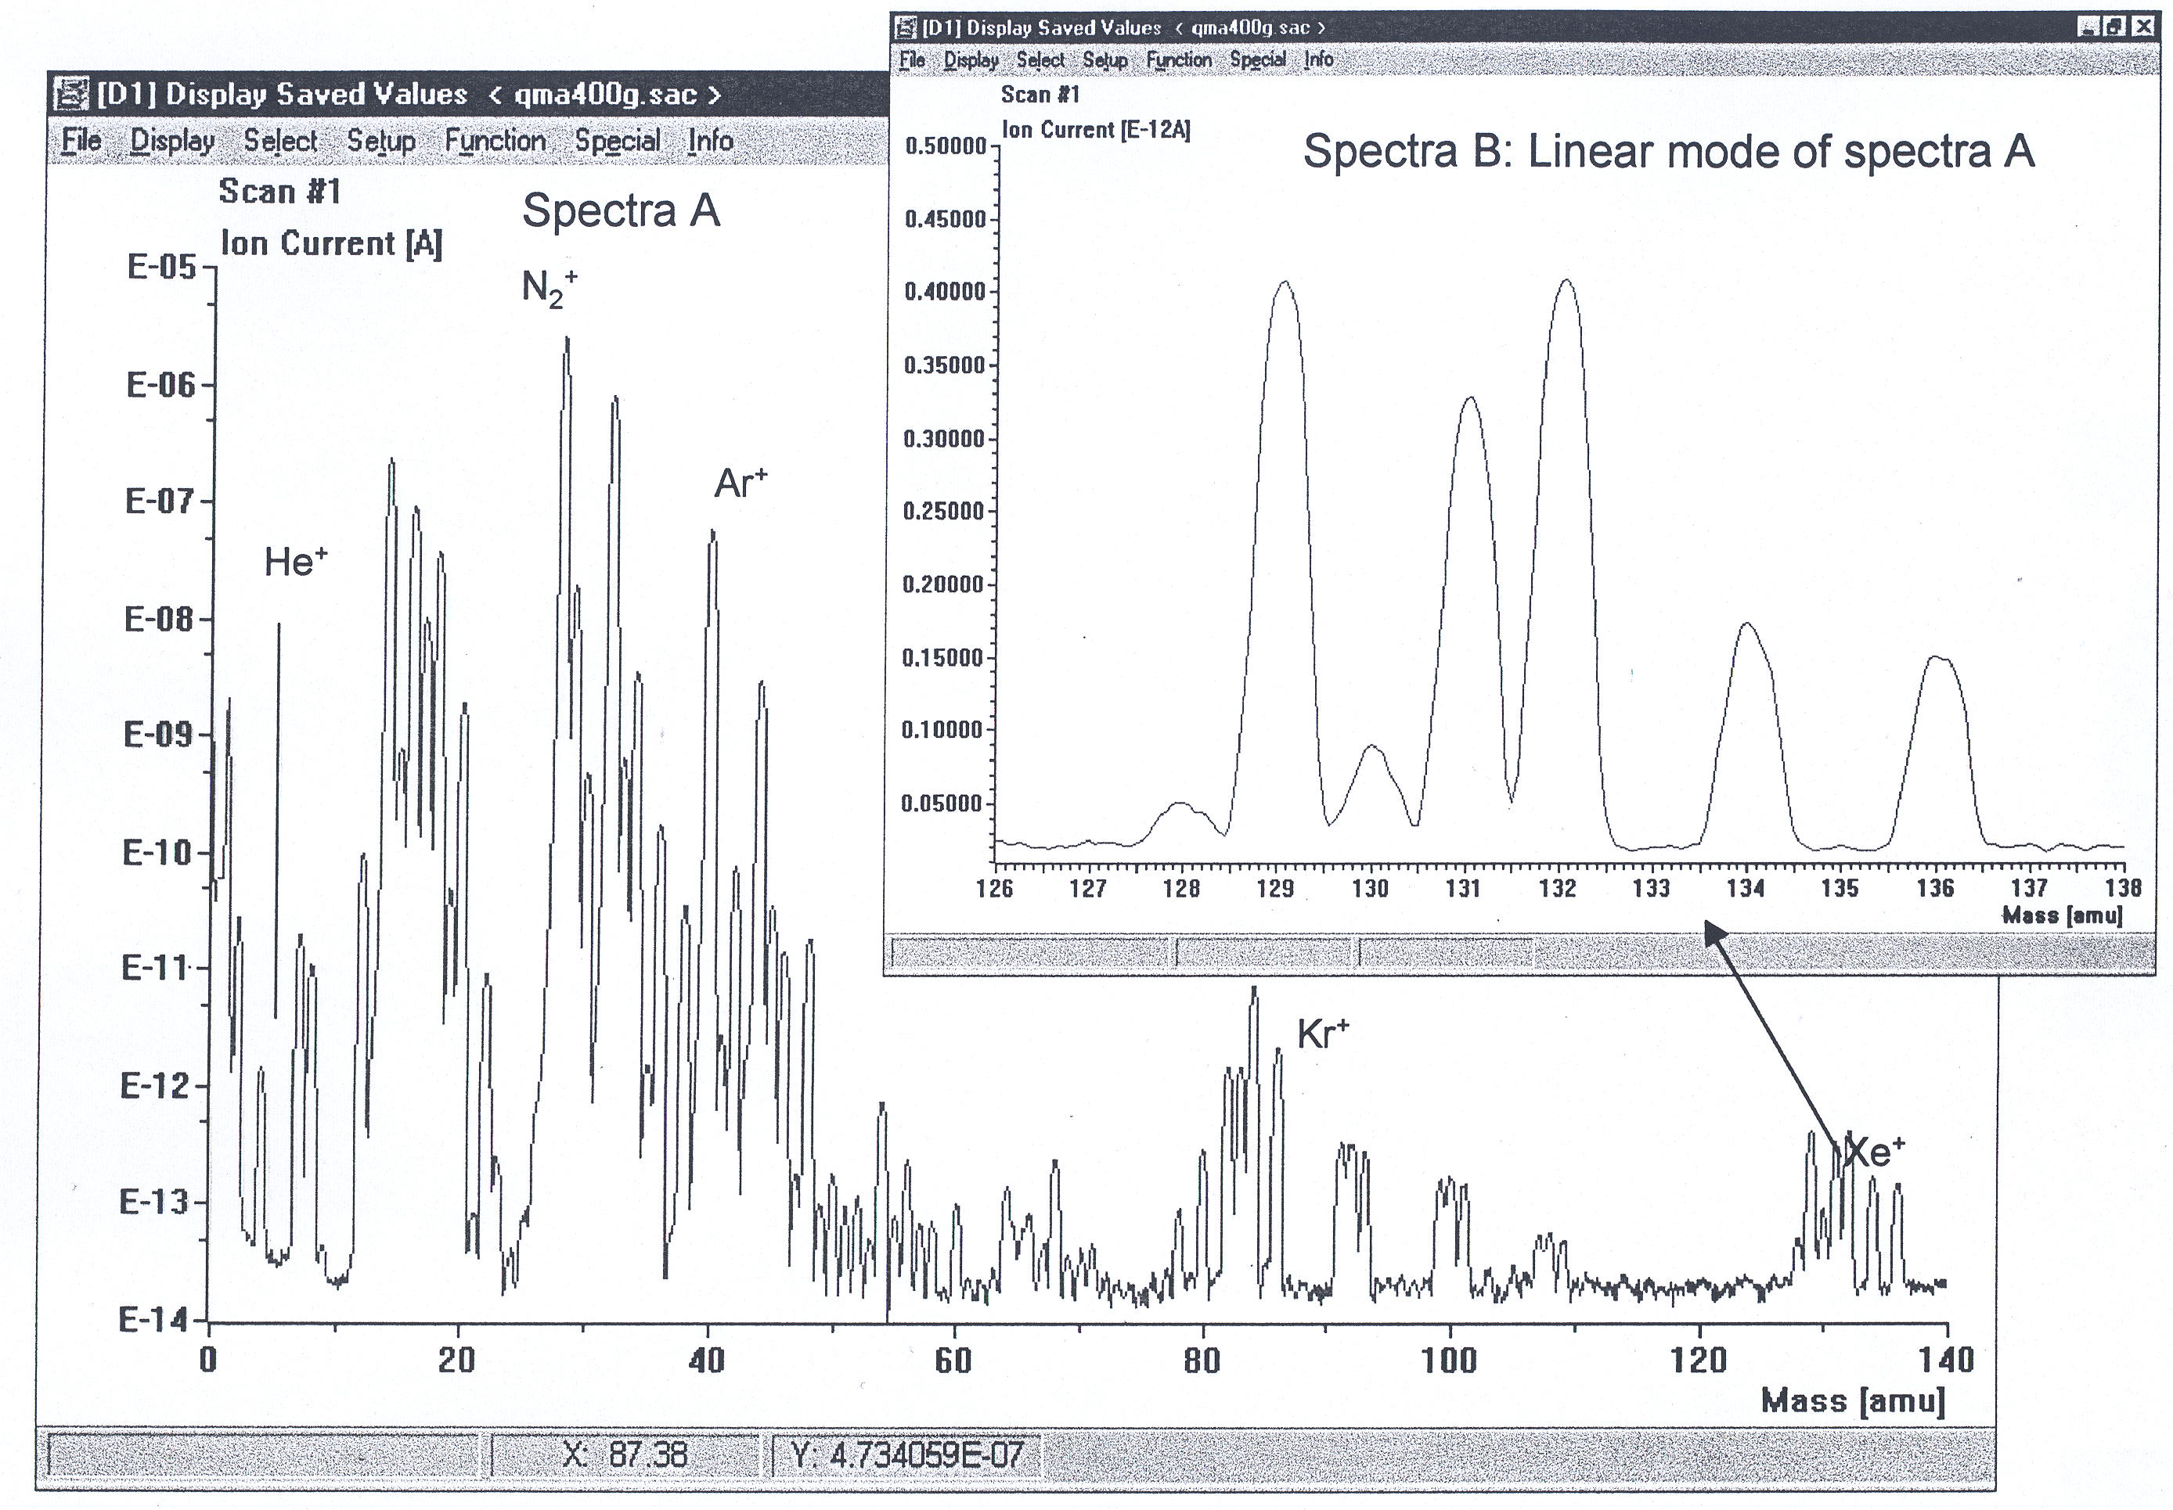
Introduction into Quadrupole Mass Spectrometry
Mass-Filter, dynamic range, air analysis
≙7.8ppb

Slide 79
Introduction into Quadrupole Mass Spectrometry
Unit Resolution: All peaks are equally broad over the whole mass range
(one amu) and
10% valley
between two neighbouring peaks of equal heigth
intensity
Resolution := M/ M
With unit resolution the
resolution increases with
increasing mass number
mass

Slide 80
Introduction into Quadrupole Mass Spectrometry
Mass-Filter, peak form and contribution to neigbouring mass

Slide 81
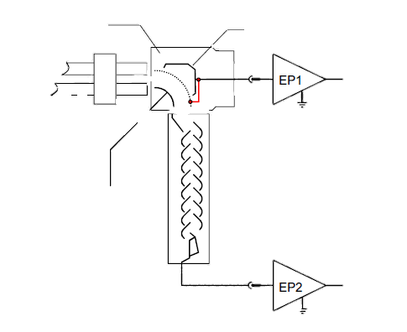
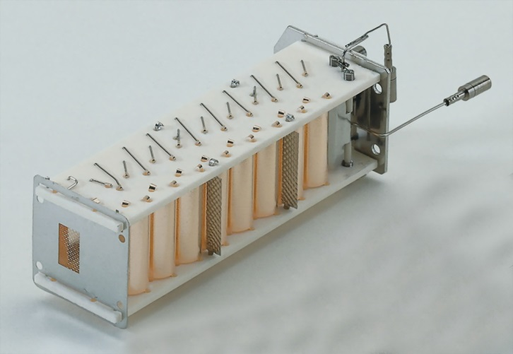
Detector
Ion-Source
Mass-Filter
Faraday
and in general:
Electron Multiplier

Slide 82
Introduction into Quadrupole Mass Spectrometry
Detectors
Faraday Cup for „robust every day operation“, detection of high ion currents, and determination of the basic sensitivity (A/mbar)
SEM for high amplification and detection of trace components

Slide 83
Introduction into Quadrupole Mass Spectrometry
Detector basics
Ion detection / Faraday and SEM
The ions that have passed the filter impinge on the Faraday collector where they release their charge. The very small resulting current is the input to the electrometer preamplifier.
If a secondary electron multiplier (SEM) is configured and switched on, the Deflection Unit directs the ions towards the SEM. The negative high voltage on the input of the SEM attracts and accelerates the ions. On impact they release electrons and these in turn release additional electrons which leads to an amplification of several orders of magnitude.
Electrometer preamplifier
This instrument converts very small currents (10 ⁻¹⁵ ...10 ⁻⁵ A) from the Faraday or SEM to a voltage which is subsequently processed in the quadrupole controller.

Slide 84
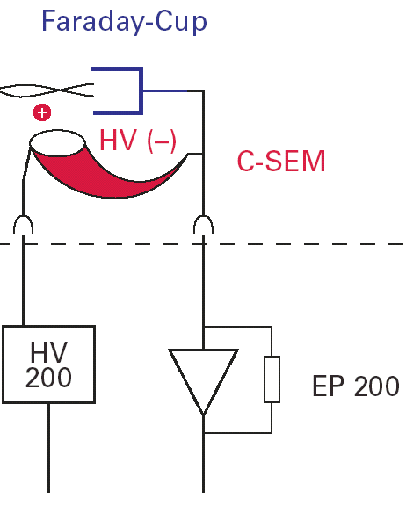
Introduction into Quadrupole Mass Spectrometry
Ions leaving the quadrupole mass spectrometer fly into a
Faraday-Cup and give off their charge
Charge is measured as a current by an electrometer amplifier
Measurable currents are from
1E-15 to 1E-8 A

Slide 85
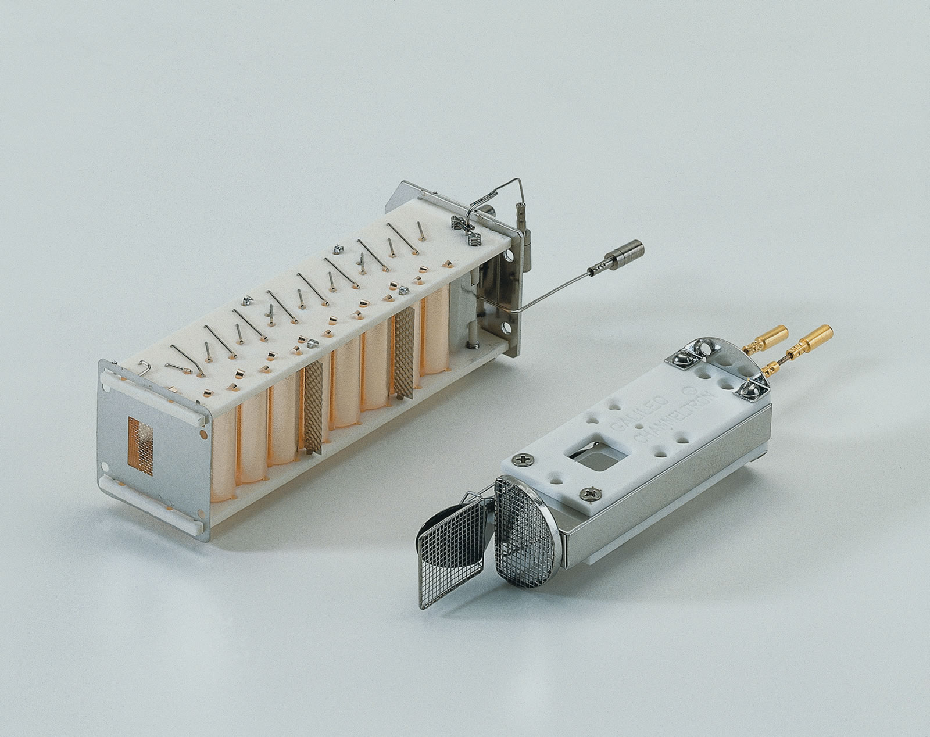
Introduction into Quadrupole Mass Spectrometry
Secondary Electron Multipliers
SEM 217,
17 discrete dynodes
ChanneltronTM,
continuous dynode
(incl. Faraday Detector)

Slide 86
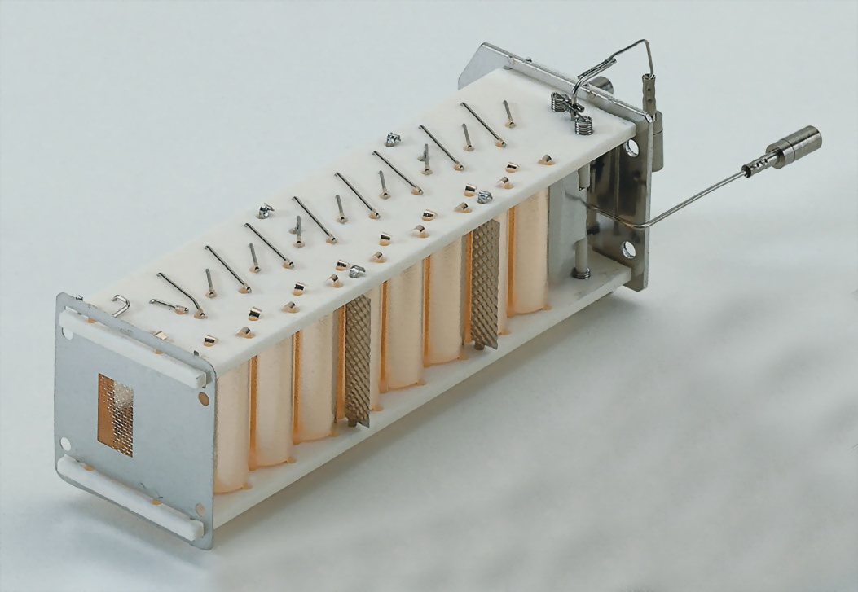
Introduction into Quadrupole Mass Spectrometry
Secondary Electron Multiplier
SEV 217,
17 discrete dynodes

Slide 87
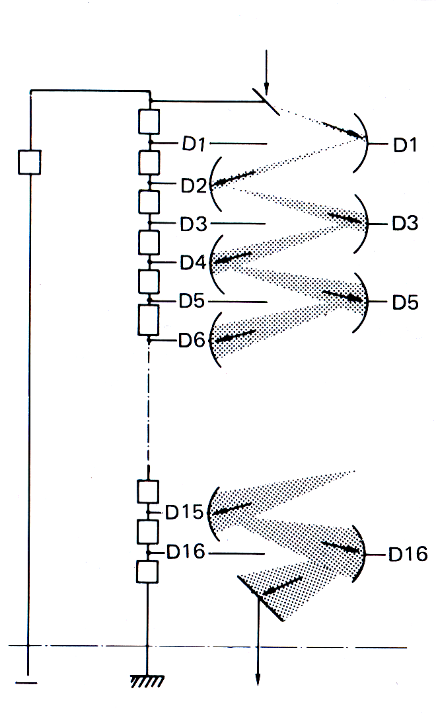
Introduction into Quadrupole Mass Spectrometry
Secondary Electron Multiplier, discrete
Positive Ion
Particles (ions, neutrals, electrons, photons) hitting a surface with high energy release several „secondary electrons“
Use of several dynodes allows for an amplification of up to 10⁸
Low ion currents can be detected easily
Measuring range 1E-15 to 1E-5A
„Counting“ of individual electron bursts allows for the detection of single ions (1E-19A)
-1 to - 3.5 kV
Electrons

Slide 88
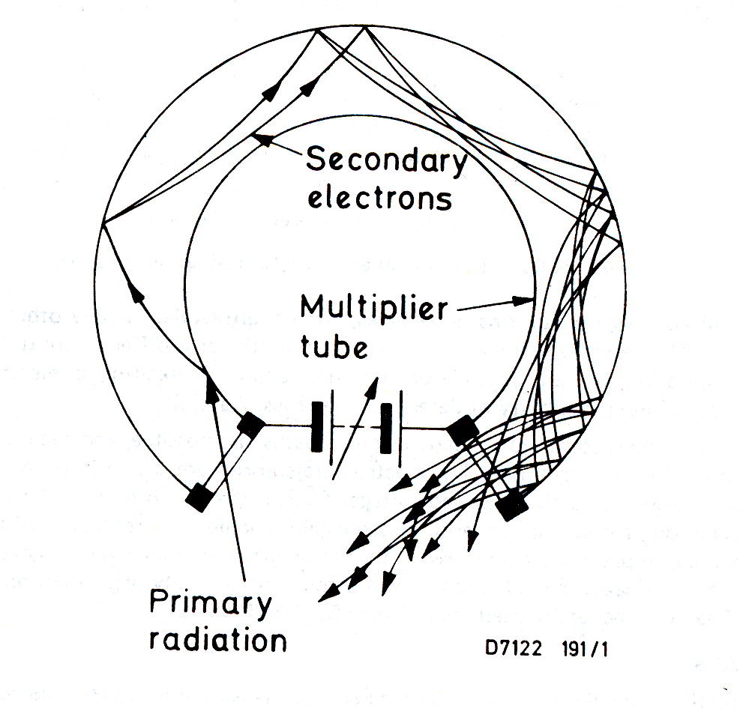
Introduction into Quadrupole Mass Spectrometry
Secondary Electron Multiplier, continuous
Multiplier consists of glass tube with semi-conducting layer
High voltage ( -1 to - 3kV) is applied to the front end of the
C-SEM
Electrons fly within the tube and release secondary electrons when hitting a surface
Bended tubes produce more hits of the electrons onto the surface than straight tubes
Ion Electrons

Slide 89
Introduction into Quadrupole Mass Spectrometry
Combined Faraday-Cup, C-SEM detector
If no voltage is applied to the C-SEM, the ions fly straight onto the Faraday-Cup
⇨ analysis of high ion currents
A high voltage applied to the C-SEM deflects the ions into its entrance
⇨ analysis of low ion currents
One electrometer can measure currents both from the Faraday-Cup and from the C-SEM

Slide 90
MS basics
General
To ensure filament longevity, ion mobility and detector operation the analyzer has to be kept under high vacuum conditions.
  At high pressure filaments burn quickly
  At high pressure Secondary Electron Multipliers degrade quickly

Slide 91
MS basics
Why is it necessary to work under vacuum?
Mass-Filter
mean free path has to be
much larger than the
dimensions of the mass-
spectrometer
5 meter
Ion-Molecule-Reactions
50 cm
5 cm
mean free path (log. scale)
5 mm
10
-5
10
-4
10
-3
10
-2
Pressure at the place of the Mass-Spectrometer

Slide 92
Introduction into Quadrupole Mass Spectrometry
Data acquisition modes
Scan Analog
Scan Bargraph
Multiple Ion Determination (MID)

Slide 93
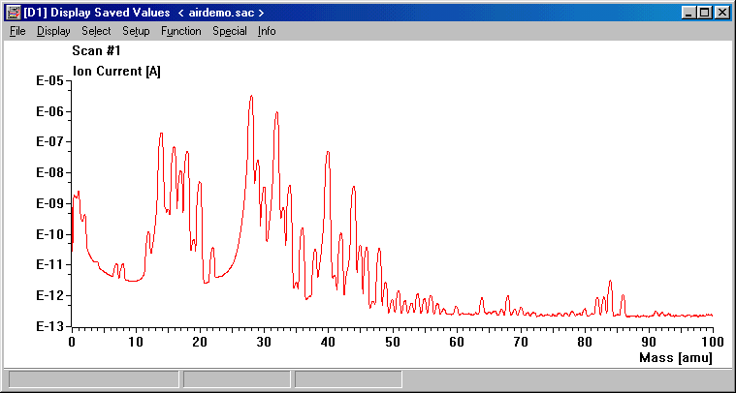
Data acquisition modes - Scan Analog
Here a range of masses are scanned and the data appears as
intensity vs. mass. This mode is mainly used when all available information from the mass spectrometer is needed, for diagnostics,
and checking mass spec performance, peak shape etc.

Slide 94
Introduction into Quadrupole Mass Spectrometry
Vacuum-System
Residual Gas Spectrum
pressure in the process chamber : 5*10 E-8 mbar
(turbo molecular pump)
H₂
,water vapour,CO and CO₂
are the dominat gases
1000000
"hydrocarbons" are clearly detected as traces
100000
10000
Intensity [Arb.Units]
1000
100
10
1
0
20
40
60
80
100
mass number

Slide 95
Introduction into Quadrupole Mass Spectrometry
UHV Vacuum- System
Classical residual gas spectrum in the UHV:
Lowest level of interference between process gas and residual gas

Slide 96
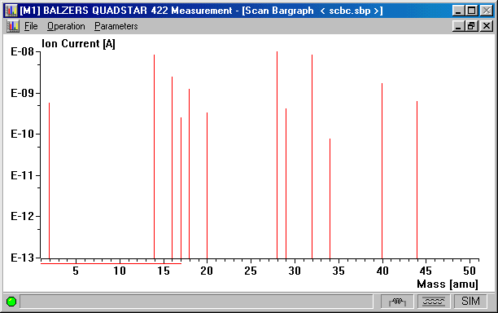
Data acquisition modes - Scan Bargraph
This mode is similar to Analog but it only reports data when a mass
peak is found or in steps of 1m/e - this reduces the data for simplicity.
This mode is mainly used for scanning for unknown components.

Slide 97
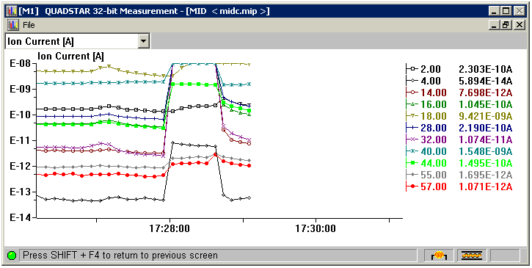
Data acquisition modes - MID
MID:
Multiple Ion
Determination
MID - here the masses to be monitored are known and the
system will only report back these points. It is the fastest mode and
very useful for trending data over time

Slide 98
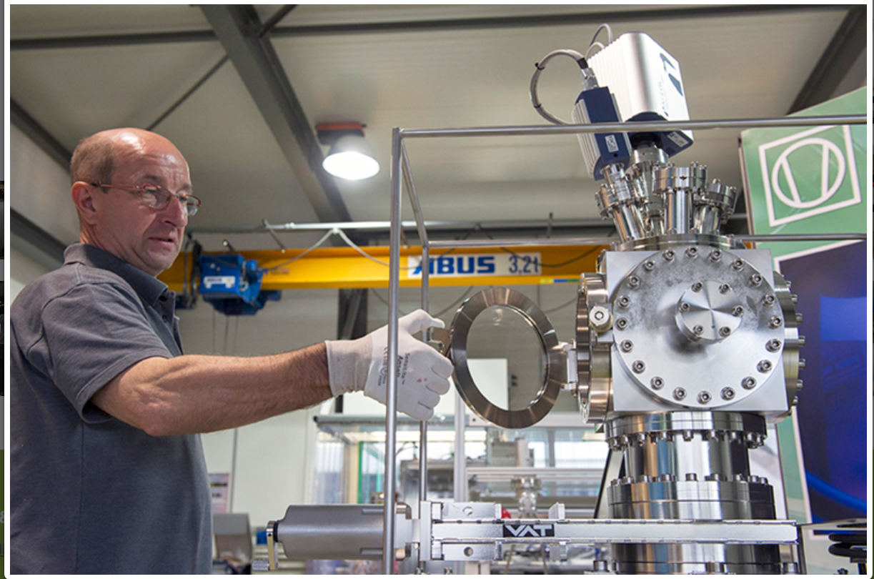

Industrial, modular systems for outgassing measurements
D & M Vacuumsystemen B.V.
https://www.dm-vacuumsystems.com/

Slide 99


Industrial, modular systems for outgassing measurements
Protocol of a calibration run

Slide 100

Industrial, modular systems for outgassing measurements
Protocol of a sample run over several hours with background data for comparison

Slide 101


Industrial, modular systems for outgassing measurements
Pfeiffer Vacuum
https://www.pfeiffer-vacuum.com/global/de/products/systems/residual-gas-analysis-systems

Slide 102
Introduction into Quadrupole Mass Spectrometry
method for background reduction
commonly used technique advantage of a biased system
Electrons can impact onto the chamber
Electrons only can impact onto the anode,
walls --> electron impact desorption
if there is electron impact desorption, then only from
well defined surfaces
e
-
e
-
e
-
Emissioncurrent
e
-
Ionisation
Ions
e
-
Ionisation
Ions
about 1 mA
e
-
e
-
Filament
Filament
e
-
-
+
-
Voltages
Ioncurrent < 1e-5 mA
+90V +150V +145V

Slide 103
Introduction into Quadrupole Mass Spectrometry
“field-axis“-technique
Chassis at ground potential
e
-
Mass-Filter
e
-
Ions
Ionisation
Ions
(10eV Energy)
150eV
e
-
Energy
Filament
Voltages
electrically isolated RF-generator
+90V +150V +140V
Ions generated in the ionisation room are accelerated by a high electrical field, they move with an energy of 150 eV (in this example)
Thus the ions can cross fringing fields very easily, excellent injection conditions into the mass filter are achieved,
a high transmission and excellent mass seperation is achieved.
Inside the filter the ions travel with a well defined energy, given by the so called „field axis voltage“ (here 10 eV)

Slide 104
Spectra interpretation
Exercises

Slide 105
Spectra interpretation - exercises
Basic steps:
Look for major peaks
Check the library/key fragment ion listing
If you suspect a certain substance, look for additional typical peaks
Remember:
Molecular peaks, represent the molecular weight of the substance
Fragment peaks, represent functional groups of a sample
Atomic peaks, represent the atomic weight of the element
Isotope peaks, occur in the same abundance as they occur in nature (if not intentionally changed)

Slide 106

Air
residual gas in system

Slide 107


Slide 108
4
Helium
used for leak detection

Slide 109


Slide 110
Acetone in air
e.g. cleaning residue
43
58

Slide 111


Slide 112
31
Ethanol in air
e.g. cleaning residue
45

Slide 113


Slide 114
69
50
Carbon tetrafluoride (CF₄) in air
Etch gas
for Semi processes

Slide 115


Slide 116
36
Hydrogen Chloride (HCl) in air
e.g. Product from PVC
38
70
72
74

Slide 117


Slide 118
Sulfur hexafluoride (SF₆) in air
e.g. Tracer gas, isolation gas
127
89
108

Slide 119


Slide 120
Solvent in air
(Thinner for Rubber cement)

Slide 121


Slide 122
Solvent in air
Filling of Zippo-Lighter

Slide 123


Slide 124
Solvent in air, Solvent of Tippex (whiteout)
Linear Alkanes are characterized by CH₂ steps
41,42,43 +14
55,56,57 +14
69,70,71 +14
83,84,85....

