Slide 1
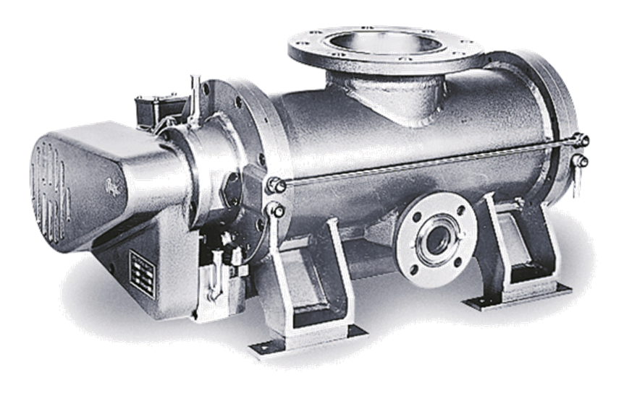
Turbomolecular pump

Slide 2
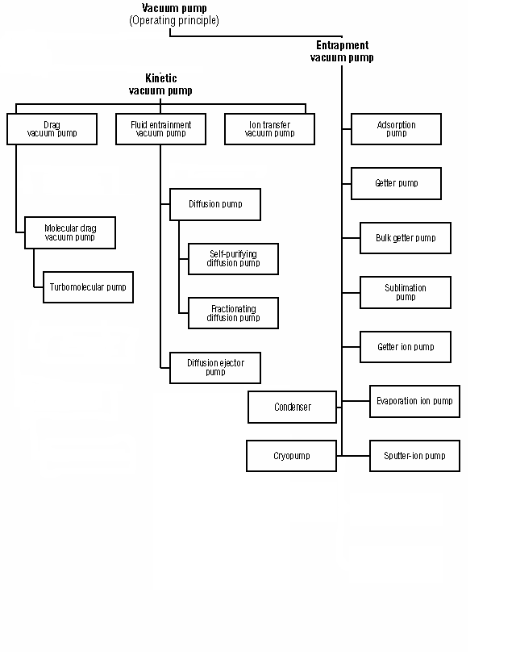
Pumps that operate in the Molecular Regime
Notes:
2

Slide 3
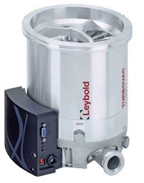
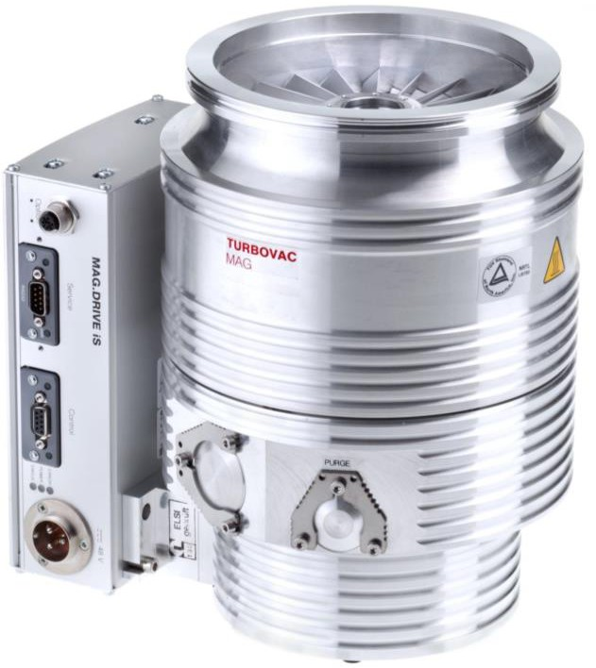

Turbomolecular Pumps – General Info
Principle of operation
Turbomolecular pumps are kinetic mechanics pumps where rotors at high rotational speed transfer momentum to particles present in vacuum system.
High and Ultra High Vacuum generation
Different models for high compression ration and high throughput
Pros
Pumping Speed
90 to 2100 l/s (325 to 7560 m³/h)
Ultimate pressure
≤ 8 x 10⁻⁸ mbar (ISO F) or ≤ 5x 10⁻¹⁰ mbar (CF)
The always need forevacuum pumps
Typical applications
Coating of optical elements, instruments and display, architectonic glasses
Analytic technology, mass spectrometry, R&D

Slide 4
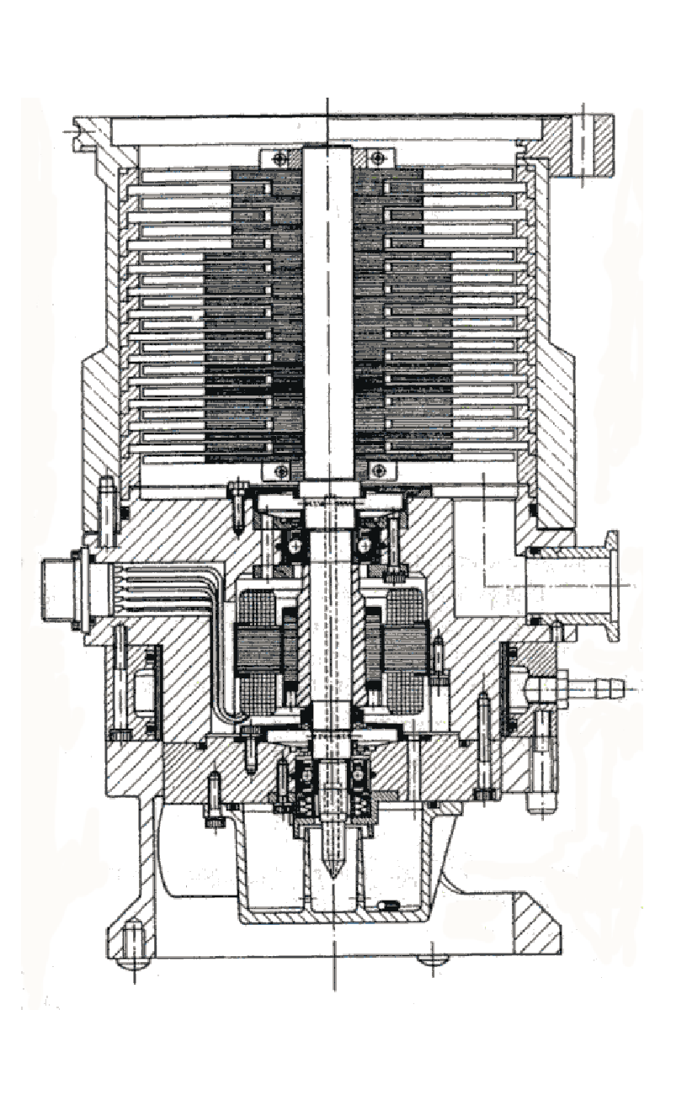
Turbomolecular Pumps
Turbopumps are axial compressors designed for pumping gasses in the molecular flow regime
Operating range 10⁻² to 10⁻¹⁰ Torr
Pumping speed 10 to 3,000 l/s
Infinite pumping capacity
Turbopumps are throughput pumps – meaning they have infinity capacity
Blade rotation peed ranges from 14,000 to 90,000 rpm – making them mechanical vulnerable
Notes:
4

Slide 5
Principle of Operation
In molecular flow, particles are not «sucked» but they move freely in the available volume;
When a gas particle hits a rotors, an impulse is transferred to the particle in direction favorable for the pumping.
Therefore, rotors need to have speed near to the mean thermal speed of the gas particles;
The mean free path of the gas particles has to be larger than the distance rotor-stator.
Static Surface
Rotating Surface

Slide 6
Theory of Turbo Pumping Effect
v
c
mean velocity
wall velocity

Slide 7
Pompe turbomolecolari: principio di funzionamento/1
Thermal speed
Impulse of the rotor blade
Stator
Impulse of the rotor blade
Notes:
7

Slide 8
Turbomolecular pump: principle of operation/1
Thermal speed
Impulse of the rotor blade
Stator
Impulse of the rotor blade
Adsorption, sojourn, desorption
Notes:
8

Slide 9
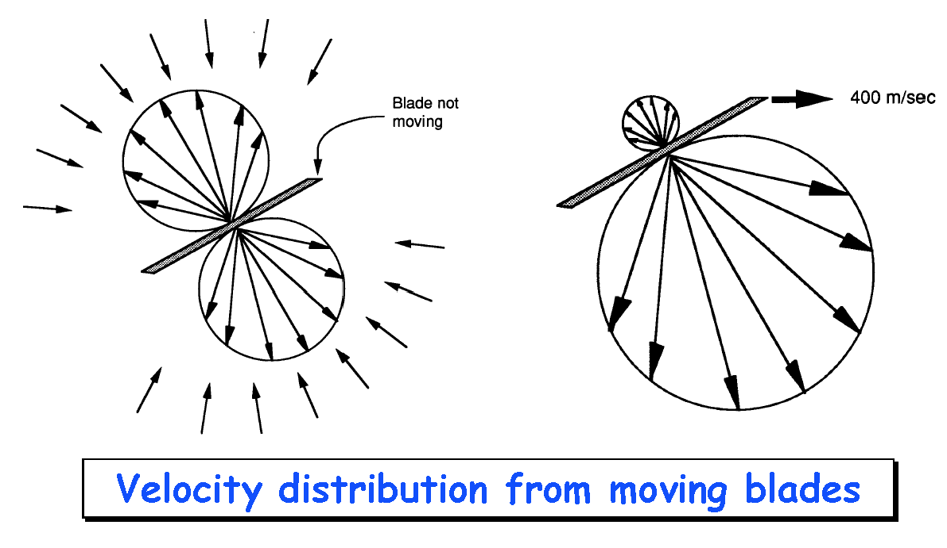
Turbomolecular pump: principle of operation /3
Notes:
9

Slide 10
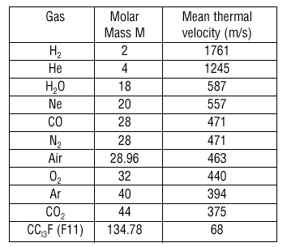
Turbomolecular pump: principle of operation /4
The pumping effect (composition of speed) is significant only when the peripheral speed of the blades is of the
Balde speed is of the same order of magnitude as the average speed of the molecules that are to be pumped (at room temperature)
Notes:
10

Slide 11
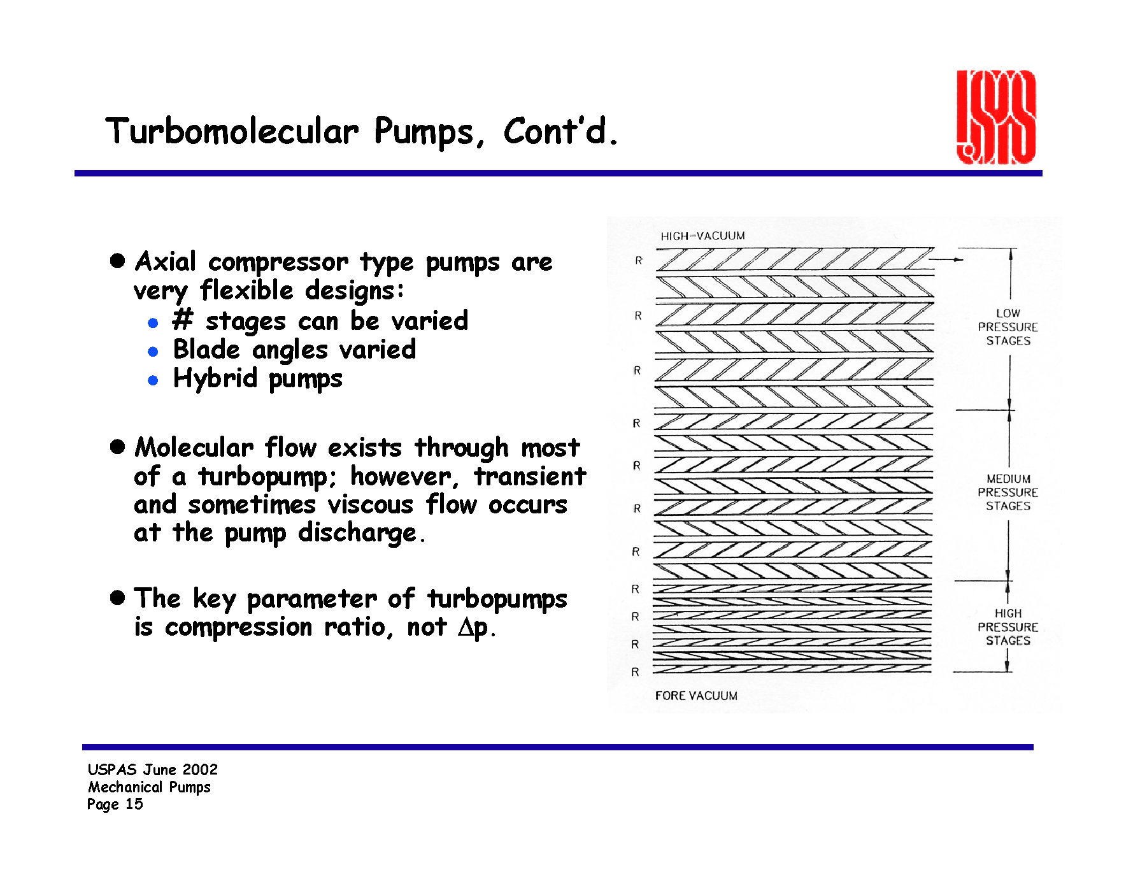
Turbomolecular pump: principle of operation/5
Axial compressor type pumps are very flexible design
  # stages can be varied
  Blade angles varied
  Hybrid pumps
Molecular flow exists through most of the a turbopump; however, transient and sometimes viscous flow occurs at the pump discharge
The key parameter of turbopumps is compression ratio, not Δp
Notes:
11

Slide 12
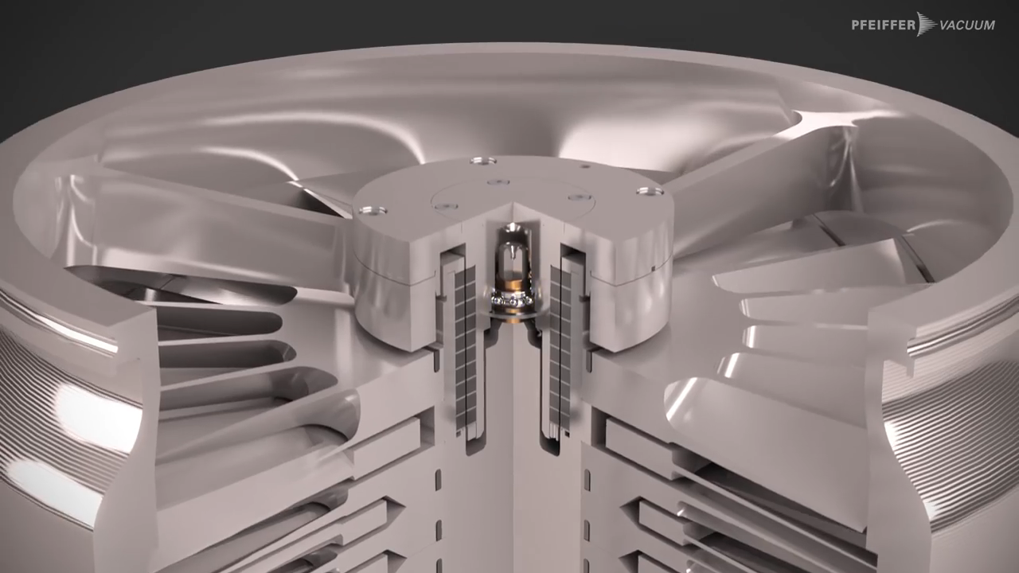
Principle of operation

Slide 13
Turbomolecular pump: key parameters
Important parameters to consider:
  Pumping speed for different gases;
  Maximum throughput for different gases;
  Compression ratio (capability to maintain a given pressure difference between inlet and outlet);
  Maximum counter pressure;
  Final pressure.
Notes:
13

Slide 14
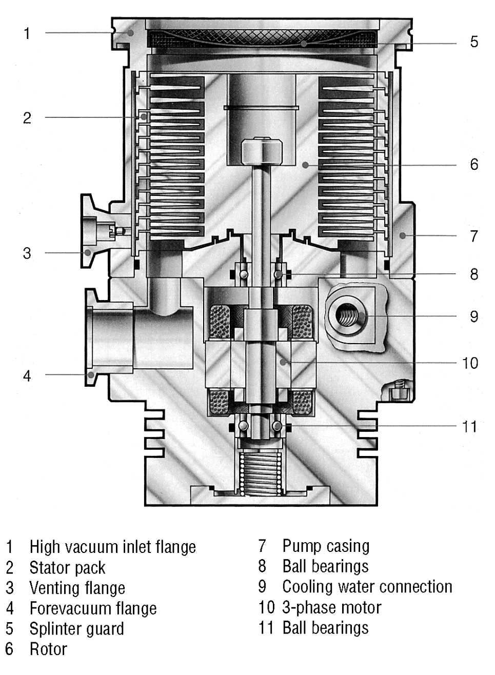
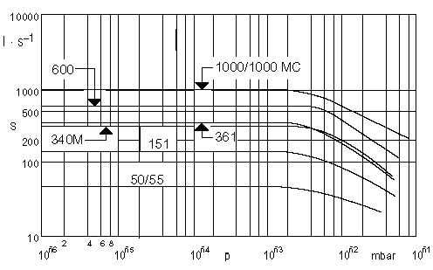
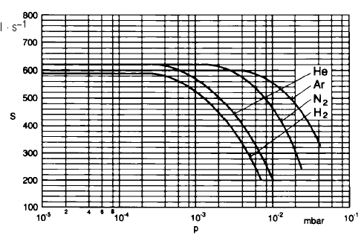
Turbomolecular Pumps
Notes:
14

Slide 15
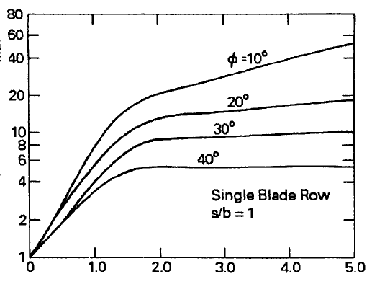
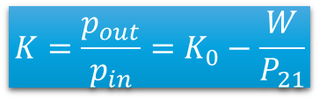
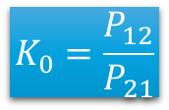
Compression ratio (1/3)
Probability of inlet into the turbo stage
$$K=\frac{p_{out}}{p_{in}}=K_{0}−\frac{W}{P_{21}}$$
Compression ratio
Compression ratio with zero inlet flow
$$K_{0}=\frac{P_{12}}{P_{21}}$$
Throughput
Using a Monte Carlo method, Kruger & Shapiro calculated K0 as function of different parameters
K₀
v_{b} / c_{w}

Slide 16




Compression ratio(2/3)
Exponential dependence on $√M$
$$K_{0}\sim Exp\left(\frac{v_{b}}{c_{w}}\right)$$
K₀
$$K_{0}\sim Exp\left(\frac{v_{b}}{\sqrt{\frac{2RT}{M}}}\right)$$
v_{b} / c_{w}
$$K_{0}\sim Exp\left(\sqrt{M}\right)$$
Pompa TURBOVAC SL 80 C

Slide 17
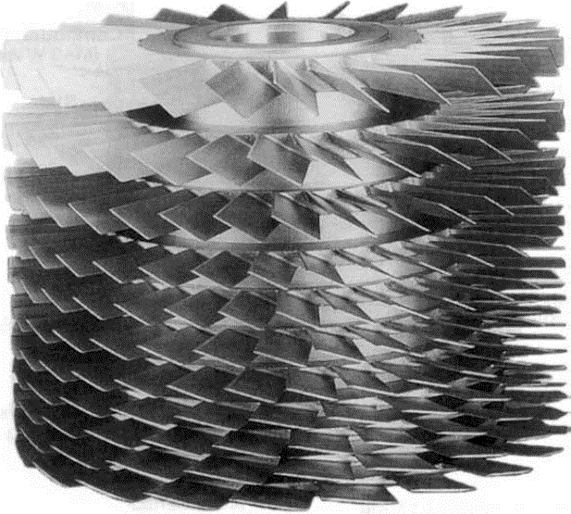
Compression ratio(3/3)
Gas Inlet (Vacuum side)
Initial stages with large angle blades to increase pumping speed
K₀
Final stages with limited angle blades to increase compression ratio
v_{b} / c_{w}
Gas Outlet

Slide 18
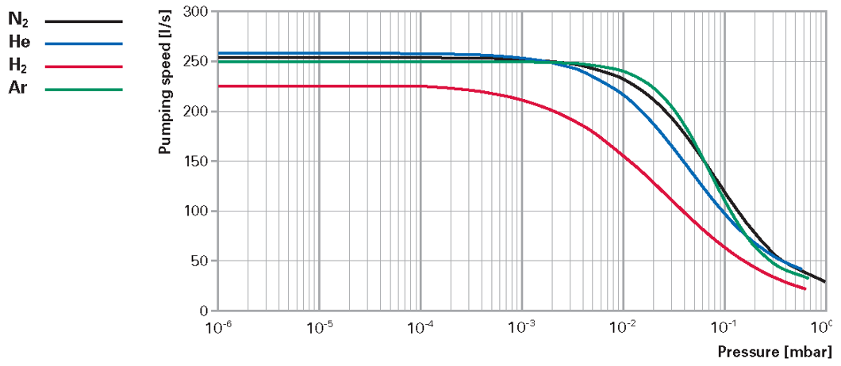
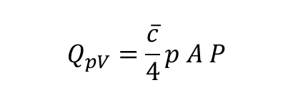
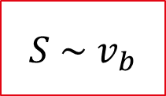

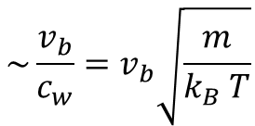
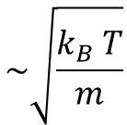
Pumping Speed
Behaviour from geometrical consideration
$$Q_{pV}=\frac{\overline{c}}{4}p A P$$
Flusso attraverso un area
$$\sim \sqrt{\frac{k_{B} T}{m}}$$
$$\sim \frac{v_{b}}{c_{w}}=v_{b}\sqrt{\frac{m}{k_{B} T}}$$
$$S \sim v_{b}$$
Velocità di pompaggio
$$S=\frac{\overline{c}}{4}A P_{Ho}$$
Pumping speed constant in a large range
Pumping speed decreases in the rasniion region where the flow changes from molecular to transient

Slide 19
Main components
Inlet net
High Vacuum
Flange
Rotation speed in range 14’000 a 90’000 rpm
Precision bearings and axis balance.
Case resistant to rotor crash. Carefull in supporting the pump.
Holweck stage used also to separate bearing with labyrinths (see later slide).
Ball bearings may be:
  Oil lubricated
  Grease lubricated
Possibility for a magnetic suspended rotor
Hybrid configurations available
Water cooling only for large loads, otherwise air cooling is sufficient
Stator
Rotor
Venting Valve
Case
Ball Bearings
ForeVacuum Flange
Water Inlet
Ball Bearings
Motore a 3 fasi
TURBOVAC 151

Slide 20

Ball Bearings and Magnetic Suspension
Stainless ball bearing, oil lubricated
1,2: Radial electromagnets
3: Radial sensors
4: Axial electromagnets
5: Axial sensor
6: Current amplifier
7: Control Unit
8: Rotor
Good compatibility with particles due to flowing lubricants
Vertical installation only possibility
Low maintenance
Stainless ball bearing, grease lubricated
Magnetic Control
Installation with any orientation
No friction, no maintenance
Compatible with moving chart
Completely hydrocarbon free
Infinite lubrication
Low vibrations
Not available for large pumps
Installation with any orientation
Attention to heating up

Slide 21
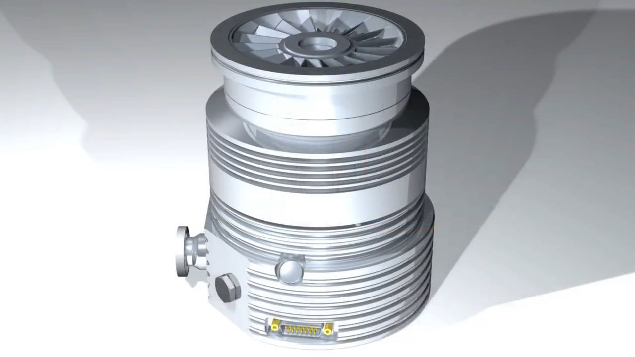
Mechanical and Magnetic Bearings

Slide 22
Further considerations
For magnetic suspended rotors
  In case of power supply deficiency, the pump acts as a generator and slowly stop the rotor on emergency bearings.
  In an abrupt venting event, the motor act as a dumper and the rotor stops on emergency bearings
  In case of an unforeseen cable removal, the motor suddenly stops, and the pump stops immediately.
To reach the ultimate pressure <5x10⁻¹⁰ mbar it is neccessary to bake the pump and use metal seals.
Corrosive gas pumping requires special attention:
  Injection of purging gases
  Protective coating
  Heating of the low vacuum region

Slide 23
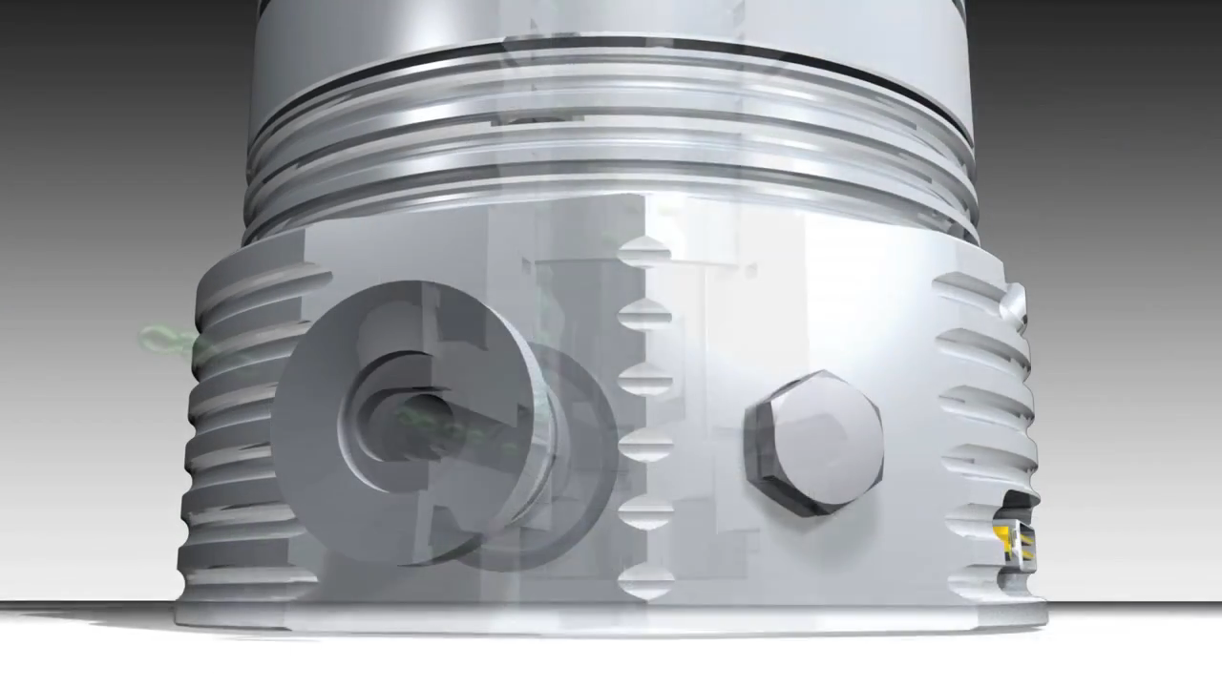
Purging gas usage

Slide 24
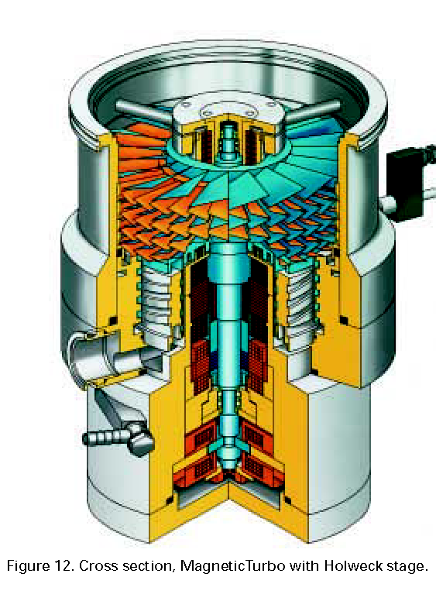
Hybrid Turbomolecular pump magnetic levitated rotor
Magnetic Bearings
Holweck Stage
Notes:
24

Slide 25



Holweck Stage
Gas particles are adsorbed on rotating surfaces. The moving surface push the gas particles in a long spiral channel.
The wall surface adds to the speed distribution of the gas particles, creating a net pumping effect.
Throughput depends on the inverse of the rotor to stator distance (gap 0.3-0.5 mm).
Stable material required for standing the centrifugal forces and temperature variations. Typical is a carbon fiber cylinder.
$K_{n}=0.5$ transition region near to molecular flow
$$λ=K_{n}∙gap \sim 0.25 mm$$
$λ p=6.67 {∙10}^{−3}$cm mbar (air at 20°C)
$p \sim 0.27$mbar
After a x100 the stage is not more effective

Slide 26
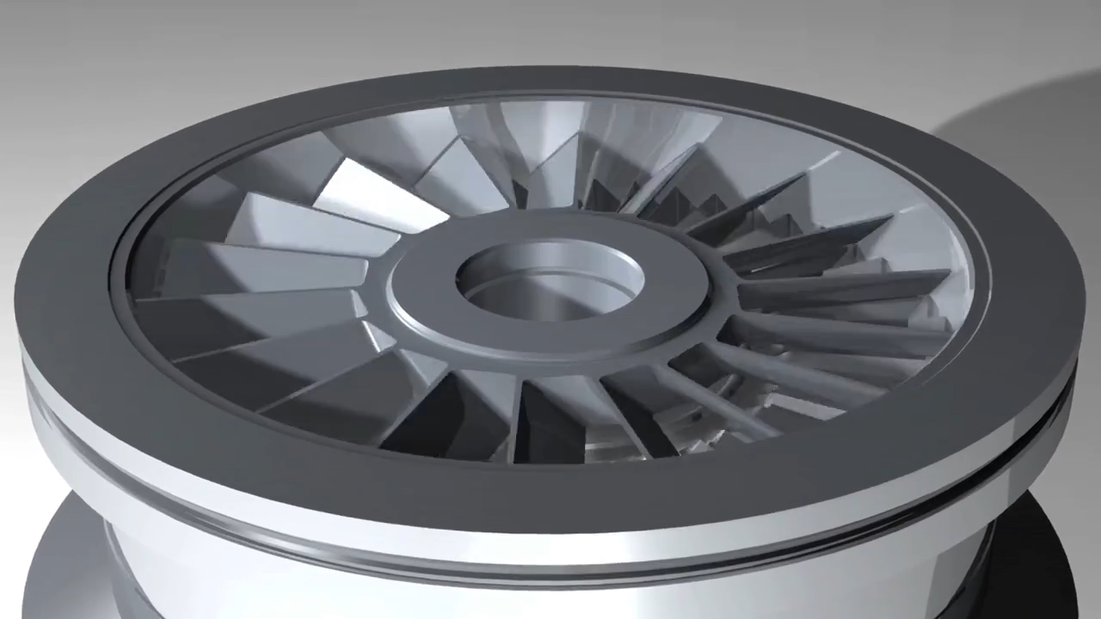
Holweck Stage

Slide 27
Turbomolecular pump with magnetic suspension
Active 1-axis
magnetic bearing system
Active 5-axis
magnetic bearing system
Notes:
27

Slide 28
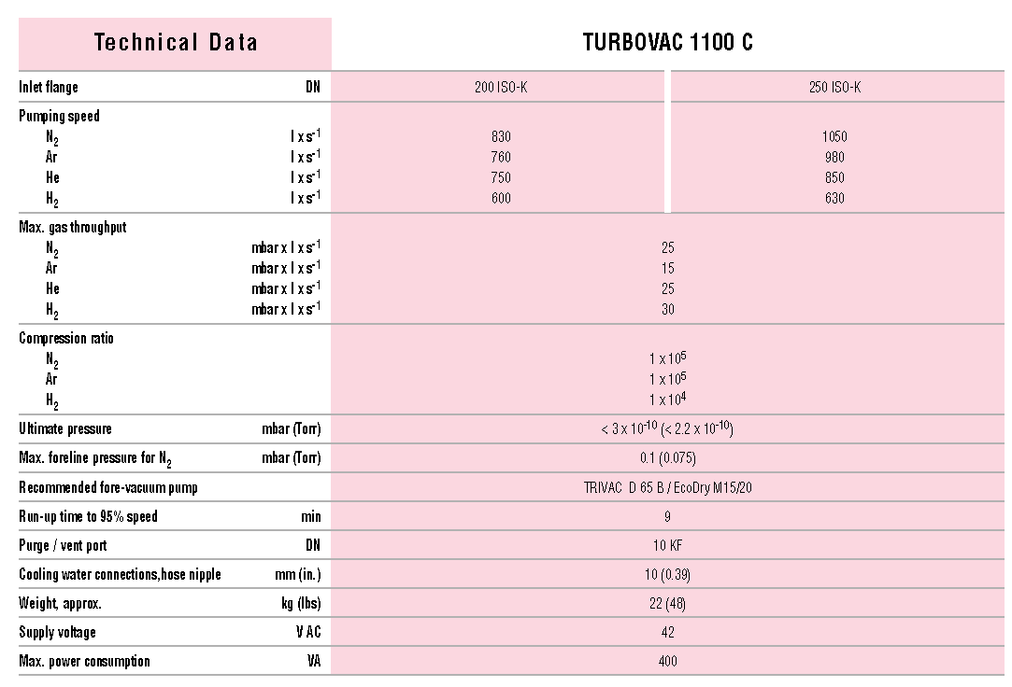

Turbo pumps: technical specifications
$$k_{0}∝ e^{\sqrt{M}}$$
Notes:
28

Slide 29
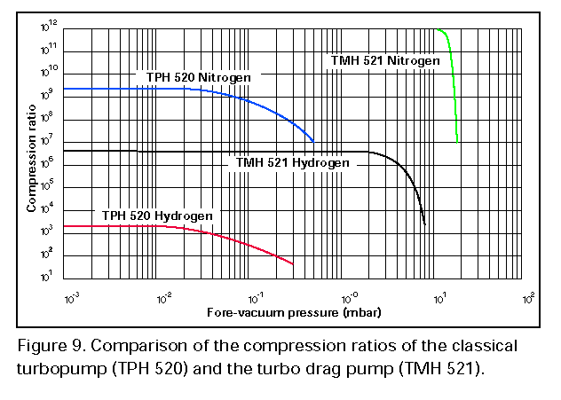
Turbo pumps: compression ratio
Notes:
29

Slide 30
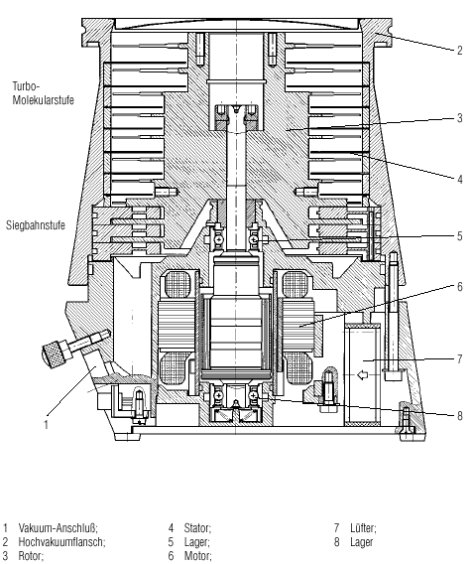
Turbo pumps: wide range /1
Horizontal
spyral
Notes:
30

Slide 31
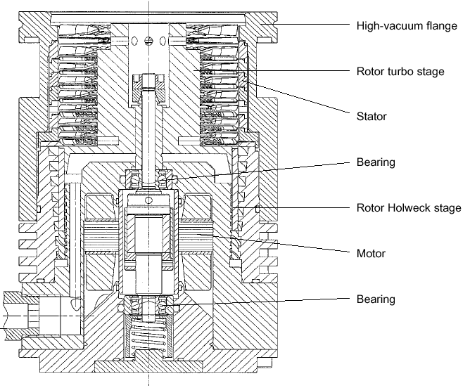
Turbo pumps: wide range/2
Vertical
Spyral
Notes:
31

Slide 32
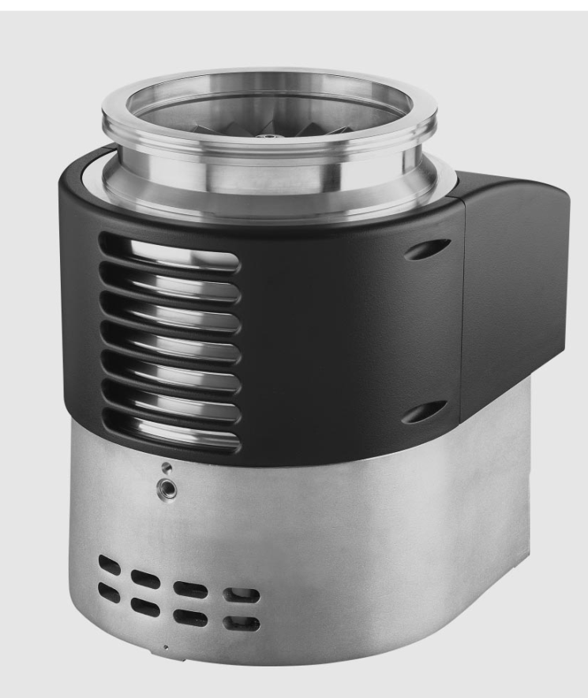
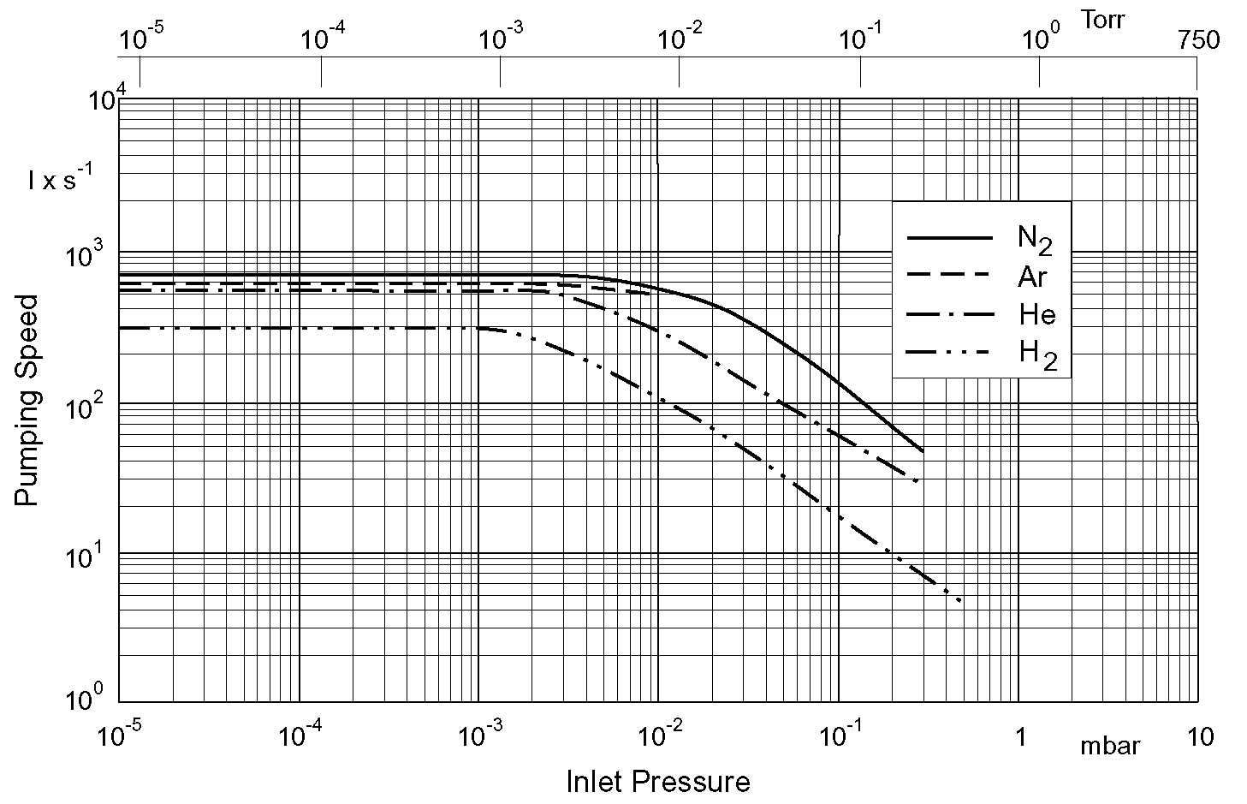
Turbo pump wide range: technical specifications
Notes:
32

Slide 33
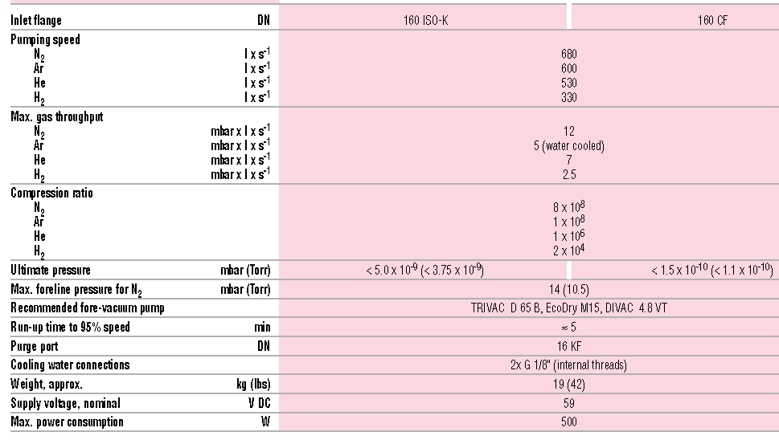
Turbo pump wide range: technical specifications
Notes:
33

Slide 34
Turbo pumps: technical specifications
<
Notes:
34

Slide 35
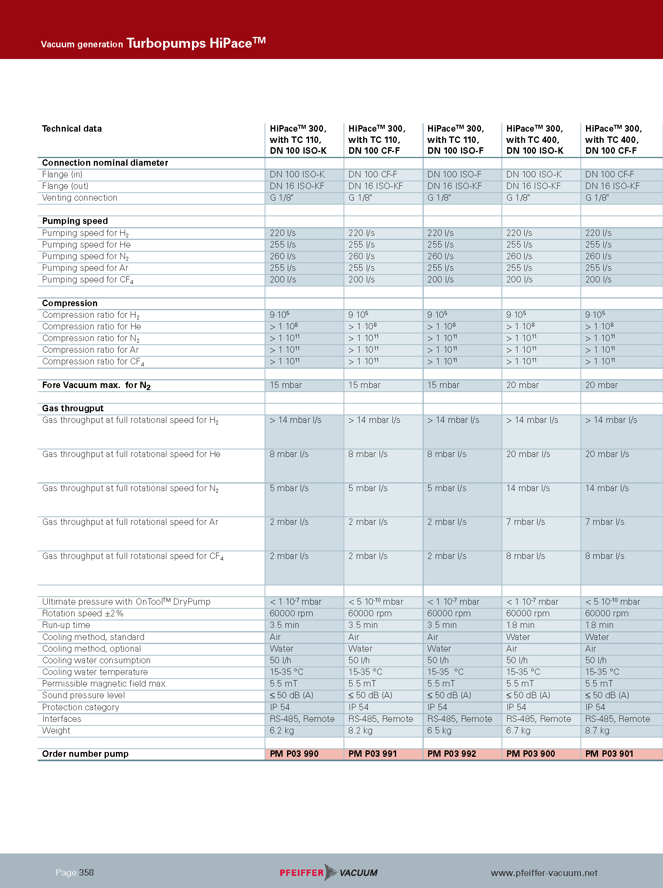
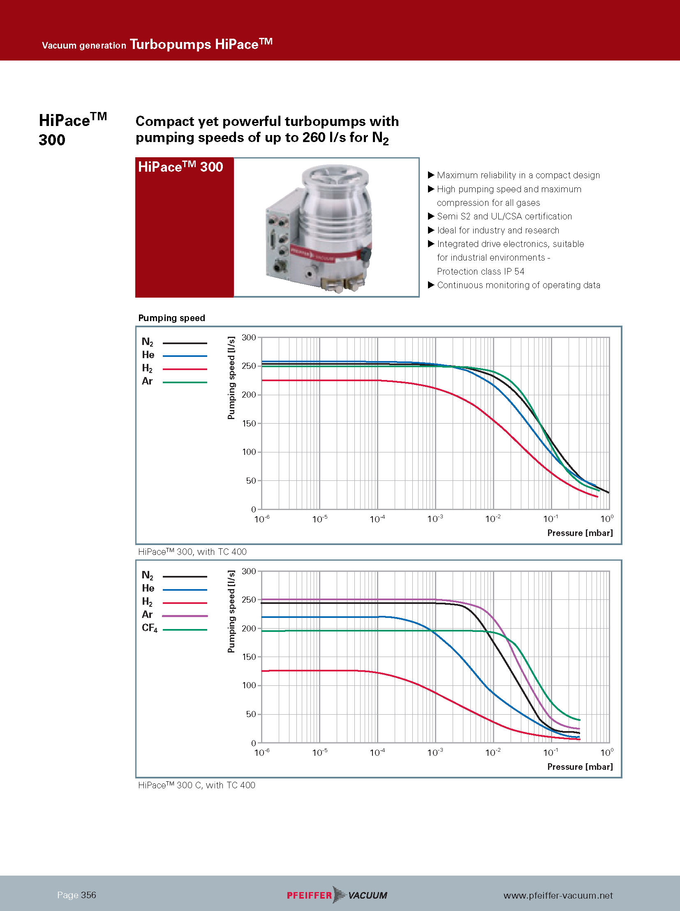
Turbo pumps: technical specifications
Notes:
35

Slide 36
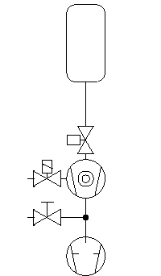
Turbo pumps: typical system
Vacuum Chamber
High Vacuum Valve
Turbo Venting Valve
TMP (TurboMolecular Pump)
Leak Detector Valve
Primary Pump
Notes:
36

Slide 37
High Vacuum Pumps (Diffusion and TMP) : Primary Pump Evaluation
Q
= Q [mbar l s⁻¹]
Q
p _{A}
Q = p _{A} * S_{eff}
S_{eff}
p _{A} * S_{eff}
S _{V} =
Q
p _{V}
p _{V}
Q = p _{V} * S_{V}
S _{V}
Notes:
37

Slide 38
High Vacuum Pumps (Diffusion and TMP) : Primary Pump Evaluation
Fore vacuum pumping speed is calculated with
the following formula
= Q [mbar l s⁻¹]
p _{A} * S_{eff}
S _{V} =
p _{V}
In a nutshell, we need to guarantee to the high vacuum pump a pressure on the outlet enough low also at the maximum throughput of the high vacuum pump.
Notes:
38

Slide 39
High Vacuum Pumps (Diffusion and TMP) : Primary Pump Evaluation
Gases or vapors pumped by the high vacuum pump MUST be transported also by the forevacuum pump that operates at higher pressures.
It is MANDATORY NOT overcome the maximum pressure on the high vacuum pump.
For the turbo pump it is possible an overload of the motor or its overheating that induces shutdon of the pump.
If Q is the effective quantity of gas or vapor that the high vacuum pumps removes at the effective pumping speed S_{eff} at pressure p_{a}, the throughput of the primary pump, with effective pumping speed S_{v} at pressur p_{v} is equal to Q (nothing is created, nothing is destroyed), Q is conserved! Then it holds
Q = p_{a} × S_{eff} = p_{v} × S_{v}
Notes:
39

Slide 40
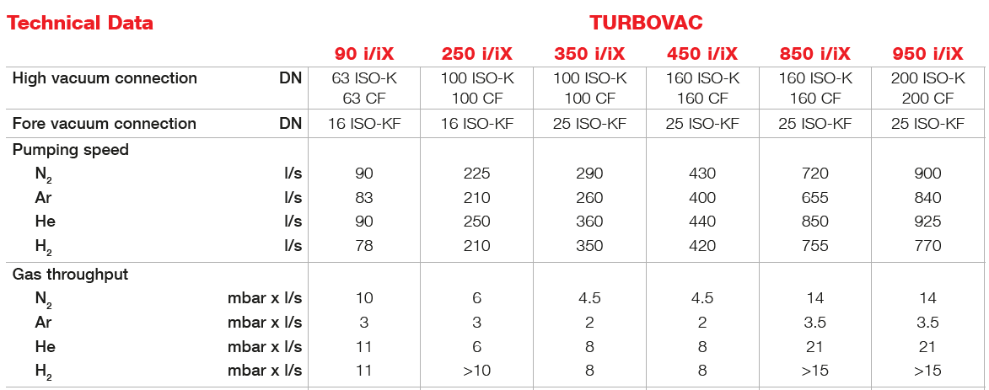
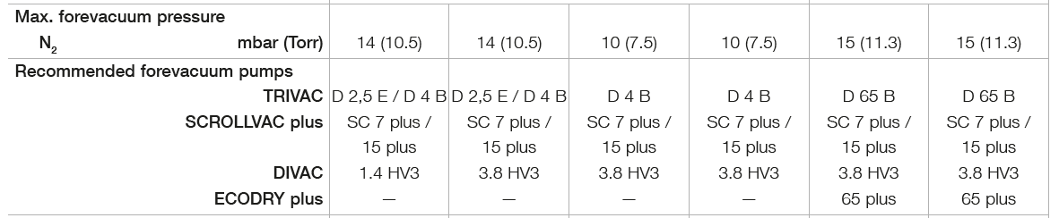
Forevacuum pump dimensioning (1/2)
Vacuum
Chamber
High Vacuum
Valve
Turbo Venting
Valve
TMP
Leak Detector
Valve
Primary
Pump

Slide 41
Forevacuum pump dimensioning (1/2)
Maximum Throghput
Q_{pV} = 25 mbar lt/s @ P_{In} = 0.1 mbar
TRIVAC D 16 B P_{Fore} = 2 mbar
Reduced Throughput
TRIVAC D 8 B P_{Fore} = 10⁻¹ mbar
Q_{pV} = 7.16x10⁻² mbar lt/s @ P_{In} = 10⁻⁴ mbar

Slide 42
Turbomolecular pump: characteristics
High cost
Mechanics critical
No risk for venting
It operates in any position
Need for a forevacuum pump
S_{He} high
Low Compression Ratio for low light gases
Infinite capacity
Between two service life> 10 000 hours
There is NO giant TMP
(max 3000 l/s)
Water: not always necessary
Hydrocarbon contamination: no, if properly used
Final vacuum: 10⁻¹⁰ mbar
Vibration: low, really low for magnetic suspended
Notes:
42

