Slide 1
Cryopumps
Vapor pressure
Evaporation and condensation
Thermal desorption and sojourn time
Sticking probability
Adsorption isotherms
Basic structure of a cryopump
Equilibrium pressure of «trapped» gases
GM refrigerator: no LHe needed
Main commercial cryopump parmeters
Cryopump operation
Cryopump regeneration

Slide 2
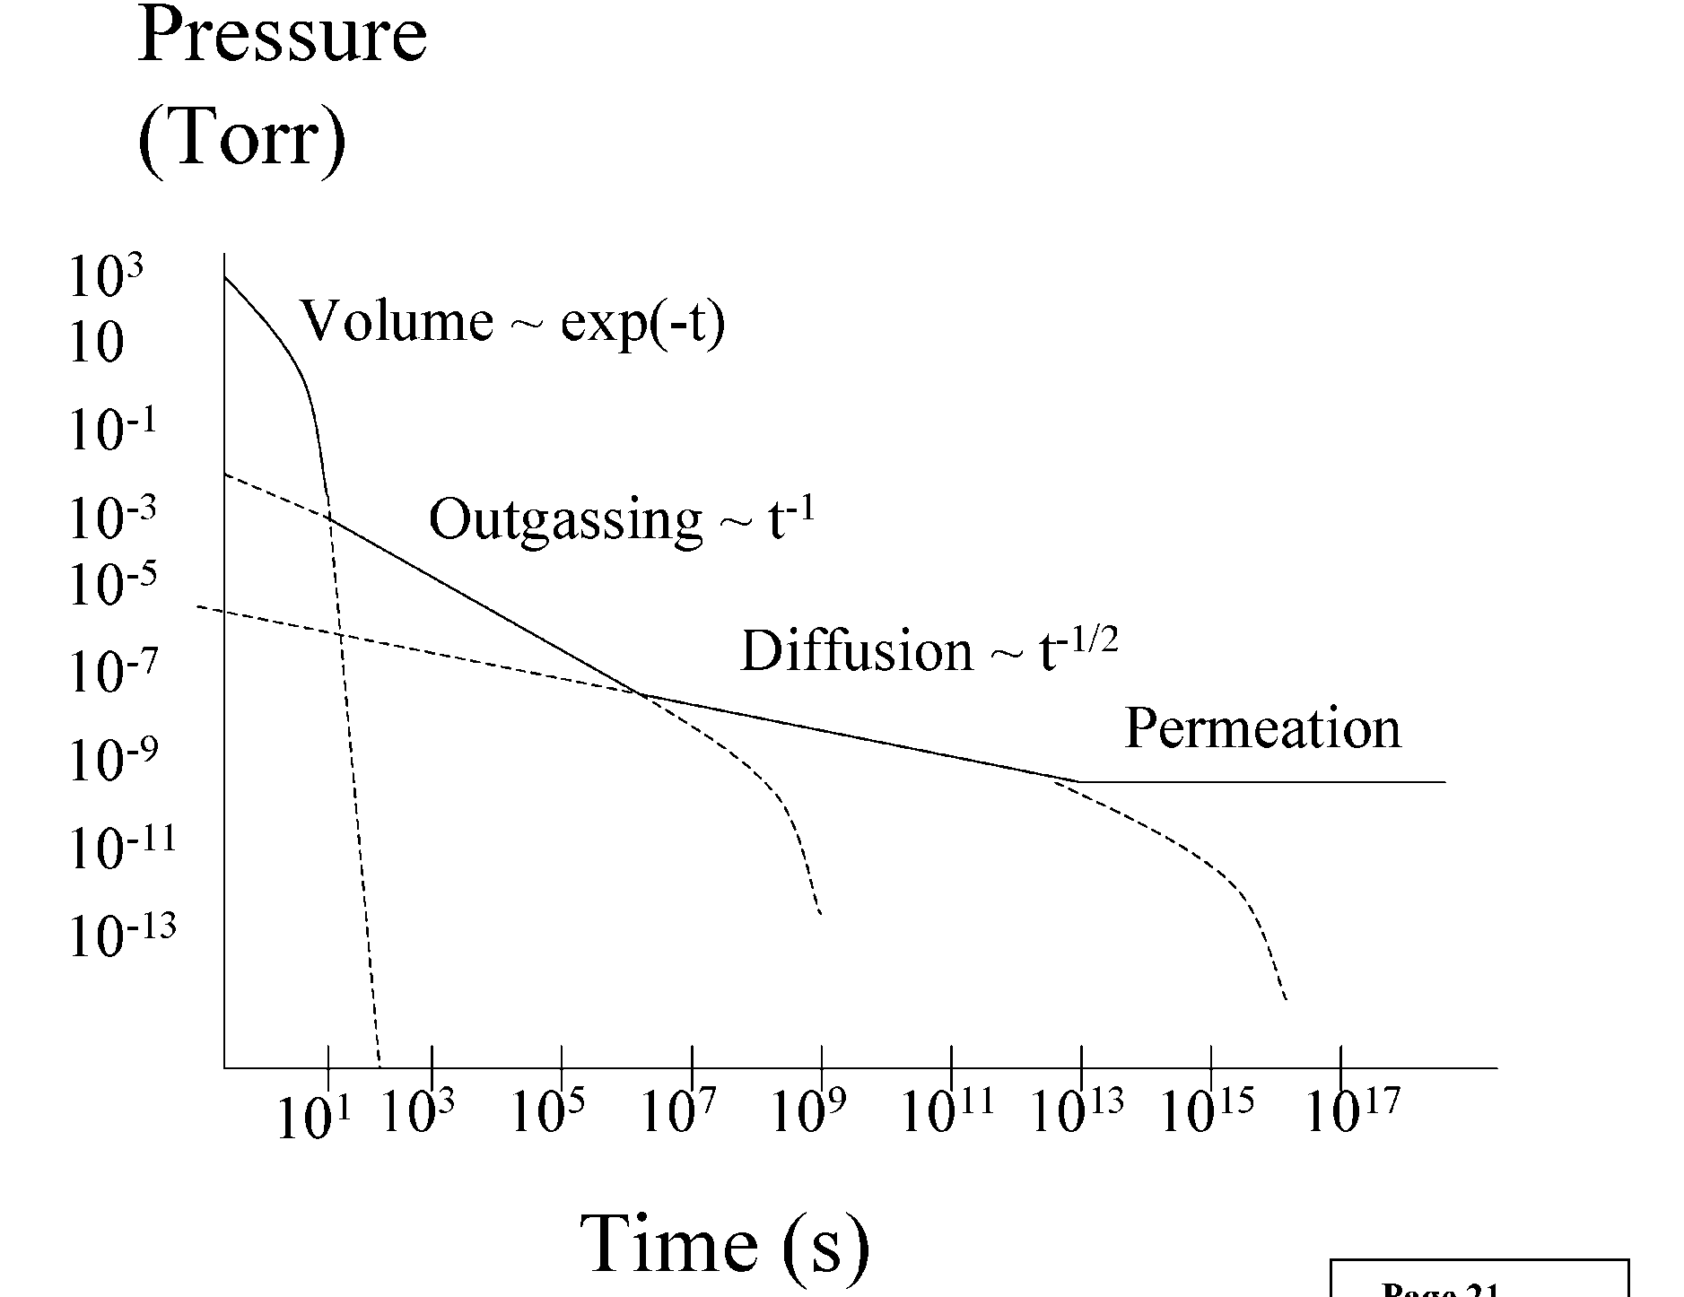
Pressure vs. Time
Fm Vacuum Techonolgy II P.D. Rack

Slide 3
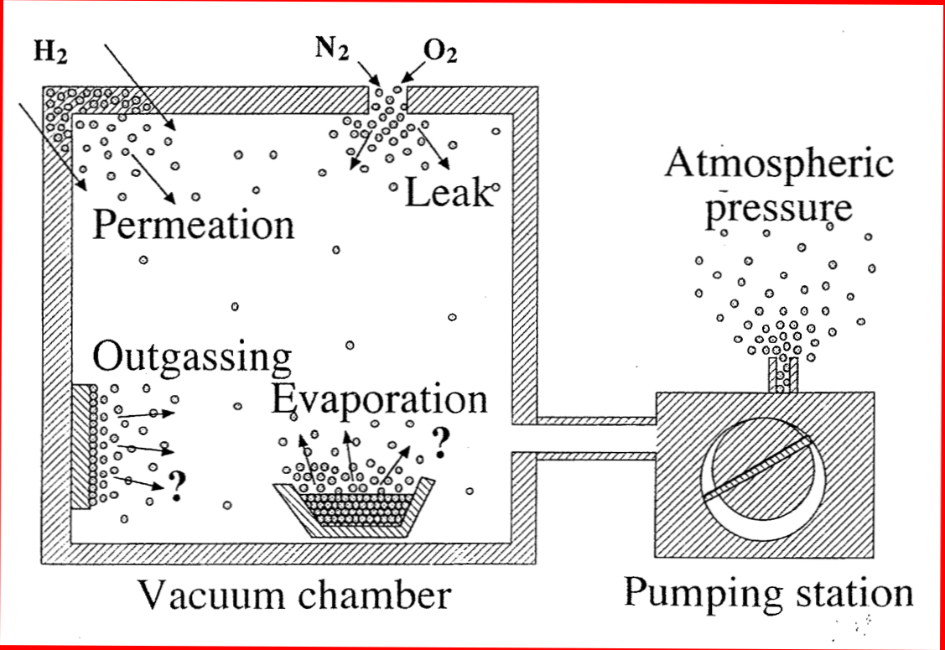
Equilibrium condition
Q
J. P. Langeron,
IUVSTA 1996

Slide 4
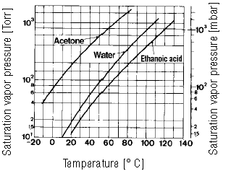
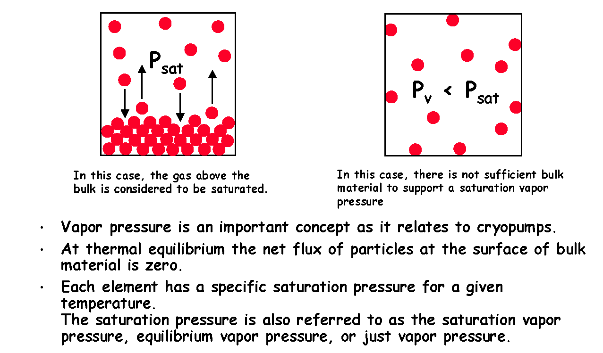
Evaporation and equilibrium vapor pressure
Equilibrium vapor pressure: is the pressure exerted by a vapor in thermodynamic equilibrium with its condensed phase in a close system at a certain temperature.
It corresponds to the equilibrium between the number of evaporated and condensed molecules.
Saturated
Not saturated

Slide 5
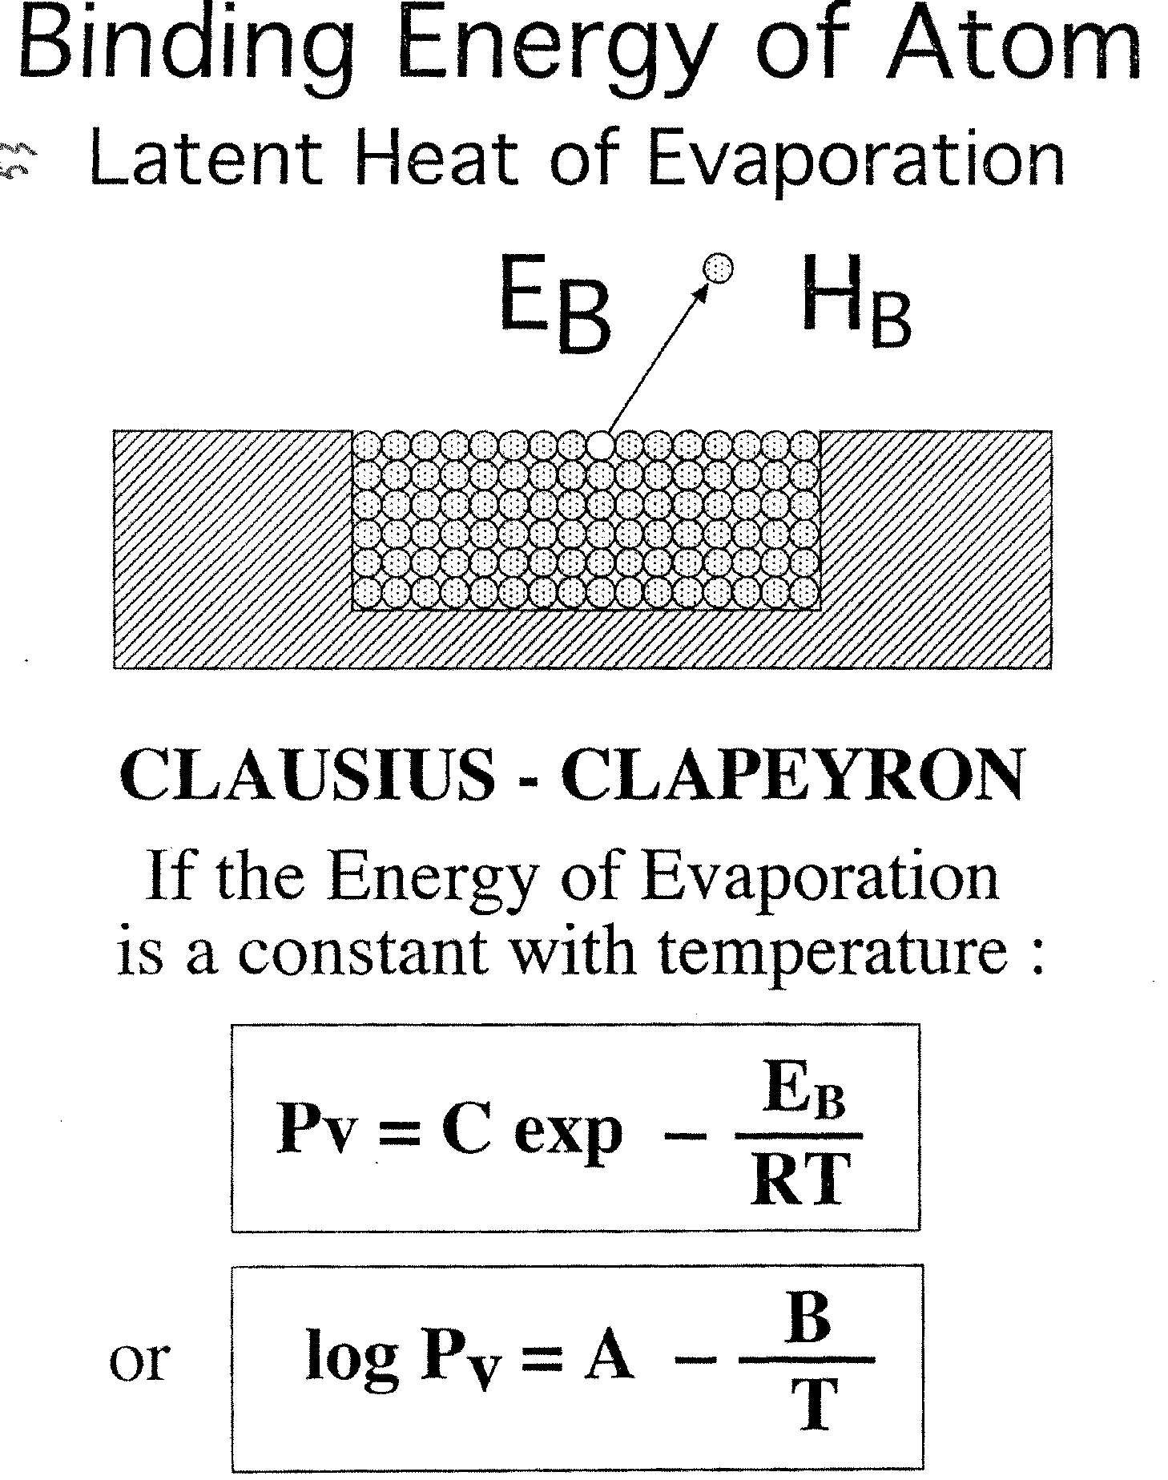
Latent heat of evaporation

Slide 6
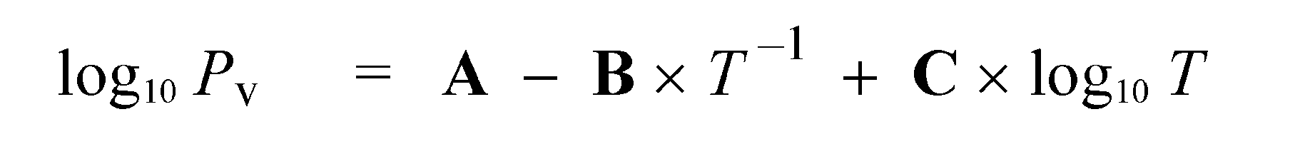
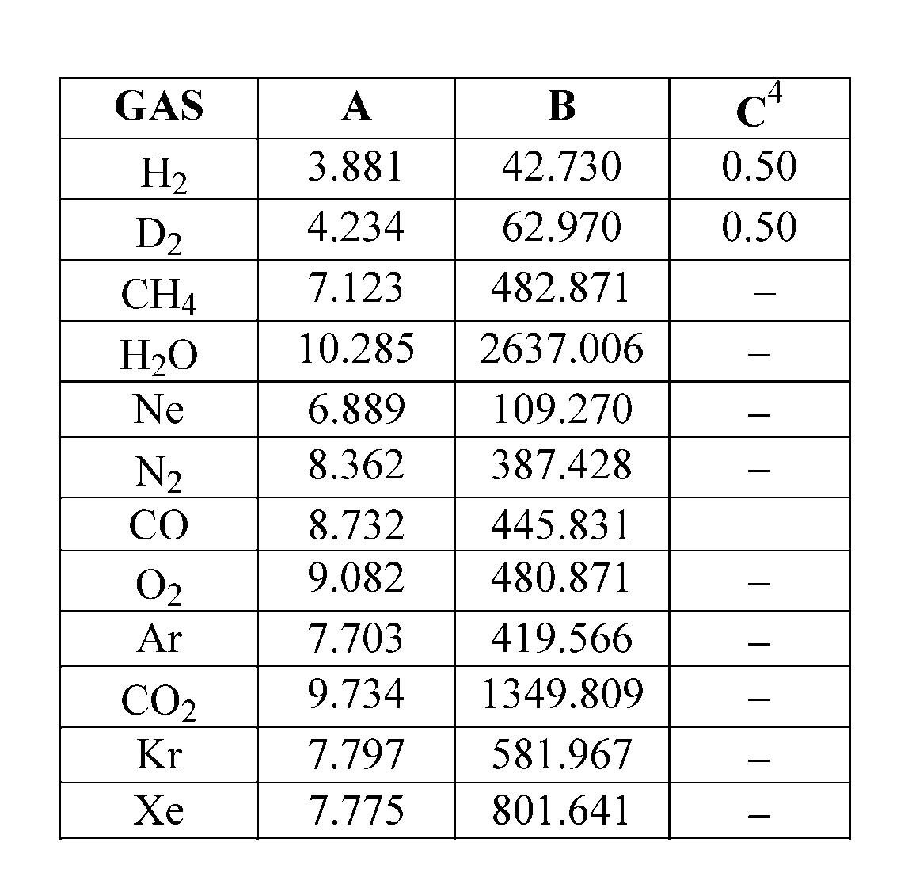
Vapor pressure
p in Torr (!)

Slide 7
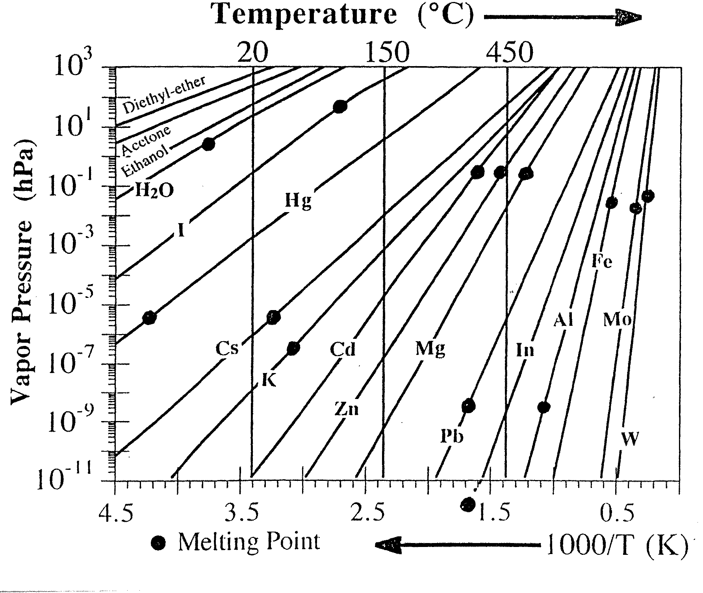
Vapour pressure vs. temperature

Slide 8
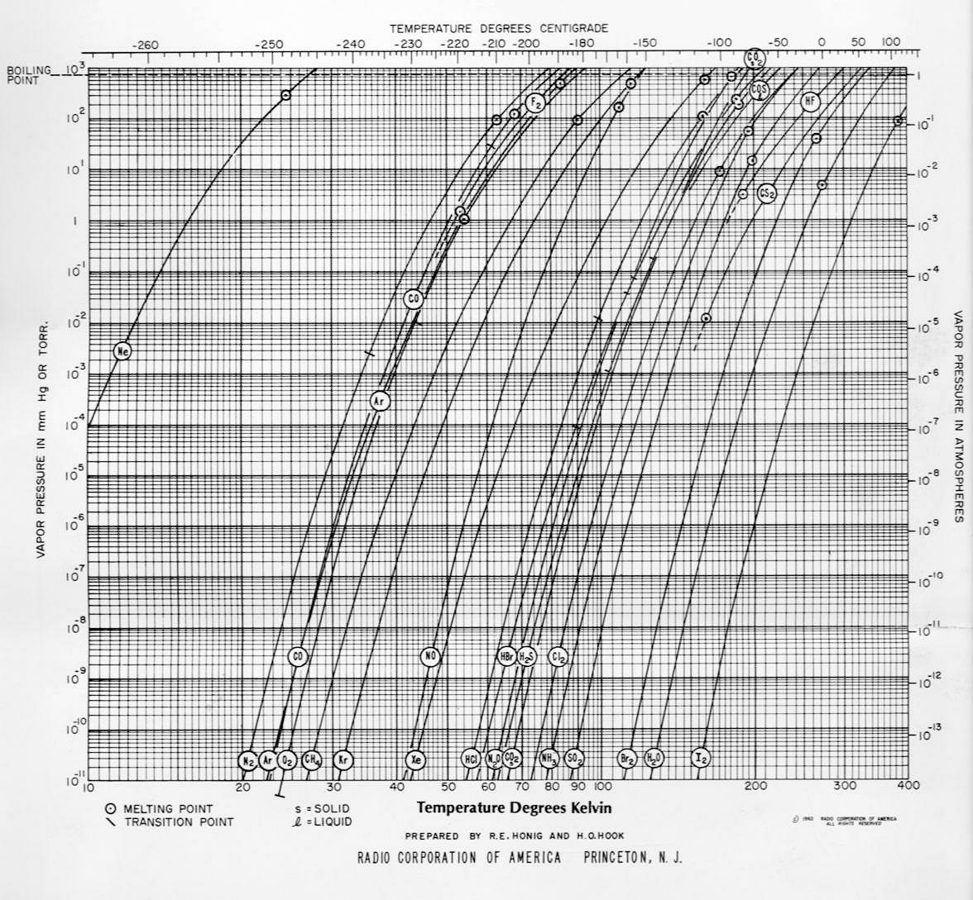
Evaporation: vapor pressure of elements
RCA Charts
See for instance:
https://old.mcallister.com/vacuum.html

Slide 9
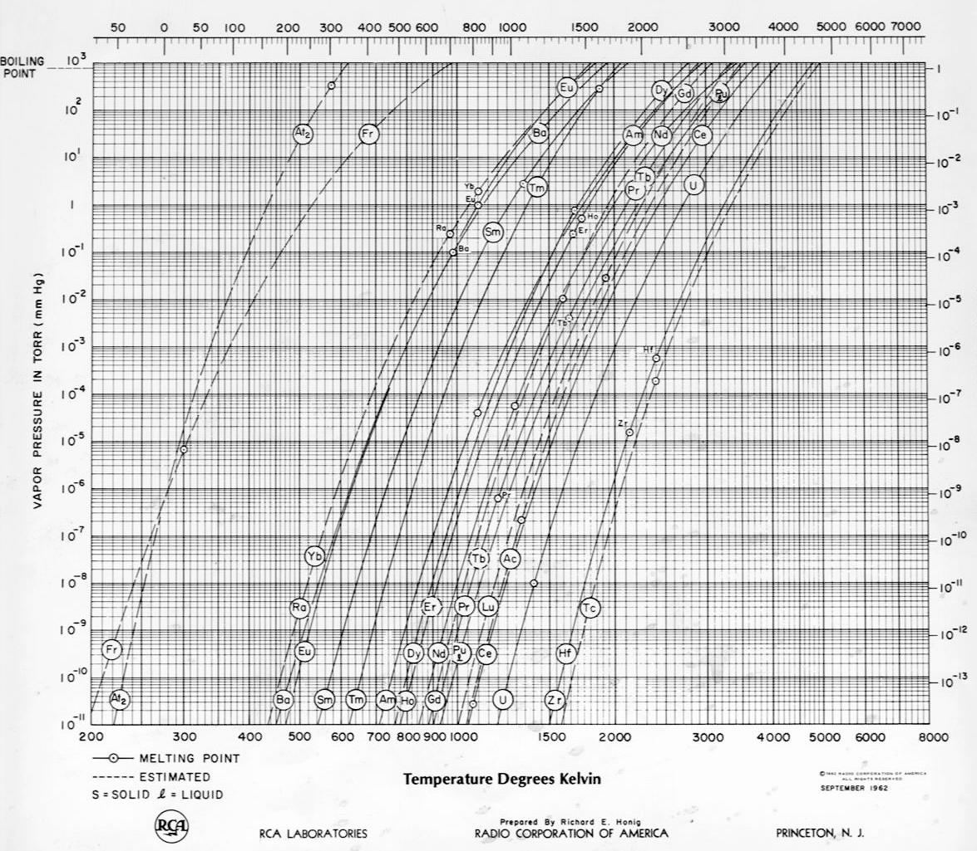
Evaporation: vapor pressure of elements
T in °C

Slide 10
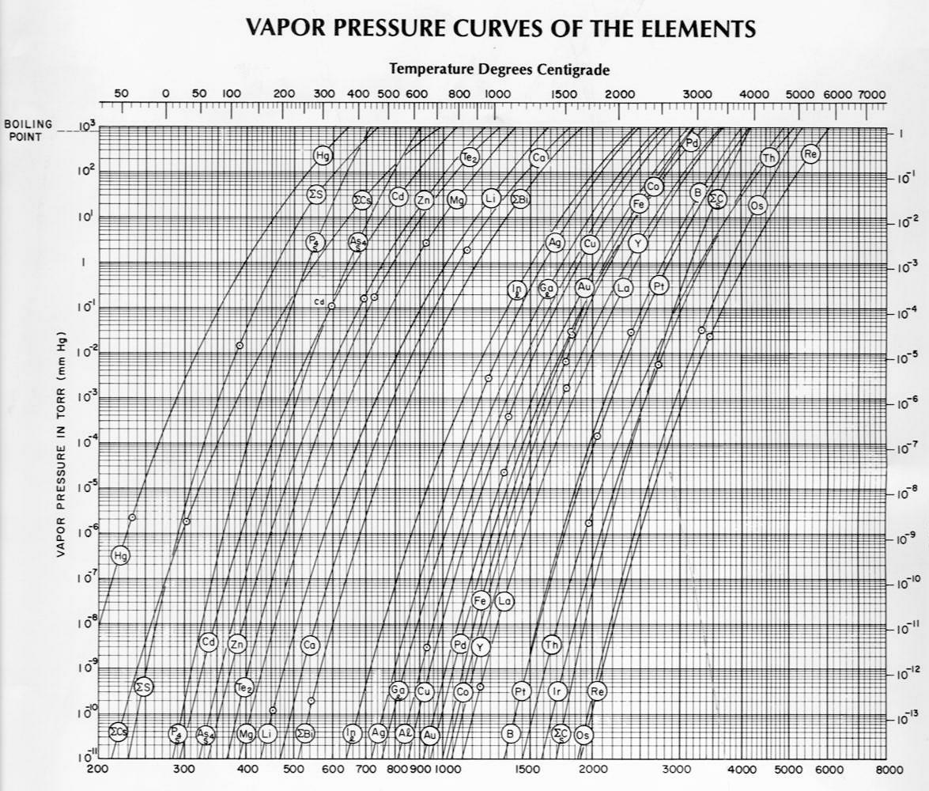
Evaporation: vapor pressure of elements
T in K

Slide 11
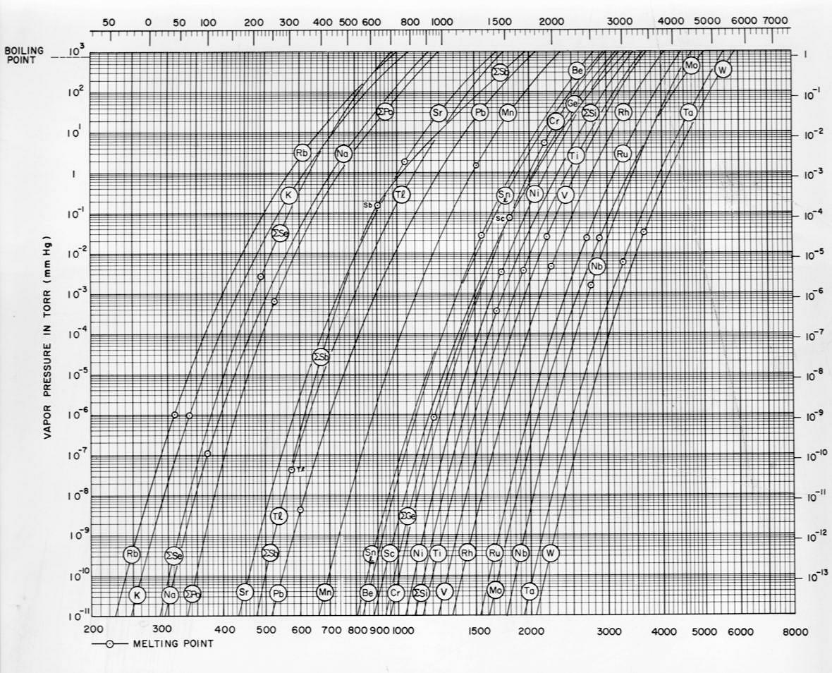
Evaporation: vapor pressure of elements
T in °C
T in K

Slide 12
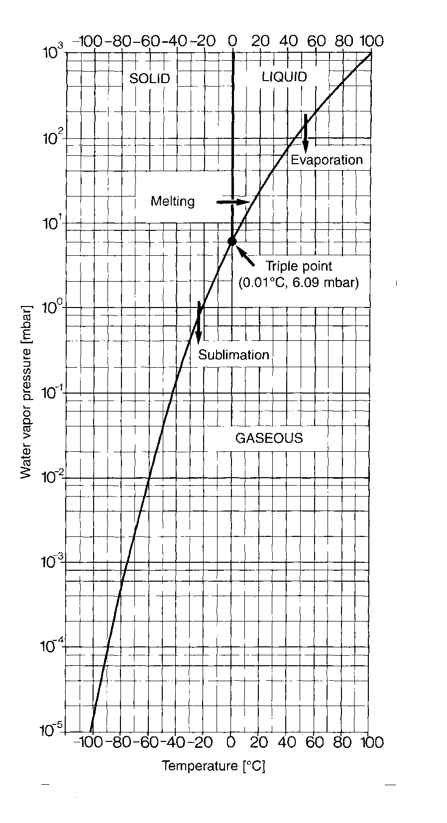
Phase diagram for water
20 mbar
H₂O

Slide 13
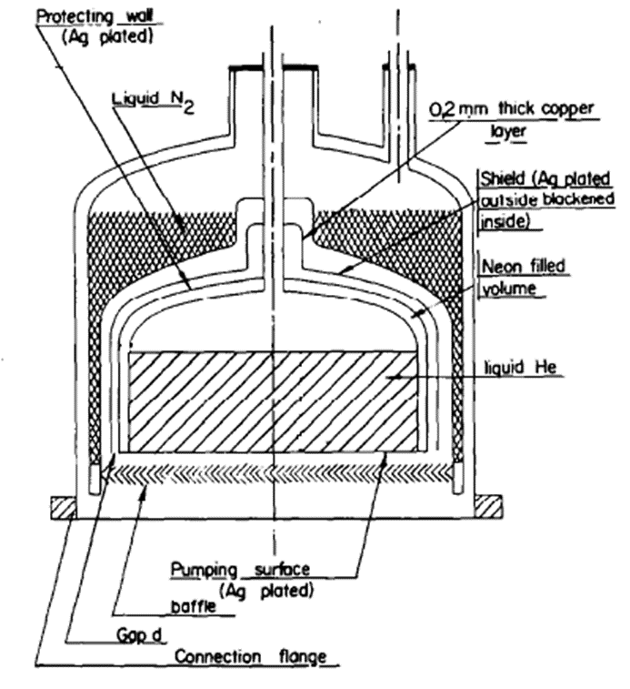

Cryopumps
Notes:
13

Slide 14
History of cryopumping
Cryopumping goes parallel to cryogenics
Gas liquefaction:
  Liquid nitrogen, 77.3 K, Dewar, 1874
  Liquid hydrogen 20.4 K, Dewar, 1898
  Liquid helium, 4.2 K, Kammerlingh Onnes, 1908
Successful use of liquid-nitrogen-cooled traps to prevent oil backstreaming from diffusion pumps was reported in the 1910s by Gaede and Langmuir.
First large-scale applications of cryopumping were triggered by the first space projects in the 1950s. They often included operation with liquid hydrogen. Space simulation chambers.
In the second half of the last century, liquid helium bath-cooled cryopumps: high pumping speed, oil free UHV
1960: cryogen free regenerative refrigerator as Gifford – McMahon cyogenerators.

Slide 15
Basic concept
Absolute temperature
Vapor pressure, saturated vapor pressure
Desorption
Sojourn time
Adsorption and desorption, adsorption isotherms

Slide 16
The absolute temperature
°C
K
B
Boiling water
100
100
0 °C
273.15 K
A
Ice melting
-273.15 °C
0 K
Notes:
16

Slide 17
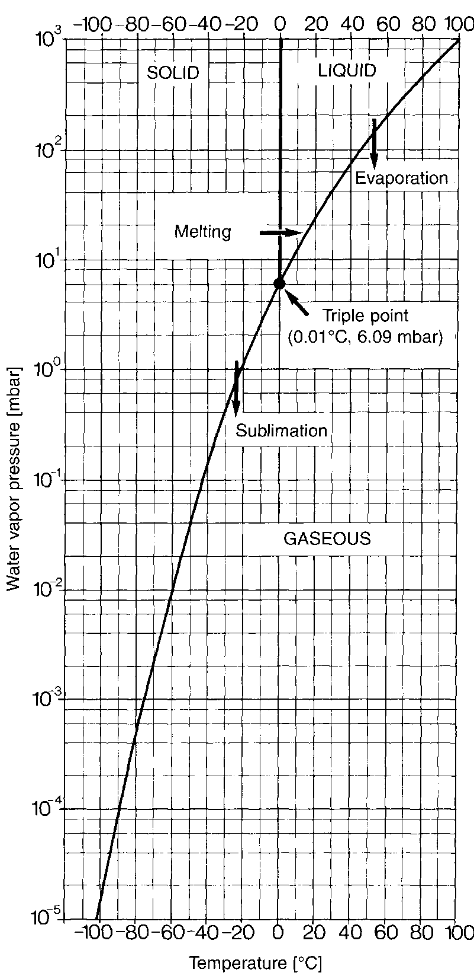
Saturated vapor pressure
The saturated vapor pressure: pressure to which a balance between the number of molecules condensed and those evaporated is formed
If you are in thermal equilibrium, the net flow is equal to zero.
.
H₂O
Not saturated
Saturated
Notes:
17

Slide 18
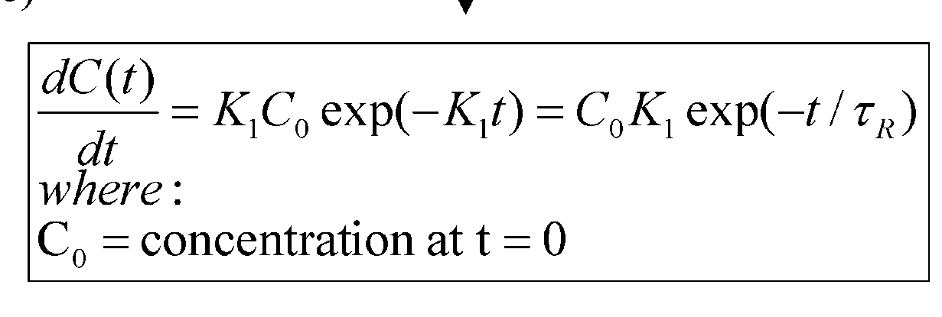
Thermal desorption: first order
The rate of desorption decreases with time, as the surface becomes less and less populated. The variation of rate vs. time is given by
The rate of desorption is proportional to the initial concentration and time dependent as
exp(-t/τ_{R}) with τ_{R} that goes as exp(-1/T)
The cryopumping is the inverse mechanism w.r.t desorption: the adsorbing surface is cooled, and the equilibrium goes in the direction of the adsorption, and gases and vapor are trapped / pumped and removed from the chamber for a “certain” time
Fm Vacuum Techonolgy II P.D. Rack

Slide 19
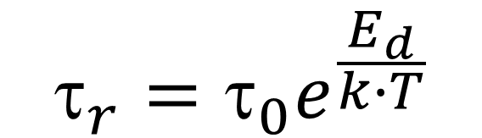
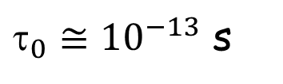
Thermal desorption: FIRST ORDER DES.
$$_{r}=τ_{0}e^{\frac{E_{d}}{k∙T}}$$
τ_{R Values} (average residence time)
E_{d} = Binding Energy
k = 86.17 10⁻⁶ eV/K)
$_{0}≅{10}^{−13}$ s
system | Desorption energy | Residence time (s)
 | Mj/(kg-mole) | @77 K | @22 °C | @450 °C
H₂O/H₂O | 40.6 | 10¹⁵ | 10⁻⁵ | 10⁻⁹
H₂O/metal | 96 | - | 10⁵ | 10⁻⁵
H₂/Mo | 160 | - | 10¹⁷ | 1
For LARGE E_{d} and low T, Long average Residence Time, i.e. «pumped»

Slide 20
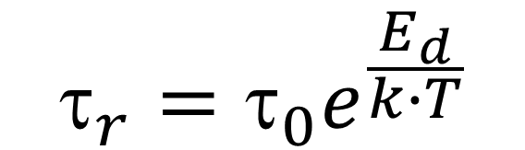
Sojourn time at cryogenic temperature
Cryosorption occurs till ~ 100 k
E(eV) | 1.9 K | 4.2 K | 50 K | 70 K
0.01 | 1 10⁶ years | 0.1 s | 1 ps | 0.5 ps
0.02 | ∞ | 3 10³ years | 10 ps | 2 ps
0.15 | ∞ | ∞ | 130 s | 6 ms
0.21 | ∞ | ∞ | 5 years | 130 s
0.3 | ∞ | ∞ | 1 10⁴ years | 12 years
$$_{r}=τ_{0}e^{\frac{E_{d}}{k∙T}}$$
V. Baglin, CAS 2017

Slide 21
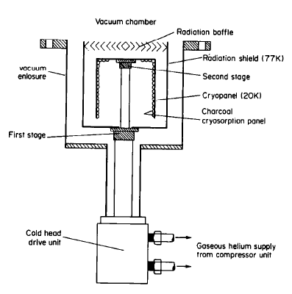
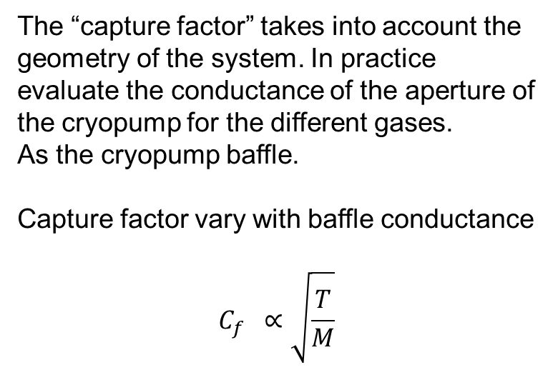
Capture factor C_{f}
Baffle in a cryopump
The “capture factor” takes into account the geometry of the system. In practice evaluate the conductance of the aperture of the cryopump for the different gases.
As the cryopump baffle.
Capture factor vary with baffle conductance
$$C_{f} ∝\sqrt{\frac{T}{M}}$$

Slide 22
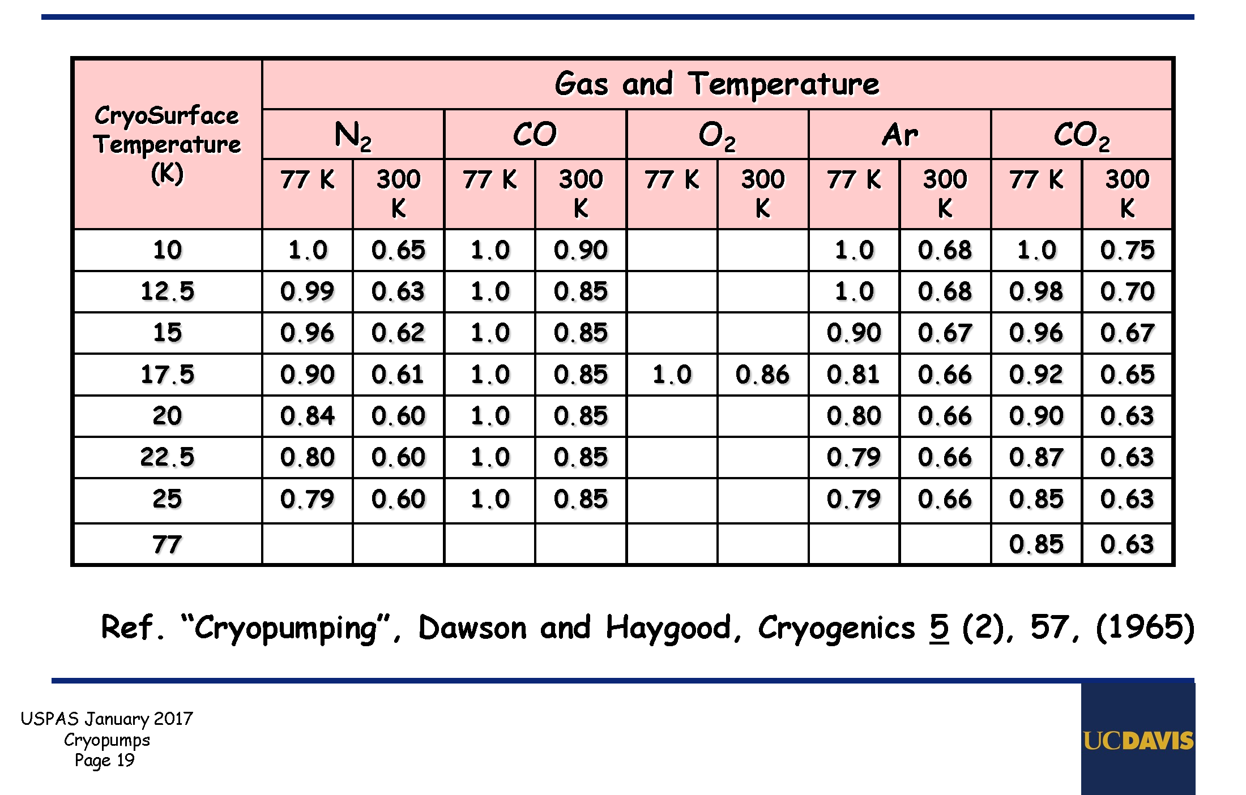
Sticking Coefficients σ
Function of gas, surface, surface coverage, temperature of gas and surface temperature

Slide 23

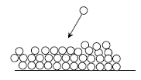
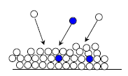
Cryopumping regimes
Physisorption
Sub-monolayer coverage : attractive force (van der Waals) between a gas molecules and a material
Binding energy for physical adsorption
H₂ from 20 to 85 meV for smooth and porous materials resp.
1 h sojourn time at 5.2 K and 26 K for smooth and porous materials resp.
Condensation
For thick gas coverage, only forces between gas molecules
Energy of vaporisation 9 to 175 meV for H₂ and CO₂ resp.
1 h sojourn time at 2.8 K and 53.4 K for H₂ and CO₂ resp.
➔ sub-monolayers quantities of gas can be physisorbed at their boiling temperature
(ex : H₂ boils at 20.3 K and a bake-out above 100 ºC removes water)
Cryotrapping
Use of a easily condensable carrier (e.g. Ar) to trap molecules with
a high vapor pressure gas (e.g. He, H₂)
V. Baglin, CAS 2017

Slide 24
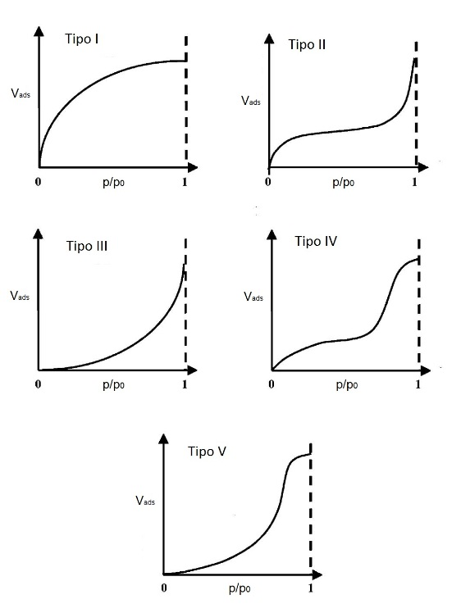
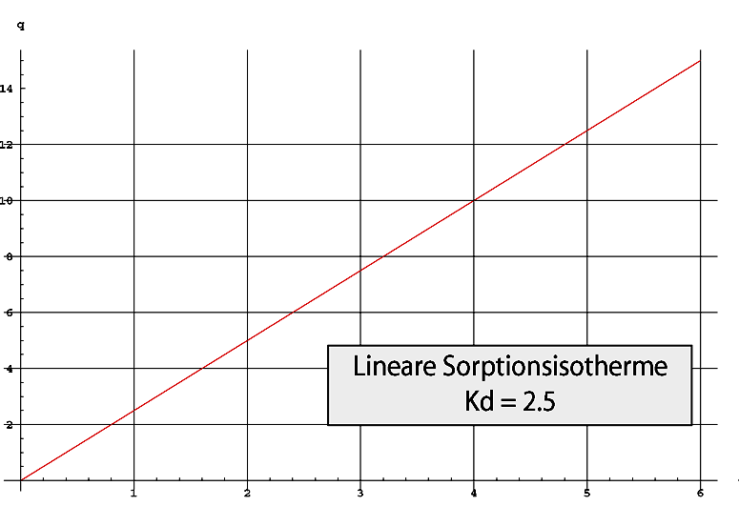
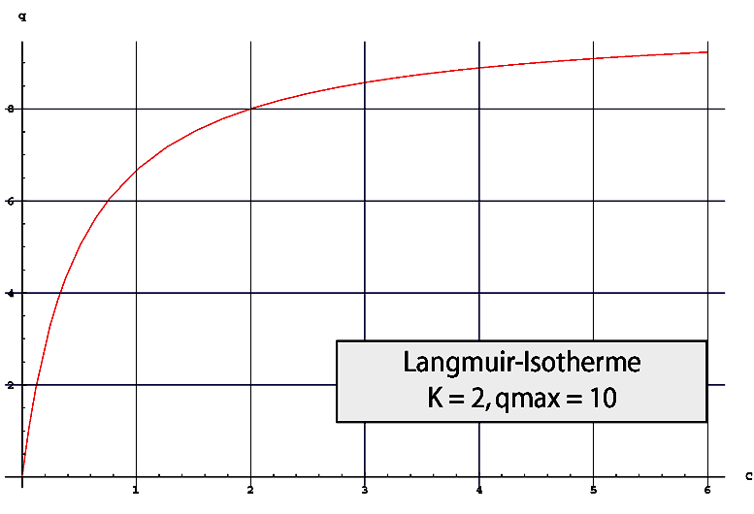

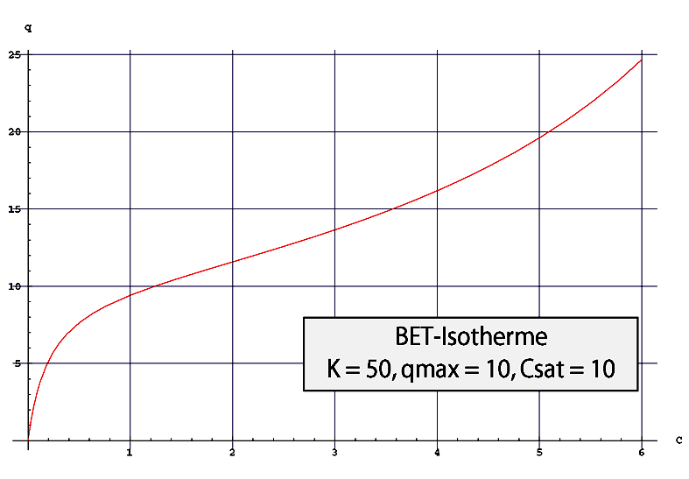
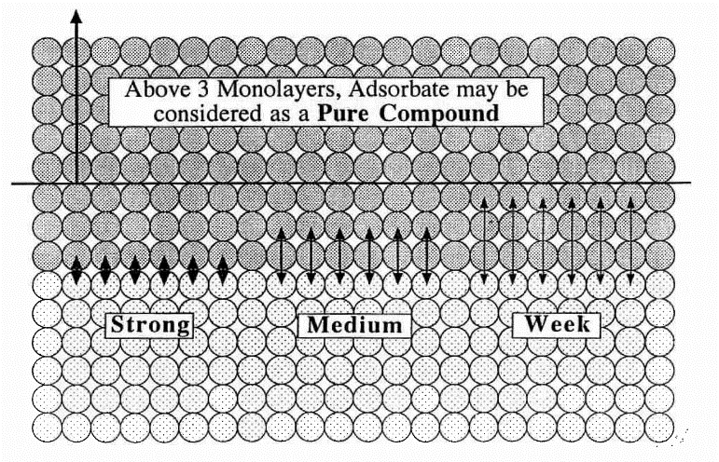
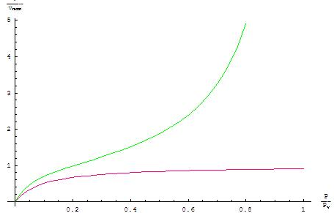
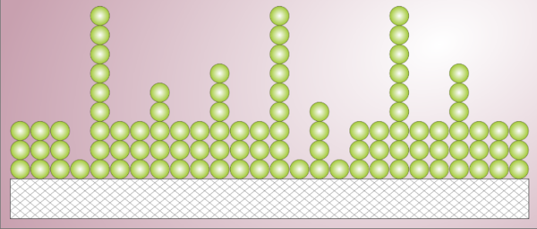
Adsorption Isotherms
Lineare: piccola copertura
<< 1 monostrato
Langmuir: 1 monostrato
Singolo monostrato
Langmuir
Catalogazione BDDT:
Brunauer, Lola S. Deming,
W. Edwards Deming e Edward Teller
BET:
Brunauer Emmett Teller
Più strati, con comportamento diverso tra primo monostrato e i successivi
J. P. Langeron,
IUVSTA 1996

Slide 25
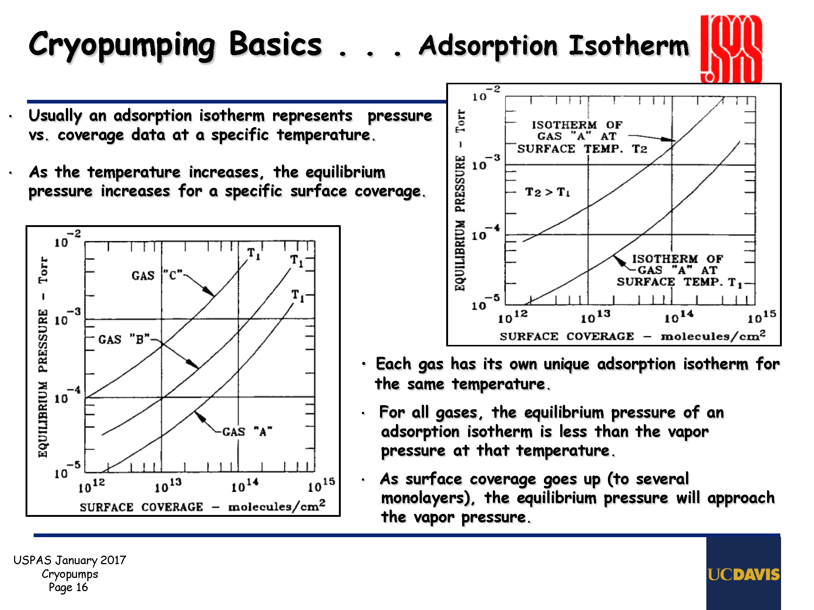
Adsorption Isotherms

Slide 26
How do we get the gas out of the space?
Cryo-pump design and performance
Water
Nitrogen and Oxygen
Helium
Hydrogen, Ne
Inlet
Cool
(H₂O only)
Baffle: 80 K
Cold
2nd stage:
14 K
Cold Charcoal
Safety Relief
Refrigerant
1st stage: 80 K
Notes:
A cryogenic pump operates by condensing and trapping the molecules on cold (or really cold) surfaces.
The water is condensed at the top on cool surfaces so that it doesn’t clog-up the rest of the pump. The nitrogen, oxygen, argon and process gases are adsorbed (caught) on the lower surfaces which are kept at about 50 Kelvin (-220˚C). For gasses that don’t condense (helium and hydrogen) there is an activated charcoal region under a cold cap. It’s hidden so that it doesn’t fill up with other gasses..
There are not moving parts in the vacuum, but a compressor is located remotely to the pump head.
If there is a problem and the pump warms up the gas that’s been trapped is released. This can cause the pressure to go up to unsafe levels. A relief valve is intended to vent the system in such emergency situations.
When the pump reaches its capacity (usually by filling with water at the top or helium on the charcoal) it must be regenerated. This is done by pumping the system with a rough pump while allowing the cryo to slowly warm to room temperature.
Pump speed is between hundreds and thousands of liters/second for water and air. Much less for hydrogen and helium.
Ultimate pressures can be 10⁻¹⁰Torr.

Slide 27
Basic structure of a cryopump
2nd stage:
14 K
Coconut
charcoal
1st stage: 80 K
Baffle: 80 K
Notes:
27

Slide 28
Cryopumping regimes
Physisorption
Sub-monolayer coverage : attractive force (van der Waals) between a gas molecules and a material
Binding energy for physical adsorption
H₂ from 20 to 85 meV for smooth and porous materials resp.
1 h sojourn time at 5.2 K and 26 K for smooth and porous materials resp.
Condensation
For thick gas coverage, only forces between gas molecules
Energy of vaporisation 9 to 175 meV for H₂ and CO₂ resp.
1 h sojourn time at 2.8 K and 53.4 K for H₂ and CO₂ resp.
➔ sub-monolayers quantities of gas can be physisorbed at their boiling temperature
(ex : H₂ boils at 20.3 K and a bake-out above 100 ºC removes water)
Cryotrapping
Use of a easily condensable carrier (e.g. Ar) to trap molecules with
a high vapor pressure gas (e.g. He, H₂)
V. Baglin, CAS 2017

Slide 29
Equilibrium pressure for condensation
It depends on:
The condenser properties (specific surface, etc)
The gas nature (vapor pressure)
The condenser temperature
The amount of condensed material.
Notes:
29

Slide 30
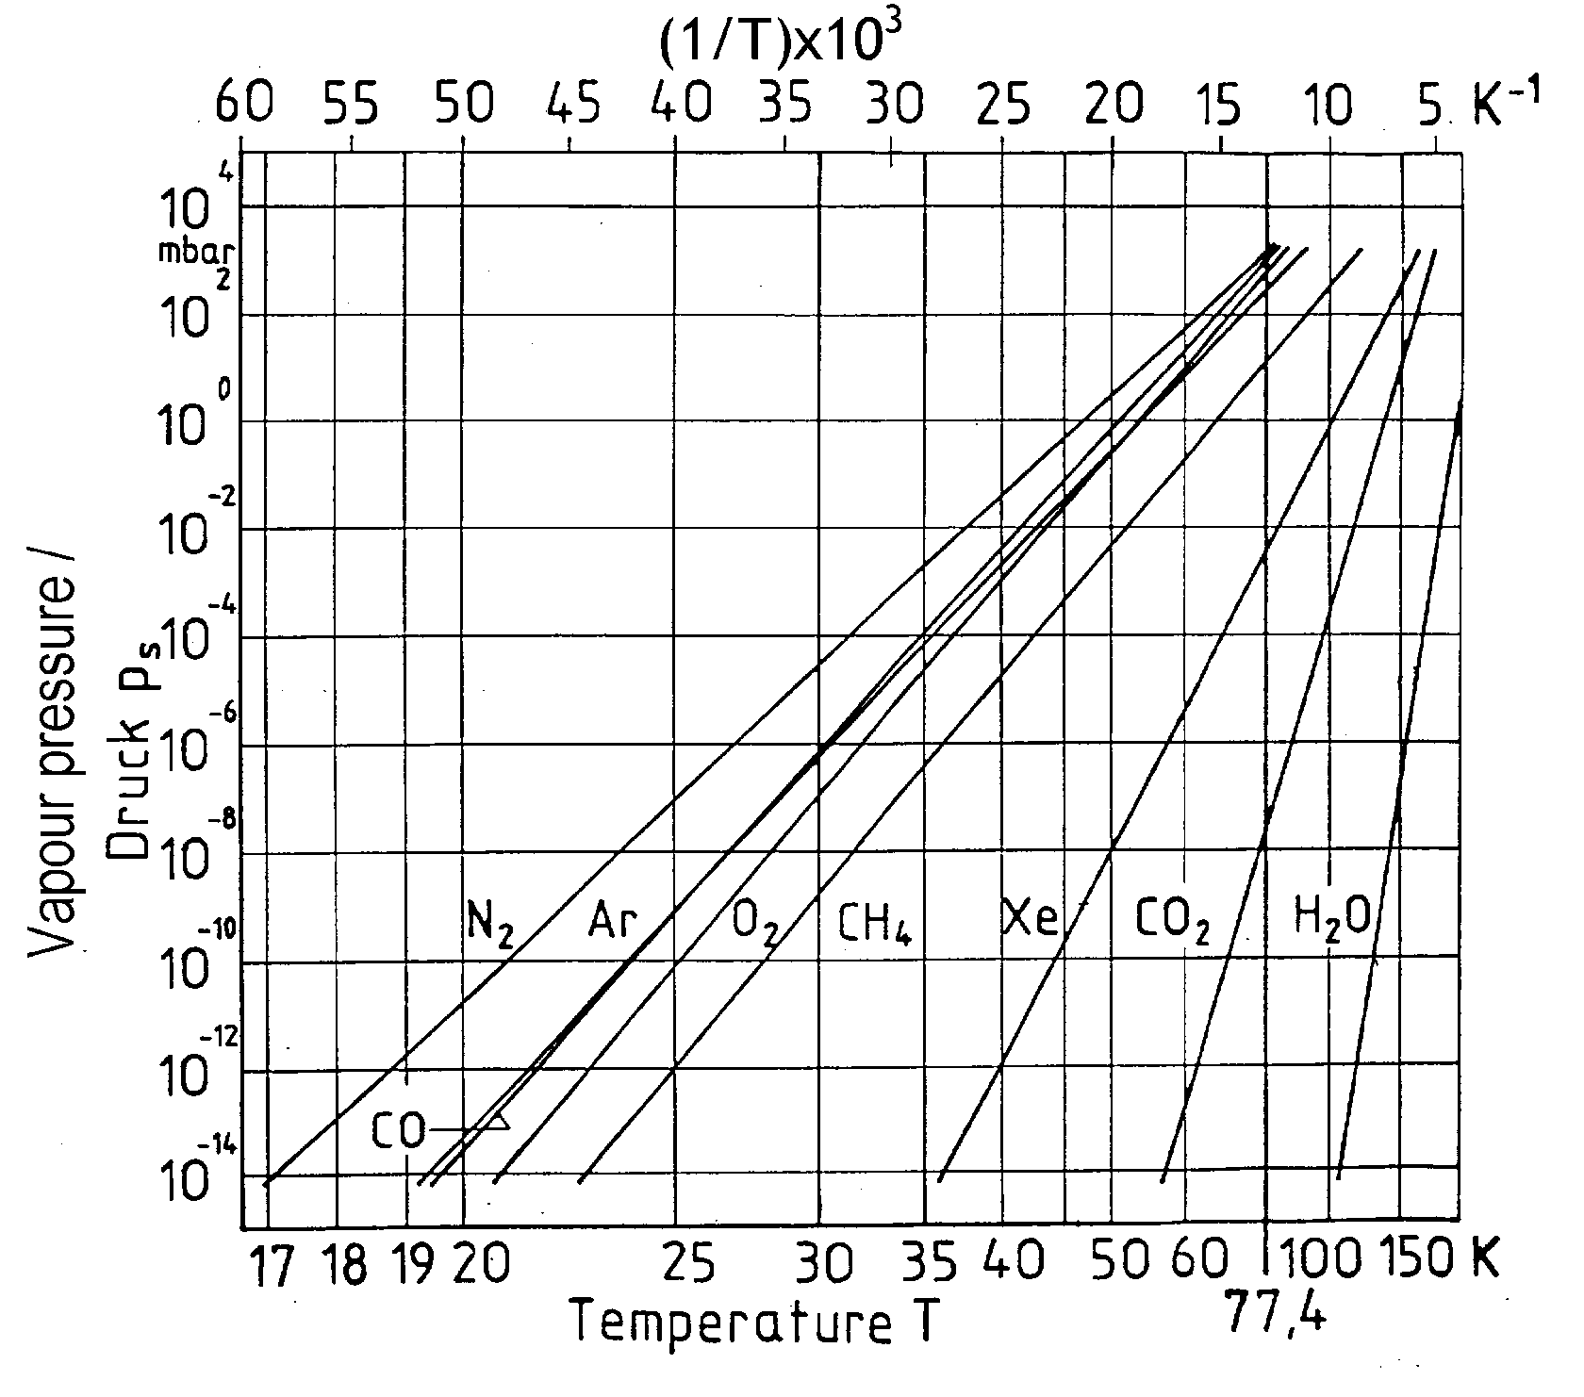
Saturation vapour pressure of various gases
CONDENSED!
Notes:
30

Slide 31
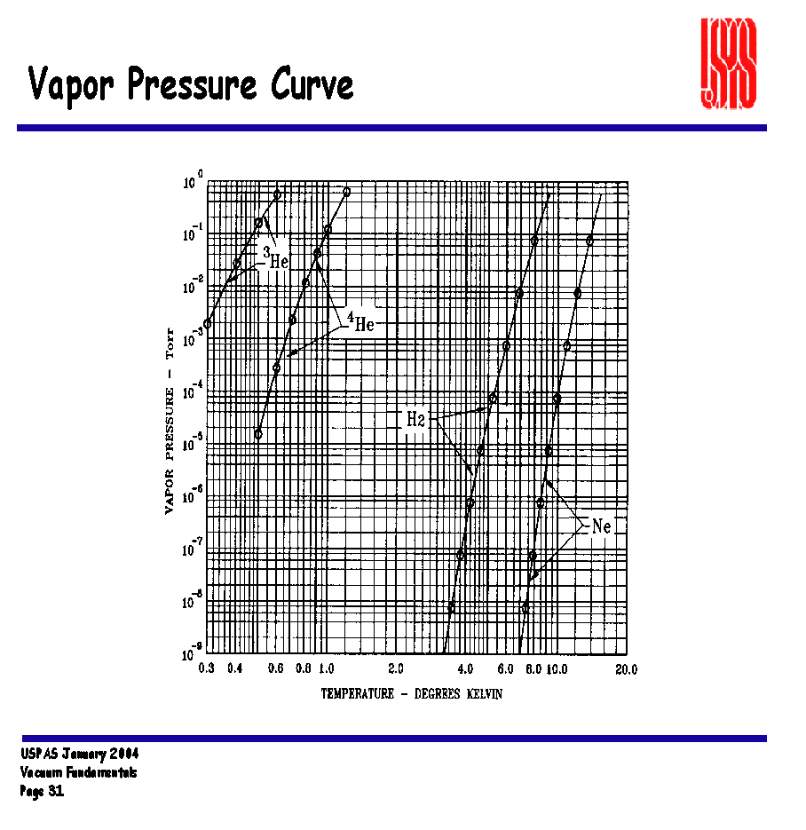
Saturated vapor pressure curves

Slide 32
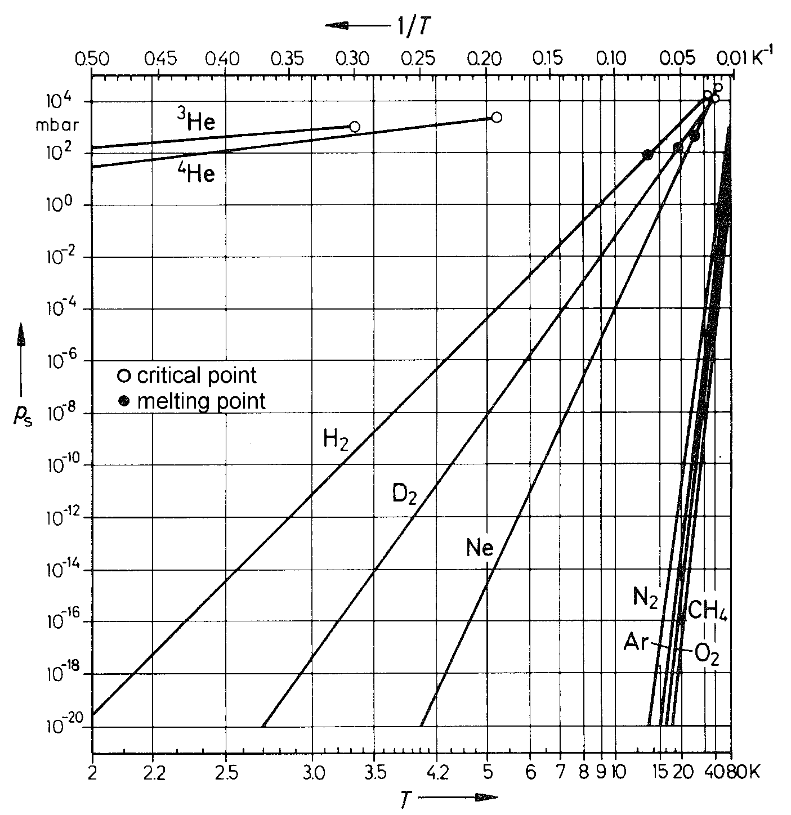
Saturation vapour pressure of various gases
Minimum closed cycle cryopump temperature
He, H₂ and Ne
cannot be
pumped by cryo-condensation
cryo-sorption at charcoal
on cryo-panel
is applied
Notes:
32

Slide 33
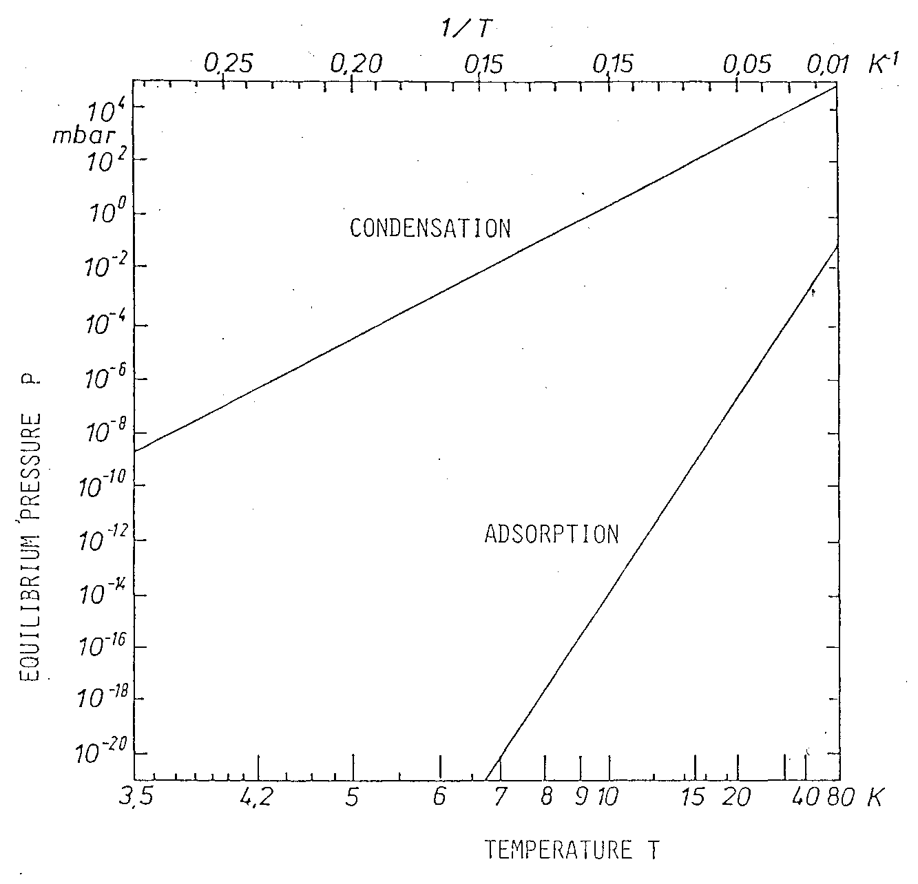
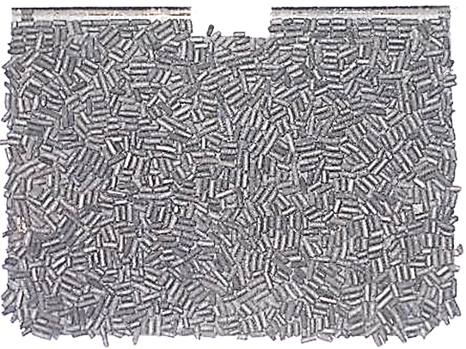

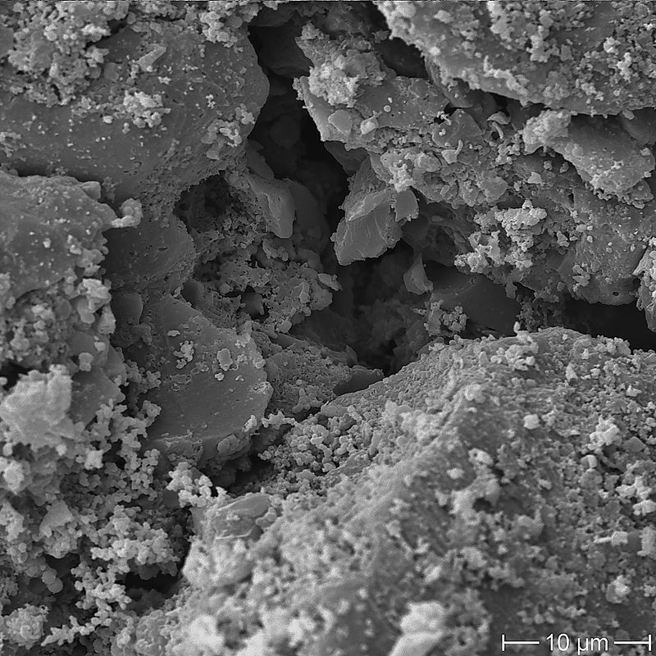
Equilibrium pressure for condensation and adsorption of H₂ on charcoal
Usually glued with Stycast
Notes:
33

Slide 34
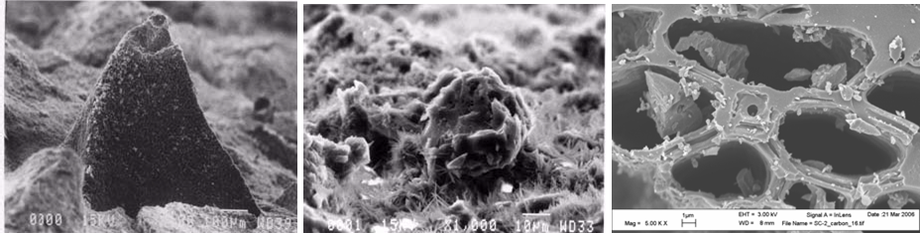
Cryosorbing materials
Large SURFACE AREA
Large temperature working range (up to ~ 30 K)
⇒ Large capacity
⇒ Large pumping speed
e.g. Activated Charcoal used for closed cycle cryopumps 20 K cryopanels
Density: 0.2 g/cm³
Specific Surface area: 500 to 2000 m²/g
  !one football pitch is 100 x 70 m², 7000 m², eq. 8 g, 40 cm³ CHARCOAL
  Capacity ~ 10²² H₂/g i.e. 10²¹ monolayers (P. Redhead, Physical basis of UHV,1968)
  Sticking coefficient ~ 30 % at 30 K (T. Satake, Fus. Tech. Vol 6., Sept. 1984)

Slide 35
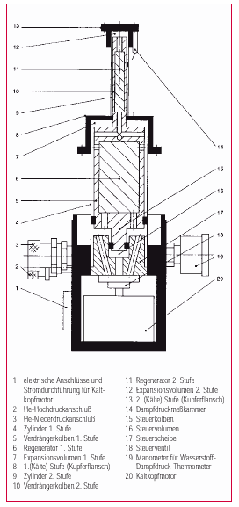
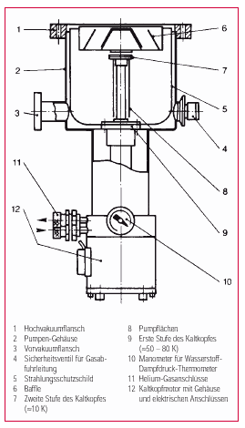
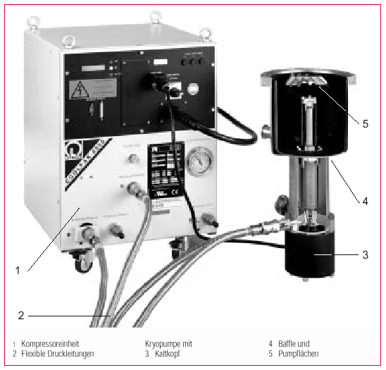
Refrigerator (GMM) cryopump
Notes:
35

Slide 36
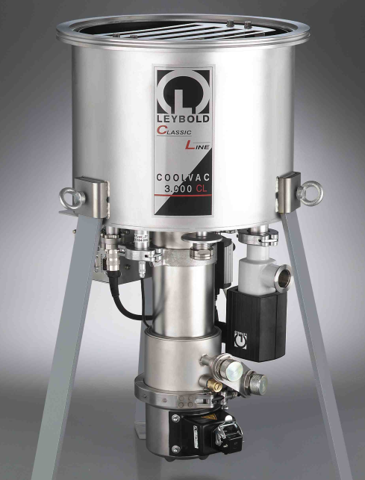
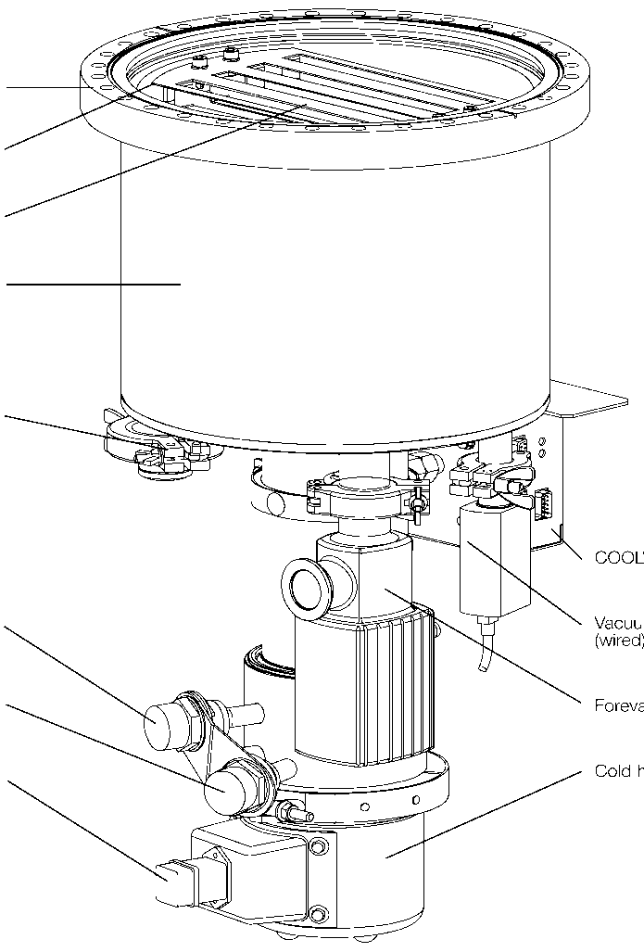
Cryopumps
High vacuum flange
Radiation shield
Baffle
Pump housing
Safety valve
Helium low pressure
connection(green)
Helium high pressure
connection(red)
Cold head motor connection
COOLVAC PM Pump Module
TTR 90 Vacuum gauge
(wired)
V2 Forevacuum valve
(controlled by SC)
Cold head motor
Notes:
36

Slide 37
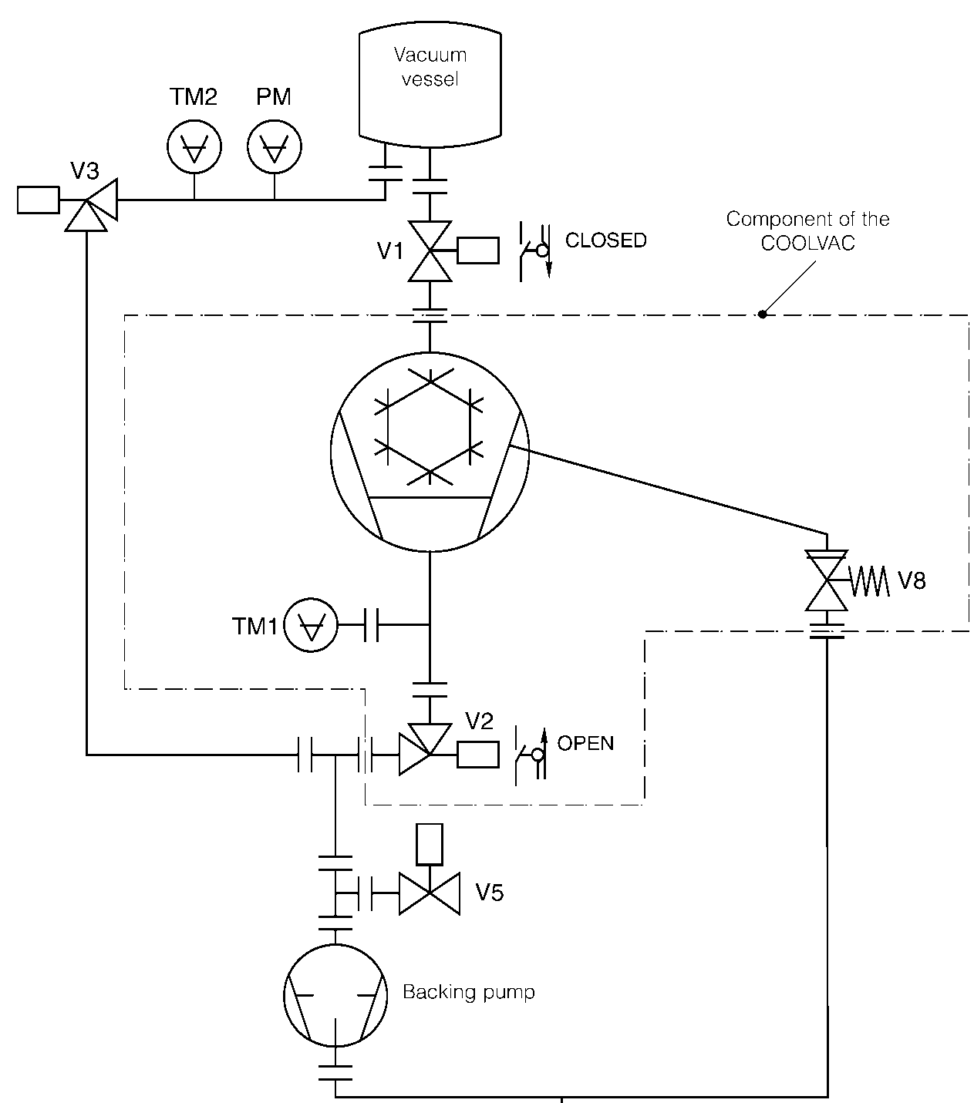

Vacuum schematics for cryopump operation
V1 High-vacuum gate valve
V2 Forevacuum valve pump
V3 Forevacuum valve
vacuum vessel
V5 Venting valve
V8 Safety valve, pump vacuum
TM1 Vacuum gauge head
TM2 Forevacuum gauge
PM High-vacuum gauge
Component of
the cryo-pump
Backing pump
Scarico
Notes:
37

Slide 38
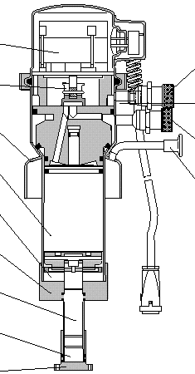
Operating principle of a GM refrigerator
Motor
He Inlet (High Pressure)
Control Valve
Control disk
Overpressure relief valve
Weld-on Pipe
He Outlet (Low pressure)
Displacer 1st Stage
Pump out connection
for insulation vacuum
Expansion volume 1st Stage
Copper flange 1st Stage
Displacer 2nd Stage
Expansion volume 2nd Stage
Copper flange 2nd Stage
Second stage temperature: about 14 K
Notes:
38

Slide 39
Criopompe a refrigeratore
Notes:
39

Slide 40

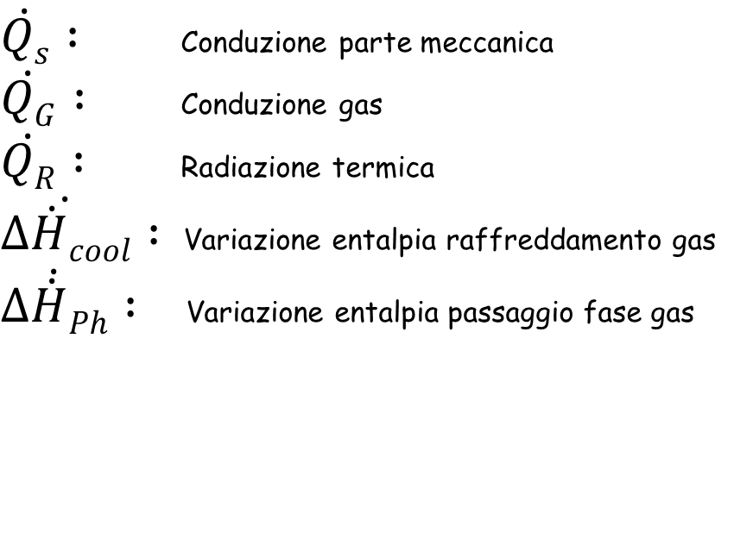
Bilancio energetico di una criopompa
^{T}high
Bilanciameno potenza dovuto a
Refrig.
Thermal Insulation
$\dot{Qs} :$ Conduzione parte meccanica
$\dot{QG} :$ Conduzione gas
$\dot{QR} :$ Radiazione termica
$\dot{∆\dot{H}cool} :$Variazione entalpia raffreddamento gas
$\dot{∆\dot{H}Ph} :$ Variazione entalpia passaggio fase gas
^{T}low
Heat Load
Structural support

Slide 41
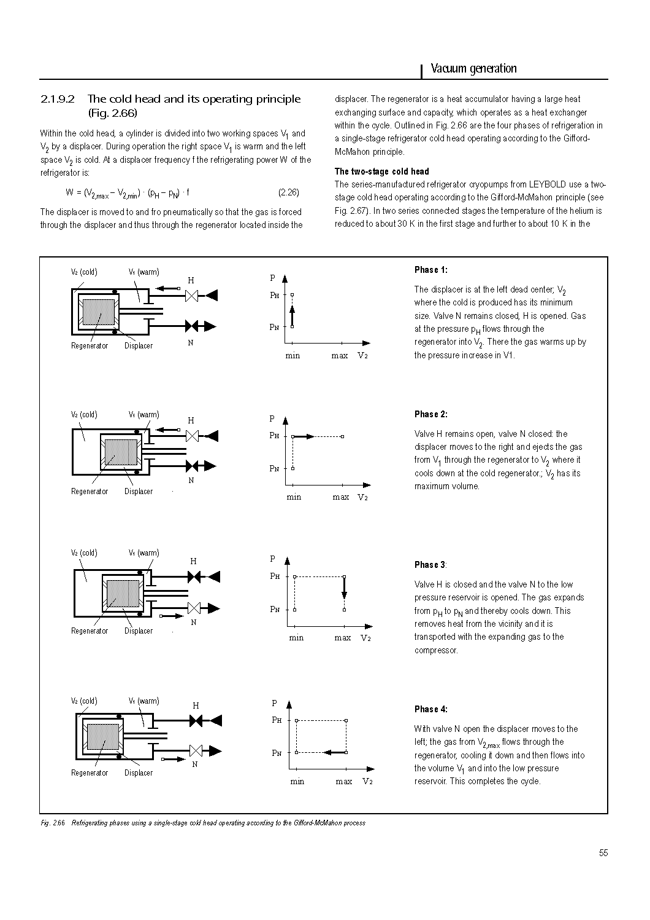

Il ciclo frigorifero GM
Due stadi in serie: il gas freddo del primo stadio va al secondo per una successva espansione.
$$\dot{Q} = \left(P_{H}− P_{L}\right)∙\left(V_{2max}−V_{2min}\right)∙f$$
f: numero di cicli al secondo
Valori tipici temperatura e potenza:
Primo stadio, 30 K, 20 – 120 W
Secondo stadio: 10 K, 2 – 20 W
Notes:
41

Slide 42
Cryopump application
Semiconductor production: coating, sputtering
  Advantages: pumping faster, excellent ultimate pressure, high flow rate for Ar, clean vacuum
Industrial processes:
  Advantages: pumping faster, clean vacuum
Applications: EB welding (Ti, Nb), implanters, Large Area Coating
Furnaces for brazing in vacuum:
  High flow, low pressure, fast cycles with automatic regeneration
Particle accelerators:
  HV and UHV lines of beams and rooms with targets in clean vacuum
Space simulation chambers:
  Pumping of large chamber at pressures less than 1x10⁻⁶ mbar, with large load of water vapor and few load of process gas
Produzione semiconduttori: coating, sputtering
  Vantaggi: pompaggi più veloci, ottima pressione finale,alta portata per Ar, vuoto pulito
Processi industriali:
  Vantaggi: pompaggi più veloci, vuoto pulito
  Applicazioni: EB welding (Ti, Nb), impiantatori, Large Area Coating
Fornaci per brasatura in vuoto:
  Alta portata, bassa pressione, cicli veloci con rigenerazione automatica
Acceleratori di particelle:
  Linee di fasci HV e UHV e camere con bersagli in vuoto pulito
Camere a simulazione spaziale:
  Pompaggio di grandi camere a pressioni minori di 1* E –06 mbar, con grosso carico di vapor d‘acqua e pochi gas di processo
Notes:
42

Slide 43
Parametri importanti di una criopompa
Velocità di pompaggio (l/s)
Portata massima (mbar*l/s)
Pressione di avviamento (mbar)
Crossover value (mbar*l)
Crossover pressure
Capacità (bar⋅l) per ciascun gas
Intervallo di rigenerazione
Notes:
43

Slide 44
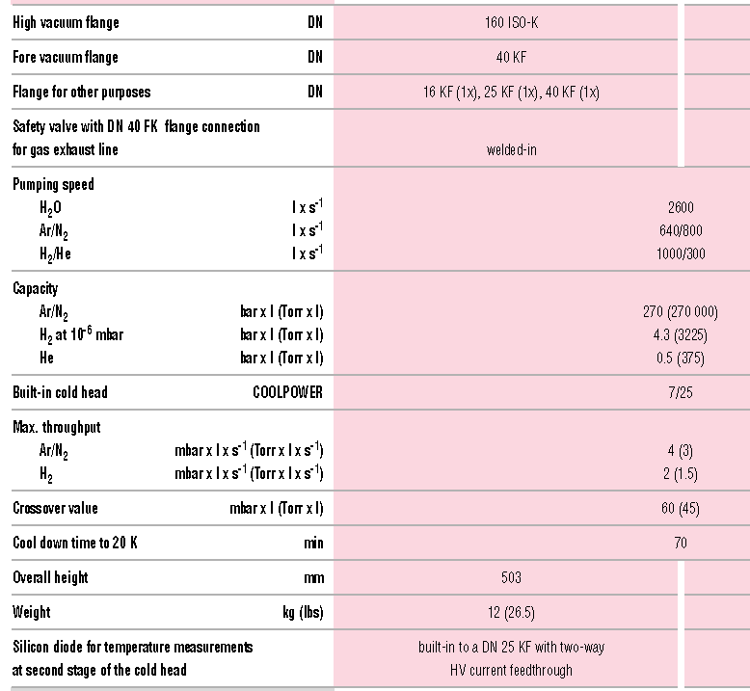
Caratteristiche di una criopompa (φ 160 mm)
Notes:
44

Slide 45


Caratteristiche di una criopompa „grande“: 60000 l/s
60000 l/s cryopump, φ 1300 mm
Parameter Value
Pumping speed (l/s) water 180000
Nitrogen 57000
Hydrogen 60000
Argon 47000
Helium 15000
Maximum throughput (mbar l /s) Argon 25
Hydrogen 12
Pumping capacity (bar l) Argon 9000
Hydrogen 150
Cool-down time (h) 5 – 6 h
Crossover (mbar l) 1000
Weight (kg) 450
Notes:
45

Slide 46

Parametri importanti di una criopompa
Velocità di pompaggio S (l/s)
$$S = \frac{Q}{P}$$
Di solito riferita a 273 K.
Dipende principalmente dalle dimensioni e dalla geometria della struttura della pompa, a patto che queste siano a temperature sufficientemente basse.
Qualche volta è indicata anche la velocità di pompaggio specifica (l/s cm₂) di apertura
La trappola che pompa il vapor d’acqua limita in parte la conduttanza (trasparenza) per gli altri gas, ma garantisce altissimo valore della velocità di pompaggio per acqua (x 4 o più), dipende dal design della baffle
Notes:
46

Slide 47

Cryopanel efficiency

Slide 48
Parametri importanti di una criopompa
Pressione di avviamento (mbar) e crossover (p⋅V)
La massima pressione di avviamento è la massima pressione alla quale la pompa può essere raffreddata senza problemi. Tipicamente il valore è inferiore a 10⁻² mbar.
Il valore di crossover rappresenta il massimo valore impulsivo di portata (mbar⋅l). In pratica il prodotto tra il VOLUME della camera e la PRESSIONE che la pompa vedrà al momento dell’apertura della sua valvola, a pompa fredda a t < 20 K.
Valori tipici per una pompa 3000 l/s: 500 mbar ⋅l (500 l a 1 mbar)!
Se non sarà presente una valvola, con grossi volumi, la pompa crio farà fatica a raggiungere le temperature operative.
Il limite di crossover con camere grandi e flusso continuo può essere di due / tre ordini di grandezza inferiore.
Notes:
48

Slide 49
Parametri importanti di una criopompa
Portata massima (mbar*l/s)
Rappresenta la massima portata massiva che la pompa è in grado di sopportare mantenendo il secondo stadio a una temperatura < 20 K.
In alcune pompe specifiche per l’industria dei semiconduttori questa grandezza è massimizzata, e può raggiungere anche qualche decina di scc/s di argon.
La pompa da 60000 litri è in grado di funzionare con un flusso continuo di 25 mbar ⋅l/s (25 cc/s!)
Notes:
49

Slide 50
Parametri importanti di una criopompa /2
Capacità (bar*l) per ciascun gas
Rappresenta la quantità di gas che la pompa è in grado di assorbire, con una riduzione limitata della velocità di pompaggio.
Tipicamente si considera la pompa satura quando la velocità di pompaggio si è ridotta alla metà di quella nominale.
La quantità di gas pompabile è molto grande per i gas condensabili (CO₂, Ar, N₂,O₂), anche dell’ordine del migliaio di litri.
La pompa da 60000 l/s è satura dopo aver pompato 9000 litri di N₂ a pressione atmosferica (9 kg)!
Per quanto riguarda l’idrogeno che viene crioassorbito può essere dell’ordine di qualche decina di normal litri. (la 60000 satura a 1500 st. L)
Quando la pompa sarà satura dovrà essere rigenerata.
Notes:
50

Slide 51
Vacuum schematics for cryopump operation
V1 High-vacuum gate valve
V2 Forevacuum valve pump
V3 Forevacuum valve
vacuum vessel
V5 Venting valve
V8 Safety valve, pump vacuum
TM1 Vacuum gauge head
TM2 Forevacuum gauge
PM High-vacuum gauge
Component of
the cryo-pump
Backing pump
Scarico
Notes:
51

Slide 52
La rigenerazione di una criopompa
TRE modalità:
Riscaldamento naturale in vuoto
Riscaldamento elettrico con possibilità di rigenerazione parziale
Riscaldamento con gas caldo
Notes:
52

Slide 53

La rigenerazione parziale/2

Slide 54

Rigenerazione parziale vs. rigenerazione totale
Durata rigenerazione totale: 2.5 ore
! Formazione di acqua liquida da EVITARE!

Slide 55
Rigenerazione parziale vs. rigenerazione totale
Durata rigenerazione fast: 40 minuti
! Formazione di acqua liquida da EVITARE!

Slide 56


Compressore elio per criopompa

Slide 57
Compressore elio per criopompa
Notes:
57

Slide 58
Cryopumps: summary charactersistics
High cost
Mechanics uncritical
No risk for venting, only DELAYS
It operates in any position
Rotary pump only required at the start and during regeneration
S_{He} low
Finite capacity: required regeneration
Between two service life> 10 000 hours
Really large and huge pumps av. (>> 30000 l/s)
Cooling water: almost always necessary
Hydrocarbon contamination: no, FREE
Final pressure limit: 10⁻¹⁰ mbar
Has vibration (1 - 2 Hz)
Notes:
58

