Slide 1
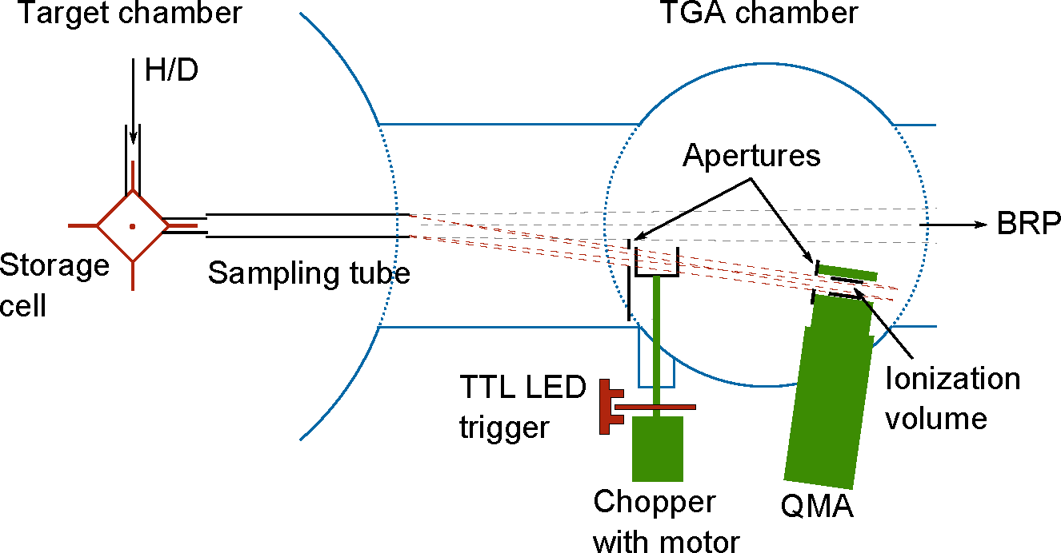
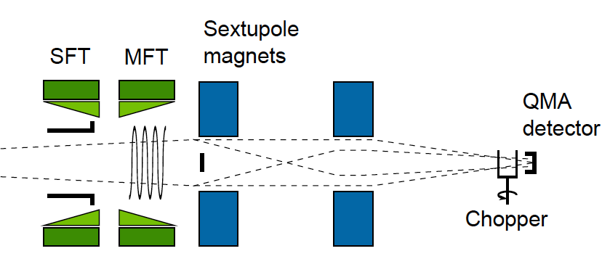
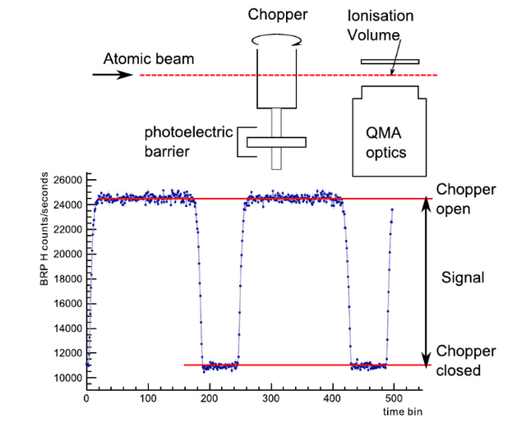
QMA for monitoring and precise measurements of ...
Ciullo Giuseppe (work done with Statera Marco et al.)
BREIT-RABI POLARIMETER
BRP
TARGET GAS ANALYSER
TGA
... populations of quantum states of polarised atomic beams and nuclear targets.
... atoms and molecules contents
in gaseous nuclear polarised target
accumulated in a storage cell,
Chopping beam techniques are needed, in order subtract
background (BG) gases.
Gaseous polarised nuclear targets consist of H (or D), the residual gas also in UHV
are mainly H₂, and the injected atoms recombine in molecules, difficult to pump.

Slide 2
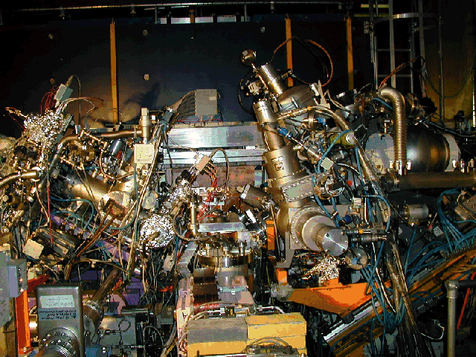
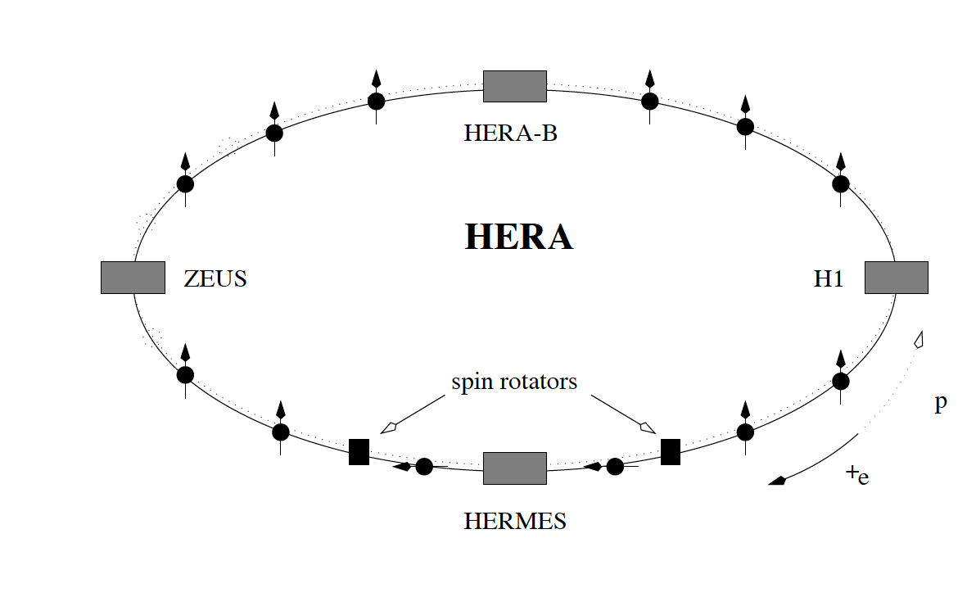
Some uses (experiments) of polarised nuclear target
Study of contribution of the spin of subnuclear
particle to the total spin of the nucleons.
Polarised positron collinding with
nuclear polarized targets
  R = σ L
  σ = cross section, L= luminosity [cm⁻² s⁻¹]
  For accelerated beam on fixed targets:
Intensity of projectiles
I_{p} [part s⁻¹]
Target thickness
t_{target} [at cm⁻²]
HERA ring at DESY (Hamburg)
L=I_{p} t_{target}
L [cm⁻² s⁻¹]
HERMES
Gases are injected in an accumulation open cell on the accelerated beam axis
HERA Beam
We inject gases which are difficult to pump, H2, D2, He and N2, Kr, Xe too.

Slide 3
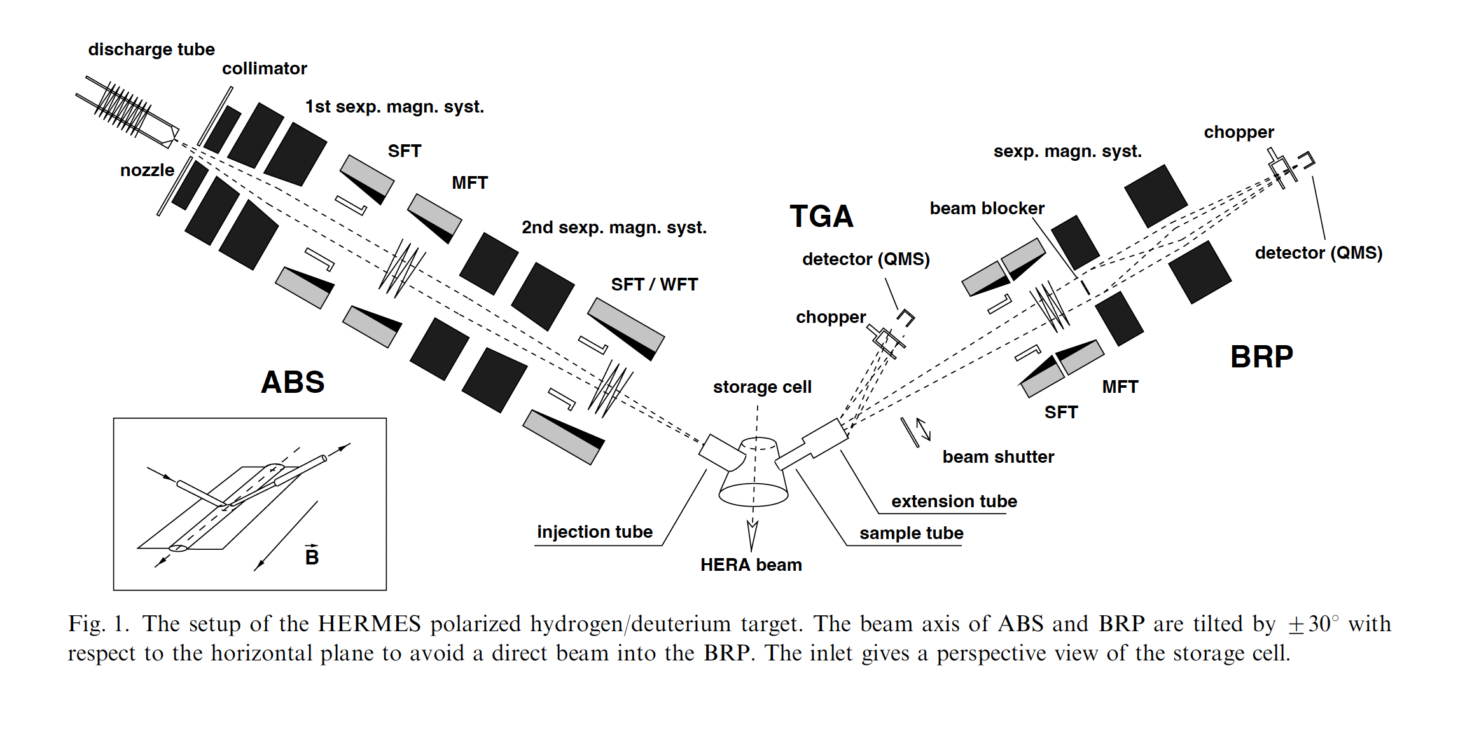
The HERMES polarized nuclear target
The diagnostics of the nuclear polarized target are performed by the TGA (Target GAs Analyzer) and the Breit-Rabi Polarimeter, which are equipped both with two QMA (Quadrupole Mass Analyser)
BRP
ABS
HERA Beam
HERA Beam
Target/year | H||(1997) | D||(2000) | H⊥(2003)
P_{t} | 0.851 ± 0.033 | 0.845 ± 0.028 | 0.795 ± 0.033
t(10¹⁴ nucl/cm²) | 0.7 | 2.1 | 1.1
FOM (P²t) | 0.5 | 1.5 | 0.7
Impressive performance of daily working system, parassitic target, just stopped for accelerator maintenance.

Slide 4
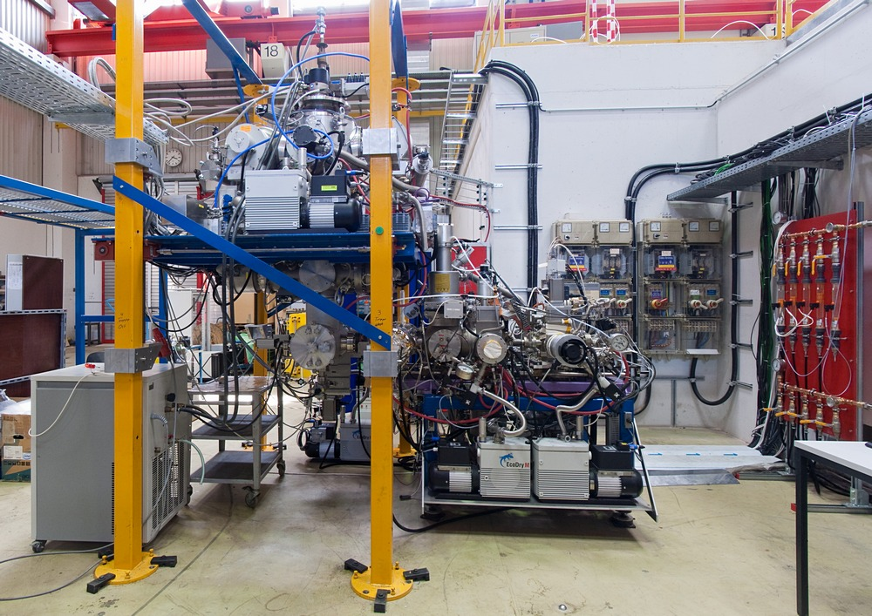
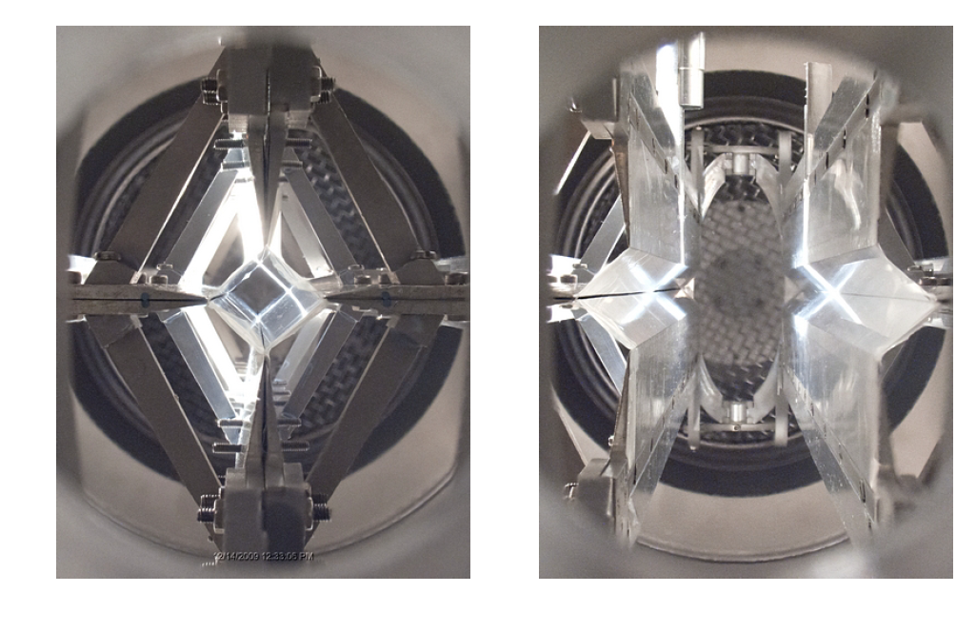
Upgrading for filtering studies of antiprotons test on p 2005-2017 COSY (FZJ) – proposal for AD (CERN)
ABS
Electric power
Tuning of the whole target,
monitoring of its perfomance
diagnostics and measurements
of atomic, molecular fraction and polarization
performed by two cross beam
QMA equipped with baffles and
choppers for a good
BG subtraction and also monitoring vacuum conditions
and openable cell performances.
Cooling water
Breit-Rabi
polarimeter
COSY/AD
beam axis
Target
chamber
Target Gas Analyser

Slide 5
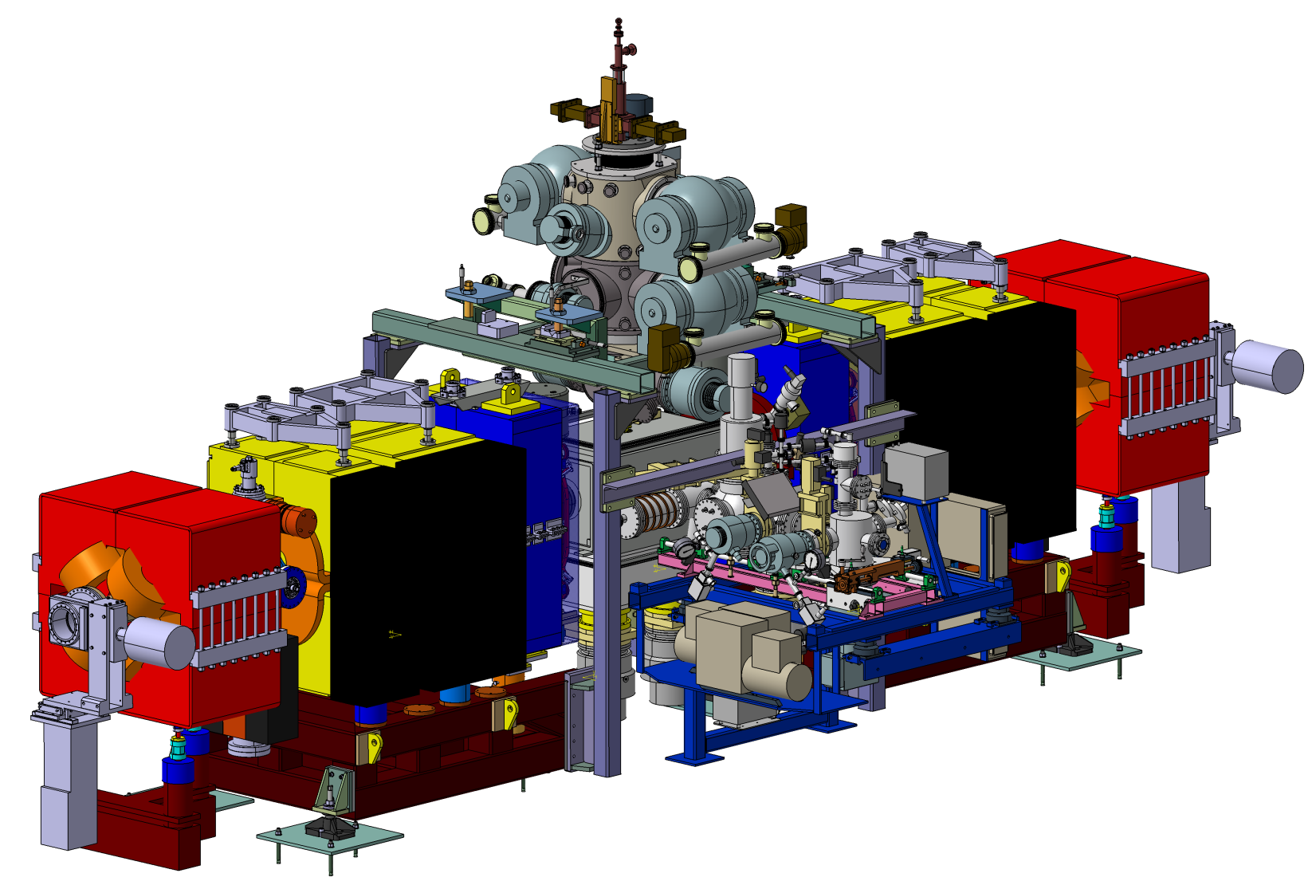
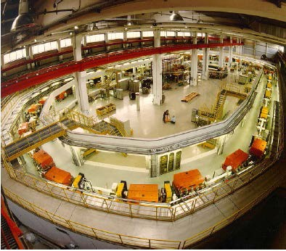
Easily moved on the beamline properly designed for the installation at COSY and at AD
Target chamber:
Detector system + storage cell
Atomic Beam Source
Momentum: <3.7 GeV/c
l Circumference: 183 m
l Polarized proton and deuteron
Six additional quadrupoles:
4 from COSY
2 from CELSIUS
Target Gas Analyser
and
Breit-Rabi Polarimeter

Slide 6
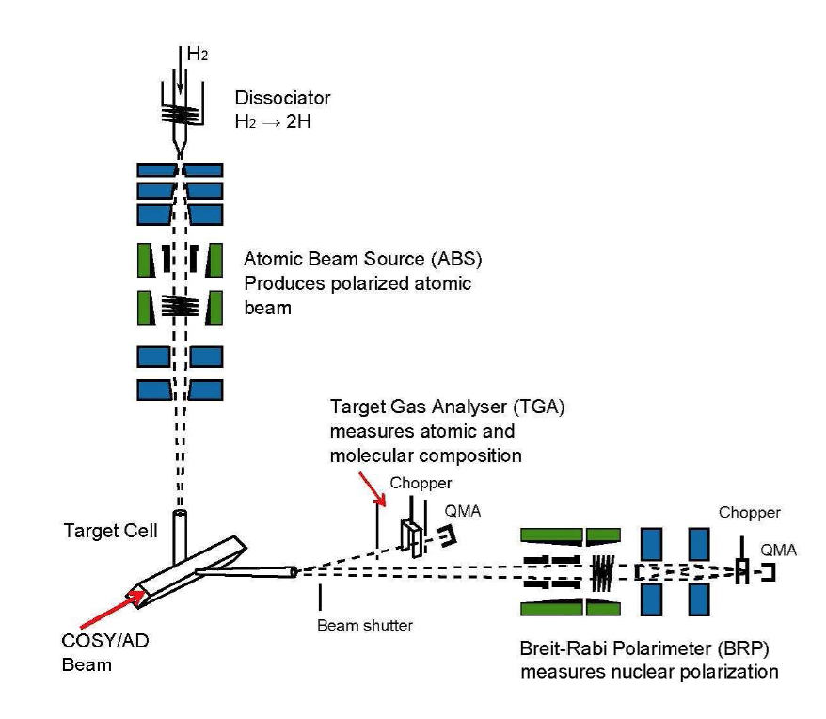
Nuclear Polarised Target – PAX SCHEME
The Target Gas Analyser (TGA) allows to
monitor and measure atomic and molecular
composition of sampled beam from the
accumulation cell, it allows also to
distinguish between the backgroung (BG) from the
TGA chamber itself, from the Cell Chamber,
and ballistic flow from ABS.
Production of
nuclear
polarized H or D
ABS
Electric power
Cooling water
QMA at the end of the Target Gas Analyzer
Diagnostics
TGA Chopper for background subtraction
The Breit-Rabi Polarimeter allows to monitor, to tune the RF transitions and finally to measure the population of quantum states and provides the polarisation of the sampled beam.
Breit-Rabi
polarimeter
COSY/AD
beam axis
Target
chamber
BRP chopper for background subtraction
Accumulation
QMA at the end of the Target Gas Analyzer

Slide 7

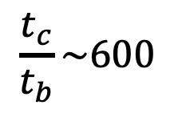
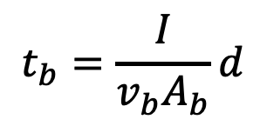

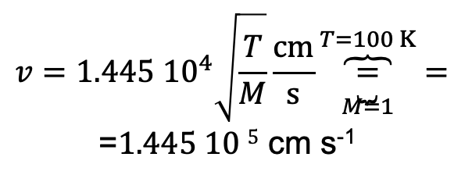
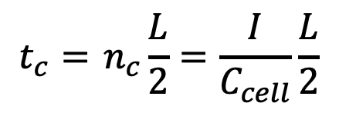

WHY an accumulation cell? Increasing t_{target}
d
accelerated beam
Free atomic beam (Target)
Accumulated atomic beam (Target)
$$v=1.445 {10}^{4}\sqrt{\frac{T}{M}}\frac{cm}{s}\overset{T=100 K}{\overbrace{\underset{M=1}{\underbrace{=}}}}=$$
=$1.445 10 5$ cm s⁻¹
$$b$$
Free atomic beam
Thickness of the target of the free beam t_{b}
$$t_{b}=\frac{I}{v_{b}A_{b}}d$$
2.6 10¹¹ At cm⁻²
$$\frac{t_{c}}{t_{b}}\sim 600$$
Integrated thickness (t_{c}) of the target along the cell
Elliptical cell
ingoing at/s=outgooing at/s
Accumulated atomic beam
$$I=C_{cell}{ n}_{c}$$
$$t_{c}={ n}_{c}\frac{L}{2}=\frac{I}{C_{cell}}\frac{L}{2}$$
$$I=n_{b}v_{b }A_{b}$$
1.5 10¹⁴ At cm⁻²

Slide 8
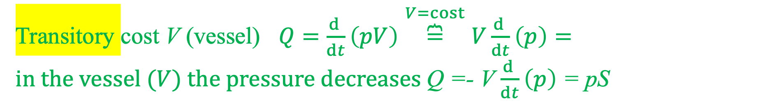
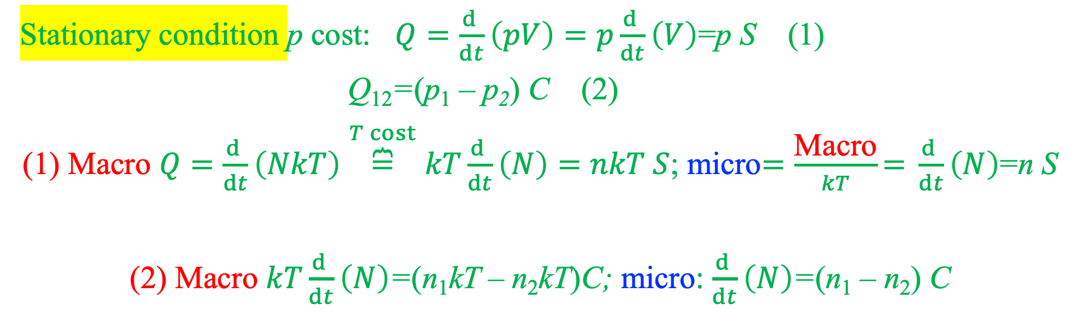
From macroscopic to microscopic quantities
Throughput Q:
mbar l s⁻¹
Stationary condition p cost: $Q=\frac{d }{dt}\left(pV\right)=p\frac{d }{dt}\left(V\right)$=p S (1)
Q₁₂=(p₁ – p₂) C (2)
(1) Macro $Q=\frac{d }{dt}\left(NkT\right)\overset{T cost}{\overbrace{=}}kT\frac{d }{dt}\left(N\right)=nkT S$; micro$=\frac{\text{Macro}}{kT}\text{= }\frac{d }{dt}\left(N\right)$=n S
(2) Macro $kT\frac{d }{dt}\left(N\right)$=(n₁kT – n₂kT)C; micro: $\frac{d }{dt}\left(N\right)$=(n₁ – n₂) C
Transitory cost V (vessel) $Q=\frac{d }{dt}\left(pV\right)\overset{V=cost}{\overbrace{=}}V\frac{d }{dt}\left(p\right)=in the vessel (V) the pressure decreases$Q =- V $\frac{d }{dt}\left(p\right)$ = pS

Slide 9
Microscopy derivation of Master equations
A₁
A₂
Stationary condition
Effective flow torwards less molecular density:
As a result we derive:

Slide 10
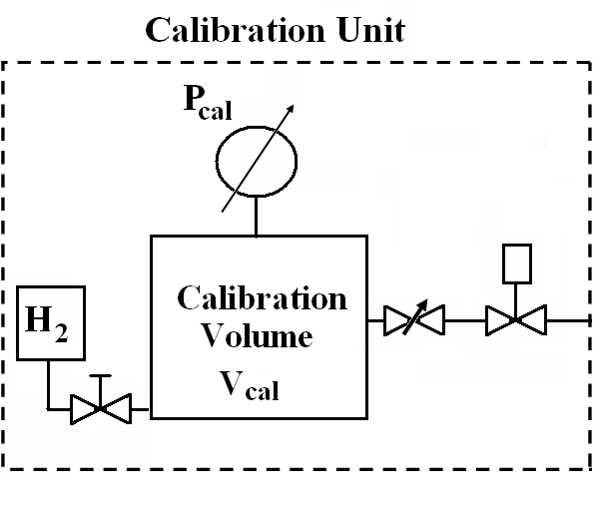
If Q is the conserved quantity in vacuum systems
Q calibration Unit is a required tool
{
Q_{cal}
C_{cal}
P_{cal} can be measured with high accuracy (0.15 %) with a baratron, but
we need the measurement of C_{Cal} .

Slide 11
Measuring P_{cal}
C_{cal} measured by
    Evacuation of V_{cal} through C_{cal}
We need the Measurement of V_{cal} ?

Slide 12
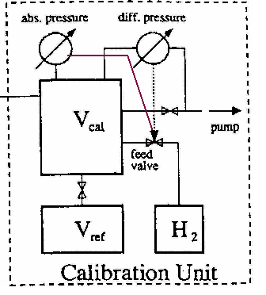
Measuring V cal
I need a reference volume V_{ref} , measured (ex situ)
By filling it with liquid (ethanol) V_{ref} .
From the relation PV=constant
In situ, by iterated expansion of gas (H₂) in V_{ref},
Is possible to measure V_{cal}
We can measure the pressure in V_{ref}, by the gauge in V_{cal}
When both volume are in comunication (valve open),
Then we close the valve between them, we pump down V_{cal} and
then we can expand again .

Slide 13
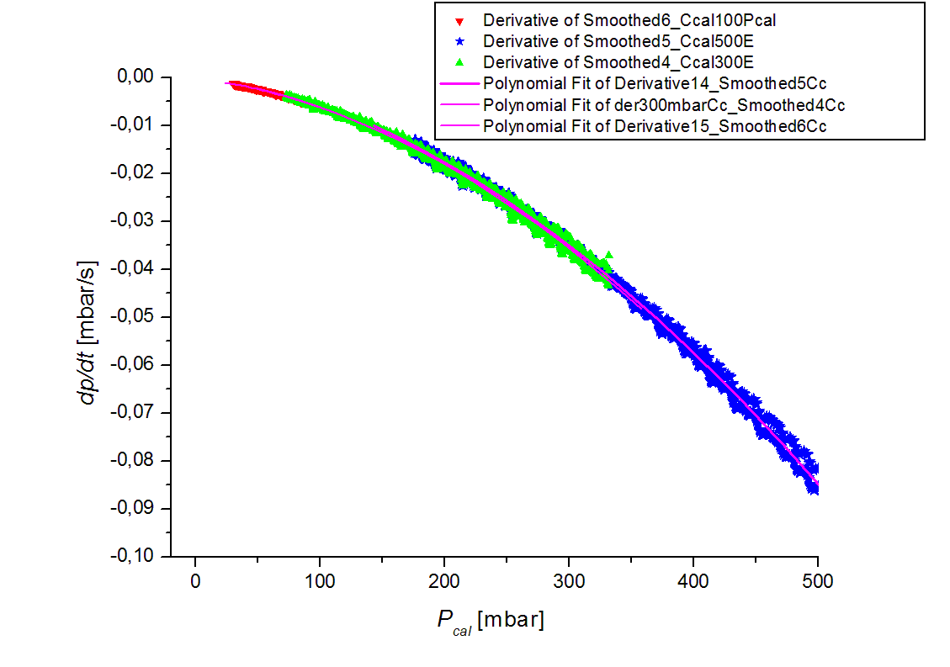
But model indipendent starting from the definition
From the definition
which applied to the evacuation
of the Volume V_{cal} becomes:
from
Then get the calibrated throughput at at fixed geometry of the connection between the
V_{cal} and the cell (C_{cal} depends on pressure p_{cal}) in the viscous regime.

Slide 14
Test on a Q cal
Measurement precision ≈ 0.5 %
Reproducibility ≈ 0.5 %

Slide 15
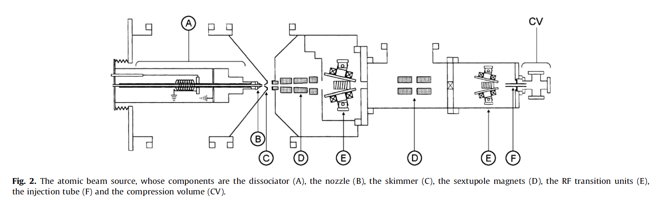
How you can measure I_{ABS}?
Q_{ABS}=(p_{cv} – p_{ch})C_{cv} injecting ABS
Q_{cal}=(p_{cv} – p_{ch})C_{cv} calibrated injection
I_{ABS} from corresponding Q_{cal} I: I_{ABS}= Q_{cal}/kT

Slide 16
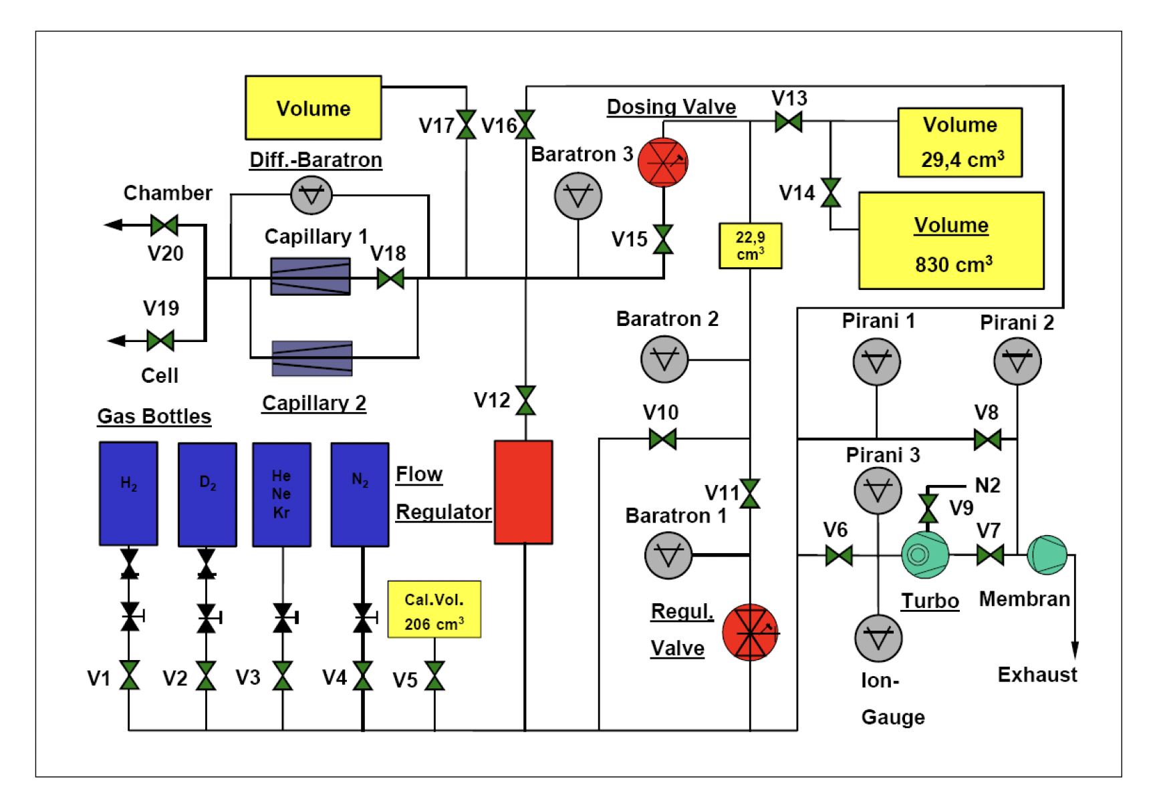
Unpolarized gas feeding system (HERMES)

Slide 17
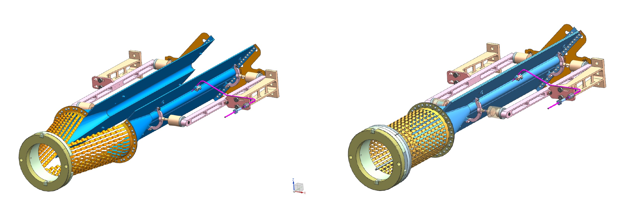
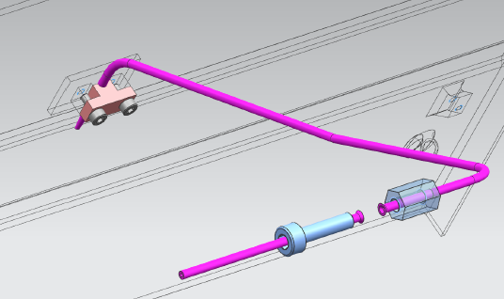
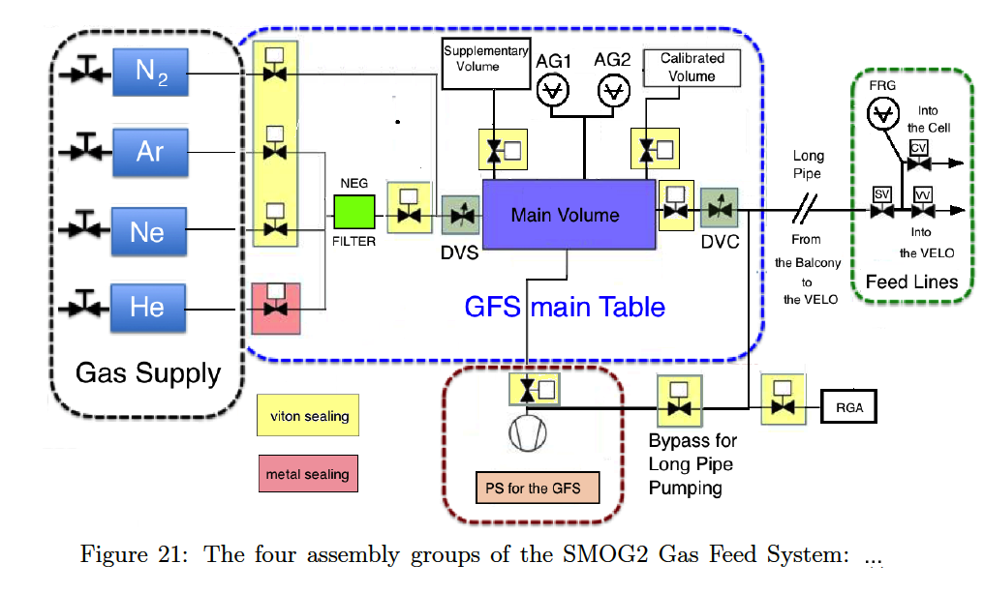
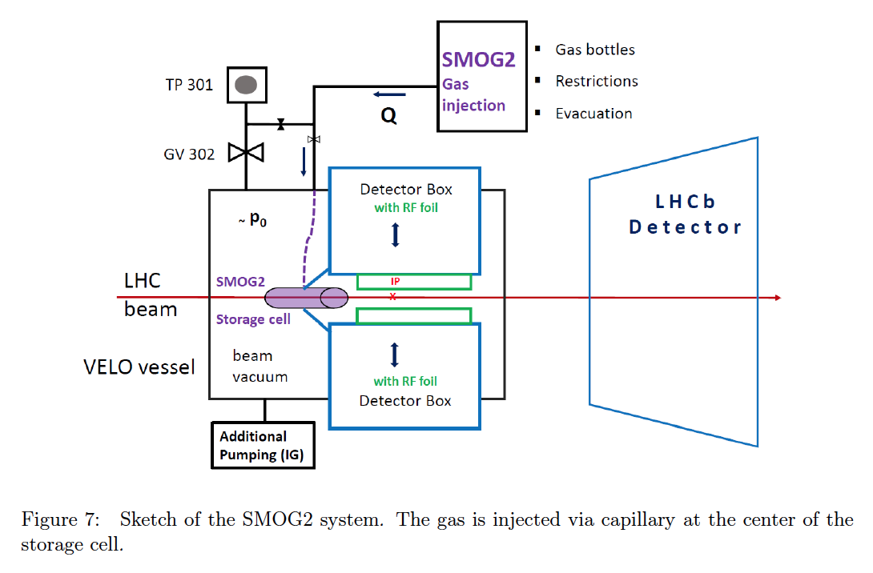
SMOG 2 injection upstream LHCb

Slide 18
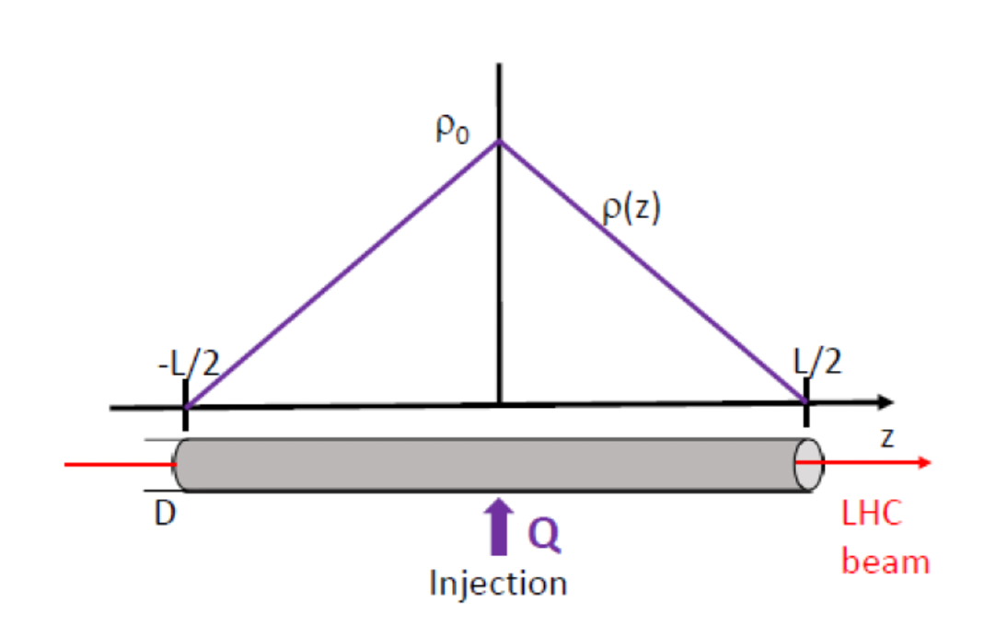
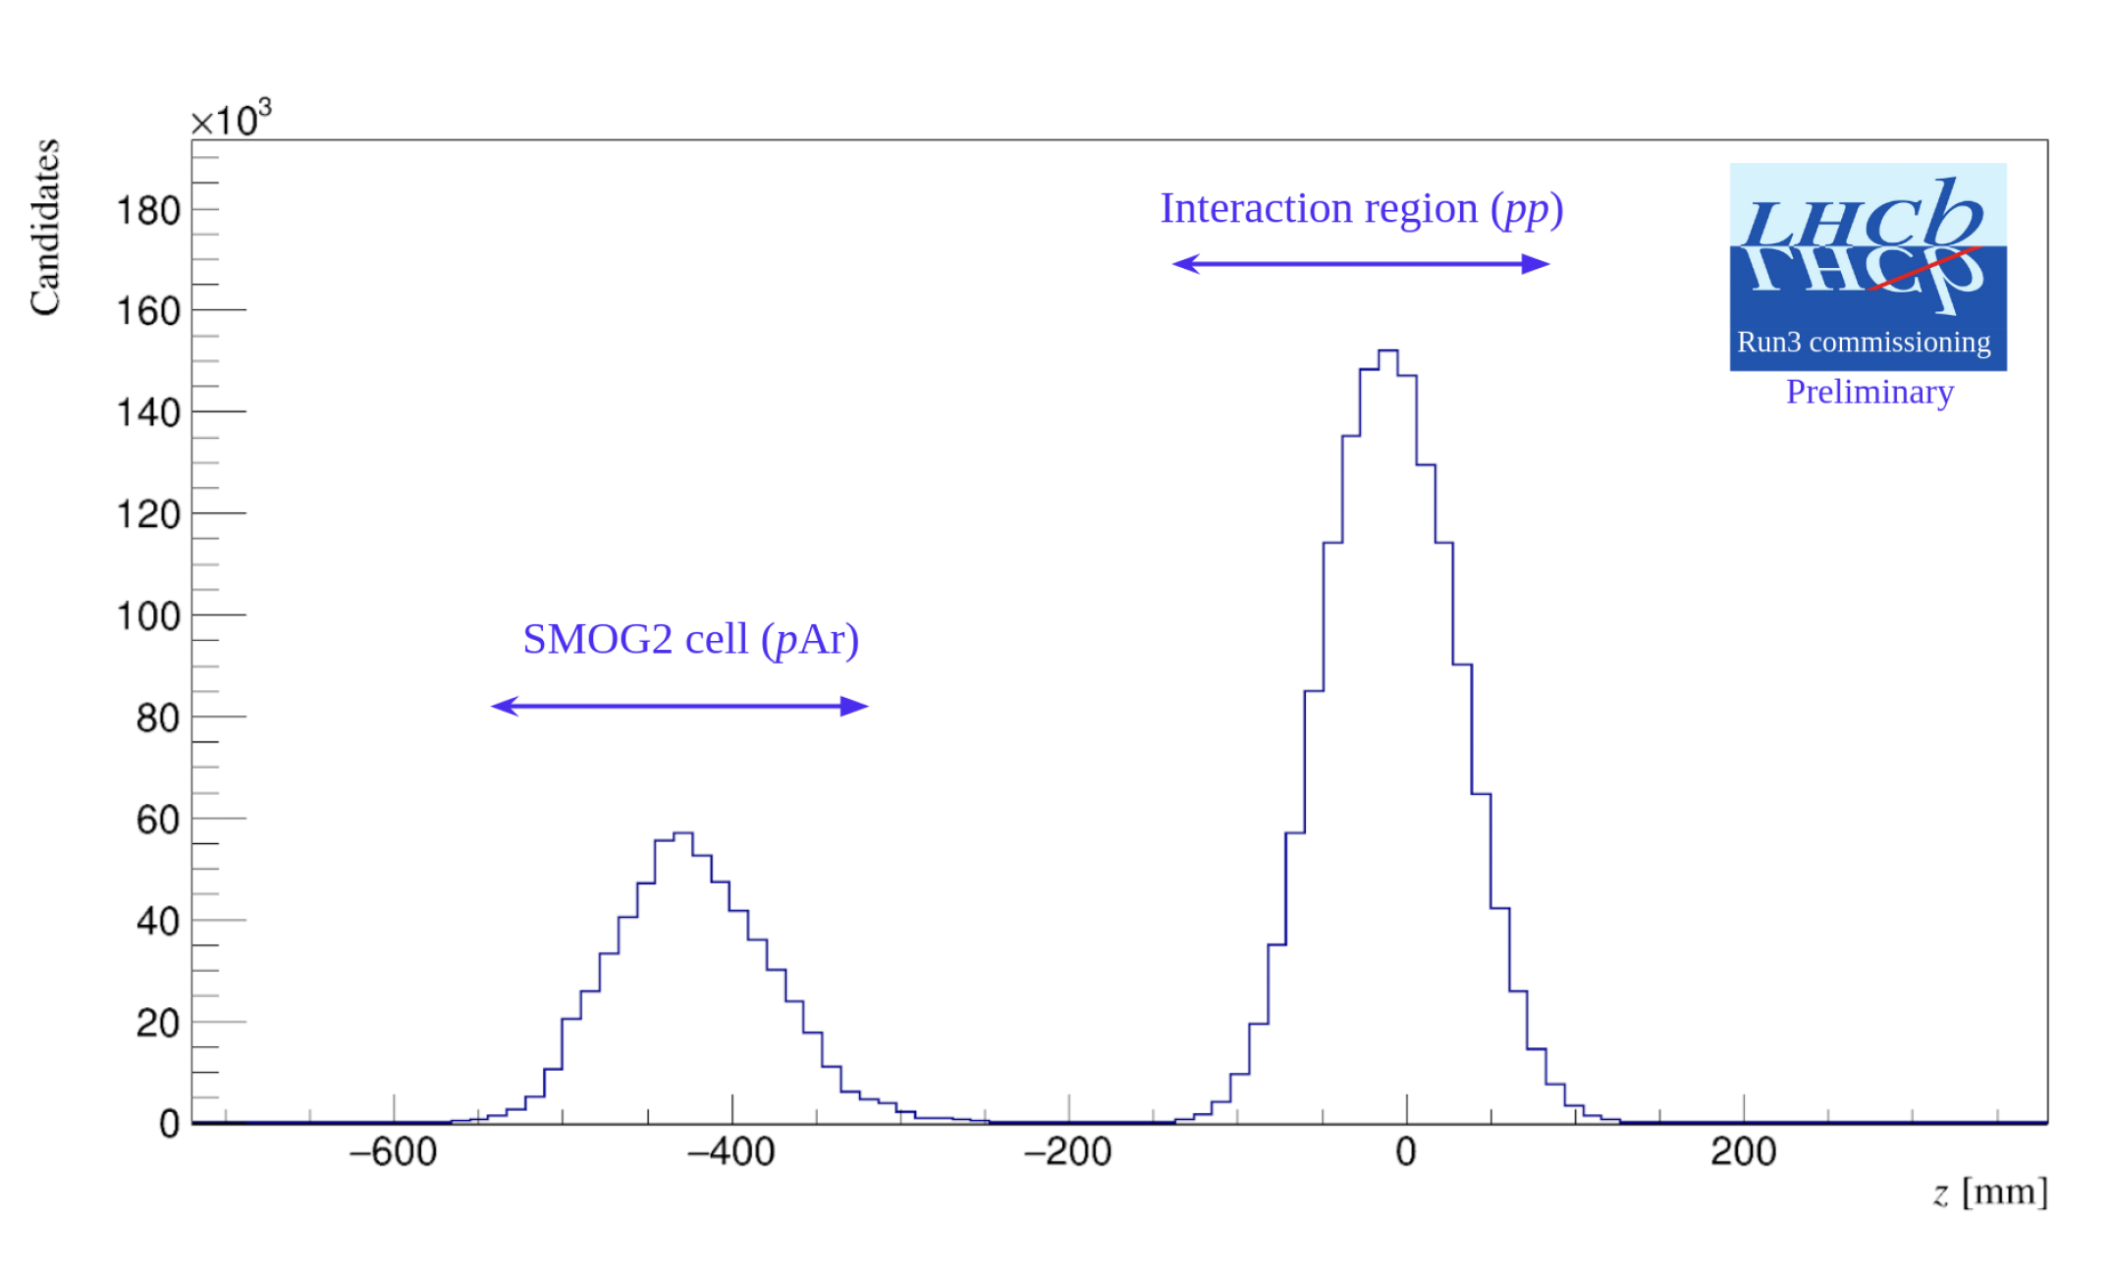
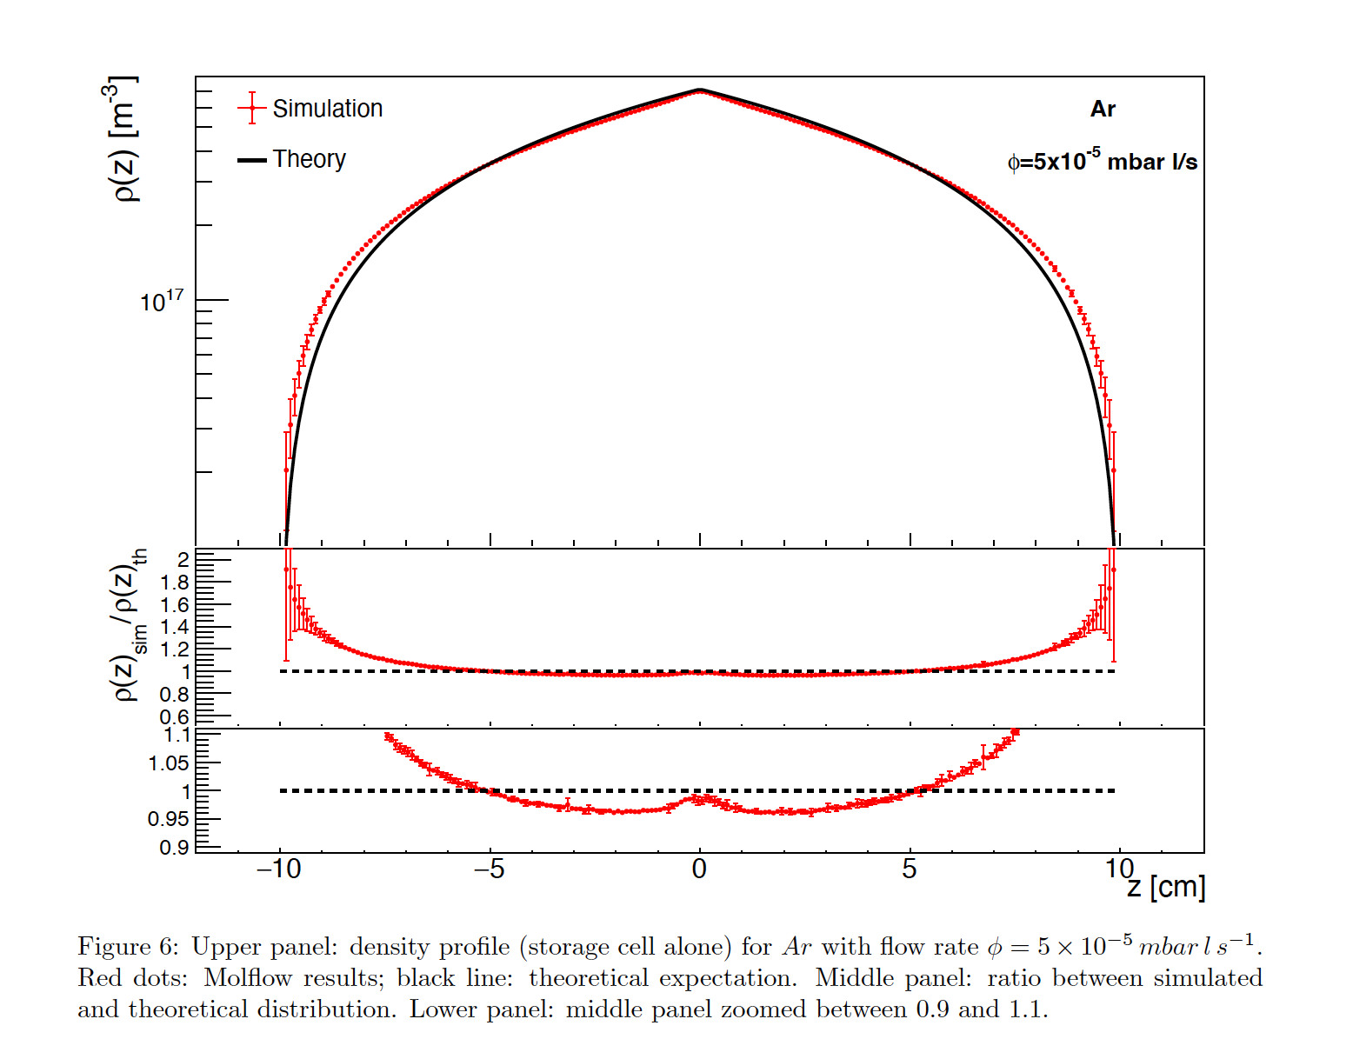
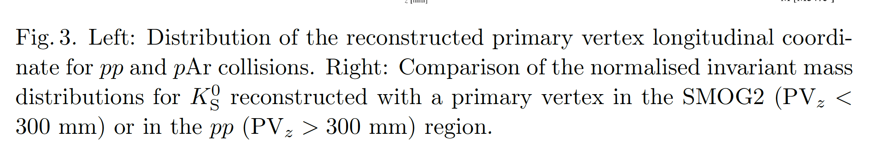
Cell thickness seen by the LHCb detector

Slide 19
It is possible to measure the conductance of the cell
The measured pressure, is not actually on the center of the cell, but with a gauge,
connected with bellow, valves and capillary, and the model, which allow has to
estimated the cell, come out from the stationary system distributed throughput,
which I’ll remind in the next slide.

Slide 20
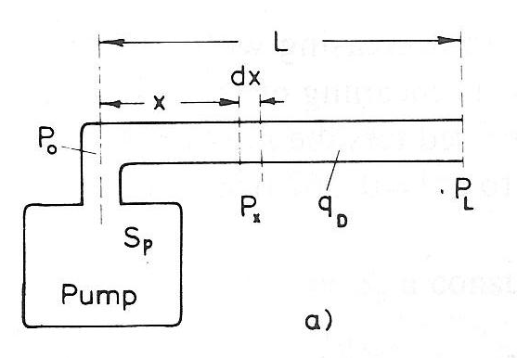
Stationary systems: distributed throughput

Slide 21
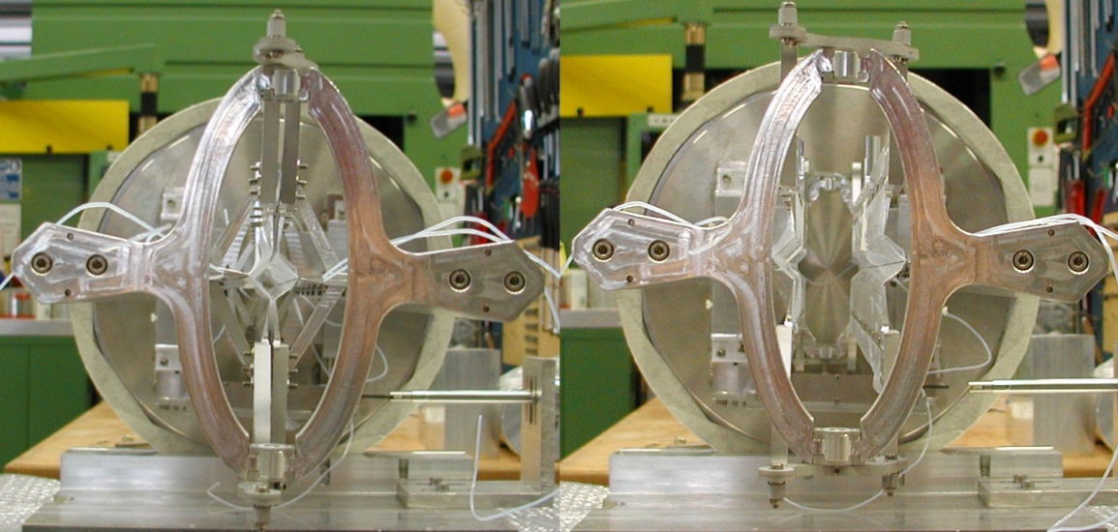
Checking if the cell close well
Measuring C_{Cell}
_{and}

Slide 22
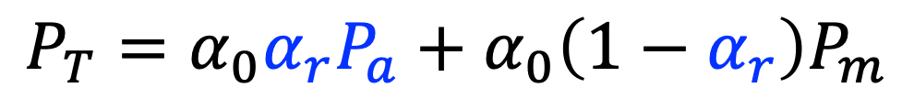
Target polarisation
$$P_{T}=α_{0}α_{r}P_{a}+α_{0}\left(1−α_{r}\right)P_{m}$$
P_{T} = total target polarization
α₀ = atomic fraction in absence of recombination
α_{r} =atomic fraction surviving recombination
P_{a} = polarization of atoms
P_{m} = polarization of recombined molecules
Relation to measured quantities, trough sampling corrections
    α_{r} = c_{α} α_{r}^{TGA}
    P_{a} = c_{P} P_{a}^{BRP}
α_{r}^{TGA}
    α_{r}^{TGA}
    measured by cross beam QMA
    P_{a}^{BRP}
    measured by cross beam QMA
    with the substraction of BGs with
    chopping beam techiniques.
    P_{a}^{BRP}

Slide 23
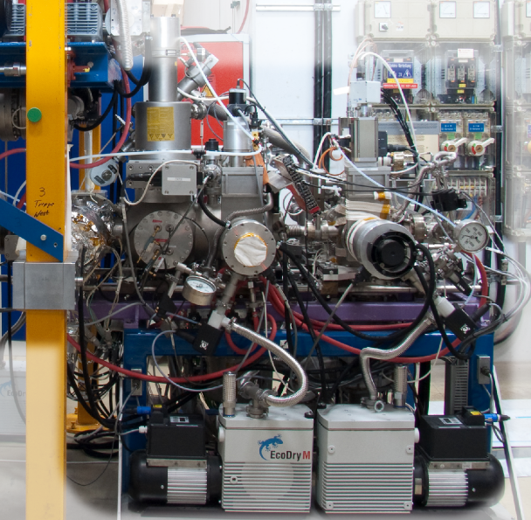
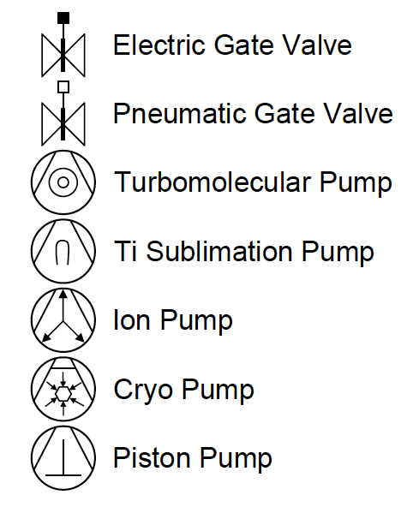
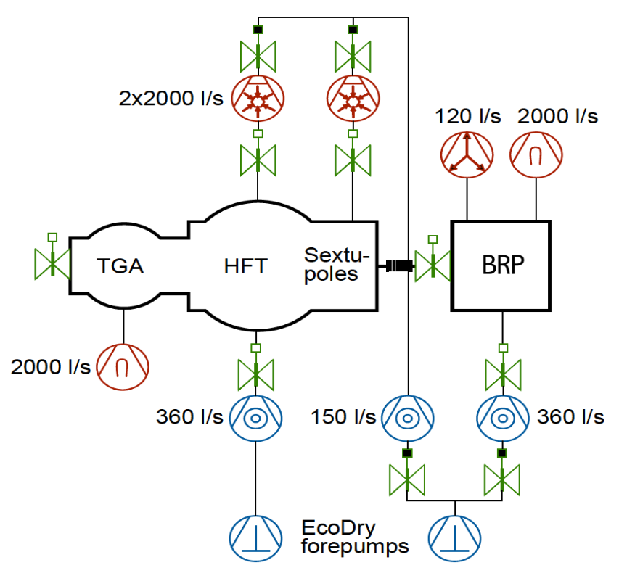
The diagnostics system vacuum scheme
TGA: NEG GP500 MK5
diode
BRP: NEG inside Ion-pump
Scroll Pumps
Initial scheme improved thanks to the characterization
of vacuum performances ad commissioning
of new pumping systems
the Ti-Ball in the TGA Chamber has been
exchanged with a NEG pump (CF150)
Also the Ion pump in the BRP has been equipped with a small NEG (CF40) inside it.
The two ecodry piston pumps, exchanged with two scroll

Slide 24
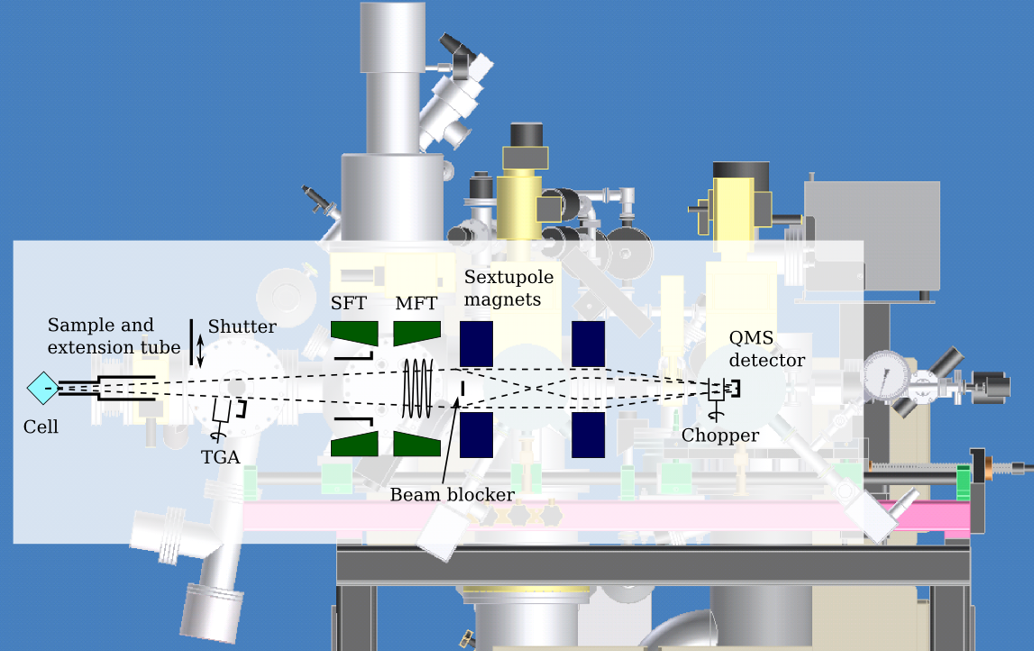
The diagnostics system inner components scheme

Slide 25
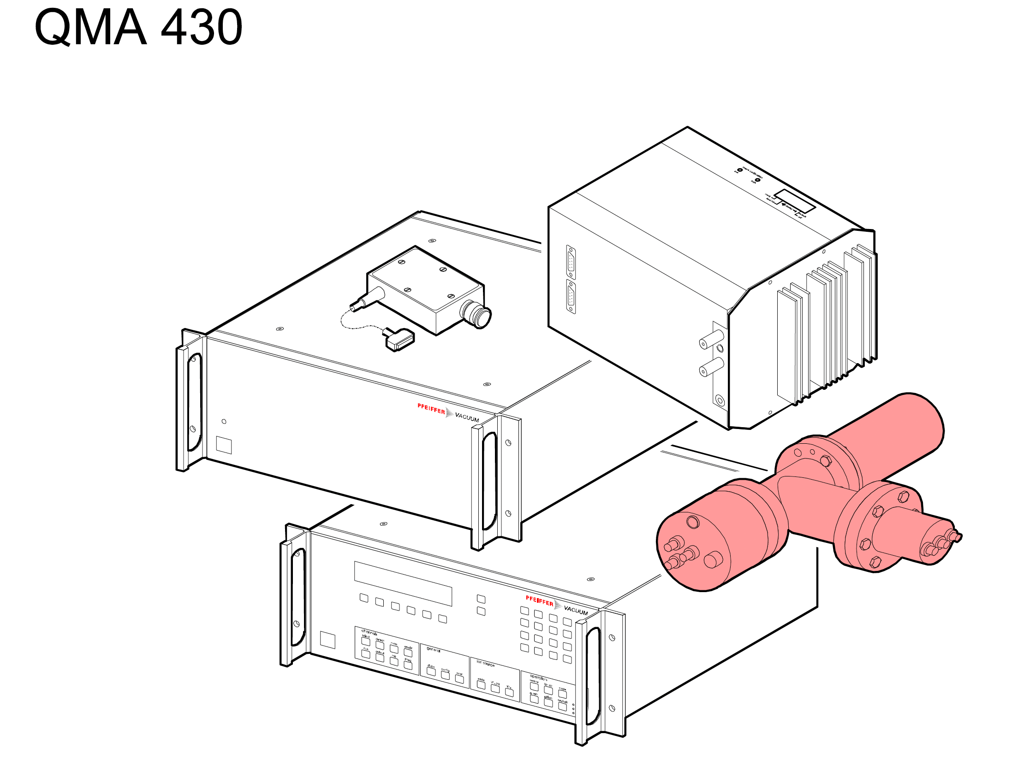
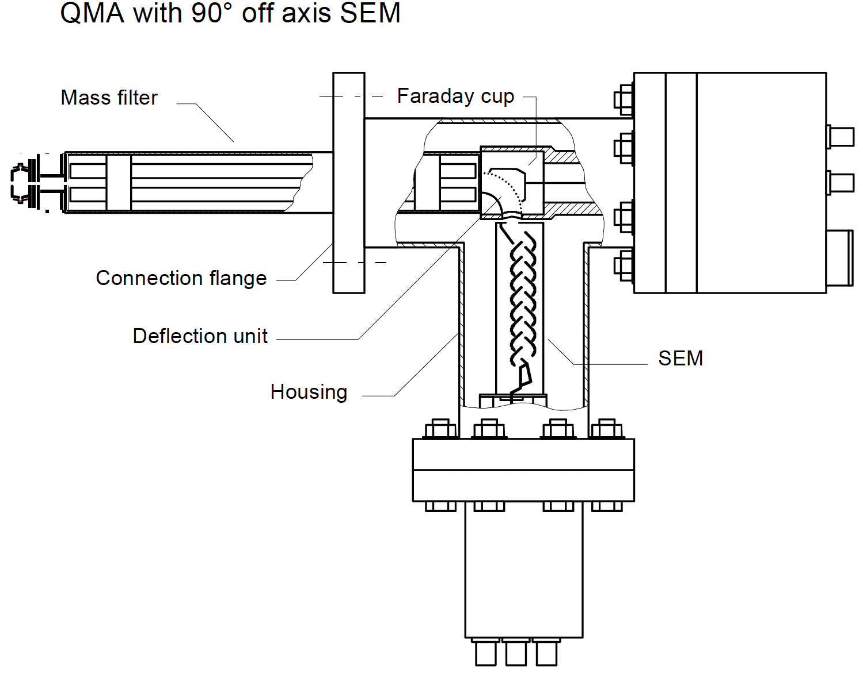
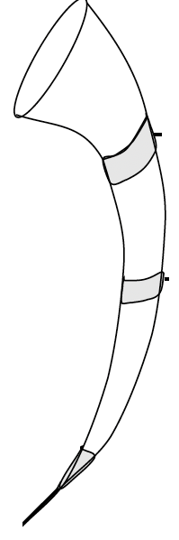
The atoms and molecules counting devices
RF module
Amplifier and Electronics QME 100
only for calibration with Faraday cup
QMA CROSS BEAM
with 90° off axis CEM
(Channel Electron Multiplier)
CEM
Channeltron
the ion optics and signal processing have to be under control and continuous cross check, for
proper calibrations and quantitative estimation.

Slide 26
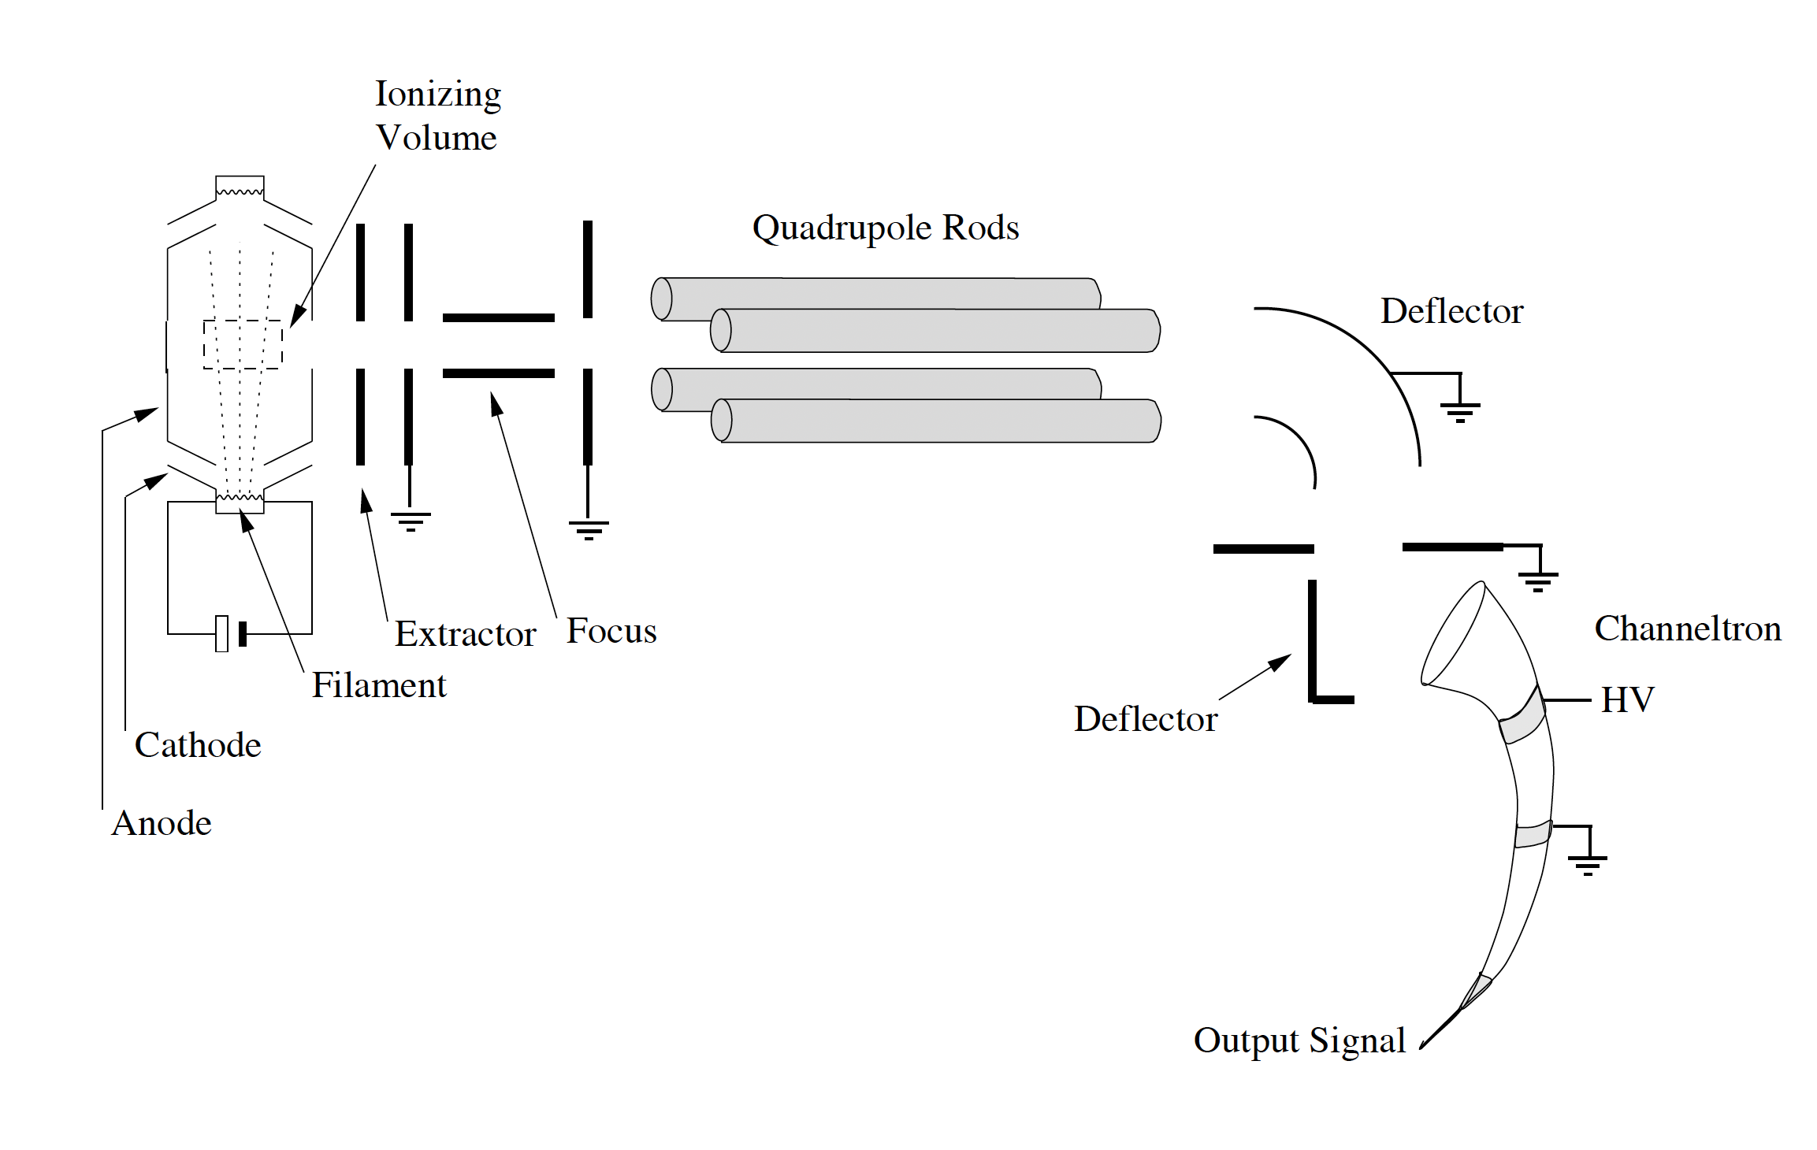
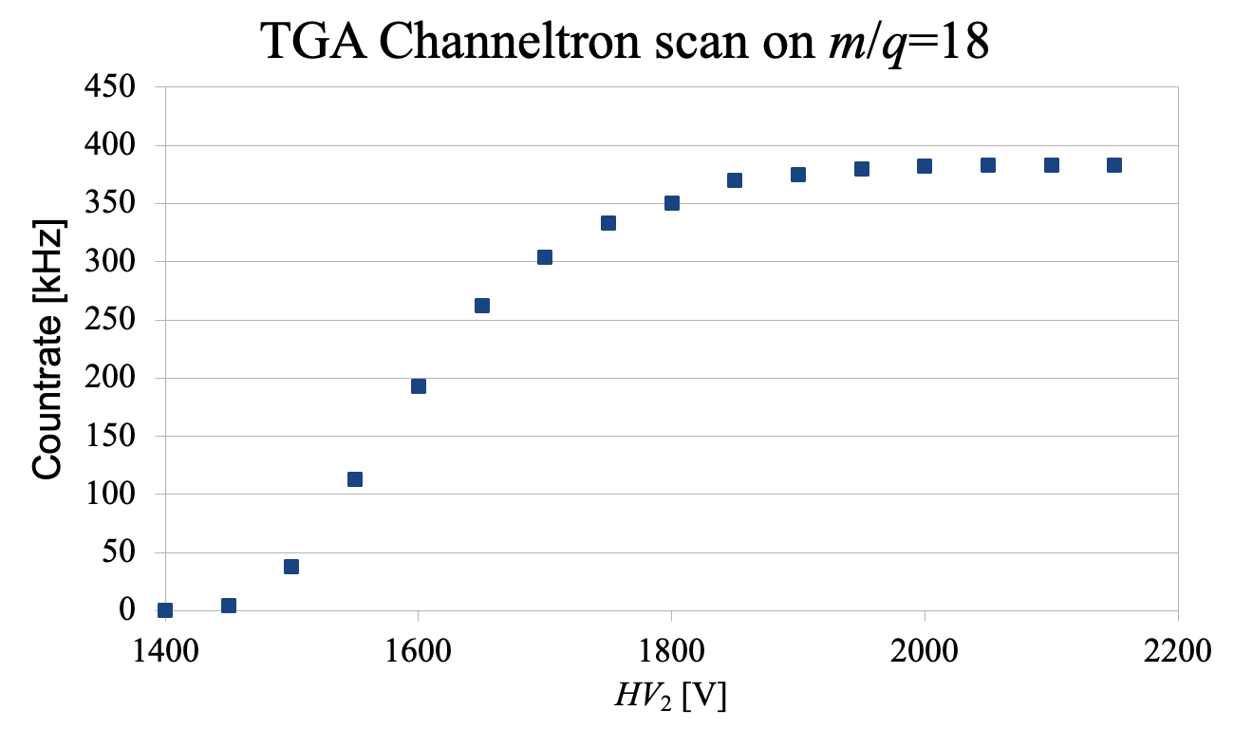
Spectrometer QMA 400 Pfeiffers Balzers
The whole filament powering,
the electrons and ions optics,
and the detector powering
and DAQ are controlled via
DAC for piloting any module
PC Software
mainly with 0-10 VDC logic,
and some module also GPIB, RS-232, RS-485
The read-out of the piloting
parameter
are performed via ADC
via software.
U₄
or as Faraday Cup
(with U₅ grounded)
U₅
U₃
HV₂
U₂
HV₁
HV₁
Extractor
Extractor
U₁
MOE

Slide 27
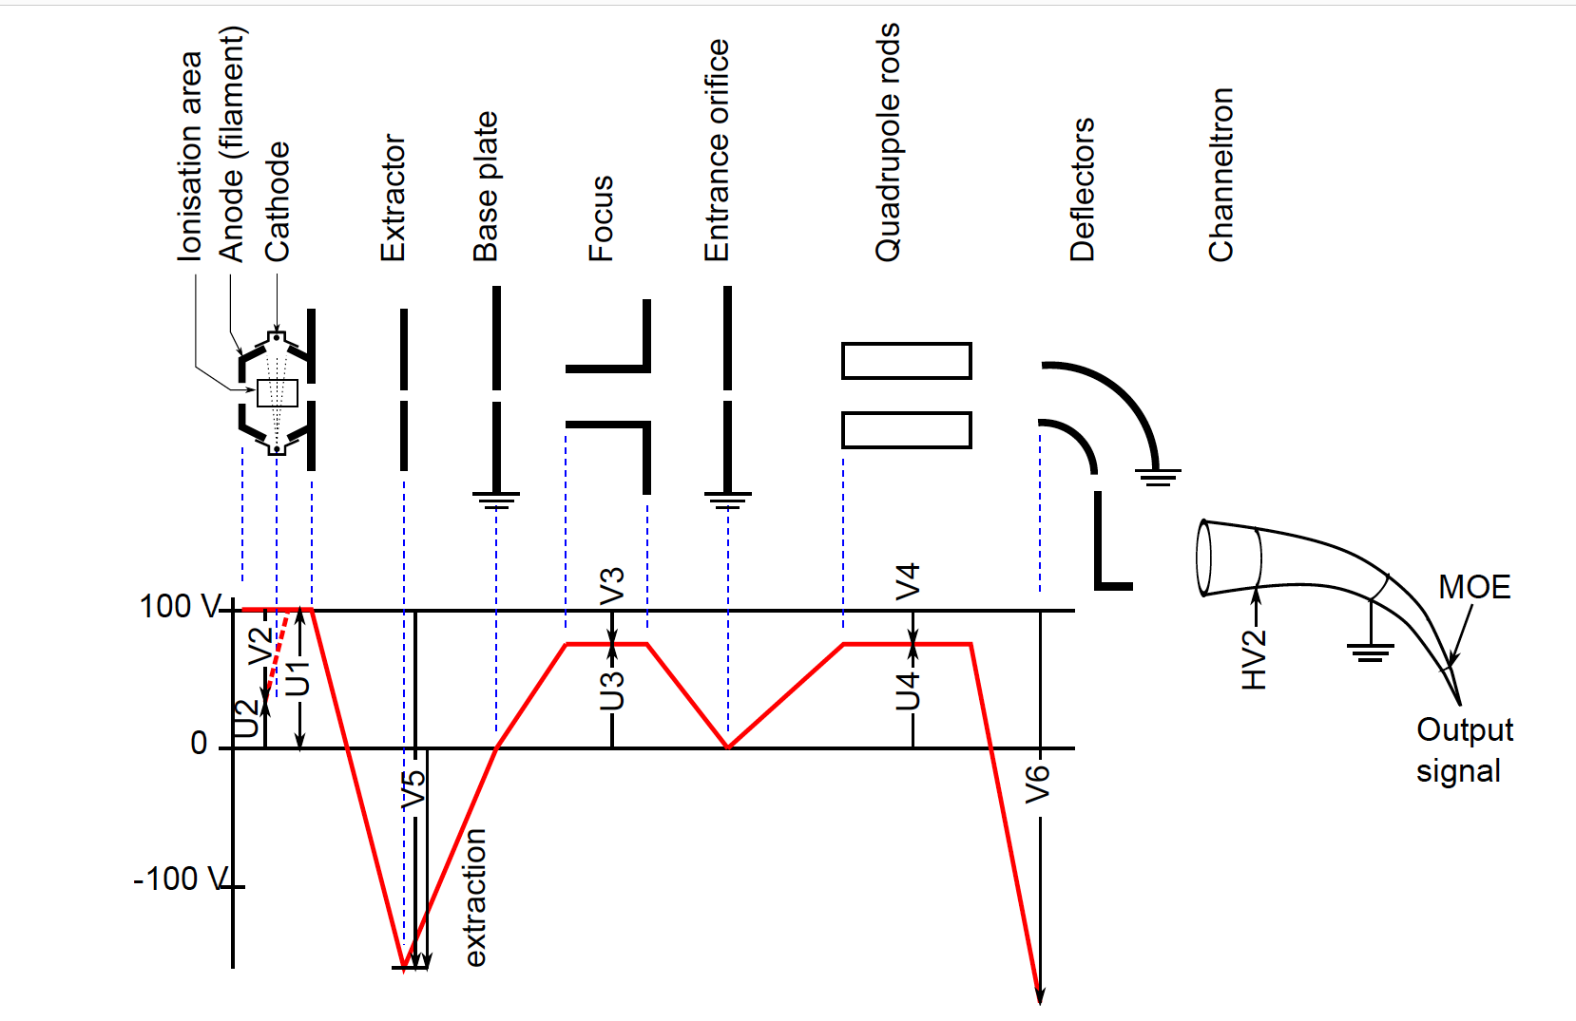
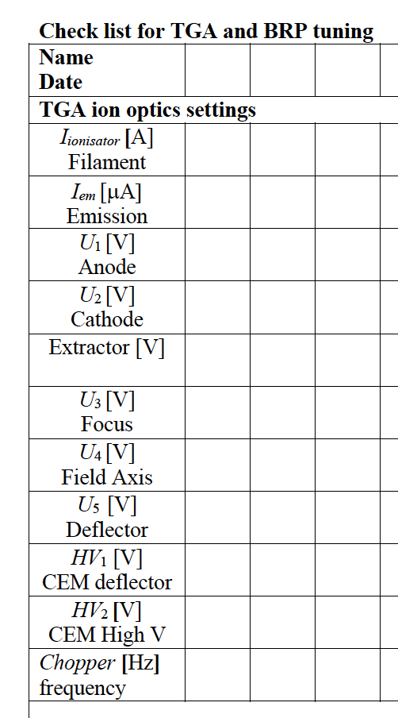
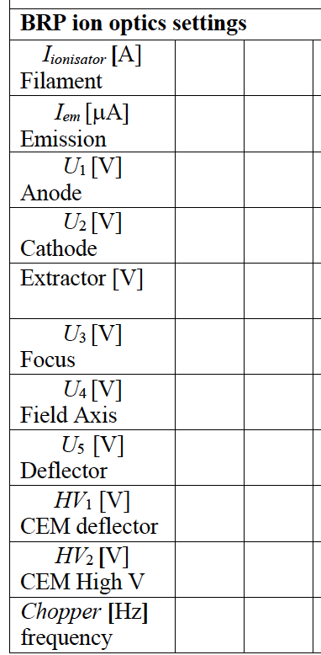
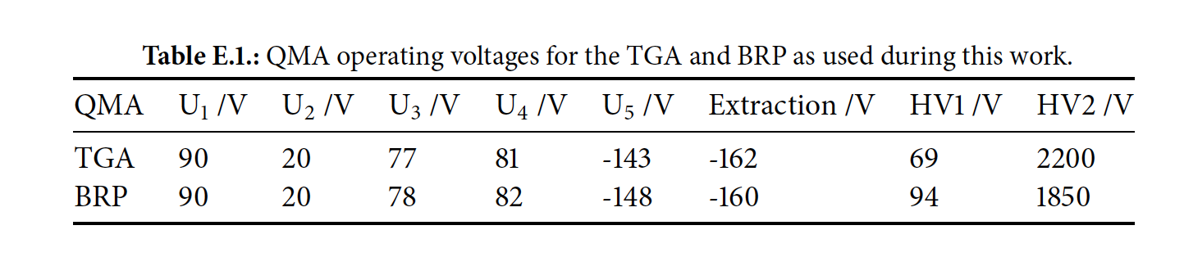
We need to check the stability of our tuning for the QMAs
HV1 →
U5

Slide 28
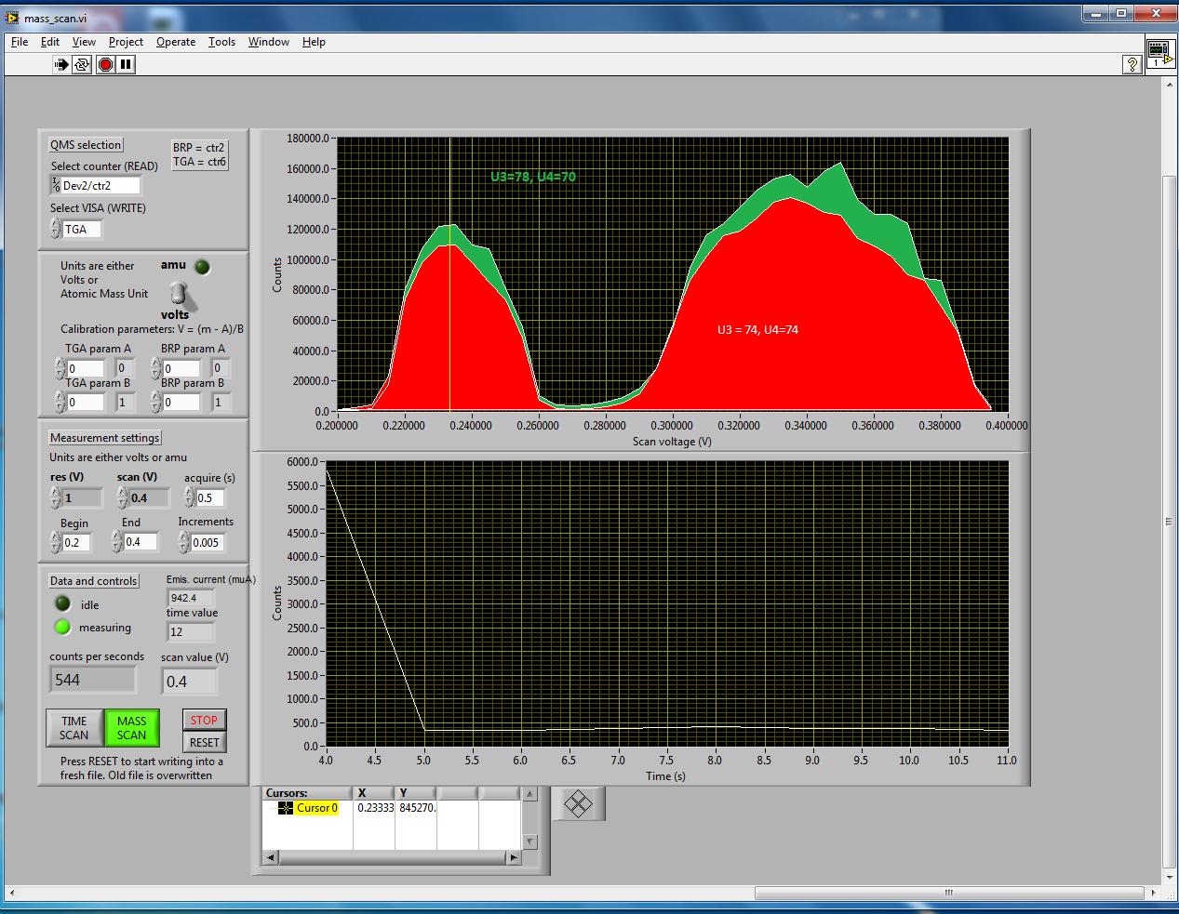
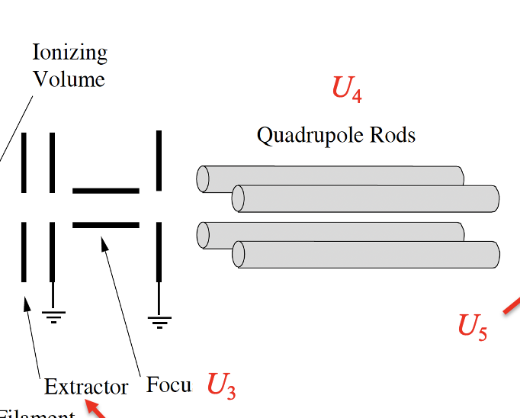
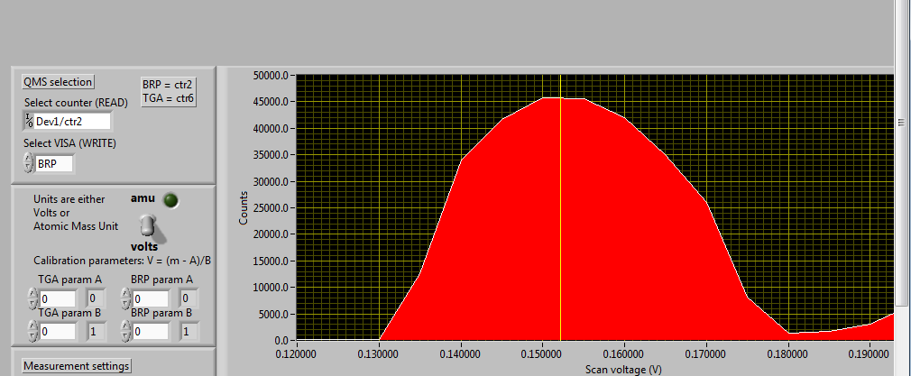
Tuning of ion optics parameters
TGA
BRP
Compromises between higher signals
and good stabilities.
For example in the tuning on TGA of m/q =1 and
and m/q=2, we choose the red one.
On BRP the setting for m/q =1 is on the max with a plateau.

Slide 29
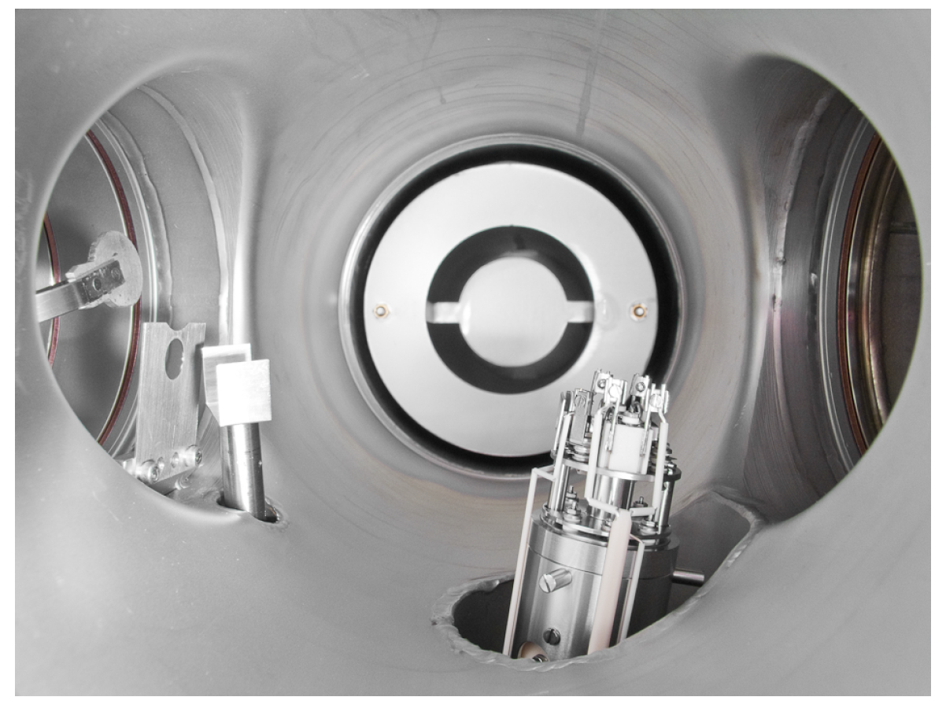

Target gas analyser
Scheme of the sampling of the target: atom and molecules diffuse towards the end of the extension tube and enter the TGA. A chopper to subtract the background. Baffles prevent atoms to hit the inner wall of ionisation volume of QMA, both tilted 7° from sampled beam axis, allowing the sampling of the beam toward the BRP
Picture of the inside of the TGA chamber,with QMA and chopper:
on the left the beam blocker, the chopper baffle and the fork chopper.
In the back the housing of the titanium sublimation pump.

Slide 30
Schemes of data acquisition and signal processing
Two types of signals:
one system which acquires QMA pulses with fast counter (DAQ), and
a second system which records analog voltages with an Analog to Digital Converter (ADC) (SLOW control).
The DAQ and the SLOW control software is programmed with the programs of the package Labview running on a standard personal computer.
QMAs pulses are amplified by fast amplifier at 1 m from QMAs.
The amplifier pulses are discriminated and converted into NIM pulses, sent to a shielded connector block (NI SC-68) an acquired by a 32-Bit counter card (NI PCI-6602).
The setup enables pulses counting for both QMAs up to one MHz.

Slide 31



Scheme of DAQ
On TGA
On M₁ 100 Cycle averaged,
On M2 Average on 300 Cycles

Slide 32
The different uses of the QMA in TGA and BRP
The QMAs installed in the TGA chamber and the BRP chamber are used in different mode of operation, let’s distinguish in
CONTINOUS MODE
  monitor vacuum and procedure of its preparation and improvements, then confirm other kind of pumping, for istance adding NEG pumps in both chambers, observing the proper setting of pumping, in order to avoid backstreaming.
CHOPPED MODE peculiar for tuning and monitoring atomic beams
  Tune the atomic beam source,
  Tune the Breit-Rabi Polarimeter
and more sofisticated
  counts atoms and molecules coming from the cell in a sampled beam,
  determine the relative population of quantum states to provide the polarization of the sampled beam, which requires different calibrations and also montecarlo simulations.

Slide 33


Continous mode: vacuum and bake-out effectiveness
Mass scan of the QMA in the
TGA Chamber.
Just after the turbo-molecular pumps
reach the regime rotation speed.
m/q (countrate)
18 (570 kHz)
TGA
28 (100 kHz)
2 (20 kHz)
1 (100 kHz)

Slide 34

I can have confidence on bake-out procedure
Looking in the base
partial pressure of
M₂ and M₁

Slide 35

Continous mode: vacuum and bake-out effectiveness
m/q (countrate)
Mass scan on m/q
for tuning of the QMA
and vacuum, partial pressures,
preparation,
test and monitoring
1 (36 kHz)
TGA
18 (260 kHz)
m/q (countrate)
2 (6 kHz)
80 (100 kHz)
Time scan on choosen m/q
In this case m/q=2 on TGA in order to follow the UHV
preparation of its Vacuum
chamber.

Slide 36


Bake out Elements and Temperatures in the real world
Two modules equipped with 16
channel of 1 kW, and interlocked with
pressure thresholds.
Each channel with PID T control, differential
and thermic switch,

Slide 37

Continous mode: vacuum and bake-out effectiveness
Mass scan on m/q
to see the effectiveness
of the bake out in this case
on the BRP.
Sometime the available time
before running is limited.
BRP
Time sc on 18
Time scan on a fixed m/q
to see the effectiveness
of the Bake out in this case
on the BRP fixing m/q=18.
one day acquisition.

Slide 38

Bake-out and conditioning, seasoning ...
Continous mode:
m/q (countrate)
18 (180 kHz)
TGA
28 (38 kHz)
44 (20 kHz)
___ m/q =2 QMA signal
Tuning of the proper flahing mode for Ti-BALL,
and monitoring of its effectiveness
on the partial pressures.

Slide 39

Continous mode:
2 (60 kHz)
m/q (countrate)
TGA
Flashing the
TGA Ti-Ball
18 (11 kHz)
28 (6 kHz)
m/q = 2

Slide 40


Difference after bake-out and help from Cryopumps

Slide 41

Ti Ball flashing improve very little
BRP

Slide 42


Back-streaming of He and Capability to pump down
TGA
He

Slide 43

Solution: NEG pumps mainly for TGA
Our Main problem
is to protect the sextupole
magnets which cannot
overcome temperature
Higher than 70 ºC.
These temperatures are in the range of what we get during the bake out of the TGA chamber. The conclusion is that we will need to cool down the flange of sextupole permanent magnets during the regeneration of the NEG pump, as usually is done for the bake-out.

Slide 44

Measurements of pumping Speed o NEG
NEG SAES Capacitorr D 2000 for TGA
Before activating the NEG, preliminarily we measured the pumping speed of the turbo pump alone, which provided a value of S_{turbo} = 122 + 3 l/s for hydrogen.
After the activaation of the NEG we measured the pumping speed of the NEG and the turbo and we get as a result S_{NEG+turbo} = 910 + 70 l/s.
We also measured the pumping speed of the NEG alone (with the valve on the turbo closed) and got only S_{NEG} = 50 + 20 l/s, much different from the expected value from the simple subtraction;
S_{NEG}= S _{NEG&turbo} – S_{turbo} ~ 780 + 70 l/s.
Anyhow for us it was a good results, we
have not only a turbo pump on the TGA,
but also the two cyopumps.
For 10⁻⁵ mbar l s⁻¹ sampled beam we expect 10⁻⁸ mbar in the TGA.

Slide 45
Commissioning of NEG PUMPS on TGA and BRP
NEG SAES Capacitorr D 2000 for TGA
After the installation and activation of the NEG pump in the TGA, opening the valve on the target chamber with the ABS in operation, the measured pressure in the TGA was
P_{TGA} = 1.6 10⁻⁸ mbar, meanwhile the target chamber pressure was P_{TC} = 3.5 10⁻⁷ mbar.
Comparing previous the value in the October 2010 run, when the TGA chamber was pumped by the TSP werecorded in the range of
P_{TGA} = 2.5 10⁻⁷ mbar at the same P_{TC} = 3.5 10⁻⁷ mbar.
Within the accuracy and the reproducibility of the gauge installed in the TGA,
it’s evident
that we improved the pumping speed of one order of magnitude.
GP 50 2F per BRP.

Slide 46

Stationary vacuum with cryopumps on
P_{TGA} < 5 10⁻¹⁰ mbar
P_{BRP} < 5 10⁻¹⁰ mbar
TGA
The ion gauge are below their minimum reading,
the cryo-pumps are running and the separation valve
is open.
The cryo-pumps are pumping also the BRP Chamber through a bellow of CF40 10 cm long and a gate valve CF40.

Slide 47


Evidence of backgrounG from TGA to BRP, not on the ion gauge
Continous mode:
P_{BRP} = 3.5 10⁻⁹ mbar
BRP
Target Valve
Separation Valve
← Not Baked→
Baked
Baked

Slide 48

Checking BRP pumping
BRP
The BRP is pumped through
the bellow and the valve conductance
by the TGA pumping system
Separation Valve

Slide 49


Opening the Target Valve and switching on ABS
18 (156 kHz)
Mass scan on m/q
to see the influence of BG
from Target Chamber:
P_{TGA} & P_{BRP} < 5 10⁻¹⁰ mbar
TGA
18 (108 kHz)
2 (40 kHz)
2 (35 kHz)
Target Valve
2 (1.6 MHz)
TGA
Mass scan on m/q
to see the influence of ABS on
from Target Chamber:
P_{TGA} = 1.6 10⁻⁸ mbar
P_{BRP} < 5 10⁻¹⁰ mbar

Slide 50


Tuning on of mass ... our ROI (region of interest)
m/q
18
Injecting D₂
2
4
TGA
1
3
19
1
17
16
20
15
14

Slide 51

Chopped Mode: monitoring the ABS perfomance
The atomic flux Φ_{a} originate esclusively from ABS.
From the dissociative ionization in the target can be neglected.
Measured just feeding molecular atoms in the cell
1 % has to be subtracted.
Sampled gas
To TGA
and BRP
extension tube
ABS Injection

Slide 52



Chopped Mode: monitoring the ABS perfomance
TGA Signal
BRP Signal

Slide 53


accurate measurements of
Atomic and molecular fraction
The measure atomic (molecular) signal S_{a} (S_{m}) is proportional
to the corresponding flux Φ_{a} (Φ_{m}) into the TGA,
the ionization cross-section $σ_{a}^{ion}$($σ_{m}^{ion}$),
the detection probability $ε_{a}^{ion}$ ($ε_{m}^{ion}),$
the mean inverse velocity of the particles <1/v_{a}> (<1/v_{m}>),
will depend on the frienging magnetic field (B) of the target, and on the emission current (I_{em}) from the electron gun which we indicate as $f\left(B,I_{em}\right)$
$${S_{a,m}∝f\left(B,I_{em}\right)σ_{a,m}^{ion} ε}_{a,m}^{ion}\left\langle \frac{1}{v_{a,m}}\right\rangle Φ_{a,m}$$

Slide 54

Our interest the number of nucleon in the target
For H and D the degree of dissociation measured by TGA using nucleon flow rates is defined as:
α^{TGA} = $\frac{φ_{a}^{TGA}}{φ_{a}^{TGA}+φ_{m}^{TGA}}$
where $φ_{a}^{TGA}$ flow rate of nucleons coming from atoms,
$φ_{m}^{TGA}$ flow rate of nucleons coming from molecules.
Flow rate of nucleons are related to atomic and molecular flow rates $Φ_{a}^{TGA}$ ${and Φ}_{m}^{TGA}$ as follow:
$φ_{a}^{TGA}= Φ_{a}^{TGA}$,
$φ_{m}^{TGA}= {2 Φ}_{m}^{TGA}$.

Slide 55



From the $S_{a,m}∝$ ... $Φ_{a,m}$:
$$α^{TGA}=\frac{Φ_{a}^{TGA}}{Φ_{a}^{TGA}+{2 Φ}_{m}^{TGA}}=\frac{\frac{S_{a}}{f\left(B,I_{em}\right)σ_{a}^{ion}ε_{a}^{ion}\left\langle \frac{1}{v_{a}}\right\rangle }}{\frac{S_{a}}{f\left(B,I_{em}\right)σ_{a}^{ion}ε_{a}^{ion}\left\langle \frac{1}{v_{a}}\right\rangle }+2\frac{S_{a,m}}{f\left(B,I_{em}\right)σ_{m}^{ion}ε_{m}^{ion}\left\langle \frac{1}{v_{m}}\right\rangle }}$$
$$α^{TGA}=\frac{S_{a}}{S_{a}+2\frac{σ_{a}^{ion}ε_{a}^{ion}}{σ_{m}^{ion}ε_{m}^{ion}}\frac{\left\langle v_{m}\right\rangle }{\left\langle v_{a}\right\rangle }S_{m}}$$
for atoms and molecules thermalized on ext. tube
$$From \left\langle v\right\rangle =\sqrt{\frac{8k_{B}T_{ext}}{πm}}:\frac{\left\langle v_{m}\right\rangle }{\left\langle v_{a}\right\rangle }= \frac{1}{\sqrt{2}} then$$
$$α^{TGA}=\frac{S_{a}}{S_{a}+\sqrt{2}\frac{σ_{a}^{ion}ε_{a}^{ion}}{σ_{m}^{ion}ε_{m}^{ion}}S_{m}}=\frac{S_{a}}{S_{a}+\sqrt{2} k S_{m}}$$

Slide 56

k calibration
Assuming the ABS flux constant and no change in temperature and current emission (o using the normalized signal S/I_{emiss} and T correction:
${φ_{tot}^{TGA}=φ}_{a}^{TGA}+φ_{m}^{TGA}=Φ_{a}^{TGA}$+2 $Φ_{m}^{TGA}$ $∝S_{a}+\sqrt{2} k S_{m}$
In HERMES changing (on purpose) the T of the cell, we change the recombination then we change for the same flow the S_{a} and S_{m} ratio.
Correction are needed with respect to the temperature of the extension tube and emission current.
But we are able to provide average calibration over the runs
for Hydrogen and Deuterium:
k measured during run for Hydrogen 0.5507 + 0.0023
k measured for Deuterium 0.861 + 0.015

Slide 57

Just showing a tipical k calibration for Deuterium

Slide 58
We have to distinguish and measure other contributions to molecules counting
Flow of molecules coming from the target chamber φ_{rg}, through the cell, which can be measured by feeding gas in the chamber of the target at the same pressure read during atomic beam injection.
Ballistic flow from ABS φ_{ball}, which can be determined by feeding in the cell different states of ABS, the ballist flow will be constant.
C. Baumgarten et al. A gas analyzer for the internal polarized target of the HERMES experiment
NIMA 508 (2003) 268-275

Slide 59




Quantum state populations:
a scheme of hyperfinestates (hps) of H and D
D
H
$$B_{c}^{H}=50.7 mT$$
$$B_{c}^{H}=11.7 mT$$
Breit-Rabi diagram for H and D
we can manage both H and D, for simplicity I’ll present more details for H

Slide 60



Quantum state selection (Stern-Gerlach and rot)
With proper RF transition units we can rotate the angular
momentum of the atoms and with a 2nd sextupole

Slide 61



RF transitions MFT
Each transition requires proper B_{hom}, B_{grad}, ν, and they can be overimposed.
The requirements are different for H and D.
For the magnet we can use the same, for RF generator we have different modules for H and D.
H
D

Slide 62

RF transitions MFT

Slide 63



RF transitions (SFT)
H
D

Slide 64



Type of transition depending on oscillating B_{HF}
B_{HF}
B_{HF}

Slide 65

Dual Cavity for H and D use SFT
Match existing geometry in the BRP, no change in volume occupied by the cavity
Oscillating field (B_{HF}) at 45º respect to the static Field and to beam axis (previously along)
Push-Pull excitation of the two rods, we have
a B_{HF} ortoghonal to the axis of the rods
B_{HF║}
To excite both
σ and
π HF transitions
B_{HF}
B_{HF ┴}
Axis of B static and gradient

Slide 66

Dual Cavity
D. RF in
H fixed rod
H. RF in
D fixed rods
lin = 44 mm
H tunable rod
Site for D RF Pick-up
H tunable rod
Site for H RF Pick-Up
D rotable rods
H rotable rods

Slide 67

First tuning the Atomic beam Source for the injection of state |1> in the cell.
CHOPPED MODE ABS MFT SCAN - BRP OFF
ABS

Slide 68


Injecting state |1> and tuning the MFT 13 of
BRP
CHOPPED MODE ABS MFT at |1> - BRP MFT 13
Sextupole Magnests defocus
|3> and |4> states
BRP
MFT 13

Slide 69

Injecting state |1> and tuning the SFT 14 of
BRP
CHOPPED MODE ABS inj. |1> - BRP SFT 14
Sextupole Magnests defocus
|3> and |4> states
BRP SFT 14

Slide 70

Injecting state |2> and tuning the SFT 24 of
BRP
CHOPPED MODE ABS |2> - BRP SFT 24
Sextupole Magnests defocus
|3> and |4> states
MFT 13

Slide 71

BRP SFT - Behavior

Slide 72


SFT dual Cavity for H and D cavity

Slide 73


The tuning to be performed for ABS and BRP
this is the simplest for polarized H.

Slide 74


BRP calibration requires measurements of
efficiencies and transmission probabilities
(11 unknowns for H, 40 for D))
Measured BRP signals S_{i} are described by a set of linear functions of four hyperfine state intensities I_{a}
S_{i}=Σ M_{ia} I_{a}
M_{ia} a matrix measurements,which depends on transition efficiencies and transmission probabilities for the hyperfine states.
C. Baumgarten et al. An atomic beam polarimeter to measure the nuclear polarization in the HERMES gaseous polarized
Hydrogen and deuterium target NIMA 482 (2002) 606-618.

Slide 75

Polarization measurements injecting state \1>.

Slide 76
The following slides are
Spares, under construction, or still under brainstorming

Slide 77

BRP vacuum check

Slide 78

Measurements of the Cell Conductance

Slide 79



Ionization cross section

Slide 80
Relative Ionization Probability

Slide 81




SEM or CEM

