Slide 1
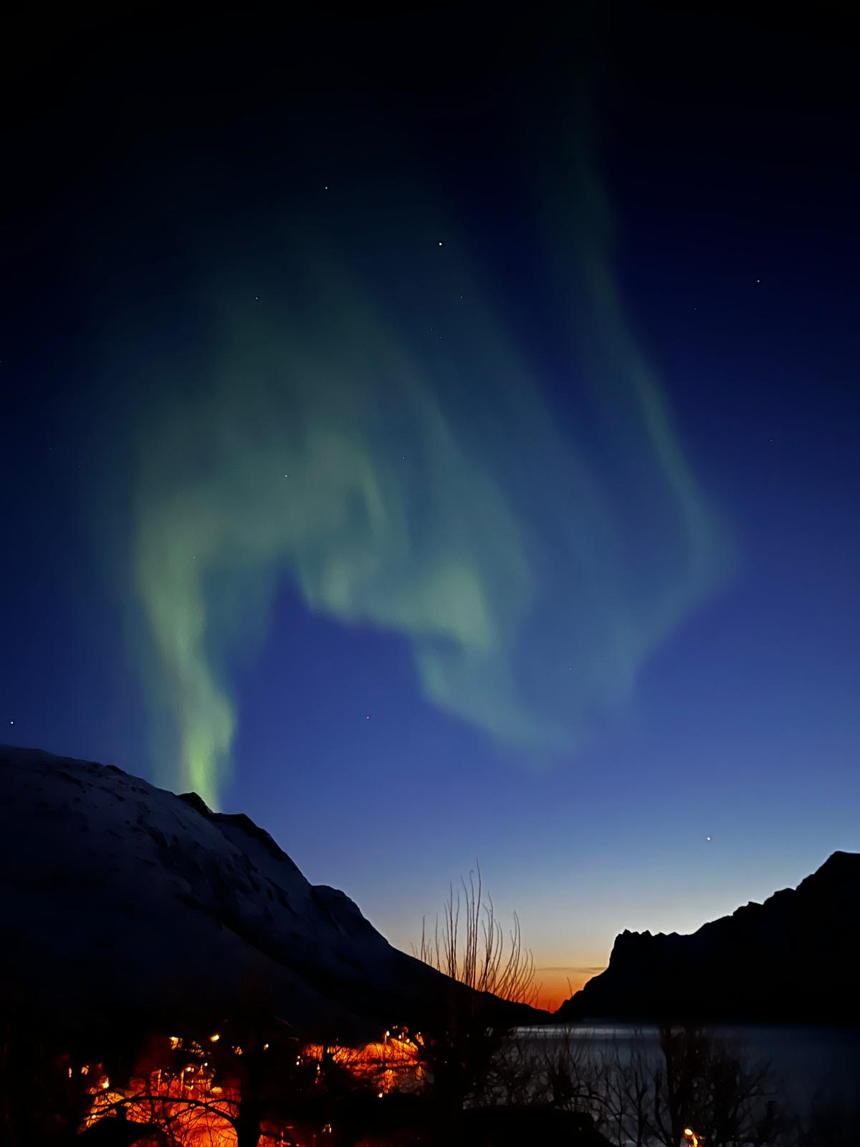
IONIZATION
GAUGES

Slide 2
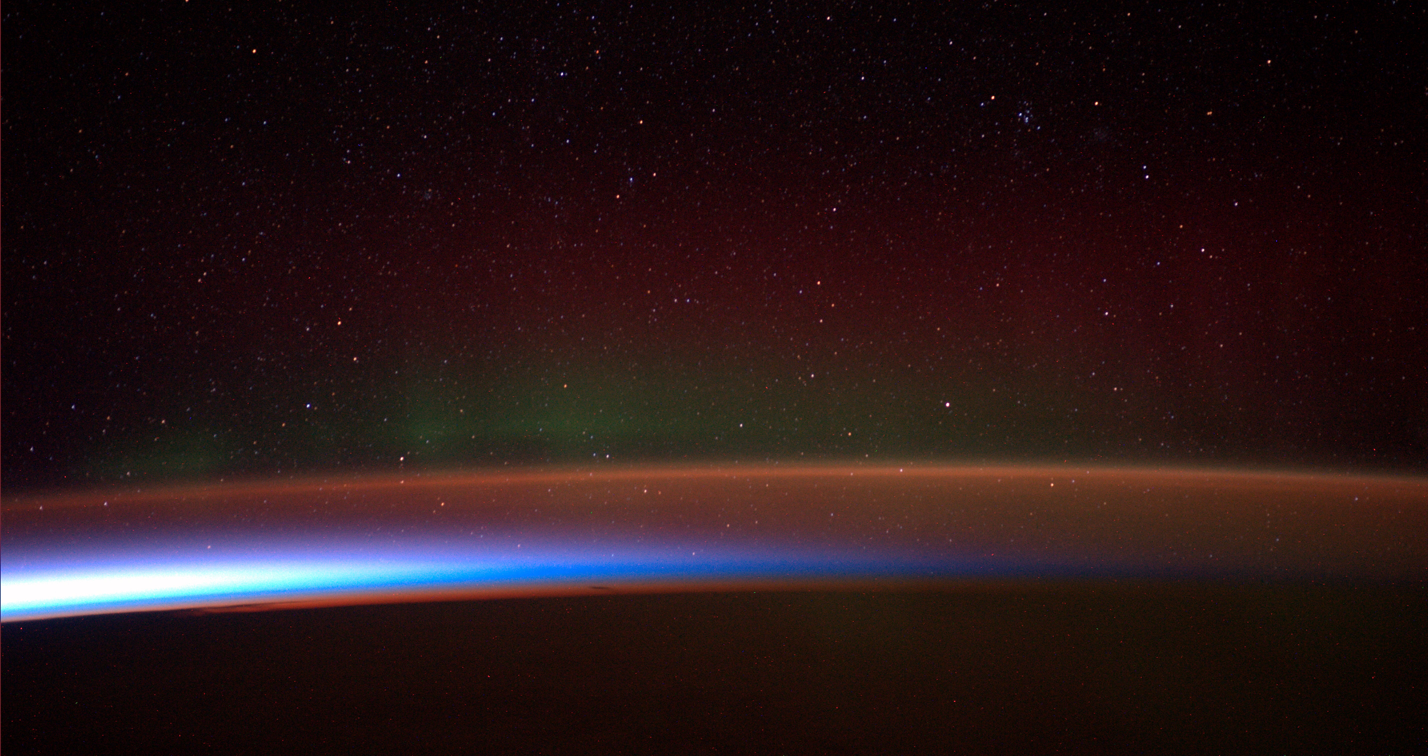
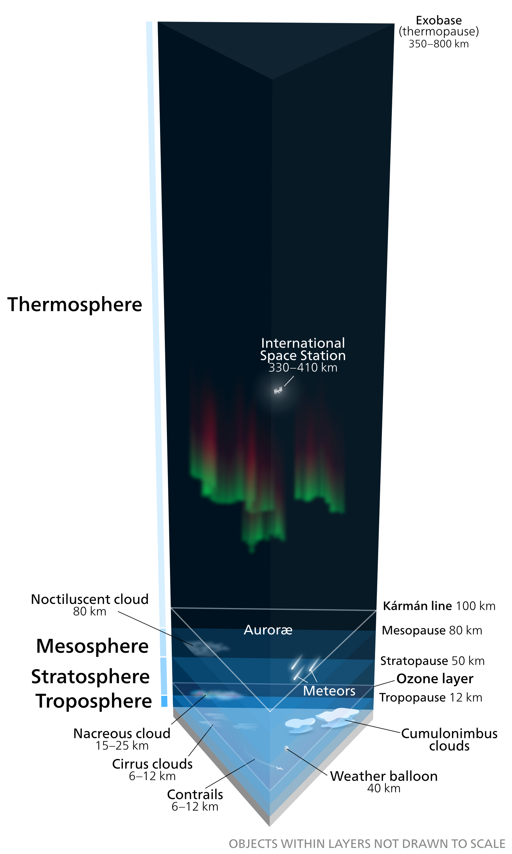
10-6 mbar
10-3 mbar
1 mbar
1000 mbar
http://www.esa.int/spaceinimages/Images/2014/06/Antarctic_aurora
https://commons.wikimedia.org/wiki/File:Earth%27s_atmosphere.svg

Slide 3
Low pressure Gauges
Pressure is the perpendicular force per area. Measuring force gets really hard at 10⁻⁸ mbar ≈ 10 ng / cm². (Resolution of good micro scale is 100 ng, see https://www.mt.com/int/de/home/products/Laboratory_Weighing_Solutions/microbalances.html)
Pressure is Force / Area. In a ideal gas p = nkT, n = number density, k = Boltzmann c., T = Temperature, if isotropic movement of particles!
.. And there is no pressure in a tube if the mean free path is > object dimensions.

Slide 4
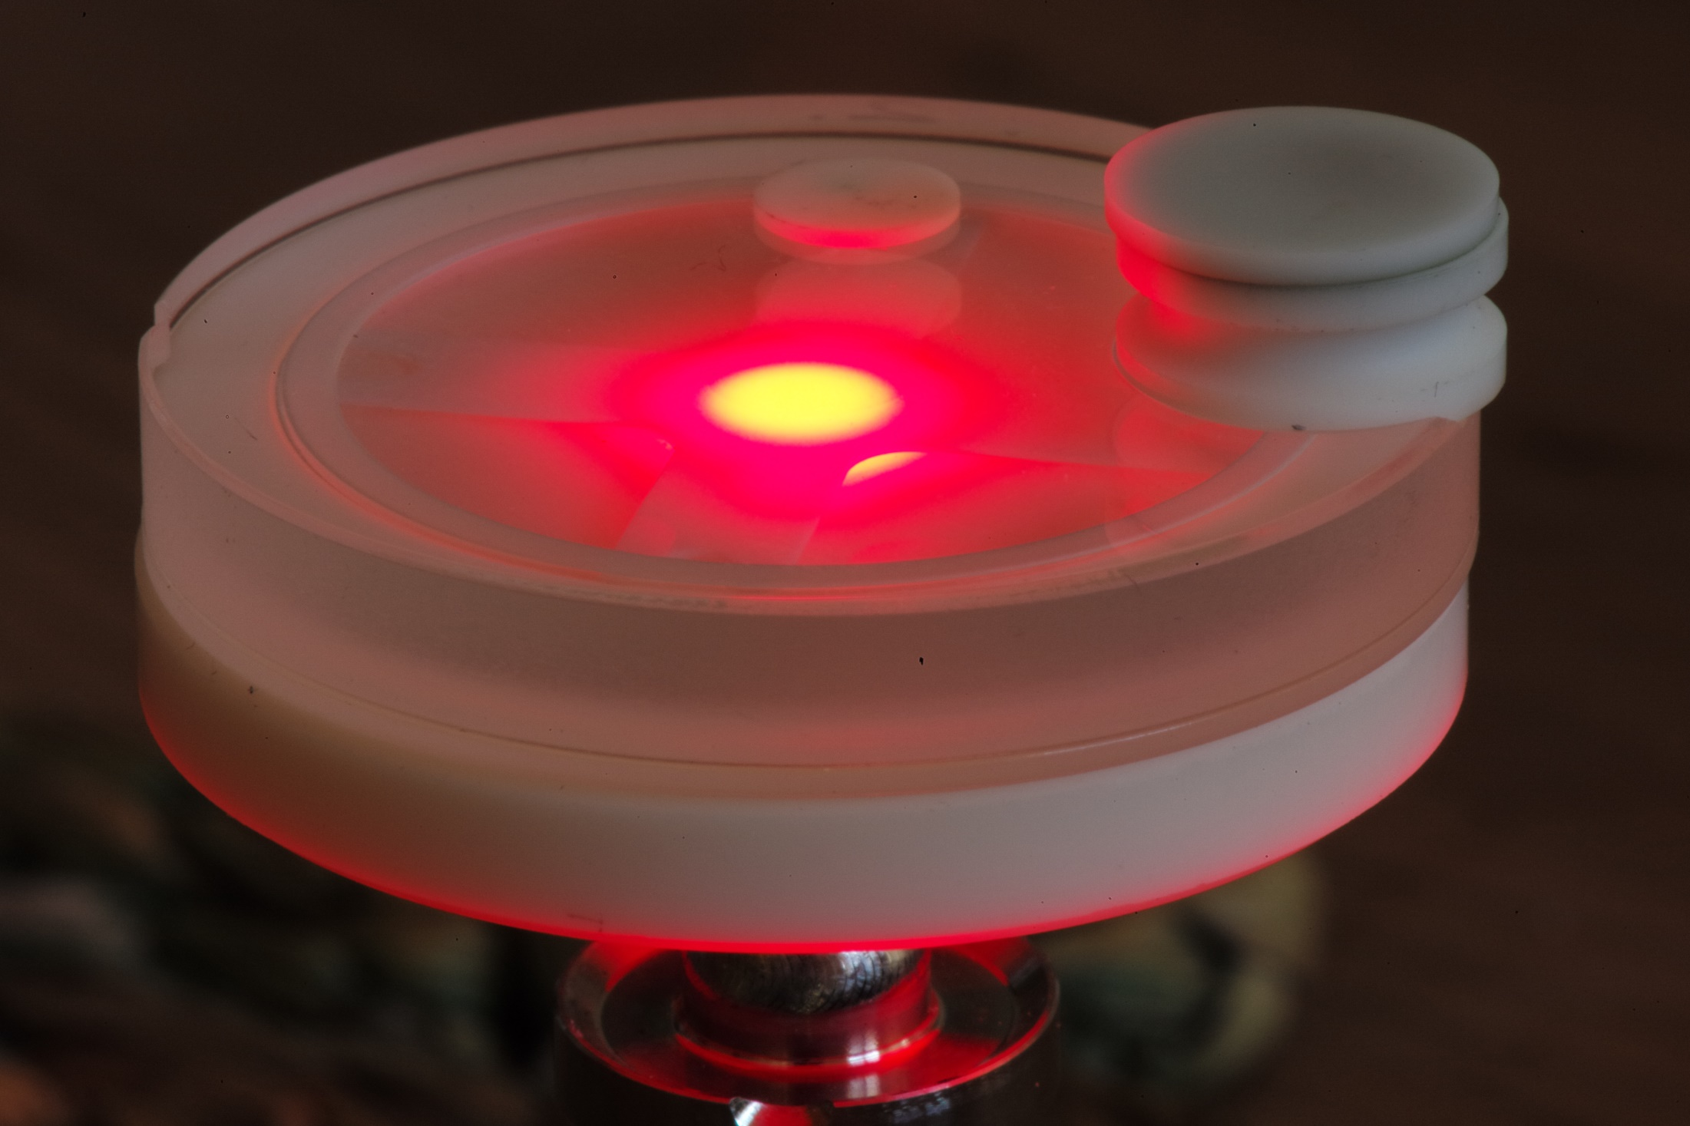
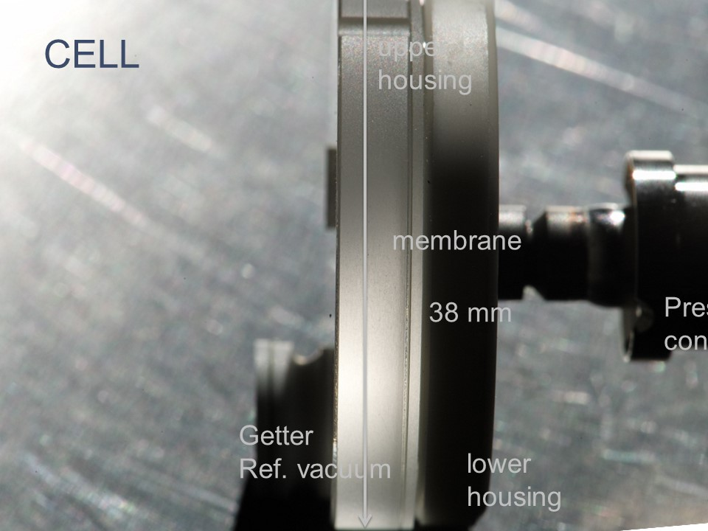
Low pressure Gauges, experimental

Slide 5
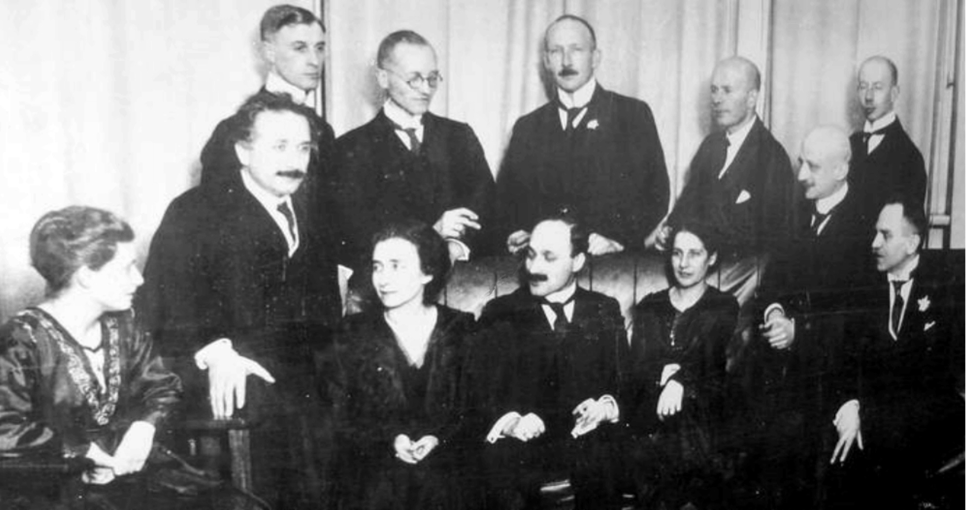
Berliner Physiker und Chemiker 1920. Stehend vlnr: Walter Grotrian, Wilhelm Westphal, Otto von Baeyer, Peter Pringsheim, Gustav Hertz. Sitzend vlnr: Hertha Sponer, Albert Einstein, Ingrid und James Franck, Lise Meitner, Fritz Haber, Otto Hahn.
https://commons.wikimedia.org/wiki/File:Berliner_Physiker_u_Chemiker_1920.jpg

Slide 6
Otto von Baeyer, Inventor of the Ion Gauge 1909, Phys. Z. 10 (1909) 168
Berliner Physiker und Chemiker 1920. Stehend vlnr: Walter Grotrian, Wilhelm Westphal, Otto von Baeyer, Peter Pringsheim, Gustav Hertz. Sitzend vlnr: Hertha Sponer, Albert Einstein, Ingrid und James Franck, Lise Meitner, Fritz Haber, Otto Hahn.
https://commons.wikimedia.org/wiki/File:Berliner_Physiker_u_Chemiker_1920.jpg

Slide 7
Who is talking?
Urs Waelchli
CTO INFICON
INFICON
Balzers & Leybold Instrumentation
Balzers
IMI Stockholm / ESA
Univ. Bern Physics

Slide 8
Science of Ionization Gauges?
I⁺
β
O
e⁻
e⁻
e⁻
Ie
H
H
Q_{i}
L

Slide 9
Science of Ionization Gauges?
I⁺
β
O
e⁻
e⁻
e⁻
Ie
H
H
Q_{i}
L
Ionization:
$$I^{+}=βQ_{i}LI^{e}$$
Ion Current = Extraction Prob. x Ionization Prob. x Path Length x Electron Current

Slide 10
Challenges of Ion Gauges:
SINK!
I⁺
SOURCE!
β
O
e⁻
e⁻
e⁻
Ie
H
H
Q_{i}
L

Slide 11
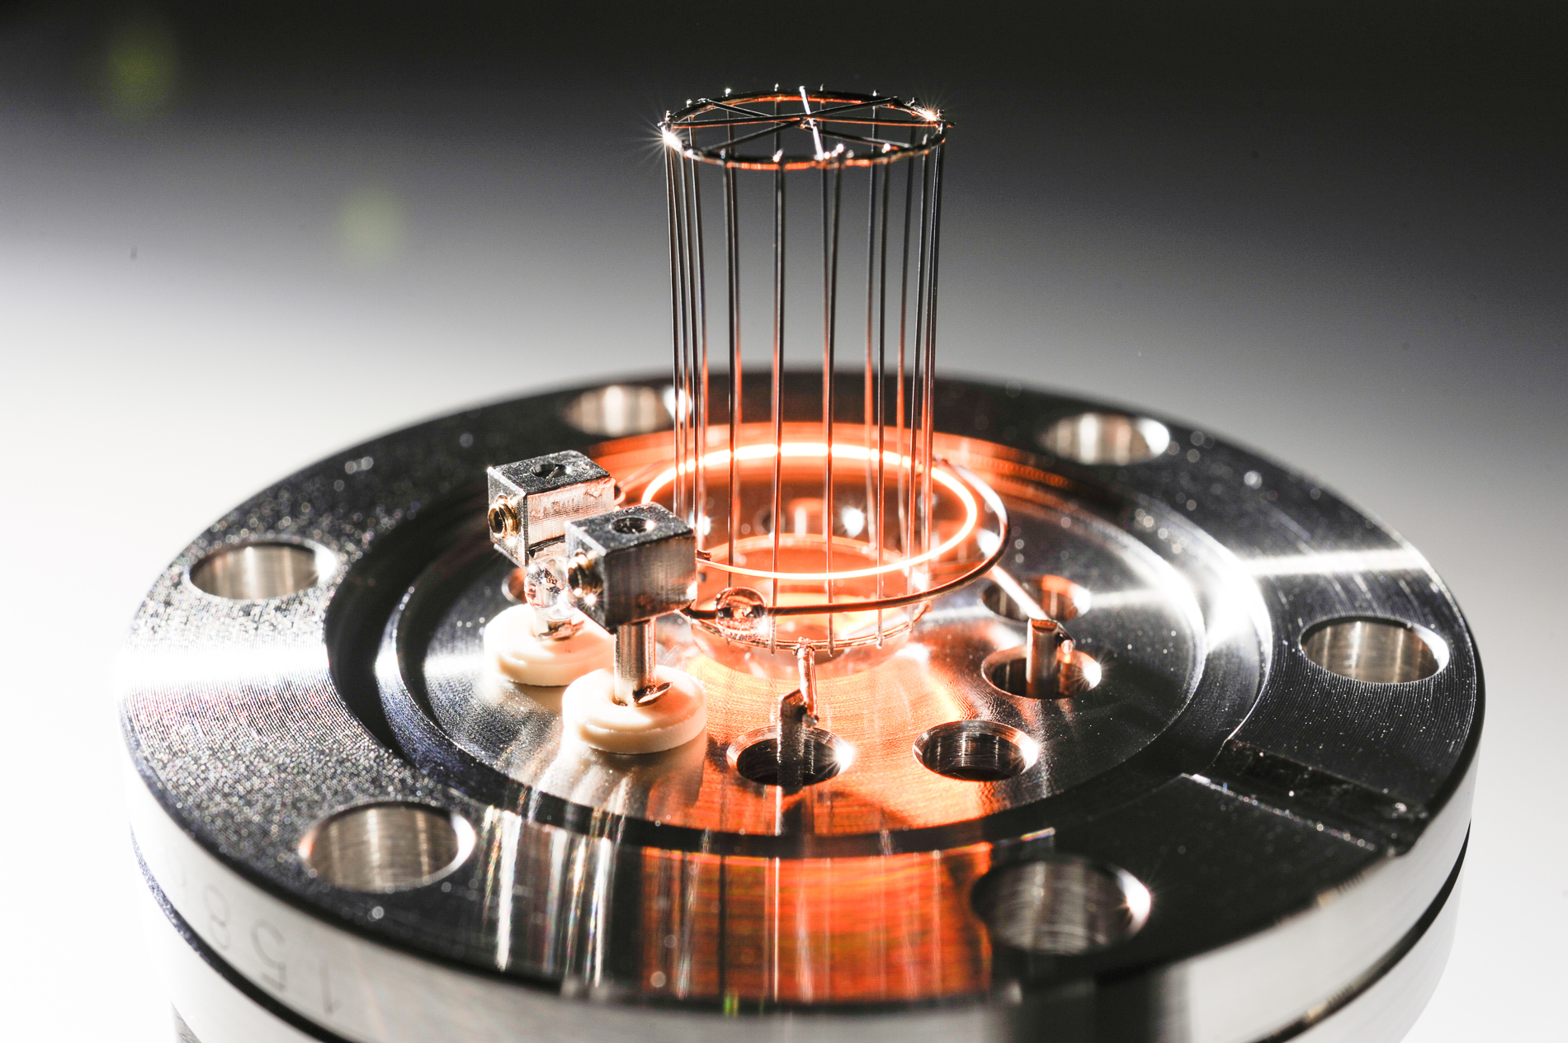
Anode Cage
Cathode (Yttria on Iridium)
Repeller “Ion Optics”
Entrance to reflector and trap

Slide 12
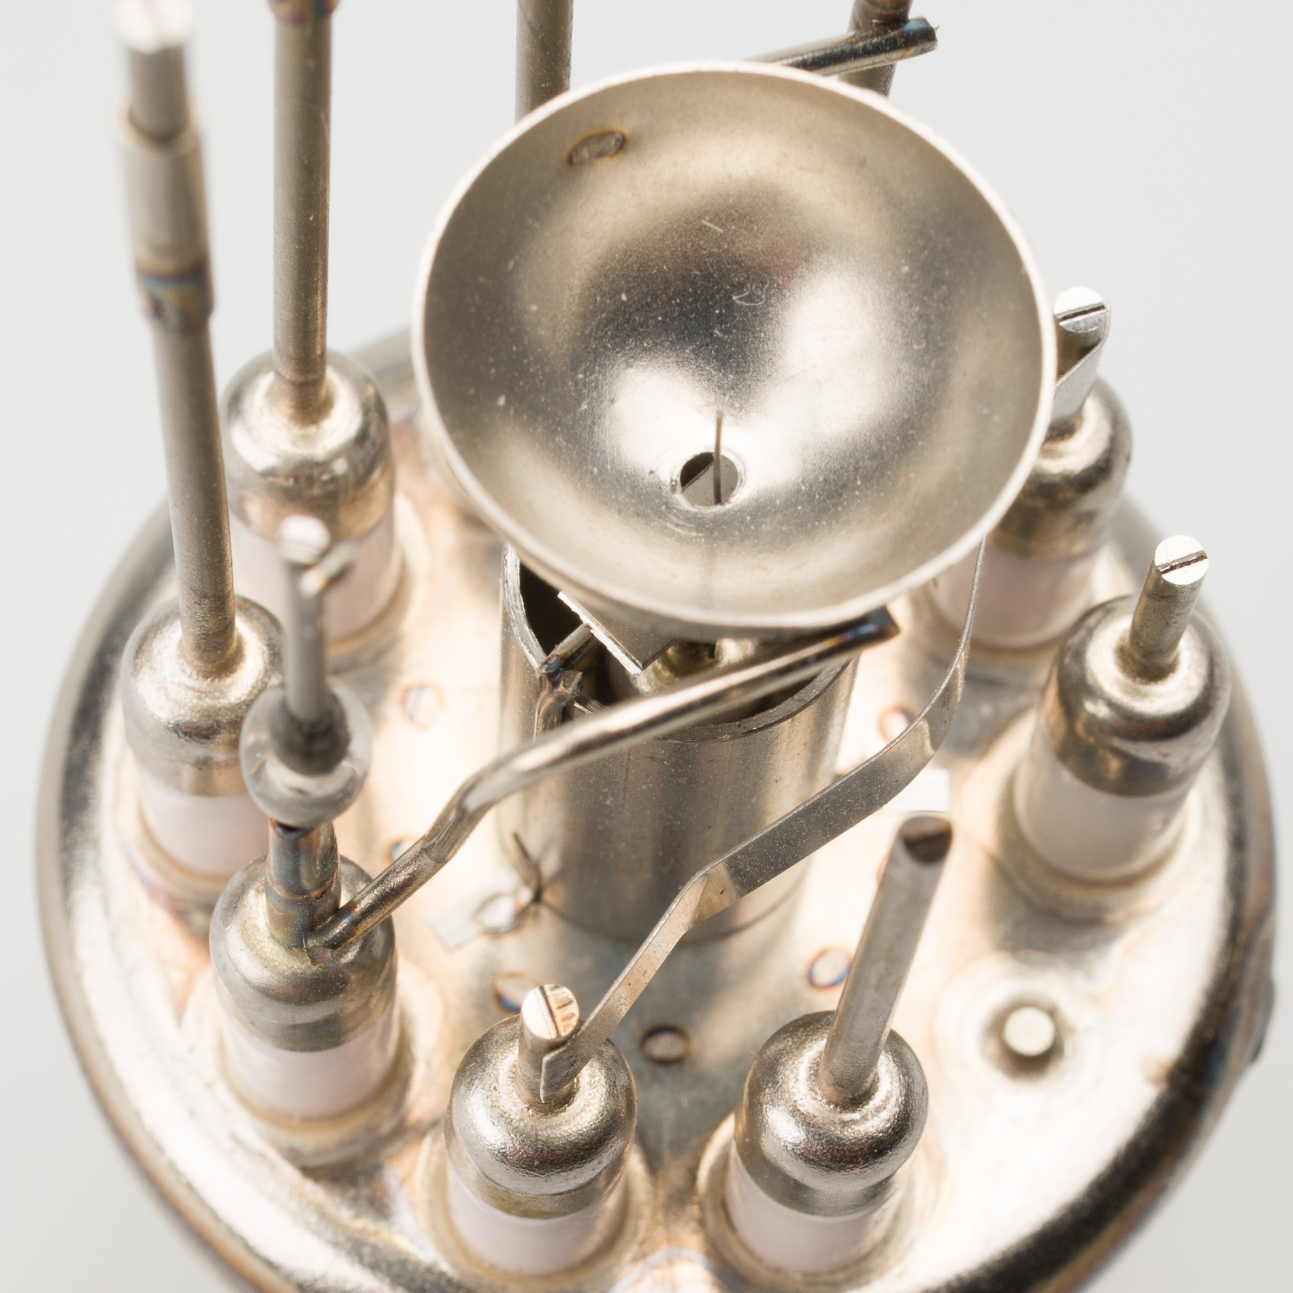
reflector
Anode Cage
Cathode (Yttria on Iridium)
Ion trap
Repeller “Ion Optics”
Entrance to reflector and trap

Slide 13
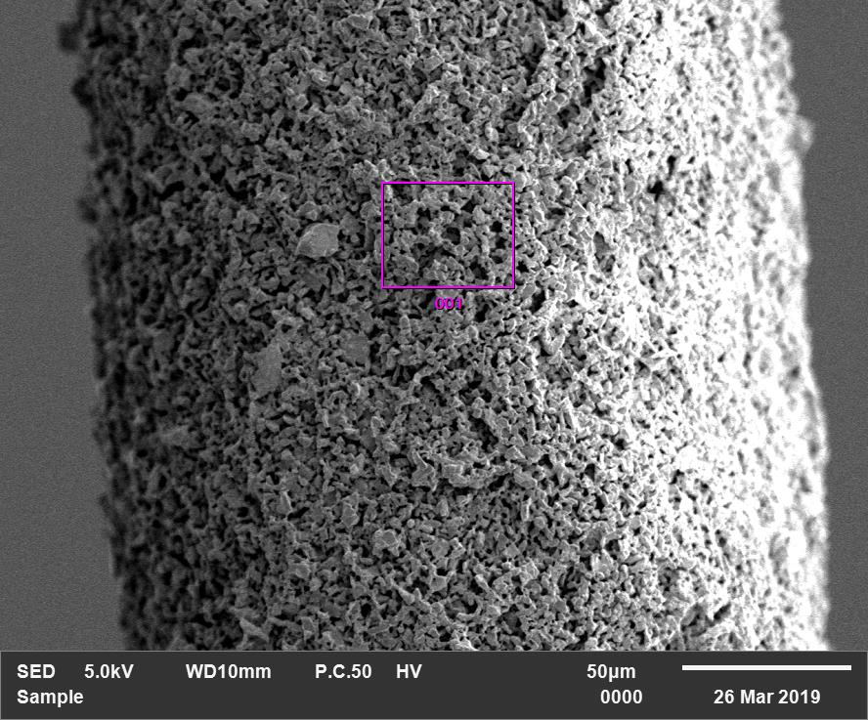
Filament (Cathode) surface
Extracted Current follows an Arrhenius equation proportional to surface times temperature square times work function in the exponent.

Slide 14
The beam dump!
Most of the energy put in is unused!
Thermal pain – degassing
Radiation – xray induced effects as photo effect and desorption
Lost electrons cause anything not suitable for a measurement
By products OMG!
There are solutions for certain applications

Slide 15
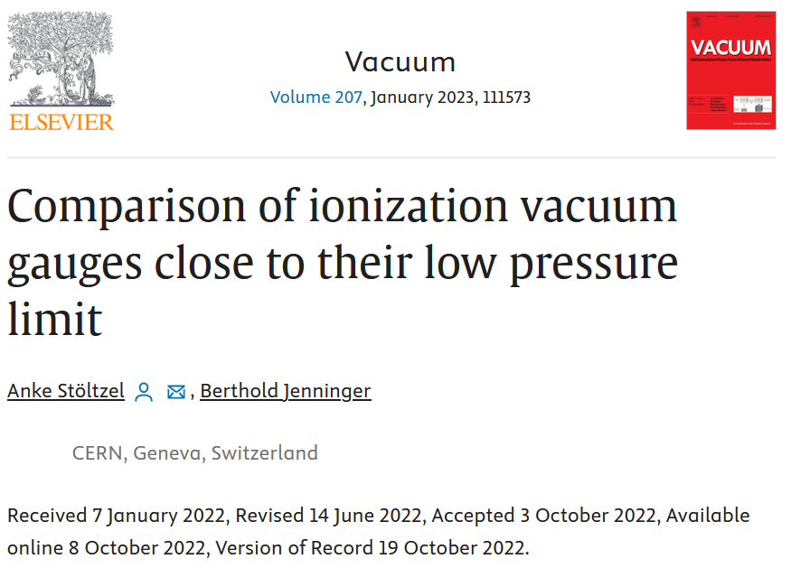
Sensitivity /Torr or /mbar

Slide 16
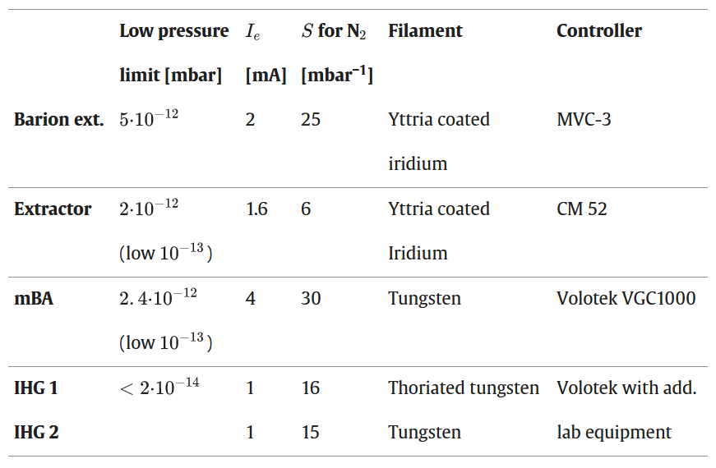
Sensitivity /Torr or /mbar

Slide 17
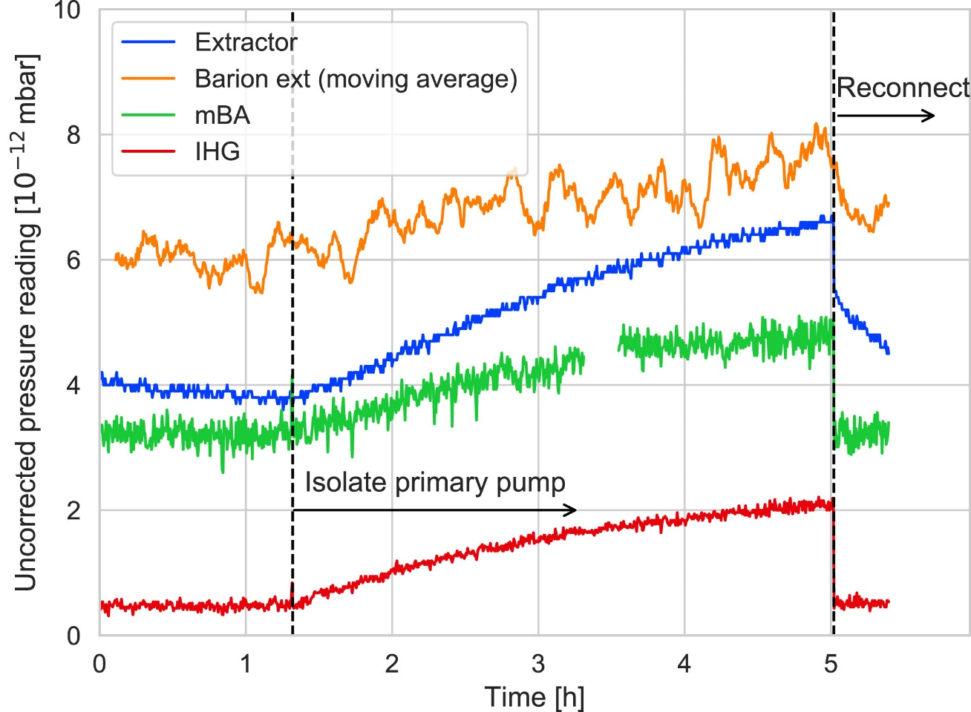
Sensitivity /Torr or /mbar

Slide 18
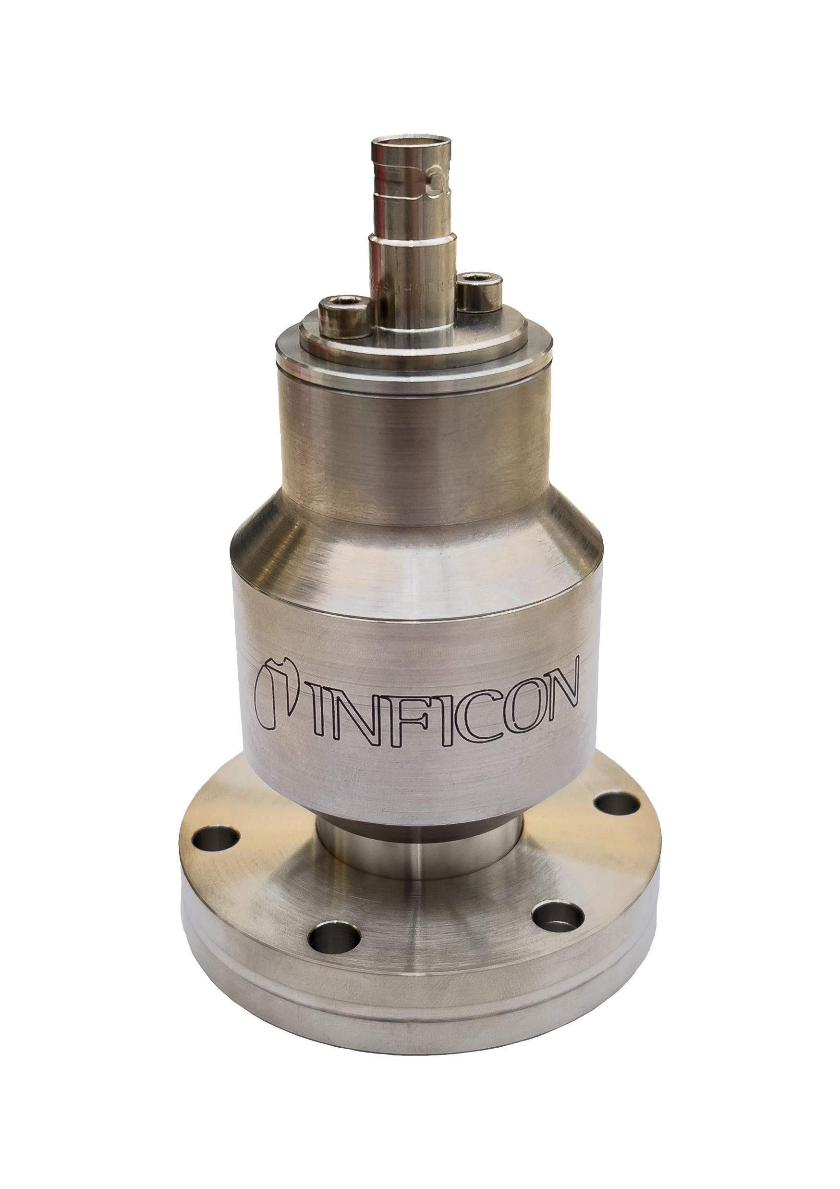
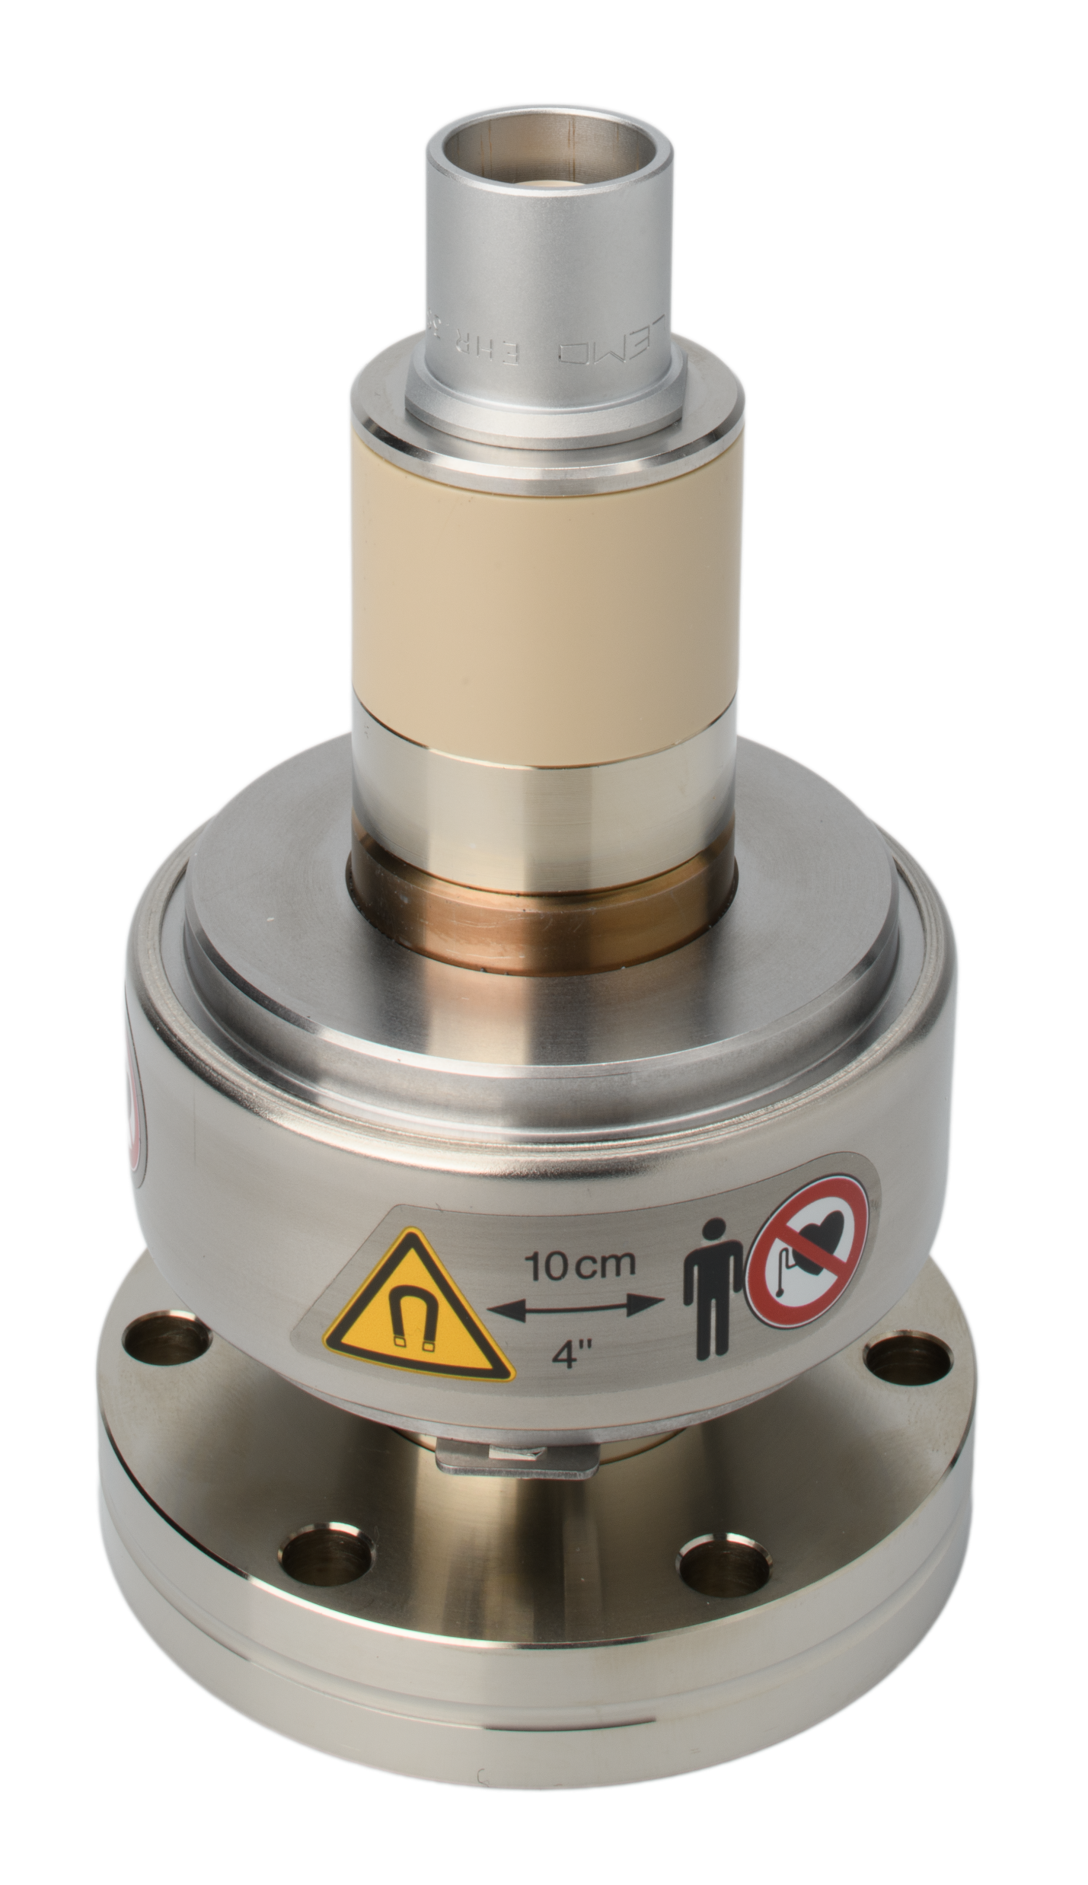
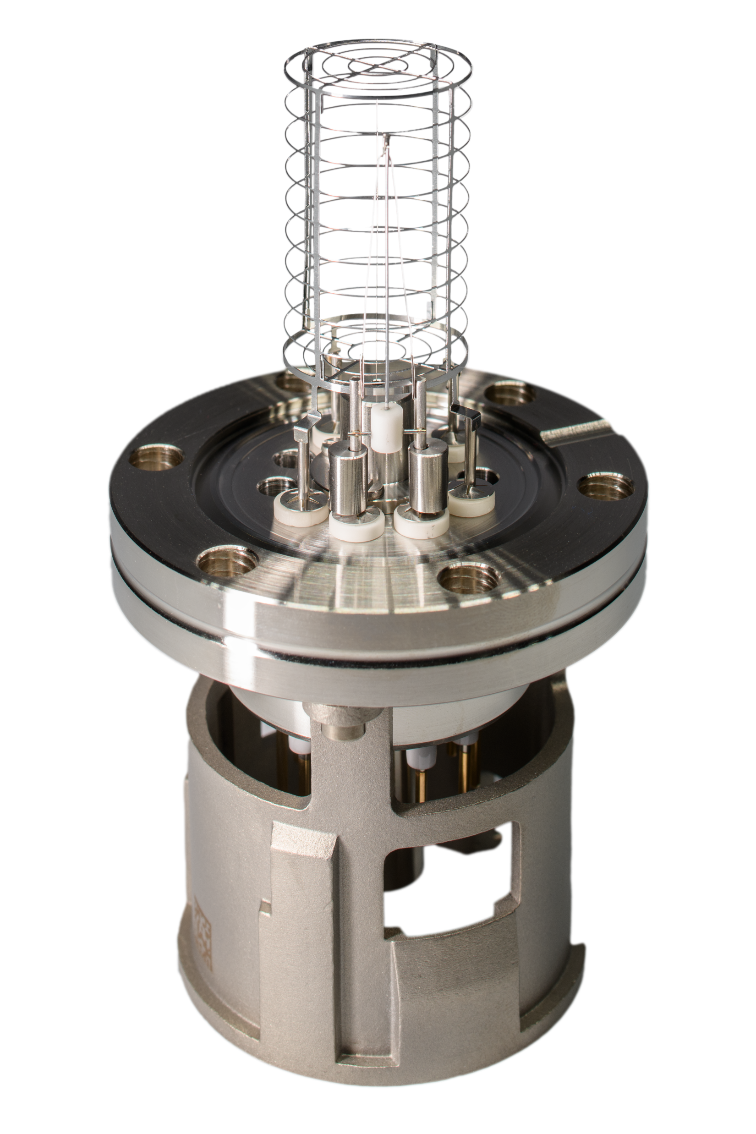
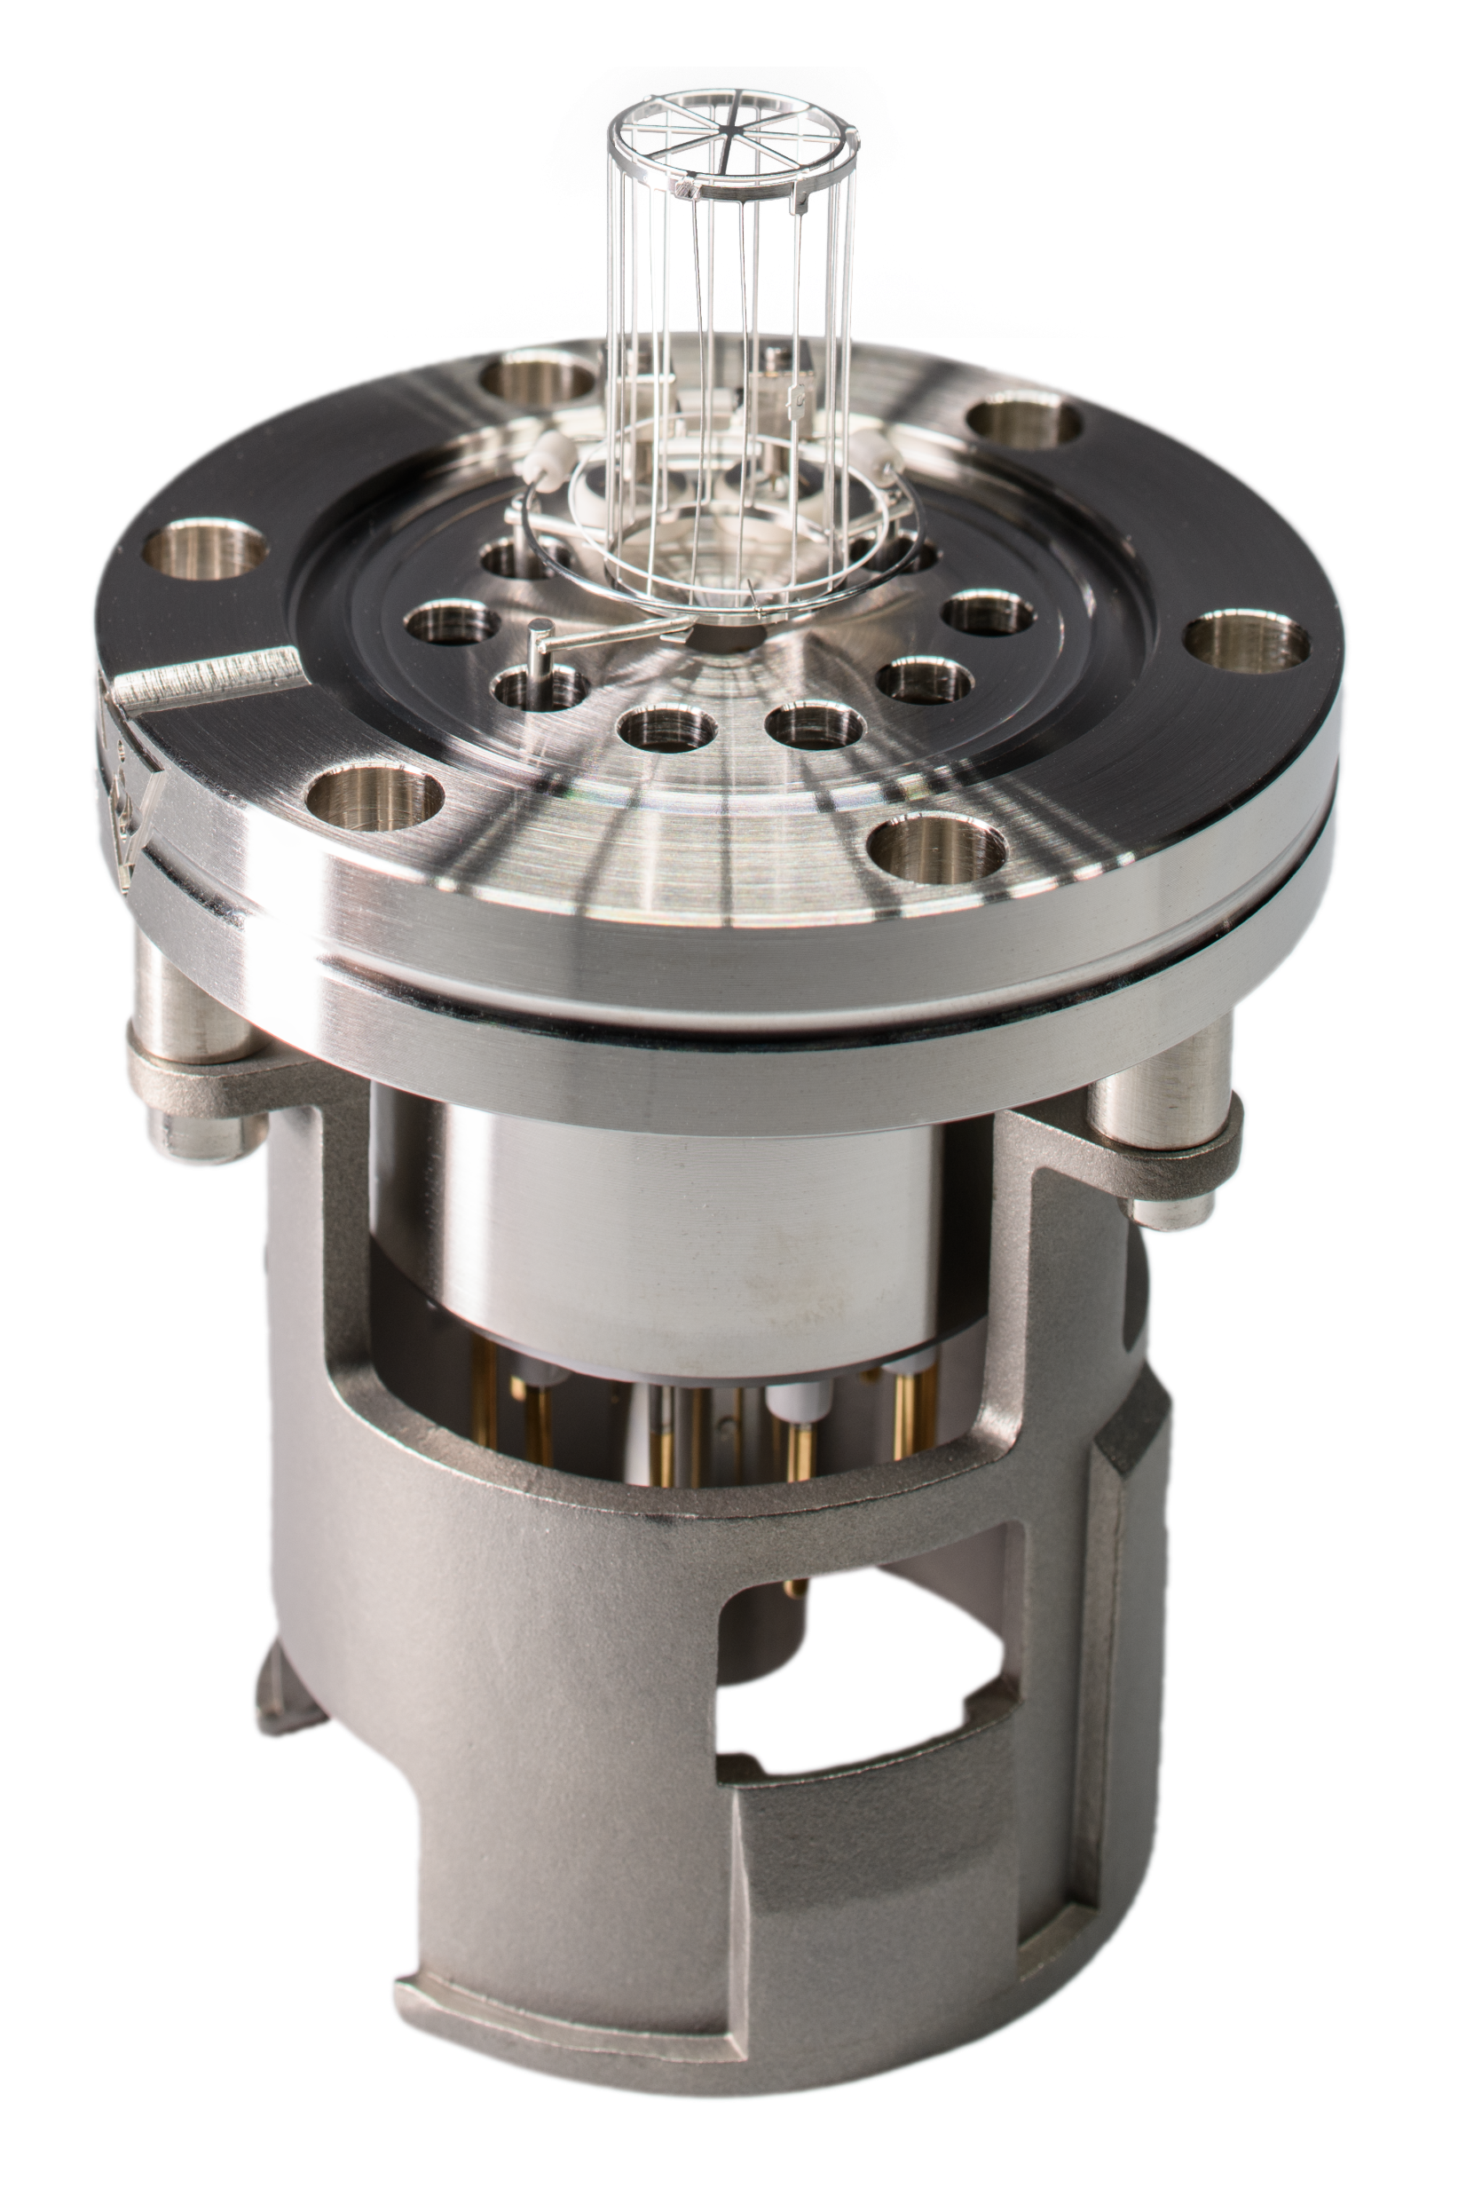
Solutions
IE514 IE414 MAG070 MAG084

Slide 19
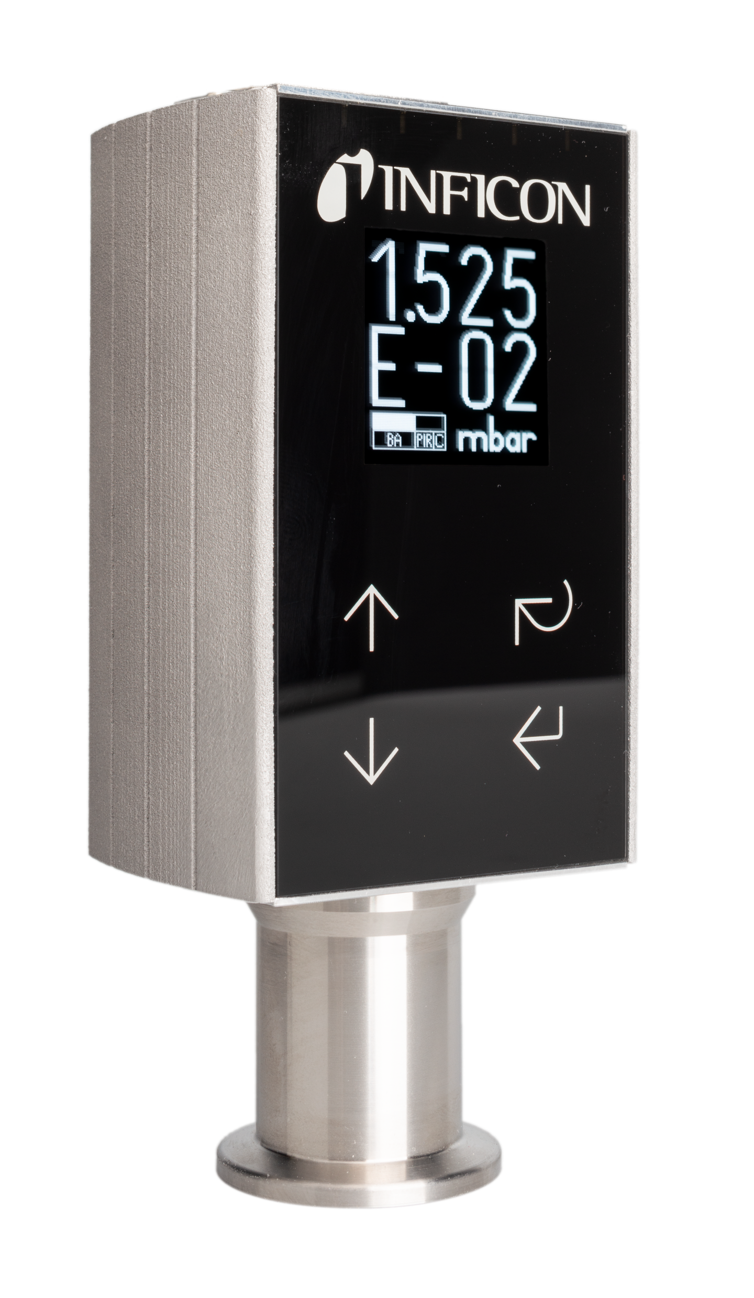
Solutions
BPG550
Can do everything on your fingerprint
Industrial Gauge fits for many applications in your everyday life

Slide 20
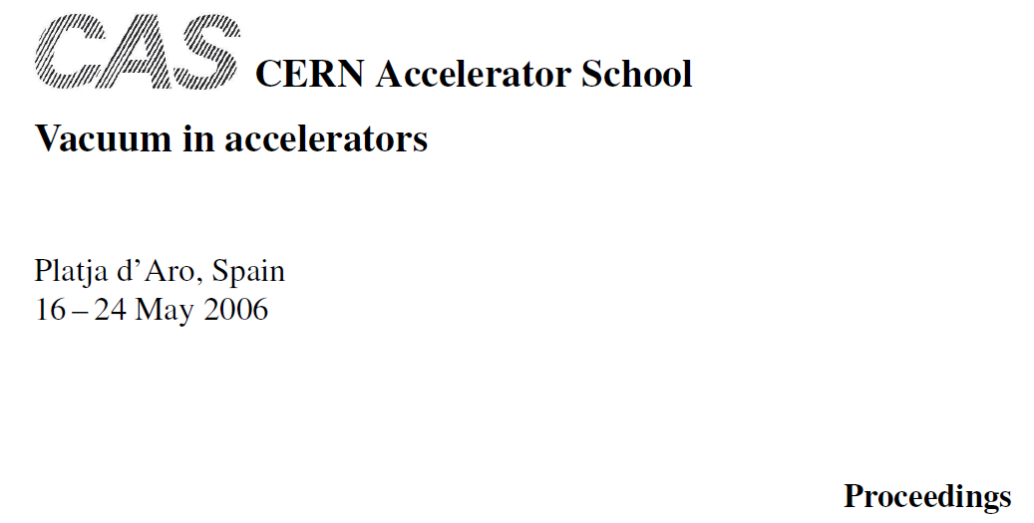
Cold Cathodes

Slide 21
Cold Cathodes
Goodies about:
They actually pump gas, forget desorption
Super stable in low vac
Excellent suitability for Hydrogen environment (@low pressures only!!)

Slide 22
Cold Cathodes
Goodies about:
They actually pump gas, forget desorption
Super stable in low vac
Excellent suitability for Hydrogen environment (@low pressures only!!)
…and they make light ☺

Slide 23
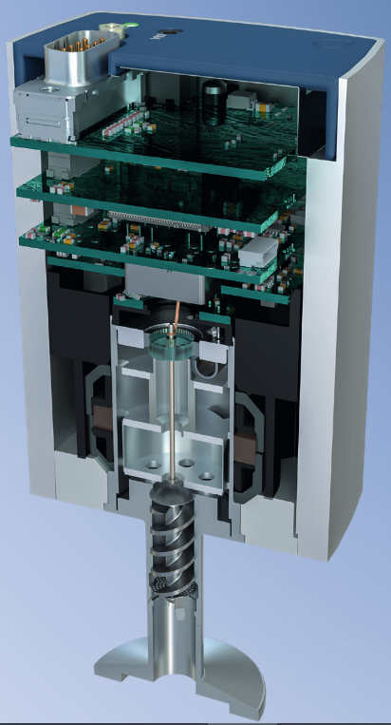
Cold Cathodes

Slide 24
Cold Cathodes
Electronics & Software
Spectrometer
Electrical Readout
(Feedthrough)
Optical Readout (Window)
Cold Cathode
Sometimes it is good to know what is in there

Slide 25
Science of Ionization Gauges?

Slide 26
Think about surfaces!
Desorption / Diffusion
Chemical Reactions
Particles on surfaces
Sealing of porous surfaces
Surface area reduction
Cosmetics

Slide 27
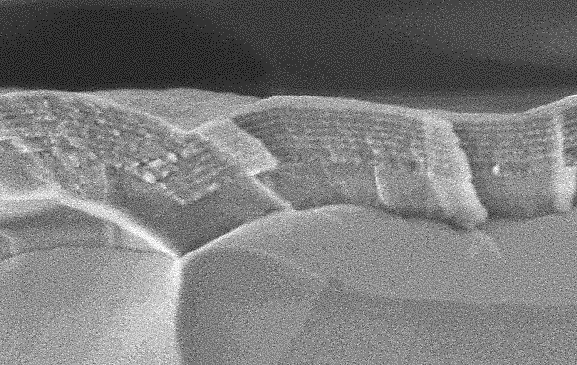
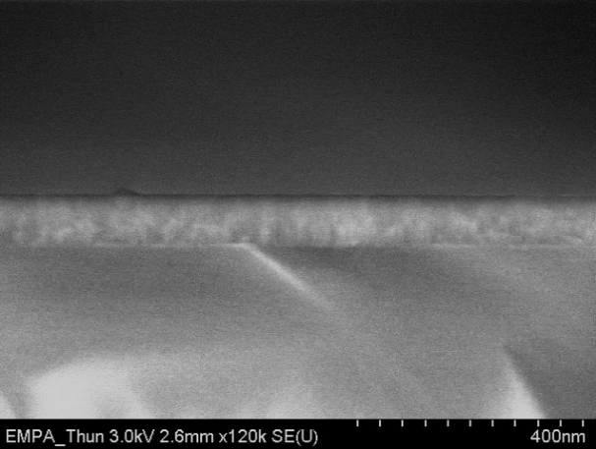
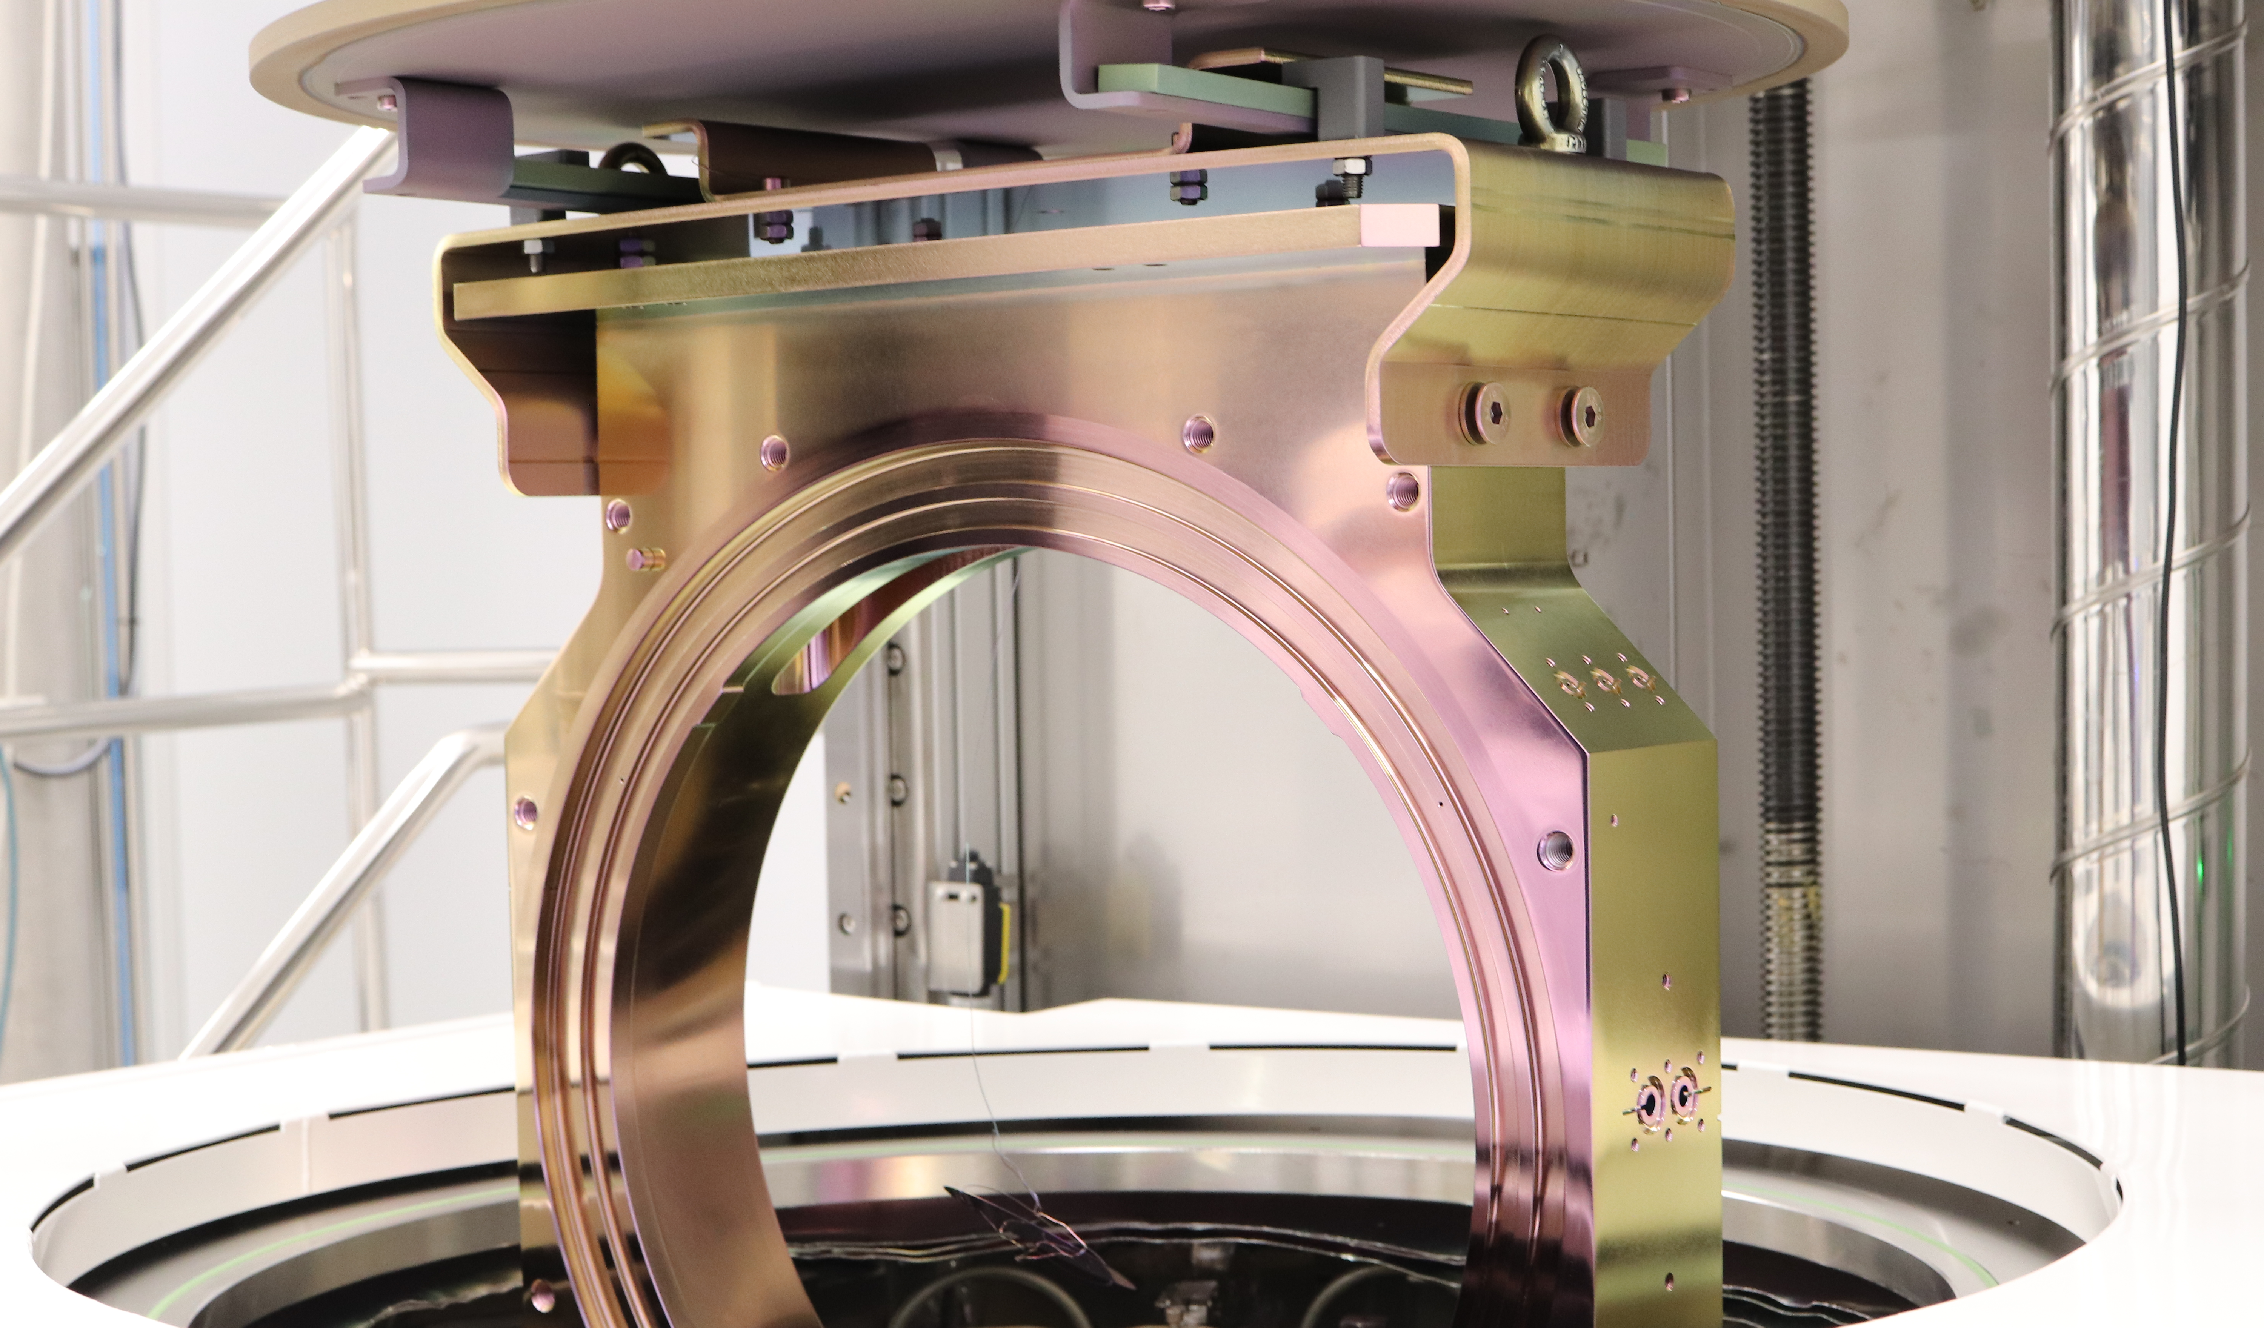
ALD on Vacuum Components
Al₂O₃
Y₂O₃
SiO₂
YF₃
AlN
HfO₂
TiO₂
MgF₂
Multilayers
500 nm
Monolayers
Oxides and Fluorides

Slide 30
