Slide 1

Corso Vuoto Avanzato
2024
INFN LASA
10-13 giugno 2024

Slide 2
Vacuum Measurement
Overview of total pressure gauges
Direct pressure gauges
Indirect pressure gauges

Slide 3
Pressure
The Ideal Gas Law – the foundation of vacuum measurements:
P = n k T
Direct pressure gauges – Those gauges directly sense force per unit area. The direct gauges give ‘true’ measure of pressure, independent of gas types, and they may be used as primary pressure standards.
Indirect pressure gauges – Those gauges explore the relations between certain physical properties (such as ionizations, viscosity, thermal energy) and the gas density. The indirect gauges are gas-type dependent and, require calibrations.

Slide 4
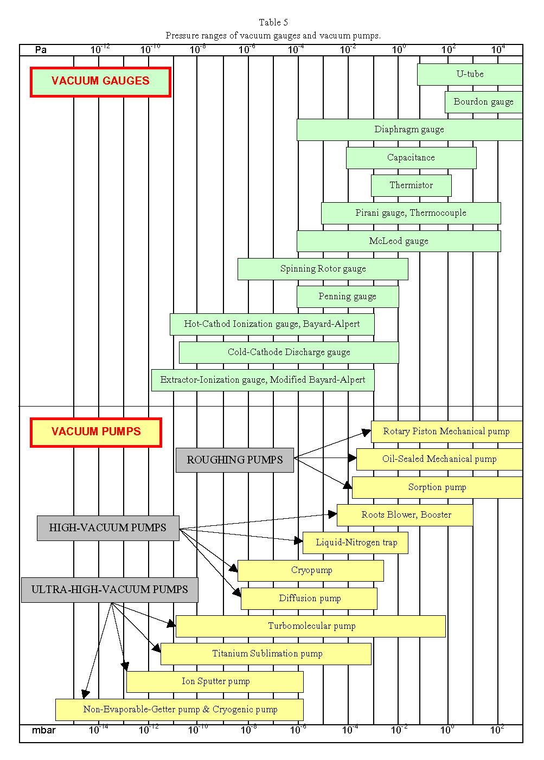
Pressure ranges and gauges
mbar 10⁻¹⁴ 10⁻¹² 10⁻¹⁰ 10⁻⁸ 10⁻⁶ 10⁻⁴ 10⁻² 10⁰ 10²
Notes:
4

Slide 5
Choice of a pressure sensor: example of possible criteria
Pressure Range
Measure absolute or relative
Reading local or remote
Accuracy
Type of gas to be measured
Dependence / independence of the reading by the nature of the gas
Employment Type: cycles, vibration, heat, etc..
Possible overloads
Cost
Frequency and type of failure, MTBF, MTTR
"Ex" specification (hazardous areas)
Contamination and cleaning of the instrument
Aging
Fragility

Slide 6
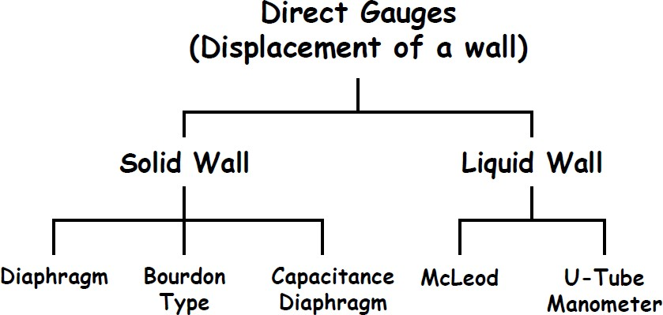
Direct Gauges at a Glance

Slide 7
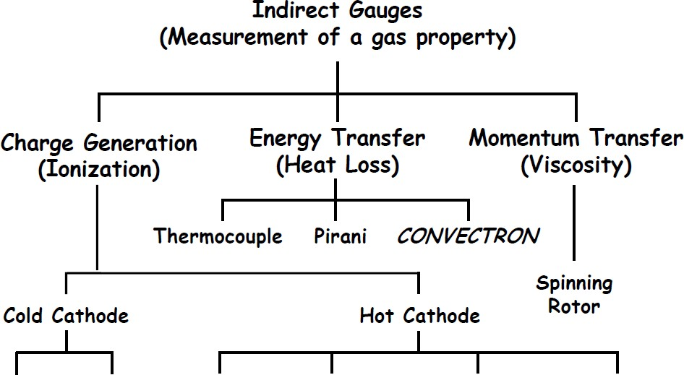
Indirect Gauges at a Glance
See next presentation
Penning
Inverted Magnetron
Triode
Bayard- Alpert
Extractor
Helmer, Bend Beam

Slide 8
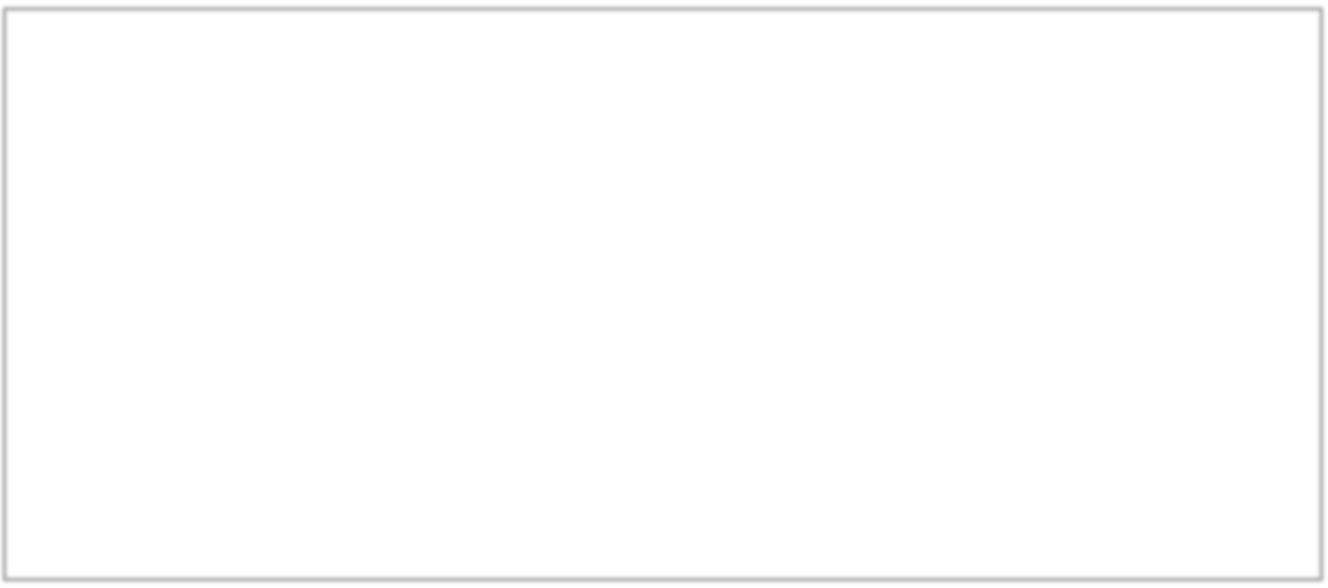
Vacuum Pressure Ranges
In today’s scientific research and industrial processes, vacuum measurements cover over 17 decades of range, from atmospheric pressure (10 ⁵ Pa) down to 10 ⁻¹² Pa.
For most applications, a combination of multiple types of gauges is needed .
Liq. Manometer McLeod
Therm. Cond. GA Cap. Diaphragm GA.
Spinning Rotor Gauge Cold Cathode Ionization Gauges
Hot Cathode Ionization Gauges
- 13
- 11
- 9
- 7
- 5
- 3
- 1
1
3
5
LOG P [Pa]

Slide 9
Pressure Units and Conversions
Mercury manometers have been used since the earliest days of vacuum technology. Thus, the mmHg, or Torr is commonly used pressure unit, especially in the US.
The SI unit for pressure is Pascal = 1 N/m².
mbar is also commonly used, mostly used in Europe (and ‘allowed’ in SI). 1 mbar = 1.00x10² Pa = 0.750 Torr
Pa |  | mbar | Torr | In. Hg | PSI | atm.
Pa | 1 | 1.00x10² | 1.33x10² | 3.39x10³ | 6.89x10³ | 1.01x10⁵
mbar | 1.00x10⁻² | 1 | 1.33 | 3.39x10¹ | 6.89x10¹ | 1.01x10³
Torr | 7.50x10⁻³ | 7.50x10⁻¹ | 1 | 2.54x10¹ | 5.17x10¹ | 7.60x10²
In. Hg | 2.95x10⁻⁴ | 2.95x10⁻² | 3.94x10⁻² | 1 | 2.04 | 2.99x10¹
PSI | 1.45x10⁻⁴ | 1.45x10⁻² | 1.93x10⁻² | 4.91x10⁻¹ | 1 | 1.47x10¹
atm. | 9.87x10⁻⁶ | 9.87x10⁻⁴ | 1.32x10⁻³ | 3.34x10⁻² | 6.80x10⁻² | 1

Slide 10
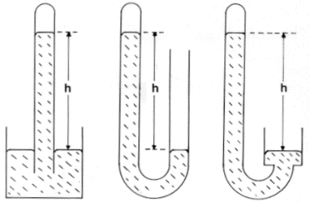
Liquid wall gauges
h
h
h
ρ_{Hg} : 13,350 kg/m³
g : 9.8 m/s²
U tube (closed) or equivalent system
Notes:
10

Slide 11
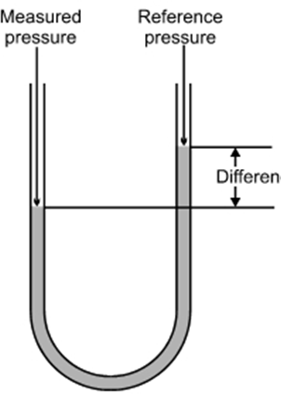
Liquid Manometers – U-Tubes
Simplest direct gauge. Mercury or oil are often used.
P₁ – P₂ = hρg
Main source of error is in measuring h
Elaborated methods developed to measure h, using optical or ultra-sonic interferometer, to achieve accuracy of 1.4 mPa in range of 1 Pa to 100 kPa in NIST, as US primary pressure standard
Unknown P₂
Ref. P₁
h
Liquid density ρ

Slide 12
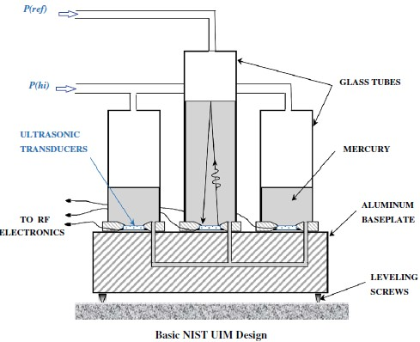
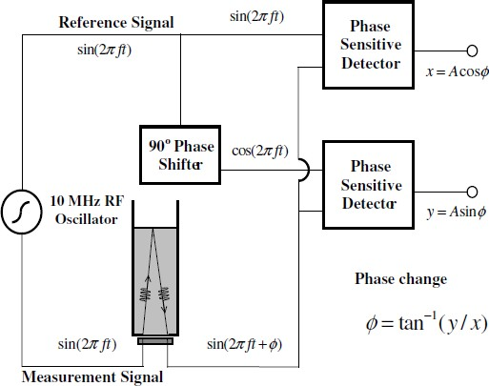
NIST Ultrasonic Interferometer (UIM)
*) Jay H. Hendricks *, Douglas A. Olson, Measurement, 43 (2010) 664–674

Slide 13

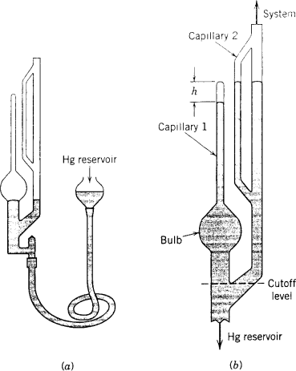
Liquid Manometers – McLeod Gauge
McLeod gauge extends U-Tube manometer range using Boyle’s law.
It is the primary pressure standard in the range of 10 ⁻² ~ 10 ³ Pa.
P = Aρgh² /(V − Ah) ≈ Aρgh² /V
V – Known volume above ‘cut-off’
A – Section area of capillary tubes 1&2

Slide 14
Solid wall gauges: relative and absolute pressure reading
Possible measure
RELATIVE
ABSOLUTE
Connection to the
vacuum system
Open reference chamber:
atmospheric pressure
is the reference
Connection to the
vacuum system
Reference is vacuum
Getter
Notes:
14

Slide 15
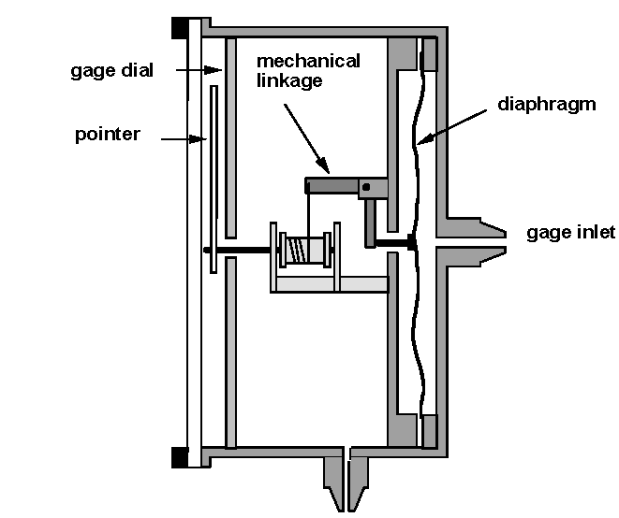
Diaphragm gauges
Gauge dial
Mechanical
Linkage
Diaphragm
Pointer
RELATIVE
&
ABSOLUTE
reading
Connection to the
vacuum system
Reference chamber
and pressure
Connection for the
ref. chamber
Notes:
15

Slide 16
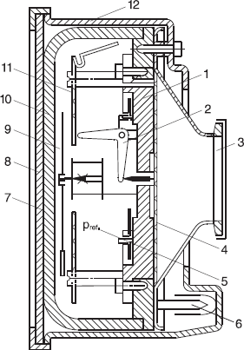
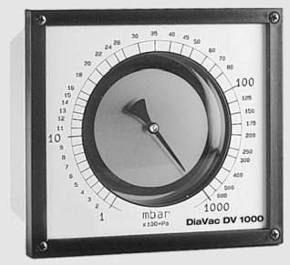
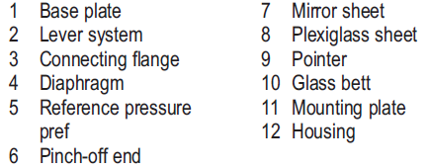
Mechanic Diaphragm Gauges
Direct gauge, independent of gas types
LeyBold DIAVAC 1000
Range: 1 ~ 1000 mbar
13

Slide 17
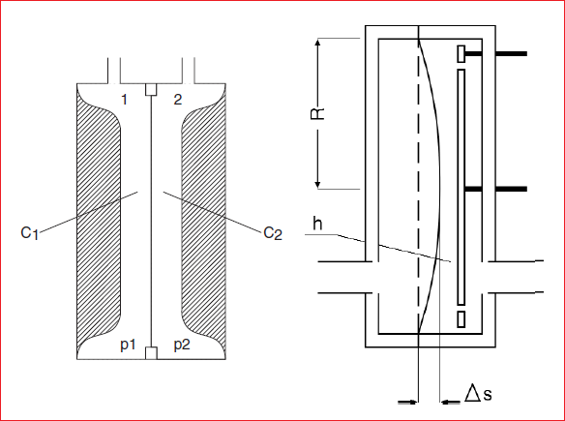
Capacitance Diaphragm Gauges
Commercial CDG systems can measure pressure ranges from 0.1 ~ 10 ⁵ Pa, independent of gas types.
Usually a sensor can only cover 3~4 decades of pressure, with accuracy ±0.5%.
CDG system with temperature control can provide accuracy and stability ±0.05%.
CDGs are commonly used in thin film depositions.
Main sources of errors are electronic drifts and diaphragm hysteresis.
C = ε₀KA/s
Differential pressure cause change in spacing, S.

Slide 18
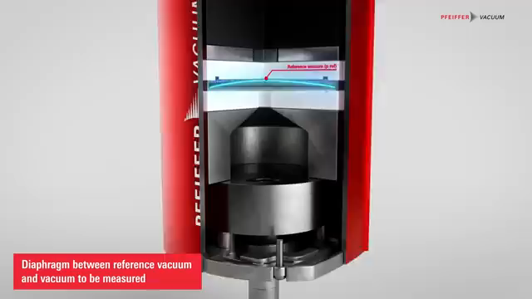
Capacitance Diaphragm Gauges

Slide 19
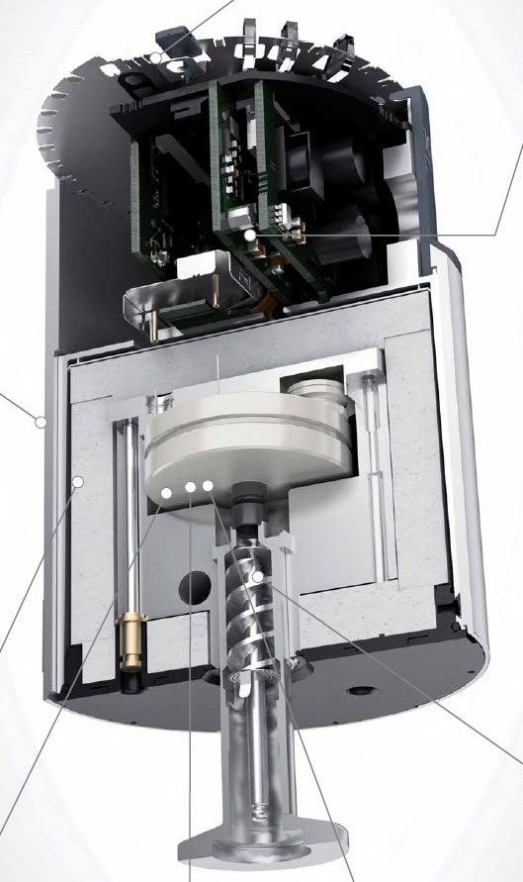
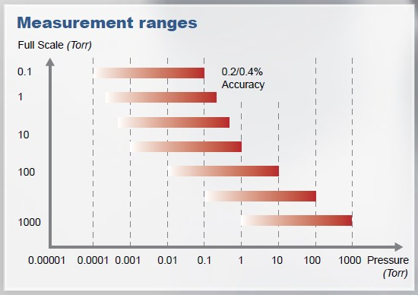
Capacitance Diaphragm Gauge – Example
INFICON’s CDGs
All-ceramic diaphragm
Wide ranges of pressure available
Temperature compensated (stabilized)

Slide 20
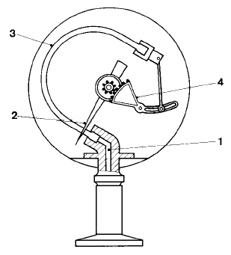
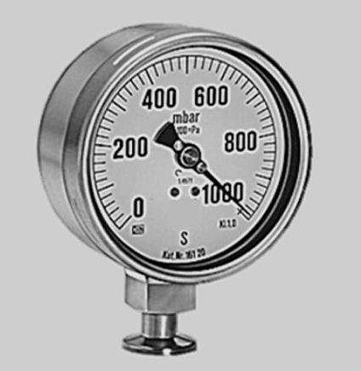
Bourdon gauge
Gears
dial
Connection to
the system
Notes:
20

Slide 21
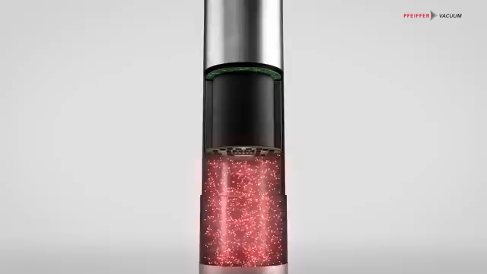
Piezo Gauge
Measuring principle: Change in the resistance of the strain gauges with pressure
Pressure range: Rough vacuum
to fine vacuum
(1 · 10³ to 1 · 10⁻¹ mbar)
Accuracy requirement: Medium

Slide 22
Indirect reading of pressure gauges
Indirect reading:
Gauges measure a property of the gas
Thermal conductivity
Ionization
Viscosity
Spinning rotor
Thermocouple
Pirani
Cold cathode
“hot” cathode
Penning
Radioactive
Bayard
Alpert
Extractor
Inverted
magnetron
Alphatron
Notes:
22

Slide 23
Indirect Vacuum Gauge Overview
Indirect gauges measure pressure by relating certain physical properties to the gas density.
Three major types indirect gauges are commonly used.
  Thermal conductivity
  Viscosity
  Ionization
Indirect gauges are gas type dependent
Most commercially available indirect gauges are calibrated to nitrogen, thus relative calibrations of other gases to nitrogen is needed (and often supplied by the gauge manufacturers.)

Slide 24
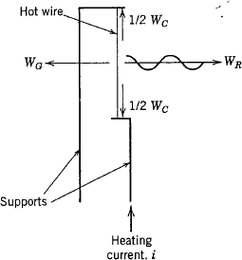
Thermal Conductivity Gauges (1)
A hot wire in a gaseous environment loses heat (thermal energy) in three ways:
  radiation, W_{R},
  conduction to supports, W_{C}, and
  transfer by the gas molecules, W_{G}.
W_{T} = W_{R} + W_{C} + W_{G}
W_{G} is pressure dependent, the base for these gauges.
The heat gas transfer is approximately proportional to m^{-1/2}, and molecular types (atomic, diatomic, triatomic, etc.), thus is gas type dependent.
W_{R} and W_{C} are independent of gas pressure, which determine the useful range of the gauges.

Slide 25
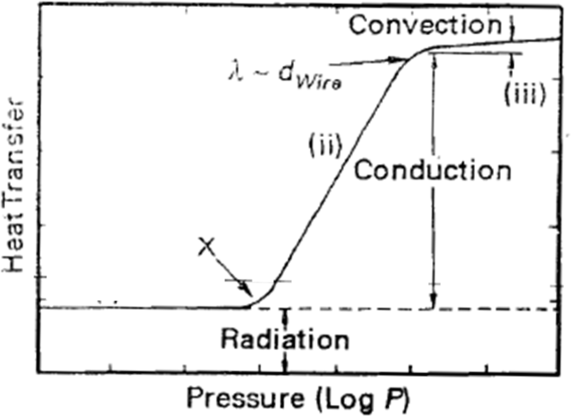

Thermal Conductivity Gauges (2)
Heat transfer may be divided into three regimes, based the pressure (mean-free length, λ)
(i) λ >>d_{wire} ; (ii) intermediate ; (iii) λ << d_{wire}
  Heat transfer insignificant as useful for
  pressure measurement
  Linear heat transfer regime
  Gas heated by the hot wire forms a
  hot sheath around wire

Slide 26
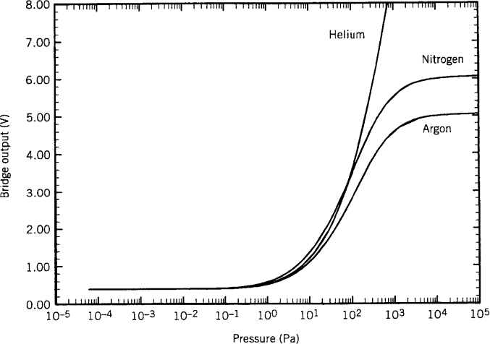
A Close Look at Heat Transfer
α is gas accommodation coefficient,
γ = c_{p}/c_{v,} c_{p}, and c_{v} are specific heat in a
constant pressure and a constant volume
process, respectively:
γ=1.667 (atoms)
γ≈1.40 (diatomic)
γ≈1.31 (triatomic)
2k
(T −T )P
W = ¹ ⋅ ^{γ +1} ⋅α ⋅
G
4 γ −1
πmT
wire
wall
wall

Slide 27
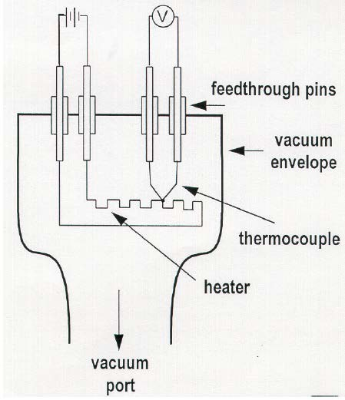
Thermocouple Gauge
Constant current through the
heater (sensor).
TC junction measures temperature
changes (due to gas heat transfer).
Working range: 10⁻² ~ 1 torr
Slow response time

Slide 28
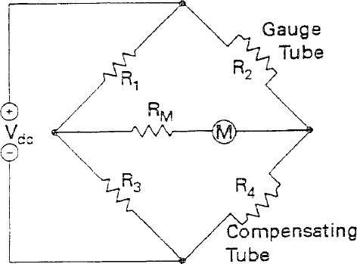


Pirani Gauge
In Pirani gauge, the heated filament constitutes an arm of a Wheatstone bridge. The Wheatstone bridge is balanced at high vacuum. Any gas heat transfer at higher pressure induces imbalance of the bridge.
Working range: 10⁻⁴ ~ 100 torr.
There are two common modes of operations.
Constant Temperature Mode
Adjusting heating current to maintain constant temperature
(thus the resistance) to keep bridge balanced.
The heating current is related to the pressure.
Constant Voltage Mode
Measure pressure with the changes in the imbalance current
^{I} imbalance
R₁ ₌ R₂ R₃ R₄
I
imbalance
= 0 when

Slide 29
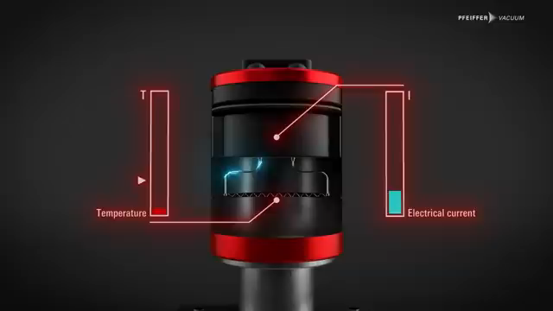
Pirani Gauge

Slide 30
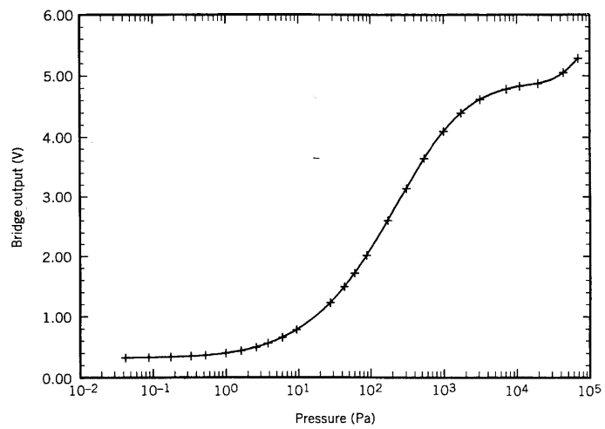
Convection Enhanced Pirani Gauge
Similar principle to Pirani gauge (but with larger tube ID)
  Conductive heat loss (10⁻³ to ~100 Torr)
  Adds convective heat loss (~100 to 1000 Torr.)
Improved temperature compensation.
Gold plated tungsten sensor wire
(lowering emissivity and resisting
contamination/corrosion).
Sensitive to mounting orientation
(at high P). (Mount horizontally!)
N₂

Slide 31
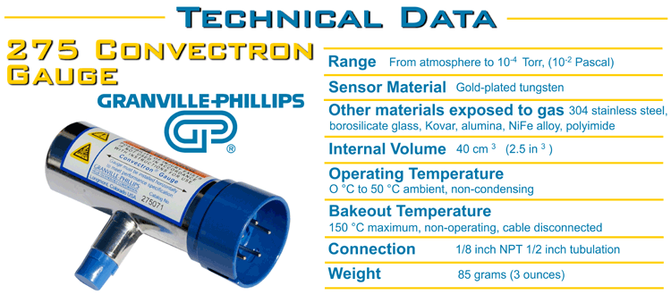
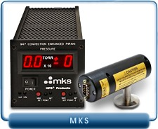
Commercial Convectron Gauges
317 Convection-Enhanced Pirani Pressure Vacuum Sensors
(1.0 10⁻³ to 1000 Torr)
Bakeable to 250°C
Yulin Li, January 14-18 2013
23

Slide 32
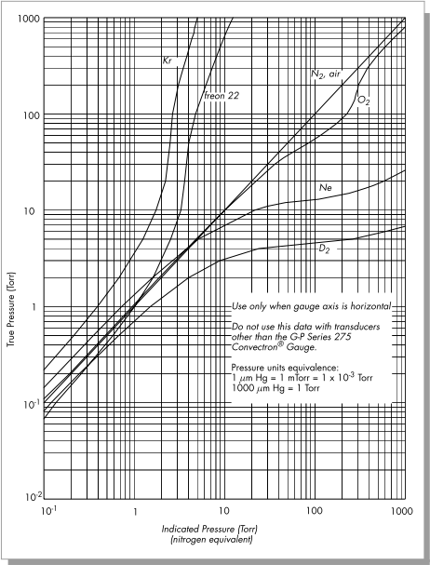
Thermal Conductivity Gauge Features
Good
Wide measurement range
Long-term reliability (some sensors operational over 30 years in CESR)
Low cost, low maintenance
Relative fast response
Not So Good
  Gas dependent, often in complicated manners, and can be potentially dangerous.
  Not suitable for corrosive applications
  Orientation dependent (>10 Torr)

Slide 33
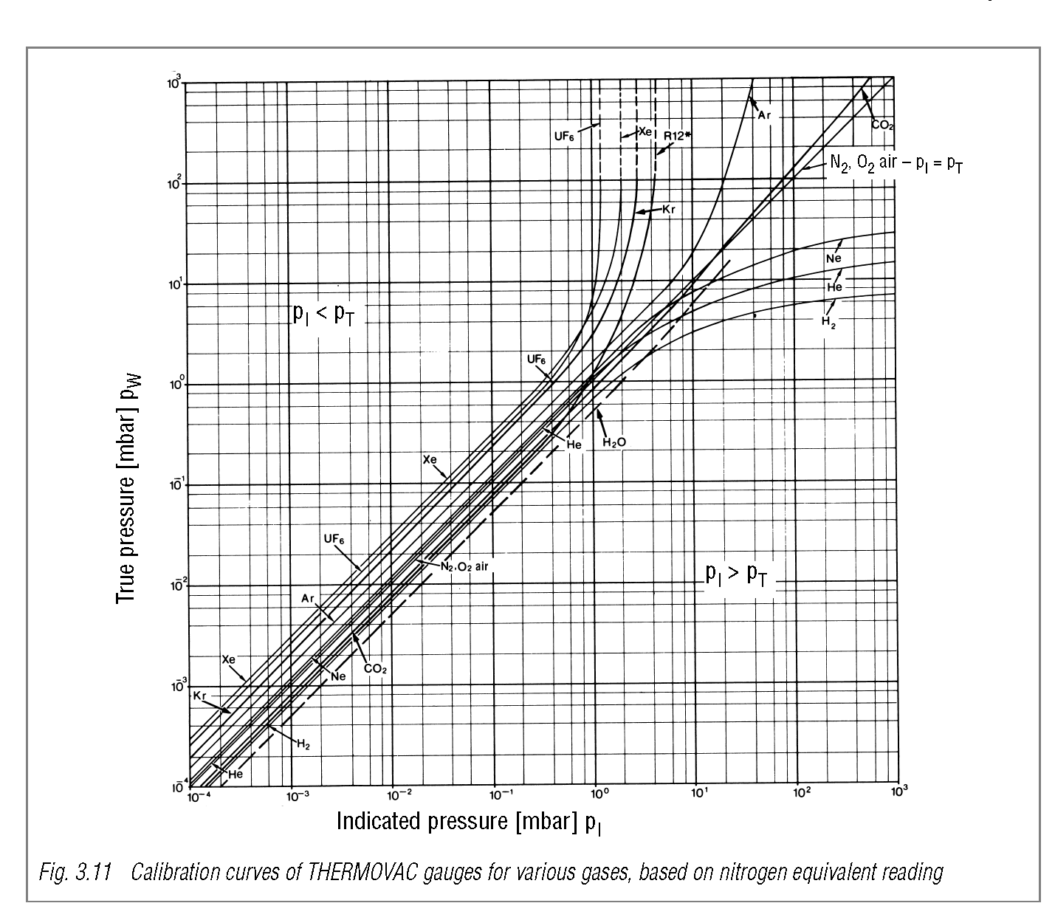
Pirani gauges: pressure reading depends on gases species
900 mbar
40 mbar
9 mbar
6 mbar
H₂
He
N₂
Ar
40 mbar
Notes:
33

Slide 34
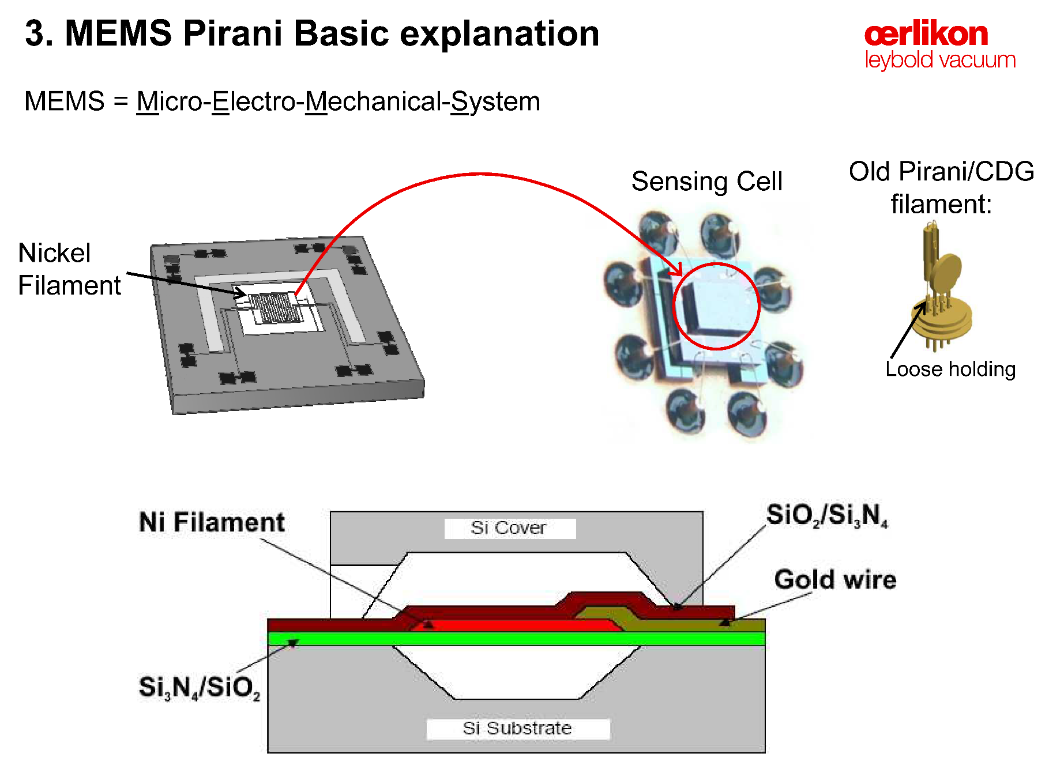
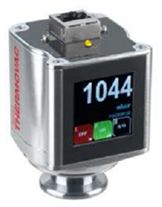
Pirani gauge with MEMS
Notes:
34

Slide 35
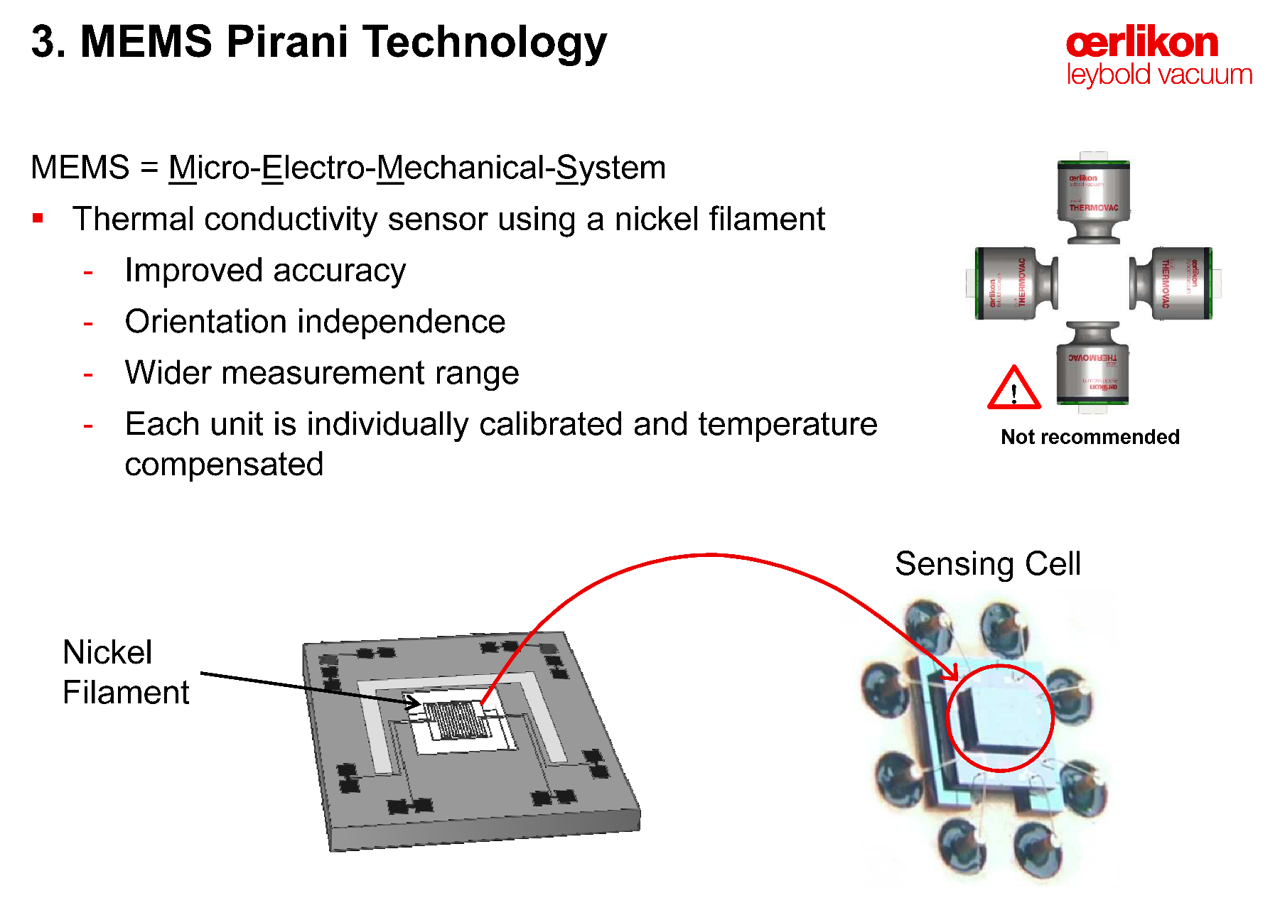
Pirani gauge with MEMS
Notes:
35

Slide 36
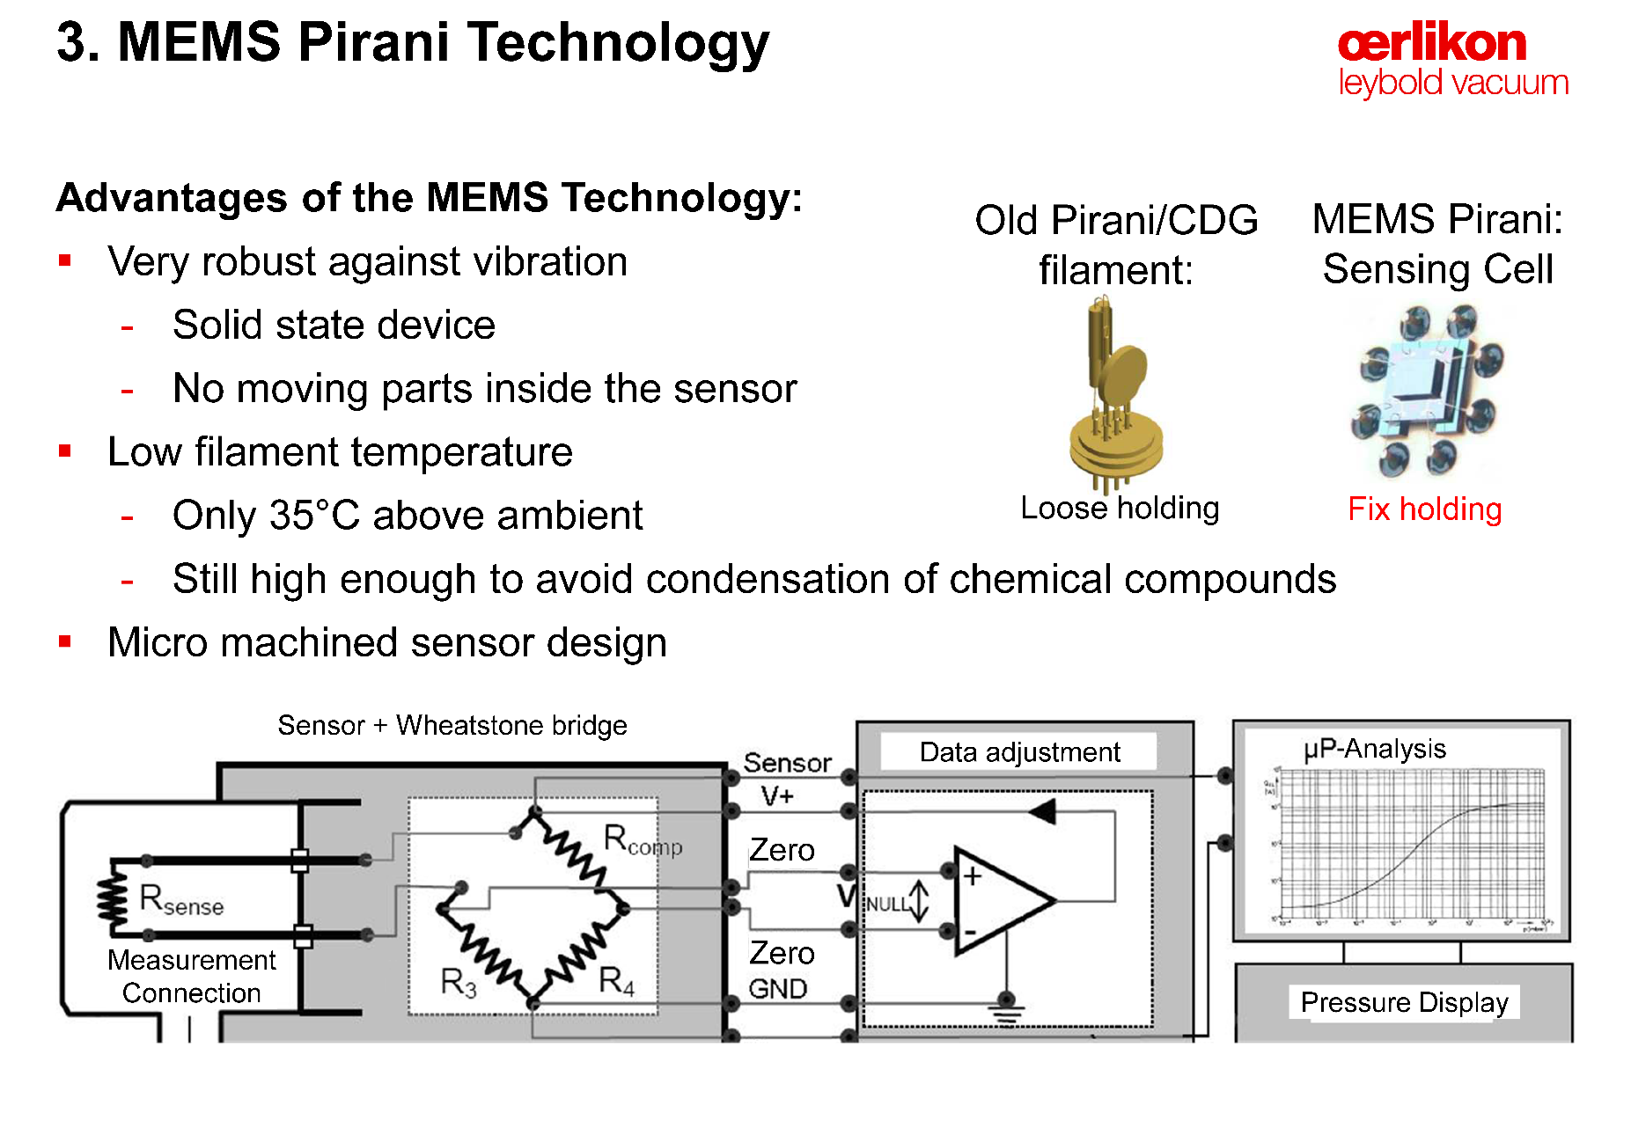
Pirani gauge with MEMS
Notes:
36

Slide 37
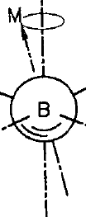
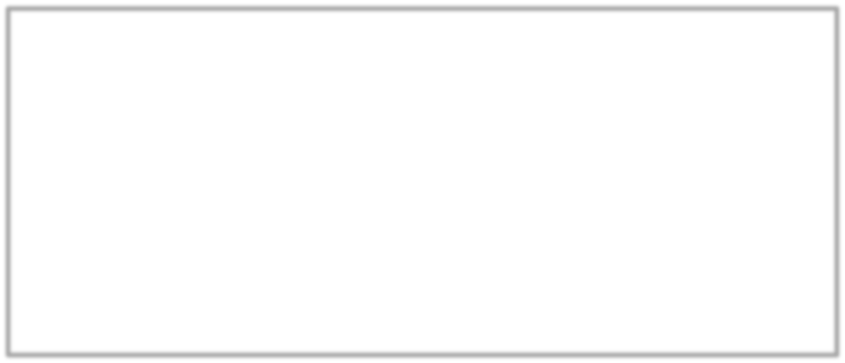
Spinning Rotor Gauge – Principle
A spinning spherical rotor, suspended, in a gas at low pressure is slowed by interacting with the gas, through momentum transfer (or molecular drag)
In the operational range (10⁻⁵ to 10⁻² Pa), the deceleration
by the molecular drag is proportional the molecule density.
SRG is gas type dependent
ω
_{P =} 1 aρ 2πkT ⎛₋ dω dt _{− 2α} dT _{− RD} ⎞
⎜ ⎟
5 σ
m
⎝
ω
dt
⎠
a – rotor diameter; ρ – rotor density;
σ – gas accommodation coefficient;
m – gas molecule mass; α – rotor C.T.E. RD – residual drag (eddy current)

Slide 38
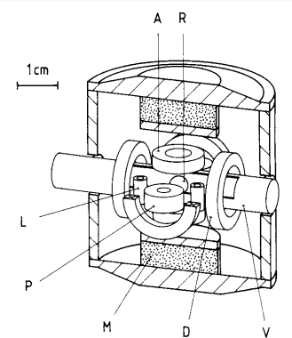
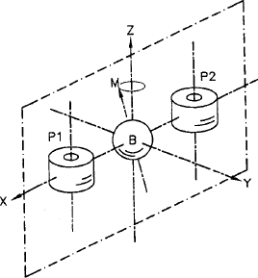
Spinning Rotor Gauge Structure
R – rotor (440 stn. stl.)
V – vacuum enclosure
M – permanent magnets
A – 2x pickup & axial control coils
L – 4x lateral damping coils
D – 4x drive coils
P – 2x rotation sensing coils
Low pressure limit: residual drags
High pressure limit: non-linearity due to non-isotropic collisions with molecules
ω = 410 – 400 rps

Slide 39
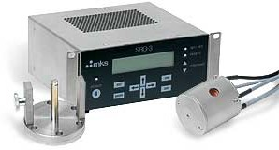
Spinning Rotor Gauge Applications
SRG maintains long term reproducibility, better than 1% over 7-year has been demonstrated. Thus, SPGs are widely used as a transferable secondary pressure standards for gauge calibrations.
SRG does not ‘alter’ vacuum environment that measuring, as compared to ionization gauges.
SRG is sensitive to shock and vibration,
as well as to changes in ambient
temperature.
SRG is relatively slow in response time.
MKS SRG-3 System

Slide 40
Indirect reading of pressure gauges
Indirect reading:
Gauges measure a property of the gas
Thermal conductivity
Ionization
Viscosity
Spinning rotor
Thermocouple
Pirani
Cold cathode
“hot” cathode
Penning
Radioactive
Bayard
Alpert
Extractor
Inverted
magnetron
Alphatron
Notes:
40

Slide 41
Cold Cathode Gauges
With a DC high voltage between a pair of electrodes in vacuum, discharge occurs. The discharge current depends on the pressure (non-linearly). However, the sustainable discharge stops around 1 Pa.
In CCGs, a magnetic field is added, with the B-field ‘perpendicular’ to the E-field (thus the cross-field). An electron ‘cloud’ is created by trapping electrons in the cross-field volume. Electrons gain energy through cyclic motions in the cross-field.
Ionization of gas molecules by electrons in the e-cloud extends the lower limit of CCGs.
CCGs are gas-dependent in a similar way as HCGs.
In a CCG, the ion current is related to pressure as:
n = 1.0 ~ 1.4
i_{g} = K ⋅ P ^{n}

Slide 42
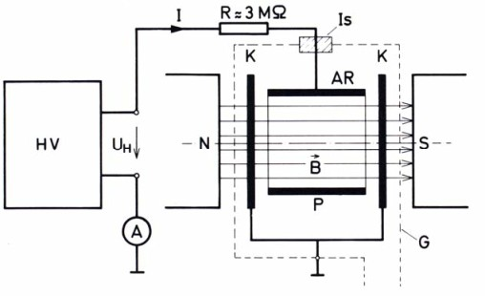
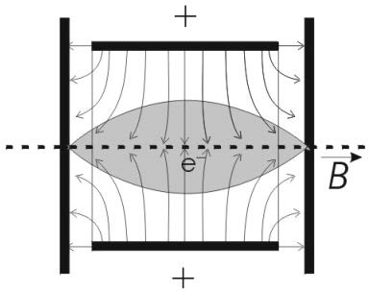
Cold Cathode Gauges – Penning Cell
At lower pressure (<10⁻² Pa), stable electron cloud confined around axis, and ion density significantly lower than that of e-cloud.
At high pressure, much higher ion density destabilize e-cloud , and plasma oscillation may occur.
Ref. K. Jousten: Ultrahigh Vacuum Gauges
AR – anode ring K – cathode
G – gauge case

Slide 43
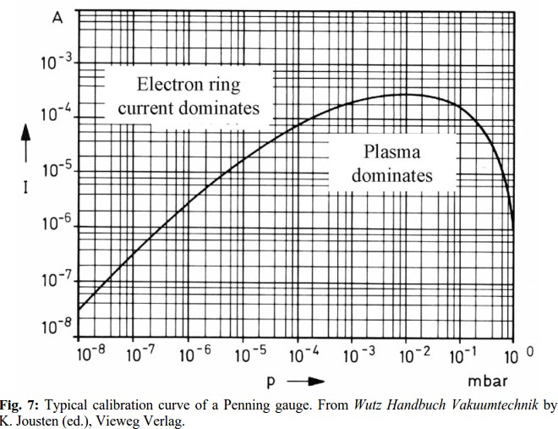
Cold Cathode Gauges – Penning Cell

Slide 44
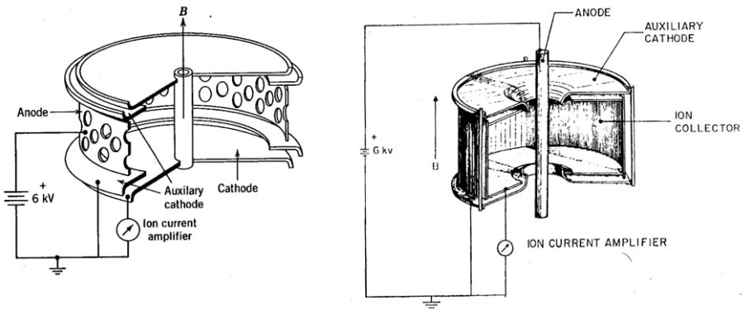
CCGs – Magnetron and inverted magnetron
Both types were developed by Redhead and Hobson in late 50’s
Much more efficient electron trapping, and more stable e-cloud (no mode-jumping) over pressure range from 10⁻³ to 10⁻¹² torr.
With guard rings, IMG is less sensitive to field emission.
MG usually has higher sensitivity, due to its larger ion collector.
Magnetron Gauge
Inverted Magnetron Gauge

Slide 45
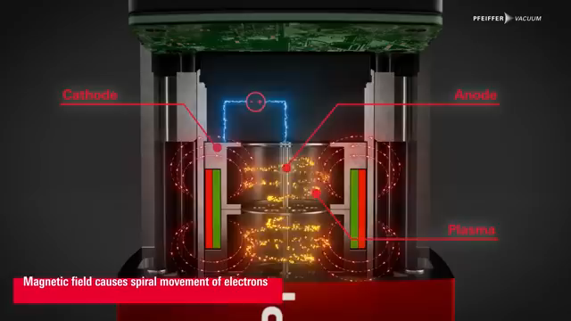
Cold Cathode Gauge

Slide 46
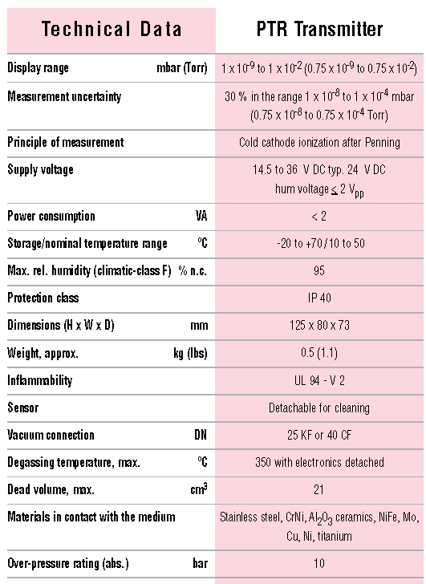
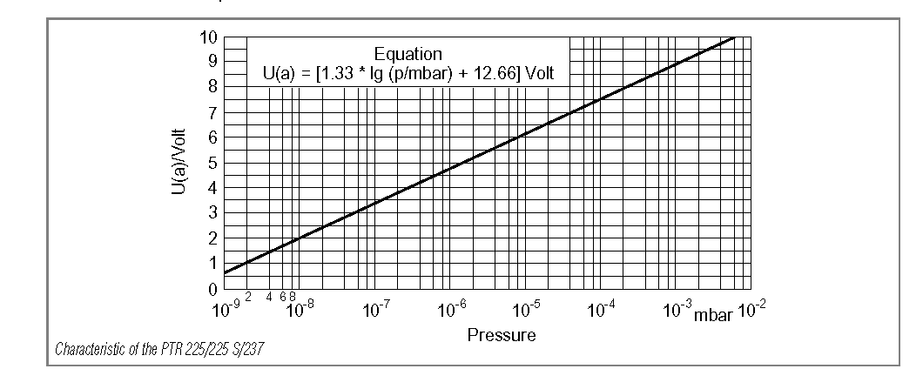
Penning (cold cathode)

Slide 47
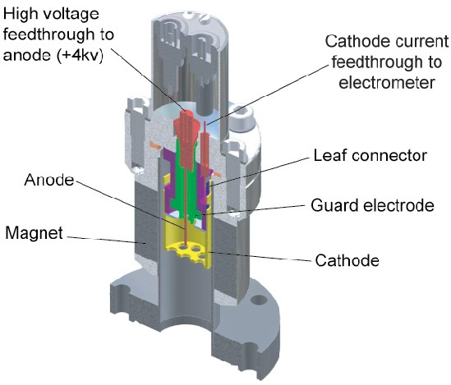
MKS-HPS Inverted Magnetron CCG
Measuring range: 10⁻³ to 10⁻¹¹ Torr
(with Series 937 Controller)
No X-ray limit
Very low power, and no heating
Very robust design
Sensitive to contaminations, no degas option
Be aware of stray B-field
MKS HPS
Model 422 CCG

Slide 48
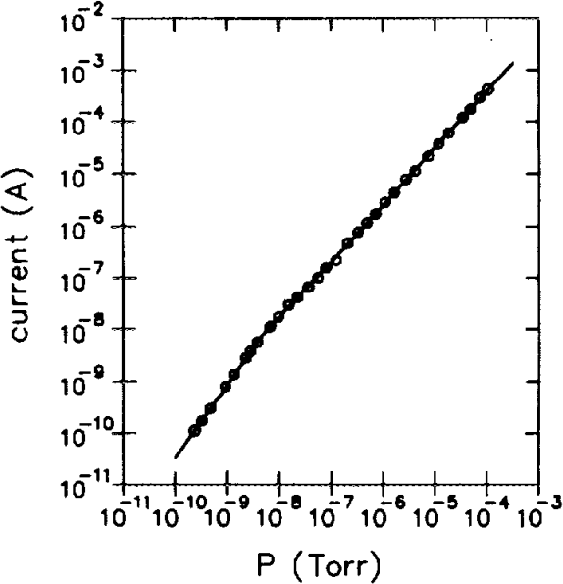
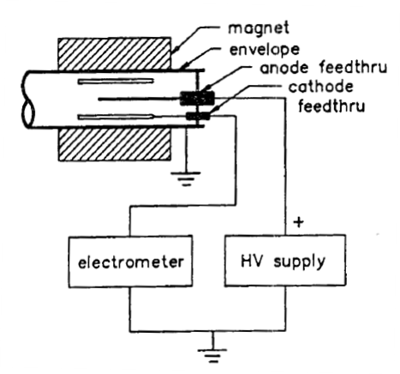


MKS-HPS Inverted Magnetron CCG (2)
n=1.09
n
i_{g} = K ⋅ P
n=1.4
CCG Circuit of Operation
With both floating anode and cathode, significantly reduce baseline current from leakages.

Slide 49


HCGs versus CCGs
Both HCGs and CCGs are variable gauges in the range of 10⁻⁴ to 10⁻¹¹ torr
 | HCGs | CCGs
Pros | Linear gauge response Higher gauge sensitivity Possible extension to XHV | Inherently rugged Very low residual ion current Low power and heating Very good long-term reliability
Cons | Higher X-ray and ESD limits Filament lifetime High power and heating Filament light | Sensitive to contamination (oil, dielectric particulates, etc.) Discontinuity and nonlinearity Long ignition time at UHV Stray magnetic field

Slide 50
Gauge Selection Considerations
Gauge Range: Multiple gauges should be installed in a accelerator vacuum system to cover pressure ranges from atmospheric pressure to the working pressure.
  Convectron Pirani gauges are ideal for pressure atm. ~ 10⁻³ torr
  Ionization gauges are usually used for HV/UHV ranges.
There are commercial ‘full-range’ combination gauges from many vendors.
RGAs should be installed for UHV accelerator vacuum systems to monitor vacuum system performances and online trouble-shooting, such as potential leaks during operations, and/or unusual beam induced pressure rises.

Slide 51
Gauge Application to Accelerators
Gauges’ long-term (multi-year) reliability is most important factor, as in many accelerator vacuum system, access to the gauge heads can be very limited. In this aspect, CCGs are preferred over HCGs (though stray magnetic field must be taken into consideration).
Gauges with ‘on-board’ electronics should always be avoided, due to the radiation damage. One should also consider the long cable factor for selecting a type of gauges. Gauges require low power is always a plus.
When installing a gauge to the accelerator beam pipe, one should avoid line-of-sight of the gauge port to the particle beam, to minimize the ‘cross-talks’ between the gauge and the beam.

Slide 52
Accelerator Vacuum Gauges – A Survey
Institute Accelerator | Total Pressure Gauge |  | Partial Pressure Gauge
 | Type/Brand | Q’ty | QMS Brand | Q’ty
Cornell / CESR | CCG / MKS | ~90 | Inficon/MKS/SRS | ~20
ANL / APS | CCG / MKS | ~140 | Spectra MKS | ~120
BNL / RHIC | CCG / MKS | >100 | MKS | ~100
BNL / NSLS II | CCG / MKS |  | Hidden
FNL / Tevtron | HCG/CCG | ~100/40 | SRS/Inficon/MKS | ~44
CERN / LHC | BAG / CCG | ~250 BAG | No fixed installation
KEK SuperB | CCG / DIA VAC | ~300
ESRF | CCG / Pfeiffer | ~200 | MKS
JLAB | HCG (EXT) for ERL-FEL CCGs for CEBAF | 100s | SRS
TLS – TPS | Extractor / Leybold | ~280 | Inficon | 6
Diamond L.S. | CCG / MKS |  | MKS
Pohang L.S. | BAG&CCG (Pfeiffer) | ~80 | Pfeiffer | 24

Slide 53


A Penning gauge on the Moon!

Slide 54


Wide range sensors
“Modern” sensors that cover from atmospheric pressure to UHV
They operate coupling two sensors in one “head”
One Pirani Gauge and one Penning gauge or one Pirani and one BA gauge
Notes:
54

Slide 55
Wide range gauge
1
2
3
4
1
7
5
4
6
7
6
5
6
1
a
b
c
Full-range vacuum gauge combining a Pirani vacuum gauge and inverted magnetron vacuum gauge; a, disassembled gauge; b, view form the side of gas inlet; c, view from the contact side.
1, conflate flange;
2, cathode housing at ground potential;
3, insulating fixture;
4, tube housing for the Pirani gauge (centered with a fine wire spiral winding);
5, permanent magnet;
6, anode with an insulating ceramic disc;
7, cathode ring limiting discharge region—holes for entering gas.

Slide 56

Wide range sensors
Other instruments as the MKS 901P : it operates from atmospheric pressure to 10⁻⁵ mbar, giving indication of the absolute pressure and of the relative pressure (ref. to atmospheric pressure).
It is used for load lock devices.
It combines Piezo and Micro Pirani™ vacuum sensor technology.
The combined output provides significantly higher accuracy, stability,
repeatability and a faster response time than conventional thermal
conductivity gauges.
Absolute pressure measurement from 1,000 to 10⁻⁵ Torr
Analog, RS232, RS485, & EtherCAT® versions
Optional integrated touch-screen display available for
local pressure indication
Notes:
56

Slide 57


Sensors, electronics, interfaces
Various architectures
OUT
AN
electronics
Interf
analog
Interf
digital
DIG
Special cable
display
AN
electronics
Interf
analog
Interf
digital
DIG
display
AN
electronics
Interf
analog
Interf
digital
display
display
DIG
Presently many gauges have RS232, only a few USB. 4-20 mA on many for industrial use. Ethernet e/o fieldbus o modbus are available.

Slide 58
Reference
Paolo Michelato – Corso Vuoto 2019
Yulin Li and Xianghong Liu – USPAS 2017

