Slide 1
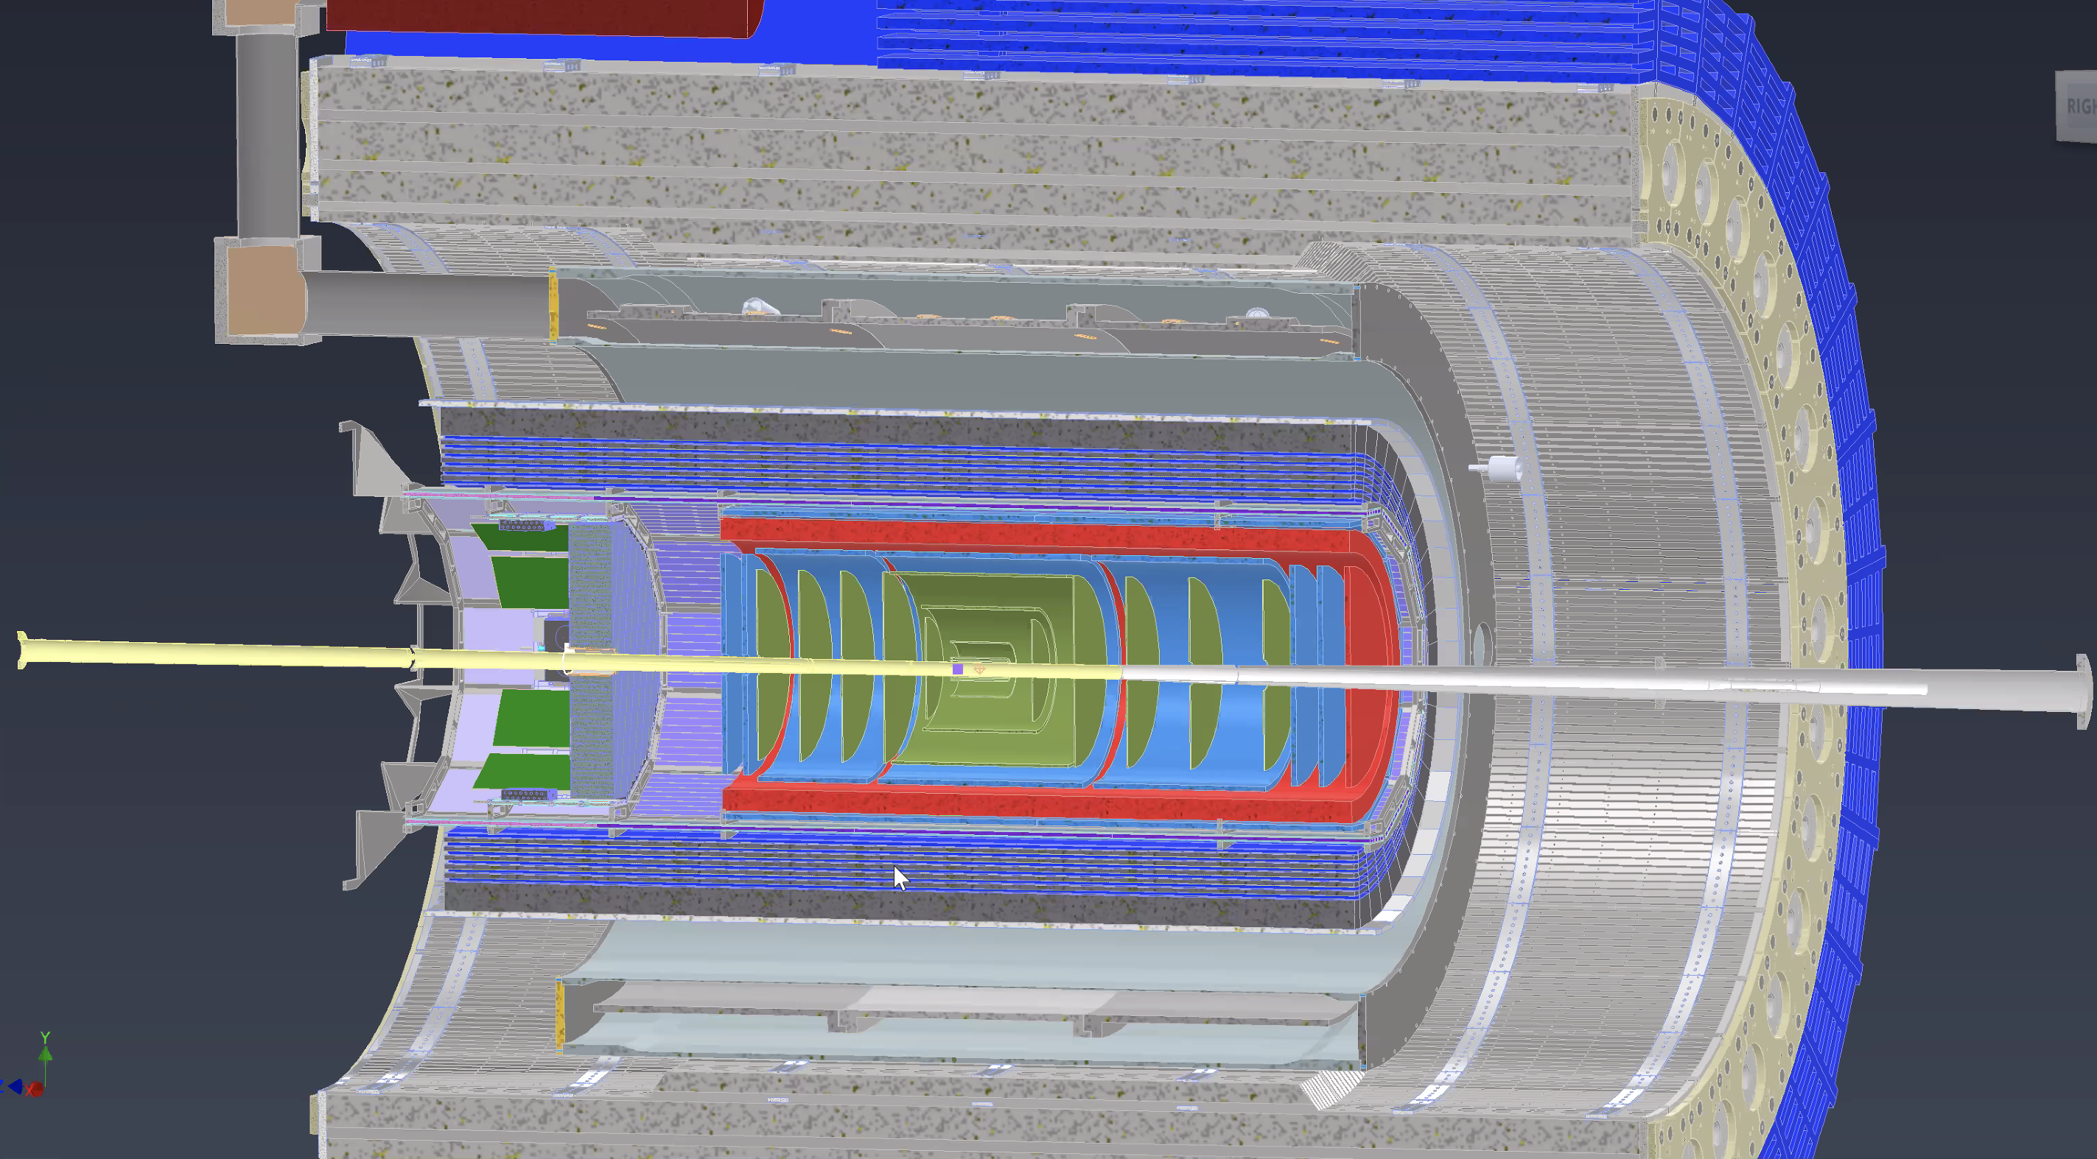
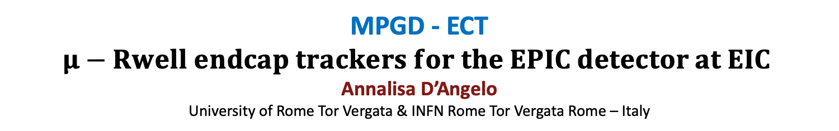
MPGD - ECT
$μ−$ $Rwell endcap trackers for the EPIC detector at EIC$
Annalisa D’Angelo
University of Rome Tor Vergata & INFN Rome Tor Vergata Rome – Italy

Slide 2
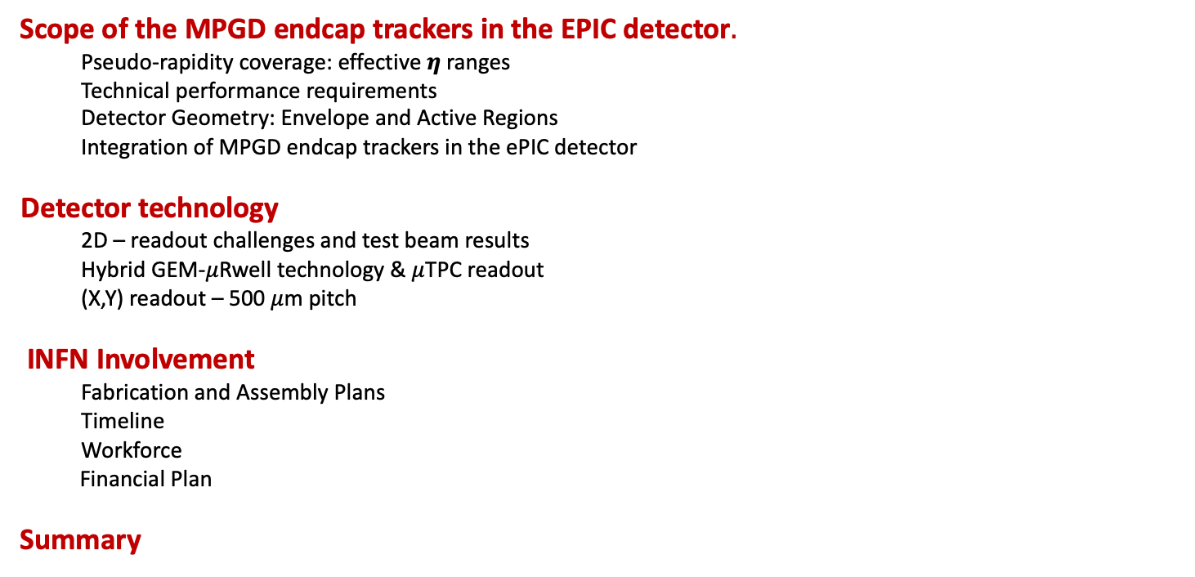
Outline
Scope of the MPGD endcap trackers in the EPIC detector$.$
  Pseudo-rapidity coverage: effective $η$ranges
Technical performance requirements
  Detector Geometry: Envelope and Active Regions
  Integration of MPGD endcap trackers in the ePIC detector
  Detector technology
  2D – readout challenges and test beam results
  Hybrid GEM-$μ$Rwell technology & $μ$TPC readout
  (X,Y) readout – 500 $μ$m pitch
  INFN Involvement
  Fabrication and Assembly Plans
  Timeline
  Workforce
  Financial Plan
Summary
EIC Referee Meeting June 10th, 2024 – Annalisa D’Angelo
2

Slide 3
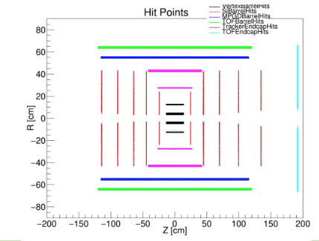
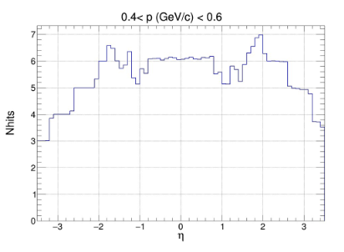
Scope of the MPGD endcaps in ePIC detector tracking
In May 2023, MC simulations showed that the tracking configuration in the endcap regions of the ePIC detector, which will experience the highest backgrounds in the experiment, would not provide enough hit points in the |η| > 2 region for good pattern recognition.
ePIC tracker geometry before June 2023
EIC Referee Meeting June 10th 2024 – Annalisa D’Angelo
3
ePIC tracker geometry before June 2023

Slide 4
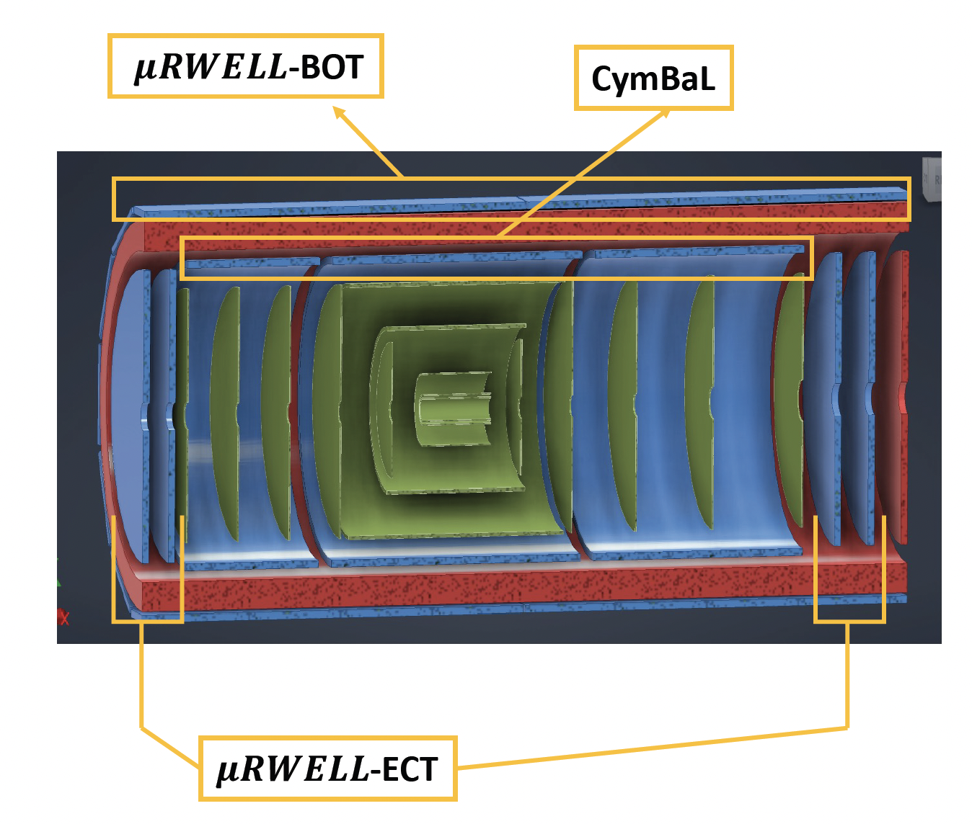
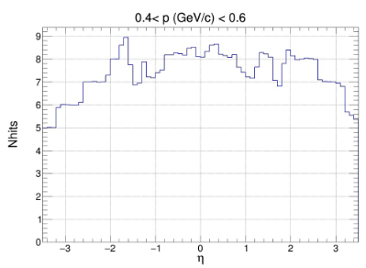


Scope of the MPGD endcaps in ePIC detector tracking
Adding two MPGD Endcap Tracking (ECT) disks both in the hadronic and in the leptonic regions increased the number of hits in the |η| > 2 region to improve pattern recognition.
-3.61$<η<−1.72$
Present Configuration
1.99$<η<$3.44
Present ePIC tracker geometry
EIC Referee Meeting June 10th 2024 – Annalisa D’Angelo
4

Slide 5

Technical Performance Requirements
Time resolution 10 ns or less to provide tracking timing
  Fast rise time ~ 20 $÷$ 50 ns
  Peaking time 50 ns
  Sampling faster than 50 MHz
Low material budget
  1-2 % X₀ - it will be the minimum compatible with the chosen technology
Spatial resolution: 150 $μ$m or better
  <150 $μ$m intrinsic spatial resolution for perpendicular tracks
  Technological optimizations to retain 150 $μ$m resolution for inclined/curved tracks
High Efficiency
  Single detector efficiency ~ 96 –97 % $→$ 92 –94 % combined efficiency for two disks
EIC Referee Meeting June 10th 2024 – Annalisa D’Angelo
5

Slide 6
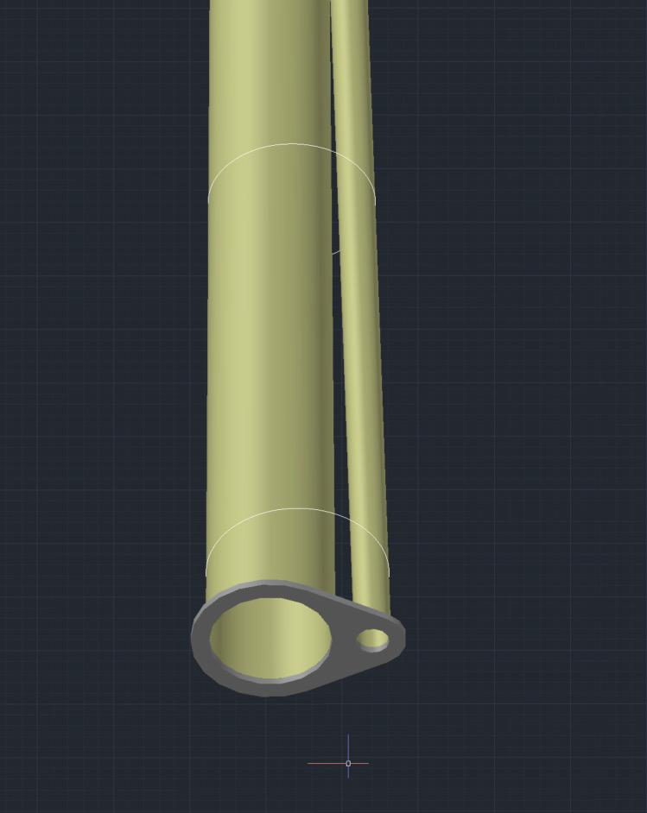
Detector Geometry: Envelope and Active Regions
MPGD Disk | Max Z Pos (cm) | Disk Outer Radius (cm) | Outer Active Reg. radius (cm) | Calculated Beam pipes radii (mm) | Offset (mm) | Disk Inner Radius (cm) | Inner Active Reg. radius (cm)
HD MPGD 2 | 163.5 | 50 | 45 | 55.8 | 22.5 | 9 | 10.5
HD MPGD 1 | 150.5 | 50 | 45 | 53.1 | 19.9 | 9 | 1.5
LD MPGD 1 | -112.5 | 50 | 45 | 37.7 | -3.1 | 4.5 | 6.0
LD MPGD 2 | -122.5 | 50 | 45 | 39.2 | -3.4 | 4.5 | 6.0
Two couples of disks: Lepton/Hadron Disks
The geometric envelope should include the electronics front-end boards
50 cm external radius/45 cm active region radius – including 5cm outer ring for services.
Different internal hole dimensions due to divergent beam pipes: 4.5 cm (LD)/9 cm(HD)
Calculated
Radii
1m
EIC Referee Meeting June 10th 2024 – Annalisa D’Angelo
6

Slide 7
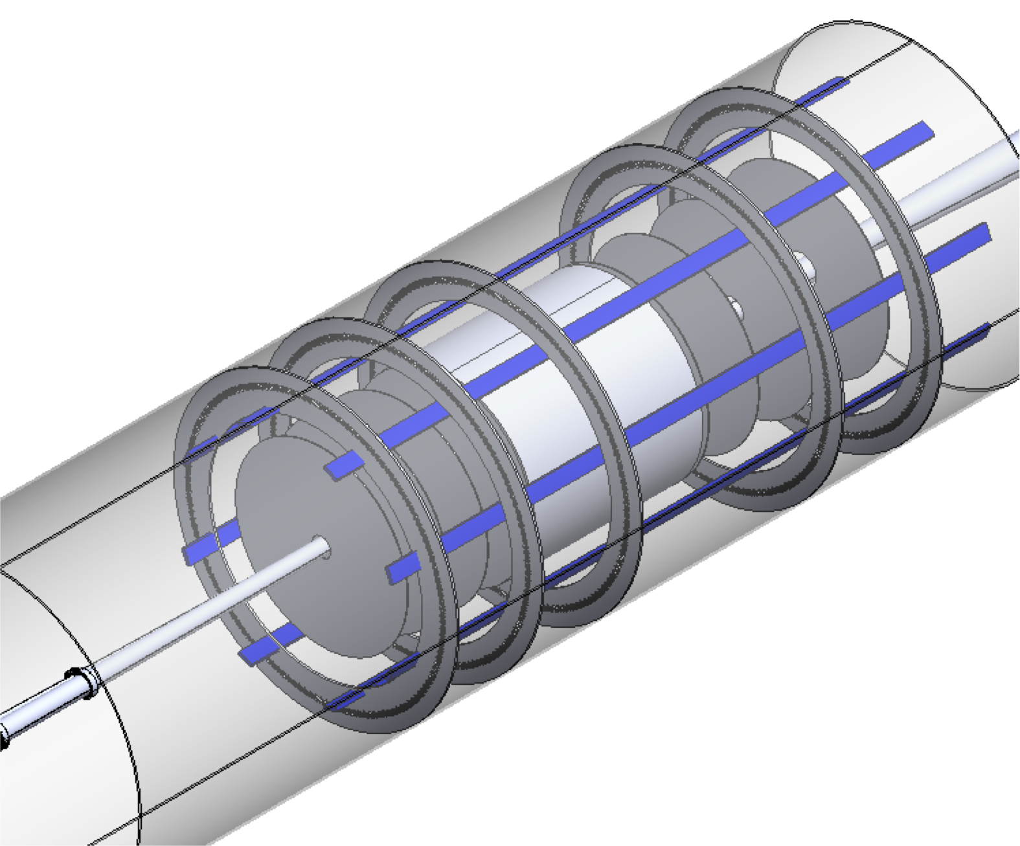
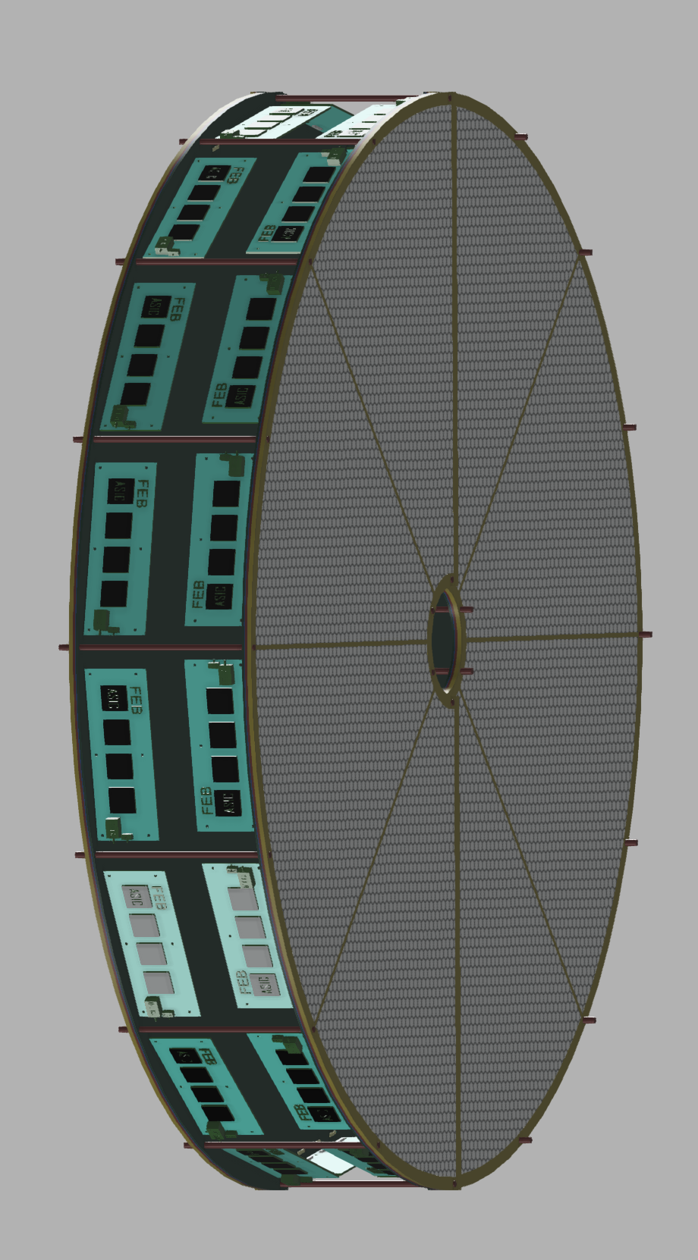
Endcap Detectors Integration in ePIC
The assigned envelope will include the detectors and the FEB electronics.
The disks will be attached together and to the support frame under design.
EIC Referee Meeting June 10th 2024 – Annalisa D’Angelo
7

Slide 8
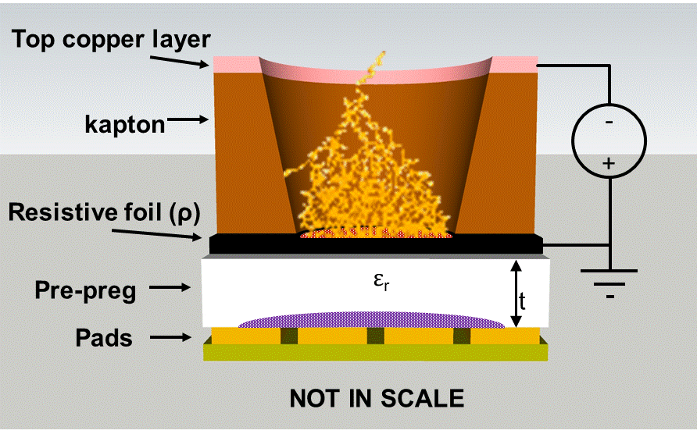
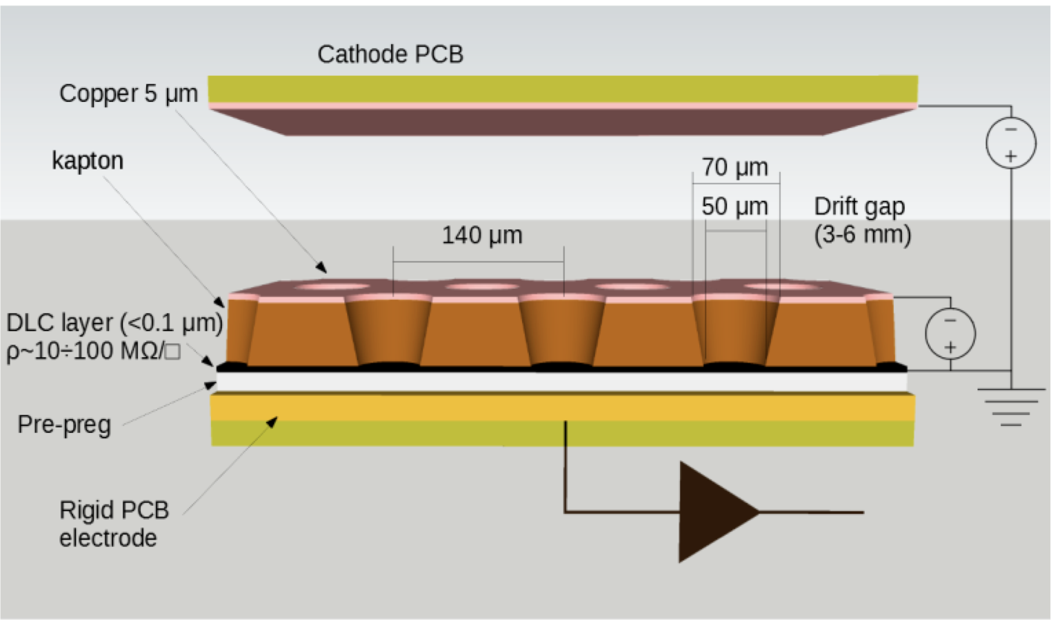
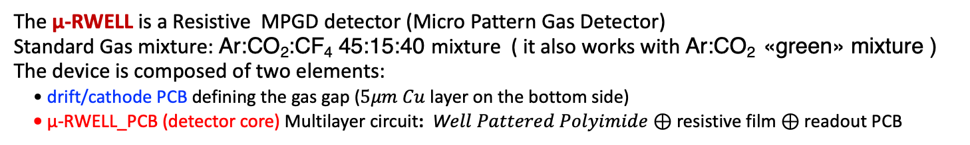
Detector Technology Choices
μ-RWELL
G. Bencivenni et al.; 2015_JINST_10_P02008
The μ-RWELL is a Resistive MPGD detector (Micro Pattern Gas Detector)
Standard Gas mixture: Ar:CO₂:CF₄ 45:15:40 mixture ( it also works with Ar:CO₂ «green» mixture )
The device is composed of two elements:
• drift/cathode PCB defining the gas gap ($5μm Cu$ layer on the bottom side)
• μ-RWELL_PCB (detector core) Multilayer circuit: W$ell Pattered Polyimide⊕$ resistive film $⊕$ readout PCB
The “WELL” acts as a multiplication channel for the ionization produced in the gas of the drift gap
The resistive stage ensures the quenching of the spark amplitude
EIC Referee Meeting June 10th 2024 – Annalisa D’Angelo
8

Slide 9
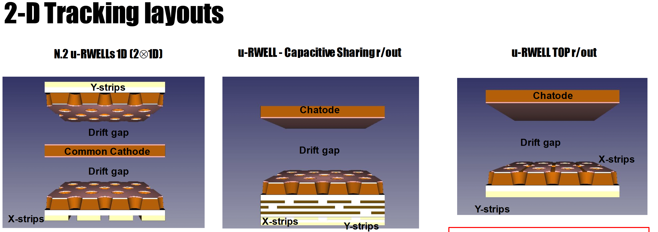
June 2023 test beam
June 2023 test beam
October 2022 test beam
1200 μm pitch
300 μm vs 1000 μm strips width
10 x 10 cm² active surface
83 channels
“Compass-like” strip configuration
Capacitive sharing
780 μm pitch
300 μm width
10 x 10 cm² active surface
128 channels
X –strips Top read-out
Y – strips standard read-out
780 mm pitch
300 mm width
10 x 10 cm² active surface
128 channels
EIC Referee Meeting June 10th 2024 – Annalisa D’Angelo
9

Slide 10
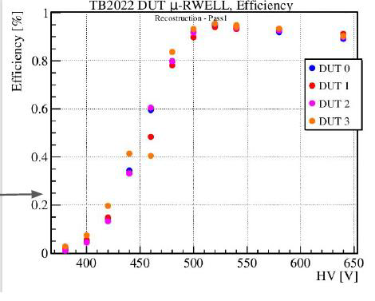
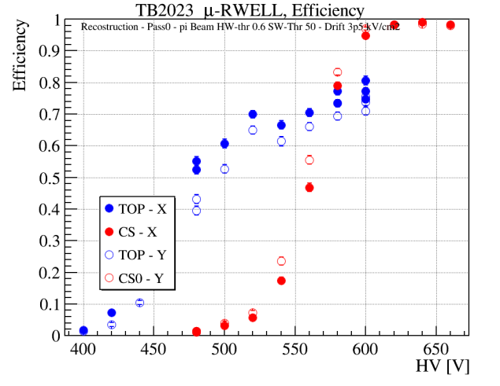
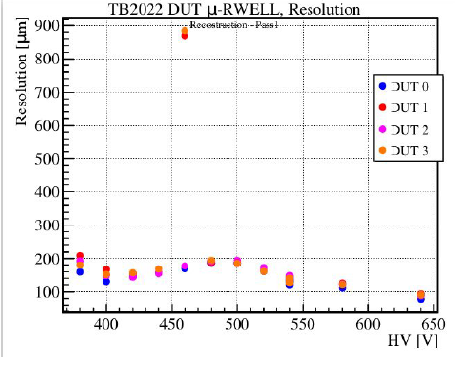
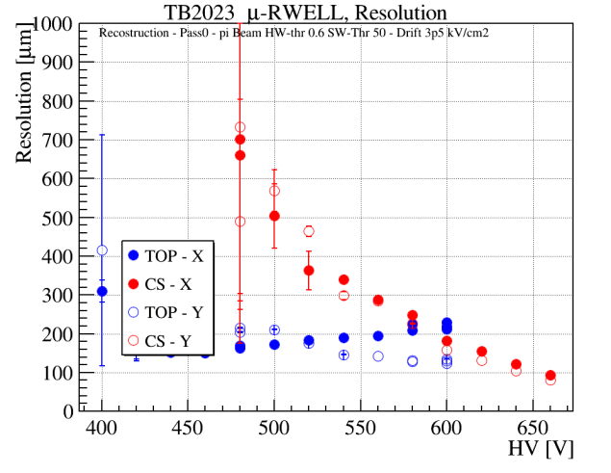
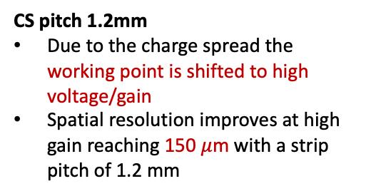
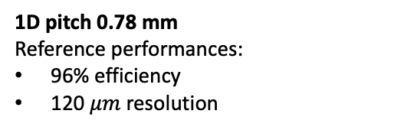
2-D Tracking layouts
CS & TOP
1D pitch 0.78 mm
Reference performances:
96% efficiency
120 $μm$ resolution
CS pitch 1.2mm
Due to the charge spread the working point is shifted to high voltage/gain
Spatial resolution improves at high gain reaching 150 $μ$m with a strip pitch of 1.2 mm
2x1D
CS & TOP
Top-r/out pitch 0.78 mm
low-voltage/gain operation but low efficiency level (80%) due to the geometrical dead zone on the segmented amplification stage
2x1D
October 2022 test beam
June 2023 test beam
EIC Referee Meeting June 10th 2024 – Annalisa D’Angelo
10

Slide 11
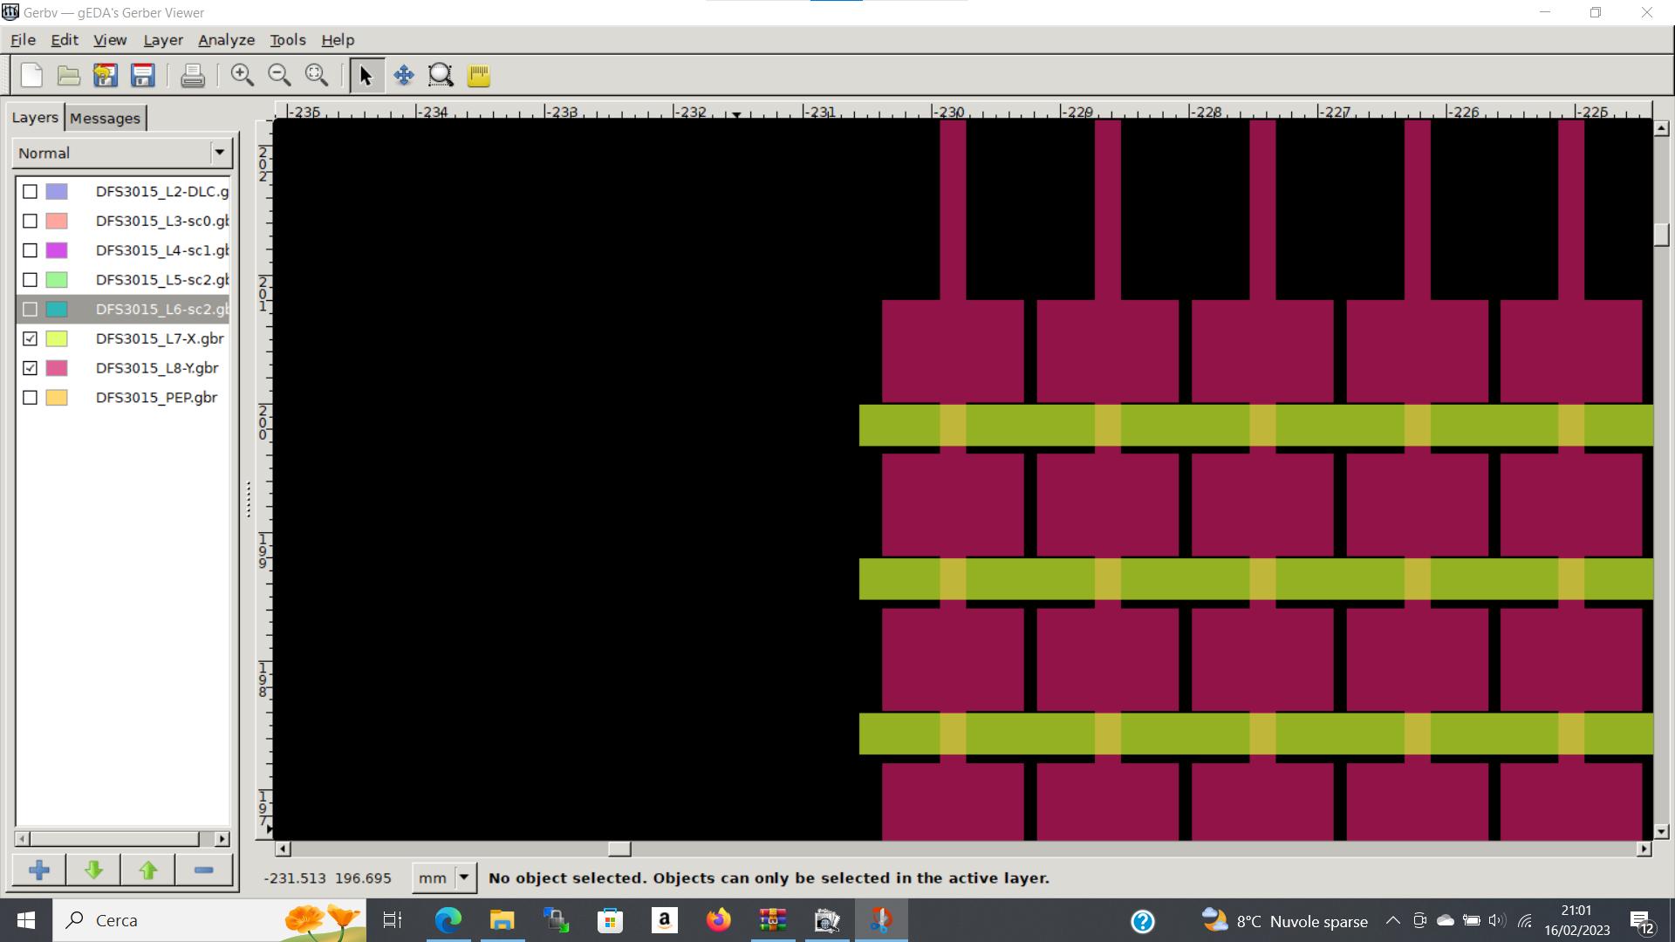
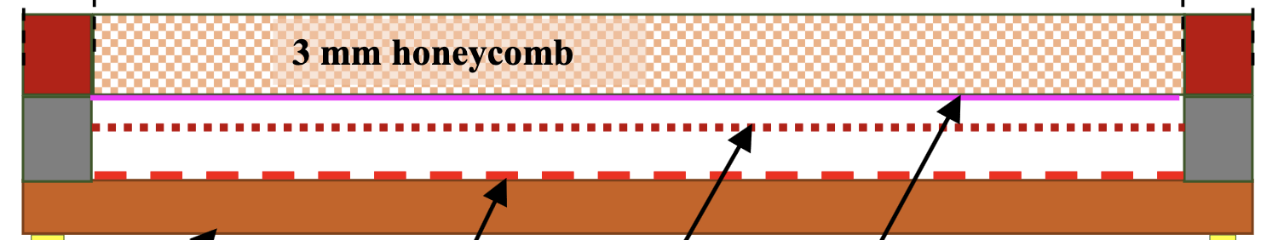


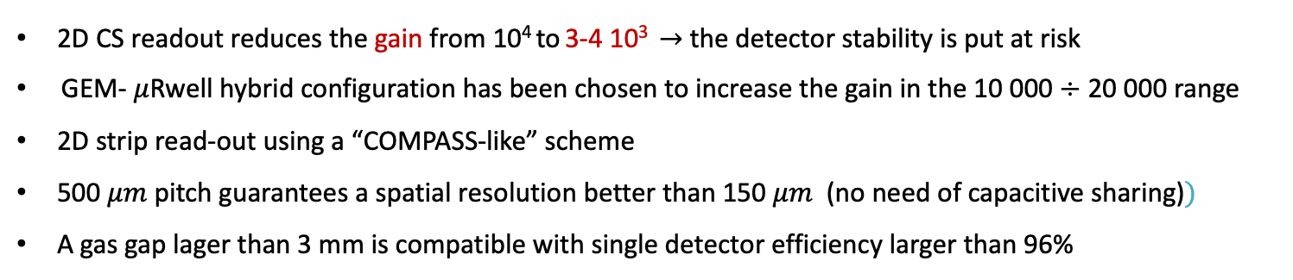
Detector Technology Choices: GEM+$μ$Rwell
GEM - $μ$Rwell Technology
3/6 mm gas gap
2/3 mm transfer gap
PCB read-out
$μ−$Rwell
GEM
cathode
2D CS readout reduces the gain from 10⁴ to 3-4 10³ $→$ the detector stability is put at risk
GEM- $μ$Rwell hybrid configuration has been chosen to increase the gain in the 10 000 $÷$ 20 000 range
2D strip read-out using a “COMPASS-like” scheme
500 $μm$ pitch guarantees a spatial resolution better than 150 $μm$ (no need of capacitive sharing)$⁡)$
A gas gap lager than 3 mm is compatible with single detector efficiency larger than 96%
EIC Referee Meeting June 10th 2024 – Annalisa D’Angelo
11

Slide 12
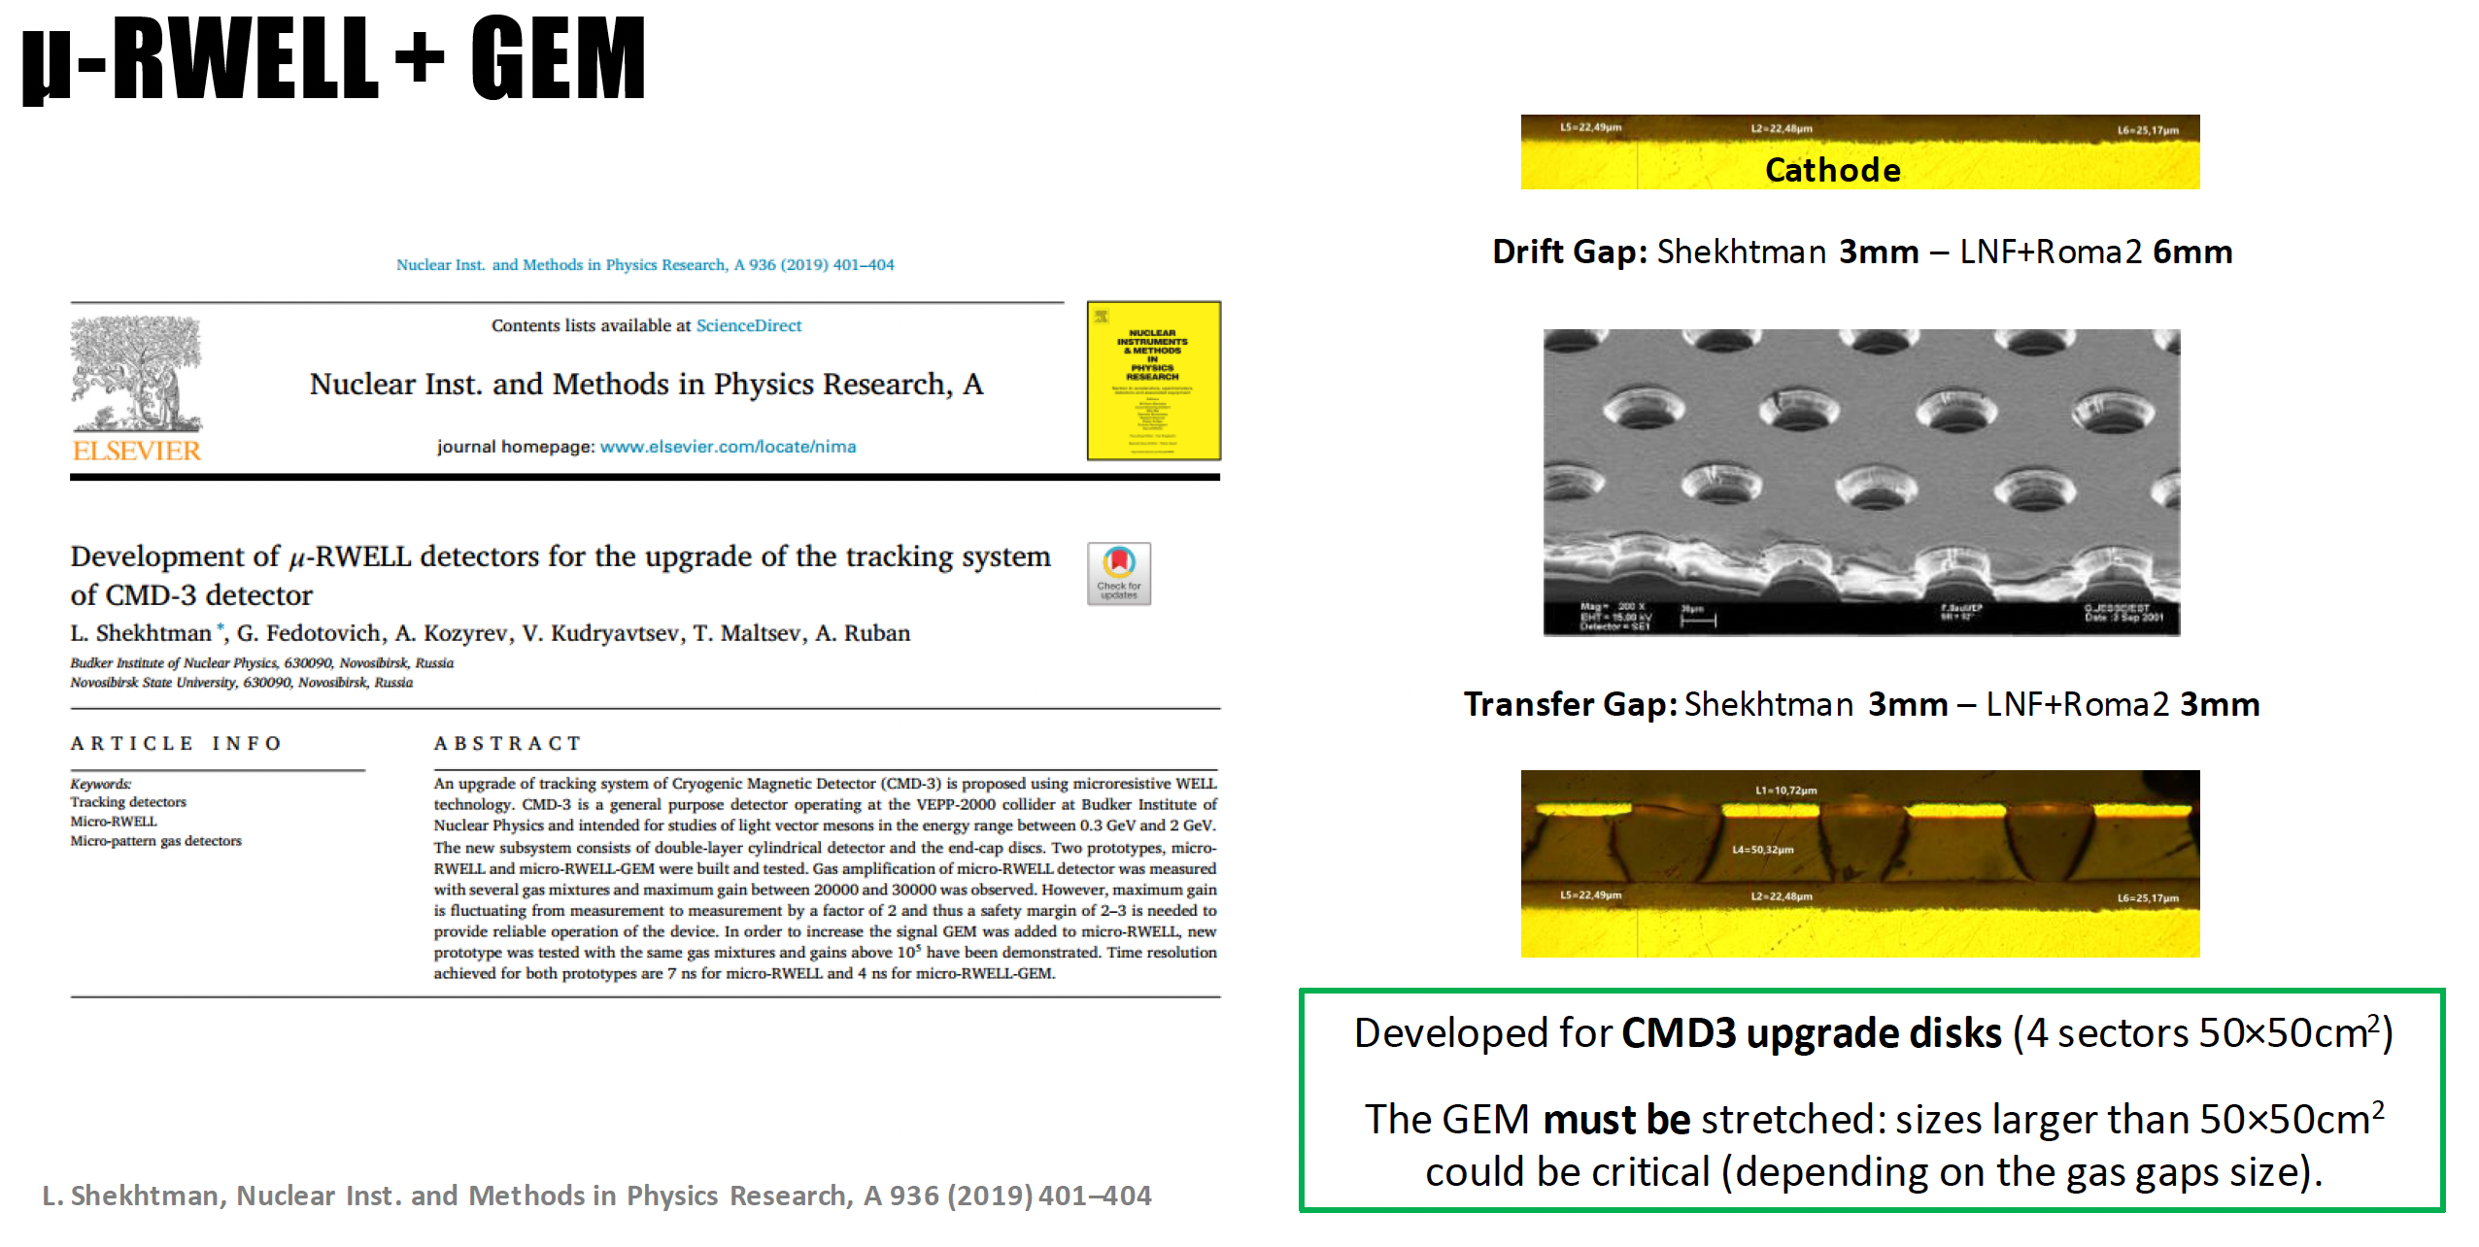
EIC Referee Meeting June 10th 2024 – Annalisa D’Angelo
12

Slide 13
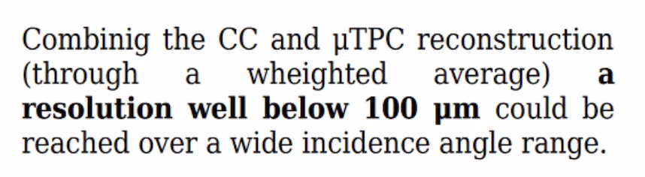
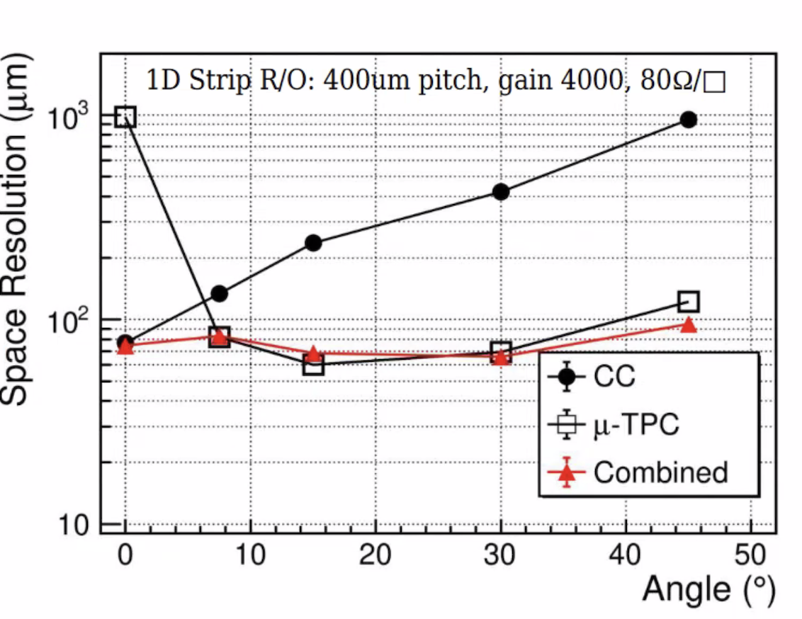
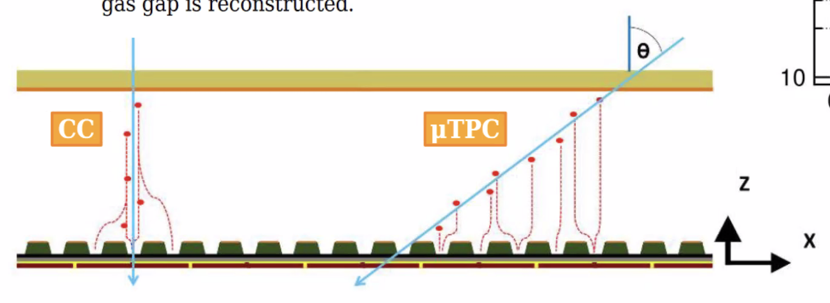

Detector Technology Choices: GEM+$μ$Rwell+ $μ$ TPC
GEM - $μ$Rwell Technology
3/6 mm gas gap
2/3 mm transfer gap
PCB read-out
$μ−$Rwell
GEM
cathode
CC= Charge Centroid
Next test beam Oct/Nov 2024
EIC Referee Meeting June 10th 2024 – Annalisa D’Angelo
13

Slide 14
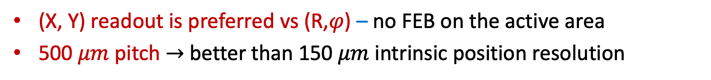
Detector Technology Choices: (X,Y) vs (R,$φ$) read-out
(X, Y) read-out geometry
PROs | CONs
The strip length does not vary much along the active area | Alignment is critical
All readout FE hybrids may be located outside the active area | Routes to read-out connectors must be accurately studied
(X, Y) readout is preferred vs (R,$φ$) – no FEB on the active area
500 $μm$ pitch $→$ better than 150 $μm$ intrinsic position resolution
Strips routing details is being studied

Slide 15

Detector Technology Choices: Detector sectors overlap
1000 mm
1000 mm
$\left|η\right|$>1.99
525 mm
525 mm
The two half disks will have 2 cm of active area overlap

Slide 16
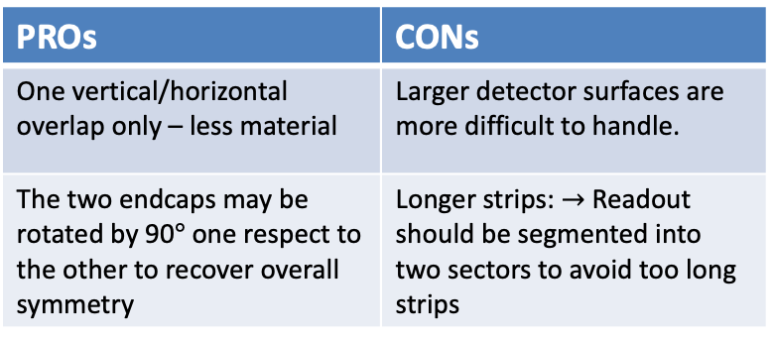
ePIC Endcaps – open options
52.5 cm
52.5 cm
      2 semi-circles
100 cm
4 Quadrants
52.5 cm
PROs | CONs
Smaller dimensions are easier to handle | Two vertical and horizontal overlapping regions – more material
Each endcap is intrinsically symmetric | We need to study how to attach two quadrants in a semi-circle
Strips length are shorter
GEM foils easier to stretch
PROs | CONs
One vertical/horizontal overlap only – less material | Larger detector surfaces are more difficult to handle.
The two endcaps may be rotated by 90$°$ one respect to the other to recover overall symmetry | Longer strips: $→$Readout should be segmented into two sectors to avoid too long strips

Slide 17
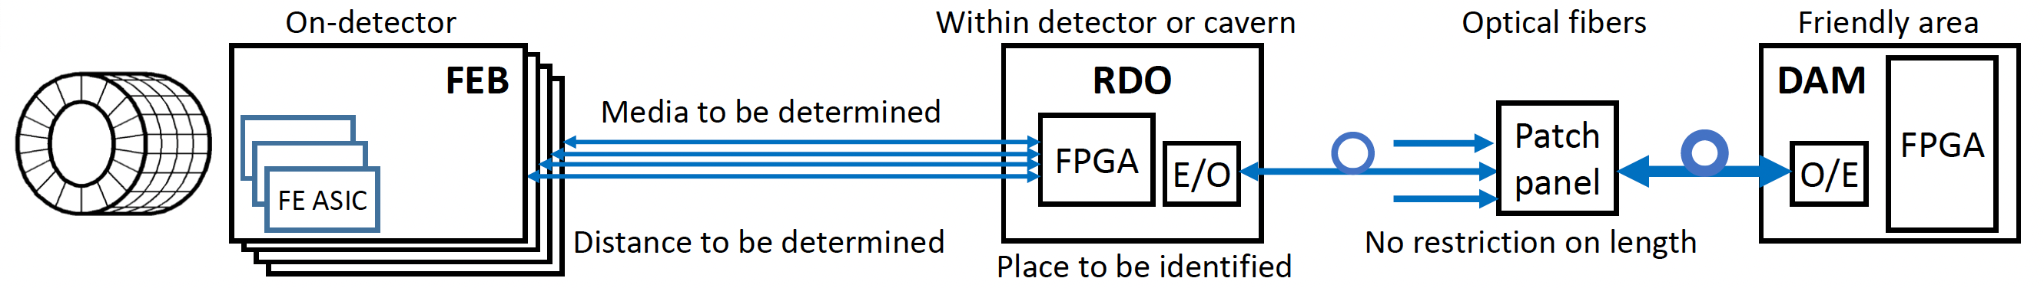
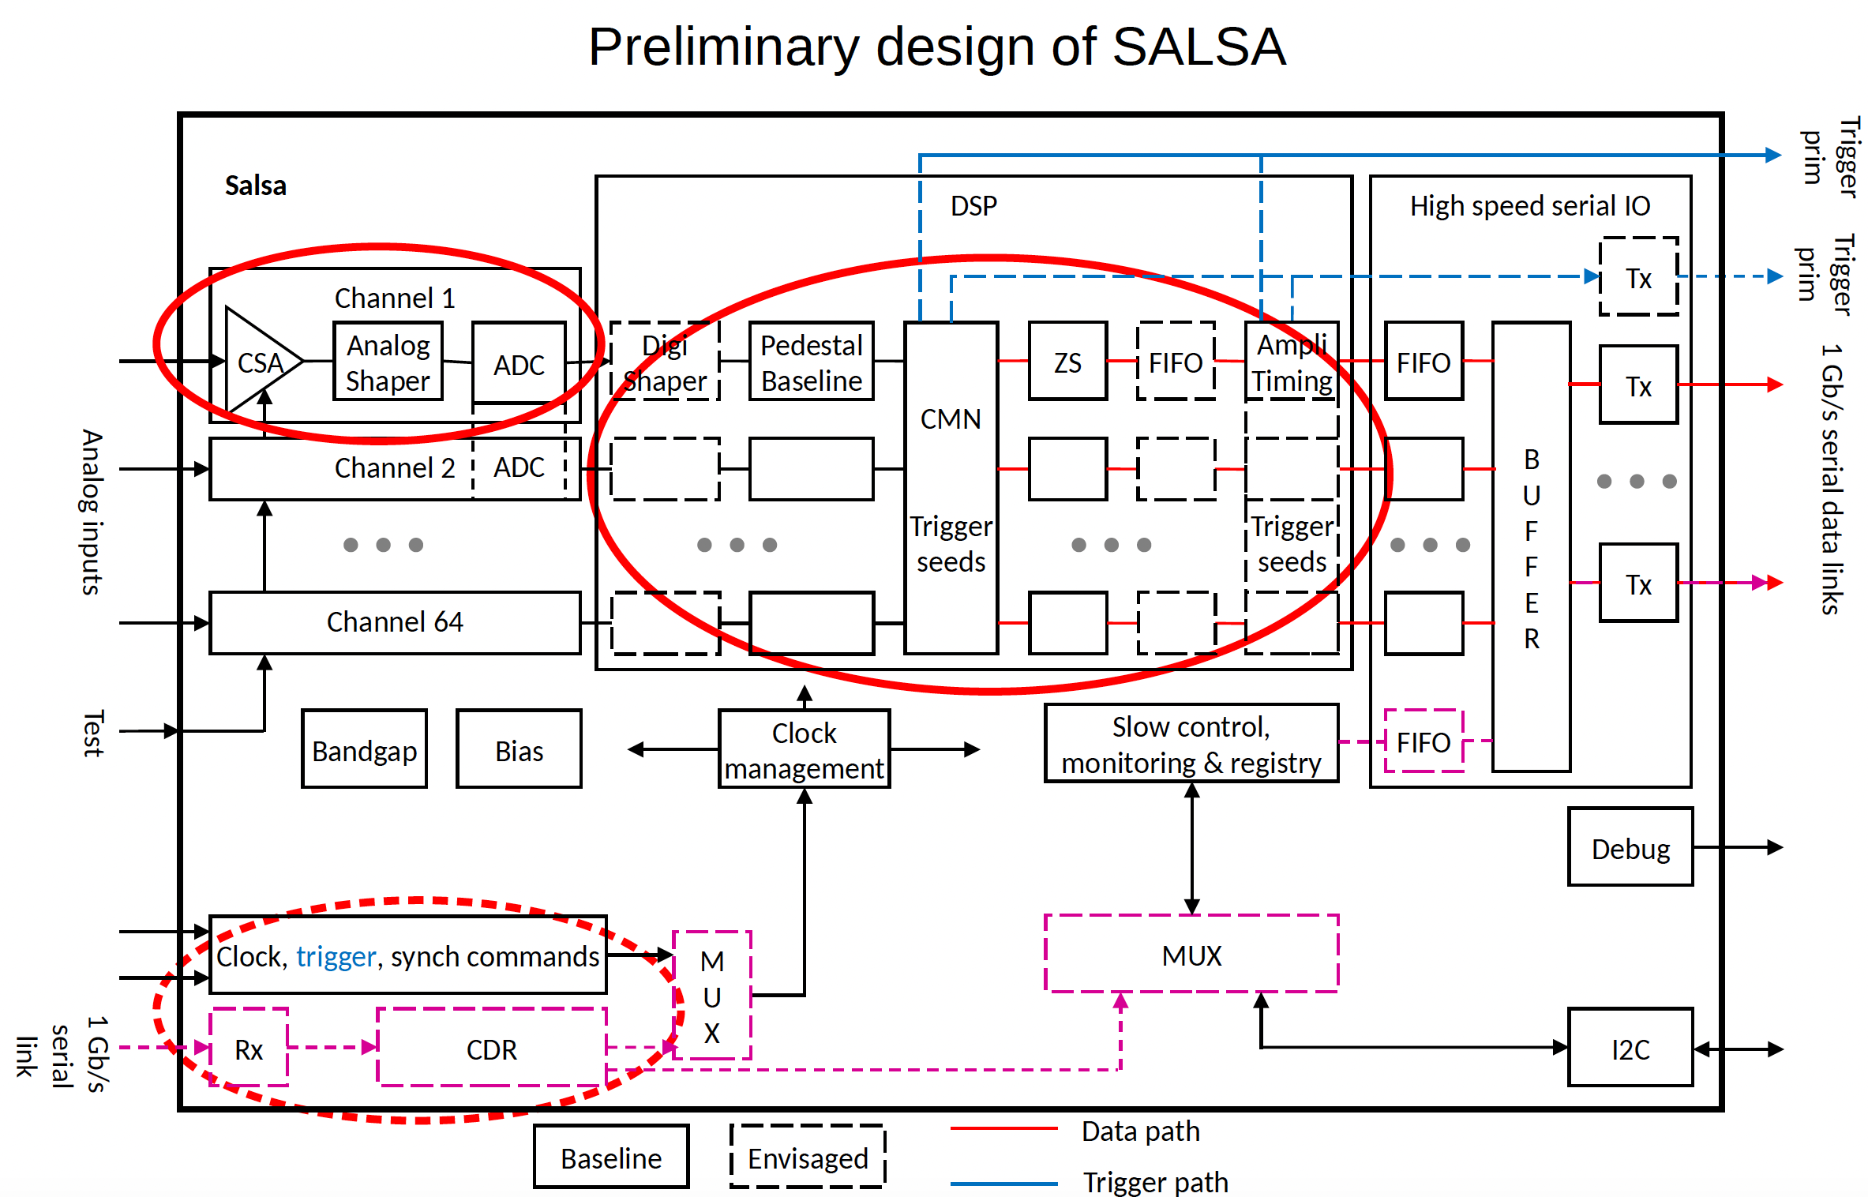
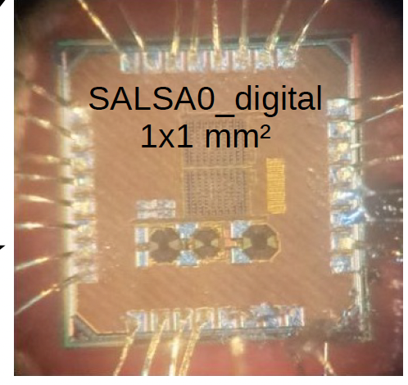
FEB – RDO – DAQ electronics
FEB is based on new SALSA chip designed and produced by the Saclay/San Paulo group for all MPGD detectors
Specific FEB form factor must be designed to fit each detector requirements
EIC Referee Meeting June 10th 2024 – Annalisa D’Angelo
17

Slide 18
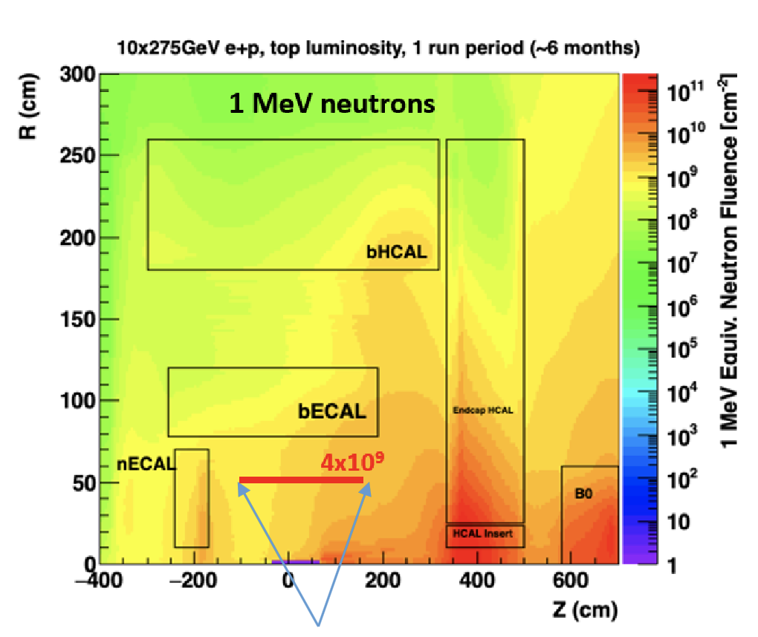

More on Technical Performance Requirements
Rate Capability
  Not critical ~ 1 kHz/cm² or less
Radiation Hardness
  Not critical for the detectors
  Important for FEBs and RDO electronics boards
Temperature Stability
  Not critical for the detector performances
  Detector calibration should consider gas pressure variations
Electronics power consumption and cooling
  SALSA ASIC consumption ~ 15 mW/channel at 1.2V $→$ 60 W/disk
  Air vs liquid cooling is under study at Saclay
EIC Referee Meeting June 10th 2024 – Annalisa D’Angelo
18

Slide 19

INFN Involvement timeline
August 2023: Interest of INFN groups to contribute to the MPGD trackers
1 year time to make the final decision about the INFN responsibility of the endcap construction
Joined DRD-1 and eRD108 communities
December 2023: Direct contact with ePIC management (Rolf Ent)
ePIC/DOE management agreed that INFN takes the leadership of MPGD ECT
eRD108 $→$ PED project: 30 k$ from DOE to provide a design by the end of 2024.
March 2024: Incremental Design and Safety Review (PDR)
Detector technical choices and project design communicated to the management
Very positive feedback
May 2024: MPGD ECT working group reinforced
Interest expressed by Paolo Musico (INFN GE) and local RM TV digital electronic group to contribute to the FEB design
Interest expressed by Temple University to contribute to the Lepton Disks construction
Support from the local INFN Director: electronics workshop and clean room
EIC Referee Meeting June 10th 2024 – Annalisa D’Angelo
19

Slide 20
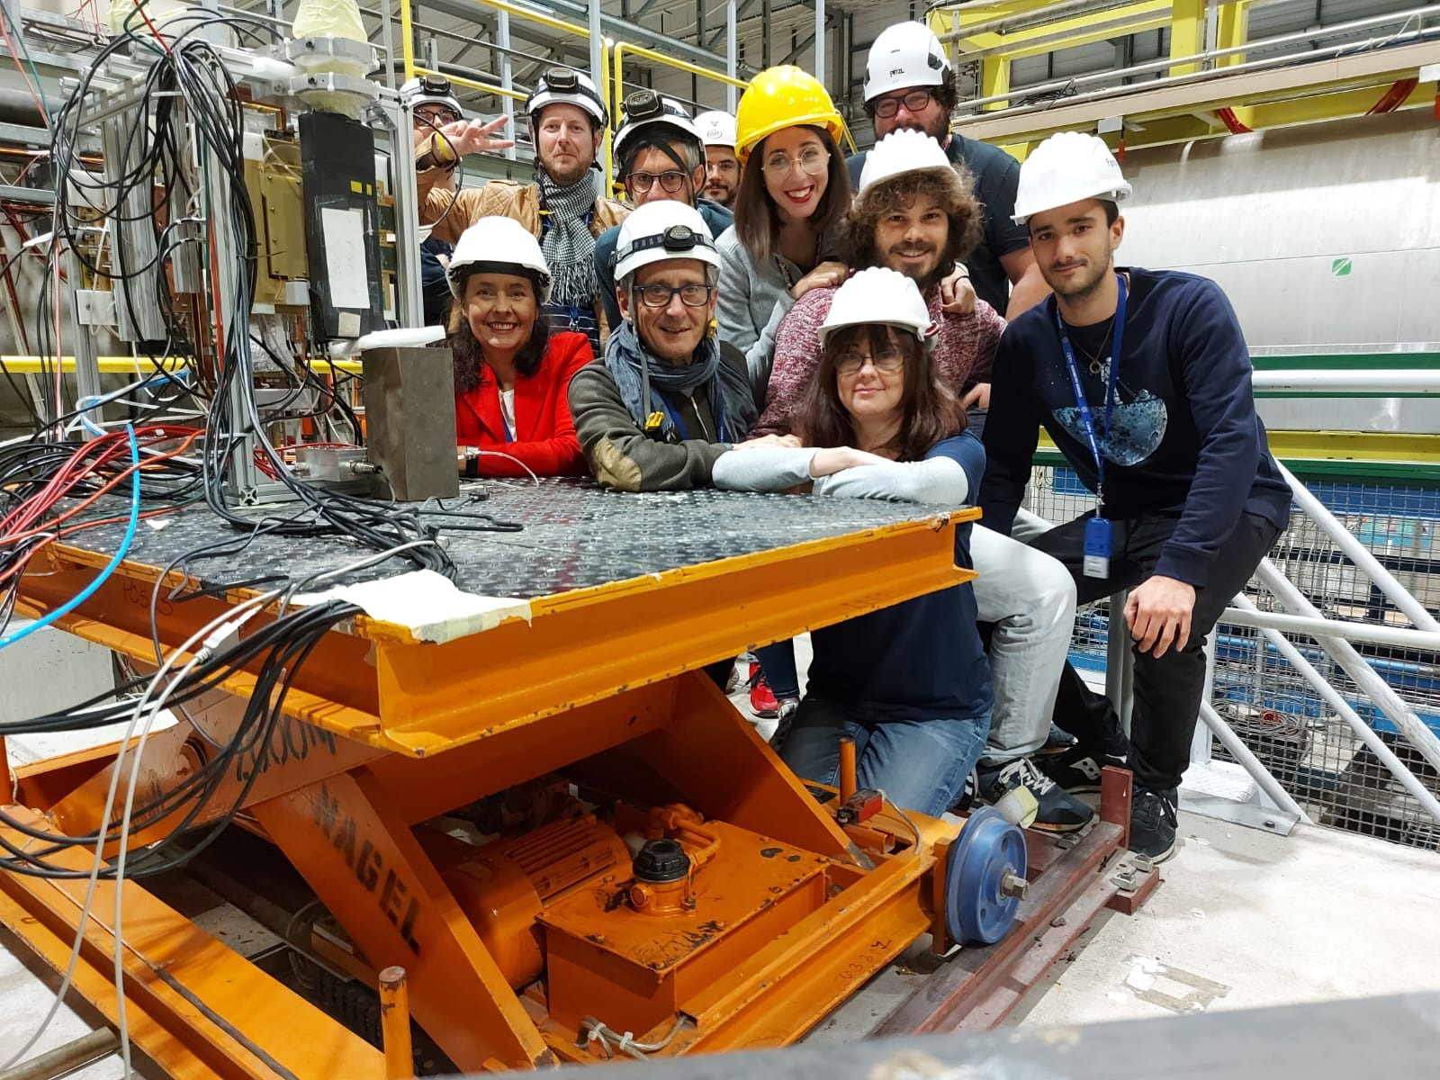

Involved Institutions & Workforce
INFN Workforce:
Roma Tor Vergata
Coordinator: A. D’Angelo,
Detector Hardware and QA: E. Sidoretti (PhD) A. Fantini, L. Lanza, Post Doc
Simulation & Reconstruction: L. Lanza, A. Fantini, R. Di Salvo
FEB Electronics: R. Ammendola
Genova
FEB Electronics: Paolo Musico, M. Battaglieri (streaming ro)
Catania
Simulation & Reconstruction: Mariagela Bondi’
The work will be performed in close connection with:
the group of Gianni Bencivenni @ INFN LNF and with the JLab detector group (Kondo Gnanvo, Seung Joon Lee)
INFN coordinates the GEM-$μ$Rwell MPGD ECT – for both the Hadron and Lepton Disks
INFN will provide the Hadron Disks and related electronics as In-kind contributions
Temple U. (Bernd Surrow , Matt Posik, ….) have expressed interest for the Lepton Disks.
EIC Referee Meeting June 10th 2024 – Annalisa D’Angelo
20

Slide 21
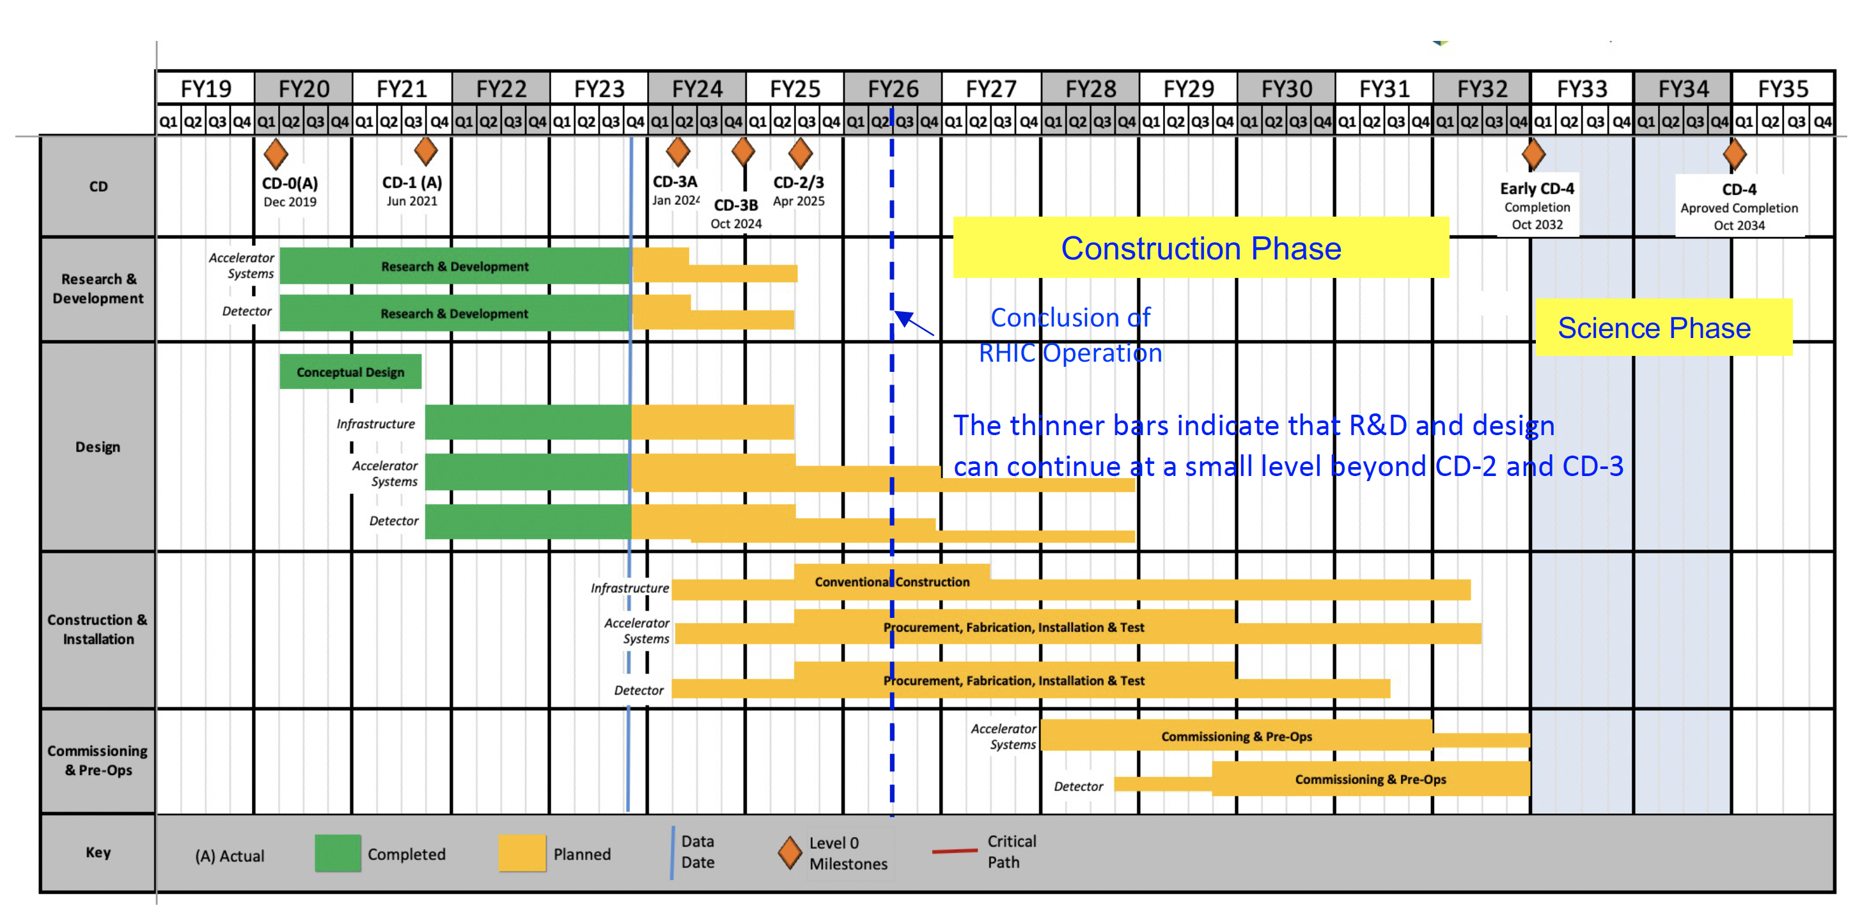
Fabrication and Assembly Plans
Design by end of 2024
2025 - 2026 pre-production and Engineering Test Article
2027 - 2029 production & QA
2030 Commissioning & Installation
MPGD Timeline |  |  | DURATION (years)
START DATE | END DATE | DESCRIPTION
3/1/24 | 12/31/24 | Detectors Overall Design | <1
1/1/25 | 12/31/26 | Pre - Production | 2
1/1/27 | 31/12/29 | Production & QA | 3
1/1/30 | 6/1/30 | Commissioning & Installation | 0.5
EIC Referee Meeting June 10th 2024 – Annalisa D’Angelo
21

Slide 22
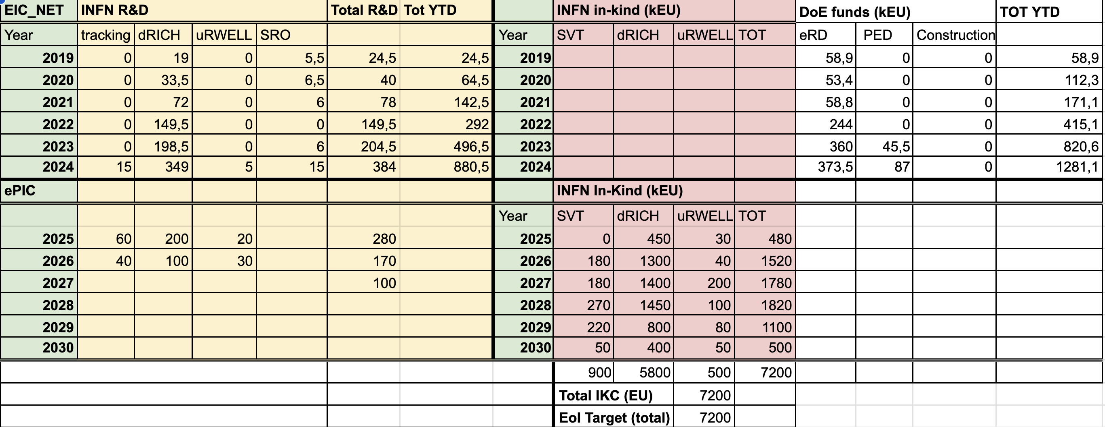
Financial Plan
5050 k€ R&D + 500 k€ coreK
EIC Referee Meeting June 10th 2024 – Annalisa D’Angelo
22

Slide 23
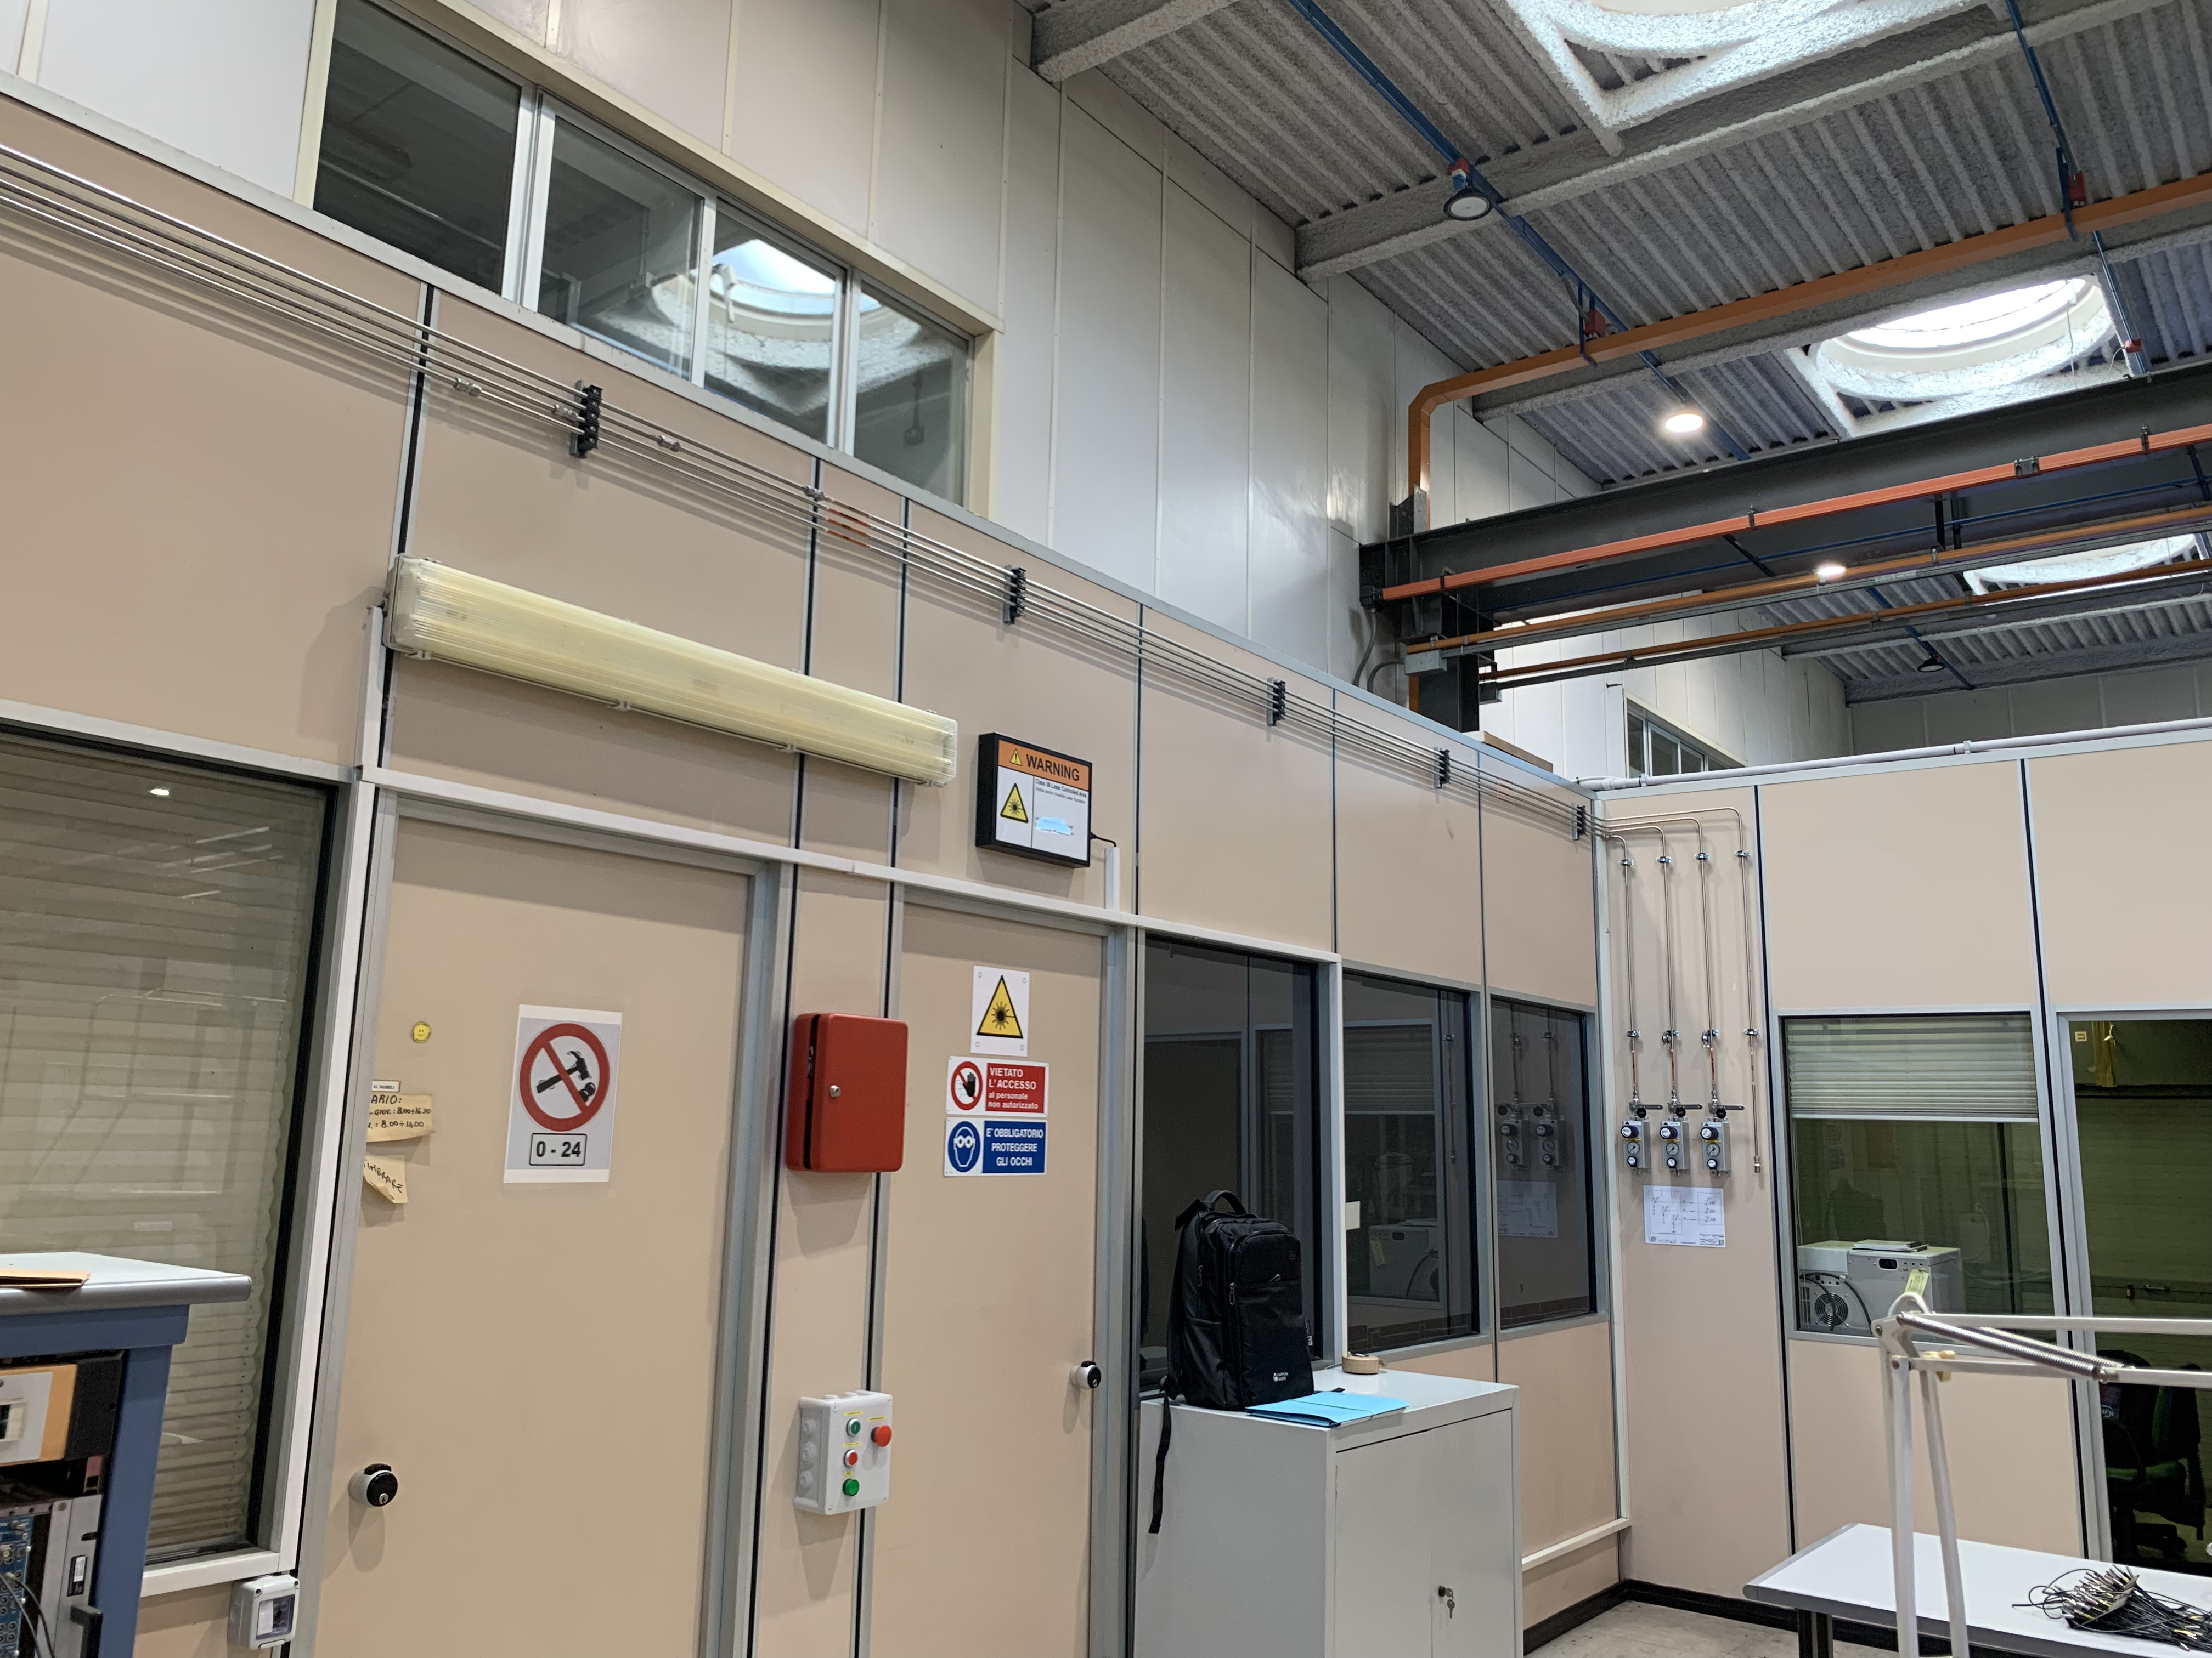
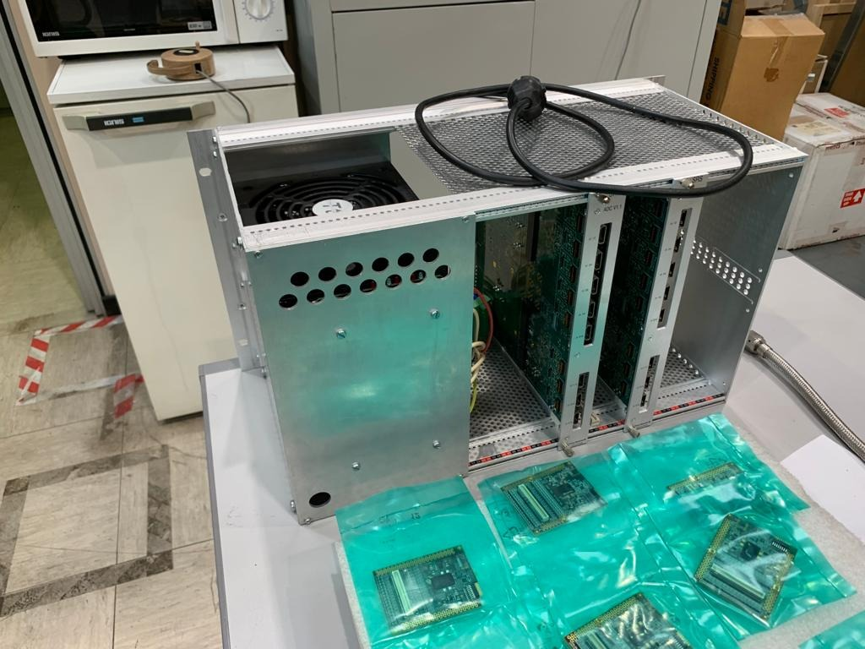
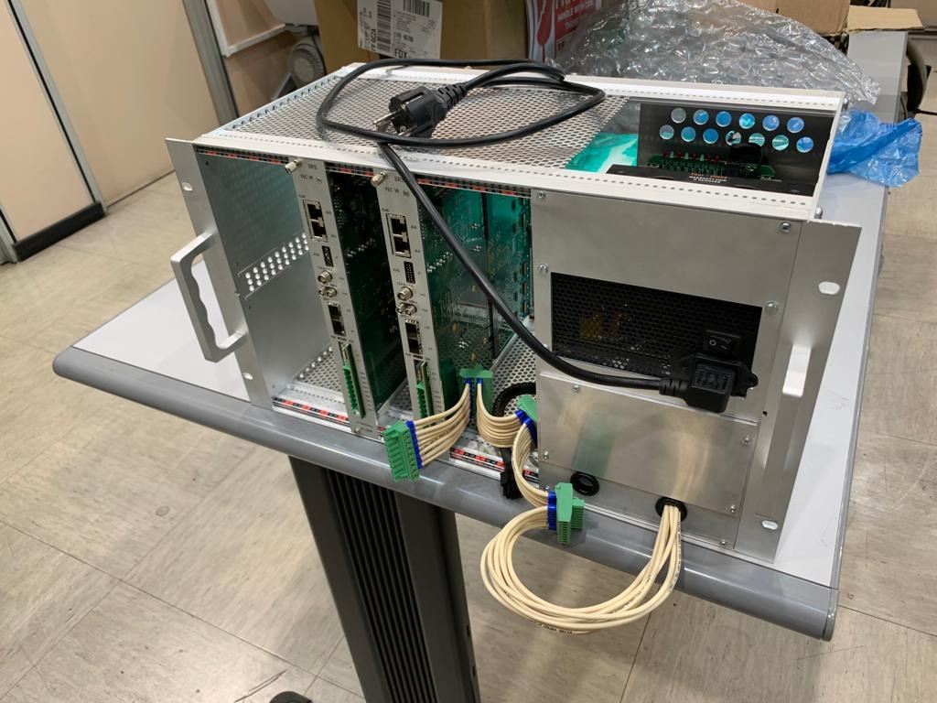
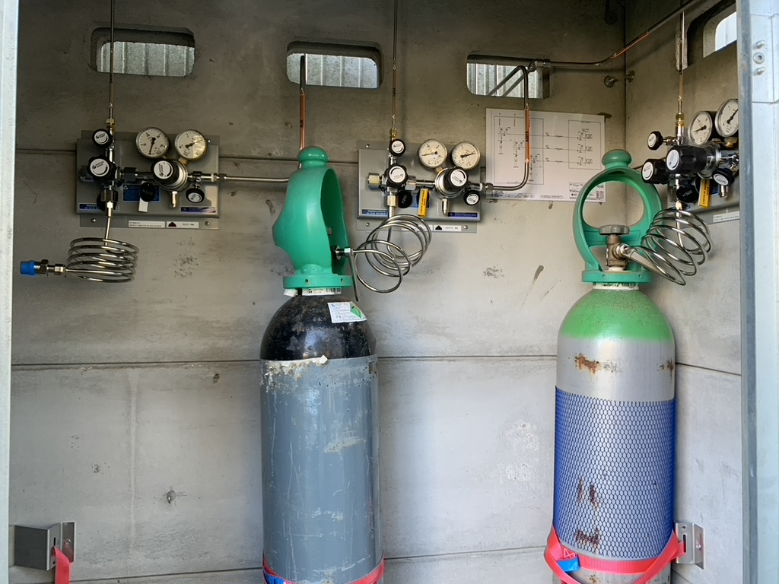
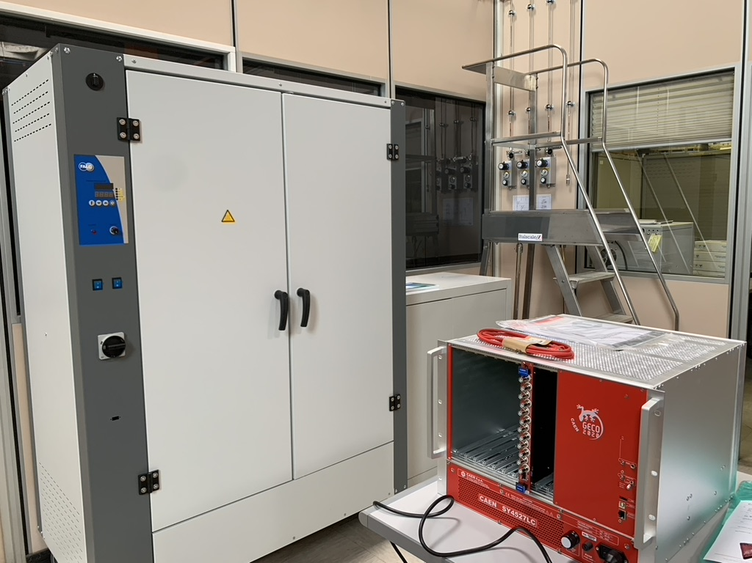
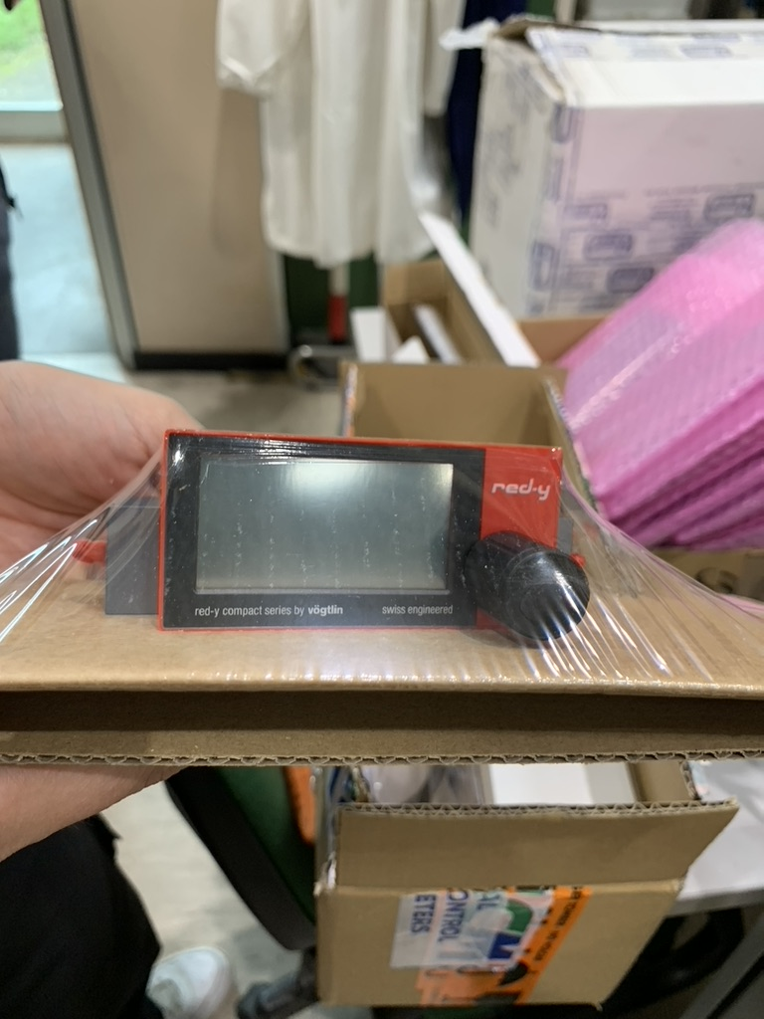
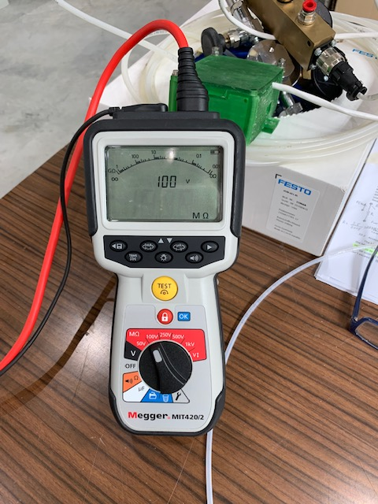
Infrastructures – synergies with JLAB12
The gas distribution system has been installed
APV25 based SRS DAQ
The oven and the
CAEN HV supply are available
Flow controller
The gas mixture
(Ar /CO2/CF445%/15%/40%) and N2 bottles are available
Megger Tester
EIC Referee Meeting June 10th 2024 – Annalisa D’Angelo
23

Slide 24
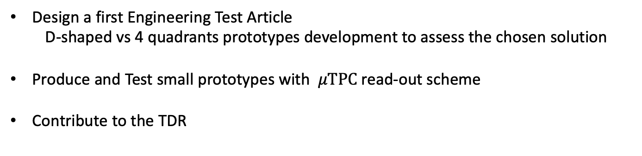
2025 RM TV Activity
Design a first Engineering Test Article
D-shaped vs 4 quadrants prototypes development to assess the chosen solution
Produce and Test small prototypes with $μTPC$read-out scheme
Contribute to the TDR
2025 Roma TV Financial Requests. (2.6 FTE)
Capitolo | Motivazione | K Euro
Missioni | Test Beam + coll. meetings | 18
Consumo | Miscela di gas e minuteria | 10
Inventariabile | Schede CAEN Canali HV | 10
Apparati | Prototipi | 30
EIC Referee Meeting June 10th 2024 – Annalisa D’Angelo
24

Slide 25

Summary
In the last year INFN has gained the leadership of the MPGD endcap trackers (ECT)
  The role has been recognized by the DOE and ePIC managements
  The main technological choices have been indicated
  Detector technology
  2D – readout challenges and test beam results
  Hybrid GEM-$μ$Rwell technology & $μ$TPC readout
  (X,Y) readout – 500 $μ$m pitch
  INFN Involvement
  Fabrication and Assembly Plans
  Timeline
  Workforce
  Financial Plan
Summary
EIC Referee Meeting June 10th 2024 – Annalisa D’Angelo
25

Slide 26
Back-up Slides
EIC Referee Meeting June 10th 2024 – Annalisa D’Angelo
26

Slide 27
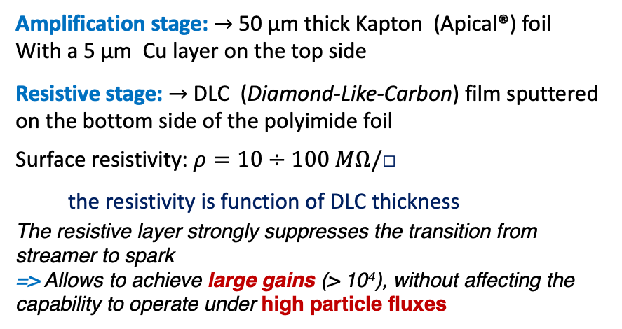

The μ-RWELL (Micro Resistive Well Detector)
The μ-RWELL is a Resistive MPGD detector (Micro Pattern Gas Detector)
Used Gas : Ar:CO₂:CF₄ 45:15:40 mixture ( it also works with Ar:CO₂ «green» mixture )
The device is composed of two elements:
• drift/cathode PCB defining the gas gap ($5μm Cu$ layer on the bottom side)
• μ-RWELL_PCB (detector core)
Multilayer circuit: W$ell Pattered Polyimide⊕$ resistive film $⊕$ readout PCB
Amplification stage: $→$ 50 μm thick Kapton (Apical®) foil
With a 5 μm Cu layer on the top side
Resistive stage: $→$ DLC (Diamond-Like-Carbon) film sputtered on the bottom side of the polyimide foil
Surface resistivity: $ρ=10÷100 MΩ/\text{□}$
the resistivity is function of DLC thickness
The resistive layer strongly suppresses the transition from streamer to spark
=> Allows to achieve large gains (> 10⁴), without affecting the capability to operate under high particle fluxes
G. Bencivenni et al.; 2015_JINST_10_P02008
EIC Meeting August 31 2023 – Annalisa D’Angelo
27
Notes:
TetraFluoromethane CF4
It is composed of 2elements: a drift/cathode standard PCB and the μ-RWELL_PCB. The space between the two elements defines the thickness of the gas gap where the ionization occurs (3/6 mm); the cathode establishes the electron field to make the free electrons drift towards the μ-RWELL_PCB, the core of the detector.
The micro-RWELL_PCB, realized by means of standard photo-lithography technology, is composed of three different elements: a well matrix patterned kapton (Apical®) foil acting as amplification element of the detector; a
resistive layer ( = 10-100Mohm/cm2. ) realized with a Diamond-Like-Carbon (DLC) film sputtered on the bottom side of the kapton foil, as discharge limitation stage; a standard PCB, segmented as strip, pixel or pad electrodes, for readout purposes

Slide 28

The μ-RWELL principle of operation
The “WELL” acts as a multiplication channel for the ionization produced in the gas of the drift gap
The charge induced on the resistive layer is spread with a time constant:
𝜏 ~ 𝜌 x c
[M.S. Dixit et al., NIMA 566 (2006) 281]:
Strips/
𝜌 $→$the DLC surface resistivity
c $→$ the capacitance (per unit area), depending on the distance between the DLC and the readout plane
𝐶 = 𝜀₀×𝜀_{𝑟}×$\frac{S}{t}$ =120 𝑝𝐹×𝐿(𝑚) − 𝑤=0.2 𝑚𝑚, 𝑝=0.4 𝑚𝑚 strip read-out
The resistive stage ensures the quenching of the spark amplitude
As a drawback, the capability to stand high particle fluxes is reduced, but appropriate grounding schemes of the resistive layer solves this problem
EIC Meeting August 31 2023 – Annalisa D’Angelo
28
Notes:
.Applying a suitable voltage between the copper layer and the DLC, the well acts as a multiplication channel for the ionization produced inthe drift gas gap.
The streamer created inside the amplification volume , inducing a large current flowing into the resistive leyer, generate a localized drop of the amplifying voltage with an effective quenching of the moltiplication process in the gas.=> this process strongly suppress the discharge amplitude allows to operate at large gains with a single amplification stage.
This time 𝜏 strongly affects the rate capability of the detector because of a local charging-up. In case of discharge this effect lowers the amplification field then stopping its propagation but at the same time switching off that part of the detector. The resistivity of the DLC is then a crucial point: a large resistivity makes the detector safer but increases the earlier mentioned 𝜏 then worsening the rate capability of the detector; a low resistivity plays an exactly complementary role: larger rate capability but lower discharge quenching power.

Slide 29


The μ-RWELL Technology
Studies have been focused on the DLC grounding layout to increase the rate capability while maintaining a safe resistivity => The solution is to reduce as much as possible the current path towards the ground connection introducing a high density “grounding network” on the resistive stage of the detector
PEP – Patterning-Etching-plating
The micro-RWELL layouts for high particle rate, G.Bencivenni et al., 2019-JINST-14-P05014
The active area is discontinued by grooves that uncover the DLC; then a copper plating, carefully separated from the copper in the active sectors, is disposed to connect the DLC to the ground.
A small dead zone on the amplification stage must be introduced for high stability operation
EIC Meeting August 31 2023 – Annalisa D’Angelo
29
Notes:
.Applying a suitable voltage between the copper layer and the DLC, the well acts as a multiplication channel for the ionization produced inthe drift gas gap.
The streamer created inside the amplification volume , inducing a large current flowing into the resistive leyer, generate a localized drop of the amplifying voltage with an effective quenching of the moltiplication process in the gas.=> this process strongly suppress the discharge amplitude allows to operate at large gains with a single amplification stage.
This time 𝜏 strongly affects the rate capability of the detector because of a local charging-up. In case of discharge this effect lowers the amplification field then stopping its propagation but at the same time switching off that part of the detector. The resistivity of the DLC is then a crucial point: a large resistivity makes the detector safer but increases the earlier mentioned 𝜏 then worsening the rate capability of the detector; a low resistivity plays an exactly complementary role: larger rate capability but lower discharge quenching power.

Slide 30





The μ-RWELL Technology
Charge Centroid reconstruction method
The track position is determined as a weighted average of fired strips
GOOD FOR ORTHOGONAL TRACKS
$$x_{hit}=\frac{\sum{x_{i}·q_{i}}}{Q_{tot}}$$
FOR INCLINED TRACKS &/or HIGH B FIELD
the Charge Centroid method gives a very broad spatial distribution on the anode-strip plane.
$$μTPC reconstruction$$
The spatial resolution is strongly dependent on the impinging angle of the track $→$A non-uniform resolution in the solid angle covered by the apparatus $→$ Large systematical errors.
EIC Meeting August 31 2023 – Annalisa D’Angelo
30
Notes:
.Applying a suitable voltage between the copper layer and the DLC, the well acts as a multiplication channel for the ionization produced inthe drift gas gap.
The streamer created inside the amplification volume , inducing a large current flowing into the resistive leyer, generate a localized drop of the amplifying voltage with an effective quenching of the moltiplication process in the gas.=> this process strongly suppress the discharge amplitude allows to operate at large gains with a single amplification stage.
This time 𝜏 strongly affects the rate capability of the detector because of a local charging-up. In case of discharge this effect lowers the amplification field then stopping its propagation but at the same time switching off that part of the detector. The resistivity of the DLC is then a crucial point: a large resistivity makes the detector safer but increases the earlier mentioned 𝜏 then worsening the rate capability of the detector; a low resistivity plays an exactly complementary role: larger rate capability but lower discharge quenching power.

Slide 31


      2D Readout Scheme
2D – readout: step by step approach
The first prototype was a set of 2x1D detectors each having the following specs, rotated by 90 degrees:
780 μm pitch
300 μm width
10 x 10 cm² active surface
128 channels
5 – 19 October 2022
Test Beam: SPS North Area H8
EIC Referee Meeting June 10th, 2024 – Annalisa D’Angelo
31

Slide 32











      2D Readout Scheme
2D – readout: 780 μm pitch-300 μm width - 10 x 10 cm² active surface
$$Δx$$
$$Δx$$
$$x (mm)$$
$$x (mm)$$
Increasing the pitch read-out the resolution is strongly affected by the number of strips among which the charge is distributed
$$Δx (mm)$$
3 strips
$$Δx (mm)$$
4 strips
EIC Meeting August 31 2023 – Annalisa D’Angelo
32

Slide 33

      2D Readout Scheme
2D – readout: step by step approach
2x1D detectors.
The 2022/2023 tests show that the optimal pitch to obtain 100 $μm$ resolution is the following:
400 μm pitch
300 μm width
EIC Meeting August 31 2023 – Annalisa D’Angelo
33

Slide 34

      2D Readout Scheme
2D – readout: step by step approach
The second prototype reads the 2-nd coordinate on the “top” copper layer
Same readout geometry as in the bottom:
780 μm pitch
300 μm width
10 x 10 cm² active surface
128 channels
The effect charge collection on the «top»
layer is the object of investigation.
EIC Meeting August 31 2023 – Annalisa D’Angelo
34
Notes:
The basic concept of capacitive-sharing readout structures is composed of a vertical stack of Transfer layers; each layer consists of 5 μm copper (Cu) pads deposited on 50 μm polyimide (Kapton) foils, in this prototipe the pad sizes are: f 200 μm x¡200 μm, 400 μm x¡400 μm, 800 μm x 800 μm for the three transfer layers
respectively. he stack of several such layers can be viewed, in a simple approximation, as a set capacitors in series along the vertical direction as a way to simply describe how charge are transferred from one layer to another.
For n layers, the number of readout pads or strips along one axis of the readout plane, connected to the front end electronics is only a fraction 1/n of the number of pads along the same axis of the first transfer layer collecting the incoming signal from the MPGD amplification structure. In essence, the pad size of this first transfer layer (layer1) defines the spatial resolution performance of the readout plane and the pad size of readout layer (layer𝑛) defines the total number of electronic channels required to read out the detector plane

Slide 35




      2D Readout Scheme
2D – readout: step by step approach
The third prototype reads both coordinates on the bottom in “COMPASS-like” strips configuration with capacity sharing read-out:
1200 μm pitch
300 μm vs 1000 μm strips width
10 x 10 cm² active surface
83 channels
0.3 mm
0.6 mm
1.2 mm
300 $μm$
1000 $μm$
1.2 mm
EIC Meeting August 31 2023 – Annalisa D’Angelo
35
Notes:
The basic concept of capacitive-sharing readout structures is composed of a vertical stack of Transfer layers; each layer consists of 5 μm copper (Cu) pads deposited on 50 μm polyimide (Kapton) foils, in this prototipe the pad sizes are: f 200 μm x¡200 μm, 400 μm x¡400 μm, 800 μm x 800 μm for the three transfer layers
respectively. he stack of several such layers can be viewed, in a simple approximation, as a set capacitors in series along the vertical direction as a way to simply describe how charge are transferred from one layer to another.
For n layers, the number of readout pads or strips along one axis of the readout plane, connected to the front end electronics is only a fraction 1/n of the number of pads along the same axis of the first transfer layer collecting the incoming signal from the MPGD amplification structure. In essence, the pad size of this first transfer layer (layer1) defines the spatial resolution performance of the readout plane and the pad size of readout layer (layer𝑛) defines the total number of electronic channels required to read out the detector plane

Slide 36


On-going Activities
TEST BEAM at CERN SPS North Area H8:
16 - 30 October 2024
$$π/μ$$
Reference
Tracker - OUT
Reference
Tracker - IN
10x10 cm²
Capacity Sharing
2D readout
Photo taken during 5 – 19 October 2022 test beam
EIC Meeting August 31 2023 – Annalisa D’Angelo
36

Slide 37

Preliminary results from June test beam
Efficiency
Preliminary Results
CS readout reaches a plateau at higher HV values than standard readout scheme.
TOP readout is not yet at plateau at 600 V
(HV was chosen not to to be raised to higher values)
EIC Meeting August 31 2023 – Annalisa D’Angelo
37

Slide 38


Preliminary results from June test beam
Resolution
Preliminary Results
CS readout reaches 100 $μm$ resolution at highest HV values (starting from 1200 $μm$ pitch)
TOP readout resolution is fixed at 250-300 $μm$
(pitch is 780 $μm$)
EIC Meeting August 31 2023 – Annalisa D’Angelo
38

Slide 39


Preliminary results from June test beam
Cluster Size
Preliminary Results
CS readout Cluster Size is not lower than 2.5 strips and increases to 4 at higher HV.
higher cluster size $→$ better resolution
TOP readout cluster size is fixed at 1.3
Bottom readout cluster size increases from 1.5 to 2.3 with HV
EIC Meeting August 31 2023 – Annalisa D’Angelo
39

Slide 40
Summary of results from June test beam
TOP read-out
The Top-readout efficiency is 80-82% (compatible with the geometrical acceptance of 87%).
The efficiency does not show the plateau below 600V HV. The signal produced does not suffer from sharing between the 2 readout views.
Spatial resolution is 250-350 μm, compatible with pitch/√12
Capacity Sharing read-out
The CS shows an efficiency plateau at 92-93% as a function of HV from 600 to 660V (too high!)
The charge spread allows a very good spatial resolution, <100 μm (at high HV).
The average cluster size increases with HV.
FUTURE ACIVITIES
2D read-out optimization:
The CS readout could be improved by eliminating one layer of sharing, going from the actual 3 capacitive ones (0.3 - 0.6 - 1.2 mm) down to 2 (0.4 - 0.8 mm).
EIC Meeting August 31 2023 – Annalisa D’Angelo
40

Slide 41



Large Area Detector prototype
A first large area 40 x 46 cm ² detector has been delivered to Roma Tor Vergata and is being characterized in collaboration with the LNF group lead by Gianni Bencivenni
1200 $μm pitch$
300 $μm vs 1000μm$strips
6 mm gas gap
EIC Meeting August 31 2023 – Annalisa D’Angelo
41

Slide 42

Possible collaboration with EIC MPDG group
INFN Manpower:
Roma Tor Vergata: A. D’Angelo (PO), R. Di Salvo (I ric), A. Fantini (RU), L. Lanza (RTDa), E. Sidoretti (PhD)
Genova: M. Battaglieri (DR), Paolo Musico (INFN) -> Readout electronics (SALSA)
Roma 1: Evaristo Cisbani (GEM expert) – Catania: Mariagela Bondi’
The work would be performed in close connection with the group of Gianni Bencivenni @ LNF and with the JLab detector group (Kondo Gnanvo)
Strategy towards the integration in the MPDG Community
We have explored the space for INFN in the EIC MPGD working group:
  We joined the eRD108 call for 2024 FY for the R&D on endcap disks
  We participate to the EIC MPGD weekly meetings
We have explored the space for the INFN Roma TV group to DRD-1
  We have submitted the request to join the DRD-1 gaseous detectors WP1 – T2
  We are in contact with the INFN reference persons
EIC Meeting August 31 2023 – Annalisa D’Angelo
42

Slide 43

Large Area Detector Development for EIC
R&D Studies for EIC disks within eRD108
(in collaboration with TU)
• readout segmentation: radius and azimuthal coordinates vs. (X,Y) geometry;
• reduced number of readout channels: capacity sharing vs. traditional charge collection;
• 2D-readout optimization: charge sharing among 2 readout layers vs. two 1D readout layers;
• performance impact of electronics position layout: on-detector vs. off-detector using flex cabling.
50 cm
Conceptual design example for an MPGD endcap disk with stacked overlapping half-disks to maximize acceptance.
EIC Meeting August 31 2023 – Annalisa D’Angelo
43

Slide 44


The Latest Configuration of ePIC detector tracking
re-inforced role of MPGD

Slide 45

The Latest Configuration of ePIC detector tracking
Two forward discs
50 cm radius
Two backward discs
50 cm radius
Cylinder inside the ToF, segmented in three longitudinal sectors
  56 cm radius
Barrel inside the DIRC: same DIRC segmentation in planar tiles, divided into two longitudinal sectors
  67 cm radius
re-inforced role of MPGD

Slide 46








      The μ-RWELL Developments: High-rate capability and improved grounding scheme
Studies have been focused on the DLC grounding layout to increase the rate capability while maintaining a safe resistivity => The solution is to reduce as much as possible the current path towards the ground connection introducing a high density “grounding network” on the resistive stage of the detector
2015
2017
2018
2020
time
R&D on low-rate layout
R&D on high-rate layout (grounding network also in the active area)
SRL_Single-Resistive-Layer
DRL-DoubleResistive Layer
SG –Silver Grid
PEP-Patterning-Etching-plating
the DLC grounding is provided all around the active area.
Two DLC layers connected by a matrix of conductive vias and grounded by a further matrix of vias to the readout electrodes
a SRL with a 2-D grounding conductive strip lines realized on the DLC layer.
the grounding grid of the DLC is patterned by etching a groove in the base material from the top
$$detection efficiency:$$
$\frac{G}{G_{0}}\sim 1 up to 35 kHz/cm^{2}$
$\frac{G}{G_{0}}>0.90 up to 3MHz/$ $cm^{2}$
$\frac{G}{G_{0}}>0.90 up to 20MHz/$ $cm^{2}$
$\frac{G}{G_{0}}>0.90 up to 20MHz/$ $cm^{2}$
EIC Italian Collaboration Meeting 2023 – Alessia Fantini
Notes:
Studies have been focused on the DLC grounding layout with the purpose to increase the rate capability while maintaining a safe
resistivity. In the first layout the DLC grounding is provided all around the active area.
To increase the rate capability of the detector it was introduced a grounding network also in the active area
First evolution is the Double Resistive Layer (DRL) where a second resistive layer has been introduced. The two layers are interleaved by a gluing film, 50 μm
thin, and connected by a matrix of metalized vias. The same scheme applies between the second layer and the readout plane. The last plane provides the final grounding to the whole resistive stage.
This version is the first where a particular attention has been paid to the minimum distance between the grounding
node and the amplification channels (DOCA standing for Distance Of Closest Approach). Although this prototype exhibited a rate capability up to 10 MHz/cm2, its
manufacturing is quite complex and not reliable for a technological transfer to industry
To meet this request a second version of the detector has been built : the Silver Grid (SG). The grounding network is created with copper strips realized by photolitography below the DLC: the base material is indeed a stack of copper, kapton, DLC and copper again. To increase the DOCA a dead area is present above the grounding strips. The alignment of these dead areas with the strip can be difficult in particular
when going toward large area devices.
This issue suggested a different procedure to obtain the grounding of the DLC => GPEP – Groove-Patterning-Etching-plating

Slide 47


The CLAS12 DC TRACKING UPGRADE
Two MPGD detector technologies have been discussed, triple-GEM and μ-RWELL
μ-RWELL technology is new, only small prototypes have been tested:
$→$ will require extensive R&D.
μ-RWELL detector is best suited for CLAS12:
– low material budget, easy to build, less support structures in the active volume of the detector.
Large area triple-GEM detectors have been used in experiments (PRad, SBS, …).
F. Sauli, Nucl. Instr. and Meth. A386 (1997) 531
G. Bencivenni et al.; 2015_JINST_10_P02008
EIC Meeting August 31 2023 – Annalisa D’Angelo
47

Slide 48

The High-Rate solution: PEP
PoS(ICHEP2022)339
Rate capability measured with 5.9 keV X-rays with Double Layer μ-RWELL (DRL) and with PEP
NB: a photon flux around 1 MHz/cm², which corresponds to a m.i.p. rate of 3 MHz/cm².
EIC Italian Collaboration Meeting 2023 – Alessia Fantini
Notes:
The prototypes have been all characterized under high intensity X-ray Philips 2217/20 gun. The detectors have been flushed with Ar:CO2:CF4 45:15:40. In this mixture the 5.9 keV X-rays
produce a ionization about 3 times larger than the one given by a m.i.p. in the 6 mm thick gas gap. The plots in fig. 4 show that for a Double Resistive Layer (left) the ratio of the measured gain to
the nominal one drops down to 90% for a photon flux around 1 MHz/cm2, which corresponds to a m.i.p. rate of 3 MHz/cm2. The PEP (right) shows a relative gain drop of 10% at flux 7 times larger,
according to the extrapolation of the fitting function since such flux is out of the range of our gun. The measurements have been performed with different collimators with the purpose to compare the
detector response as a function of the irradiated area. As expected the larger the irradiated area the worse is the rate capability with a saturation effect due to the fact that in PEP the sector width is 1
cm and larger collimators do not affect any longer the behaviour of the single sector.

Slide 49





      The μ-RWELL Development for Large Area Detectors : $Spatial resolution →μ$TPC reconstruction
A possible solution : $μTPC reconstruction$
The electrons created by the ionizing particle drift towards the amplification region
In the μTPC mode from the knowledge of the drift time and the measurement of the arrival time of electrons, the track segment in the gas gap is reconstructed
The fit of the analog signal gives the arrival time of drifting electrons.
By the knowledge of the drift velocity, the 3D trajectory of th ionizing particle in the drift gap is reconstructed.
drift field $E_{D} = 1 kV/cm$
Integrated charge as a function of the
sampling time
Example of a track reconstruction using the TPC algorithm.
Comparison of the CC and $μTPC$ reconstruction algorithms in function of the impinging angle
EIC Meeting August 31 2023 – Annalisa D’Angelo
49
Notes:
The idea developed for the ATLAS MicroMegas of the New Small Wheels [10, 11], and also implemented on the BESIII cylindrical GEM [12, 13], is to reconstruct a track segment inside the detector conversion gap rather than a single hit exploiting the analog readout of the signals.
$μ$TPC0=> a readout approach that combines measurement of the arrival time of electrons and the amplitude of the signals on the strips
The fired strips represent the projection of the track on the readout and each center is the x coordinate of the corresponding ionization.
These hits are recorded at different times tk , depending on the distance of the ionization electrons from the readout plane. Applying the simple formula
zk = v_drift * (tk-t0) the z position of the k-th cluster can be computed.

