Slide 1
GPU-accelerated dose engine for adaptive particle therapy
Funded by European Union’s Horizon 2020 research and innovation program under the Marie Sklodowska-Curie grant agreement No 955956
This work was partially carried on within the SIG_PNR project of the Istituto Nazionale di Fisica Nucleare under the supervision of the Commissione Scientifica Nazionale 5

Slide 2
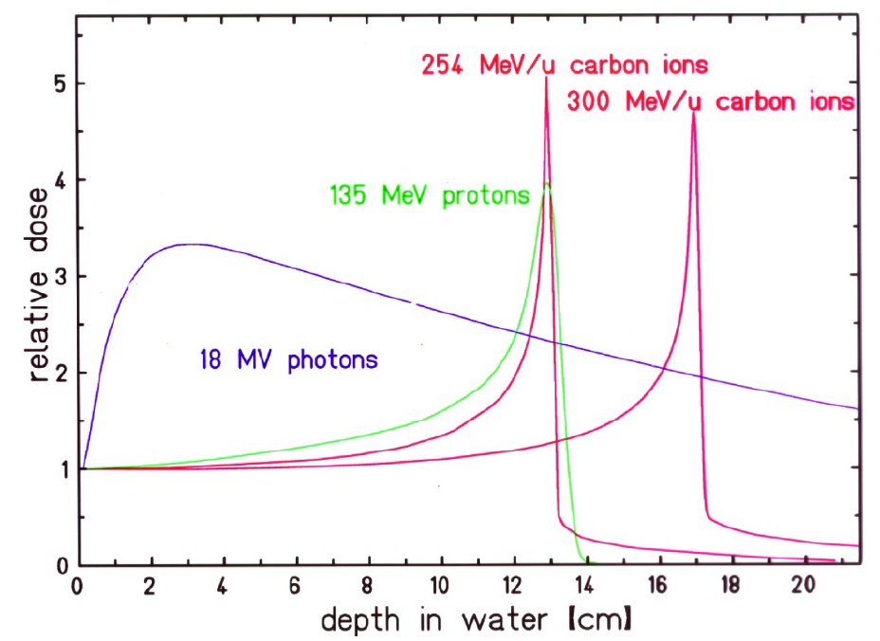
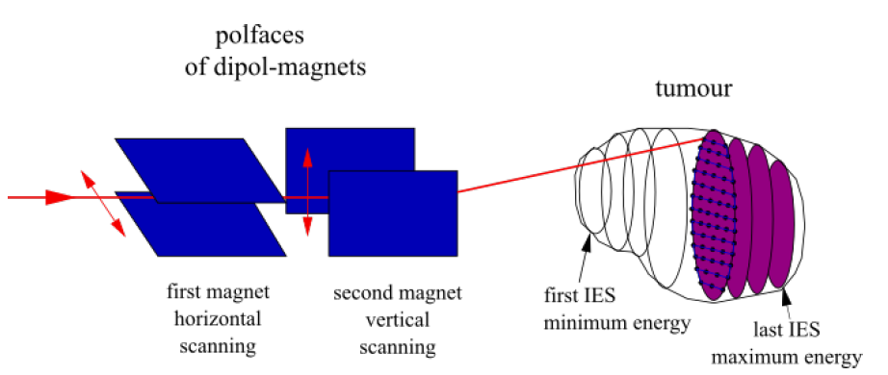
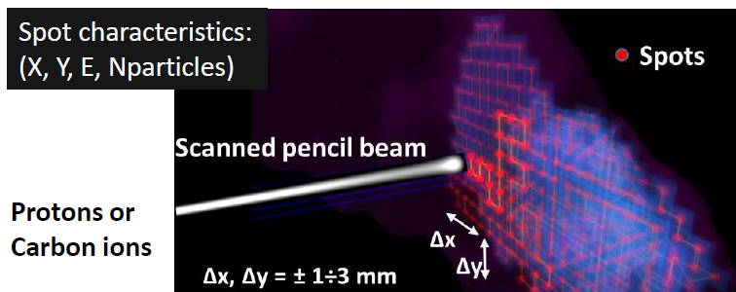
Particle therapy’s rationale
M. Krämer and M. Durante. “Ion beam transport calculations and treatment plans in particle therapy”
Marco Durante and Harald Paganetti. “Nuclear physics in particle therapy: a review”
Spot ~ ${10}^{4}÷{10}^{5}$
Cosimo Galeone, c.galeone@gsi.de

Slide 3
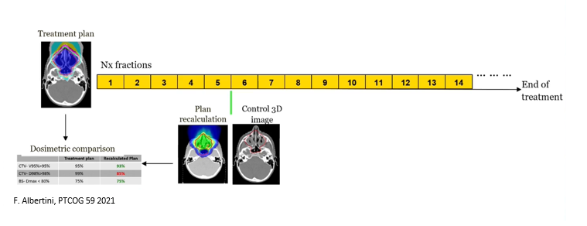
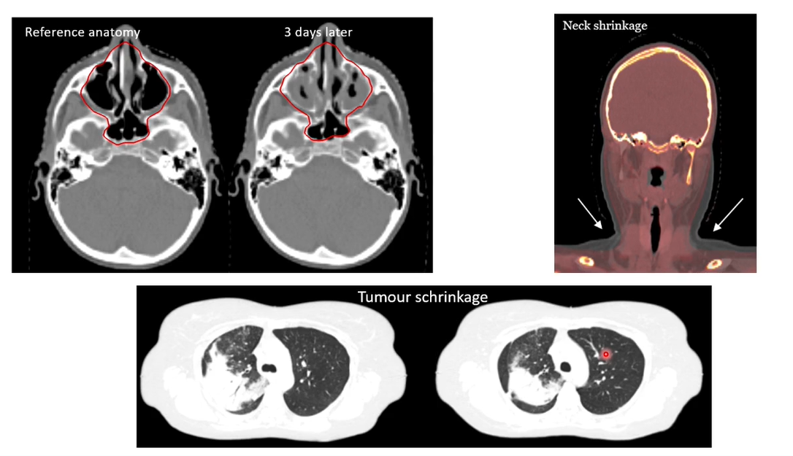
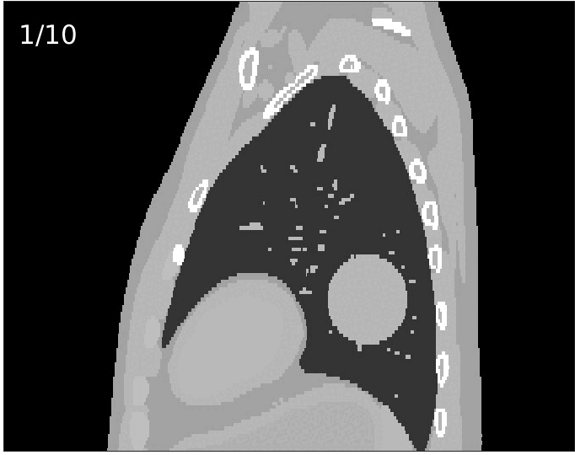
Why do we need to adapt?
Inter-fractional motions
Intra-fractional motions
Cosimo Galeone, c.galeone@gsi.de

Slide 4
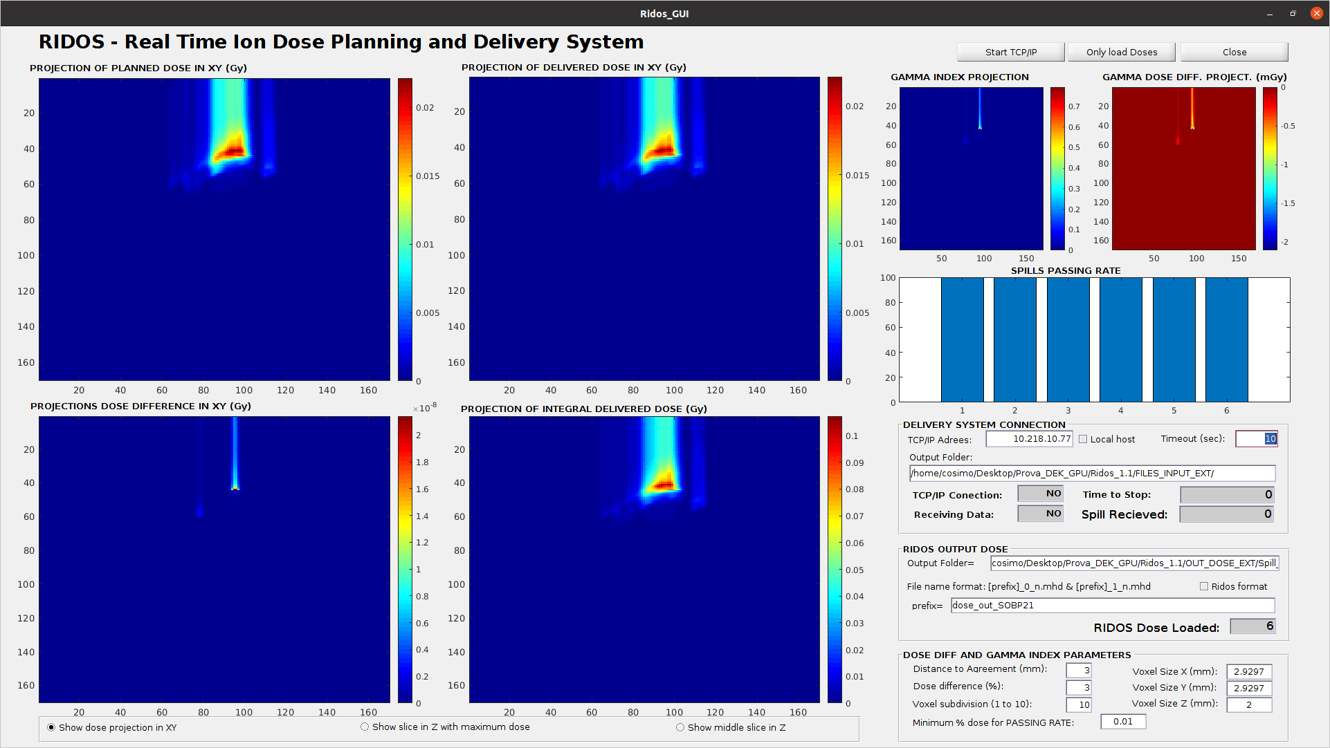
Online Daily Adaptive Therapy
F.Albertini, et al. “Online daily adaptive proton therapy”
P.Botas et al. “Online adaption approaches for intensity modulated proton therapy for head and neck patients based on cone beam CTs and Monte Carlo simulations”, PMB, 2018
Ma J et al. “A robust intensity modulated proton therapy optimizer based on Monte Carlo dose calculation”, Med. Phys, 2018
M. Matter,et al.” IMPT plan generation in under ten seconds on a GpU”, Acta ncologica, 2019
M. De Simoni, et al. “A data-driven fragmentation model for carbon therapy gpu-accelerated monte-carlo dose recalculation”, Frontiers in Oncology, 2022
K.Choi et al,” FRoG—a new calculation engine for clinical investigations with proton and carbon ion beams at CNAO”, Cancers, 2018
S.Giordanengo, et al. “RIDOS: a new system for online computation of the delivered dose distributions in scanning ion beam therapy “, Physica Medica, 2019
A.Duetschler, et al. “A motion model-guided 4D dose reconstruction for pencil beam scanned proton therapy A motion model-guided 4D dose reconstruction for pencil beam scanned proton therapy”, PMB, 2023
Cosimo Galeone, c.galeone@gsi.de

Slide 5
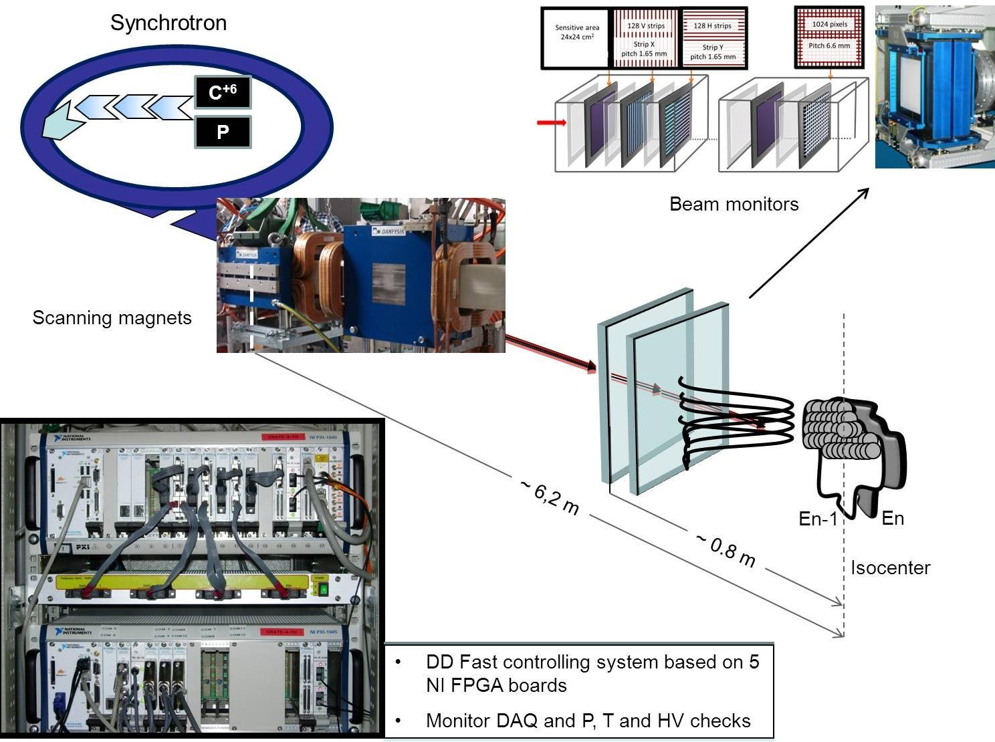
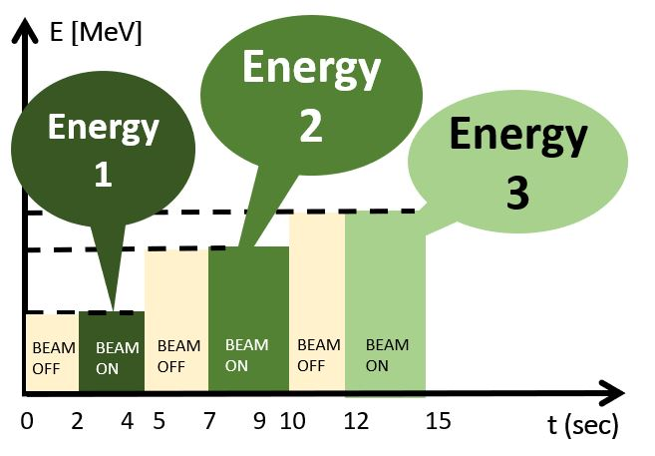
Dose Delivery System (DDS) to control the beam
Scheme of the CNAO DDS
Transparent ionization chambers to control the beams and drive the treatment
INPUT:
Planned spot characteristics
INPUT:
Measured spot characteristics
Beam position;
Number of particles;
Motion phase (research DDS)
DDS
3D
4D
Cosimo Galeone, c.galeone@gsi.de

Slide 6
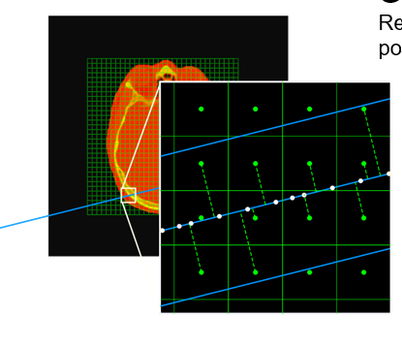
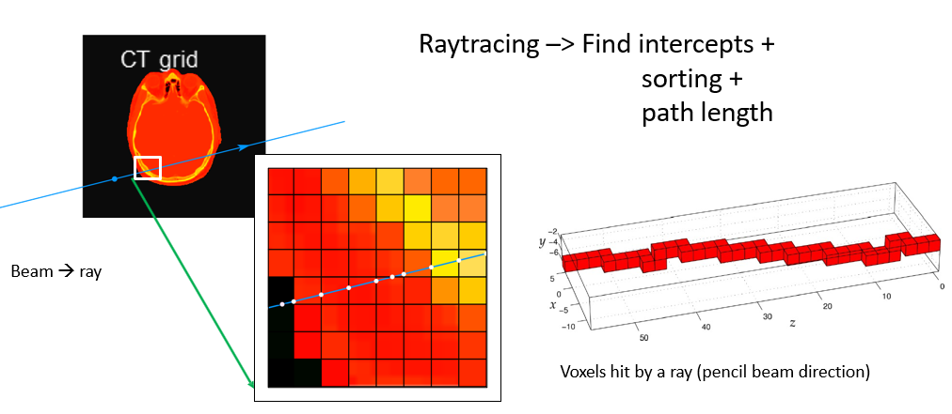
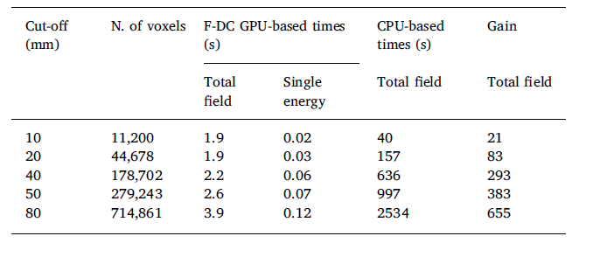
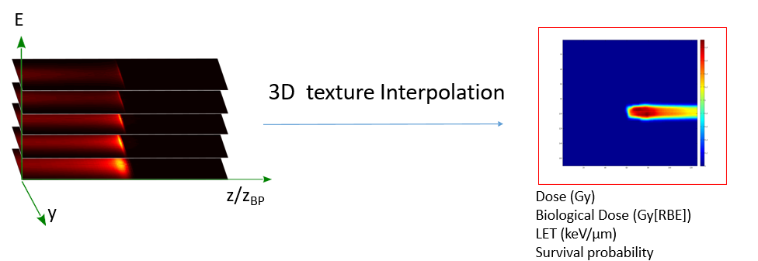
GPU-accelerated dose engine (RIDOS)
Each spot reconstructed in parallel:
Raytracing;
Voxel cutoff
3D-LUT interpolation
Comp. Grid = 170x170x125;
N of Rays = 1248;
N of slice = 39;
CPU: XeonE5-1620v2-3.7-4C-16GB
GPU: Nvidia TESLA-K40c
Cosimo Galeone, c.galeone@gsi.de

Slide 7
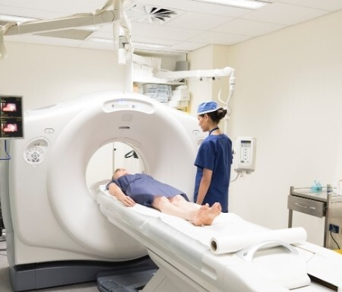
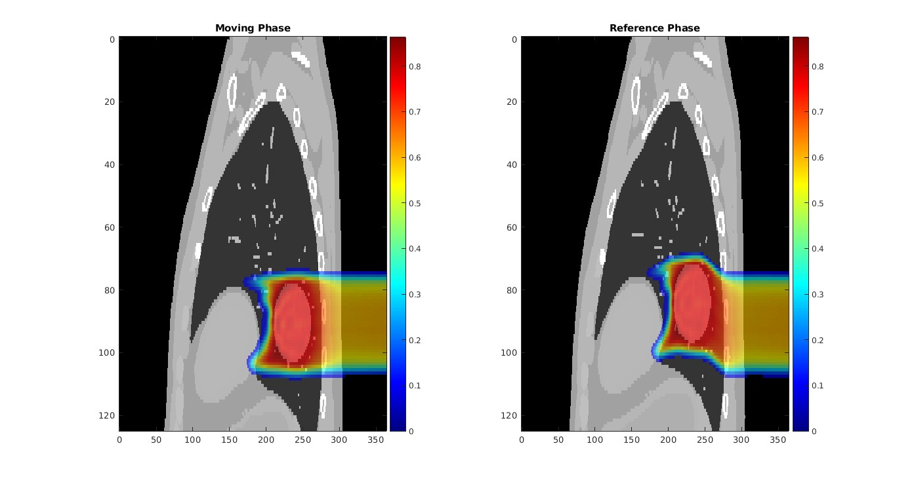
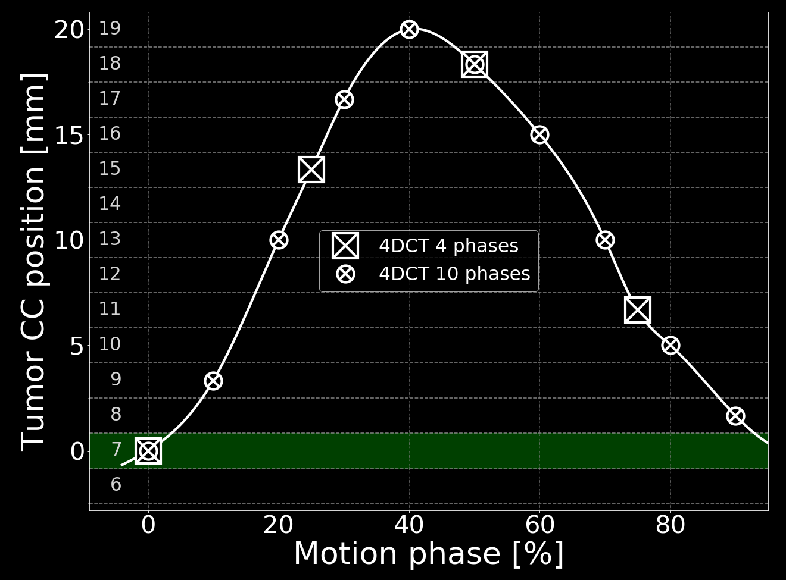
GPU-accelerated dose engine (4D-RIDOS)
4DCT
Moving Phase
Reference Phase
Reference phase
T. Steinsberger, PhD defense, 2023
Cosimo Galeone, c.galeone@gsi.de

Slide 8
Deformable Vector Fields
y
z
DVFs = displacement on the three dimensions (mm)
x
Warping with Plastimatch (CPU), 66.3 ms
Warping with 4D-RIDOS (GPU), 3.2 ms
CT grid = 365x365x126
Moving Phase
Reference Phase
Intel Xeon W-11855M, 62GB RAM
3D process, performed after each calculation
NVIDIA RTX A5000 Laptop GPU
Cosimo Galeone, c.galeone@gsi.de

Slide 9
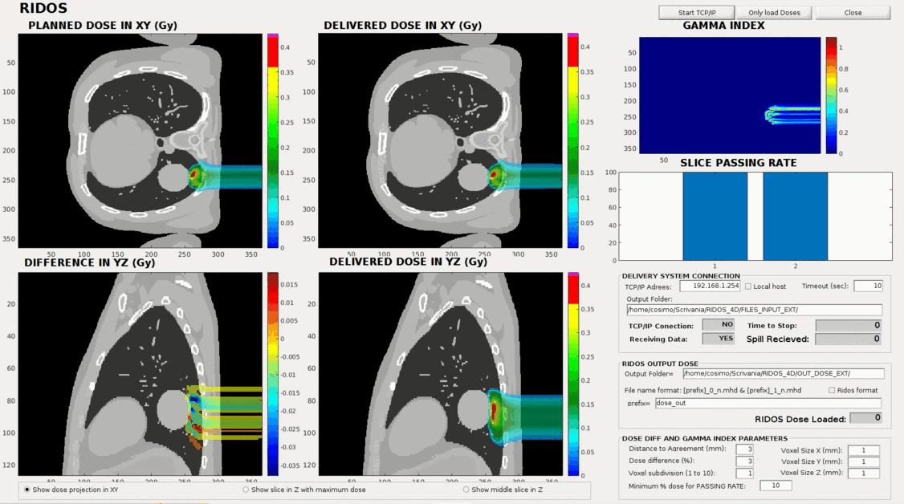
Experimental test 4D-RIDOS
All calculations performed with clinical accuracy
~ 0.25 ms per spot reconstruction
~ 2.2 ms per spot delivery
C.Galeone, et al. “Real-time delivered dose assessment in carbon ion therapy of moving targets”, PMB, 2024
Cosimo Galeone, c.galeone@gsi.de

Slide 10
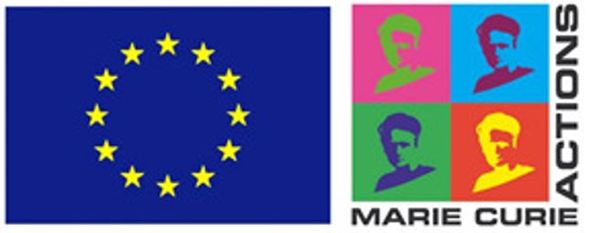
CONCLUSIONS
Proved feasibility of real-time (3D-4D-5D) GPU-accelerated dose engine in a clinical environment
NEXT STEPS
Extended experimental campaign with anthropomorphic phantom;
FUTURE PROSPECTIVES
Integration of 4D-RIDOS in clinical practice
THANK
YOU
Funded by European Union’s Horizon 2020 research and innovation program under the Marie Sklodowska-Curie grant agreement No 955956
Real-time adaptive therapy
This work was partially carried on within the SIG_PNR project of the Istituto Nazionale di Fisica Nucleare under the supervision of the Commissione Scientifica Nazionale 5
Cosimo Galeone, c.galeone@gsi.de

