Slide 1
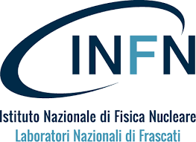
Consiglio dei Laboratori - Preventivi 2025
PROPOSTA DI GRANT GIOVANI IN CSN5 ANNO 2024
OPTIMAL
Simone Manti
Frascati, 09/07/2024

Slide 3
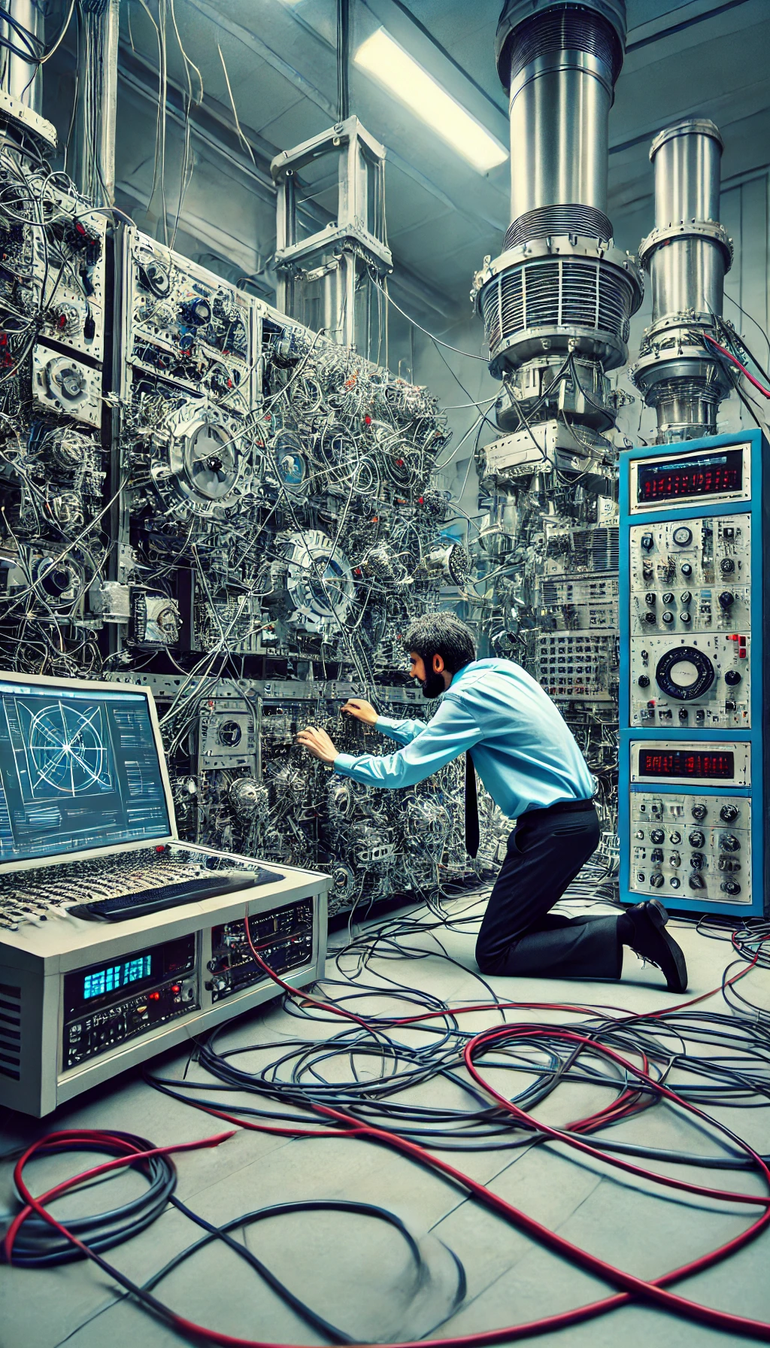
Challenges in X-ray Beamline Optimization
Manual Optimization of Parameters
Dependence on human input
Challenges in reproducibility
Time constraints

Slide 4
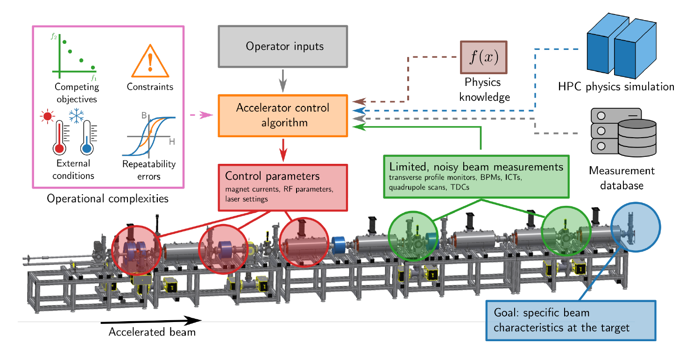
State of the Art
Advancements:
Machine Learning algorithms can learn from data to identify optimal settings.
Bayesian Optimization (BO) utilizes surrogate models (Gaussian Processes) to guide optimization, effective for problems with noisy and time-consuming acquisition functions.
Reinforcement Learning (RL) builds a model through iterative feedback suitable for scenarios requiring large numbers of control parameters.
Roussel, Ryan, et al. "Bayesian optimization algorithms for accelerator physics." Phys. Rev. Accel. Beams (2024).

Slide 5
State of the Art
Advancements:
Machine Learning algorithms can learn from data to identify optimal settings.
Bayesian Optimization (BO) utilizes surrogate models (Gaussian Processes) to guide optimization, effective for problems with noisy and time-consuming acquisition functions.
Reinforcement Learning (RL) builds a model through iterative feedback suitable for scenarios requiring large numbers of control parameters.
Applications:
BO and RL have been successfully applied in various domains, including particle accelerators, detector designs, and laser pulse optimization in Free-Electron Lasers.
X-ray Beamlines:
Optimize parameters for X-ray Absorption Spectroscopy
Autoalignment of a X-ray focusing system
Current Gaps:
Fewer applications of BO in X-ray beamlines compared to other areas.
Opportunity to develop ML-aided techniques to enhance efficiency and in X-ray experiments.

Slide 6
O1. Optimization Framework
O2. Experimental Setup for X-ray Emission Spectroscopy
OPTIMAL
automated Optimization of x-ray beamline Parameters using experimenT-Informed MAchine Learning methods
O4. X-ray Beamlines Applications
O3. XES Spectra Optimization

Slide 7
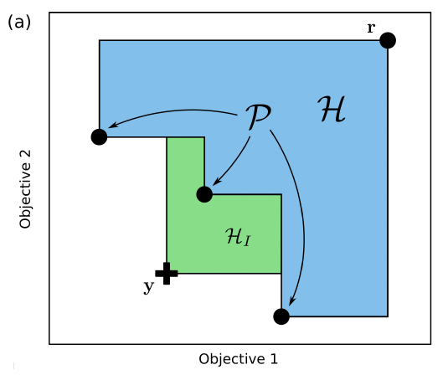
O1. Optimization Framework
Framework for optimizing experiments based on X-ray detection
Modules for Data Acquisition, Setup Control, Simulations, and Multi-Objective Optimization
Two techniques: Bayesian Optimization and Reinforcement Learning
Employ Machine Learning models trained on Ray-Tracing simulations of the experiment
Pareto Front
Bayesian Optimization
Reinforcement Learning

Slide 8
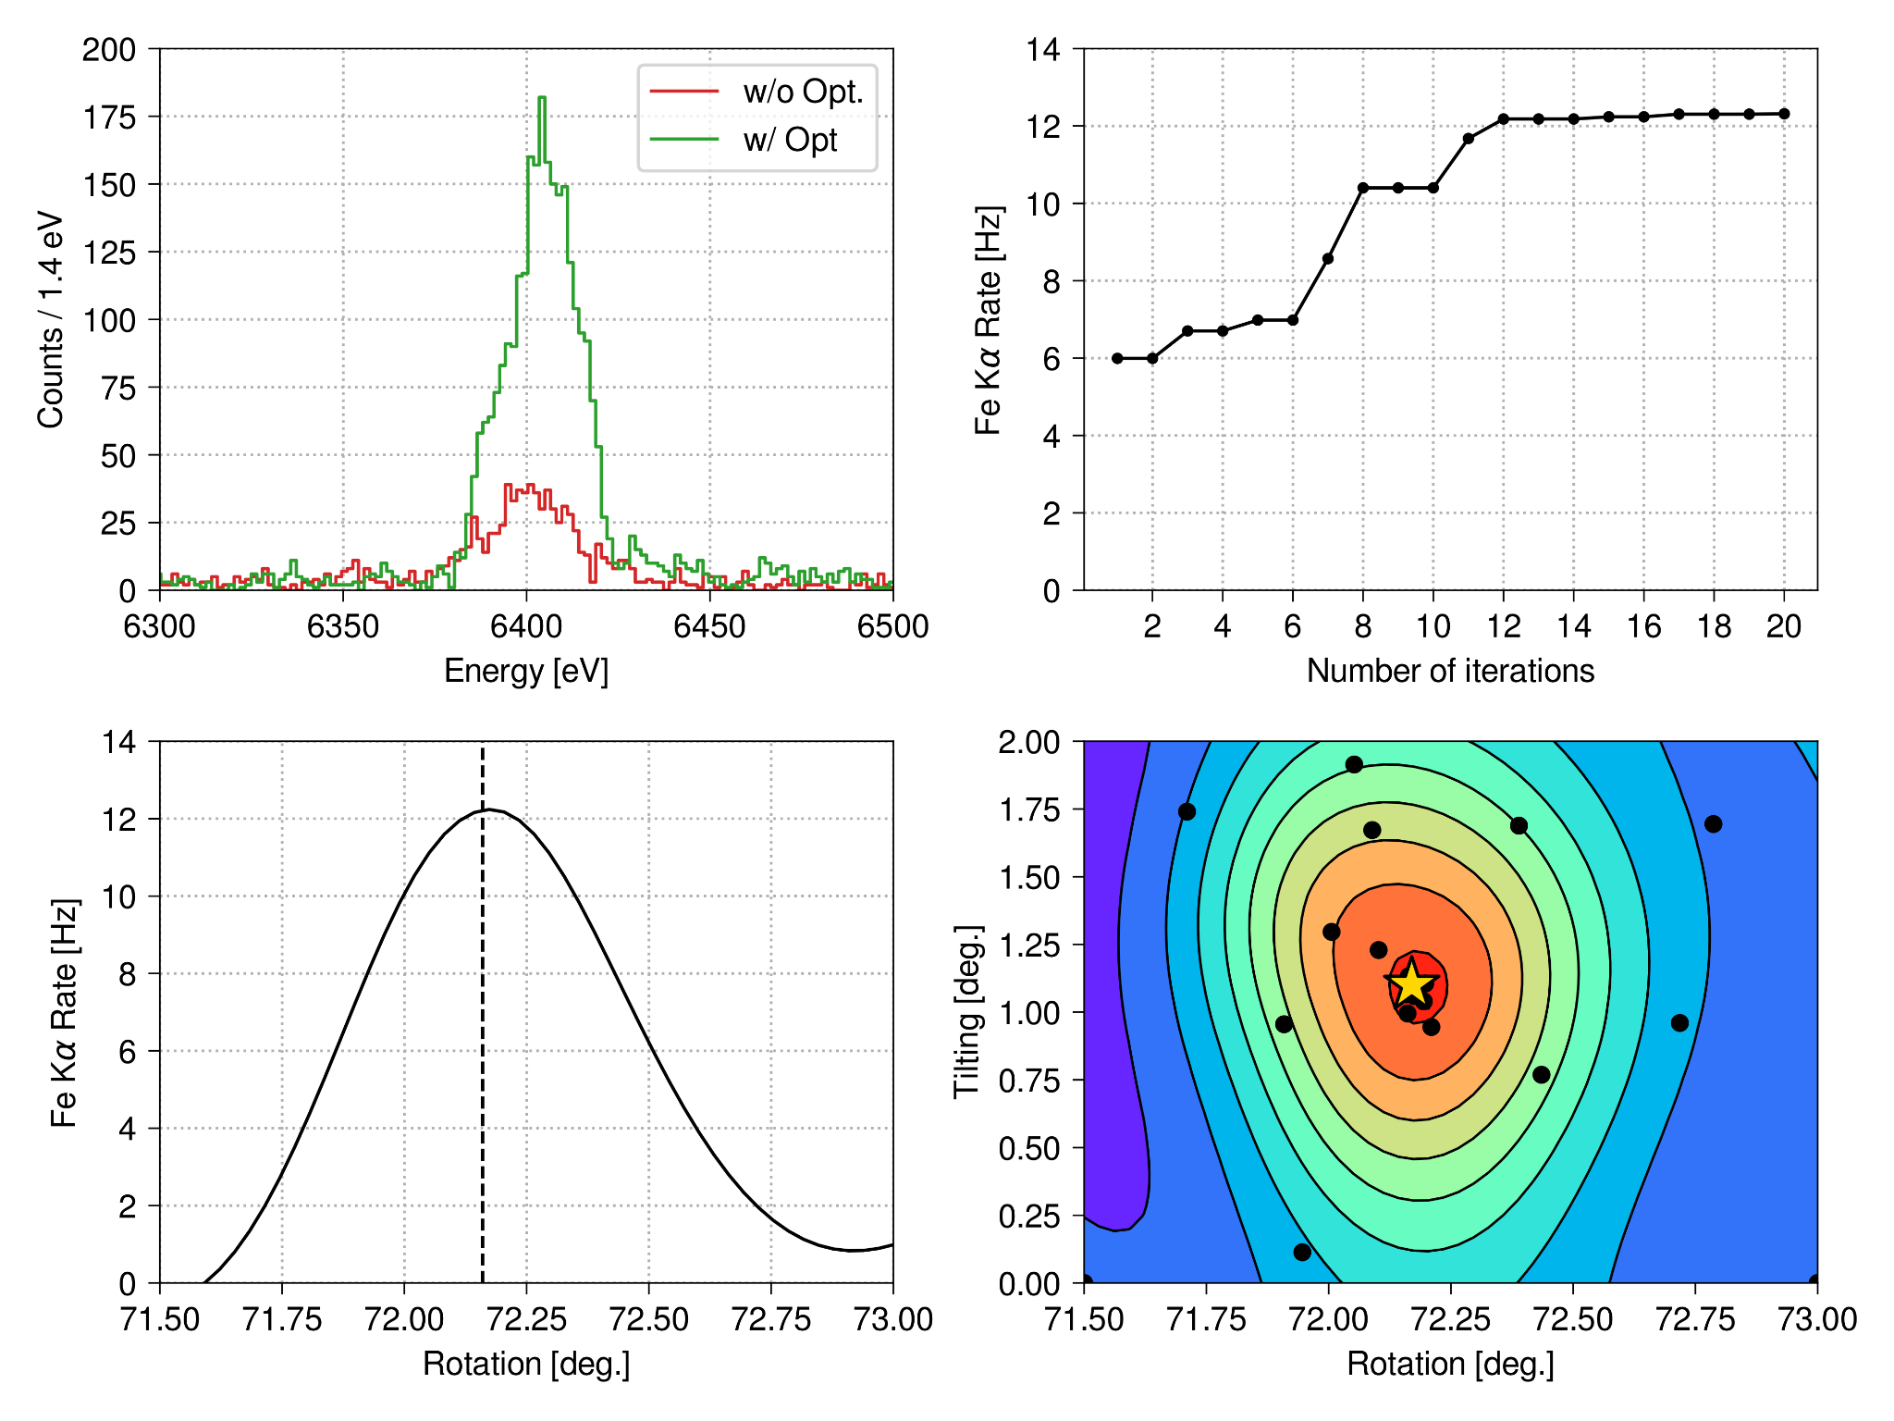
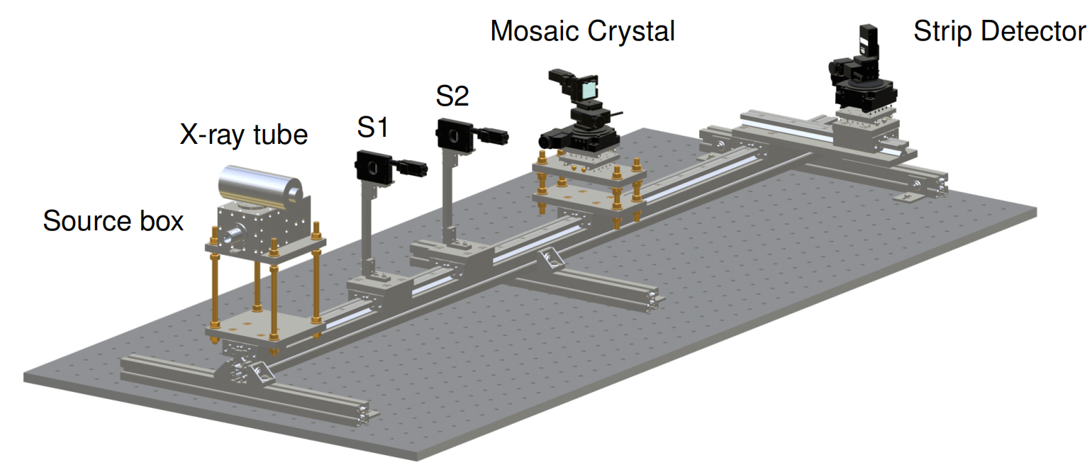
O2. Experimental Setup for X-ray Emission Spectroscopy (XES)
I performed feasibility test at the LNF studying FeK⍺ emission line, have shown that optimizing parameters for XES, can lead to a significant improvement of the emission line’s rate under study, with a gain of a factor 10 in the overall acquisition time
The current VOXES setup is inadequate for
this purpose, as a Strip Detector with 1D spectra data limits the effectiveness of ML features extraction for the optimization loop!

Slide 9
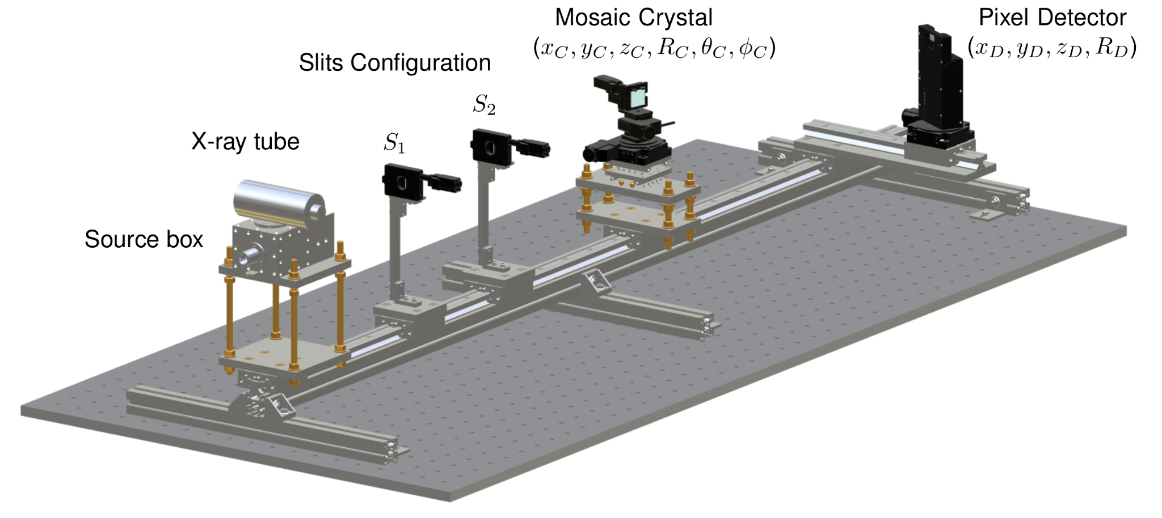
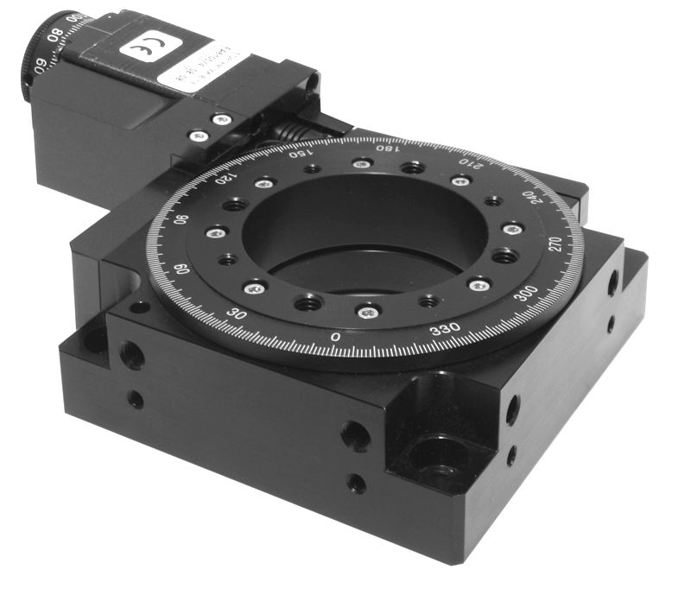
O2. Experimental Setup for XES
A pixel detector with a 2D spectrum offers significantly more information, enhancing the training phase, and thus the spectral feature extraction part
The best balance solution between cost and project requirements is the AdvaPIX Timepix3 from ADVACAM (Prague, Czech Republic).
Plus a 4-axis motorized stage system from STANDA company, like the old ones, for their easy communication interface with the framework using the libximc package.
AdvaPIX Timepix3
Energy range of 5.4 to 20 keV
Si sensor thickness of 300 μm
Pixel size of 55 μm
Resolution 512×256 pixels
Sensitive Area 14x14 mm
STANDA motorized stage

Slide 10
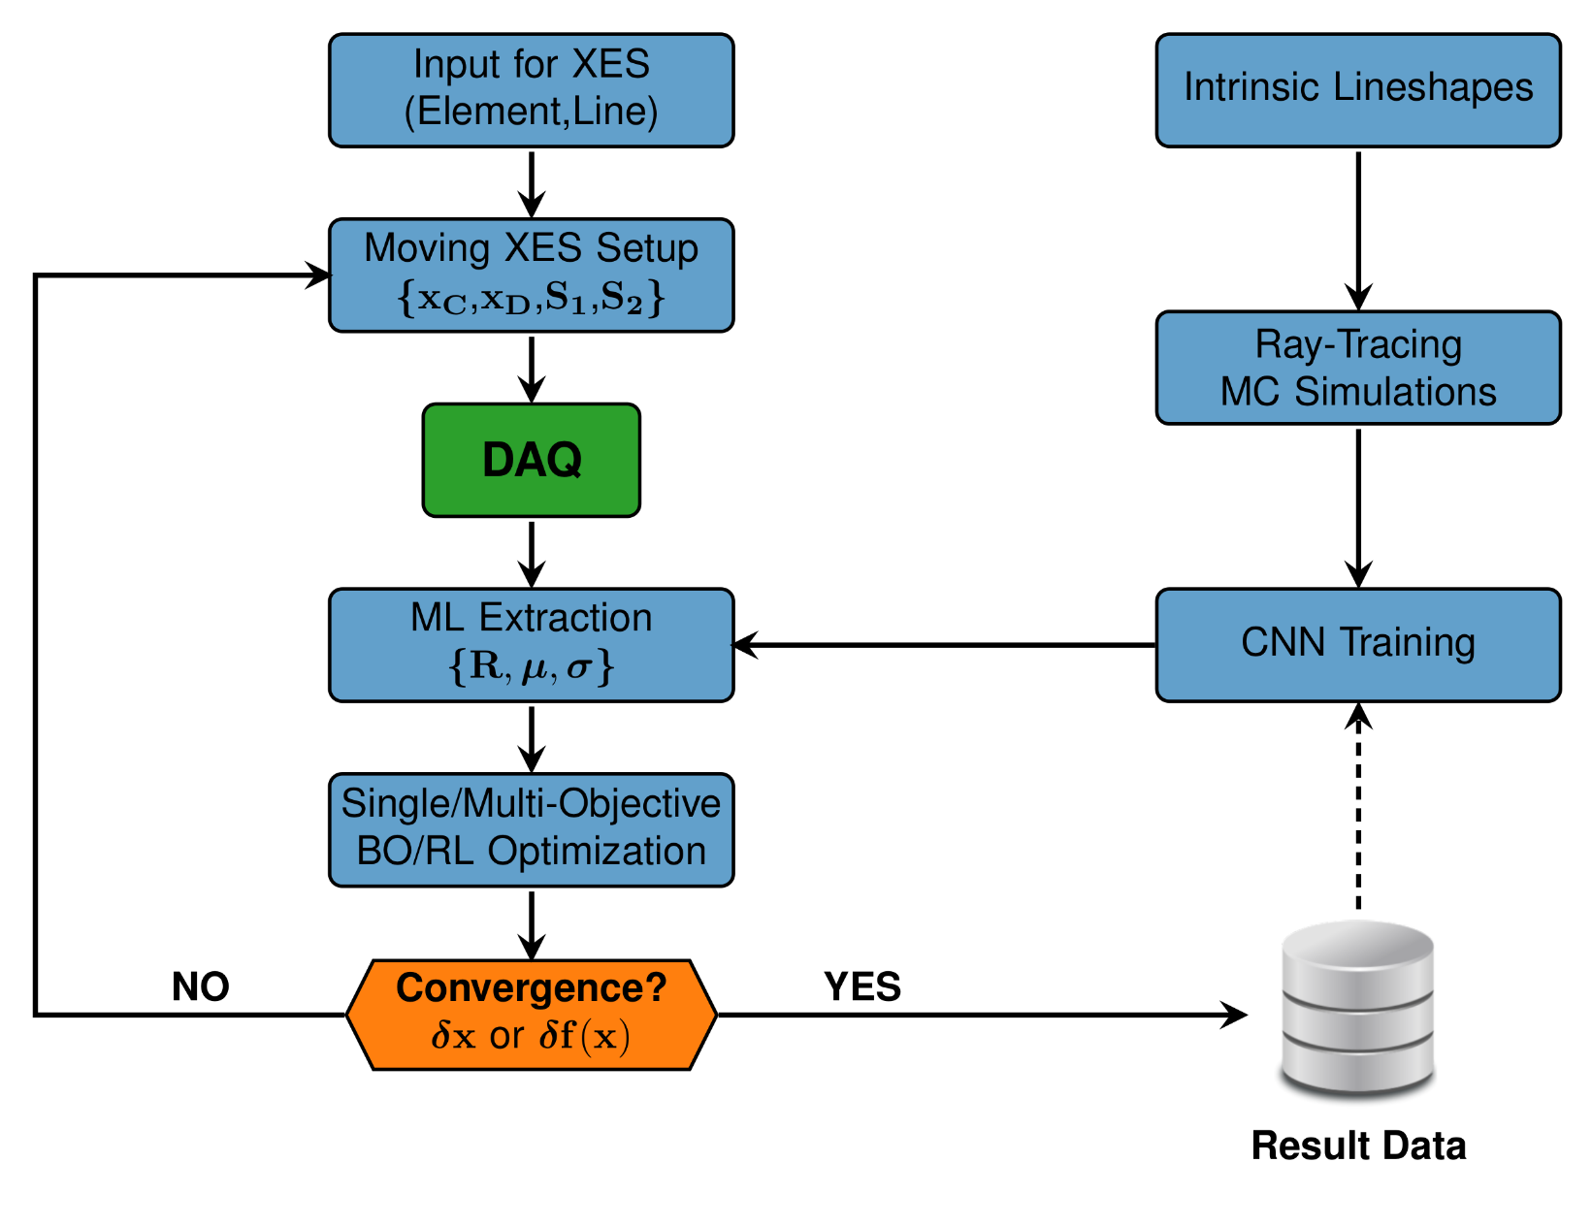
O3. Spectra Optimization Workflow
Kristian Piscicchia, Sandro Donadi, Simone Manti, Angelo Bassi, Maanel Derakhshani, Lajos Diósi, Catalina Curceanu, "X-Ray Emission from Atomic Systems Can Distinguish between Prevailing Dynamical Wave-Function Collapse Models." Physical Review Letters 132.25 (2024): 250203.
Simone Manti, Fabrizio Napolitano, Alberto Clozza, Catalina Curceanu, Gabriel Moskal, Kristian Piscicchia, Diana Sirghi and Alessandro Scordo. "Enhancing Performances of the VOXES Bragg Spectrometer for XES Investigations." Condensed Matter 9.1 (2024): 19.
Simone Manti, Mark Kamper Svendsen, Nikolaj R. Knøsgaard, Peder M. Lyngby & Kristian S. Thygesen, "Exploring and Machine Learning structural instabilities in 2D materials." npj Computational Materials 9.1 (2023): 33.
Simone Manti, Fabian Bertoldo, Sajid Ali & Kristian S. Thygesen, "Quantum point defects in 2D materials-the QPOD Database." npj Computational Materials 8.1 (2022): 56.

Slide 11
O4. X-ray Beamlines Applications
Goal:
Test the possibility of applying the developed optimization framework to the DAFNE-Light beam facility at LNF.
Expected Outcomes:
Demonstrate Framework's Potential: Showcase the adaptability of the framework to any X-ray beamline.
Identify Applications: Document potential applications or experiments that can benefit from these enhancements, both within LNF and externally.

Slide 12
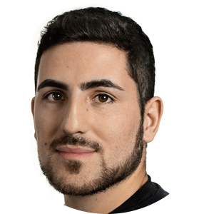
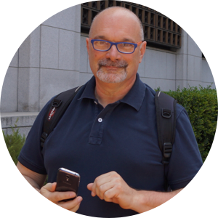
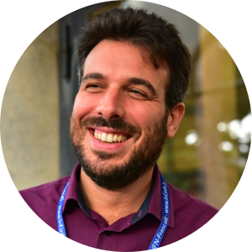
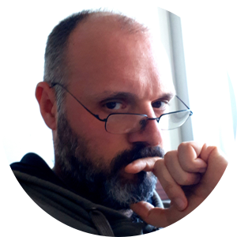
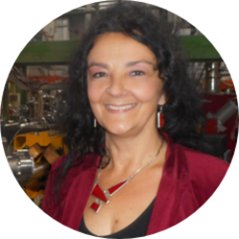
Organization
Simone Manti (INFN,LNF)
FTE:1.0 All WPs
WP1 - Developing the Optimization Framework (Months 1-12)
D1.1 Technical note on the optimization framework (Month 6)
D1.2 Documentation on raytracing simulations (Month 6)
D1.3 Summary of training and validation of ML models (Month 6):
M1 Framework implemented (Month 12).
WP2 - Assembling the experimental setup (Months 1-15)
D2.1 Report on the integration of detector (Month 6)
D2.2 Summary on measurements with the new detector (Month 12)
M2 Detector integrated (Month 6)
WP3 - Optimization of XES measurement (Months 13-24)
D3.1 Results of optimization with the new setup (Month 21)
WP4 - Dissemination and Validation of results (Months 19-24)
M3 Measurement at DAFNE-Light (Month 21)
Alberto Clozza (INFN,LNF)
FTE:0.3 WP2
Alessandro Scordo (INFN,LNF)
FTE:0.3 WP1,WP3
Massimiliano Bazzi (INFN,LNF)
FTE:0.1 WP2
Catalina Curceanu (INFN,LNF)
FTE:0.1 WP4

Slide 13
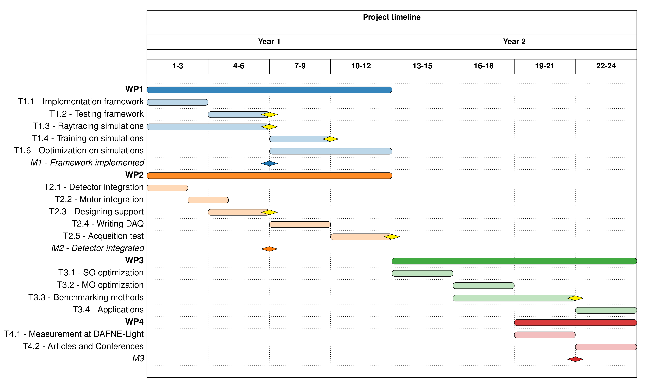

Slide 14
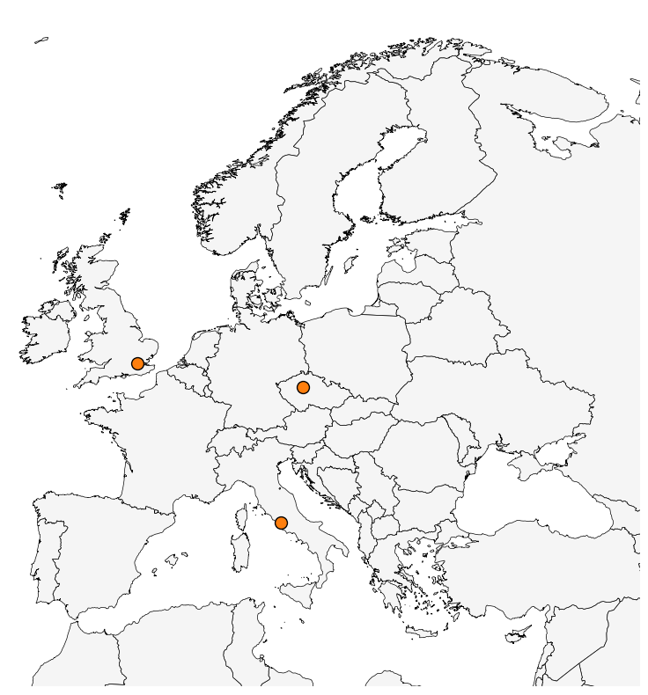
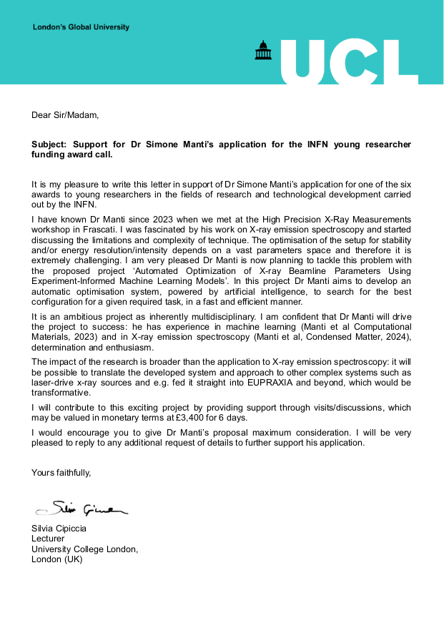
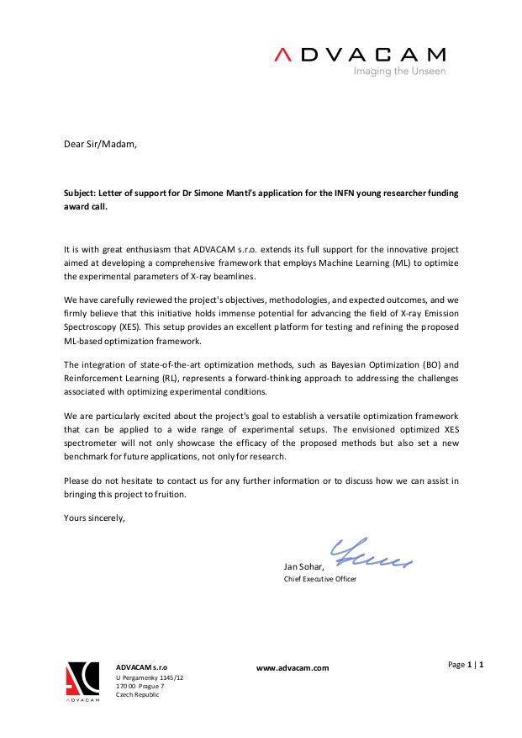
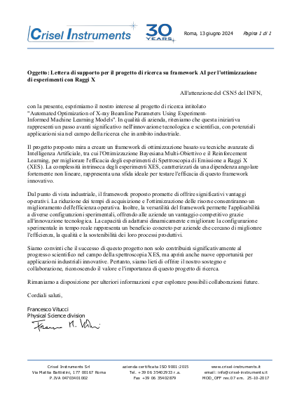
Synergies
INFN Scientific Commissions and Collaborations:
VOXES (LNF)
DAFNE-Light (LNF)
EuAPS (LNF)
EuPRAXIA (LNF)
SPHINX (CSN5)
National and International Research Institutions:
Advanced X-Ray Imaging Group (London)
Industry and Private Sector
ADVACAM (Prague)
CRISEL (Rome)

Slide 15
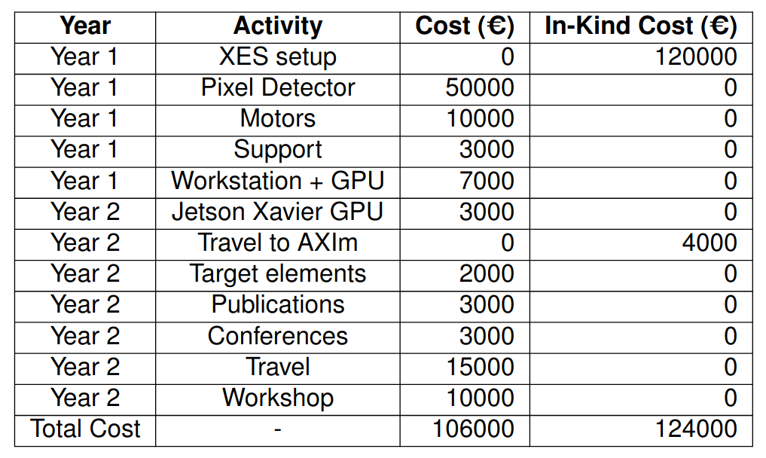
Cost
The overall cost of OPTIMAL is 230 k€, of which 124 k€ are in-kind contributions, and 106 k€ are requested for the project: 70 k€ for the first year and 36 k€ for the second year of the project.
In-kind contributions:
XES Setup
Travel to AXIm
Financial requests:
Setup
Publications
Dissemination

Slide 16
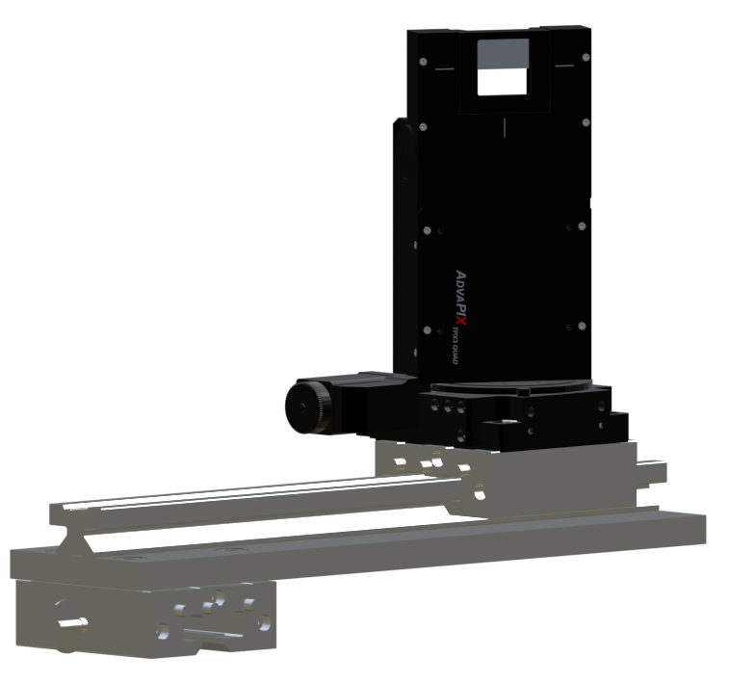
Support to LNF Services
Design Services (0.5 Man-Month):
CAD Modeling: Detailed 3D models for integration support of the pixel detector and motorized stages with the VOXES setup.
Mechanical Workshop Services (0.5 Man-Month):
Custom Fabrication: Precision fabrication and mounting of integration supports to perfectly fit with the existing setup.

Slide 17
Impact:
Advancements in X-ray Beamline Optimization:
Generalized framework for enhanced collaboration and data reproducibility.
Open-source software potential.
Automation reduces human errors and improves efficiency.
Tenfold reduction in acquisition time, leading to cost savings.
Social and Technological Benefits:
Improved safety in high-radiation environments.
Enhanced efficiency for material science and high-throughput elemental analysis.
Risks Assessment:
Inaccuracy of Ray-Tracing Simulations (T1.3)
Data Integration and Feature Extraction Issues (T1.5)
Delays in Ordering or Integrating New Equipment (T2.1, T2.2, T2.3)
Single/Multi-Objective Optimization Complexity (T3.1,T3.2)

Slide 18
Conclusion
Challenges in X-ray Beamline Optimization:
Complex parameter adjustments requiring innovative solutions.
OPTIMAL Project:
Advanced framework using Bayesian Optimization and Reinforcement Learning with Machine Learning for efficient Multi-Objective optimization.
Project Organization and Costs:
Structured approach with detailed planning and budget management.
Thank you for the attention!

Slide 19
SPARE

Slide 20
Risks Assessment
1. Inaccuracy of Ray-Tracing Simulations (T1.3)
• Risk: The ray-tracing simulations may not accurately describe the XES experiment, as they are typically devoted to X-ray beamlines optics and sources, but they are not optimized for simulating mosaic crystals. Such materials have been indeed included in the XOP package only by M. Sanchez del Rio [17].
• Mitigation: Maintain close contact with the developer of the SHADOW-XOP program, Manuel Sanchez del Rio, to seek assistance to improve the accuracy of the simulations.
2. Data Integration and Feature Extraction Issues (T1.5)
• Risk: Integrating data from different sources and accurately extracting features from XES spectra using deep learning may present technical challenges.
• Mitigation: Use historical data to bridge gaps between simulated and real-world data.
3. Delays in Ordering or Integrating New Equipment (T2.1, T2.2, T2.3)
• Risk: Potential delays in the procurement or integration of the pixel detector and other new equipment could affect project timelines.
• Mitigation: Use a CCD from the VOXES project as a temporary measure to initiate measurements until the pixel detector integration is complete. This CCD, although less efficient and with too small sensitive area, will allow for continued progress on the project.
4. Single/Multi-Objective Optimization Complexity (T3.1,T3.2)
• Risk: Balancing multiple objectives (e.g., acquisition time, energy precision, and resolution) in the optimization process may be complex and computationally intensive.
• Mitigation: Regularly evaluate and adjust the optimization strategies based on intermediate results. Engage with experts in optimization and machine learning to refine and enhance the optimization algorithms. Specifically, contact Lucio Anderlini (Florence Section of INFN), whose expertise in artificial intelligence and deep learning can provide valuable insights and support for the project.

