Slide 1


ASTERIX
(Accelerating STructures made of multiplE sectoRs In X-Band)
3 anni (2025-2027)
Units: LNF, LNS, Roma1
Research line: Accelerators and related technologies
Nuova Proposta di Esperimento in CSN5 (INFN)
L. Faillace (Resp. Naz.) - LNF
July 09, 2024
Support from INFN-LNF Laboratory
External Collaborators: V. Dolgashev (SLAC), Tetsuo Abe (KEK)
PhD student from the University of Science and Technology of China (USTC)
Esperimenti in CSN5 correlati:
MICRON (2022-2024)
ARYA (2020-2023)
DEMETRA (LNF/LNS)

Slide 2
ASTERIX team
LNF | FTE | LNS | FTE | Roma1 | FTE
L. Faillace (Resp. Naz.) | 0.4 | G. Torrisi (RL) | 0.1 | L. Ficcadenti (RL) | 0.3
D. Alesini | 0.2 | D. Mascali | 0.05 | M. Petrarca | 0.2
M. Bellaveglia | 0.05 | G. Mauro | 0.1 | M. Migliorati | 0.2
S. Bini | 0.2 | G. Sorbello | 0.2 | G. Silvi | 0.2
F. Cardelli | 0.3 | T. Isernia | 0.3 | L. Palumbo | 0.4
M. Carillo | 0.2 | R. Palmeri | 0.3
E. Chiadroni | 0.2 | A. Locatelli | 0.1
A. Falone | 0.2 | C. De Angelis | 0.1
A. Gallo | 0.15 | L. Vincetti | 0.1
A. Giribono | 0.2
A. Liedl | 0.1
L. Piersanti | 0.1
S. Pioli | 0.2
B. Spataro | 0
C. Vaccarezza | 0.2
Tot./Unit | 2.7 |  | 1.35 |  | 1.3
LNF
Roma1
LNS
Total FTE
5.35
L. Faillace CdL (Preventivi) INFN-LNF, 09-07-2024

Slide 3
Motivation
The Accelerating gradient is the key parameter
for the design, construction and cost of future linear accelerators
Linacs must be reliable and cost-effective
World-wide intense and systematic research (SLAC/INFN/KEK/CERN/Tsinghua Uni) on high-gradient accelerating RF structures started with the investment for the construction of normal-conducting linear colliders, new generation X-FELs, etc.
In order to be feasible the design of linear colliders posed a minimum value on the accelerating gradient → 100 MV/m.
L. Faillace CdL (Preventivi) INFN-LNF, 09-07-2024

Slide 4
Research Context
Framework of a continuous more-than-two-decade-long collaboration on the study of RF structures with increasing accelerating gradients and the RF breakdown physics: SLAC (USA), INFN-LNF and KEK (Japan)
Study of various geometries, materials, surface processing techniques and technological developments of advanced accelerating structures working in X-band (11 – 12 GHz):
  This research is strongly required by a demand for ever more advanced accelerating structures, with accelerating gradients well-above 100 MV/m, since higher efficiency and robust manufacturing play a major role for the next generation of linear particle accelerators for research;
  These structures are made of hard copper and hard copper alloys → better high-gradient performance;
  Different geometries, e.g. “open-type” structures (two halves, four quadrants, etc.)
  Alternative “braze-free” joining techniques, e.g. EBW and TIG welding.
Applications: future linear colliders; existing and new-generation X-FELs, such as EuPRAXIA@SPARC_LAB; industrial, and medical applications.
L. Faillace CdL (Preventivi) INFN-LNF, 09-07-2024

Slide 5
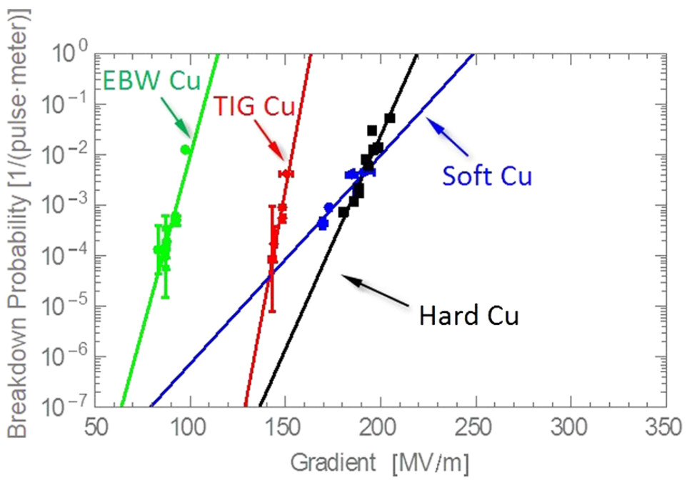
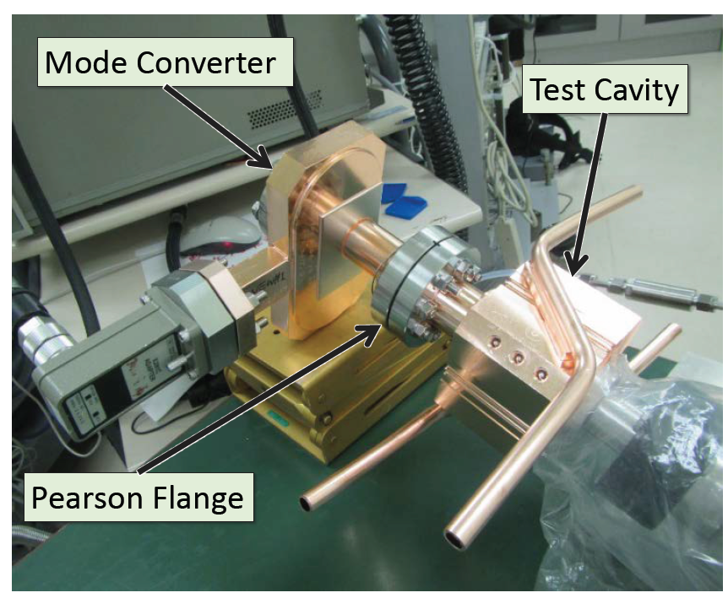
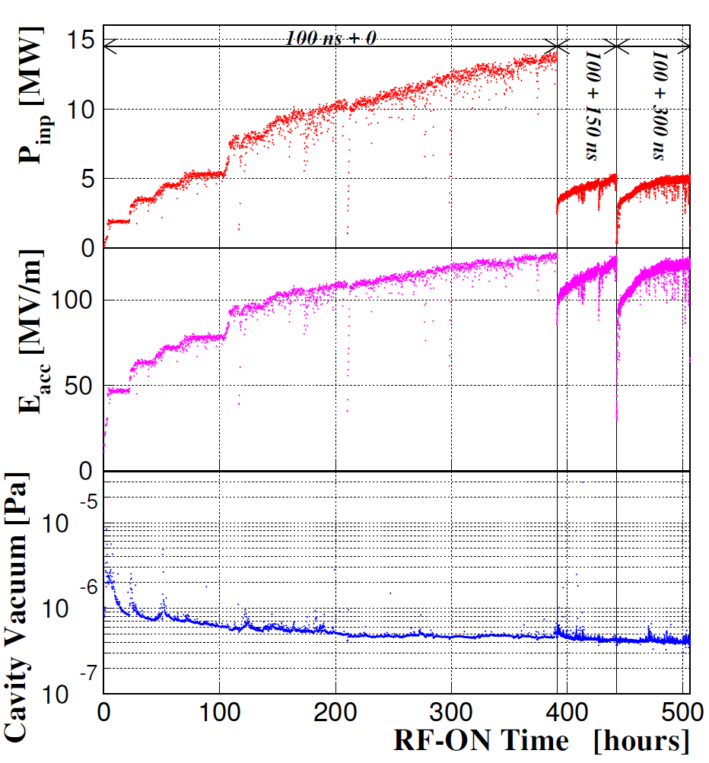
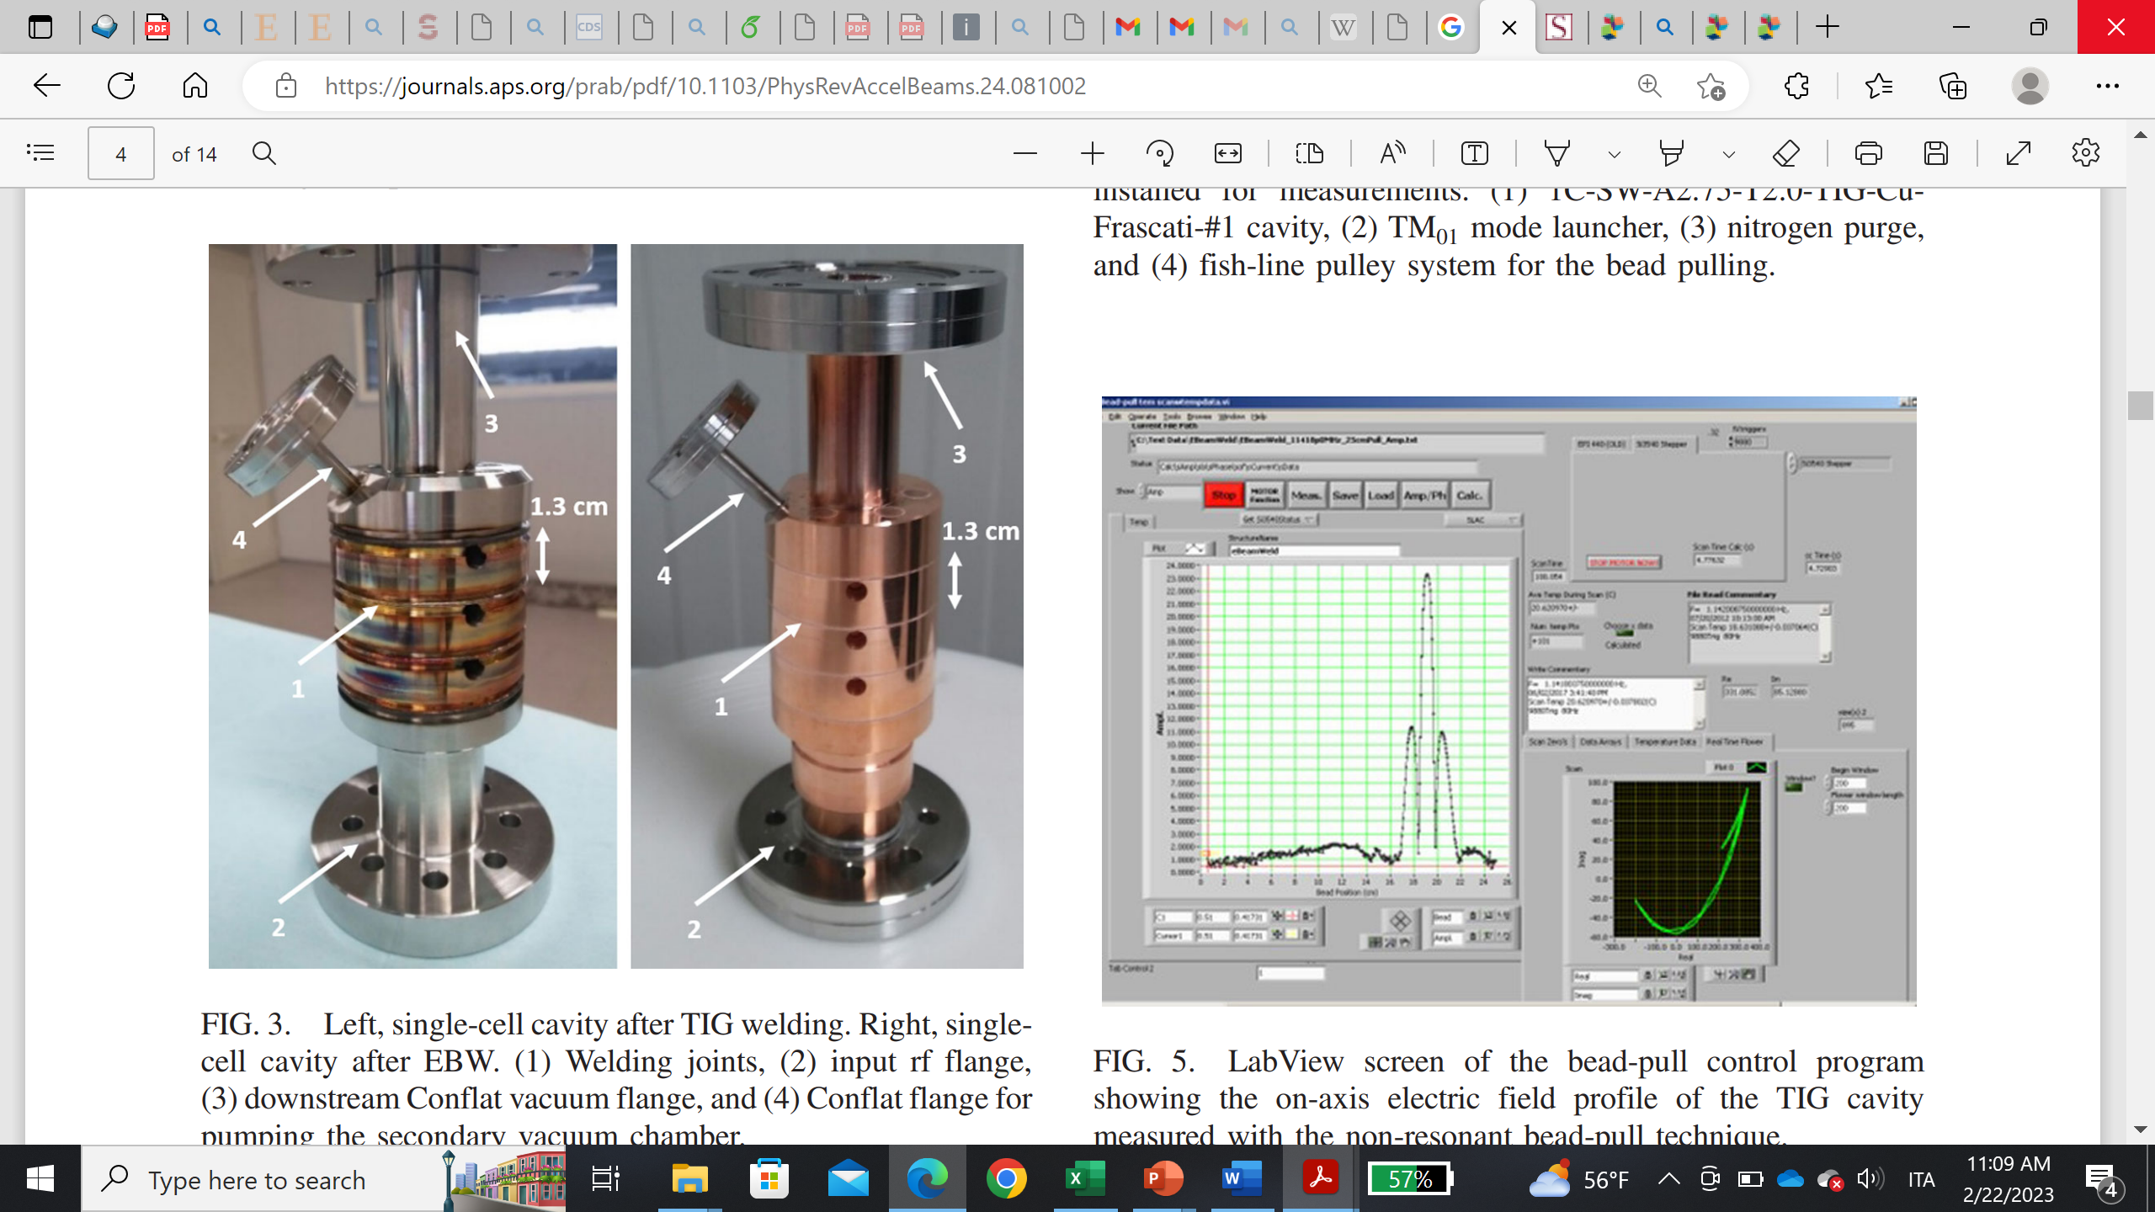
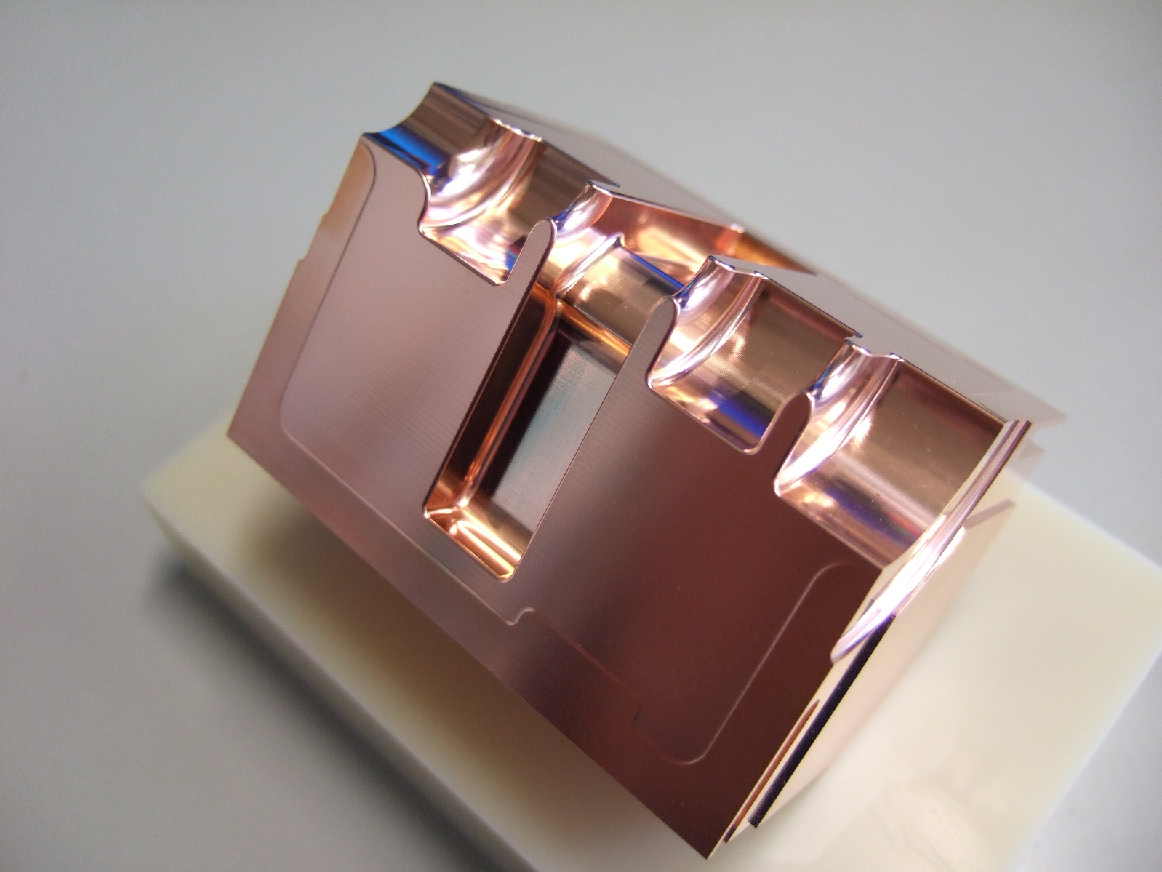
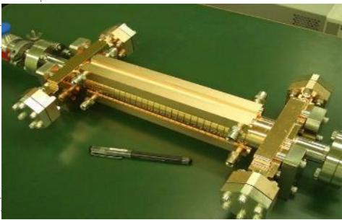
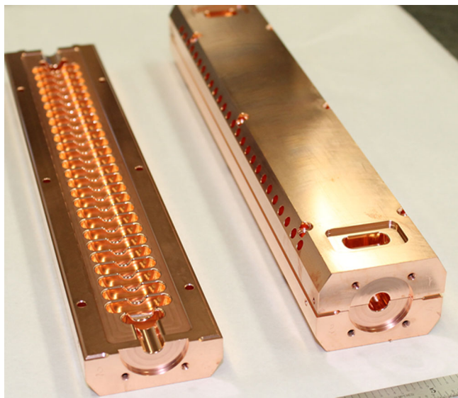
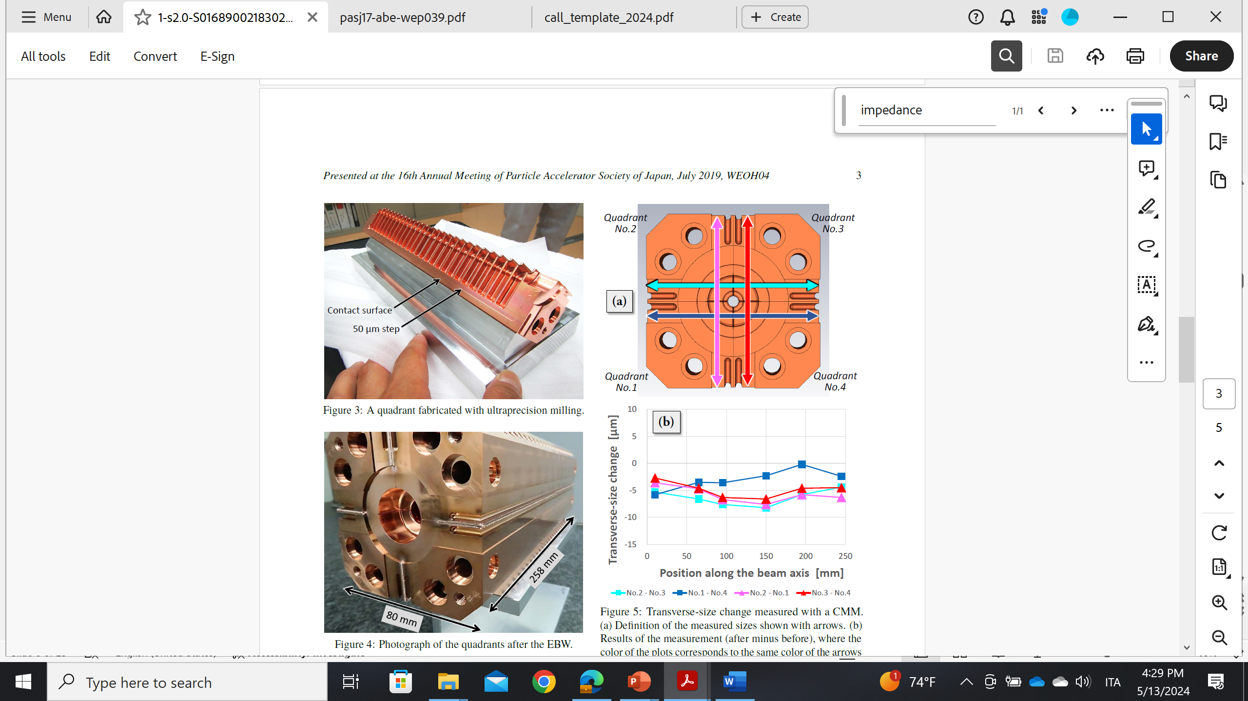
State-of-the-art
“Single-cell” cavities (open and closed; disk-type and multi-sector)
TW multi-cell structures (open and closed; disk-type and multi-sector)
Open-type multi-sector cavities, typically of small lengths (20- 25 cm).
TIG
EBW
open
62.448 mm
One quadrant
T. Abe, et al., High-gradient test results on a quadrant-type X-Band single-cell structure.
Dolgashev VA, Faillace L, Spataro B, Tantawi S, Bonifazi R. High-gradient rf tests of welded X-band accelerating cavities. Physical Review Accelerators and Beams. 2021 Aug 10;24(8):081002.
30 cm
SLAC/CERN 2018
X-band
2 halves, open structure
Brazed
High-power tested:
→ Gradient: 100 MV/m with 200 ns pulse length.
KEK (Tetsuo Abe) 2023
X-band
4 quadrants
EBW welding
To be High-power tested.
22 cm
CERN 2007
X-band
4 quadrants
Clamped, high T-treated
High-power Tested:
→ Gradient: 80 MV/m with 40 ns pulse length.
30 cm
CLIC-G-OPEN
L. Faillace CdL (Preventivi) INFN-LNF, 09-07-2024

Slide 6
Goal
ASTERIX stands apart from state-of-the-art
First-time demonstration of practical, meter-long, X-band RF accelerating structure for real linear accelerators:
high accelerating gradients (>100 MV/m);
composed of four-quadrants (“open-type”);
made out hard copper;
joined and vacuum sealed by using TIG welding (“braze-free” technique).
Requirement to be competitive among the world-wide collaboration
cancellation of the dipole and quadrupole EM field components, detrimental for the beam dynamics
improved pumping speed and easy insertion of HOM absorbers (in case of multi-bunch operation)
Superior high-gradient performance, compared with soft copper
cost-effective and robust manufacturing.
L. Faillace CdL (Preventivi) INFN-LNF, 09-07-2024

Slide 7
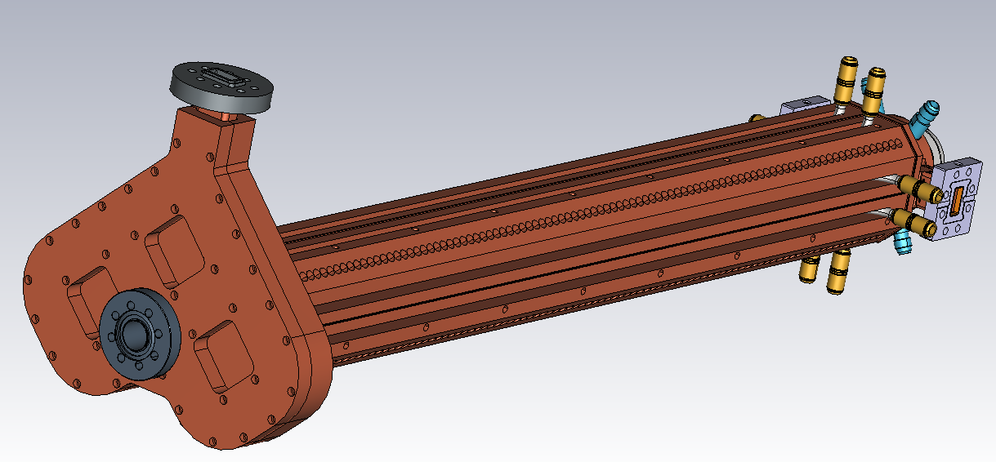
Full TW multi-cell X-band structure
TIG-welded
4-quadrants
«open-type»
Cooling channels
90 cm
Integrated
mode-launcher
TIG welding joints
Fabrication out of hard copper
Increase in vacuum pumping speed
Overall reduction of the fabrication costs
Easy insertion of HOM absorbing materials
tuners
27 cm
L. Faillace CdL (Preventivi) INFN-LNF, 09-07-2024

Slide 8
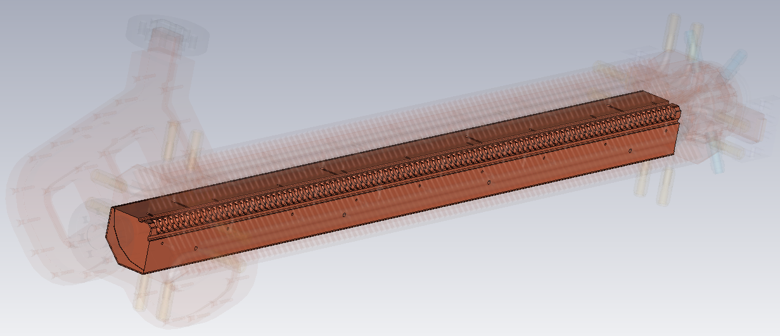
Full TW multi-cell X-band structure
Secondary vacuum chamber (extra pumping, easy insertion of HOMs absorbers in multi-bunch operation,…)
Single quadrant
TIG welding joints
Alignment pins
L. Faillace CdL (Preventivi) INFN-LNF, 09-07-2024

Slide 9
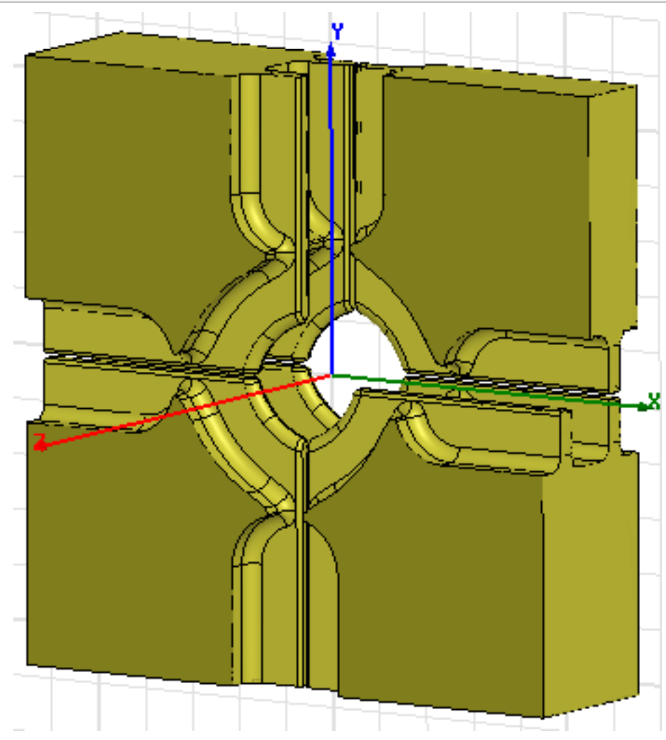
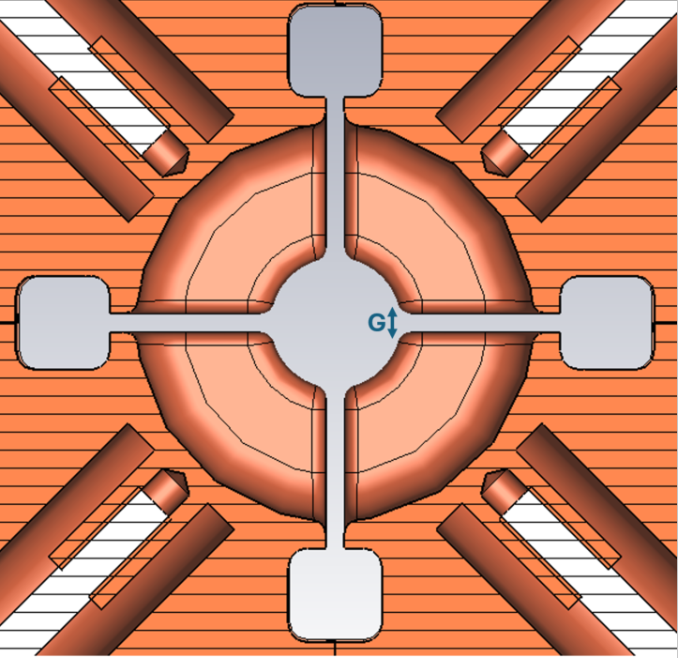
Objectives
Cell with HOM WGs
Cell without HOM WGs
tuners
Secondary vacuum chamber
World-wide collaboration
&
EuPRAXIA@SPARC_LAB scenario
Reasonable scope, time and budget
MULTI-BUNCH GEOMETRY
SINGLE-BUNCH GEOMETRY
RF and thermo-
mechanical analysis
Wakes/HOMs mitigation
Multipacting analysis
Tolerance and misalignment analysis.
DESIGN
DESIGN
Low-precision full model for mechanical tests (quadrant straightness and alignment, TIG welding process, vacuum tightness) → 1° year
Prototyping activity, nominal precisions (small-scale structure, 30 cm and 20 cells) → 2° year
Full-scale structure with four-port RF mode-launchers → 3° year
Limited time, budget
Future experiments
Version 2.0
Asterix &Obelix
FABRI-
CATION
LATINO Laboratory
INFN-LNF
Validate the structure's fabrication within required tolerances for tuning:
measure key RF parameters (resonant frequency, quality factor, and coupling coefficient ← scattering parameters.
Bead-pull for on-axis electric field amplitude and phase.
Asterix& Obelix
LOW RF POWER TEST
TEX facility INFN-LNF
High-gradient performance (compressed pulse up to 200 MW from VKX8311A 50 MW X-band klystron by CPI and BOC-type compressor):
Accelerating gradient
RF breakdown probability
Dark current (surface field emitted electrons)
HIGH RF POWER TEST
HIGH RF POWER TEST
L. Faillace CdL (Preventivi) INFN-LNF, 09-07-2024

Slide 10
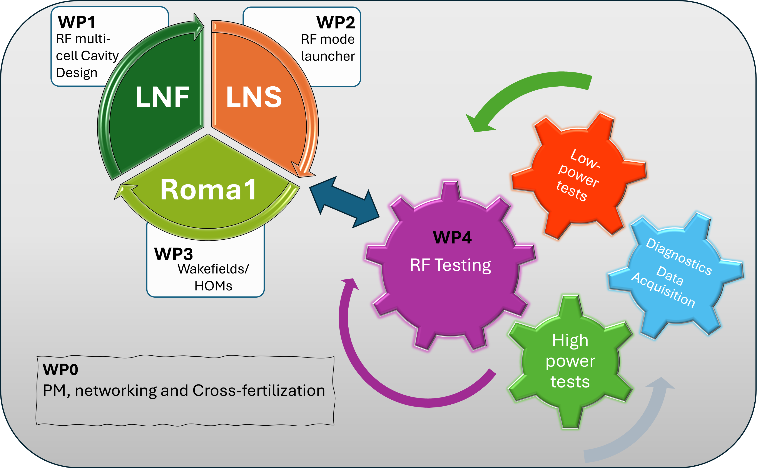
L. Faillace CdL (Preventivi) INFN-LNF, 09-07-2024

Slide 11
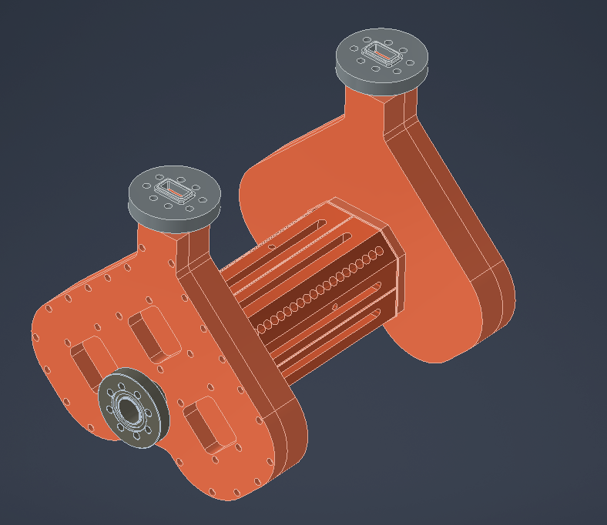
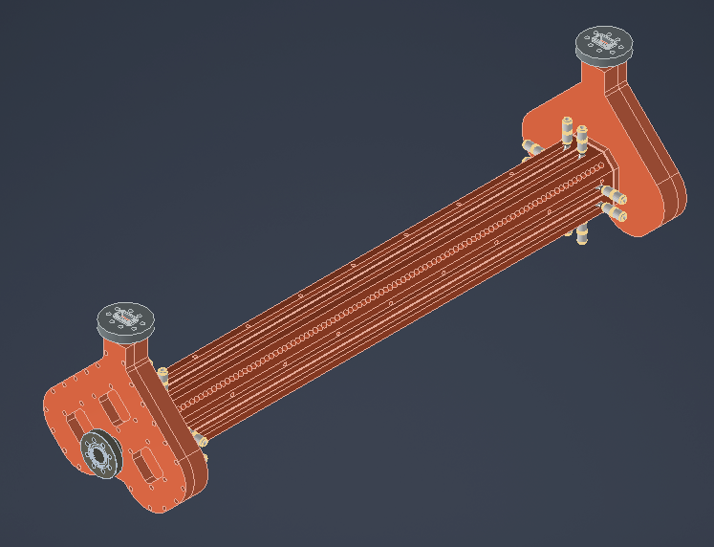
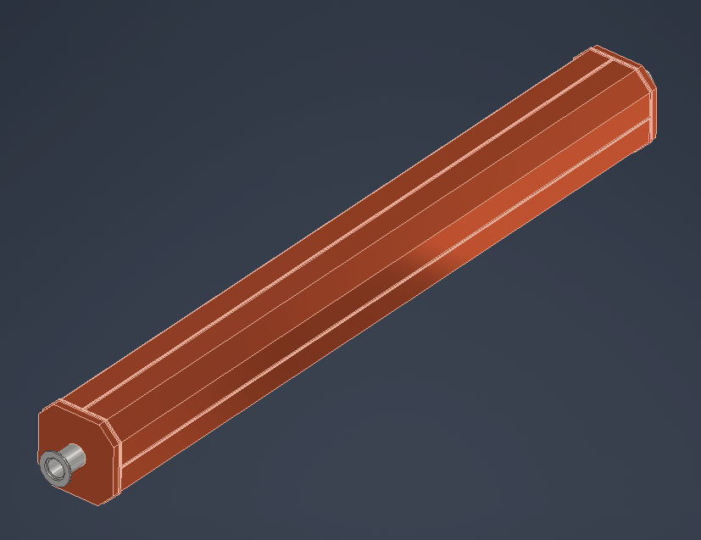
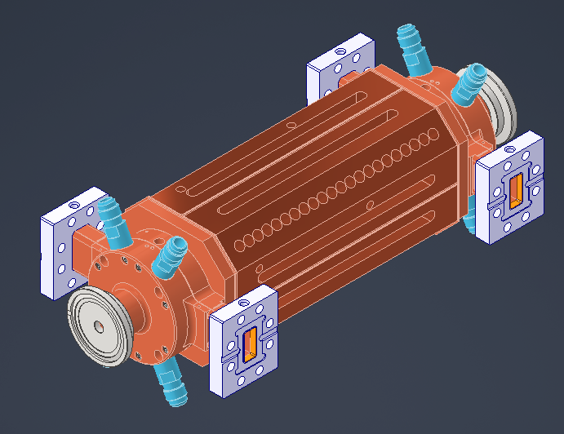
4-port Mode-launchers
Fabrication of final
Full-scale structure and Mechanical Validation
Fabrication of small-scale
prototypes/mechanical Validation
RF and Wakefields/HOMs Optimization
Low-precision Full-scale fabrication/mechanical characterization
Low and High RF power testing of small-scale protoypes
Low and High-power Testing of Final full-scale structure
quadrant straightness and alignment
TIG welding process
vacuum tightness
30 cm
4-port Mode-launchers
Standard couplers
90 cm
90 cm
Report 1
Report 2
Report 3
Report 4
Report 5
Report 6
30 cm
Start
2025
End
2025
End
2026
End
2027
Feasibility Study
Prototyping Activity
Final full-structure Tests
Report of the Feasibility Study (RF and Wakefields/HOMs);
Report of the Mechanical Engineering of the low-precision prototype with standard RF couplers for Mechanical, TIG welding and vacuum testing;
Report of the Mechanical Engineering of the small-scale structures with ad-hoc integrated RF Mode Launcher couplers;
Report of the low/high RF power testing of the small-scale structures;
Report of the Mechanical Engineering of the Full Structure with with ad-hoc integrated RF Mode Launcher couplers;
Final Report of low and High RF power testing of final full-scale structure.
7 Milestones
6 Deliverables

Slide 12
Budget
YEAR |  | Cost | Quantity | INFN Units
1 | Software License – CST Microwave Studio | € 31,000.00 | 2.00 | LNF/LNS | Ask for advance
 | Inventariabile (Workstation) | € 6,000.00 |  | LNF | Ask for advance
 | Consumabili | € 35,000.00
 | Missions | € 4,500.00 |  | LNF/LNS/Roma1
 | TOT. 1st year | € 76,500.00
2 | Consumabili | € 70,000.00 |  | LNF | Prototyping (max 30 cm)
 | Cavi+WG adapters, 2xRF power loads | € 56,500.00 |  | LNF | Activity: Cavity+MLs
 | 2xFCs | € 4,800.00 |  | LNF
 | Turbopump and Scroll | € 8,000.00 |  | LNF
 | Missions | € 12,000.00 |  | LNF/LNS/Roma1
 | TOT. 2nd year | € 151,300.00
3 | Consumabili | € 130,000.00 |  | LNF | Full structure (90 cm)
 | Missions | € 12,000.00 |  | LNF/LNS/Roma1
 | TOT. 3rd year | € 142,000.00
TOT |  | € 369,800.00
L. Faillace CdL (Preventivi) INFN-LNF, 09-07-2024

Slide 13
Thanks for your attention!
L. Faillace CdL (Preventivi) INFN-LNF, 09-07-2024

