Slide 1

CSN5 INFN-LNF
C. Vaccarezza Coordinatore LnF
CDL Preventivi july 9th 2024

Slide 2
Outline
CSN5 update
CSN5-LNF overview
New Experiment proposals and Calls
Ongoing experiment report

Slide 3
CSN5 update
14 July 2024
NEW Data base preventivi 2025 open until July 14th Luglio 2024 (23:59)
17 July 2024
Data base assegnazioni (richieste aggiuntive, sblocchi sj) open until July 17th 2024
22-24 July 2024
Next CSN5 meeting: July 22-24 2024 at LNGS

Slide 4
IMPORTANTE !
Sono stati riaperti i termini per la sottomissione delle proposte
Grant Giovani 2024.
Il termine ultimo è VENERDì 2 AGOSTO ALLE ORE 11:59.
Chi ha già sottomesso un progetto può accedervi per eventuali correzioni.
In questo caso se avete dubbi tecnici potete rivolgervi ad Anna Di Virgilio.

Slide 5


Procedura di Ranking dei Proposal di Esperimenti Standard
Ad ogni nuovo proposal di esperimento standard è assegnato un ranking numerico (n ∈ ℕ) suddiviso in 3 voci.
Impatto scientifico/tecnico. Chiarezza nella spiegazione della novelty e sull’incremento rispetto allo stato dell’arte. Attinenza con le mission dell’Ente. Attinenza con le tematiche della CSN5. (1-10)
Chiarezza nella spiegazione delle metodologie. Chiarezza nella spiegazione dei risultati attesi. Metodi di valutazione del progresso dell’esperimento. Analisi e mitigazione dei rischi. (1-10)
Sostenibilità dell’esperimento. Consistenza e giustificazione delle richieste finanziarie. Consistenza del personale impegnato nell’esperimento con l’attività prevista. Competenza dei proponenti riguardo l’argomento della proposta. (1-10)
Il voto di ogni voce verrà accompagnato da un giudizio.
Alberto Quaranta
Meeting CSN1 – Isola d’Elba – 17 maggio 2023

Slide 6
Giudizi e Selezione Finale
I voti vanno accompagnati da giudizi puntuali e dettagliati dai quali si evincono le ragioni del voto.
I giudizi vanno presi anche come indicazioni utili a migliorare la proposta.
Ogni sottocommissione stila i giudizi collegialmente preoccupandosi della coerenza fra termini e/o aggettivi con il risultato finale.
Per passare la prima fase un proposal deve totalizzare almeno 18/30 e (∨) deve aver preso un voto maggiore di 4/10 su tutte le voci.
Gli esperimenti respinti potranno ritentare l’anno successivo tenendo presenti le osservazioni della Commissione.
Alberto Quaranta
Meeting CSN1 – Isola d’Elba – 17 maggio 2023

Slide 7
Dopo la Riunione di Luglio e Prima della Riunione di Settembre
Ai proposal approvati a luglio verranno assegnati almeno 2 referee, di cui almeno 1 fra i coordinatori. Deve essere presente almeno un esperto del settore eventualmente esterno alla Commissione.
I referee si studiano la proposta, individuano forze e debolezze e fanno un’analisi dei costi del progetto.
Prima della riunione di settembre i PI devono organizzare un (unico) incontro fra il gruppo e i referee durante il quale la proposta viene discussa nel dettaglio.
Durante l’incontro i referee possono già proporre rimodulazioni del piano di lavoro e dei costi.
I coordinatori devono diffondere le informazioni e le scadenze a tutti gli associati e avvisare i PI della loro sezione di mettersi in contatto con i referee.
Alberto Quaranta
Meeting CSN1 – Isola d’Elba – 17 maggio 2023

Slide 8
CSN5 overview 2024
People= 60 (-37%) : Ric. 33 (-39%), Tec. 27( -34 %) FTE= 17.7 (-50 %)
DETECTORS 3
DARTWARS*
INTERDISCIPLINARY 2
SAMADHA*
ACCELERATORS 6
CROWN
SL_BETATEST
MICRON*
PBT*
QUB_IT*
SAMARA DTZ*
RESILIENCE*
H2BTF
SPHINX
* CLOSING NO EXT. REQUESTED

Slide 9
New proposals for 2025
New proposals con RN @ LNF
ASTERIX RN L. Faillace
New proposals con RL @ LNF
BOND RL S. Dabagov
New proposal GRANT giovani:
OPTIMAL RN S. MANTI
SELENE RL R. Bedogni
SUPERMAD RL G. Maccarrone
QUARTET RL C. Ligi

Slide 10

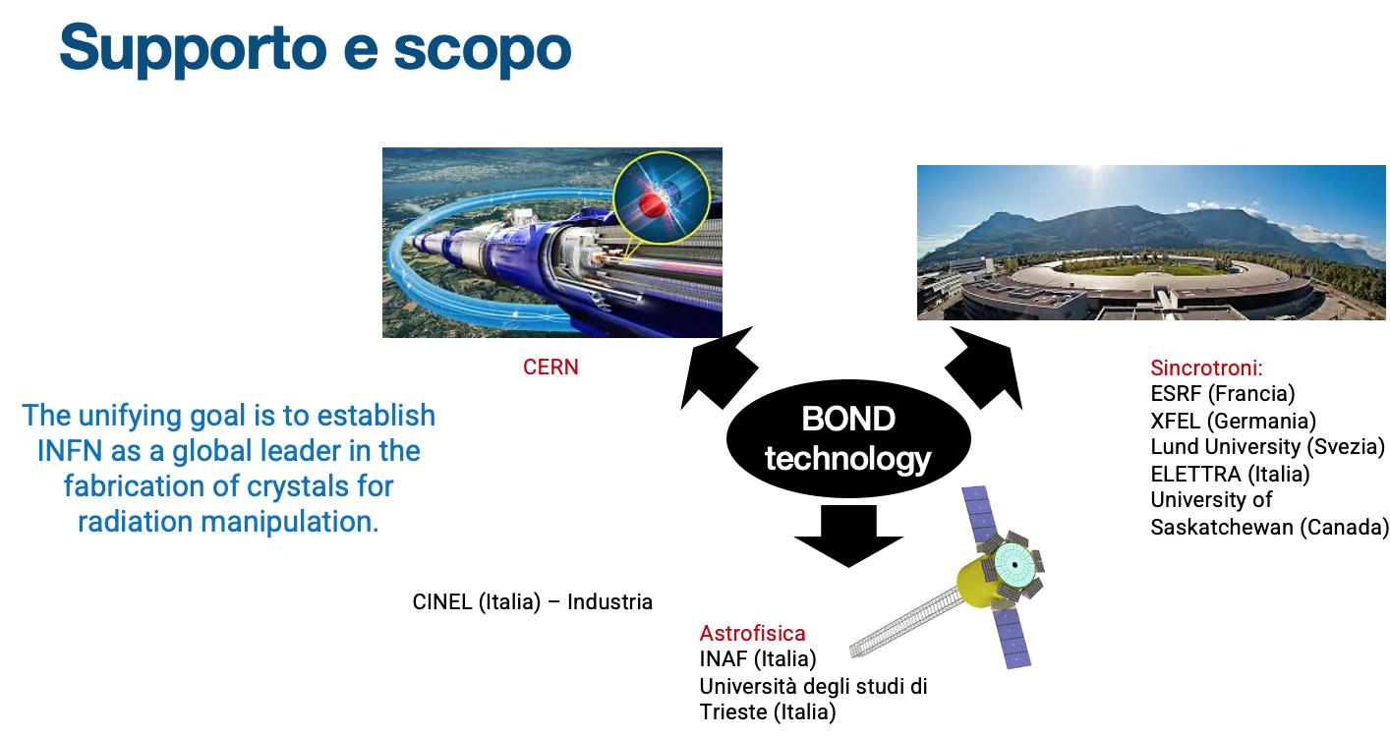
BOND - CRYSTAL BOND
Progetto CALL CSNV
2025-2027
CALL
CSN5
Unità partecipanti: Ferrara
    Legnaro (D. De Salvador)
    Trieste (F. Arfelli)
    Frascati (S. Dabagov)
Acronimo e Titolo: BOND - Crystal BOND
Area di ricerca: Acceleratori
Responsabile nazionale: Andrea Mazzolari

Slide 11
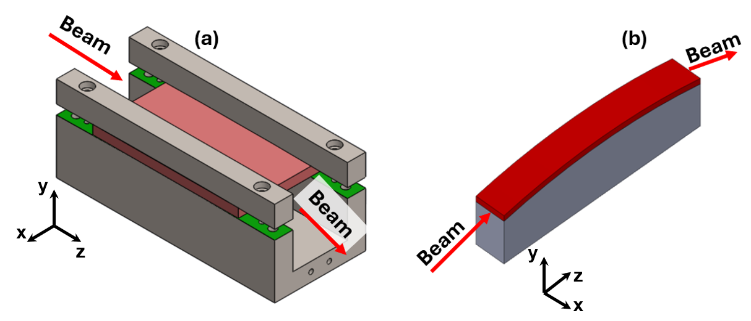

Deflessione di fasci di particelle @ CERN
Deflessione di fasci di particelle a «largo angolo». Di interesse per CERN-LHC e futuri acceleratori: tecnologia abilitante per esperimenti a targetta fissa
Tecnologia attuale
Deformazione del cristallo imposta da supporti meccanici.
Ingombranti
Pesanti
Difficili da realizzare perché richieste tolleranze stringenti
Tecnologia proposta
Cristallo in silicio deformato tramite «anodic bonding» di silicio su vetro
Assemblato leggero
Ingombro ridotto
Curvatura estremamente uniforme
Anodic Bonding: process of joining a alkali glass and silicon substrate together using heat and voltage.
(200-430)°C
(0.2-2.5)kV

Slide 12
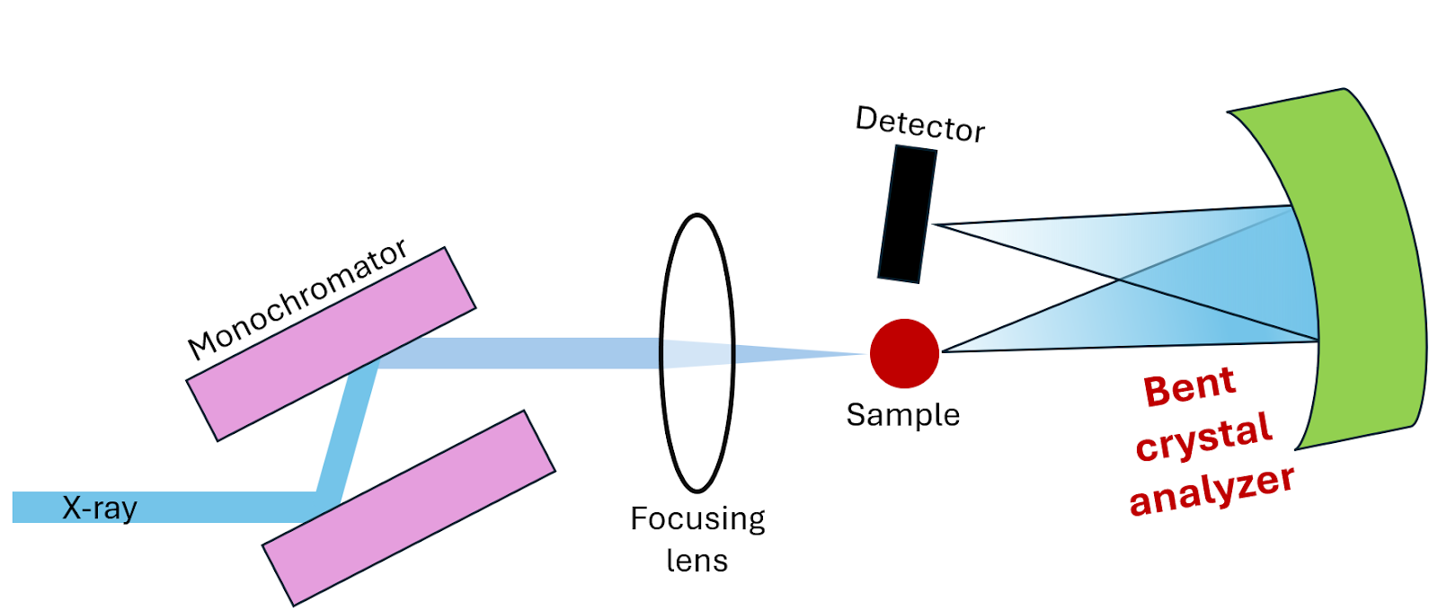
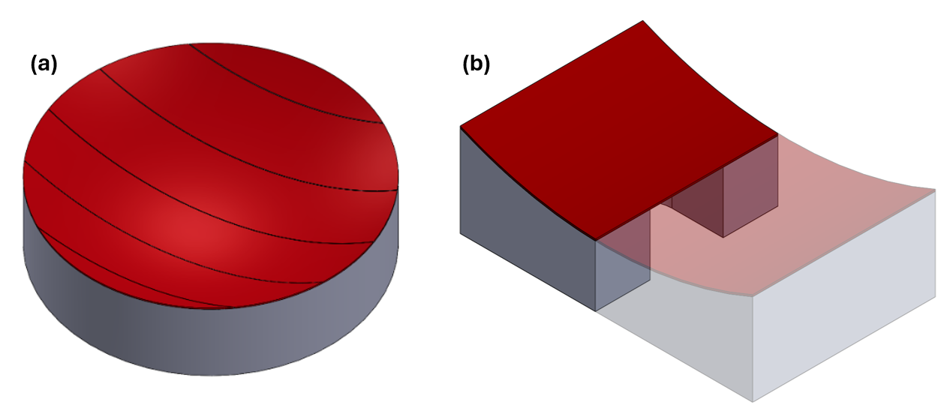
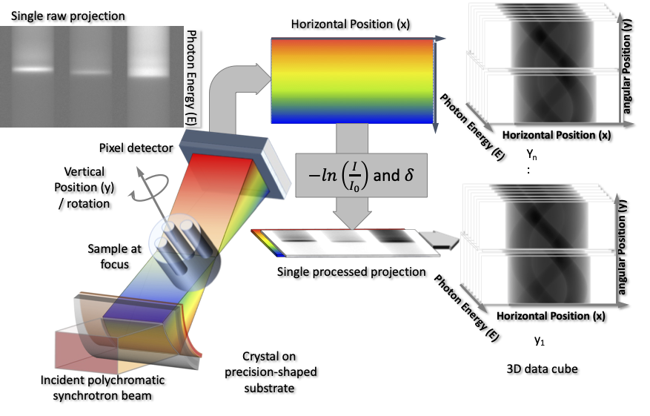
Ottiche per raggi-x @ sinctrotroni
Sviluppo di innovative ottiche per raggi-x da impiegare per tecniche di imaging presso sincrotroni.
Materiali innovativi quali germanio, quarzo, niobato di litio.
Cristalli deformati tramite anodic bonding e thermo-compression bonding.
Thermo-Compression
Bonding: method that brings two metals into atomic contact by simultaneously applying force and heat causing diffusion to occurr

Slide 13
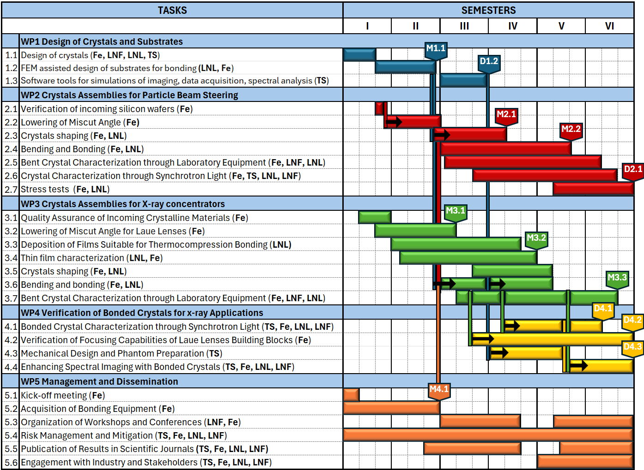
Cronoprogramma
Attività distribuita in 3 anni
Primo anno progettazione ed acquisizione strumentazione
Secondo anno R&D
Terzo anno R&D e testing.

Slide 14
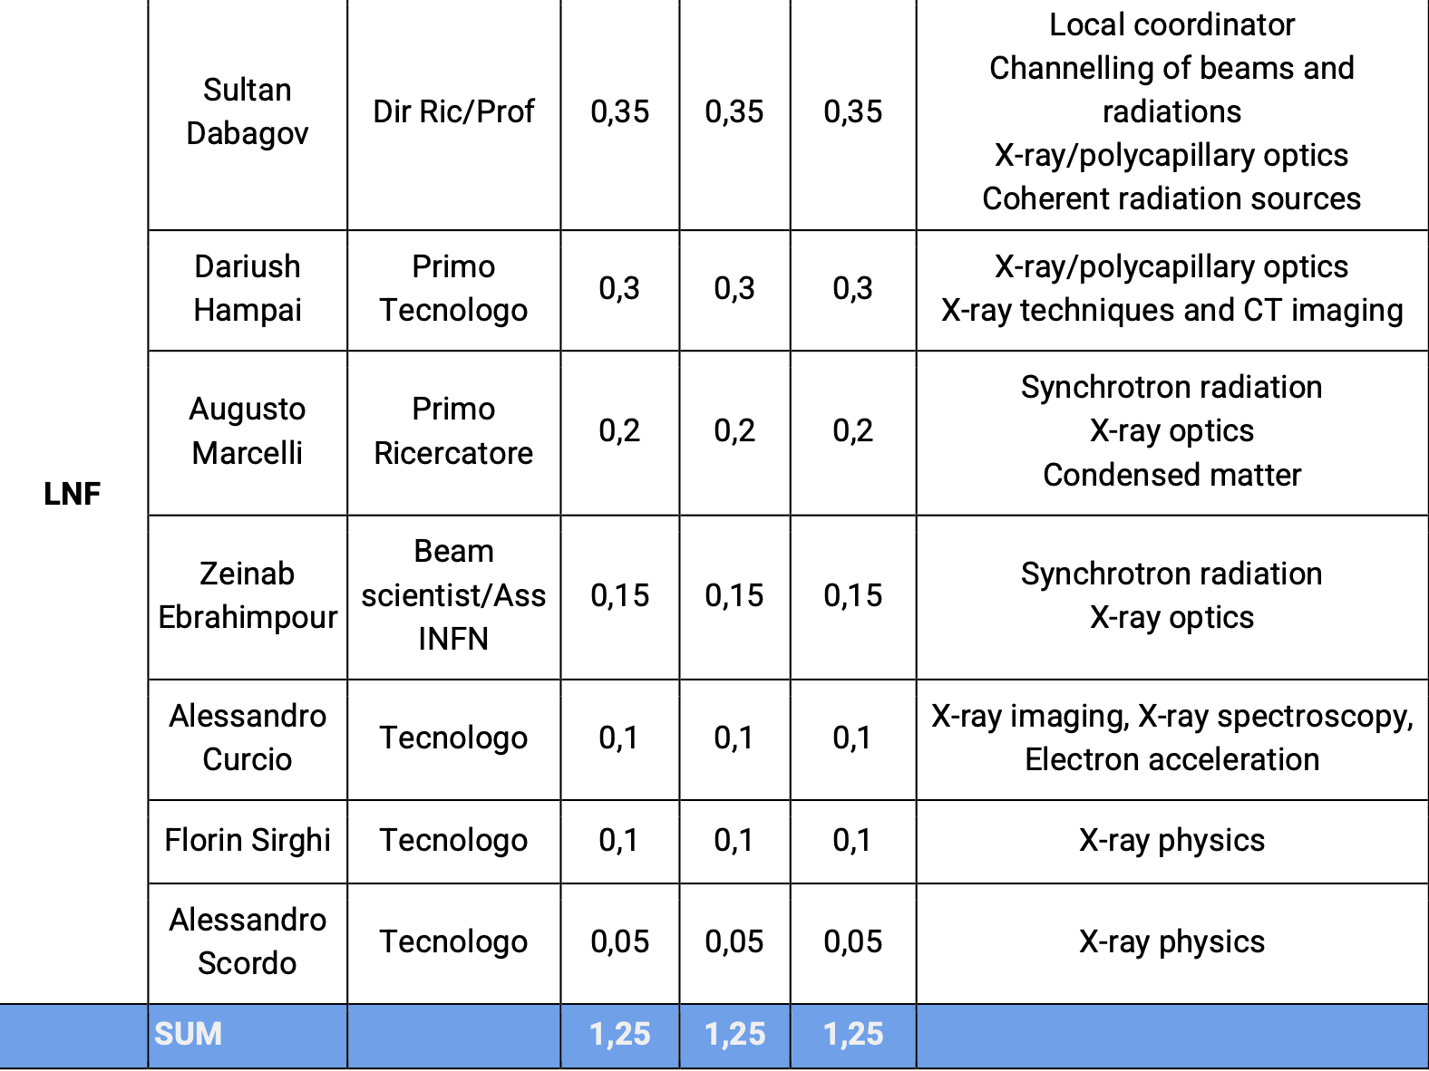
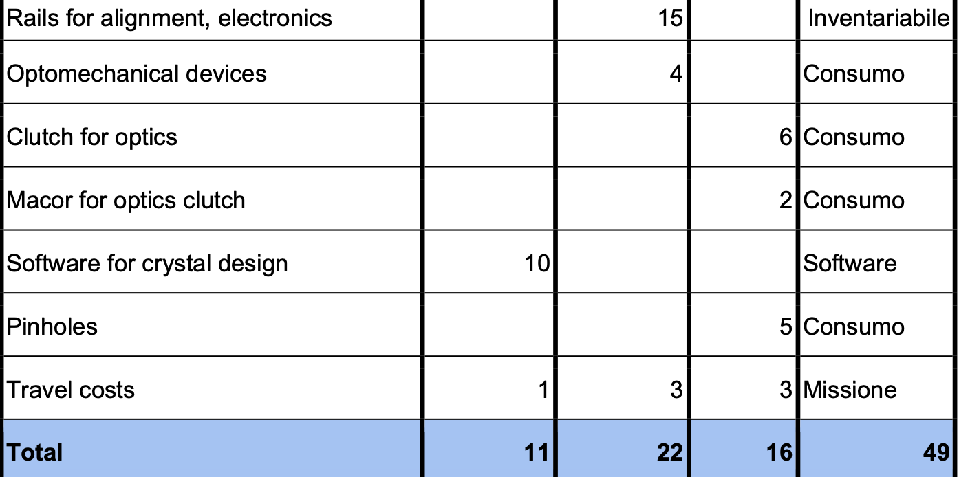
Impegno personale e preventivi spesa
Richiesta complessiva 972 KEuro
Personale LNF 2025-2027
Unità | 2025 | 2026 | 2027
Ferrara | 378 | 112 | 90
LNL | 83 | 51.5 | 65.5
TS | 48 | 51 | 44
LNF | 11 | 22 | 16
Richiesta LNF per 2025
Preventivi progetto

Slide 15

QUART&T: QUantum Architectures for Theory & Technology
The QUantum Architectures for Theory & Technology (QUART&T) project aims to develop demonstrator quantum architectures, establishing the foundation for experimental platforms where theoretical models and phenomena of interest to the INFN can be tested.
A quartet of crucial optimizations:
All-to-all connectivity;
Tunable couplings;
Higher-dimensional systems (Qudits);
Circuit Quantum Electrodynamics
The project goal and the crucial optimizations will be reached through:
Design and simulation of a superconducting quantum systems;
Fabrication of the designed quantum systems;
Control and readout of the quantum systems with quantum limited electronics and FPGA-based boards;
Simulations experiment with the developed quantum systems

Slide 16
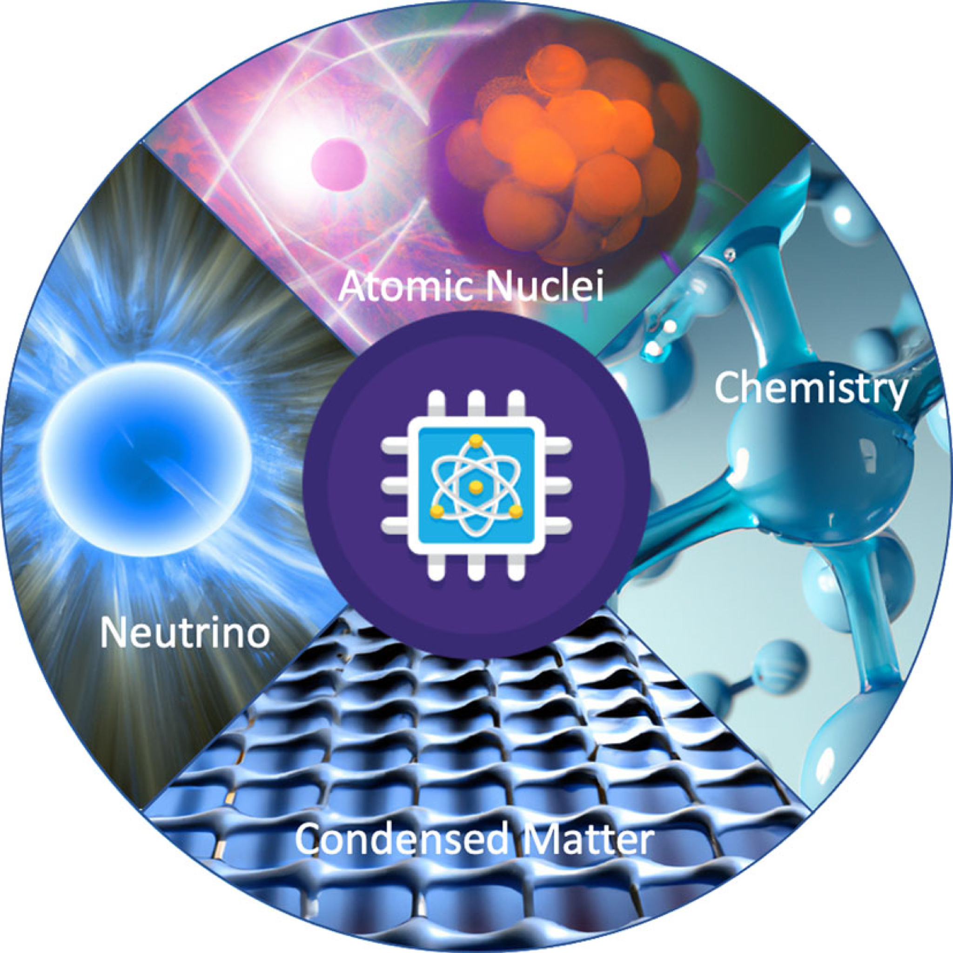
QUART&T: Motivation
Quantum many-body systems are one of the most daunting computational challenge in theoretical physics;
This class of problems is characterized by a Hilbert space size that increases steeply when the number of one-body (particle) increases;
Many-body systems are relevant in nuclear physics, atomic physics, astrophysics, low dimensional gravity, condensed-matter physics, and quantum chemistry;
This large size leads to severe restrictions in the class of many-body systems that one can solve exactly on classical computers;
Quantum computers contain an exponential complexity:
➡ suitable for tackling many-body;
➡ second quantization share many formal aspects with qubits;
Eur. Phys. J. A 59, 227 (2023)

Slide 17
QUART&T: why analog
Natural Representation of Quantum Systems
Analog quantum computers can directly represent and manipulate many-body quantum states. This direct representation allows for a more intuitive and efficient mapping of the physical system onto the quantum hardware;
Continuous Variables and Hamiltonian Dynamics
Many-body systems are described by complex Hamiltonians, which govern the dynamics of these systems. Analog quantum computers can simulate these Hamiltonians directly by evolving the quantum states according to the continuous variables, closely mimicking the natural evolution of the physical system;
Efficiency in Handling Interactions
Many-body systems involve a large number of interactions between particles. Analog quantum computers can efficiently handle these interactions due to their ability to represent and evolve the entire system collectively. This is often more challenging for digital quantum computers, which need to discretize the interactions into sequences of quantum gates;
Less Overhead from Error Correction
While digital quantum computing relies heavily on quantum error correction to maintain coherence and fidelity, analog quantum computing can sometimes be more robust against certain types of noise and errors. This is particularly advantageous for many-body simulations, where the complexity of the system can make error correction highly resource-intensive;

Slide 18
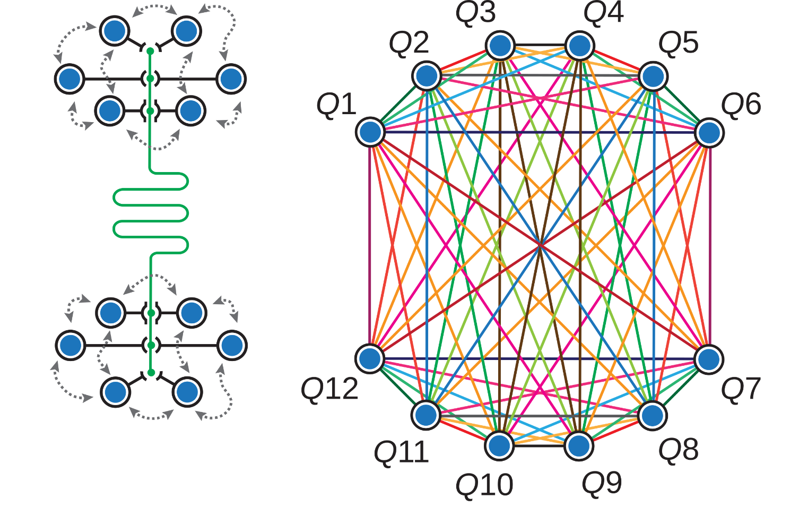
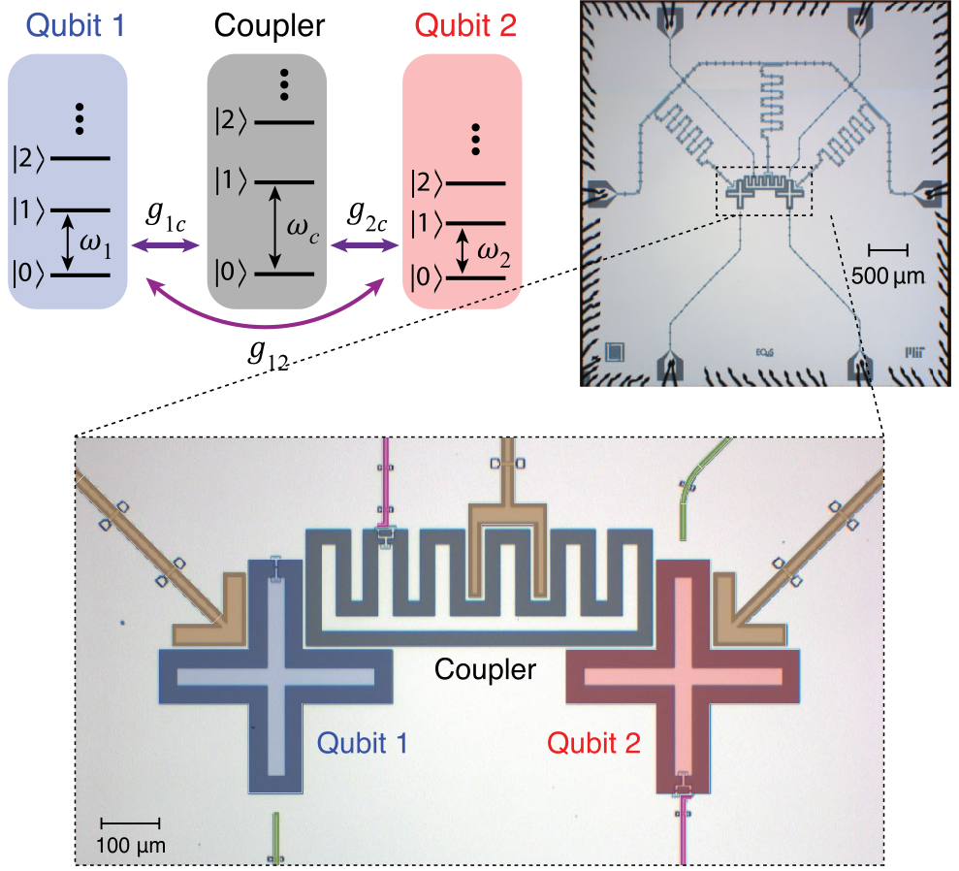
QUART&T: all-to-all connectivity
Single qubits can be coupled together using an intermediate electrical coupling circuit (coupler).
All-to-all connectivity between qubits allows two-qubit gates to be executed between any qubit pair. It enables the simulation of complex many-body interaction patterns without the need for complex routing or intermediate qubits.
Implementation is possible with both 2D and 3D qubit architectures.
QUART&T: tunable couplings
Tunable couplers use an external control parameter to tune the interaction strength between qubits;
In superconducting circuits an external control parameters can be implemented through SQUID or qubit;
Tunable couplers dynamically control the qubit-qubit interaction without the need for physical changes to the system;
In many-body physics, the interactions between particles are key to understanding the collective behavior of the system. Tunable couplings allow for the exploration of various interaction regimes, from weak to strong coupling;

Slide 19
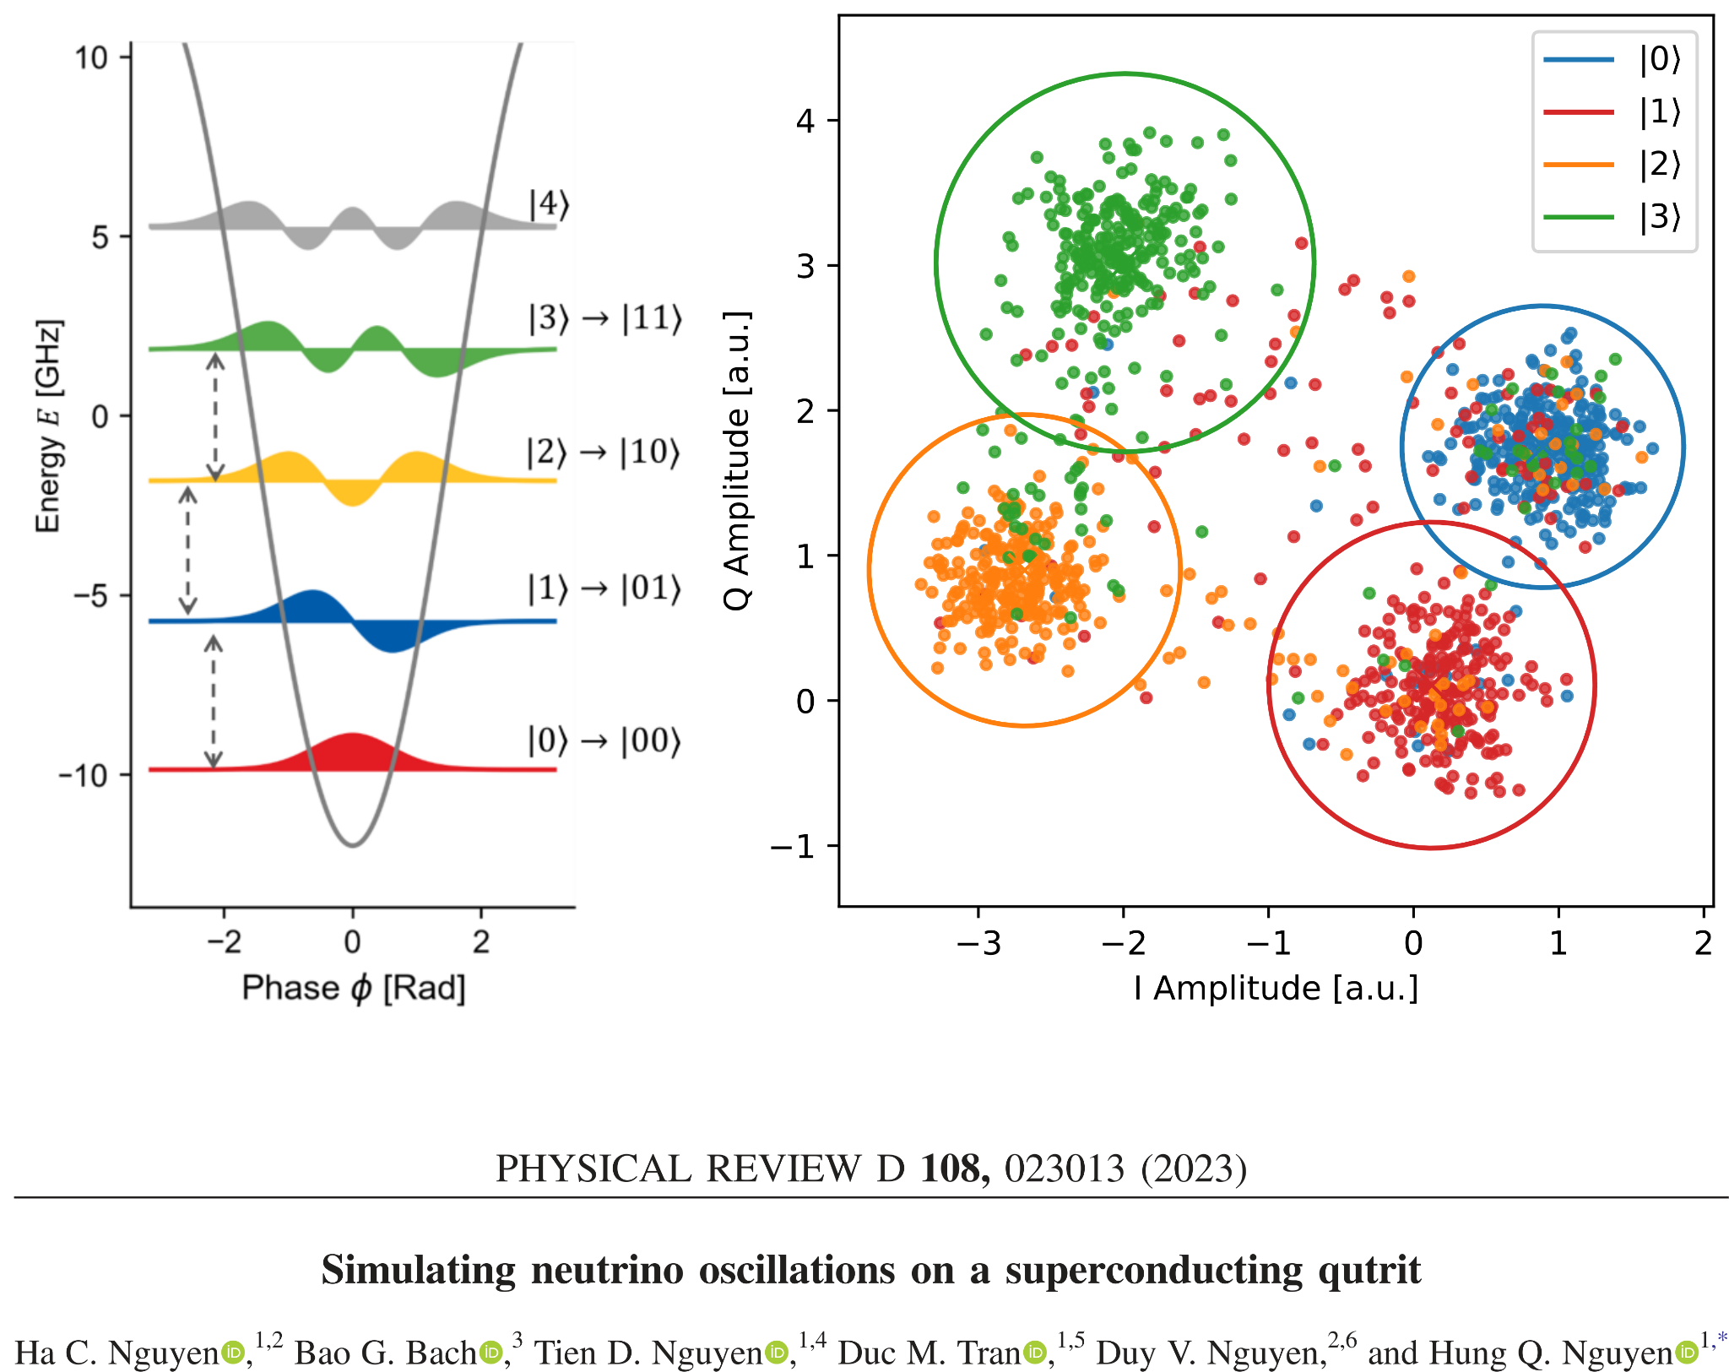
QUART&T: Higher-dimensional systems
A qudit with d levels provides a larger Hilbert space compared to a qubit ➡ fewer qudits can represent the same amount of information as a larger number of qubits
Provide reduction of the circuit complexity,
simplification of the experimental setup;
The accuracy and efficiency of simple quantum circuits and algorithms can be enhanced by qudit-based architecture;
Possibility of driving higher-order transitions in a
transmon or fluxonium qubit;
More natural mapping of complex systems, qudits can significantly enhance the efficiency and accuracy of many-body simulations.
d = 2 qubit
d = 3 qutrit
d = 4 ququart

Slide 20
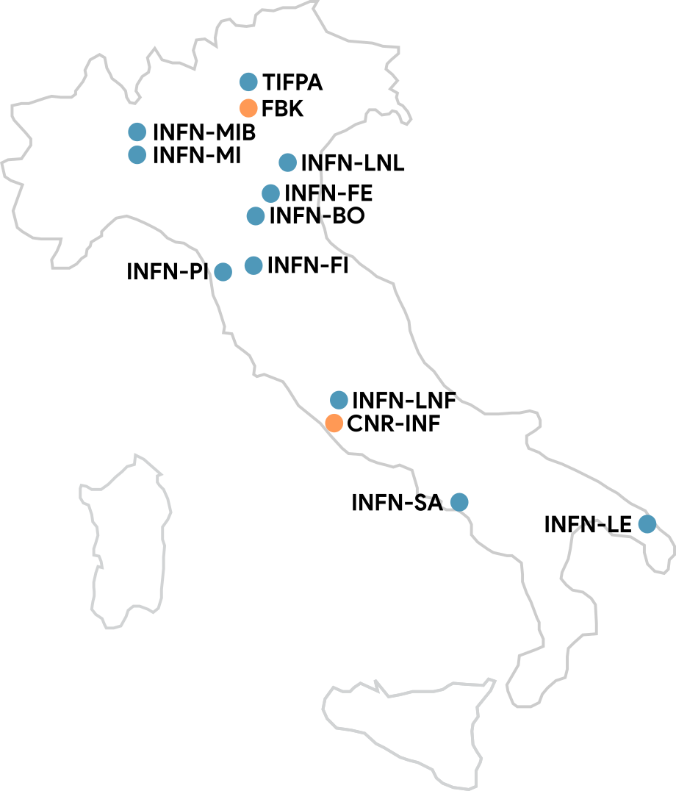
QUART&T: Involved Groups and WPs
WP1: Theoretical Background
INFN-BO, INFN-FI, INFN-Pi, INFN-FE, INFN-TIFPA
WP2: Design and simulations of planar devices
INFN-FI, INFN-BO, INFN-MIB, INFN-TIFPA
WP3: Design and simulations of 3D devices
INFN-LNF WP leader (A D’Elia), INFN-LE, INFN-LNL
WP4: Qubit Fabrication
INFN-LNF, INFN-LNL, INFN-TIFPA, FBK, and CNR-IFN
WP5: Software and readout development
INFN-BO, INFN-FE, INFN-MI, INFN-MIB, INFN-LNF
WP6: Quantum limited amplification
INFN-MIB, INFN-LNF, INFN-SA, INFN-TIFPA, FBK
WP7: Packing optimization
INFN-LNF WP leader (A Rettaroli), INFN-TIFPA, INFN-PI
WP8: Characterization, Measurement
and Simulation demonstration
INFN-LNF, INFN-BO,INFN-LE, INFN-MIB, INFN-PI, INFN-TIFPA
WP9: Application for quantum sensing and ML
INFN-LNF, INFN-LE, INFN-MIB, INFN-MI, INFN-PI
WP10: Management and Communication
INFN-MIB and all the other involved units
8 INFN Units
INFN Bologna
INFN Ferrara
INFN Firenze
INFN Lecce
INFN Milano
INFN Milano Bicocca
INFN Gruppo Collegato di Salerno (INFN Napoli)
2 INFN National Laboratories
INFN Laboratori Lazionali di Frascati (LNF)
INFN Laboratori Lazionali di Legnaro (LNL)
1 INFN Research Center
Trento Institute for Fundamental Physics and Applications (TIFPA).
2 External Research Centers
Fondazione Bruno Kessler (FBK, Trento)
Istituto di Fotonica e Nanotecnologie (CNR-IFN, Roma)

Slide 21
QUART&T: Attività
Richieste LNF:
20k€ fabbricazione dispositivi
5 k€ consumi
11 k€ apparati
5 k€ missioni
Attività 2025:
- Sviluppo Qubit 3D
- Test e ottimizzazione photon counter a 2 Qubits
- Test Quantum Amplifiers
Milestones 2025:
M12: Test risonatore e Qubit
M12: Design e simulazione di Qubit 3D
FTE LNF
C Gatti | 0 (+40% PNRR+5% QUANTERA)
C Ligi (RL) | 20%
A D’Elia | 100%
M Beretta | 0 (+25% PNRR-ICSC)
L Piersanti | 5% (+20% PNRR-NQSTI)
S Tocci | 0 (+100% PNRR-NQSTI)
F Chiarello (CNR) | 30%
F Mattioli (CNR) | 20%
G Torrioli (CNR) | 20%
B Buonomo | 20%
L Foggetta | 20%
TOT LNF | 4.25 FTE

Slide 22

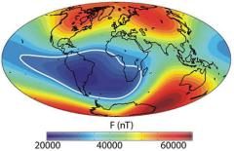
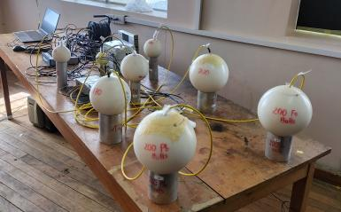
SELENE 2024-2026
Space weather Effect at different altitude LEvels measured by a NEutron and muon detectors network
RN: D. Grandi (MiB)
50+ participants from 7 Labs/sections
MiB, Cagliari, Trento, Torino, Trieste, Frascati, Napoli
SELENE will take advantage of the maximum of the 25th solar cycle (period 11 years) to study the effects of solar phenomena like solar flares and Coronal Mass Ejections on the cosmic ray flux at the ground level
Anagrafica LNF 2025 tot = 1,00 FTE
ROBERTO BEDOGNI (RL, ric.) 0,20
CLAUDIO CANTONE (tecn) 0,20
ANTONINO PIETROPAOLO (assoc. Ric.) 0,10
ABNER IVAN CASTRO CAMPOY (adr) 0,10
MIGUEL ANGEL CABALLERO PACHECO (adr) 0,40
Bonner spheres by LNF operating in Chacaltaya (5300 m )

Slide 23
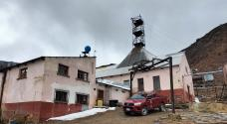
SELENE 2024-2026
Space weather Effect at different altitude LEvels measured by a NEutron and muon detectors network
Methods
Low-cost portable muons and neutron detectors, all interconnected via ethernet
Newly developed, portable equipment, will be:
  validated by working alongside with the internationally recognized permanent neutron stations that belong to the network www.nmdb.eu
  Deployed in field to quickly cover a larger range of latitudes (geomagnetic cut-offs) and elevations during solar events of especial interest during the 25th solar maximum
SELENE will benefit from the experience and the neutron monitoring network of former SAMADHA
SAMADHA established the worldwide highest neutron monitoring station – see doi.org/10.22323/1.444.1254
Chacaltaya:
  is the only station with real time neutron spectrometer (Bonner spheres by LNF)
  Covers the South Atlantic anomaly region
SAMADHA waits for the solar maximum and aims at establishing Chacaltaya as a permanent station
LNF task
Maintenance of the Bonner spheres in Chacaltaya
Producing spectrometric data
LNF requests for 2025
To CSN5: 5 k€ (missioni Bolivia) + 5 k€ (spares and replacement pieces)
To LNF services: none
Chacaltaya lab

Slide 24

SuperMAD
(Superconducting Materials for Axions Detectors)
SuperMAD aims at developing and studying superconducting materials with different characteristics and different TRL (Technology Readiness Level) with the final scope of improving the actual state of the art in SC Haloscope production for Dark Matter Detectors
SuperMAD Scope: Report for a possible upgrade of a large Cu cavity (100MHz) (Flash Like CSN2) to SC haloscope.
SuperMAD collects the legacy of SAMARA WP2 (WP1 was dedicated to accelerator Cavity)
Collaboration
Activities (3WP)
SRF Materials (LNL + ENEA)
Impedance Measures (RM3 + TO)
SC Resonators (LNF + ENEA)
Unit | FTE | Resp.
LNL | 4.05 | C. Pira (RN)
LNF | 0.5 (+0.4 ENEA) | G. Maccarrone
RM3 | 2.5 (+0.5 ENEA) | N. Pompeo
TO | 4 | G. Ghigo

Slide 25
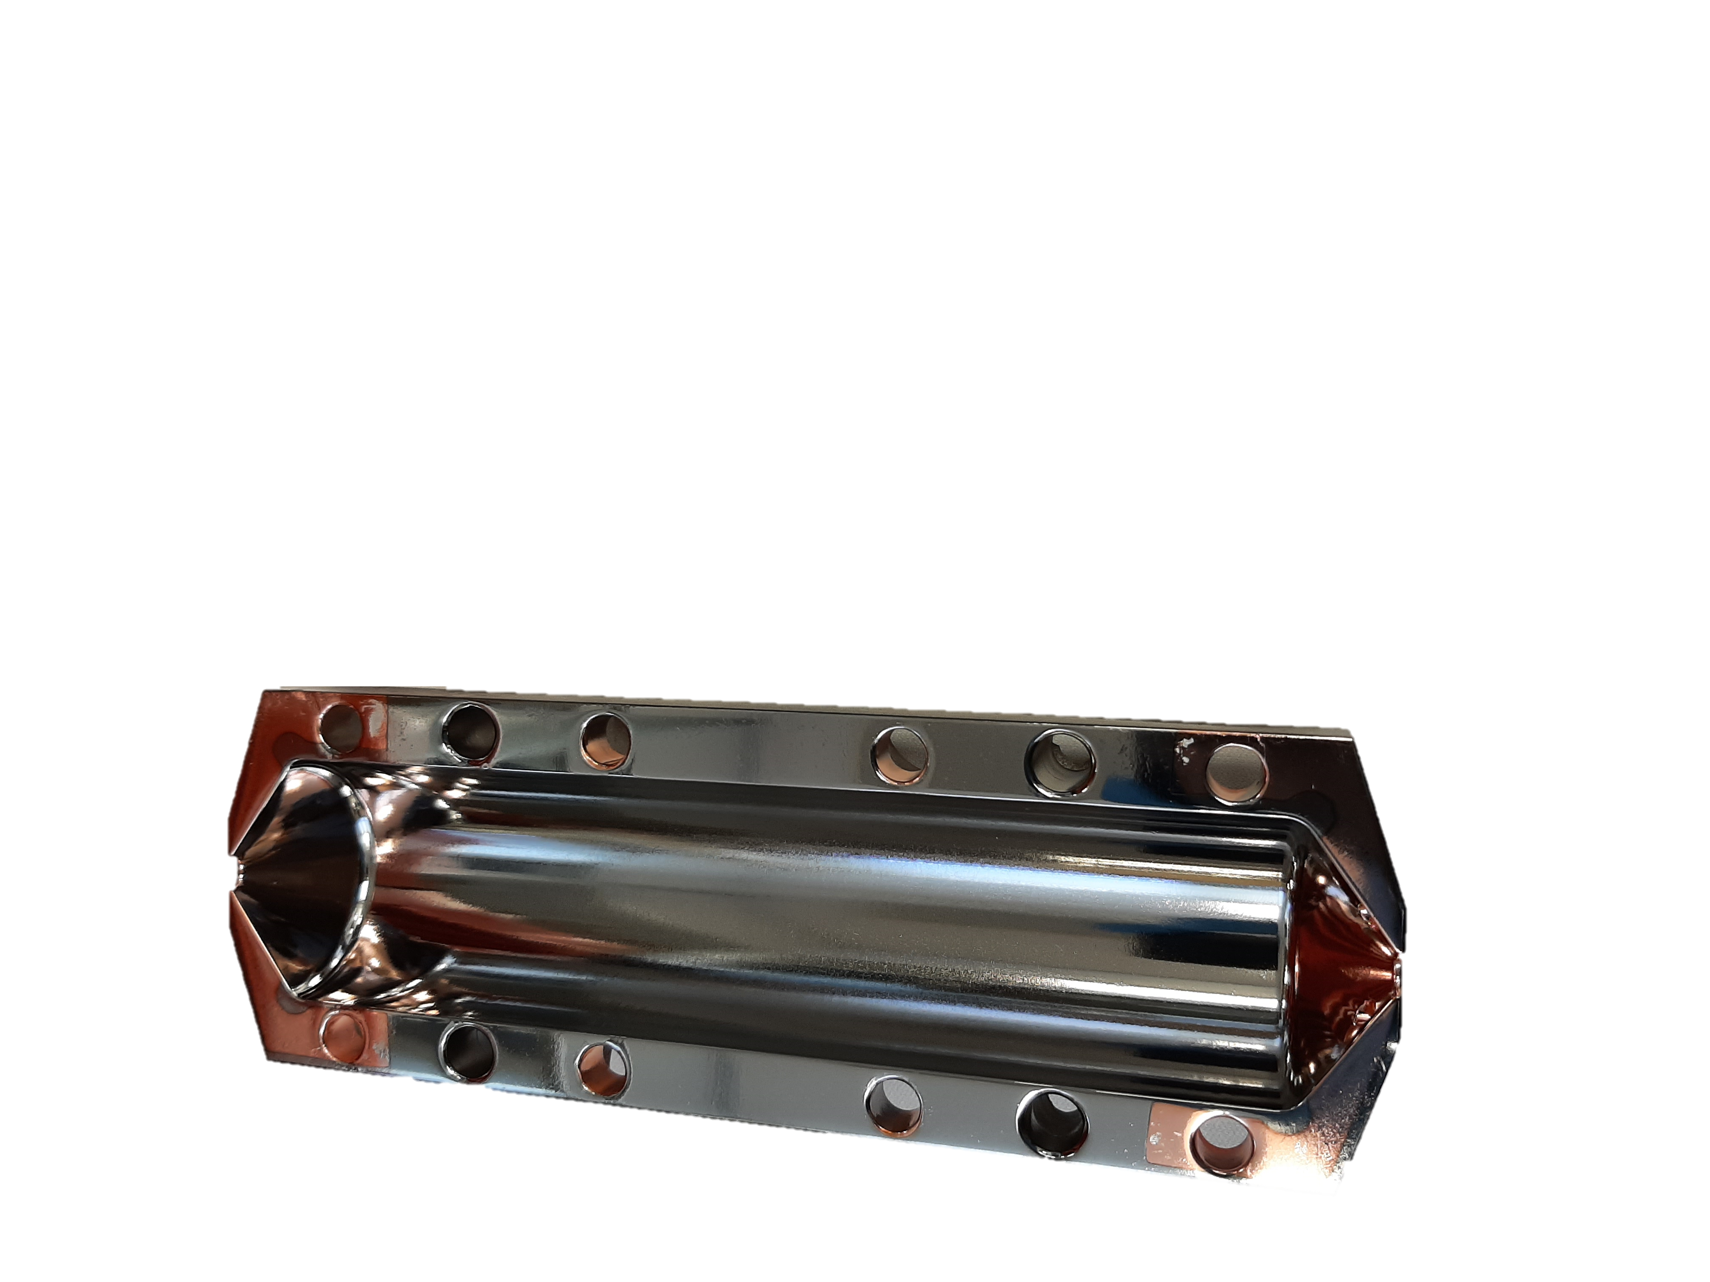
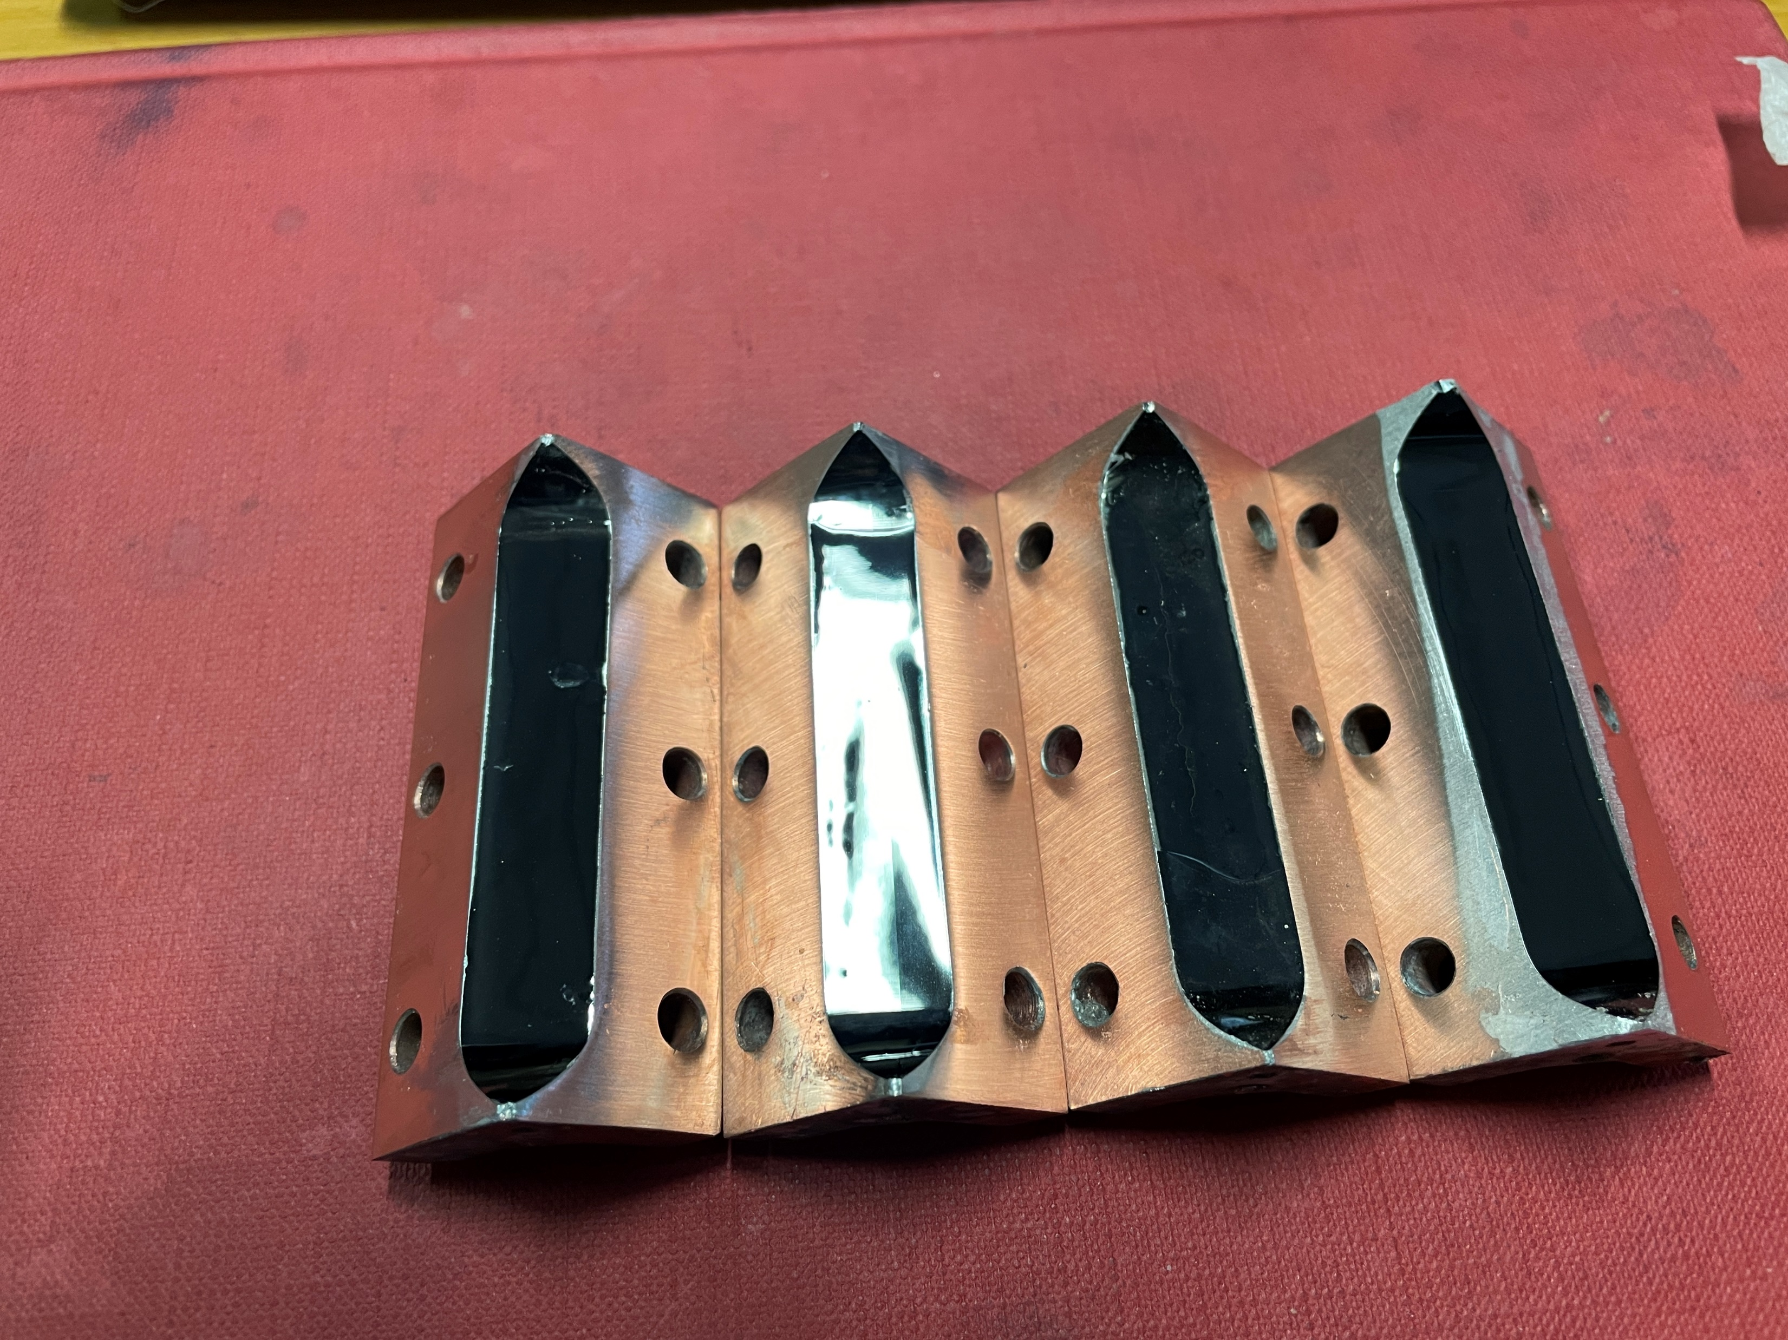

Axions Detection
Magnetic Field (B)
The axion haloscope was designed to scope microwave photon signals from the axions in our galactic halo
The signal power can be enhanced by the resonance effect that occurs when the axion mass matches the natural frequency of the detection system
Signal ≅ Q * B²
Photon (γ)
Virtual Photon (γ)
Axion (a)
Cu – ReBCO
Q factor for Cu cavity is limited by anomalous skin effect
New in SuperMAD:
REBCO Tapes (HTC Commercial)
High Performances at High B field
Direct Deposition not possible
Solder/Glue is challenging
Iron Based Fe(Se,Te)
High Performances at High B field
Direct Deposition Possible (Electrodeposited)
Low TRL (Technology Readiness Level)
To improve Q
Use of SRF in High Magnetic Field
SAMARA results on Nb-Ti
(10 GHz –QUAX)
Q₀ _{NbTi} > 20 * Q_{0 Cu} @ 15 mK, 2T
Q₀ _{NbTi} > 10 * Q_{0 Cu} @ 4K, 5T
Q₀ _{NbTi} > Q_{0 Cu} up to 9 T @ 4K
Measured at
LNF - ColdLab

Slide 26
SuperMAD @ LNF
Design, simulation, construction and test of Cavities
Material analysis with multiharmonic AC susceptibility
LNF participants:
G. Maccarrone (RL) 0.2
D. Di Gioacchino (Ass. Sen) 0.3
ENEA-Frascati (to be ass.). 0.2+0.2
New in SuperMAD:
10 slice Cu reference Cavity at 8.5 GHz (Sinergy with QUAX)
Single Slice with different superconducting materials to be mount on the reference Cavity and tested versus T and B
Test of superconducting materials using magnetic gradiometer to identify different transition phases versus T and B
LNF Requests for 2025 KEu:
Missioni Italia 1
ReBCO Tapes 6
OHFC Cu 1
Liquid He 9
Drawing and preliminary simulation of 10 slices RF Cu reference cavity using Ansys HFSS.
Requests for LNF-Labs 2025
Mechanical Workshop
10 Slices Cu cavity construction 1mu

Slide 27

2024 ongoing experiments
Dartwars, Qubit, resilience
SAMADHA,
h2btf, Micron, samara

Slide 28
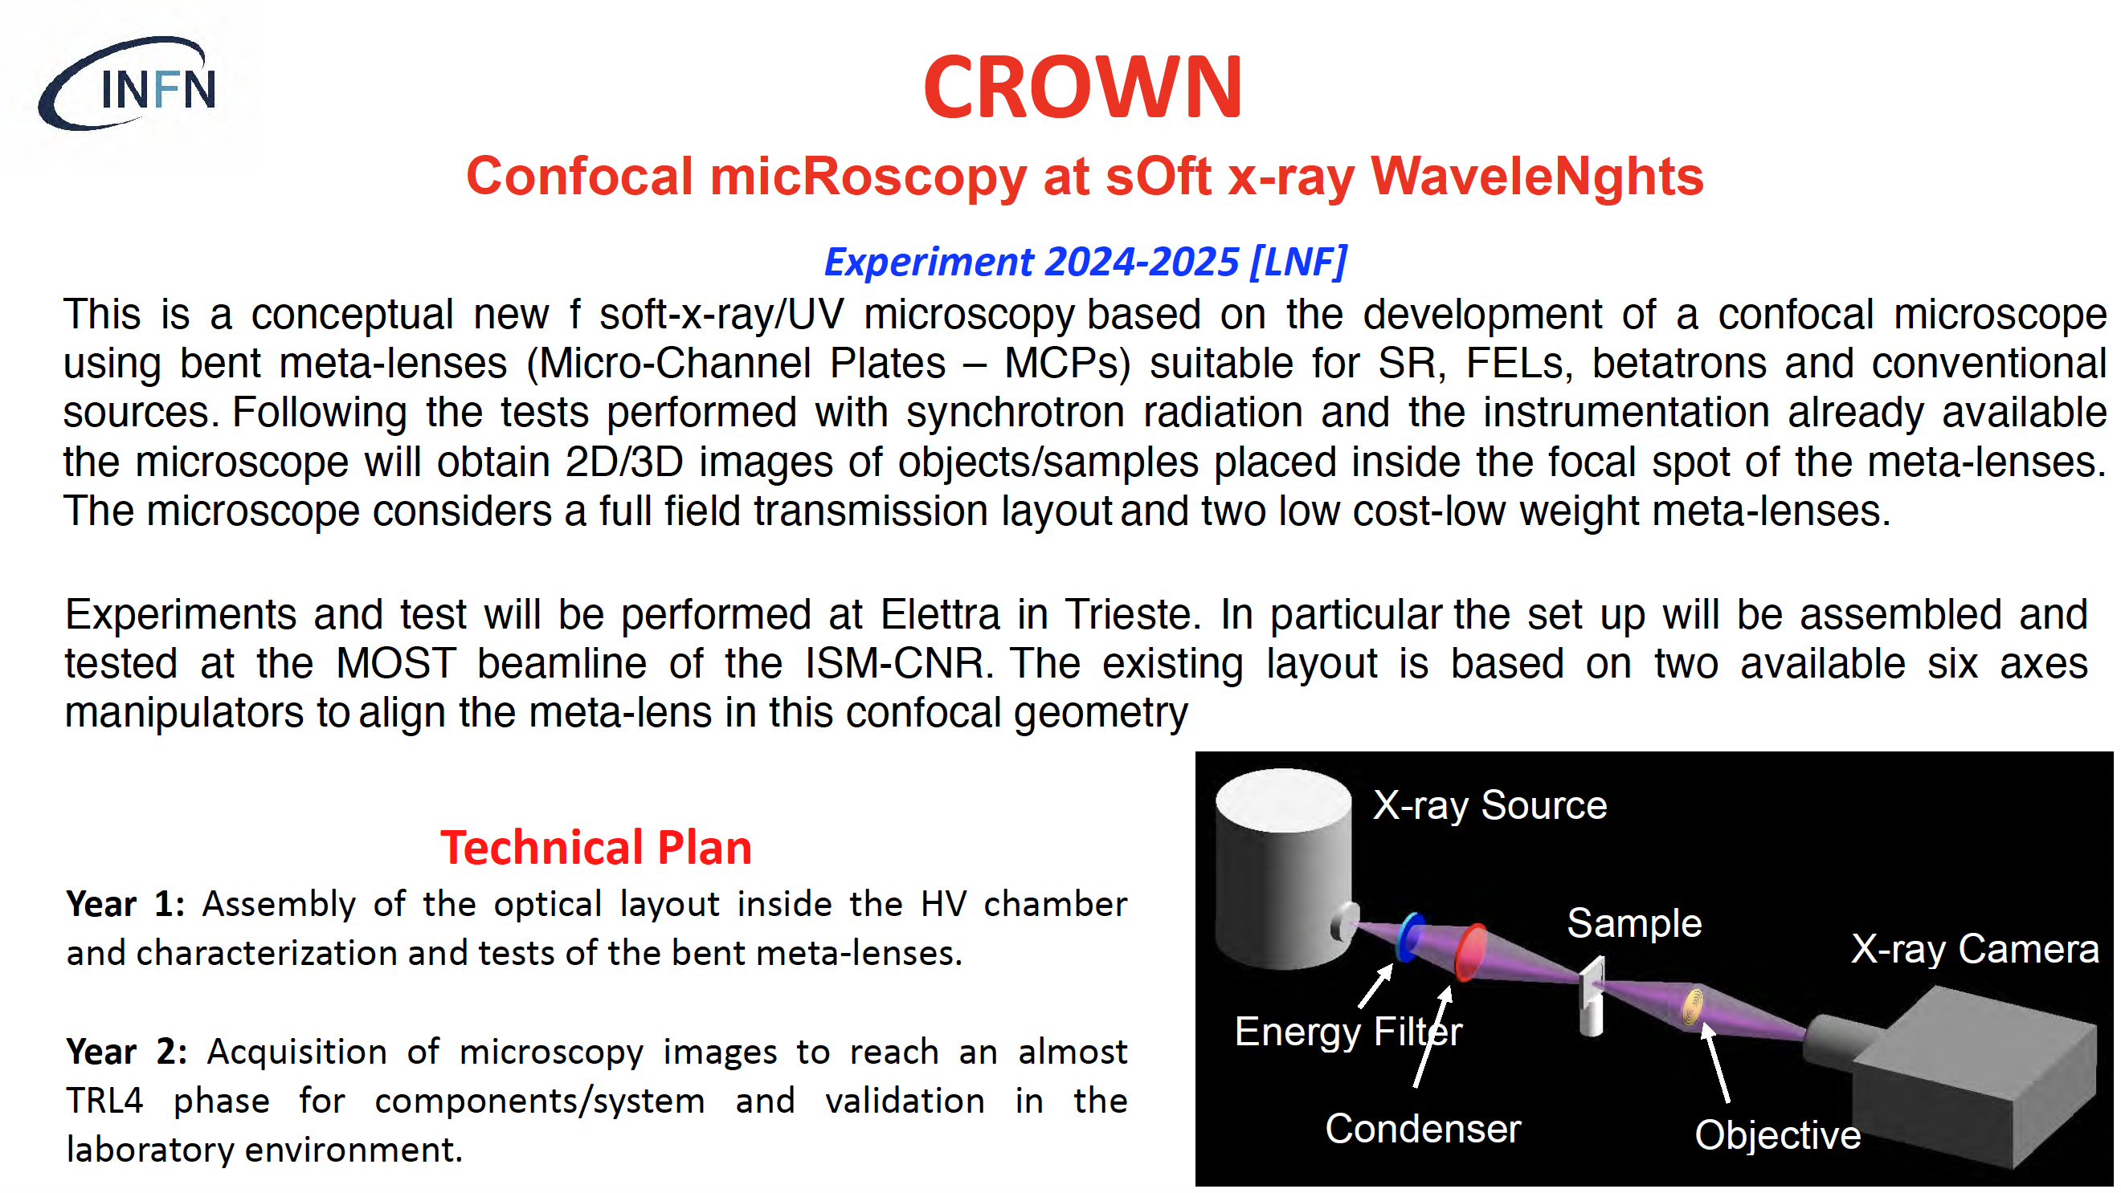

Slide 29
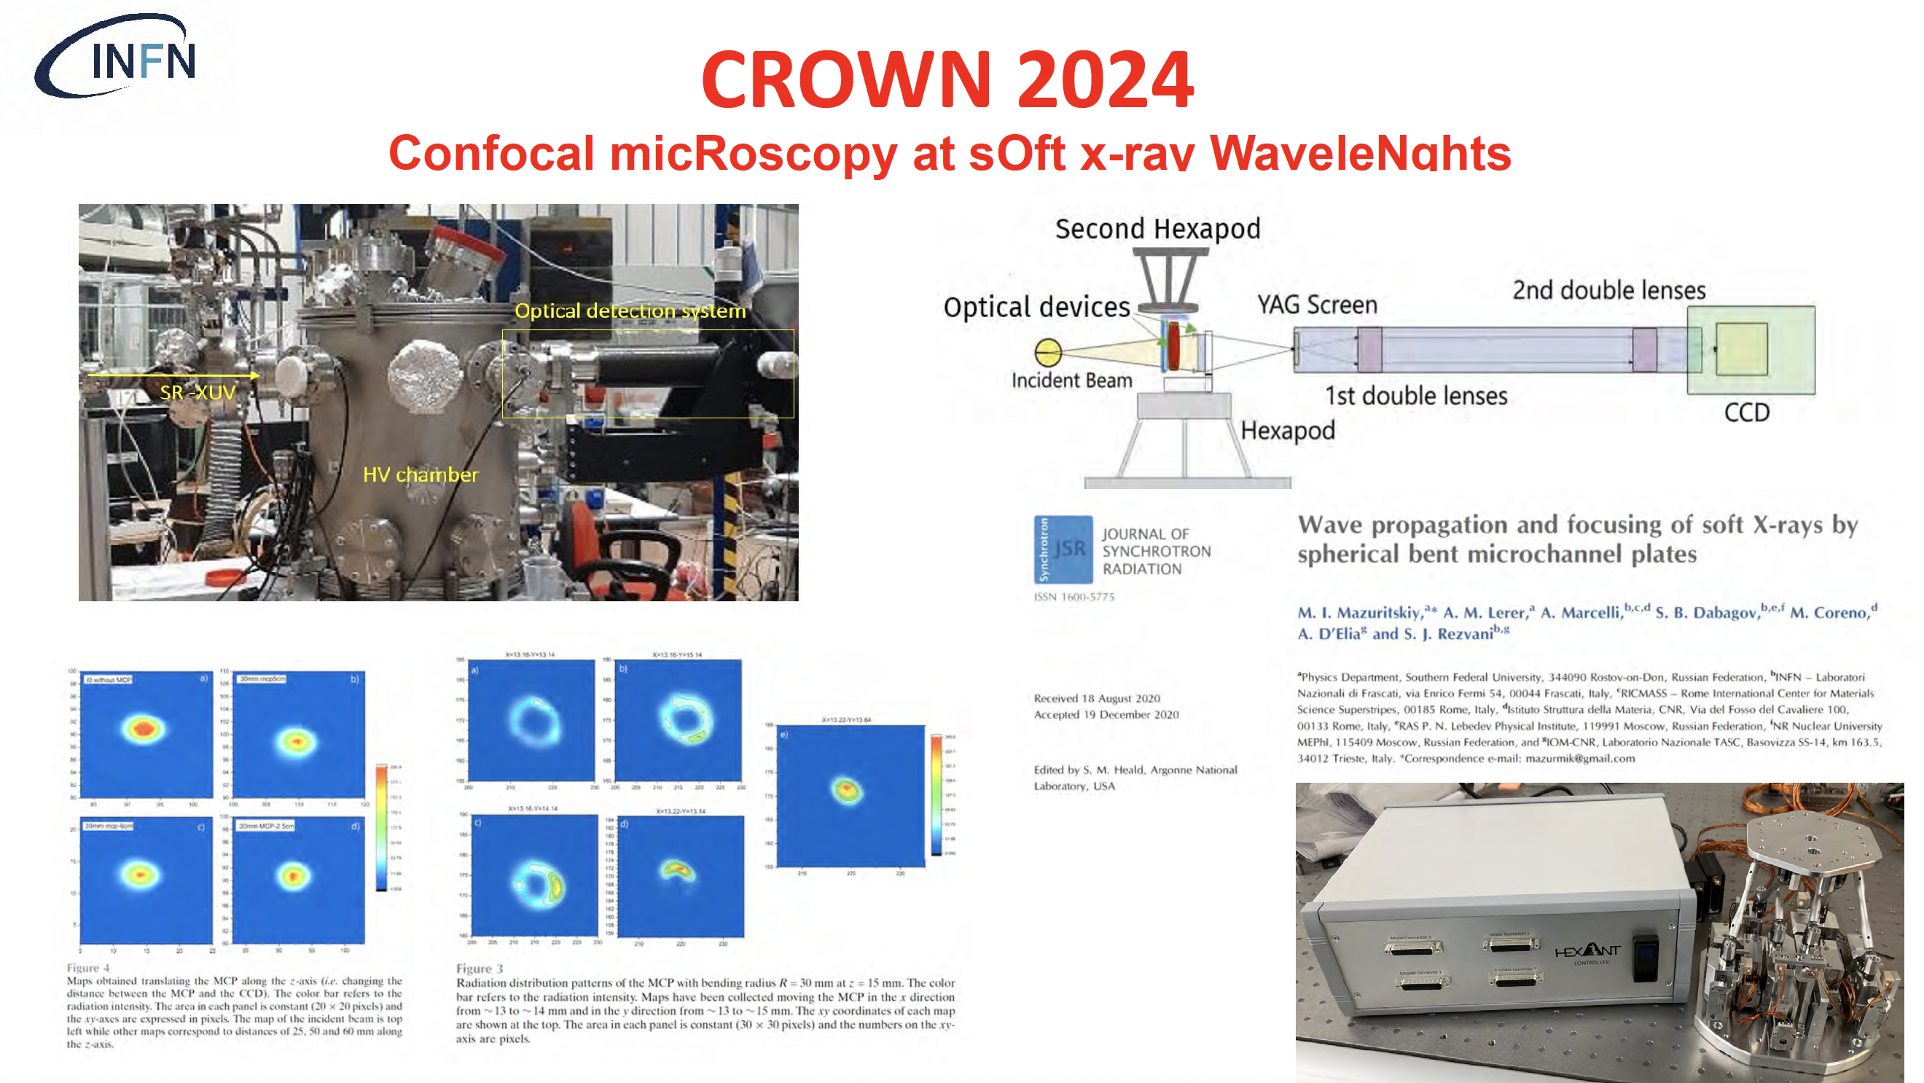

Slide 30
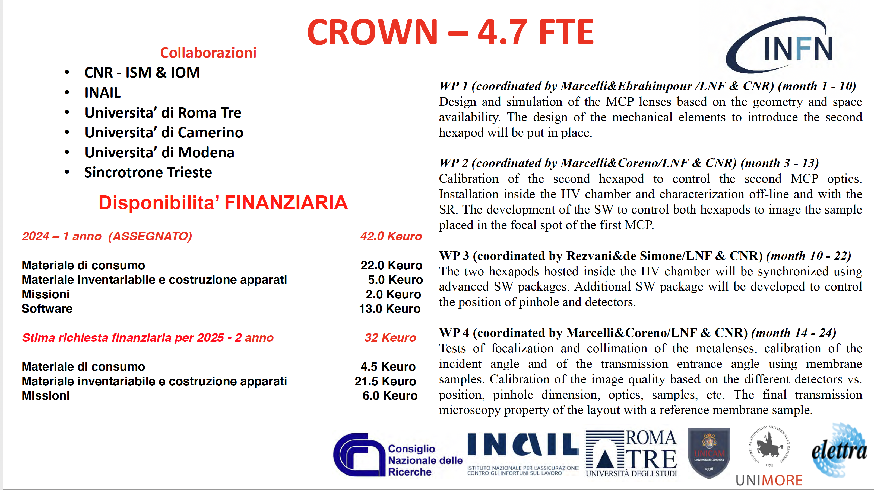

Slide 31
SL_BetaTest
Resp. Naz./Loc LNF: Enrica Chiadroni (Sapienza Univ., Ass. LNF);
Resp. Loc. RM1: Andrea Mostacci; Resp. Loc. RM2: Alessandro Cianchi;
Resp. Loc. Mi: Andrea Renato Rossi
4-years experiment: 2024-2027

Slide 32
Motivation
SL_BetaTest is a 4-years experiment to study betatron radiation emission from beam-driven PWFA at SPARC_LAB as a test-bed for a plasma undulator device
The EuPRAXIA@SPARC_LAB project focuses to realize a compact plasma-based user facility
Plasma acceleration module
Ancillary components
  Compact diagnostic station
  Active Plasma Lens based transfer line
Conventional undulators are still too long => not compact and expensive
betatron motion of electrons in an ion-channel to emulate an undulator
⇒ very compact device
Betatron motion consists in oscillations normal to the propagation direction
It is relevant only in a uniform focusing channel, like a plasma channel
Spin-off of SL_COMB2FEL

Slide 33
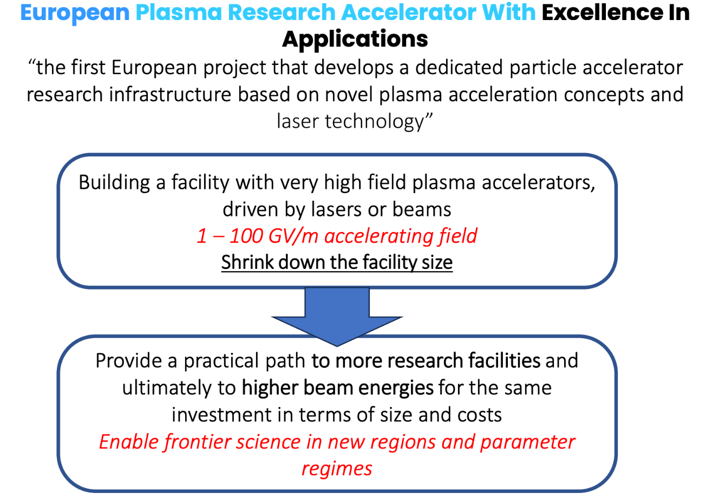
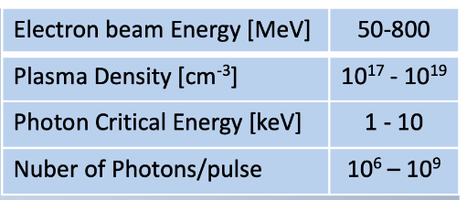
International and National Scenario
EuPRAXIA - PP ESFRI
EuPRAXIA Advanced Photon Source EuAPS - PNRR
Laser-driven betatron radiation source at SPARC_LAB
Collaboration among INFN, CNR, University of Tor Vergata
Operational user facility at SPARC_LAB by the end of 2025
EuPRAXIA precursor for a user-facility

Slide 34
Synergy with EuAPS
The SL_BetaTest experiment would take advantage of
the experience on numerical studies and simulations gained in the ongoing EuAPS project
the betatron radiation detection, which is common in the two experiment, despite of the different spectral range
However the SL_BetaTest project aims at the exploitation of betatron radiation to build a very compact undulator to be implemented in a plasma-based accelerator for FEL generation. Therefore R&D on the most suitable plasma-based source is needed to maximize the transverse wakefield (focalization), while canceling the longitudinal wakefield component (acceleration) => Ion column formation
This regime is not suitable for the EuAPS project, since the number of photons is quite low and EuAPS has been funded to be a betatron-based user facility

Slide 35
Activity in 2024
Beam dynamics simulations to study the interaction of both, a single and double bunch, with a preformed plasma to
  Set the electron beam parameters (charge, transverse size, emittance, energy, duration, …)
  Define the ion channel size
  Identify a working point to plan experimental tests
Preliminary studies of wakefields in the capillary used to
  Quantify their effects
  Guide the capillary geometry

Slide 36
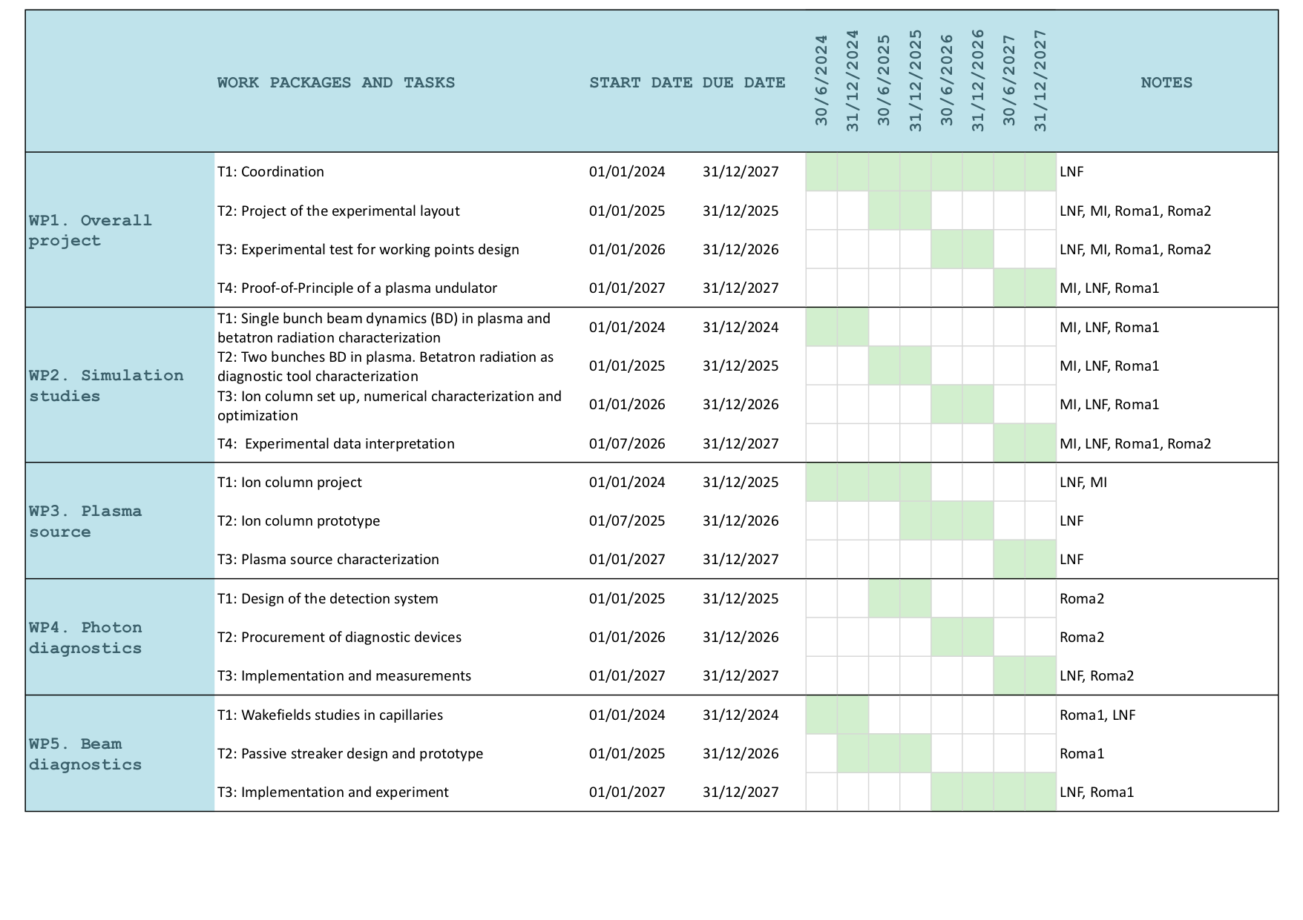
Gantt-chart and Milestones for 2024 and 2025
WP2.M12 Single bunch beam dynamics (BD) simulations in plasma
WP2.M12 Electron beam parameters table for the definition of betatron radiation properties
WP2.M12 Theoretical studies to drive the choice between laser and electron beam for the ion column formation
WP2.M24 Two bunches BD in plasma. Betatron radiation as diagnostic tool characterization
WP3.M12 Test on different gases and capillaries
WP4.M24 Design of the detection system
WP5.M12 Numerical and theoretical study of wakefields in capillaries
WP5.M24 Passive streaker prototype

Slide 37
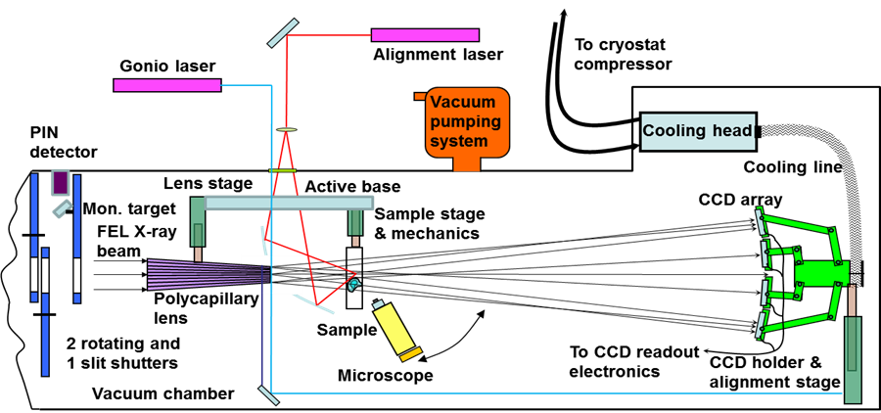
Structure Probing by Holographic Imaging at Nanometer scale with X-ray lasers (SPHINX)
SPHINX aims producing an X-ray phase-contrast holography system for femtosecond imaging microscopic samples and their internal parts with nanometer resolution, using a combination of polycapillary lenses, large X-Ray CCD arrays and XFEL sources. The proposed configuration allows beam splitting, focusing, magnification and refractive diffraction in the keV range.
  Applications in cellular biology, nanorobotics, 3D circuitry.
  Plan to liaise with Research Infrastructures (DIAMOND, European X-FEL, PSI)
SPHINX received an essential support from INFN and EU2020 ATTRACT (DEVELOPING BREAKTHROUGH TECHNOLOGIES FOR SCIENCE AND SOCIETY)
M. Iliescu INFN-CDL preventivi 2024

Slide 38
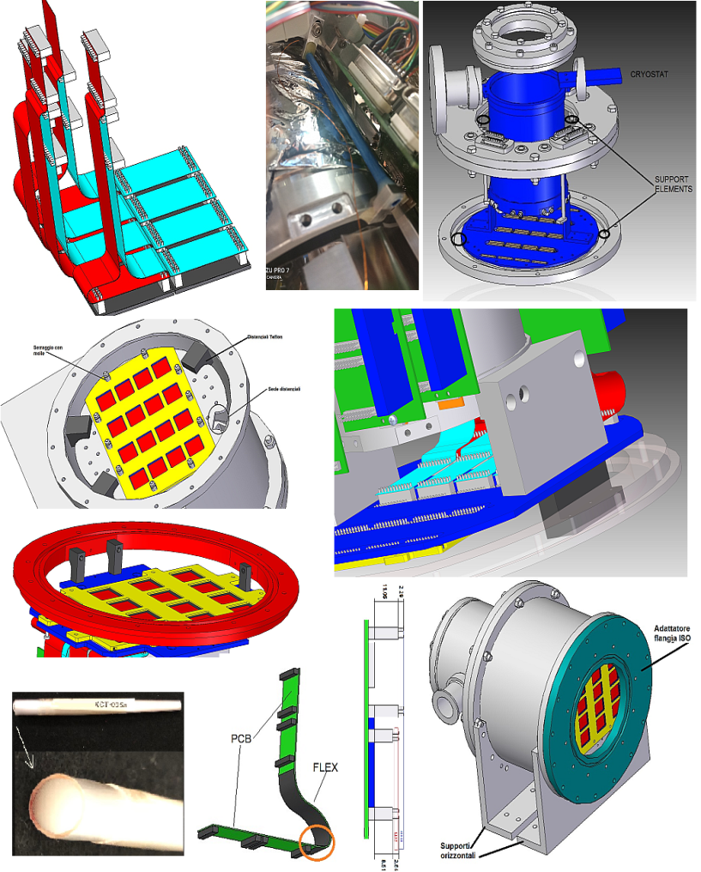
Structure Probing by Holographic Imaging at Nanometer scale with X-ray lasers (SPHINX)
  Current prototype status:
  1. Full design (mechanics, cryogenics and electronics)
  finalized; production completed, delivered.
  2.First X-ray polycapillary optics delivered by INFN XLab, synchrotron tests in preparation.
  3. DAQ and slow control software completed.
  4. MC code in advanced phase; reconstruction
  program work initiated
  5. Calibration systems under development
  -CCD pixel alignment
  -optics alignment
  -energy calibration
M. Iliescu INFN-CDL preventivi 2024

Slide 39
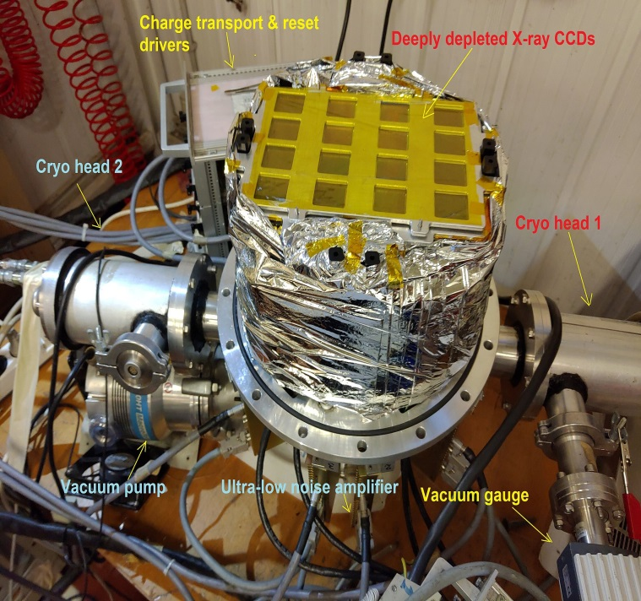
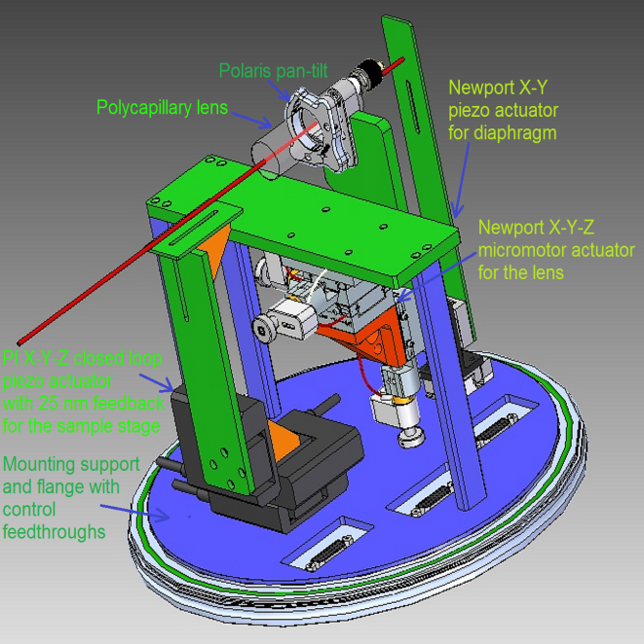
Structure Probing by Holographic Imaging at Nanometer scale with X-ray lasers (SPHINX)
  Curent prototype status:
  6. Full detector assembly completed.
  7. Vacuum and cryogenic testing completed.
  8. Optics bench design and construction completed, second vacuum chamber and feedtrough realized.
  The bench parameters are:
  -10 degrees of freedom (8 translations, 2 rotations)
  -50 nanometer average precision
  -25 nm precision with position feedback for the
  sample stage.
  9. Measurement plan with DIAMOND synchrotron ongoing
  10. Contact with European X-FEL established, more specific plans to follow the optics investigation.
M. Iliescu INFN-CDL preventivi 2024

Slide 40
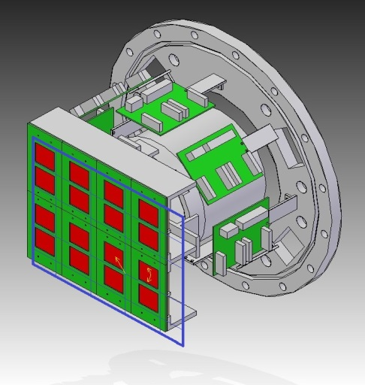
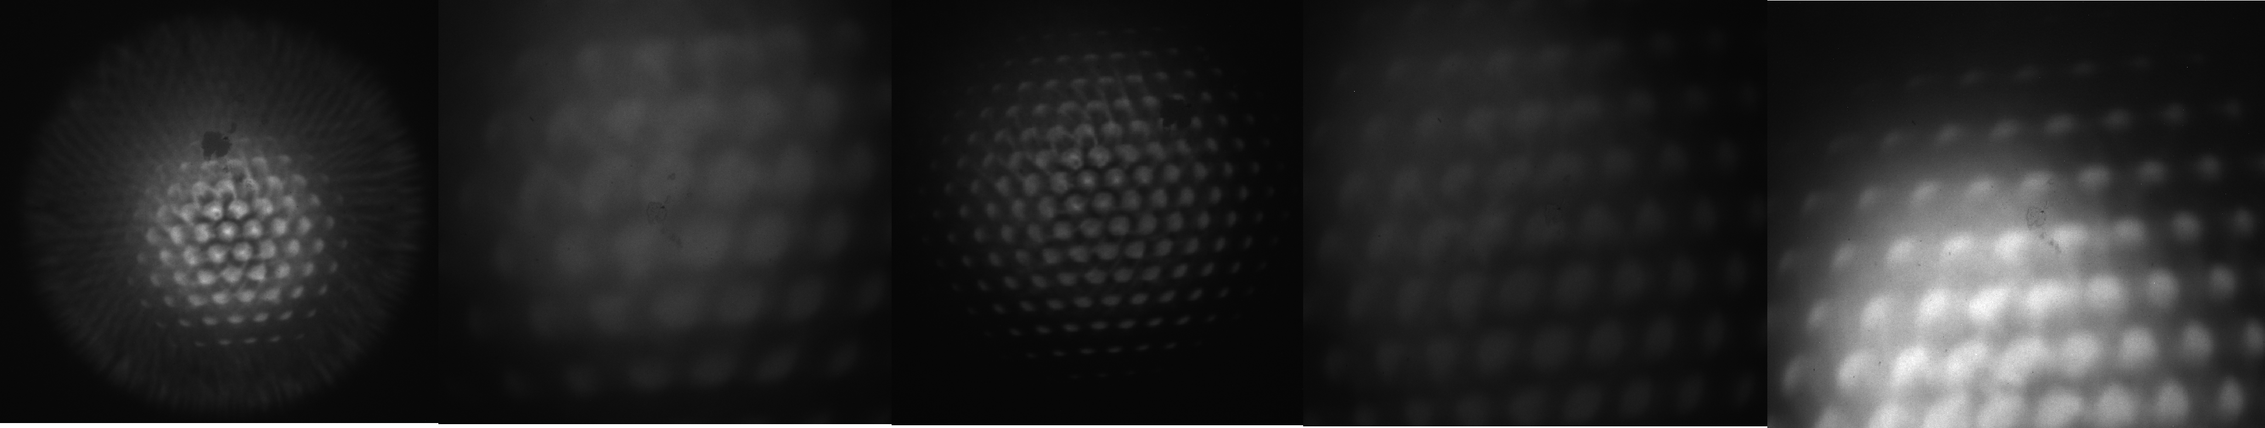
Structure Probing by Holographic Imaging at Nanometer scale with X-ray lasers (SPHINX)
Activities completed in the first months of 2024
-Pubblication of SPHINX project in NIM A https://doi.org/10.1016/j.nima.2024.169083
-Electronic design of the upgraded CCD charge transport drivers
(available ones from 2002, untraceable components )
-X-ray pixel alignment sistem design (~μm precision grid, actuators)
-Construction of benches for optics characterization at LNF:
1-Capillary divergence measurements at X-Lab using microfocus X-ray tube
Lens response at different exposures and distances using focal and off-focus X-ray spot.
M. Iliescu INFN-CDL preventivi 2024

Slide 41
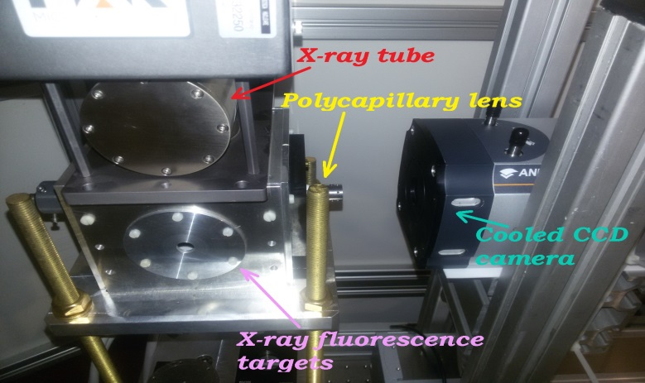
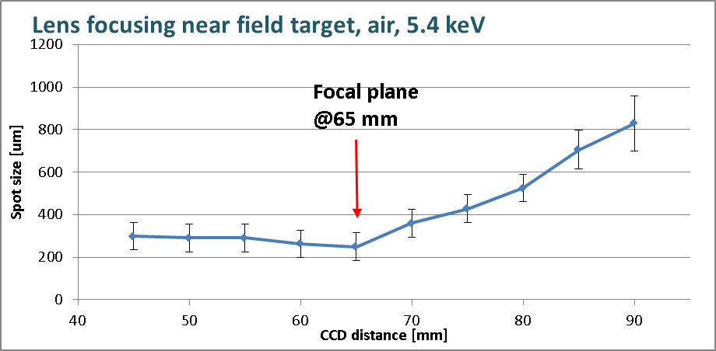
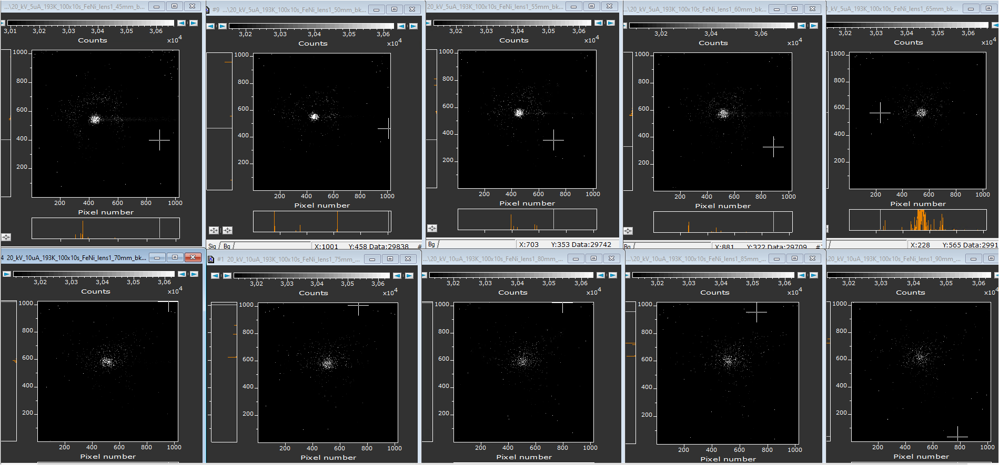
Structure Probing by Holographic Imaging at Nanometer scale with X-ray lasers (SPHINX)
Activities completed in the first months of 2024
2-Lens focusing measurements in SPHINX Lab using CCDs and X-ray fluorescence targets
-Work on the reconstruction software
M. Iliescu INFN-CDL preventivi 2024

Slide 42
Structure Probing by Holographic Imaging at Nanometer scale with X-ray lasers (SPHINX)
Activities to be done in 2024
Completion of the prototype setup:
-upgrading a fraction of the the CCD charge transport drivers (reduction agreement to
ensure operability, completion by extra requests or 2025)
-execution of the mechanical X-ray pixel alignment system
-optical bench calibration system (laser + commercial diffraction pattern generator)
-installation of vacuum setup adapters for the synchrotron line
Testing the basic functioning of the full apparatus at LNF
Completing the reconstruction software, together with a MC simulation code
Experimental proof of concept on the coherent synchrotron beamline using the SPHINX prototype, Phase 1:
-testing the polycapillary optics in beam and designing the interface with the beamline
-attempting installing the needed instrumentation and testing the full functionality
(S.J., depending on current progress)
-possible sample measurement campaign and holographic reconstruction with
moderate resolution (not yet included, to be requested only if completion of previous)
M. Iliescu INFN-CDL preventivi 2024

Slide 43
Structure Probing by Holographic Imaging at Nanometer scale with X-ray lasers (SPHINX)
Activities foreseen for 2025
-completing the upgrade of the CCD charge transport drivers
-upgrading the optical calibration system (reusing the laser, replacing the commercial DOE
with a professional one, custom design)
-upgrading the vacuum system (pumps from 2002), the X-ray optics and the sample
handling system
Experimental proof of concept on the coherent synchrotron beamline using the SPHINX prototype, Phase 2:
-installing the needed instrumentation (testing the full functionality, if not done in 2024)
-two sample measurement campaigns and holographic reconstruction with moderate
resolution (limited by the coherent beamline parameters and by the detector size)
-data analysis
-publication of the results
-beginning the design of the full X-FEL apparatus
-starting the collaboration with European X-FEL (preliminary contact established)
M. Iliescu INFN-CDL preventivi 2024

Slide 44
Structure Probing by Holographic Imaging at Nanometer scale with X-ray lasers (SPHINX)
Financial requests for INFN CSN5 2025:
-4.0k (costruzione apparati) completion of update of obsolete electronic drivers and cabling
-10.0k (costruzione apparati/inventario) improving setup functionality: optimized polycapillary lens, diffraction grids, vibration dumpers, microscopic sample handling system under vacuum (temperature controller, microscope, tweezers)
-5.0k (inventario) upgrade of the optics calibration commercial DOE with a professional one, custom design, reusing the laser from the first system
-7k (inventario) vacuum pumping system, to replace the obsolete one from 2002
-7k (missioni) two missions to synchrotron with full setup and team, installation, testing and
measurement campaign)
Total: 33 k
LNF Services 2024:
-0.5 MU SPCM for realizing and installing small mechanical items .
M. Iliescu INFN-CDL preventivi 2024

Slide 45

Thanks for you attention

Slide 46
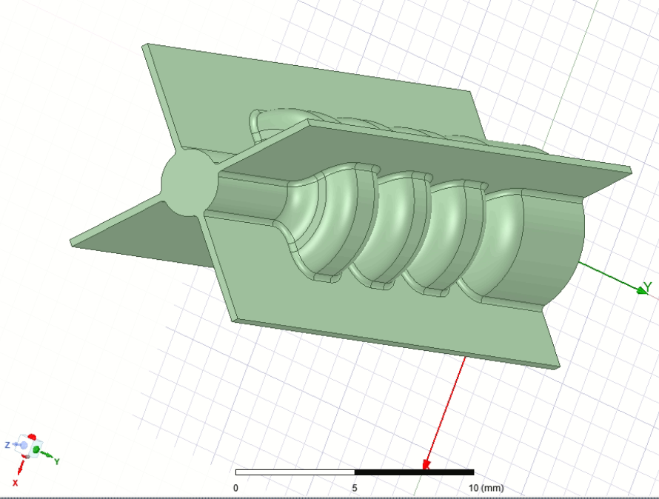
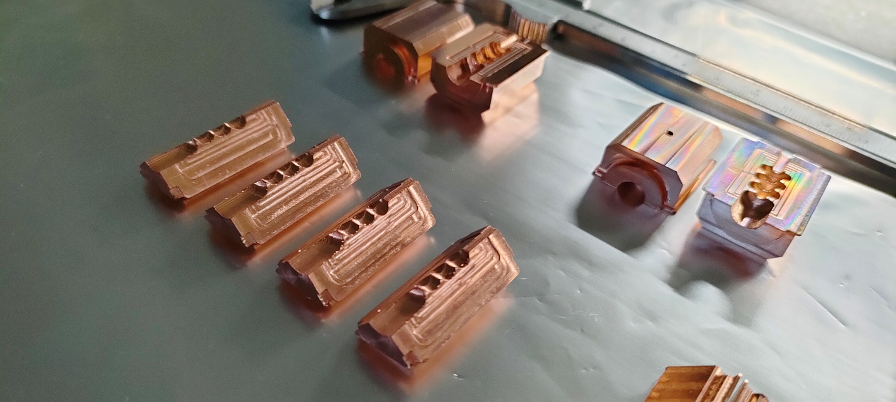
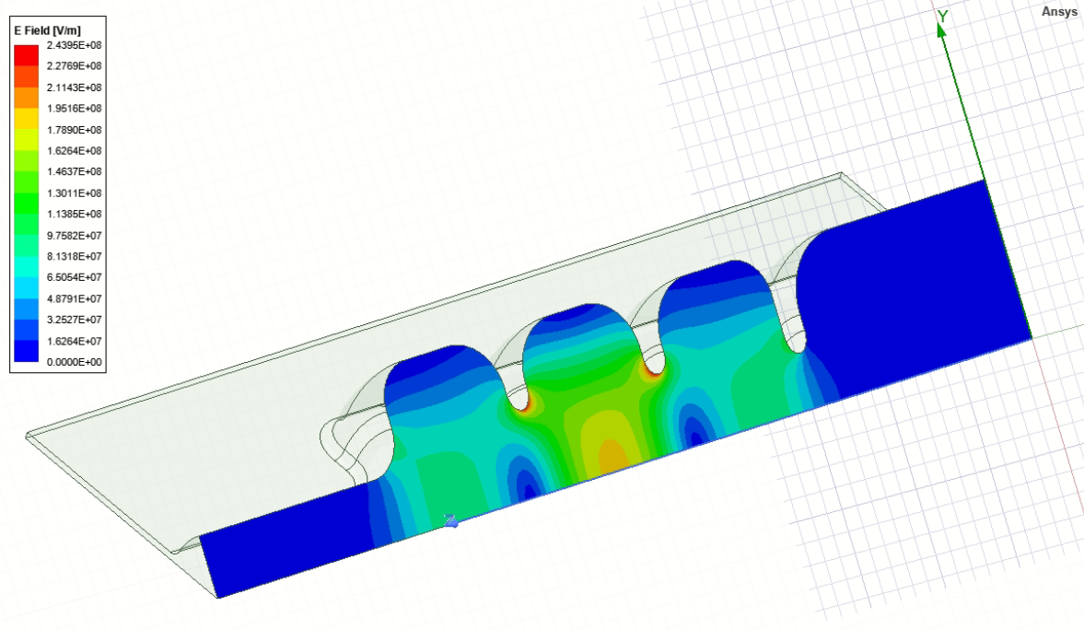
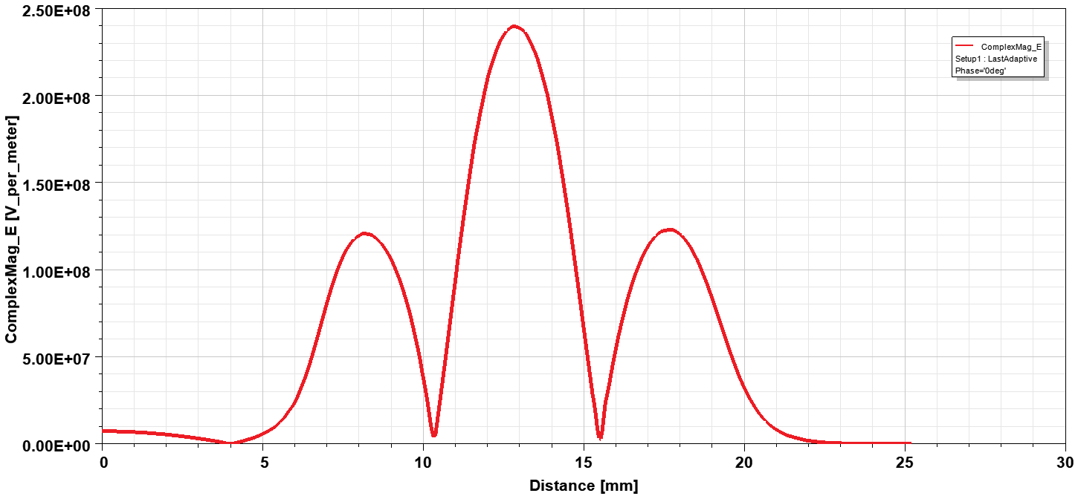
MICRON
Cavity Design, Prototyping and Fabrication – Multiple parts open structures
TIG welding on the outer slots → avoiding high temperature brazing and/or diffusion bonding processes (the typical assembly methods widely used to manufacture ultrahigh vacuum accelerating devices) which - occurring at about 800–1000 °C - significantly change the cavity mechanical properties.
Main RF Parameters
Parameter | Value
Resonant frequency, f [GHz] | 35.982
Quality factor Q | 6000
Shunt impedance [MΩ/m] | 160
Power loss [MW] | 0.75
a [mm] | 2
a/λ | 0.24
t [mm] | 0.635
Iris ellipticity | 1.38
Accelerating Gradient (MV/m) | 150 MV/m
Machined sectors for 2-halves and 4-quadrants Cavities
All cavity sectors were manufactured by using a CNC 5-axis milling machine.
Machining tool is crucial:
Tungsten-carbide tool → Tolerance = +- 10 µm; Roughness with Ra = 1.6 µm.
Diamond tool with spherical radius < 1 µm → Tolerance = +- 5 µm; Roughness with Ra < 80nm.
The electric field in the middle cell is two times higher in the middle cell in order to localize and analyze the RF breakdown events.

Slide 47
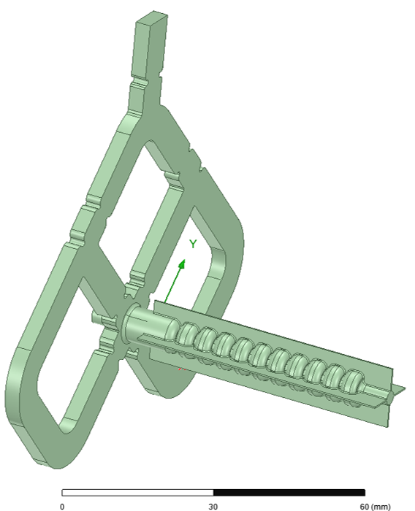
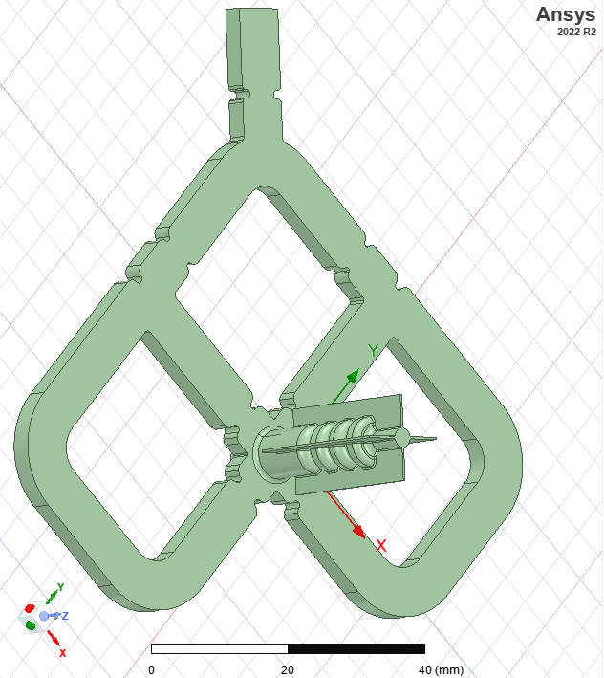
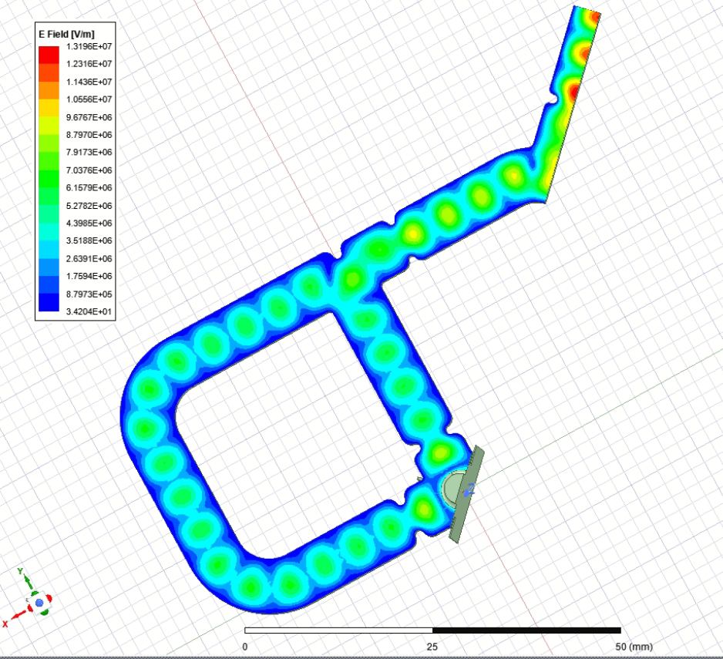
Four-port mode launcher for dipole and quadrupole component cancellation
Ka-Band RF Mode Launcher
Four-port mode launcher with 4-quadrants multicell-cavity
(engineering in-progress)
RF input power
Four-port mode launcher is matched with the resonant Ka-band structure made of four quadrants;
The launcher is optimized with a reflection coefficient at the RF input power port S11 < -40 dB;
Mechanical engineering and executive drawings (in-progress) for the Fabrication and Welding of the multi-cell cavity with mode launcher for low-power RF tests to be conducted during in 2024 @ RF-Lab LATINO, INFN-LNF.
Marco Bellaveglia 10%
Fabio Cardelli 10%
Luigi Faillace (RL) 30%
Alessandro Gallo 10%
Anna Giribono 10%
Claudio Marcelli 10%
Luca Piersanti 10%
Bruno Spataro 0%
Cristina Vaccarezza 15%

Slide 48
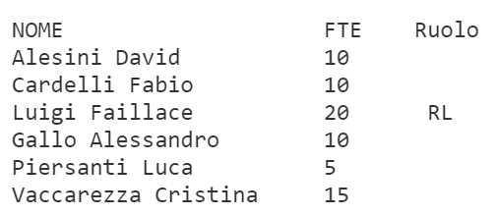
HB2TF (call)
The proposal is related to the development of a High Brightness Beams Test Facility (HB2TF) at the INFN-LASA laboratory. The Test Facility will allow to perform developments in the areas so far illustrated and to carry out experiments with the high current CW electron beam in frontier areas of accelerator physics. The Test Facility setup will comprise a high-performance laser driven DC Gun followed by a normal conducting RF buncher-acceleration section to provide 1 MeV 5 mA CW electron beam
The WP3 of HB2TF is devoted to the design, realization, installation of all the warm radio-frequency systems in the test facility. The core being the two normal-conducting RF, 650 MHz buncher cavities with all the ancillaries required to provide the design bunching and acceleration of the about 1 MeV, 5 mA, CW electron beam and namely: • 80 kW in total, 650 MHz RF power amplifier • Waveguides, circulator, RF load • RF field amplitude and phase control systems

Slide 49
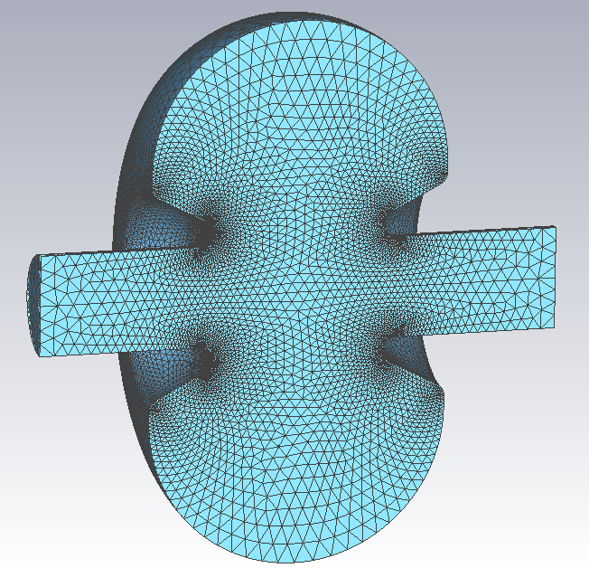
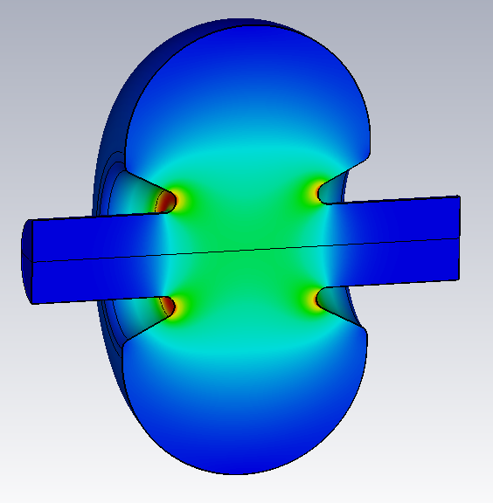
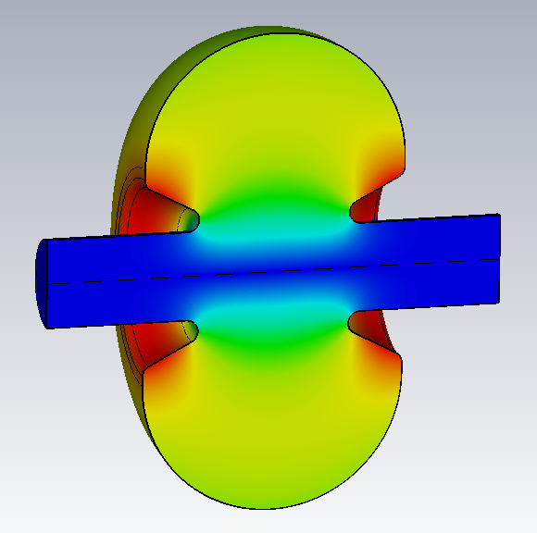
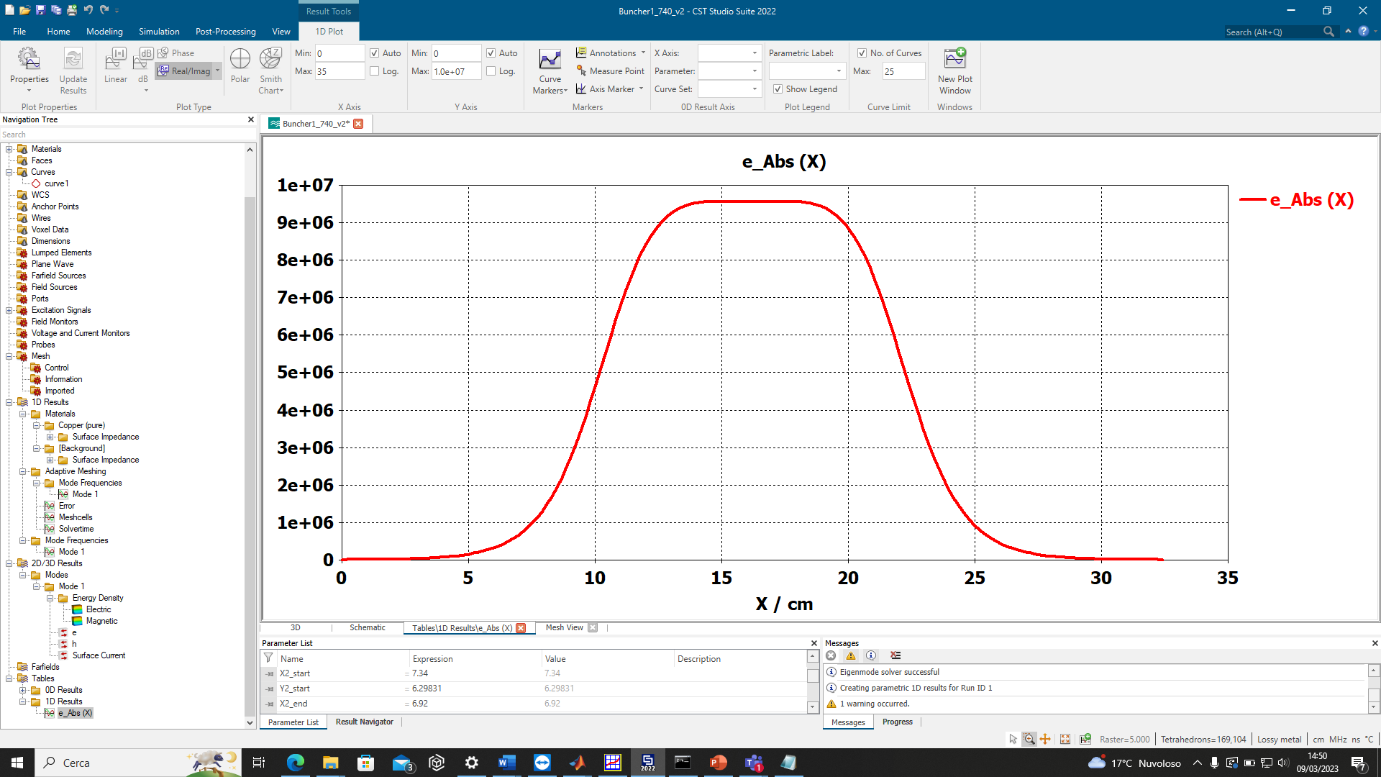
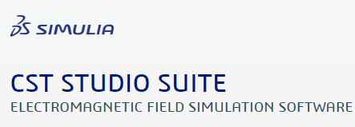
E-field
H-field
g
On-axis E-field (a.u.)
 | SF/Luigi | CST
Frequency | 650.372 MHz | 650.180 MHz
Quality Factor Q₀ | 31,710 | 31,699
Eff. Shunt impedance | 6.209 MOhm | 6.210 MOhm
On-axis E_{peak} | 2.7 MV/m | 2.7 MV/m
E_{peak} | 6.13 MV/m | 6.29 MV/m
H_{peak} | 4.66 kA/m | 4.66 kA/m
P_{RF} | 10.28 kW | 10.26 kW
g ≈ 17cm

Slide 50
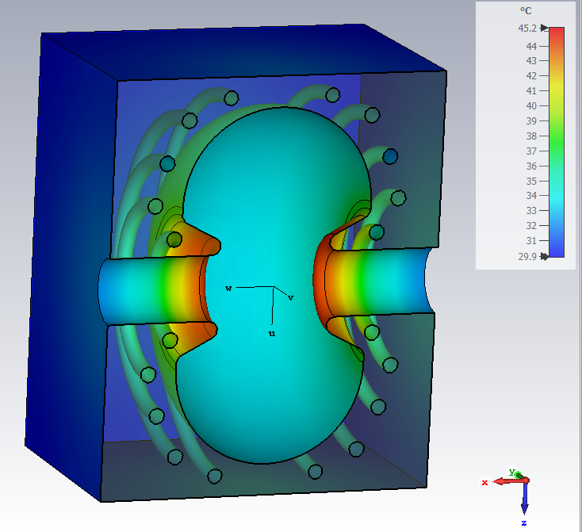
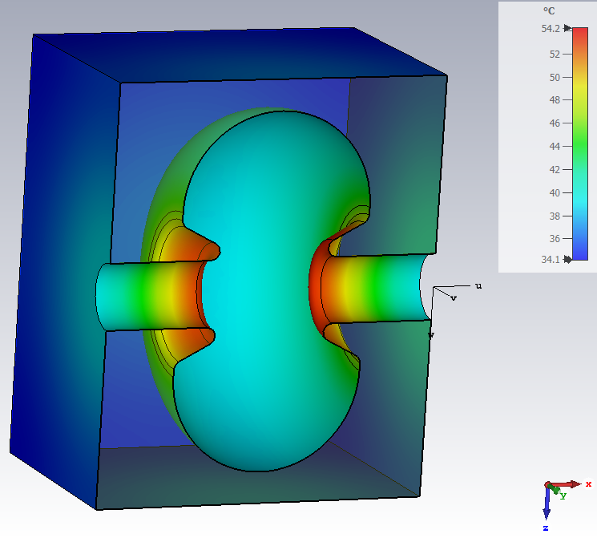
Buncher Machining Options and Preliminary Thermal Analysis
Cavity made of of bulk copper
Possible fabrication in two halves with lathe machine
Two parts are brazed
Cooling channels inserted on outer shell
RF power = 10.3 kW
No cooling, only Ambient
Channel radius = 7.5 mm
Water Temperature = 30 C
Water flux = 10 l/min

