Slide 1
Spatial resolution of tracker detector
Giacomo Traini

Slide 2
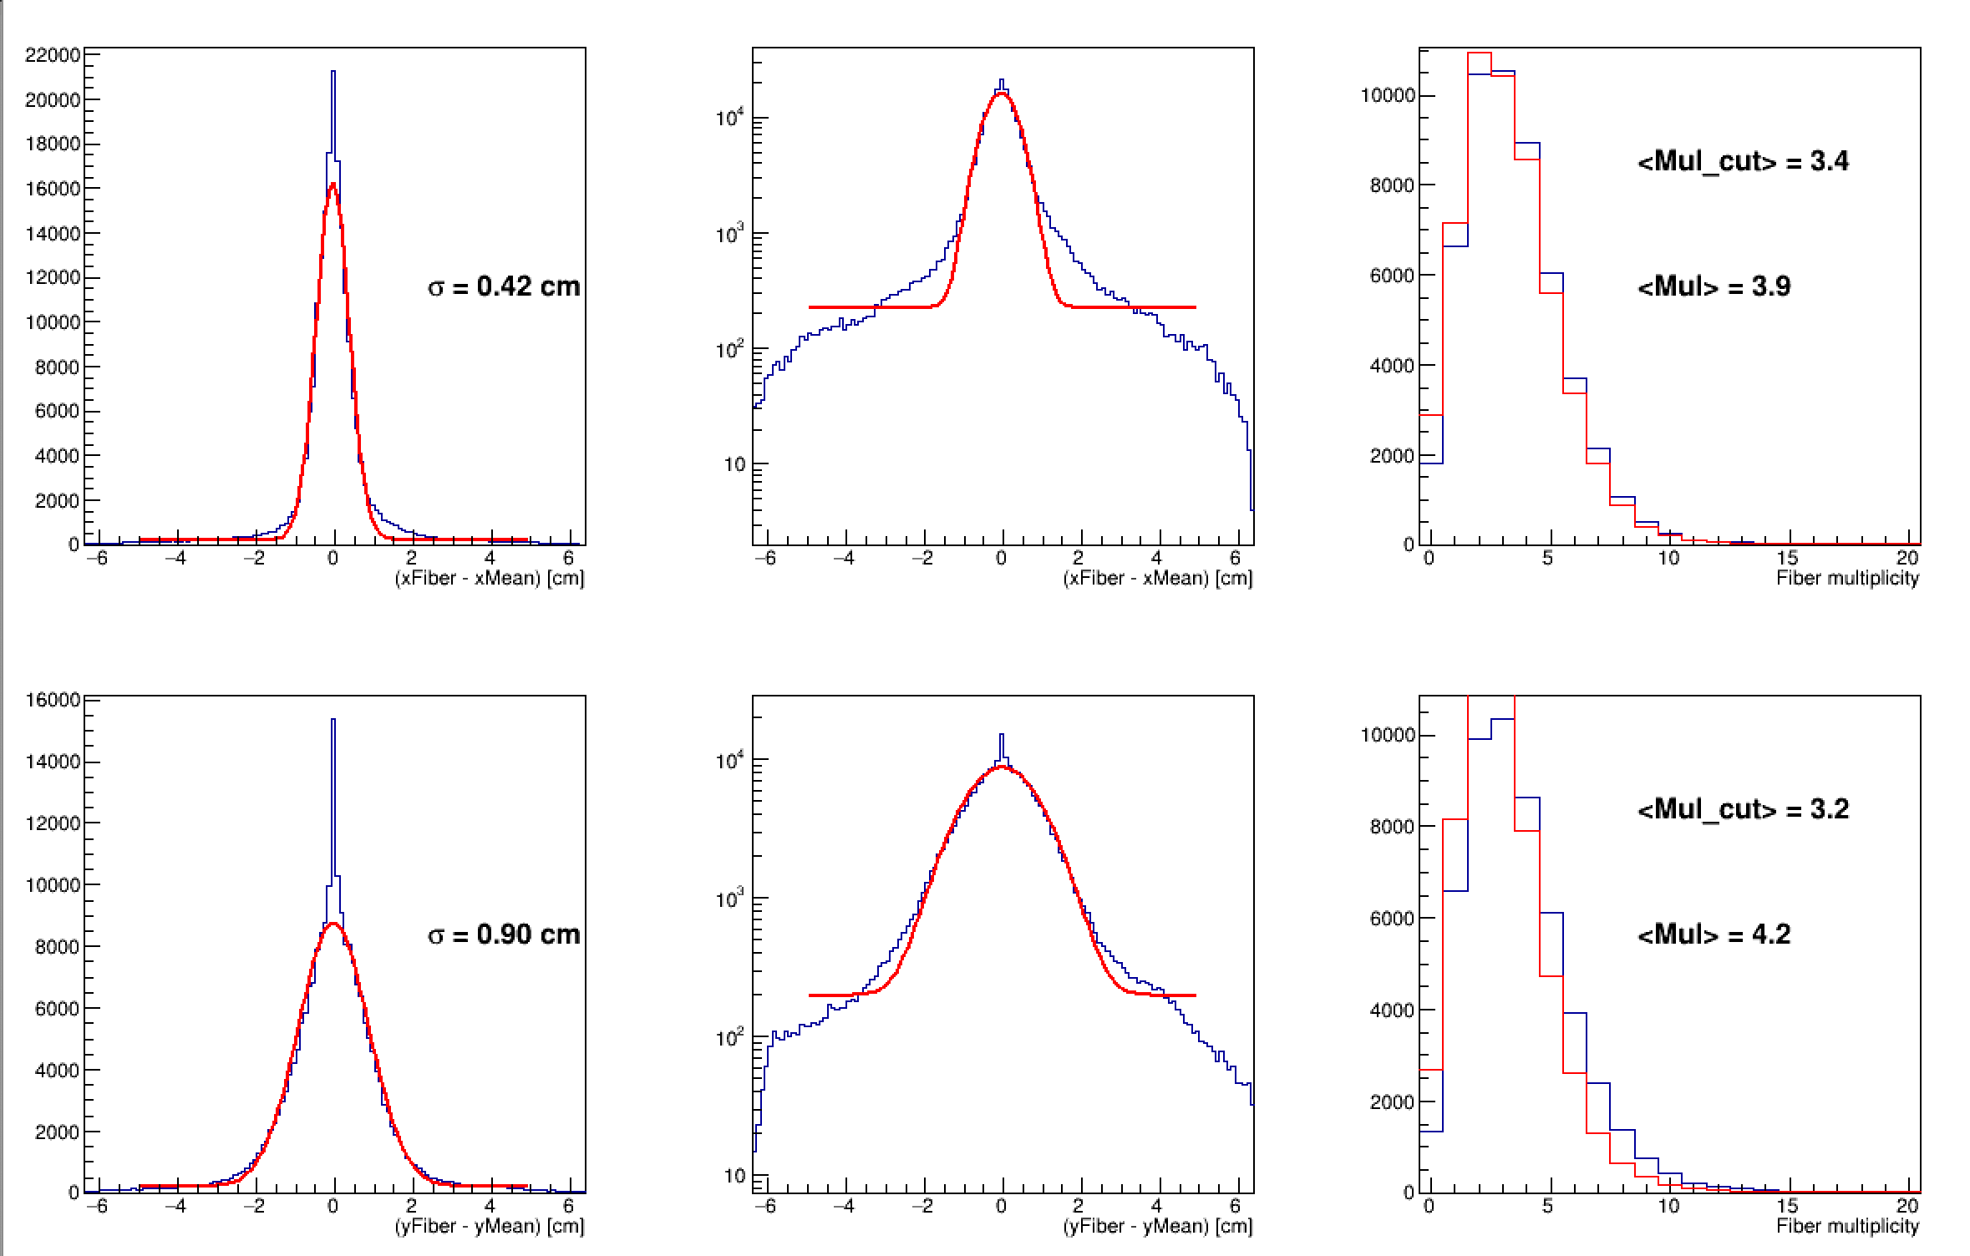
E = 227 MeV

Slide 3
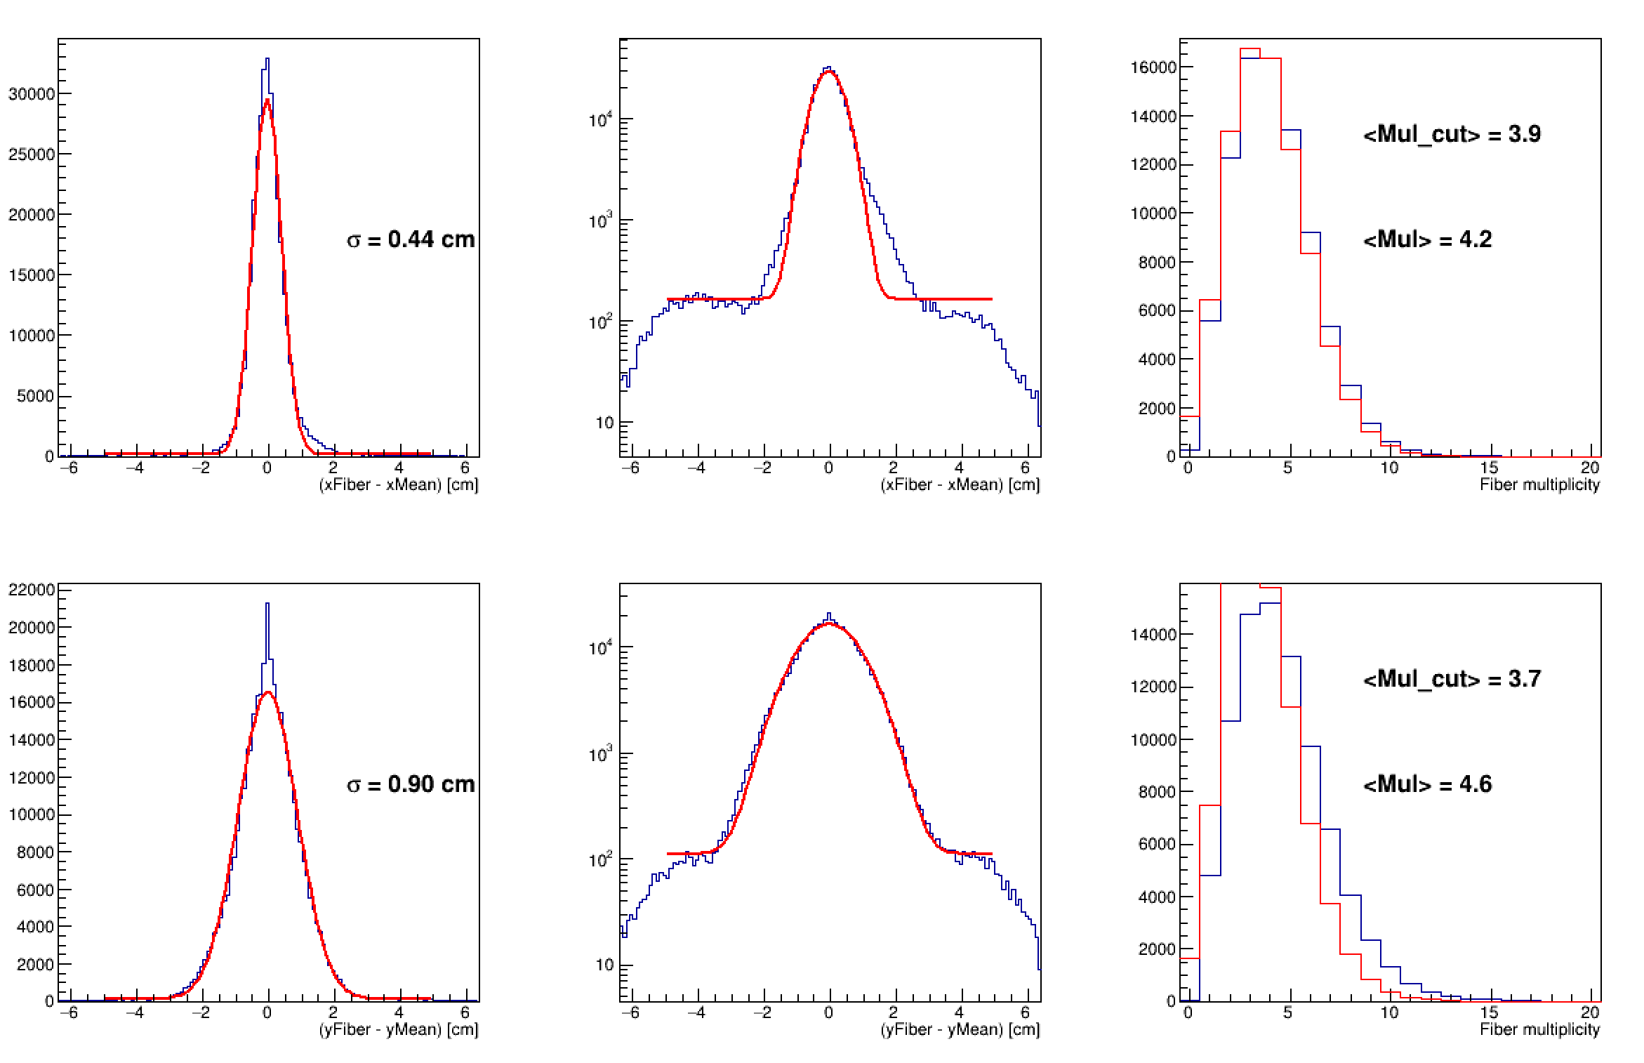
E = 201 MeV

Slide 4
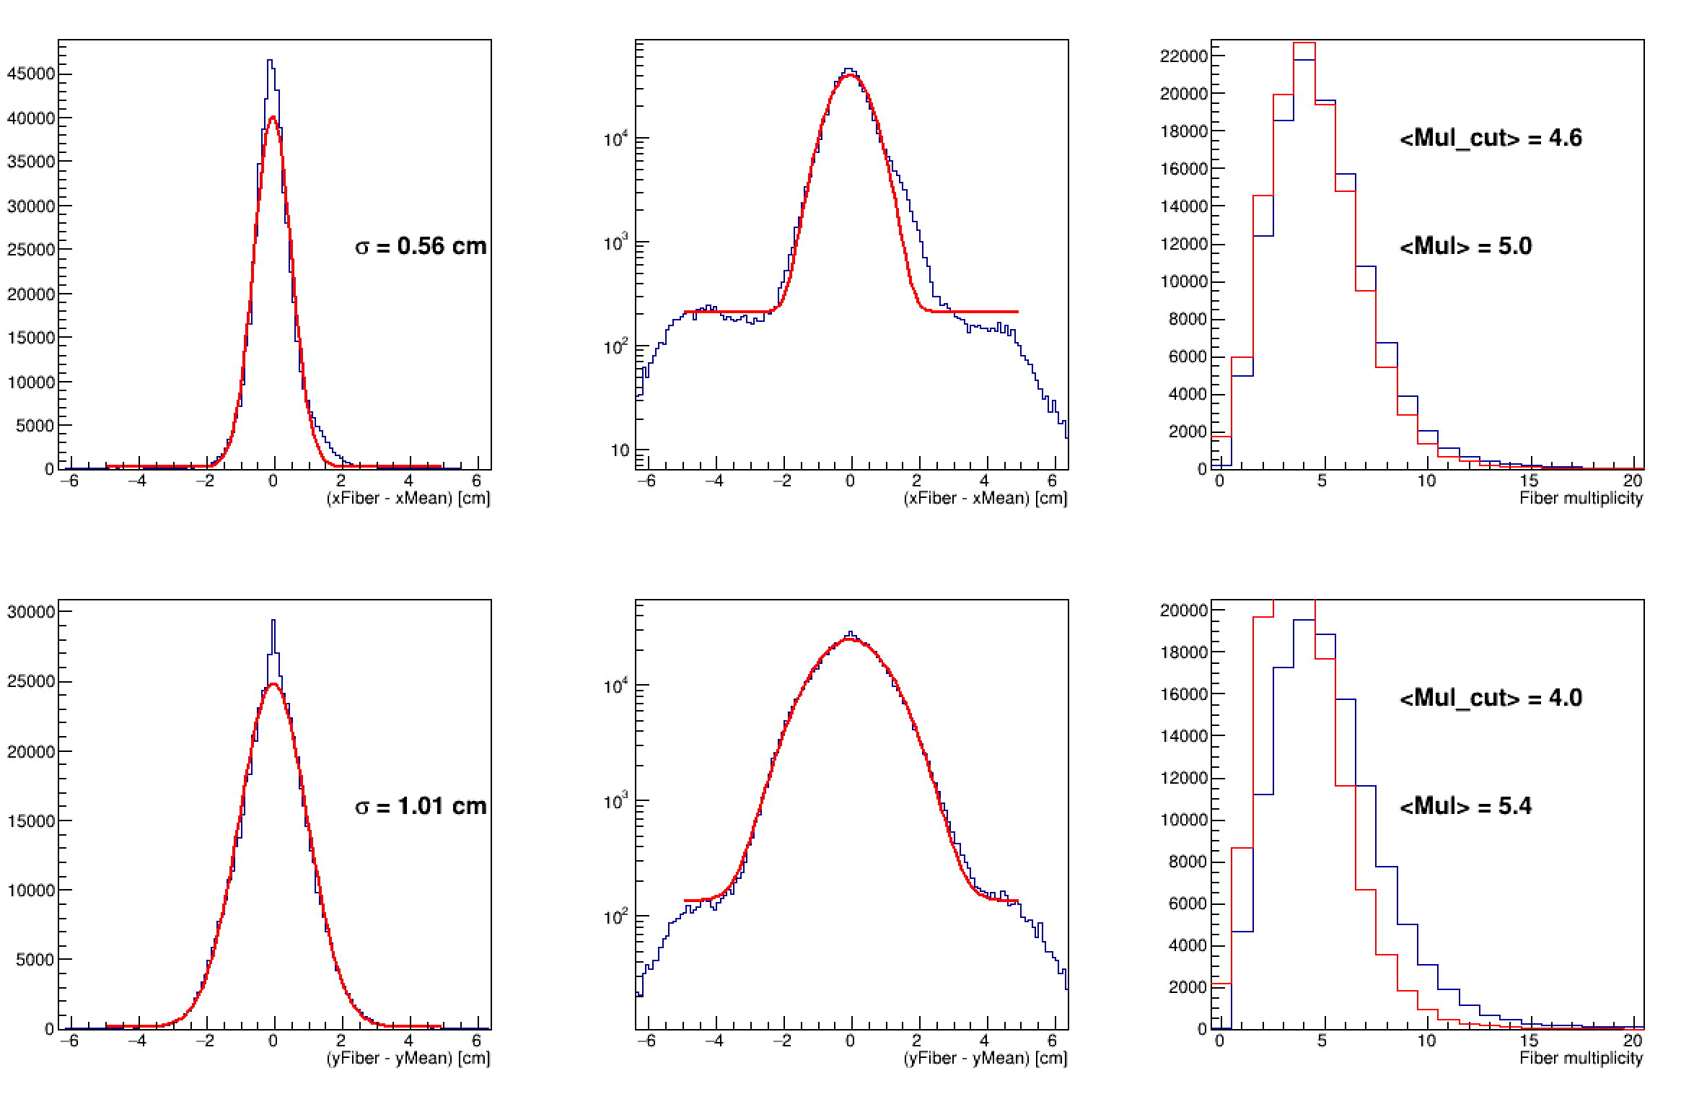
E = 170 MeV

Slide 5
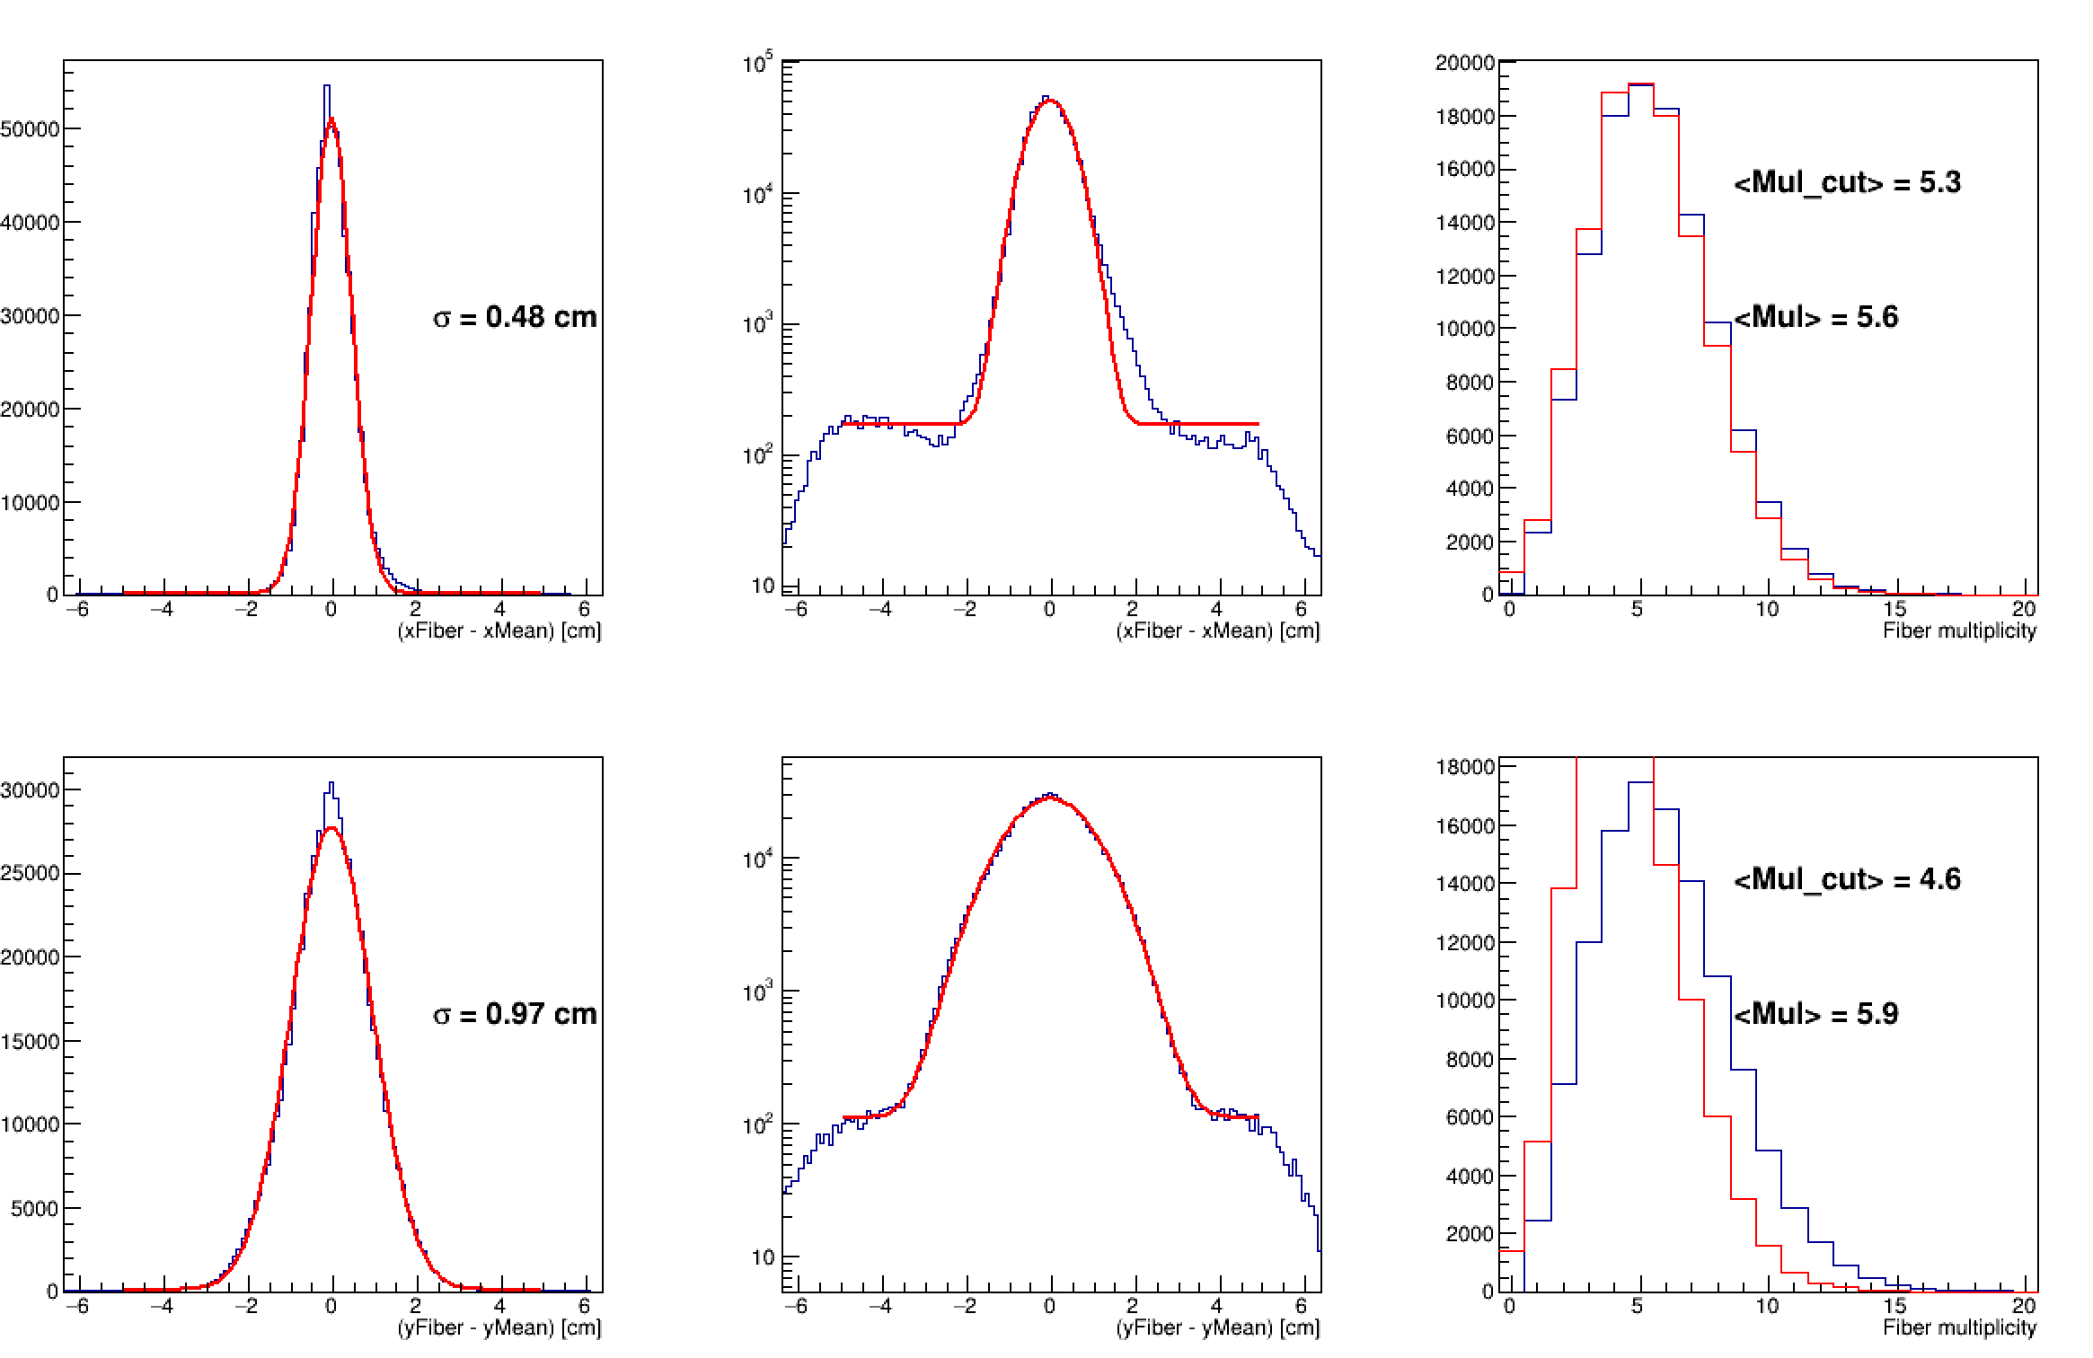
E = 140 MeV

Slide 6
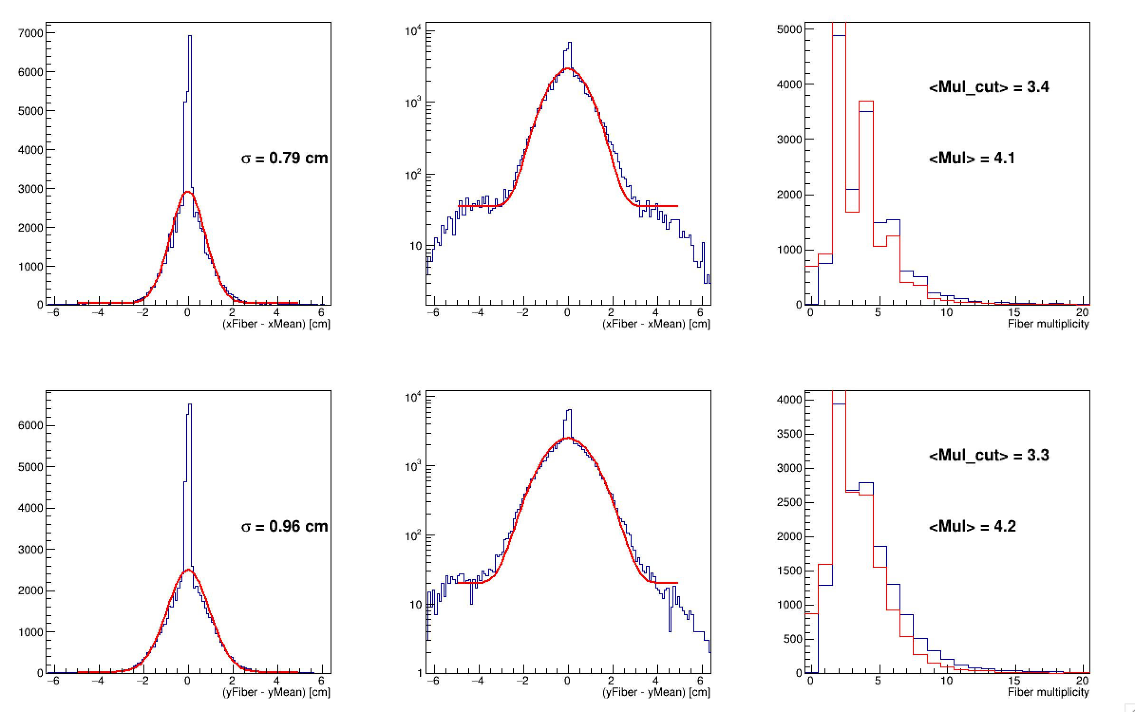
E = 62 MeV

