Slide 1



Linacs for FLASH radiotherapy
Young@INFN seminar
Lucia Giuliano, PhD
Sapienza University of Rome
SBAI Department

Slide 2

OUTLINE
FLASH radiotherapy
ElectronFLASH@Institut Curie
Safest for deep tumors
FlashLab@Sapienza

Slide 3

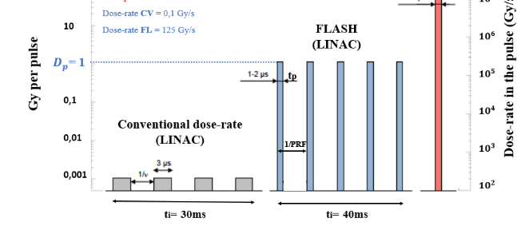
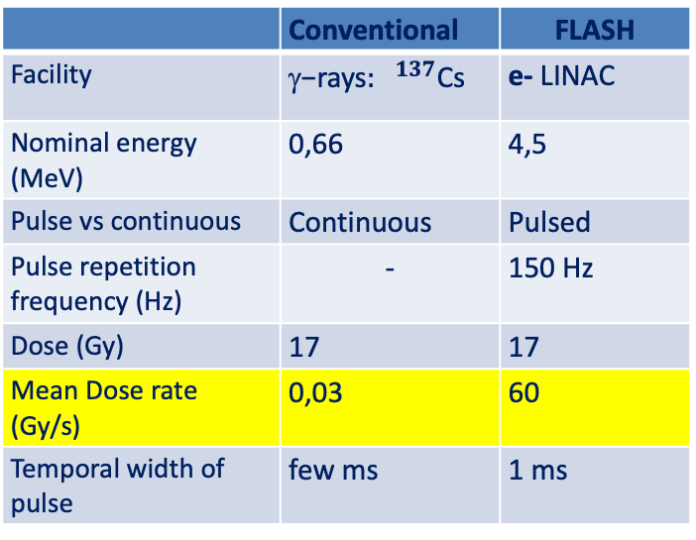
FLASH effect in Radiotherapy
Favaudon et al., Science Translational Medicine 6, 2014
Example ν=100Hz
 | Conventional | FLASH
Facility | ${\text{−}\text{rays}: }^{137}$Cs | e- LINAC
Nominal energy (MeV) | 0,66 | 4,5
Pulse vs continuous | Continuous | Pulsed
Pulse repetition frequency (Hz) | - | 150 Hz
Dose (Gy) | 17 | 17
Mean Dose rate (Gy/s) | 0,03 | 60
Temporal width of pulse | few ms | 1 ms
Dose rate =125 Gy/s
Dose rate =0,1 Gy/s
Fig. Courtesy of Vincent Favaudon - Curie Institute
FLASH THERAPY is a new way to deliver the dose:
μs pulses of radiation,
beam-on time < 100-200ms
high dose per pulse (>1 Gy)
high mean dose rate (>40-100Gy/s)
Control 17 Gy CONV 17 Gy FLASH
Healthy Fibrosis Healthy
FLASH irradiation protects healthy tissues from damage and remains as efficient as CONV irradiation in the repression of tumor growth

Slide 4
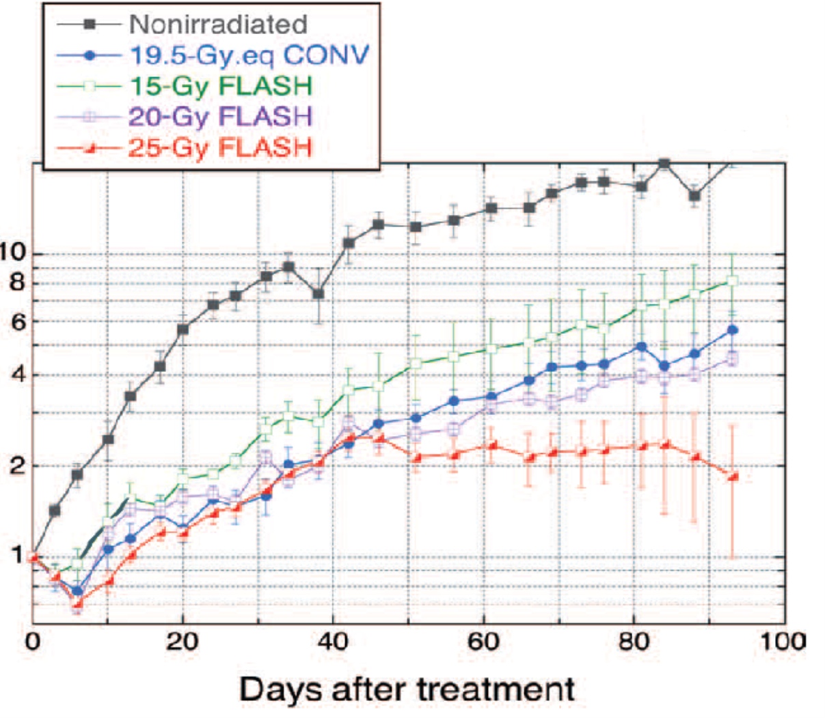
FLASH effect in Radiotherapy
Favaudon et al., Science Translational Medicine 6, 2014
Example ν=100Hz
 | Conventional | FLASH
Facility | ${\text{−}\text{rays}: }^{137}$Cs | e- LINAC
Nominal energy (MeV) | 0,66 | 4,5
Pulse vs continuous | Continuous | Pulsed
Pulse repetition frequency (Hz) | - | 150 Hz
Dose (Gy) | 17 | 17
Mean Dose rate (Gy/s) | 0,03 | 60
Temporal width of pulse | few ms | 1 ms
Dose rate =125 Gy/s
Dose rate =0,1 Gy/s
Fig. Courtesy of Vincent Favaudon - Curie Institute
FLASH THERAPY is a new way to deliver the dose:
μs pulses of radiation,
beam-on time < 100-200ms
high dose per pulse (>1 Gy)
high mean dose rate (>40-100Gy/s)
Control 17 Gy CONV 17 Gy FLASH
Healthy Fibrosis Healthy
FLASH irradiation protects lungs from radiation-induced fibrosis and is as efficient as CONV irradiation in the repression of tumor growth

Slide 5
Accelerator to investigate the FLASH effect
Understanding the FLASH RT limits (min/max dose/time)
Clarify the bio mechanisms underlying FLASH effect
Defining conditions for clinical practice
Institut Curie commisioned a new Linac dedicated for Flash therapy and radiobiology experiments.
We have developed the RF and beam dynamics design of the accelerator built by the company S.I.T. Sordina IORT Technologies S.p.A.

Slide 6
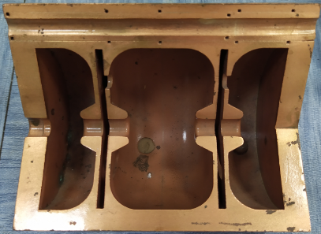
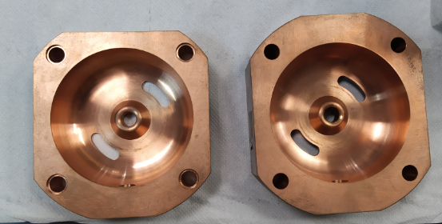
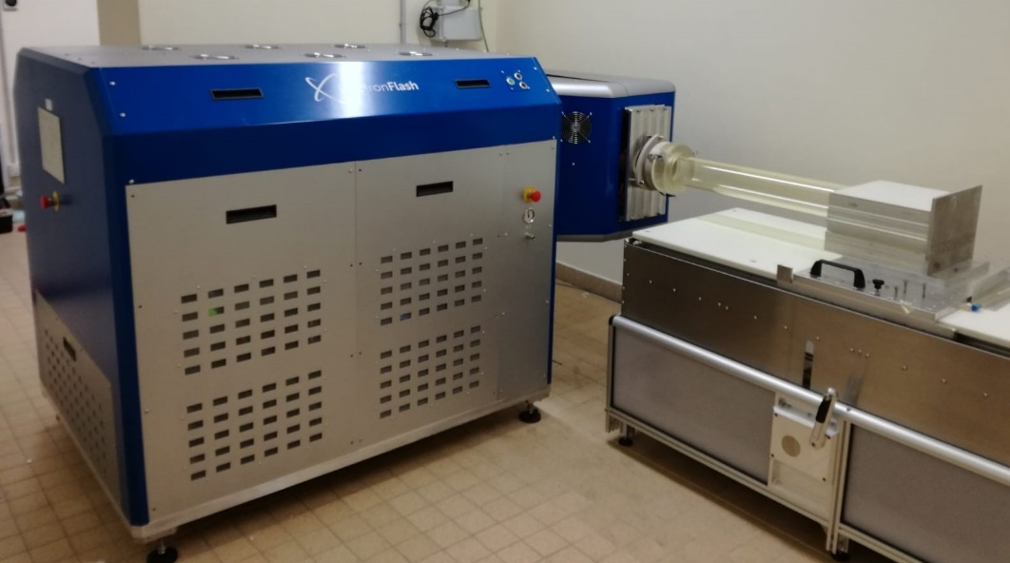
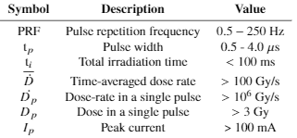

Realization of ElectronFLASH
Medical Linac for preclinical FLASH studies
Low energy electrons (max 9 MeV)
High peak current to deliver high dose
Linac installed at Institut Curie (5 - 7 MeV)

Slide 7
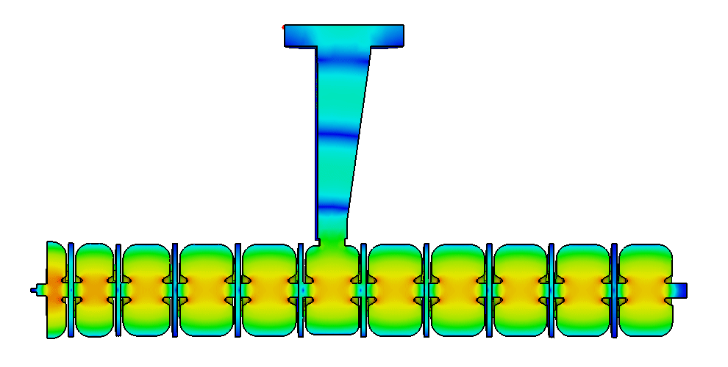
Linac @Instut Curie: electromagnetic design
Input power
The resonant modes have a fixed spatial configuration
They oscillate in time
The electromagnetic energy is reflected back and forth at both ends of the cavity
Cathode
E field
S-band linac (f=2,998 GHz)
Bi-periodic geometry
Standing wave structure (SW)
π/2 mode: Coupling cells are empty (no field inside)
Magnetic coupling with hole off axis

Slide 8

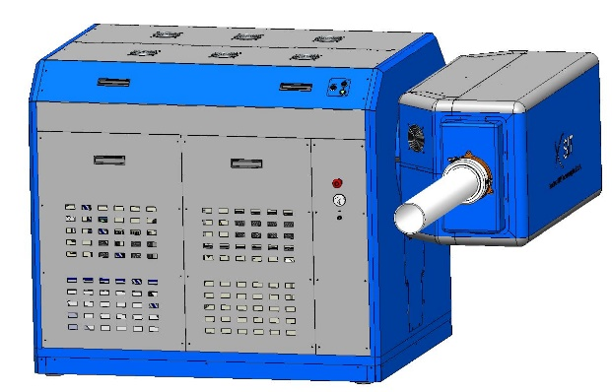
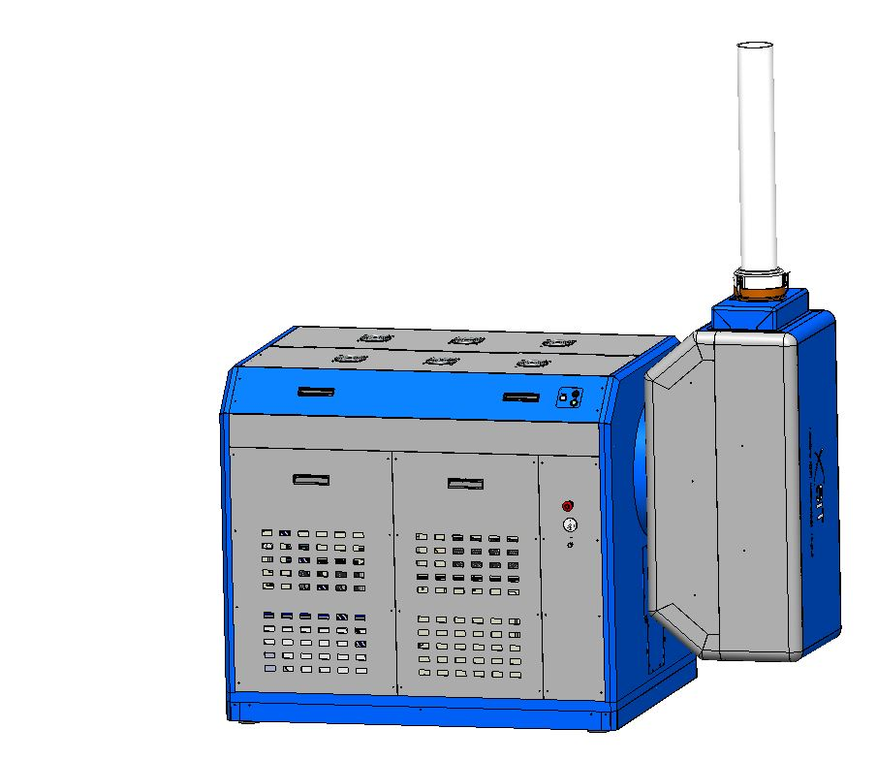
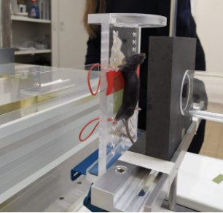
In vivo and vitro experimental set-up
In vivo
In vitro

Slide 9

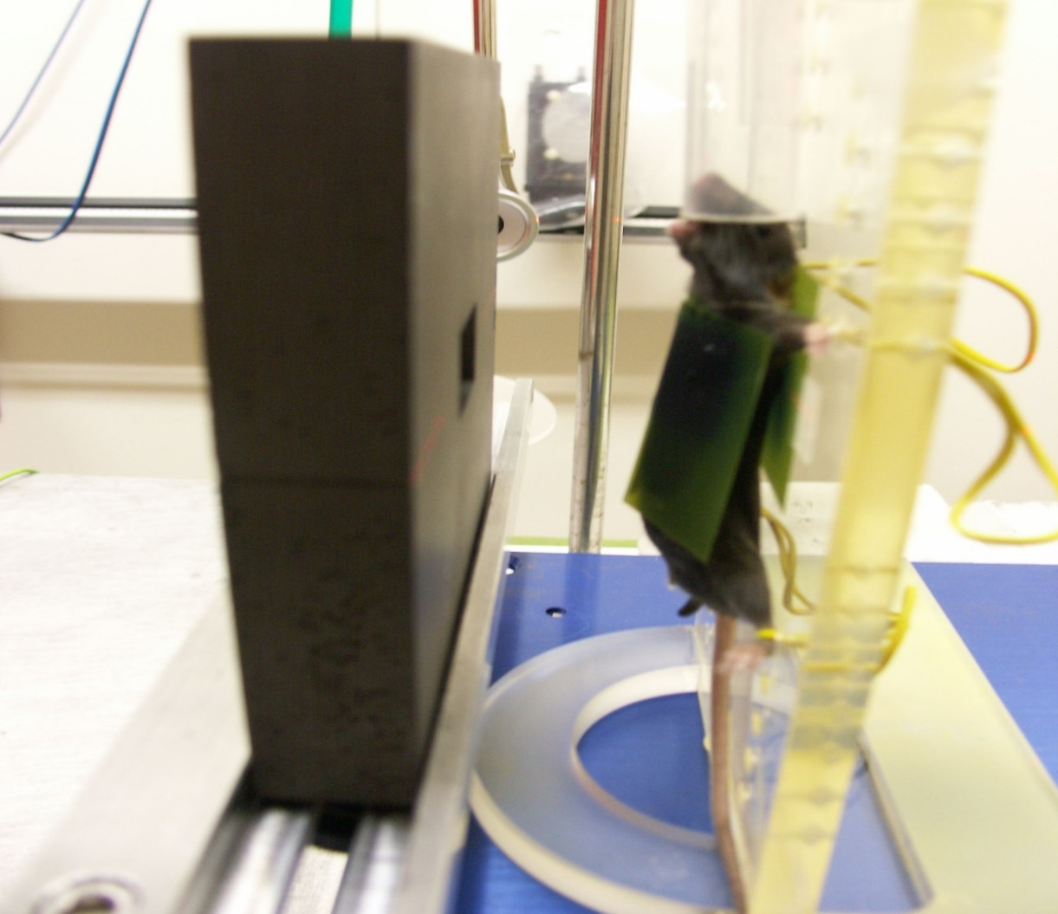
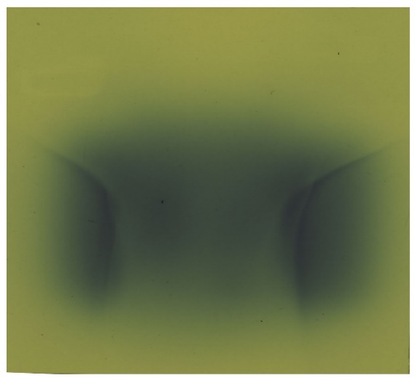
Dosimetry Issues in FLASH-RT
Accurate dosimetry of these ultra-high dose rates is a major challenge and crucial for the safe transition of FLASH radiotherapy into clinical practice.
Pic. Courtesy of S. Heinrich
  Ionization chambers and classical dosimeters need to be adapted to operate under high dose rate conditions: they read dose > 40 Gy in less than 100 ms
The films must be verified by a second dosimeter
Analysis require long time (24h to scanner film and several time to analyzed them)
Current precision on dose with film dosimetry > 5%

Slide 10
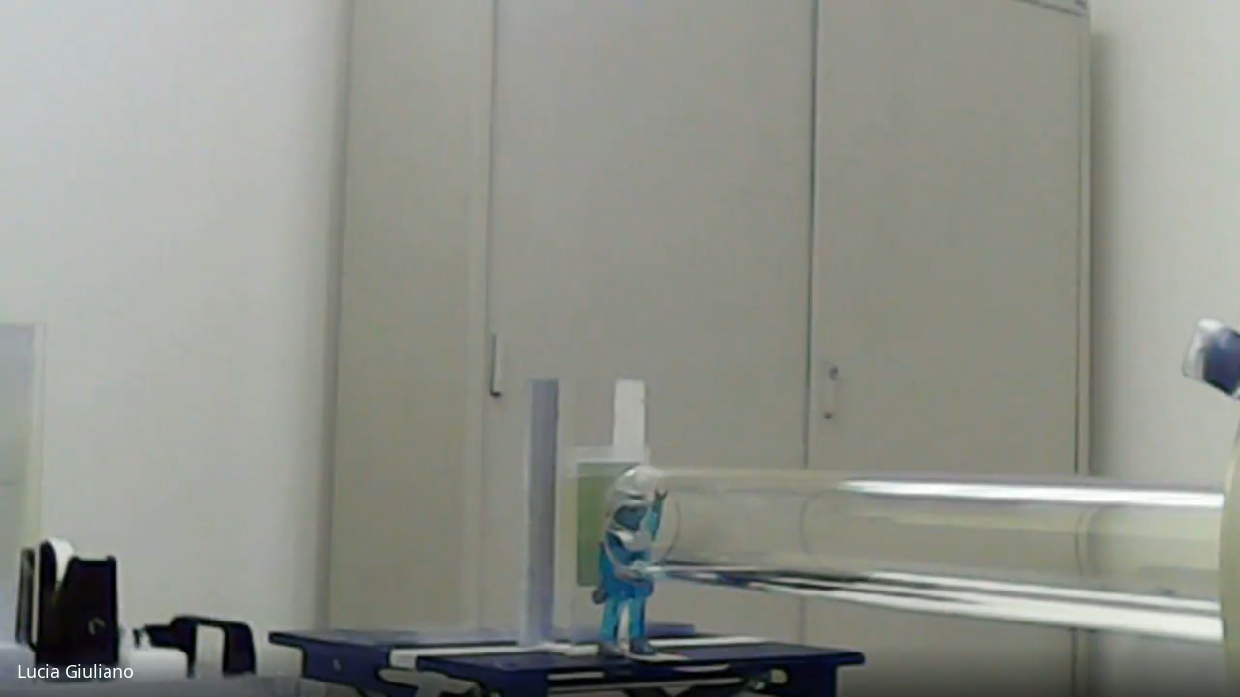
Irradiations at Institut Curie
RADIOCROMIC FILM
IRRADIATED SAMPLE

Slide 11
FLASH effect was identified with low energy electron-beam not appropriate to treat deep tumors:
SAFEST
SApienza Flash Electron Source for radio-Therapy

Slide 12
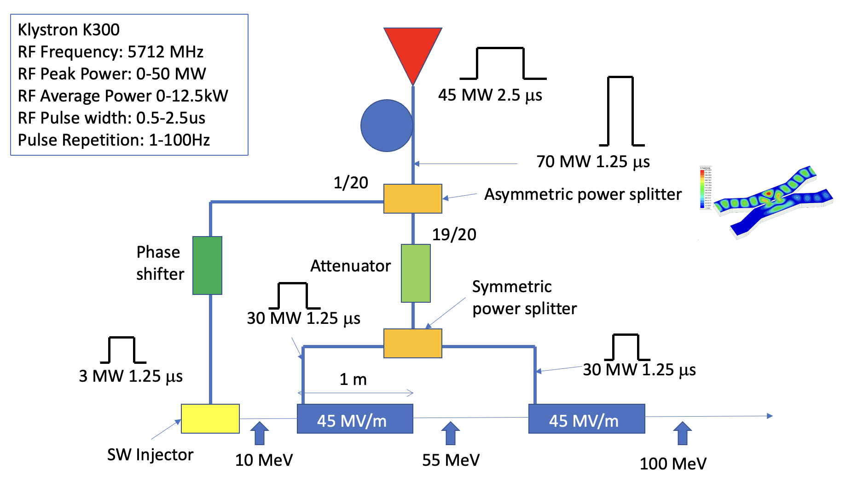
SAFEST PROJECT general layout
Frequency | 5.712 GHz
Beam Energy | 65 - 100 MeV
RF Repetition rate | 100 Hz
C-band average accelerating gradient | 45 MV/m
RF pulse duration | 1.2 – 2.5 μs
In pulse dose rate | > 10^6 Gy/s
Average dose rate | > 100 Gy/s
Dose per pulse | >> 1 Gy
Hybrid configuration with SW Injector and TW accelerating structures with one klystron
An asymmetric power splitter allows avoiding the circulator for the SW
C-band combines a high shunt impedance with a high transmission efficiency:
high peak current for FLASH regime.

Slide 13
SAFEST PROJECT general layout
Frequency | 5.712 GHz
Beam Energy | 65 - 100 MeV
RF Repetition rate | 100 Hz
C-band average accelerating gradient | 45 MV/m
RF pulse duration | 1.2 – 2.5 μs
In pulse dose rate | > 10^6 Gy/s
Average dose rate | > 100 Gy/s
Dose per pulse | >> 1 Gy
Standing wave Injector

Slide 14
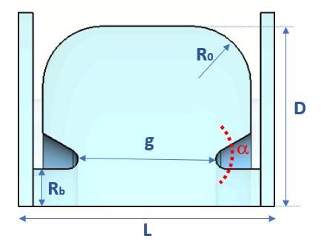
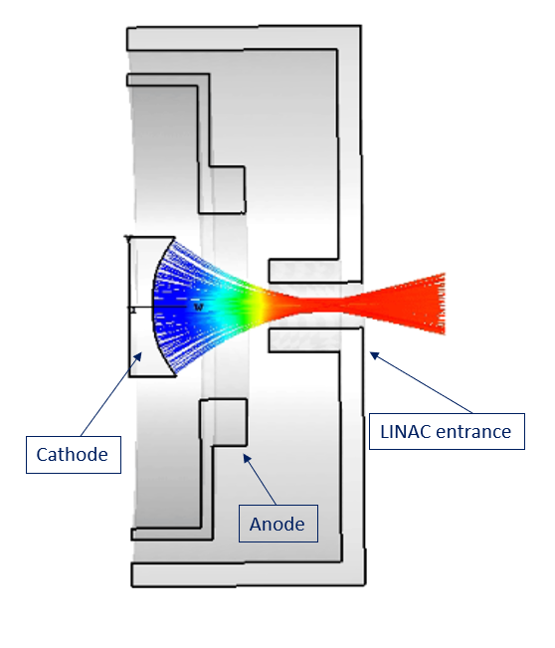
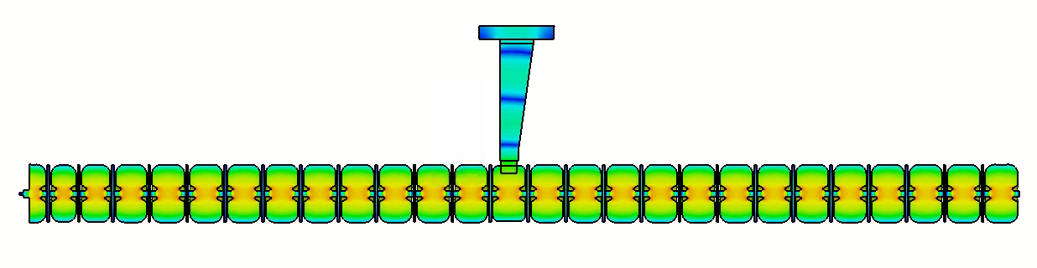
Electrons source and SW injector
Electron source: pulsed DC thermionic gun at 15 kV.
D | g | L | Rb | Ro | α
38.25 | 15.6 | 24.4 | 3 | 6 | 30°
Single cell parameters [mm]
Standing wave, bi-periodic geometry with on-axis coupling cells
π/2 mode
Nose - cone geometry: produces very high electric field in the middle of the accelerating cells
Bunching section for low-energy beam capture (> 45%)
Beam energy up to ≈ 10 MeV and 100 mA beam peak current
Power in
Freq | Rshunt | Q
5.712 GHz | 116 MΩ/m | 11260
DC gun
Bunching section
Other contribution L. Faillace and D. Francescone

Slide 15
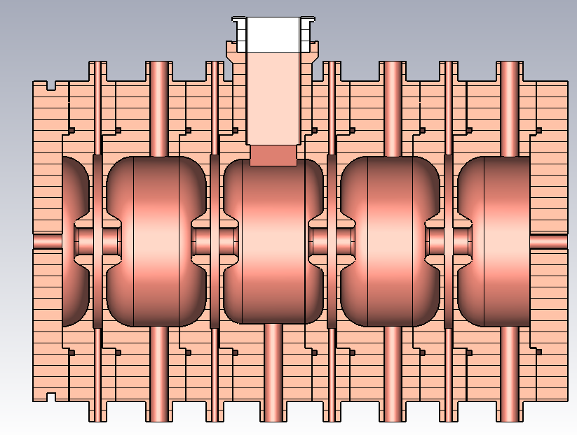
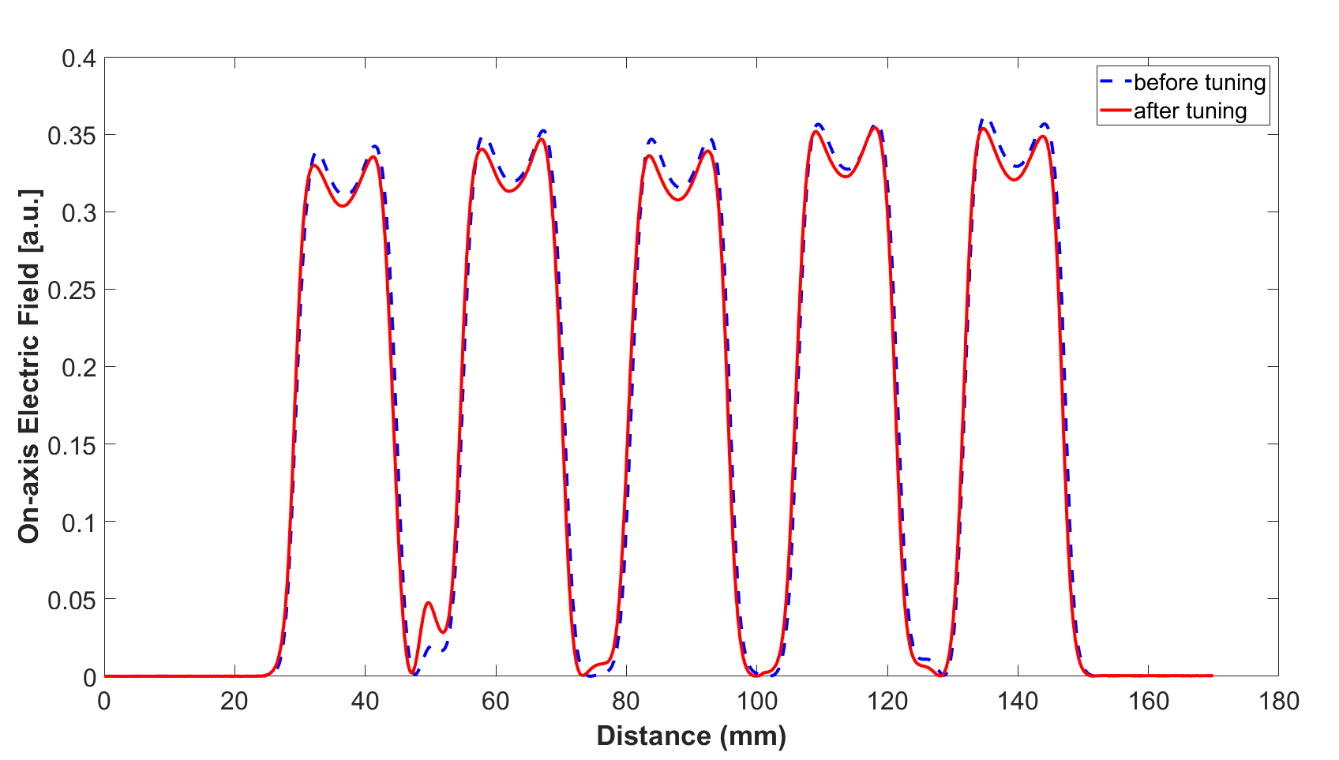
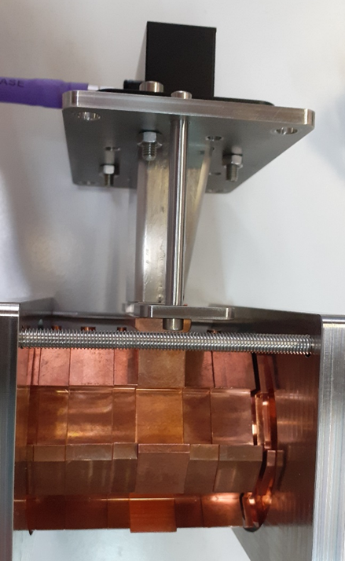
Accelerating Field measurement
Power In
C-Band (f=5.712 GHz) prototype comprises five identical accelerating cells, representing the linac’s speed-of-light section
The bead-pull measurements showed an almost equal flatness of the electric field in the five accelerating cells.
The electric field measurements confirmed the presence of the π/2 mode with a high electric field in the accelerating cells and no field in the coupling cells.
Beam axis
RF power

Slide 16
SAFEST PROJECT general layout
Frequency | 5.712 GHz
Beam Energy | 65 - 100 MeV
RF Repetition rate | 100 Hz
C-band average accelerating gradient | 45 MV/m
RF pulse duration | 1.2 – 2.5 μs
In pulse dose rate | > 10^6 Gy/s
Average dose rate | > 100 Gy/s
Dose per pulse | >> 1 Gy
Traveling wave structure

Slide 17
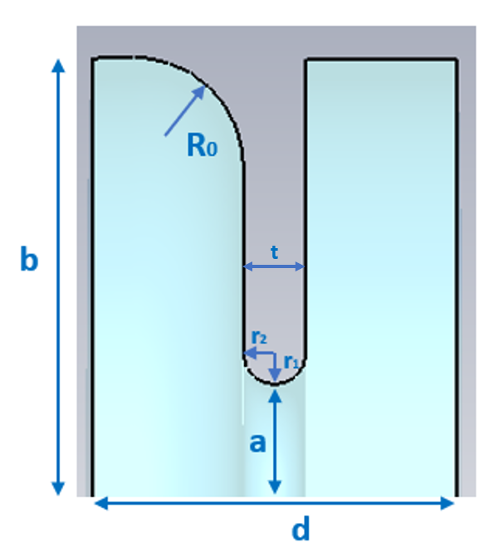
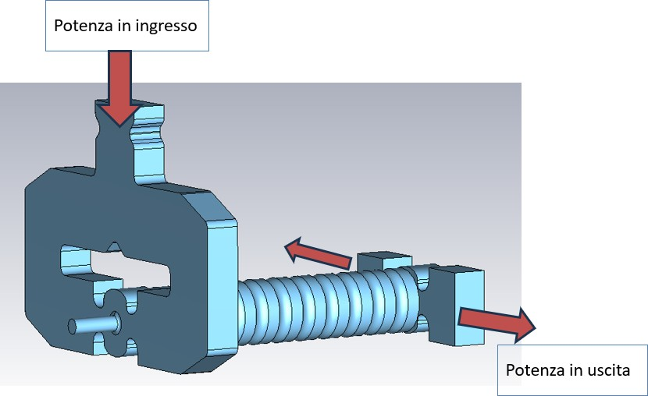
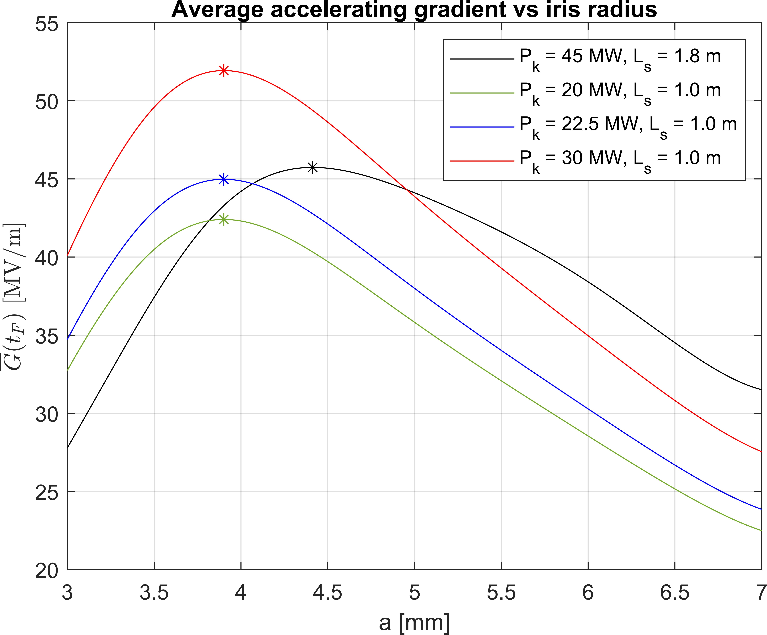
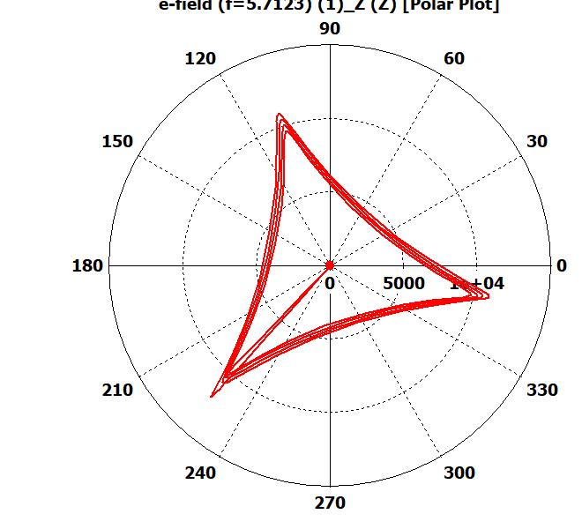
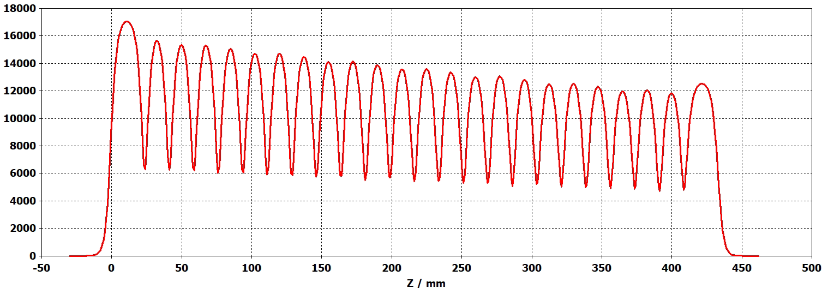


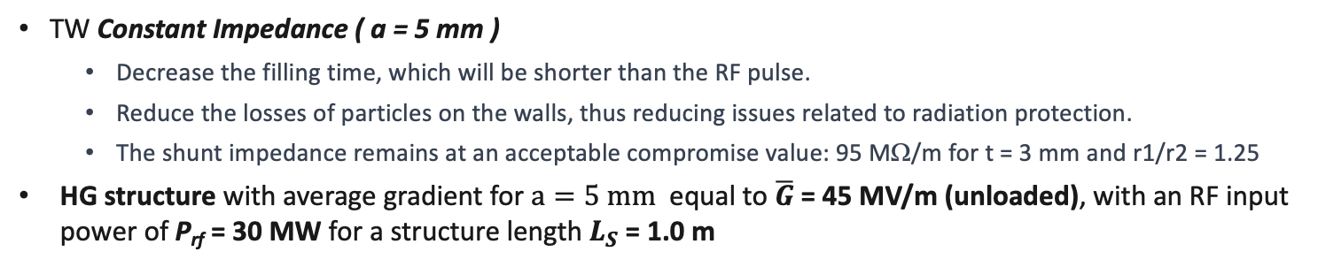

TW prototype RF design
Single Cell design
Asymmetric cell to facilitate mechanical processing.
Power in
Dual-feed different input and output RF power couplers
a | b | d | R0 | t | r1/r₂
5 | 21.03 | 17.5 | 6 | 3 | 1.25
$2π/3$cell-to-cell phase advance @5.712 GHz
Power out
TW Constant Impedance ( a = 5 mm )
  Decrease the filling time, which will be shorter than the RF pulse.
  Reduce the losses of particles on the walls, thus reducing issues related to radiation protection.
  The shunt impedance remains at an acceptable compromise value: 95 MΩ/m for t = 3 mm and r1/r2 = 1.25
HG structure with average gradient for $a=5 mm$ equal to $\overline{G}$= 45 MV/m (unloaded), with an RF input power of P_{rf} = 30 MW for a structure length $L_{S}$= 1.0 m
a.u.
Electric field polar plot with $2π/3$cell-to-cell phase advance
3D Electric field on beam axis

Slide 18
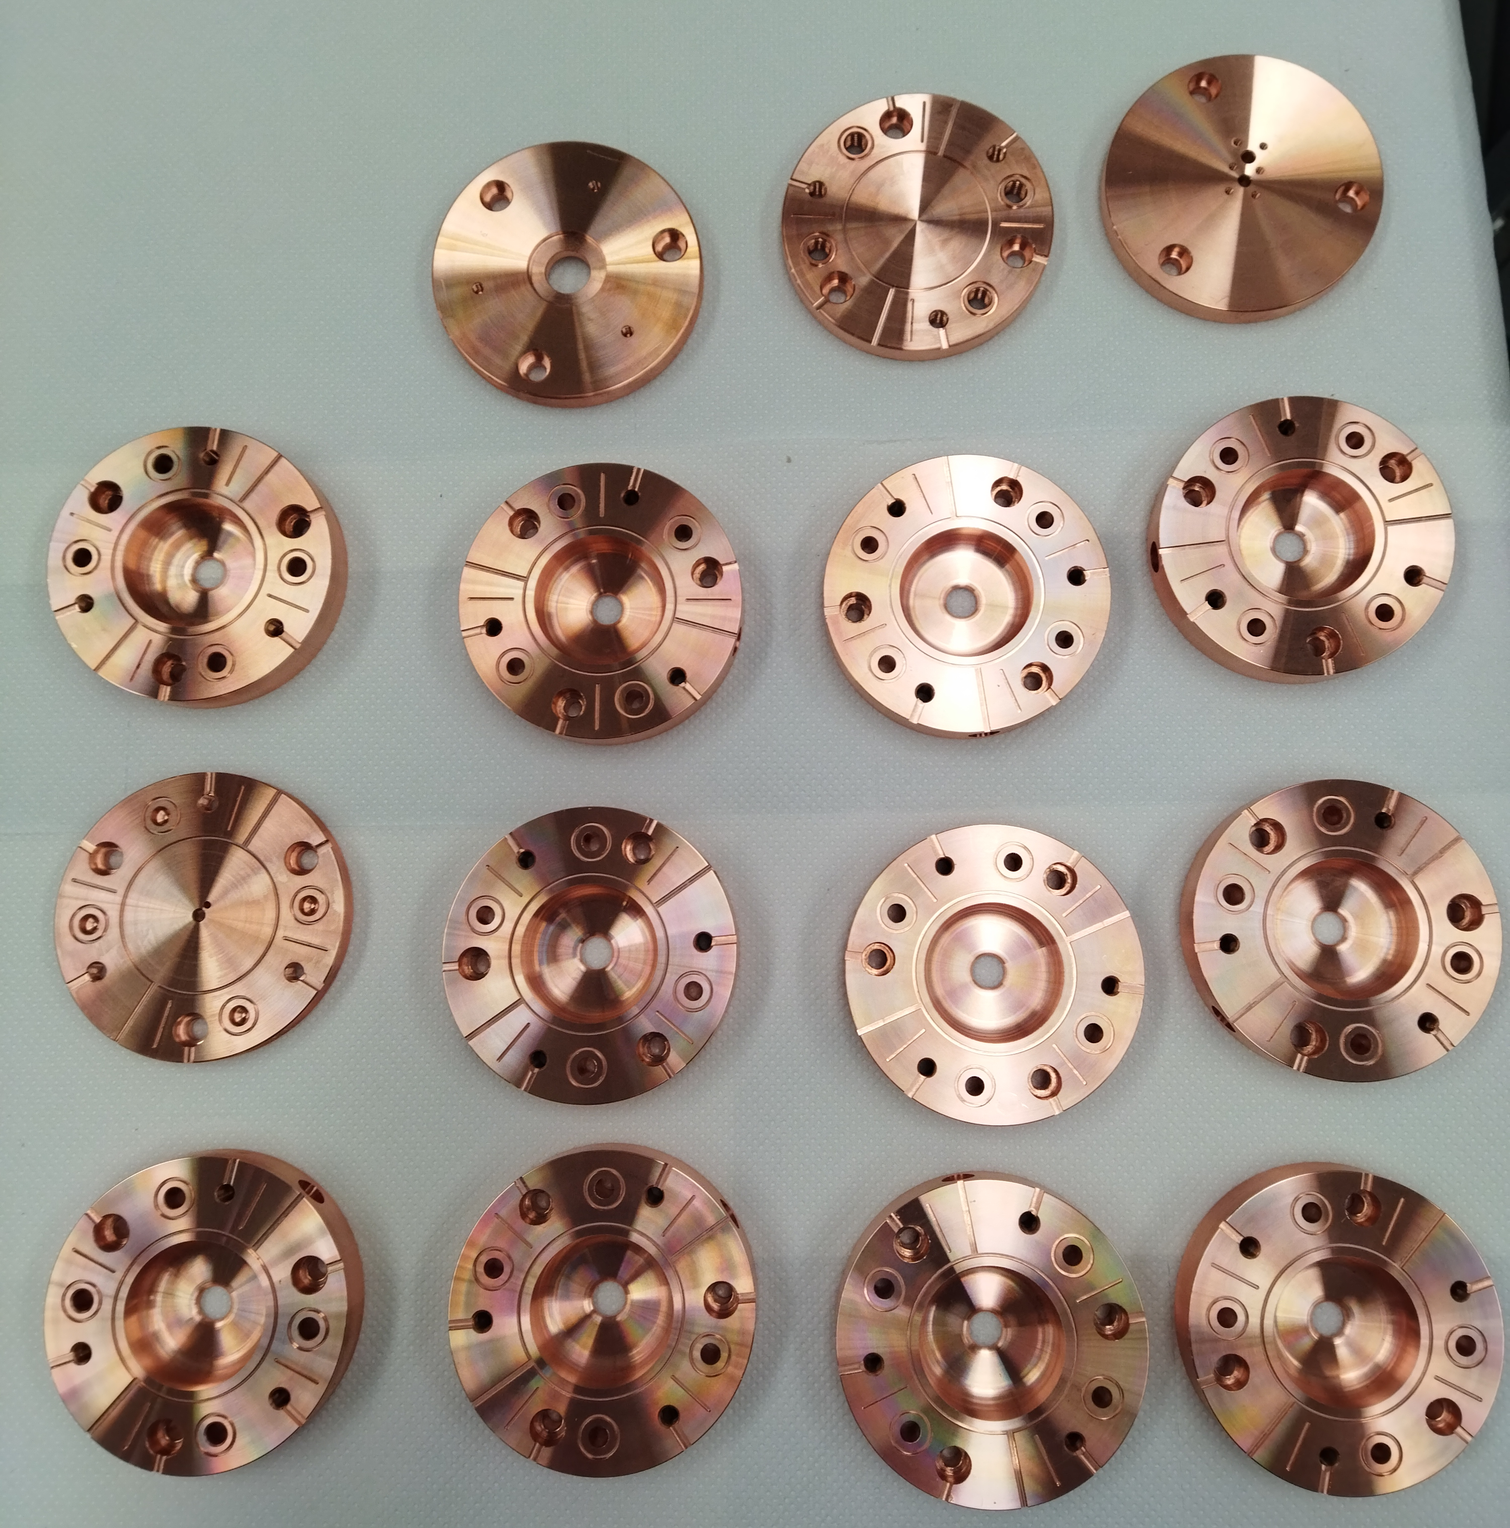
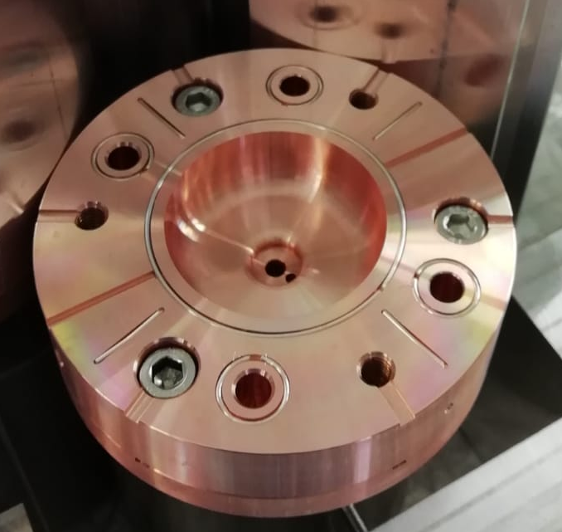
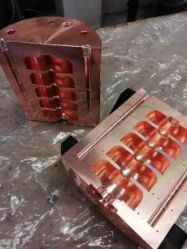


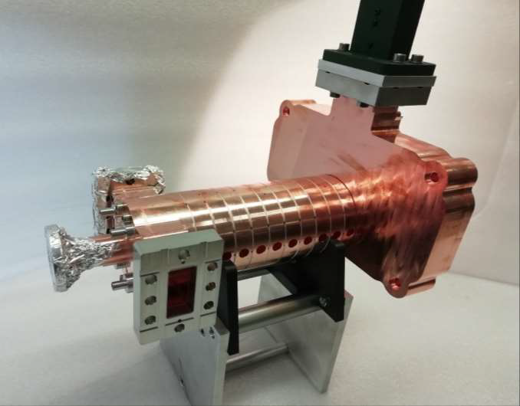
Prototyping phase
Pre-prototypes on 5-cells without couplers to test the brazing procedure, vacuum sealing and the in-house mechanical design.
Prototype of 12 cells with couplers has been brazed @INFN LNF –FRASCATI oven to perform low-power RF tests.
Brazing alloy
In house building of the accelerating cavities
Screws
Screws: prevent external clamping and ensure alignment and easier assembly
Main contributors: D. Alesini, R. Di Raddo, L. Faillace, L. Giuliano, M. Magi, M. Migliorati

Slide 19
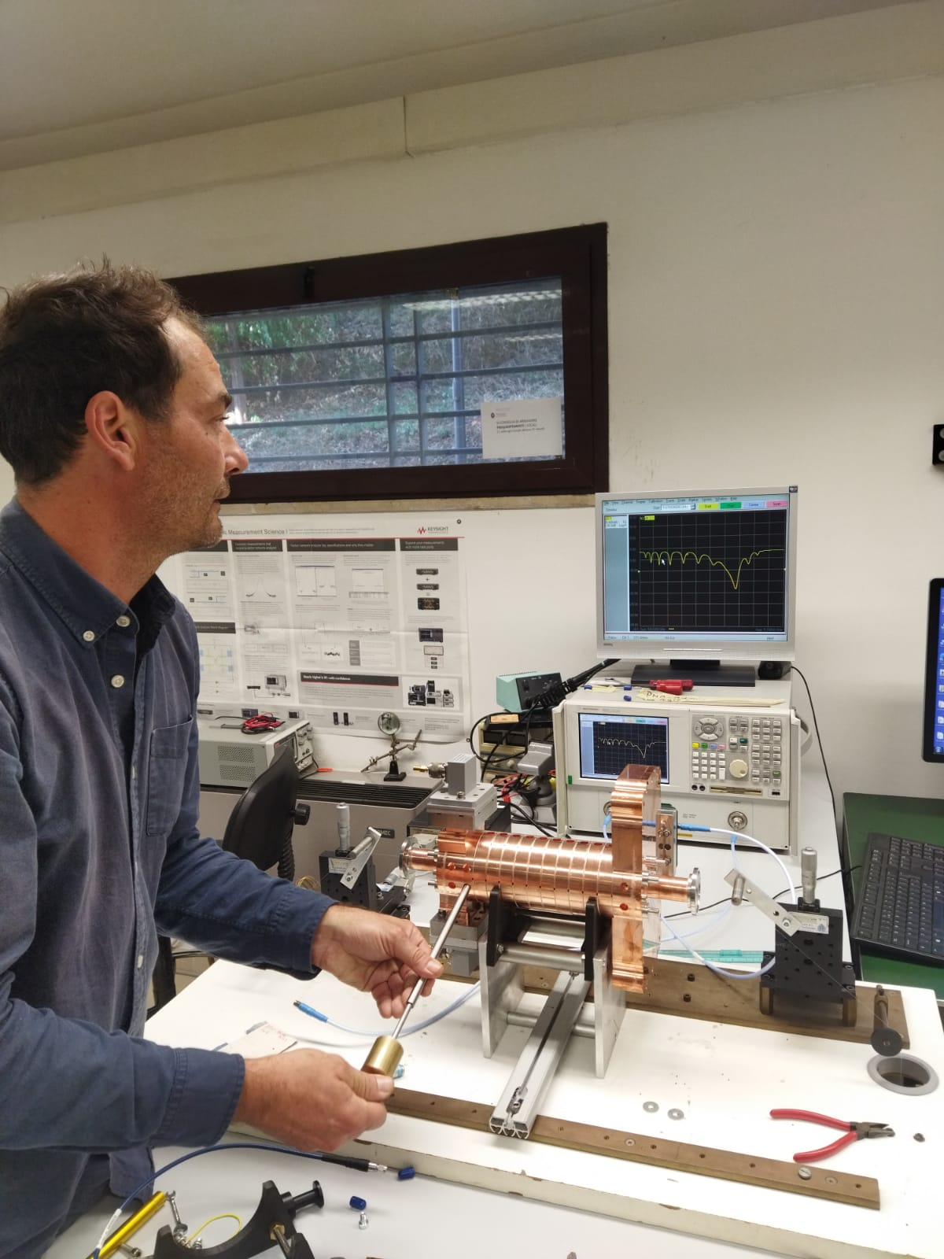
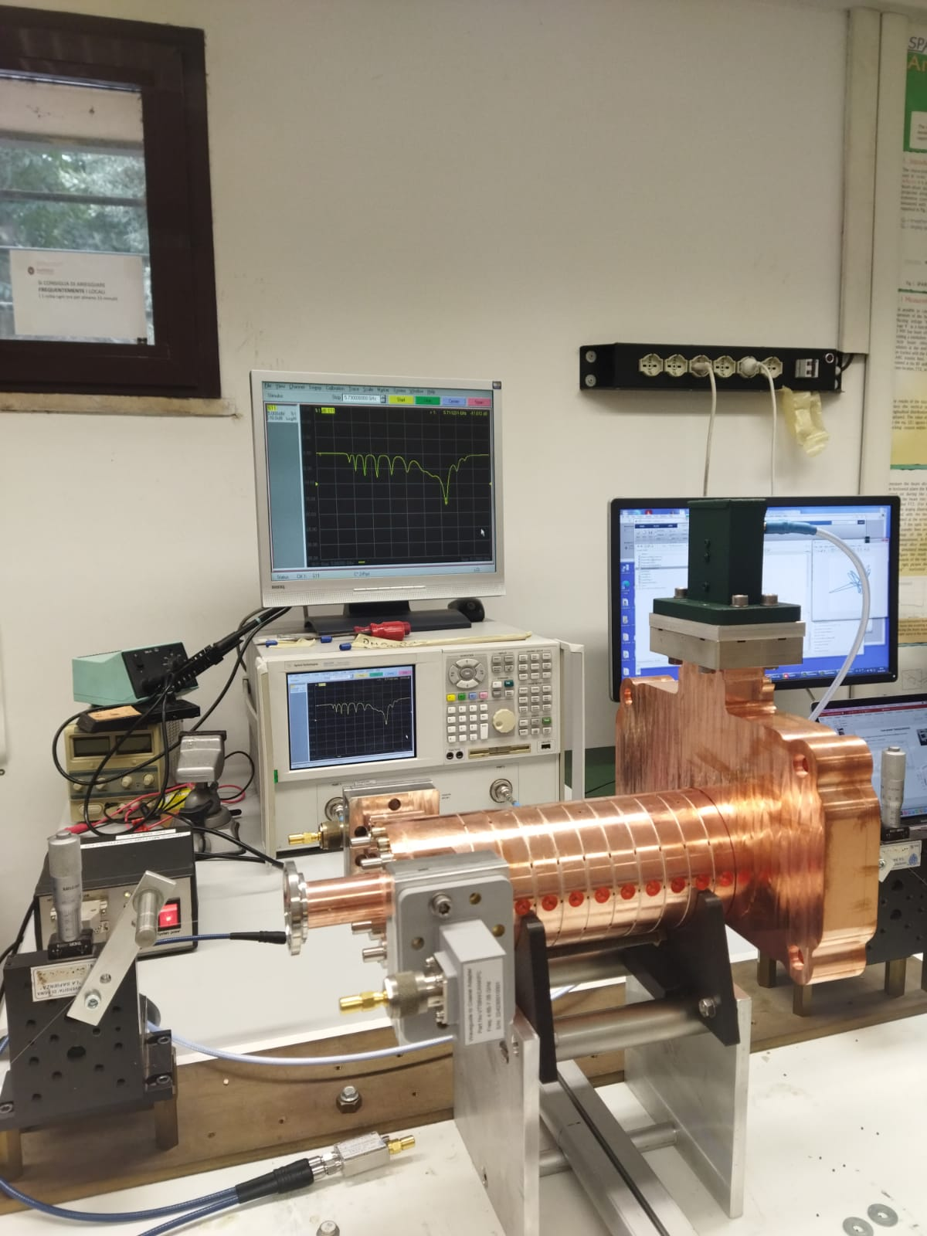
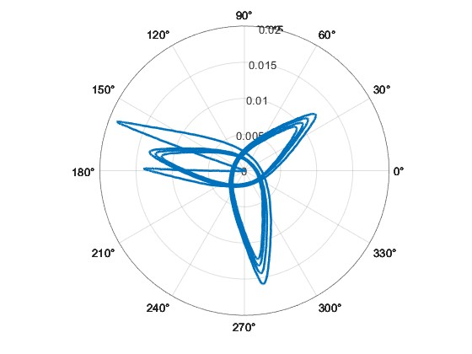
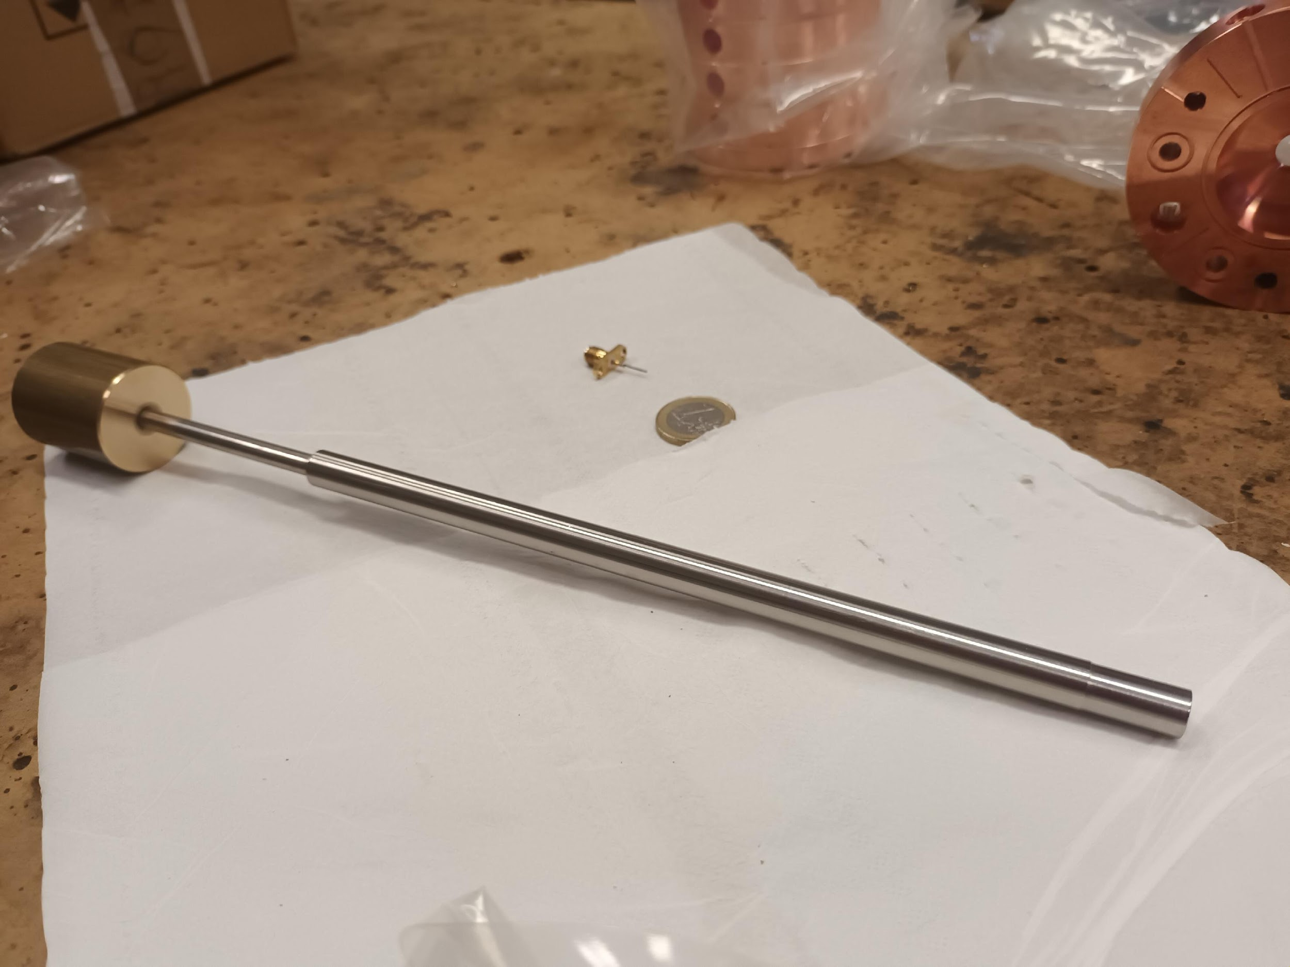
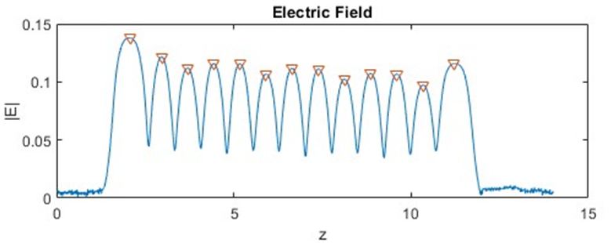
BeadPull measurements after tuning
The structure after mechanical processing is untuned: tuning by deformation
Input coupler
Electric field after tuning
Output coupler
120 degree the phase shift of the electric field in the adjacent cell
tuners
Others contribution: F. Cardelli, D. Alesini,L.Faillace, L.Ficcadenti A. Mostacci

Slide 20

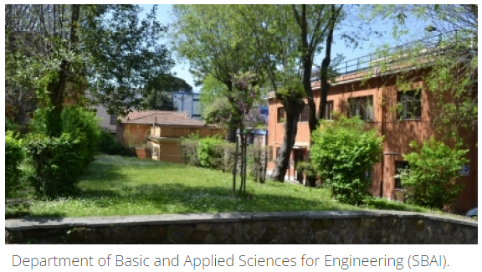
First step@Sapienza
Machine for pre-clinical studies of FLASH was funded with budget of 1.6 ME
5 MW 4 μs
Pulse compressor 20 MW, 1 μs
Asymmetric power splitter
Phase shifter
Attenuator
1 mt
30 MV/m
30 MeV
SW Injector
TW Structure

Slide 21
Thanks to…
M. Magi, M. Migliorati, A. Mostacci, L. Palumbo (Sapienza University of Rome)
L. Ficcadenti, (INFN-ROMA, Rome)
D. Alesini, R. Di Raddo, L.Faillace, B. Spataro (LNF-INFN, Frascati)
SiT Sordina IORT technology spa Company
..and to you for your attention!!
Young@INFN

Slide 22
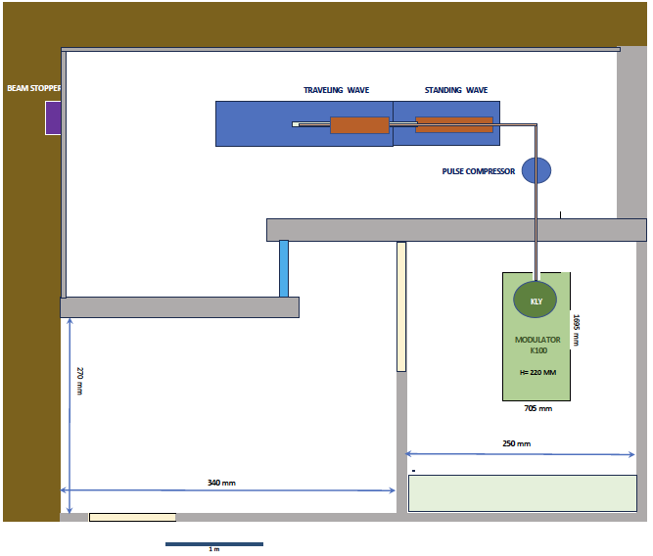
FlashLAB@SBAI

