Slide 1
Quantum Computing
Concezio Bozzi
LNF, 30 Maggio 2024

Slide 2
Quantum Computing in a nutshell
Concezio Bozzi
LNF, 30 Maggio 2024

Slide 3
What is a Quantum Computer?
Credits: A. Roggero, V. Amitrano

Slide 4
What is a Quantum Computer?
Credits: A. Roggero, V. Amitrano
Superconductive circuits
Trapped ions
Photons
Neutral atoms

Slide 5
What a quantum computer does
Credits: A. Roggero, V. Amitrano

Slide 6
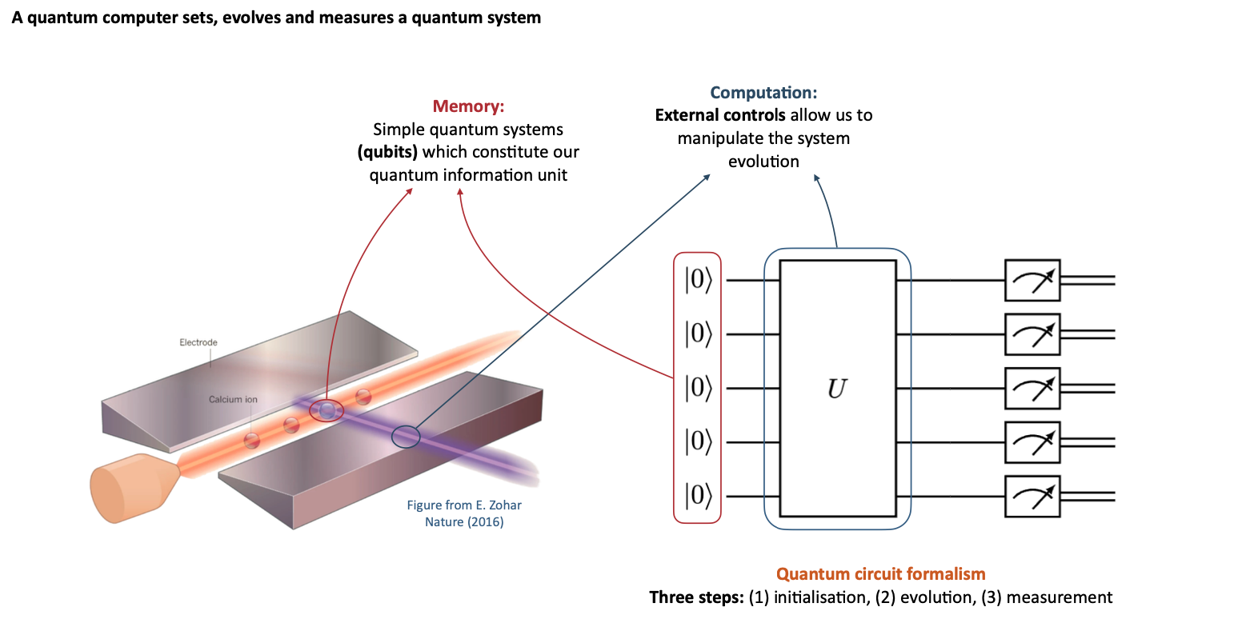
What a quantum computer does
Credits: A. Roggero, V. Amitrano

Slide 7
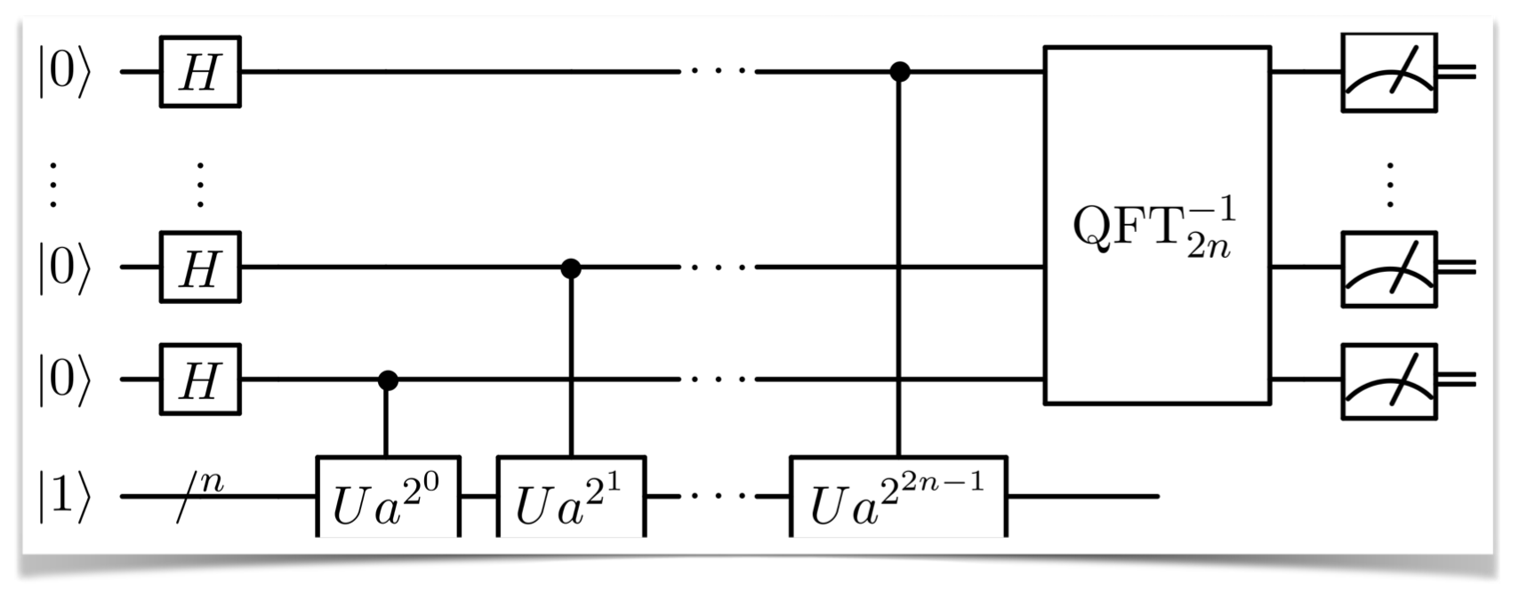
What a quantum computer does
Credits: A. Roggero, V. Amitrano

Slide 8
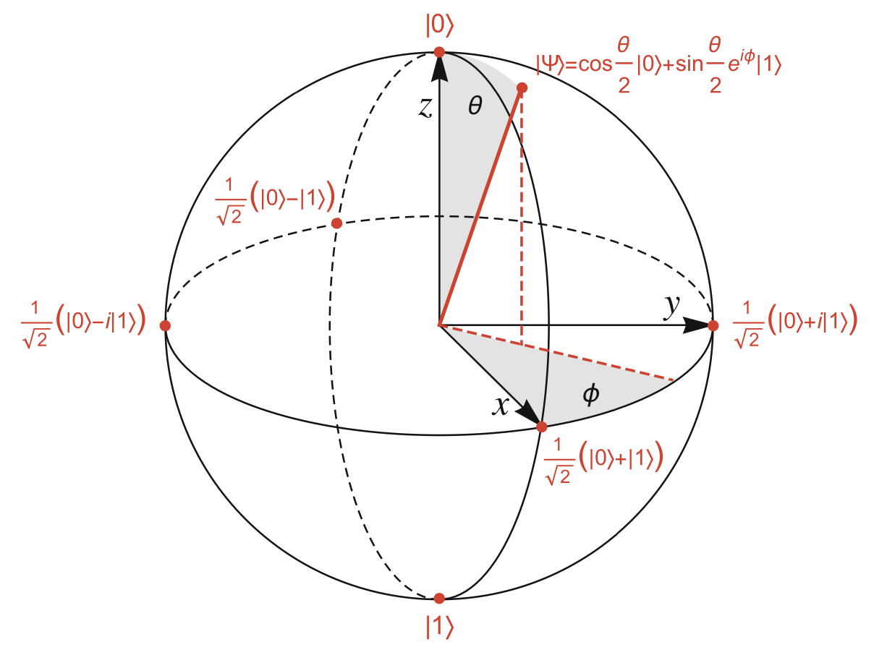
Promises
Quantum Computing is the art of making use of the resources that quantum mechanics gives us
Exponentially store information
Solve “hard” (classical) problems
Revolutionize cryptography
Threaten existing algorithms
New algorithms from quantum cryptography, quantum networking
Bring foundational quantum mechanics to the fore
Superposition, entanglement, interference
Gain new insights into complex algorithms and complexity theory

Slide 9
Advantages of quantum systems
There is a large scaling between classical and quantum systems:
A state of N (qu)bits can hold:
Bit: a single number [0...(2^{N}-1)]
Qubit: 2^{N} complex numbers
in principle, a Quantum system can contain much more information
As quantum states can be put in superposition, a quantum operator only takes one cycle to process
O(1) operator processing

Slide 10
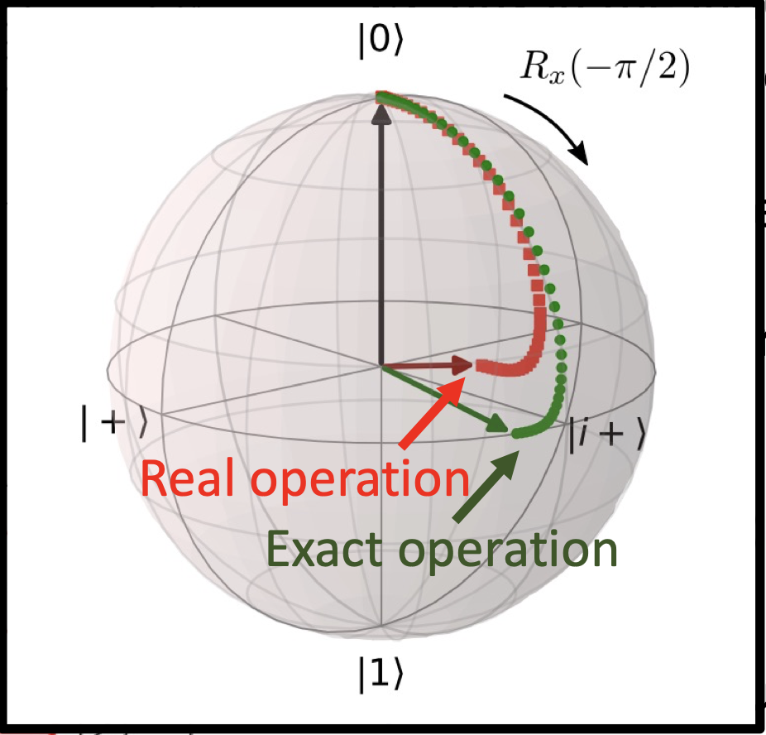
Challenges
Measurement always intrinsically disturbs the quantum system
Quantum systems need to be totally isolated
But
System needs to be controlled
Data needs to be input and output
Qubits within the system need to (strongly) interact with each other
Quantum computers today suffer from
Decoherence, i.e. lack of isolation
Noise, i.e. component fidelity
Error mitigation / error correction needed

Slide 11
The NISQ era
Near-term Intermediate-Scale hardware is prone to errors
Each operation takes some time and has a certain “fidelity”
Simple estimate: a quantum circuit 100 qubits wide by 100 gate-layers deep executed with 0.1% gate error yields a state fidelity of less than 5 × 10⁻⁴
System is not fully isolated → Decoherence (T_{dec})
Run time of a circuit must be less than decoherence time: T_{run } < T_{dec}

Slide 12
Recent results on error correction
https://doi.org/10.1038/s41586-024-07107-7
https://doi.org/10.1038/s41586-023-06927-3

Slide 13
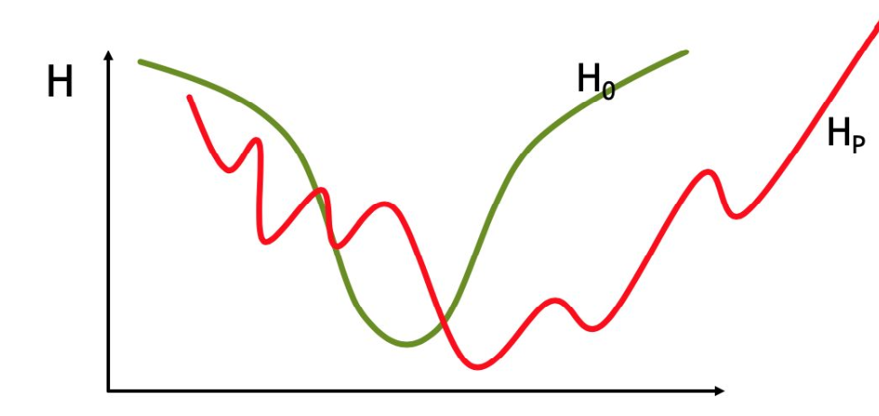
Two approaches to quantum computers
Digital quantum computers (e.g. IBM):
Program quantum circuits to build a universal quantum computer that replaces in principle all current classical systems
Currently available technologies: Trapped Ions, neutral atoms, Superconducting qubits, photonic QC, silicon QC
Analog quantum computers (e.g. D-Wave):
Use single-purpose highly optimized systems, with limited capabilities
Quantum annealers

Slide 14
QC Hardware

Slide 15
Take-home message
Quantum computers hold exceptional promise to transform computation
Their realization requires overcoming many significant challenges
Qubits are the basic units of quantum computation
Quantum gates operate on qubits to change their states
Quantum gates are combined into quantum circuits to perform quantum algorithms
A wide range of technologies are being explored to produce qubits
Superconductors, trapped ion, photonic, silicon-based, neutral atoms, …
Developing quantum algorithms is very challenging
Only a handful of algorithms exist, still all listed on a single webpage
Quantum advantage has long been a target for quantum computation
Can be argued that it was achieved for very specific cases

Slide 16
Quantum Computing in HEP
Concezio Bozzi
LNF, 30 Maggio 2024

Slide 17
A Cicerone for QC in HEP
https://arxiv.org/pdf/2307.03236

Slide 18
A Cicerone for QC in HEP
https://arxiv.org/pdf/2307.03236

Slide 19
Quantum Computing at INFN
Concezio Bozzi
LNF, 30 Maggio 2024

Slide 20
Early (and ongoing) studies
Efforts emerged at INFN over the past years, in a bottom-up approach
CSN4 “iniziative speciali”, e.g.
Foundational studies, theory of measure, entanglement (BELL)
Quantum Systems: entanglement, simulations, information (QUANTUM)
O(10) research groups, actively working on multiple fronts, e.g.
emulation of multi-body system hamiltonians and simulation on real hardware platforms (superconducting, Rydberg atoms, ions)
study of quantum algorithms, e.g. Bayesian optimization
Codes for quantum error correction
Well-established research activities, exploiting synergies between research groups

Slide 21
Early (and ongoing) studies
Efforts emerged at INFN over the past years, in a bottom-up approach
CSN5:
Quantum simulations (theories with “sign problem”)
Experimenting with Quantum Computers (EQC): study QC frameworks per QC, develop algorithms for graph-coloring and LQCD-inspired problems, optimization and error mitigation, test on real hardware (through CINECA)
DARTWARS: Build and test Travelling Wave Parametric Amplifies to read tiny signals close to the quantum limit with reasonable amplification rate and as large as possible bandwidth
QUB-IT: Quantum sensing with superconducting qubits for fundamental physics
QUANTEP: Learn to develop and operate “universal” quantum gates using Linear Optic Quantum Computation technology.
QUANTERA & Quantera2 : A leading European network of 39 public Research Funding Organisations (RFOs) from 31 countries supporting excellent Research and Innovation in Quantum Technologies (QT)
7 INFN projects: Qu3D, QuICHE, QuantHEP, SECRET, PACE-IN, SQUEIS, T-NiSQ (details in bkcp)

Slide 22
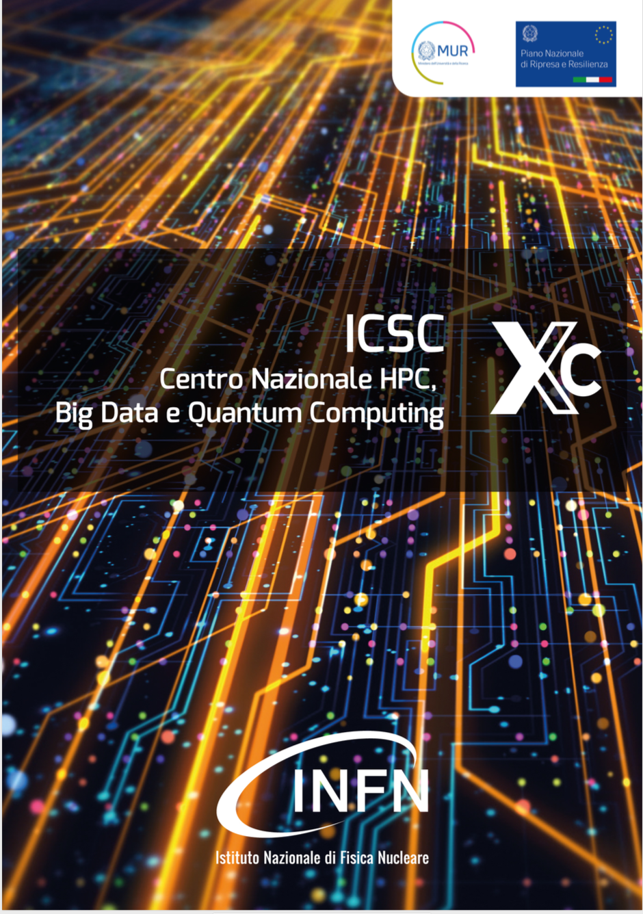
ICSC

Slide 23
Spoke 10 - Quantum Computing
Goals:
Exploitation of QC to solve complex problems in the field of optimization, simulation and machine learning.
Identify quantum algorithms characterized by a speedup, even limited, if compared with the corresponding classical algorithm.
Use the quantum approach to perform calculations on state-of-the-art classical computers (quantum-inspired algorithms, emulators, tensor network computations)
To gain significant benefits in terms of algorithms efficiency without using a quantum hardware.
This will lead to a hybrid systems configuration, that will integrate quantum and classical high-performance computing in order to solve complex problems in a sustainable time.
Activities: development and application of
high-level quantum software for general purpose problems and for scientific and industrial applications;
libraries and development frameworks to access quantum accelerators;
low-level software for the physical operation of specific quantum computers;
software for benchmarking and verification of the quantum computations, optimization of algorithms and compilation;

Slide 24
Work packages/tasks
Leader: INFN
Leaders: CNR, CT
Leader: CINECA
T1.1 New algorithms
PV, BO, IIT, CT, CINECA, CNR, PI, Sapienza, BA, P.Mi, PD
T1.2 Applications and use cases
IIT, BO, CINECA, CNR, INAF, INFN, PV, PI, BA, MIB, Polimi, PD
T2.1 Mapping and compilation
BO, CNR, PI, Polimi
T2.2 Emulation
CINECA, INAF, BA, PD
T3.1 Photonic (RM1, CNR, MIB, PV, NA)
T3.2 SC circuits (NA, INFN, MIB, CNR, CT)
T3.3 Atoms (CNR, PD); T3.4 Ions (PD, CNR);
T3.5 Models and firmware (CT, Polimi, BA, PD, MIB, CNR, PI)

Slide 25
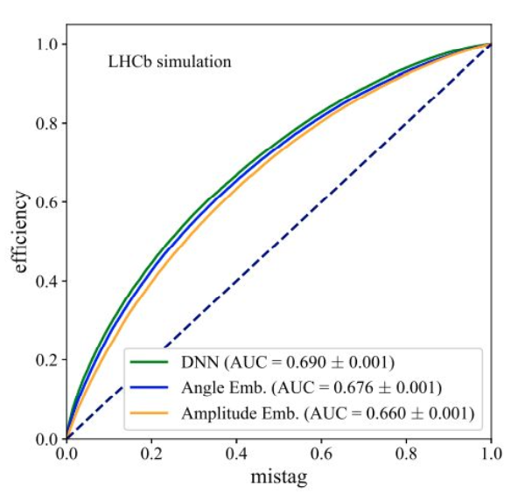
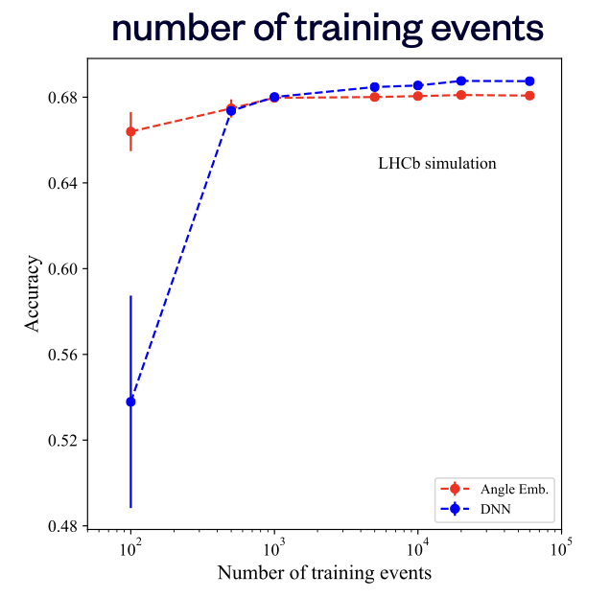
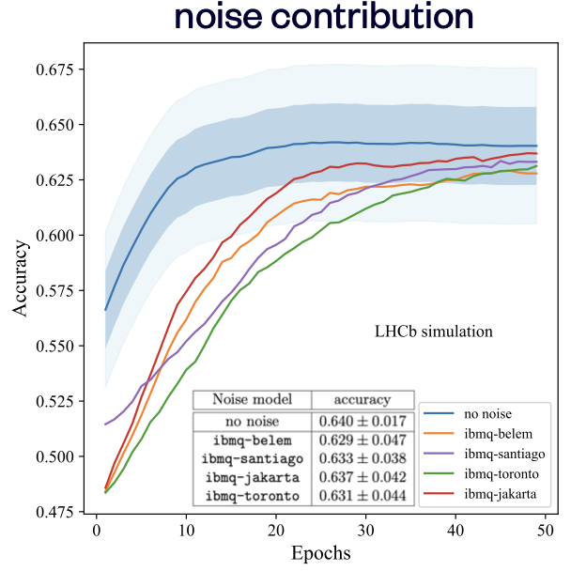
Quantum ML for categorization
Variational quantum classifiers for b-jet tagging
For complete dataset (16 qubits), QML performs slightly worse than DNN
For a low number of training events, the Angle Embedding performs better than the DNN
Simulate noise contribution from several IBM backends. Simpler structures are robust to noise

Slide 26
Some (biased!) references
Collective neutrino oscillations
Quantum support vector machines for neutrino physics (DUNE)
Quantum Auto-Encoder for detection of long-lived particles (ATLAS)
Extension of Variational Quantum Eigensolver to study excited states
Quantum Diffusion Models

Slide 27
Community building
Partnerships in various consortia, e.g.
Quantum Computing and Simulation Center Padova (QCSC)
Quantum Trento (Q@TN)
Superconducting Quantum Materials and Systems Center (SQMS)
Events/workshops
QML session at AI@INFN - Artificial Intelligence at INFN (Bologna, May 2-3, 2022)
Workshop on Quantum Computing @ INFN (Bologna, November 14-15, 2022)
Workshop on Quantum Technologies (Computing, Sensing & Simulation) (Torino, June 7-9, 2023)
Quantum Computing and Simulation Workshop (Venice, October 11-13, 2023)

Slide 28
Quantum Hardware
Quantum computing studies are initially performed on simulators that run on classical computers
Usage of real quantum hardware happens at a later stage
In the past:
Access to D-Wave annealer through CINECA (still available)
Also, pilot access to e.g. Rigetti through cloud-provisions (Amazon Web Services)
Ephemeral resources obtained on a case-by-case basis (e.g. Quantinuum)
Usage of IBM resources through CERN was a game changer
We learned a lot, especially on the reliability of such complex systems…

Slide 29
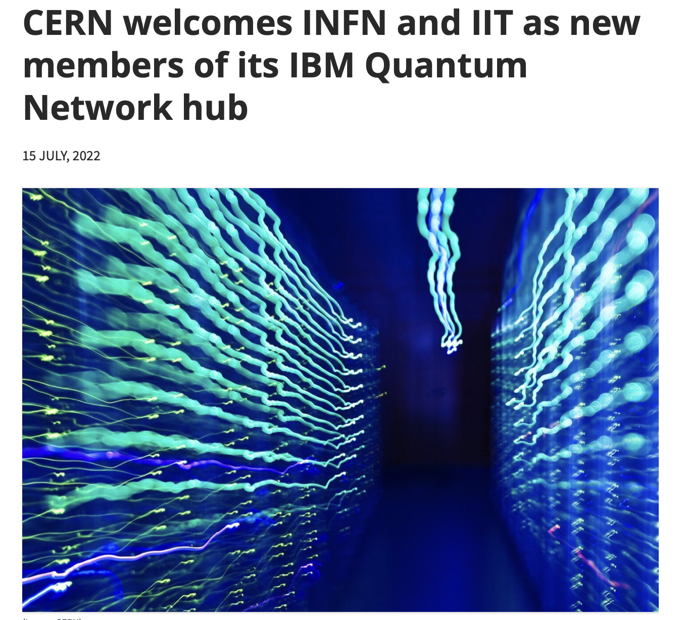
INFN (and IIT) members of CERN IBM Q hub
CERN Quantum Hub is a collaboration of Institutes working on quantum computing for fundamental science applications.
CERN-INFN agreement for prioritised usage of IBM Quantum resources
Started on May 15th, 2022
Ended on May 14th, 2024
O(10) projects, in association with several university groups
More than 50 collaborators
600 mins / months of QPU time
Used up to 4 days / month in the last quarter!

Slide 30
Projects
Simulations
QCD (Pisa, Bologna, Bari)
collective ν oscillations (Trento, INFN-TIFPA)
nn potential (Trento, INFN-TIFPA)
Quantum machine learning in HEP, nuclear and GW physics (Padova, INFN-PD, Sapienza, MIB)
e.g. b-tagging at LHCb
Charged particle tracking (INFN-FE)
Technological
Innovative 2D materials (Tor Vergata, Pavia)
Foundational
Noisy quantum algorithms (Trieste)
Exploring QC (Ferrara)

Slide 31
A couple of results obtained on IBM quantum hardware resources
Comparison of quantum error mitigation strategies for Hamiltonian simulation and variational quantum algorithms, using as test bench some simple fermionic systems and discrete gauge theories.
Charged particle tracking at HL_LHC with
Hybrid quantum-classical graph neural networks
(shown at EUCAIF2024, accepted at ICHEP2024)

Slide 32
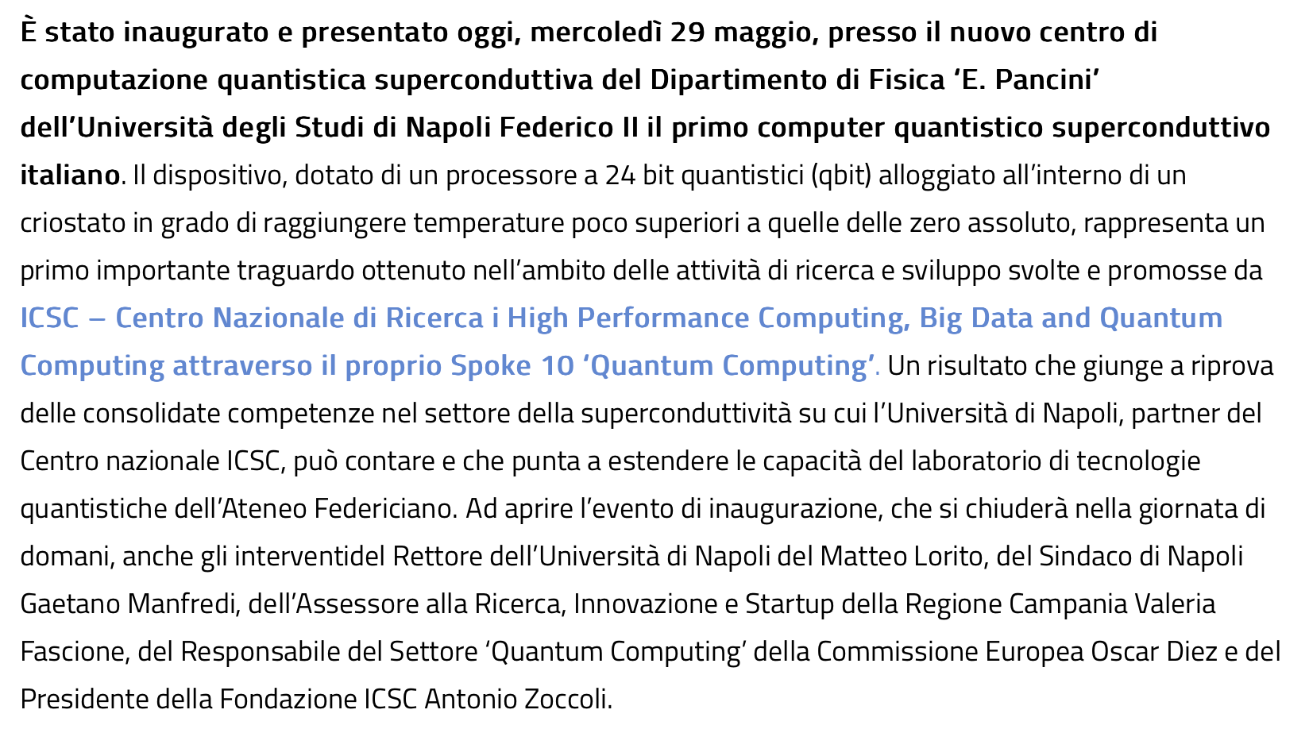
A new kid on the block!
https://www.supercomputing-icsc.it/2024/05/29/inaugurato-alluniversita-federico-ii-di-napoli-il-primo-computer-quantistico-superconduttivo-italiano/

Slide 33
What next?
Quantum hardware (badly) needed
Too early to buy commercial objects, cloud access preferable
In touch with CERN Quantum Technology Initiative
Access through CINECA / QCSC (D-Wave, IQM, Pasqal?)
Exploring procurement through ICSC (IBM, QuEra, AQT)
Simulators are our day-to-day workhorses
Integration of both quantum hardware and simulators in our computing infrastructure would be beneficial
Ongoing efforts in that direction (e.g. AI_INFN CSN5 project)
Beware: rapidly moving targets!

Slide 34
Outlook / strategy
Quantum hardware (badly) needed
a computing infrastructure enabling integration and seamless access to real hardware and simulators
within the domain of CNC/C3SN
Community building
Bottom-up approach so far
Joint CSN4/CSN5 initiatives
More structured approach to
Discuss scientific goals and objectives
Decide directions and priorities

Slide 35
Backup

Slide 36
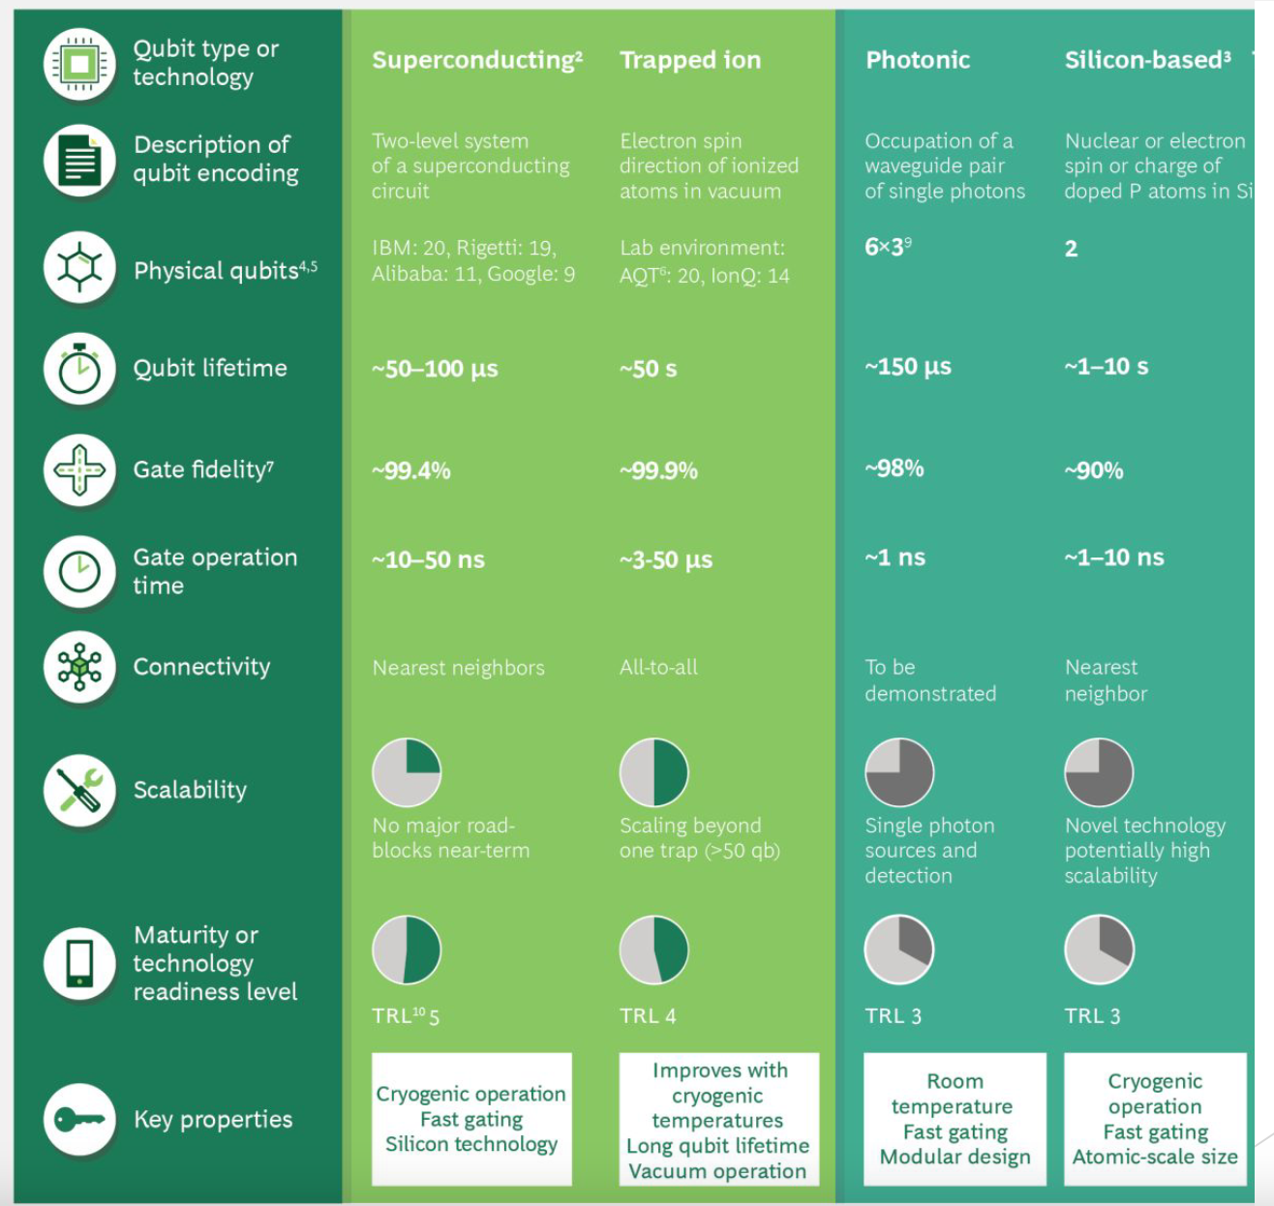
Circuit/gate QC

Slide 37
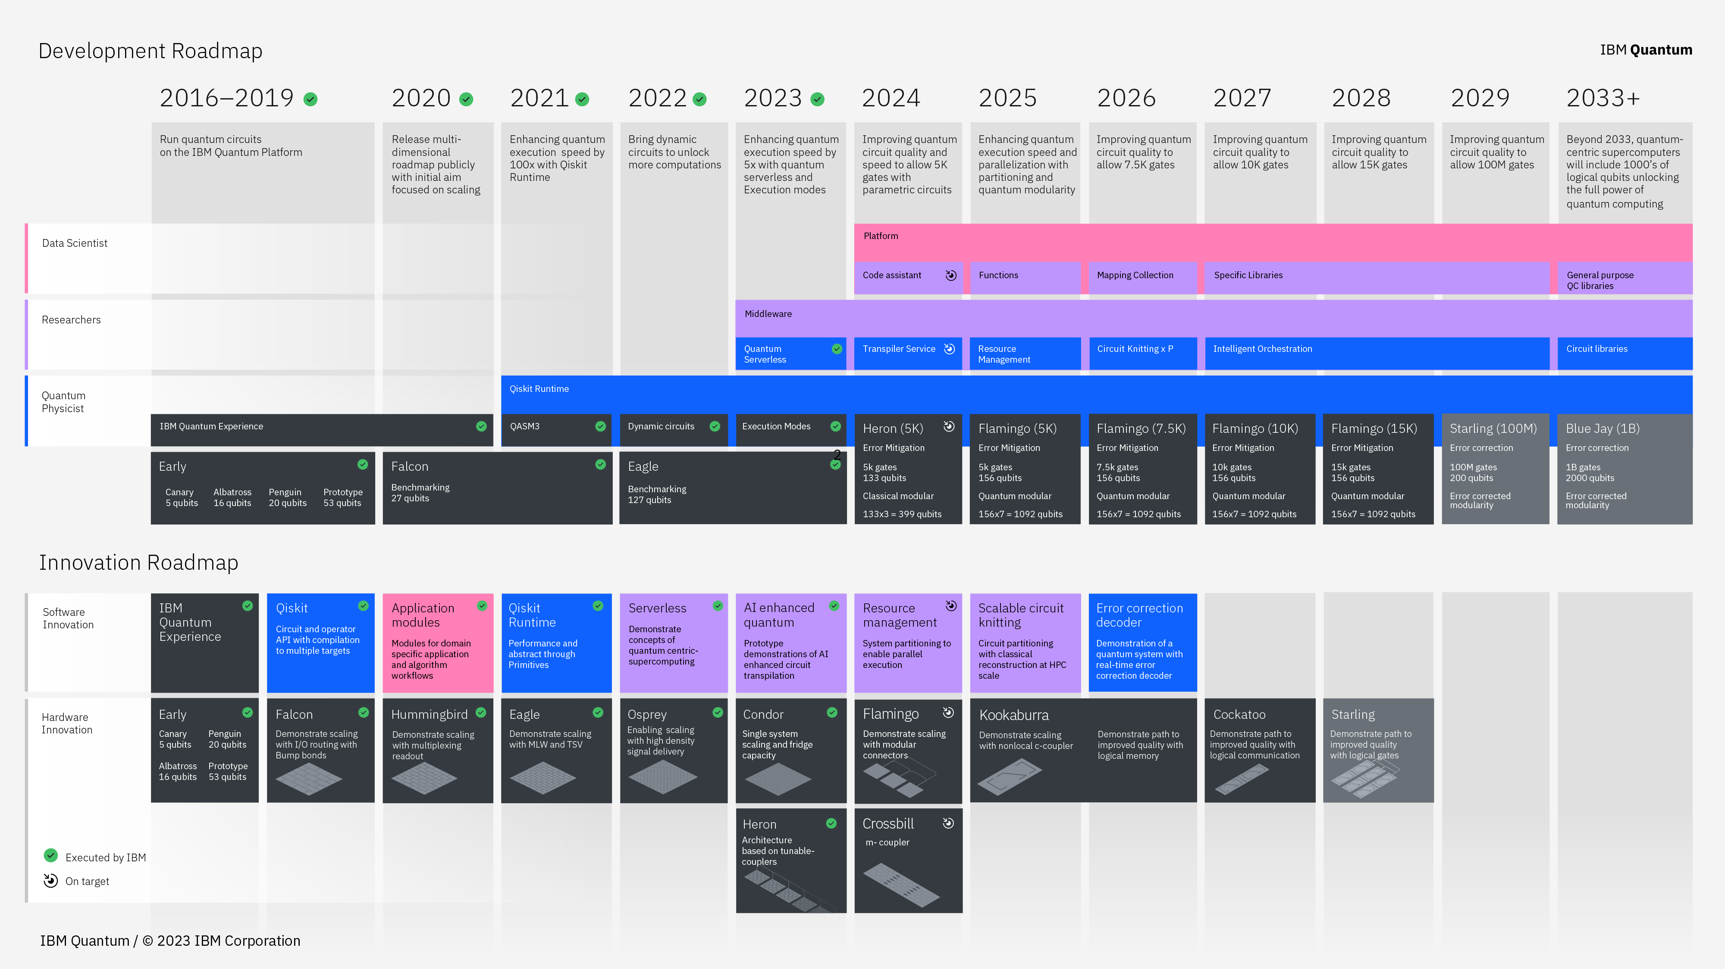

Slide 38
INFN@SQMS
GGI, LNGS, LNL, Ferrara, Firenze, Padova, Pavia, Roma I
theory at the fundational / metrological level
theory and algorithms for quantum applications
measure and mitigate the negative impact of radioactive background
contribute/improve our expertise in superconducting cavities
couple transmons and (B-friendly) cavities
make LNGS a national test/characterization facility for Quantum devices
Ph.D. schools/workshops/conferences at GGI (and elsewhere)
help young people enter this field

Slide 39
Quantera
A leading European network of 39 public Research Funding Organisations (RFOs) from 31 countries supporting excellent Research and Innovation in Quantum Technologies (QT)
INFN joined Quantera as one of the Italian funding members in 2018
2019 call: 5/15 INFN proposals accepted (total: 12/85 proposal accepted)
Qu3D - Quantum 3D Imaging at high speed and high resolution, Milena D’Angelo (BA)
QuICHE - Quantum Information and Communication with High-dimensional Encoding, Chiara Machiavello (PV)
QuantHEP - Quantum Computing Solutions for High-Energy Physics, Simone Montangero (PD)
SECRET - SECuRe quantum communication based on Energy-Time/time-bin entanglement, Giuseppe Vallone (PD)
PACE-IN - Photon-Atom Cooperative Effects at Interfaces, Paolo Facchi (BA)

Slide 40
Quantera-2
2021 call: 39 projects awarded funding, 2 with INFN participation
SQUEIS: Squeezing-Enhanced Inertial Sensing (G. Tino, FI)
establish new frontiers in atom interferometry by devising and applying quantum-enhancement techniques based on squeezing to state-of-the-art applications in gravimetry, gradiometry and inertial sensing.
tunable atom-atom interaction in quantum gases, as well as non-demolition measurements via the coupling of atoms and light
T-NiSQ: Tensor Networks in Simulation of Quantum matter (S. Montangero, PD)
systematically develop quantum-inspired algorithms to benchmark, certify and validate quantum devices
Tensor networks play a central role
Develop benchmarking tools for high-dimensional quantum systems in the presence of noise and test them in state-of-the-art quantum simulations and computations.
Advance our understanding of dynamical and strong- correlation effects in quantum matter also beyond the NISQ era

Slide 41
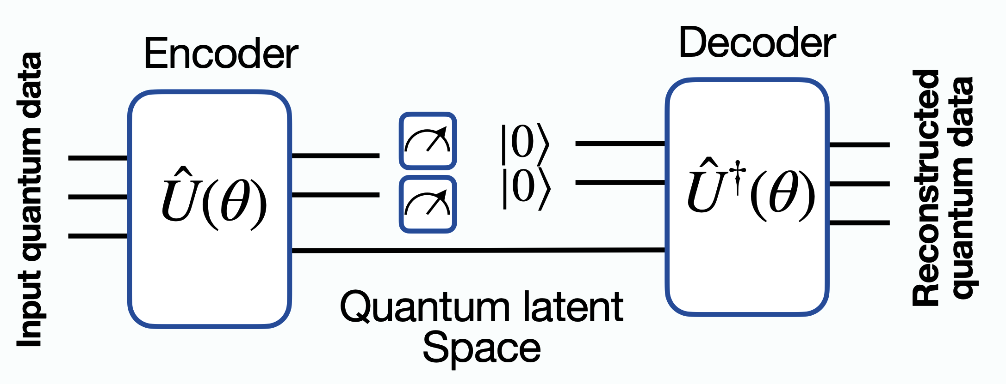
ANOMALY DETECTION FOR LONG LIVED PARTICLES
Design and train a Quantum-AE able to identify highly displaced decays using the ATLAS muon spectrometer information
Classical AE
NORMAL event
“image” representation of a prompt decay in multi-muons
Quantum-AE
ANOMALOUS event
“image” representation of a highly displaced decay in multi-muons
S.Bordoni et al, Particles 2023, 1, 1–15

Slide 42
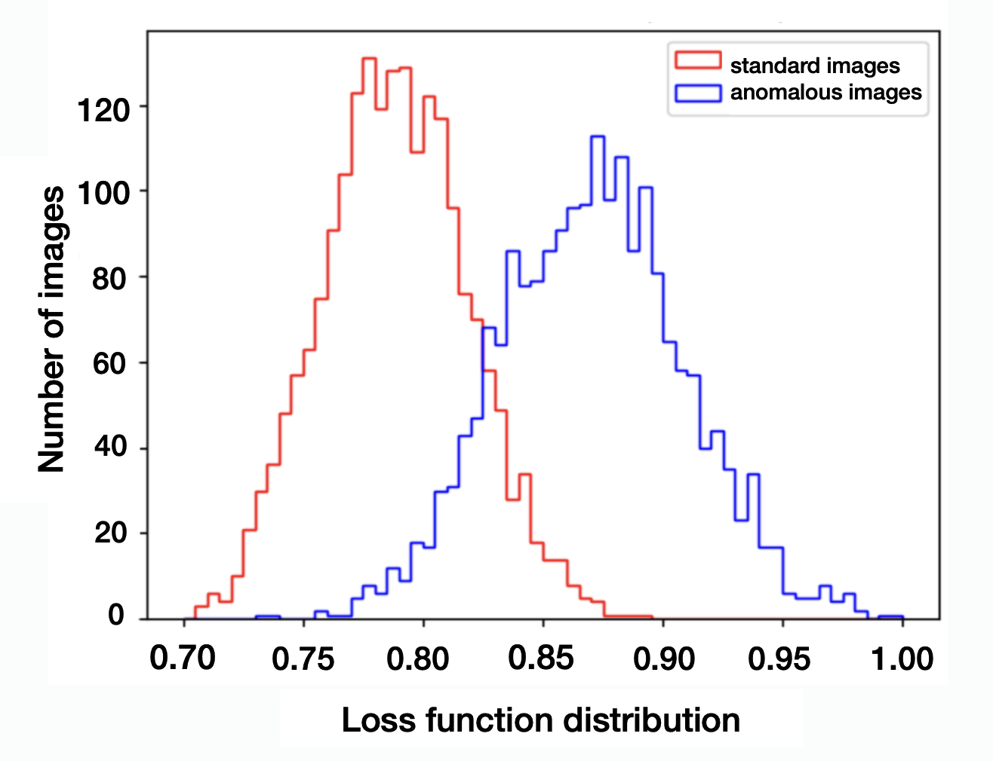
ANOMALY DETECTION FOR LONG LIVED PARTICLES
parametric quantum circuit ansatz
$$U(θ)$$
description of the quantum noise and quantum error correction
a crucial issues still to be solved …
S.Bordoni et al, Particles 2023, 1, 1–15

Slide 43
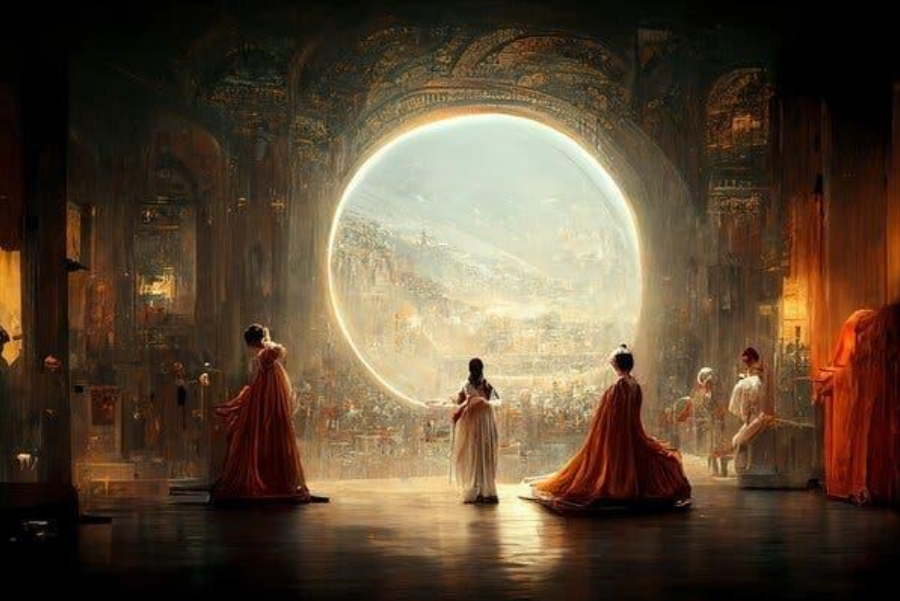
DIFFUSION MODELS
generative AI models, inspired by non-equilibrium thermodynamics, that use artificial neural networks to gradually add and then remove noise from data, with the aim of generating or reconstructing high-quality data sample
Data data corruption through noise injection Noise
Data generation of new data via denoising Noise
predicted by an ANN
used in multiple AI applications (generation of artificial images and videos (DALL-E, Stable Diffusion, Sora, ...), denoising and reconstruction of corrupted images, super-resolution, ...)

Slide 44
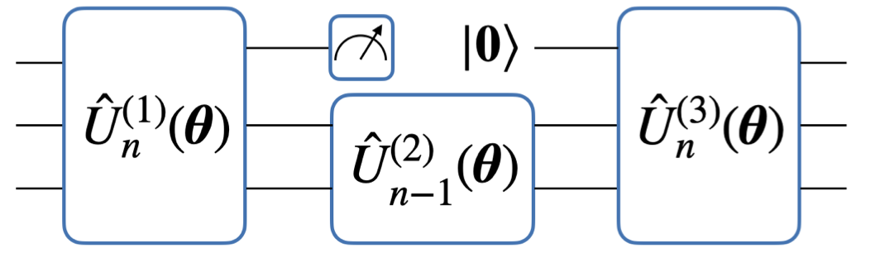
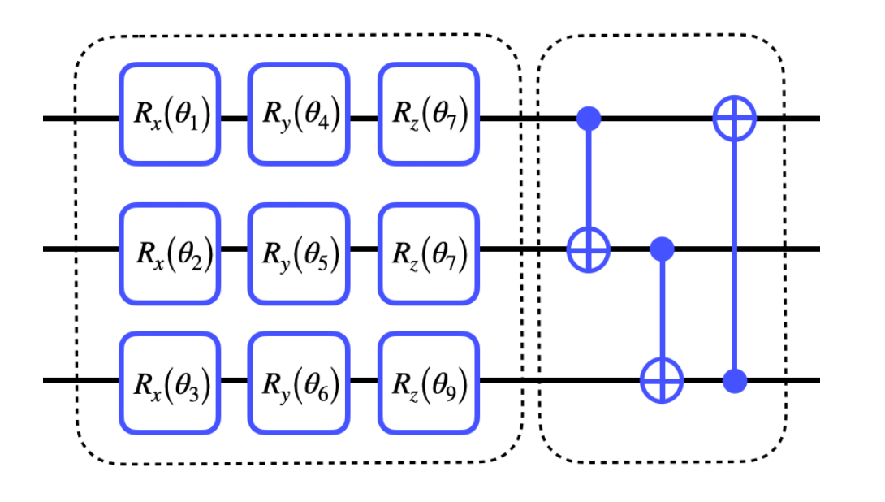
QUANTUM IMPLEMENTATION
leverage the ability of variational quantum circuits to efficiently represent the solution space of the problem and to identify complex correlations in data in order to implement a quantum denoiser
parametric
quantum
circuit
entangler
xL-layers
A. Cacioppo, L.Colantonio, S.Bordoni, S.Giagu, arXiv:2311.15444 [quant-ph]

Slide 45
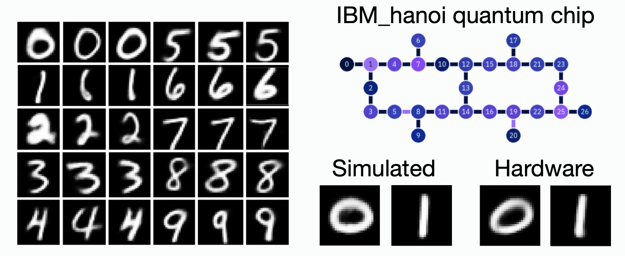
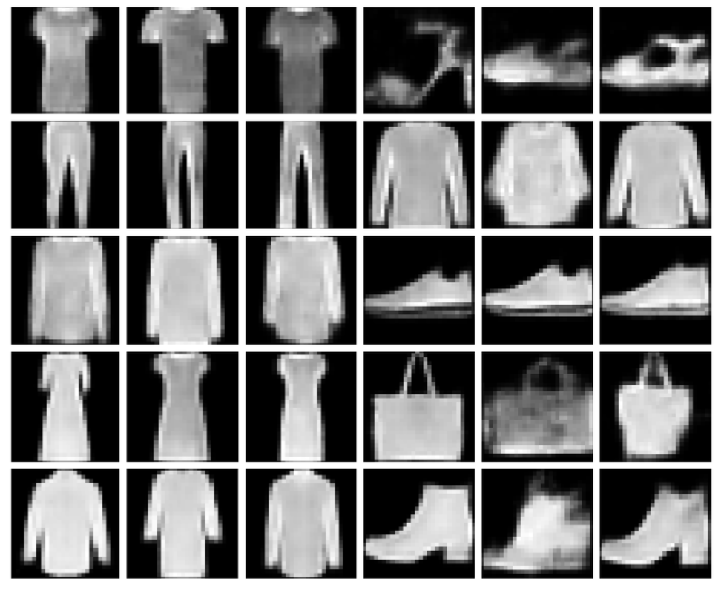
QUANTUM DIFFUSION MODEL
data points encoded into quantum states. Markov chain implemented by a quantum circuit acting as a denoiser
can be used in a full quantum or in an hybrid mode, where the quantum circuit is trained in the latent space of a classical AE
conditioning achieved by adding ancillary qubits to encode labels
Quantum Denoiser
$$P(θ,1)⋯P(θ,T)|x_{T}⟩=|x_{0}⟩$$
$$P(θ,t)|x_{t}⟩=|x_{t−1}⟩⇒$$
$$Loss=1−𝔼[F]$$
quantum in-fidelity
parametric quantum circuit ansatz
Conditioned hybrid
(simulation)
Conditioned hybrid
(quantum hw)
A. Cacioppo et al, arXiv:2311.15444 [quant-ph]
xL-layers

Slide 46
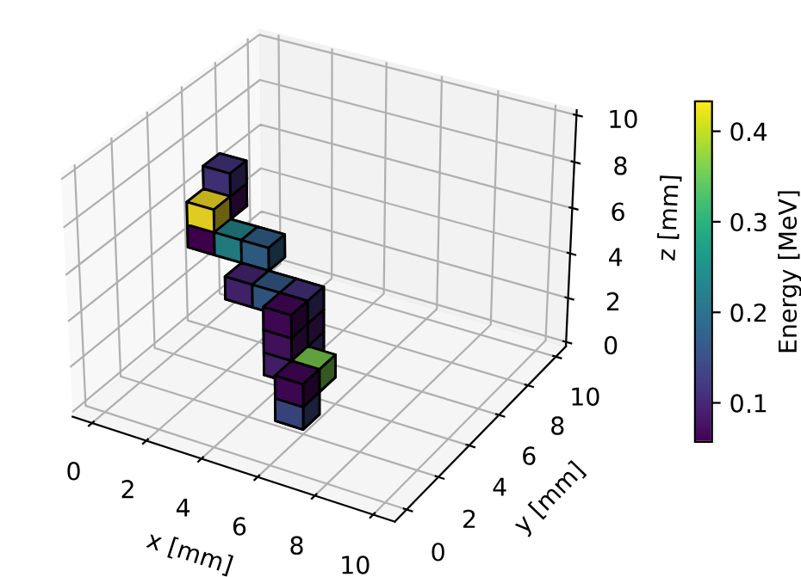
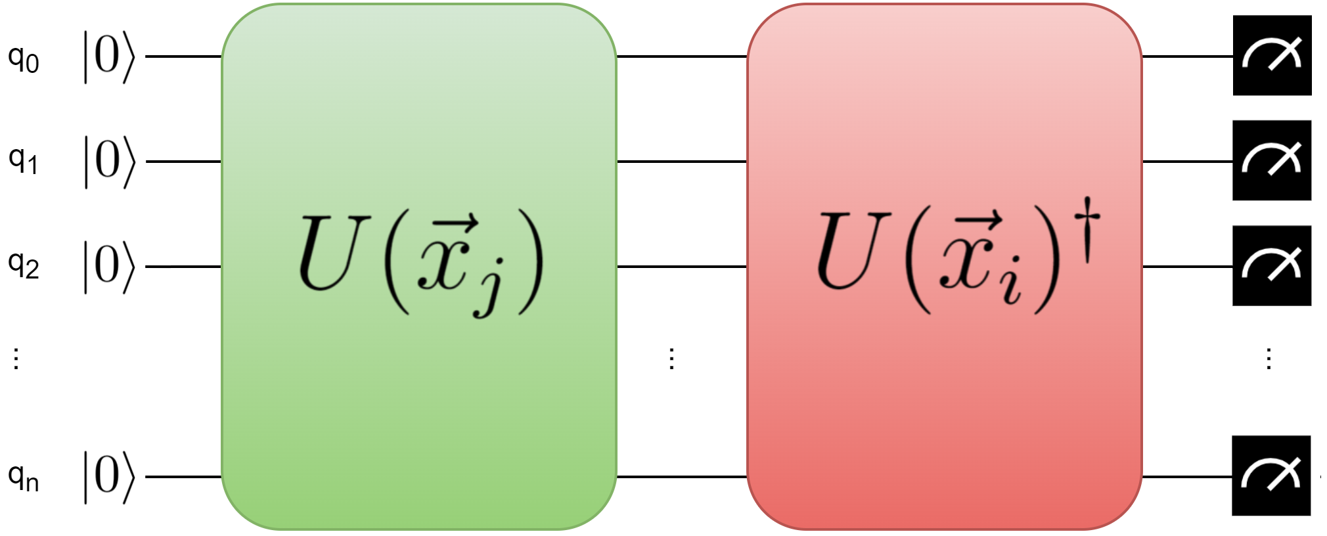
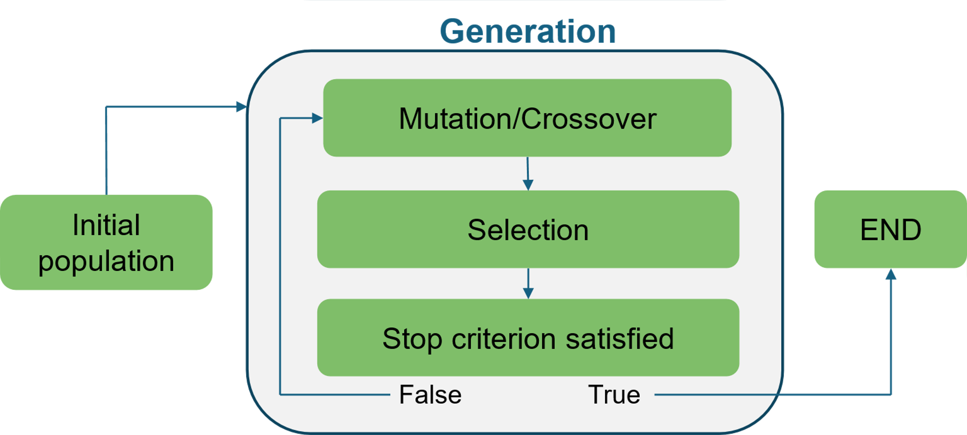
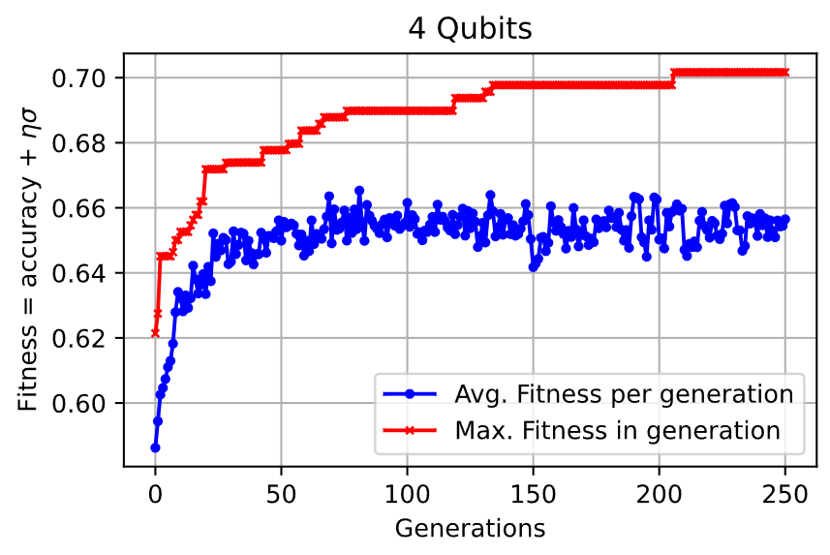
Quantum ML for neutrino physics
DUNE experiment (ton-scale LArTPC) low-energy physics reach is to be fully explored.
Potential for high sensitivity to $0νββ$ deay of the$^{136}Xe$ isotope.
But advanced background suppression techniques are needed $→$ investigate Quantum Kernel methods.
Optimizing quantum kernels is an open problem $→$ investigate genetic Quantum Kernel optimization.
Quantum circuits with this structure are suitable kernels.
Premiating both Quantum Kernel performance and «NISQ friendliness».
$→$ test on quantum hardware is necessary.
Results will be presented at Neutrino Physics and Machine Learning (NPML2024), Zurich, CH
Credit: R. Moretti
Advisors: A. Giachero, F. Terranova.

Slide 47
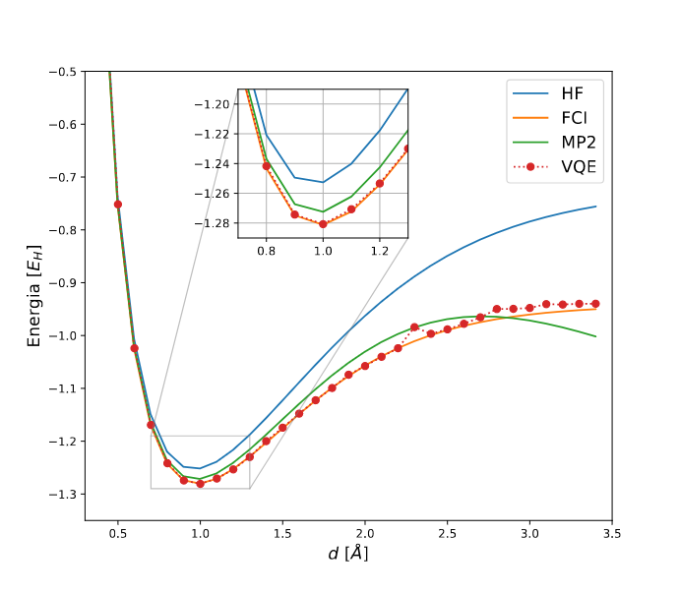
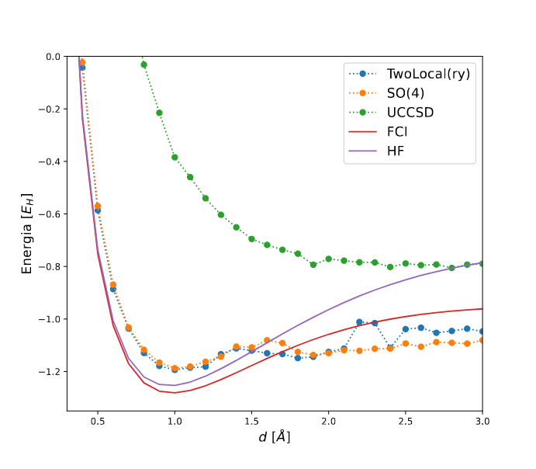
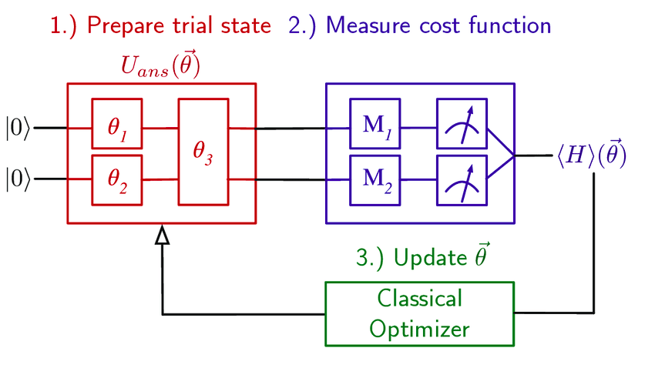
Variational Quantum Eigensolver
Classical problem scales exponentially.
VQE is a Hybrid Quantum computing method: efficient even with NISQ devices (if large enough to represent the state).
VQE is a method to find and build, as a circuit, the ground state of a given Hamiltonian → the ground state can then be directly studied.
Used generally for quantum chemistry, but can be applied to studies of nuclear structure problem, new materials.
https://doi.org/10.1016/j.physrep.2022.08.003
Various VQE variations are continuously created: they usually introduce novel trial states, or novel optimization methods to counter noise effects. → VQE is estimated to surpass classical methods, but on-hardware studies are still required
https://doi.org/10.1088/2058-9565/acd1a9
INFN-MIB published an extension of VQE to study exited states different from the ground one and proposed various bachelor thesis to introduce students to current topics of research.
http://dx.doi.org/10.3390/e23060657
Credit: R. Carobene
Advisors: A. Giachero

