Slide 1
ATTIVITÀ DEL GRUPPO TEORICO UNICA-INFN-CA SU EINSTEIN TELESCOPE E ONDE GRAVITAZIONALI
Staff: M. Cadoni, L. Modesto, P. Olla, nuovo RTT 02/A2
Dottorandi: A. P. Sanna, M. Pitzalis, (M. Oi)
Partecipiamo all’OSB-Div1-Fundamental Physics
Dal 2025, apriremo la sigla INFN TEONGRAV nella nostra sezione
ATTIVITÀ SCIENTIFICA
Studio del rumore Newtoniano atmosferico dei rivelatori di onde gravitazionali di terza generazione (v. intervento di A. P. Sanna)
Uso dei dati di LIGO-VIRGO e forecast per ET per lo studio del possibile accoppiamento cosmologico dei buchi neri (collaborazione con il GSSI: M. Branchesi, R. Murgia, …)
Pensiamo di aprire una nuova linea di ricerca su segnature di Quantum Gravity nelle osservazioni di ET
Kickoff ET Cagliari – 24/06/2024

Slide 2
Atmospheric Newtonian noise modeling for third-generation gravitational-wave detectors
Speaker: Andrea Pierfrancesco Sanna
Based on: Phys. Rev. D 106 (2022) no. 6, 064040
In collaboration with: Davide Brundu, Mariano Cadoni, Piero Olla, Mauro Oi
Kickoff ET Cagliari – 24/06/2024

Slide 3
Motivations
Third-generation gravitational-wave detectors are expected to enhance the sensitivity of a factor 10 and to push the frequency bandwidth down to 2-3 Hz
The major limitations in this frequency band are expected to come from the Newtonian Noise
Seismic Noise
Atmospheric Noise
[Saulson (1984)], [Harms (2019)]
[Creighton (2013)]
Main objective
Improve the estimation of the atmospheric noise and compare it with the ET sensitivity curve
Kickoff ET Cagliari – 24/06/2024
1

Slide 4
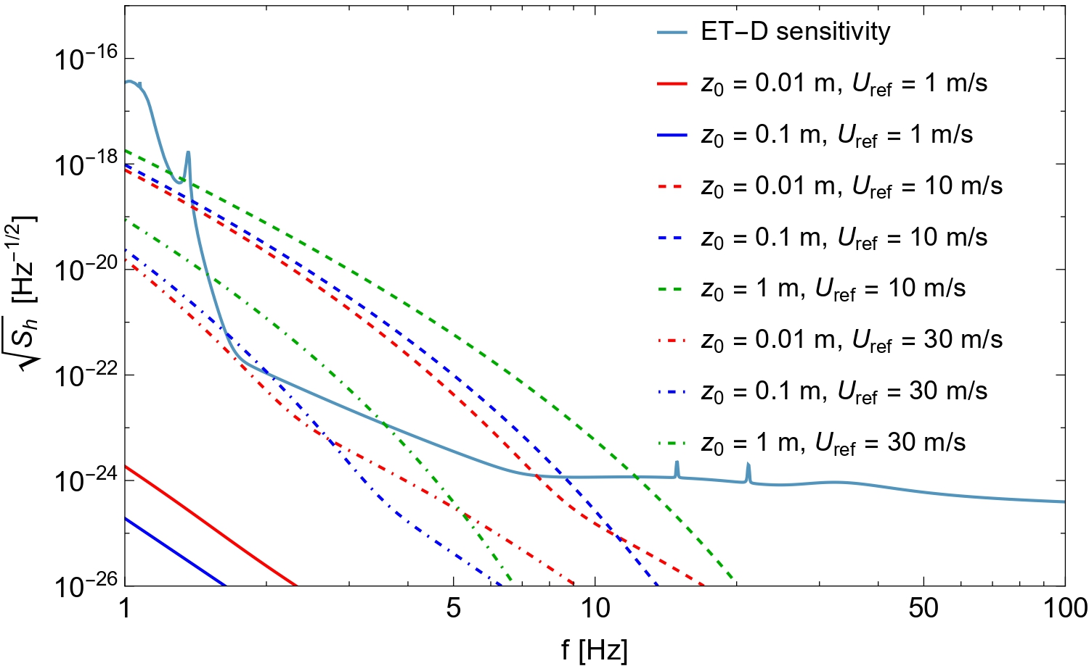
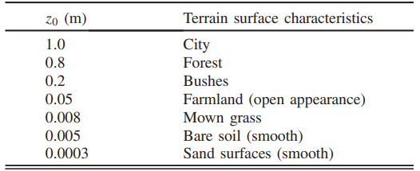
Results
Detector depth: 5 m
$$U_{wind}∝\ln{\frac{x_{3}}{z_{0}}}$$
Reference values of the roughness of the terrain
Kickoff ET Cagliari – 24/06/2024
2

Slide 5
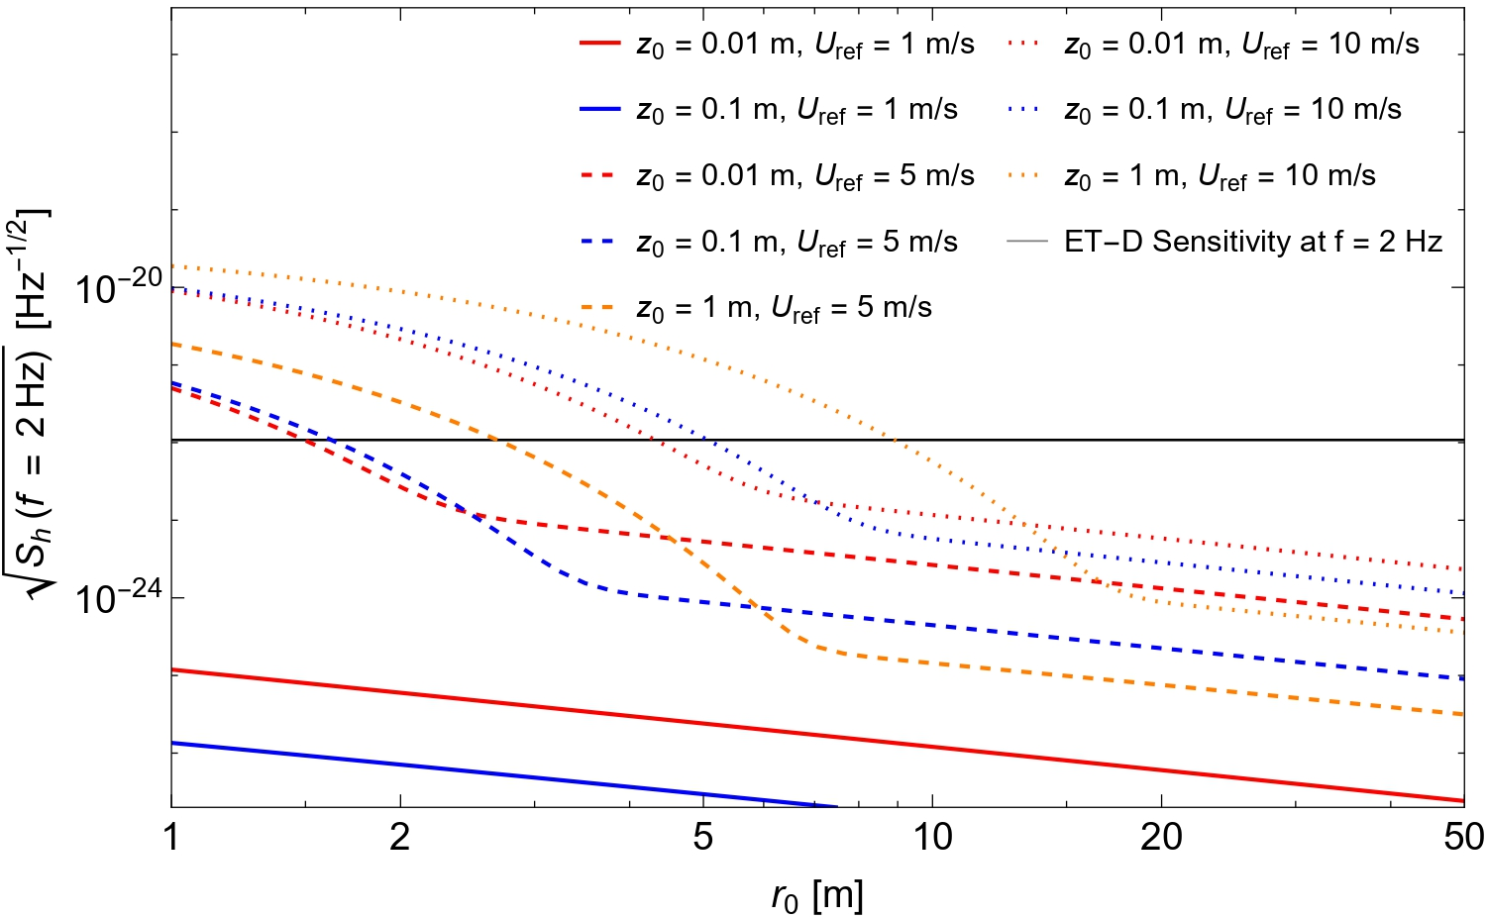
Results
$$U_{wind}∝\ln{\frac{x_{3}}{z_{0}}}$$
Reference values of the roughness of the terrain
Kickoff ET Cagliari – 24/06/2024
3

Slide 6
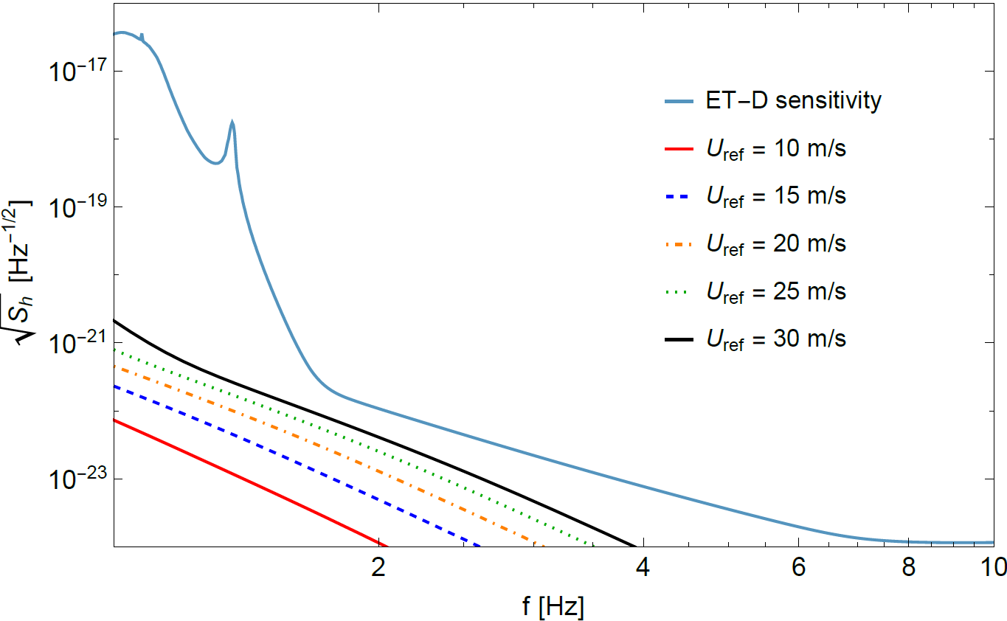
Results
$z_{0}=0.1,$ detector depth: 50 m
For large values of the wind speed, the noise is only a factor ~5 below the sensitivity curve
Kickoff ET Cagliari – 24/06/2024
4

Slide 7
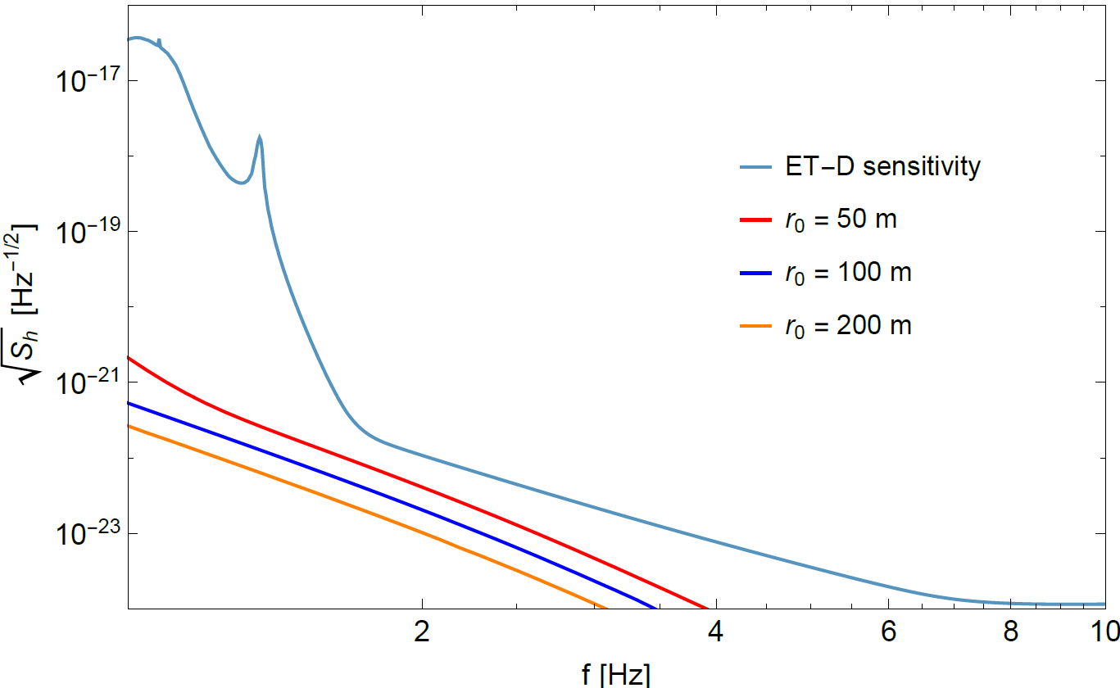
Results
$z_{0}=0.1$, $U_{ref}=30 m/s$
For $r_{0}=50 m$, the noise is a
factor ~10 below the sensitivity curve
Passive mitigation may be insufficient!
Kickoff ET Cagliari – 24/06/2024
5

Slide 8
Conclusions
General features
Noise is suppressed at large frequencies
Noise is partially mitigated placing the detector underground
Future perspectives
More accurate modeling of atmospheric turbulence
(our study provided only orders of magnitude estimates)
Numerical simulations (atmospheric codes) are essential
Measurements in situ of the temperature field
Kickoff ET Cagliari – 24/06/2024
6

