Slide 1
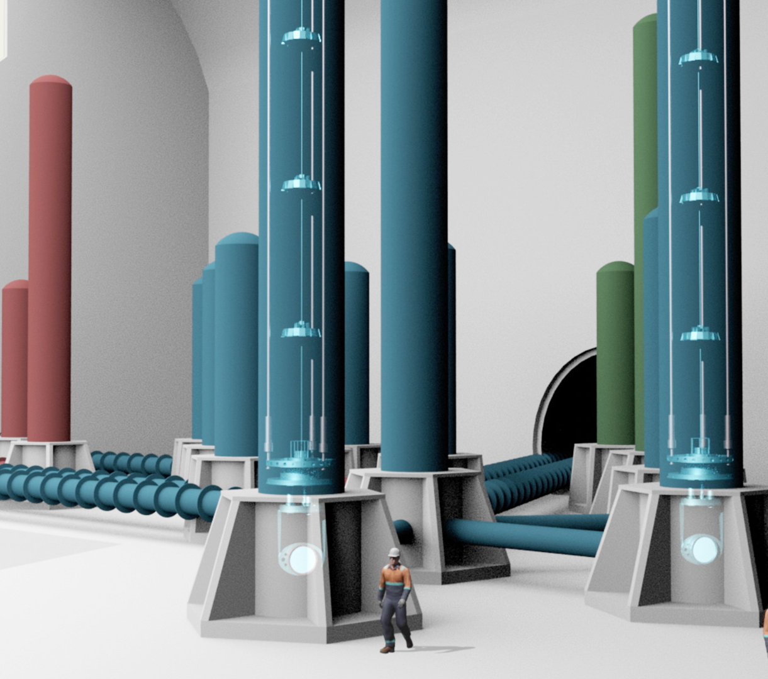


ET-GENERATION June 2024
La Collaborazione e
l'Organizzazione:
struttura e opportunità
D. D’Urso

Slide 2
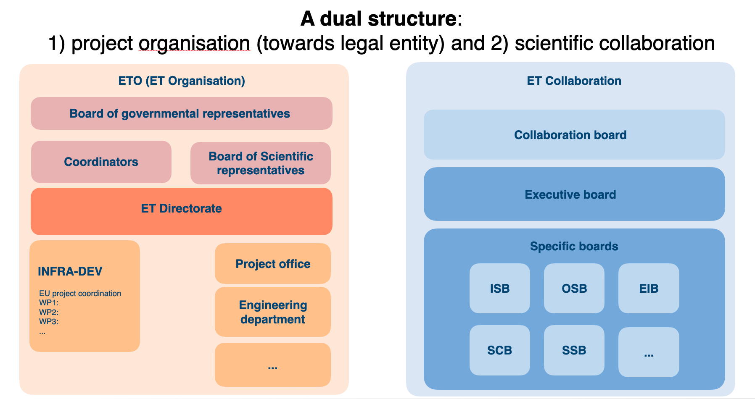
ET Organization & ET Collaboration

Slide 3
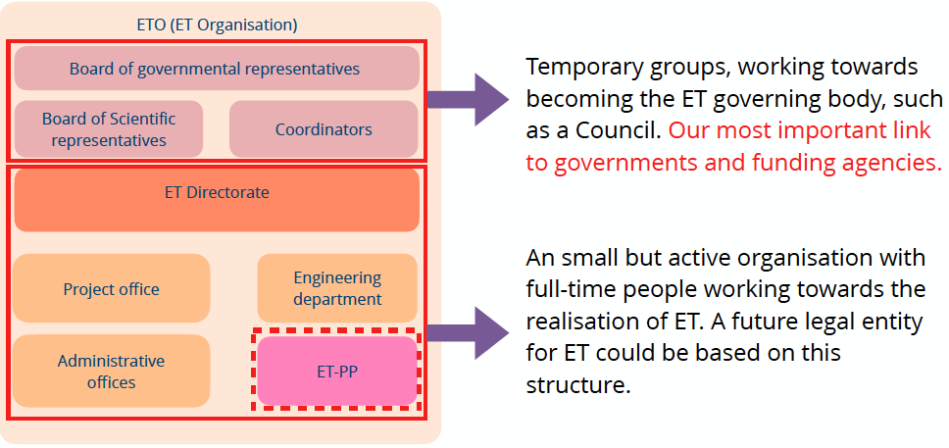
ET Organization (ETO)
The main objective of the ETO Directorate is to provide the Board of Governmental Representatives (BGR) with all the material necessary for a first approval of the creation of the research infrastructure in the selected construction site(s).

Slide 4
Proto-council
Advisory Bodies
Scientific and Technical Advisory Committee
Program Advisory Board
ESFRI Coordinators
Stan Bentvelsen, Antonio Zoccoli
BGR (Board Governm. Represent.)
Policy & monitoring
BSR (Board Scient. Represent.)
Project Directorate
F. Ferroni, A. Freise
M. Martinez
ET Collaboration
CERN
MOA CERN-INFN-Nikhef
P. Chiggiato
TDR ET Vacuum Pipe
monitoring
Providing services
Policy proposals+
monitoring
CB
Collaboration Board
EB
Executive Board
  Deliverables:
  Beam pipe vacuum
  Site Preparation
  Civil Infrastructure
monitoring
Informing
reporting
managing
advisory
managing
reporting
delivering
INFRA-DEV
M. Martinez
WP1 Coordination and Management
WP2 Organization , Governance, Legal
WP3 Financial Architecture
WP4 Site Preparation
WP5 Project Office/Engineering Dept.
WP6Technical Design
WP7Transfer of Technology
WP8 Computing and Data Access
WP9 Sustainable Development Strategy
WP10 Education, Outreach, Citizen Engagement
SSB
Services and Standards Board
FNR
Forum of National Representatives
SF
Science Forum
reporting
Requirements
& competences
managing
Providing services
participating
supervisioning
Communication Office
Strategy
ISB
Instrument Science Board
EIB
Electronics/Computational Infrastructure Board
OSB
Observational Science Board
SCB
Site Characterisation Board
Project Office
setting
Engineering Department
ET Organization
Specific Boards

Slide 5
Activities on three fronts
ETO (international project organisation)
• Provide project management and all engineering work.
• Decide on governance, type of legal entity and financial frameworks, ... • Engineering work and technical design of the research infrastructure.
ET Collaboration (international)
  Define scientific vision and detector requirements. For example: science case for ET,
  which are the key characteristics of a good ET site.
  Research and development the technology required for ET. For example, silicon mirrors, cryogenic suspension systems, ...
Local teams
  Site characterisation with seismic and geological studies.
  Deliver design and implementation plans that are unique to the region.
  Develop economic case and deliver socio-economic impact plan.

Slide 6
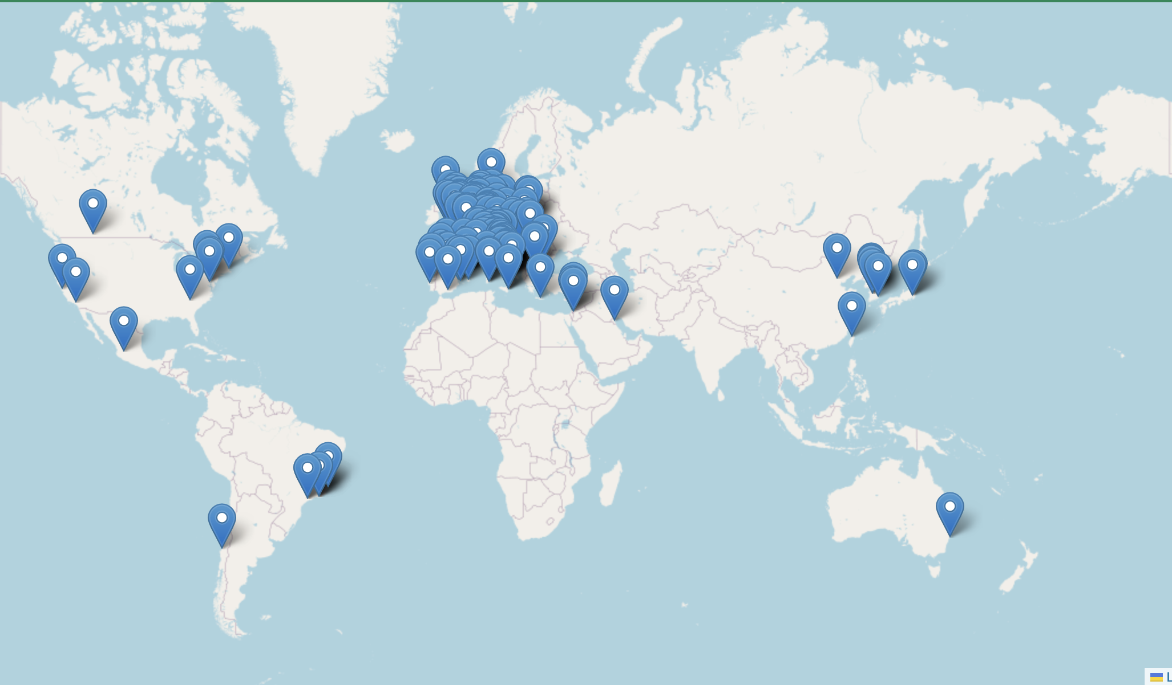
ET Collaboration
ET Member‘s affiliation map
1690 Members
243 Institutions
29 countries.

Slide 7
Main Activities
Self-structuring (Bylaws, SSB committees, new RUs), …
  Under the responsibility of the Collaboration Board chaired by Eugenio Coccia
Contribute, in synergy with the ETO, to all the needed steps toward the realization of the ET observatory
  Optimize the science return
    Define optimal ET geometry and localization
  Evolve the ET CDR toward TDRs:
    PBS (Product Breakdown Structure)
    WBS (Work Breakdown Structure)
  Develop the Enabling Technologies
    R&D activities

Slide 8
Optimize Science return
CoBA (Cost Benefit Analysis) process
  Optimization science return: CoBA Science document
    ET-0084A-23: https://apps.et-gw.eu/tds/ql/?c=16584
  Differential comparison of the (technical, commissioning, operation) risks of the interferometers in the possible geometrical configurations
    ETRAC (ET Risk Assesment Committee) (accomplished!!!)
    ET-DREaMS (Differential Risk Evaluation and Mitigation Strategy)
  The next steps (under ETO responsibility)
    Civil Infrastructure construction solutions and costs (Engineering Department)
    Political and financial implications (BGR & Coordinators)

Slide 9
Product Breakdown Structure
The first step towards the ET Technical Design Reports (TDRs)
is the realisation of the Product Breakdown Structure (PBS)
This activity has been driven by a committee (PBS team) composed by the Project Office and some of the chairs of the ISB and EIB (in collaboration with the SPB)
This activity heavily involved competences and human resources of the ET Collaboration, whose members filled up the PBS files

Slide 10
R&D
National funds for R&D
Common fund are current limited to vacuum and civil engineering studies (@CERN)
R&D scenario and roadmap on going
  DB of enable covered technologies
  avoid duplication of efforts
  R&D that can be offered to new RU
  international R&D plan

Slide 11
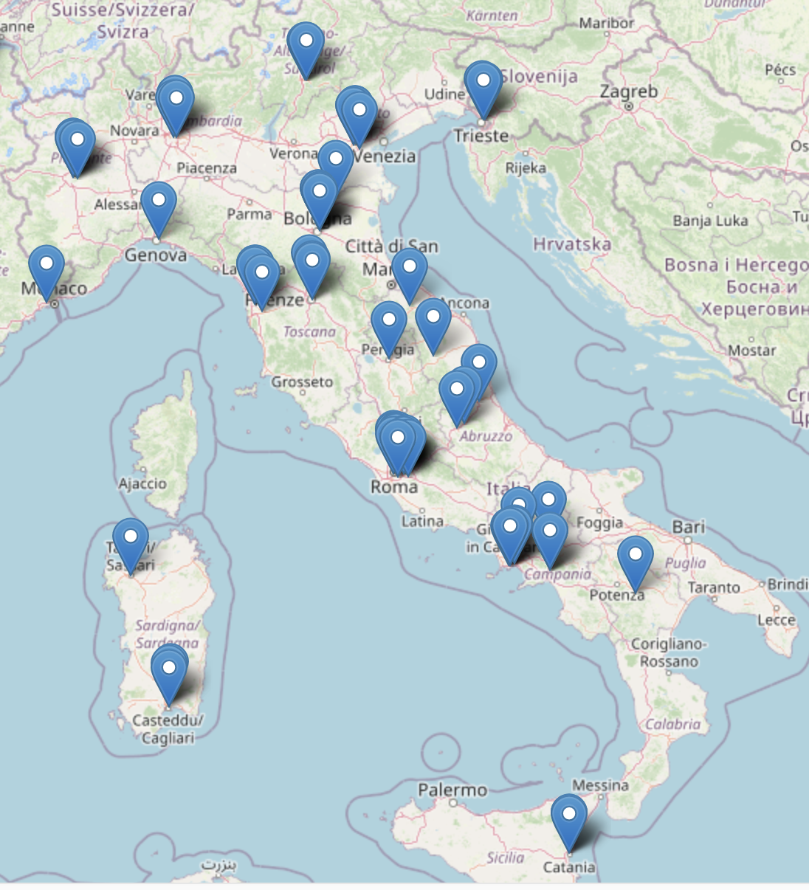

ET Italia
605 members of 81 institutions for 27 RU
Site Characterization
R&D enabling technologies
sinergia con altri progetti INFN
Finanziamenti: nazionali (fondo Ferroni-Fedeli, PRIN), regionali (RAS) ed europei

Slide 12
ET Enabling Technologies
Challenging engineering
New technology in cryo-cooling
The multi-interferometer approach asks for two parallel technology developments:
New technology in optics
Evolved laser technology
  ET-LF:
    Underground
    Cryogenics
    Silicon (Sapphire) test masses
    Large test masses
    New coatings
    New laser wavelength
    Seismic suspensions
    Frequency dependent squeezing
New laser technology
Evolved technology in optics
High precision mechanics and low noise controls
  ET-HF:
    High power laser
    Large test masses
    New coatings
    Thermal compensation
    Frequency dependent squeezing
Highly innovative adaptive optics
High quality opto-electronics and new controls
High quality opto-electronics and new controls
Notes:
Michele

Slide 13
R&D Research lines
  3G Vacuum Systems and Cryogenics (VAC)
  Cryogenic payload (CPAY-LF)
  Suspensions and Seismic Isolation Systems (SUS)
  Active Noise Mitigation (ANM)
  Core Optics and Coatings (CRD)
  Wave front sensing and control (WSC)
  Quantum Noise Reduction (QNR)
  Stray light mitigation (SLM)
  Computing
  DAQ

Slide 14
Synergies with VIRGO
Frequency dependent squeezing (10 dB)
High power laser (1.5 MW intracavity power planned for VnEXT vs 3 MW planned for ET)
Thermal compensation system
Input and output optics
Parametric instabilities mitigation
Coatings
Mirrors
Payload
Seismic superattenuator
Scattered light mitigation
Digital electronics and calibration

Slide 15
ET candidate sites
Two sites officially candidate:
  EMR EUregio, border region between Nederland, Belgium and Germany
  Sardinia (Sos Enattos area)
A third potential site is located in Saxony (Lusatia), still not official
Overall site evaluation is a complex task depending on:
  Geophysical and environmental quality
  Financial and organization aspects
  Services, infrastructures

Slide 16
Site Candidature Action lines
Site monitoring
  identification and quantification of local source impact
  implication for site preservation quality
Geological studies
  understanding and characterization of local geology
Civil and environmental engineering
  pre-feasibility study
  geotechnical investigation
  optimal placement and environmental sustainability of the underground and surface infrastructures

Slide 17
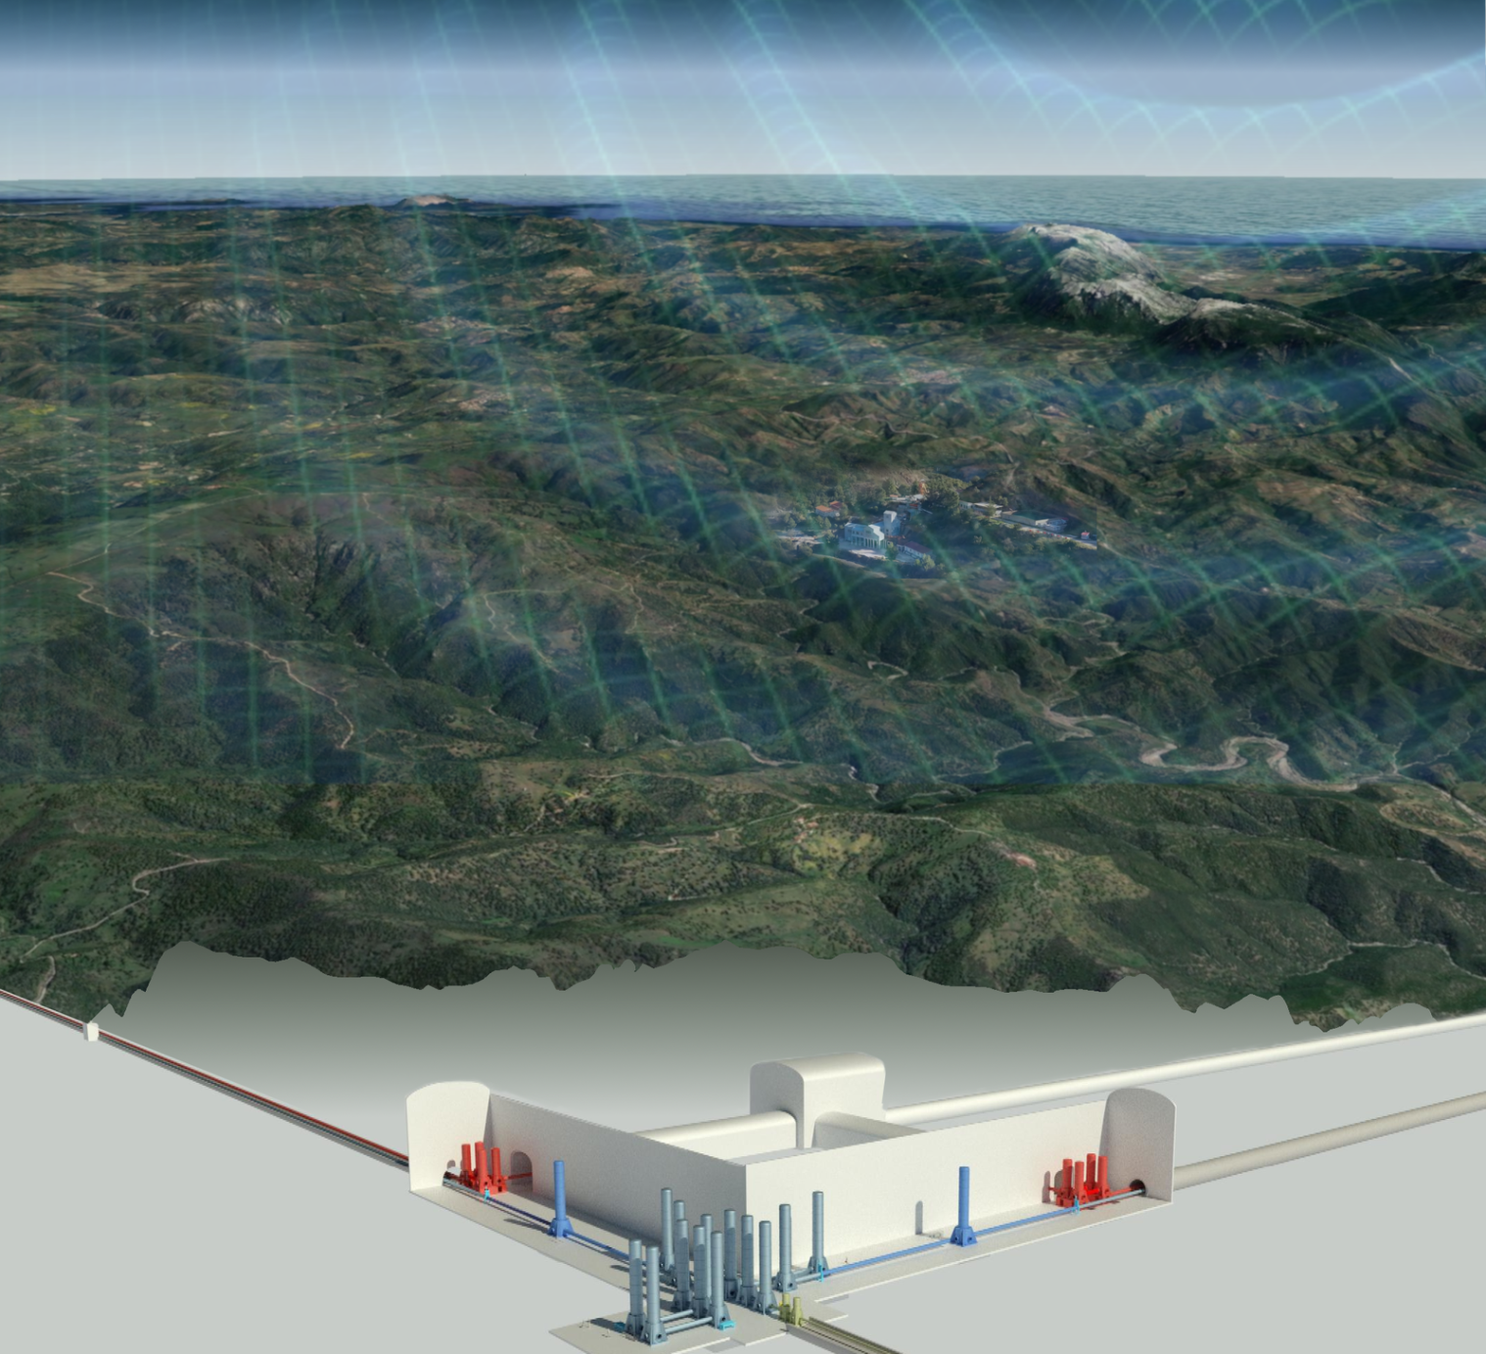
Sardinia:
Site Monitoring

Slide 18
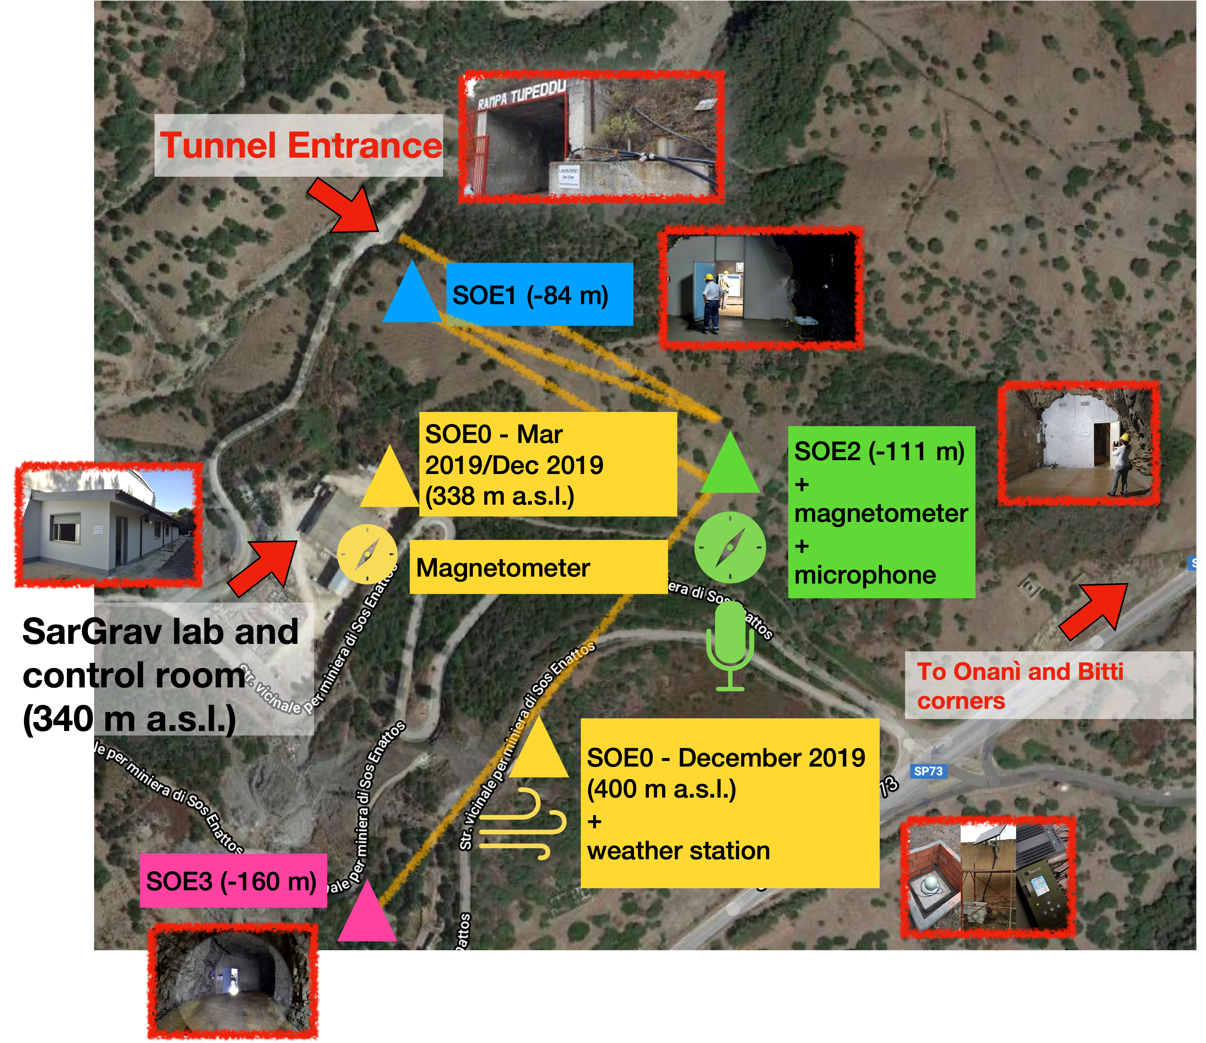
Credits to D. Rozza
PERMANENT ARRAY since 2019
Since 2019, in Sos Enattos there are:
4 permanent seismic stations for long term studies
(Trillium 240, 360 and 120 Horizon, Guralp 360)
1 weather station
1 microbarometer
3 magnetometers (MF6-06)
2 microphones
1 high precision tiltmeter (Archimedes prototype)

Slide 19
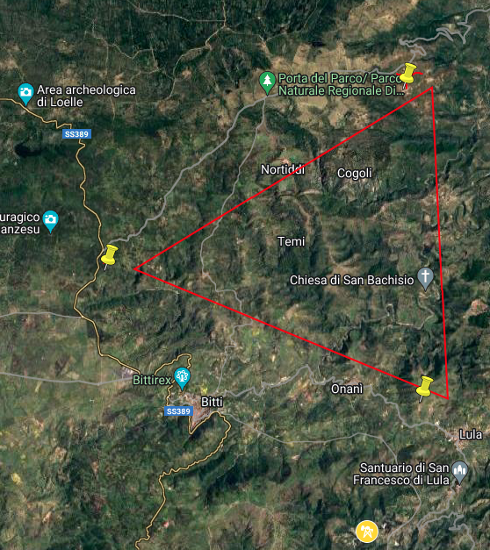
Credits to D. Rozza
PERMANENT ARRAY since 2021
P3
Since 2021, more permanent sensors have been installed at 2 of the proposed vertices (P2, P3)
2 broadband seismometers on surface
2 broadband seismometers in borehole
P2
2 magnetometers at P2
Acoustic measurement campaign at P2 & P3 borehole areas in the next months
Gravimetric campaign will start soon
In the next months Sos Enattos area will be reached at 1 TB/s
New measurement stations in the other candidate vertices
P1
Sos Enattos

Slide 20
Sardinia: Site Monitoring
Local Noise Sources

Slide 21
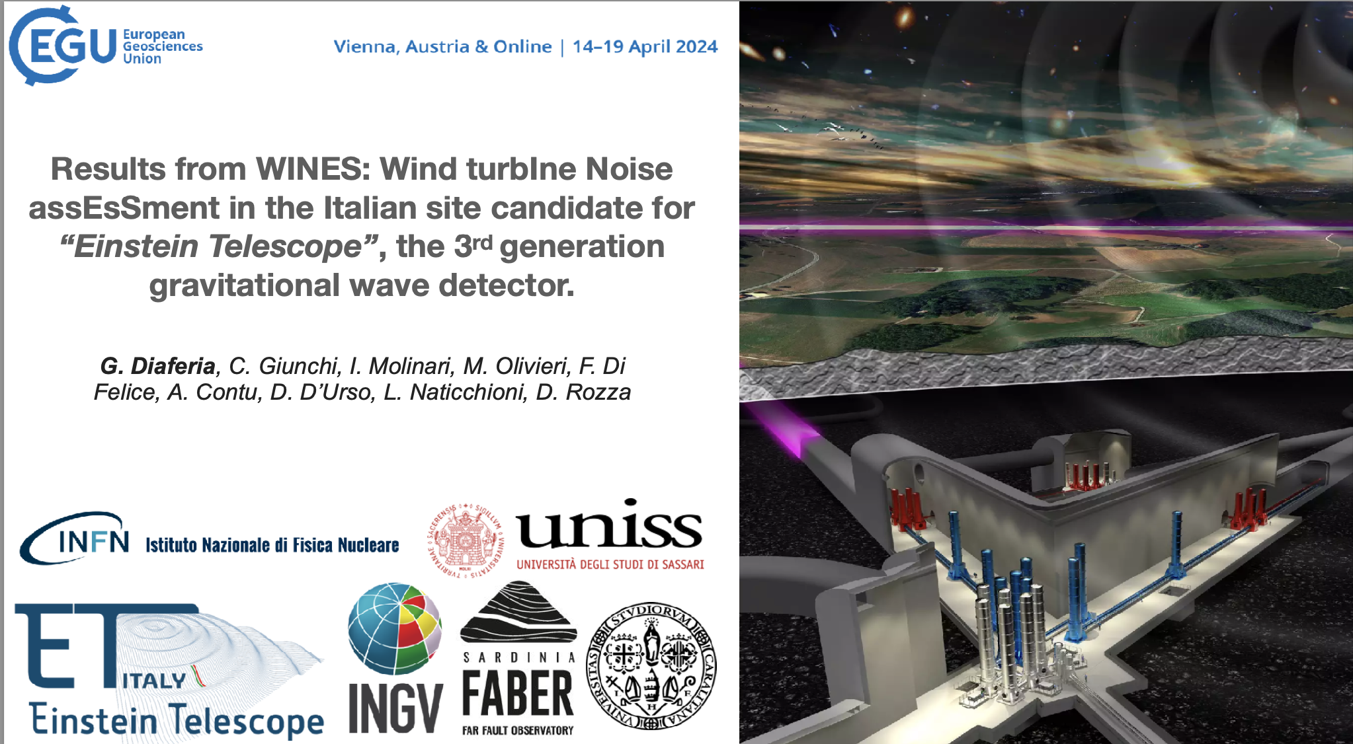
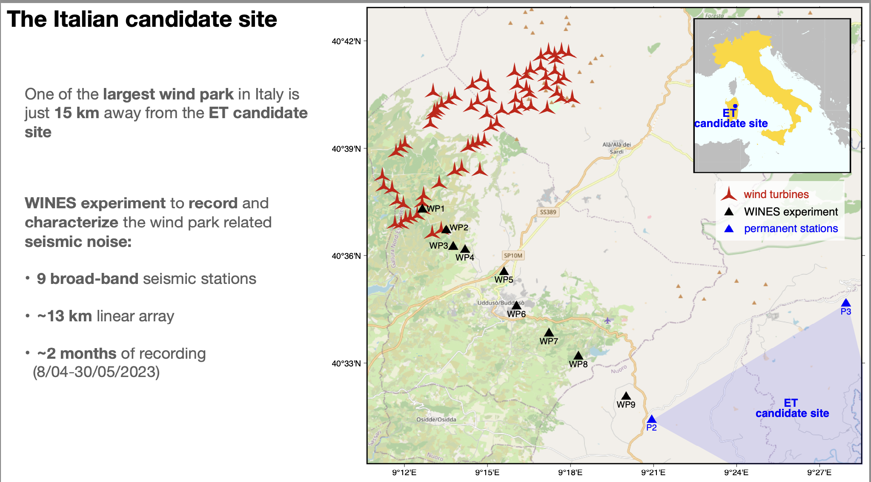
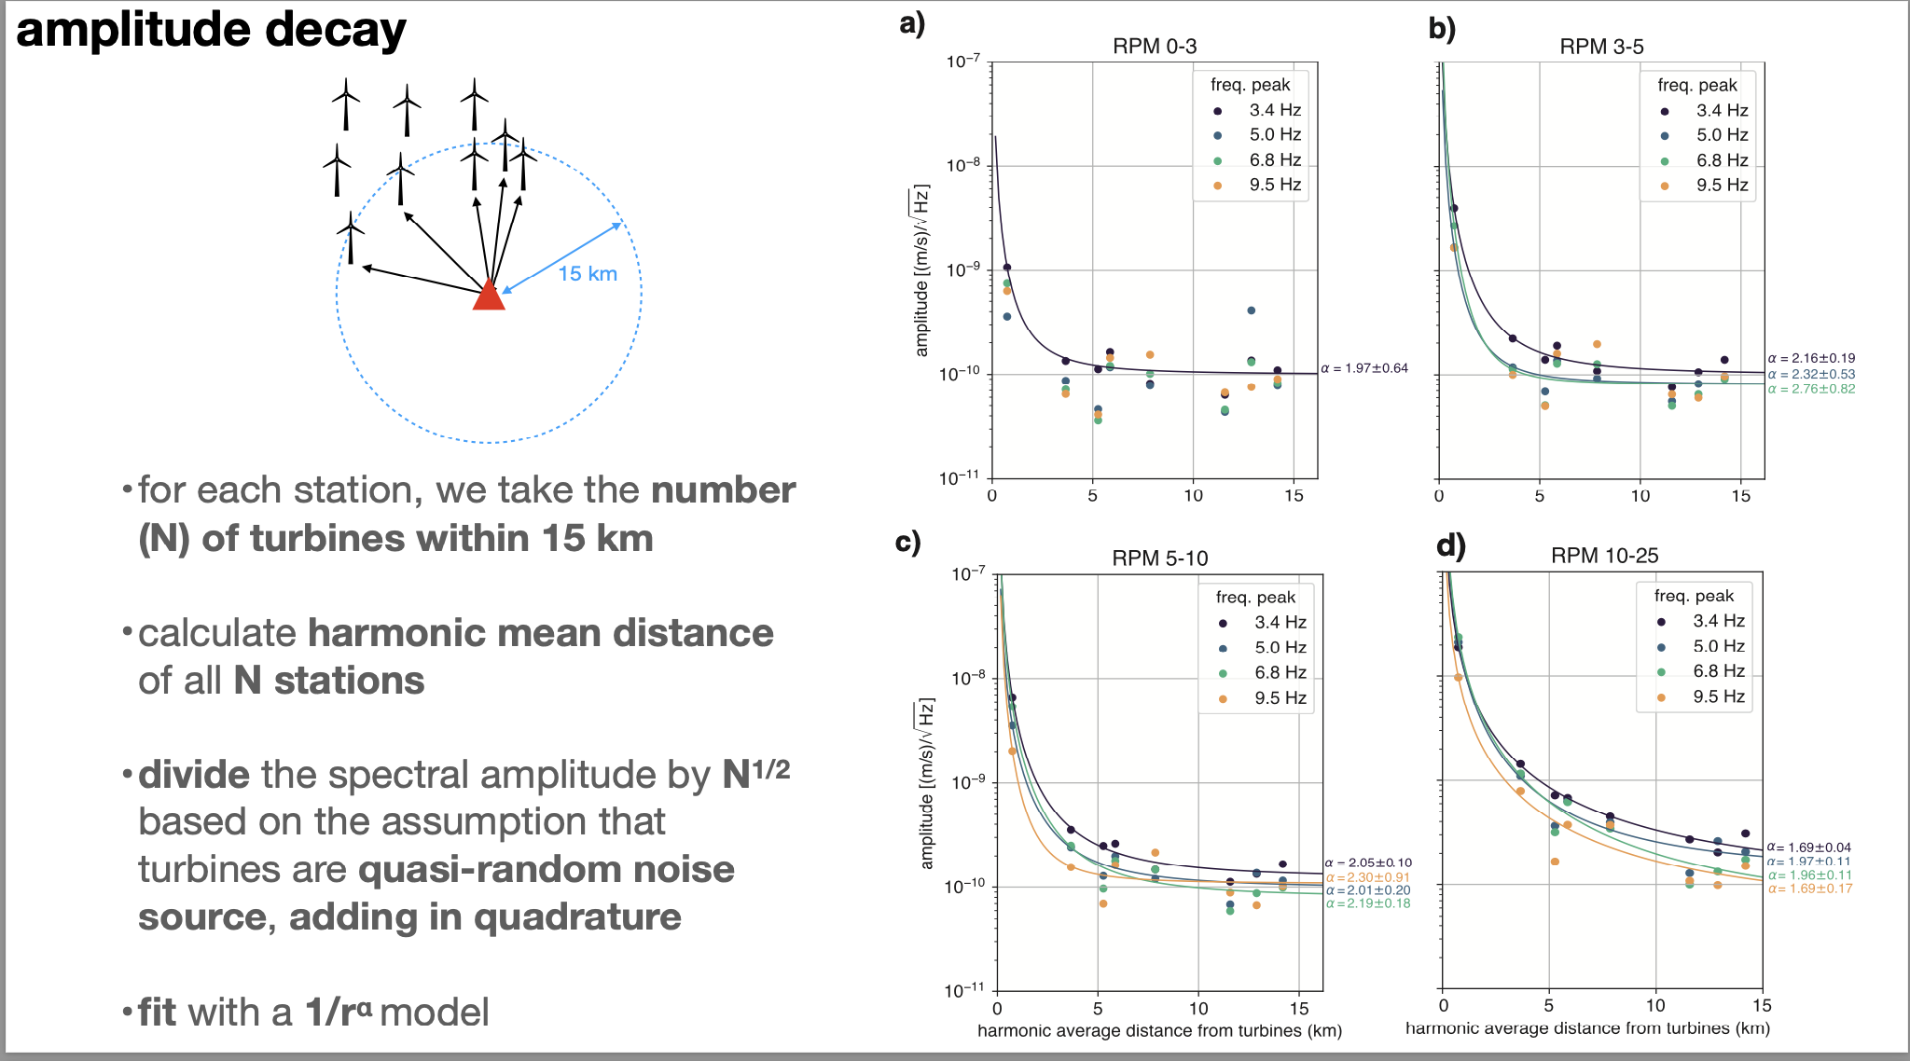
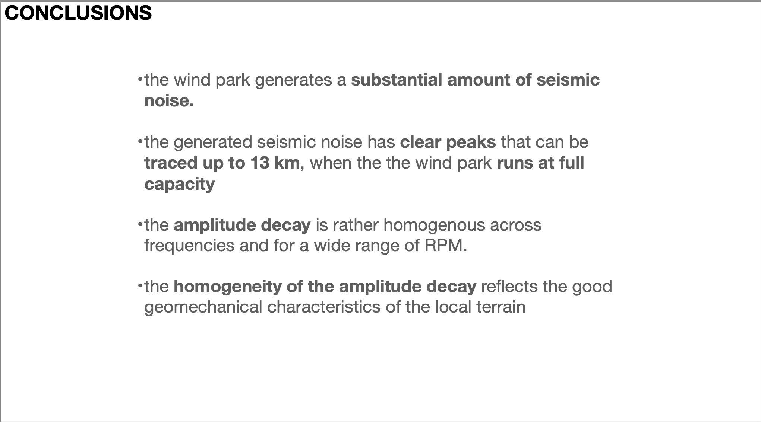

Slide 22
Sardinia: Site Monitoring
Impact of local noise

Slide 23
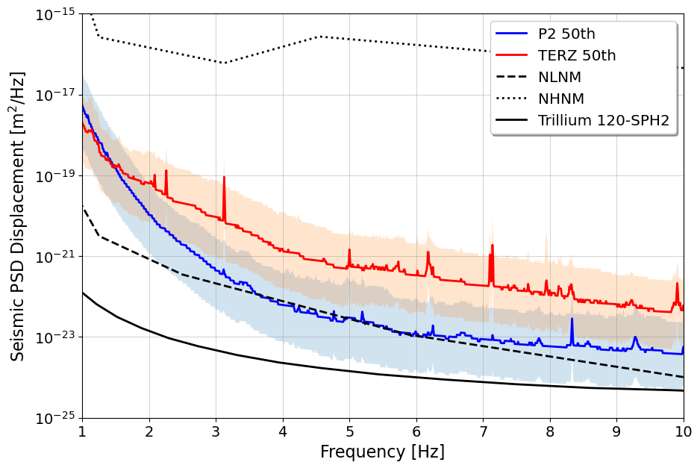
https://indico.ego-gw.it/event/710/contributions/6467/attachments/3562/6370/go
Credits to D. Rozza
and M. Di Giovanni

Slide 24
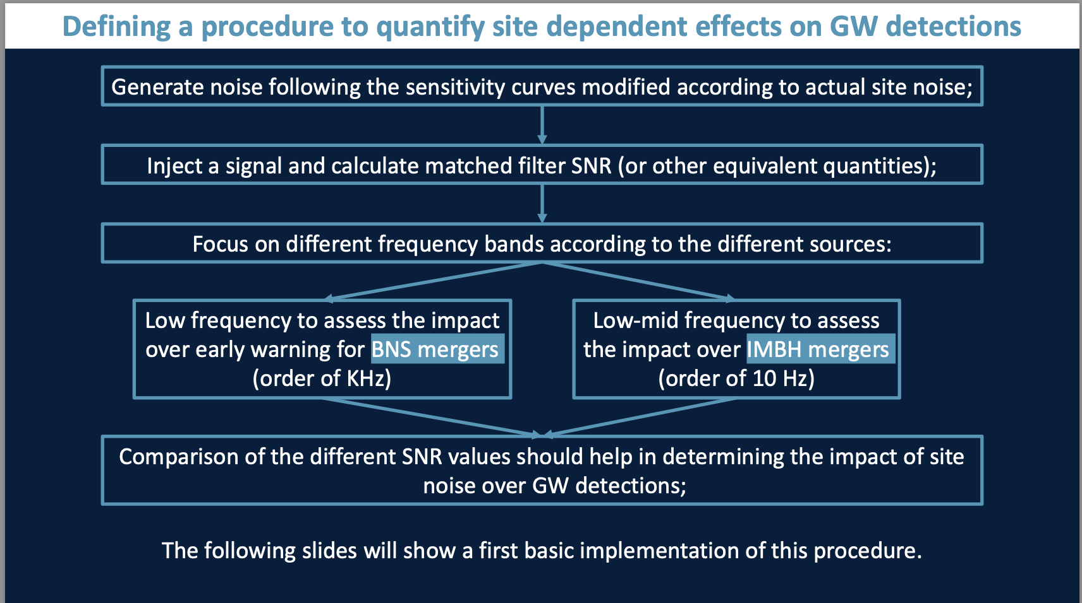
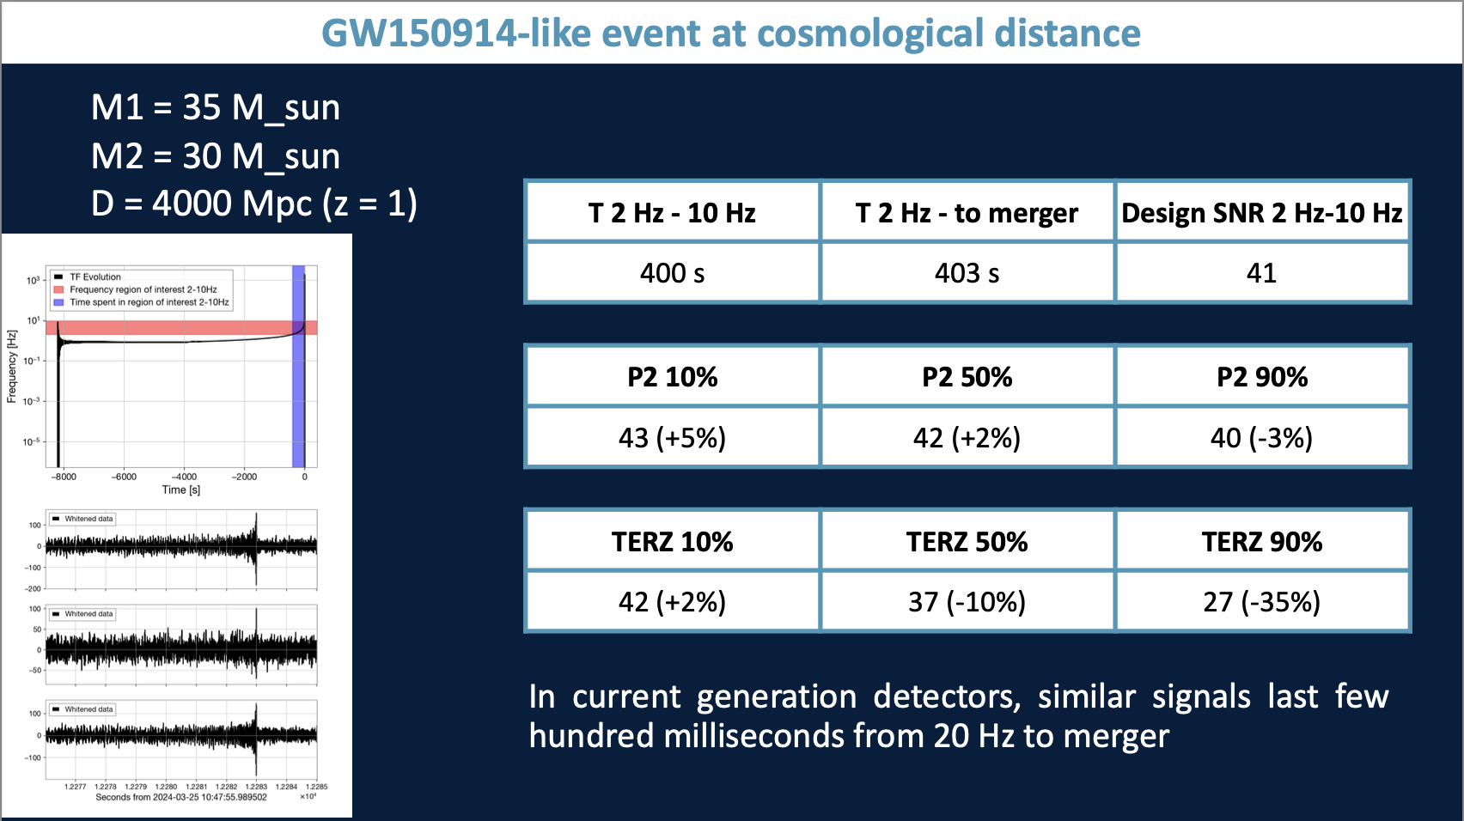
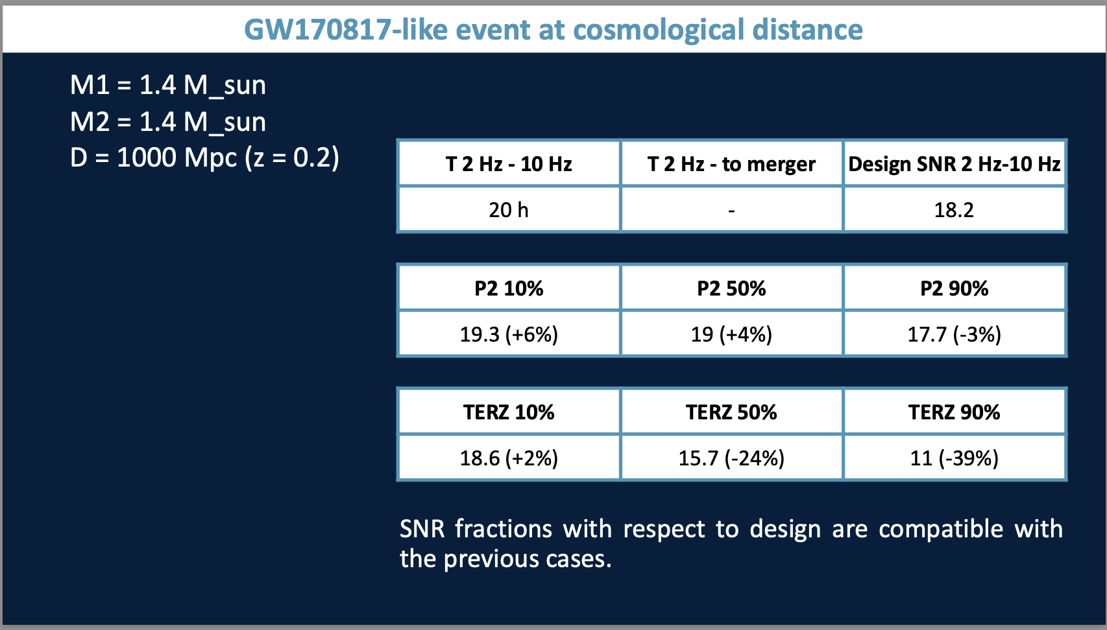
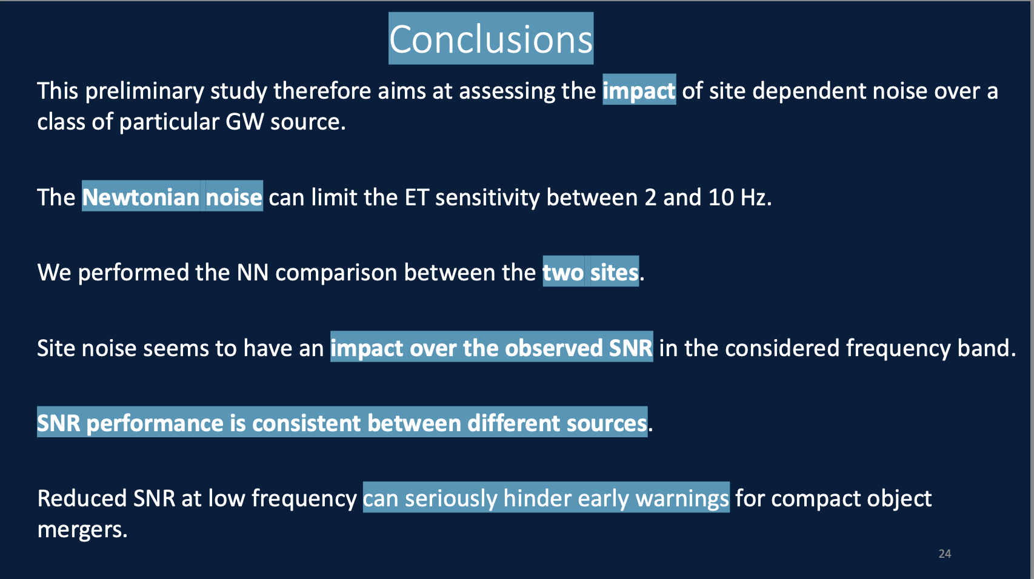
Credits to D. Rozza
and M. Di Giovanni

Slide 25
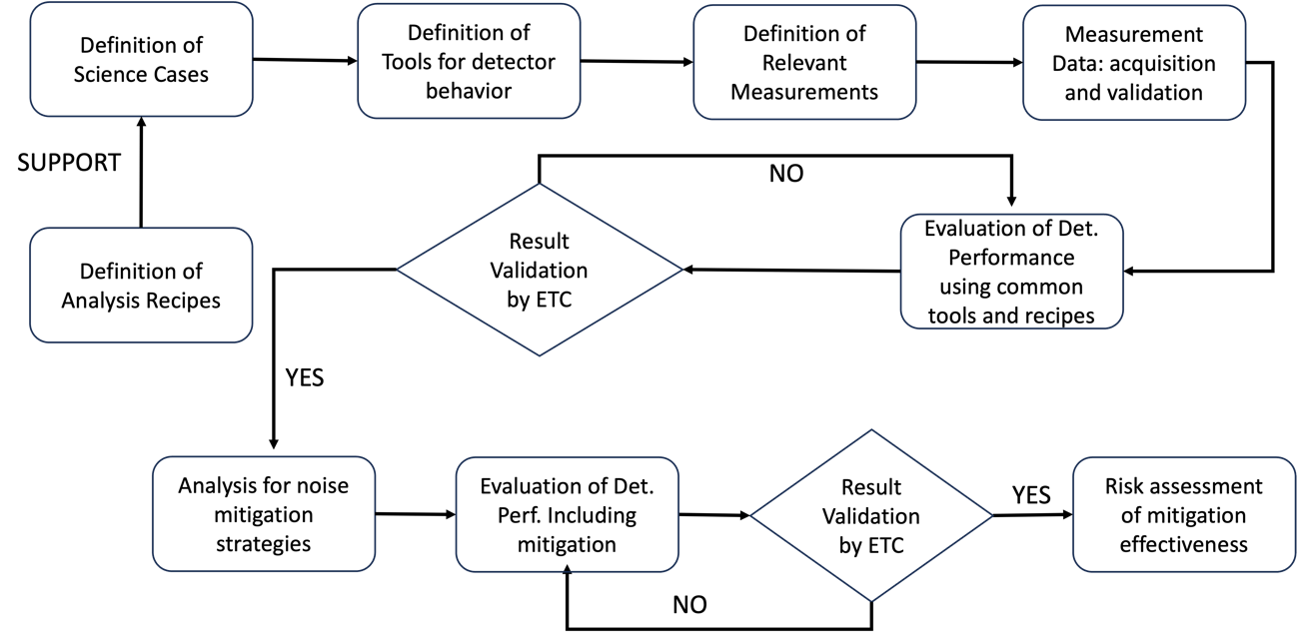

Slide 26
ET Localization in Sardinia

Slide 27
