Slide 1
The status of test facility in LNL
Gianluigi Piazza, INFN-Bologna

Slide 2
Refurbishment of LNL lab

Slide 3
Refurbishment of LNL lab

Slide 4
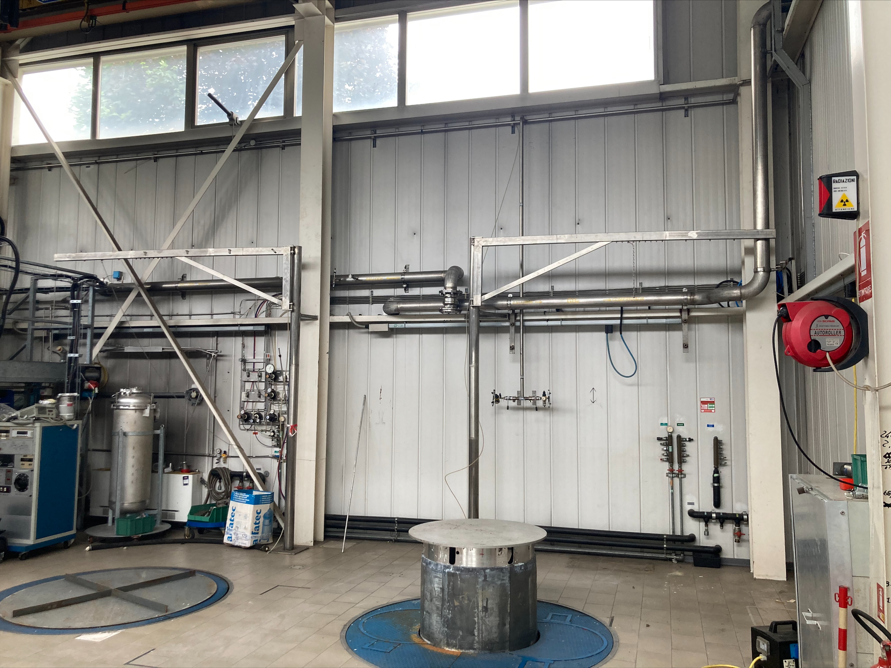
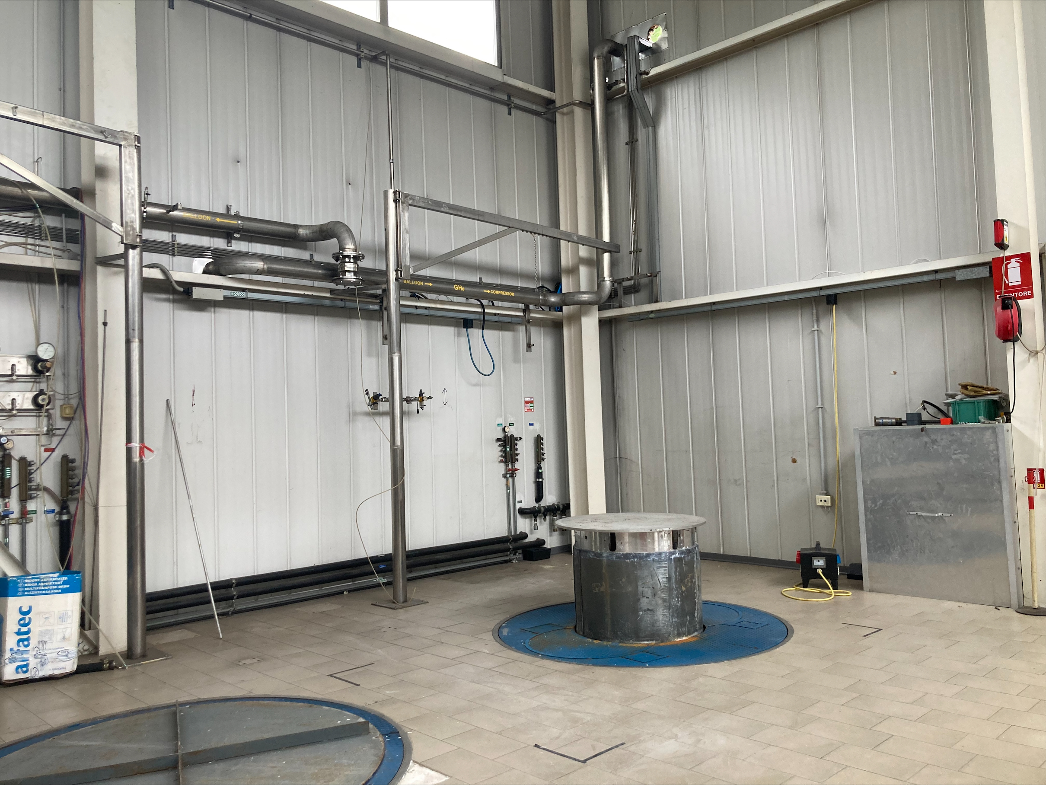
Refurbishment of LNL lab

Slide 5
Refurbishment of LNL lab
Transfer lines: the old ones have been dismounted and the new vacuum insulated lines are ready to be installed by C.I.T.I. Snc; These 4 transfer lines (2 DN15 PN16 and 2 DN40 PN16 ) ends inside the lab with Johnston bayonette and will remain at LNL.
Electric cabinet: all the materials have been delivered to LNL and is ready to be mounted and wired by an external company

Slide 6
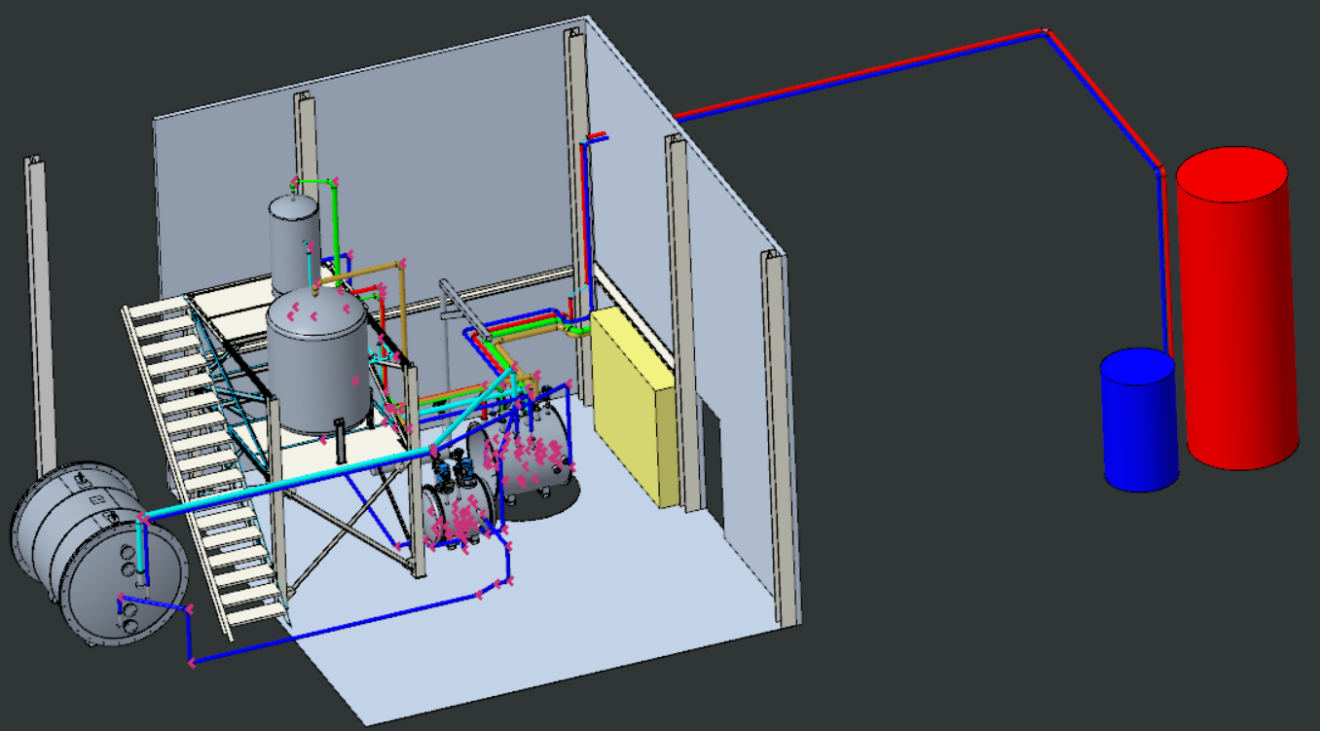
LNL preliminary layout

Slide 7
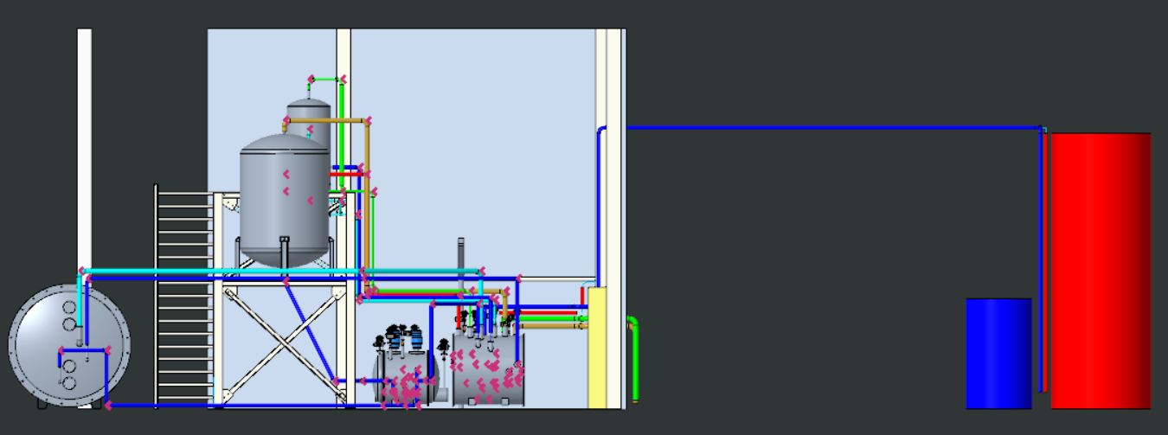
LNL preliminary layout

Slide 8
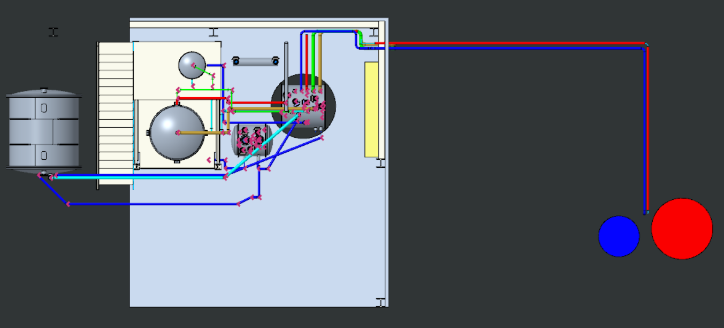
LNL preliminary layout

Slide 9
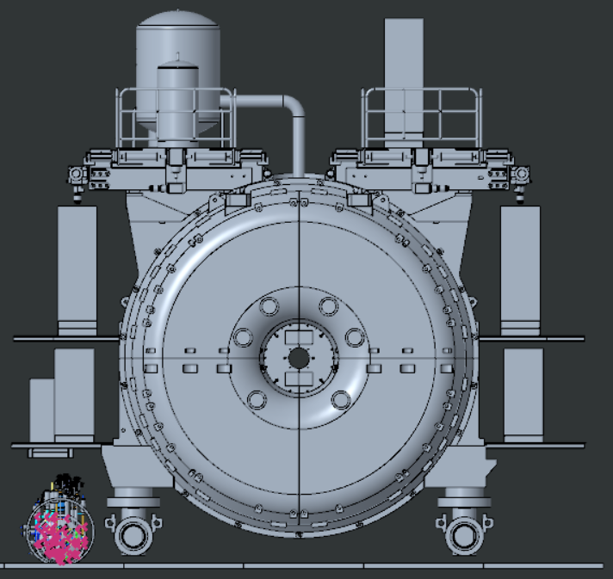
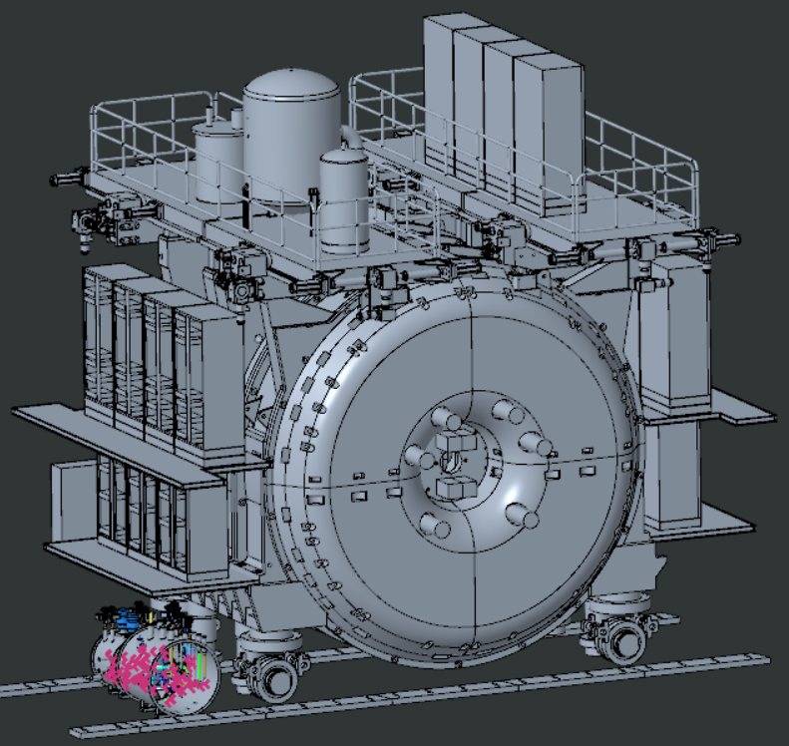
FNAL final destination layout
8 m

Slide 10
In conclusion
We plan to have GRAIN cryostat ready for the beginning of next year.
We are investigating for a company to fabricate and install all the rest of cryogenic system
(valve box, pump box, phase separator, recondenser and filters)
We plan to have all the plant ready for tha half of 2025

