Slide 1
GRAIN cryogenic system
Gianluigi Piazza, INFN-Bologna

Slide 2
Simplified scheme of GRAIN cryogenics

Slide 3
GRAIN Piping & Instrumentation Diagram
LAr PHASE SEPARATOR
ARGON
RE-CONDENSER
VALVE BOX
GRAIN CRYOSTAT
PUMP BOX

Slide 4
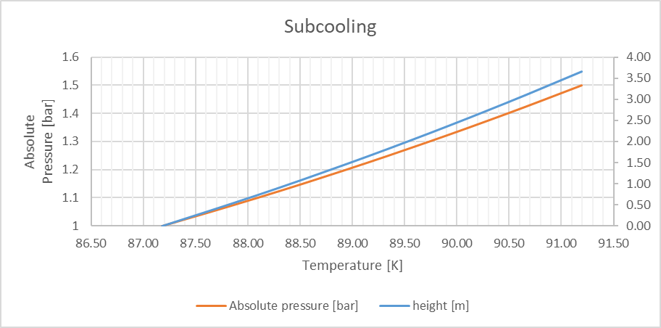
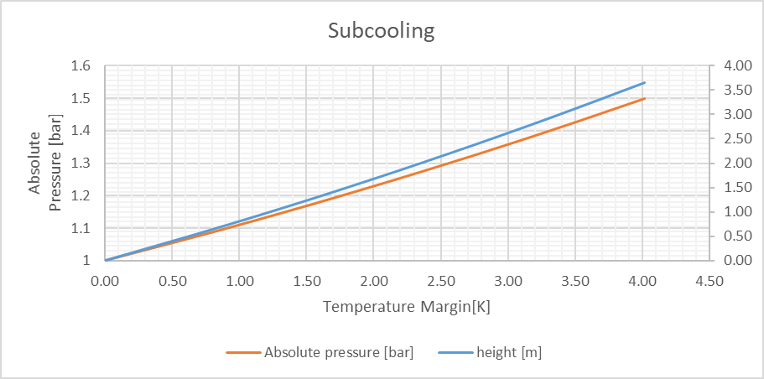
Sub-cooling
Bubbles formation due to heat produced by electronics must be avoided, sub-cooling of LAr is needed in order to have a temperature margin
Temperature margin [K]
Hydrostatic height

Slide 5
Phase Separator
It is a dewar thin and long installed at the available height in order to accomplish the sub-cooling.
A first sizing has been done based on a capacity of ca 200 L:
ø =600 mm ; h=1500 mm → V=400 L of which 200-300 L are useful
The vacuum tank of the phase separator for the thermal insulation will have the following dimensions:
ø =800 mm ; h=2000 mm

Slide 6
GRAIN Cryostat: inner vessel design
639
65
1629
1250
1500

Slide 7
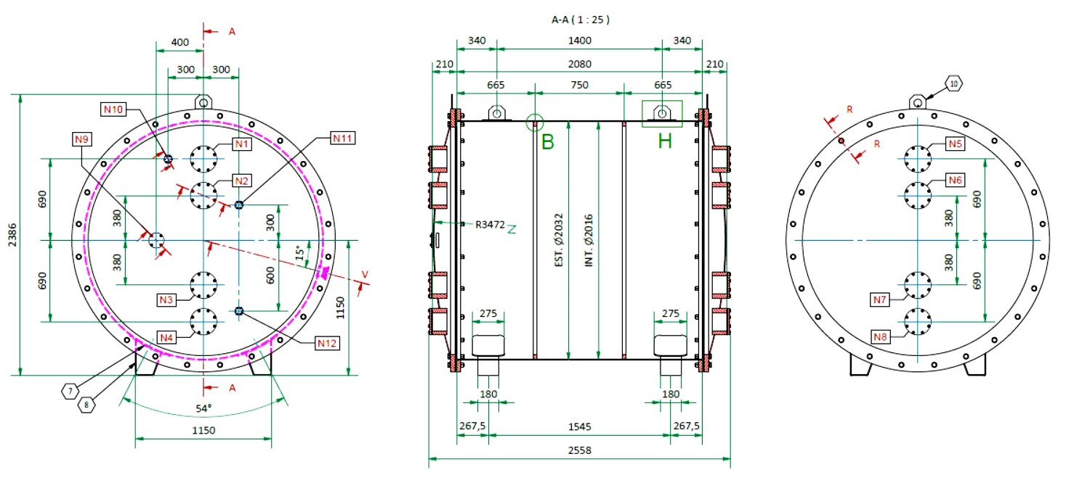
GRAIN Cryostat: test vacuum tank
Almost all details have been discussed with the company CryoService
that is starting to manufacture. It will be ready in 6 months

Slide 8
Re-condenser
This U-tube heat exchanger is
dimensioned for 1500 W.
The boil off is produced by the static heat load, detectors heat load and feedthroughs.
The GAr formed has to be
re-condensed and sent for gravity to the recirculation pump

Slide 9
Re-circulation Pump
The mass flow is given by the boil-off plus the recirculation needed for maintaining the purity of Lar:
The total heat load must be of max 1500 W, that means 7,5 g/s
For a complete re-circulation of 0,7 m3 of Lar in 43 h we need ca 6,5 g/s
→ total mass flow ca. 14 g/s

Slide 10
Re-circulation Pump

Slide 11
Purification filters
Control valve
manual valve to be placed
Made of molecular sieve (sintered disk) and small spheres of Al2O3 coated with Cu
One purifier for the filling and two in parallel for the recirculation
The filters have not been sized and designed yet.
In order to dismount and regenerate the filters there will be placed a CF flange and a manual shut-off valve on both sides;
in this way the filter can be removed and installed, preventing air from entering.

Slide 12
Electric control panel
The project has been completed with the help of LNL cryogenic division staff, and all the material has been delivered to LNL.
Analog Input: 52
Analog Output: 21
Digital Input: 14
Digital Output: 9
Plus some spares

