Slide 1
A consideration about the average number of clusters
F. Grancagnolo

Slide 2
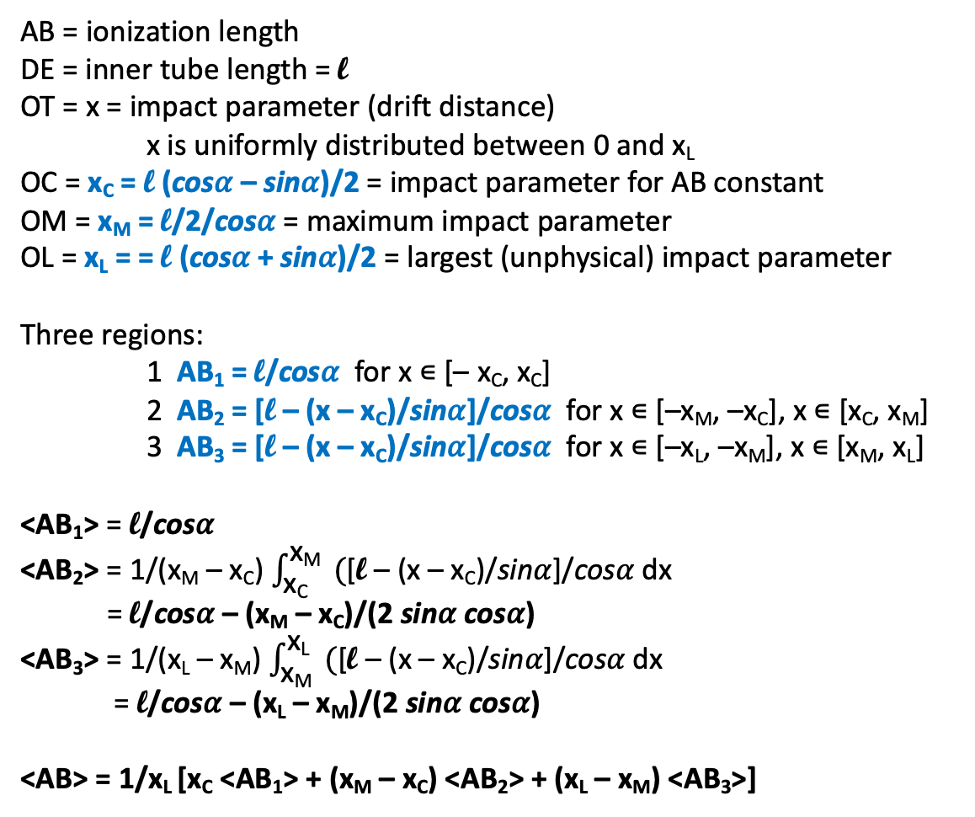
AB = ionization length
DE = inner tube length = l
OT = x = impact parameter (drift distance)
x is uniformly distributed between 0 and x_{L}
OC = x_{C} = l (cos𝛼 – sin𝛼)/2 = impact parameter for AB constant
OM = x_{M} = l/2/cos𝛼 = maximum impact parameter
OL = x_{L} = = l (cos𝛼 + sin𝛼)/2 = largest (unphysical) impact parameter
Three regions:
1 AB₁ = l/cos𝛼 for x ∊ [– x_{C}, x_{C}]
2 AB₂ = [l – (x – x_{C})/sin𝛼]/cos𝛼 for x ∊ [–x_{M}, –x_{C}], x ∊ [x_{C}, x_{M}]
3 AB₃ = [l – (x – x_{C})/sin𝛼]/cos𝛼 for x ∊ [–x_{L}, –x_{M}], x ∊ [x_{M}, x_{L}]
<AB₁> = l/cos𝛼
<AB₂> = 1/(x_{M} – x_{C}) $\int_{\text{x}\text{C}}^{\text{x}\text{M}}{ (}$[l – (x – x_{C})/sin𝛼]/cos𝛼 dx
= l/cos𝛼 – (x_{M} – x_{C})/(2 sin𝛼 cos𝛼)
<AB₃> = 1/(x_{L} – x_{M}) $\int_{\text{x}\text{M}}^{\text{x}\text{L}}{ (}$[l – (x – x_{C})/sin𝛼]/cos𝛼 dx
= l/cos𝛼 – (x_{L} – x_{M})/(2 sin𝛼 cos𝛼)
<AB> = 1/x_{L} [x_{C} <AB₁> + (x_{M} – x_{C}) <AB₂> + (x_{L} – x_{M}) <AB₃>]
beam
direction
generic
track
.
D
.
B
.
O
.
C
.
x_{C}
T
x
.
.
x_{M}
M
.
x_{L}
L
A
E
𝛼

Slide 3
The following table gives the average ionization length <AB> for the different beam angles
 | 0° | 30° | 45° | 60°
x_{C} | l/2 | 0.18 l | 0 | 0.18 l
x_{M} | l/2 | 0.58 l | 0.71 l | 0.58 l
x_{L} | l/2 | 0.68 l | 0.71 l | 0.68 l
x_{C}/x_{L} | 1 | 0.26 | 0 | 0.26
(x_{M}-x_{C})/x_{L} | 0 | 0.59 | 1 | 0.59
(x_{L}-x_{M})/x_{L} | 0 | 0.15 | 0 | 0.15
<AB₁> | l | 1.15 l | 1.41 l | 1.15 l
<AB₂> | - | 0.69 l | 0.71 l | 0.69 l
<AB₃> | - | 1.04 l | 1.41 l | 1.04 l
<AB> | l | 0.86 l | 0.71 l | 0.86 l

Slide 4
The average number of clusters is: <N> = <AB> 𝜹, with <𝞼_{N}> = [<AB> 𝜹] ^{1/2}.
l = 0.8 cm | 0° | 30° | 45° | 60°
<AB> | 0.80 cm | 0.69 cm | 0.57 cm | 0.69 cm
<N> | 10.0 | 8.62 | 7.12 | 8.62
<𝜎_{N}> | 3.16 | 2.94 | 2.67 | 2.94
l = 1.2 cm | 0° | 30° | 45° | 60°
<AB> | 1.20 cm | 1.03 cm | 0.85 cm | 1.03 cm
<N> | 15.0 | 12.87 | 10.62 | 12.87
<𝜎_{N}> | 3.87 | 3.59 | 3.26 | 3.59

