Slide 1
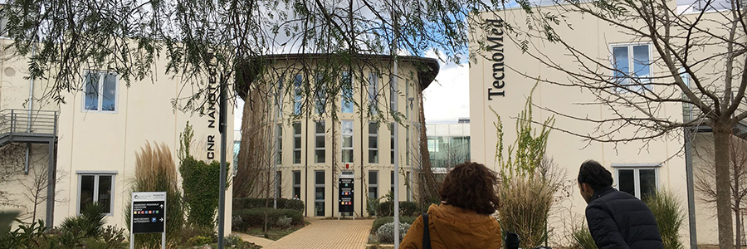
CNR Nanotec-Lecce

Slide 3
CNR Nanotec-Lecce
Cleanroom
Charact/NanoMagnetism
Photonics/Nanochem
Biology
Devices

Slide 4
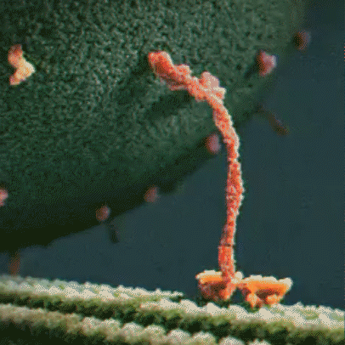
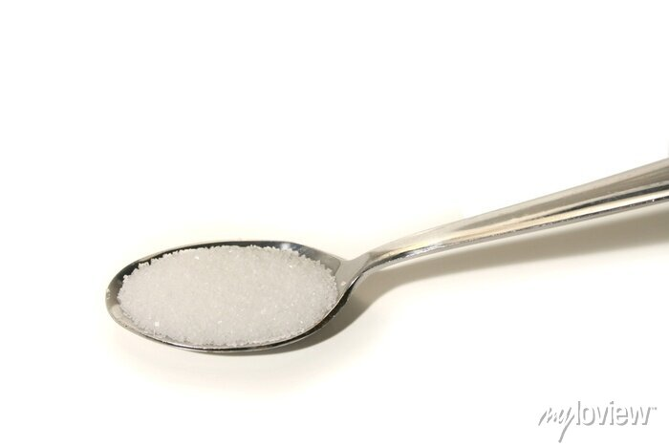
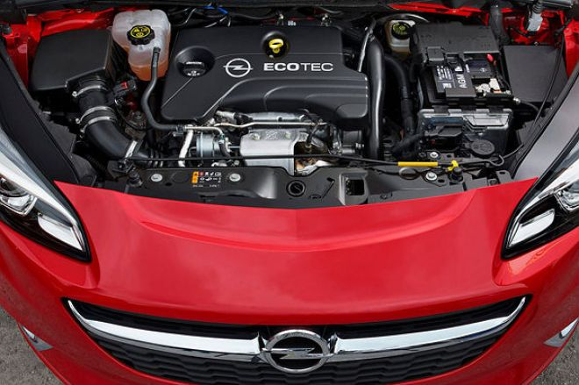
Smaller than Petit?
Some numbers
$$P(molec. engine)={10}^{−16}W$$
$P\left(opel\right)={10}^{5}W$ (100CV)
$$\frac{P\left(m.e.\right)}{V}=\frac{{10}^{−16}W}{{\left(10nm\right)}^{3}}={10}^{8}W/m^{3}$$
$$P(opel)/V={10}^{5}W/m^{3}$$
$$size\sim 10nm$$
1μm/s
${10}^{21}molec. eng.$ = ${10}^{5}W$ = Opel

Slide 5
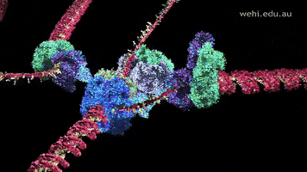

Slide 6
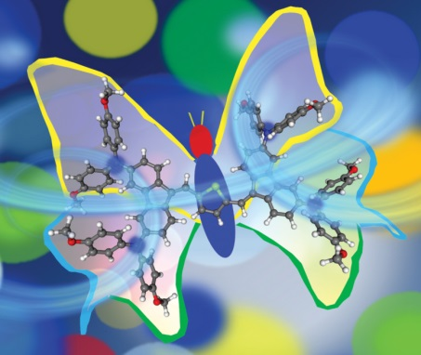
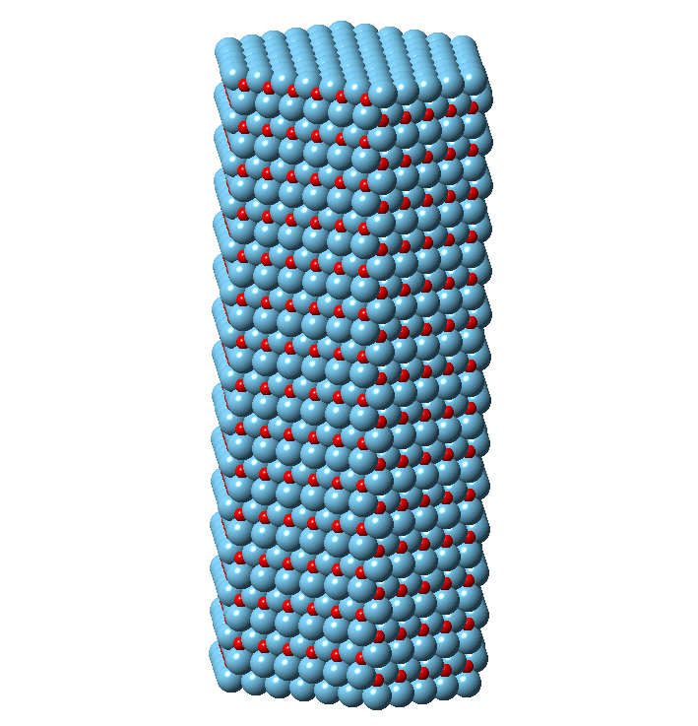
Nanochemistry
Green Chemistry
Advanced Devices
Synthesis of Organic Functional Molecules
Development of Complex Colloidal Inorganic Nanocrystals & Study of Nanomaterial Surfaces

Slide 7
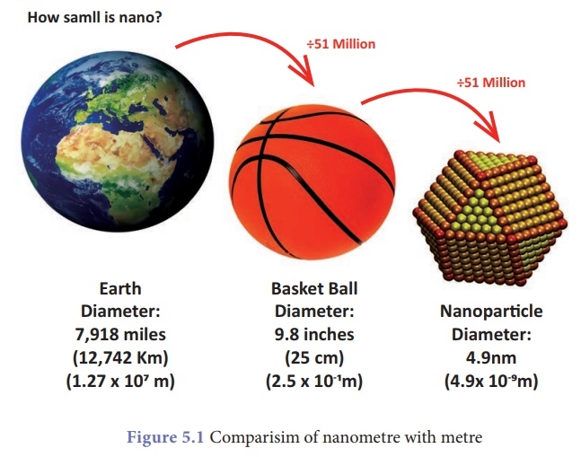
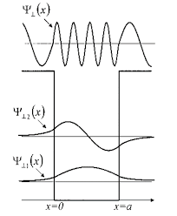
Nanochemistry

Slide 8
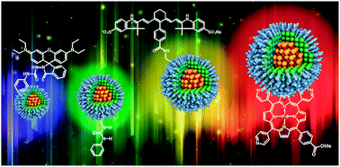
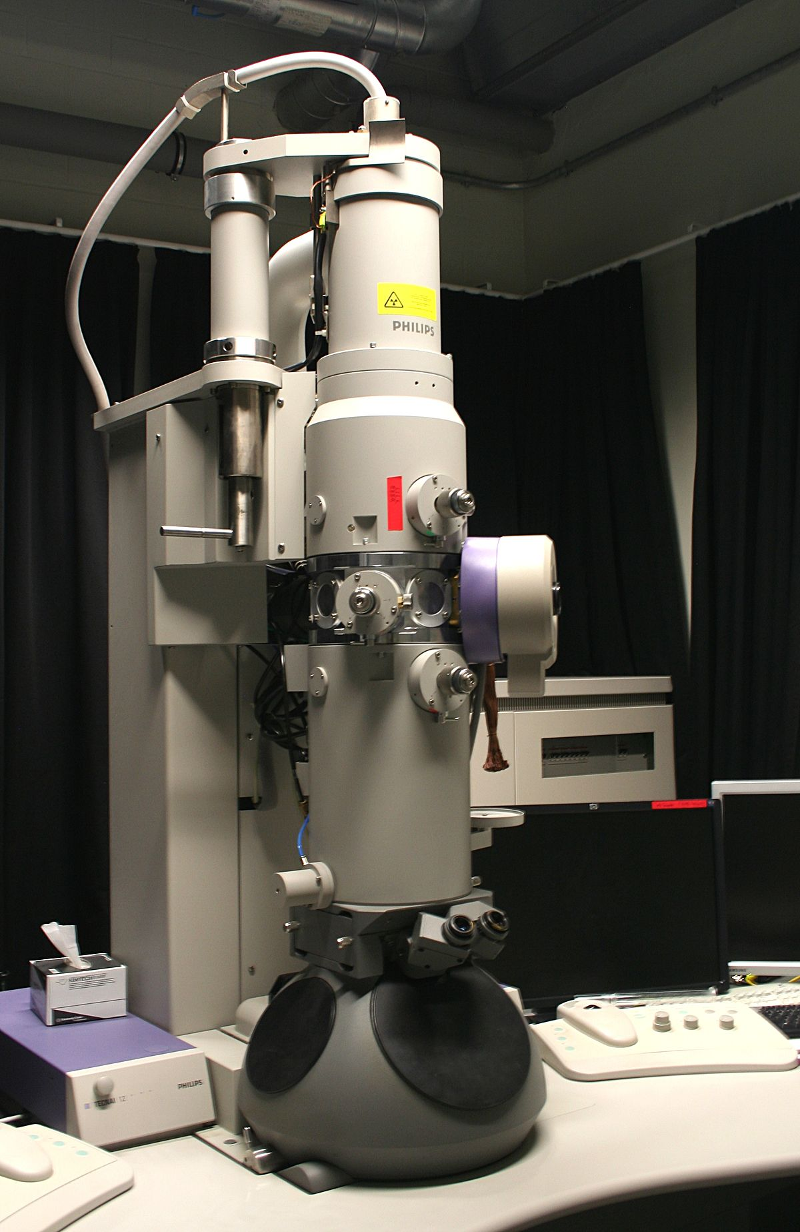
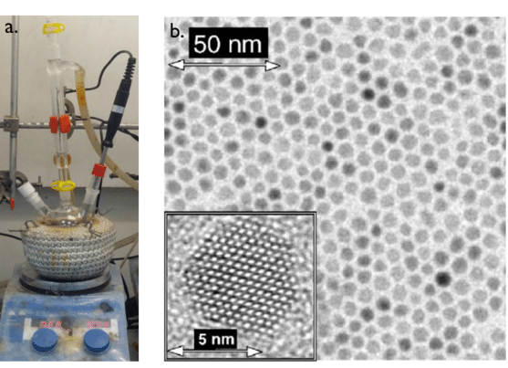

Slide 9
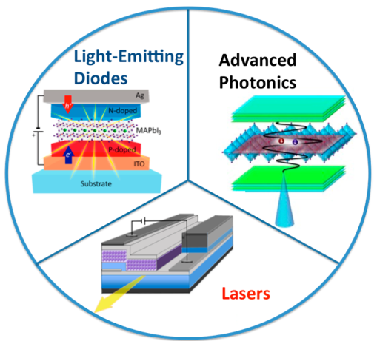
Device Photonics Facilities

Slide 10
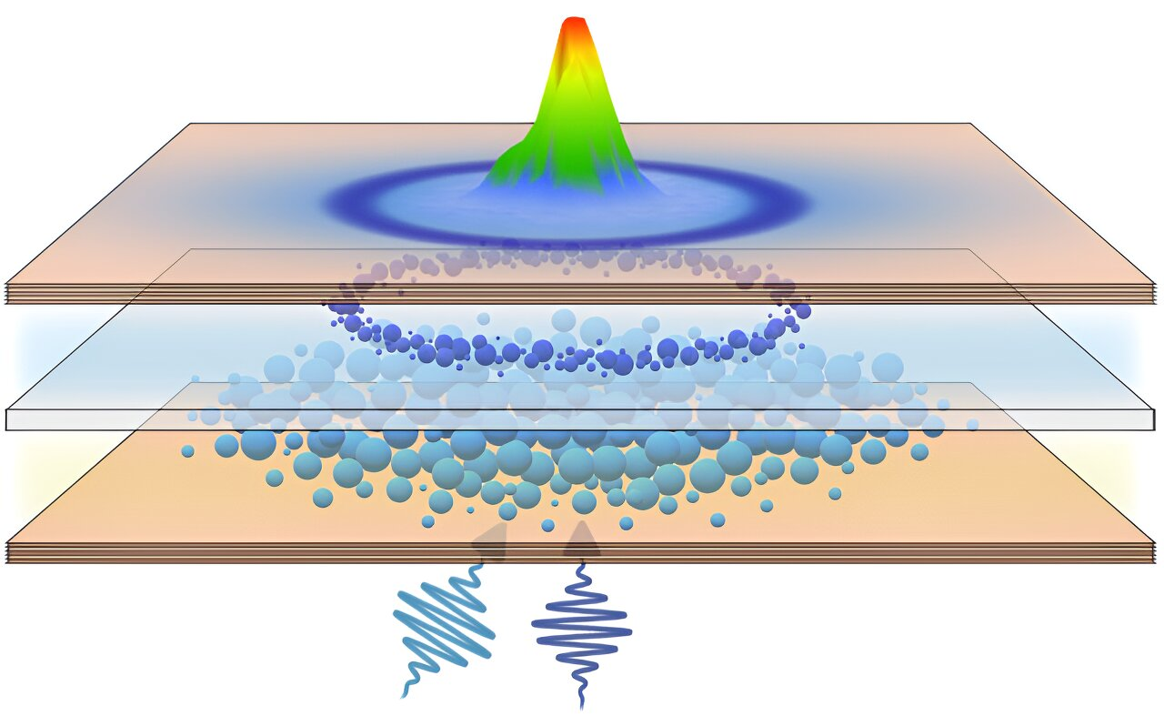
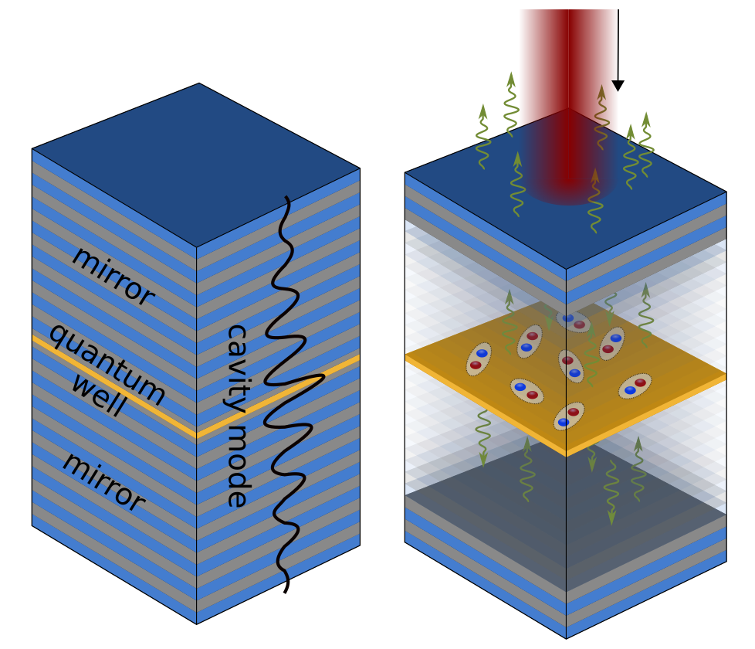
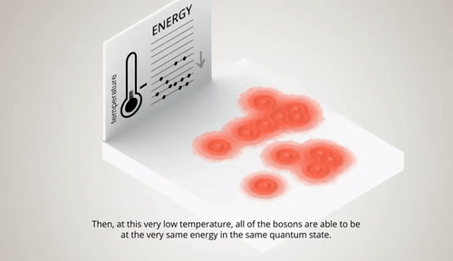
Polariton states

Slide 11
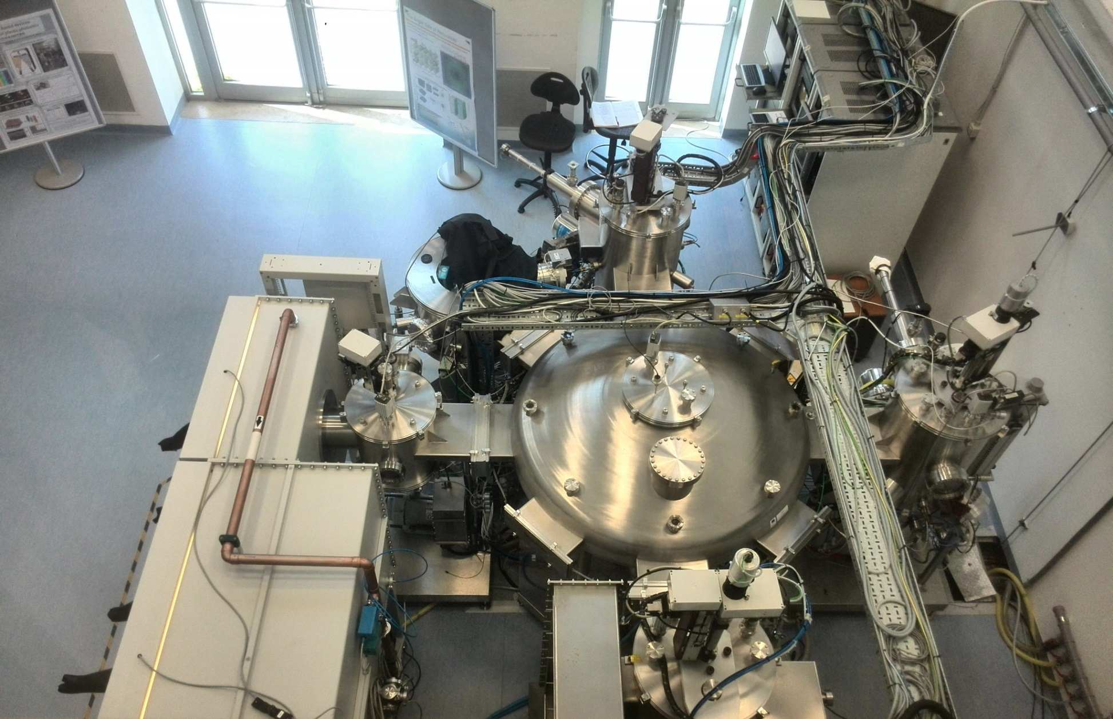
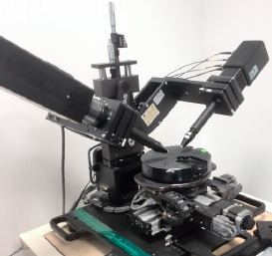
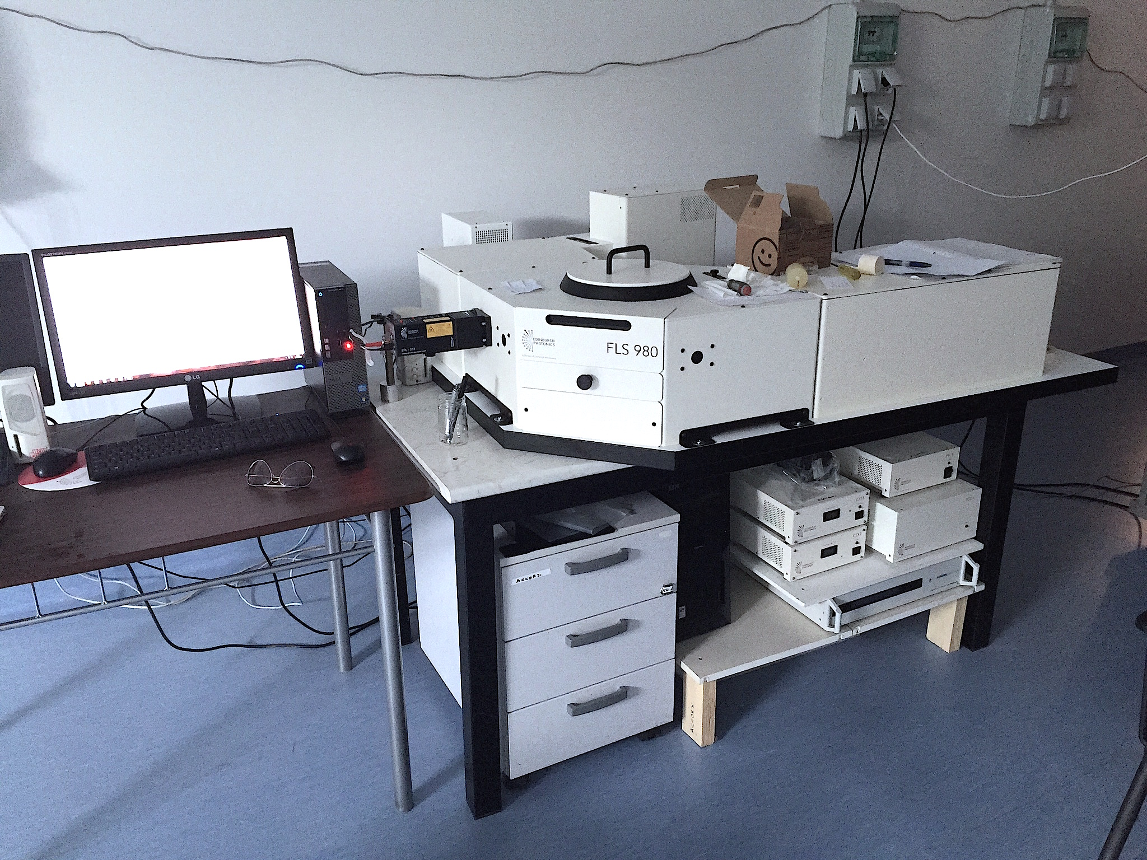
Big Facilities for optoelectronic and photonic devices
Ellipsometer
Cluster tool for OLED fabrication
Fluorimeters

Slide 12
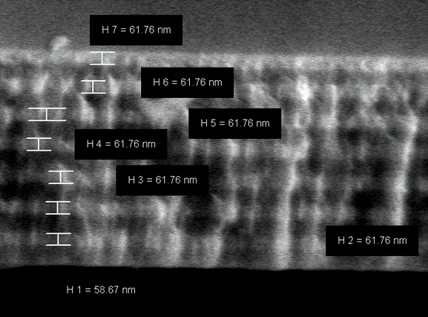
Very narrow electroluminescence in DBR mirror based OLEDs
DBR cross-section

Slide 13
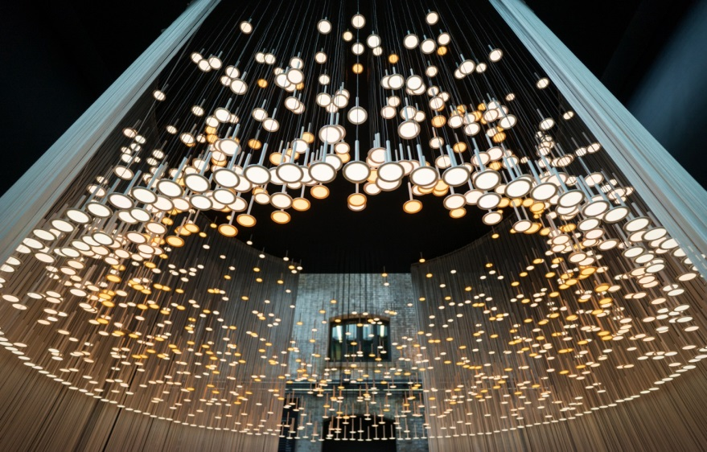
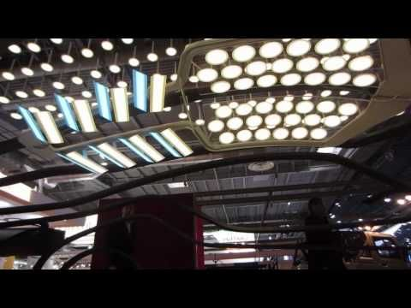
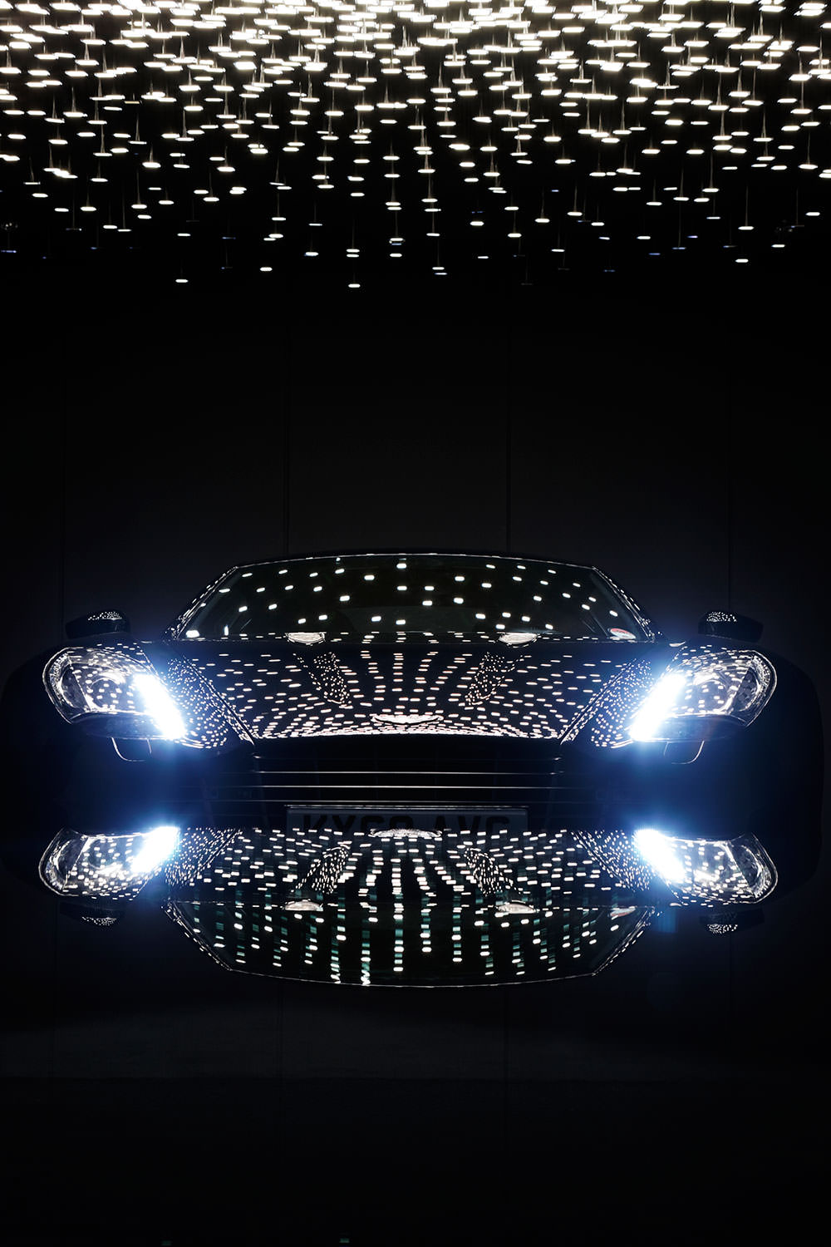
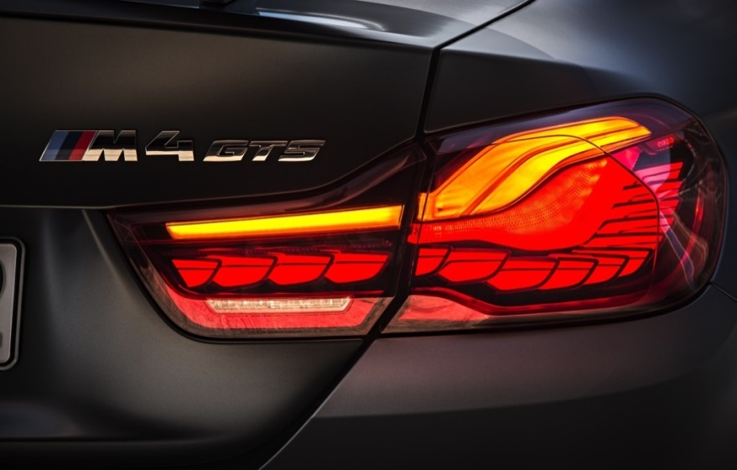
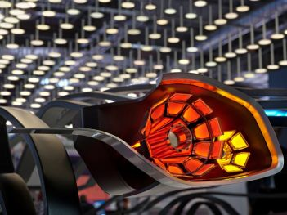
OLED for automotive and lighting applications
https://www.blackbody.fr/

Slide 15
Polariton chemistry: sintesi chimiche accelerate dal vuoto quantistico
UNISALENTO/CNR NANOTEC/CNR-IMM

Slide 16
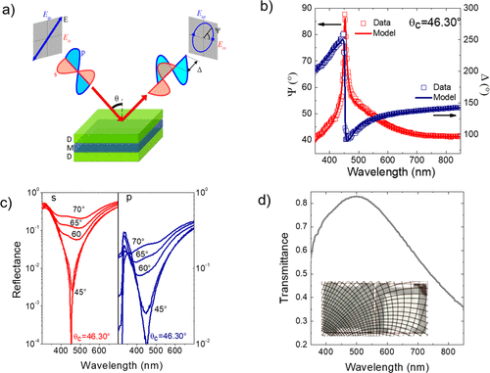
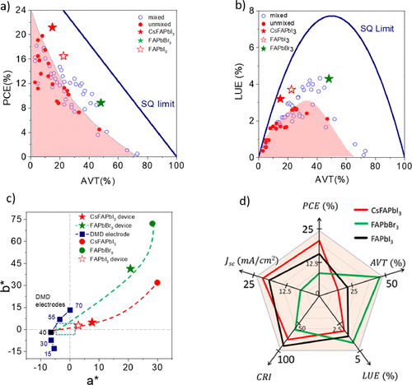
Photovoltaics for Agricolture and Smart cities

Slide 17
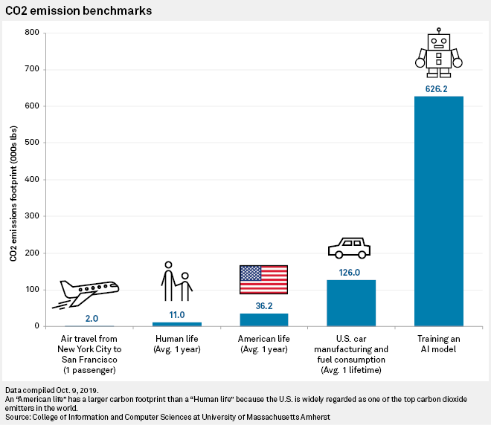
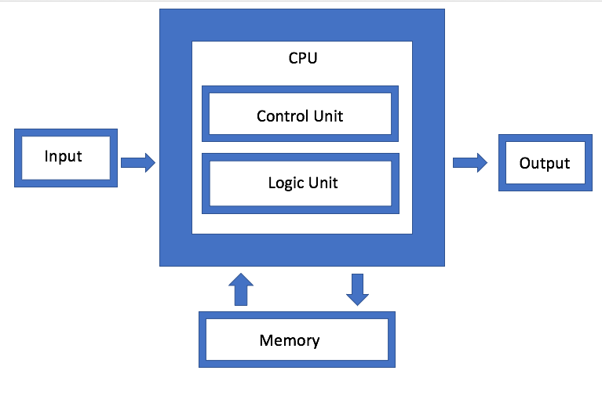
Von Newmann bottleneck
https://open-neuromorphic.org/p/bits-of-chips-truenorth/
Researchers estimated that creating GPT-3, for example, which has 175 billion parameters, consumed 1,287 megawatt hours of electricity and generated 552 tons of carbon dioxide - the equivalent of 123 gasoline-powered passenger vehicles driven for one year.

Slide 18
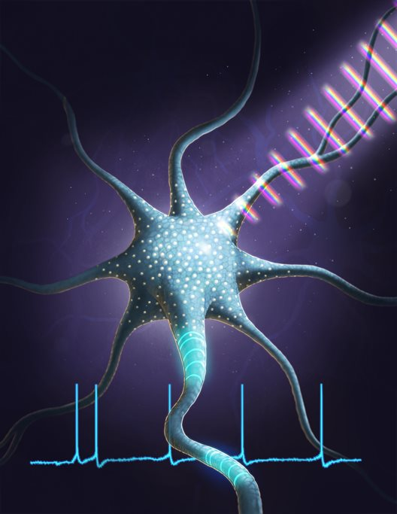
Nature is better

Slide 19
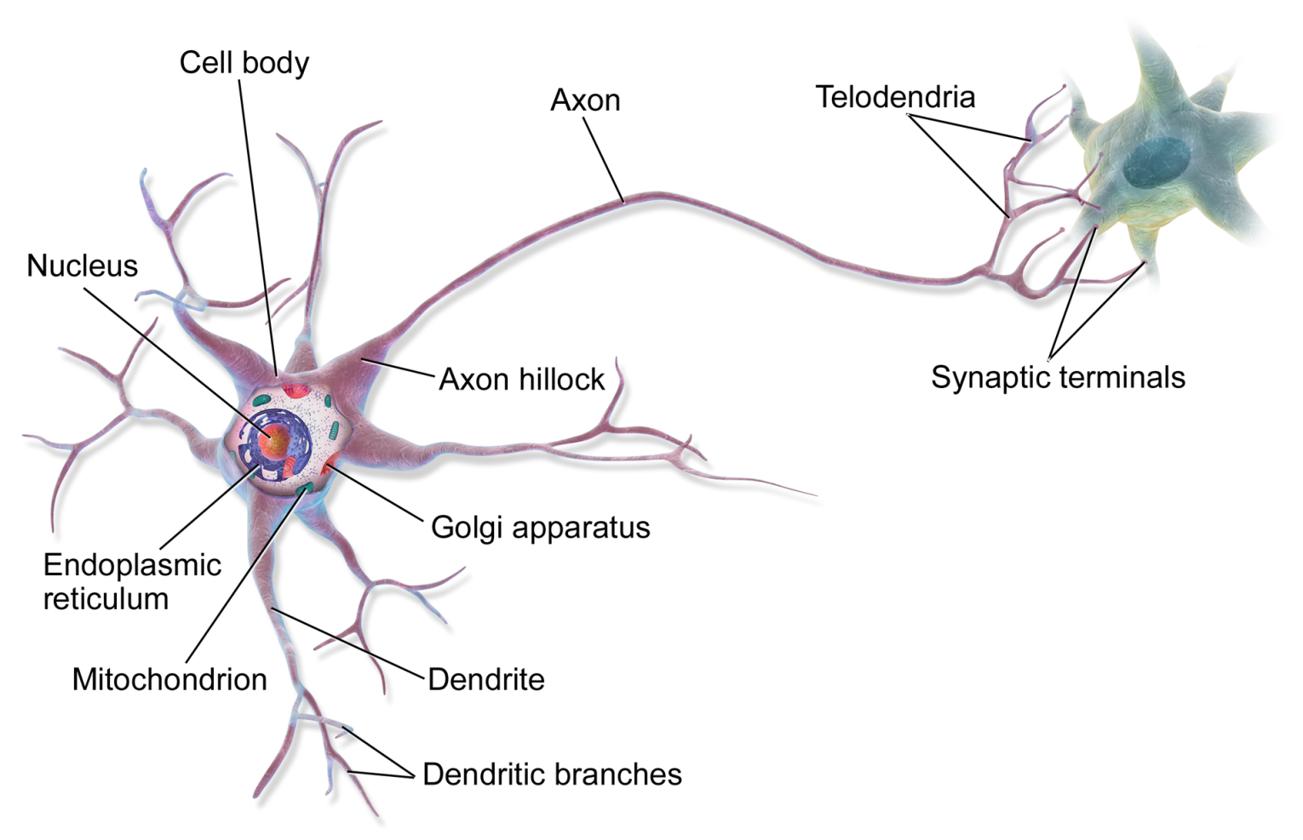
Neurons

Slide 20
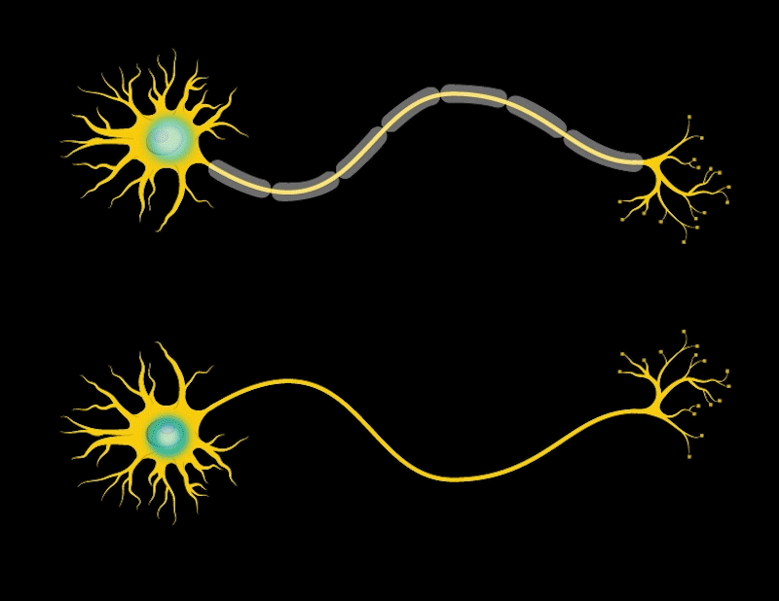
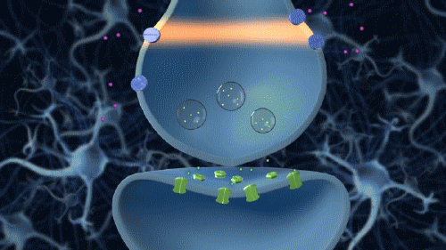
Biology vs. models
20000 ATP/bit=1fJ/s for transmission
50-500fJ/s fires
32bit/sec
Brain= 2% wt; 20W consuming

Slide 21
Biology vs. models

